Slide 1

Notes:
MINISTRY VISION: We see teens, communities and society transformed through discipleship in the Word, the presence and the power of God.

Slide 2
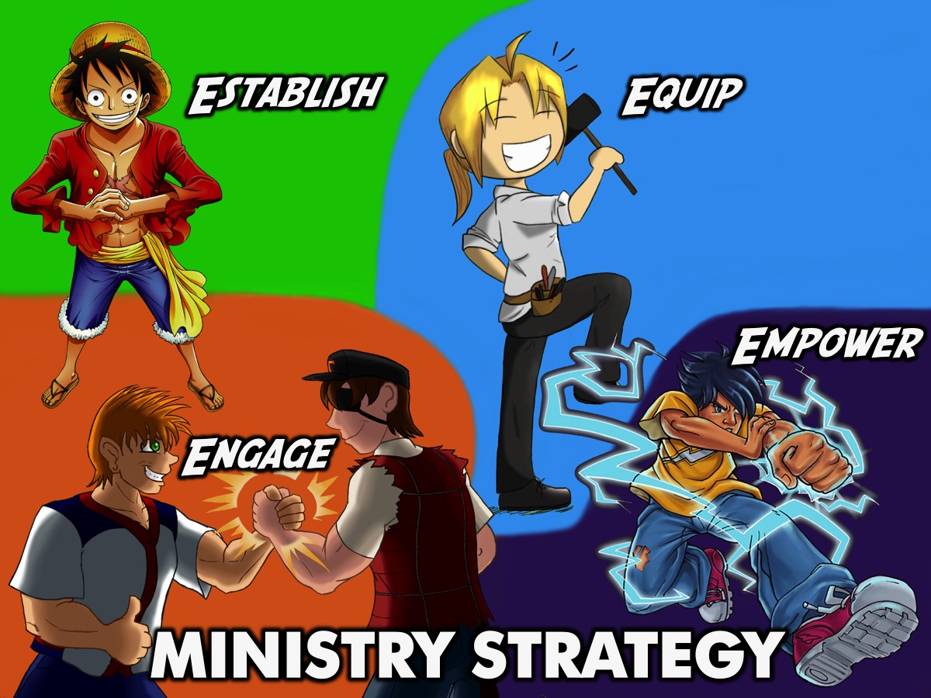
Notes:
MINISTRY STRATEGY:

Slide 3
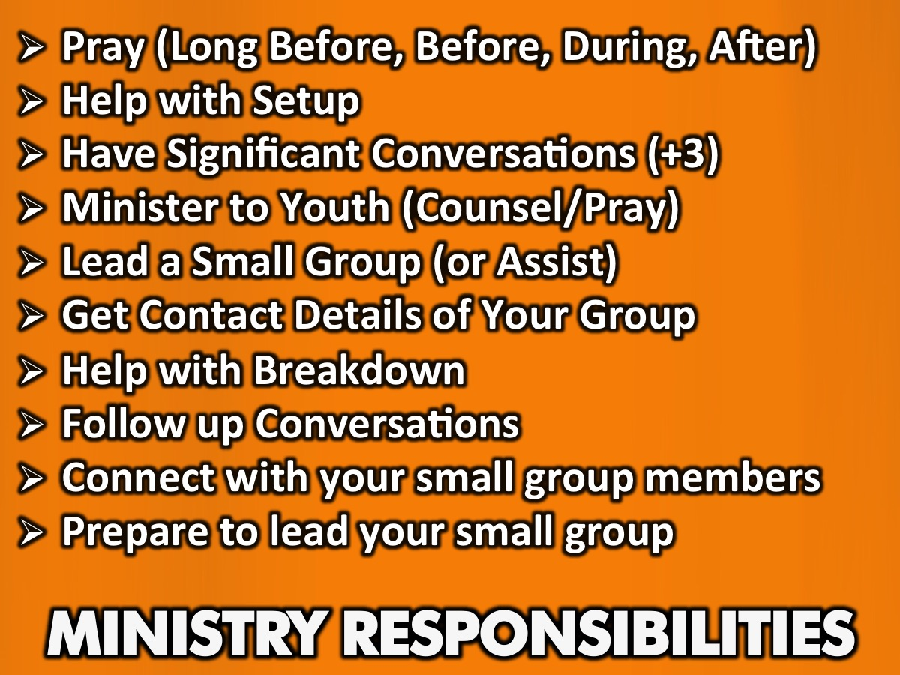
Notes:
Ministry Responsibilities:
Pray (Long Before, Before, During, After)
Help with Setup
Have Significant Conversations (+3)
Lead a Small Group (or Assist)
Help with Breakdown
Follow up conversations
Connect with your small group members
Prepare to lead your small group

Slide 4
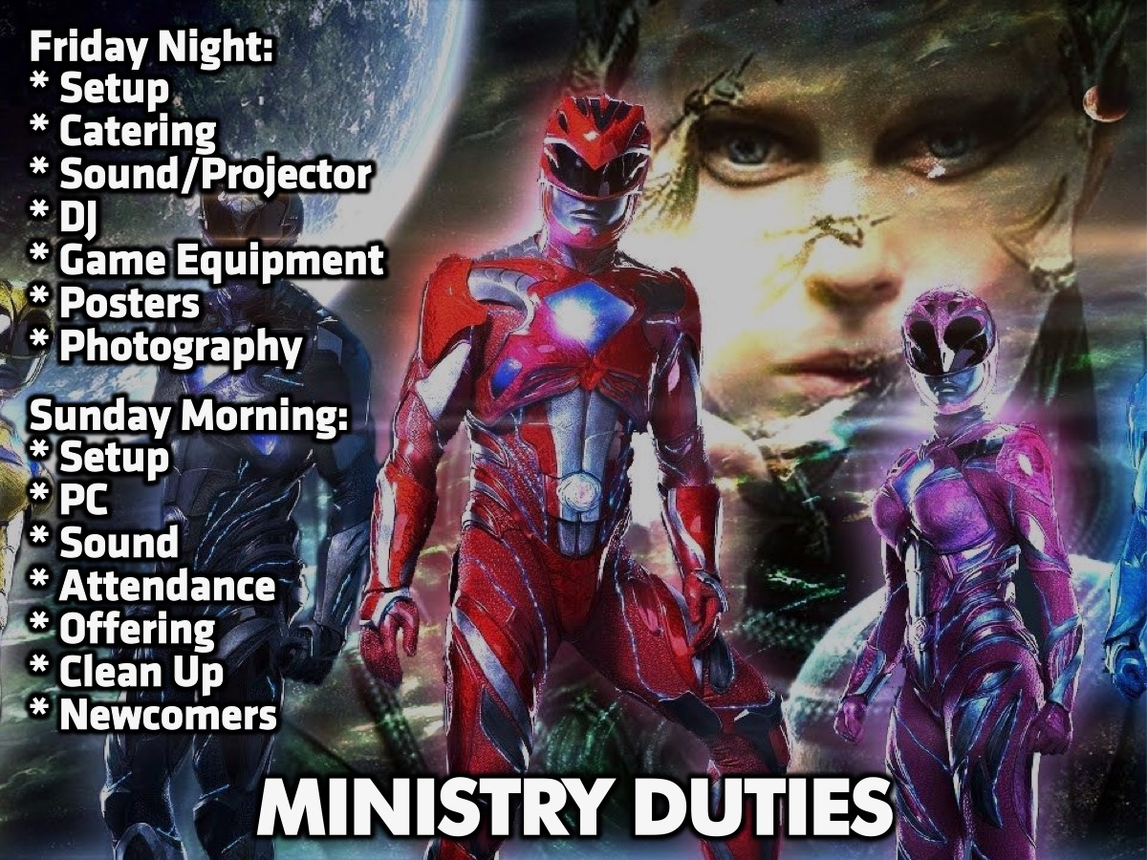
Notes:
Areas of Ministry we need help with:
Friday Night:
* Setup - Tables/chairs/posters/event stuff
* Catering
* Sound
* DJ
* Game Equipment
Sunday Morning:
* Setup
* PC
* Sound
* Clean up between services
* Newcomers - Greet, Photos, Handouts

Slide 5
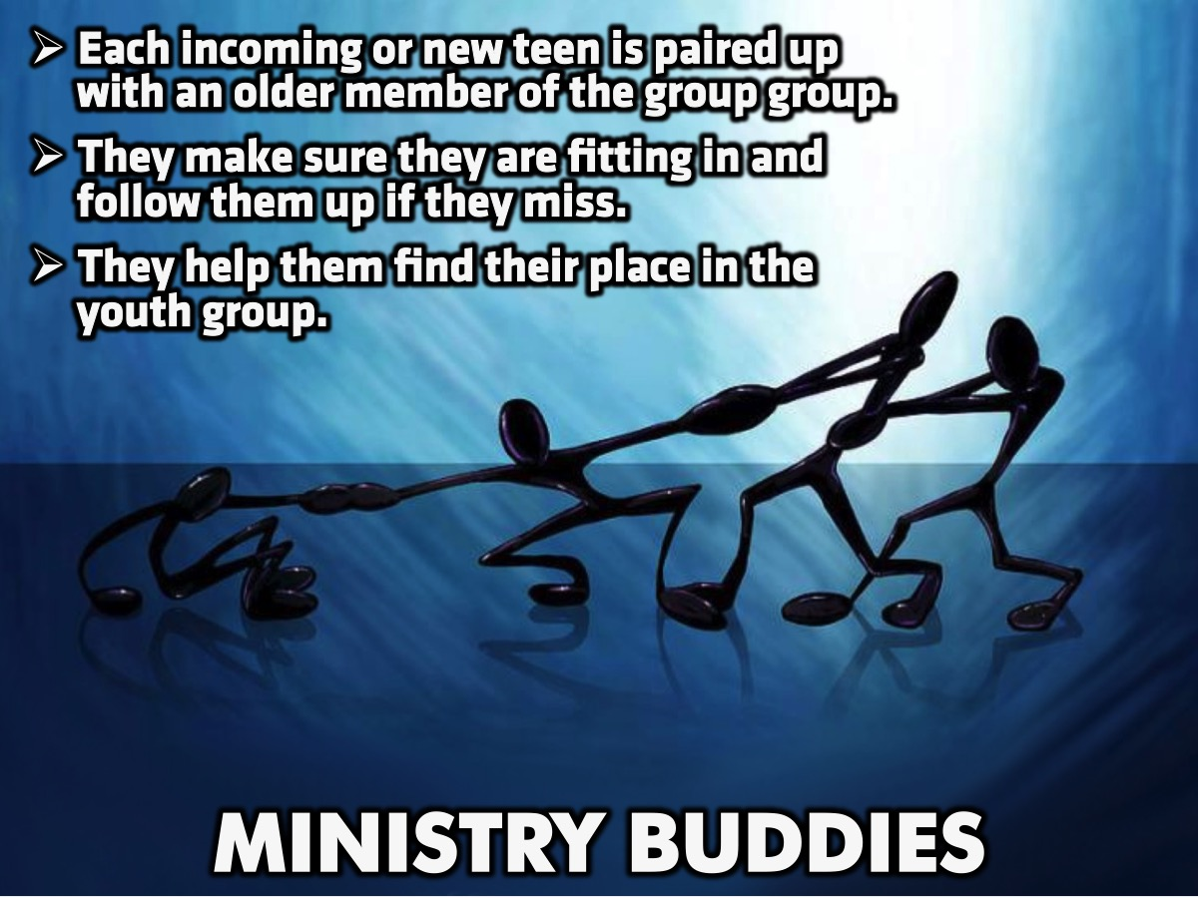

Slide 6
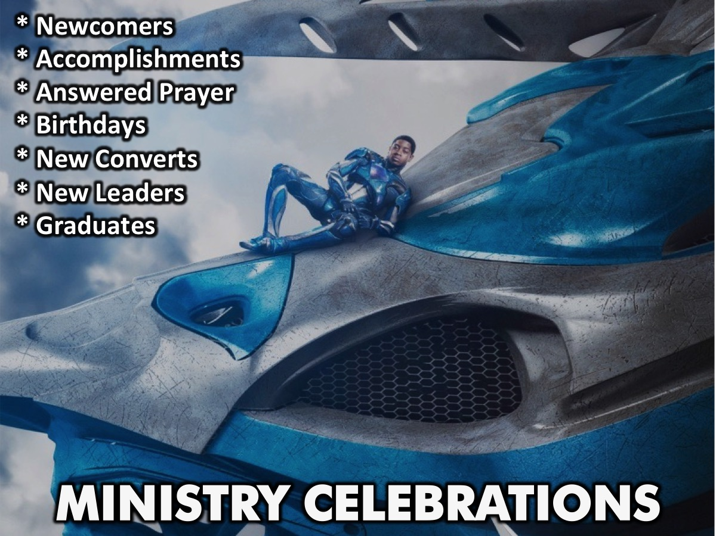
Notes:
What aew

Slide 7
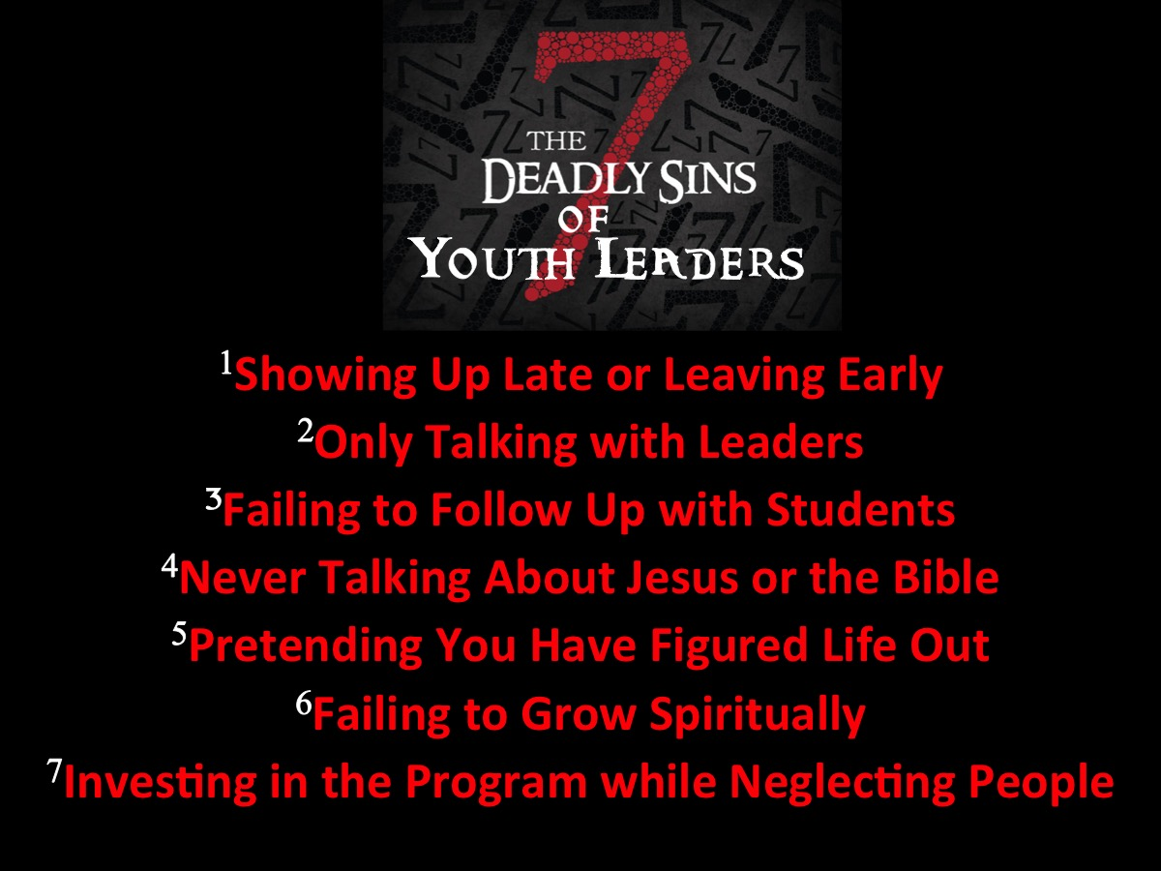
Notes:
7 Deadly Sins of Student Ministry Volunteers
By Chase Snyder May 30, 2017
For student ministries, volunteer engagement is essential. The days of a student ministry being led by a charismatic leader with adult chaperones is as far behind us as bellbottom jeans. Every church ministry must be aligned around relational discipleship for the flourishing of the Gospel. Student ministries will fail to develop disciples when the student pastor is the only person investing into the lives of the students. When we fail to develop disciples, we fail to fulfill the Great Commission.
Leaders are the key to student ministry discipleship. You can say goodbye to discipleship if multiple adult leaders are not connected to students. That’s a big deal! The discipleship process must involve every adult volunteer. If we want to ensure every adult is on mission we need to identify what is getting in the way of our discipleship efforts.
Are you committing any of these deadly sins? Be honest with yourself, then take the necessary steps to get back on track with God’s mission.
1. Showing Up Late And/Or Leaving Early
Nothing communicates a lack of investment more than showing up late or leaving early. A large portion of discipleship is proximity. Those who are inconsistent at Bible studies and worship gatherings are not developing disciples. The Great Commission doesn’t say “Sit in a youth room to fulfill a student-to-leader ratio.” Jesus commissions every disciple to create disciples.
2. Only Talking With The Adults
Why are you volunteering with the student ministry? Is it to invest in students? Great. Investment doesn’t end once you step into the room; that is when investment begins! Don’t fall into the temptation of sitting in the back of the student room and chatting with the other adult leaders. You are serving to make a Gospel difference in a teenager’s life. So pull up a chair and get to know some students.
3. Failing To Follow Up With Students
One hour of communication per week does not sustain a friendship. Discipling students involves following up with students throughout the week. This may look different each week (attending ball games, texting students Bible verses, inviting students to events), but the key is to show up in the life of a student. When you show up outside of “church time” students will begin to see that God cares for them outside of “church time.”
4. Never Talking About Jesus Or The Bible
Student ministry isn’t all fun and games. Who am I kidding? Student ministry is awesome! The presence of games shouldn’t lead to an absence of Biblical instruction. Each student ministry volunteer has a responsibility to share about the grace, love and goodness of Jesus. Don’t let the student pastor be the only voice the students hear.
5. Pretending That You Have Figured Life Out
You know that being an adult doesn’t bring clarity to life and an uncanny ability to live perfectly! Be careful not to project a “holier than thou” persona in front of your students. Jesus has saved you, and the students, by grace alone. Sure you have some wisdom to share, but be sure that you are communicating that you still need Jesus.
6. Failing To Grow Spiritually
The number one role of a student ministry volunteer is to be a spiritual leader. It doesn’t matter what area you serve in, you must be growing spiritually. The church’s mission is to create disciples. Only disciples can create disciples. An excellent book to gauge your spiritual health is Ten Questions To Diagnose Your Spiritual Health by Donald S. Whitney.
7. Investing In The Program While Neglecting People
How many hours have you spent working on the worship set list this week? Or how much time have you spent looking at your small group lesson for Sunday? How about this one: How many hours have you spent encouraging and communicating with students this week? Preparation and study are essentials to be a great leader, but when we drift away from the people and only invest in the program, lesson or worship gathering, our students will leave the church.
Now What?
After taking an honest look at this list, how many of these sins are you struggling with? Being able to diagnose our current level of engagement will allow us to dive deeper into our discipleship efforts!

Slide 8

Notes:
This section was shared with our volunteers to inspire them to not just do stuff for God but actually develop intimacy with God.

Slide 9
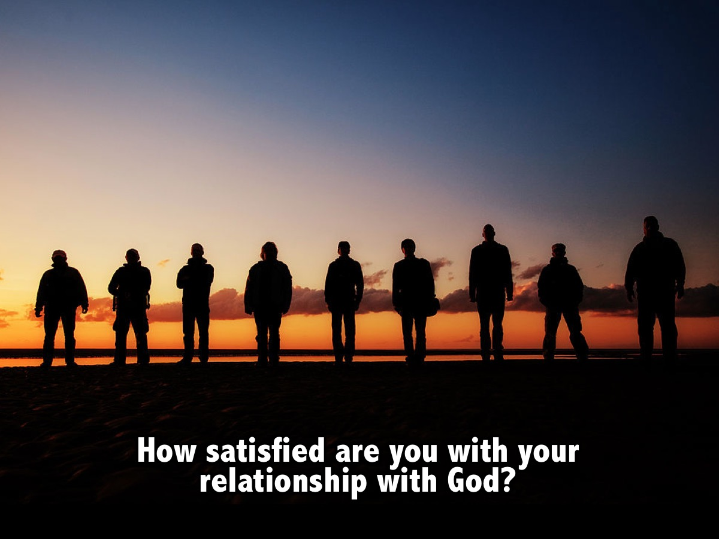
Notes:
The Continuum: Get youth to stand on a continuum as they answer this question of how satisfied they are and also how close they want to get to God: (1) How satisfied are you with your relationship with God? (1 is unsatisfied and 10 is fully satisfied).

Slide 10
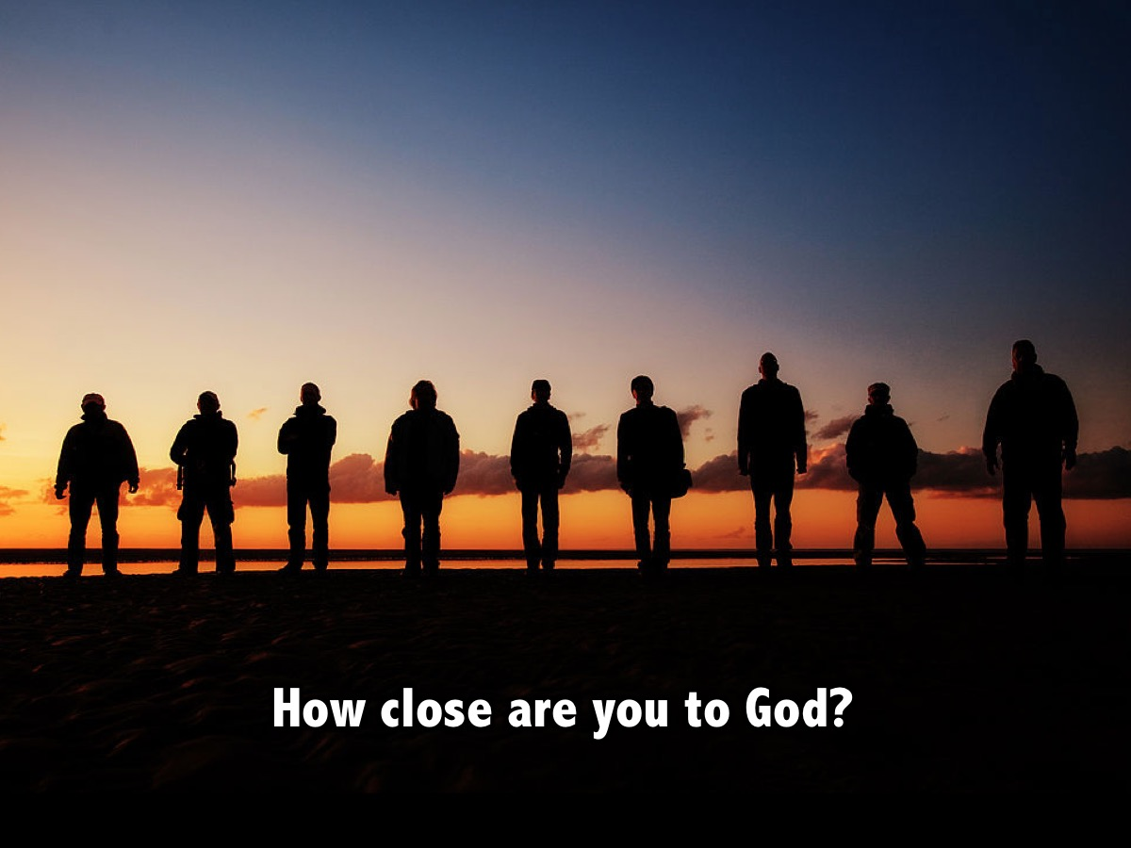
Notes:
(2) How close are you to God?

Slide 11
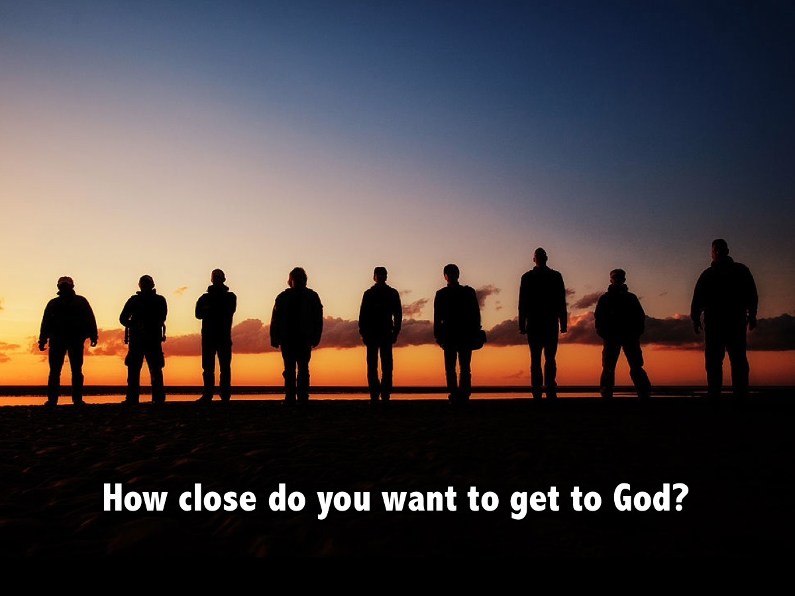
Notes:
(3) How close do you want to get to God?

Slide 12
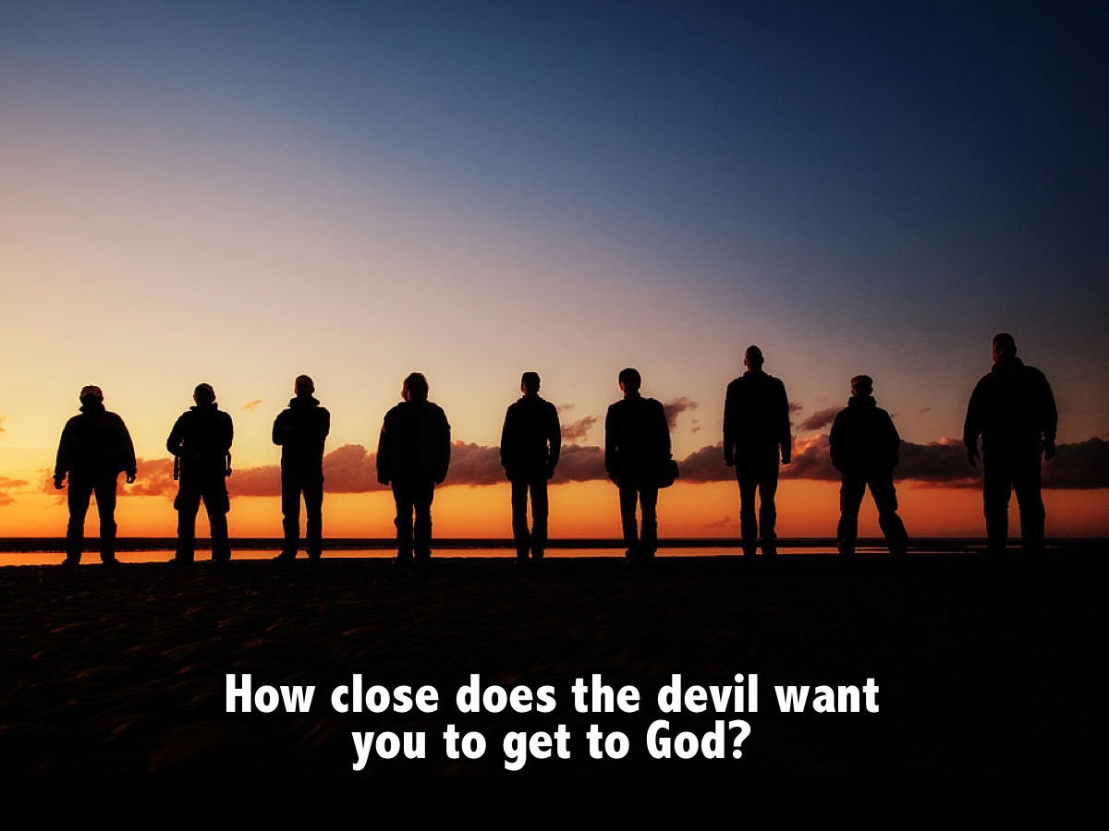
Notes:
(4) How close does the devil want you to get to God?

Slide 13

Notes:
(5) How close does Jesus want you to get to Father God?

Slide 14

Notes:
Challenge: There are 6 shifts that need to take place for us to experience more of God in our lives:
1. From Inside to Outside - Living for God
2. From There to Here - Living with God
3. From Head to Heart - Engaging the Word
4. From Closed to Open - Engaging with Others
5. From Full to Empty - Loving like God
6. From Next to Now - Loving the Movement

Slide 15
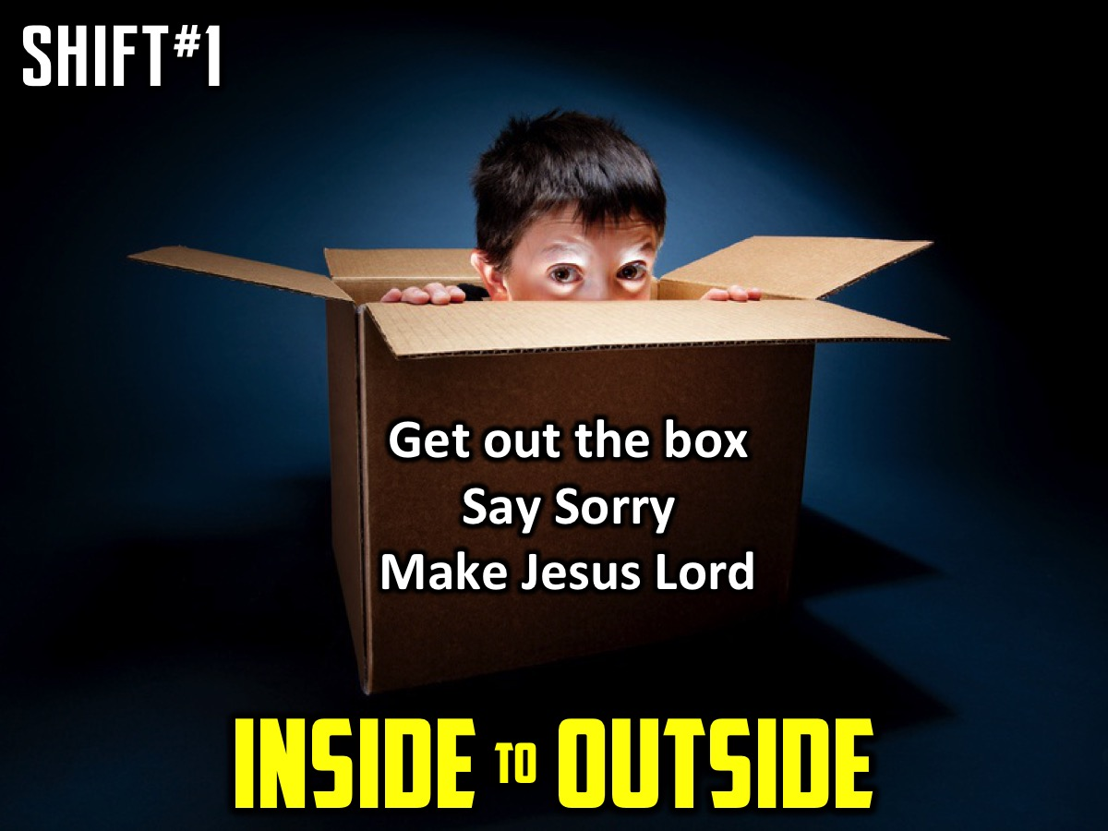
Notes:
Shift 1: From Inside to Outside
Do you live in a box? Many of us live in a small box called the Kingdom of Me. It’s a place where we are fully in charge and control everything that happens. It feels safe and secure and gives us the illusion of protection. We convince ourselves that as long as we stay in the box everything will be fine. Jesus wants us to live a life of more and so He calls us to live outside of the box. There is no life in the Kingdom of Me – we have to enter God’s Kingdom to receive lie.
We cannot simply ask God to help us with our own lives – we have to die to our lives and begin living God’s life.
Matthew 10:39 – Whoever finds their life will lose it, and whoever loses their life for my sake will find it.
Leaving the box is losing your life for Jesus sake and it is the only way to come out of the box and find real life. We really want to bring God into the box and have Him fix it up for us – but this will never satisfy us as it is just trying to control Him. We have to move our thinking from inside the box to outside the box and the only we we can do that is to be fully consumed by Love himself. Intimate relationship with the King is the abundant life Jesus talks about. Leaving the box is the only way we can foster this relationship. God is and has everything we need.
The Gift of Freedom
Trusting God enough to get out of the box of our own kingdom and live in the wide open space of God’s kingdom, brings us the gift of freedom. All our striving to provide for and protect ourselves is actually based in Fear – fear rules in the Kingdom of Me. We are worried we will loose what we have worked so hard to acquire – money, power, relationship, control. We must be willing to abandon our own kingdoms so that there will be only one kingdom under one King and that His will, will be done on earth (in our lives) as it is in Heaven.
Instead of consuming God to meet our own needs in the box, we leave the box and become consumed by Him. His thoughts become our thoughts and we are able to demonstrate His love for others through us. To leave the box we must die to the idea of being in charge. The key to this is being willing to submit, over and over again until we let go of every piece of the Kingdom of me we are holding.
We find it difficult to submit because, when we try to do it we discover exactly where we are drawing our identity from in the box. Affirmation that comes from our ability to do things – gifts, talents, strengths, skills, training, learning etc – that gives us more of a sense of worth and significance than simply knowing we are loved by God will keep us living in the box. We must allow Christ to continually remind us that apart from Him we are nothing, but with Him we are everything.
Surrender to Love
Practically, leaving the box, means living in Gods Kingdom and that means surrendering our lives. We think of surrender as defeat, as being crushed by a powerful foe, and so we live in fear and resist surrender. Fear is driven by our self-reliance – I feel fear and anxiety when I am not in control. The antidote to fear is faith, and faith means being fully grounded in the reality that there is very little that I actually control.
God is King! If I believe that I have nothing to fear – I can surrender, not in defeat, but n faith! This kind of surrender feels more like falling in love – its risky but its exhilarating and ultimately the only way to find joy. This requires us to trust – When we don’t trust we go picking through the garbage heap to try and provide and fend for ourselves. We forget that in God’s kingdom there is more than enough to go around. God keeps calling us, with love and tenderness, back out of our little kingdoms, and into His where there is always plenty.
As we surrender we move from wanting our own lives to wanting God’s life, to simply wanting God. We realise that if we have God we have everything we need.
Shift in Action
One of the core actions that strengthens this daily decision to get out of the box, and builds deep intimacy with God is the simple action of saying to God “I’m Sorry” when we make choices that hurt others or God himself. When we honestly confess that we are not trusting God or that we went our own way instead of His, intimacy is restored. He knows what you did before you tell Him, but He wants us to trust him enough to believe He’s really got your back so that you never think of hiding anything from Him.
Romans 8 38 – 39 (Nothing can separate us from His love).
Taking time for a bit of brief examination and honest conversation with God helps us see the ways in which we are living in the box. Regular confession is like checking our GPS and seeing where we have gotten off track.
Saying you are sorry builds trust through conversation.
Small Group Questions:
1. Where are you living now in your relationship with God?
2. In the next week, what practical steps can you take to live outside the box?
Challenge 1:
Jesus wants us to live a life of more and so He calls us to live outside the box. There is no life inside the box. We have to enter God's Kingdom to receive life. Leaving the box is losing your life for Jesus sake and is the only way to find real life. Instead of consuming God to meet our own needs in the box, we must leave the box and become consumed by Him.
Challenge 2:
Leaving the box means living in God's Kingdom and that means surrendering our lives. We think of surrender as defeat, so we live in fear and resist surrender. Fear is driven by our self-reliance. We feel fear and anxiety when we are not in control. The antidote to fear is faith, and faith means being fully grounded in the reality that there is very little that I actually control. God is King! If I believe I have nothing to fear, I can surrender, not in defeat but in faith. This kind of surrender feels more like falling in love - it's risky but it's exhilarating and ultimately the only way to find joy!

Slide 16

Notes:
Question: In the next week, what practical steps can you take to live outside the box?

Slide 17
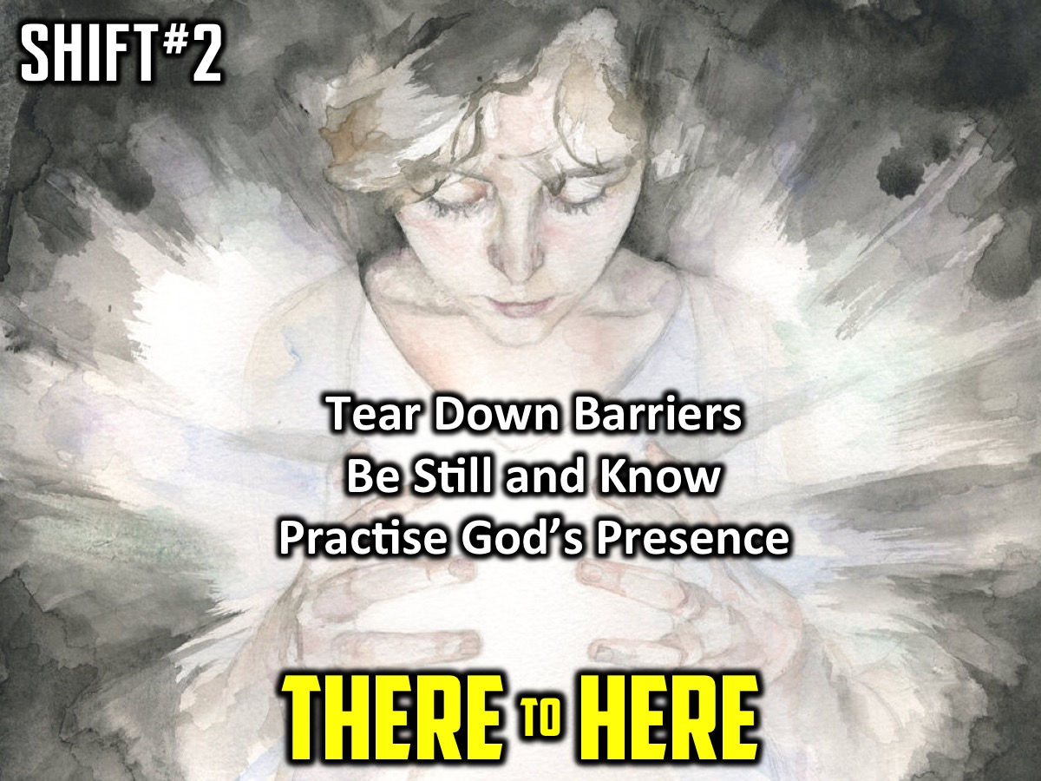
Notes:
Shift 2: From There to Here (Me to We) – Be Still and Know
Leaving your box can be scary. And finding God can be even more of a challenge. Where is God? Is he up in heaven? Is he on standby to rush to help us like an armed response guy?
The Bible says God is closer than a brother (Proverbs 18:24); he is with us (Matthew 28:20) and even more: God is inside us! He wants to fill us up with more of himself! To help experience this as a relating we have to take make a Shift: The Shift from Me to We.
We often say: I am going to do this, or I am going to go here, or I have this homework to do, or I have a difficult challenge to face. Maybe we even say: I have to read the Bible, go to church, pray, tell other about Jesus, etc. We need to start using We instead of Me: We are going to school today, We are going to love someone today, We are going to face this challenge together.
We stop asking God to be with us, or to help us with something, but remind ourselves that God is already with us by including him in whatever we do and engage in a conversation with him.
God won’t force himself on us – he waits for us to give him permission to fill us.
God wants to completely consume us so his thoughts are our thoughts, so his desires are our desires.
We must tear down any barriers we have erected between us and God by inviting God to fully invade our lives.
The secret is to “Be Still and Know” (Psalm 46:10). We should regularly quieten ourselves down and simply know that God is with us and that he loves us. Find quiet moments in the day to remind yourself that God is with you and ask him to fill you and then live you know aware that he is with you and that you do things together – a shift from Me to We.
As we slow down and are still with God, we spend time in His presence and we ask ourselves: Where is God right now? Is he close or far away? If he seems far off, we invite God to show us if there are any barriers that have been erected between us and Him and ask him to remove the barriers.
He is closer than a brother – we don’t need to ask him to travel from heaven to get to us – we need to be aware he is inside us and wants to live life in and through us!
Small Group Questions:
1. What stops you from taking time to stop and just be with God?
2. What can you do this week to be still and know that God is with you?
Challenge:
Each day, find time to be still, even if it is only for five minutes. Remember that God is here with you, not out there. Pay attention to when you think “me” (or “I”) and mentally replace it with “we.”
Reflect on this verse: My heart has heard you say: “Come and talk with me.” And my heart responds: “Lord, I am coming.” (Psalm 27:8, NLT)

Slide 18
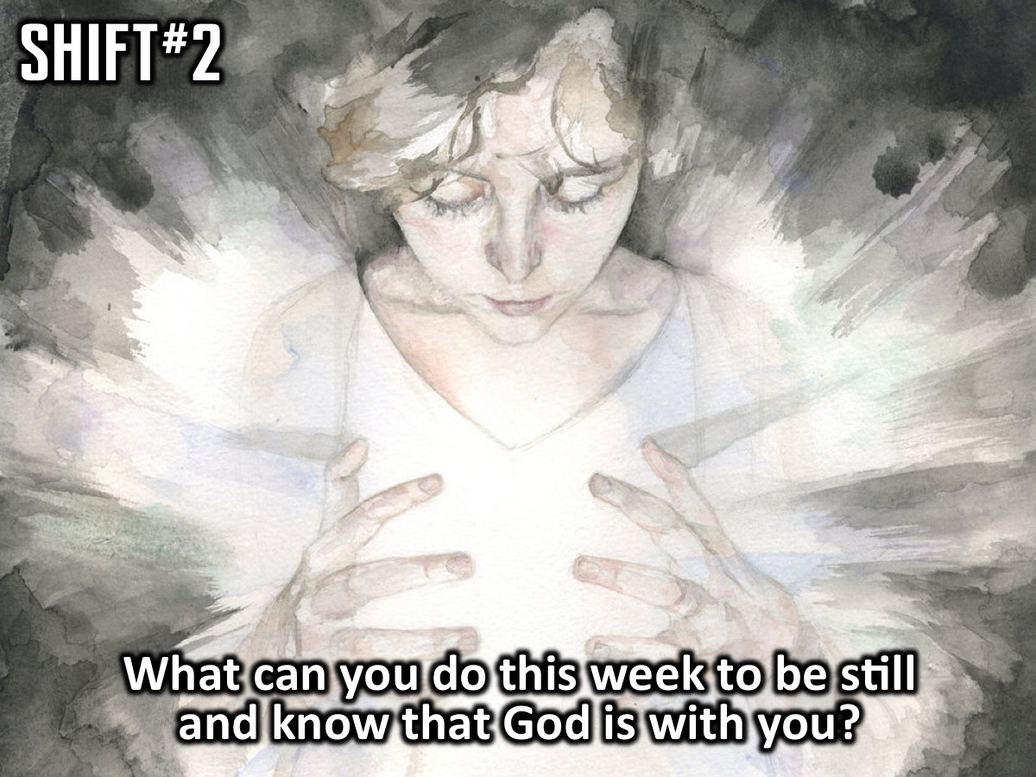
Notes:
Question: What can you do this week to be still and know that God is with you?

Slide 19

Notes:
Shift 3: From Head to Heart
As we get out of our box and become more aware that God is not just nearby but is in us we face a challenge: we love experiencing intimacy with God as we think of "we" instead of me, but we tend to drift. We don’t do what we want to do and we do what we don’t want to do. (Romans 7:15)
What shift needs to happen to keep us from drifting?
The secret is engaging with the Bible. People who are closest to God interact with the Bible every day. They read it, study it, reflect on it and memorize it. They are hungry for God and they see the Bible just as essential to their lives as food. It is not just an intellectual pursuit but a deep hungering love.
Jesus told us not to live on bread alone but on God's words and truth. (Matthew 4:4).
The Bible in 90 Days reading plan can revolutionize our lives as we read twelve pages of the Bible every day. You immerse yourself in the story and get an overview of God's plan for His people and their redemption. It would take about 45 minutes a day. Some people move on to a yearly bible memory plan where every 15 days you memorize a verse.
Although reading the Bible is an intellectual exercise, Bible engagement causes a shift - moving our relationship with God from our heads to our hearts. The goal is falling in love with God's Word and engaging with Scripture. We stop seeing the Bible as a guide to help me provide for myself or to protect myself as I live in my box, and we shift to see it as a guide that will help us engage with others outside of our box - in the world. We see the Bible as a map for living outside of the box!
As we fall in love with the Bible we begin to experience more of God! When we shift from our heads (thinking about the Bible) to our hearts (falling in love with the Bible) that we move closer to living a life of more.
The key is to Eat Something Good Everyday! We should see the Bible like we see food - not just a habit but something we cannot do without or we will die. The Bible is a feast for our soul - a love letter not just a rule book. The goal is not to snack on it but consume it like we would consume a seven course meal. Jesus said if we hunger and thirst for righteousness we would be filled (Matthew 5:6). God will fill us as we immerse ourselves in the Word.
When we read and reflect on the Bible regularly it gives us strength like a healthy meal, strength to battle the distractions that can injure our relationship with God, and strength to choose to live in God’s kingdom rather than our own. Imagine if we were as connected to our Bibles as we are to our cell phones and messages from social media.
We need both quantity and quality time engaging with the Bible. We should read big parts of the Bible every day and also spend time thinking and meditating on what we read. Here are some principles to follow:
1. Read through the entire Bible - from beginning to end. Take a year or try the 90-day experience.
2. Read everyday - try eating something good everyday by setting aside some time everyday to read the Bible unrushed and uninterrupted.
3. Reflect on what you read - we need to slow down and savor what we read - it is not fast-food. We should read, meditate, pray and contemplate. Ask yourself, What did I like about the words I just consumed? And ask God, What do you want me to know?
4. Memorise Scripture - especially verses or passages that are especially inspiring or encouraging to you.
To pursue intimacy with God you need to spend time digging into the scripture yourself. Attending church won’t do this for you!
If you long for more in your life, if you want a deeper sense of God’s presence and peace, if you want the fullness of a relationship with Him, you will find these when you feast on His Word. When you cross the line and develop a passionate love affair with the Bible you will gain a holy longing in which you desire more and more time with God.
Questions:
1. What experience have you had reading the Bible on your own?
2. What can you do to start getting into the Bible every day?
Challenge:
Decide right now what next step you need to take to engage with the Bible (with your heart and not just your mind). Maybe it is to read a chapter every day, or read it through in 90 days or memorise a verse every two weeks. Doing nothing is not an option. You will starve!
Challenge 2:
So we heard many of you struggle to connect with the Bible so we thought it would be fun to help get you into it. So everyday of this week we will read one chapter and I will put out a question to help you engage with the Bible. If you take on the challenge by the end of this week you would have read through one whole book of the Bible!!! Grab a piece of paper and pen, as you read Ephesians 1 in your Bible ask yourself "Who does God say I am?" Write down your thoughts. End with a word of prayer thank God for who you are in Him!

Slide 20
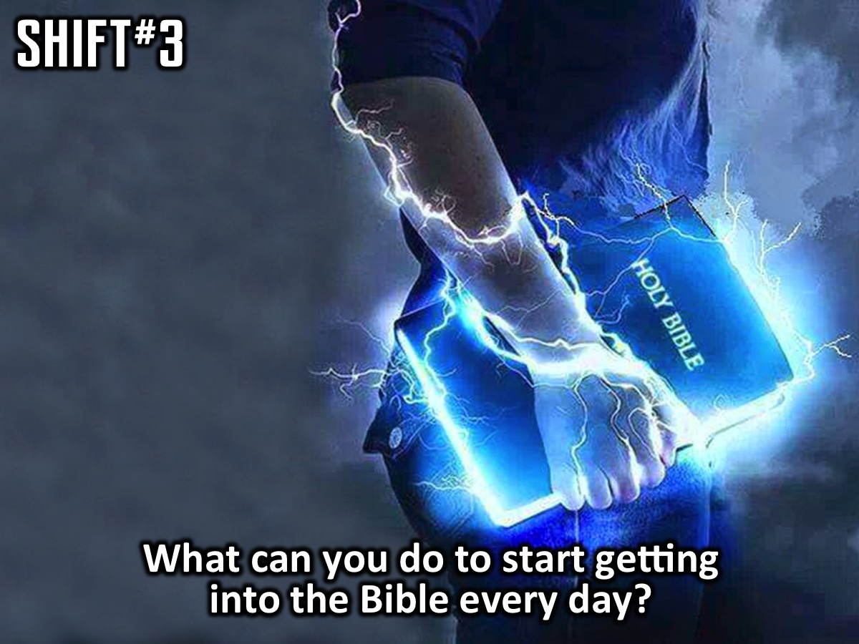
Notes:
Question: What can you do to start getting into the Bible every day?

Slide 21

Notes:
Shift 4: From Closed to Open
So far we have gotten out of our box (from Inside to Outside by learning to say sorry to surrender control of our whole lives to God), we became aware that God is in us and not somewhere out there (From There to Here by taking time to “be still and know”), and we started reading the Bible everyday to keep us from drifting (from Head to Heard by eating something good everyday). The next shift is from Closed to Open where we realize that life is meant to be lived in community and not isolation.
God intended us to live in relationship with himself and with other people. Those who live a life of more intimacy with God do not do it alone! We have to open up our lives to others in community to experience greater intimacy with God. The key here is to Build a Web.
In Genesis God declared everything was good except man’s aloneness. (Genesis 2:18). So God made a helper for him. From the beginning with were designed to do life together, to be open to truth from others, to be held accountable, to encourage and be encouraged – to experience life with others.
Sadly, from the beginning we started to build walls between us and other people but we need to start taking down the walls to experience community with other people.
The only thing that will last from life in the end is people. Jesus said that “where two or three gather in my name, there am I with them.” (Matthew 18:20). And John said: “If we love one another God lives in us and his love is made complete in us.” (1 John 4:12). In Ephesians 4:15-16 Paul speaks of how we are designed to be interdependent – interconnected into a network of relationships.
Why should we build a web of relationships?
1. It is the way to experience life as it is supposed to be lived.
2. Because God asks us to do so.
Jesus had a web of relationships around his life. Some close friends, a group of disciples and even others beyond his 12.
Like Jesus, there are three kinds of relationships we all need in life:
1. Small Groups – a safe place where we can process the issues of life, to talk about God, make sense of the world and figure out how to live in God’s kingdom. It is a place to speak the truth in love. We learn how to listen to each other in small groups and also speak into each others lives so we can grow spiritually.
2. Spiritual Friendships – these are friends that we can speak about our spiritual lives with. It is a two way relationships in which we give and receive love and encouragement.
3. Mentoring Relationships – we also need relationships with people who know more than we do and we need to offer our help to those who know less than we do. We need to have mentors and we need to be mentors. People who live a life of more intimacy with God seek our mentors and coaches.
Reflect:
You are all children of the light and children of the day. We do not belong to the night or to the darkness. Therefore encourage one another and build each other up, just as in fact you are doing. (1 Thessalonians 5:5,11)
Therefore confess your sins to each other and pray for each other so that you may be healed. The prayer of a righteous person is powerful and effective. (James 5:16)
Questions:
1. How easy is it for you to let others into your life?
2. Does the thought of it completely overwhelm you or excite you?
Challenge:
Every day decide to open yourself up to the people in your life, looking for those who can become part of your relational web. You need them and they need you.

Slide 22
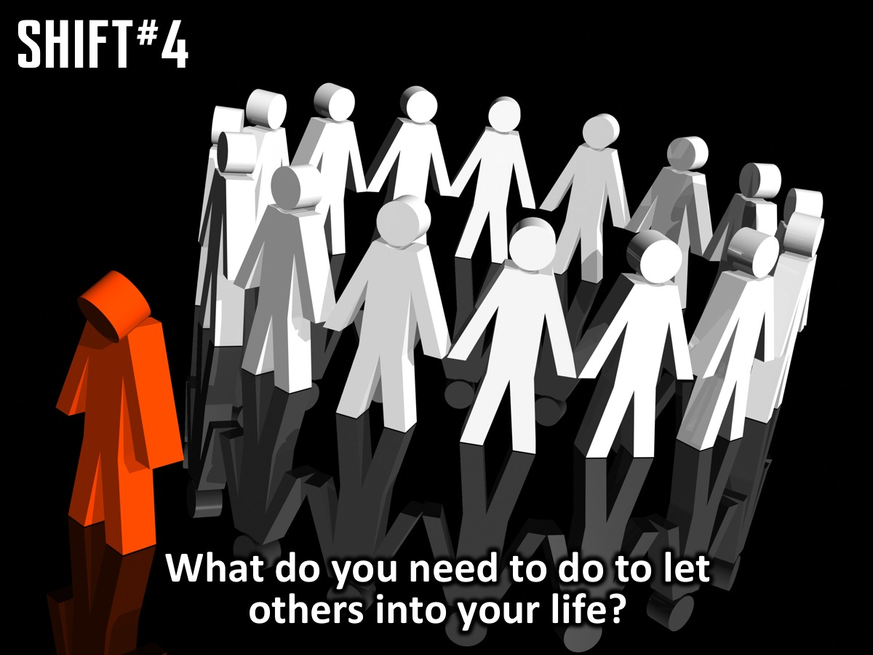
Notes:
Question: What do you need to do to let others into your life?

Slide 23
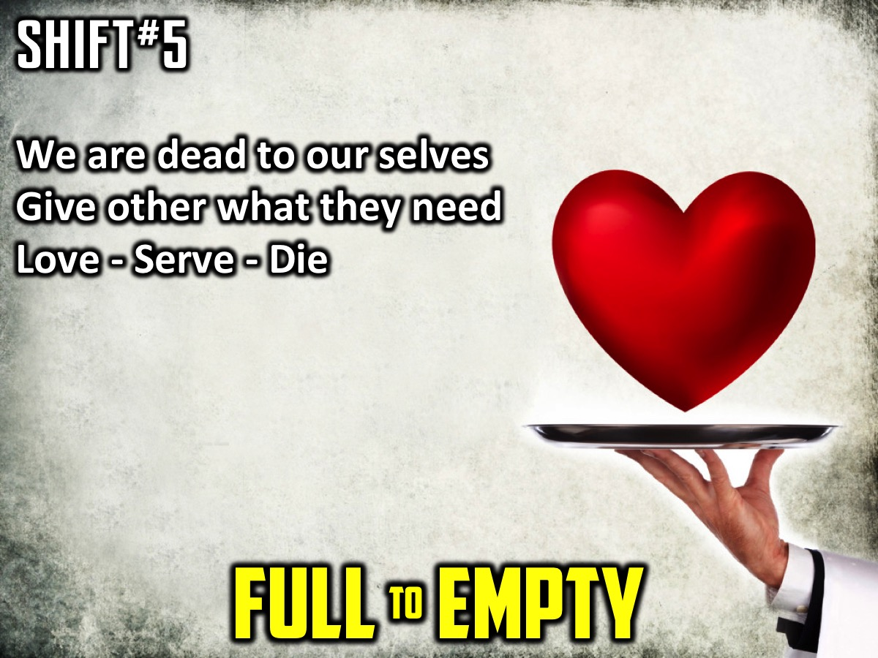
Notes:
Shift 5: From Full to Empty
Once we have chosen to let God be King, to get out of our box and live in God’s kingdom, we’re kind of out of a job. We are no longer kings of our lives responsible for protecting our little kingdoms. We are unemployed. But God has a new job for us – our job in God’s kingdom is to love people. John 13:34 says: “So now I am giving you a new commandment: Love each other. Just as I have loved you, you should love each other.” But this does not have much to do with warm fuzzy feelings, rather it has to do with serving people.
When we follow Jesus we are called to die – to die to our own desires and needs. What if we were to put to rest that part of us that wants our own way and really surrender every part of our life to God? What if I lived as though I was dead? Dead people don’t need anything – they don’t argue whether they are right or wrong – they don’t worry about being late or doing their own thing – they have lots of time of their hands and don’t have to rush.
When someone asks for something for us we should not hesitate to stop and serve them – asking God to show us what he wants to give to them through us. We are dead so don’t have much to give them, but God has lots to give to them through us. People around us need a word, a touch, or a look from God!
So our job is to love, which means to serve, which means to die.
The shift is from full to empty. When God fills us with his love and blessings we often keep it all for ourselves to stay full but God is calling us to give it all away to others and trust that He will fill us up again! We must be willing to empty ourselves every day rather than hoarding the love that God gives us!
To love what is important to God, we have to be willing to lose what is important to us. People who live a life of more move from living with the love of God stored up in their box to living outside the box where they give away God’s love every day!
People matter so much that Jesus gave his life for them: John 3:16. And we ought to also lay down out lives for our brothers: 1 John 3:16. Jesus said: “There is no greater love than to lay down one’s life for one’s friends.” (John 15:13). We are called to copy Jesus example of becoming a servant: Philippians 2:5-8. In Galatians 2:20 we read: “My old self has been crucified with Christ.[a] It is no longer I who live, but Christ lives in me. So I live in this earthly body by trusting in the Son of God, who loved me and gave himself for me.” When I die to myself and have Christ living in me – fully consuming me and intimate with me – I can then love what matters most to God – people!
We often give a little to others, but not everything. We're unwilling to empty ourselves so there’s nothing left but God loving through us. Maybe it is because we don’t trust God’s abundance, God’s ability to replenish us when we empty ourselves completely. God’s love can only flow through us when we make the shift from full to empty.
Questions:
(1) What do you think about your new job of loving others?
(2) What do the people closest to you need from God today? How is he asking you to meet that need?
Challenge:
Each, day remember your job is to love, which means to serve, which means to die to what you want in order to give people what they need, which is a touch from God. Start close in with those nearest and dearest to you.

Slide 24
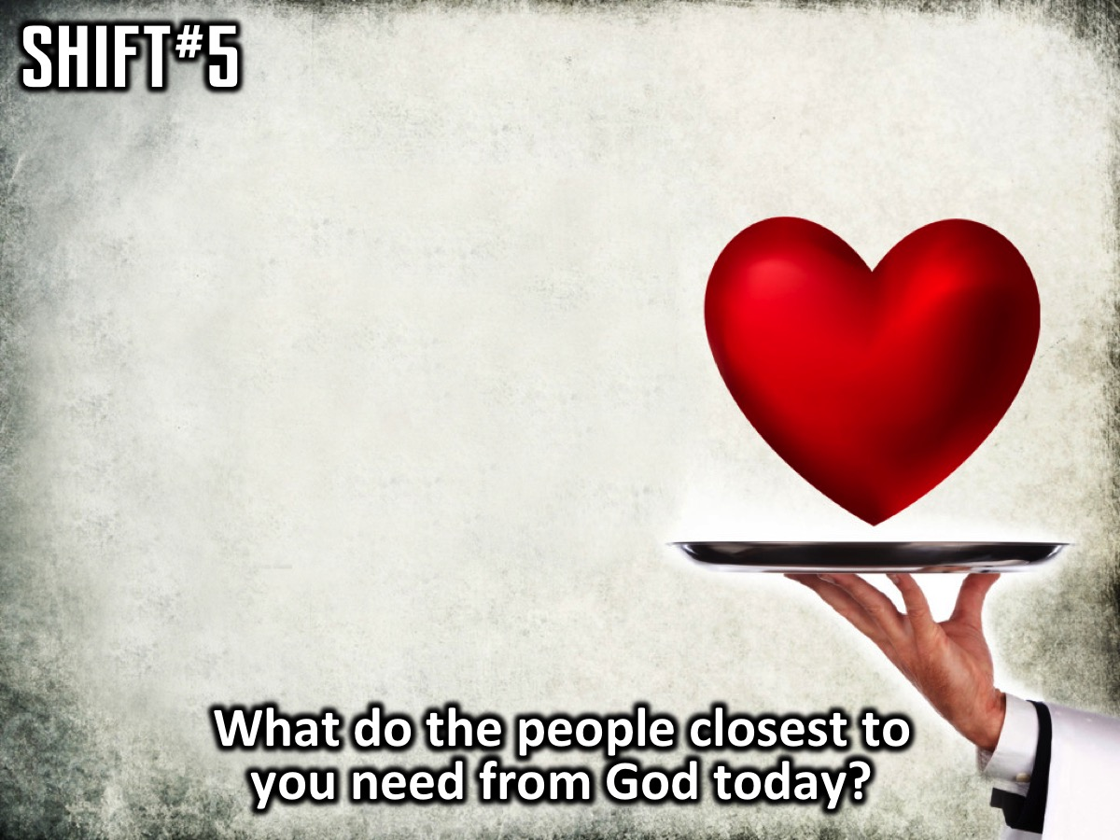
Notes:
Question: What do the people closest to you need from God today? How is he asking you to meet that need?

Slide 25

Notes:
Shift 6: From Next to Now
We tend to focus on the future. We worry about what lies ahead of us and this often makes us miss what is happening now – in the present moment.
The shifts we have made so far are: We move from in the box to out (our Kingdom to God’s kingdom) and learn to say we are sorry; we move from there to here (or from me to we) as we learn to be still and know God; we shift from our heads to our hearts as we eat something good from God’s Word every day; we move from closed to open as we build a web of relationships and community; and we move from trying to fill ourselves to emptying ourselves as we love, serve and die. These shifts in our hearts and actions move us towards a life that is truly life.
The essential thing that holds all these shifts together is a new view of time. Everything we do is shaped by our view of time: How we trust God, love others, read God’s Word or serve others.
The next shift is from next to now - a life of more is lived in the moment, trusting God to handle the future. We don’t need to know what is next – we just need to know who is in charge of what’s next and be in relationship with Him.
When we worry about what comes next we stop living in the moment happening now. Our worries and anxieties are the remains of a life in the Kingdom of Me. Our heavenly Father has already figured out all the things that are necessary for our life. We can focus on today because he has everything else covered.
The secret is to: Slow Down to Be With. We slow down so we don’t miss the moment and at a slower pace we engage with and love people.
So how do people live in the now? When the children of Israel travelled to the Promised Land, God led them with a pillar of could by day and a pillar of fire by night. They lived in the now of every day! They often complained or let fear get the better of them and God responded with protection and provision. Today we have the Holy Spirit who lives in us to lead and guide us.
Dallas Willard once said that the secret to being spiritually healthy is to ruthlessly eliminate hurry from our lives. We just have to slow down to be with God and with people. When we hurry we miss the joy that comes from trusting God and seeing Him provide in ways that exceed our expectations.
We must stop pushing. Push kills your life. It destroys the moment. It stops us being with God and people.
Try this exercise: think of your last week or month and ask yourself: What percentage of time did I live fully present in the moment? Do I have any regrets?
When you go to sleep at night, ask yourself: What percentage of my day did I live fully present before God and the people He put in my life? And what percentage did I live thinking about what’s next?
We must live each moment as an encounter that has meaning, believing that God is directing our steps for a purpose. When we are fully present we are able to respond to God’s promptings and to respond to them. Sometimes we miss moments before we rush right past them.
To be with others we must stop seeing them as distractions or interruptions and see them as people that God is using to speak to us. We must be with others, connect with them, listen to their stories, and try to ask God in each of those moments, God what do you want me to do in this moment? How can I extend Your love in this moment? How can I bless this person in this moment?
Jesus told us not to worry about tomorrow (Matthew 6:34). He lived this way. He was never in a rush. He trusted His Father. He was fully present to everybody. He lived moment by moment and responded to the promptings of the Holy Spirit.
James 4:13-15 challenges us to live in the moment: “Look here, you who say, “Today or tomorrow we are going to a certain town and will stay there a year. We will do business there and make a profit.” How do you know what your life will be like tomorrow? Your life is like the morning fog—it’s here a little while, then it’s gone. What you ought to say is, “If the Lord wants us to, we will live and do this or that.”
This does not mean that we become a slacker or ignore our responsibilities. We still need to prepare things in advance. Living in the moment does not mean that we quit looking ahead completely. It is a matter of balance and priorities. Keep everything in God’s perspective. We need to work smarter, not harder.
When we are worried about the future we need to ask: Do I know what to do now? We normally know what we need to do in the moment. If we don’t know the answer, we can connect with God and ask Him what he wants us to do right now and He will guide us by His Holy Spirit.
Remember Jesus said that tomorrow will take care of itself!
When we shift our thoughts from next to now and shift our actions by slowing down and being with God and people we will never miss our life. Instead, we’ll discover the life that is truly life, which God wants to give us right now.
Small group questions:
1. Think about your relationship with speed: Do you life to go fast? Why?
2. What do you think about people who go slow?
3. What can you do to slow down and be with God and people?
Challenge:
Each day, focus on what’s happening right now instead of worrying about what’s next. Slow down to be with God and others. Do not miss your life.

Slide 26
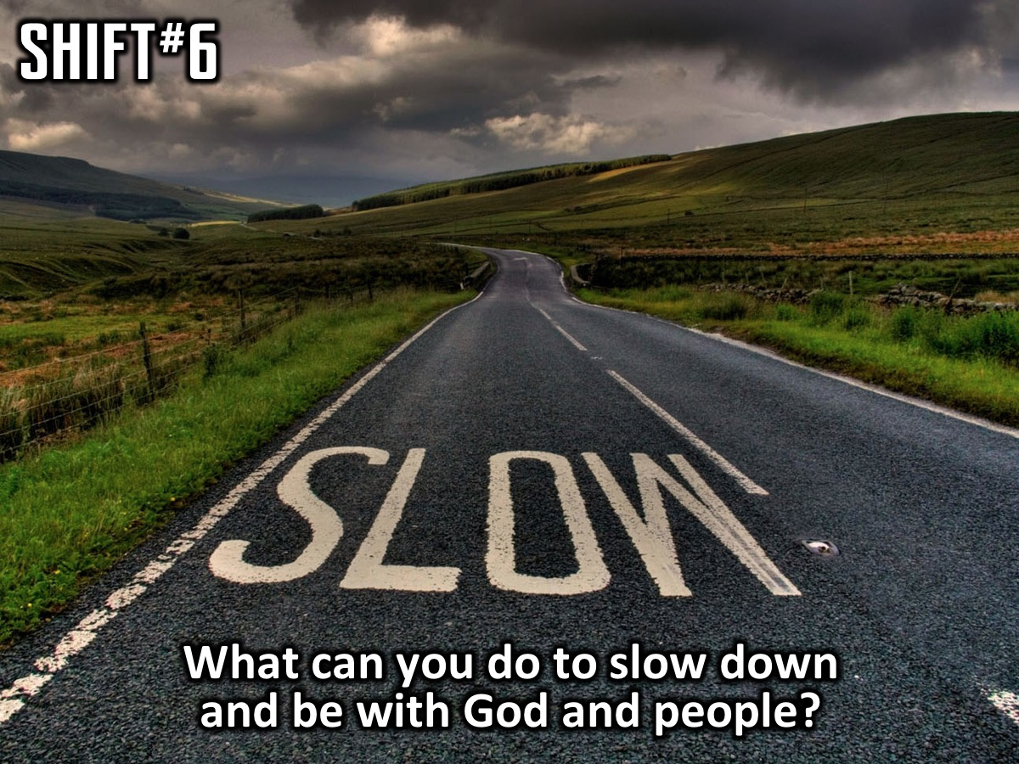
Notes:
Question: What can you do to slow down and be with God and people?

Slide 27
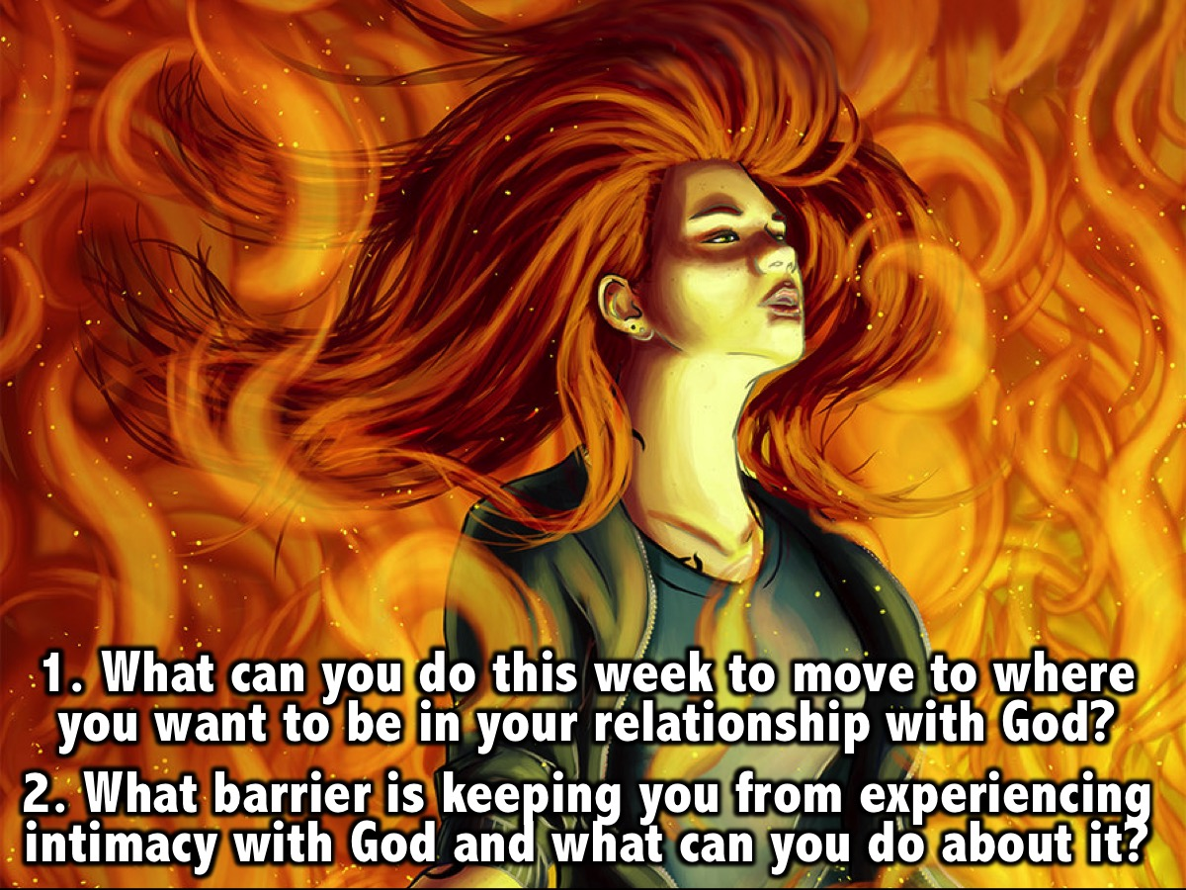
Notes:
Small Group Questions: (1) What can you do this week to move to where you want to be in your relationship with God? (2) What barrier is keeping you from experiencing intimacy with God and what can you do about it?

Slide 28

Notes:
Lifeguards wanted! This short session was presented to inspire our adult leaders to fulfill their role as watchmen or life guards in our ministry.

Slide 29
Notes:
Video: Trailer for the new Baywatch movie. Get it on YouTube at: https://www.youtube.com/watch?v=nZ5tqzw841s

Slide 30
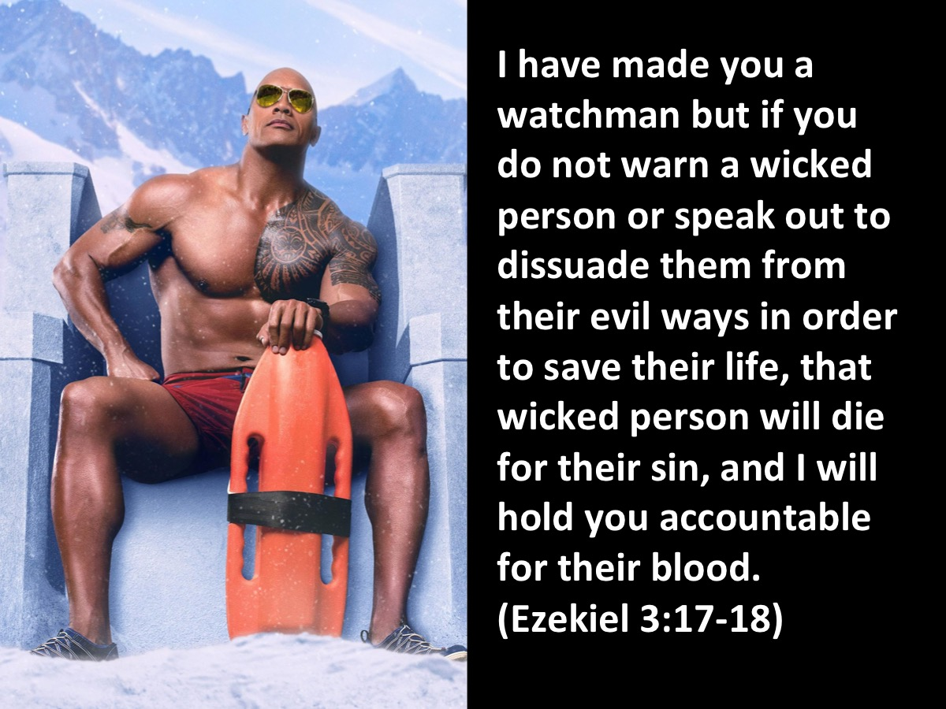
Notes:
As adult leaders or volunteers we are watchmen or life guards! “I have made you a watchman but if you do not warn a wicked person or speak out to dissuade them from their evil ways in order to save their life, that wicked person will die for their sin, and I will hold you accountable for their blood.” (Ezekiel 3:17-18)

Slide 31

Notes:
We are here to keep watch over youth - to see when they are at risk or when they need saving.

Slide 32
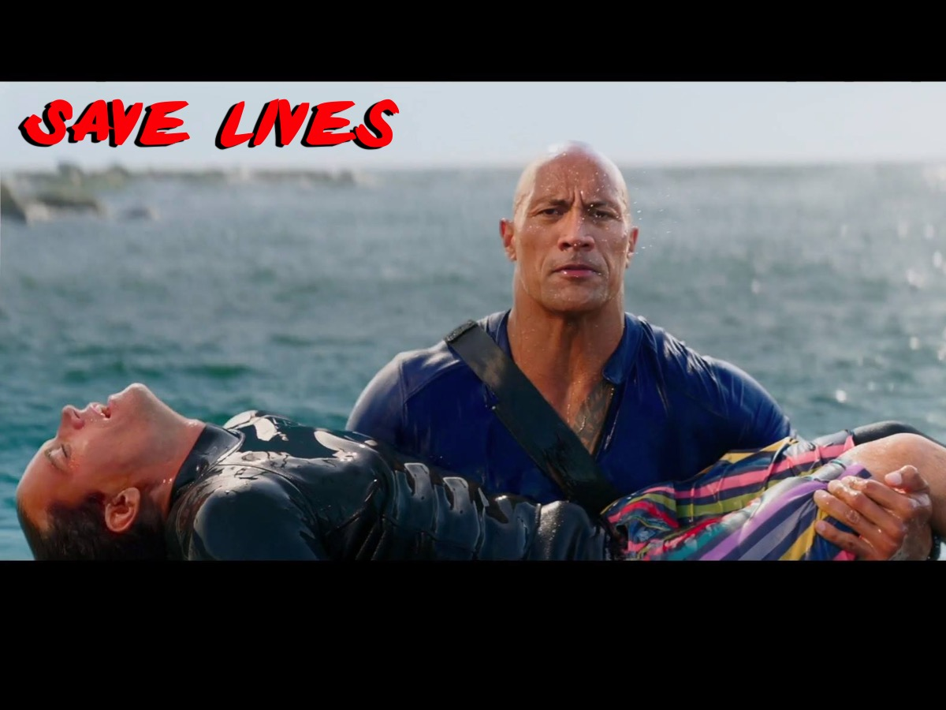
Notes:
We are here to save lives!

Slide 33

Notes:
We may have to take risks to save lives.

Slide 34
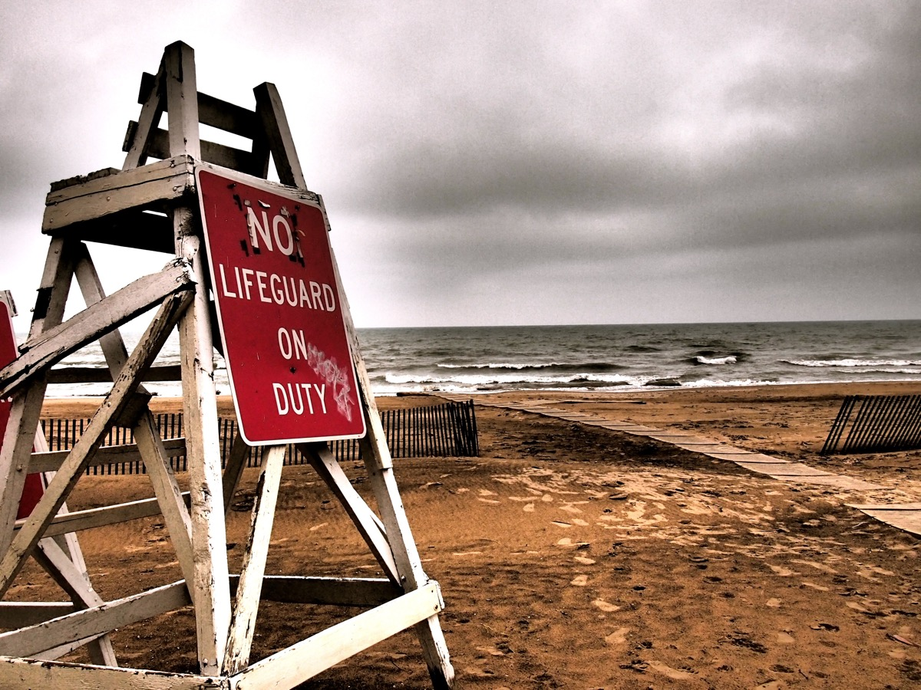
Notes:
We can’t have this happen! We need all of us to be lifeguards who are always on duty!

Slide 35

Notes:
Here is some presentation material to go along with a booklet we give to our volunteers so they know exactly what we are doing in youth ministry, what their roles are, how to create wow events and how to lead small groups. Here is a link to download the booklet: http://www.ymresourcer.com/documents/Leader_Survival_Kit.pdf

Slide 36
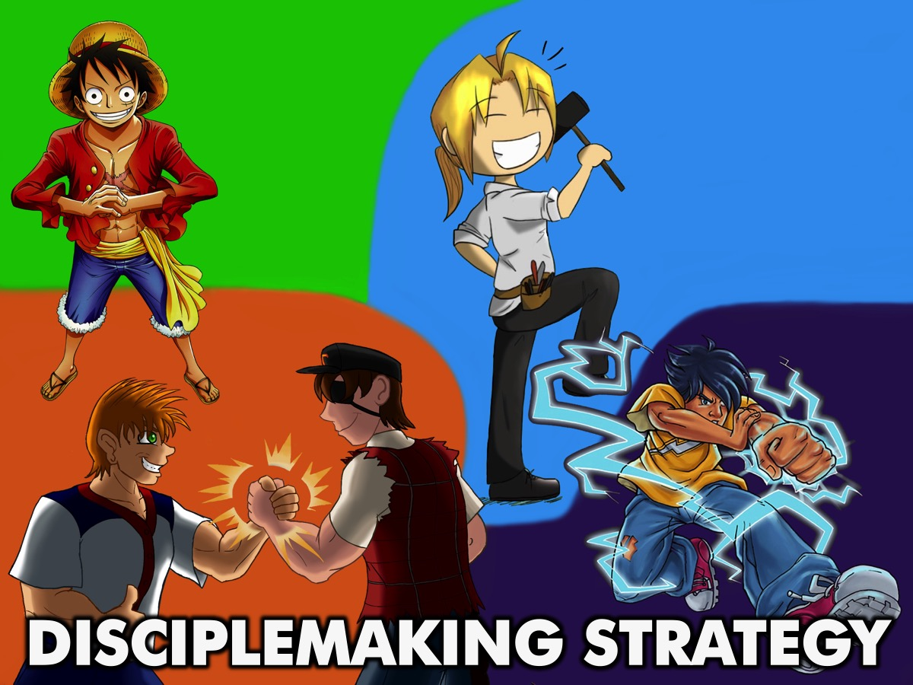
Notes:
Disciplemaking Strategy: As a youth ministry we believe it is critical to embrace the same approach for disciplemaking as the wider church so have built out youth ministry around the same four phases of ministry.

Slide 37
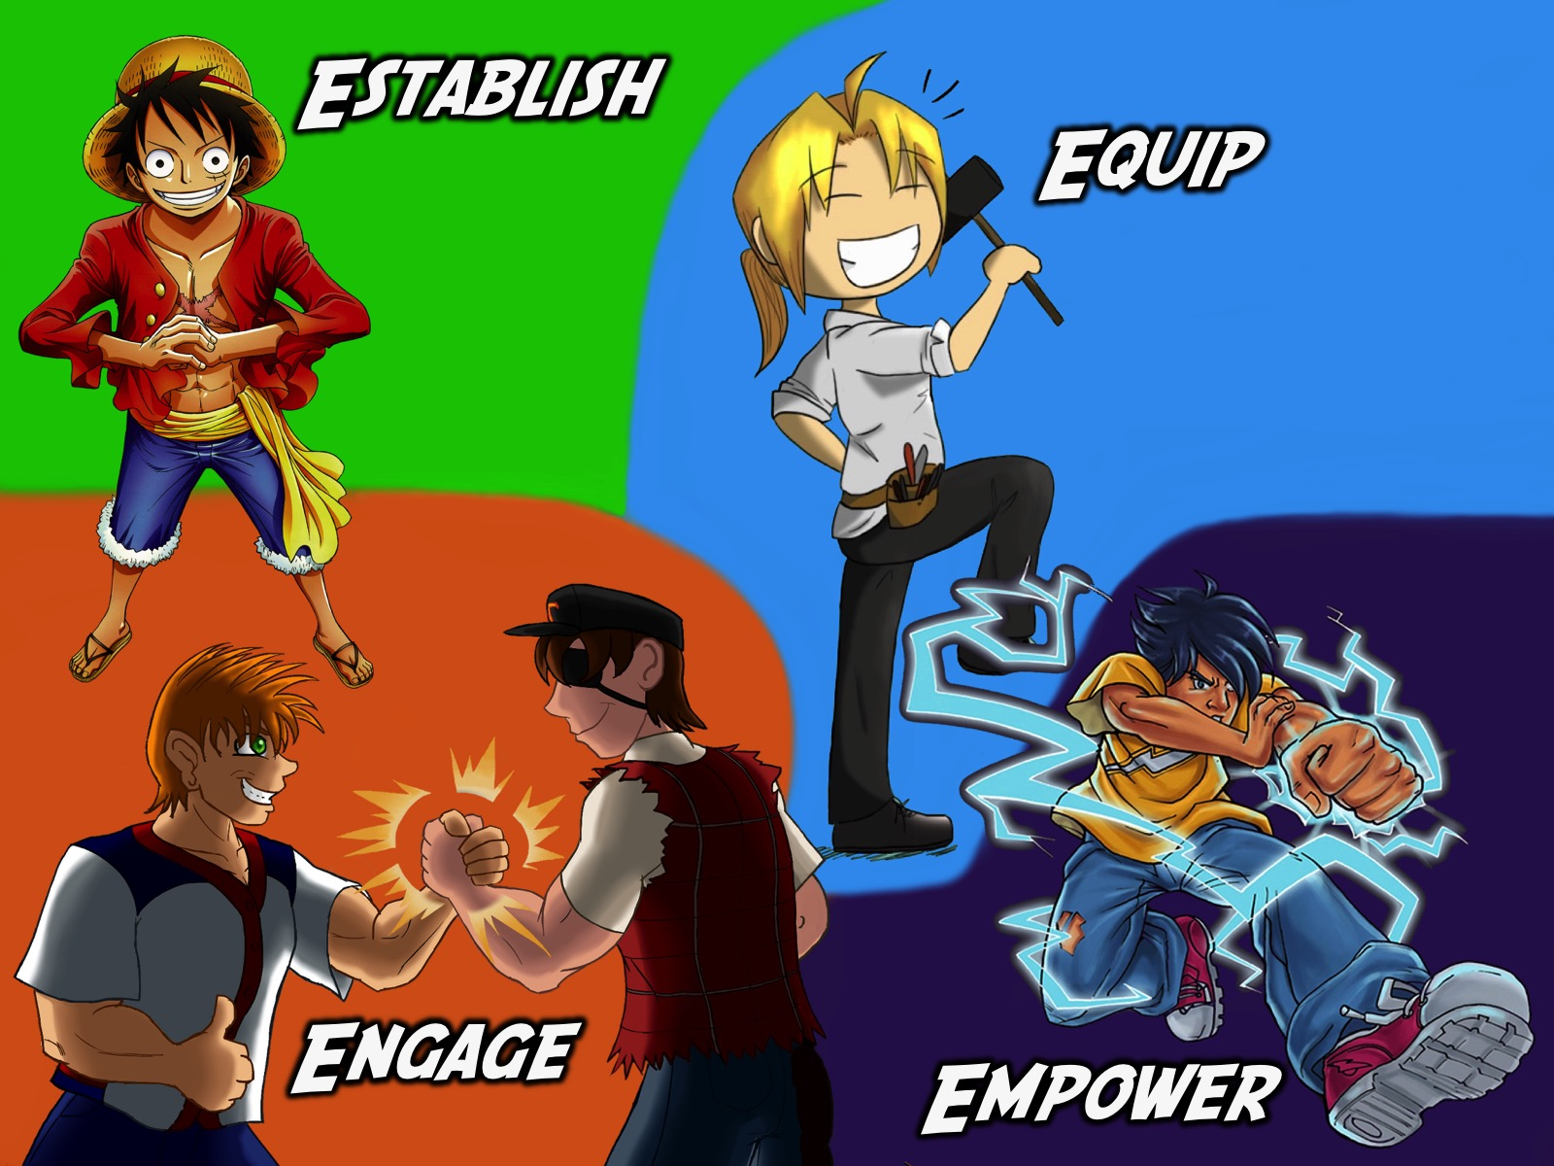
Notes:
Disciplemaking Strategy: As a youth ministry we believe it is critical to embrace the same approach for disciplemaking as the wider church so have built out youth ministry around the same four phases of ministry.

Slide 38
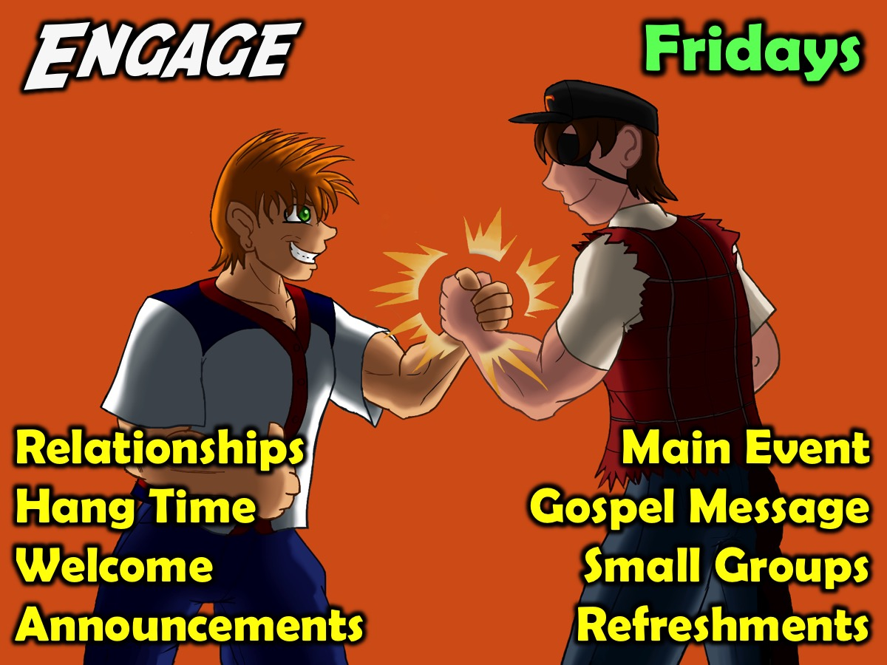
Notes:
1. Engage. Our Friday night event is an opportunity for teens to bring their friends so they can engage with other believers and with God. The key components of our Engage event are: Relationships, Hang Time, Welcome, Announcements, Main Event, Gospel Message, Small Groups & Refreshments.

Slide 39
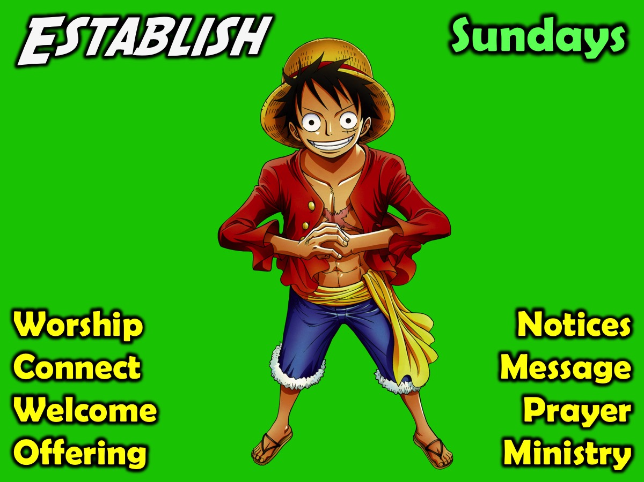
Notes:
2. Establish. Our Sunday morning event helps to establish teens in the faith. The key components are: Worship, Connect, Welcome, Offering, Notices, Messages, Prayer & Ministry.

Slide 40
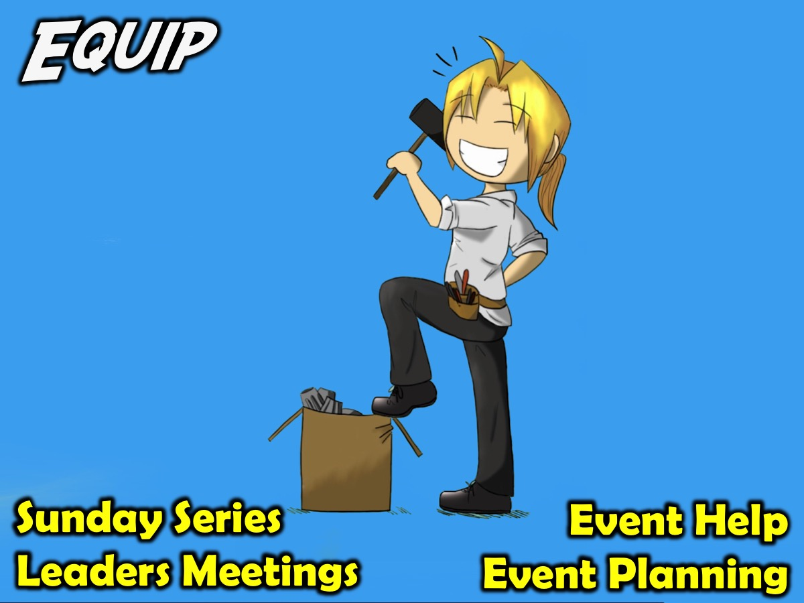
Notes:
3. Equip. We equip teens to minister among their peers in these ways: Equipping series on a Sunday morning; monthly leadership meetings and weekly prayer meetings; helping to plan and setup Friday night events or present part of a Sunday morning service (i.e. Welcome, Notices, Offering).

Slide 41
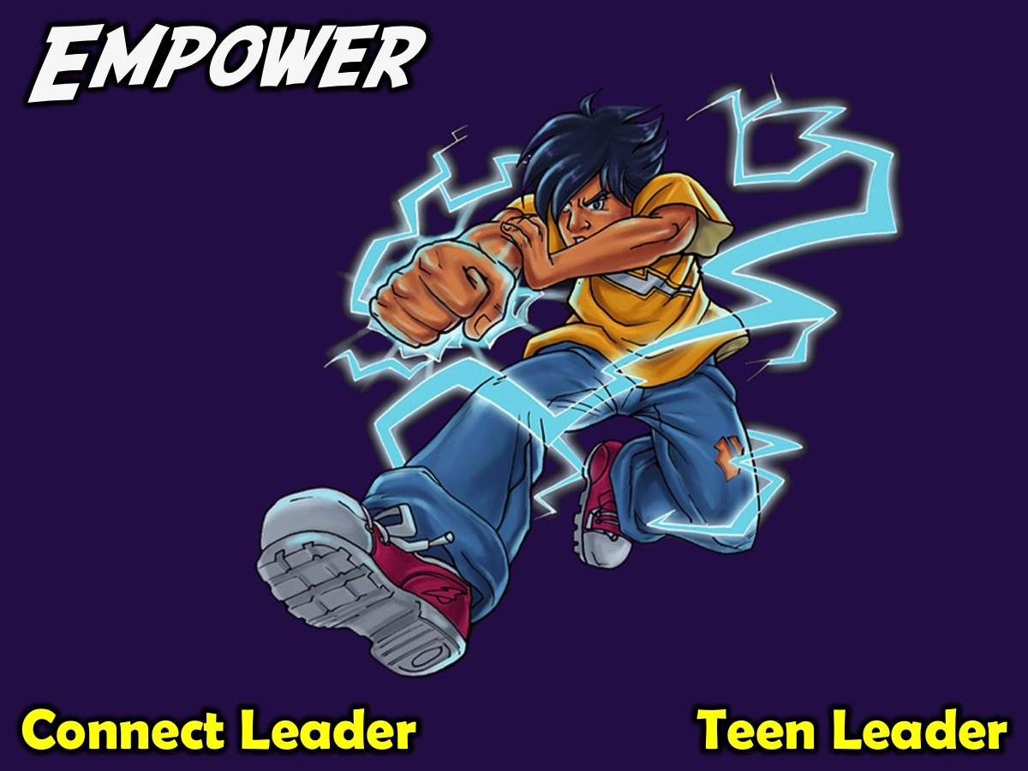
Notes:
4. Empower. We empower teens by releasing them to serve as Connect Leaders or as Teen Leaders who help plan and present weekly events.

Slide 42
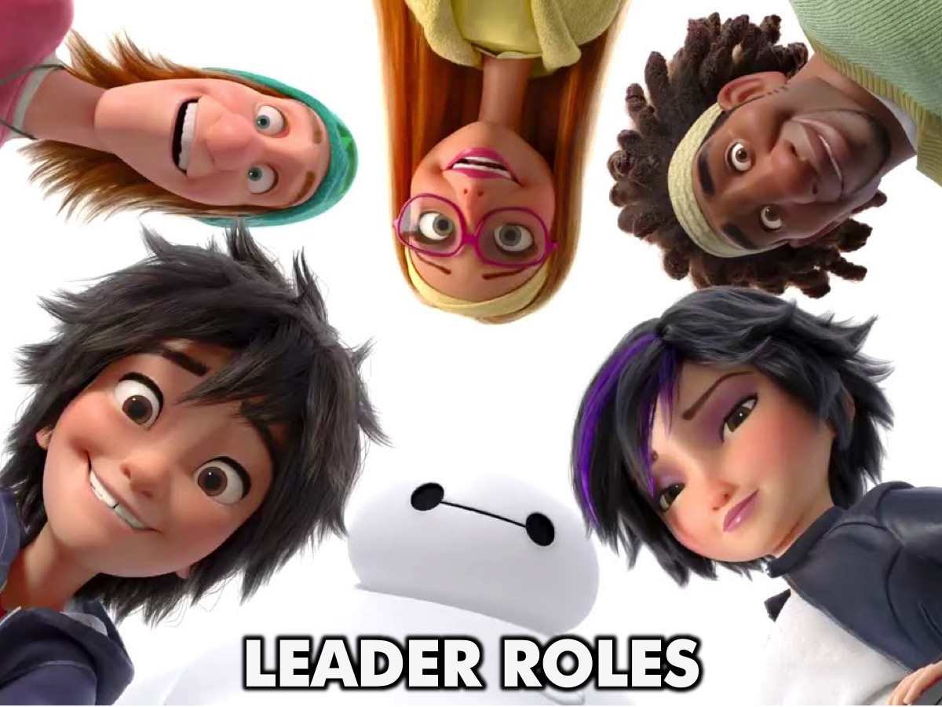
Notes:
Leader Roles: Here are some guidelines for leaders to know what their roles are.

Slide 43
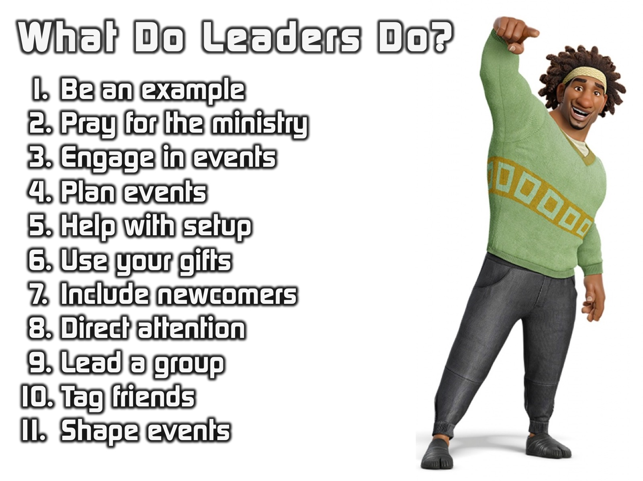
Notes:
Here are some guidelines we give to teen leaders in our ministry: Be an example. Pray for the ministry. Engage in events. Plan events. Help with setup. Use your gifts. Include newcomers. Direct attention during events. Lead a group. Tag friends on Facebook. Shape events.

Slide 44

Notes:
Creating WOW Events: I recently briefed our teen leaders about their involvement in planning and presenting Wow events at our Friday night youth event, and listed the following practical guidelines they needed to follow:

Slide 45

Notes:
1. Design the Event – it is their responsibility to design the event from start to finish – not just come up with a few games.

Slide 46

Notes:
2. Work With Others – some teens are tempted to plan and lead an event on their own – we are looking for teamwork!

Slide 47
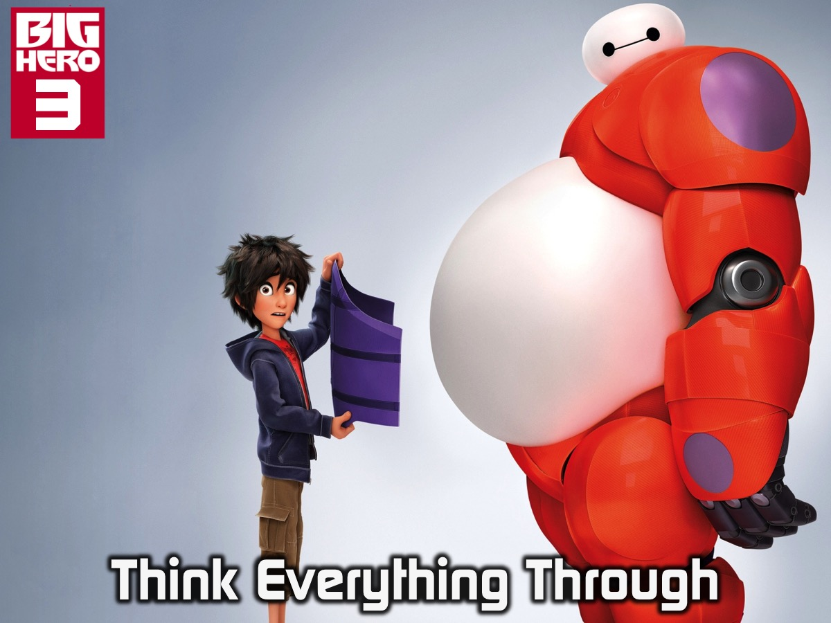
Notes:
3. Think Everything Through – they need to consider every aspect of the event and ensure it works together.

Slide 48

Notes:
4. Figure Out the Details – there is a tendency to do surface level planning but they have to get specific with every detail!

Slide 49
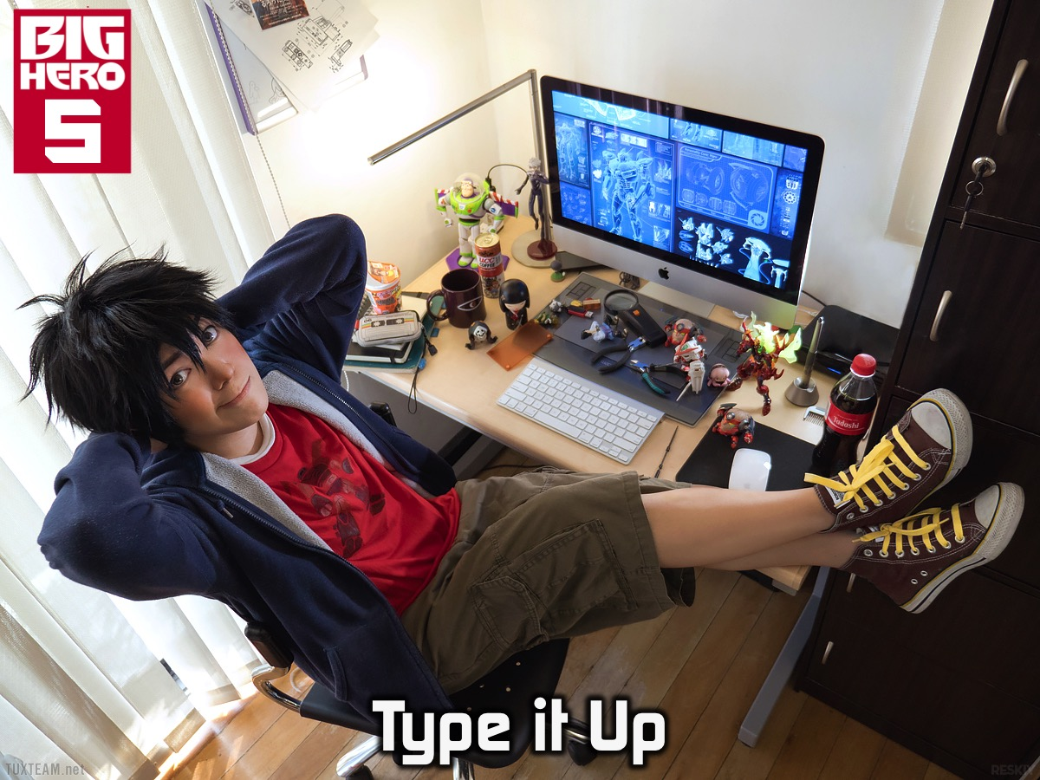
Notes:
5. Type it Up – when people actually type out the whole event it forces them to be more thorough and tighter.

Slide 50

Notes:
6. Submit it for Review: Send it by Tuesday – we set a deadline in the week when the outline for the event must be submitted.

Slide 51

Notes:
7. Create Group Questions – they are responsible to create five questions for small groups based on the theme.

Slide 52
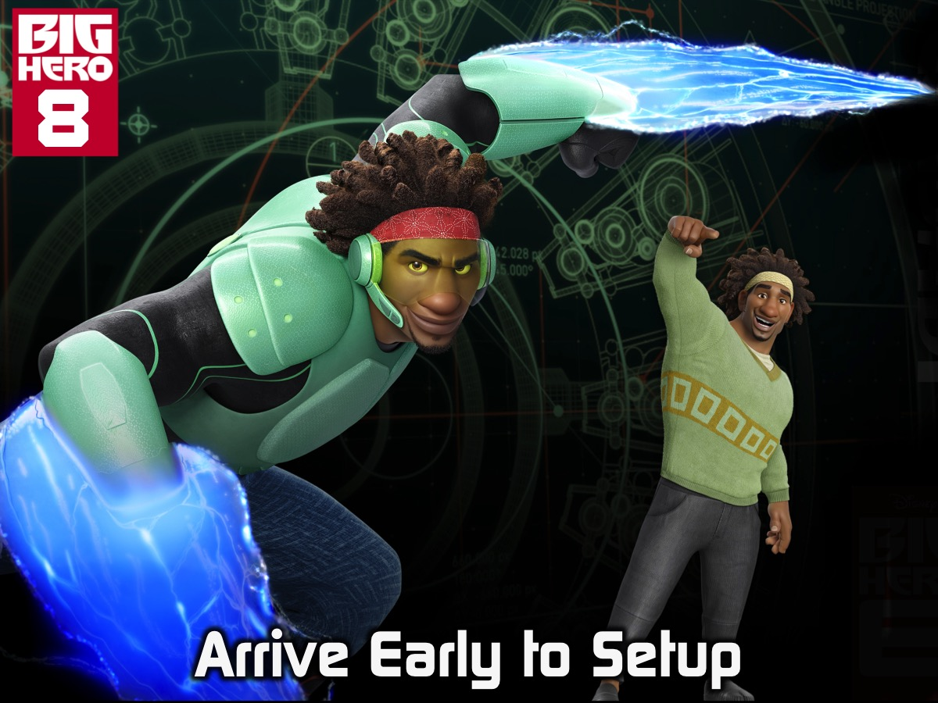
Notes:
8. Arrive Early to Setup – we challenge them to get to the veue at least an hour before it starts to set up properly!

Slide 53

Notes:
9. Set Things Up – this reminds them that it is their responsibility to ensure everything is ready for the event.

Slide 54

Notes:
10. Walk Through the Event – about 30 minutes before the event we walk through the Presentation to ensure all is clear.

Slide 55
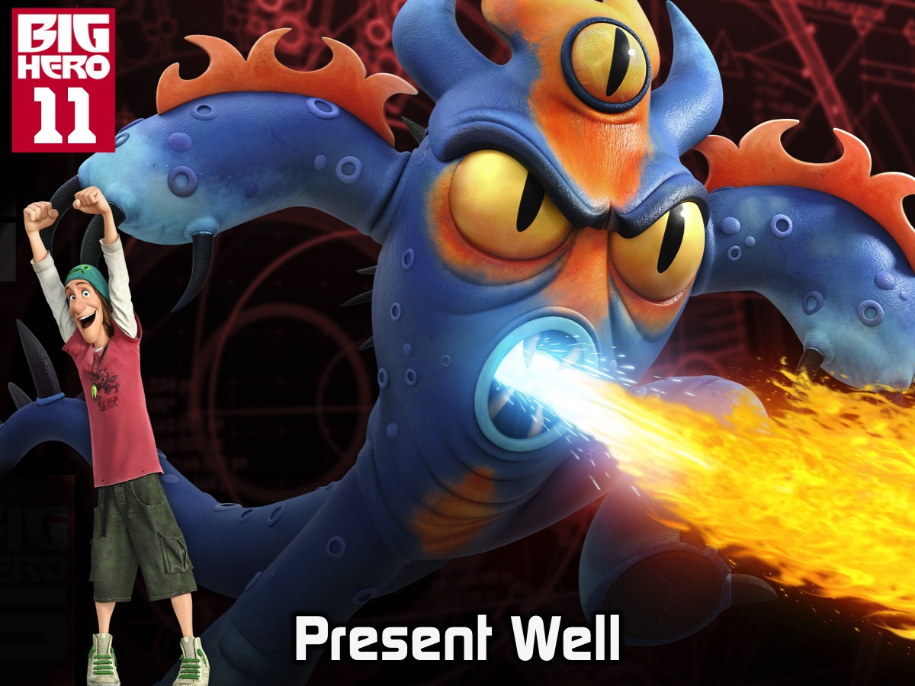
Notes:
11. Present Well – they are challenged to be confident and lead the event well on the night.

Slide 56

Notes:
12. Ask for Feedback – after the event we expect they will get feedback about the event and how they led it.

Slide 57

Notes:
13. Improve Next Time – based on the feedback they reveive they are challenged to think of how they can improve.

Slide 58
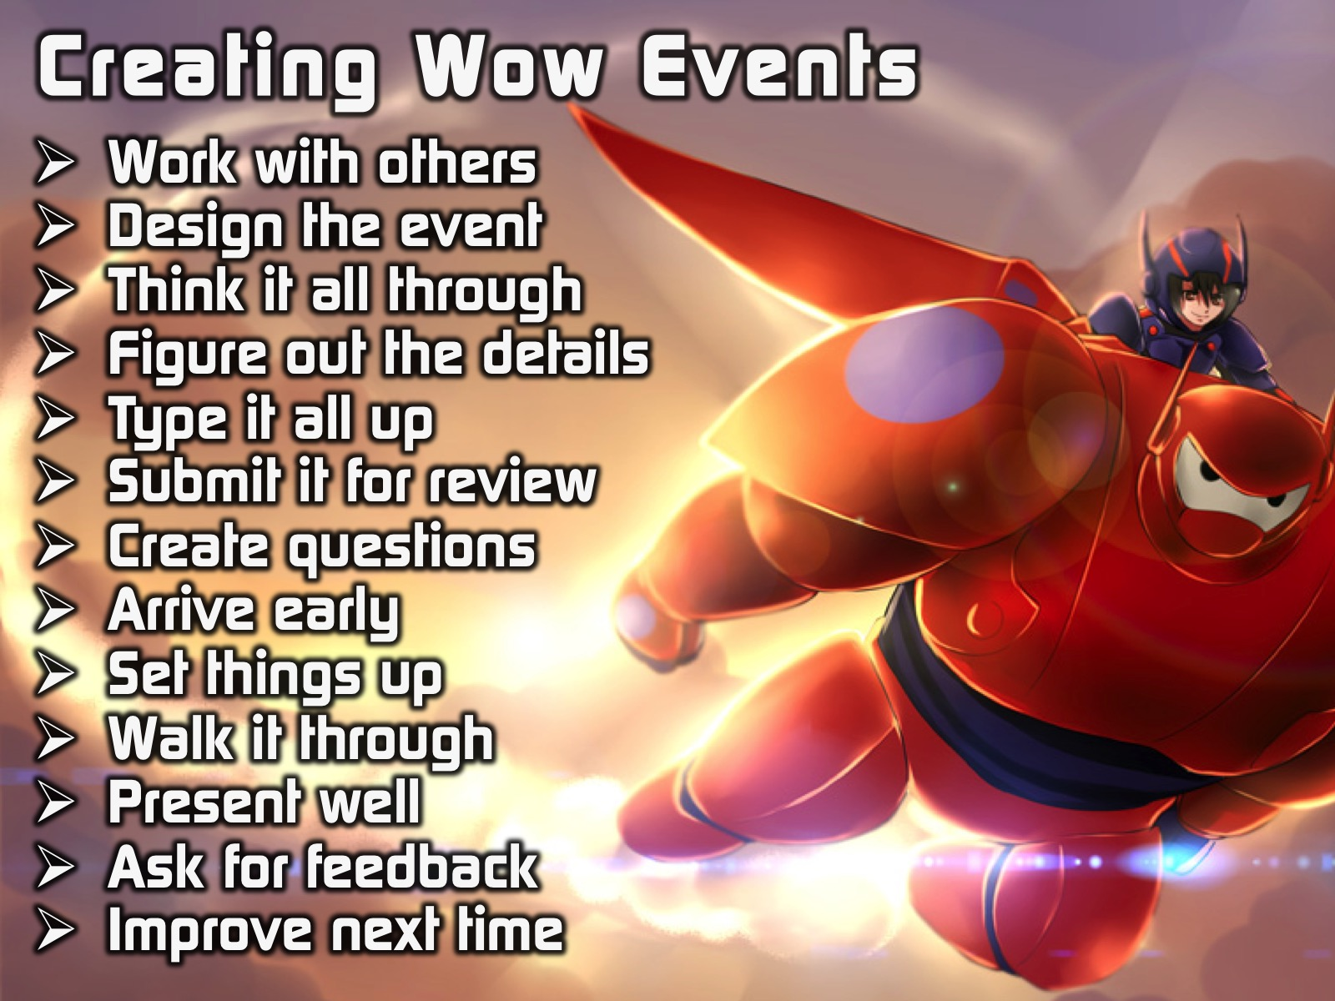
Notes:
So here are a summary of the guidelines we want our teen leaders to fulfil as they design and present a Wow event:
* Work with others – some teens are tempted to plan and lead an event on their own – we are looking for teamwork!
* Design the event – it is their responsibility to design the event from start to finish – not just design a few games.
* Think everything through – they need to consider every aspect of the event and ensure it works together.
* Figure out details – there is a tendency to do surface level planning but they have to get specific with every detail!
* Type it all up – when people actually type out the whole event it forces them to be more thorough and tighter.
* Send it by Tuesday – we set a deadline in the week when the outline for the event must be submitted.
* Create group questions – they are responsible to create five questions for small groups based on the theme.
* Arrive early (6:30) – we challenge them to get to the veue at least an hour before it starts to set up properly!
* Set things up – this reminds them that it is their responsibility to ensure everything is ready for the event.
* Walk through event – about 30 minutes before the event we walk through the Presentation to ensure all is clear.
* Present well – they are challenged to be confident and lead the event well on the night.
* Ask for feedback – after the event we expect they will get feedback about the event and how they led it.
* Improve next time – based on the feedback they reveive they are challenged to think of how they can improve.

Slide 59
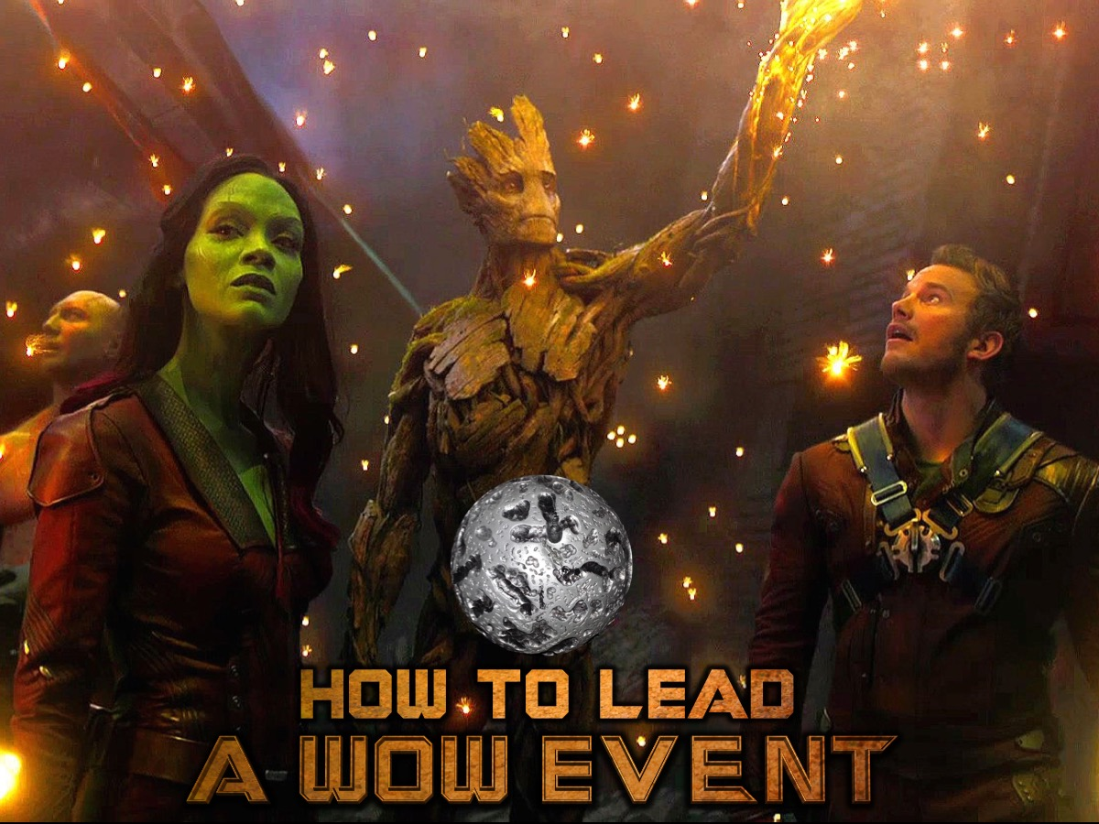
Notes:
How to Lead a Wow Event: Here are some guidelines on how to actually run a Friday night event.

Slide 60

Notes:
(1) Do Your Homework. It takes a lot of work to pull off a Wow event so makes sure you put in the hours necessary to create the event. Start working long before the week of the event so you don’t end up in panic stations and last minute desperation.

Slide 61
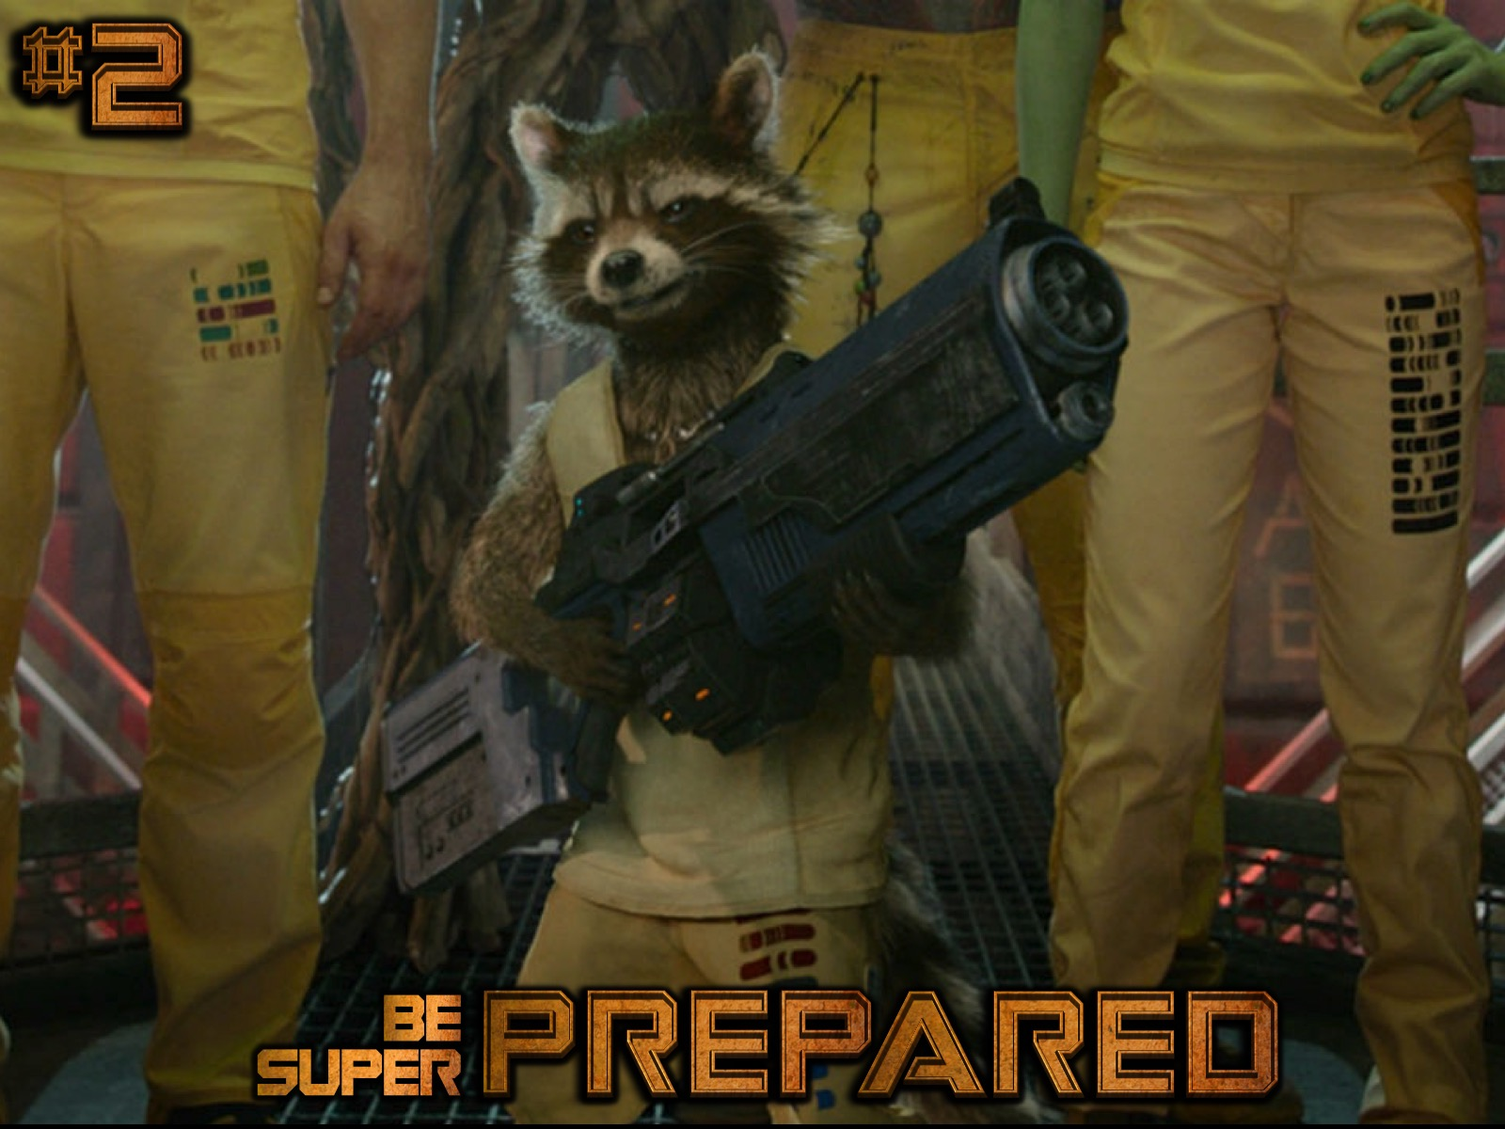
Notes:
(2) Be Super Prepared. Think through every single detail of the program. Write or type everything out to ensure that nothing is left unprepared. This will help things go smoothly on the night and increase your confidence levels.

Slide 62

Notes:
(3) Brief Your Team. Before the prayer time, gather everyone who is helping you pull off the event and make sure everything knows exactly what they are responsible to do. If there are any question patiently answer them going over things more than once if necessary!

Slide 63

Notes:
(4) Look the Part. It will add to the event if you think through how you will present yourself on the night as a leader. This does not mean wearing a suit an a tie but there could be items of clothing or accessories that will help you look and play the part as MC on the night.

Slide 64

Notes:
(5) Come Out Blazing. When you start the event make sure you come out guns blazing – this means, confidently welcoming people and reflecting the level of excitement that you want the audience to reflect. This means knowing exactly what you are going to do at each moment of the event!

Slide 65
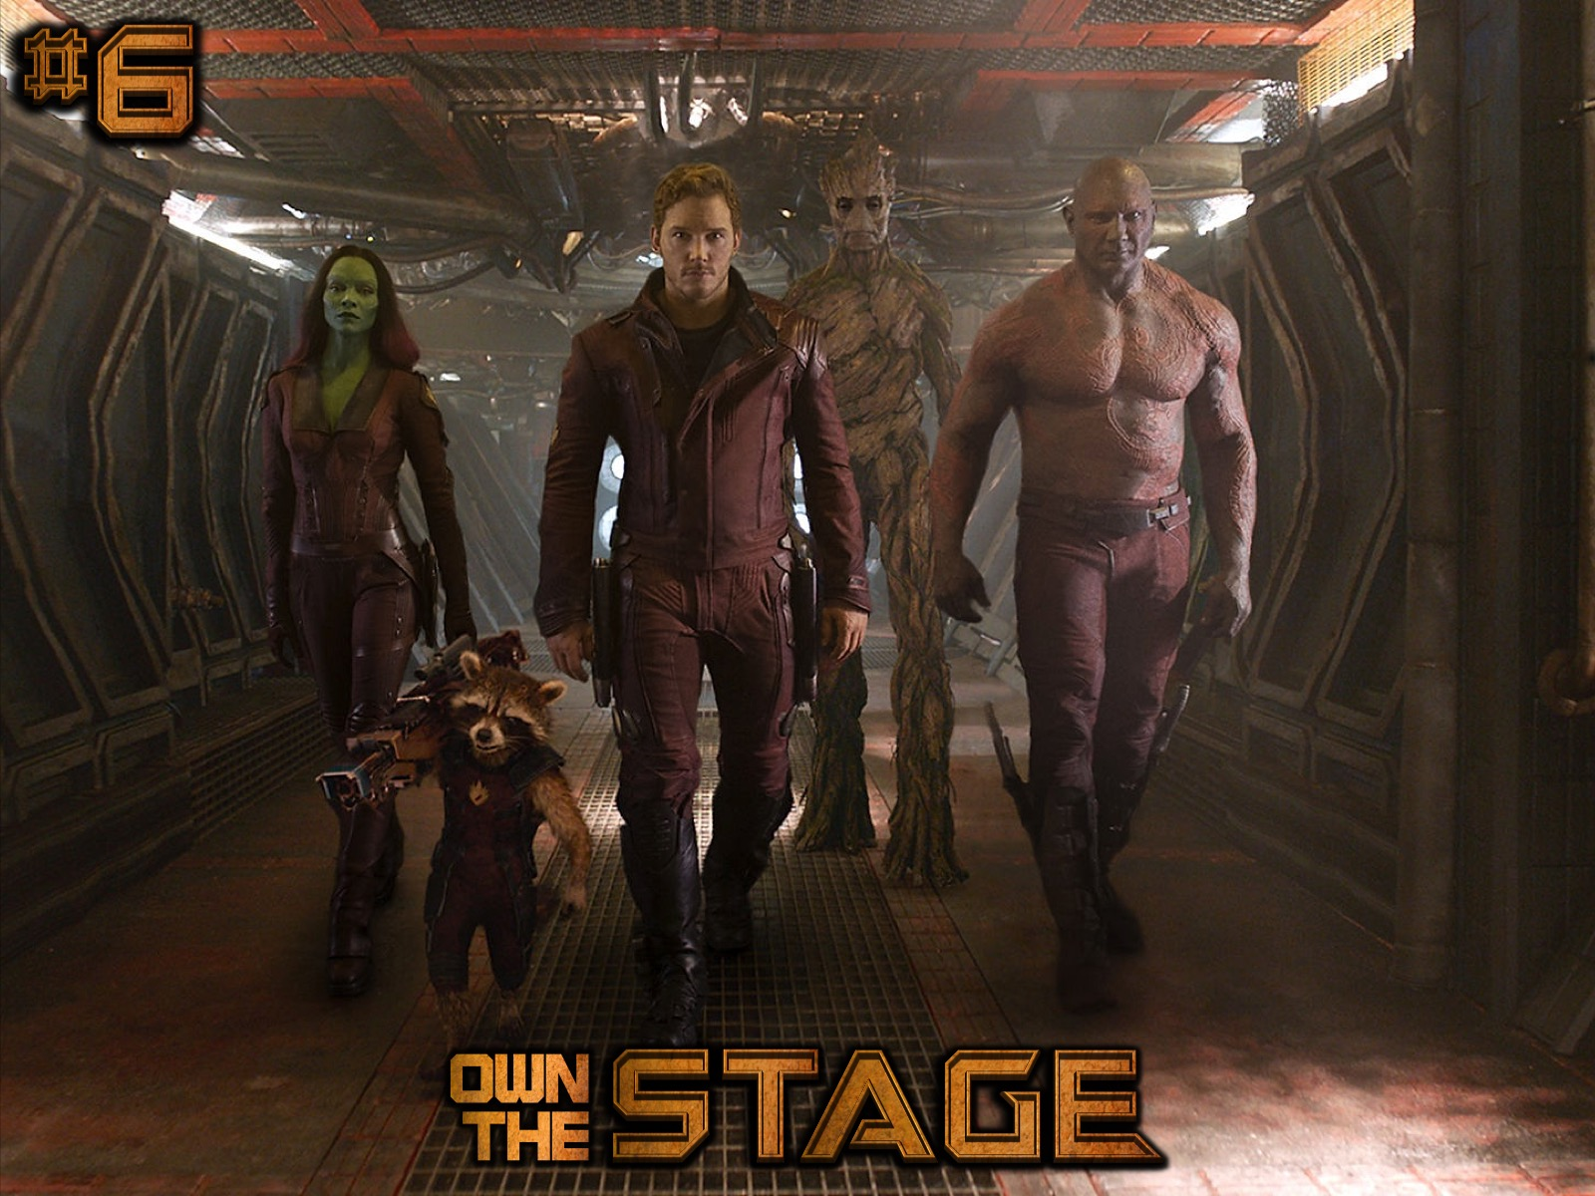
Notes:
(6) Own the Stage. Make the stage your own by moving around and standing in a central part of the stage.

Slide 66
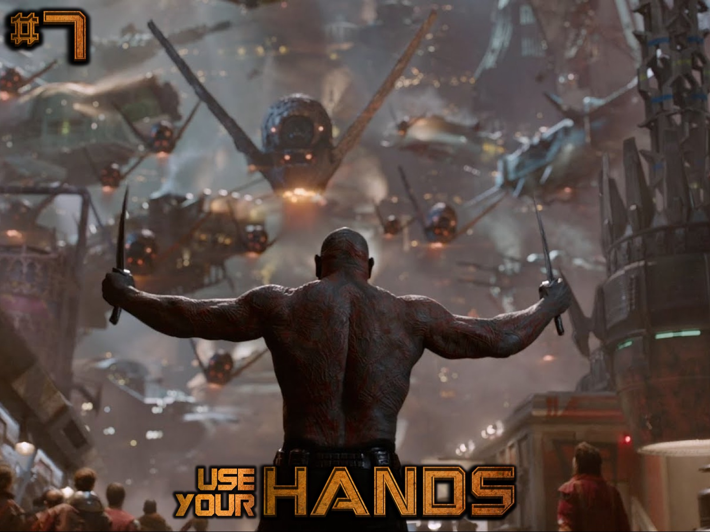
Notes:
(7) Use Your Hands. The bigger your audience the bigger your gestures need to be – so be willing to exaggerate your movements to ensure people are drawn in to the event.

Slide 67
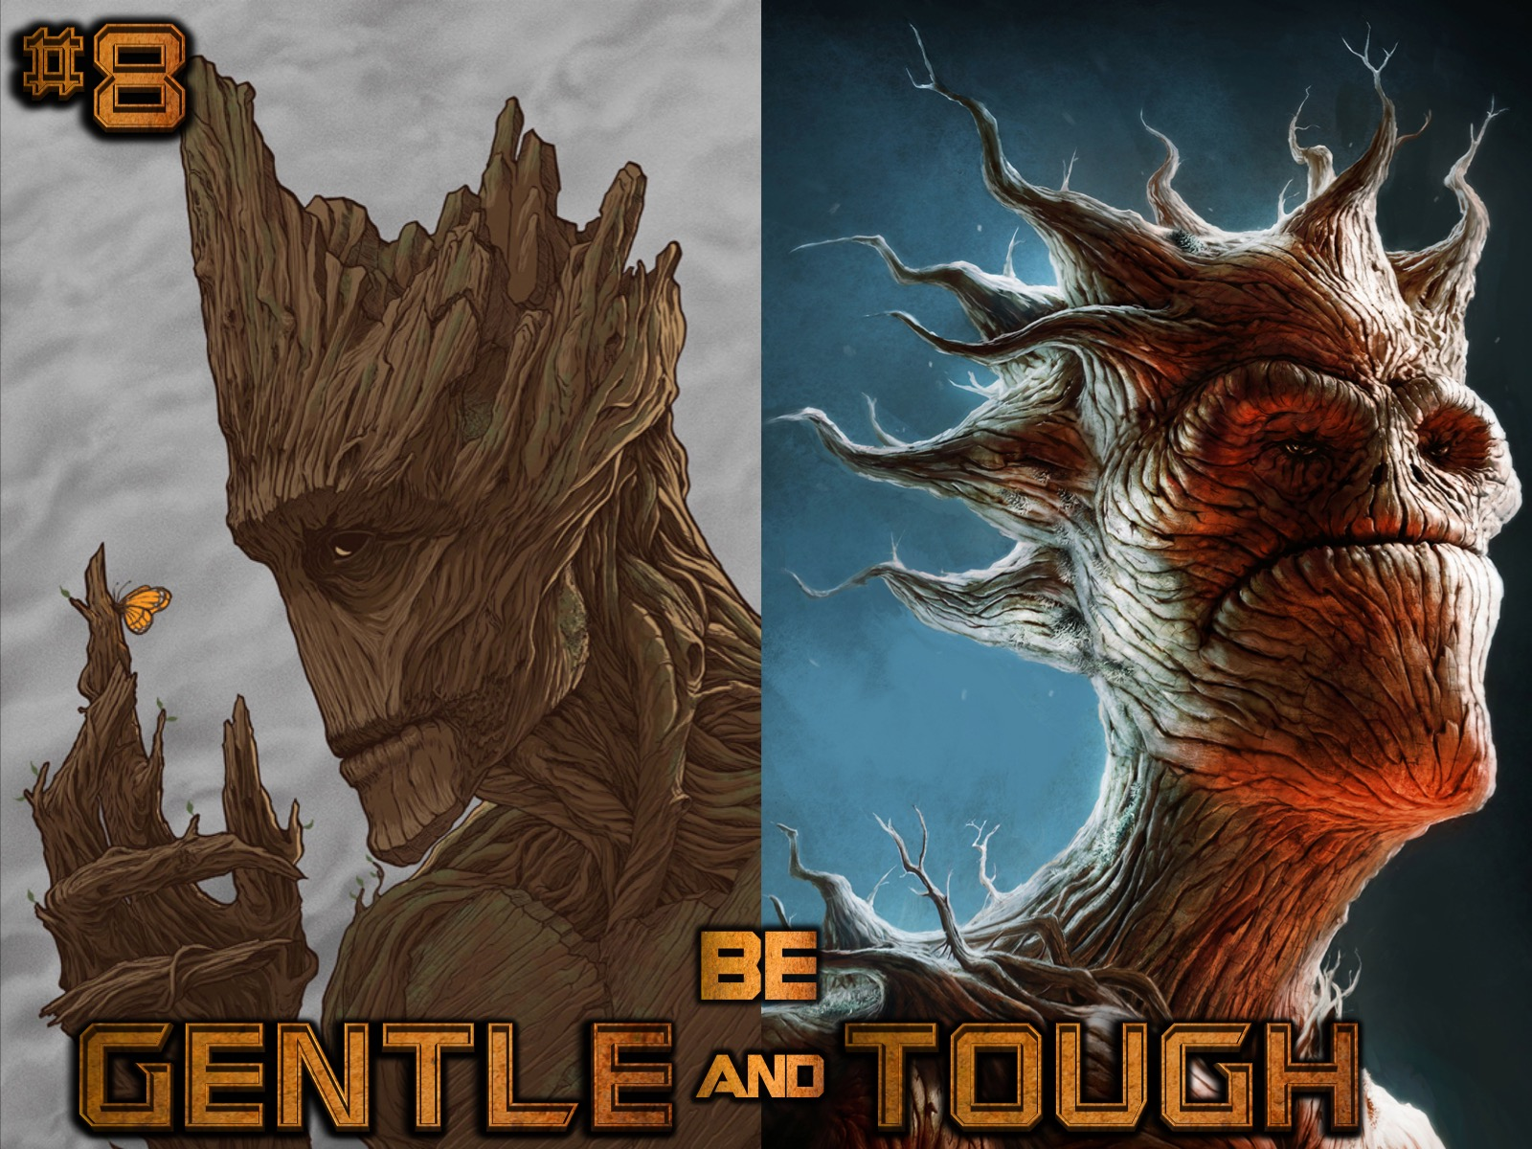
Notes:
(8) Be Gentle and Tough. Throughout the event there may be those moments when people will be tempted to check out or chat with their friends. Be sure to take a gentle approach in drawing them back into the group or you will alienate them. It is best if you brief your fellow teen and adult leaders to help with “crowd-control” so you don’t have to chastise people from the stage.

Slide 68

Notes:
(9) Watch the Clock. It is critical to keep a close eye on how long each part of the event is taking and make the necessary adjustments along the way so that you don’t run out of time and end up sacrificing important parts of the event due to a lack of control. Don’t be afraid to leave out an activity along the way if time is running short.

Slide 69

Notes:
(10) Always Be Flexible. If an activity is not working out or you sense that you need to move on from something that is dangerous then be willing to be flexible with the program.

Slide 70
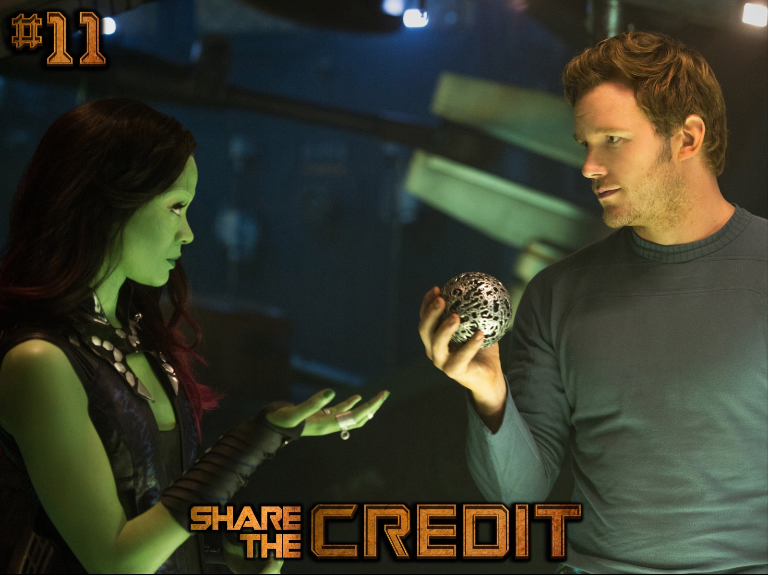
Notes:
(11) Share the Credit. When the event is over and people thank you for an amazing event be sure to give credit to others who have helped you create and present the event.

Slide 71
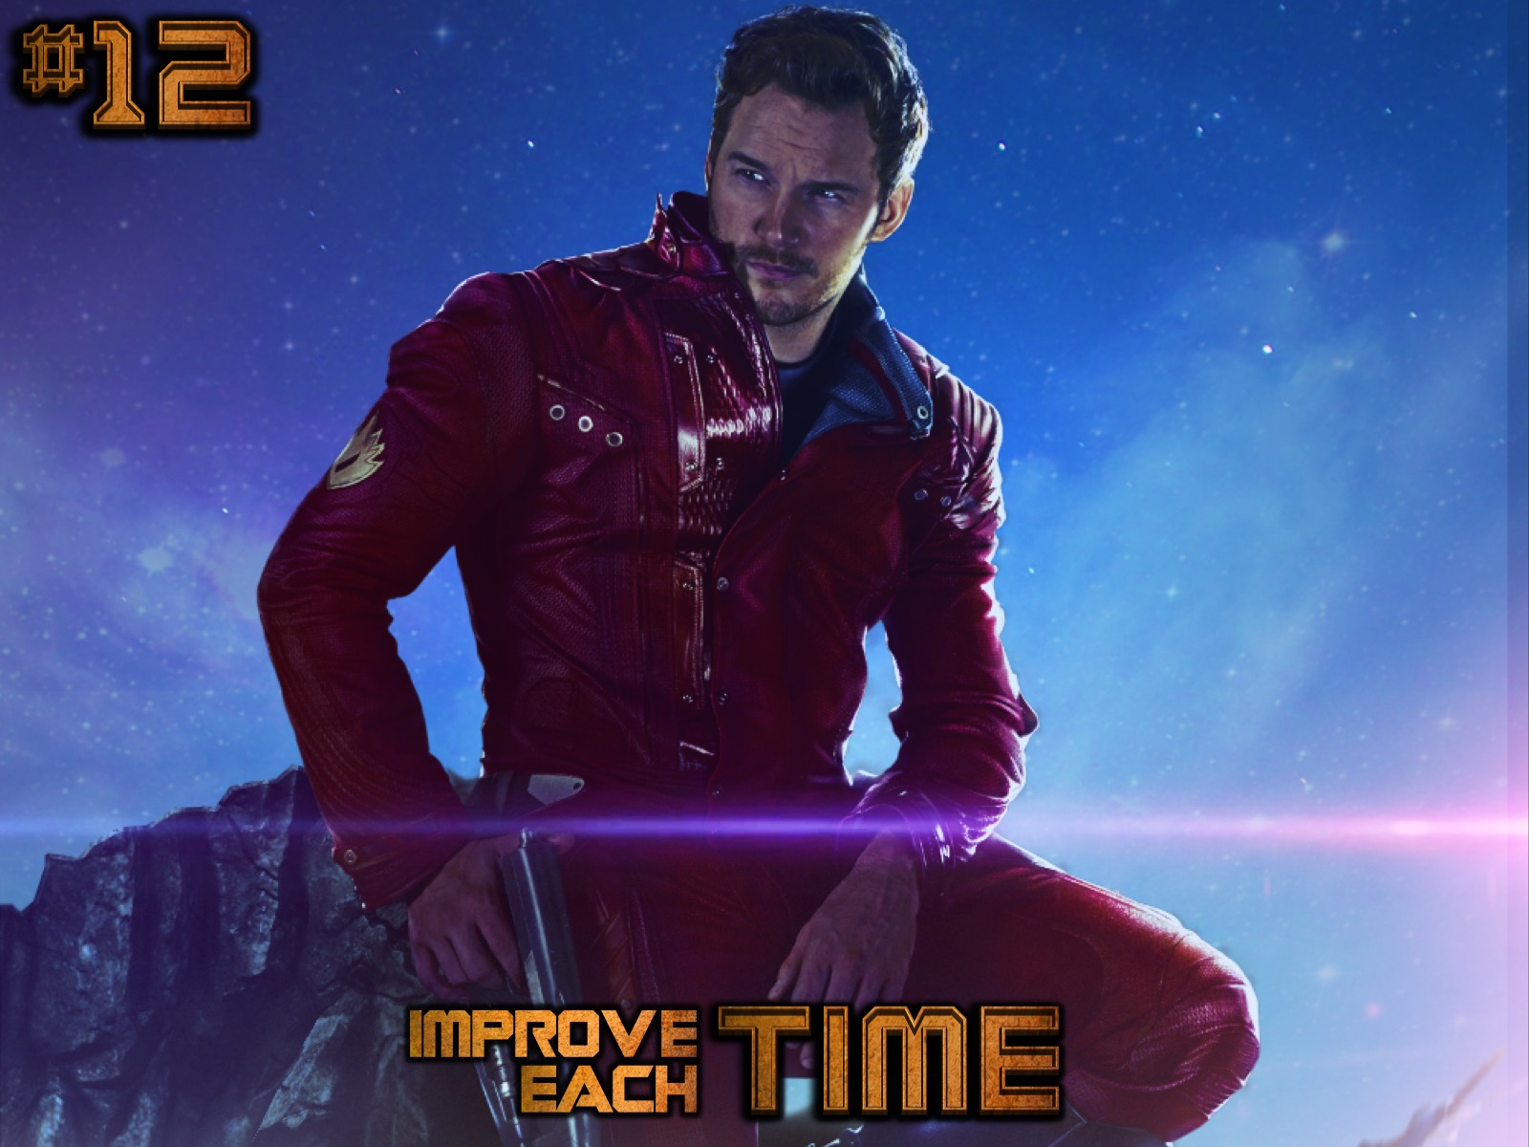
Notes:
(12) Improve Each Time. Ask for feedback from peer and adult leaders and look for ways that you can prepare and lead a better event the next time round.

Slide 72
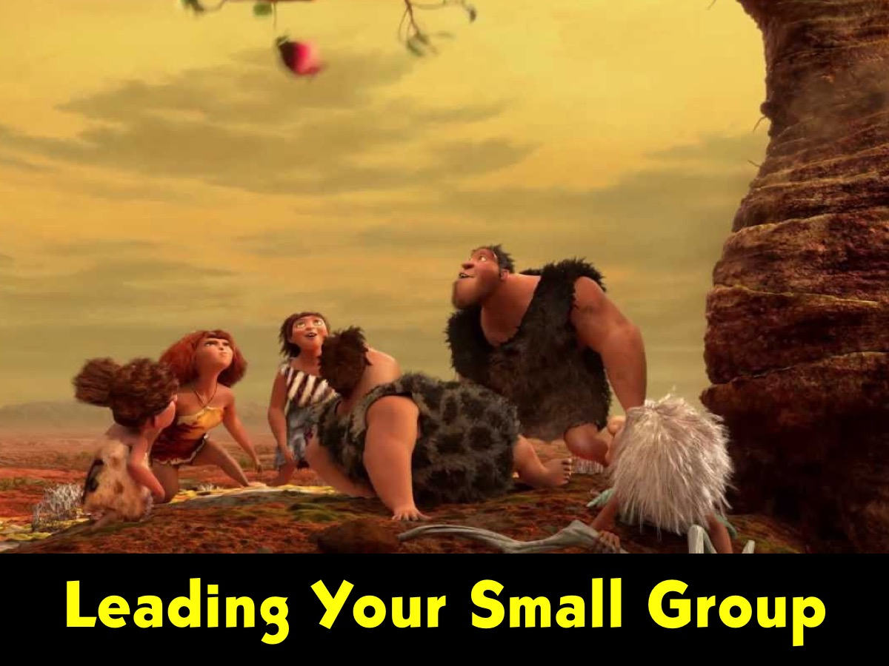
Notes:
Leading Your Small Group: This is the presentation used on Sunday afternoon at our leaders training session to help our teen leaders improve their skills in running small groups on Friday nights at youth.

Slide 73

Notes:
1. Get your guys - as soon as the teens who are in your small group are allocated to you, try and get them into a huddle as soon as possible.

Slide 74
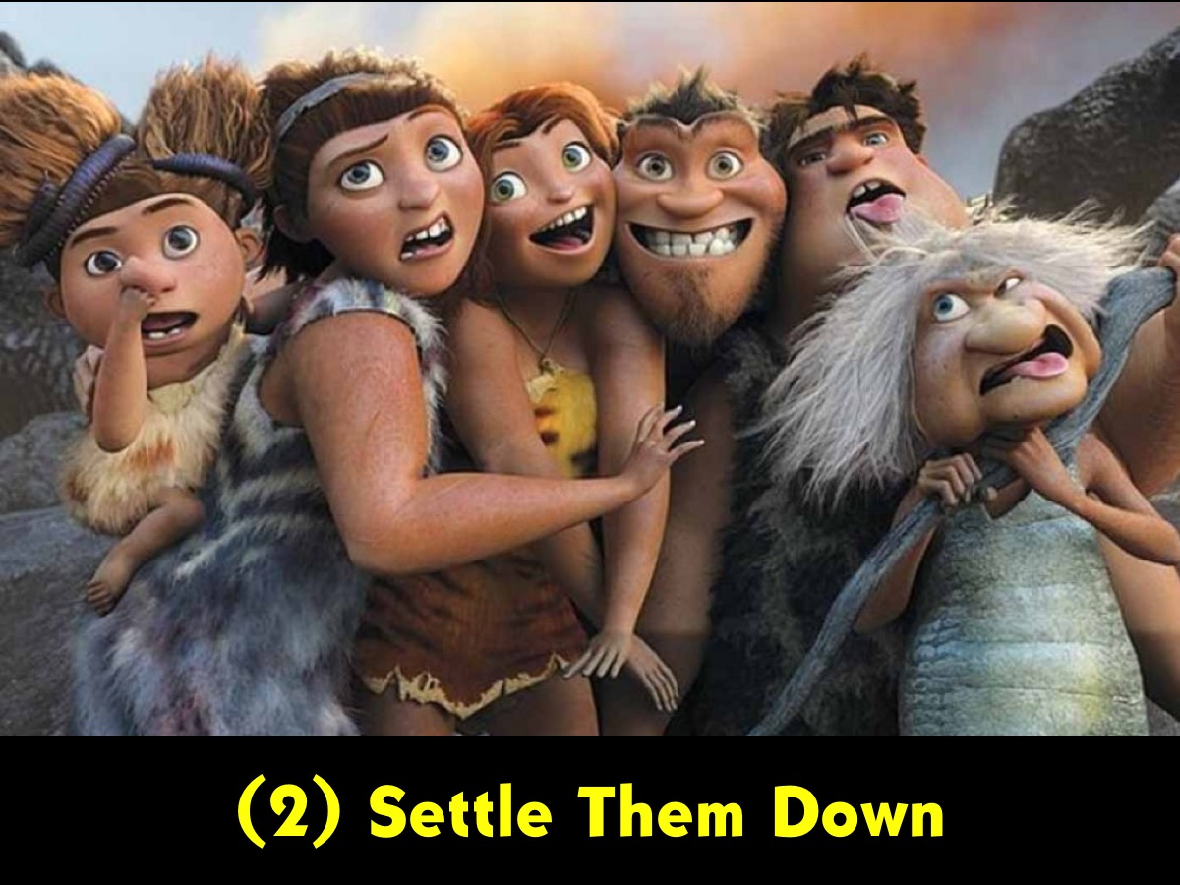
Notes:
2. Settle them down - it is the leaders responsibility to encourage their group members to sit down and get ready for the group time.

Slide 75
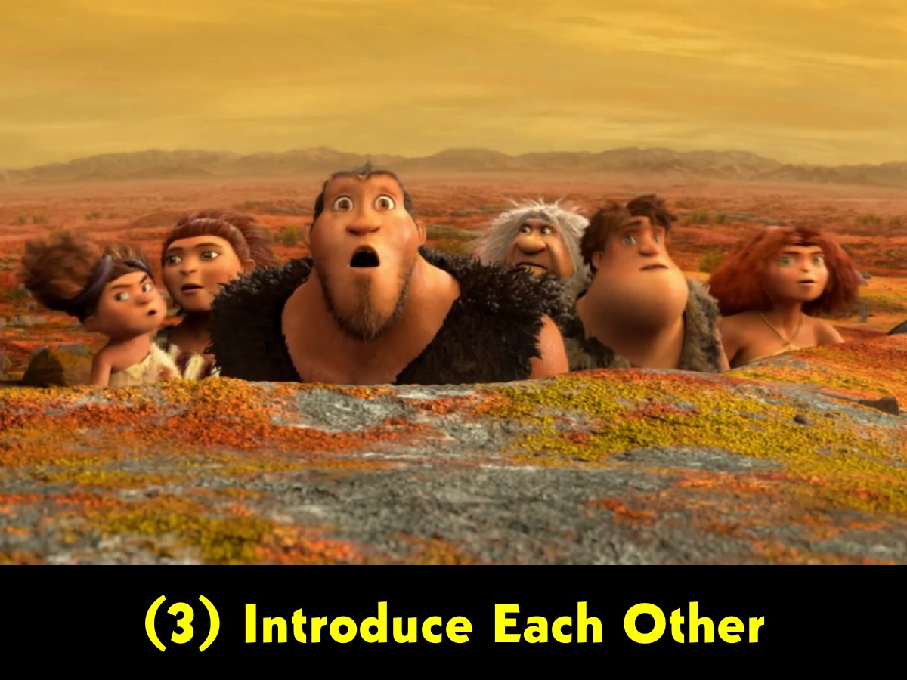
Notes:
3. Introduce each other - As leaders are given different teens each Friday night it is necessary to make sure that the teens know each other - so it is necessary to have each person share their names and if necessary a little about themselves.

Slide 76
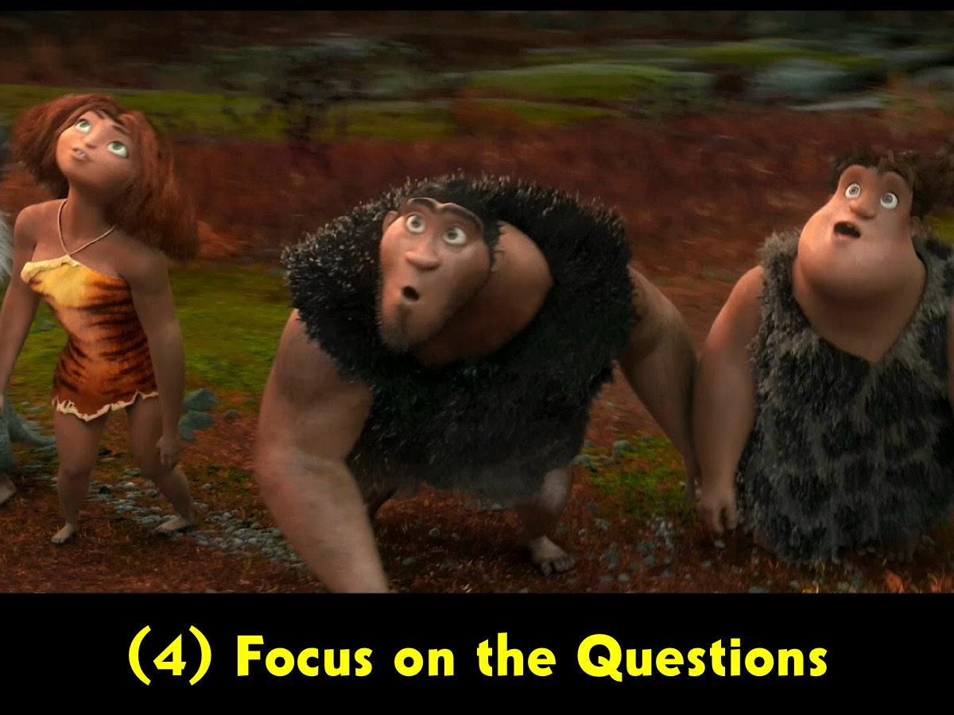
Notes:
4. Focus on the questions - it is the leader's responsibility to keep their small group focused on the questions and this is something that will take effort and guidance along the way.

Slide 77

Notes:
5. Handling Different Characters – today we are going to explore different group member characters to empower you to handle them in your small group.

Slide 78

Notes:
A. The Newcomer

Slide 79
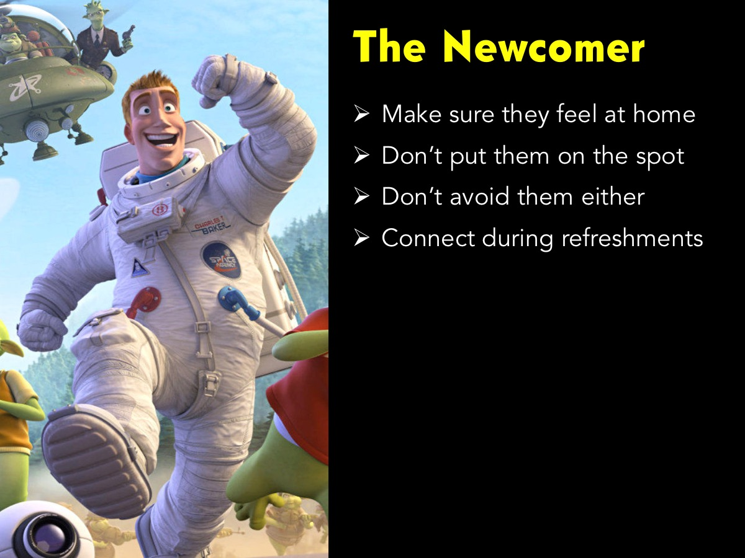
Notes:
The newcomer is new to the group and will be hesitant to speak until they feel comfortable. Some tips: (1) Make sure they feel at home. (2) Don’t put them on the spot. (3) Don’t avoid them either. (4) Connect during refreshments.

Slide 80
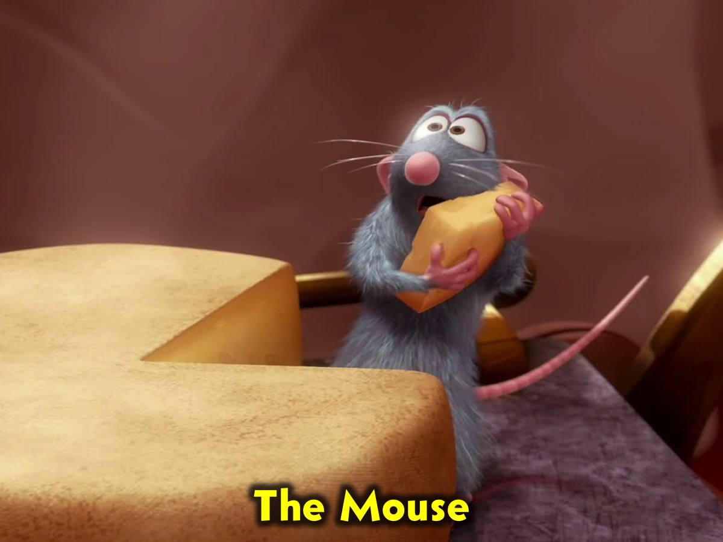
Notes:
B. The Mouse

Slide 81
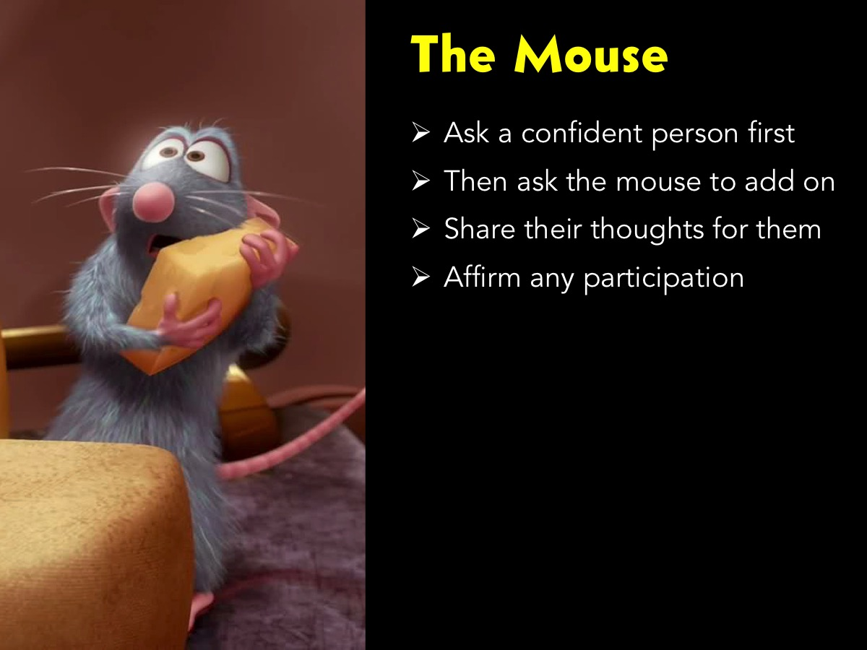
Notes:
This person, also called the ‘wallflower’ talks too little or not at all. The leader should encourage them to participate by asking a confident person a question and then asking the wallflower to respond. It is also useful to overhear what they say in a small group context and then reinforce their comments to the whole group. The leader could also engage in one‑on‑one conversation during fellowship time with them and reinforce private comments so they will want to talk to the bigger group at a later stage.

Slide 82
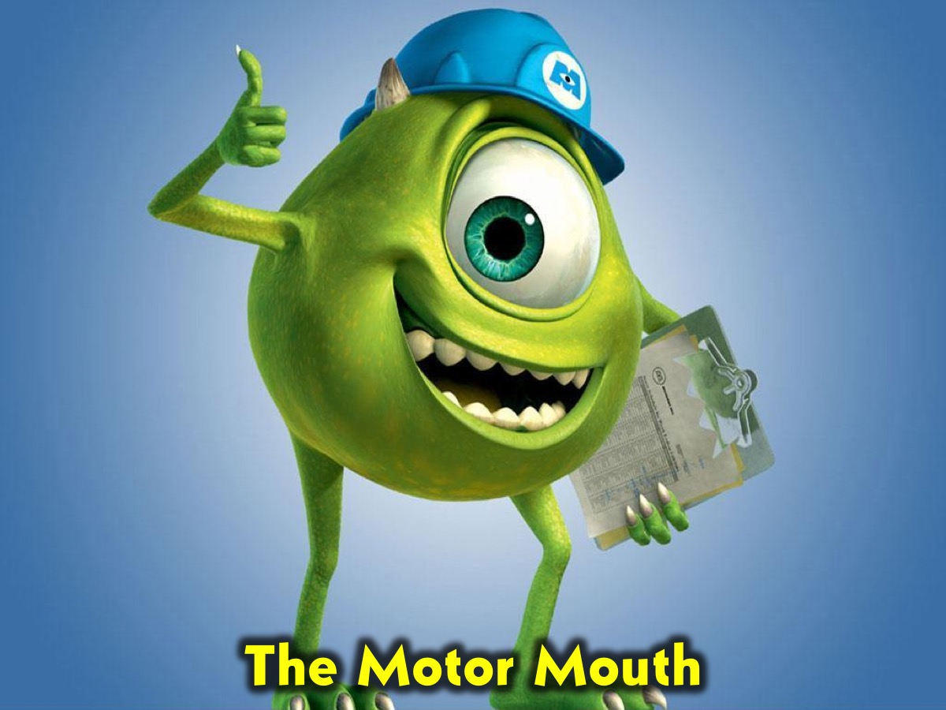
Notes:
C. The Motor Mouth

Slide 83

Notes:
Some people talk a great deal and consume valuable time and distract other learners with irrelevant ideas. While there is a general rule, “never interrupt a talking student,” the case of the over‑talker may be one exception. The leader should limit the ‘motor mouth’ by being direct or suggesting that he talk with you after the lesson. Where possible such counsel should happen privately, unless this fails to help.

Slide 84

Notes:
D. The Mule

Slide 85

Notes:
The ‘mule’ who takes exception to everything said by the leader or anyone else. They tend to be stubborn and argumentative. Get the ‘mule’ to contribute to both sides of an argument and affirm them for both sides of their analysis. Pay little attention to their negativism. Direct confrontation may be less effective as they will perceive it as positive reinforcement. If confrontation is necessary, it should be done privately and should focus on the negative behaviour and not the issue that was raised.

Slide 86

Notes:
E. The Joker

Slide 87

Notes:
The Joker seldom says anything deep or serious – choosing rather to play the role of the clown. If you ask a few follow up questions of the Joker you will find that they actually have some valuable insights to add to the group discussion.

Slide 88

Notes:
Gospel Training: One of the things we do periodically with our volunteers is ensure that they know how to share the gospel. Here is some material adapted from Dare2Share’s Lead The Cause event.

Slide 89

Notes:
The GOSPEL - The gospel is the ultimate love story (Romans 5:8)

Slide 90

Notes:
God created us to be with him.
We are a special creation of God handcrafted by God himself (Genesis 2:7, 21-22)
We were made in the image of God (Genesis 1:26a)
We were created to connect with God on the deepest most intimate level (Genesis 3:8)

Slide 91

Notes:
Our sins separate us from God.
Sin is breaking God’s commands, violating God’s character and missing God’s mark (Genesis 2:16-17; 3:8)
When Adam and Eve sinned everything changed: Their eyes were opened (Gen 3:7) their doom was sealed (Gen 2:7) and their descendants were condemned (Romans 5:12)

Slide 92

Notes:
Sins cannot be removed by good deeds.
Because we could never be good enough (Matthew 5:48)
Because the Law is a mirror to show us our sin and not a ladder to get us to heaven (Romans 3:20)
Because even our good deeds come from selfish motives (Isaiah 64:6)

Slide 93

Notes:
Paying the price for sin, Jesus died and rose again.
Jesus died in our place for our sins (Isaiah 53:5-6)
His resurrection demonstrated that He was who He claimed to be (Acts 1:3)

Slide 94

Notes:
Everyone who trusts in Him alone has eternal life.
We are saved by grace through faith, not by good works (Ephesians 2:8-9)
We are justified by God the Father through faith in Jesus alone (Romans 3:21-24)
When we trust in Jesus as our savior he exchanges our sin for his righteousness (2 Corinthians 5:21)

Slide 95

Notes:
Life with Jesus starts now and lasts forever.
Eternal life begins as soon as you believe in Jesus (John 6:47)
Eternal life is eternal (John 10:28-30)
Eternal life is not just about quantity, but quality (John 17:3)

Slide 96

Notes:
1. God
Venue: Youth Room
Activity: Show the Creation Presentation. Then give each person a copy of this personal love letter from God to read: “My dearest child. You are my unique and special creation. I crafted you in my own image, forming you out of the dust of the ground and breathing into you the breath of my spirit so you became a living being. I created you to enjoy the most intimate of relationships humans could ever experience - the ability to hear my voice and know that I heard your every word. I promise to walk with you and protect you from all harm. I will always love you because I made you and you are precious and honoured in my sight! With all my love, your father, God.”
Teaching: God created us to be with him. (1) We are a special creation of God handcrafted by God himself (Genesis 2:7, 21-22). (2) We were made in the image of God (Genesis 1:26a). (3) We were created to connect with God on the deepest most intimate level (Genesis 3:8)

Slide 97

Notes:
2. Our
Venue: Youth Room Graffiti Wall

Slide 98

Notes:
3. Sins
Venue: His Diz Room.

Slide 99

Notes:
4. Paying
Venue: His Kids Worship Room.

Slide 100

Notes:
5. Everyone
Venue: The Youth Room

Slide 101

Notes:
6. Life
Venue: The Youth Room.

Slide 102

Notes:
What Now?
You’ve explained the GOSPEL, what now?
Ask 2 Questions: (1) Does this make sense – if they say “no”, explain it again. If they say “yes”, move on to the next question. (2) Is there anything holding you back from trusting in Jesus right now? From here the conversation can go in one of three different ways:
1. Some will reject the gospel and mock you (so be strong) (Acts 17:32).
(a) Remember that persecution is part of being a Christian witness (2 Timothy 3:12).
(b) Count it an honour to be mocked or marginalized for Jesus (Matthew 5:11-12).
(c) Treat the ones who persecute you with love and respect (Romans 12:14). Stay calm and speak softly (Proverbs 15:1), Refuse to argue (2 Timothy 2:24), Ask questions that make them think (Mark 12:13-17).
2. Some will be intrigued and want to find our more (so be sharp!).
(a) Some people need time to process, think and wrestle with questions (John 3:1-7).
(b) Keep the relationship going and try to help them find solid answers
(c) Keep praying for them (1 Timothy 1:3-4)
3. Some will be ready to trust in Jesus right away (so be strategic!) Persuade them to A, B, C:
Accept Christ (you can lead them in a prayer or not – John 1:12)
Belong to a church (get them plugged into a good church – Hebrews 10:25)
Commit to The Cause (encourage them to tell others – 1 Thessalonians 1:8)
Help them grow deeper in their relationship with Jesus (2 Peter 3:18)

Slide 103

Notes:
The Prayer of Salvation: Dear God, thank you that you created me to be with you. I know that my sins separate me from you and that I cannot remove my sins through good deeds. Thank you that Jesus died to pay for my sins and right now I put my trust in you alone and I receive your free gift of eternal life. Thank you that eternal life starts now and lasts forever. Amen.
Challenge: If you prayed that prayer for the first time then please come forward so I can pray for you.

Slide 104

Notes:
Ask – Admire – Admit
These three habits will help us bring the gospel up more naturally.
1. Ask Great Questions – it does 3 things: (a) It breaks down barriers and opens up hearts (John 4:7). (b) It helps you understand and emphasize with others (2 Timothy 2:23-26). (c) It gives you time to pray and ask God for help (Matthew 10:19-20). Learn to ask questions that engage, not enrage. Jesus asked engaging question (over 300) – in Mark 16 there are 16 questions alone. Move from secular subjects to spiritual subjects.
2. Admire Everything You Can About What They Believe – Focus on areas of commonality, not areas of difference (Acts 17:22-23). Admiring what you can about what they believe will build bridges, not walls (Proverbs 15:1). You can find something to admire about every belief system. You are not endorsing their belief system. If you can’t find anything in their belief system to admire then admire their honesty in sharing it with you.
3. Admit that the reason you’re a Christina is that you are so messed up you needed someone else to rescue you (Jesus). (1 Timothy 1:13-15). This humble strategy shatters stereotypes. It shows that we are one beggar showing another beggar where to find bread. It prepares the way for a real gospel-focused conversation as opposed to just an evangelistic presentation.

Slide 105

Notes:
Now What?
1. Memorise the GOSPEL word for word.
2. Practise until you are able to explain it conversationally in any context.
3. Think of each point as a different chord in the GOSPEL love song.
4. Don’t be ashamed to share it with anyone and everyone! (Romans 1:16).

Slide 106

Notes:
Prayer Training: Here is a session we used to help our volunteers grow in prayer.

Slide 107

Notes:
The PRAYS Model is a method based on the prayer that Jesus used to teach his disciples to pray.

Slide 108

Notes:
It is found in Matthew 6:9-13: “Our Father in heaven, hallowed be your name, Your kingdom come, your will be done, on earth as it is in heaven. Give us today our daily bread. And forgive us our debts, as we also have forgiven our debtors. And lead us not into temptation, but deliver us from the evil one. ”

Slide 109

Notes:
1. Understanding the PRAY Prayer Model
Praise: “Our father in heaven, hallowed be your name.”
Request: “Your kingdom come, your will be done, on earth as it is in heaven. Give us today our daily bread.”
Admit: “And forgive us our debts as we have also forgiven our debtors.”
Yield: “And lead us not into temptation but deliver us from the evil one.”

Slide 110

Notes:
2. Using the PRAY Prayer Model.

Slide 111

Notes:
A. Write a Letter to God Using the PRAY Outline
Praise: Dear God, I thank and praise you because…
Request: I ask you, God, to…
Admit: I admit that…
Yield: God, I yield…

Slide 112

Notes:
B. Spend Time in Prayer Using the PRAY Outline
Praise: Thank and praise God for who he is, how great He is and how you love him.
Request: Ask God to work in your life and through you to bring his kingdom to earth.
Admit: Admit that you need God in your life and that you need his help to make disciples.
Yield: Tell God that you surrender to Him and want to be used by Him to reach your friends.

Slide 113

Notes:
C. Pray Through Psalms Using the PRAY Outline
Praise
We are going to begin our time of PRAISE by finding reasons to praise God in Psalm 100: "Shout with joy to the Lord, all the earth! Worship the Lord with gladness. Come before him, singing with joy. Acknowledge that the Lord is God! He made us, and we are his. We are his people, the sheep of his pasture. Enter his gates with thanksgiving; go into his courts with praise. Give thanks to him and praise his name. For the Lord is good. His unfailing love continues forever, and his faithfulness continues to each generation.”
I praise you God because you are….
Request
As we move into the next phase in the Lord’s Prayer let’s been to bring our REQUESTS before the Lord. Here is a passage from Psalm 71 to guide our prayers: In you, Lord, I have taken refuge; let me never be put to shame. In your righteousness, rescue me and deliver me; turn your ear to me and save me. Be my rock of refuge, to which I can always go; give the command to save me, for you are my rock and my fortress. Deliver me, my God, from the hand of the wicked, from the grasp of those who are evil and cruel.
Lord, I ask you to…
Admit
As we move into the next phase of our prayer, let’s ADMIT where we have fallen short of God’s best for our lives and receive his pardon and grace to live in freedom! Here is a passage from Psalm 51 to guide our prayers: Have mercy on me, O God, according to your unfailing love; according to your great compassion blot out my transgressions. Wash away all my iniquity and cleanse me from my sin.
Lord, I admit that…
Yield
As we move into the next phase of our prayer, let’s Yield ourselves to the Lord. Here is a Psalm to guide our prayers: “Surrender yourself to the Lord, and wait patiently for him. Do not be preoccupied with an evildoer who succeeds in his way when he carries out his schemes. Let go of anger, and leave rage behind. Do not be preoccupied. It only leads to evil. Evildoers will be cut off from their inheritance, but those who wait with hope for the Lord will inherit the land.”
Lord, I yield…

Slide 114

Notes:
3. Use the PRAY Prayer Model to Get Youth Praying
A. Teach the PRAY model and pray during meetings.
B. Use the PRAY model in your pre-service prayer.
C. Start a WhatsApp prayer group. Facilitate an hour of prayer during the week using the outline.

Slide 115

Notes:
4. Use the Lord’s Prayer to Encounter God.
I came across a tool some years back called a Dyadic Encounter With God and it was based on the Lord’s Prayer. Each word or phrase of the prayer is introduced and followed by three questions causing you to think deeply and engage with God. It is done in pairs (a dyad is a word used to describe the interaction that happens between a pair of individuals) but can be used solo.
The Dyadic Encounter With God: The Lord’s Prayer
Rules:
* There are no right or wrong answers. Answer as you think of feel in the moment.
* Do not look ahead to the questions that come later.
* Anything you discuss must be kept confidential.
* Each partner responds to each statement before continuing.
* Listen attentively, do not criticise or evaluate your partner’s answers.
* Answer each statement openly and honestly.
Our Father
My relationship with my early father is…
The qualities I want in a father are…
When I think of God as my father, I think of…
In heaven
If I were to describe my idea of heaven, I would say it is like…
My most "heavenly" experience so far has been…
I look forward to being with God in heaven because…
Hallowed
To me holiness means…
I think of myself as holy when…
When I consider God's holiness, I think of myself…
Be your name
People should not abuse God's name because…
When I hear someone abuse God's name, I feel…
If I abuse God's name, I feel…
Your kingdom come
When I picture Jesus as a king, I see…
The idea of Jesus as king helps me to…
Your will be done
The best way to discover what God wants me to do is…
The person I know who best understands God's will for them is…
On earth
I believe God's will for me now is...
What I think is God's will for me now makes me feel…
My biggest problem with doing God's will is...
As it is in heaven
The person who has best helped me to grow as a Christian is…
This person has helped me to…
Jesus' statement: "You must be perfect" (Matthew 5:48) make me feel…
Give us today our daily bread
The one material thing I most desire right now is…
When I see the belongings of my friends, I feel…
The belongings that I own are…
Forgive us our debts
One time I experienced forgiveness was…
I need forgiveness now for…
As we also have forgiven our debtors
I have difficulty forgiving someone who…
I need to forgive…
For me to forgive this person means that I must…
And lead us not into temptation
My most frequent temptation is…
I usually deal with temptation by…
I successfully deal with temptation when I…
But deliver us from the evil one
The greatest evil in the world today is…
If I had the power to change this, I would…
Sometimes I wonder why God allows…
For yours is the kingdom
I want Jesus to be my king, but…
If Jesus were truly my king, I would…
And the power
I sense the power of God at work when…
I question God's power when…
And the glory
Christian can glorify God by…
I think I can glorify God when I…
Forever
The concept of forever makes me feel…
The statement: "God is eternal" makes me feel…
Amen
Spend a short time in silence with your partner. Then pray for each other - for the doubts, hurts and the joys that you have shared together. Pray for the questions you have about the future and for your relationship with God.

Slide 116


Slide 117

Notes:
This is the Growth Path that we share with our Adult Leaders so they know how our various events or initiatives fit into our disciplemaking strategy.

Slide 118

Notes:
How Can You Get Involved? Here are 10 guidelines as you consider becoming an adult volunteer at Encounter Youth:

Slide 119

Notes:
1. Attend Regularly: High school ministry can’t be rostered - it takes regular contact with youth to build relationships with them and impact their lives.

Slide 120

Notes:
2. Participate in Activities: Jump in alongside youth and you will very quickly be accepted.

Slide 121

Notes:
3. Guide a Group: Sit at a table and help to keep discussion on track and involve quieter youth.

Slide 122

Notes:
4. Cover An Area: Look out for a specific area of ministry that you can take responsibility for.

Slide 123

Notes:
5. Attend Adult Gatherings: Adult leaders meet together once a month for encouragement and sharing about the ministry.

Slide 124

Notes:
6. Attend Leader Gatherings: Adult and teen leaders gather once a month on a Sunday after the second service.

Slide 125

Notes:
7. Mentor Youth: Look for ways to share skills and help youth develop in areas of their lives.

Slide 126

Notes:
8. Counsel Youth: As relationships develop you will have opportunities to help youth with issues they struggle with.

Slide 127

Notes:
9. Start a Group: God may have you launch and run a connect group with a segment of youth like these leaders have done with lads from Parkhurst.

Slide 128

Notes:
10. Share the Word: Adult leaders may even get to share the Word on Sunday mornings or speak at other events.

Slide 129


