Slide 1

Notes:
Engaging Teens
Teens are not adults. They won’t track with you if you are boring them or speaking over their heads – they will simply check out and chat with their friends, check their Facebook messages or just go into that mental space where you are not invited. So, how do we engage teens in a public setting like a sermon or a devotional at the end of an event?

Slide 2

Notes:
The Hunger Games phenomenon! Have you notices how engaged teens have been with the Hunger Games series? Since the first book was published and as each movie has been released the interest of teens has been captivated. Here is the trailer for the 4th movie which is due out in a few months time.

Slide 3
Notes:
Video: Hunger Games Mockingjay Part 2 Trailer. Get it on YouTube at: https://www.youtube.com/watch?v=cbd_s-486vQ

Slide 4
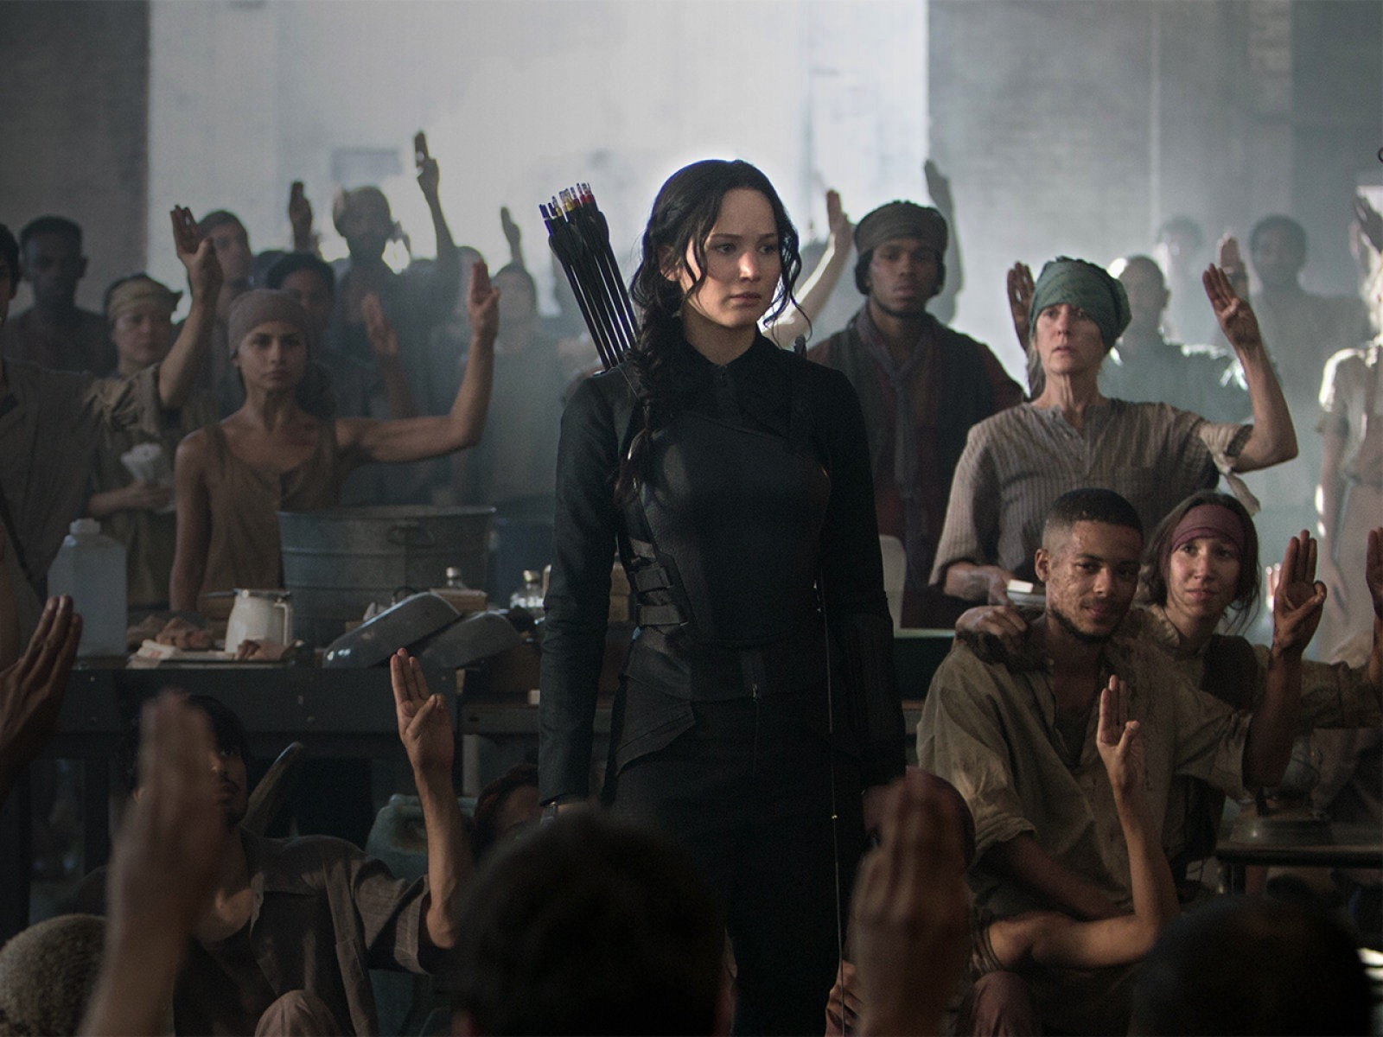
Notes:
A teenager steps forward and leads a rebellion against impossible odds but engaging people in a way that fills them with courage to take action.

Slide 5
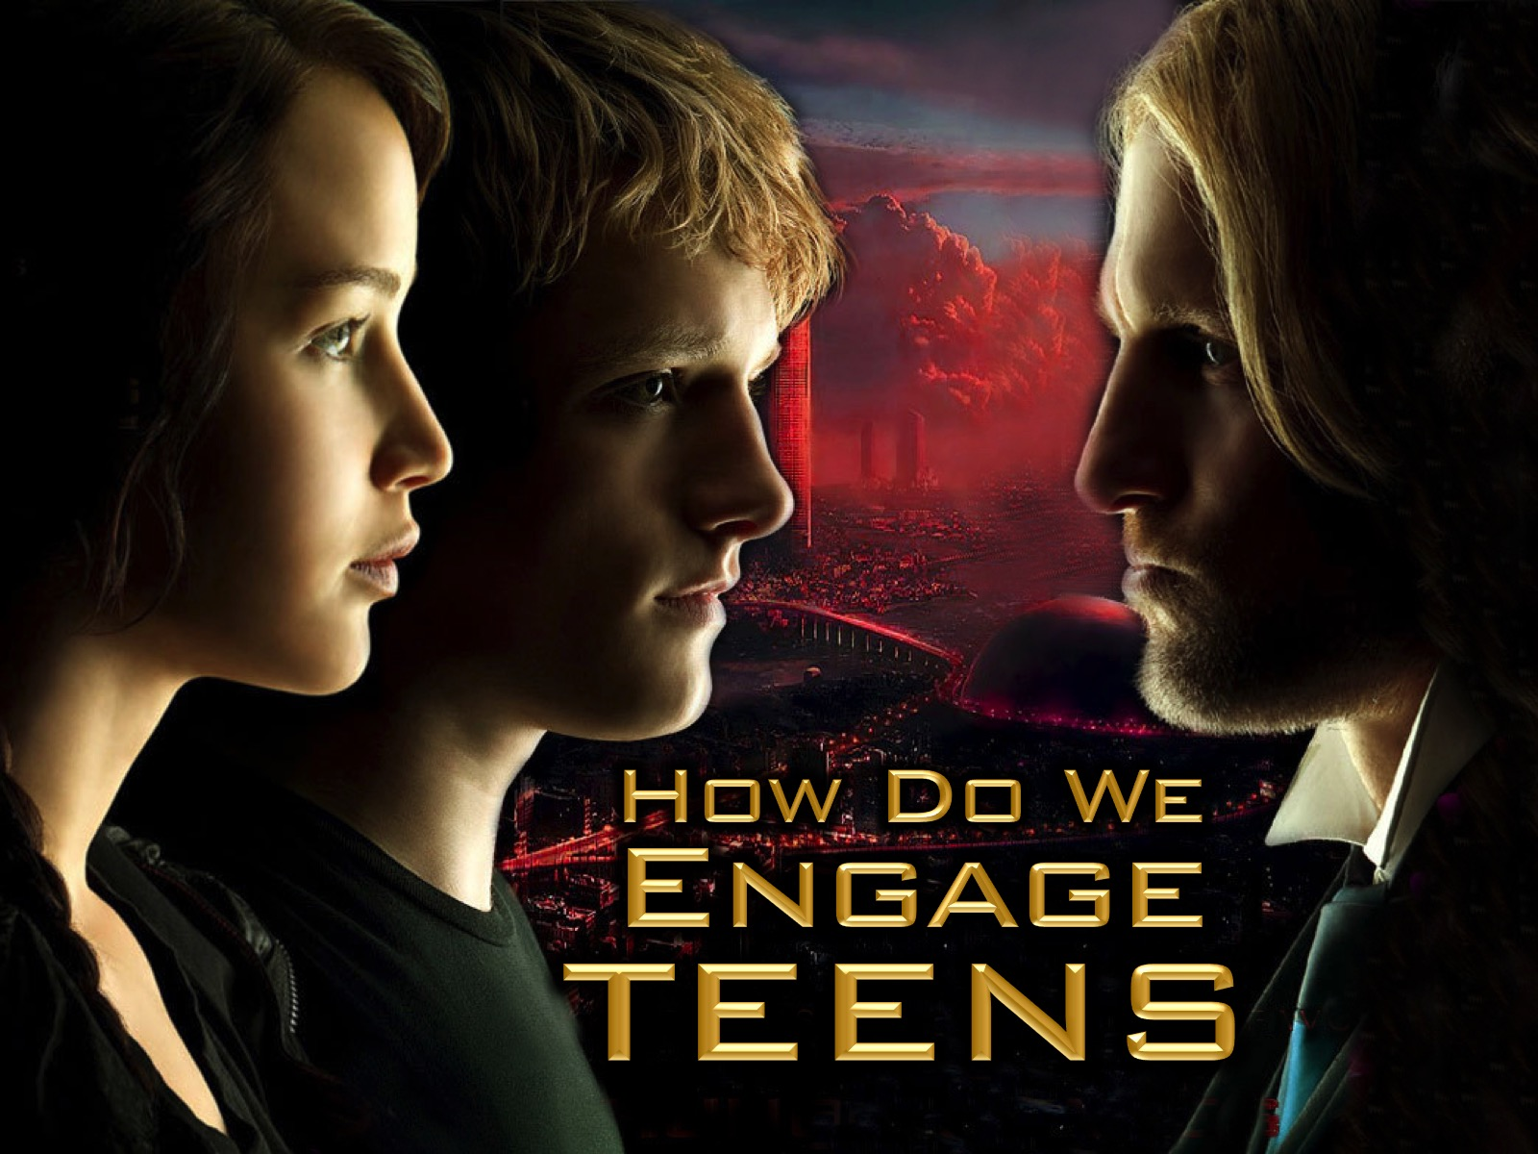
Notes:
Teens are not adults. They won’t track with you if you are boring them or speaking over their heads – they will simply check out and chat with their friends, check their Facebook messages or just go into that mental space where you are not invited. So, how do we engage teens in a public setting like a sermon or a devotional at the end of an event?

Slide 6
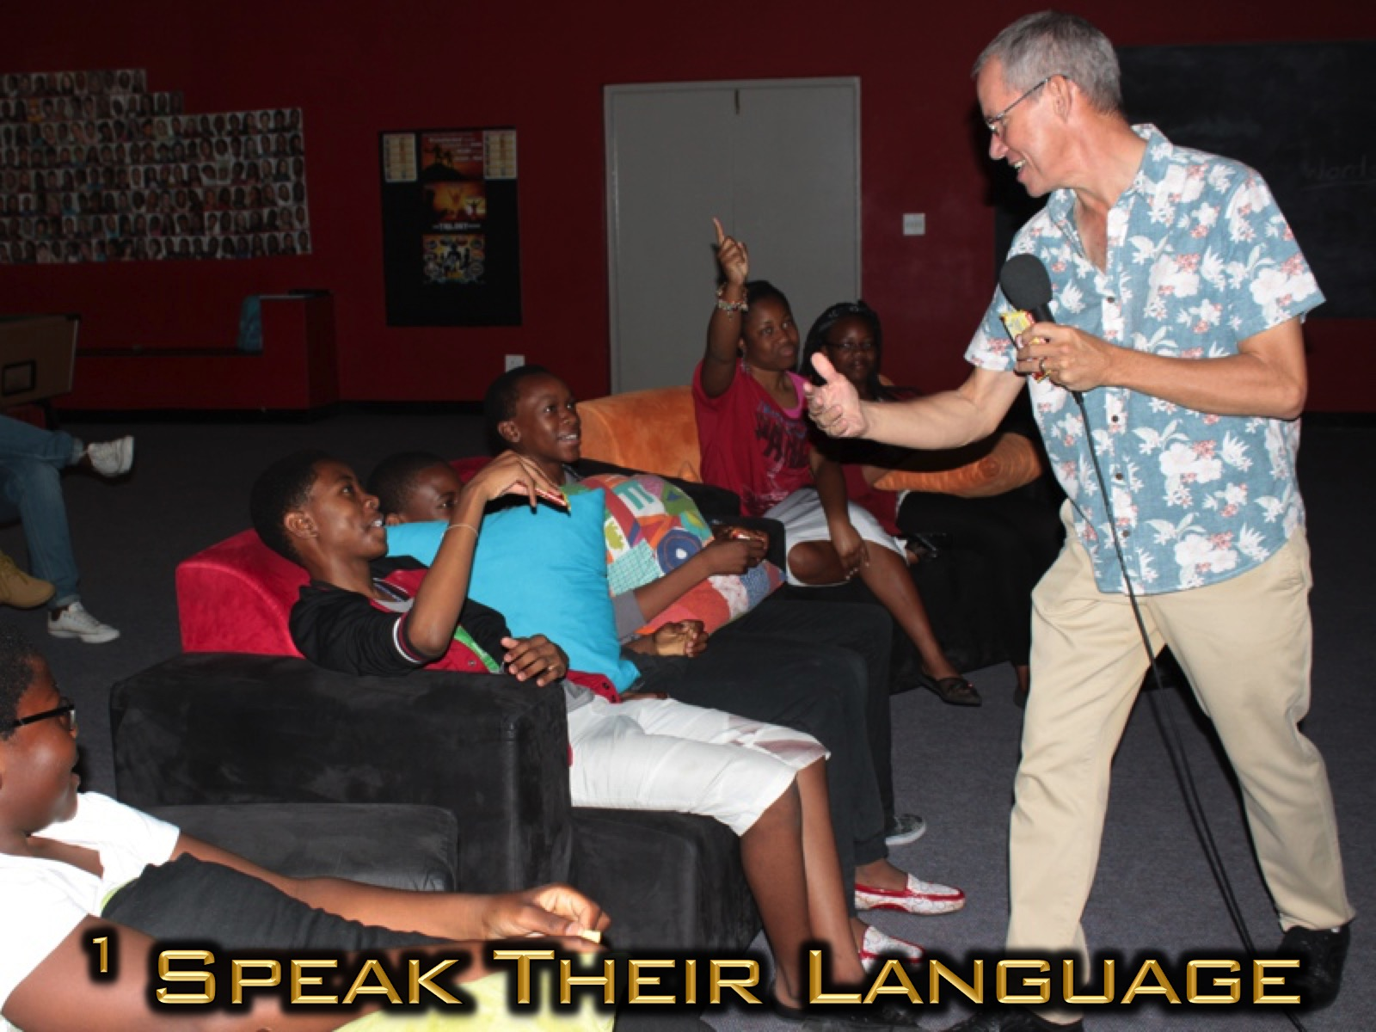
Notes:
1. Speak their Language. Have you ever tried to speak to someone who does not speak your language? It is difficult if not nearly impossible as you are reduced to hand gestures and hopefully a word or two that is common. Speaking to teens also requires an ability to relate to their vocabulary. This does not mean that we use monosyllables, or baby language, but that we choose words and concepts that they will be able to immediately relate to – and if we use unusual concepts then we take time to explain what we mean. In a recent message I recently spoke about how many of us friend-zone Jesus. The teens were surprised that I knew the phrase and even more amazed that I was able to make a challenging point out of it – you could just see that I had their attention from then onwards!

Slide 7
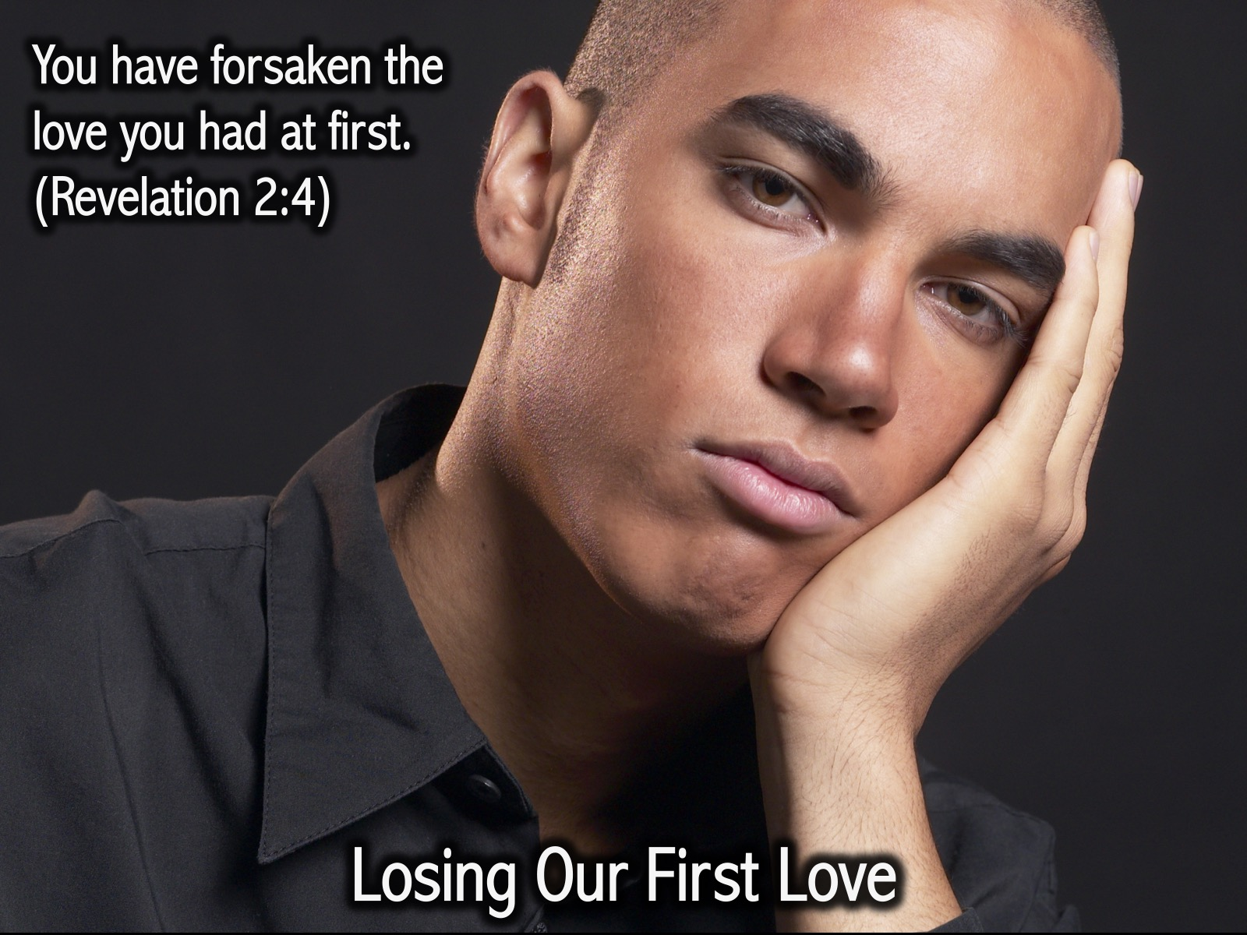
Notes:
Sometimes we lose our first love. You have forsaken the love you had at first. (Revelation 2:4)

Slide 8
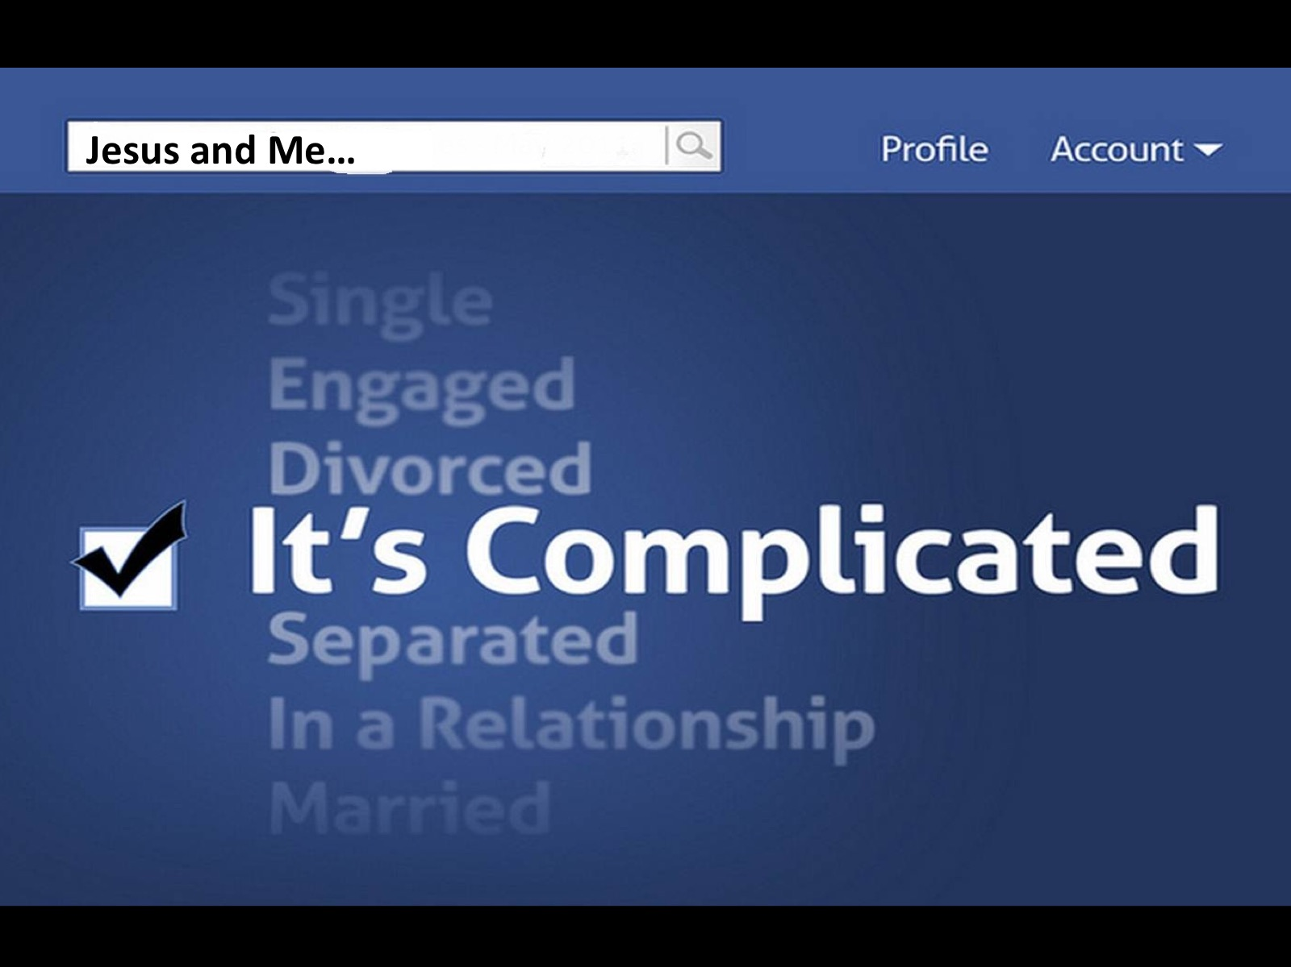
Notes:
and the relationship we have with Jesus becomes complicated.

Slide 9
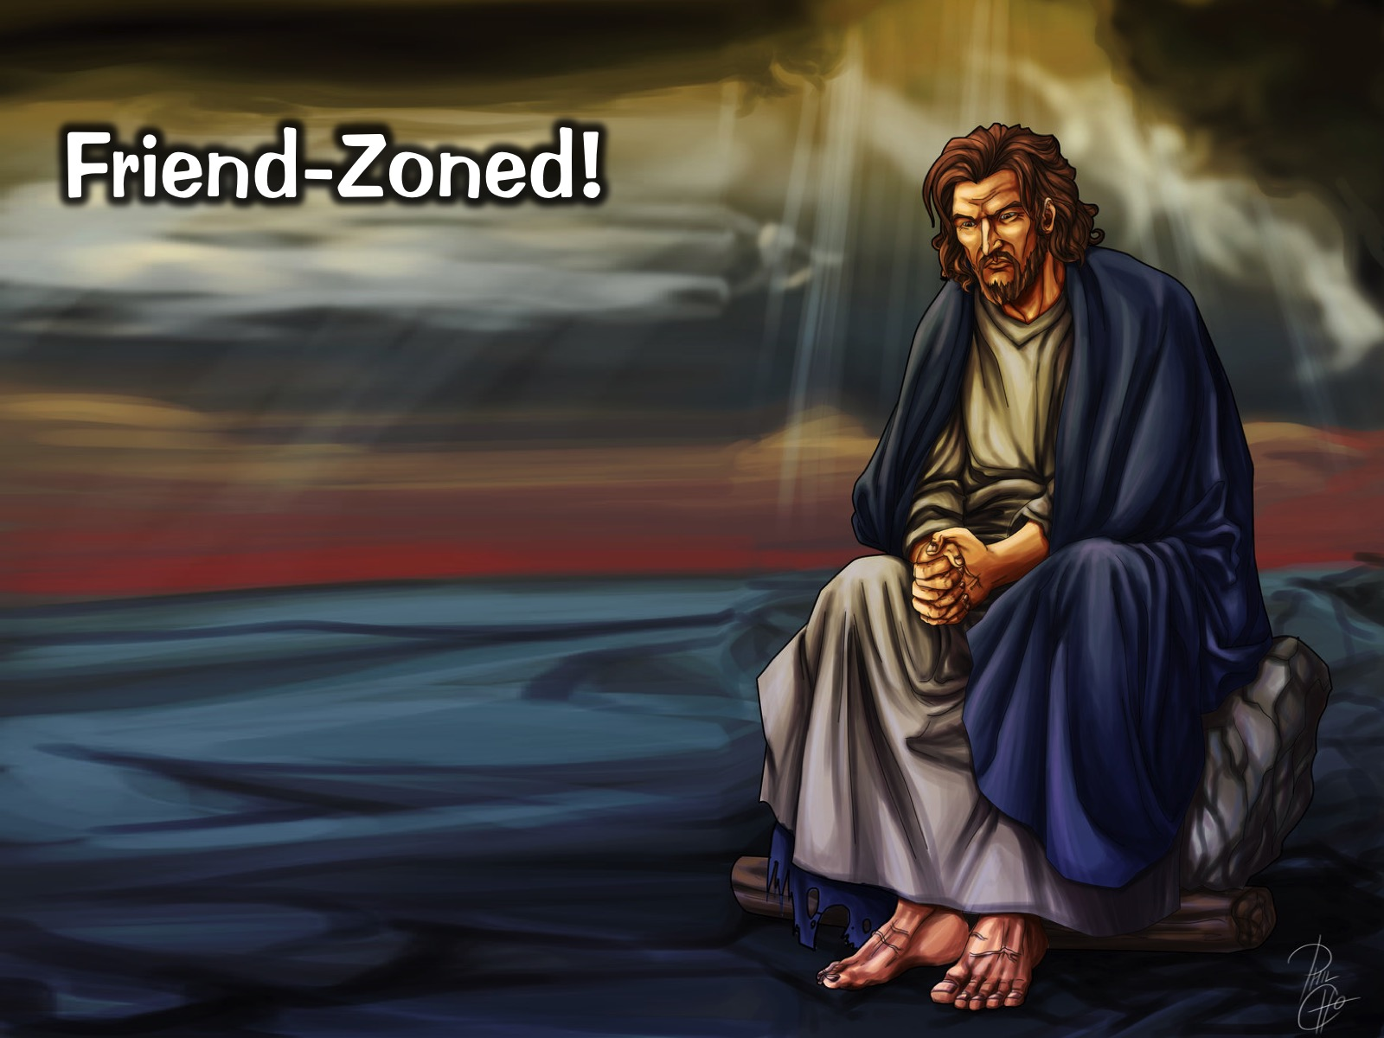
Notes:
Maybe Jesus gets friend-zoned!

Slide 10

Notes:
Maybe today it is your moment to come back to Jesus – to your first love! Let’s pray and ask God to help us return to our first love.

Slide 11
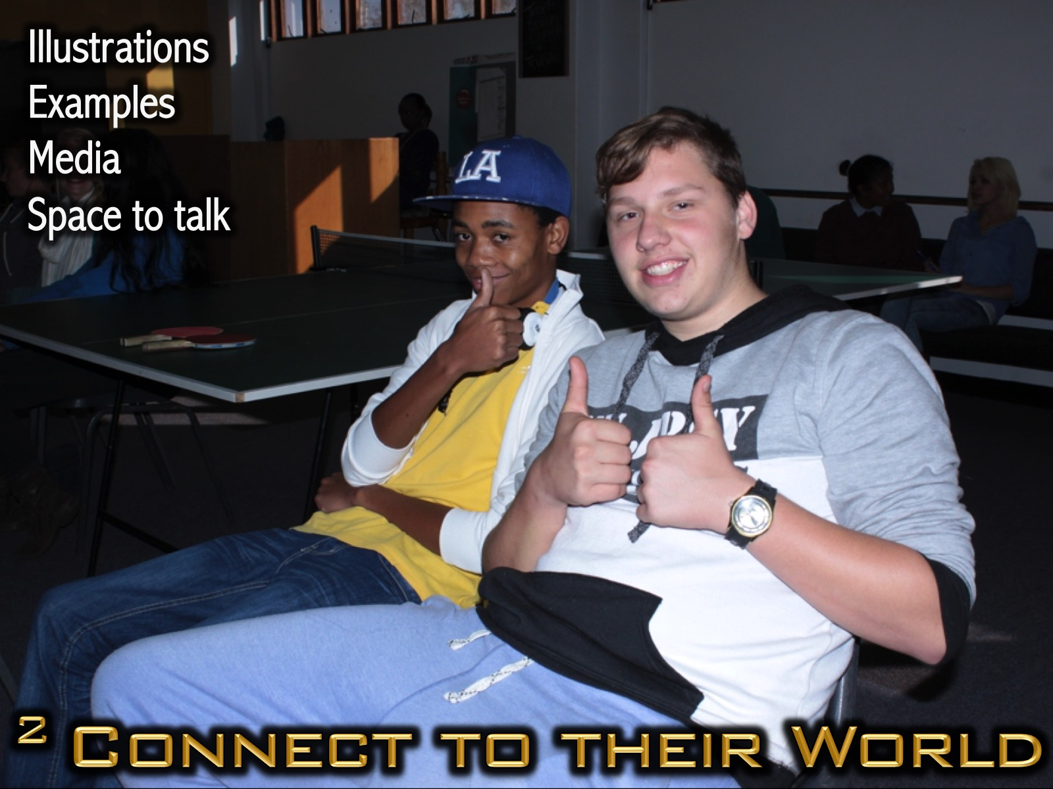
Notes:
2. Connect to their World. As I watch teenagers in church services listening to adult preachers who have a diverse audience in front of them – including children through to the elderly, I notice how quickly they zone out because the preacher is not making significant connections to their world. The stories used are too often about marriage, driving, work, etc, - all things that are not yet a part of their world. Effective youth communicators will use illustrations and examples that directly relate to the world of teens. It helps to make use of media that teens are consuming including gaming, TV-series, movies, etc. Also create space in which teens get to talk about their world and realize that what they are listening to intersects with their world.

Slide 12
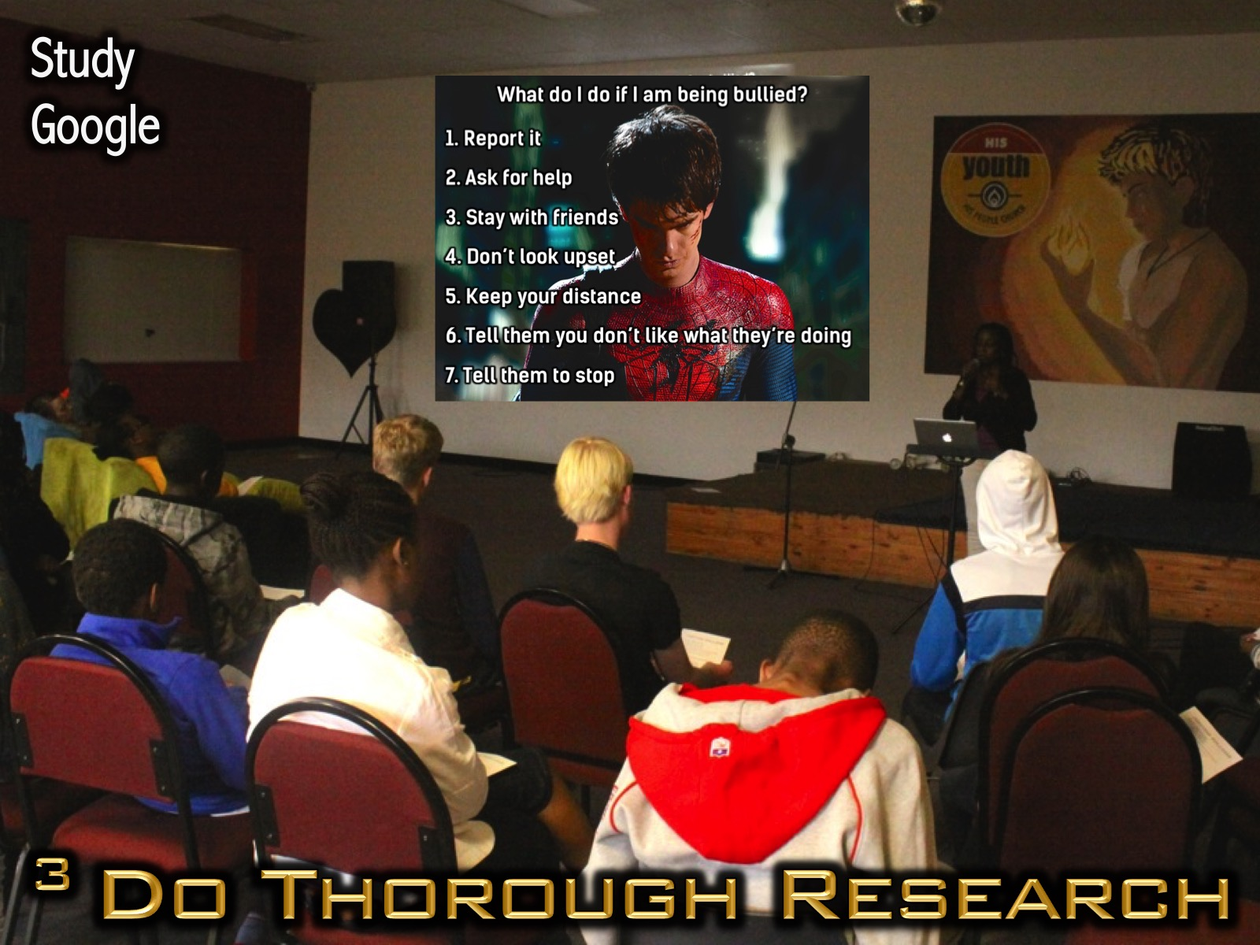
Notes:
3. Do Thorough Research. I trust no one would ever be tempted to think that speaking to youth requires little preparation. In fact, quite the opposite is true. Teens are at such a critical phase of their development and at risk of being led away from the faith of their upbringing that we need to work even harder when preparing to speak to them. This means we must do our homework; study extensively, really get into Scripture, make wise use of Google searches to see how others have approached the topic and only then be brave enough to stand in front of teens.

Slide 13
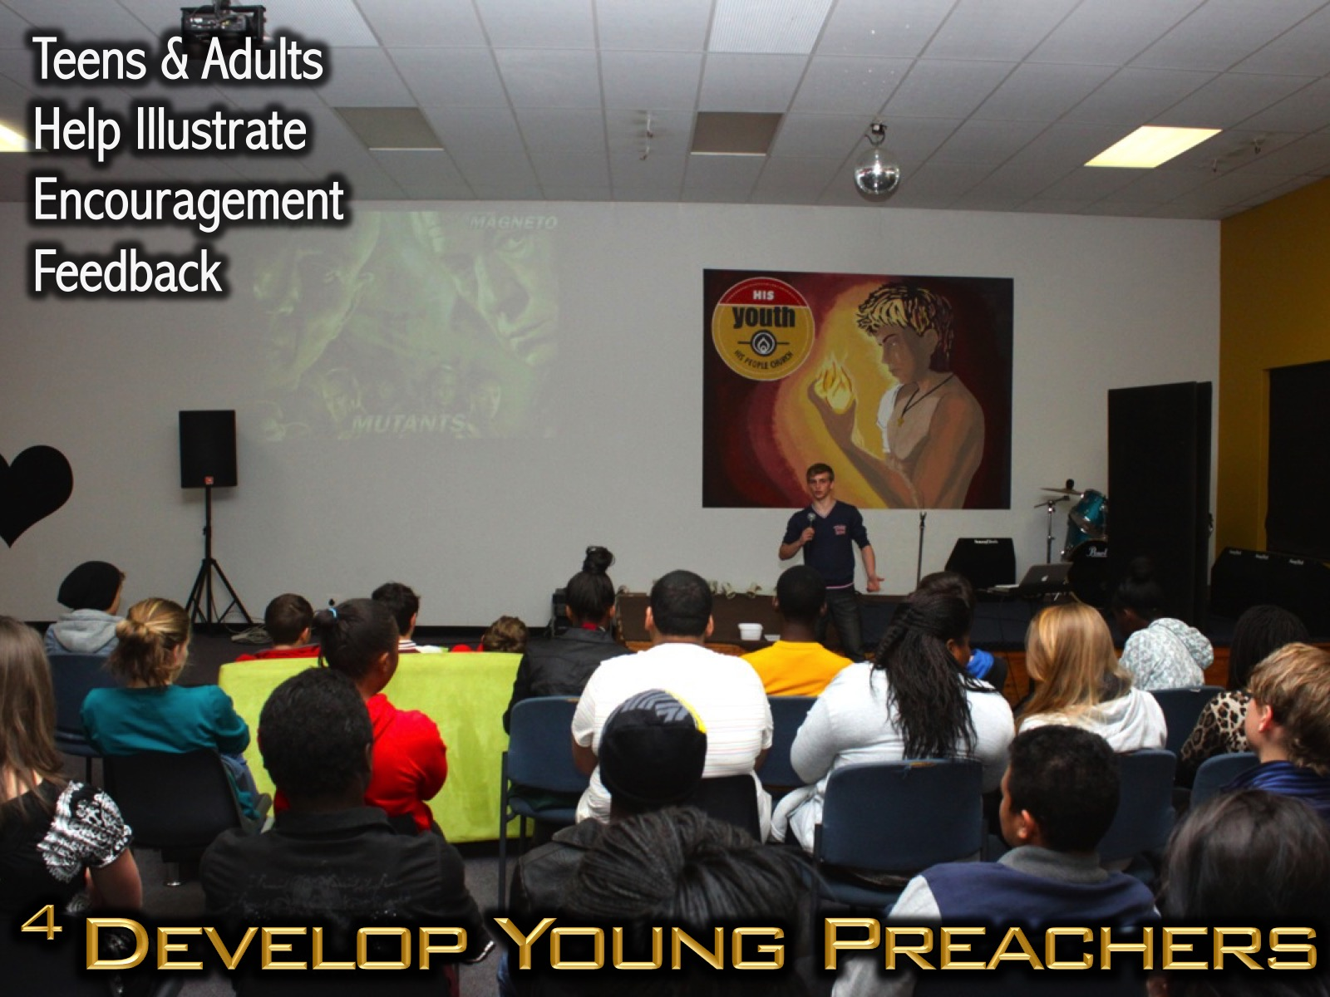
Notes:
4. Develop Young Preachers. Some of us really love preaching but must fight the temptation to be the only ones communicating in the group. While we may still present up to half of what is shared, we must develop teenagers and young adult volunteers as preachers and help them with crafting and illustrating their message and then evaluate their presentation and give them constructive feedback on how to improve as preachers.

Slide 14
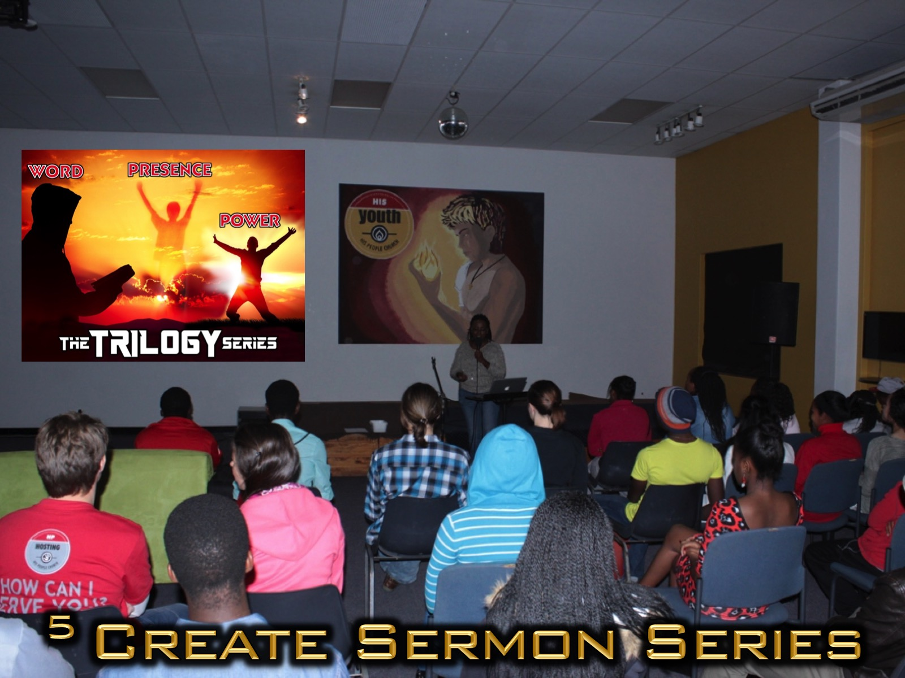
Notes:
5. Create Sermon Series. Consider tackling topics over a period of time rather than dealing with something different each time. Designing a sermon series that lasts for a month or a school term will enable you to go much deeper into the subject and take away the pressure of figuring out what to share each week.

Slide 15
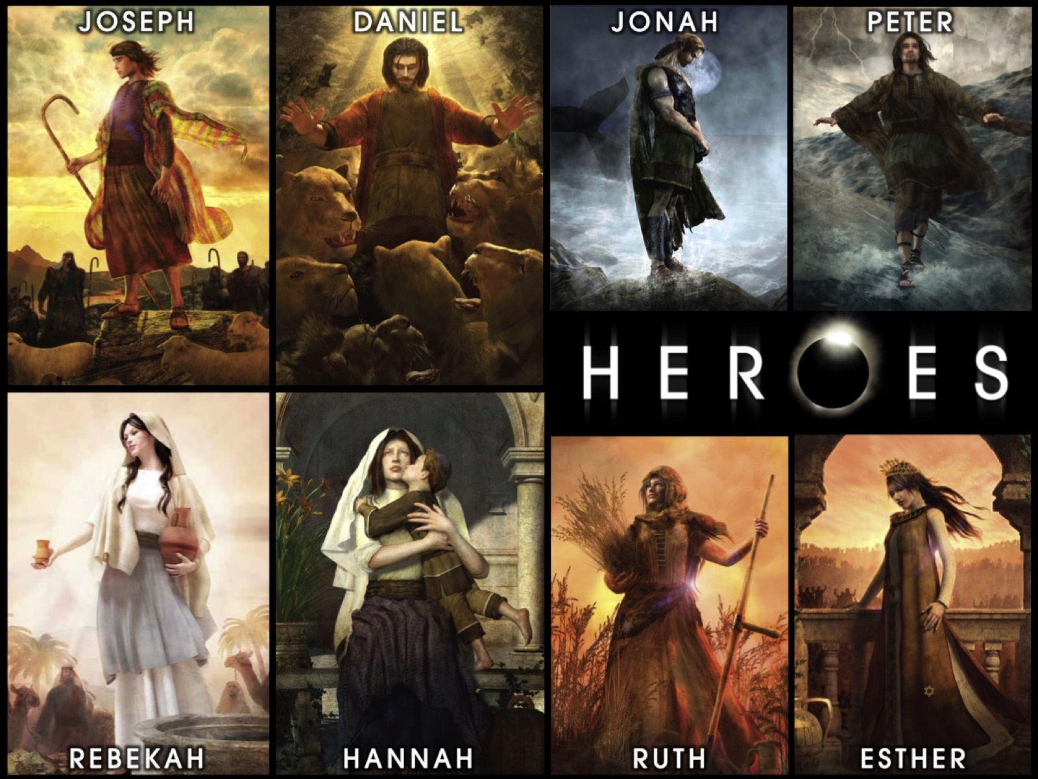

Slide 16
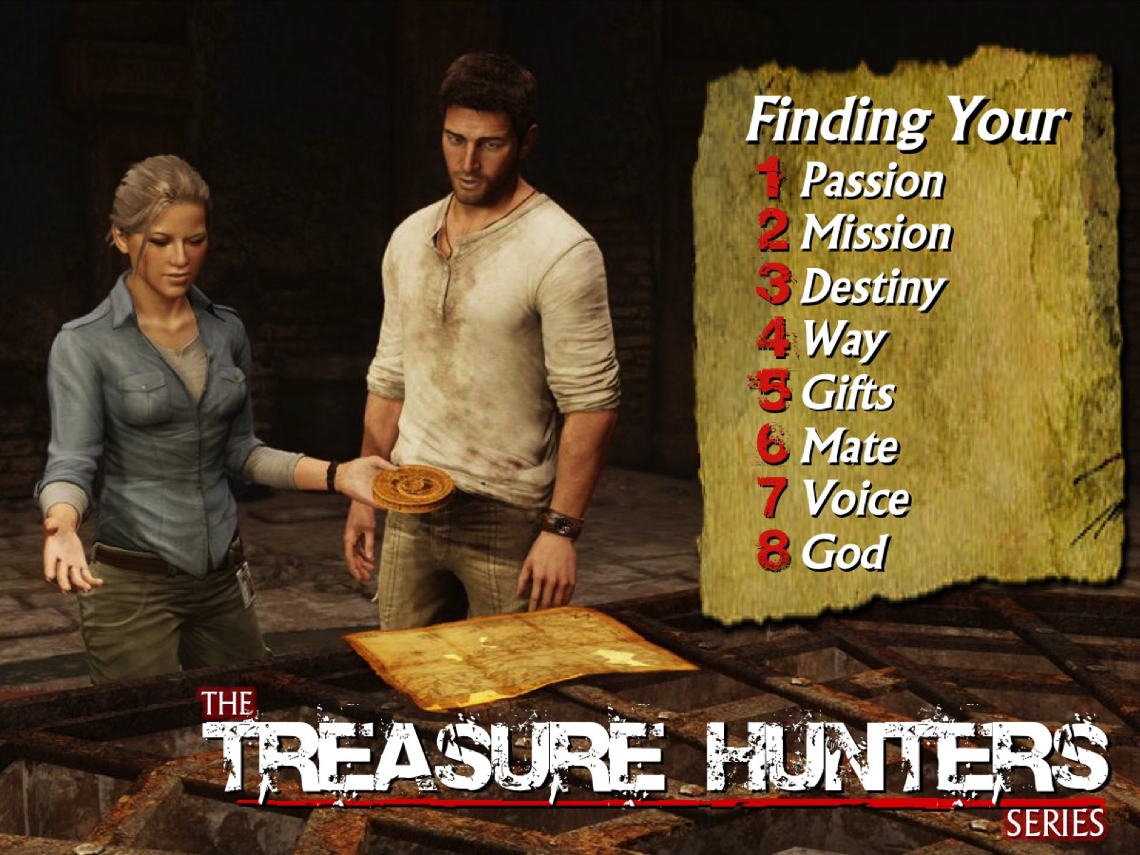

Slide 17

Notes:
The Call to Victory Series

Slide 18


Slide 19


Slide 20

Notes:
Two weeks ago at igniteYOUTH on Sunday mornings we started our series in the book of Jonah in the Bible.

Slide 21

Notes:
Welcome to week 1 of the Giant Slayer series.

Slide 22
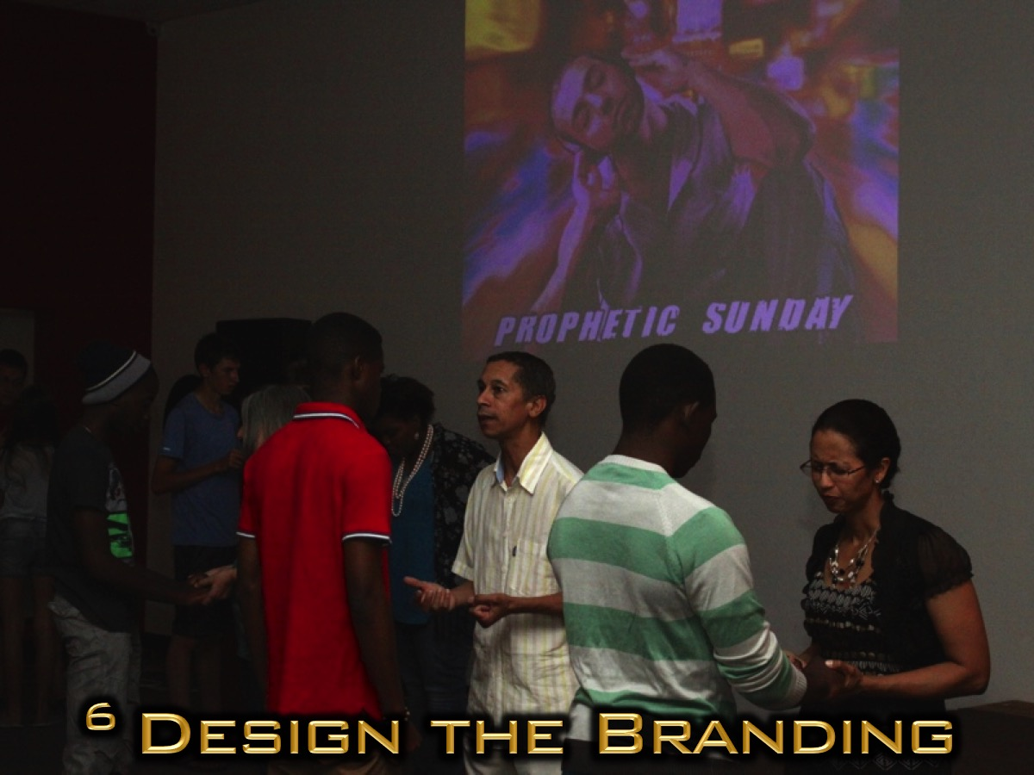
Notes:
6. Design Message Branding. Each sermon series and message within the series should be well designed with graphic elements that draw teens in. It helps if you use images from media they relate to like movies, comics, series, games, etc.

Slide 23

Notes:
In our Fire Fighters series we based each of the 8 weeks around a different superhero who had an experience of that issue:

Slide 24

Notes:
Batman who fought against abuse

Slide 25

Notes:
The Hulk who fought againt anger.

Slide 26

Notes:
Captain America who fought againt anxiety.

Slide 27

Notes:
Thor who fought againt relationship breakups.

Slide 28

Notes:
Spiderman who fought againt bullying.

Slide 29

Notes:
Iron Man who fought againt depression.

Slide 30

Notes:
Hancock who fought againt drugs.

Slide 31

Notes:
The X-Men who fought against peer pressure.

Slide 32

Notes:
Superman who fought againt suicide.

Slide 33
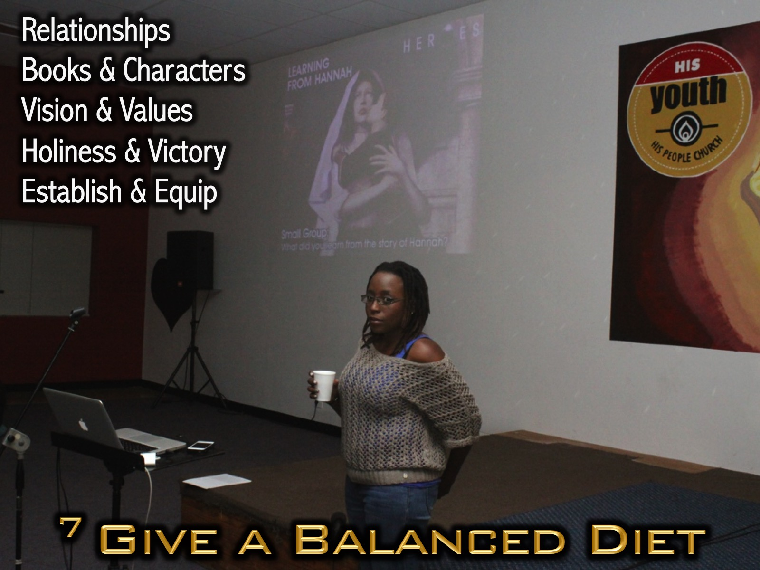
Notes:
7. Give a Balanced Diet. Take a long term look at what you are teaching teens over the course of a year and maybe even over the course of the five years they spend in your ministry will ensure that we are providing a solid diet that will help them grow in the faith.

Slide 34
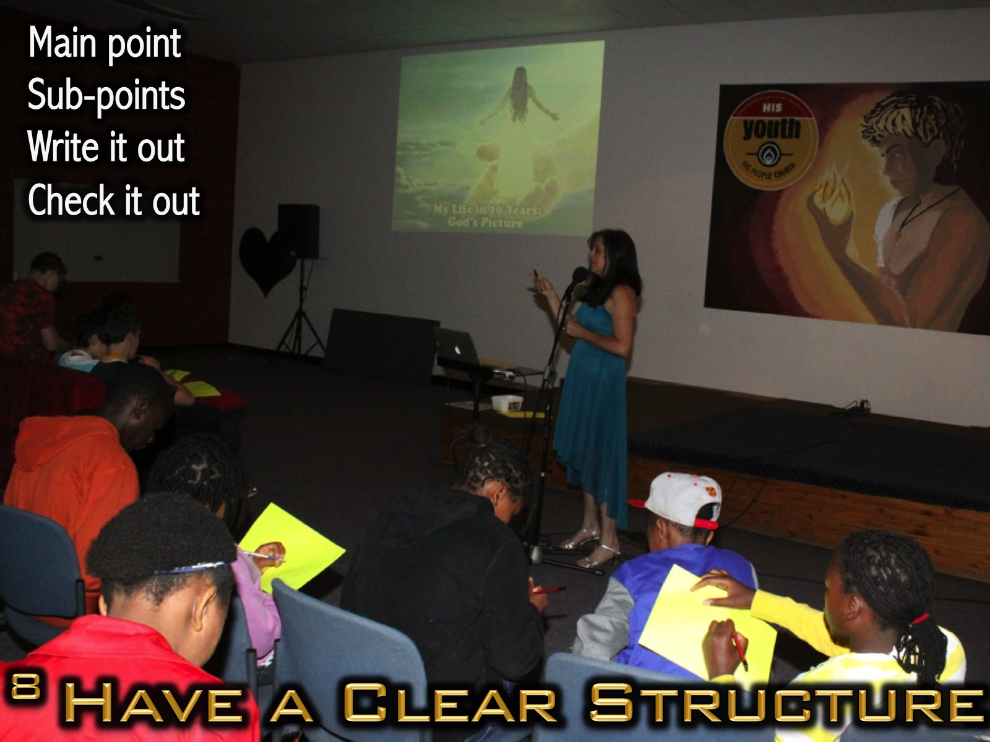
Notes:
8. Have a Clear Structure. Create a main theme and build points around it – write the structure out so you can see it and ensure that it works together.

Slide 35
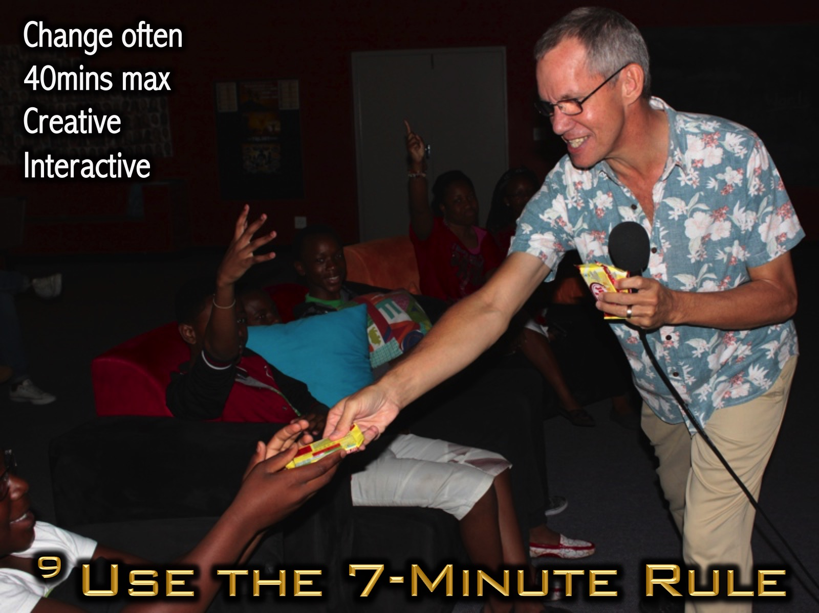
Notes:
9. Use the 7-Minute Rule. This rule says that you should do something different ever 5 to 7 minutes during your message. Your whole teaching experience should not be longer than 40mins and be creative and interactive.

Slide 36
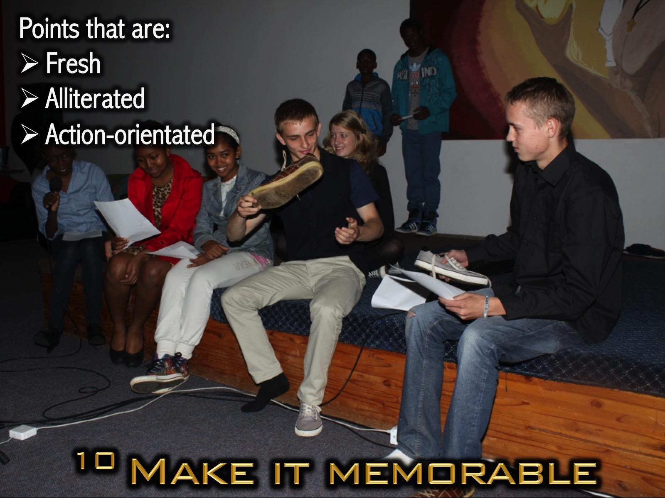
Notes:
10. Make Your Message Memorable. Your main points need to be fresh, alliterated; action-orientated – in fact, they are not actually points but life guidelines or directions from God. Here is an example: This morning we are going to explore 5 secrets to living a pure life – firstly, to live a pure life you must…

Slide 37
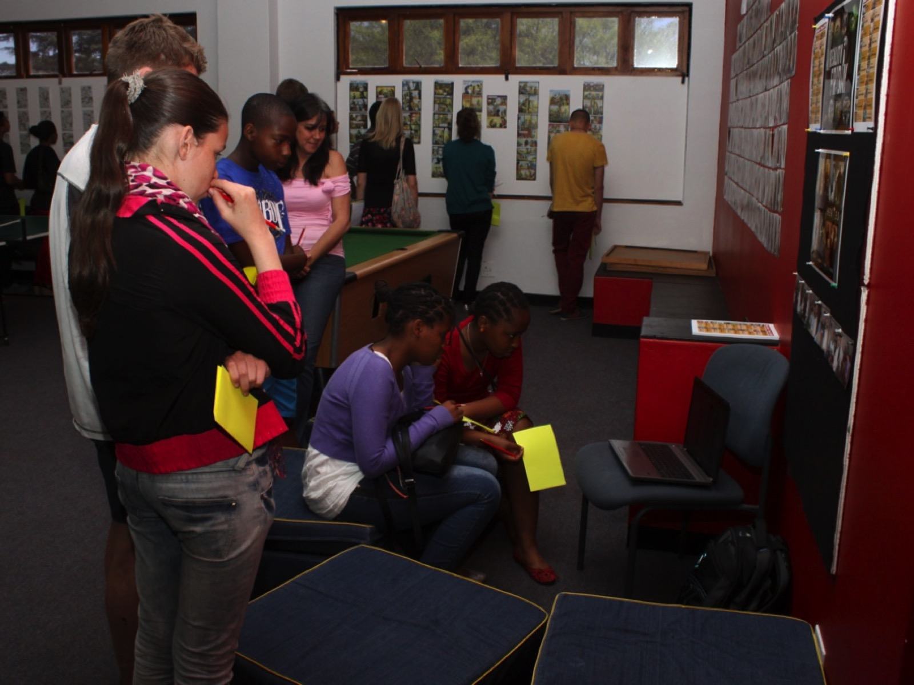
Notes:
Tens watching videos or reading printed Manga bible stories.

Slide 38
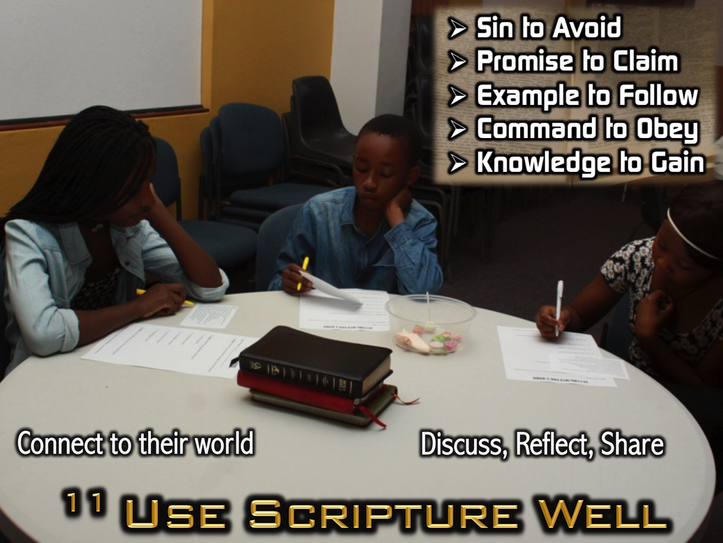
Notes:
11. Use Scripture Well. You message should be Bible-based without it being a homily. Teens should leave having been impacted by the Word of God but not bored because the whole message was about the world in which it was written. Make sure the Word connects with their world by showing them it’s relevance to their lives, getting them to discuss what it means to them in pairs or in small groups, and challenge them to get into the Word for themselves – possibly using a devotional approach of SPECK where they read a passage and then look for a a Sin to Avoid, a Promise to Claim, an Example to Follow, a Command to Obey, and a Knowledge to Gain.

Slide 39
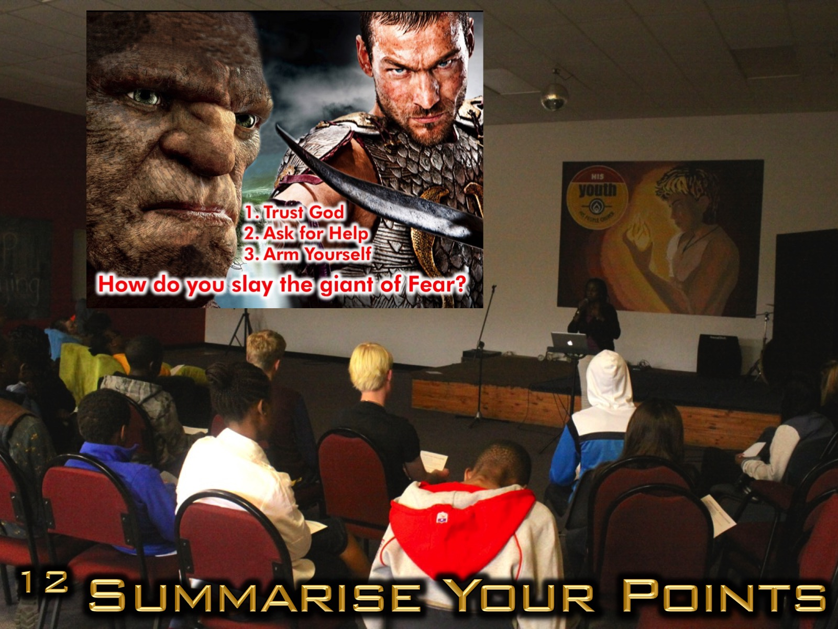
Notes:
12. Summarise Your Main Points. End your message, before closing in prayer, with a concise summary of what you have taught by reviewing the main points. This will help teens remember what you have taught them in the session.

Slide 40
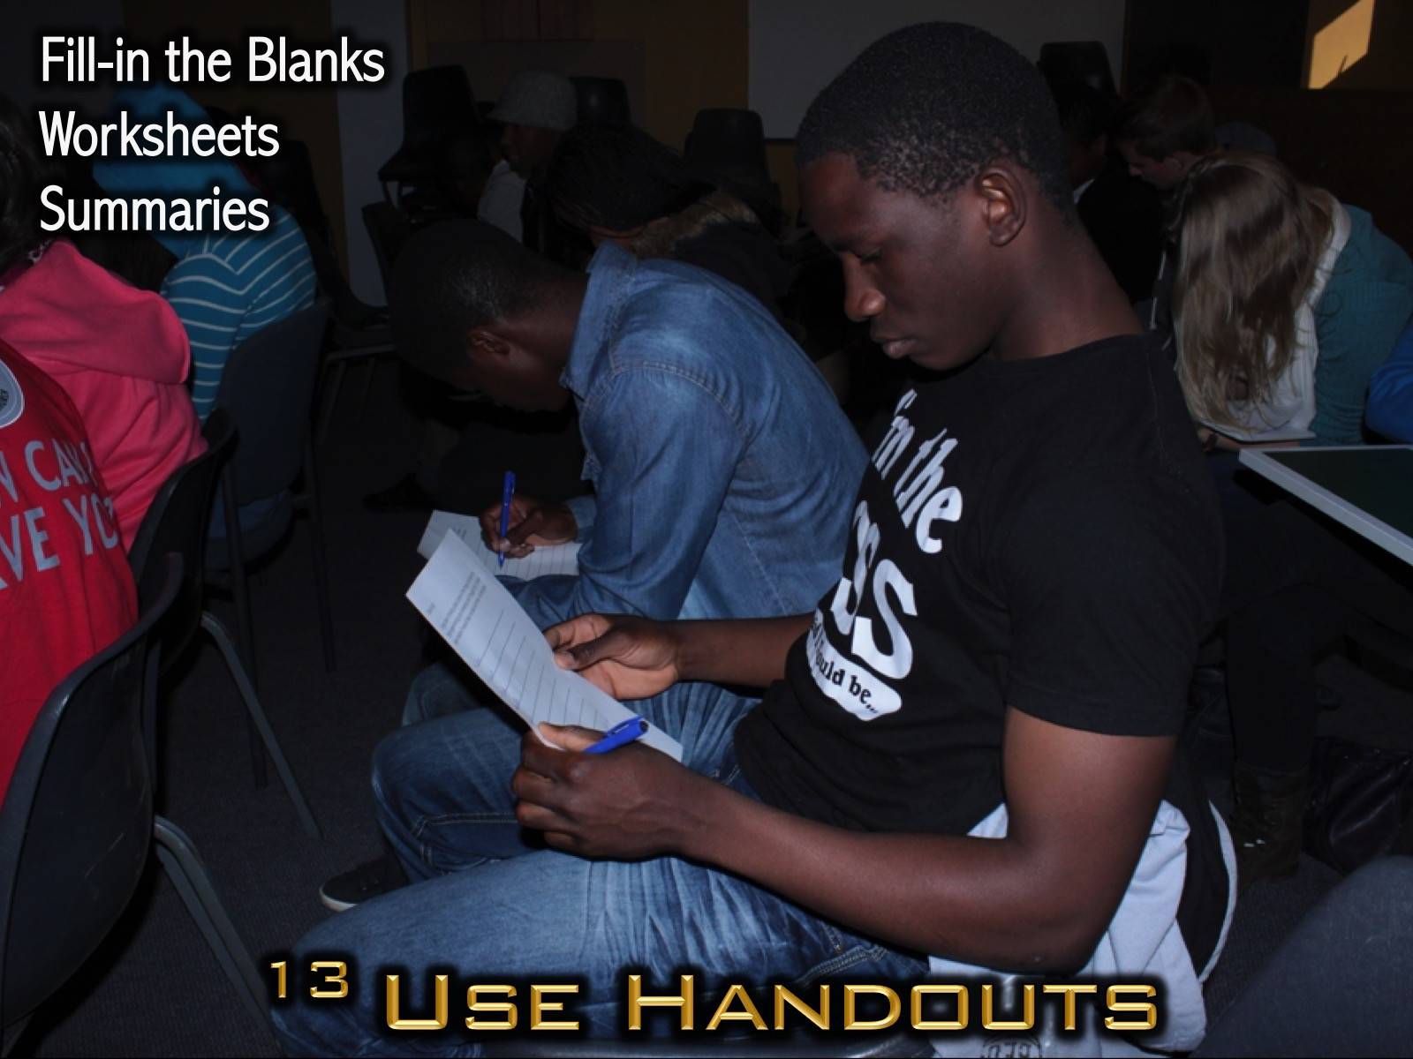
Notes:
13. Use Handouts. Consider creating a handout that teens use during the service to make notes and then take away with them. Here are some types of handouts to consider using: (1) Fill-in the blanks used to enable note taking; (2) Worksheets used to facilitate creativity and interaction and (3) Summaries where the message notes are provided for revision purposes.

Slide 41
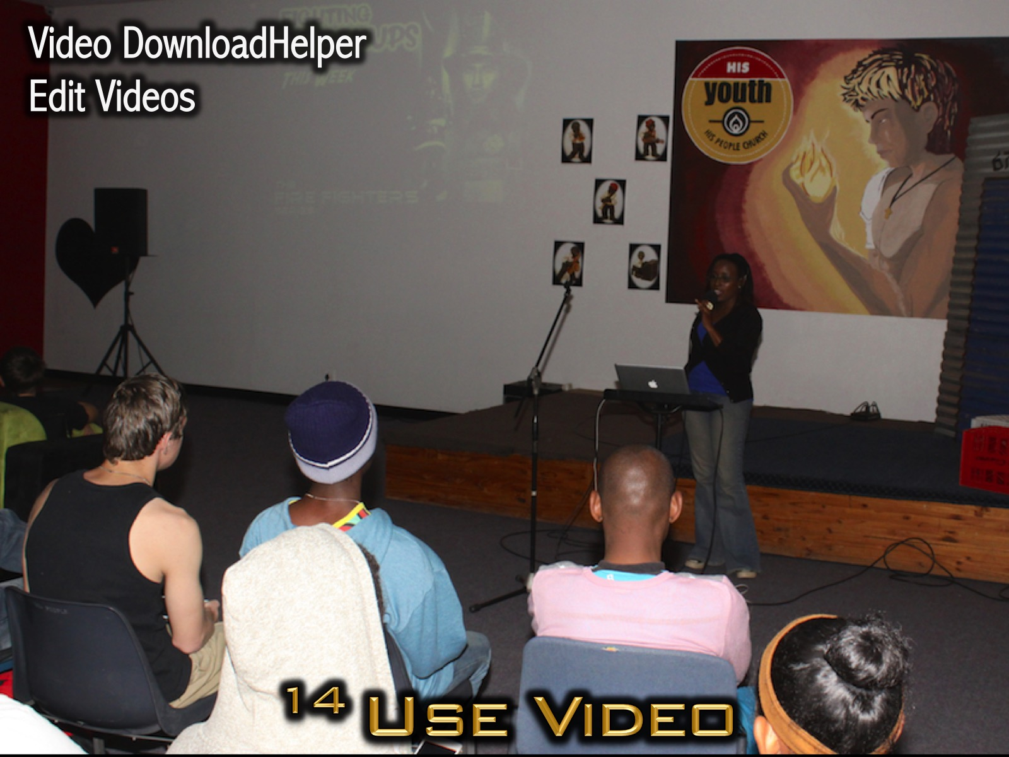
Notes:
14. Make Use of Video. This generation of teens are the video generation so it makes sense to use video in appropriate places to setup your message or illustrate key points. If you are using PowerPoint them make use of the browser add-on known as Video DownloadHelper in a browser like Firefox to easily save a streaming video from YouTube to your hard drive. You should develop the ability to edit videos so that inappropriate or irrelevant content can be removed before you show the clip.

Slide 42
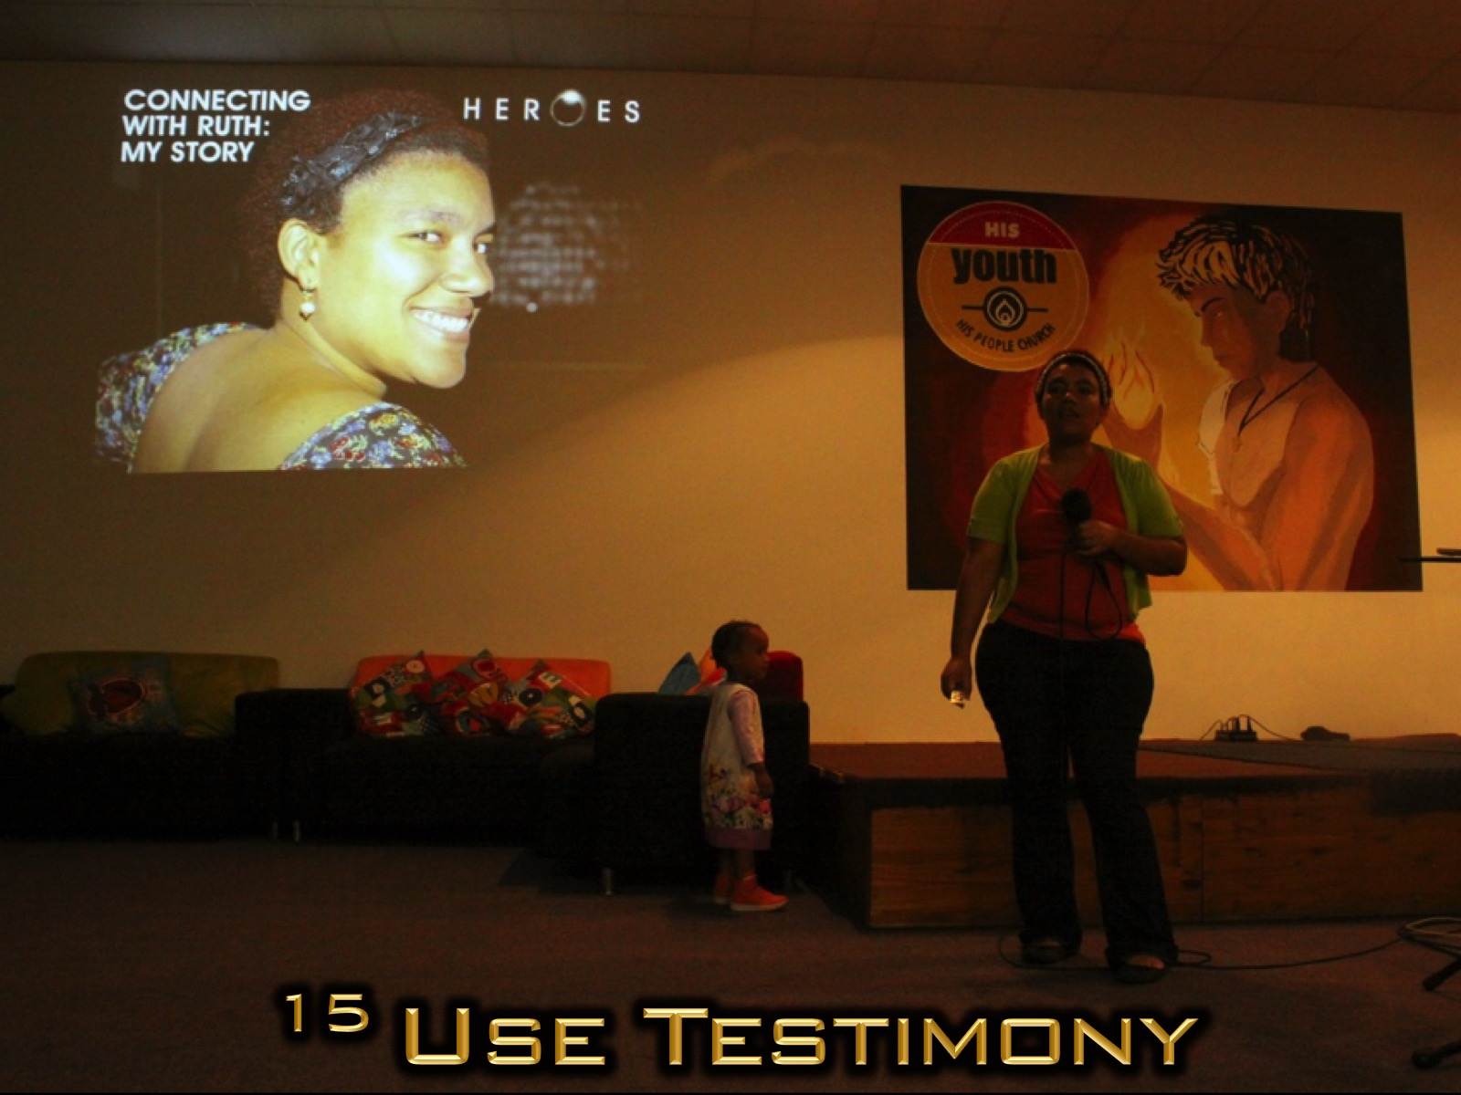
Notes:
15. Make Use of Testimony. Share your experience dealing with the topic or invite other leaders or teens to talk about their experience.

Slide 43
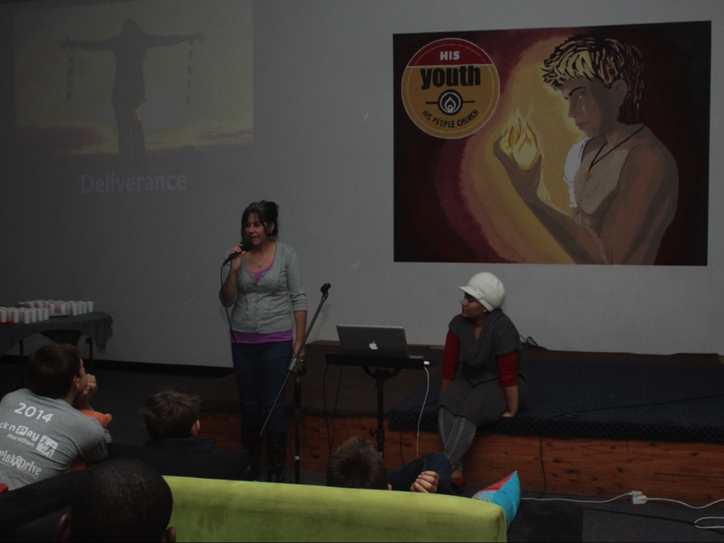
Notes:
Here Debbie was sharing a testimony of deliverance in the life of a person she was counselling.

Slide 44
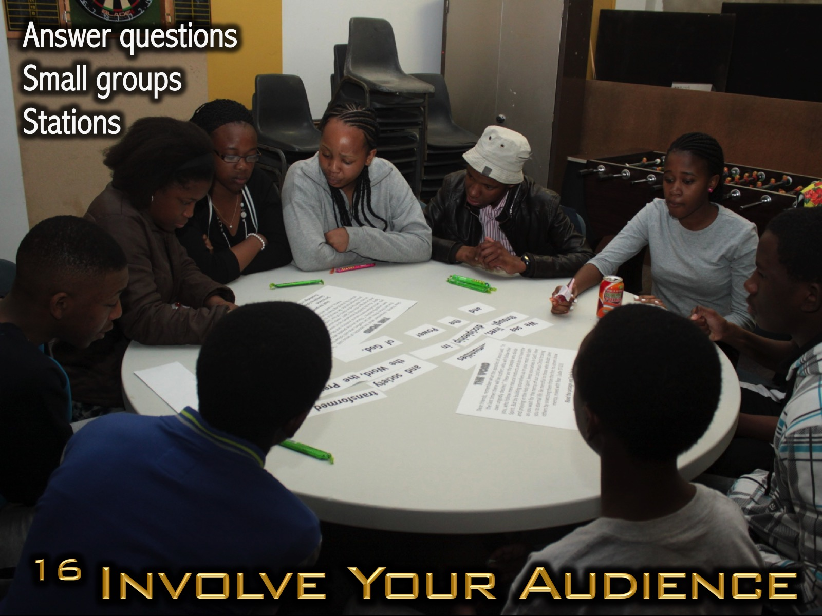
Notes:
16. Involve Your Audience. Have teens share with each other by answering questions in pairs; divide into small groups to interact around a question or application of teaching; or create stations where teens experience what you have taught them.

Slide 45
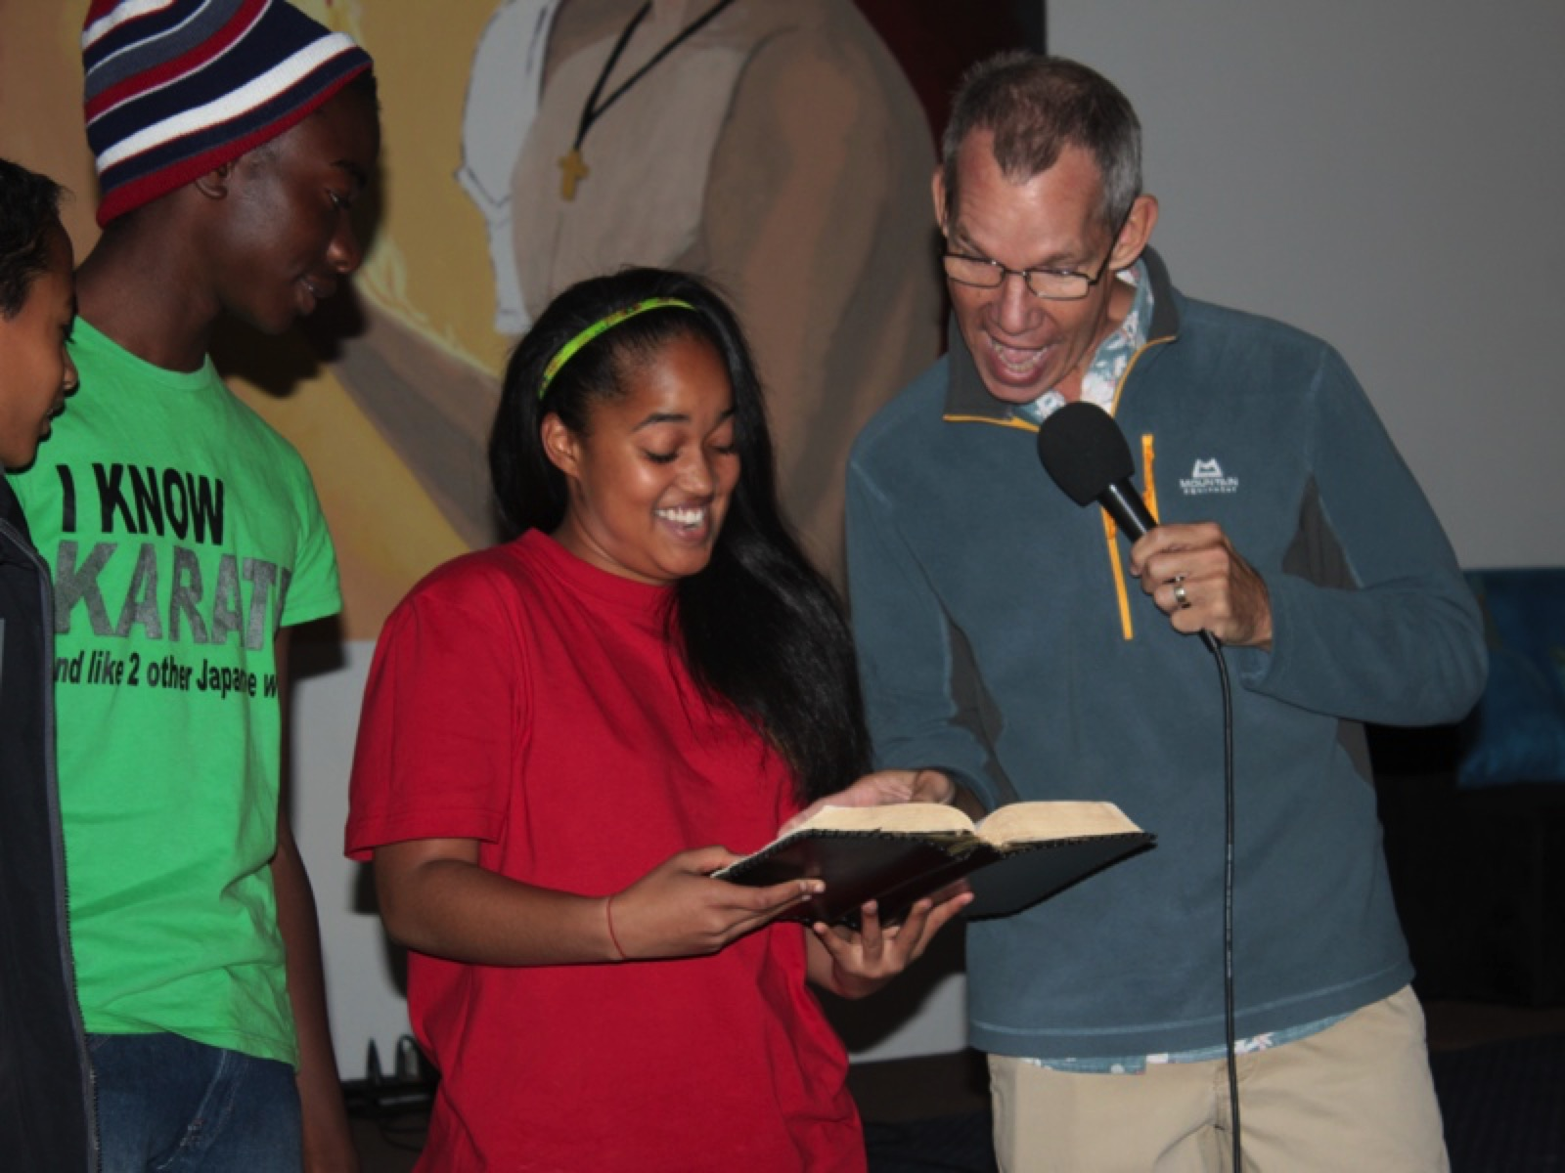
Notes:
Youth trying to open my bible to a page that is not marked in yellow highlighter - passages that refer to the presence of God. They would earn a slab of chocolate if they were successful.

Slide 46
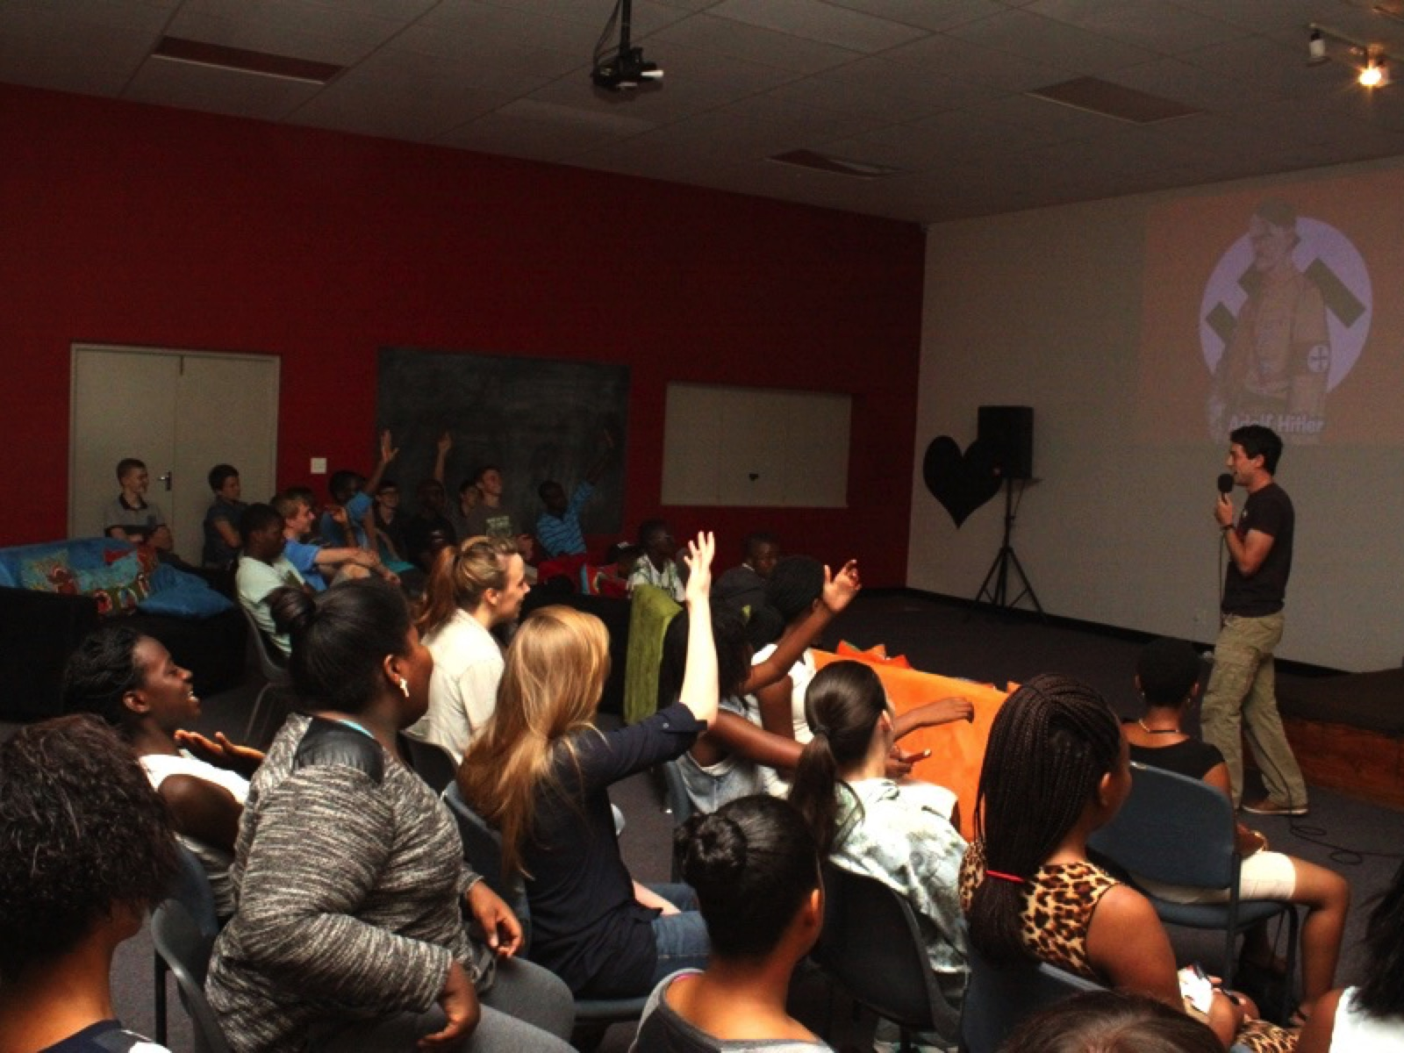
Notes:
A preacher using a quiz in 2 halves of the room to generate involvement in the message.

Slide 47
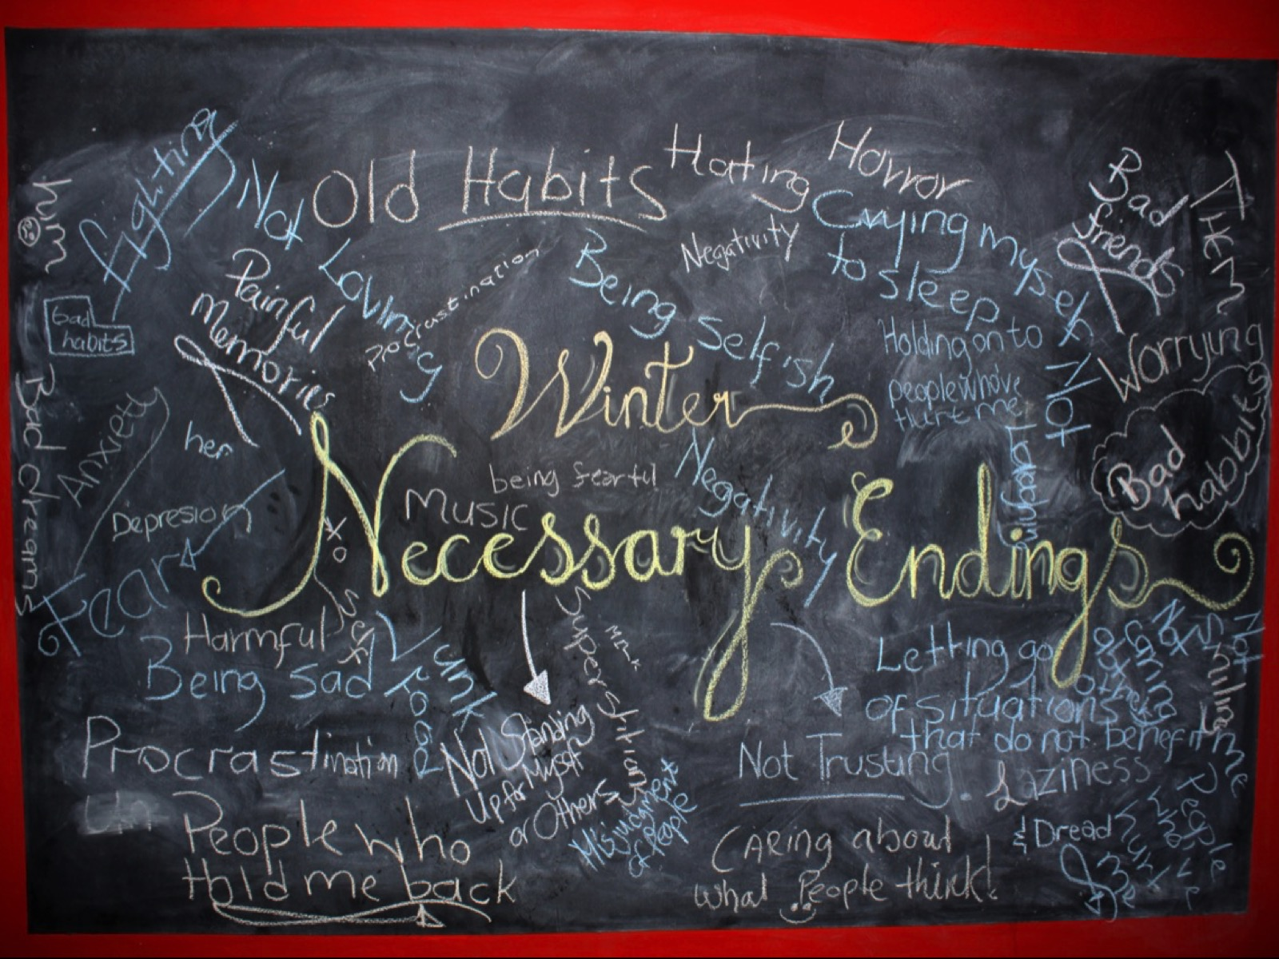
Notes:
In a contemplative service teens wrote down things that needed to end in their lives (Winter).

Slide 48
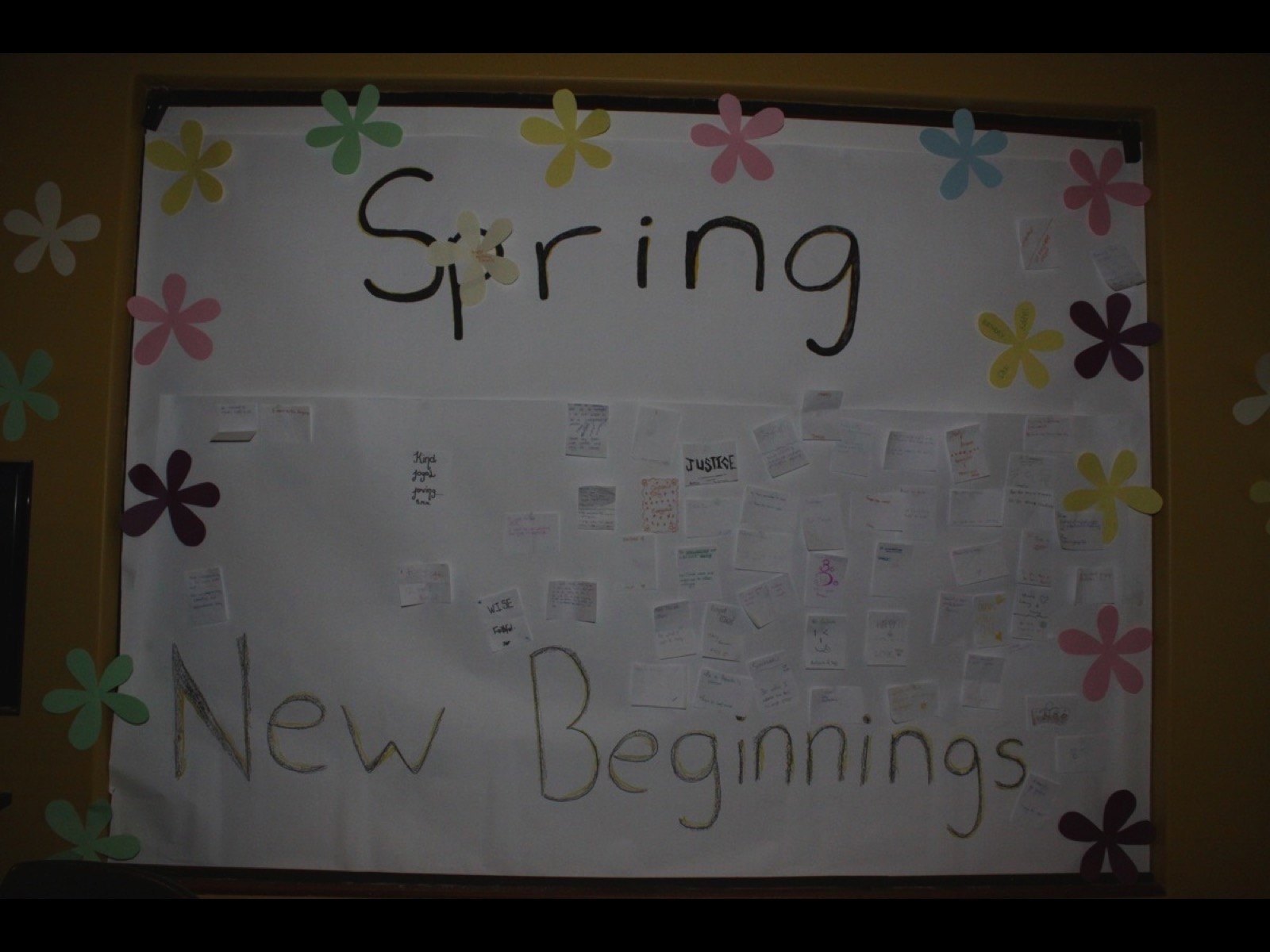
Notes:
In the same contemplative service teens wrote down things that needed to start in their lives (Spring).

Slide 49
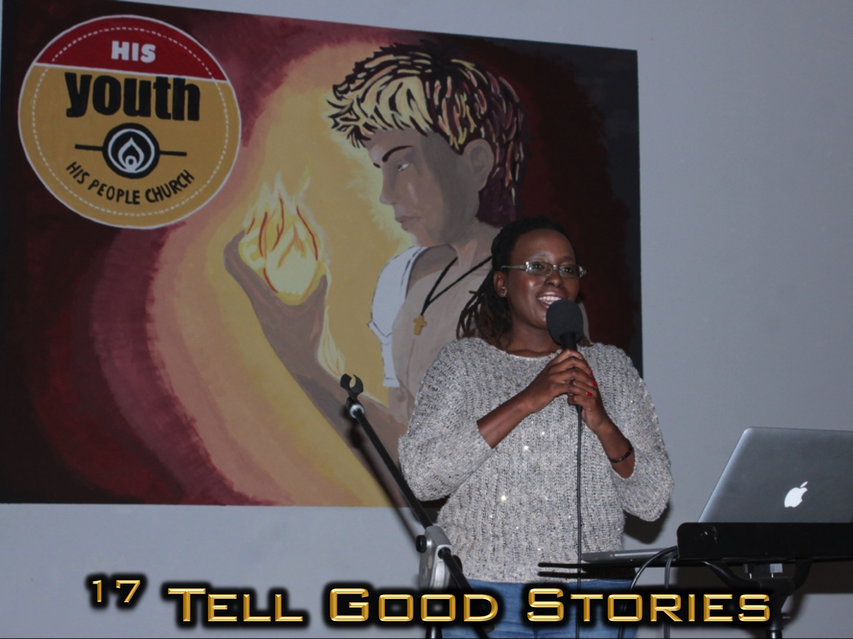
Notes:
17. Tell Good Stories. Storytelling is critical to engage teens in the conversation. You can tell stories from you life, stories that you find in your research or from the pages of Scripture. Many teens do not know the “old” Bible stories so be sure to start there!

Slide 50
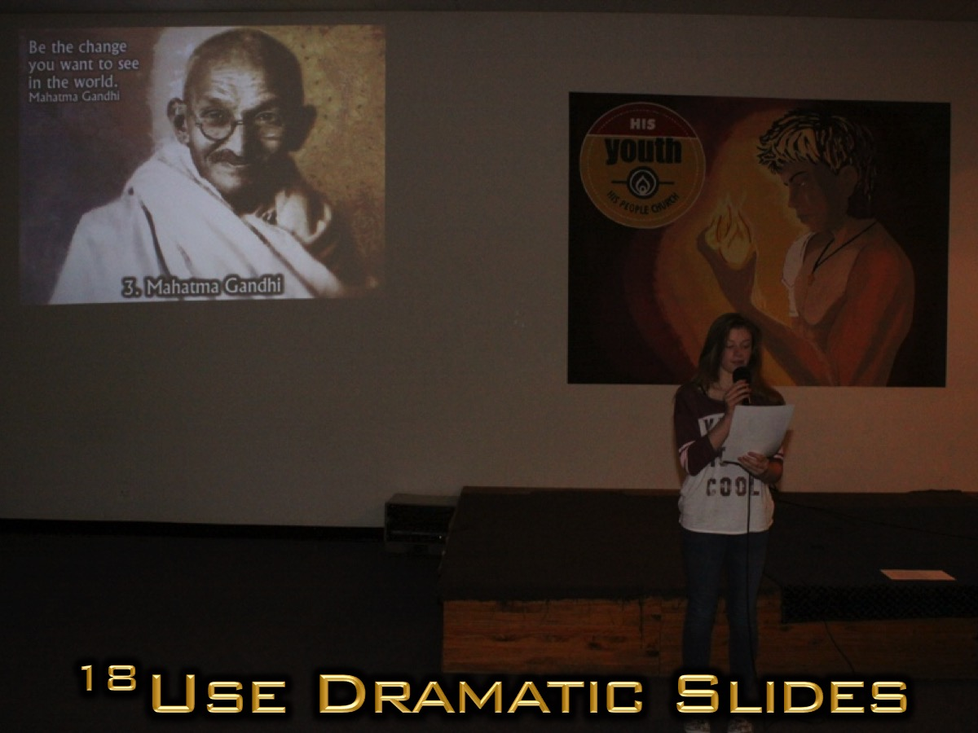
Notes:
18. Use Dramatic Slides. You probably should be using some form of presentation to visually back up your speaking.

Slide 51

Notes:
I strongly suggest that you avoid using bullet points in favour of full slide images with text overlaid using Shadow or Glow effects so the words are not lost in the image. Spend a good amount of time searching for high quality images once you have figured out your content for the message.

Slide 52

Notes:
This week is all about thinking revolutionary…

Slide 53

Notes:
Who Were Great Historical Revolutionary Thinkers?

Slide 54

Notes:
2. Walt Disney - Walter Elias "Walt" Disney was a prominent figure within the American animation industry and throughout the world, he is regarded as a cultural icon, known for his influence and contributions to entertainment during the 20th century. As an animator and entrepreneur, Disney was particularly noted as a filmmaker and a popular showman, as well as an innovator in animation and theme park design. He and his staff created numerous fictional characters including Mickey Mouse, Donald Duck, and Goofy.

Slide 55

Notes:
Who Were Great Biblical Revolutionary Thinkers?

Slide 56
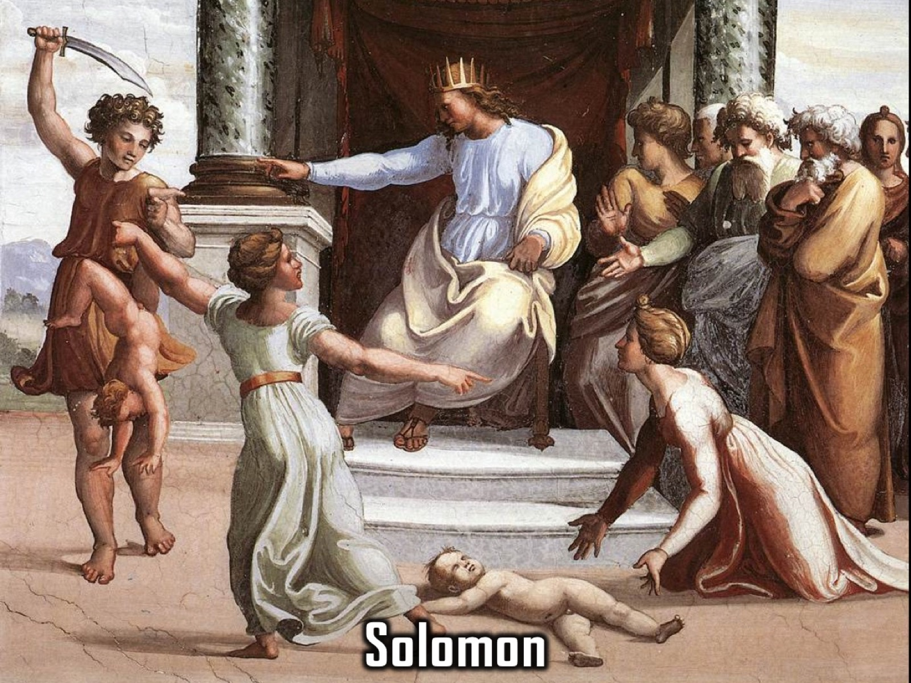
Notes:
1. Solomon: He was definitely one of the wisest kings in the history of Israel. One day two women came to him and had a dispute about which baby had been killed and who should get the one that was still alive. He suggested that the baby should be cut in halt. One woman said he should do that, but when the other woman said He should give the baby to the other woman Solomon knew that she was the real mom and gave her the baby.

Slide 57
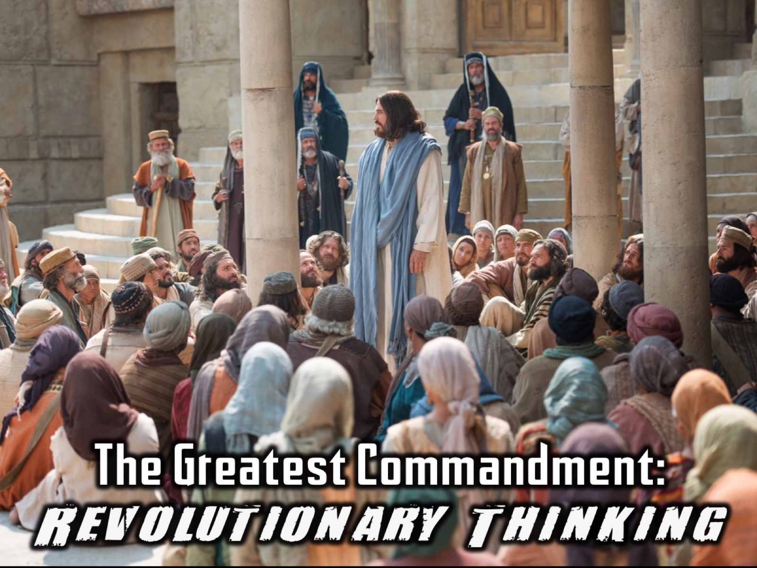
Notes:
The Greatest Commandment was an example of Revolutionary Thinking!

Slide 58
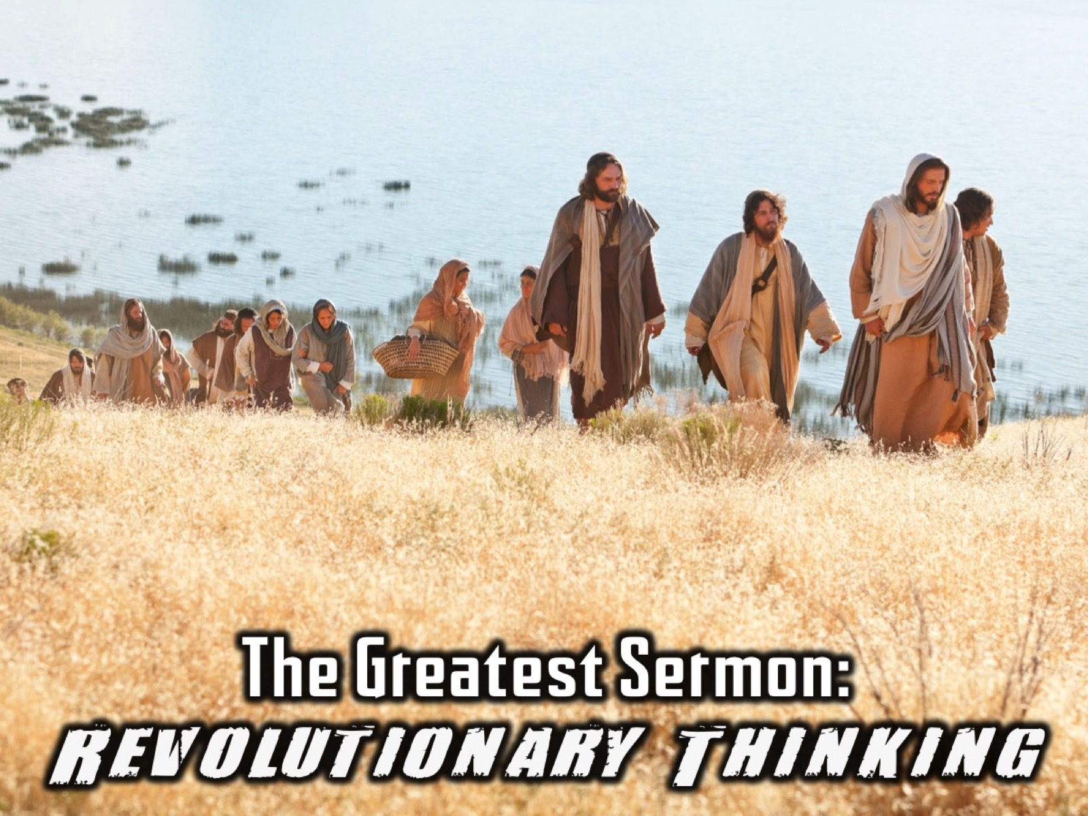
Notes:
The Greatest Sermon was an example of Revolutionary thinking. Jesus preached an amazing sermon to the crowds on a mountain that is known as the Sermon on the Mount. It is full of revolutionary thinking.

Slide 59
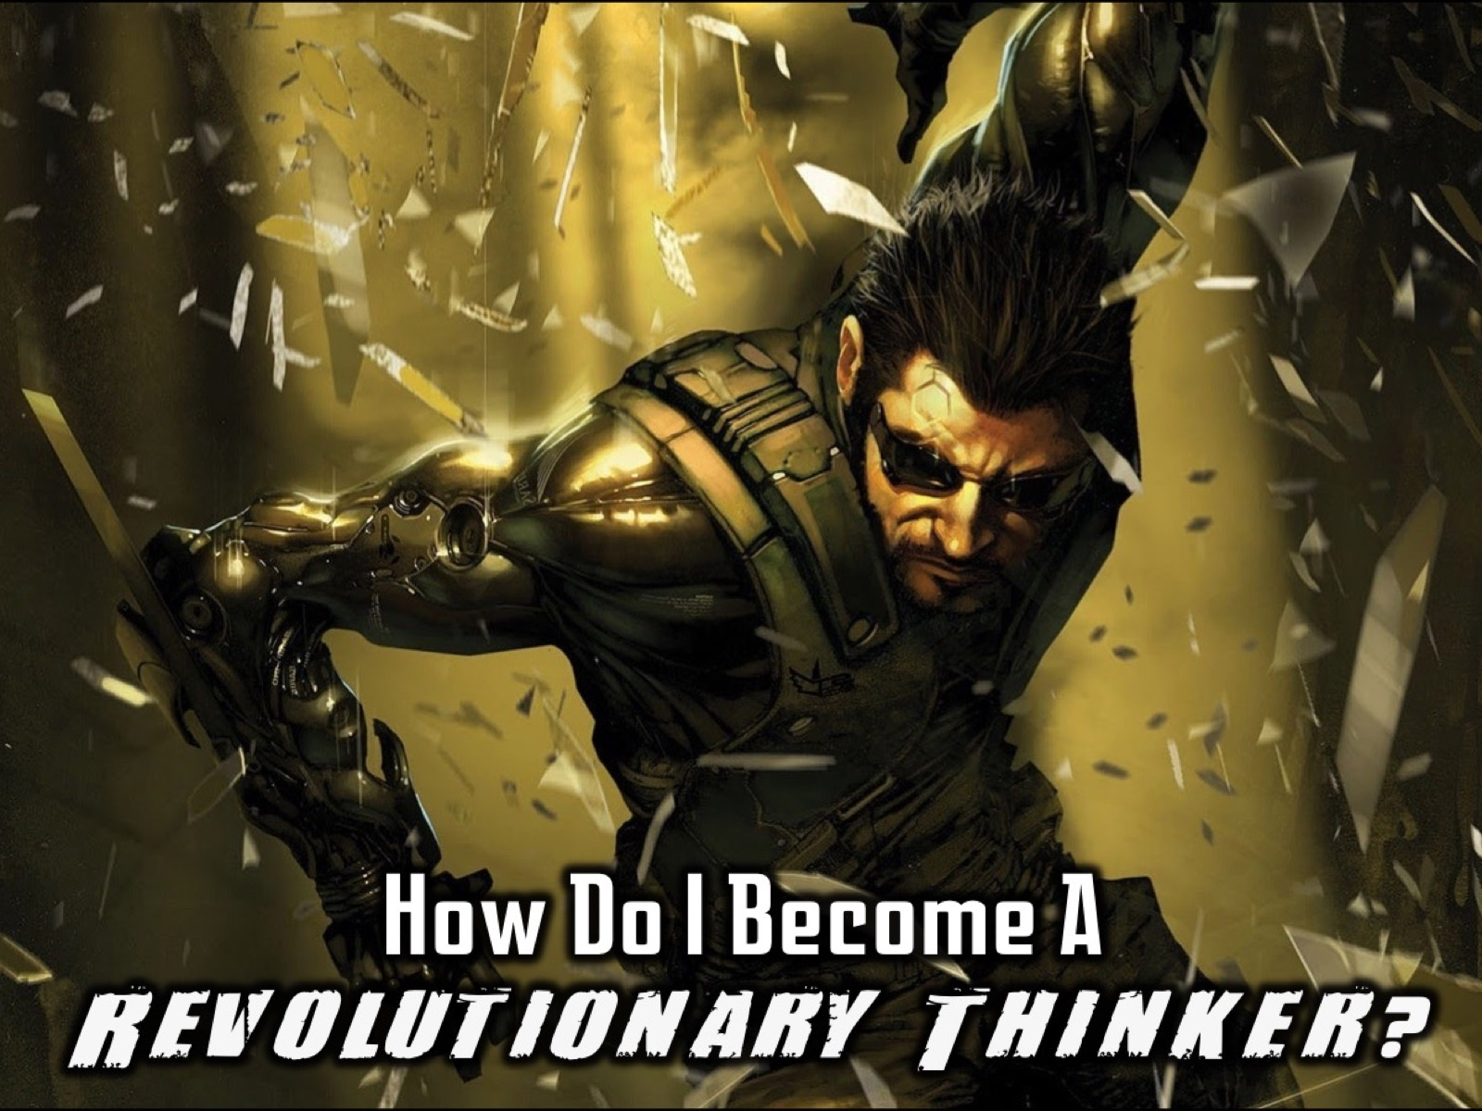
Notes:
So, how do I become a revolutionary thinker?

Slide 60

Notes:
1. Have Dreams: See a Better Future. Revolutionary thinkers have a vision of a future that is better than the present!

Slide 61
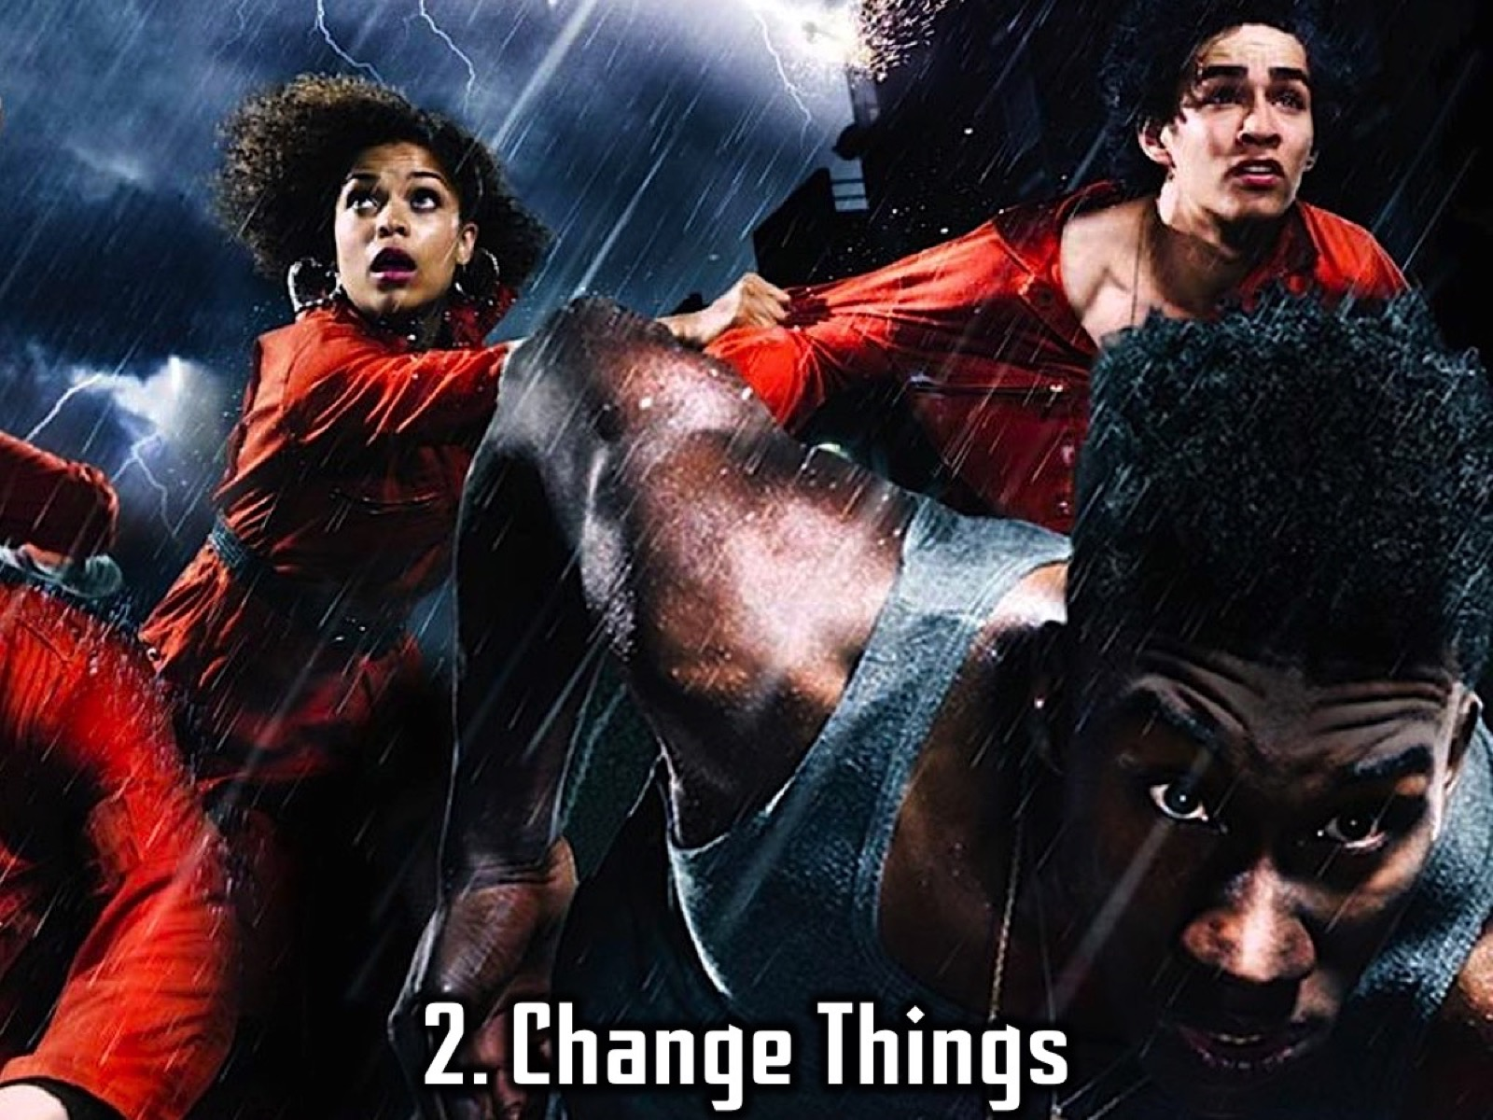
Notes:
2. Change Things: Be a Change Agent. Revolutionary thinkers learn how to influence people around them.

Slide 62
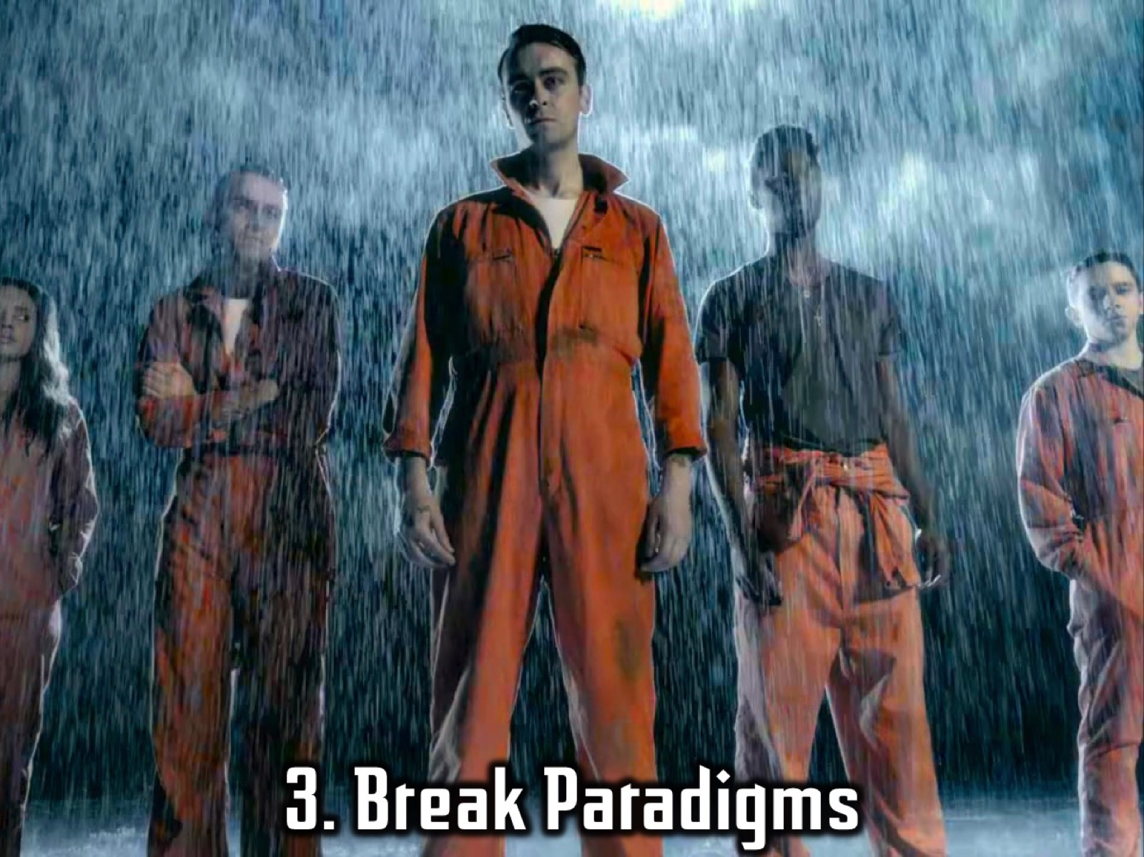
Notes:
3. Break Paradigms. Revolutionary thinkers are not happy with the status quo and set out to challenge and change existing thought patterns.

Slide 63
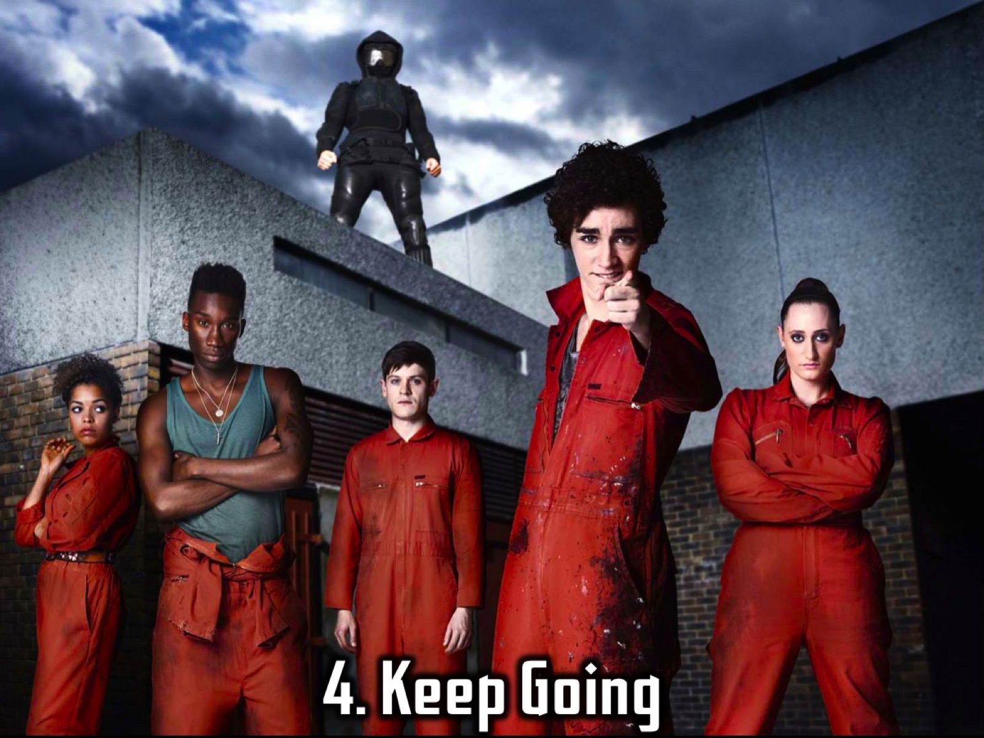
Notes:
4. Keep Going. Revolutionary thinkers keep going even when there are obstacles or when people disagree with them.

Slide 64

Notes:
5. Hear God. Revolutionary thinkers are tuned to God’s voice and receptive to the Holy Spirit.

Slide 65
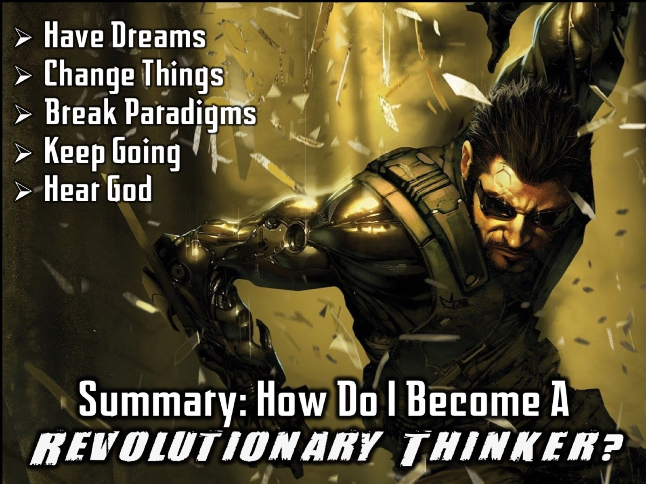
Notes:
Summary: So, how can I become a revolutionary thinker? (1) Have Dreams. (2) Change Things. (3) Break Paradigms. (4) Keep Going. (5) Hear God.

Slide 66
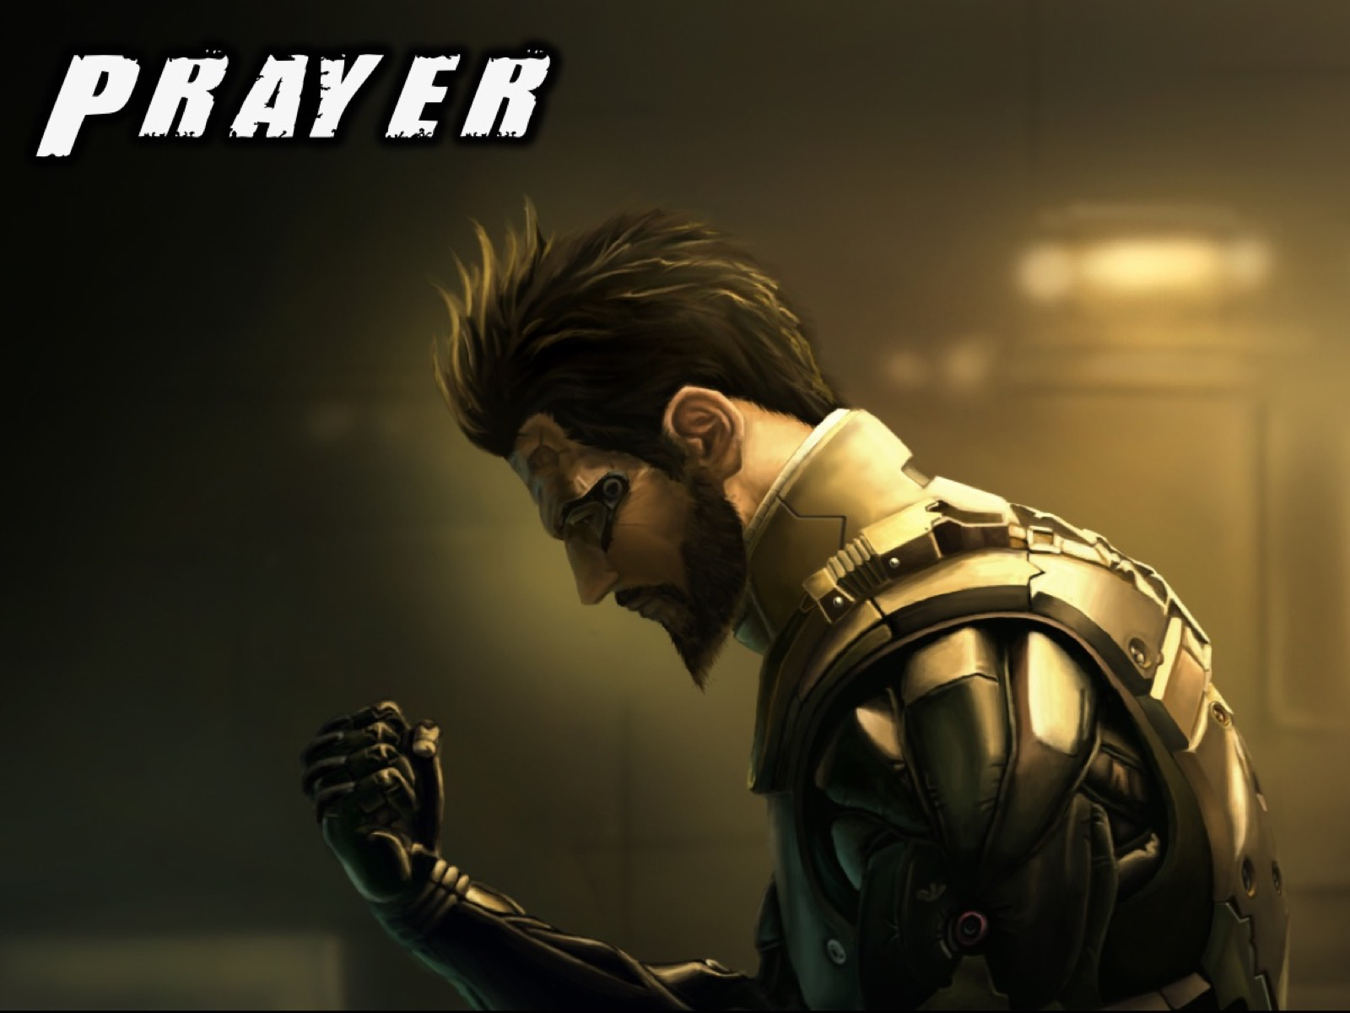
Notes:
Prayer

Slide 67

Notes:
19. Share Your Messages. So many leaders create outstanding messages and programs each week that are never seen or used again. When you create anything in youth ministry you should be thinking about sharing it with other leaders. Take a look at the Youth Ministry Resourcer website that I maintain (www.ymresourcer.com) – especially the Programs Page where whatever we do on a Friday Night or Sunday morning at His Youth is uploaded within a day or two of the event so others can adapt and use it in their context.

Slide 68
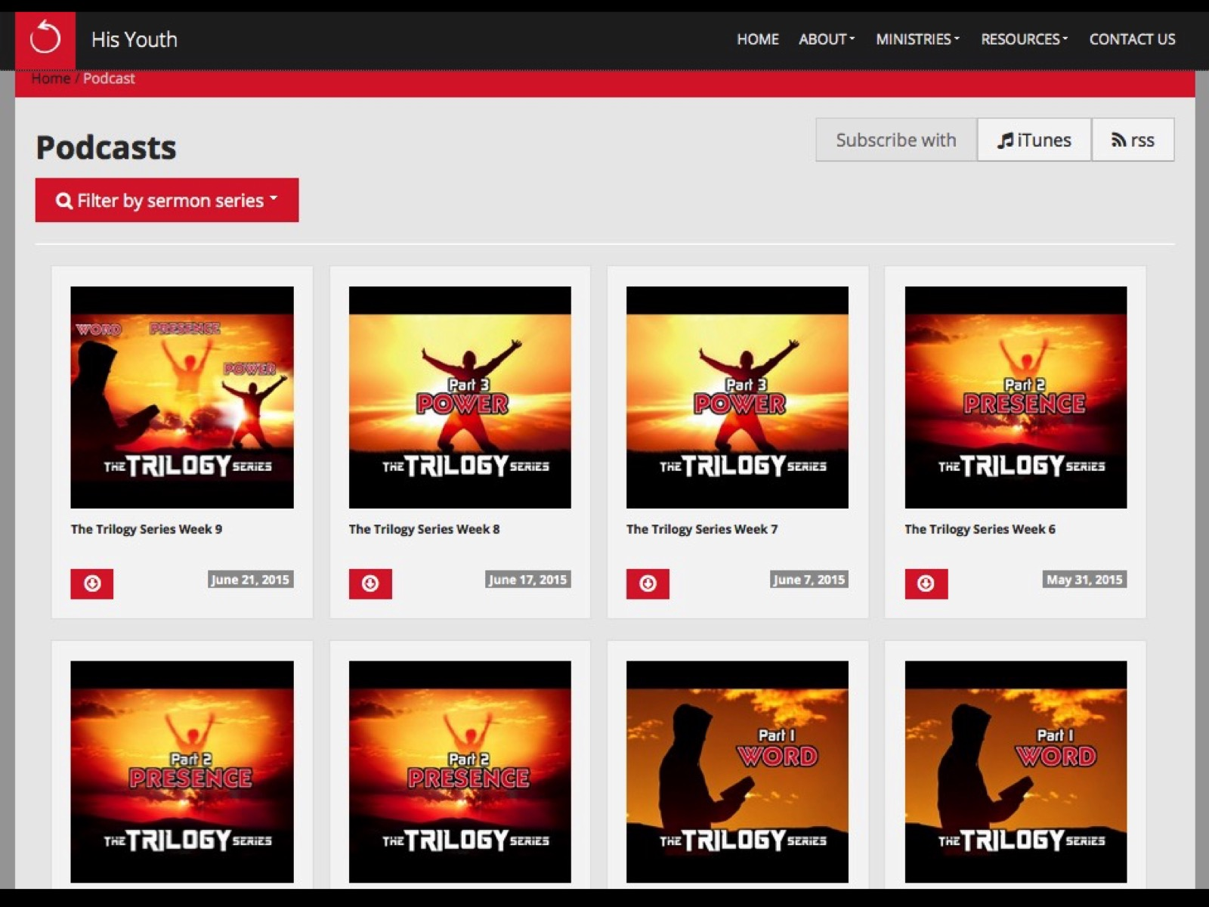
Notes:
Here is an example of our youth website where our sermons are podcast each week and the notes are also made available.

Slide 69
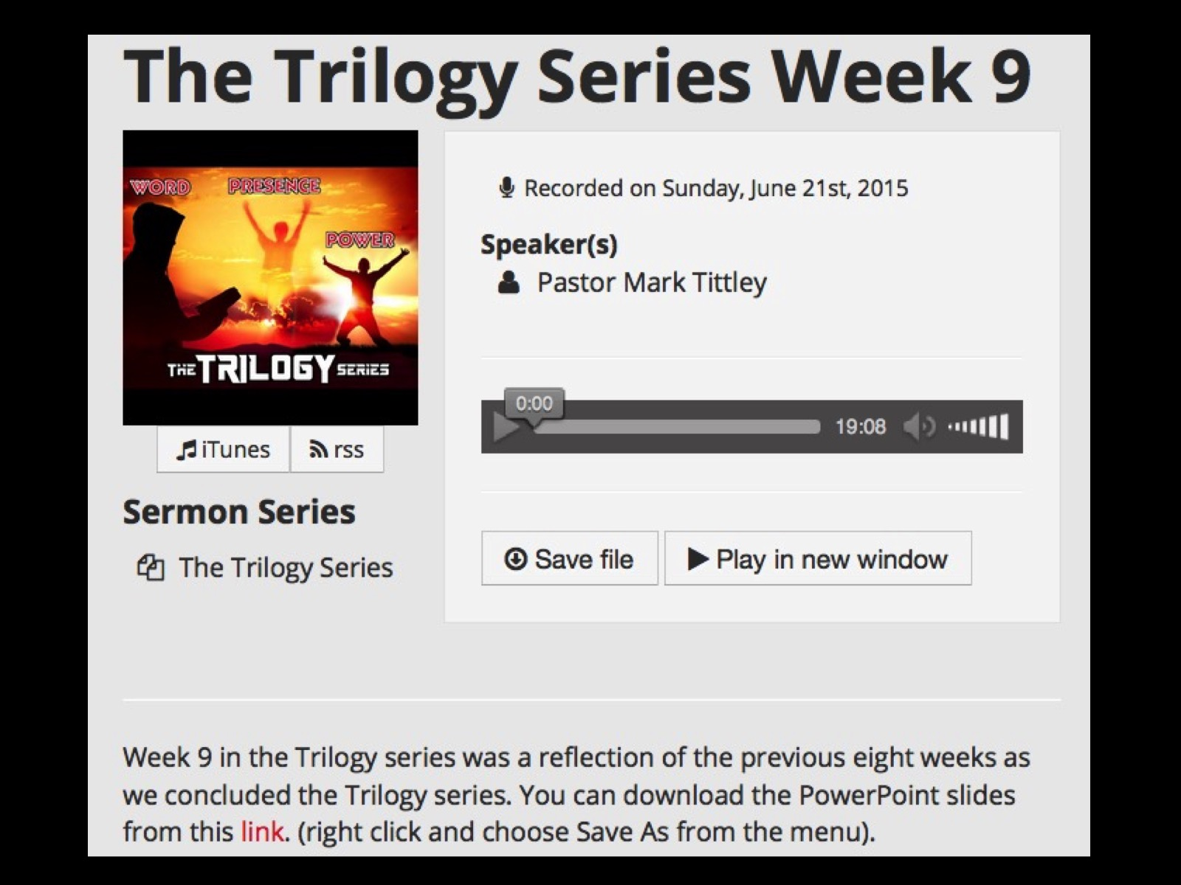
Notes:
Here is an example of our youth website where our sermons are podcast each week and the notes are also made available.

Slide 70
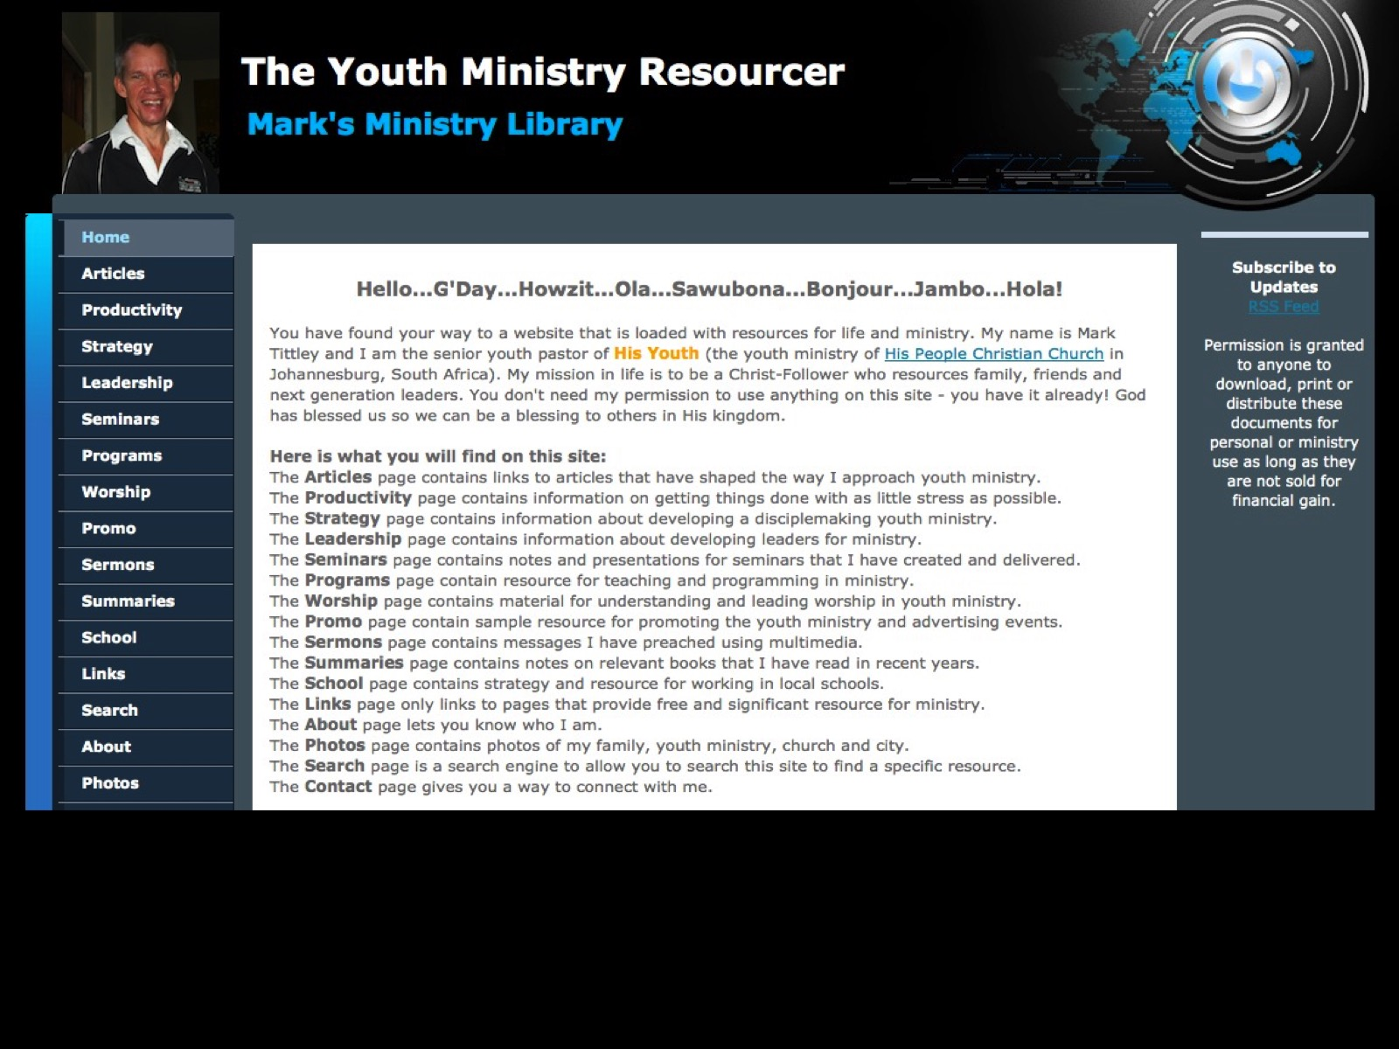
Notes:
I also upload all messages delivered at His Youth (including notes, audio, PowerPoint and handout) to my website at www.ymresourcer.com.

Slide 71
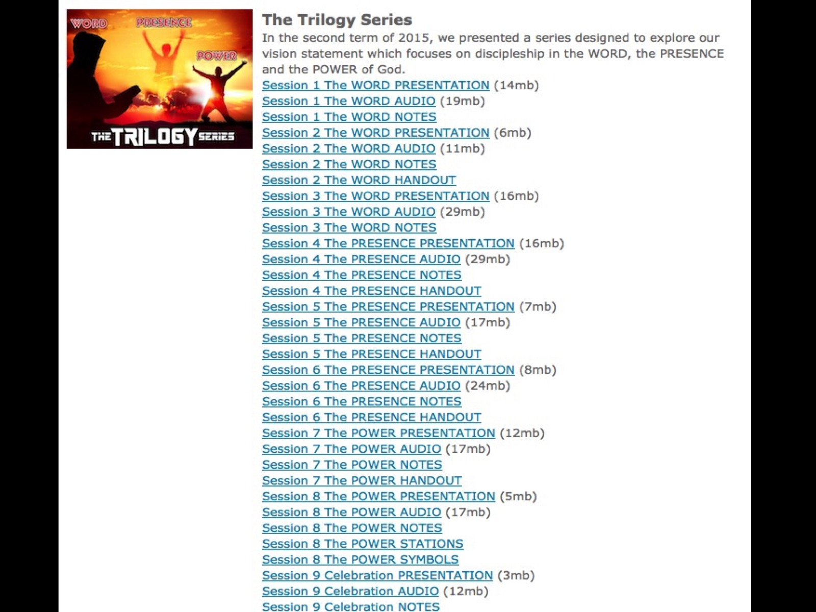
Notes:
Here is an example of our last sermon series with all the uploads ready for download.

Slide 72
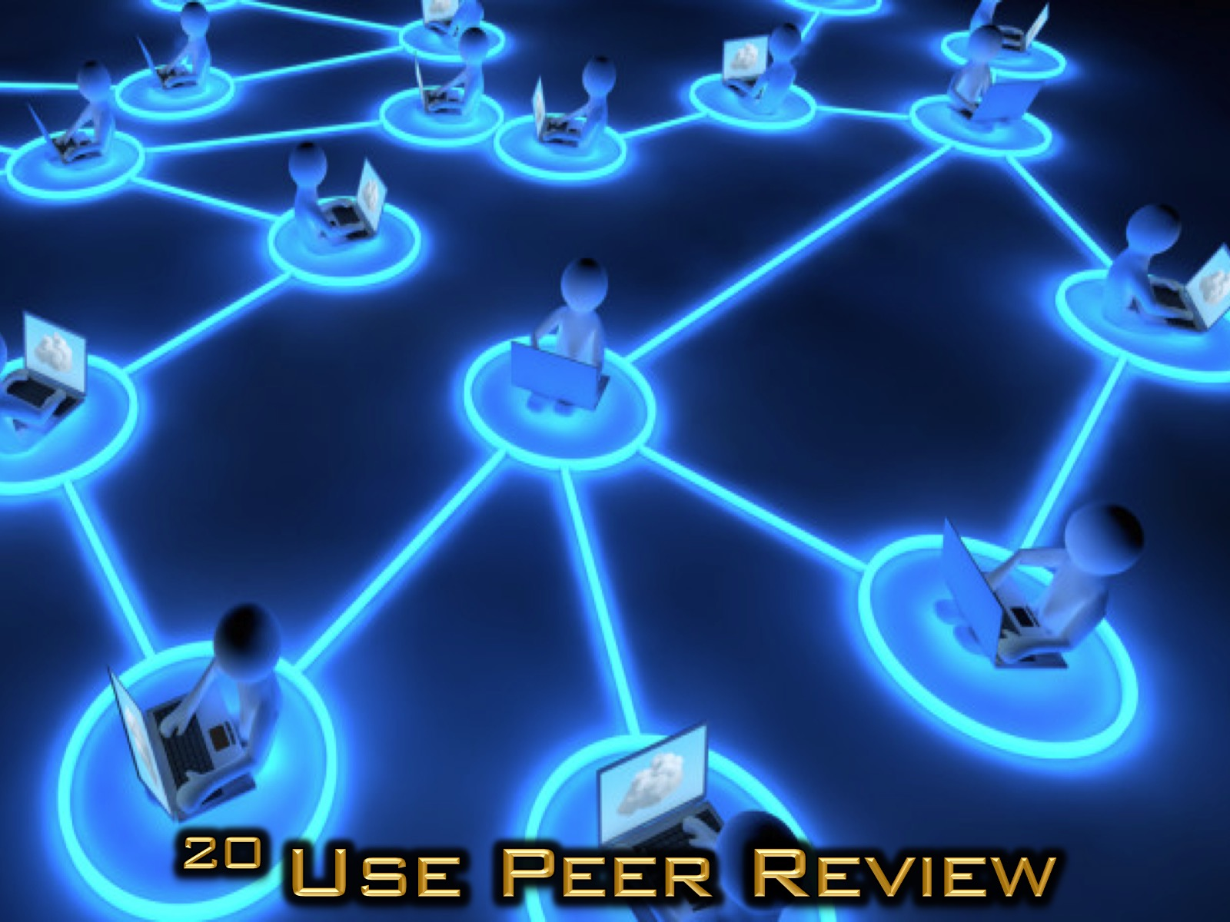
Notes:
20. Use Peer Review. At His Youth, the Sermon Notes and the PowerPoint slides for the message that is going to be preached on Sunday are posted in a closed Facebook group for review and suggestions for development. This helps us ensure that others on our leadership team are able to help with the design and creation of the message. Our adult and teen leaders are members of this Facebook group. Our church has regular sermon planning meetings that enable preachers from our different congregations and services to get help and share ideas and resource as they develop their messages.

Slide 73
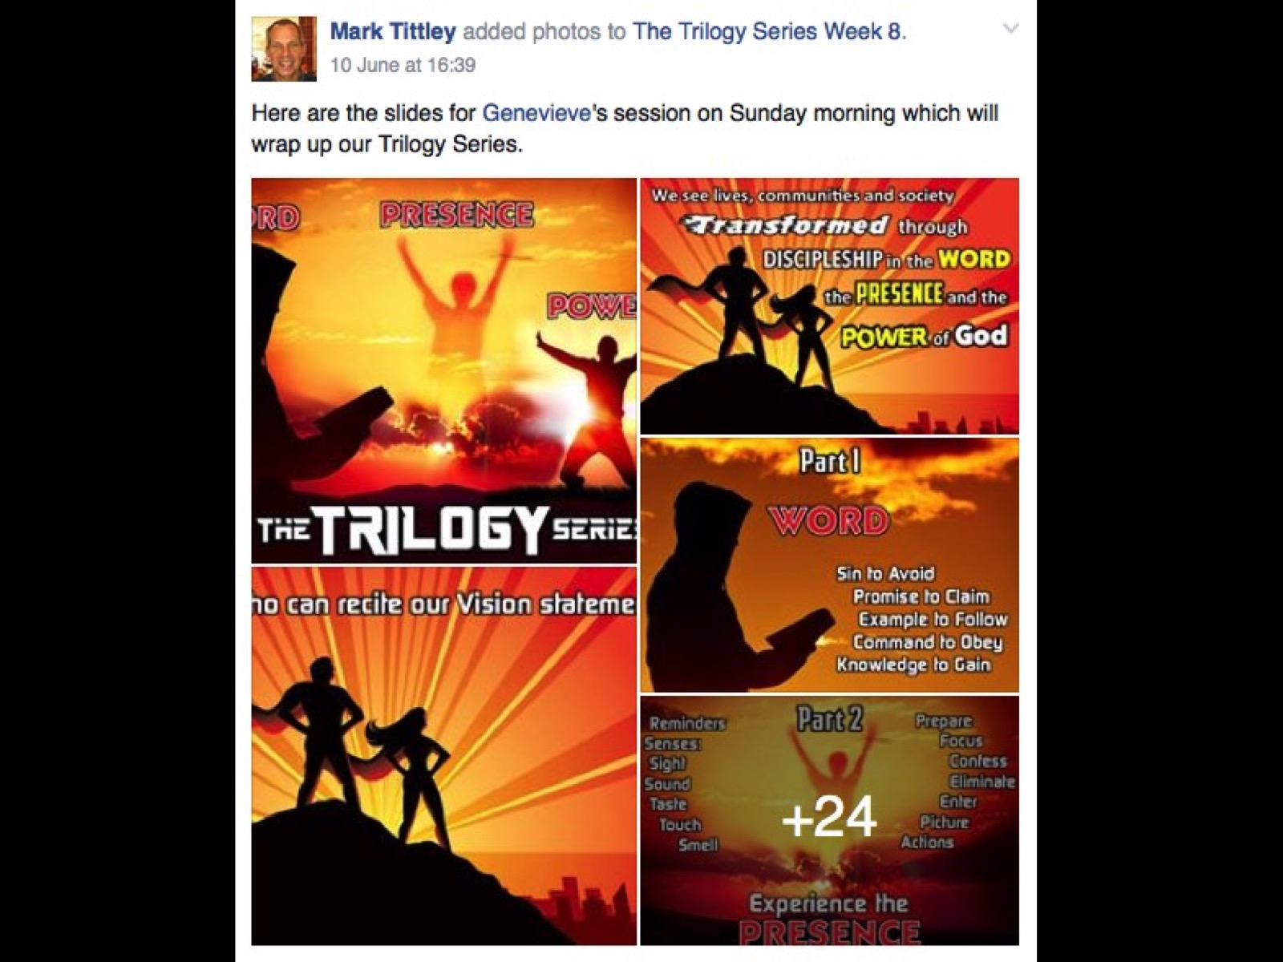
Notes:
Here is an example of our Facebook Preview page - each image has the sermon notes included in the comments section which allows people to read what the point is all about and then also make comments to help the preacher improve the message or slides. Videos are also previewed using this Preview group.

Slide 74
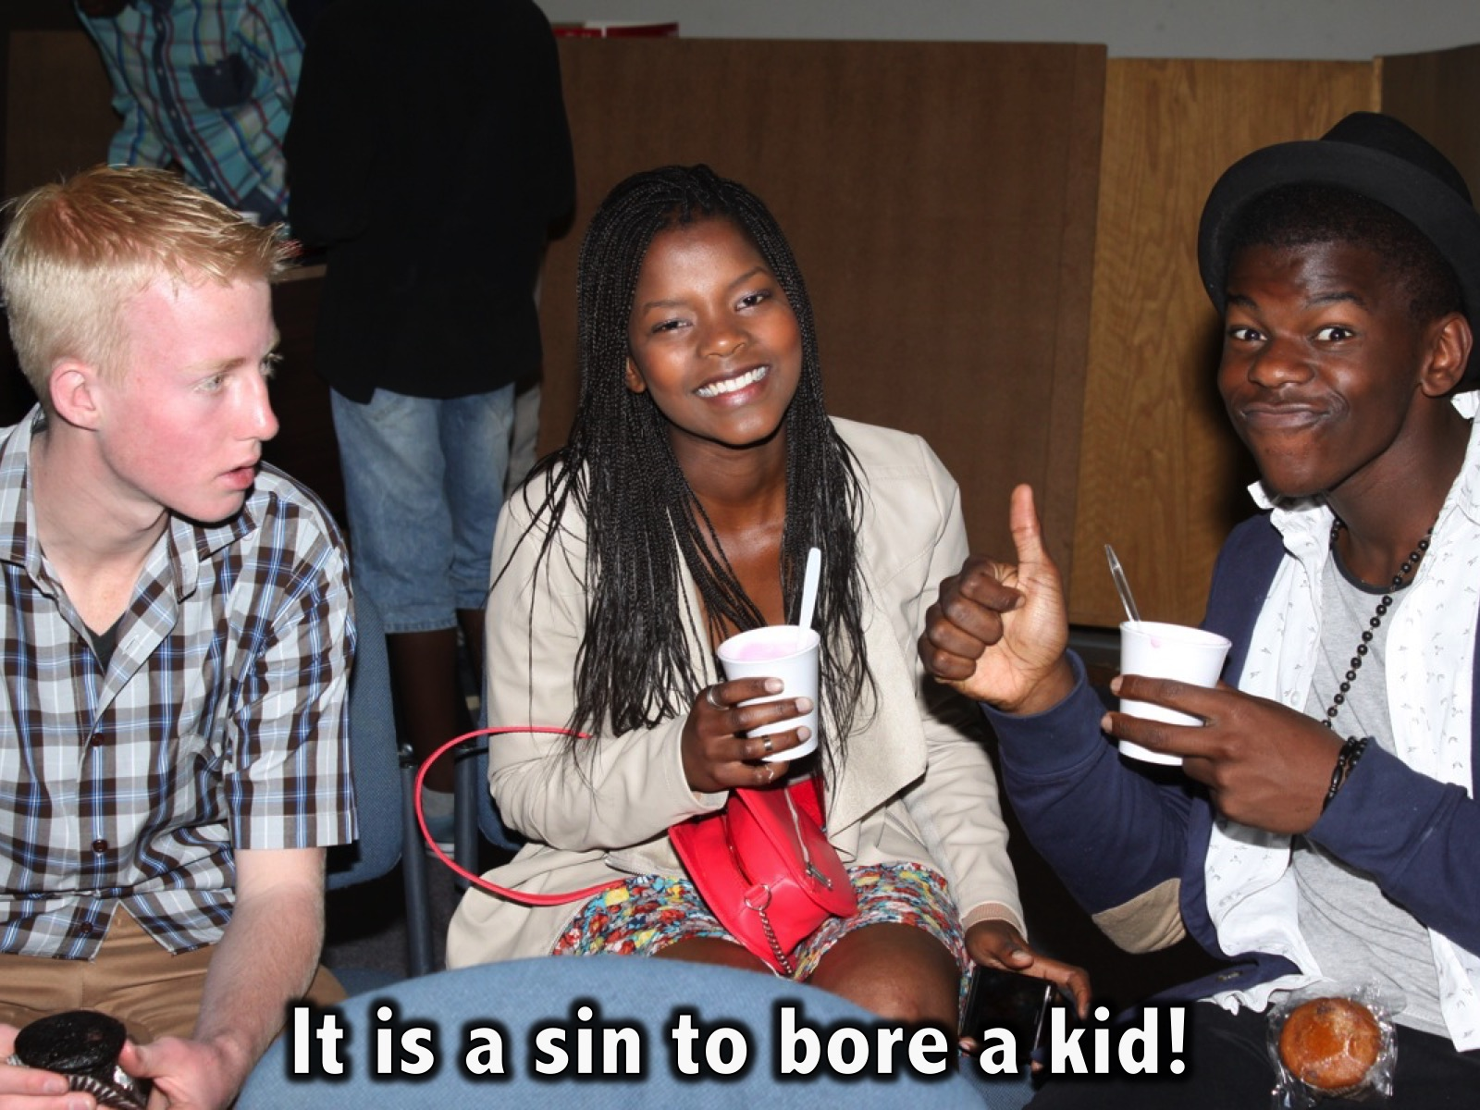
Notes:
Jim Rayburn, the founder of Young Life in North America, once said: “It is a sin to bore a kid.” Maybe we never be guilty of speaking in a way that does anything less than inspires, encourages, convicts, exhorts and releases teens into a life of disciplemaking and impact for the sake of the Gospel!

Slide 75
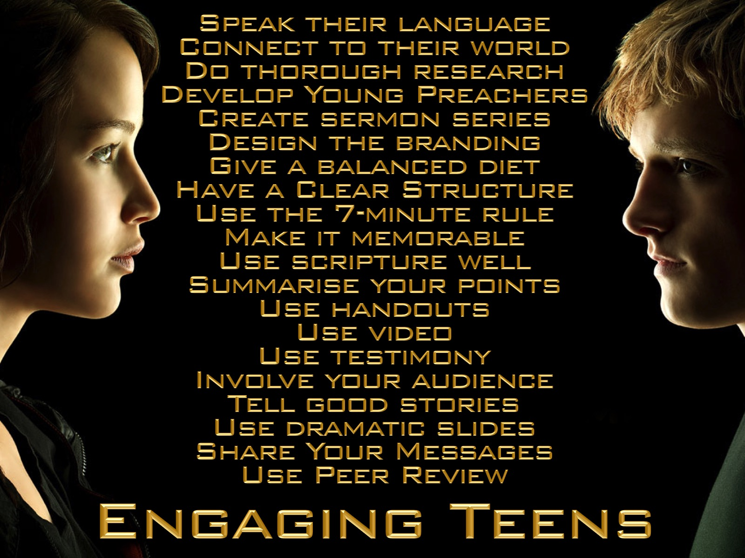
Notes:
So here are my top 20 keys to engaging teens: Speak their language, Connect to their world, Do thorough research, Create sermon series, Design the branding, Give a balanced diet, Have a clear structure, Use the 7-minute rule, Make it memorable, Use scripture well, Summarise your points, Use handouts, Use of video, Testimony, Involve your audience, Tell good stories, Use dramatic slides, Share Your Messages, Use Peer Review.

