Slide 1
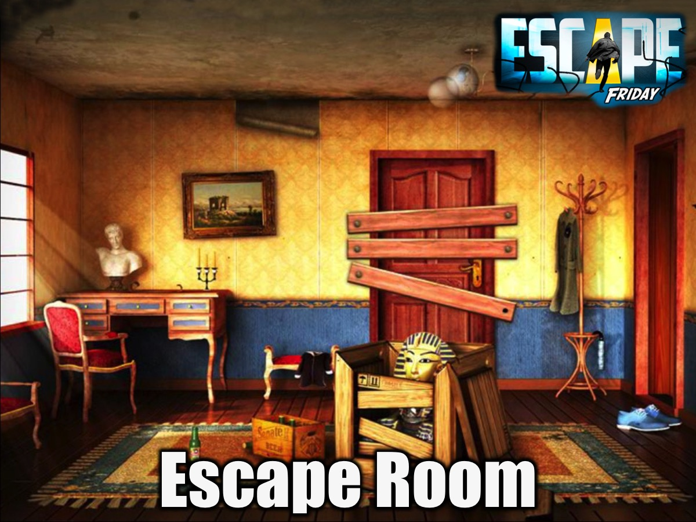
Notes:
This week is Escape Room Night. Here are the notes for running the event:
I want to create a night of intrigue, but I realised that trying to make a copy of a professional Escape Room with real life props would be nearly impossible. So I have designed a more compact Escape Room, which Players can still walk around in, but where the physical interaction between Player and Room is minimal. Interaction takes place through the Players imagination (which makes or breaks the experience, so we will have to try and feed it as much as possible; playing in the dark – using glow stick as torches to see-, playing eerie music in the back ground and giving imaginative descriptions of the rooms layout).
Teams are each placed in a “Room” and have to investigate its aspects and contents in order to escape, all the while being hunted by a Phantom.
Below is a description of the aspects of the Room, how it works, the Leaders’ role and some other finer details.
The Rooms
The Escape Room is divided into five chambers: 1) the Sanctum (main room where groups start); 2) the Study; 3) the Crypt; 4) the Gallery; 5) the Store Room.
Each room is barred by a “door” (in reality, just a propped up trestle table). To access a room, members of the group must sit in the chairs (one per chair), leaving the chair facing the “door” they want to open empty. Positioned, the group tells the leader that they want to open the door to that room. The leader confirms, the unseated members stand in the centre next to their seated companions, and the door “opens”. Players are now allowed to enter that room
An Aside: (In the case of a large group, enforce a rule that in order to keep the door open, the seated members must remain seated. This will prevent congestion when rooms are entered. Leaders must just facilitate to make sure that seated members get a chance to participate. If groups are small, players don’t have to stay in chairs).
Players enter the rooms by walking around the “doors”. The contents of each room are stuck to the back of the “door”. The leader gives a description of the room and the Players investigate (by asking the leader questions, who will provide them with any information relevant to the question asked – e.g.: “Can I move the table?”, or “I pick up the book”). When a group wants to leave a room and investigate another, they exit the room (by walking around the “door” back into the Sanctum), decide on the next room, and then position themselves on the chairs, keeping the chair opposite the room they want to open vacant. Each time a door is opened, the last opened door closes. The action of opening/closing doors ends each turn and begins a new one. All actions must be run by the Leader in order for them to be valid and for an orderly progression of event to occur.
Descriptions:
Without descriptions, the room itself is very plain, thus it is very important to dress the descriptions up. The Sanctum one might describe as a cold stone room, dimly lit by torchlight. In the centre are chairs of stone, situated like a cross – a foreboding reminder of the fate of the group if all attempts to escape prove futile… The Leaders’ imagination fuels the Players’ imaginations. Describe the feel, the mood and the layout of each room. Here are a list of the rooms and their contents to include in your descriptions
The Study
“You enter a dark room. Unlike the Sanctum, the floors are wooden and an ornate carpet lies on the floor. In the centre of the room is a desk and in the far corner is a book shelf.” – The description of the Study. Descriptions for the contents are:
The Desk:
“The Desk is very old, covered in dust – it looks as if it has not been used in a hundred years. You notice two drawers on the desk’s side”;(if they ask to open the drawers): “You try, but the drawers are both locked”
(When Drawer #1 is opened) “You find another key and a letter”
(when Drawer #2 is opened) “You find a cog”
The Book-shelf:
“The Book-shelf is old and sturdy. It is empty, except for one book.
(if they ask to take the book, give them the pieces of paper stuck behind the bookshelf print-out) “you find a diary”
The Gallery
“The Room’s floor and walls are stone. The remains of a once regal and exquisite carpet lie sprawled over the floor. At the end of the room on the wall hangs a rectangular object” – the description of the Gallery. Description of contents:
Dusty Painting
“Upon inspecting the object, you see that it is a painting, but of what you are unsure. Dust obscures the image.
(if they try and wipe the Portrait without the Dust Rag) “You fail to wipe the dust away. It is layered on too thickly”
(wipe Portrait with Dust Rag) “You succeed in cleaning the painting. You see it is a Portrait of a man holding a skull. You notice on the frame some peculiar letters.”
(Inspect the letters) “The letters read…” – letters will be on portrait.
(once they cut the painting) “the painting tears and out falls a key”
The Store Room
“This room reeks of decaying food and mould. Against the one wall is a cupboard made of sturdy oak.” – Description of the Store Room. Description of the contents:
The Cupboard
“The Cupboard is sturdy and strong”
(if they try and open the Cupboard) “You try, but the Cupboard doors are locked.”
(once Cupboard has been opened) “Inside the cupboard you see a Lever and on the one shelf a Knife and a Dust Rag”
(if they pull Lever without the “missing piece”) “You pull the lever, but nothing happens. You look closer and see that there is a piece missing – a cog like piece”
(pull lever with “missing piece inserted) “You pull the Lever and hear a rumbling sound. It appears to be coming from the Crypt.”
The Crypt
“This room has the stench of death; the smell of putrid flesh meets your nostrils. Lining the room are empty candle holders. In the centre of the room stands a coffin” – description of the Crypt. Description of the contents:
The Coffin
“The coffin is made of stout wood and lined with ivory. The lid bears the image of a skull. The lid also looks loose”
(Remove lid). “The lid tumbles off the coffin with an almighty crash. The room echoes eerily and the lid lies broken on the stone floor. Inside the coffin is a corpse”
(investigate the Corpse) “The Corpse lies distorted in the coffin, his hands held together as if clenching something.”
(look in the Corpse’s hands) “you tear away the Corpse’s hands and finds a key”
Technical list of the Rooms’ Contents
The contents of the Study are:
A desk with two drawers, both are locked.
Drawer #1 is opened by Key #1 (found in the Crypt, in the Corpse hand), this drawer contains Key #2 (which unlocks the Cupboard in the Store Room) and a letter warning the group about the Phantom and how to avoid him.
Drawer #2 is opened by Key #3 (found in the Dusty Portrait in the Gallery); this drawer contains the “missing piece” for the lever in the Cupboard (which opens the Escape Door in the Crypt).
A Book-shelf
A Diary (has miscellaneous information about the Rooms – adds a bit of intrigue), which contains the Caesar Cipher Key needed to decode the instructions on the Dusty Portraits frame.
The contents of the Store Room are:
A Cupboard, locked – unlocked by Key #2 (found in Drawer #1 in the Study). The cupboard contains:
A lever, missing a piece to enable it to work.
A Dust Rag, used to wipe down the Dusty Portrait in the Gallery.
A Knife (used to slice open the Dusty Portrait to find Key #3, which unlocks Drawer #2 in the Study)
The contents of the Gallery are:
A Dusty Portrait (obscured by dust, needs the Dust Rag to make the coded markings on the frame – use Caesar Cipher Key).
Key #3 (hidden in Dusty Portrait, needs Knife to open) which unlocks Drawer #2 in the Study.
The contents of the Crypt are:
A corpse (with Key #1, which unlocks Drawer #1 in the Study, in his hand)
Stone Archway (the Escape Door, opened by the Lever in the Store Room)
The Phantom
Taking the key from the corpse (which begins the route) and closing the Crypt Door, awakens the Phantom (either a leader who is dressed up as the corpse or just imaginary figure that the leader must mentally keep track of). The Phantom begins in the Crypt, and then moves in a clockwise motion to the next room at the end/beginning of each turn (each Door Change).
If the group opens the door of the room the Phantom has moved to, the Phantom ‘kills’ one member (that member, the strongest or leading member, is removed and sits out for the remainder of the game). The Phantom is inactive for the rest of the turn, allowing groups to investigate the room that he was in. When the turn ends (another Door Change), the Phantom moves from the room he was in to the next room, continuing his route. Special exception to the inactive rule occurs when the Phantom is in the Crypt. If the Crypt is opened and The Phantom is inside, he ‘kills’ a member of the group, but doesn’t become inactive. Rather he stays in the room and anyone that goes inside is ‘killed’.
If enough of the group is ‘killed’, it is game over. In cases of large groups, the game is over when the group size becomes 4. In small groups, the game is over when only 2 people remain.
The Route
No matter how the group decides to proceed at first, the “route” can only begin when they take the Key from the Corpse in the Crypt (also triggering the Phantom). The steps the groups must take in order to escape are these:
Open Crypt Door.
Enter Crypt.
Take Key (#1) from Corpse in the Crypt.
Exit Crypt.
Open the Study Door (Phantom comes into play)
Enter Study (Phantom is in the Crypt)
Use Key (#1) to open Drawer (#1)
Take out Key (#2) and Warning Note (groups must figure out how the Phantom moves).
Retrieve Diary off the Bookshelf
Exit the Study
Open the Store Room Door
Enter Store Room (Phantom is in the Study)
Use Key (#2) to open Cupboard
Take Knife and Dust Cloth
Exit the Store Room
Open the Gallery
Enter the Gallery (Phantom is in the Store Room)
Use Cloth to wipe down the Dusty Portrait.
Dusty Portrait becomes a Portrait of a man with a skull; the code on the frame becomes visible.
Use Caesar Cipher Key in Diary to solve the code (answer: Cut Death down and the Key to Life is found).
Use Knife to cut Portrait, Key (#3) is found.
Take Key (#3).
Exit Gallery
Open the Study
Enter the Study (Phantom is in the Gallery)
Use Key (#3) to unlock Drawer (#2)
Take “Missing piece”
Exit the Study
Open the Store Room
Enter the Store Room (Phantom is in the Crypt)
Insert “Missing piece” into Lever.
Pull Lever; hear rumbling sound from the Crypt.
Exit the Store Room
Use Warning Note to figure out that the Phantom will be in the Crypt next.
Open a miscellaneous door (any room other than the Crypt – Phantom moves to the Crypt)
Open the Crypt (Phantom is in the Study)
Enter the Crypt
See Stone Archway is open
The End.
The Leaders’ role: The Leaders’ role in this game is to act as the interactive “interface” between the Players and the Room. The leaders supply a description of the room and its contents and answer questions the players may ask about interaction and use of objects. For example, in the Study are pictures of a desk and a book shelf. The Leader provides a description of the room and its contents. It is the role of the Player/s can then ask questions about the contents, asking if they can “Investigate further”, “”pick up the objects” or move/open it. The leader answers, giving any further information there is about the thing in question or is they can interact with the object directly. Such a discourse between Leader and Player/s make play out as such:
Leaders: You enter a small musty room. The walls are lined with decaying wooden panelling. From the ceiling hang cobwebs. In the middle of the room you see a desk and in the far corner you see a bookshelf)
Player/s: I inspect the desk.
Leaders: You inspect the desk and discover it has two drawers.
Player/s: I try and open the drawer.
Leaders: You try to open the drawer, but it is locked and you fail to open it. You wonder if there is a key around.
In addition to giving descriptions about contents and interaction, Leaders are also responsible for orchestrating the opening and closing of doors (Door Changes) – verifying which door the group wishes to open and which doors will be closed as a result. Only one door may be open at a given point. Another responsibility of the leader is to keep track of the Phantom (which room he is in) selecting removing the victim when the group encounters the Phantom.
List of Props required for set up and running the event
16 trestle tables/boards to act as the rooms’ “doors”
4 portrait print outs
4 cupboard print outs
4 desk print outs
4 Warning notes
4 knife print outs
4 “missing piece” print outs
4 lever print outs
4 dust rag print outs
4 Key #1 print outs
4 Key #2 print outs
4 Key #3 print outs
4 Diary print outs
48 glow sticks
4 Caesar Cipher key print outs

Slide 2
Notes:
Welcome to Escape Friday.

Slide 3
Notes:
On Sunday morning in our Breakout Series we are dealing with Temptation.

Slide 4
Notes:
Next Friday is Valentines Night.

Slide 5
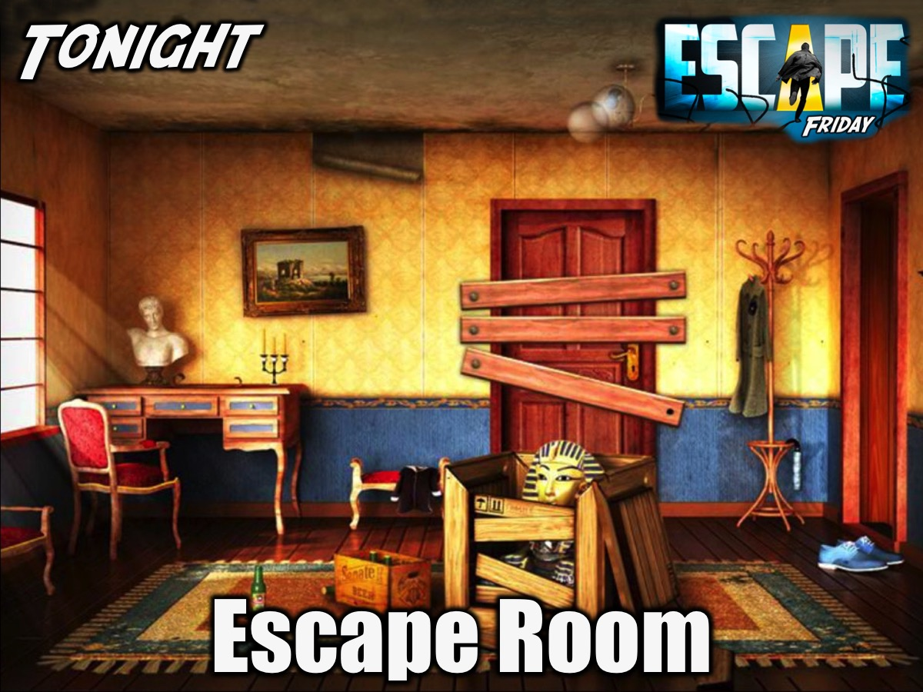
Notes:
Tonight is our Escape Room Night.

Slide 6
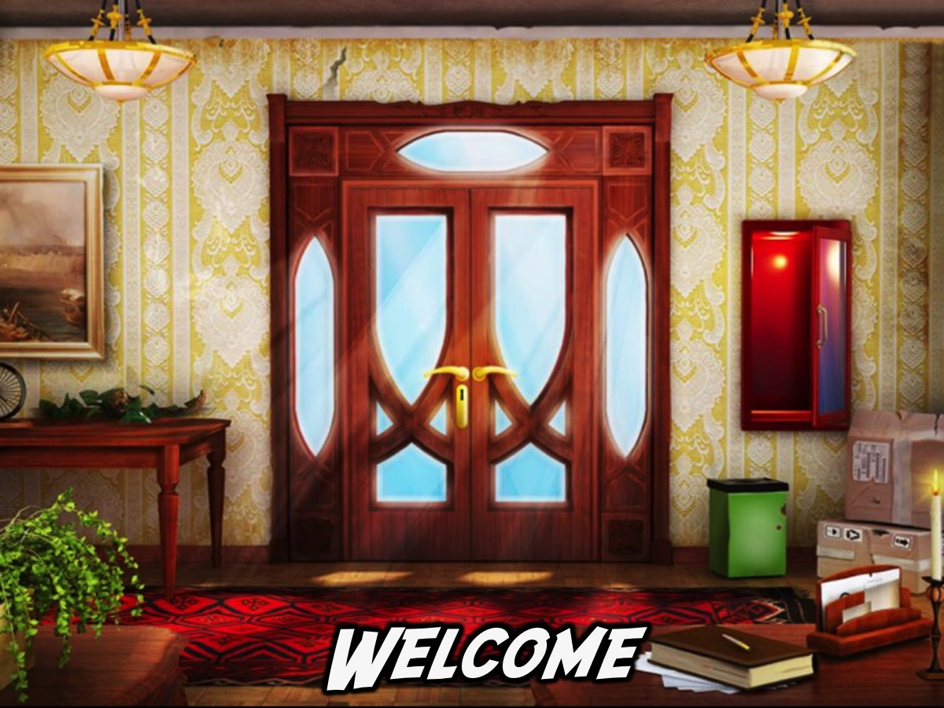
Notes:
Welcome to any newcomers and regulars.

Slide 7
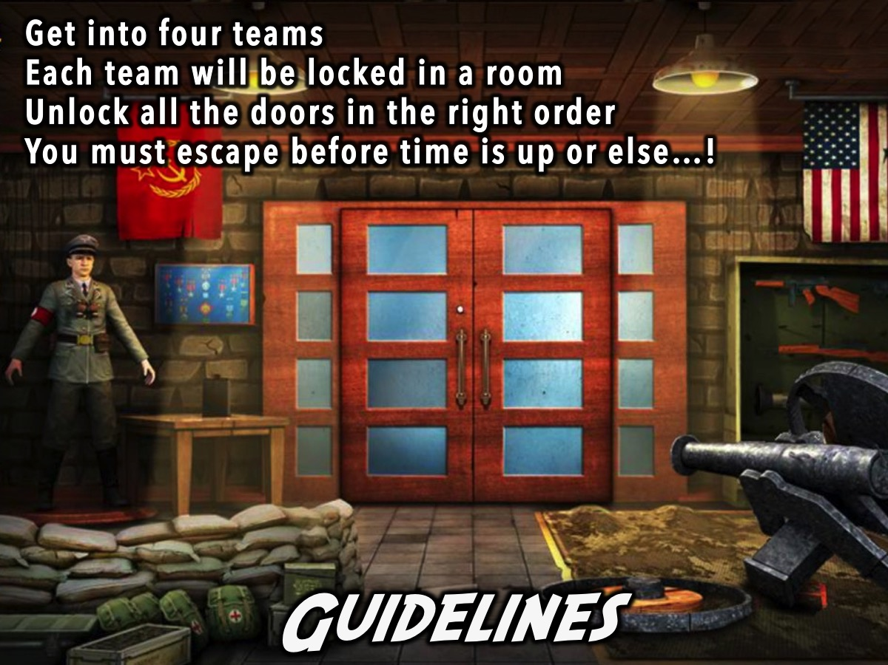
Notes:
Guidelines: (1) Get into four teams. (2) Each team will be locked in a room. (3) Unlock all the doors in the right order. (4) You must escape before time is up or else…!

Slide 8
Notes:
Small Groups. Here are the small group questions: (1) What helped or hindered you escaping the room? (2) What do you need to escape from in life? (3) What will help you escape those things? These verses have some great insights: “Our God is a God who saves; from the Sovereign Lord comes escape from death”. (Psalm 68:60). “Be always on the watch, and pray that you may be able to escape all that is about to happen”. (Luke 21:36). “No temptation has overtaken you that is not common to man. God is faithful, and he will not let you be tempted beyond your ability, but with the temptation he will also provide the way of escape, that you may be able to endure it”. (1 Cor 10:13). (4) Pray for each other to become escape artists.

Slide 9
Notes:
Don’t forget that next Friday is Valentines Night - bring a friend.

Slide 10
Notes:
Refreshments are served.

