Slide 1
Notes:
Today I want to share a message with you that has been birthed in my heart over the past few weeks.

Slide 2
Notes:
Let me start by telling you a story of two photos. These are photographs that I have had enlarged over the past year. This first one if of my neighbour, Uncle Barrie. He lived his life with a good focus on his family but it was all about this life. He did not think much about, or really care about, the next life. He passed away half way through last year and I displayed this photo at his memorial service.

Slide 3
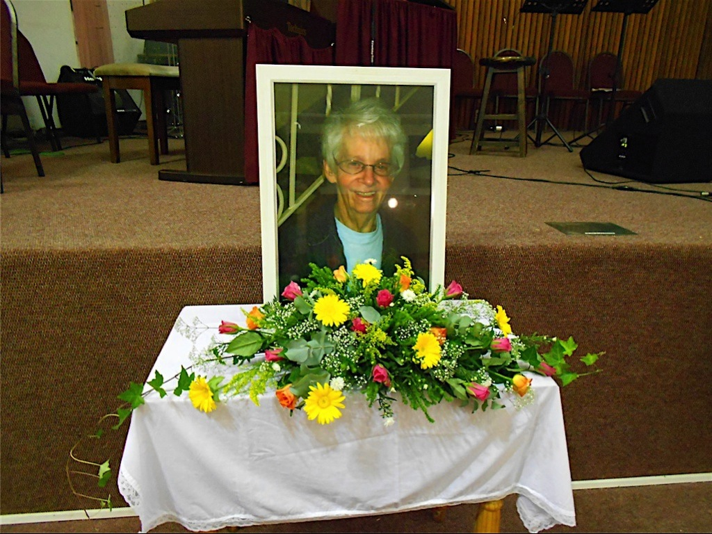
Notes:
Here is the second photo that I had developed – it is a photo of my Mom and was displayed at her funeral service in Durban last week. She lived a long life – 79 years in fact, but throughout her life she not only enjoyed this life and loved her husband and looked after her children – but she also believed strongly that this life was not the end of our life – that we would spend eternity in heaven and she did everything she could to live her life with this knowledge and until the last week of her life she told people about the next life.

Slide 4
Notes:
My Mom lived in the Light of Eternity. It was like that life affected every decision she made or action she took in this life.

Slide 5
Notes:
Have you heard the expression – Living on the edge? People who are unafraid and who always get up close to danger!

Slide 6
Notes:
Well, my Mom believed that the Bible encouraged us to Live on the Edge of Eternity.

Slide 7
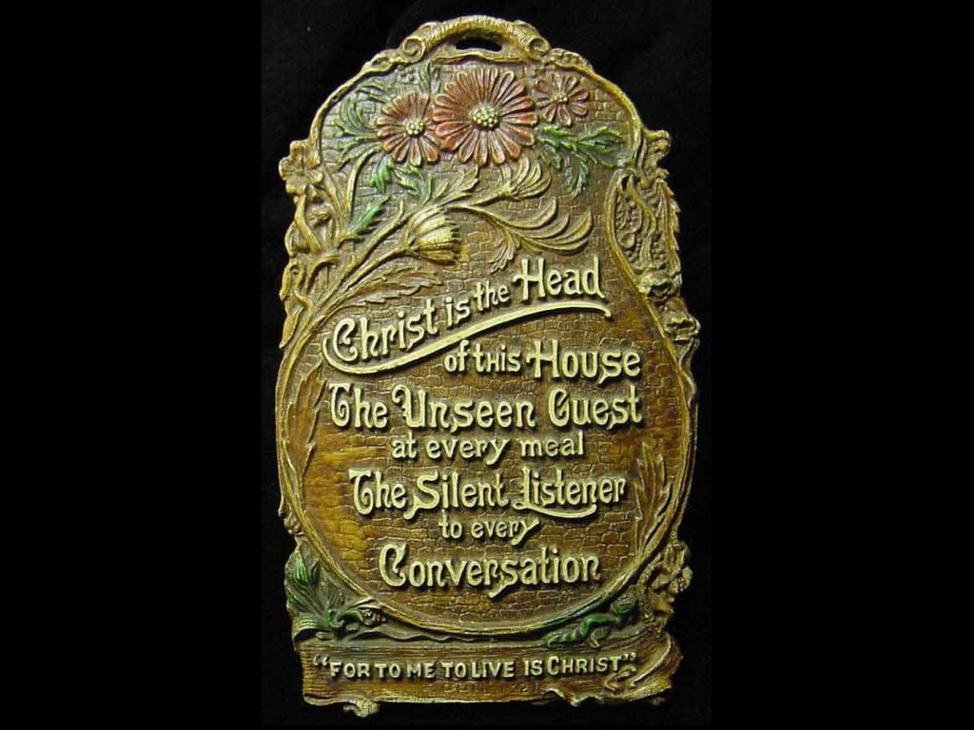
Notes:
We had this poem displayed in our home throughout the years that I grew up: Christ is the Head of the House, the Unseen Guest at every meal, the Silent Listener to every Conversation. People who visited our home knew that there was more to our home than what you could see. The Unseen, the presence of Jesus, was very much real in our home.

Slide 8
Notes:
Some people live their lives focused on the Here and Now! They don’t think about what will happen when they die – nor do they think about the possibility of a world that is alongside our physical world.

Slide 9
Notes:
But others, like their lives with a focus on the Hereafter – there is more to this life, that our earthly existence is not the end of the story – in fact, it is just the start of a very long story!

Slide 10
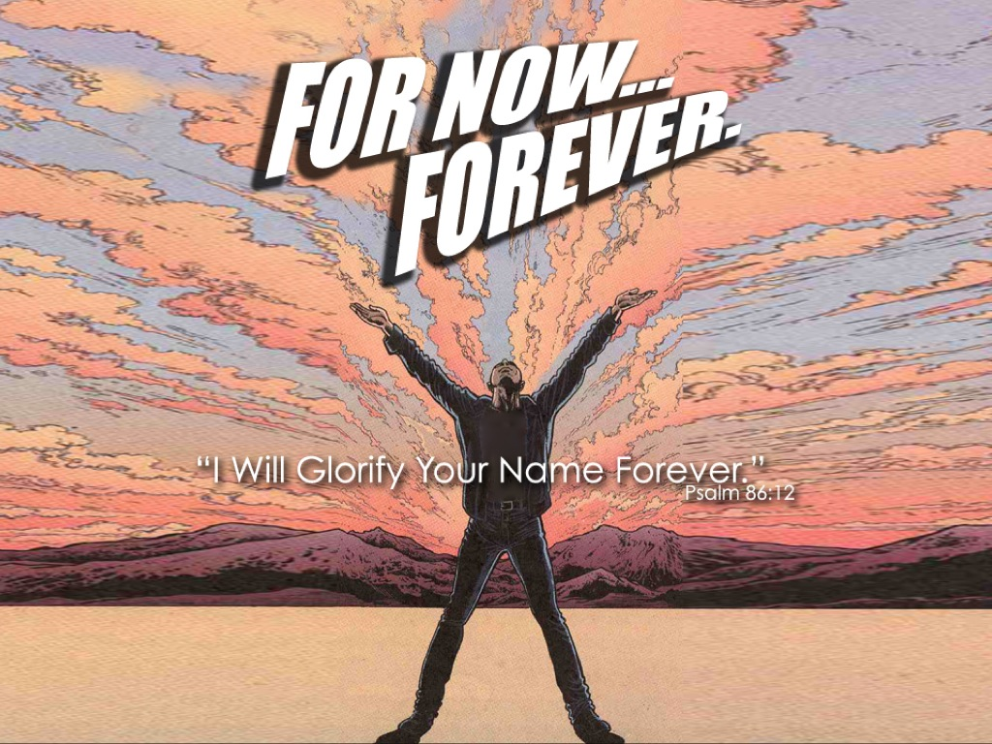
Notes:
For example, David says in one of the Psalms: I will glorify your name forever (Psalm 86:2). That is For Now AND Forever!!!

Slide 11
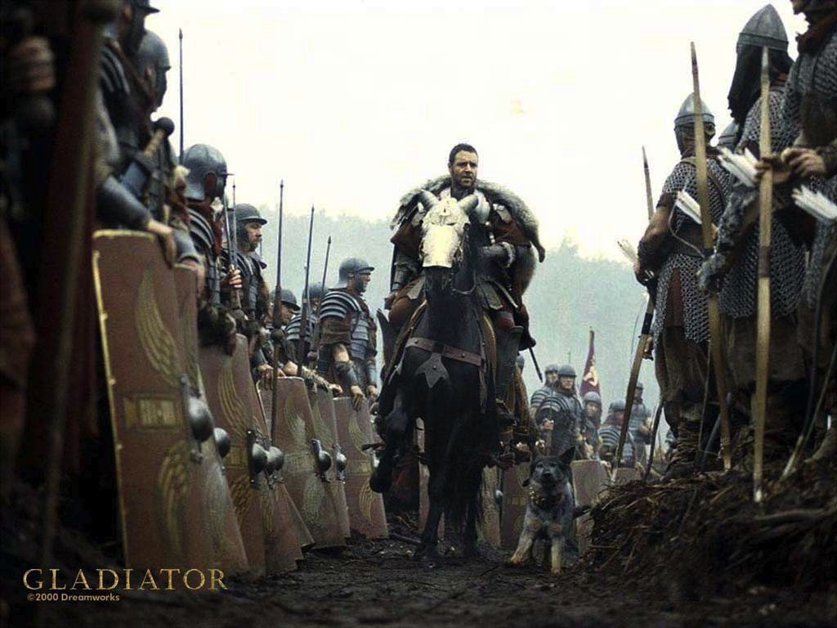
Notes:
Do you remember the old film Gladiator. Where Maximus gives his men a speech before they go into battle. He said: What we do in this life, echoes in eternity.

Slide 12
Notes:
Do you remember this scene from Gladiator? What we do in life, echoes in eternity!

Slide 13
Notes:
What we do in life, echoes in eternity!

Slide 14
Notes:
What we do in life, echoes in eternity!

Slide 15
Notes:
Not Eternity – the perfume by Calvin Klein

Slide 16
Notes:
Nor a computer game called End of Eternity

Slide 17
Notes:
But Eternity – forever and ever and ever.

Slide 18
Notes:
Almost like Buzz Lightyear – “To infinity and beyond”

Slide 19
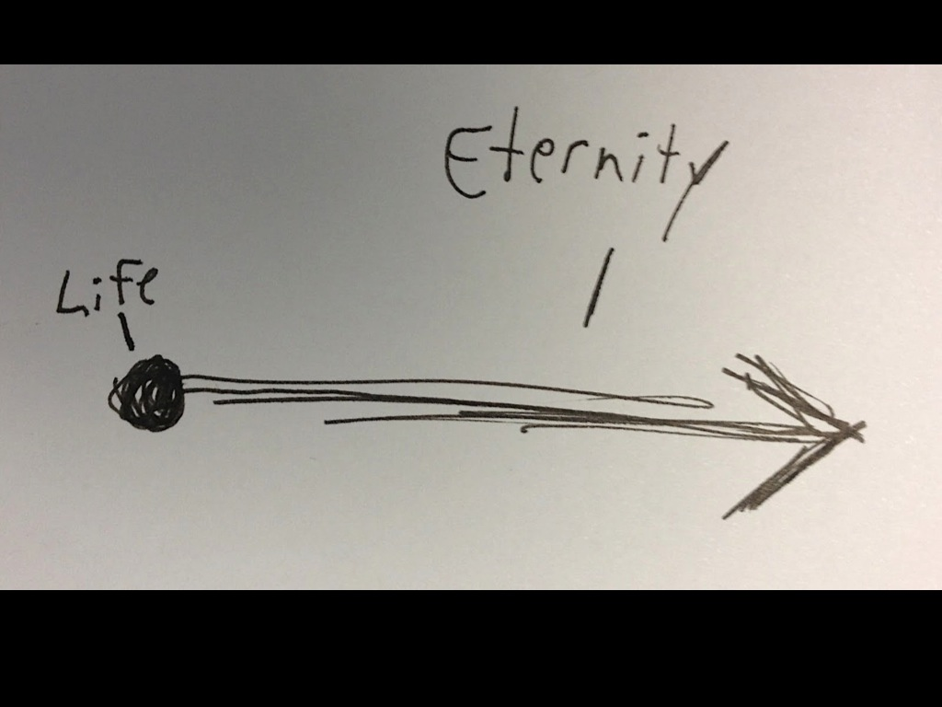
Notes:
Maybe this drawing gives us some idea of what eternity is. If our life is just a dot – eternity stretches on – well forever!

Slide 20
Notes:
Here is one Bible verse that speaks of eternity: Daniel 12:3: “Those who are wise will shine as bright as the sky; those who lead many to righteousness will shine like the stars forever.”

Slide 21
Notes:
Why don’t we live like we are on the edge of eternity?

Slide 22
Notes:
Mahatma Gandhi said: “Learn as if you were going to live forever. Live as if you were going to die tomorrow.”

Slide 23
Notes:
Live like you were dying.

Slide 24
Notes:
James 4:13-14 says: Now listen, you who say, “Today or tomorrow we will go to this or that city, spend a year there, carry on business and make money.” 14 Why, you do not even know what will happen tomorrow.

Slide 25
Notes:
What is your life? For you are a mist that appears for a little time and then vanishes (James 4:14).

Slide 26
Notes:
Instead you ought to say: “If it is the Lord’s will, we will do this or that.” (James 4:15)

Slide 27
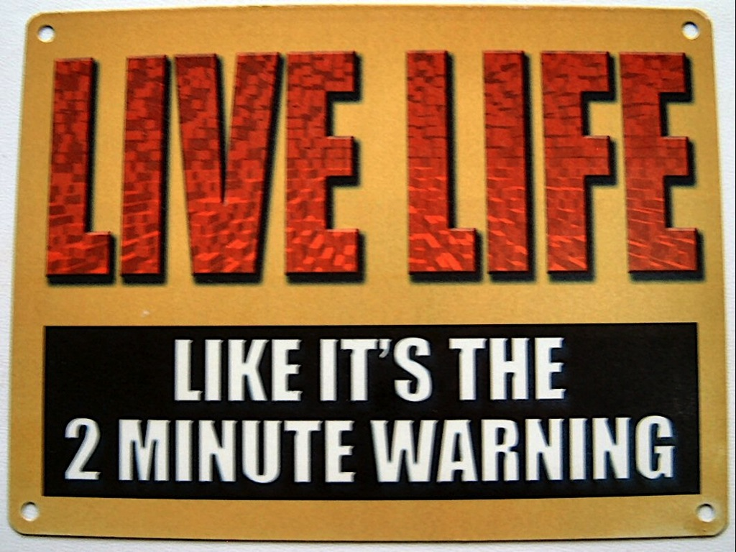
Notes:
Maybe we should live life like it’s the 2 minute warning. This happens when people are given a warning that there is 2 minutes before they have to get up and speak or do something.

Slide 28
Notes:
Hebrews 12:1-3

Slide 29
Notes:
We are surrounded by people (mentioned in chapter 11) who have gone before us – who lived long ago – and who are now watching our lives…

Slide 30
Notes:
We are encouraged to get rid of anything that will hinder us from running a good race (we need to throw all the trash out of our lives).

Slide 31
Notes:
And run our race with endurance…

Slide 32
Notes:
Looking to Jesus who set such a great example for us.

Slide 33
Notes:
Here is a question: if you were to die tomorrow, what would you do today?

Slide 34
Notes:
From next week we will start looking at how to actually live on the edge of eternity.

