Slide 1

Notes:
Last week we started a new series called: Living on the Edge of Eternity. Here is a short review of what we covered...

Slide 2

Notes:
Some people live their lives focused on the Here and Now! They don’t think about what will happen when they die – nor do they think about the possibility of a world that is alongside our physical world.

Slide 3

Notes:
Some people live their lives focused on the Here and Now! They don’t think about what will happen when they die – nor do they think about the possibility of a world that is alongside our physical world.

Slide 4
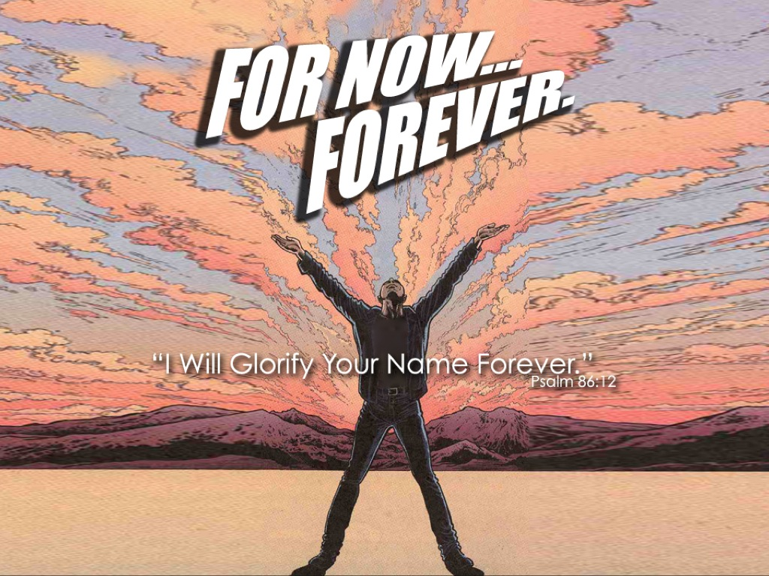
Notes:
For example, David says in one of the Psalms: I will glorify your name forever (Psalm 86:2). That is For Now AND Forever!!!

Slide 5

Notes:
What we do in life, echoes in eternity!

Slide 6
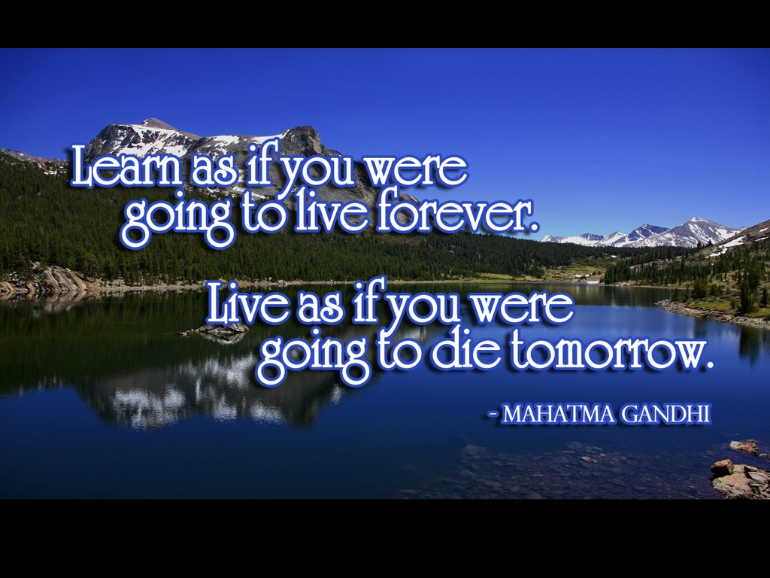
Notes:
Mahatma Gandhi said: “Learn as if you were going to live forever. Live as if you were going to die tomorrow.”

Slide 7

Notes:
Live like you were dying.

Slide 8
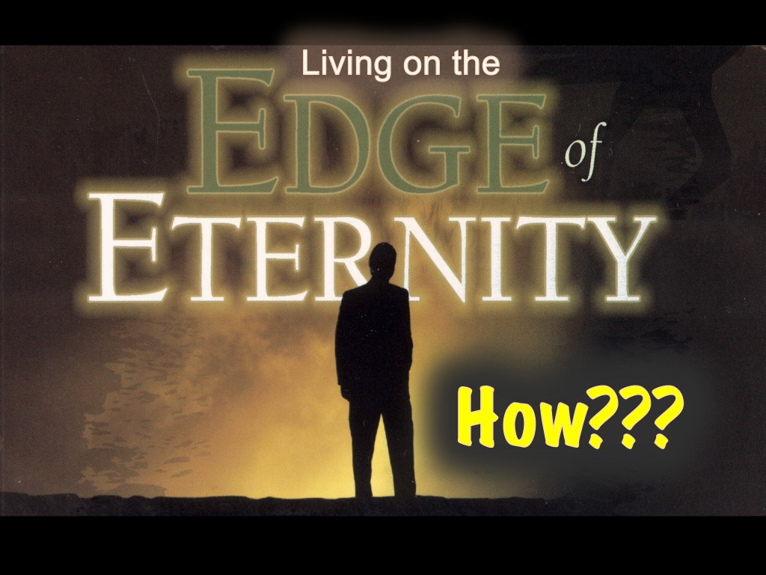
Notes:
So how do we live on the edge of eternity? What can we do practically?

Slide 9

Notes:
1. Think about Eternity - By Living in the Word

Slide 10
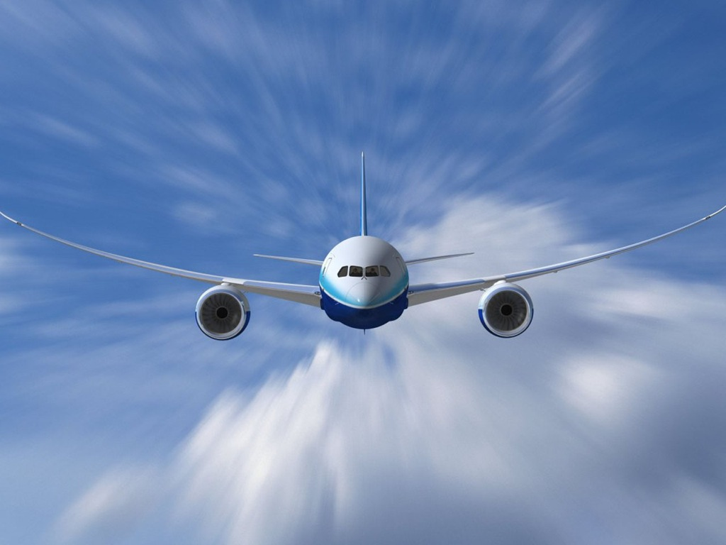
Notes:
Most people only think about eternity when they are in an airplane in a storm.

Slide 11
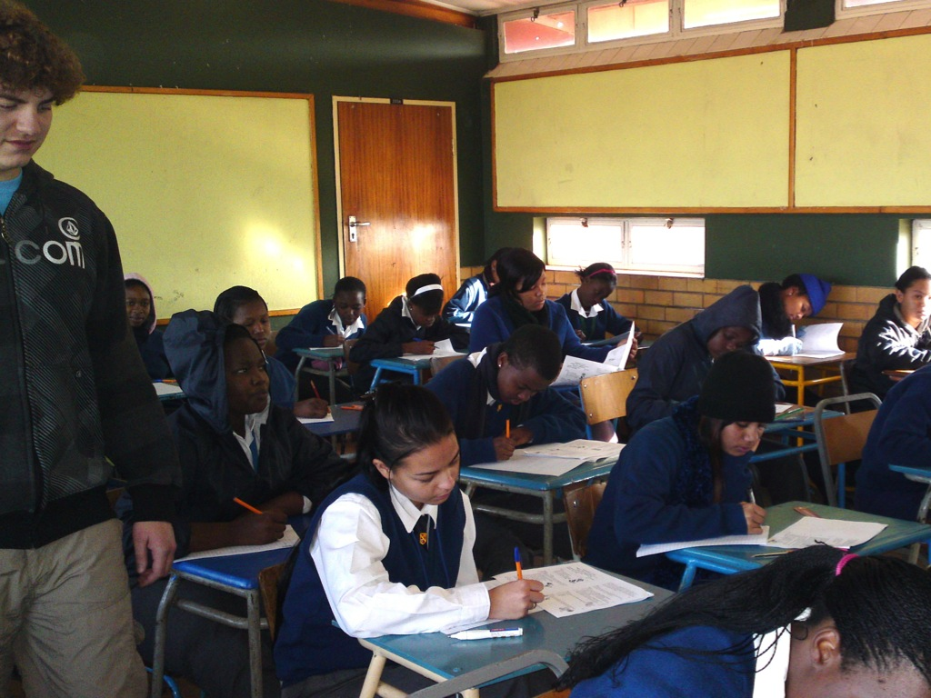
Notes:
Most teenagers think about eternity when they are writing an exam that they have not learned for.

Slide 12
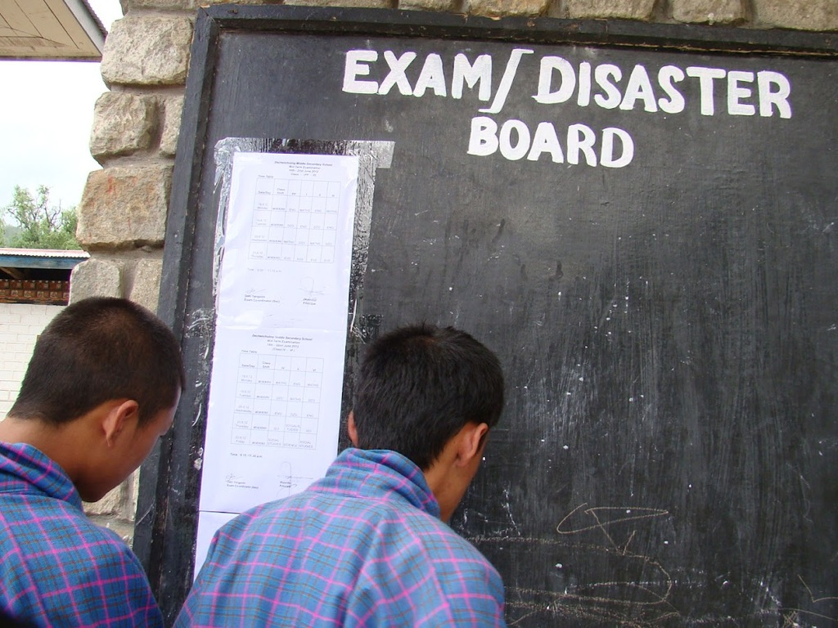
Notes:
Or when the marks are published and they know their parents are going to find out soon or later that they failed.

Slide 13
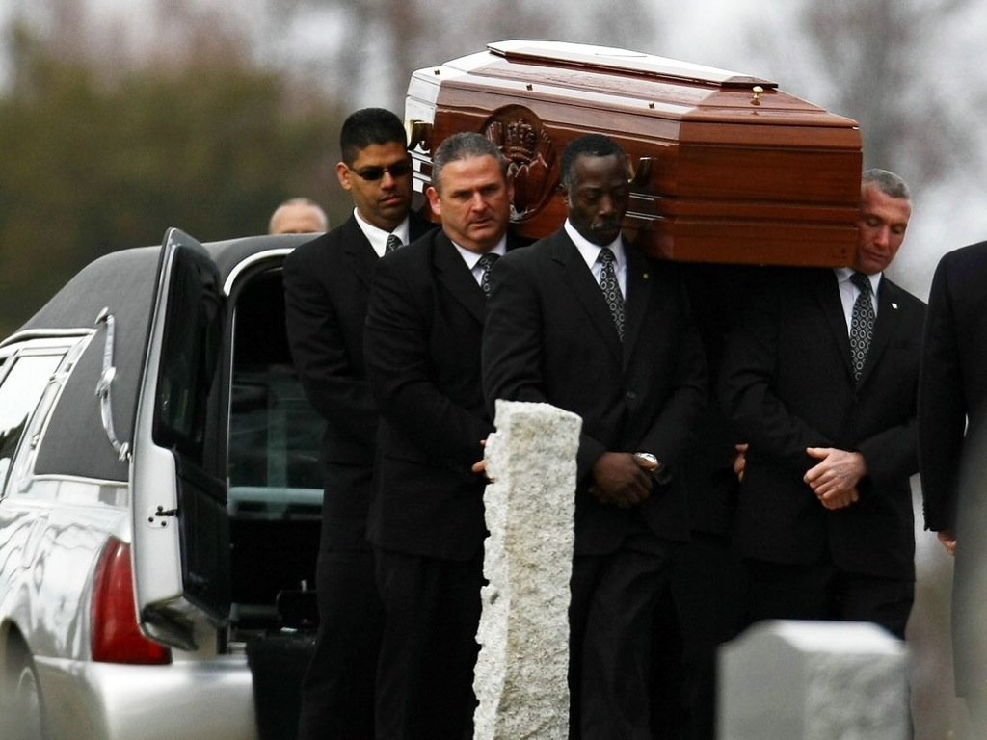
Notes:
Or when they go to a family members funeral.

Slide 14
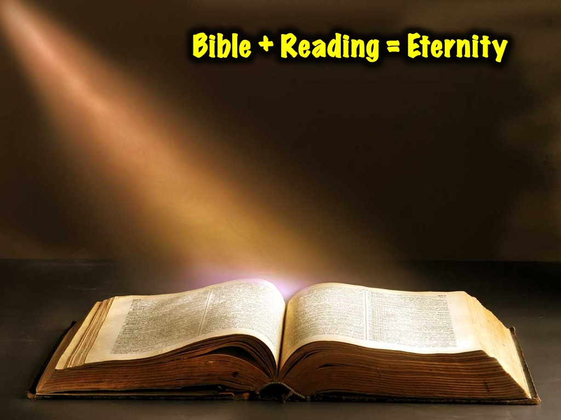
Notes:
Here is a formula: take the Bible, add some reading and you will be aware of eternity!

Slide 15

Notes:
You can’t read the Bible without stumbling across an unseen realm!

Slide 16
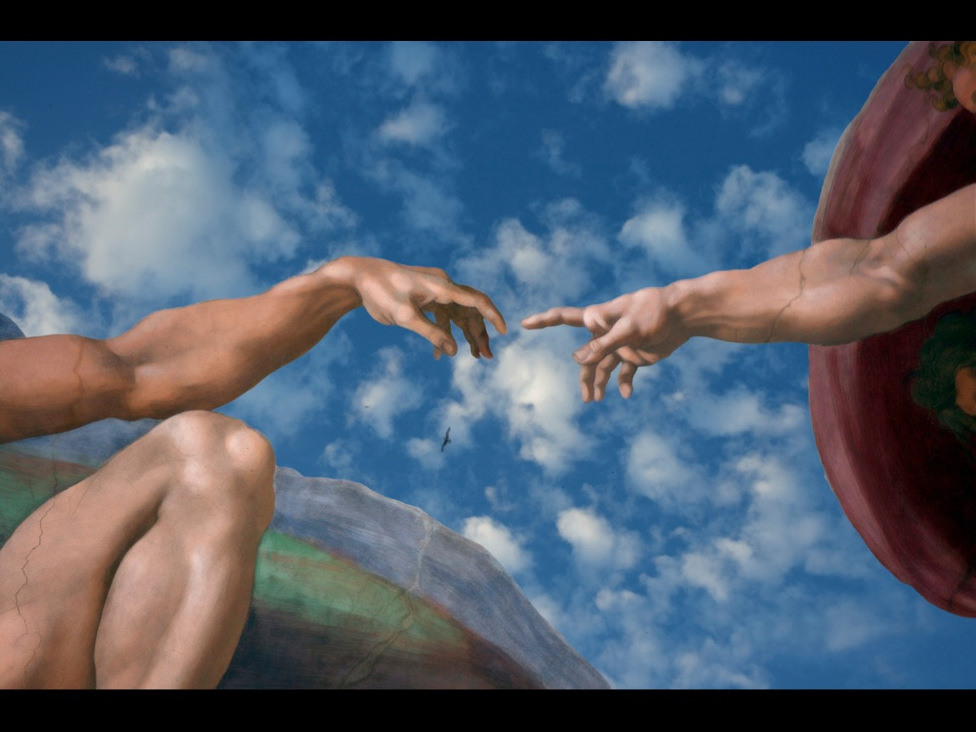
Notes:
The whole creation account speaks of an unseen Creator creating a world and people.

Slide 17
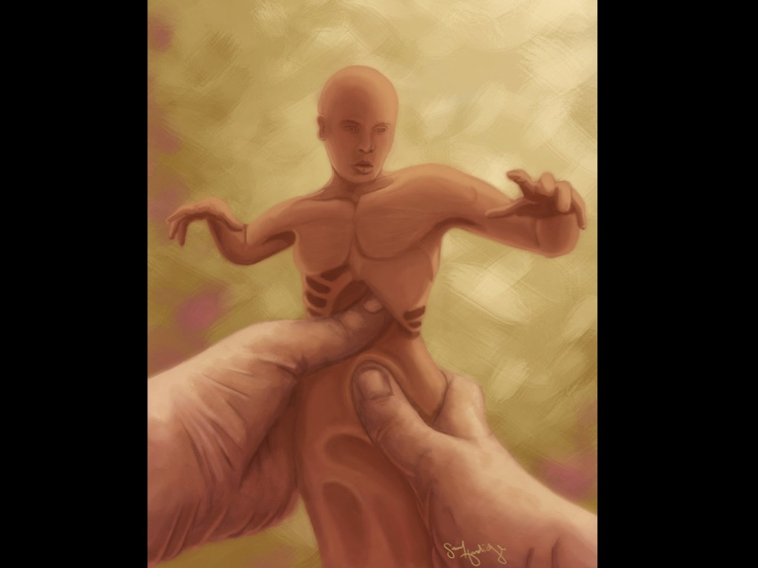
Notes:
A human being is formed out of the dust of the ground.

Slide 18
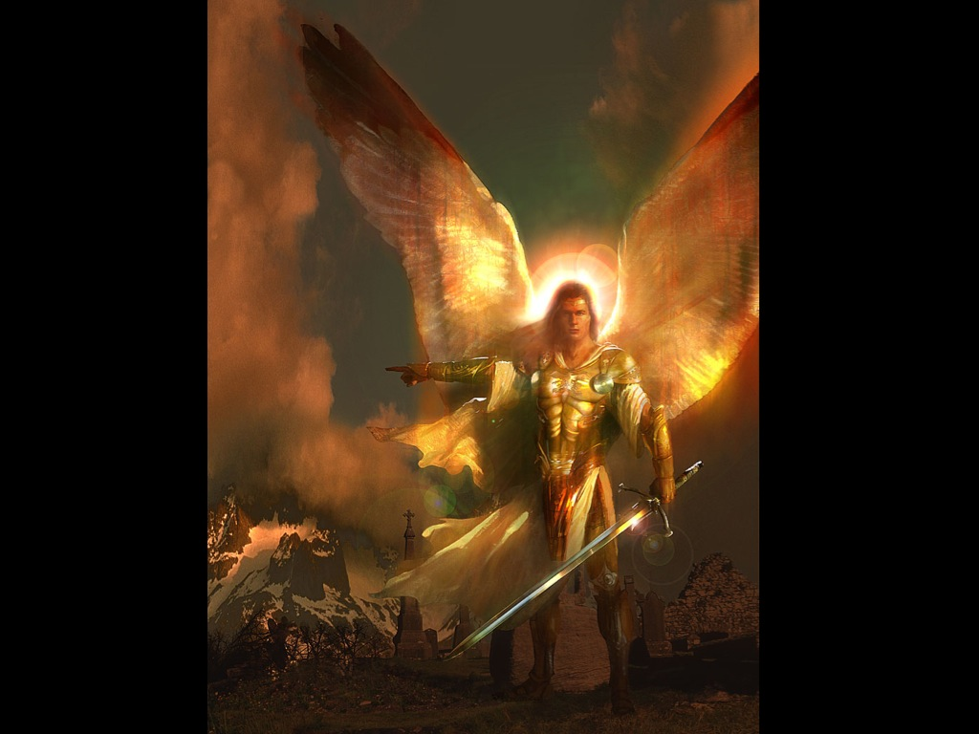
Notes:
When Adam and Eve sin they are banished from the garden of Eden and an angel with a flaming sword guards the entrance.

Slide 19
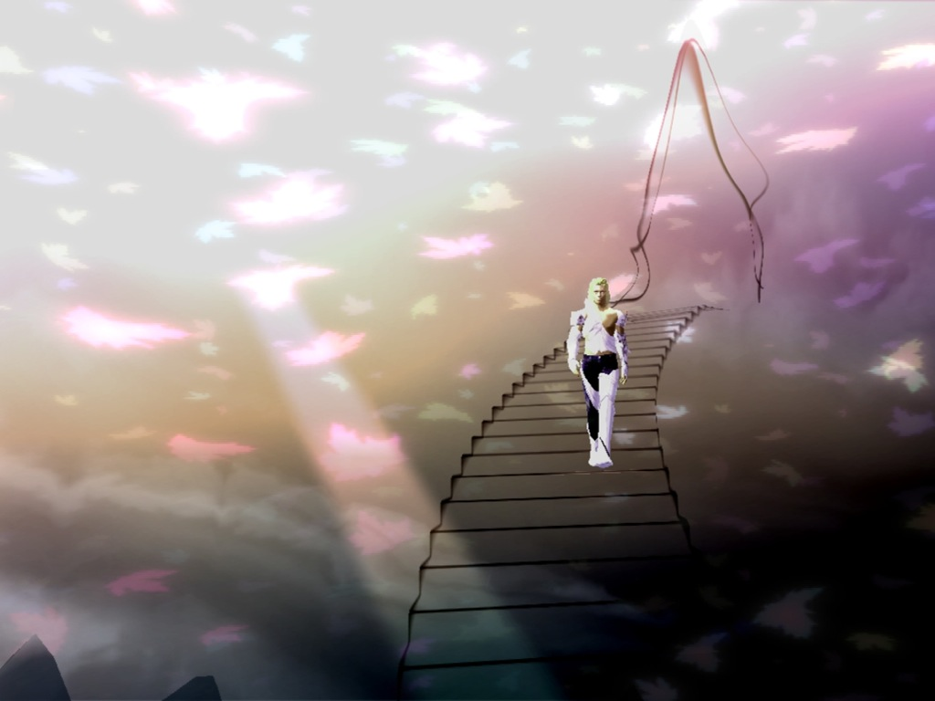
Notes:
Some guy, Enoch, gets so close to God that one day he is out on a walk and he is never seen again – he gets taken to the next life without even dying!

Slide 20
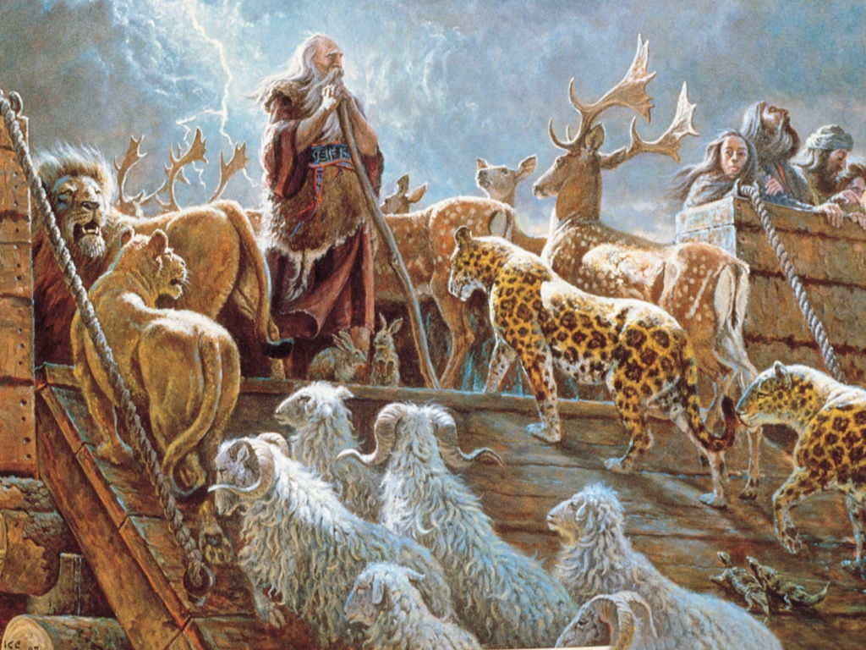
Notes:
Noah pulls off an amazing feat of gathering two of every animal and bird on earth and putting them onto a boat! Good luck getting this right without some outside help!!!

Slide 21
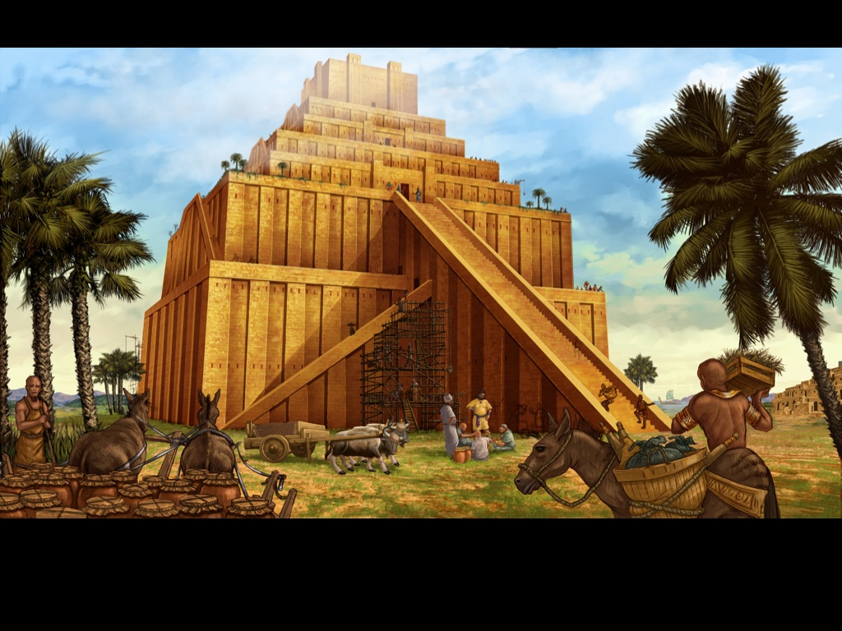
Notes:
Then there is the tower of Babel – God confuses the building by making everyone speak in different languages.

Slide 22
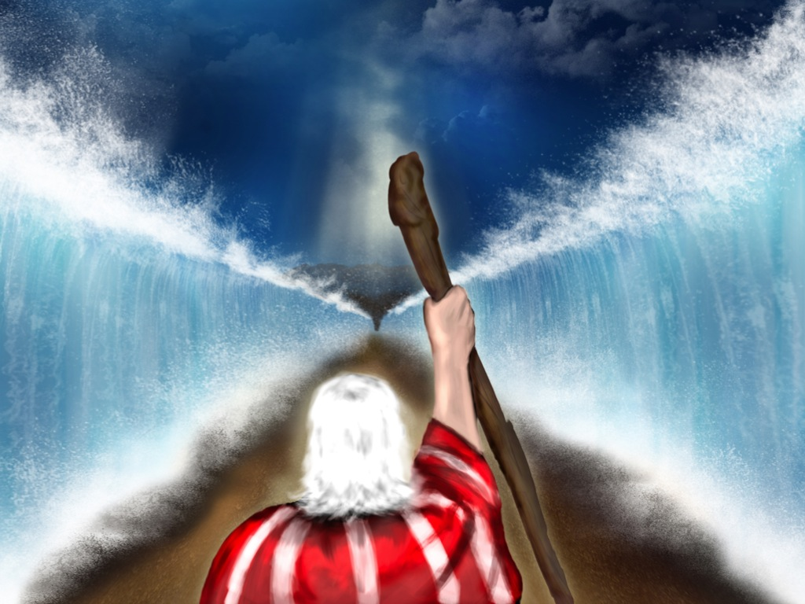
Notes:
Moses leads the people out of Egypt and parts the Red Sea with a stick!!!

Slide 23
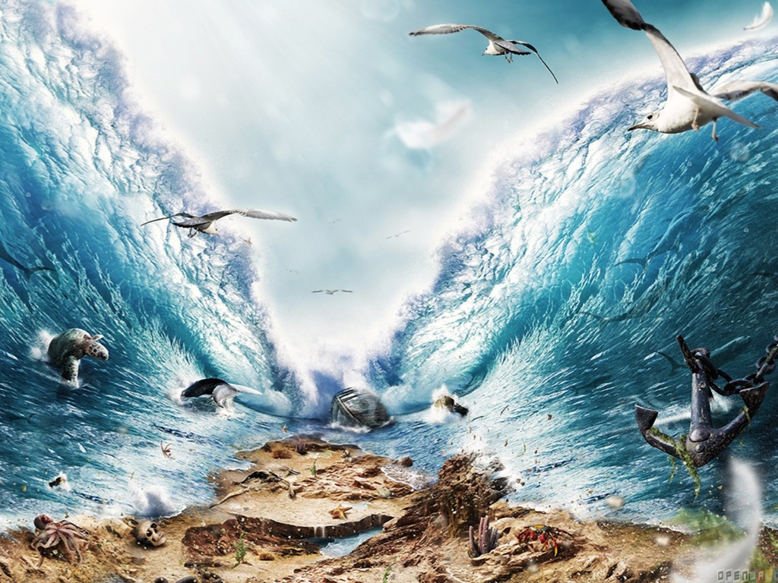
Notes:
Moses leads the people out of Egypt and parts the Red Sea with a stick!!!

Slide 24

Notes:
Sadly most people don’t actually read the Bible.

Slide 25
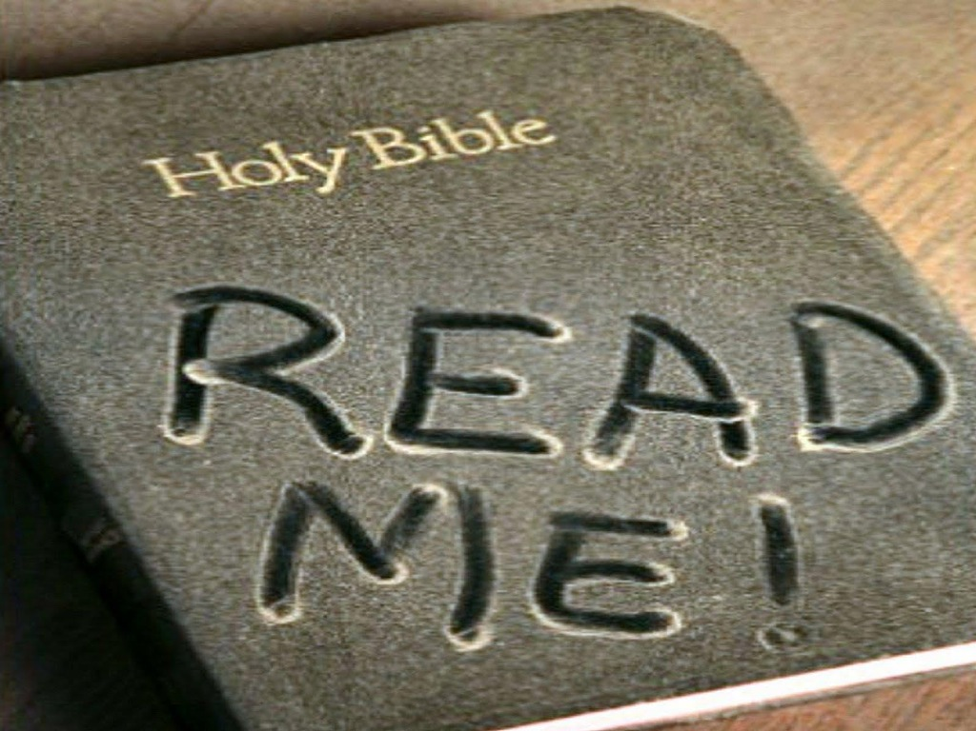
Notes:
Most Bibles lie around gathering dust!

Slide 26

Notes:
I have started this year using an App on my iPhone called YouVersion.

Slide 27

Notes:
I am using a daily Bible reading plan to read the whole bible in 90 days. I challenge you to start reading the Bible EVERY day!

Slide 28
Notes:
So, think about eternity by reading the Bible and…

Slide 29

Notes:
Expect the supernatural!

Slide 30
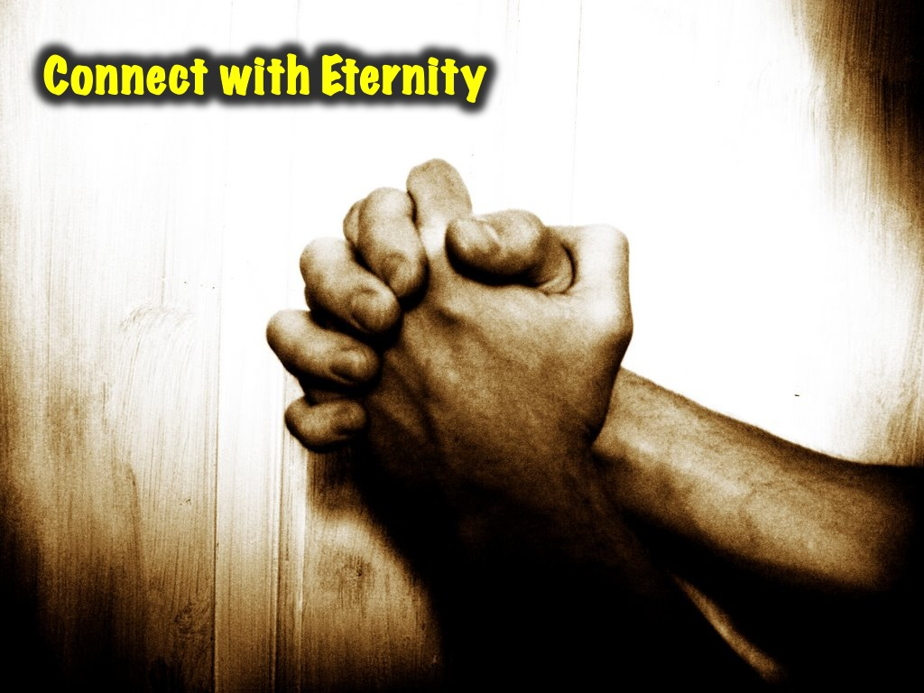
Notes:
2. Connect with Eternity – through prayer. Speak with God all the time. The Bible says we are to: Pray always! Pray continuously!

Slide 31
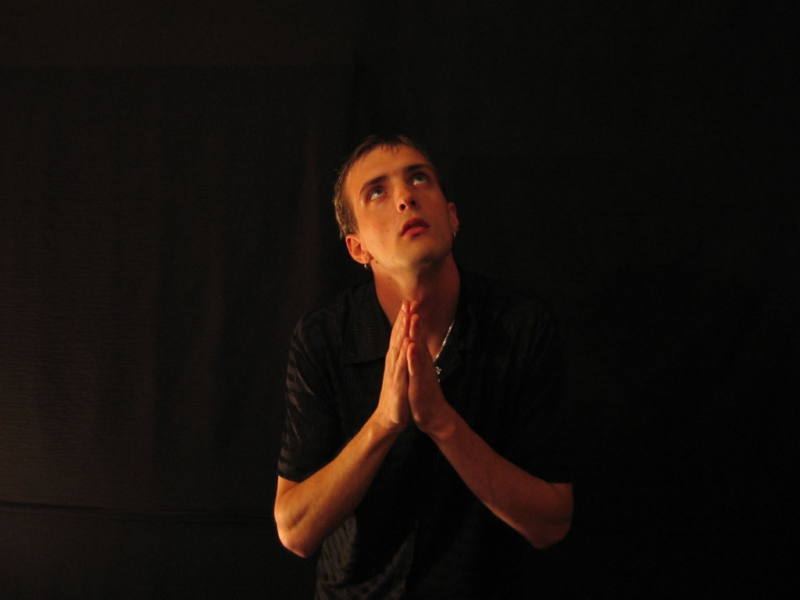
Notes:
In the morning before you go to school find time to pray, and then throughout the day turn your thoughts to God in prayer, and at the end of the day finish with prayer!

Slide 32

Notes:
3. Invest in Eternity – do acts of kindness.

Slide 33

Notes:
Invest in Eternity - "Do not store up for yourselves treasures on earth, where moth and rust destroy, and where thieves break in and steal. But store up for yourselves treasures in heaven, where moth and rust do not destroy, and where thieves do not break in and steal. For where your treasure is, there your heart will be also. Matthew 6:19-21

Slide 34
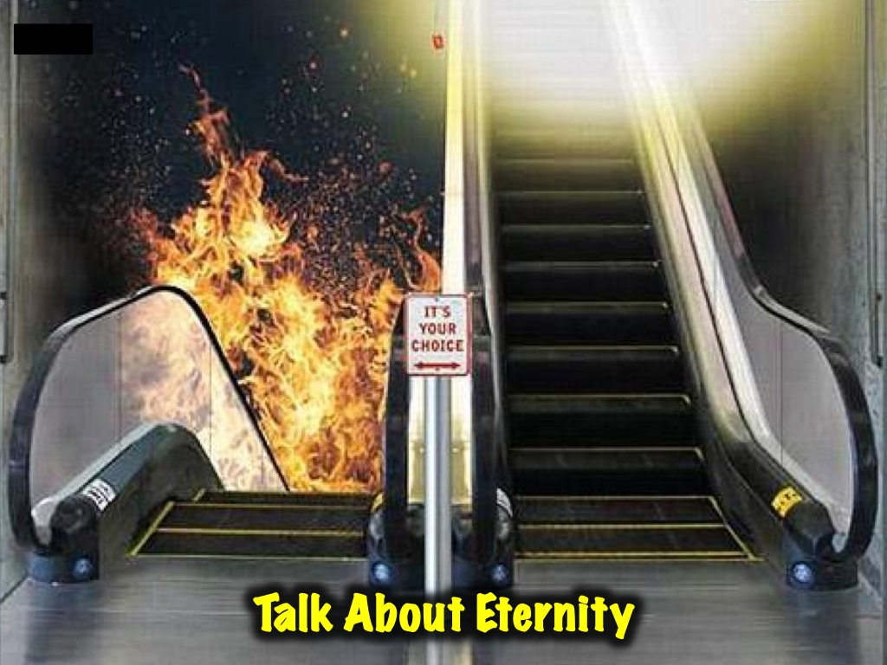
Notes:
4. Talk about Eternity – tell others about the reality of heaven and hell – about what happens to us when we die – we don’t just decompose in a grave – our body may do that but our soul/spirit lives on with God!

Slide 35
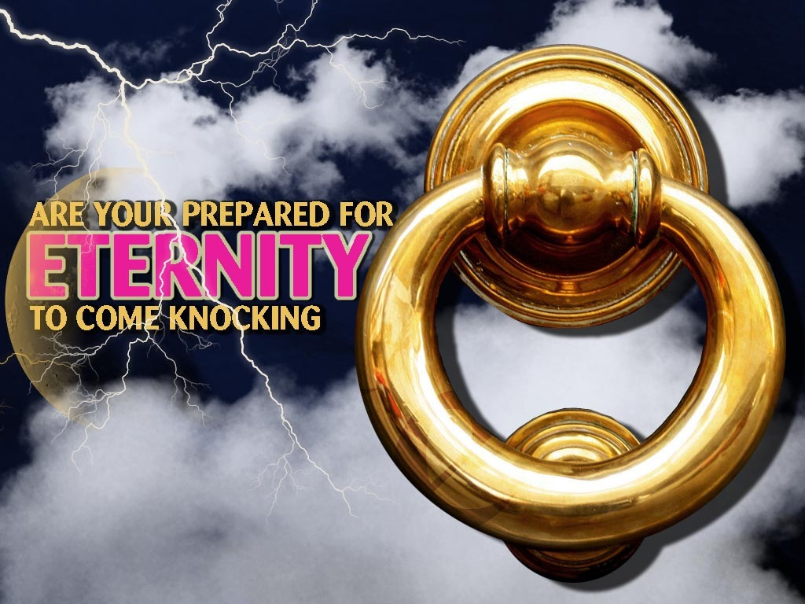
Notes:
Are you prepared for eternity to come knocking?

Slide 36
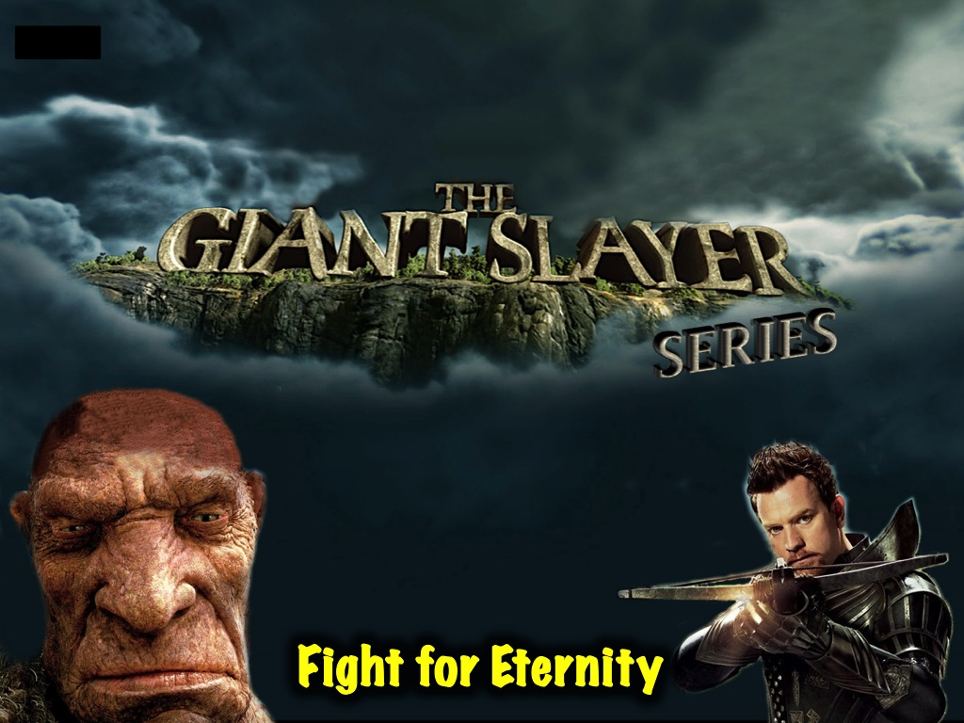
Notes:
5. Fight for Eternity – slay some giants that stand in your way!!! Don’t miss our Giant Slaying series starting next Sunday morning!

