Slide 1
Notes:
Two weeks ago we started a new series called: Living on the Edge of Eternity. Here is a short review of what we covered...

Slide 2
Notes:
So how do we live on the edge of eternity? What can we do practically?

Slide 3
Notes:
Last week we looked at how can can Think about Eternity by Living in the Word.

Slide 4
Notes:
2. Connect with Eternity – today we are going to look at another way to live on the edge of eternity!

Slide 5
Notes:
Prayer is a portal to eternity – our way of connecting with eternity.

Slide 6
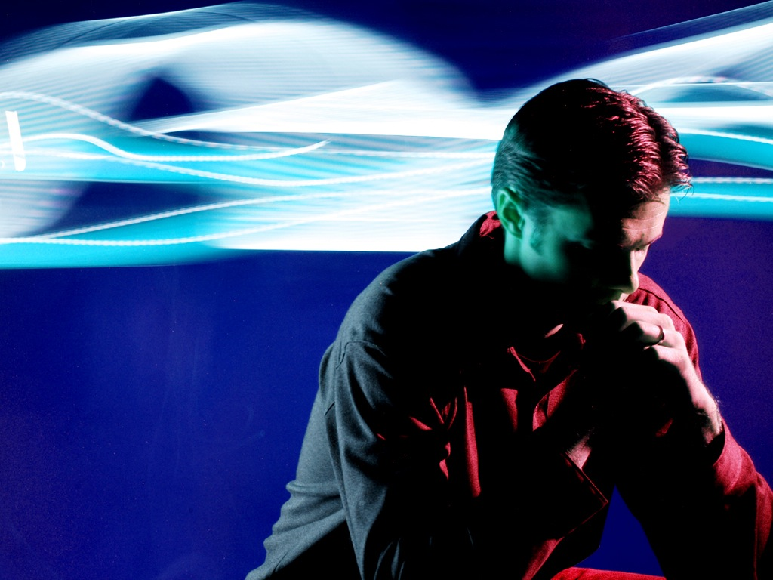
Notes:
We are not just speaking to ourselves when we pray!

Slide 7
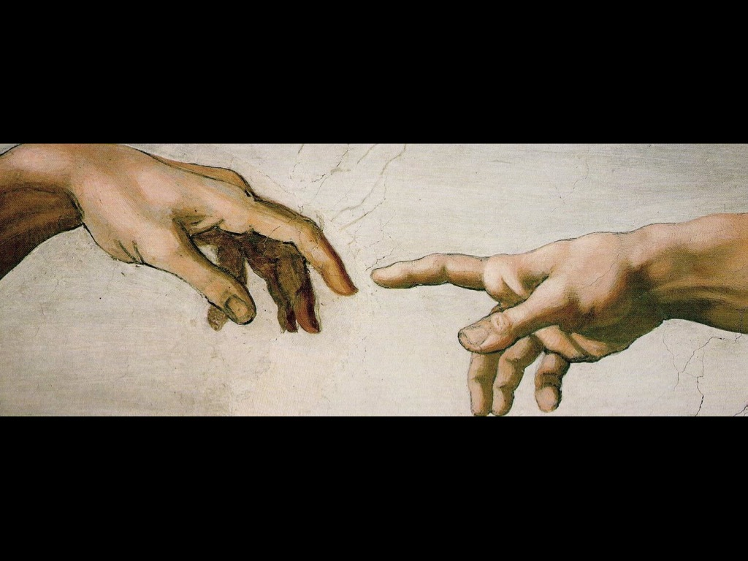
Notes:
We are making a connection with the God who created us.

Slide 8
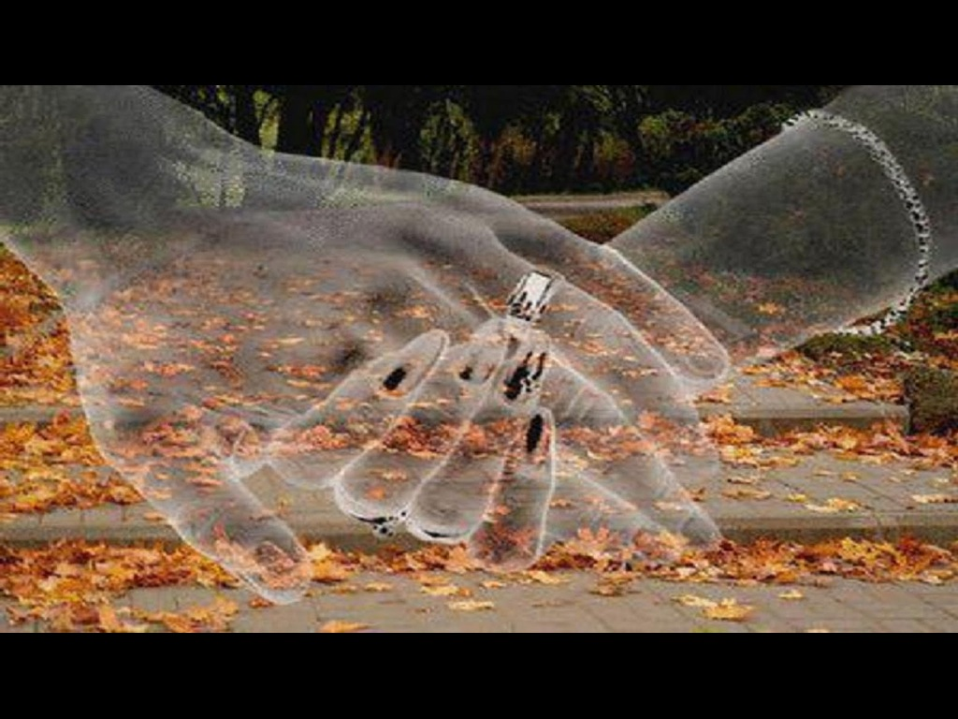
Notes:
It is like two lovers connecting with each other

Slide 9
Notes:
We are making a divine connection every time we pray!

Slide 10
Notes:
We have a direct channel of communication with the God who creation heaven and earth.

Slide 11
Notes:
If you send someone a “please call me” you really hope that they will call you back. And if you call someone on the phone you really believe that they will answer you…

Slide 12
Notes:
Here is a promise from God – that if we call to him, he will answer us and tell us great and unsearchable things that we do not know (Jeremiah 33:3)

Slide 13
Notes:
You see God hears prayers.

Slide 14
Notes:
And even more amazing than that – he answers them. Sometimes his answer may be Yes or No or Wait – but he always answers.

Slide 15
Notes:
There is a promise in the book of Chronicles in the Old Testament that if we humble ourselves and seek God’s face, and repent from our sin, he will hear from heaven and forgive us our sins and heal our land.

Slide 16
Notes:
This is the kind of prayer that touches heaven

Slide 17
Notes:
And when we touch heaven God will change earth!

Slide 18
Notes:
I strongly suspect that if we saw all the difference even the tiniest of our prayers make and all the people those little prayers were destined to effect, and all the consequences of those prayers down through the centuries, we would be so paralyzed with awe at the power of prayer that we would be unable to get off up our knees for the rest of our lives.

Slide 19
Notes:
Prayer Changes Things!

Slide 20
Notes:
Do you know that prayer is the key to all the treasures of this life and hereafter – we have the key in our hands to unlock treasure!

Slide 21
Notes:
Prayer is the source of strength for life!

Slide 22
Notes:
Prayer is a lifeline for our soul – a lifeline we can use as often as we like!

Slide 23
Notes:
Prayer will make a man cease from sin, or sin will entice a man to cease from prayer.

Slide 24
Notes:
No wonder the Bible challenges us to be devoted and tireless in prayer, ever watchful and always grateful. Colossians 4:2

Slide 25
Notes:
You can pray the Lord’s prayer.

Slide 26
Notes:
You can pray the serenity prayer.

Slide 27
Notes:
But you need to pray each morning before you go to school, and then throughout the day turn your thoughts to God in prayer, and at the end of the day finish with prayer!

Slide 28
Notes:
So, finally, let me ask you – How is your prayer life?

Slide 29
Notes:
Next week we will look at how to Invest in Eternity.

