Slide 1

Notes:
Two weeks ago we started a new series called: Living on the Edge of Eternity. Here is a short review of what we covered...

Slide 2

Notes:
So how do we live on the edge of eternity? What can we do practically?

Slide 3

Notes:
1. Think about Eternity by Living in the Word.

Slide 4
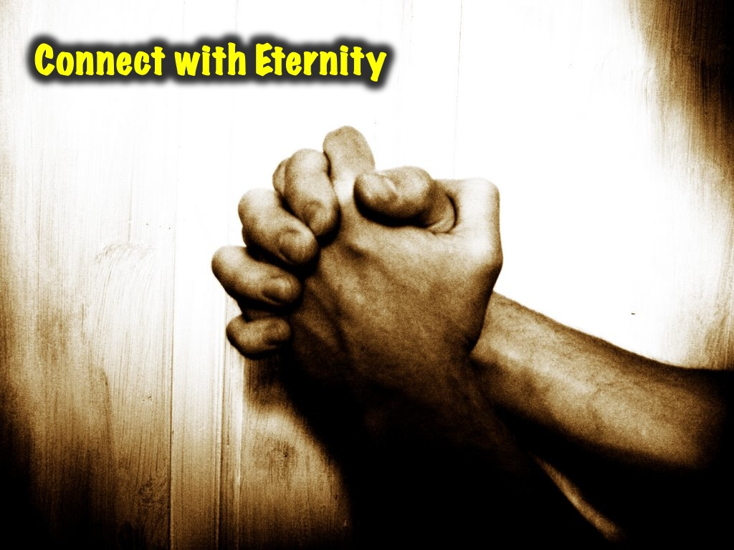
Notes:
2. Connect with Eternity through prayer

Slide 5

Notes:
This week we will explore how to Invest in Eternity by doing acts of kindness.

Slide 6
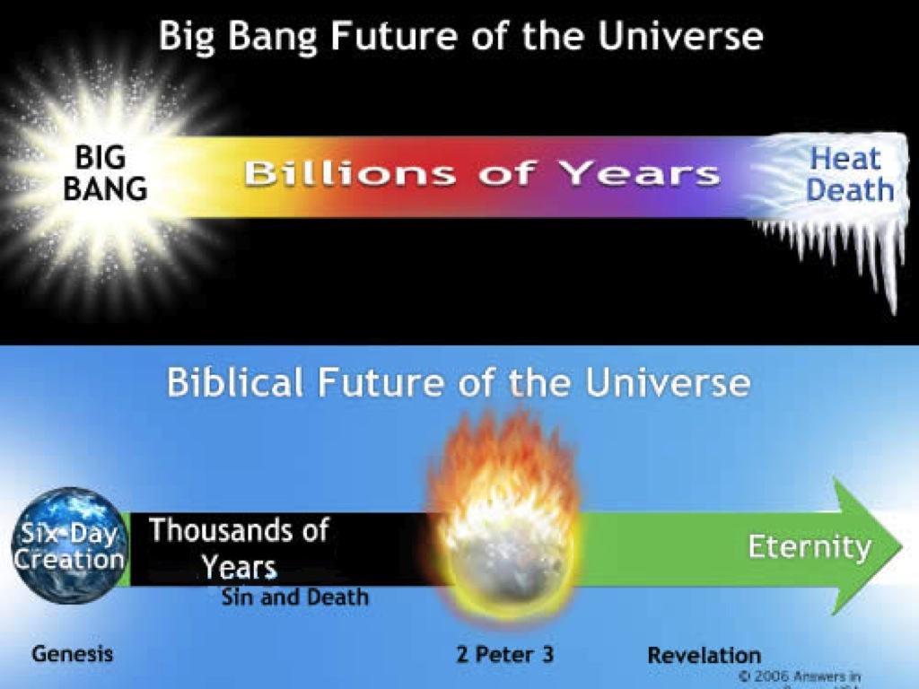
Notes:
Some of us here don’t really believe that The World was created in 7 days. The same way that it is hard to believe that they were giants roaming around in bible times. For the giants if you research they are fossil of skeletons that are 4 meters tall that is twice my height. And Now every quickly I want to stack the Worldly Theory verses the Godly theory on Creation. Worldly theory is the Big Bang theory, where pure energy exploded and made matter. Godly Theory is creation, 6 days of creation and rest on the 7th. So Always remember a non believe can never tell what came before the big bang theory and why it happened. But we can always say God. And also hold on to the fact that a man with an Experience will always be more driven than a man with a theory.

Slide 7
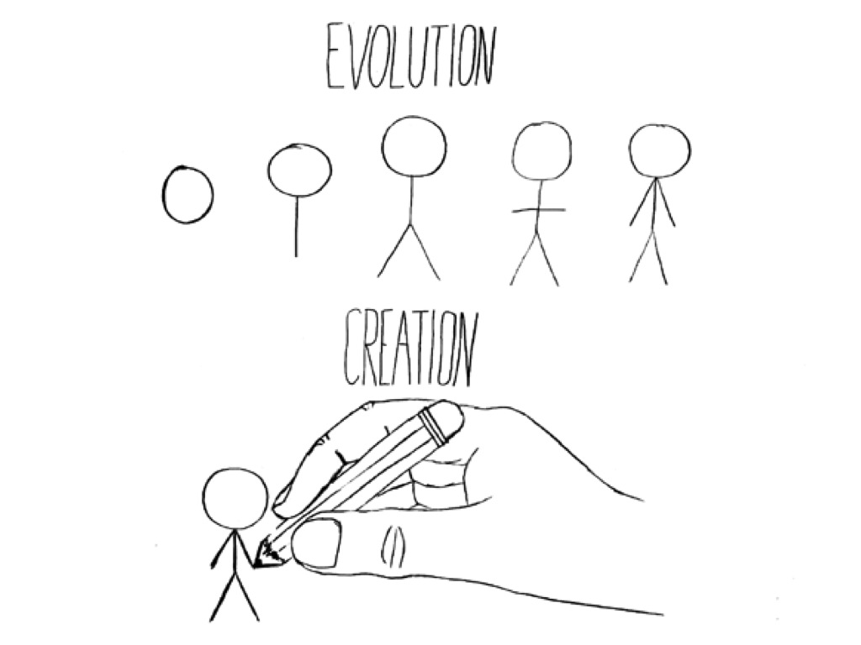
Notes:
No scientist as experienced the truth of The Big bang theory. But every Christian has experienced the truth of God and that experience confirms God, Jesus, the bible and everything that is in it including Creation. So always remember the experience that brought you here is greater than any educated guess.

Slide 8

Notes:
Connecting with eternity is getting to know God. This happens when we do the things he does. Jesus himself said he only does what he sees his father in heaven do

Slide 9

Notes:
And the only way we can do this and connect with eternity is by also being in close relationship with God like a son to his father.

Slide 10

Notes:
This is because the Father wants to teach the son to love what he loves so they enjoy it together.

Slide 11

Notes:
Jesus lived a life to teach us how to live and in the same way he was connected with God so we can be connected too.

Slide 12
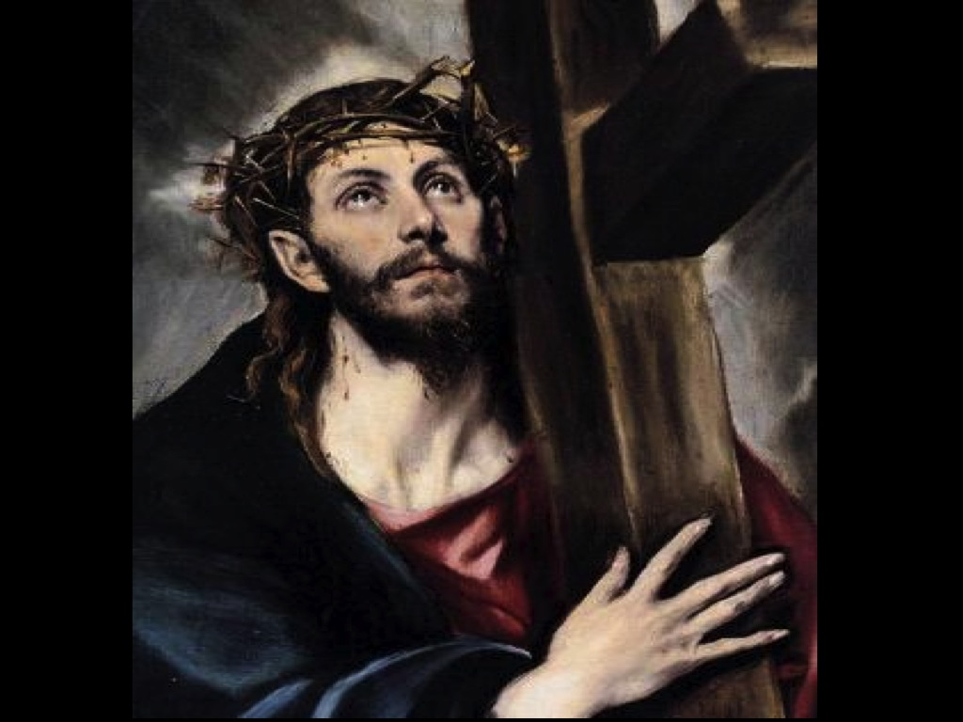
Notes:
Jesus’ life showed that God values service through sacrifice and generosity. Jesus came to serve and when we serve we bond with God and connect with Eternity.

Slide 13
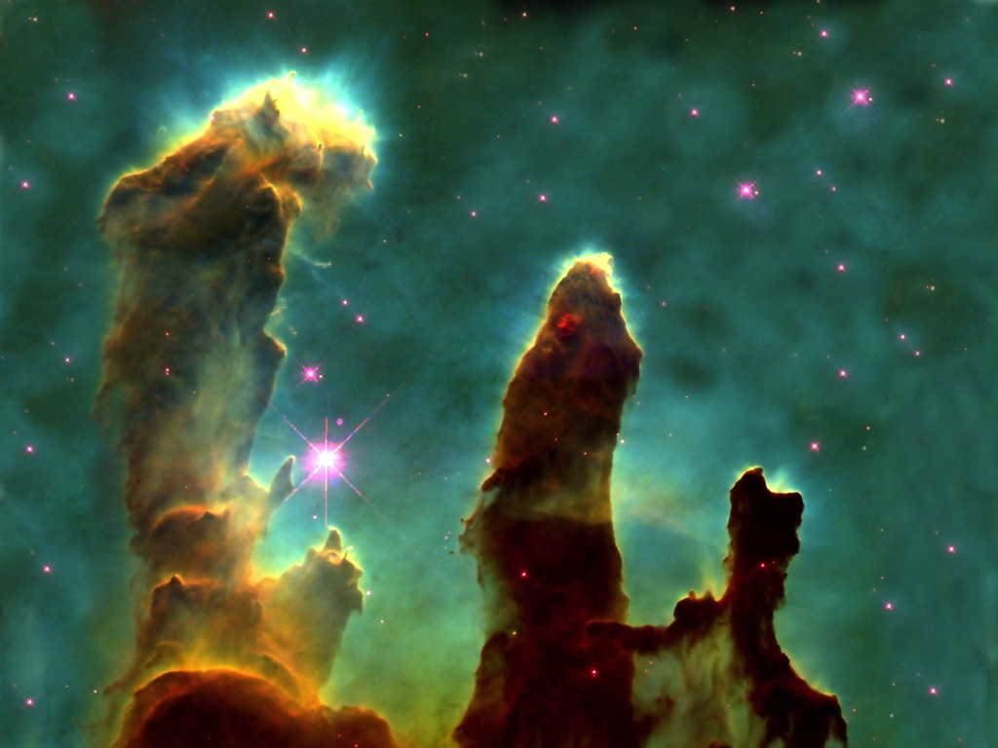
Notes:
Even Creation was an act of service, God made the world for us so we could know how much he loves us. Eternity is not just living forever Eternity is a relationship with Jesus. When we connect with eternity we allow God to move throughout lives.

Slide 14

Notes:
And therefore we get blessing - like a reward for doing something right!

Slide 15
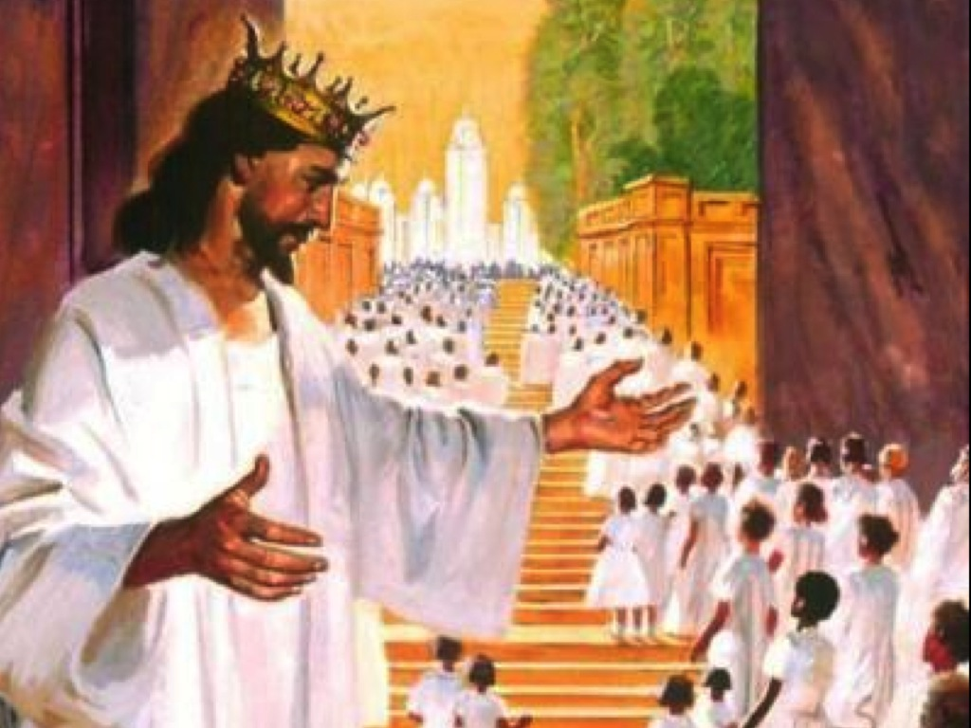
Notes:
Some blessings are for now and others are for heaven. This is because we have a reward in heaven. This reward is based on our service.

Slide 16
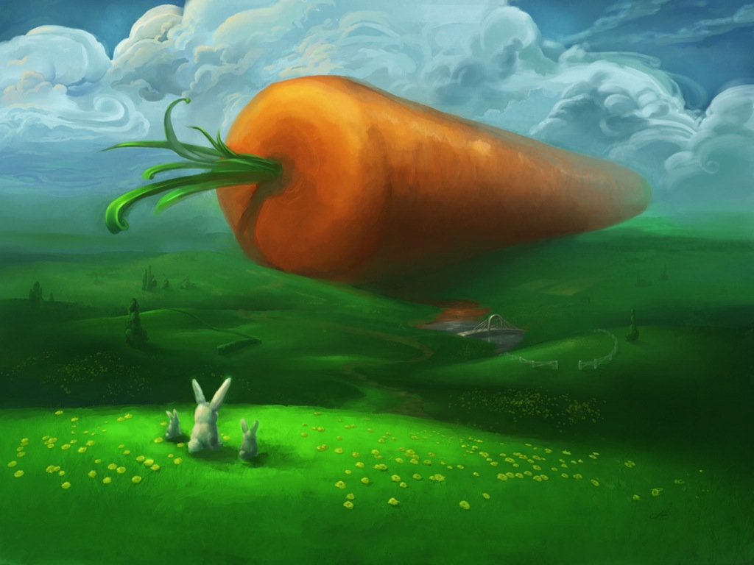
Notes:
We all get a welcome package when we get to heaven and the size of that is based on how much you serve.

Slide 17

Notes:
It is like coming first in a school sports event and getting a medal.

Slide 18
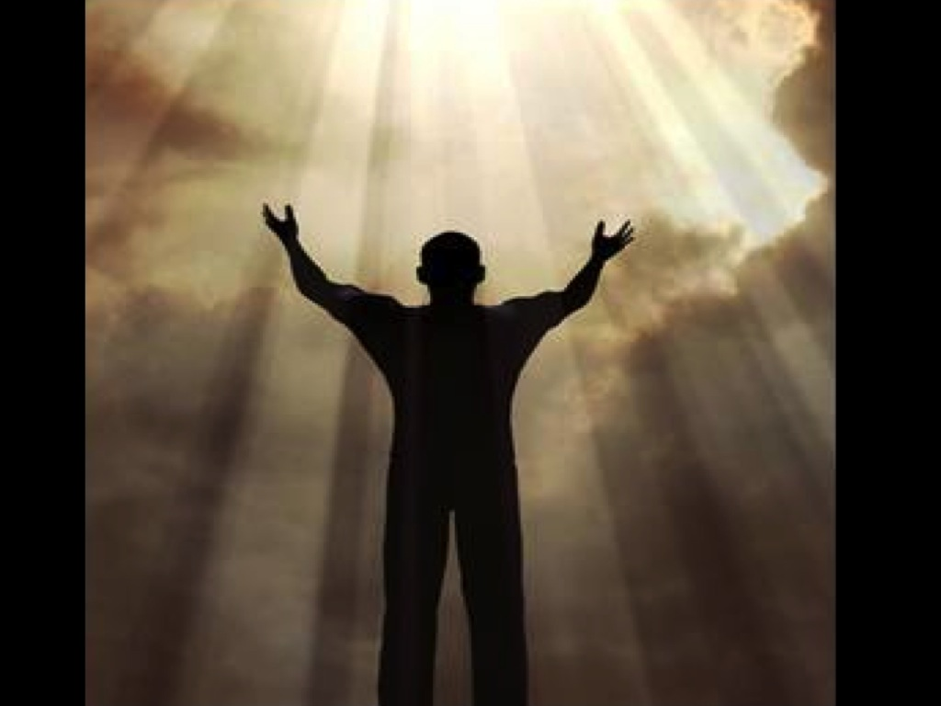
Notes:
But there is a greater reason to serve. God serves because it is the best way to live. And when we serve like him we connect with them he brings fulfillment in our lives.

Slide 19
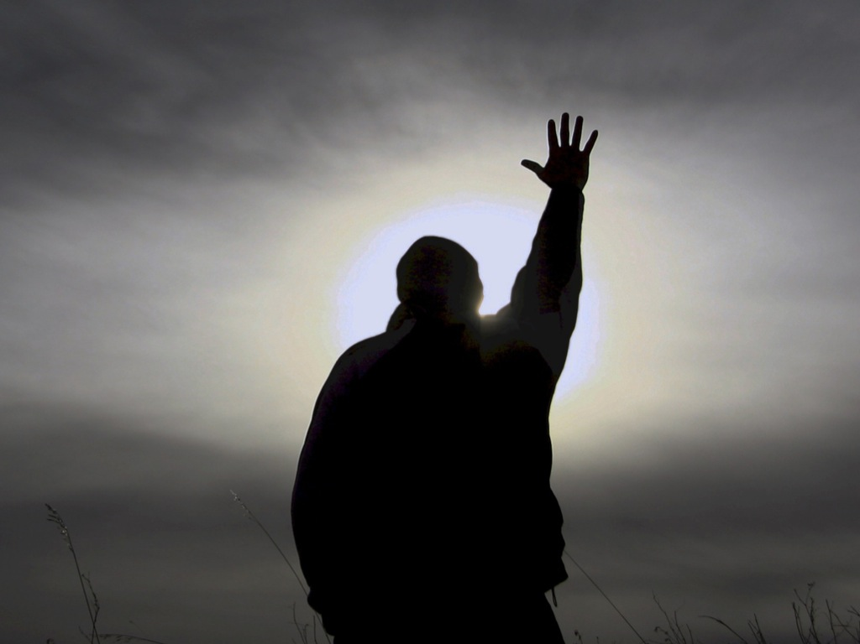
Notes:
We bring his presence into our lives; we bring his power into our lives. Friendships will be created, fights will be stopped and joy will be abundant.

Slide 20
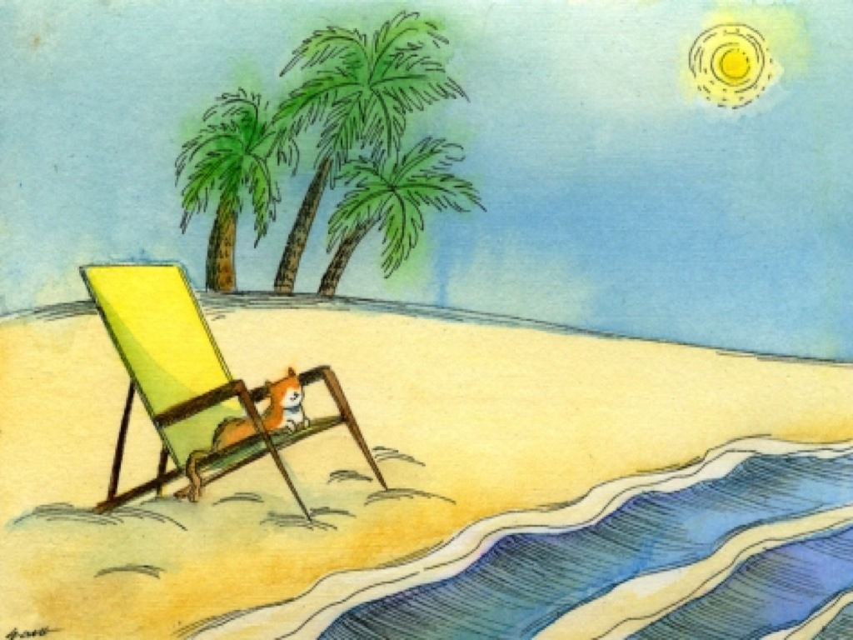
Notes:
Your life will improve when you serve because there is power and honour from God when we serve.

Slide 21

Notes:
God himself gave honour to his own work of creation by resting on the 7th and we honour his work by going to church on Sunday the 7th day of the week.

Slide 22
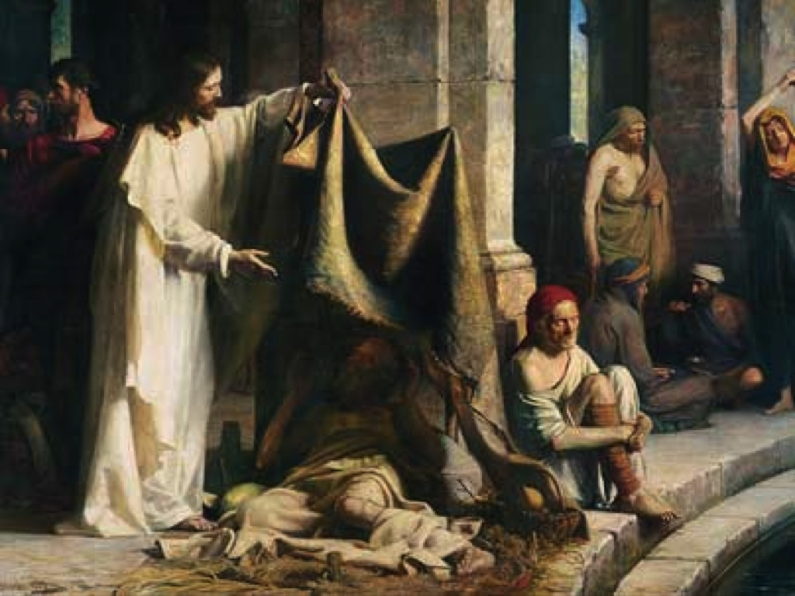
Notes:
The bible says God honours those who honour him and God will honour you when you serve.

Slide 23
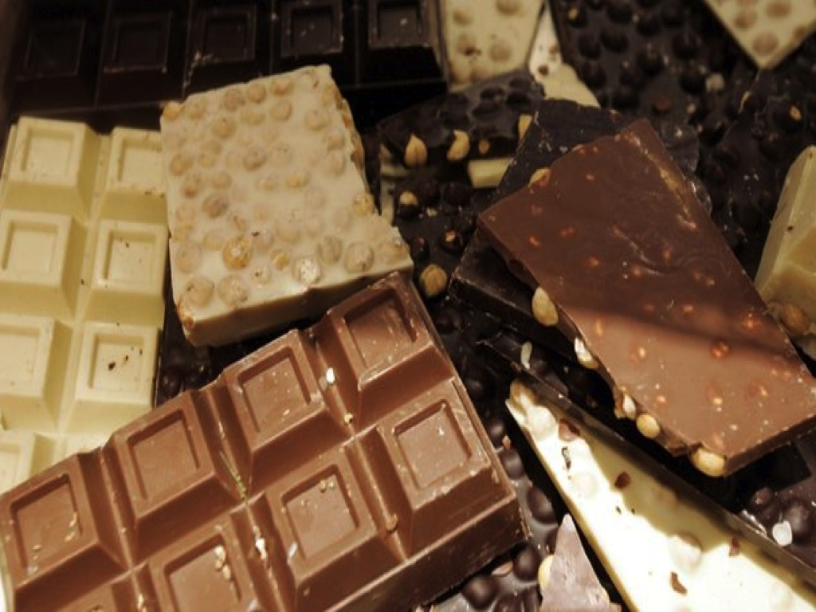
Notes:
And this is because you are connecting with eternity and getting to know him better. The same way a Father rewards his son for showing a characteristic he likes. Maybe if you show courage you could get a Cadbury chocolate.

Slide 24
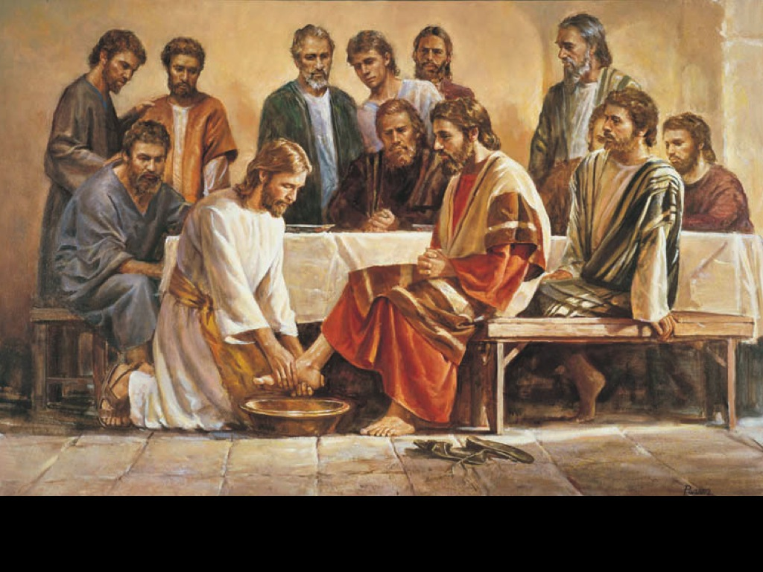
Notes:
When you make God proud with service he will let you share in his happiness. Jesus himself said anything you do for the least of his people you do for him and anything you Do Not do for the least of his people you do not do for him. And for those who do serve people they will have eternal glory. Now the question is how do you SERVE? I believe you serve with your Words, Time and Prayer. But Above All Service is Sacrifice.

Slide 25
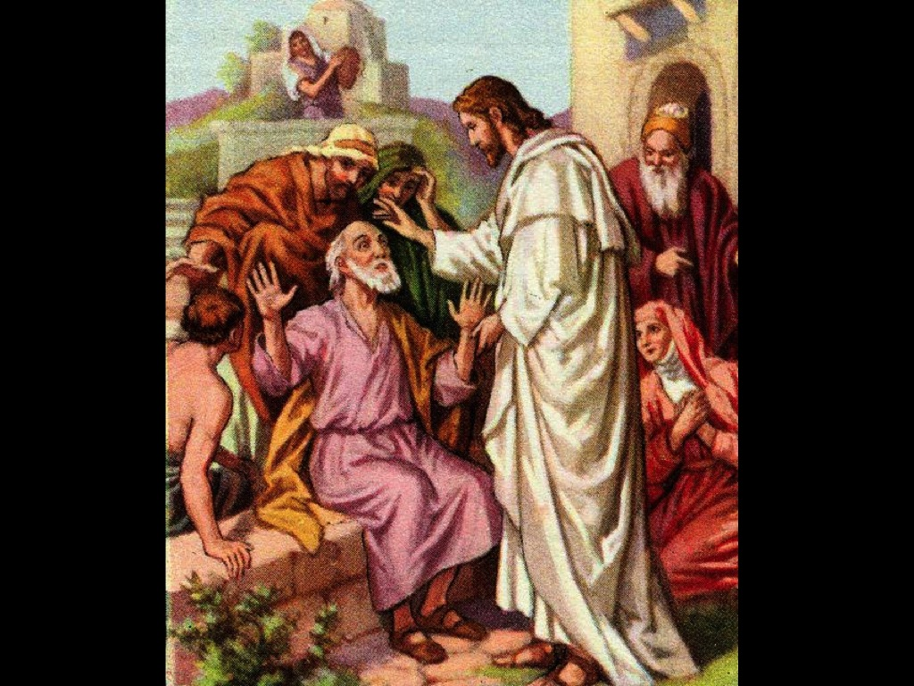
Notes:
When you use your words, time or prayer for someone else and give up something. The bible says forgive as god forgave you, now I’m saying and I’m challenging you to serve as God served you and sacrifice as God sacrificed for you. Ask God as we pray for opportunities for you to serve.

Slide 26
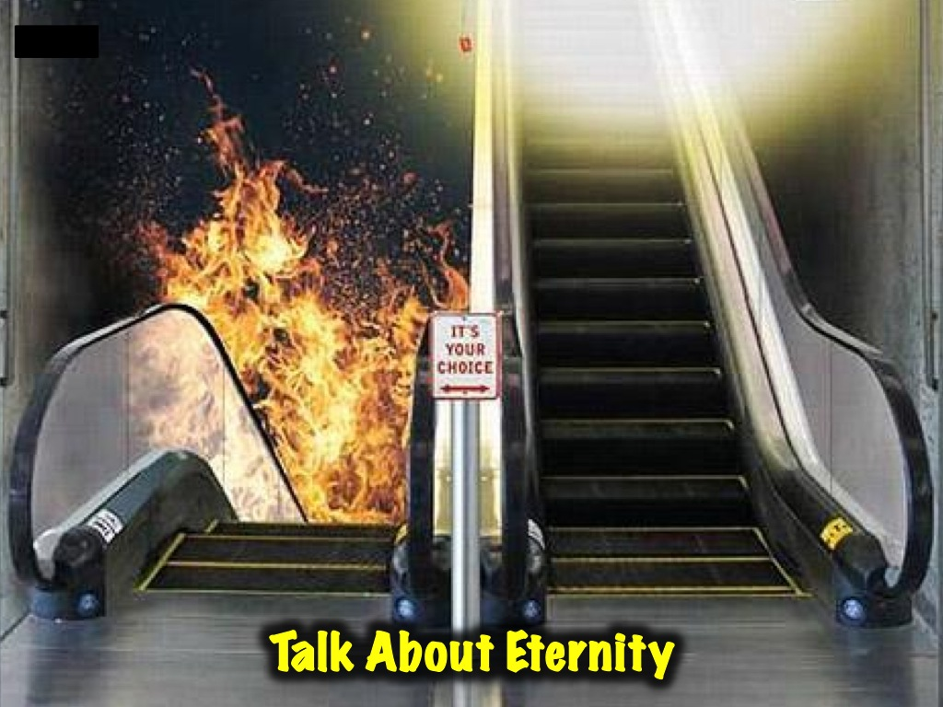
Notes:
Next week we will show how that we live on the edge of Eternity by talking about eternity.

