Slide 1
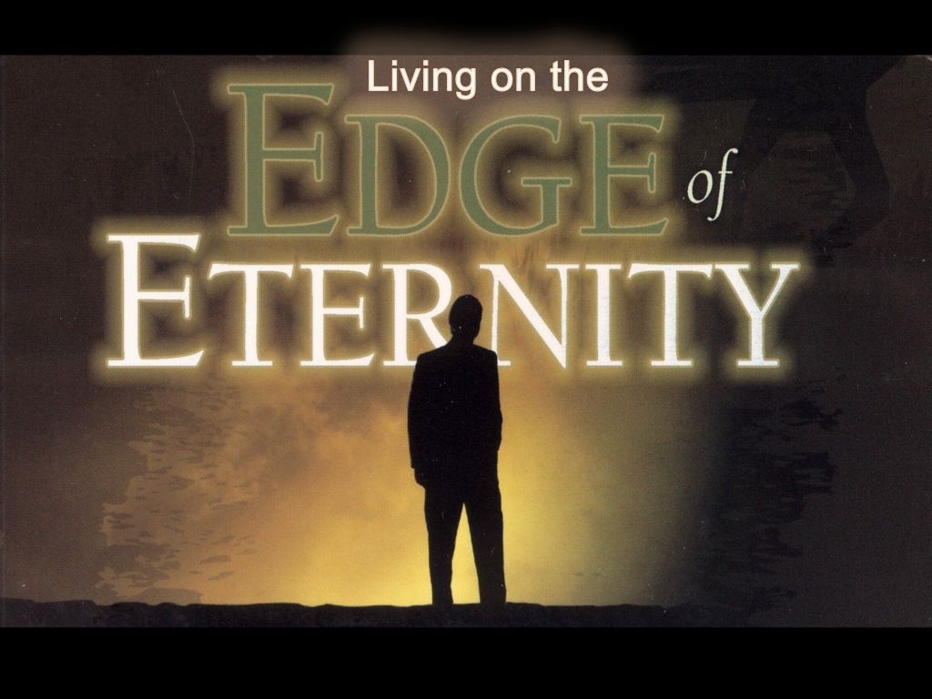
Notes:
A few weeks ago we started a new series called: Living on the Edge of Eternity. Here is a short review of what we covered...

Slide 2
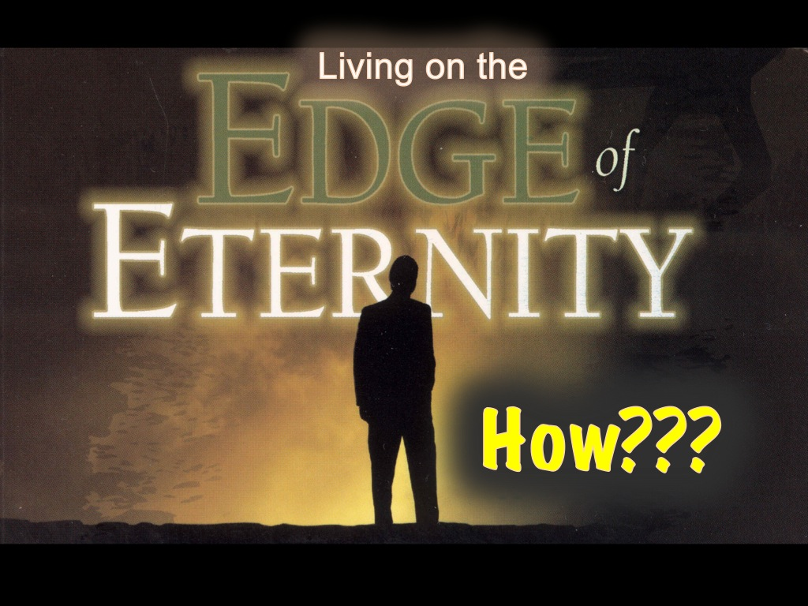
Notes:
So how do we live on the edge of eternity? What can we do practically?

Slide 3
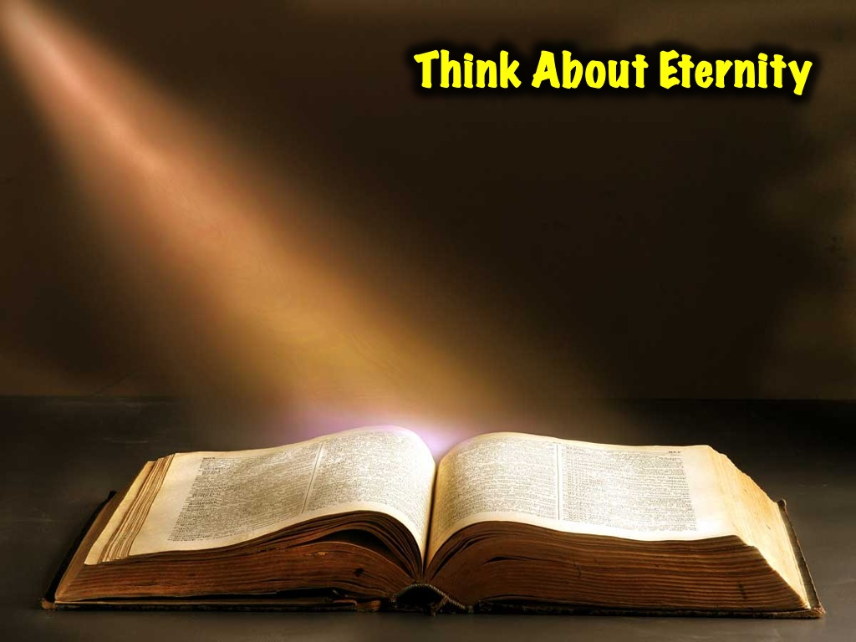
Notes:
1. Think about Eternity by Living in the Word.

Slide 4
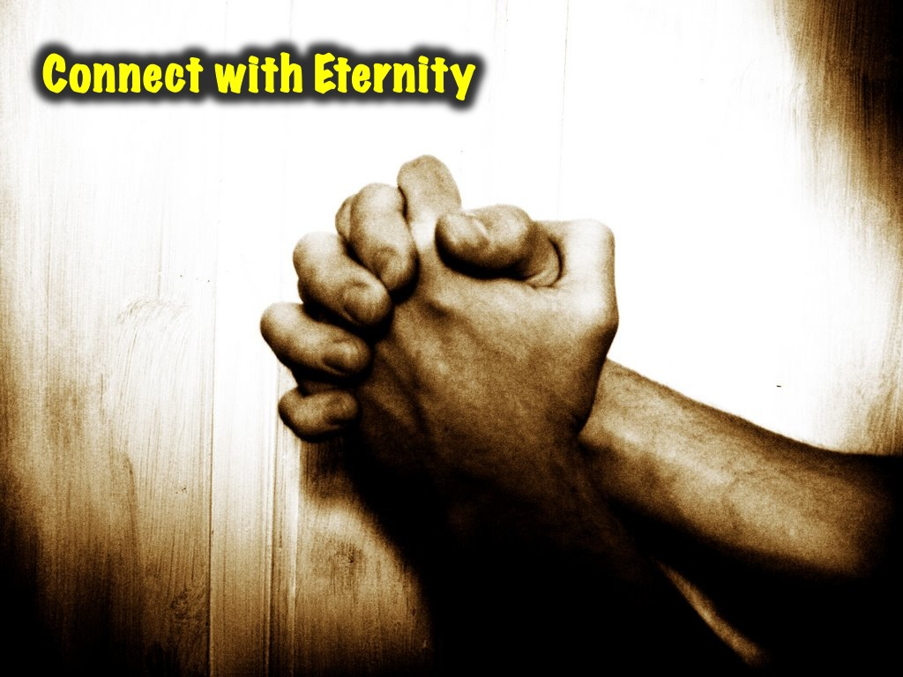
Notes:
2. Connect with Eternity through prayer

Slide 5

Notes:
3. Invest in Eternity by doing acts of kindness.

Slide 6
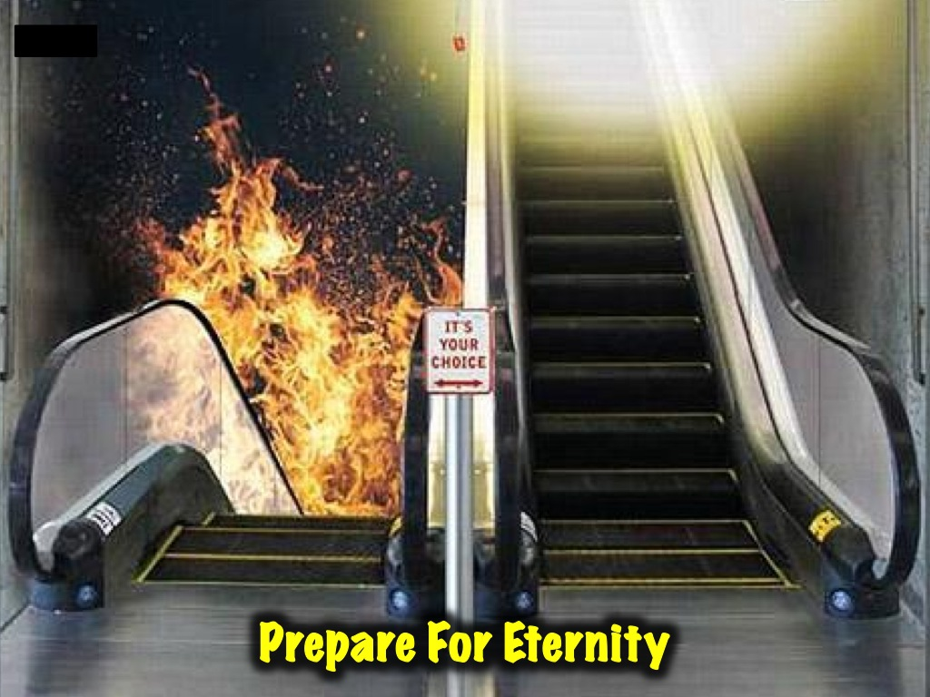
Notes:
4. Talk About Eternity - This week we are going to consider how we can live on the edge of eternity by talking about Eternity.

Slide 7
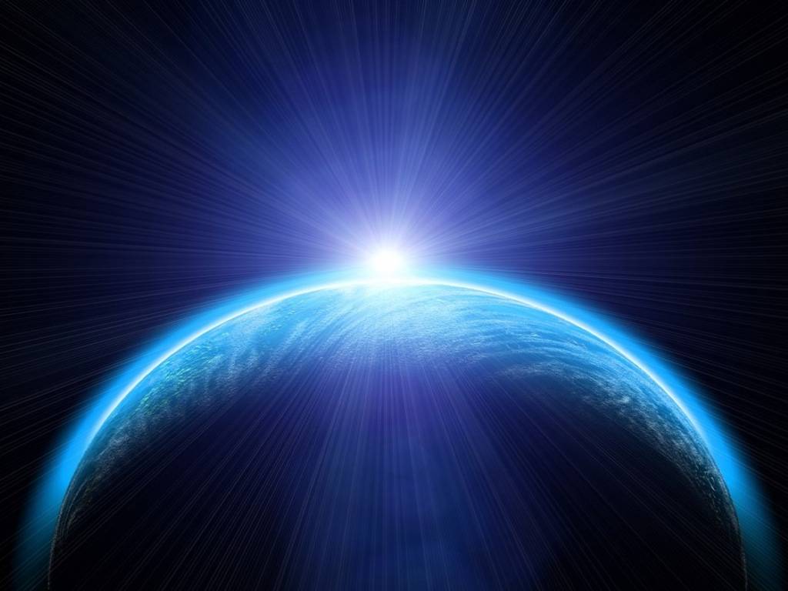
Notes:
Let’s step back into eternity past!

Slide 8
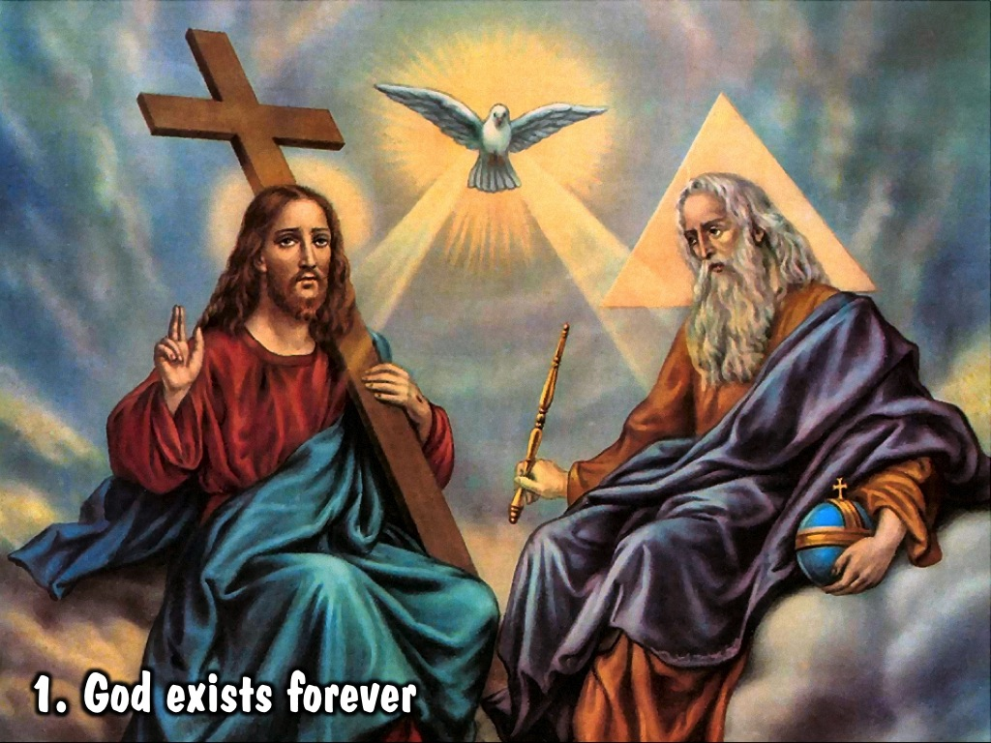
Notes:
(1) God exists forever – Father, Son and Holy Spirit in relationship.

Slide 9
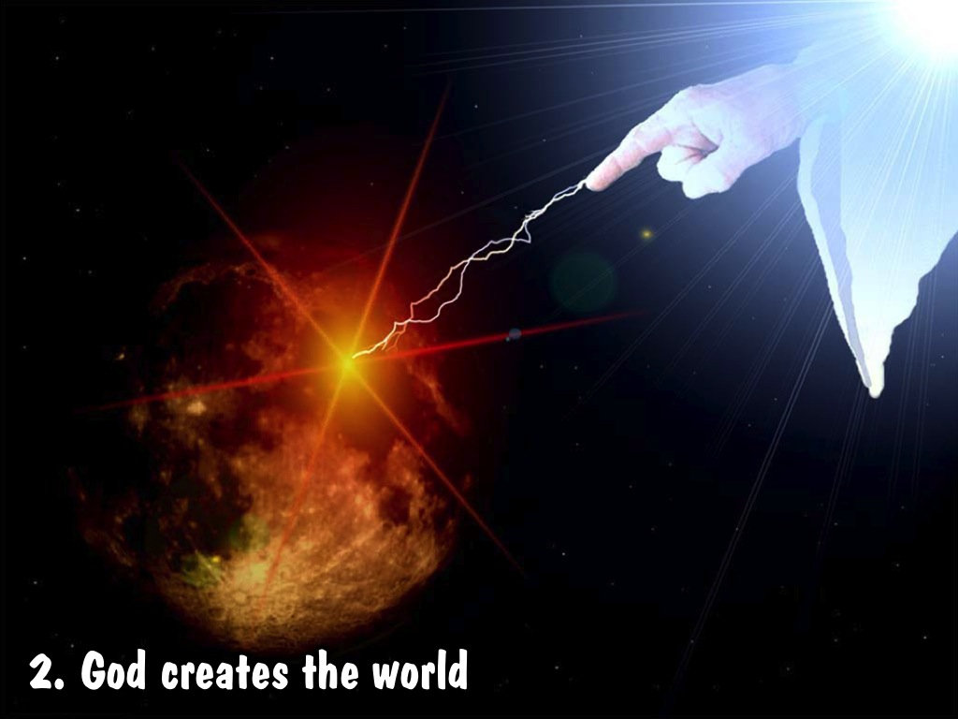
Notes:
(2) God creates the world – the sun and the moon, the earth and the planets, the flowers and the trees, the birds and the animals, the birds and and says: ”It is good!”

Slide 10
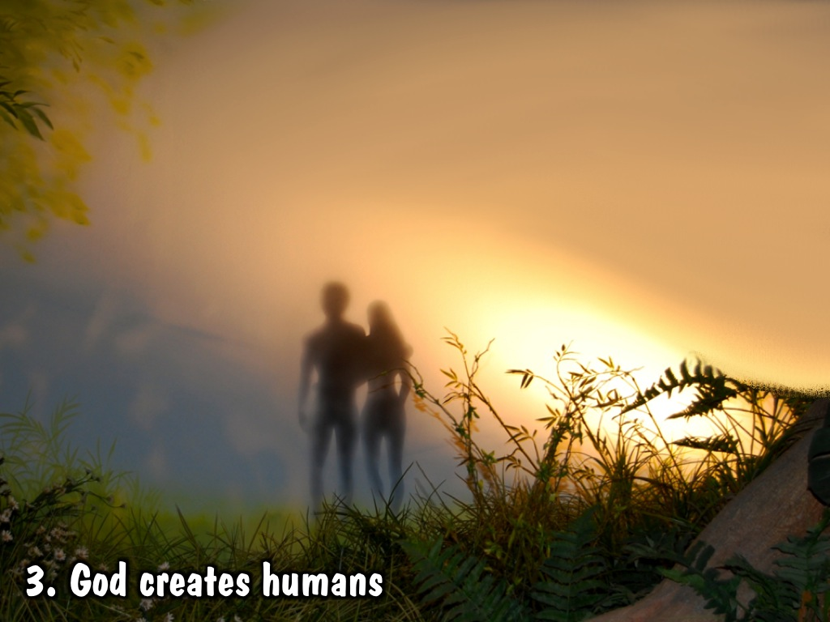
Notes:
(3) God creates humans – he creates Adam and Even in his own likeness and says: ”It is very good!”

Slide 11
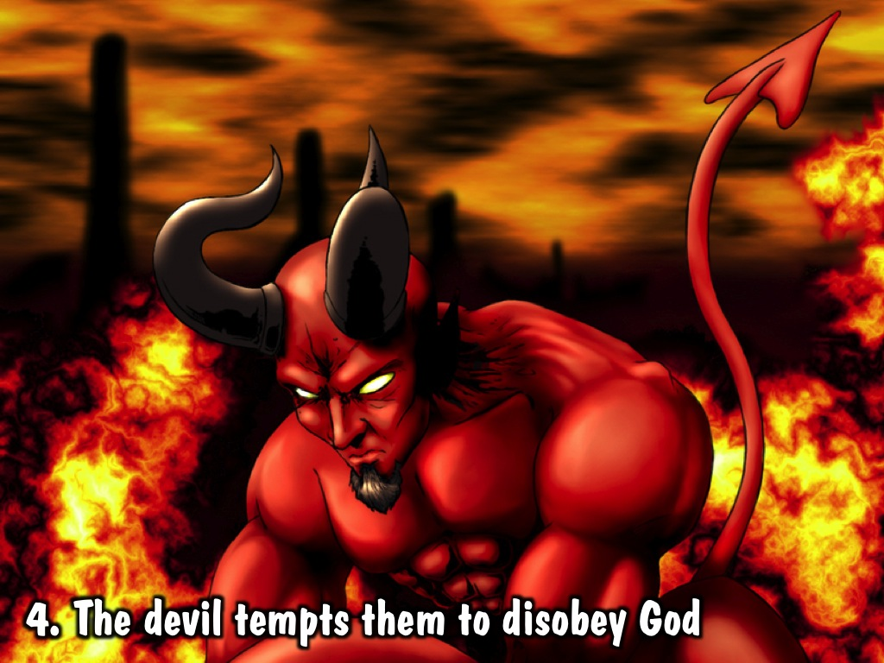
Notes:
(4) The devil tempts them to disobey God – God told them not to eat from the tree of the knowledge of good and evil, but the devil says they should not believe God and do it anyway!

Slide 12
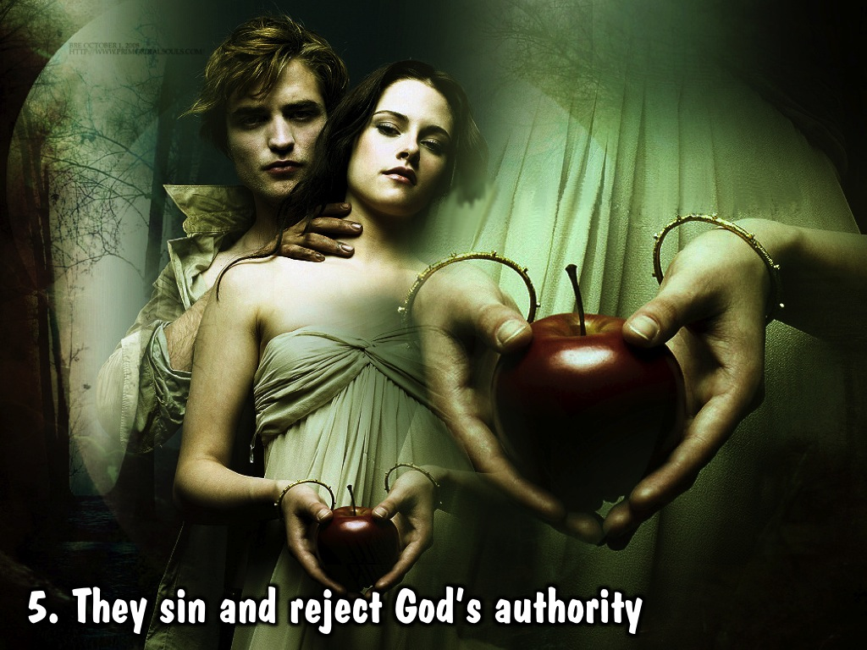
Notes:
(5) They sin and reject God’s authority – God told them not to eat from the tree of the knowledge of good and evil, but they listened to the devil rather than to what God had told them.

Slide 13
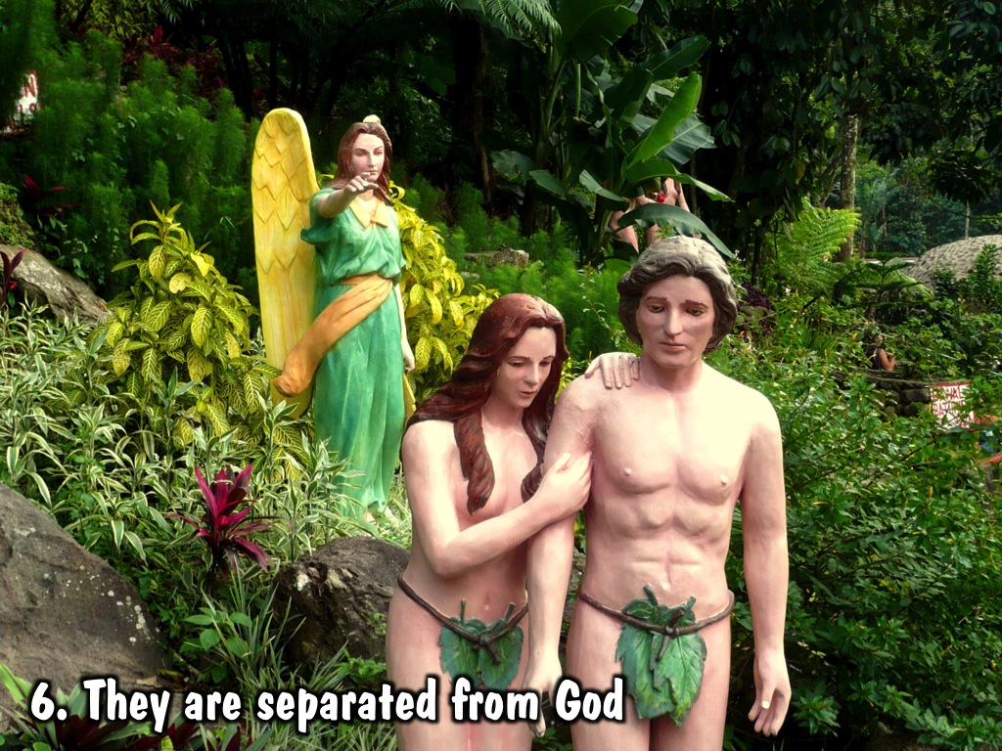
Notes:
(6) They are separated from God. If they had eaten from the tree of life in the garden they would have lived apart from God forever – so God had to banish them from the garden and put an angel at the entrance to stop them returning.

Slide 14
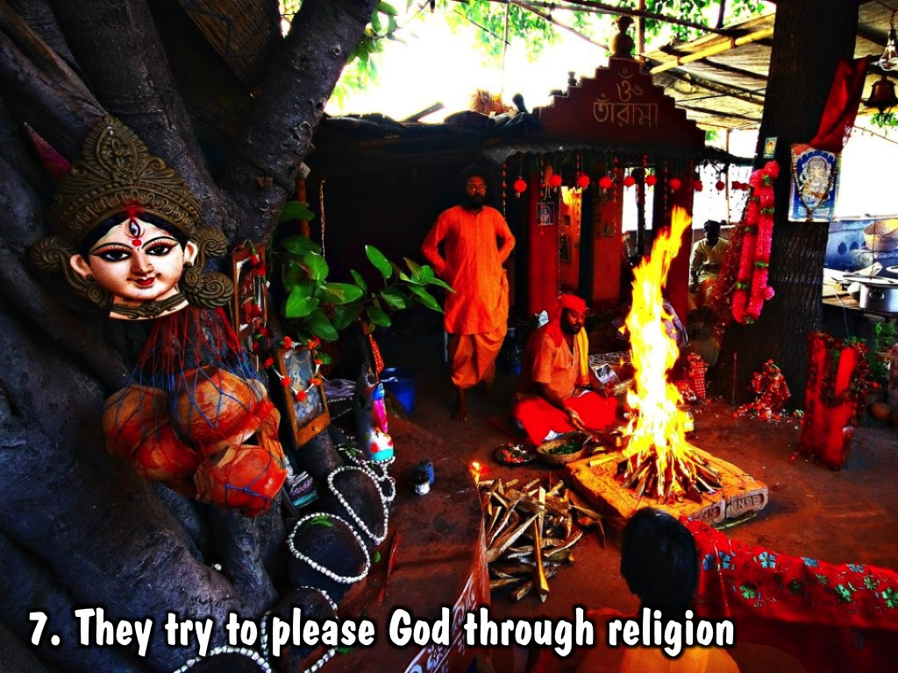
Notes:
(7) They try to please God through religion - but it could get them re-united with God.

Slide 15
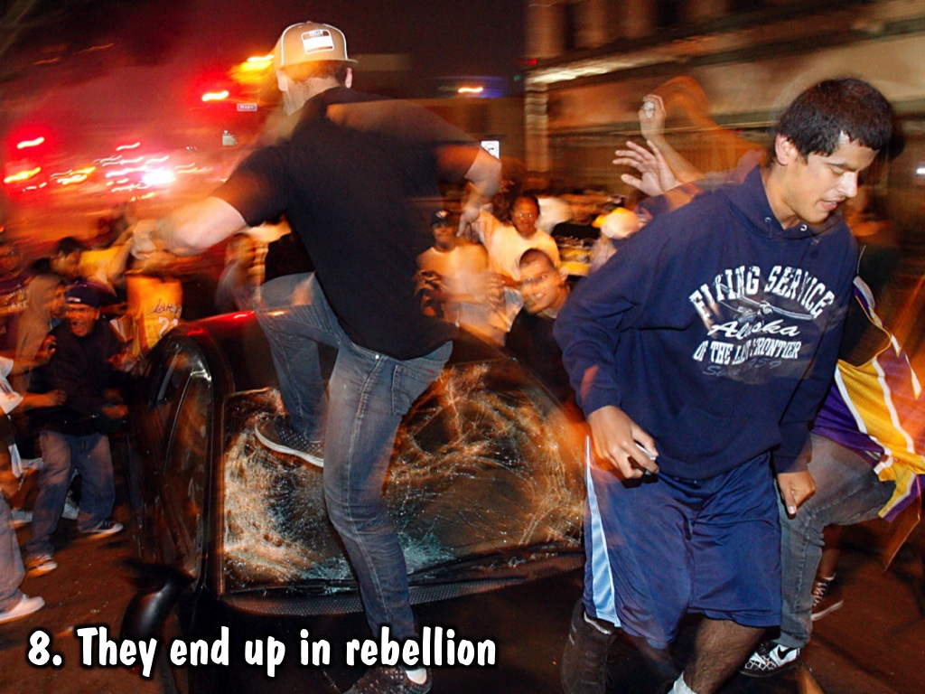
Notes:
(8) They end up in rebellion – all kinds of wickedness and evil is done by creatures who are moving further and further away from their Creator.

Slide 16
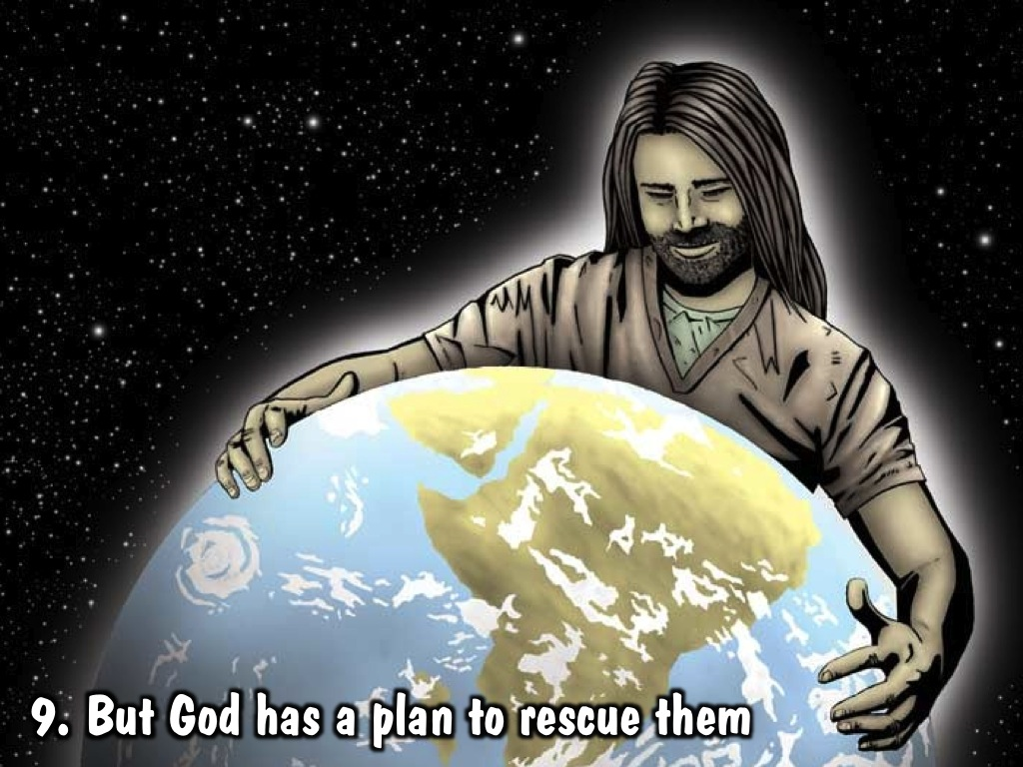
Notes:
(9) But God has a plan to rescue them - God loves them too much to leave them without hope in the world.

Slide 17
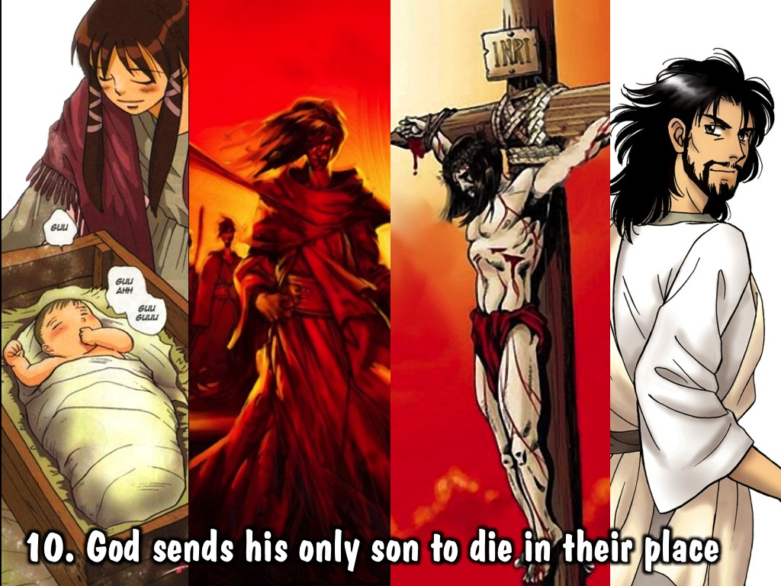
Notes:
(10) God sends his only son to die in their place – God sent his only Son to become a human being, to live a perfect life, to die as a sacrifice for their sins and rise again to give them eternal life.

Slide 18
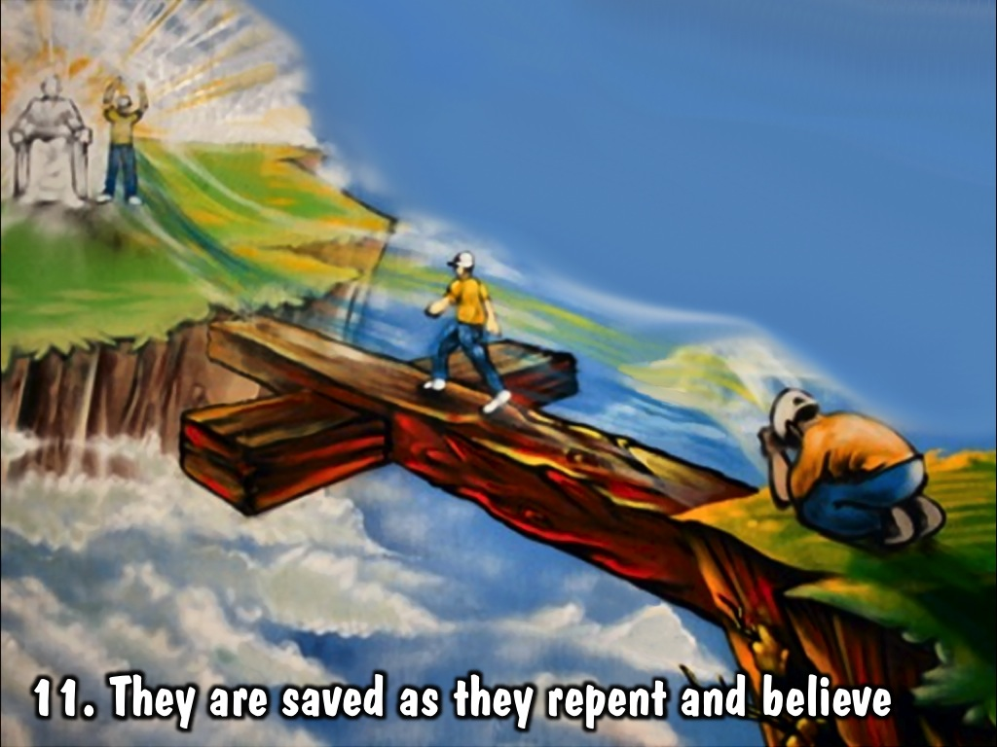
Notes:
(11) They are saved as they repent and believe – All they have to do is trust in Jesus alone for their salvation.

Slide 19
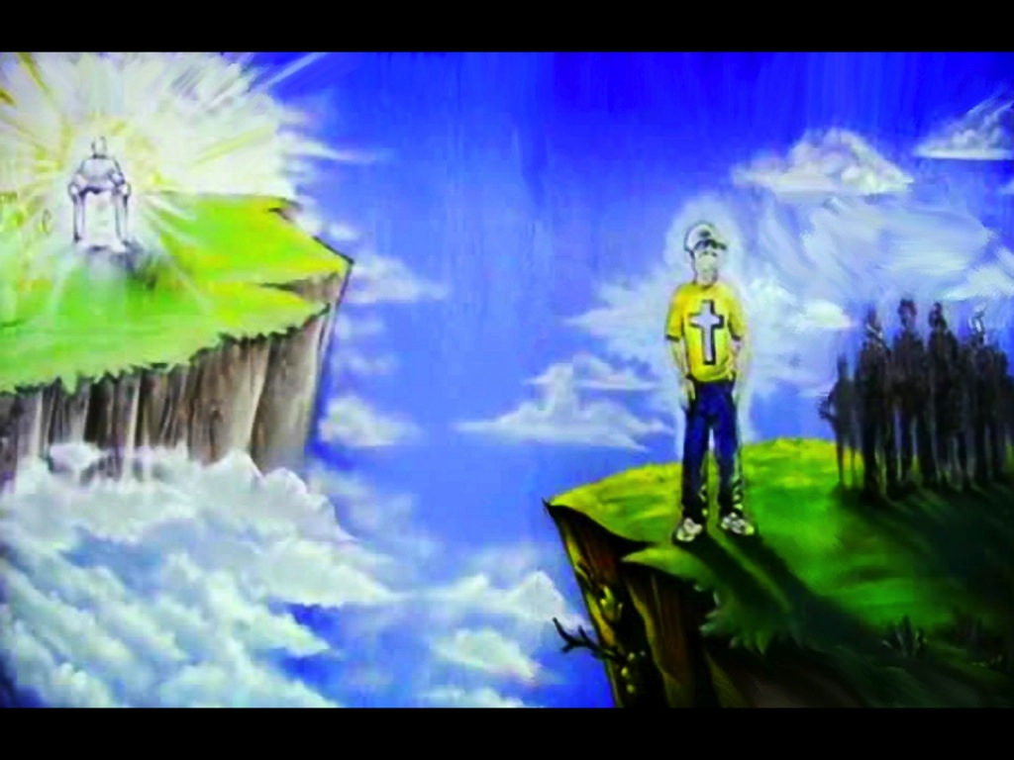
Notes:
Video: The Bridge

Slide 20
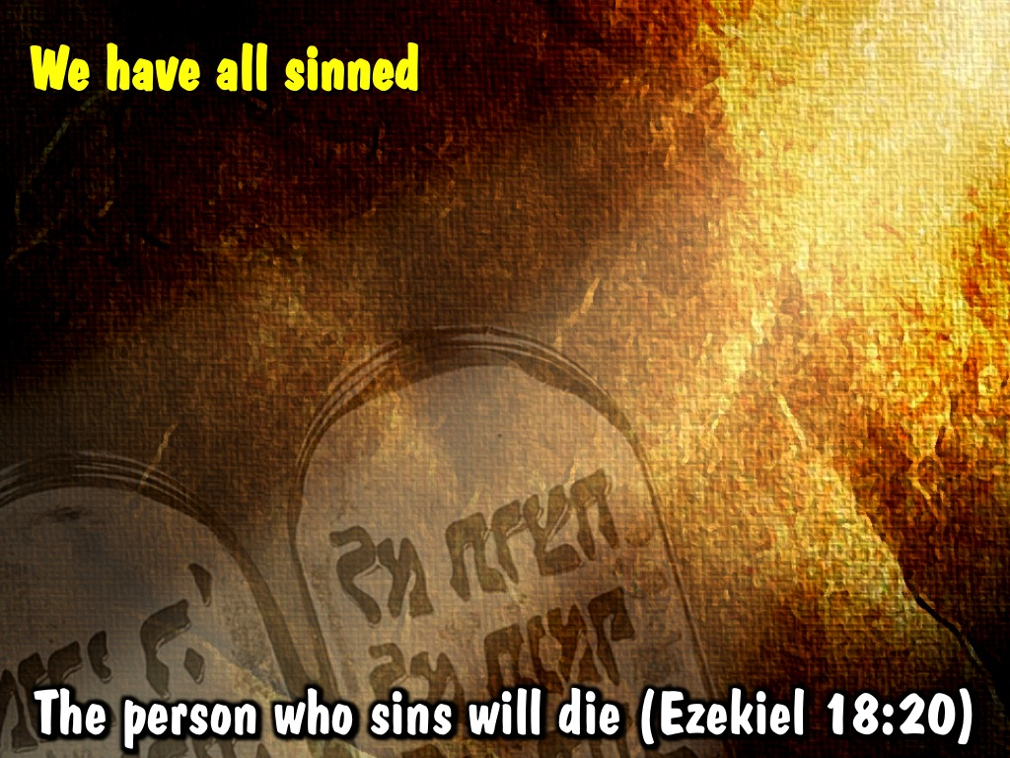
Notes:
The Bible says that we have all sinned or done wrong in the sight of God. That law is quite clear that the person who sins will die (Ezekiel 18:20).
20

Slide 21
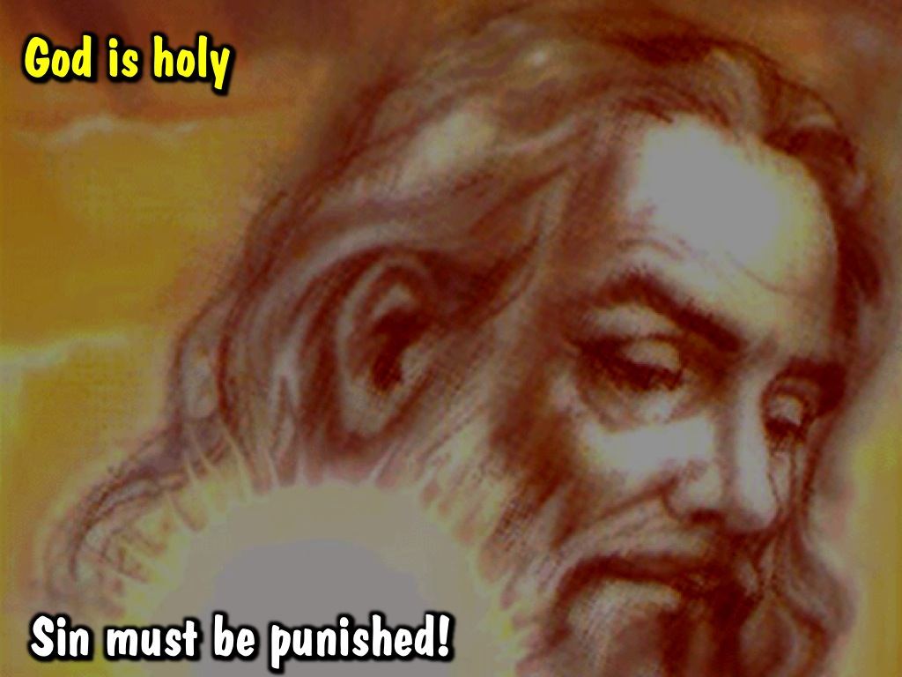
Notes:
God is holy and sin must be punished!
21

Slide 22
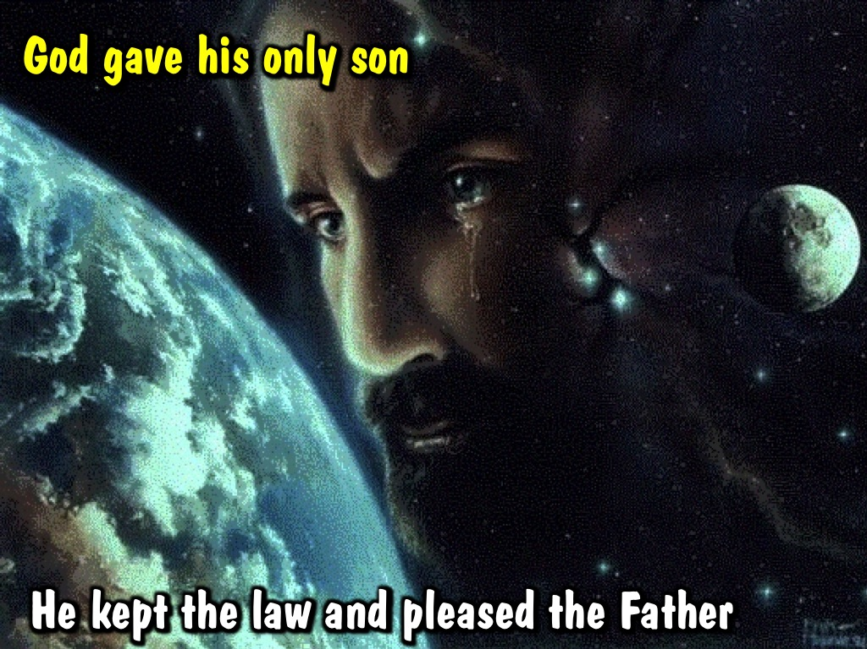
Notes:
God gave his only son – who lived a perfect life, kept the law and pleased the Father.

Slide 23
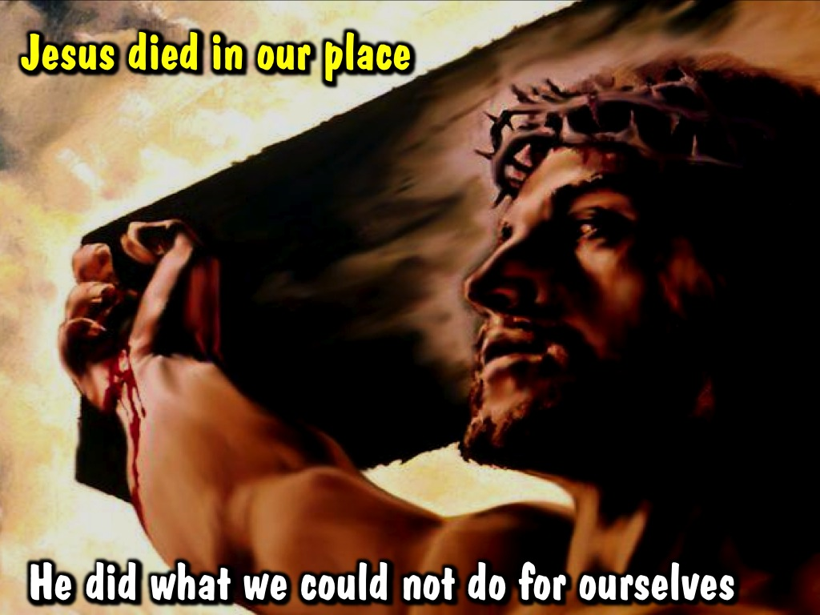
Notes:
Jesus died in our place – he did what we could not do for ourselves.

Slide 24
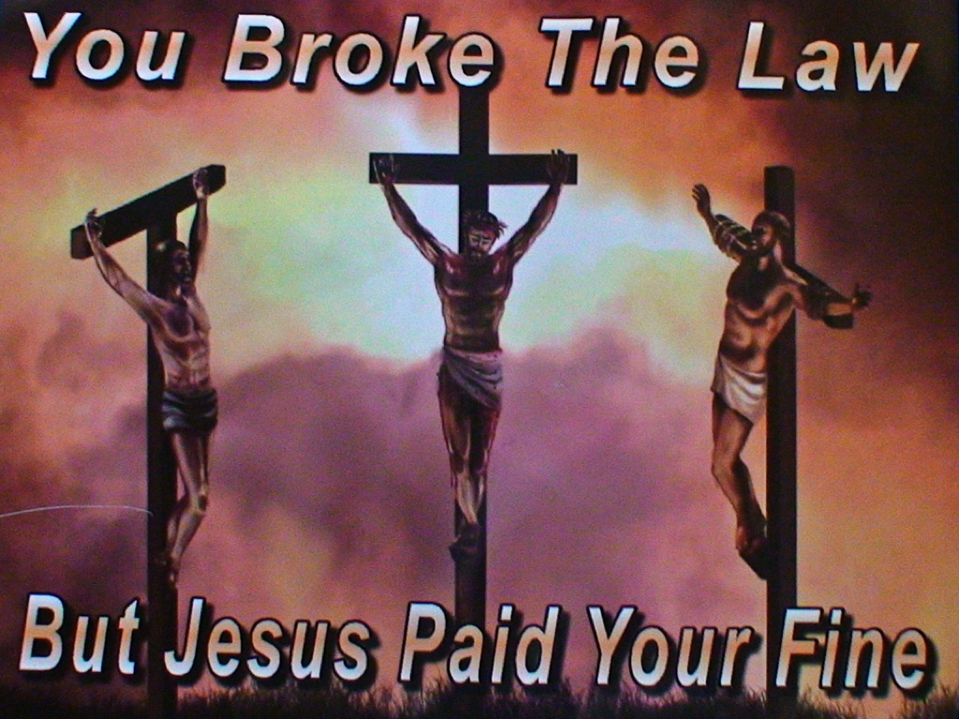
Notes:
You broke the law, but Jesus paid your fine!
24

Slide 25
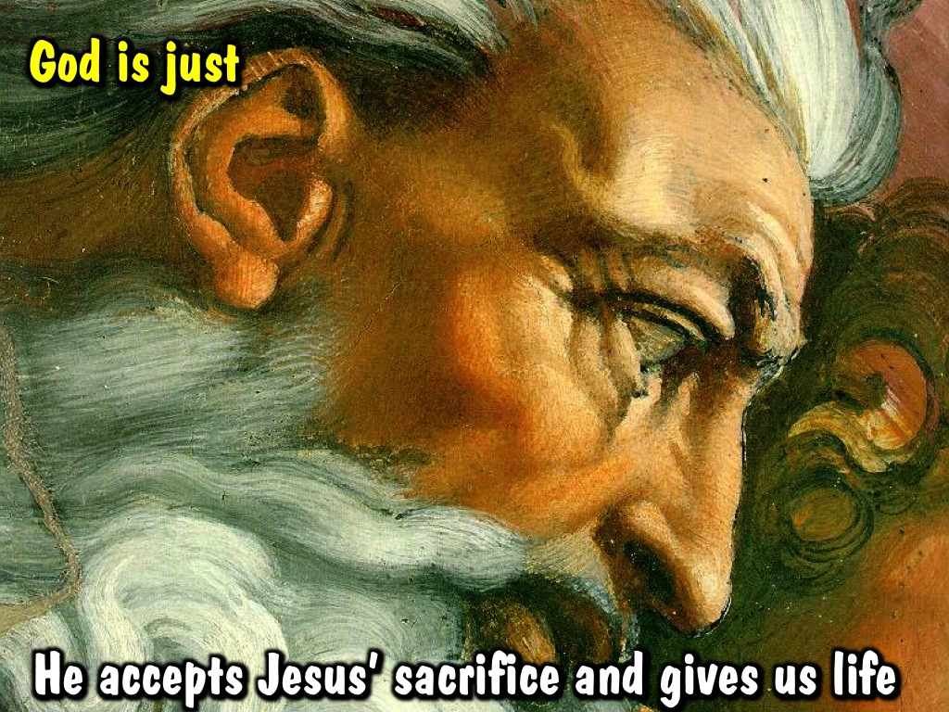
Notes:
God is just – he accepts Jesus’ sacrifice and gives us eternal life.
25

Slide 26
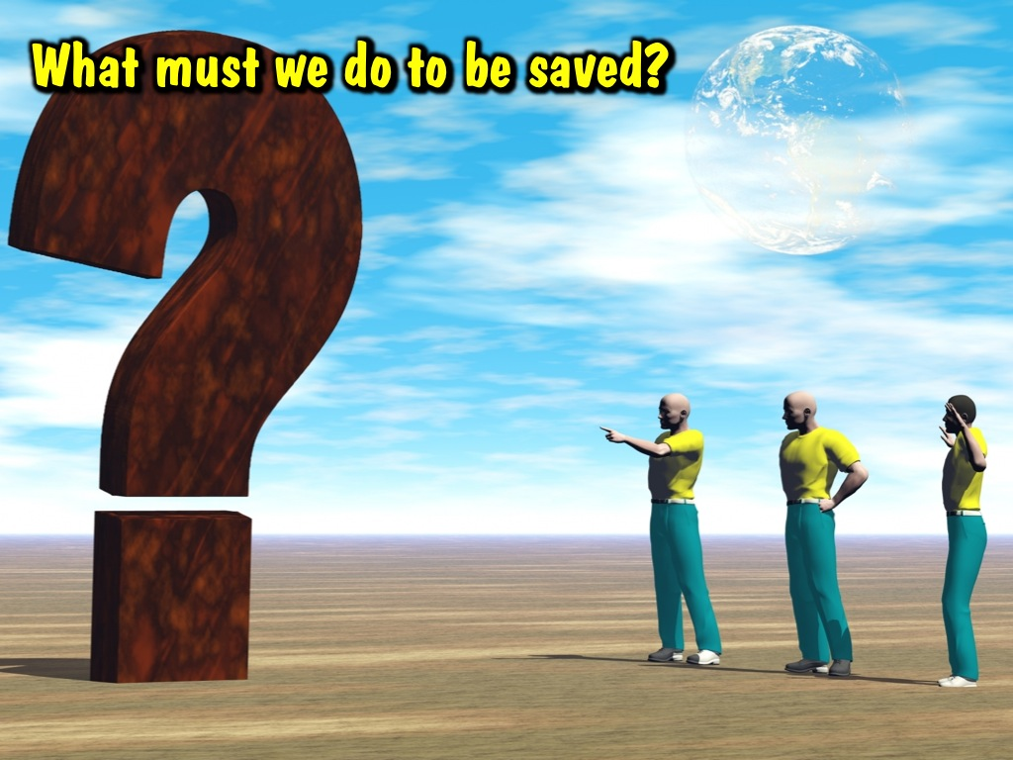
Notes:
God is just – he accepts Jesus’ sacrifice and gives us eternal life.
26

Slide 27
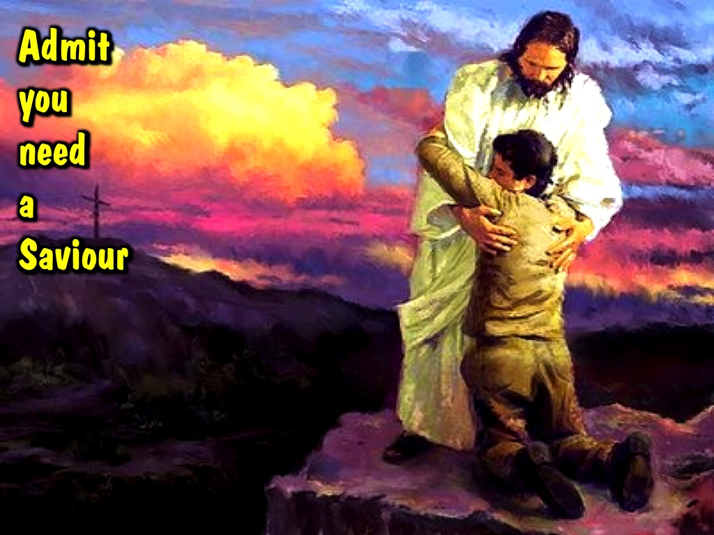
Notes:
We have to repent and believe

Slide 28
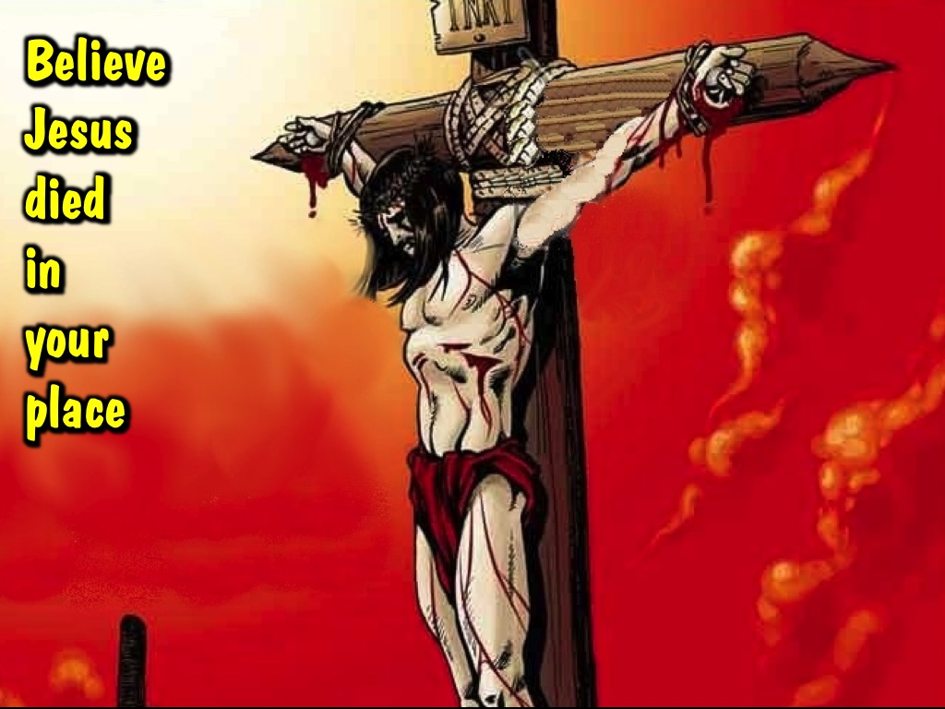
Notes:
We have to repent and believe

Slide 29
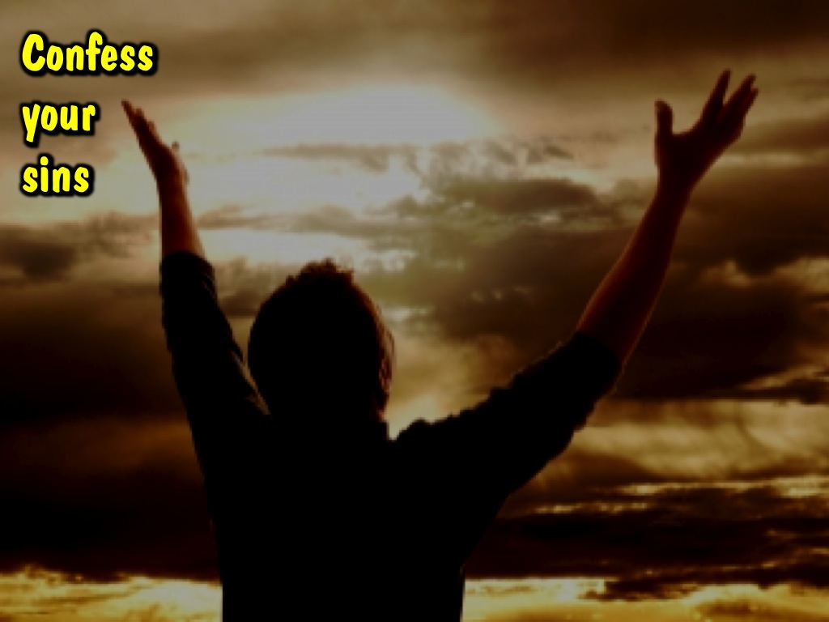
Notes:
People who believe in Jesus receive forgiveness for their sins through him. Acts 10:43

Slide 30
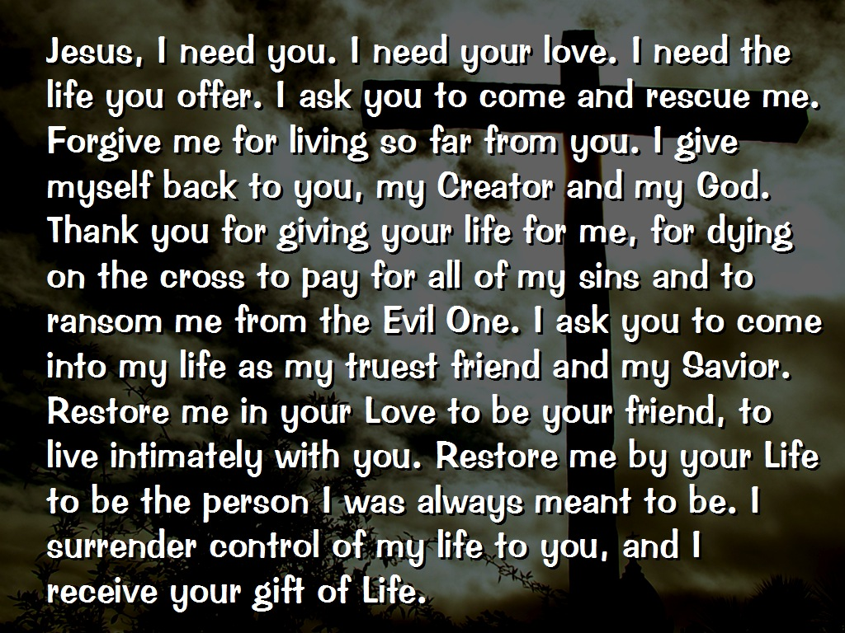
Notes:
What is your choice today? If you want to realign your life, then pray this prayer with me.

Slide 31
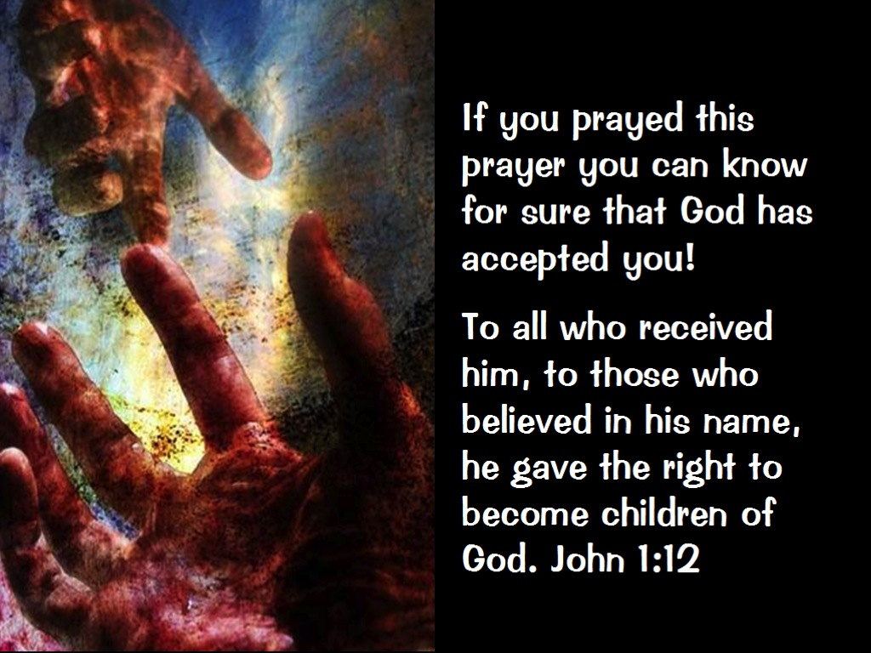

Slide 32
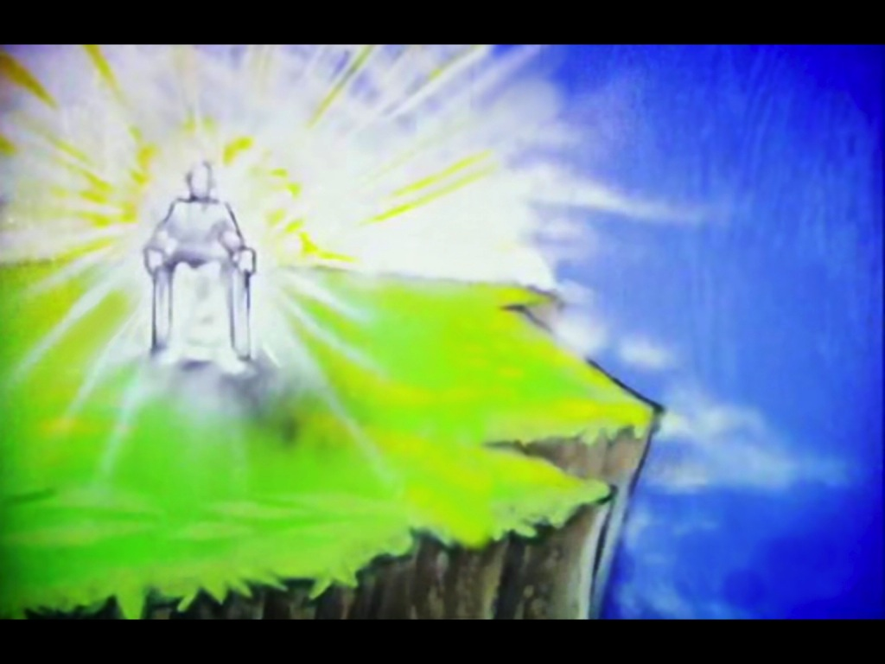
Notes:
(1) God has completed his mission to create a place and a people that will forever live in harmony with himself and each other.

Slide 33
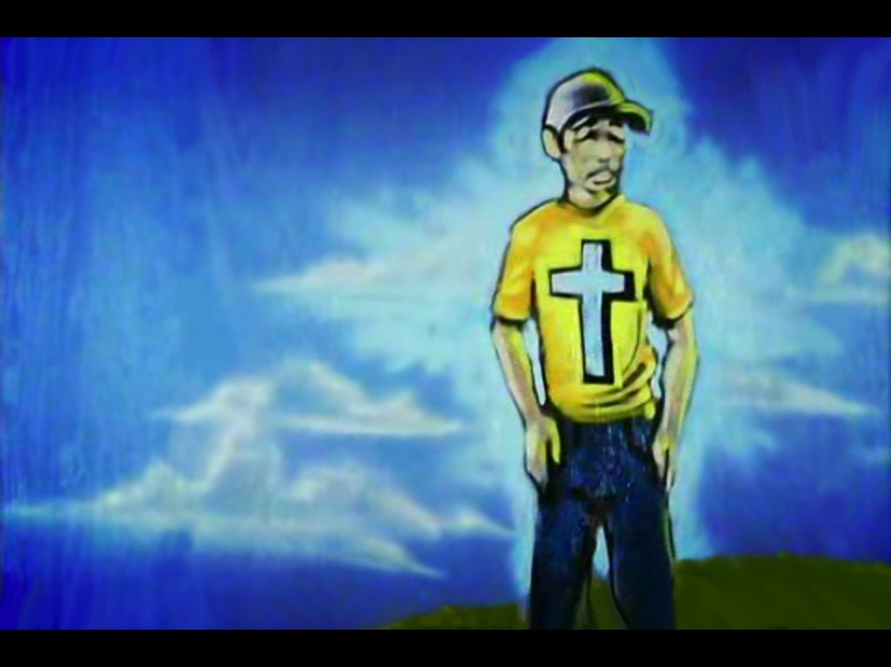
Notes:
(2) He has created human beings and he loves them like a father loves his son – but there seems to be a problem – what is that hole in his heart?

Slide 34
Notes:
(3) Humans have sadly decided to rebel against their creator and a great chasm now exists between them and their Creator.

Slide 35
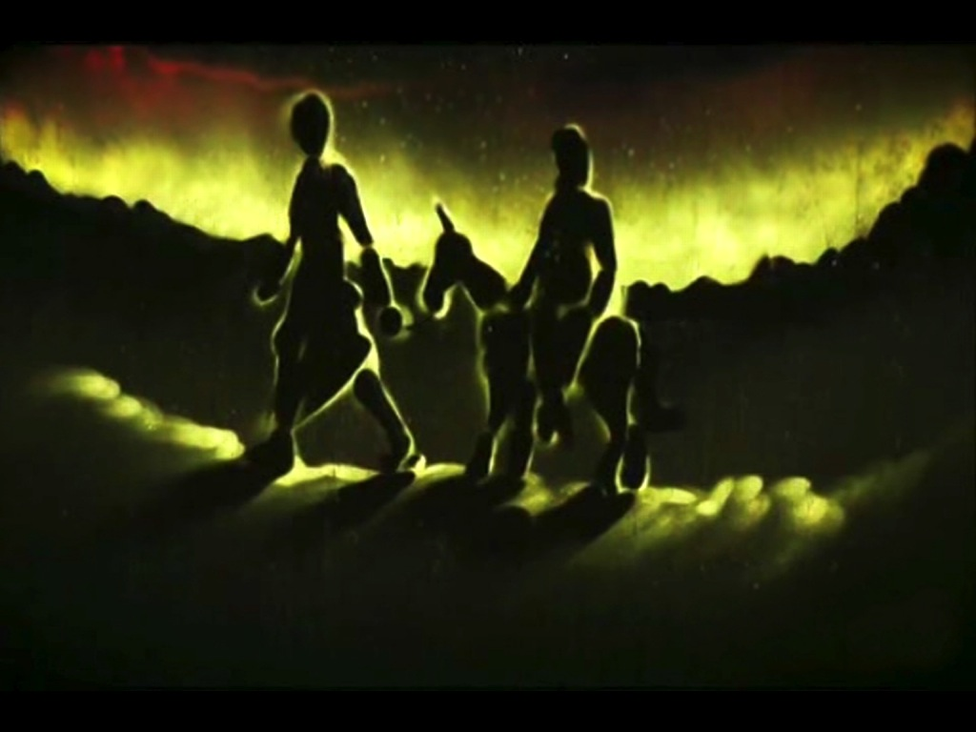
Notes:
(4) But God has a plan – he sends his only son to be born as one of them and to live a perfect life.

Slide 36
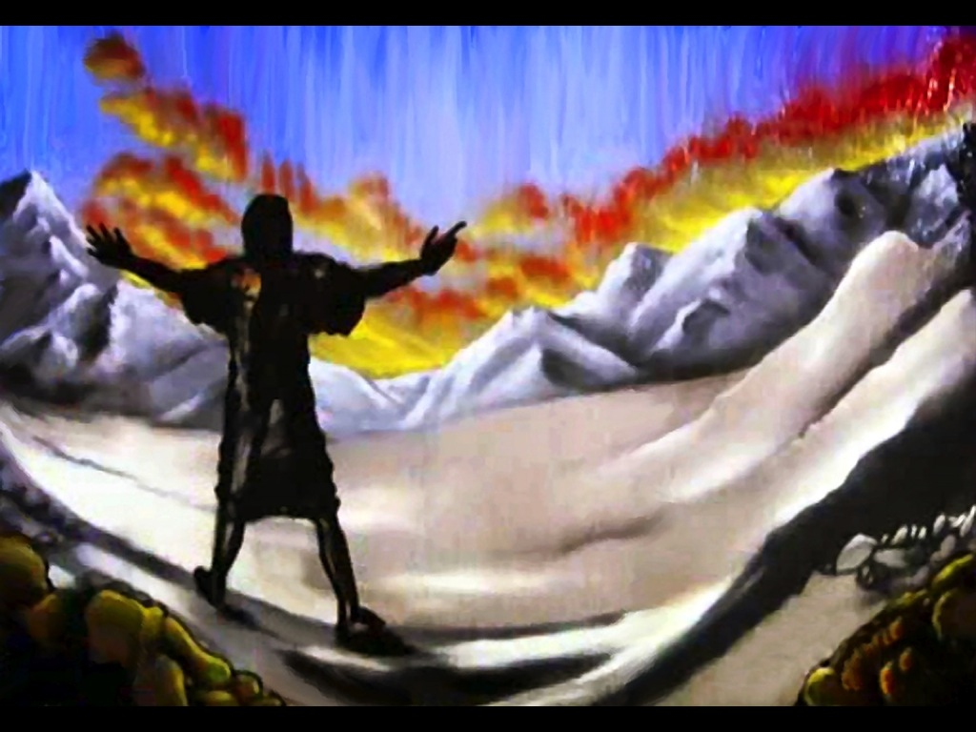
Notes:
(5) Soon he comes of age and begins to tell the world of the Father’s love for his children.

Slide 37
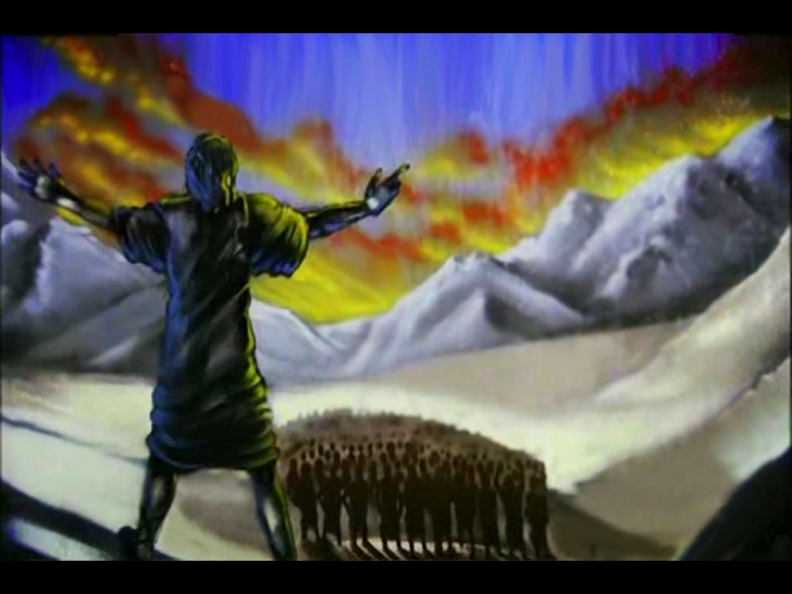
Notes:
(6) Great crowds begin to follow him and it seems like they are returning to Father.

Slide 38
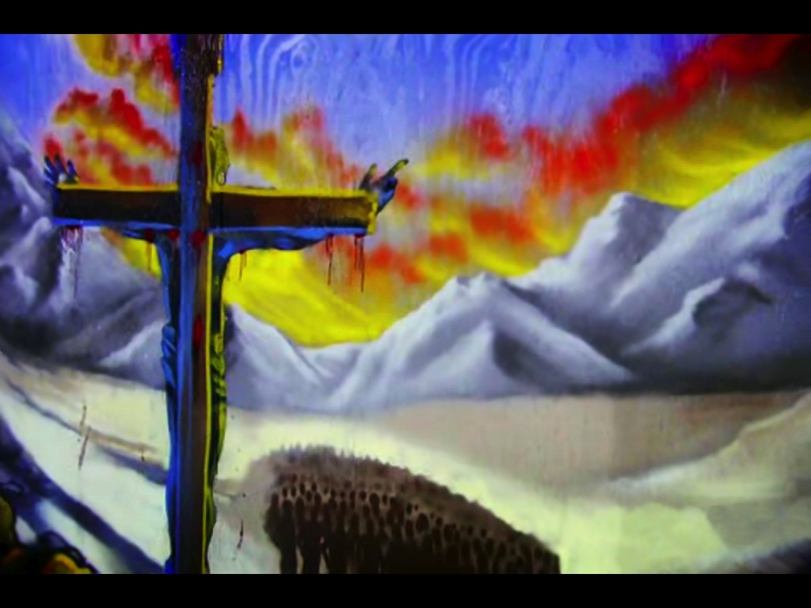
Notes:
(7) But sadly these very people that God created turn against him and they murder his only Son. Is this the end?

Slide 39
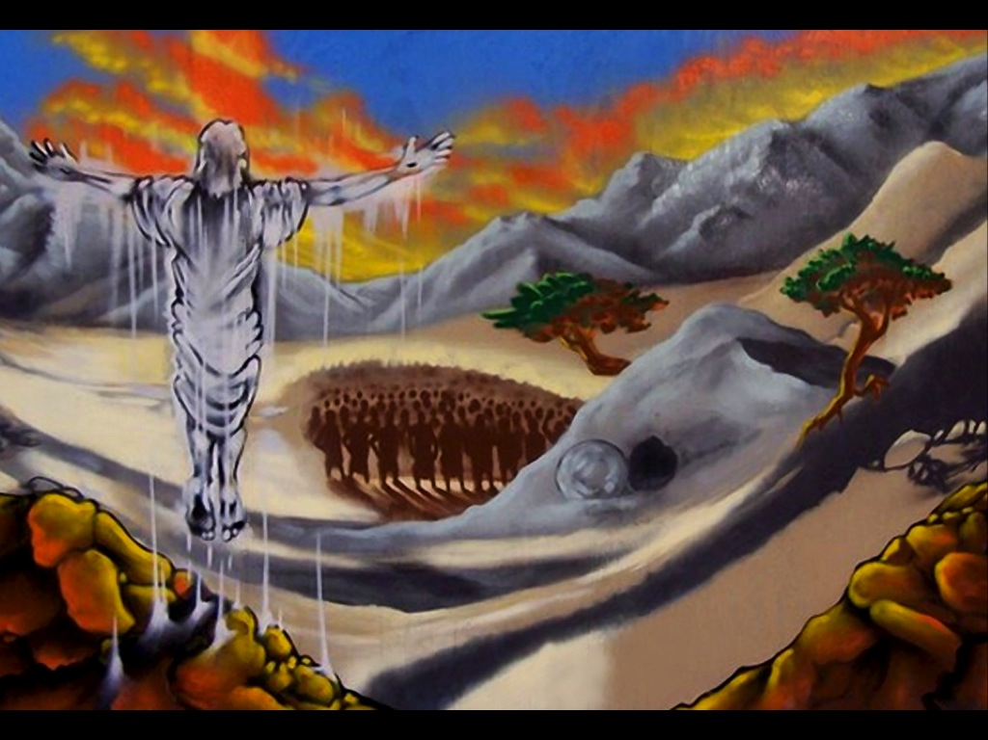
Notes:
(8) No, after three days the Son is raised from the dead and proclaims that a way has been opened up for humans to return to Father.

Slide 40
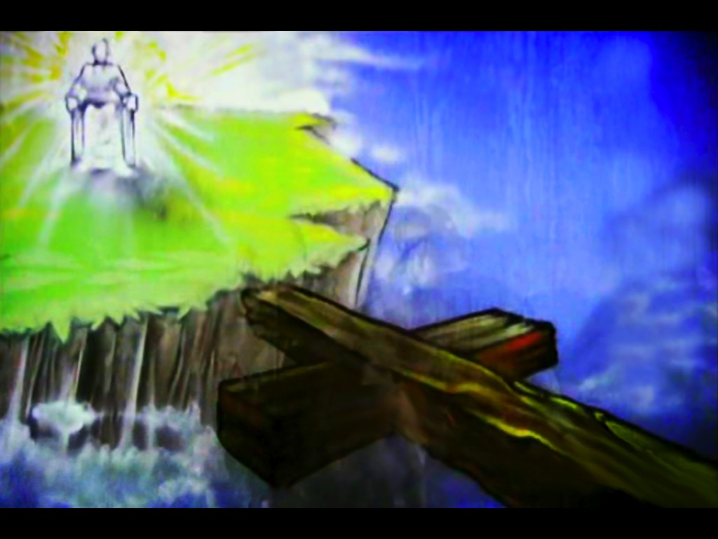
Notes:
(9) The gulf between God and humankind had been bridged by the death of the Son.

Slide 41
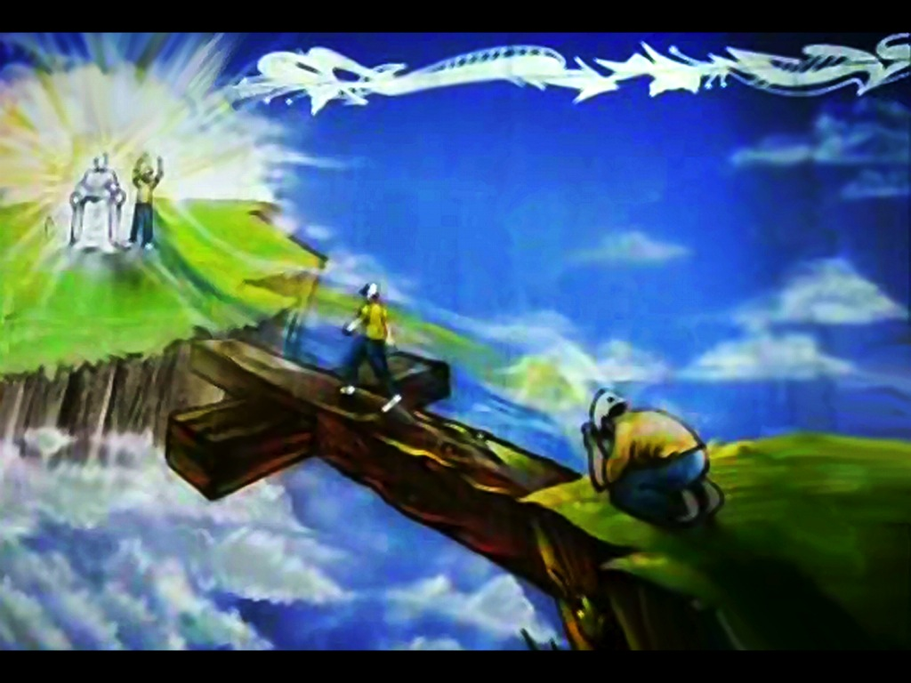
Notes:
(10) And all humankind has to do is repent and believe in what Jesus did on the cross.

Slide 42
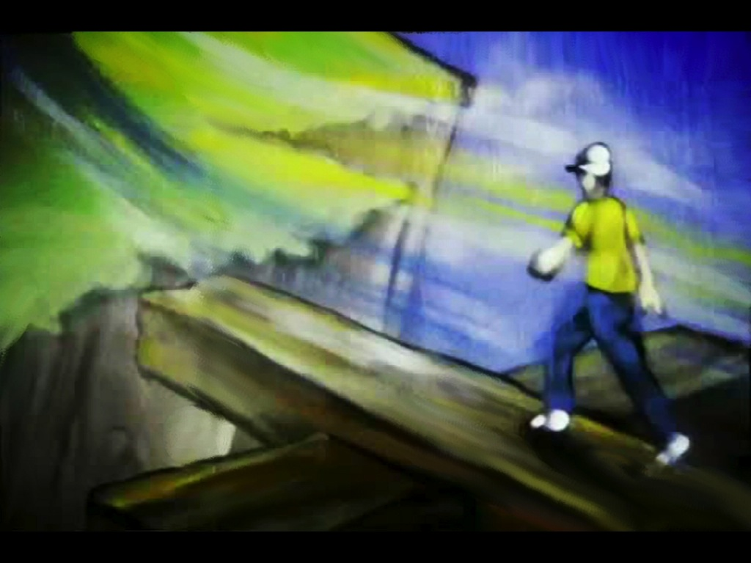
Notes:
(11) And they can cross the chasm that has kept them away from their Creator.

Slide 43
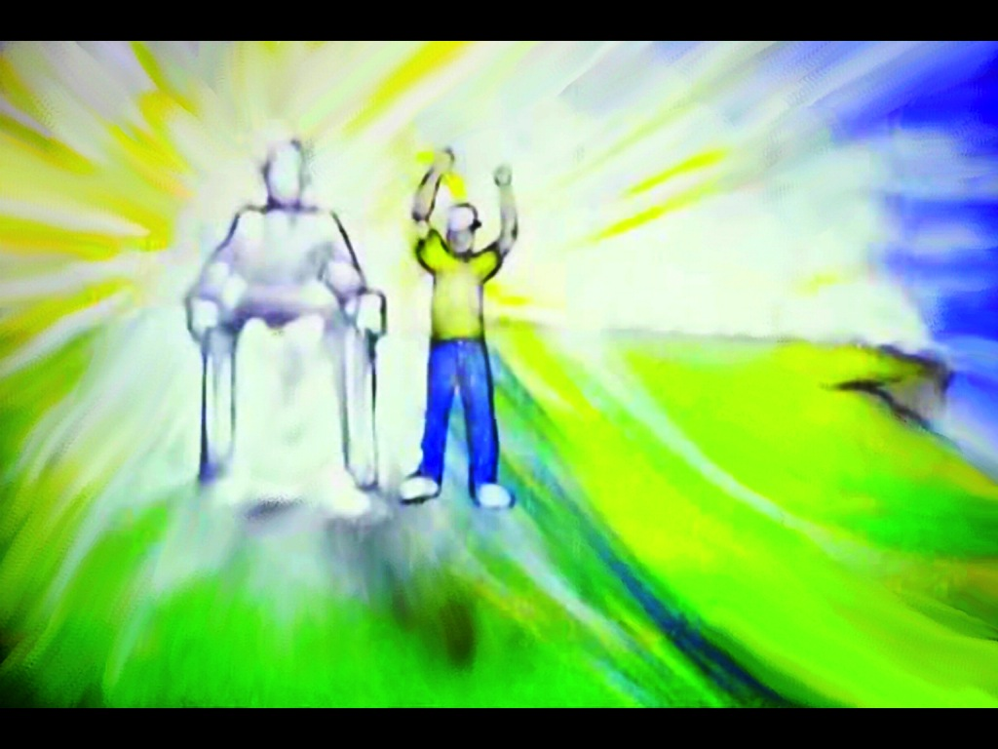
Notes:
(12) And they spend eternity with God.

Slide 44
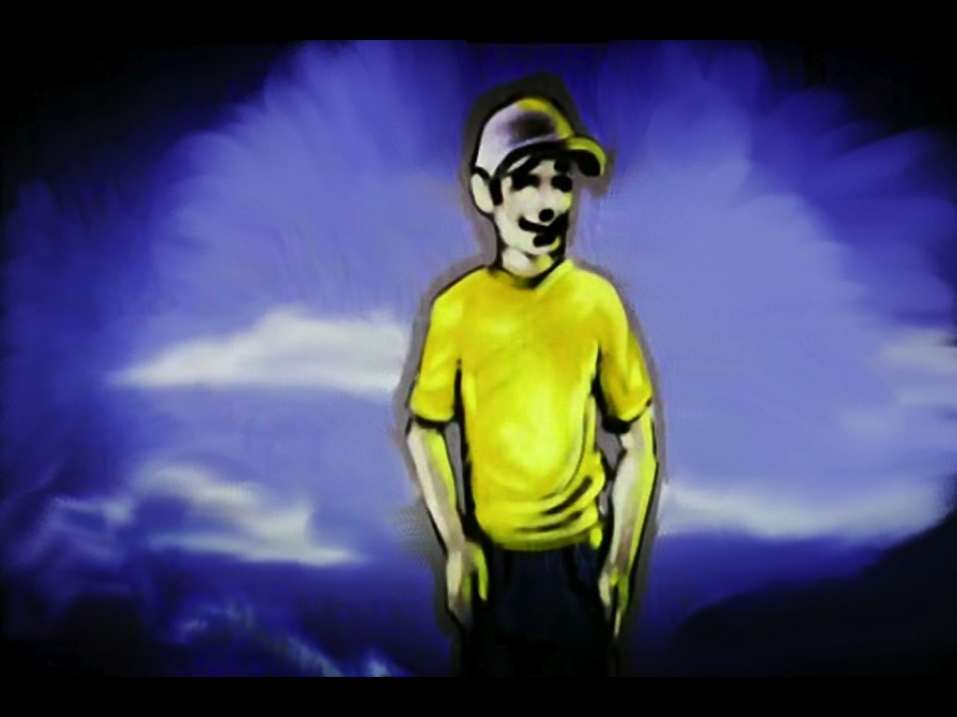
Notes:
(13) They will live for all eternity in perfect harmony, with no hole in their heart!

