Slide 1

Notes:
This week is Fear Factor Night.

Slide 2

Notes:
Welcome to Escape Friday.

Slide 3

Notes:
On Sunday morning in our Breakout Series we are dealing with Fear.

Slide 4

Notes:
Next Friday is our Comedy Club Night.

Slide 5

Notes:
Welcome to any newcomers and regulars.

Slide 6

Notes:
Are you ready for Fear Factor?

Slide 7

Notes:
Audio/Visual presentation of Fear Factor Moments
Audio Track: Fear Factor - Full Theme Song - DASH. Get it on YouTube at: https://www.youtube.com/watch?v=3KgCml_30Cs

Slide 8


Slide 9


Slide 10


Slide 11


Slide 12


Slide 13


Slide 14


Slide 15


Slide 16


Slide 17


Slide 18


Slide 19


Slide 20


Slide 21


Slide 22


Slide 23


Slide 24


Slide 25


Slide 26


Slide 27
Notes:
Video: Fear Factor Moments. Edited from two videos (Aligator Tank and Bee-Ware) on YouTube at: https://www.youtube.com/watch?v=GHoEVo7ucTM and https://www.youtube.com/watch?v=Z_igtl4xODI.

Slide 28

Notes:
Teams: Divide into 4 Teams

Slide 29
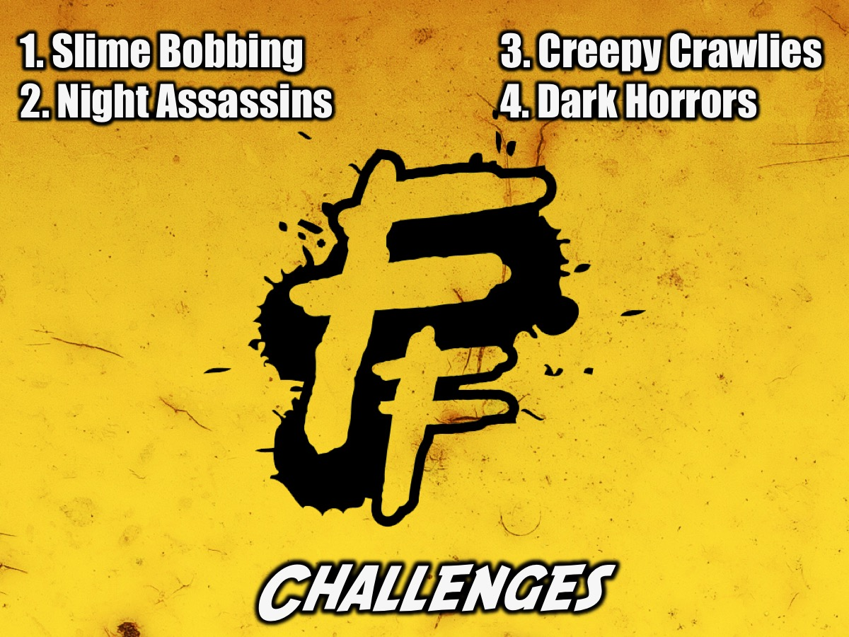
Notes:
Challenges: Each team will face four challenges:
1. Slime Bobbing. A team will choose one player who will be blindfolded and given a bowl full of jelly and different items inside - they have to get all the items out the bowl without using their hands to touch the items. The team will be timed to see how many points they get for the challenge.
2. Night Assassins. The team must find 5 (?) items hidden around the parking lot and will be hit by balls and water bombs, the longer they take to complete the challenge. Their time will determine how many points they get for the challenge.
3. Creepy Crawlies - A team member is blindfolded and lies on the ground and has insects placed on their body. The longer the team takes to complete a challenge the closer the insects will get to their face.
4. Dark Horrors - A team member will walk through a dark room to find items and there will encounter horrors along the way (like a spider in a web, blood and other horrors).

Slide 30
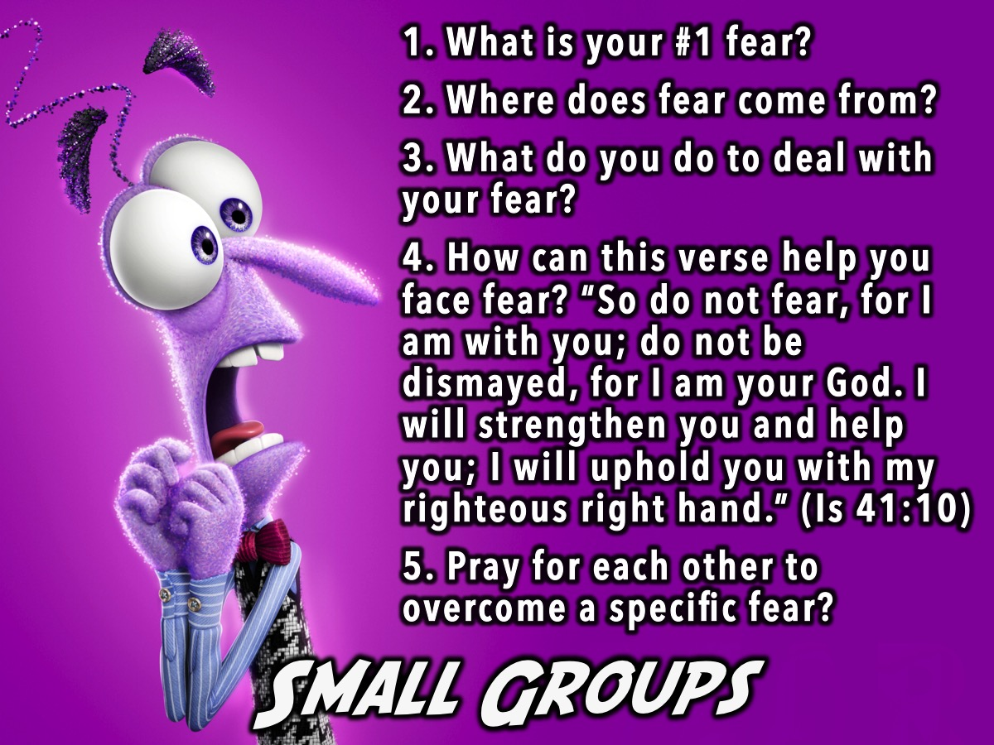
Notes:
Small Groups. Here are the small group questions: (1) What is your #1 fear? (2) Where does fear come from? (3) What do you do to deal with your fear? (4) How can this verse help you face fear? “So do not fear, for I am with you; do not be dismayed, for I am your God. I will strengthen you and help you; I will uphold you with my righteous right hand.” (Is 41:10). (5) Pray for each other to overcome a specific fear?

Slide 31

Notes:
Winners: We are going to announce the winners who will come forward to receive their prizes.

Slide 32

Notes:
Next Friday night is Comedy Club Night.

Slide 33

Notes:
Refreshments are served.

