Slide 1

Notes:
This week we are going to learn how to fight abuse.

Slide 2

Notes:
Any ideas on who our superhero is this week?

Slide 3

Notes:
If you did not get it with that last pic then now you will!

Slide 4

Notes:
Batman hates abuse – he has dedicated his life to fighting abuse in any form!

Slide 5

Notes:
His mom and dad were killed in an ally by a Mugger and that trauma influenced Bruce Wayne as he grew up.

Slide 6
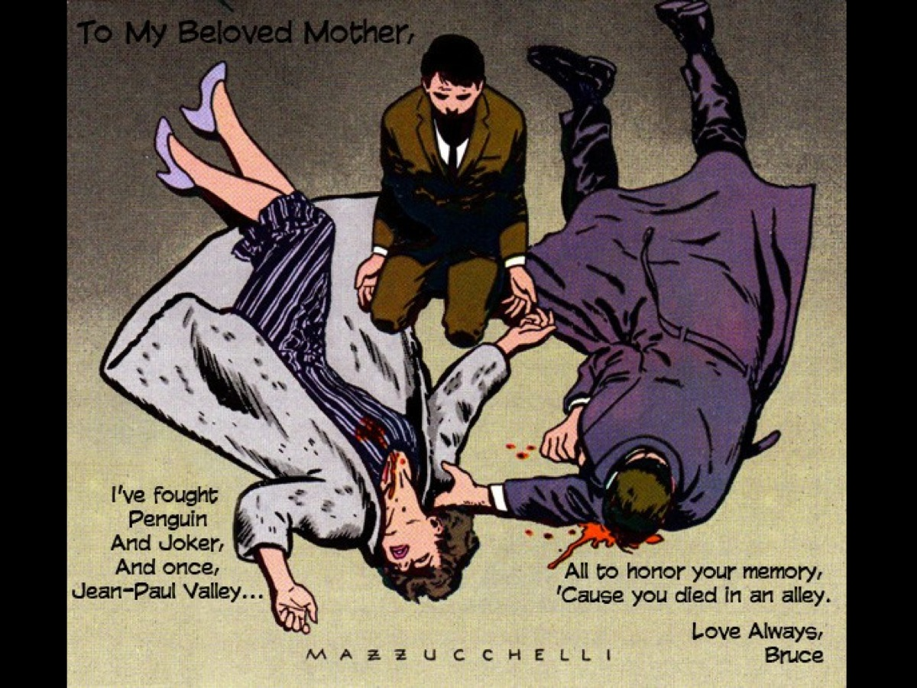
Notes:
In fact, he fights crime to honour his parent’s memory.

Slide 7

Notes:
In one of the comics, billionaire Bruce Wayne, who as a child witnessed his parents' murder, encounters the social worker Debra Kane, who takes Wayne to check up on her clients: he sees clear cases of child abuse and brave but futile resistance to it. Wayne's loyal butler, Alfred Pennyworth, gives him the secret files from his mother's investigation into child abuse, which had led to her and her husband's assassination, illuminating the darkest mystery of Wayne's childhood. As Batman, Wayne investigates child abuse and, through a series of informants, is led to a child sex tourism syndicate using a fictional southeast-Asian country. Batman travels to Udon Khai and, with the help of a local rebel force of guerrilla fighters, topples the kingpin who controls the industry. In the process, he avenges the murder of his parents.

Slide 8

Notes:
Batman has his work cut out for him as he stands up against people who like to abuse people – including… the Joker…

Slide 9

Notes:
and Bane.

Slide 10

Notes:
Let’s begin by understanding abuse.

Slide 11

Notes:
Let’s start by looking at the word “abuse”. To abuse means to use wrongly, or improperly, or to misuse.

Slide 12
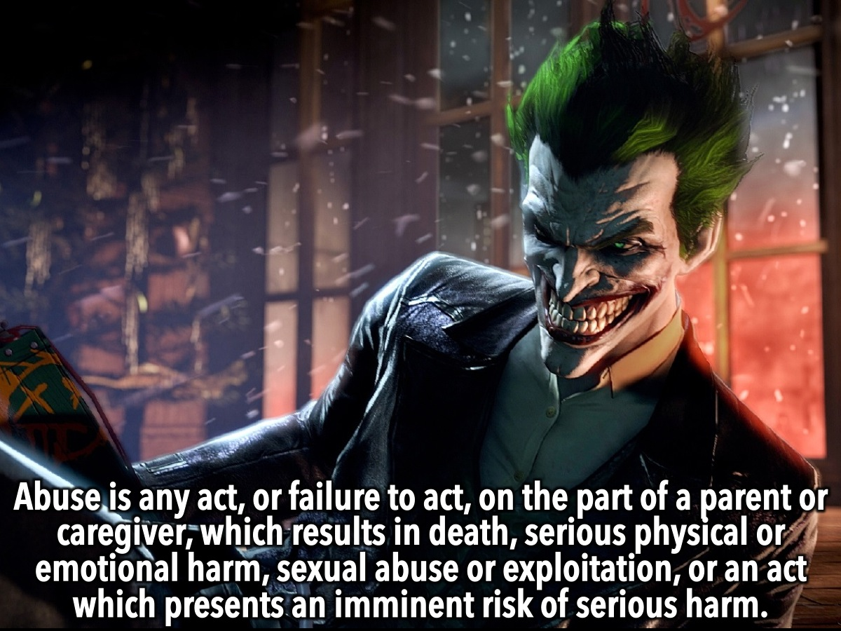
Notes:
So abuse is any act, or failure to act, on the part of a parent or caregiver, which results in death, serious physical or emotional harm, sexual abuse or exploitation, or an act or failure to act which presents an imminent risk of serious harm.

Slide 13
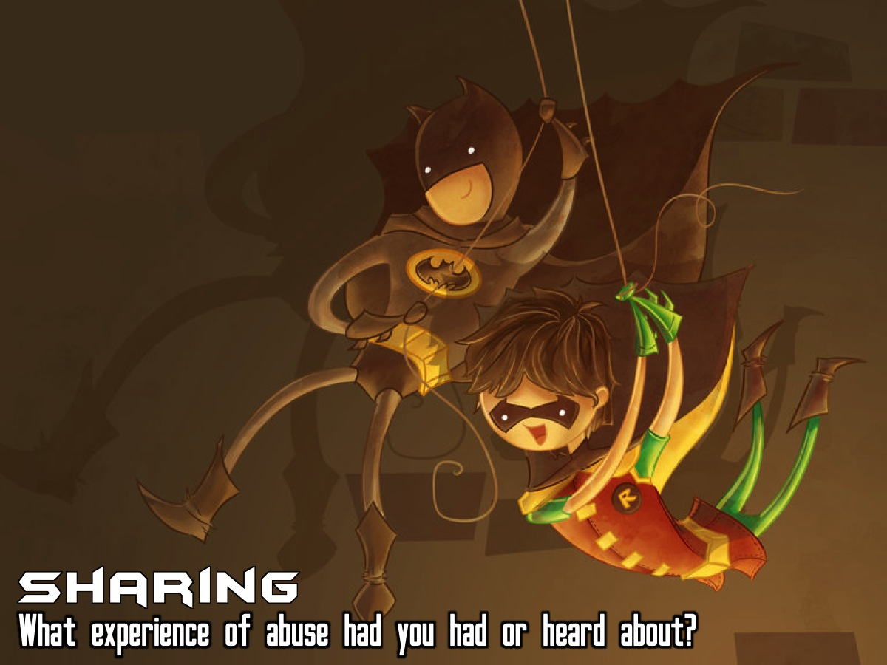
Notes:
Sharing: What experience of abuse have you had or heard about?

Slide 14

Notes:
There are different kinds of abuse:

Slide 15

Notes:
First take a look at these split screen images and see if you can identify different kinds of abuse.

Slide 16
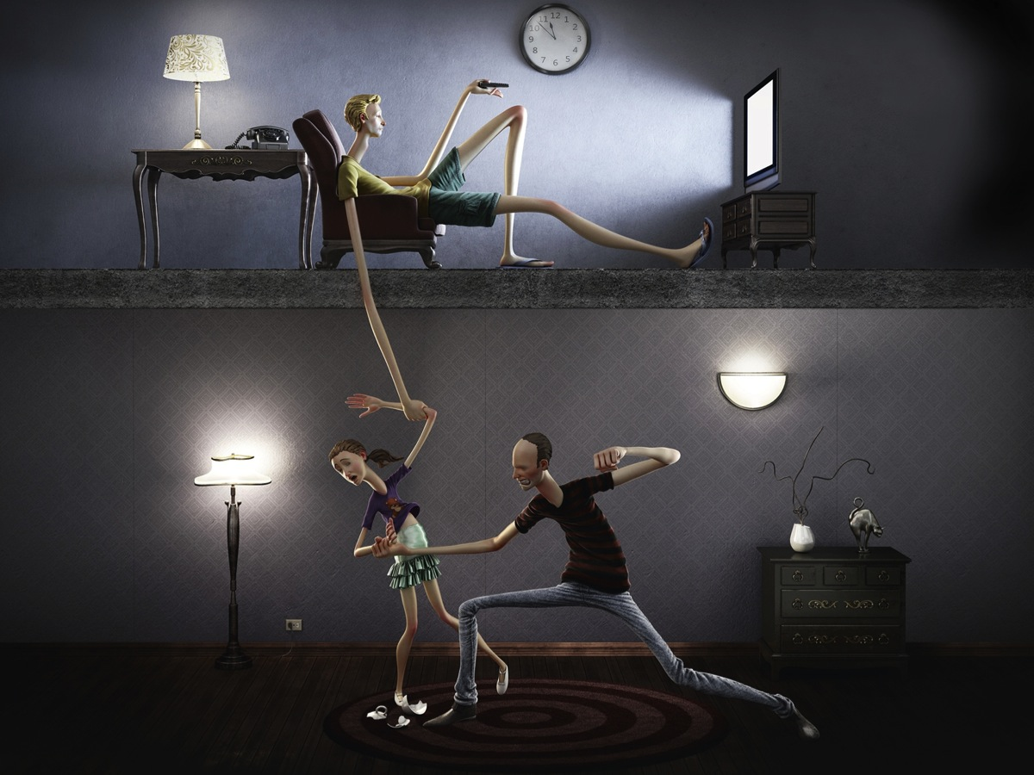
Notes:
Here is the second split-screen image illustrating kinds of abuse.

Slide 17
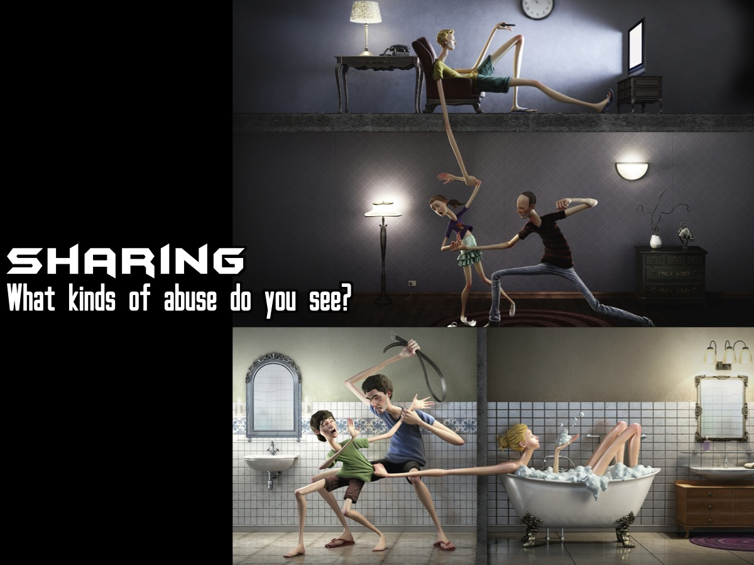
Notes:
Sharing: Turn to the person next to you and take turns sharing different kinds of abuse you identified in the pics with each other.

Slide 18
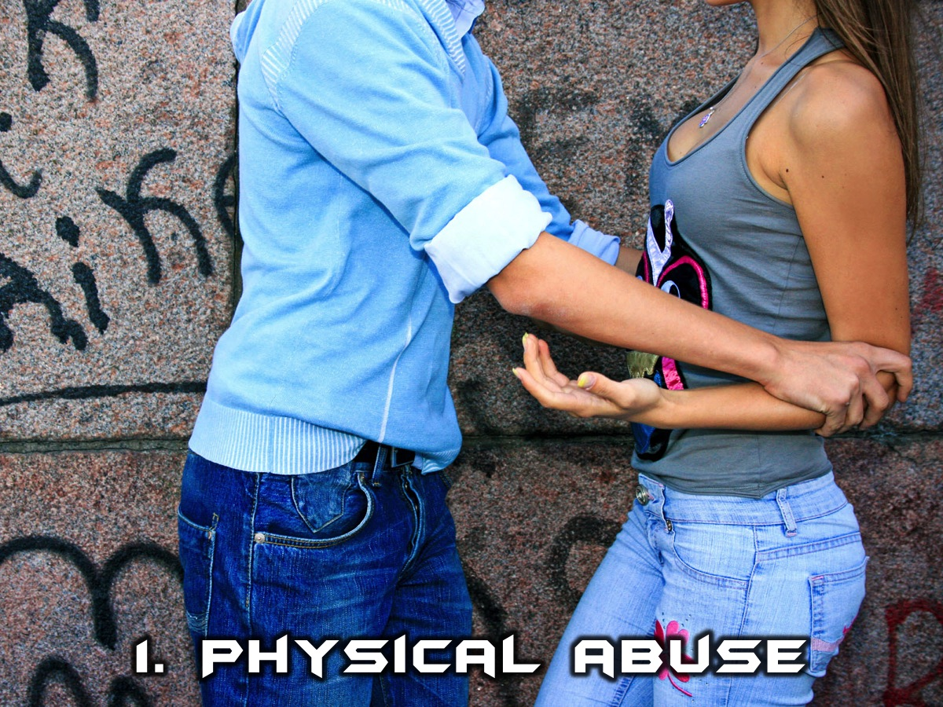
Notes:
1. Physical Abuse. A non-accidental physical injury as a result of punching, beating, kicking, biting, shaking, throwing, stabbing, choking, hitting, burning or otherwise harming a child, that is inflicted by a parent, caregiver or other person who has responsibility for the child. Such injury is considered abuse regardless of whether the caregiver intended to hurt the child.

Slide 19

Notes:
2. Sexual Abuse. A form of child abuse that includes any sexual act performed with a child by an adult or older child, with our without force or threat of force. It may start as seemingly innocent touching and progress to more serious acts, including verbal seduction or abuse, anal or vaginal intercourse, oral sex, sodomy, manual stimulation, direct threats, implied threats or other forms of abuse.

Slide 20
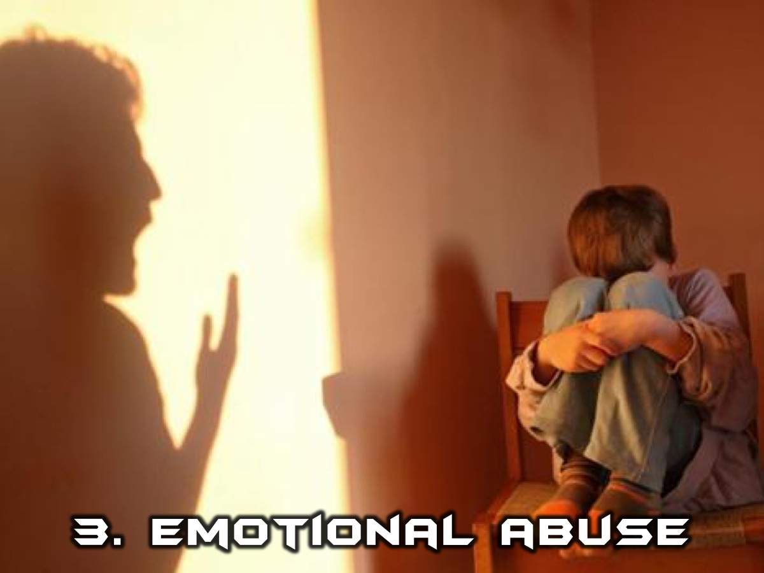
Notes:
3. Emotional Abuse. This is a pattern of behavior that affects a child’s sense of worth by communicating to the child that he or she is not worthy, loved or important. It may include harsh demands, constant criticism, threat or yelling.

Slide 21
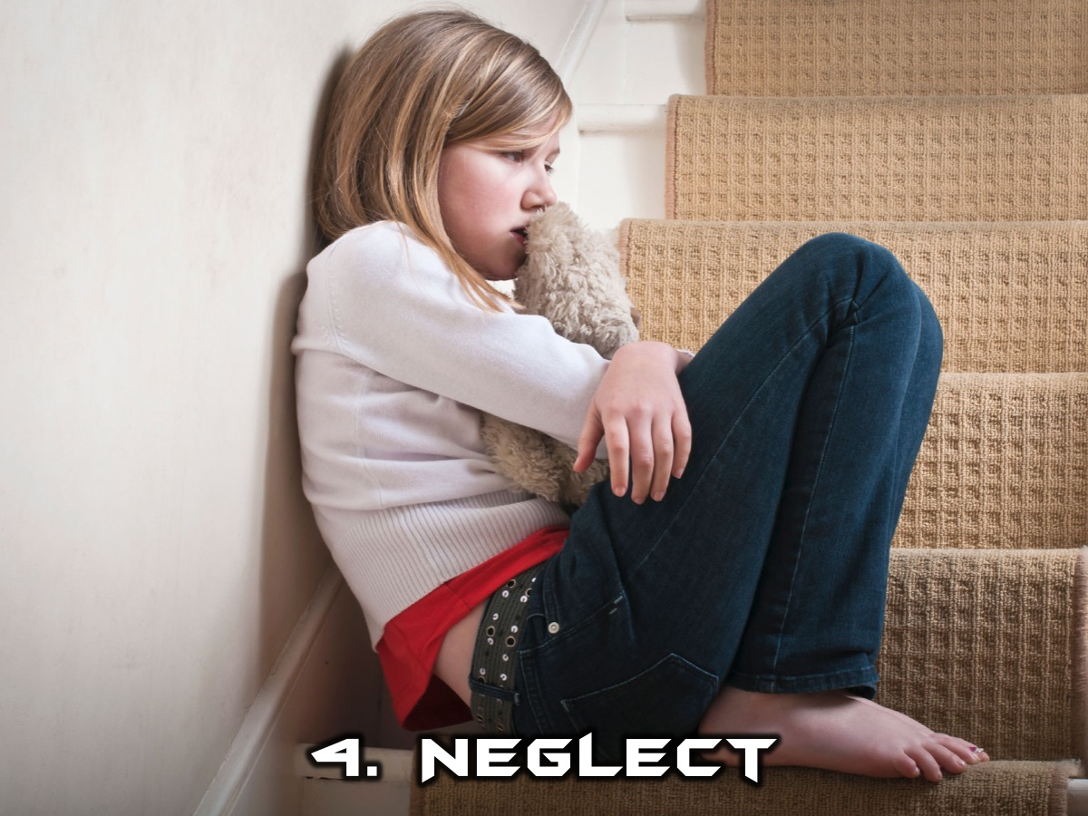
Notes:
4. Neglect. Neglect is a failure to meet the child’s basic needs, e.g., not providing enough food, shelter or basic supervision, necessary medical or mental health treatment, adequate education or emotional comfort.

Slide 22
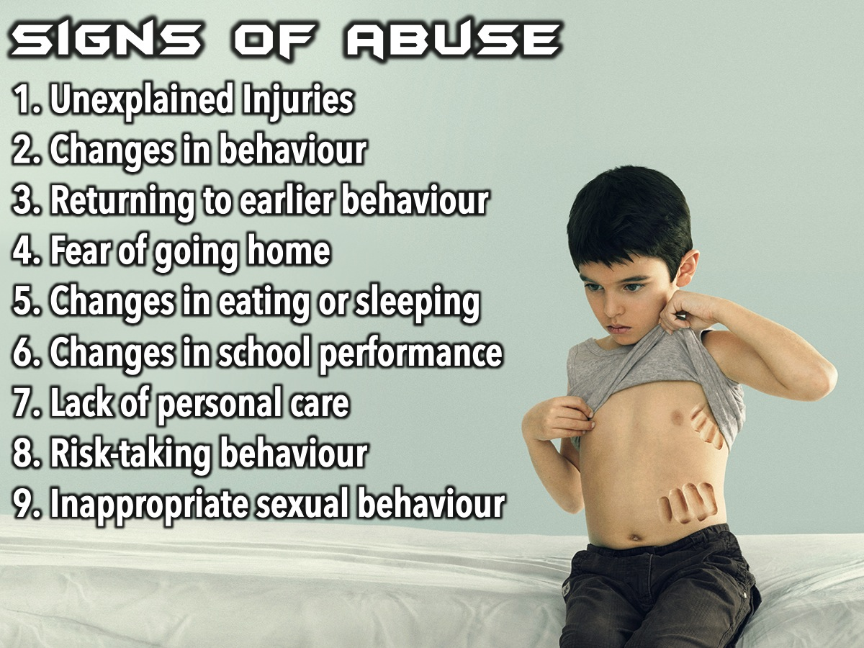
Notes:
Here are some signs that a person may be abused: (1) Unexplained injuries (bruises, burns, etc., often which the child cannot explain). (2) Changes in behavior (becoming anxious, scared, depressed, etc.). (3) Returning to earlier behaviors (regressing to thumb sucking, bed wetting, fear of the dark or of strangers, etc.). (4) Fear of going home (apprehension of leaving school or going to a person who has been abusing them). (5) Changes in eating (resulting in weight gain or loss) or sleeping (nightmares or difficulty falling asleep, fatigued). (6) Changes in school performance and/or attendance (difficulty also in concentrating in school, excessive absences, etc.). (7) Lack of personal care or hygiene (may appear uncared for, body odor). (8) Risk-taking behaviors (using drugs or alcohol, carrying a weapon, etc.). (9) Inappropriate sexual behavior (may exhibit overly sexualized behavior or use explicit sexual language).

Slide 23
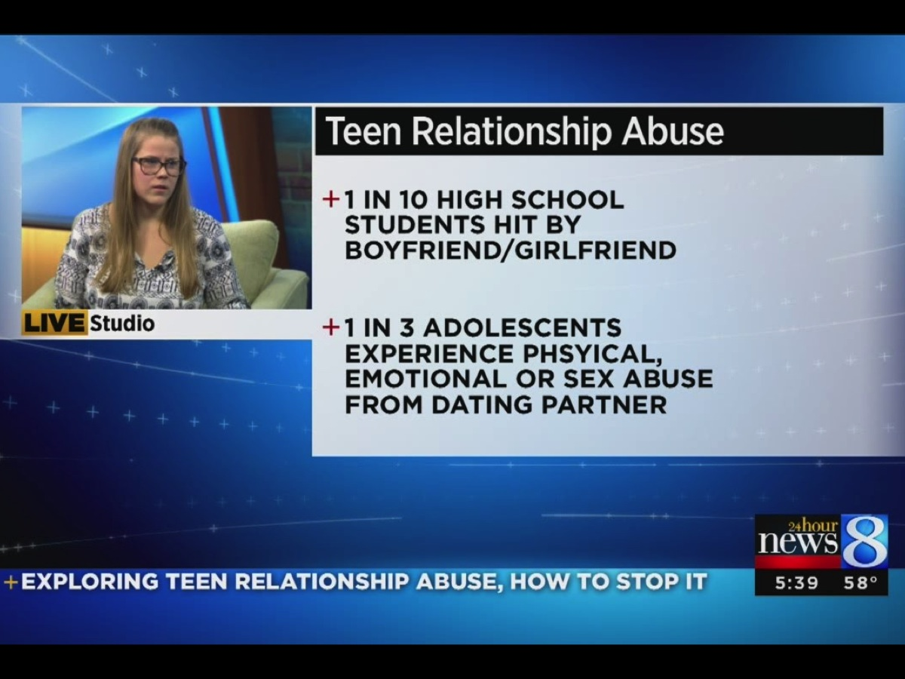
Notes:
The statistics for teen relationship abuse suggest that we are talking about a very serious problem! For example: 1 in 10 high school students are hit by their boyfriend or girlfriend. 1 in 3 adolescents experience physical, emotional or sex abuse from their dating partner.

Slide 24

Notes:
I am sure you know that there are hijacking hotspots around the country – places where your risk of getting hijacked are much higher than in other places.

Slide 25

Notes:
There are also abuse hotspots that you need to be on the guard against:

Slide 26

Notes:
1. Dating

Slide 27
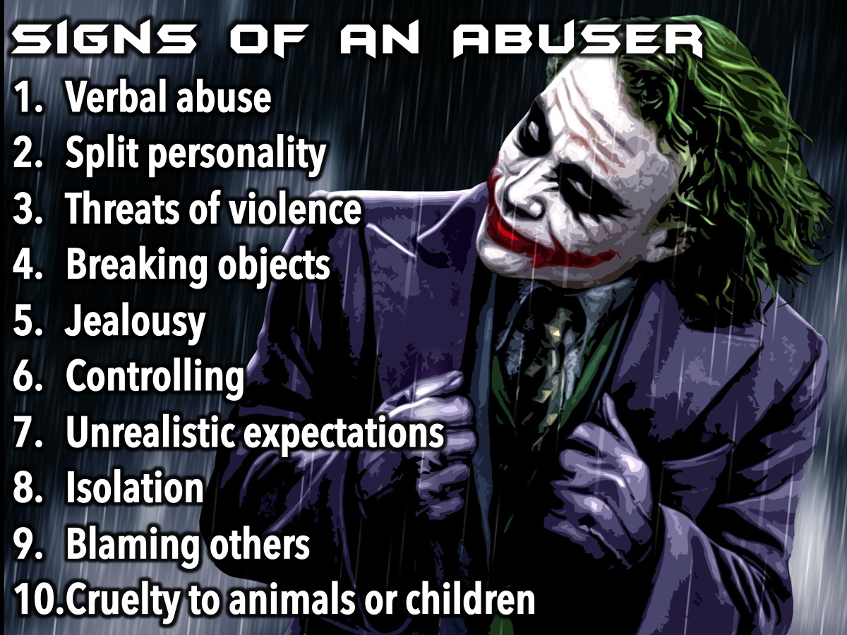
Notes:
There are warning signs that will help you identify a potential abuser: (1) Verbal abuse. (2) Split personality (Jekyll/Hyde). (3) Threats of violence. (4) Breaking or striking objects. (5) Jealousy. (6) Controlling behavior. (7) Unrealistic expectations. (8) Isolation. (9) Blames others for their problems or feelings. (10) Cruelty to animals or children.

Slide 28

Notes:
2. Home

Slide 29
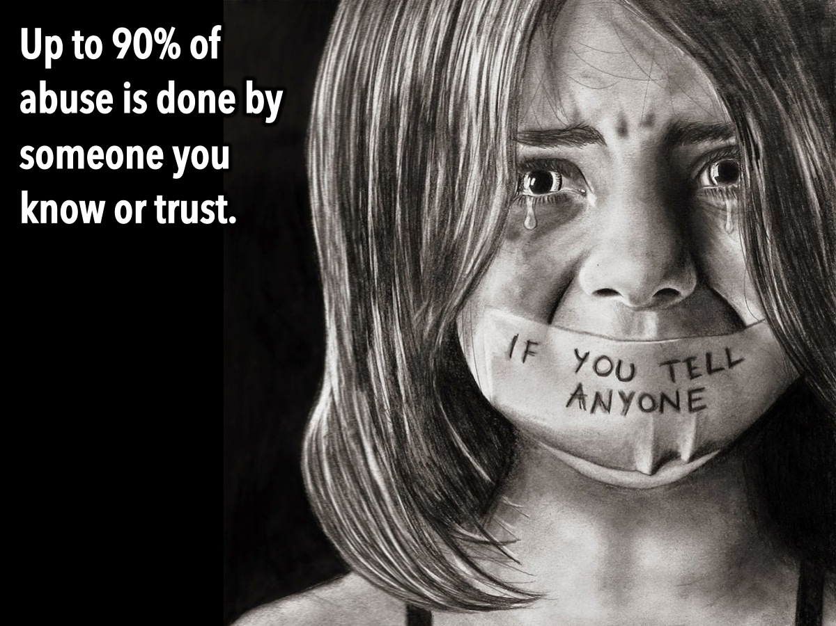
Notes:
Up to 90% of abuse is done by someone you know or trust.

Slide 30

Notes:
3. Groups

Slide 31
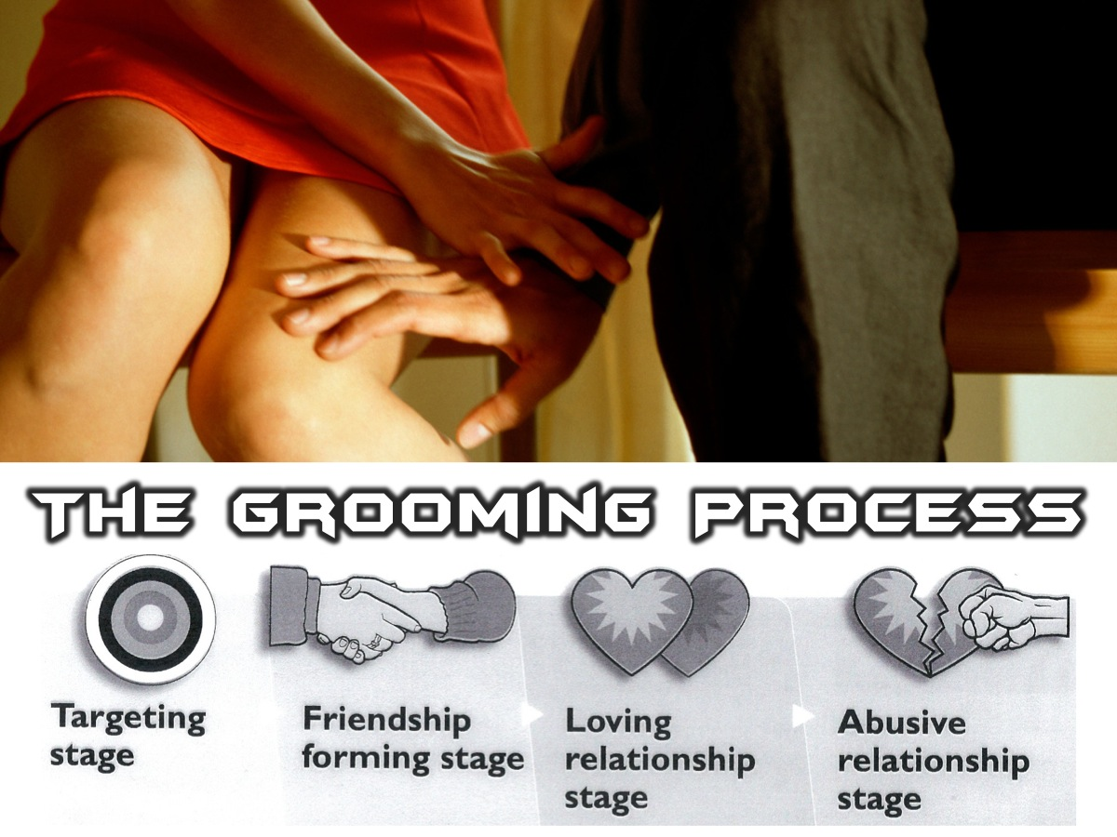
Notes:
You need to watch out for the grooming process that can take place in groups within society: It starts with the targeting stage where the abuser targets a person, then there is the friendship forming stage, followed by the loving relationship stage and finally the abusive relationship stage.

Slide 32

Notes:
4. Parties

Slide 33

Notes:
To have your drink spiked with a date rape drug while you are in a club is a very scary scenario!

Slide 34
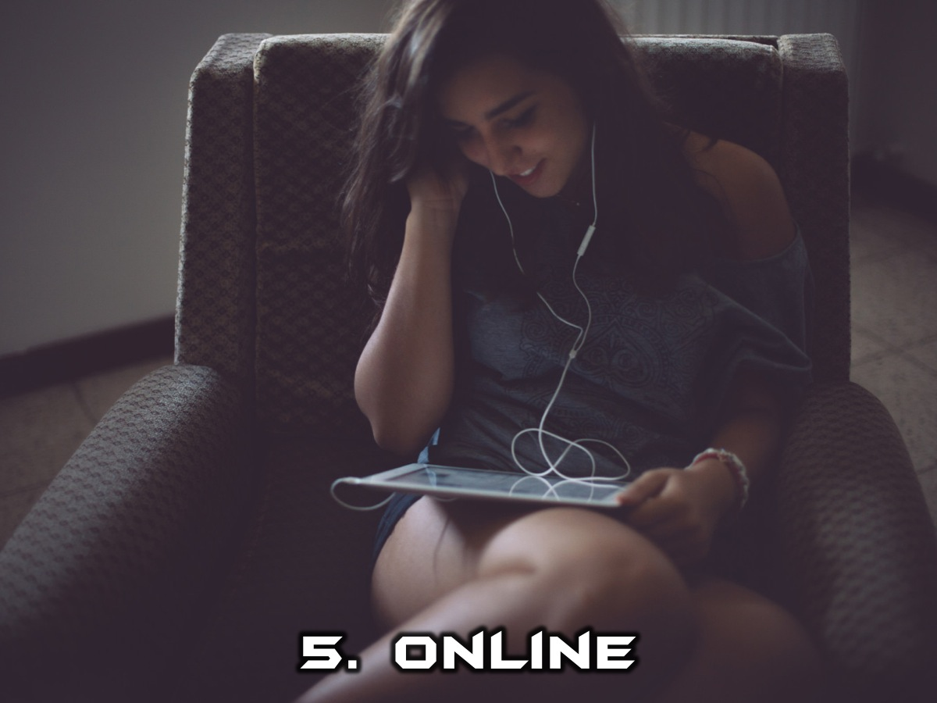
Notes:
5. Online

Slide 35
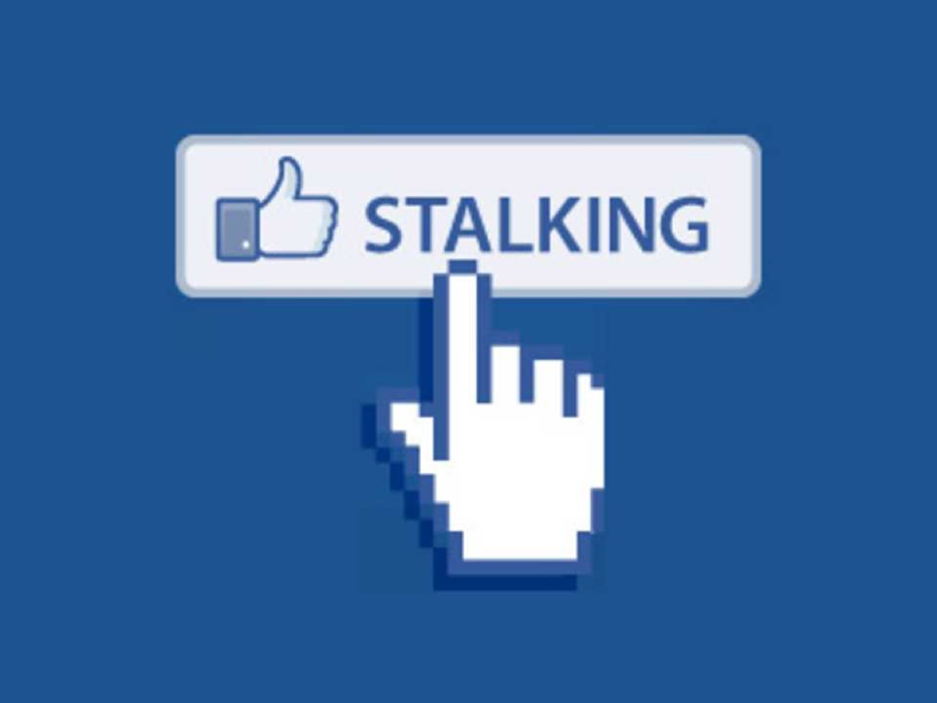
Notes:
Facebook stalking is just one example of how you can be abused online.

Slide 36
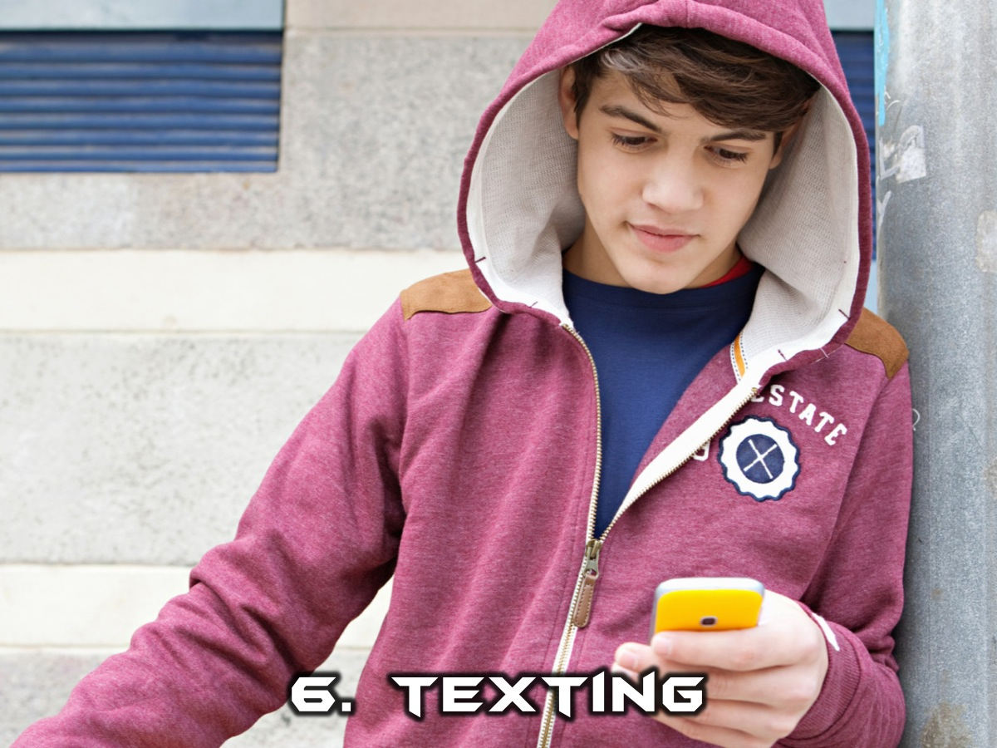
Notes:
6. Texting

Slide 37

Notes:
I came across this image this week – the caption says: “Sexual predators can hide in your smartphone”.

Slide 38

Notes:
So how do we go about fighting abuse?

Slide 39
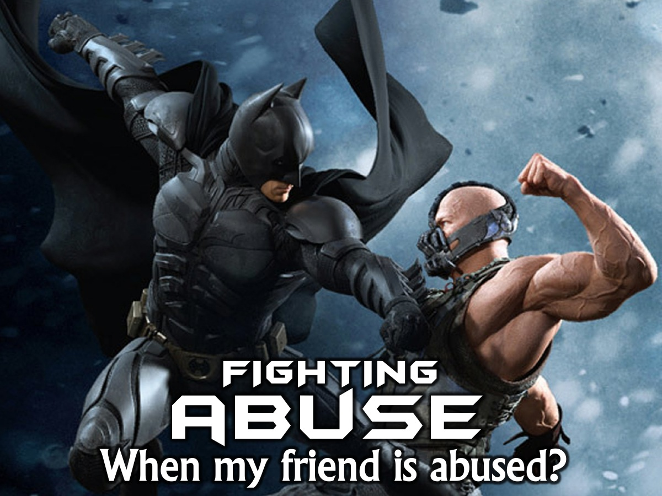
Notes:
What can we do to help protect our peers from abuse?

Slide 40

Notes:
1. Watch Them – look out for the signs of abuse we discussed earlier.

Slide 41
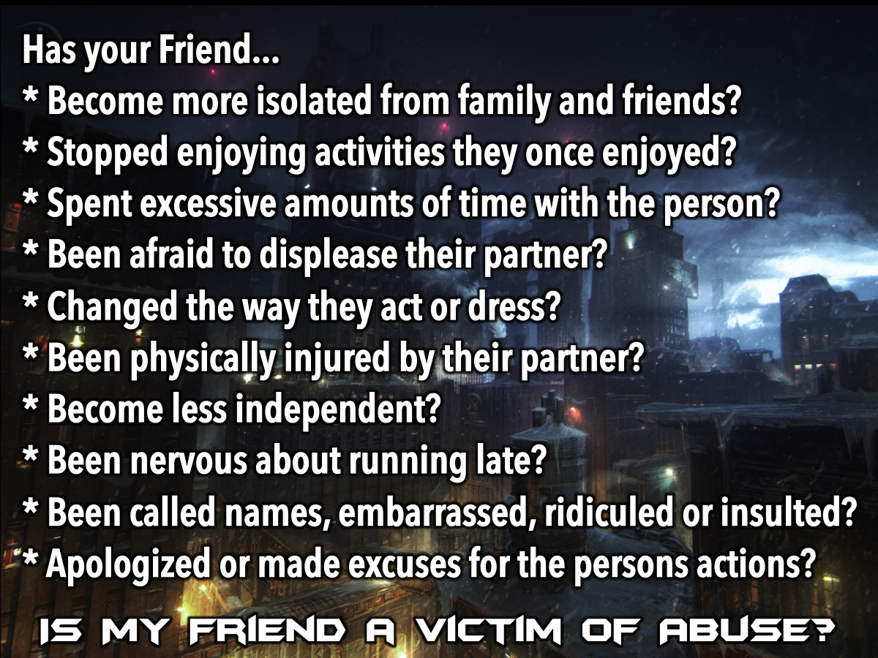
Notes:
Is my friend a victim of abuse? Has your Friend: Become more isolated from family and friends? Stopped enjoying activities they used to enjoy? Spent excessive amounts of time with the person? Been afraid to displease their partner? Changed the way they act or dress? Been physically injured by their partner? Become less independent? Been nervous about running late? Cancel plans or seem nervous to participate in certain activities? Been called names, embarrassed, ridiculed, or insulted by their partner in front of you or other people? Apologized or made excuses for the actions or behaviors of his or her partner? If you said yes to two or more of these questions, your friend may be in an abusive relationship.

Slide 42

Notes:
2. Help Them

Slide 43
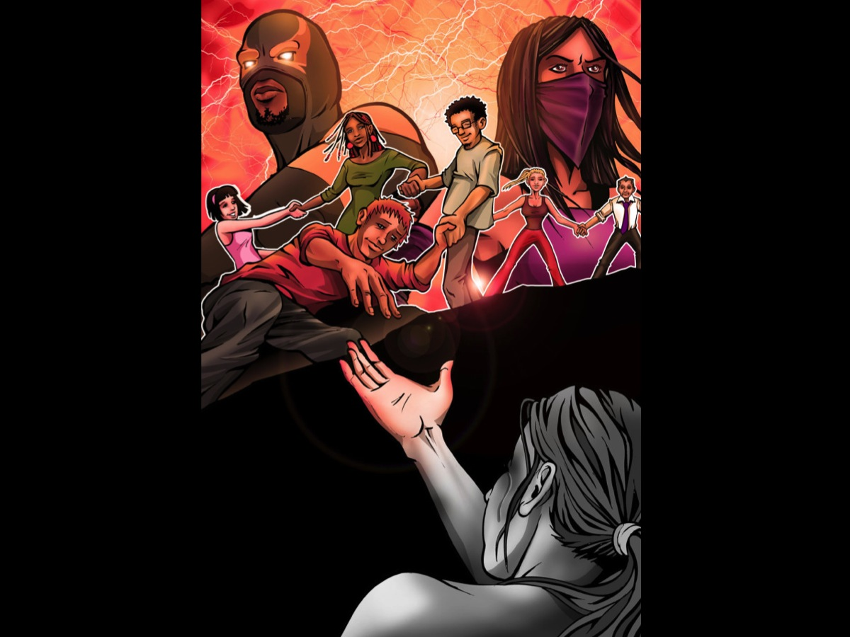
Notes:
We can’t just walk past and do nothing when a friend is in trouble – we have to be everyday heroes – the good samaritans who stop to help. And if we work together there is nothing that we can’t do!

Slide 44

Notes:
3. Refer Them

Slide 45

Notes:
Find someone who can give them the counselling they need to deal with the trauma they have experienced.

Slide 46

Notes:
4. Support Them

Slide 47

Notes:
They may just need some encouraging from the sidelines – let them know that they are still special in the eyes of God and that you are there for them.

Slide 48
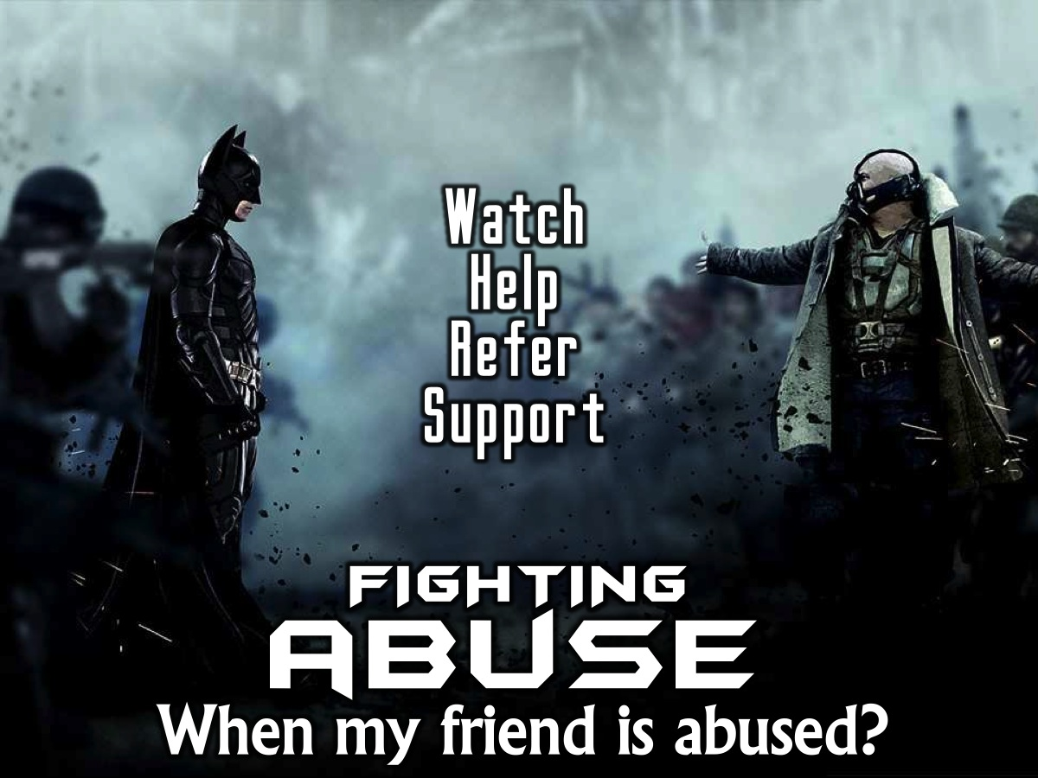
Notes:
Summary: How do we fight abuse in others? (1) Watch Them. (2) Help Them. (3) Refer Them. (4) Support Them.

Slide 49
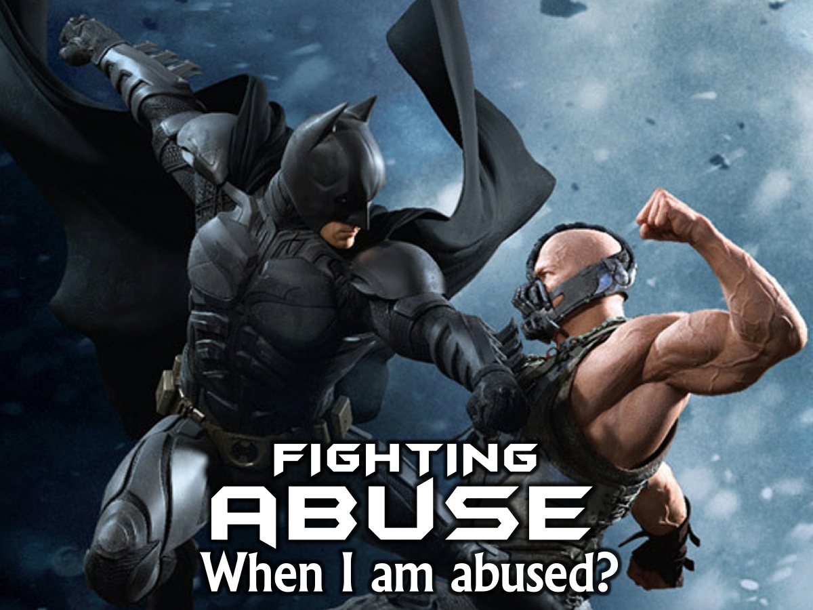
Notes:
What can we do to help protect our selves from abuse?

Slide 50

Notes:
1. Get Smart - Spot the warning signs that abuse is happening or on the horizon!

Slide 51
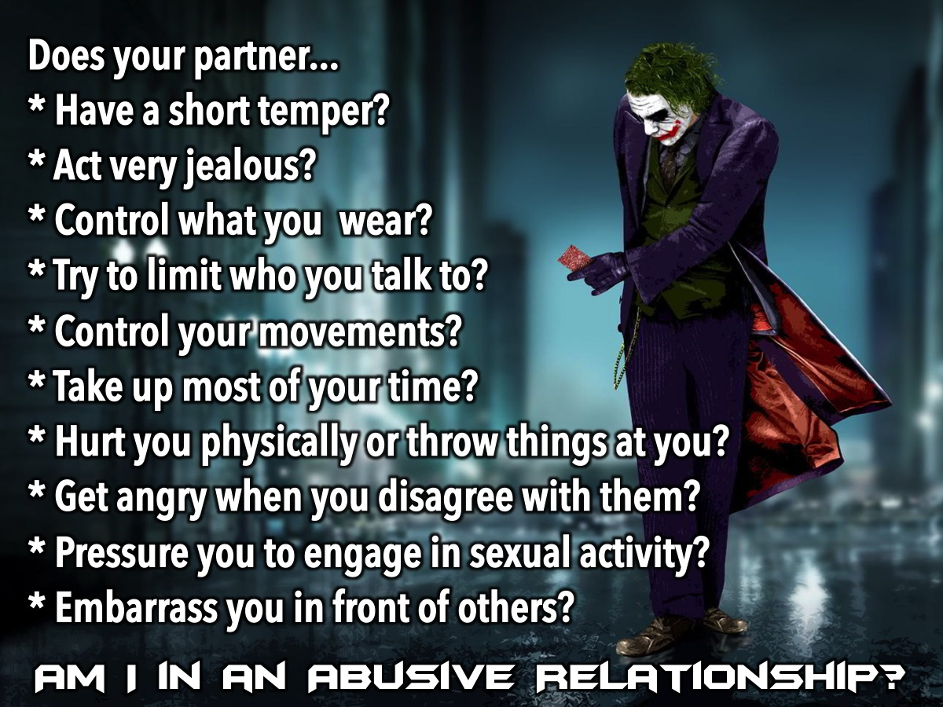
Notes:
Here are some questions to ask to check whether you are in an abusive relationship: Does your partner: Have a short temper? Act very jealous? Control what you wear? Try to limit who you talk to? Control your movements? Take up most of your time? Hurt you physically or throw things at you? Get angry when you disagree with them? Pressure you to engage in sexual activity? Embarrass you in front of others? If you answered yes to three or more of these questions you might want to consider talking to someone you trust about your relationship.

Slide 52

Notes:
2. Get Connected

Slide 53

Notes:
Hangout with friends – do things together and you will be much safer.

Slide 54

Notes:
3. Get Backup.

Slide 55
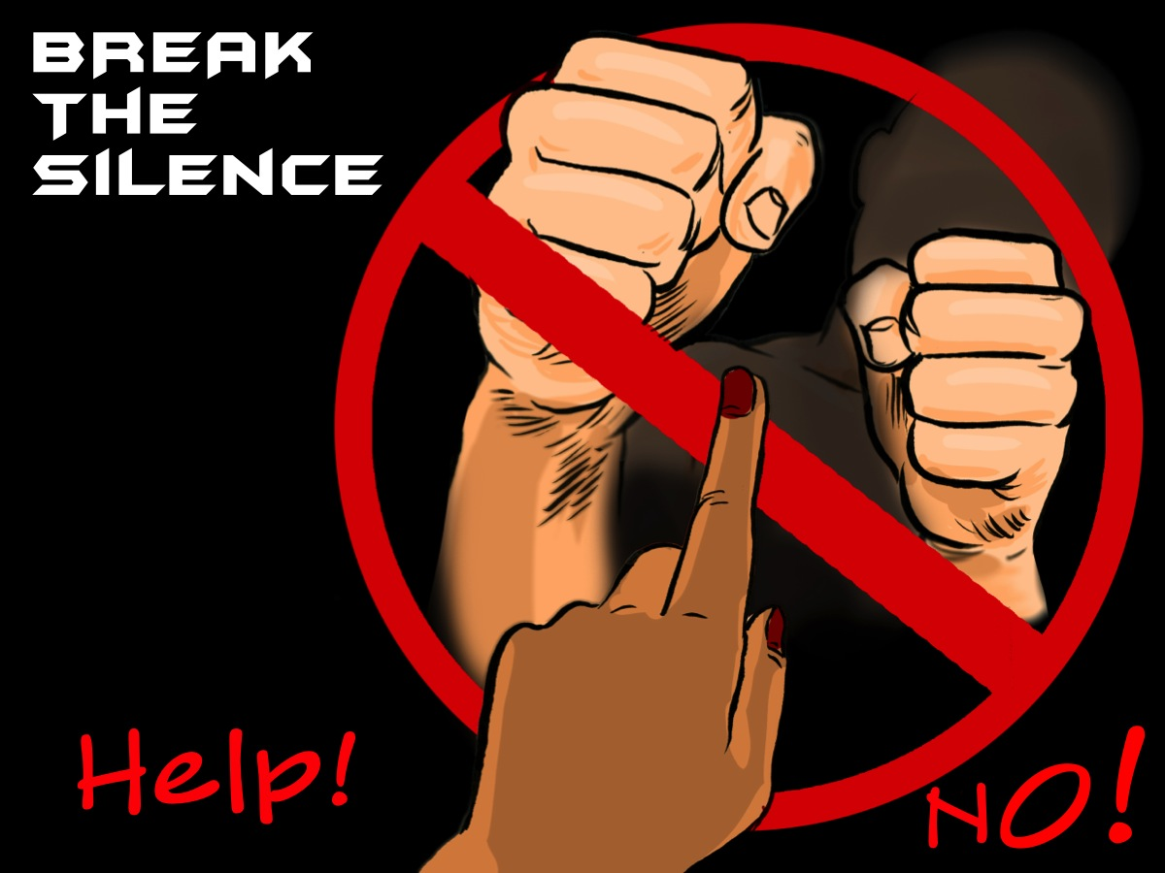
Notes:
You have to break the silence! Don’t keep it to yourself – tell your friend and ask them to help you in your situation.

Slide 56
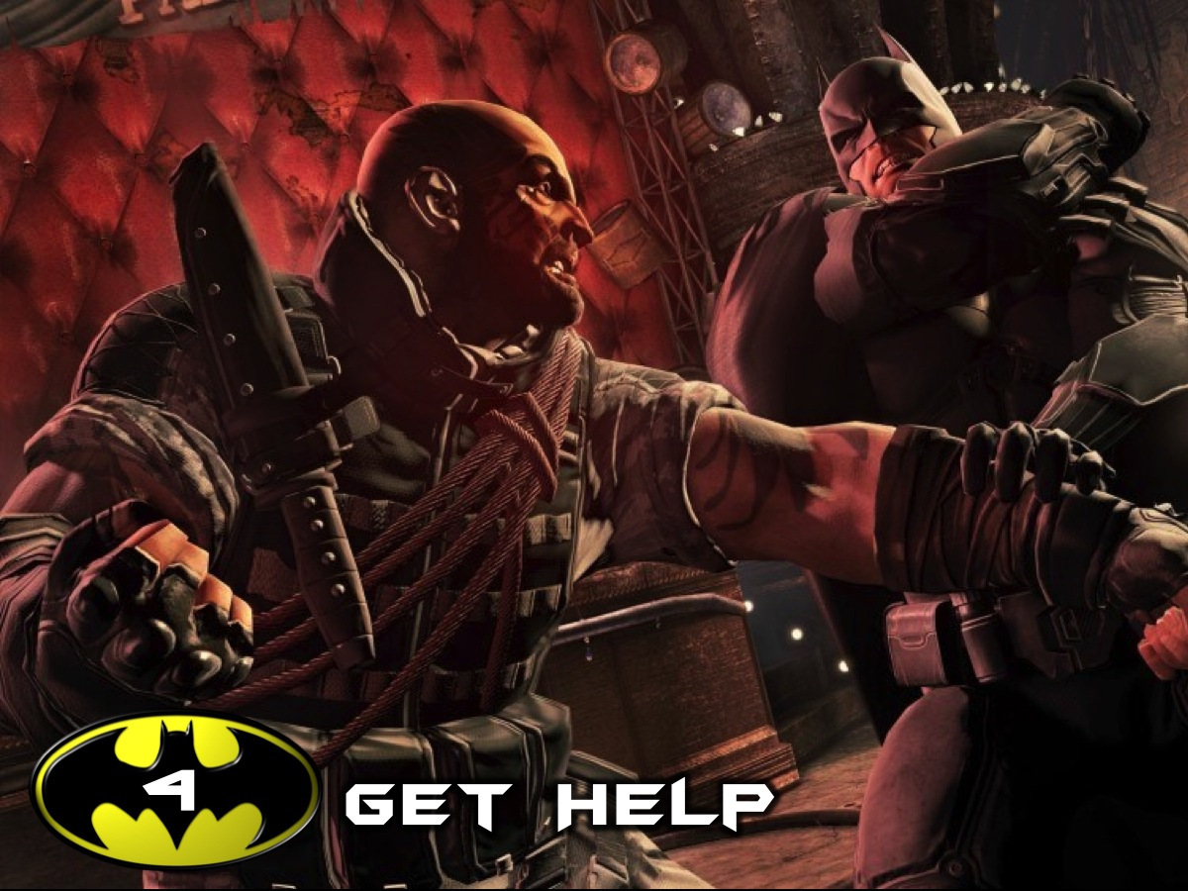
Notes:
4. Get Help - there are some things in life that you can’t handle on your own and some things that even a friend can’t handle.

Slide 57
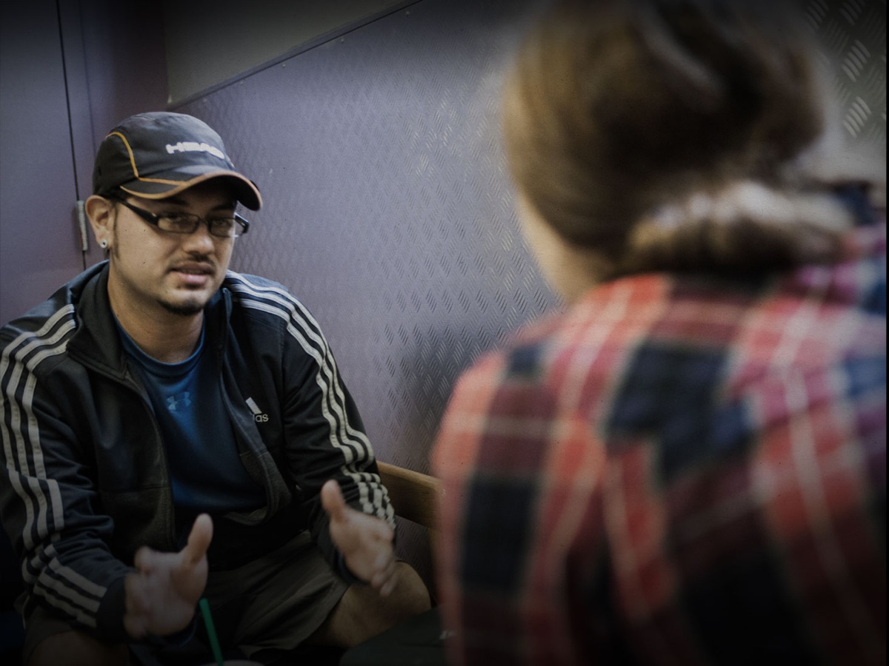
Notes:
Speak to someone who can make sure you get the professional help that you need.

Slide 58

Notes:
5. Get Out.

Slide 59

Notes:
If you are in a potentially abusive relationship, get out! Stop making excuses for the person or hoping that things will changes. It will only get worse!

Slide 60
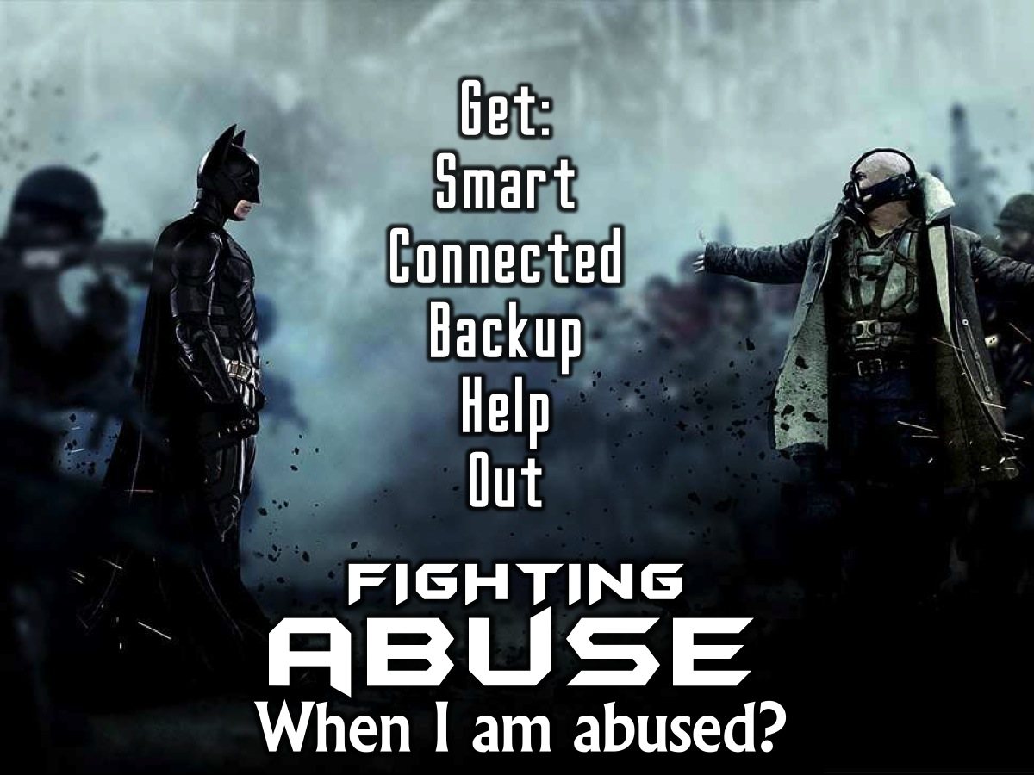
Notes:
Summary: How do we fight abuse against us? (1) Get Smart. (2) Get Connected. (3) Get Backup. (4) Get Help. (5) Get Out.

Slide 61
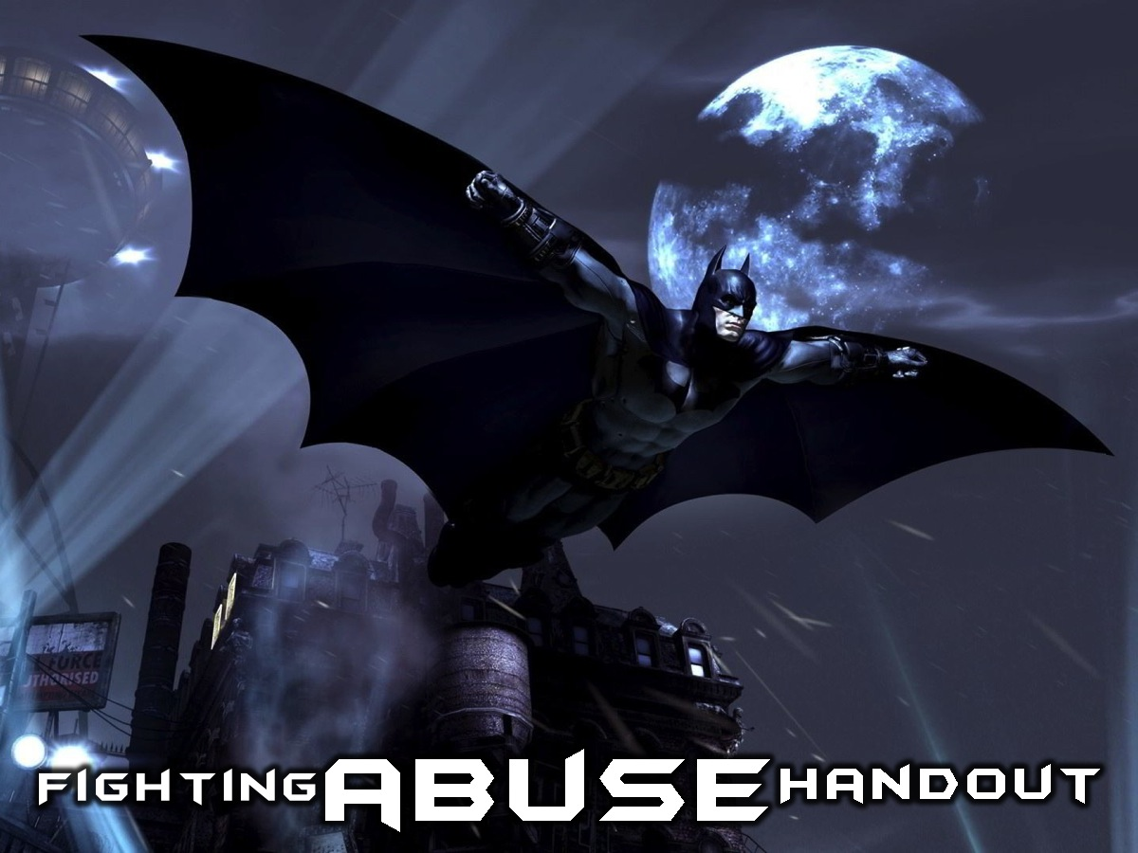
Notes:
We are going to give you each a copy of the Fighting Abuse handout so you have the information we covered this morning.

Slide 62

Notes:
Let’s Pray

