Slide 1
Notes:
Today we are going to talk about Fighting Anger!

Slide 2
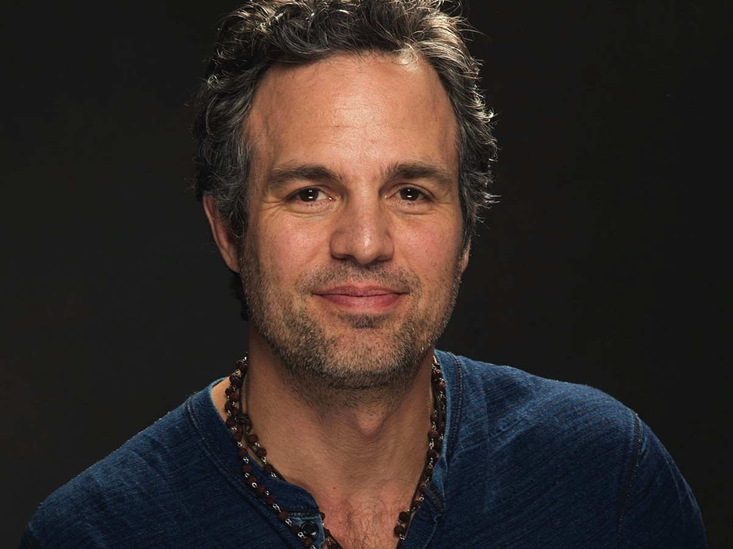
Notes:
Bruce Banner is a calm and peaceful guy – a doctor, scientist

Slide 3
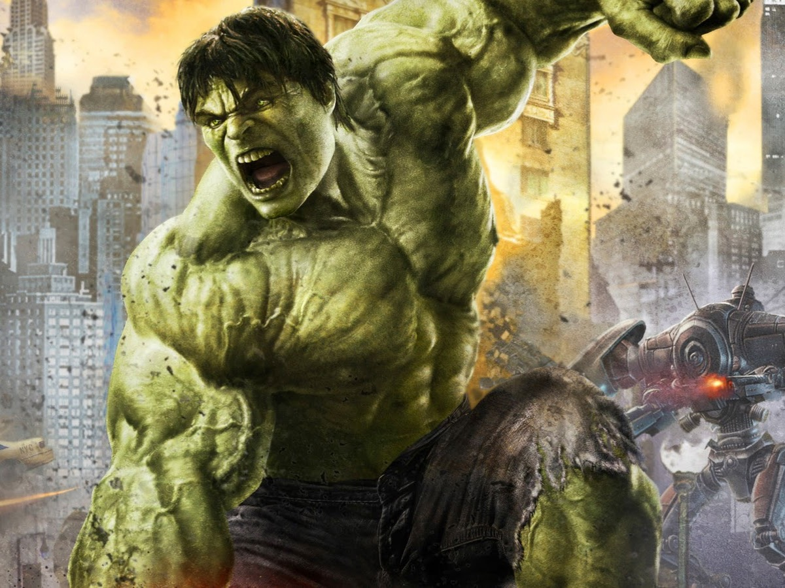
Notes:
And he becomes the Hulk – smashing and destroying things.

Slide 4
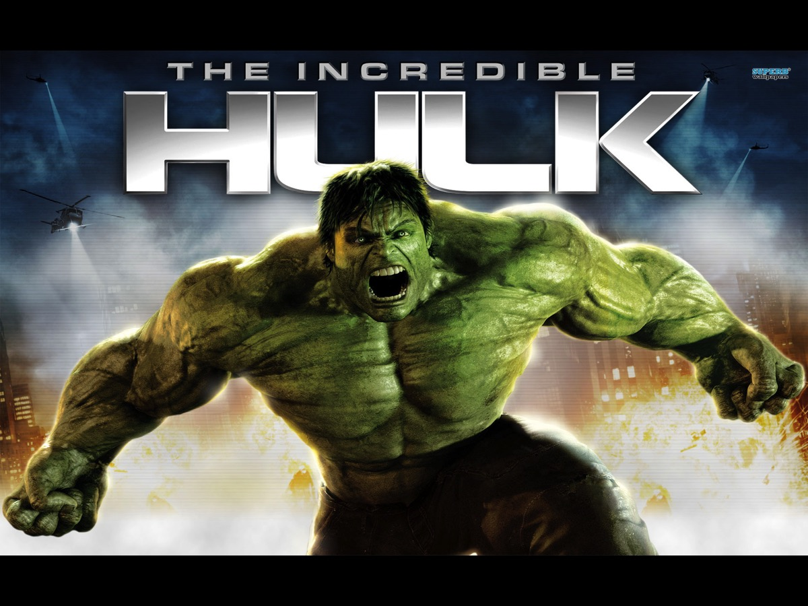
Notes:
The incredible hulk!

Slide 5
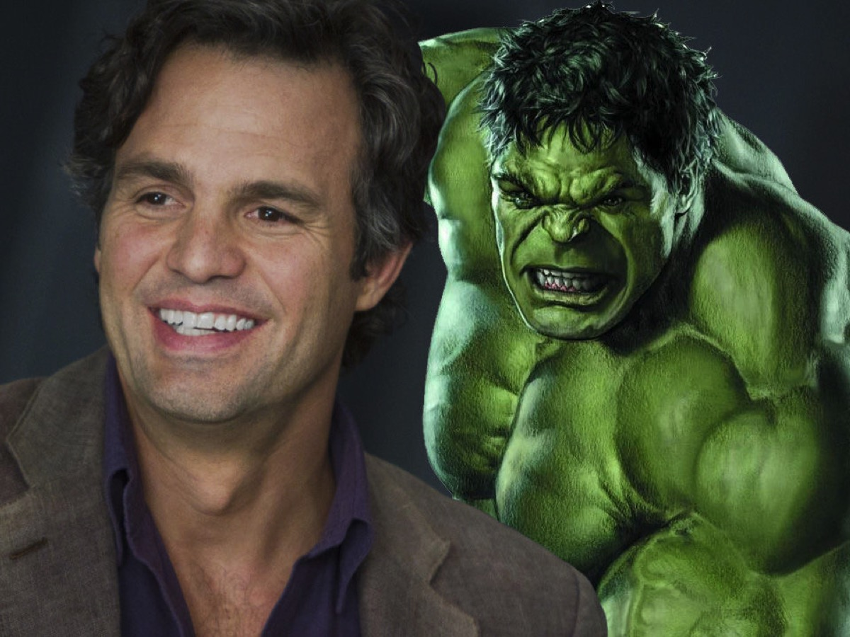
Notes:
How does such a nice guy become such a beast?

Slide 6
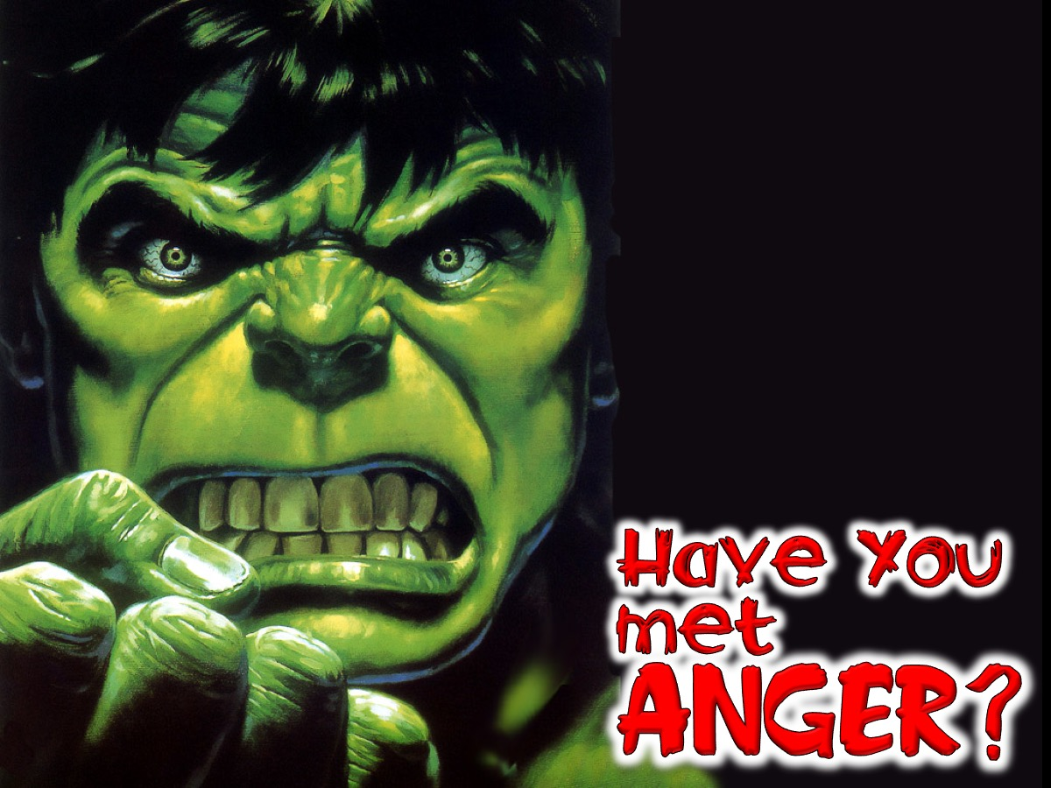
Notes:
Have you met anger?

Slide 7
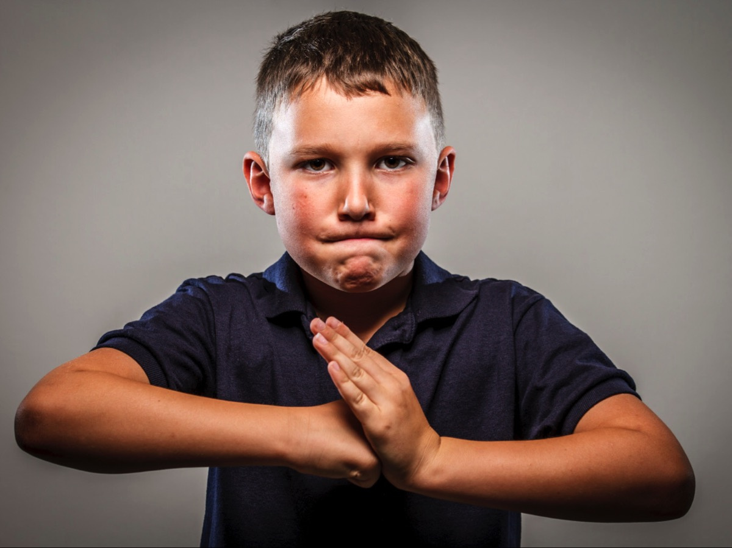
Notes:
Maybe in the school yard bully!

Slide 8
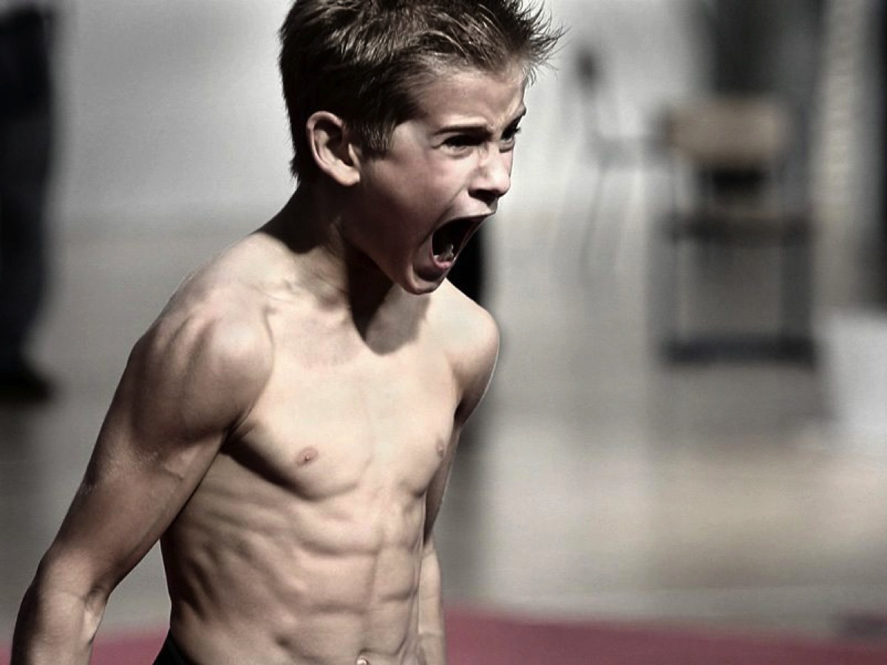
Notes:
Or that the kid that just loses it!

Slide 9
Notes:
It is not just a guy thing!!!

Slide 10
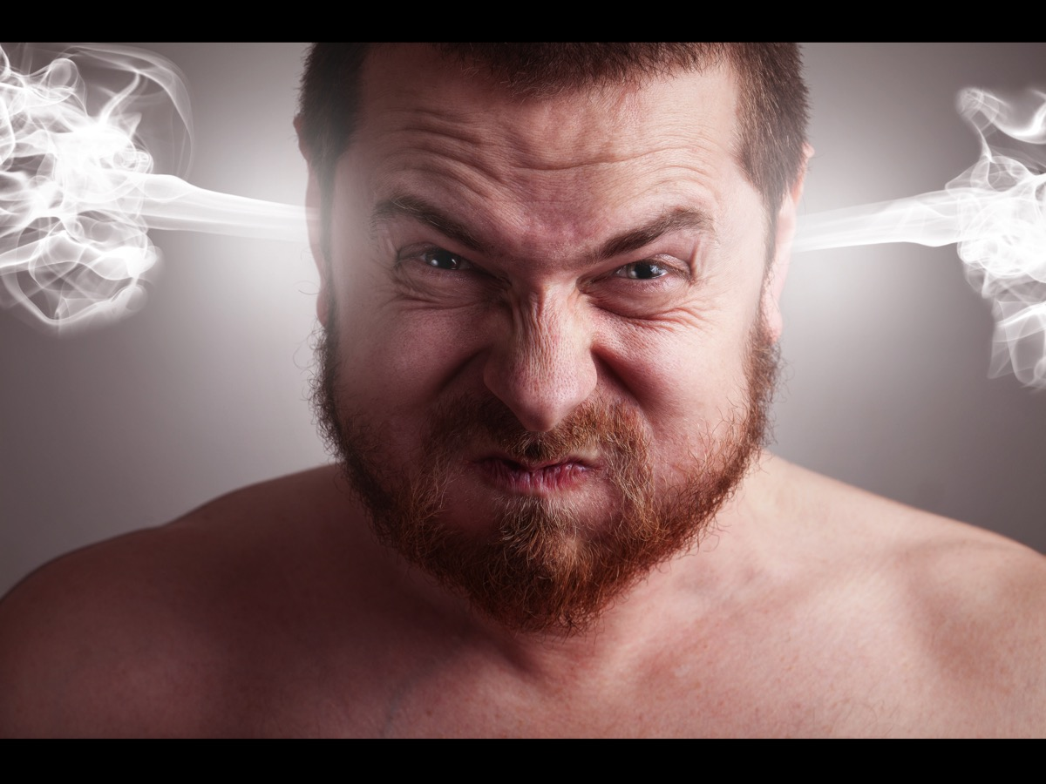
Notes:
Cartoons love to show anger as steam coming out of ears!

Slide 11
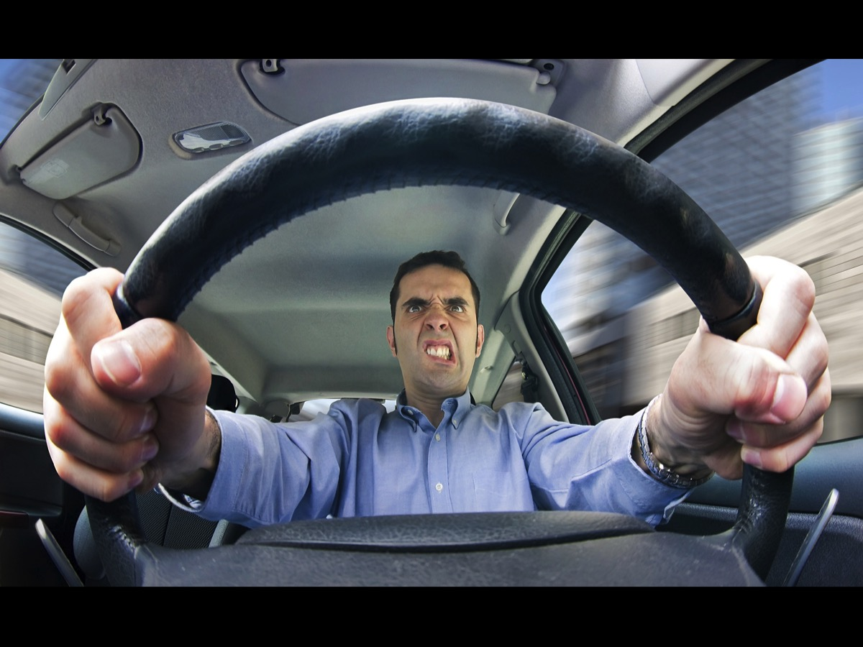
Notes:
Most of your don’t drive yet – but you ain’t seen nothing like anger until you have seen road rage!

Slide 12
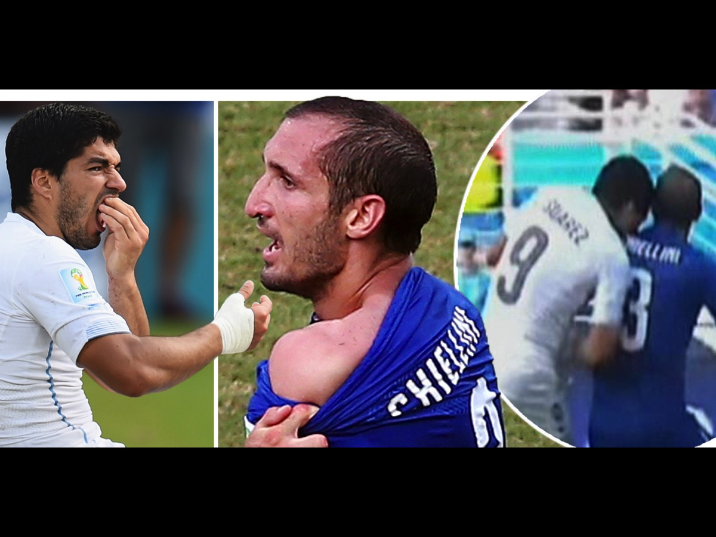
Notes:
If you were watching the world cup – you may have seen the incident when Suarez bit Chiellini. Clearly the guy has anger issues!

Slide 13
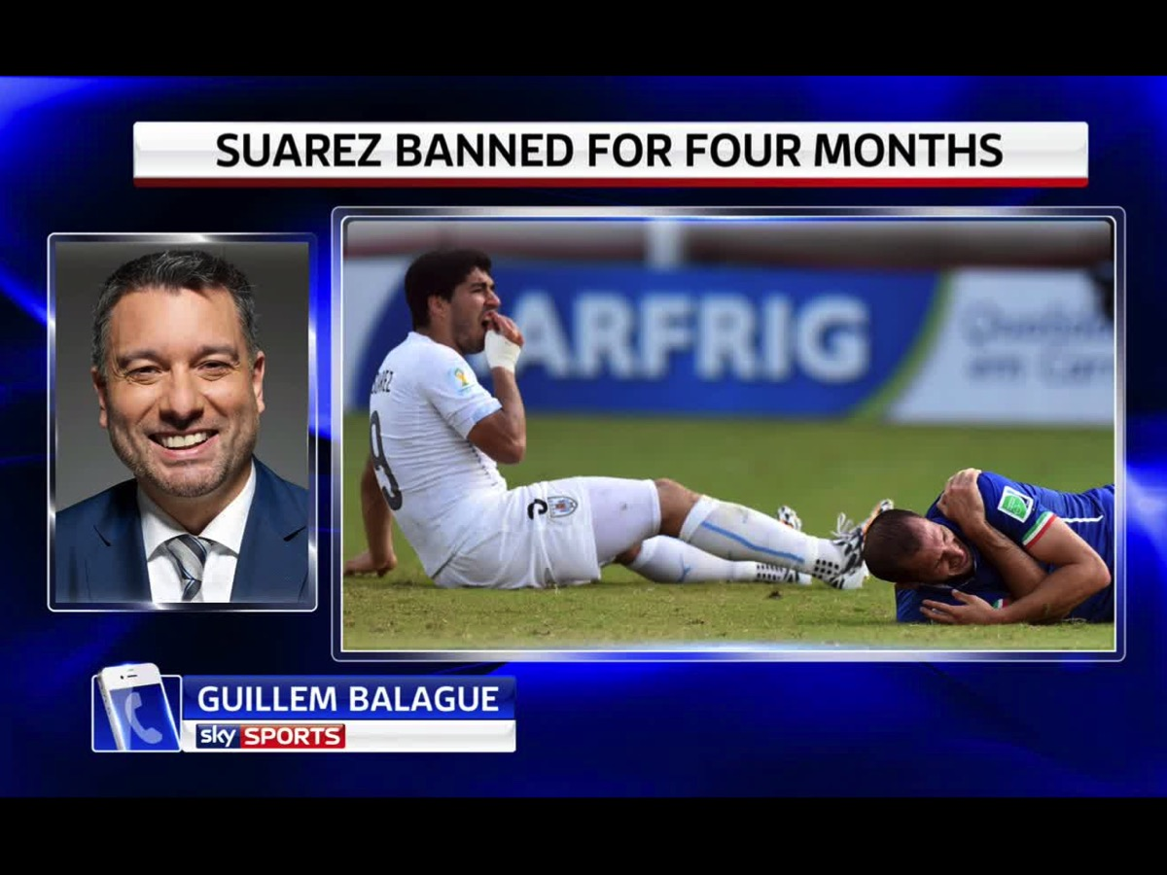
Notes:
As a result he was banned for four months.

Slide 14
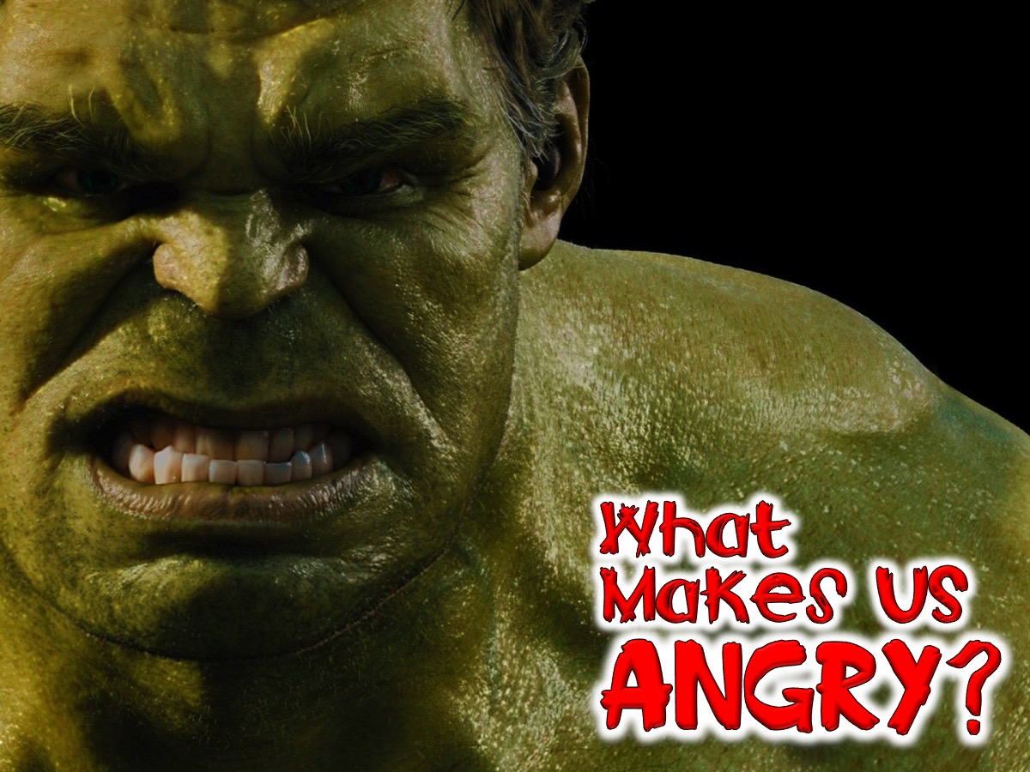
Notes:
What Makes Us Angry?

Slide 15
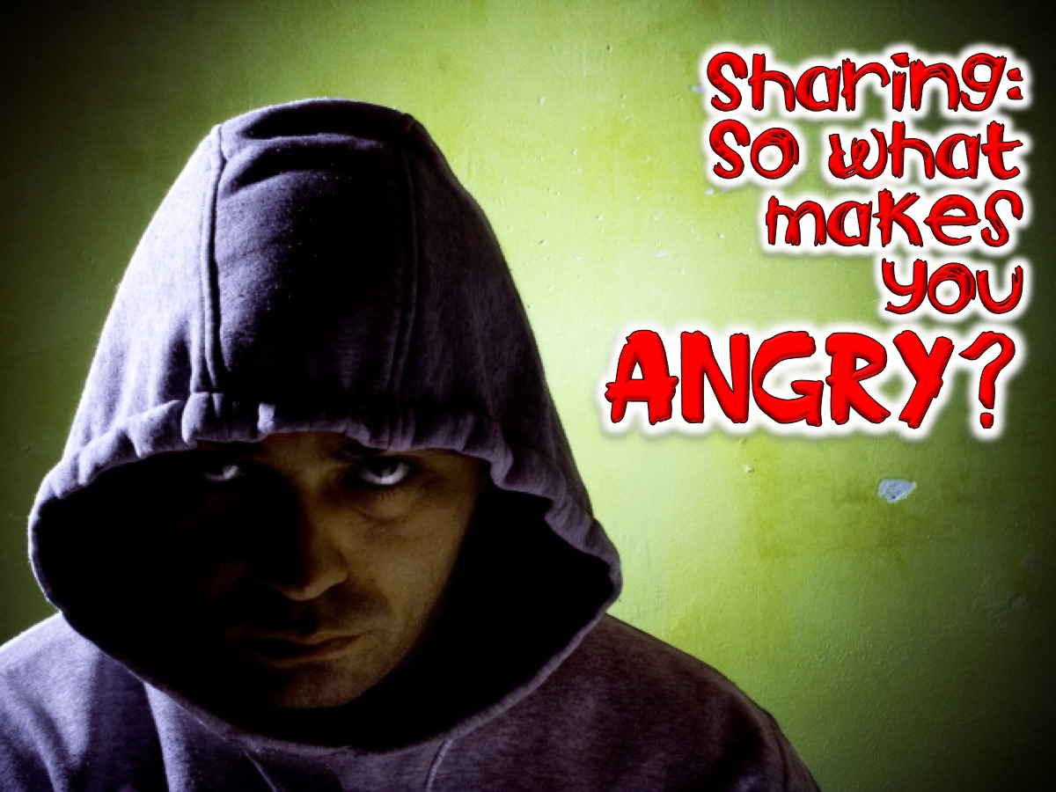
Notes:
Sharing: So what makes you angry?

Slide 16
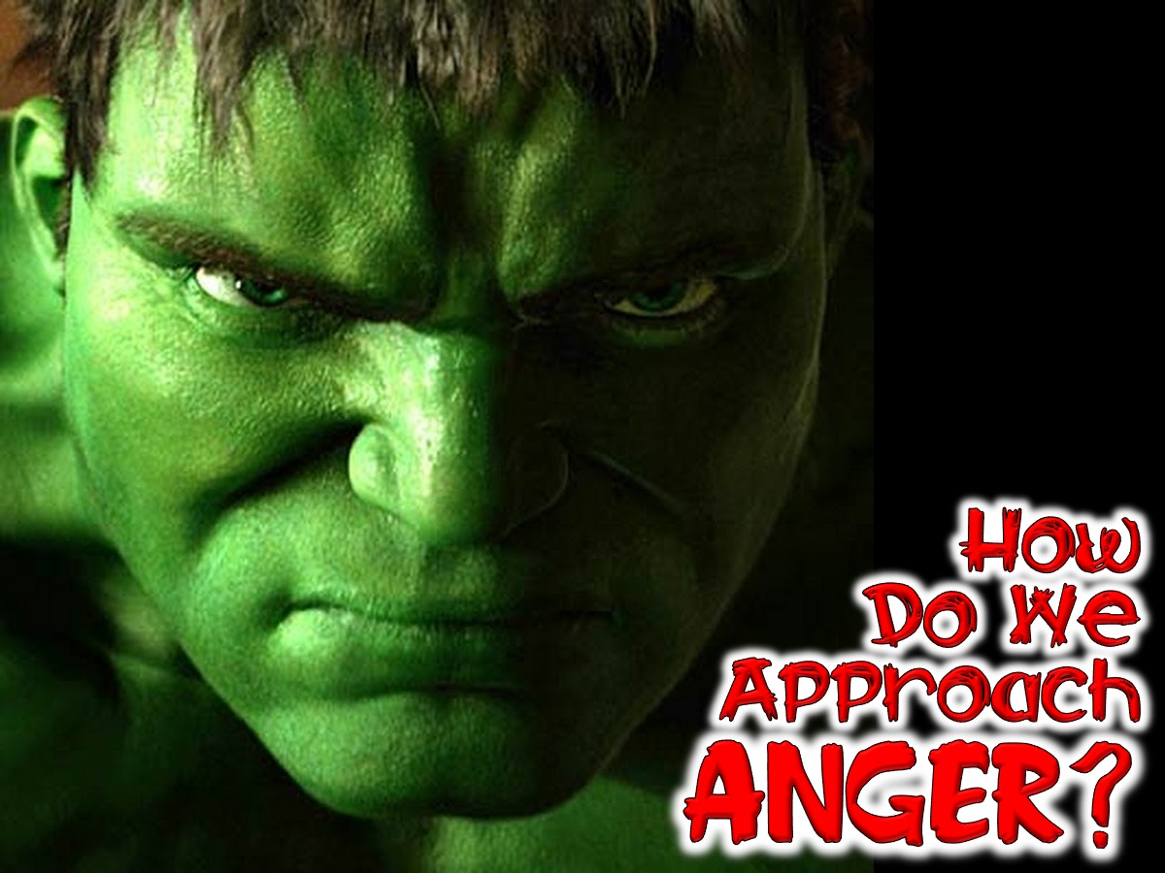
Notes:
How Do We Approach Anger?

Slide 17
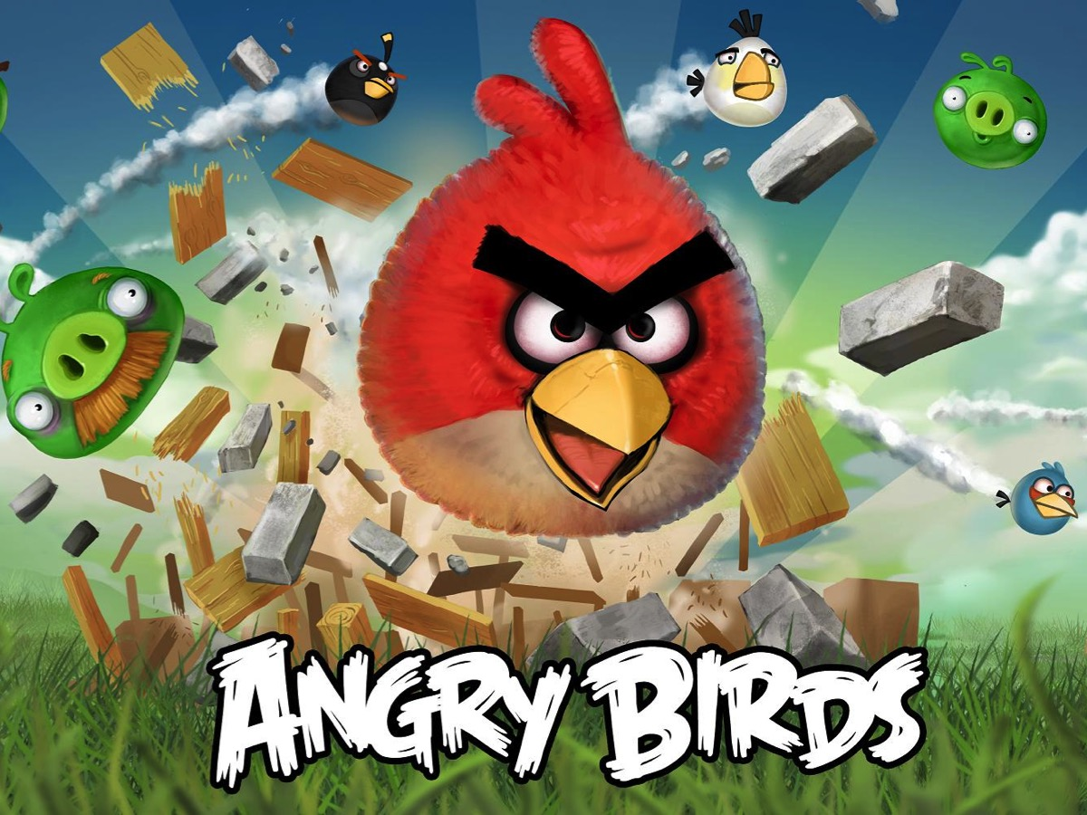
Notes:
You all know about Angry Birds!

Slide 18
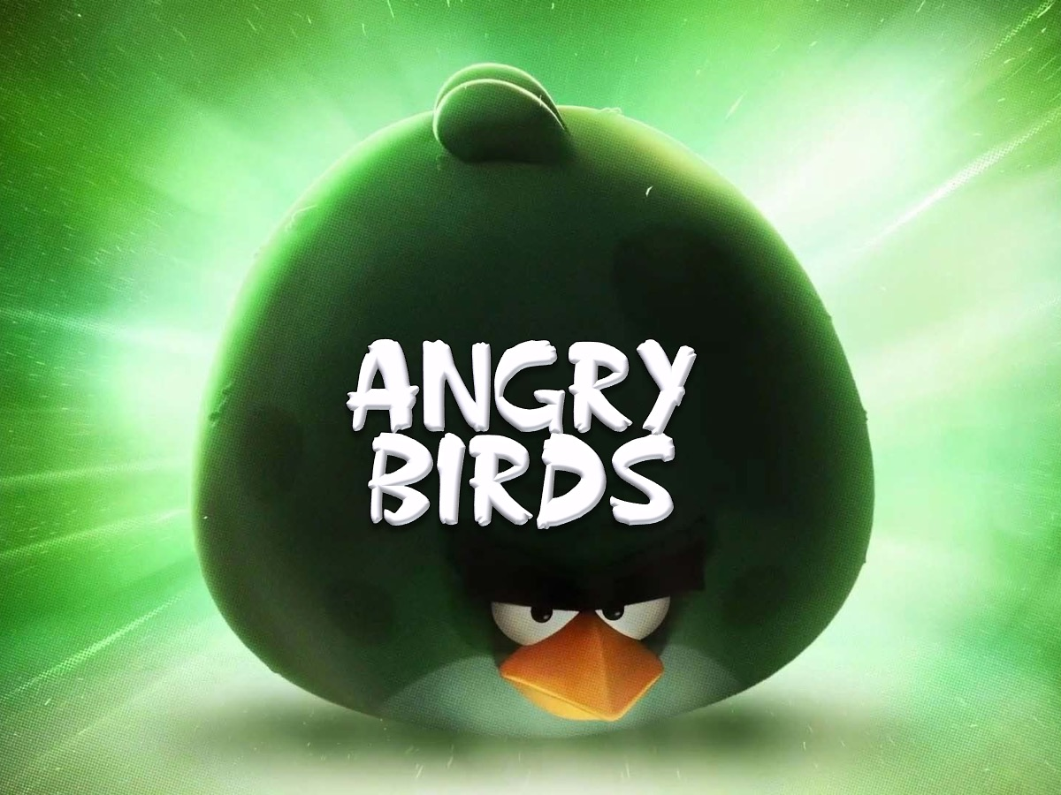
Notes:
They get really angry

Slide 19
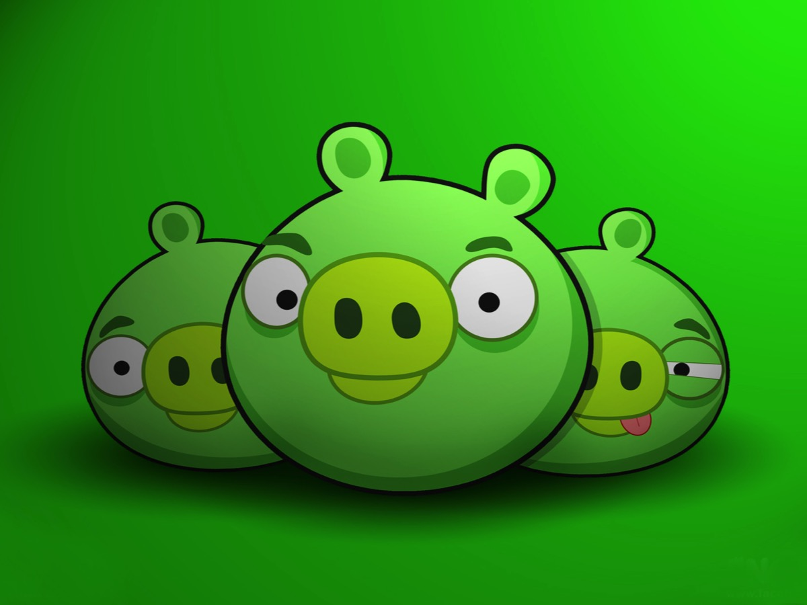
Notes:
And really hate the pigs!

Slide 20
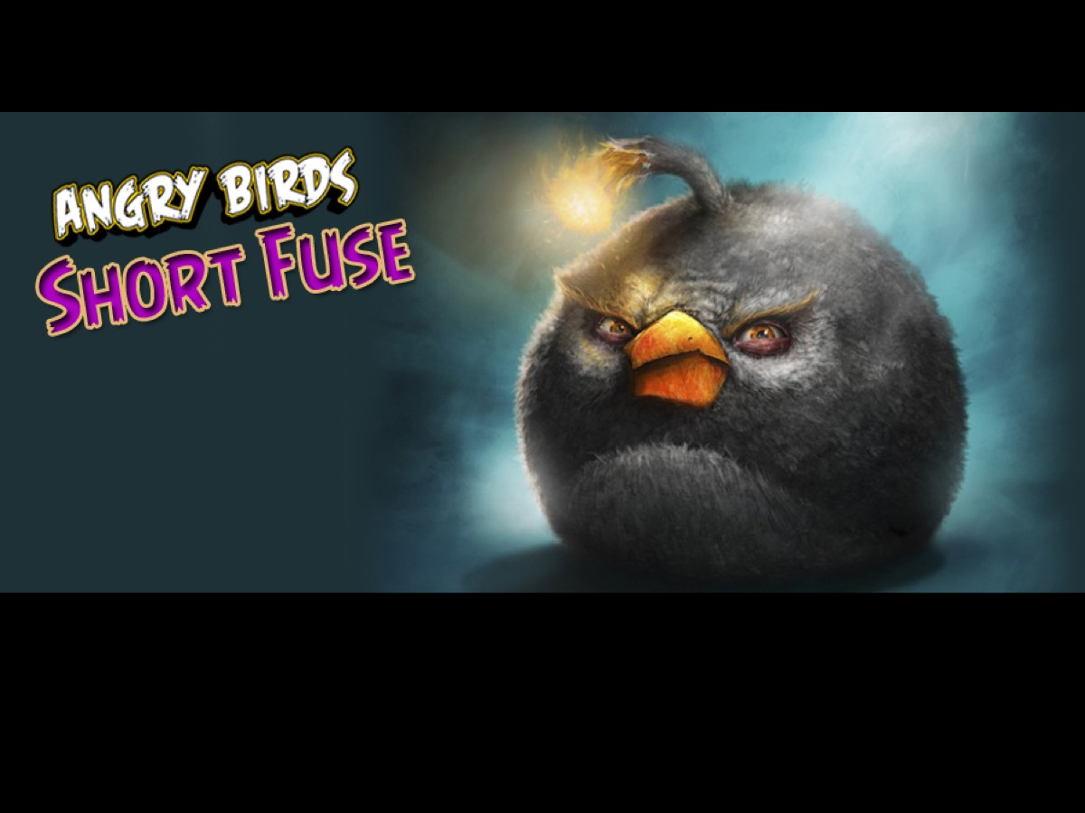
Notes:
One of the newest Angry Birds is called Short Fuse

Slide 21
Notes:
God on the other hand – is the opposite of Short Fuse! He is compassionate and gracious, slow to anger and abounding in Love. (Psalm 103:8)

Slide 22
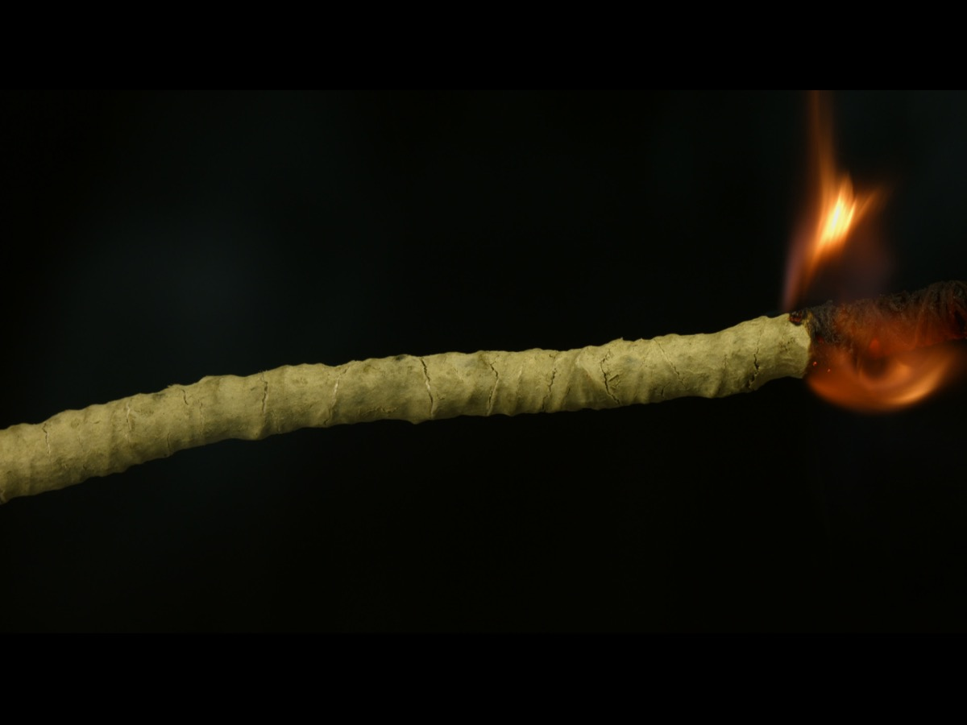
Notes:
He has a long fuse that burns really slowly!

Slide 23
Notes:
We are challenged to be slow to anger! It does not say never get angry – but be slow to get angry – just like God!

Slide 24
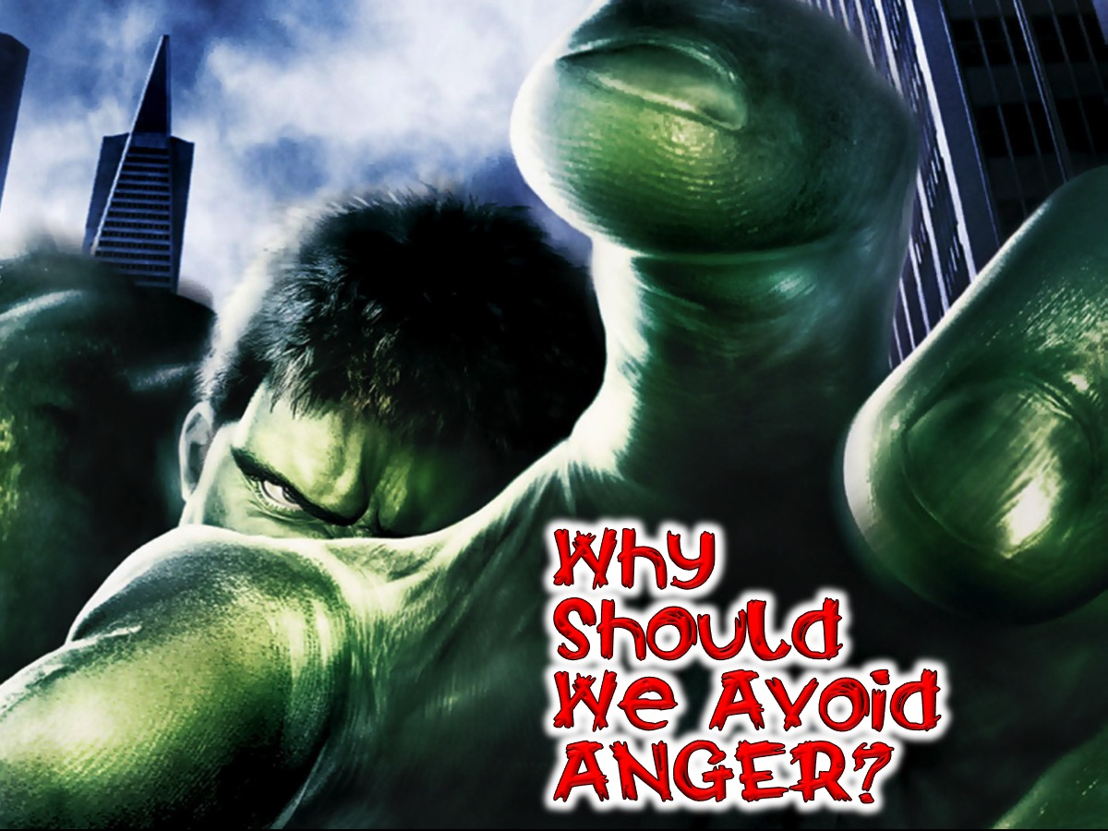
Notes:
Why Should We Avoid Anger?

Slide 25
Notes:
Anger is like taking poison and waiting for the other person to die.

Slide 26
Notes:
Holding on to anger is like grasping a hot coal with the intent of throwing it at someone else; you are the one who gets burned! (Buddha)

Slide 27
Notes:
We think that hating is a weapon that attacks the person who harmed us. But hatred is a curved blade. And the harm we do, we do to ourselves. (Mitch Albom)

Slide 28
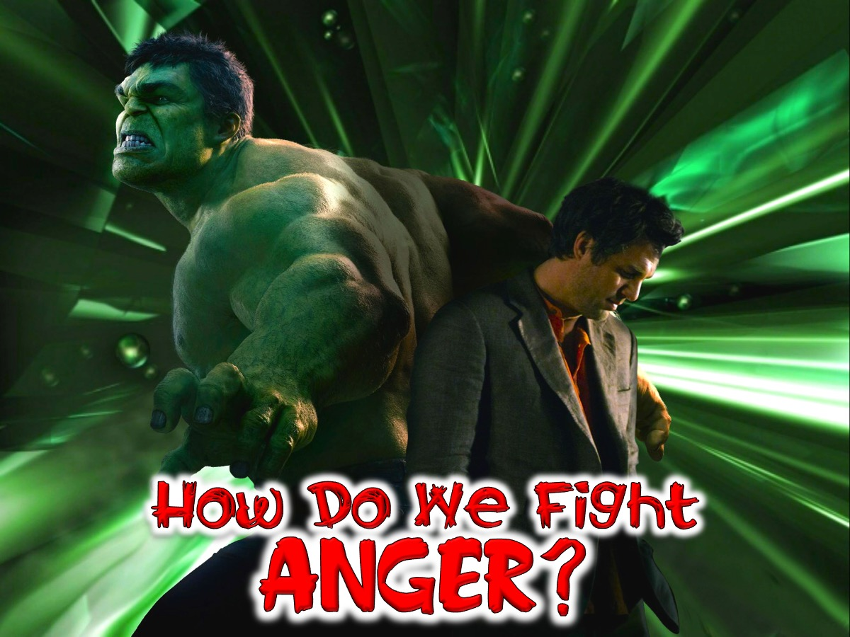
Notes:
How Do We Fight Anger?

Slide 29
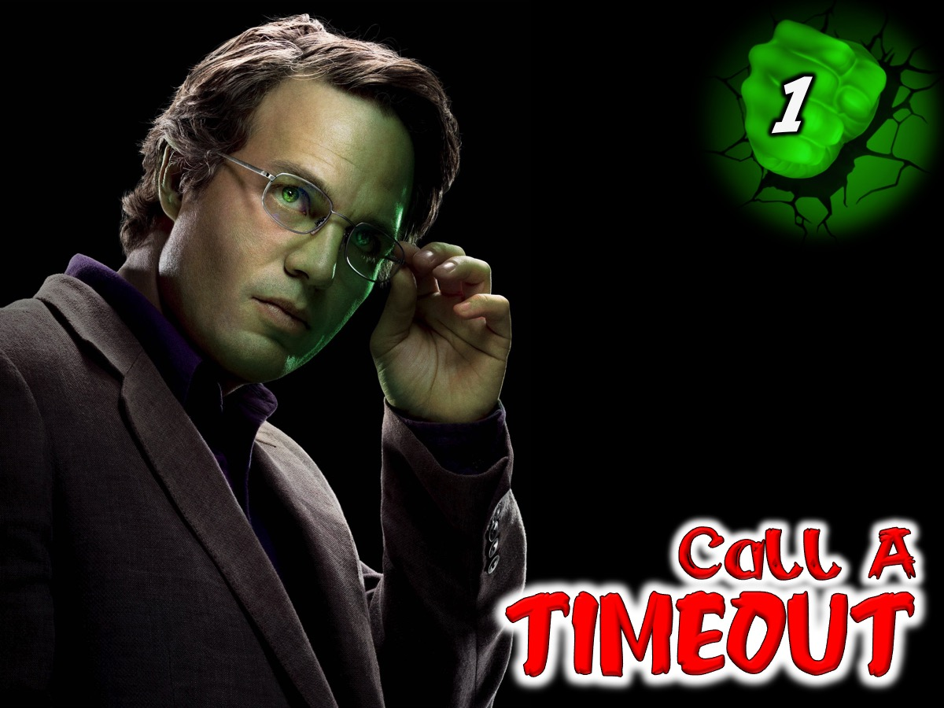
Notes:
1. Call a Timeout

Slide 30
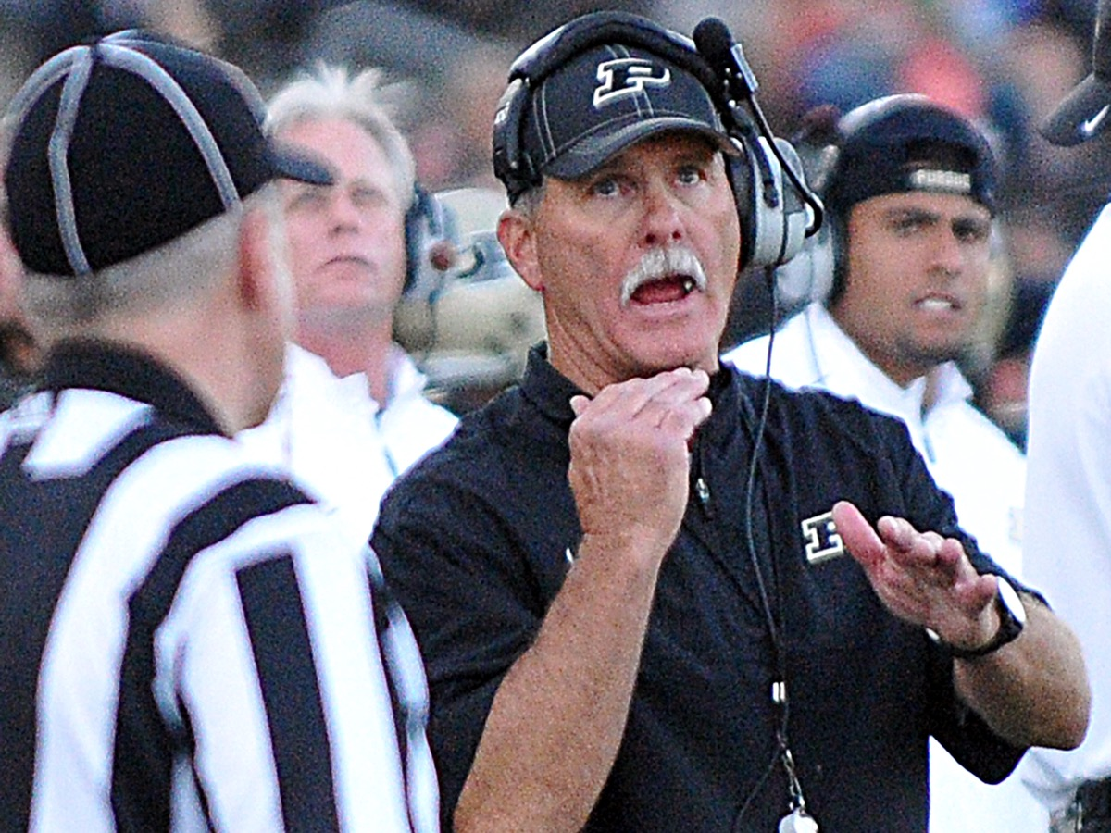
Notes:
This tried and true method of taking a step back works best when someone else is not attempting to escalate the argument. If possible, say, “I need a minute,” and step from the room. Count slowly to ten, or thirty, until you are able to control your breathing and regain logical thought.

Slide 31
Notes:
Freeze your words and actions, divert your mind and laugh for a little while! That will help tame the demon called anger!

Slide 32
Notes:
2. Check the Triggers

Slide 33
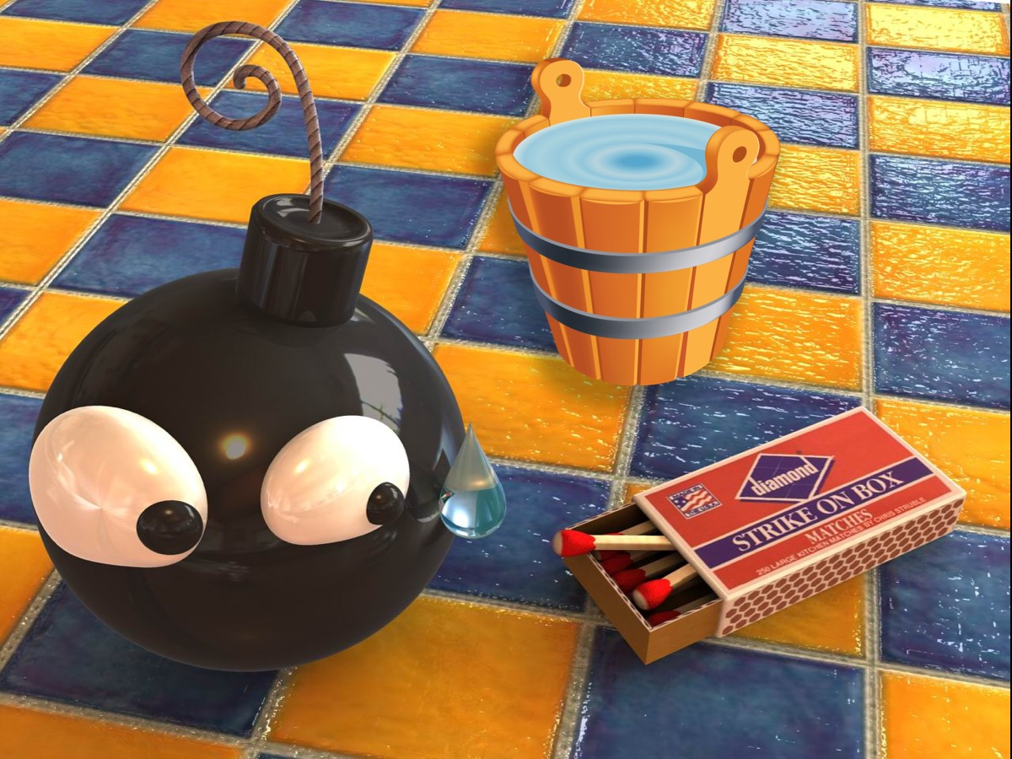
Notes:
If we are going to deal with anger we must find out what cause anger (the bomb)– what do you feel when you start to get angry (the match) and what can you do to minimise the anger (the bucket of water)?

Slide 34
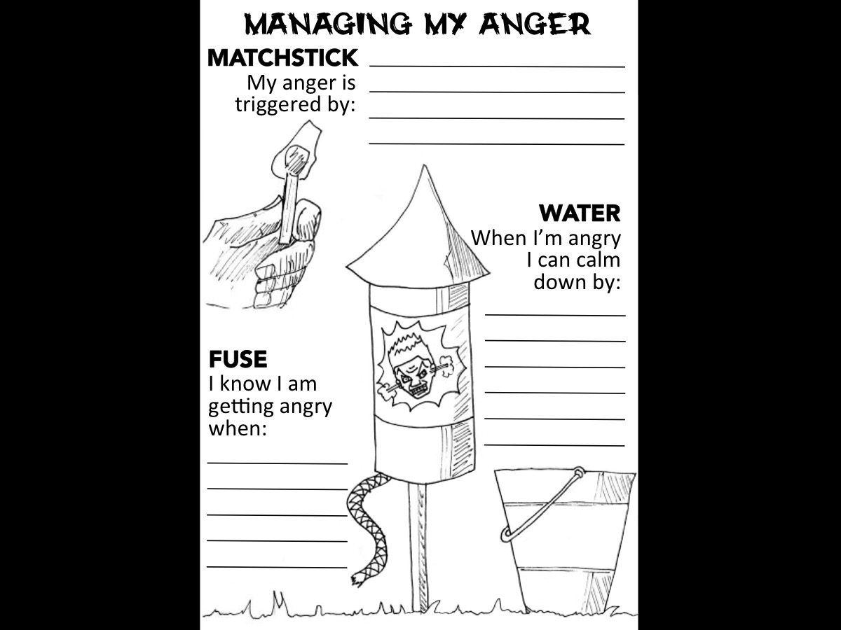
Notes:
Anger management experts have devised a simple but effective method of addressing anger - The Anger Management Sheet: (1) The Firework represents anger. (2) The Match is something that makes you angry. (3) The Fuse represents the sensations you feel that warn you that you are getting angry. (4) The Firework exploding would be you losing your temper. (5) The Bucket of water represents things you can do to stop you control your anger. This exercise will help us define anger and then deliver it to God. Like pulling back the covers on a lumpy bed to see what’s hiding underneath, ask yourself the simple question: “Why am I really angry?” Most people never ask this question, they just immediately react to the trigger of their anger. Take the time to reflect and define. Having identified your anger, talk to God about your hurt. The real reason for your anger is where God wants to meet you. Tell Him all about it, and ask Him for help.

Slide 35
Notes:
3. Correct Your Thinking

Slide 36
Notes:
You could practise Steam Journaling – it is about venting and letting off steam by writing down the angry thoughts that you are experiencing. Then you look back at your thoughts and ask yourself two questions in order to start seeing things from a different perspective: (1) What actions are in my power to reduce the tension of this situation in a positive way? (2) What are my fears about taking one or more positive steps to improve the situation?

Slide 37
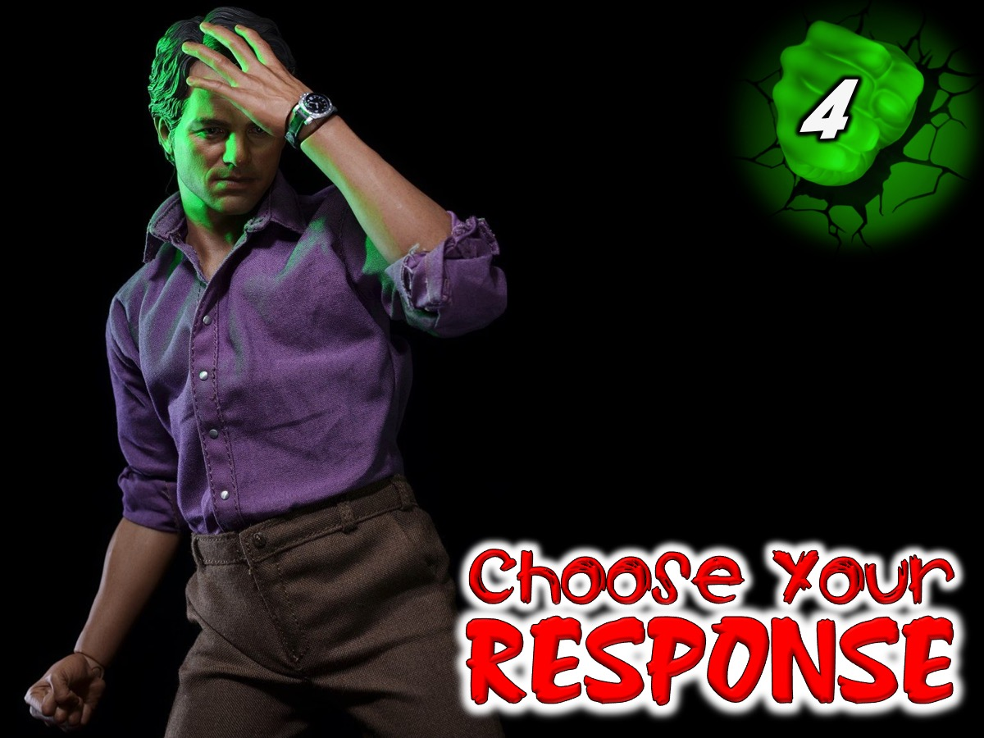
Notes:
4. Choose Your Response

Slide 38
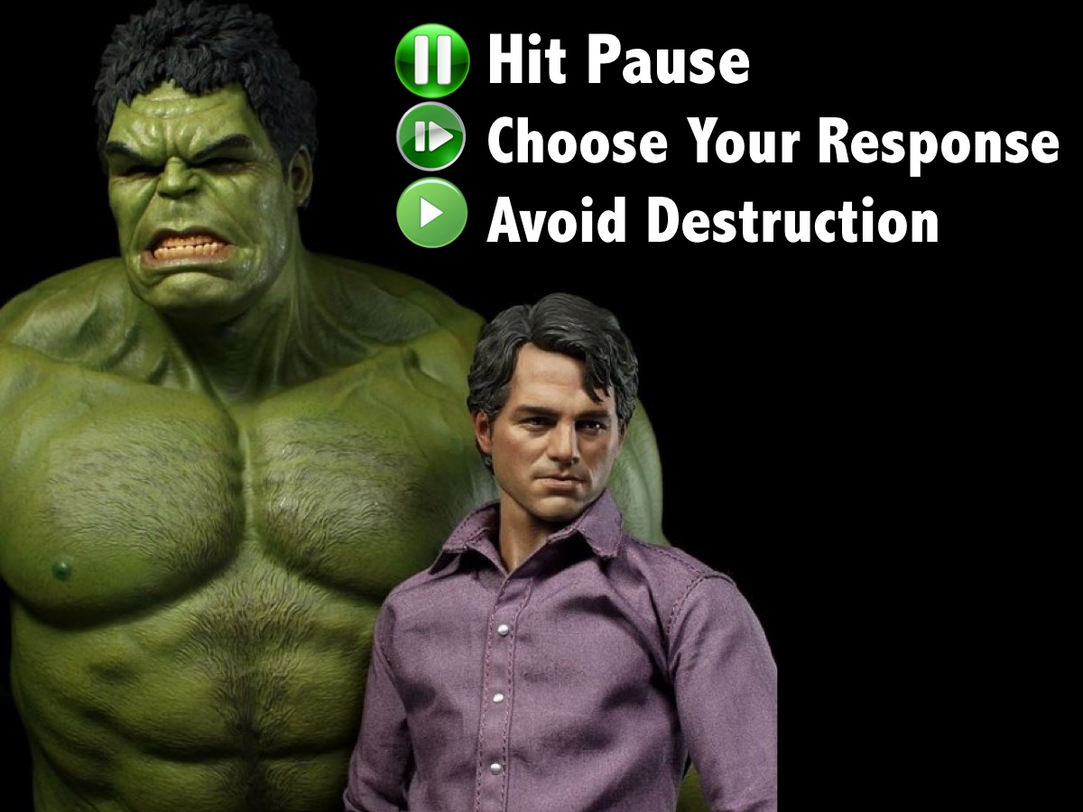
Notes:
A key to dealing with anger is to be able to press pause when your emotions rise and choose the most appropriate response for the situation - one that will not harm yourself or other.

Slide 39
Notes:
Summary: To Fight Anger: (1) Call a Timeout. (2) Check the Triggers. (3) Correct your Thinking. (4) Choose Your Response.

Slide 40
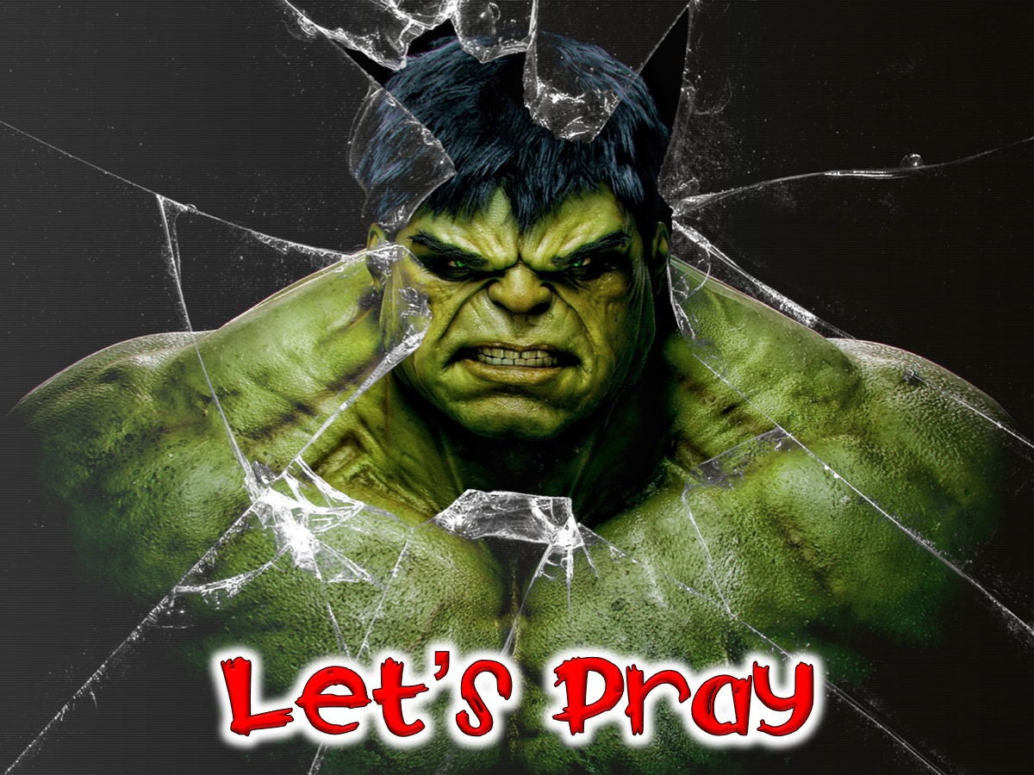
Notes:
Let’s pray

