Slide 1

Notes:
This week we are going to learn how to fight anxiety.

Slide 2

Notes:
Can you guess who our superhero is this week?

Slide 3

Notes:
Yep, it is Captain America. Here is a poster from a previous movie: The First Avenger

Slide 4

Notes:
And this is the poster from the new movie: The Winter Soldier.

Slide 5

Notes:
Superheroes and Anxiety. I am quite sure that is the first time anyone has but those words together in a hurry. Surely Superheroes don’t get affected by anxiety.

Slide 6

Notes:
Chris Evans (the actor who plays Captain America in the movies) has serious anxiety issues!

Slide 7
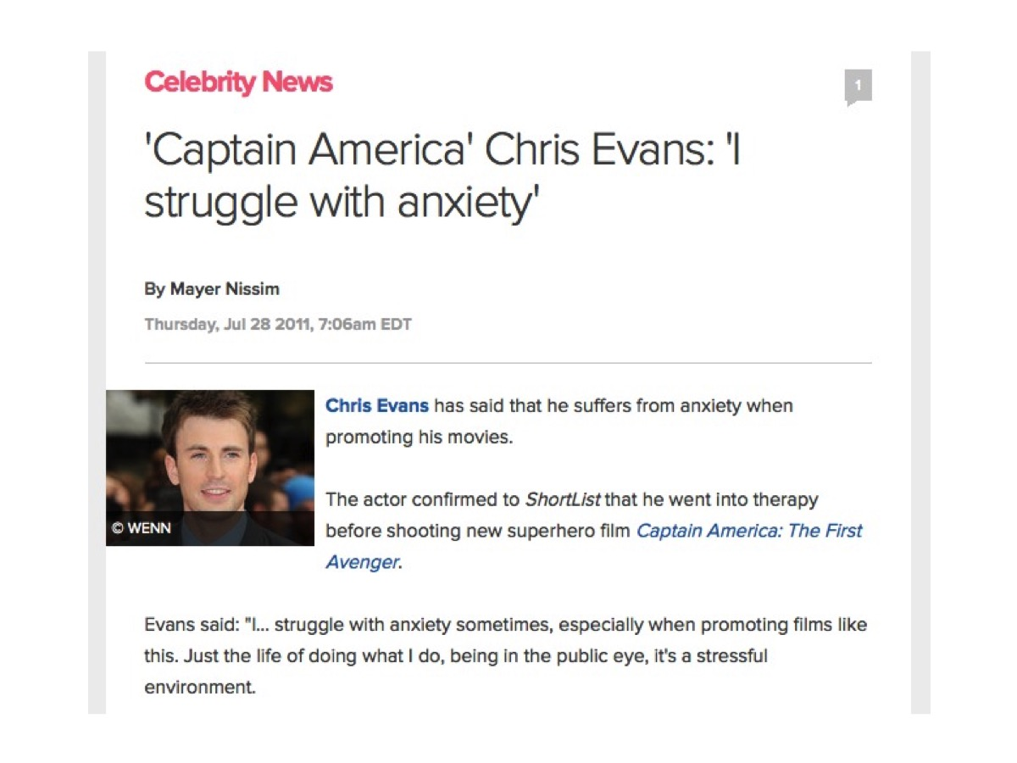
Notes:
Captain America Chris Evans: I struggle with anxiety. Chris Evans has said that he suffers from anxiety when promoting his movies. The actor confirmed to ShortList that he went into therapy before shooting new superhero film Captain America: The First Avenger. Evans said: "I… struggle with anxiety sometimes, especially when promoting films like this. Just the life of doing what I do, being in the public eye, it's a stressful environment.

Slide 8

Notes:
Captain America has enemies that are enough to make anyone to experience anxiety!

Slide 9

Notes:
Red Skull – who makes Hitler, Sadam Hussein and Bin Laden look like the Three Stooges.

Slide 10

Notes:
And of course there is Bucky who is The Winter Soldier!

Slide 11
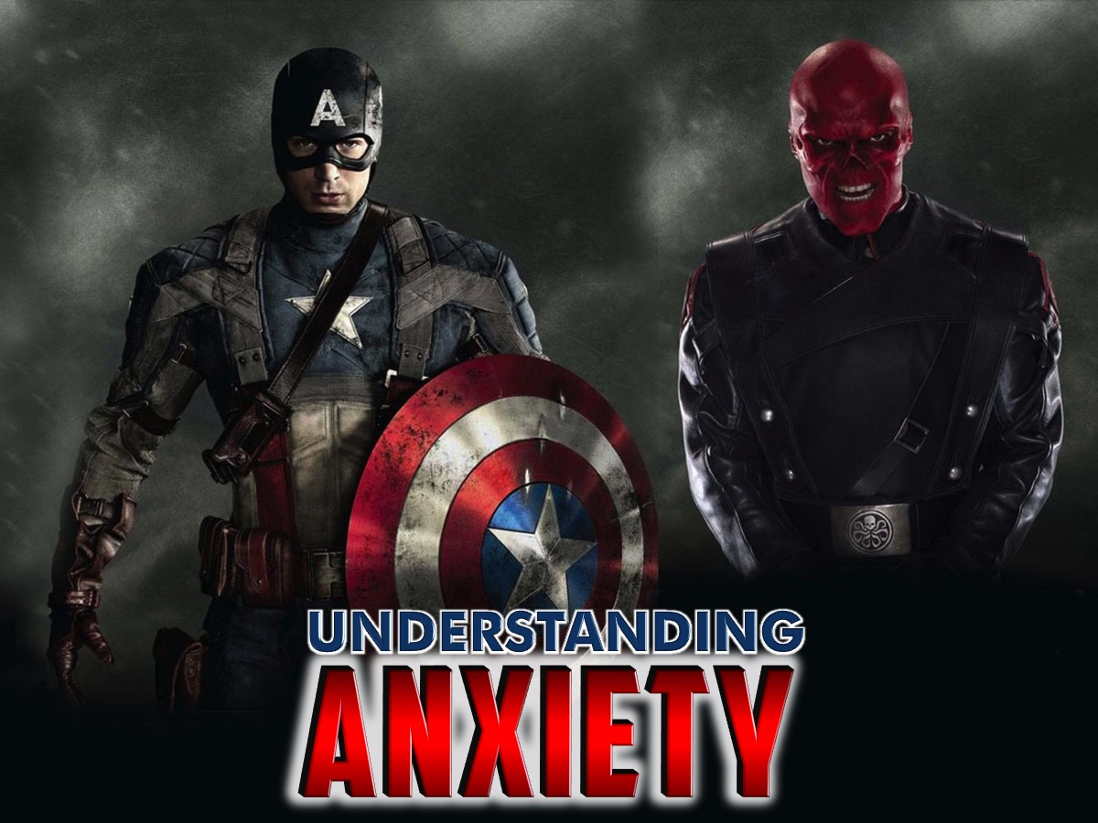
Notes:
Let’s begin by understanding anxiety.

Slide 12
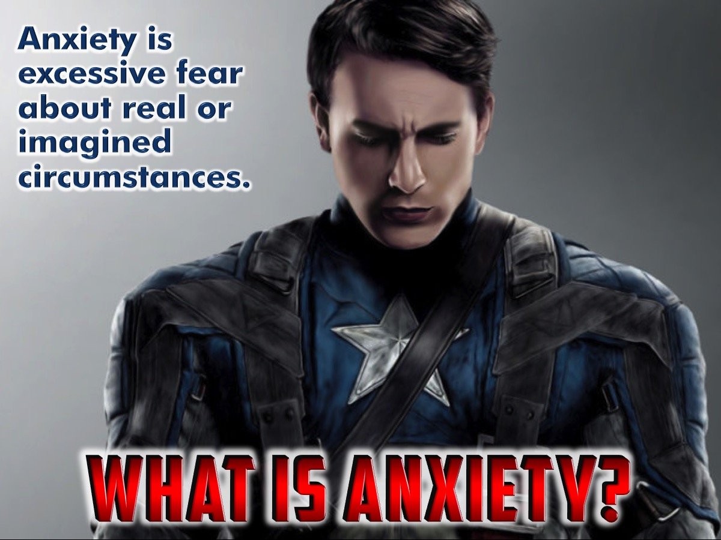
Notes:
Anxiety Defined: Anxiety is excessive fear about real or imagined circumstances.

Slide 13
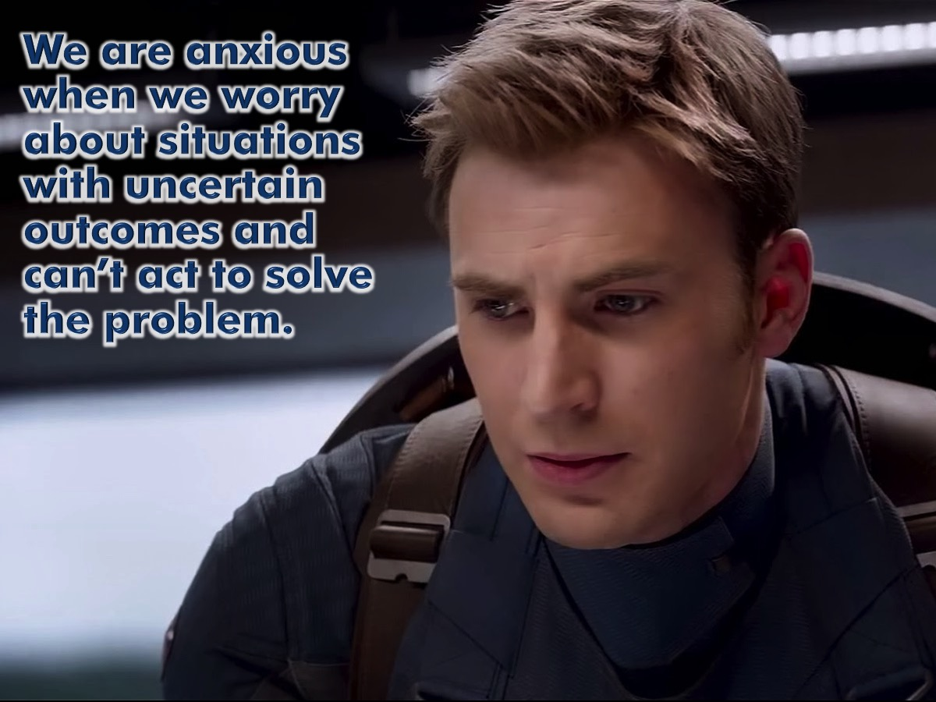
Notes:
We are anxious when we worry about situations with uncertain outcomes and can’t act to solve the problem.

Slide 14
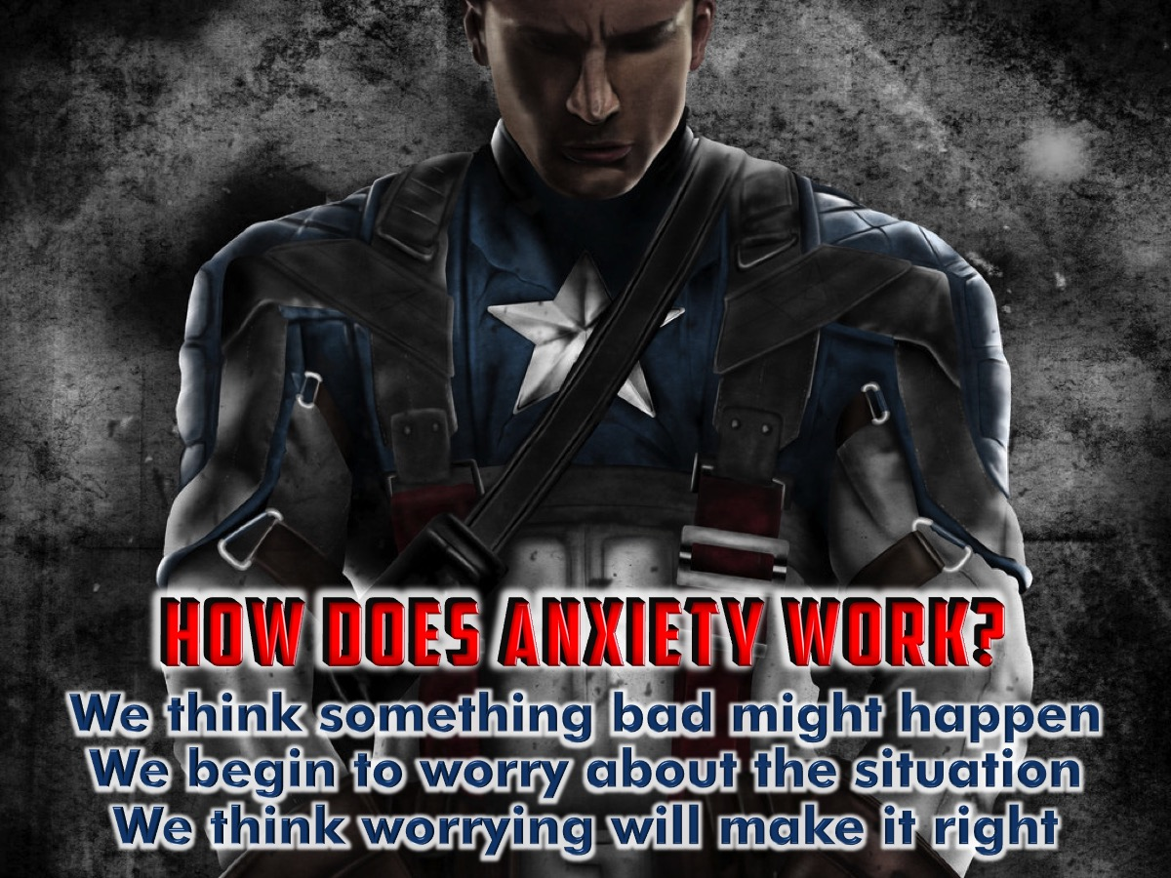
Notes:
How Does Anxiety Work? People worry because they think something bad might happen, so they activate a hyper-vigilant strategy of worry and think that “if I worry I can prevent this bad thing from happening or catch it early,” Put another way: “If you didn't worry, things might get out of hand.” The worrier's credo is that if you can simply imagine something bad happening, it's your responsibility to worry about it.

Slide 15
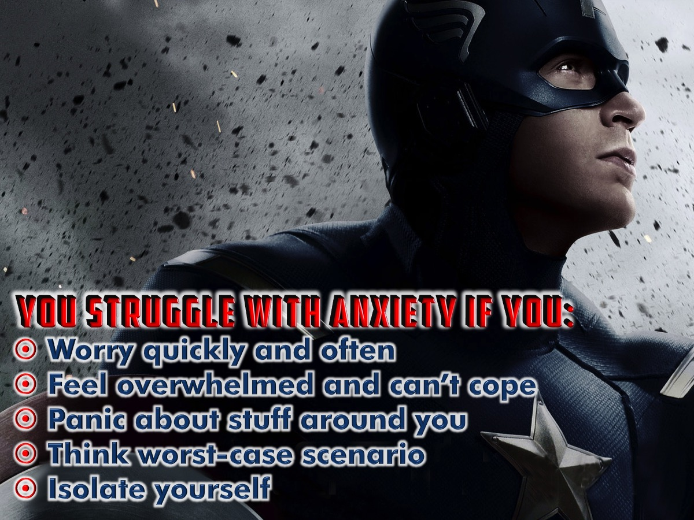
Notes:
You Struggle with Anxiety If You: Worry quickly and often; Feel overwhelmed and can’t cope; Panic about stuff around you; Think worst-case scenario and Isolate yourself.

Slide 16
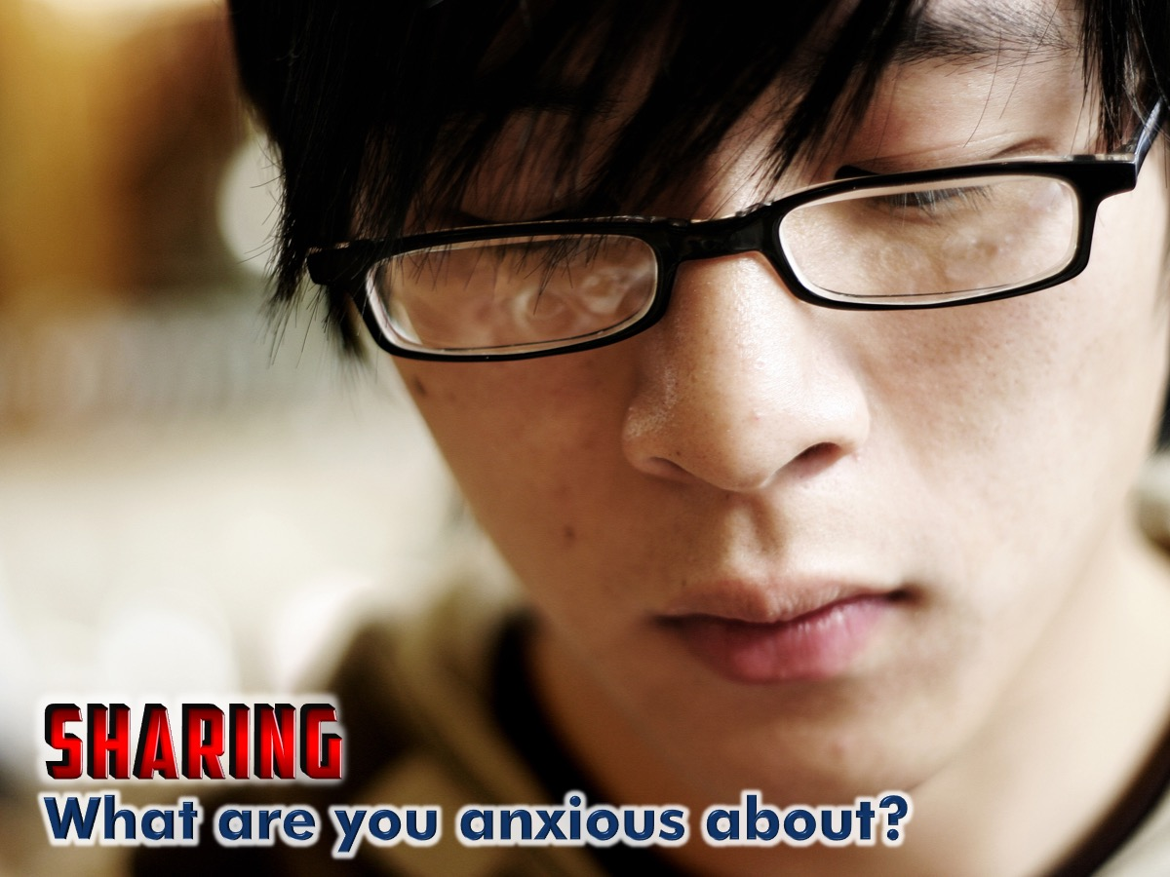
Notes:
Sharing: What are you anxious about?

Slide 17

Notes:
Here are four good reasons not to worry:

Slide 18
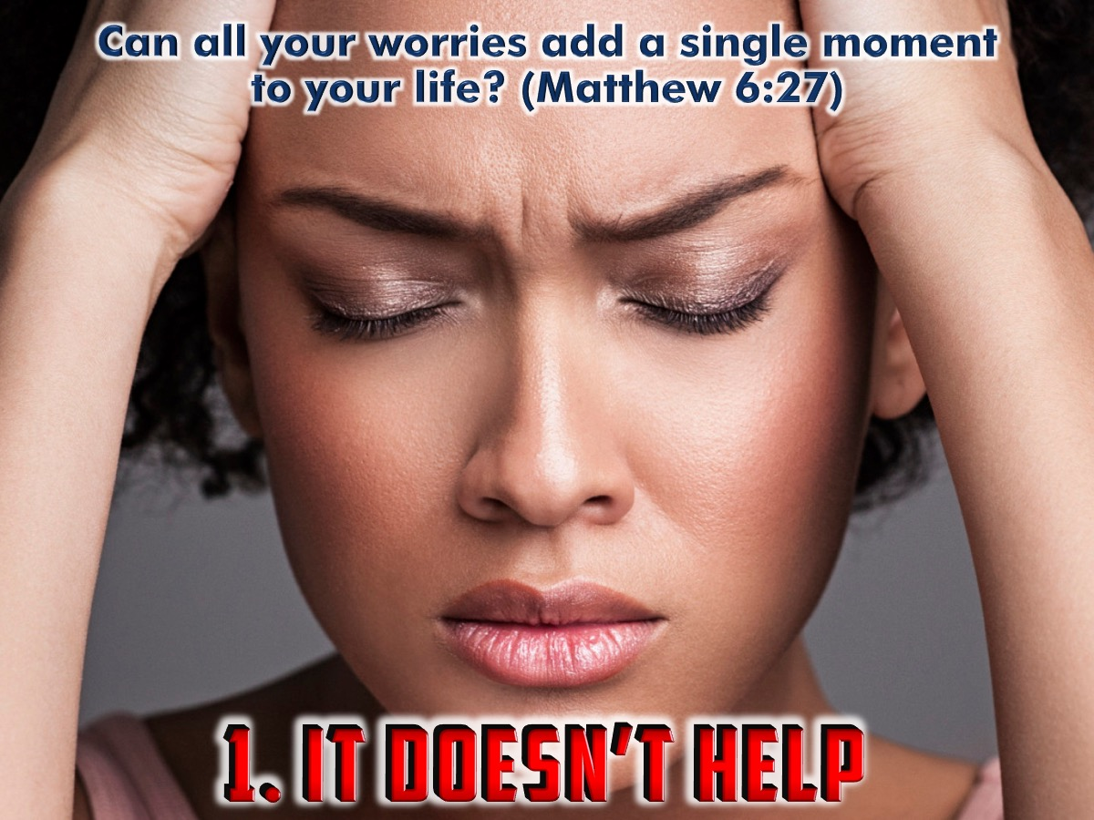
Notes:
1. It Doesn’t Help! Worrying accomplishes nothing. “Can all your worries add a single moment to your life? And why worry about your clothing? Look at the lilies of the field and how they grow. They don't work or make their clothing, yet Solomon in all his glory was not dressed as beautifully as they are.” (Matthew 6:27-29)

Slide 19
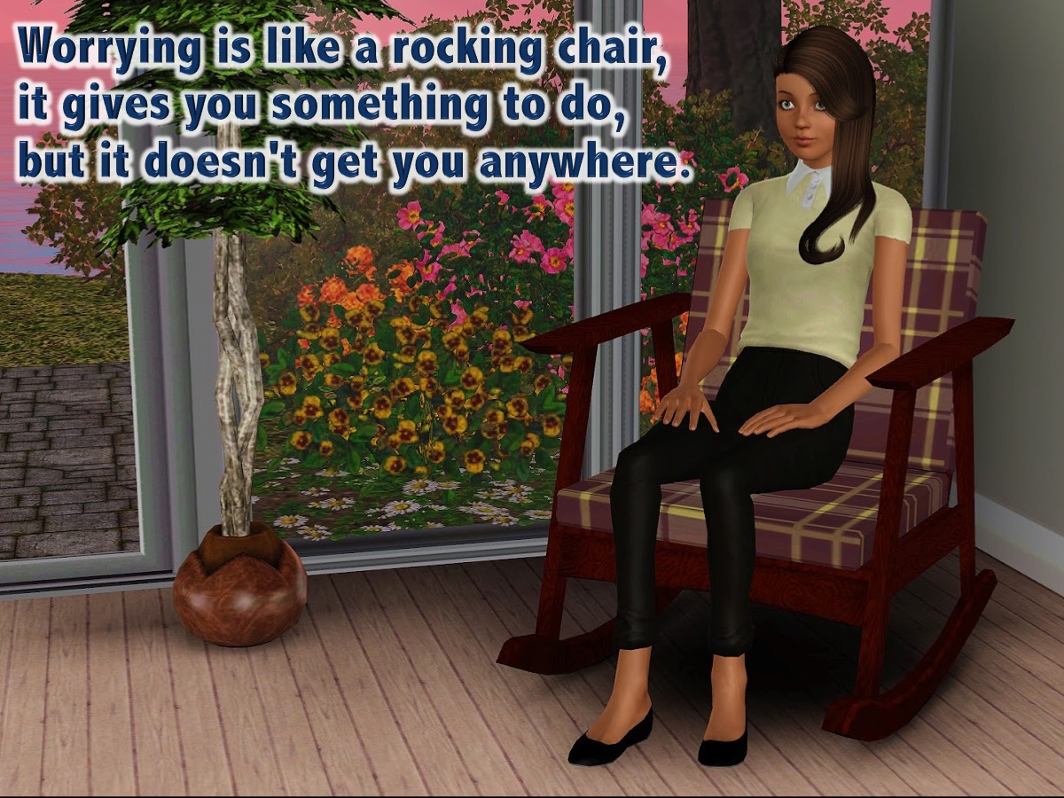
Notes:
Worrying is like a rocking chair, it gives you something to do, but it doesn't get you anywhere.

Slide 20
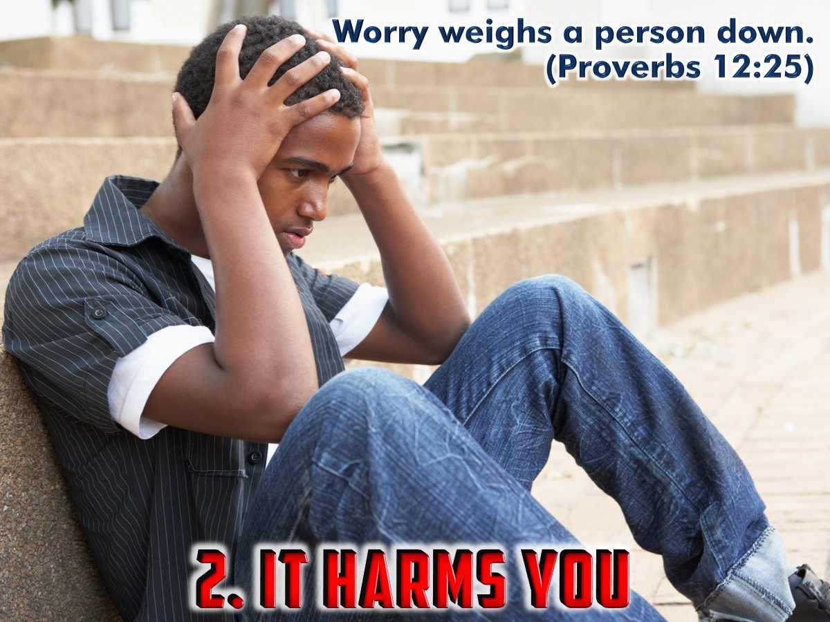
Notes:
2. It Harms You! Worrying is Not Good for You. “Worry weighs a person down; an encouraging word cheers a person up.” (Proverbs 12:25)

Slide 21
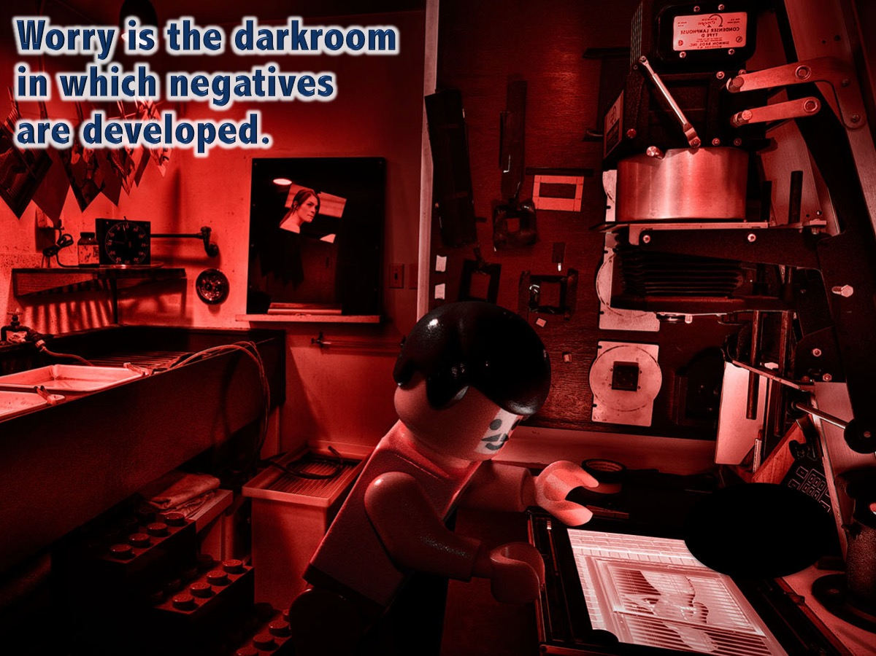
Notes:
Worry is the darkroom in which negatives are developed.

Slide 22
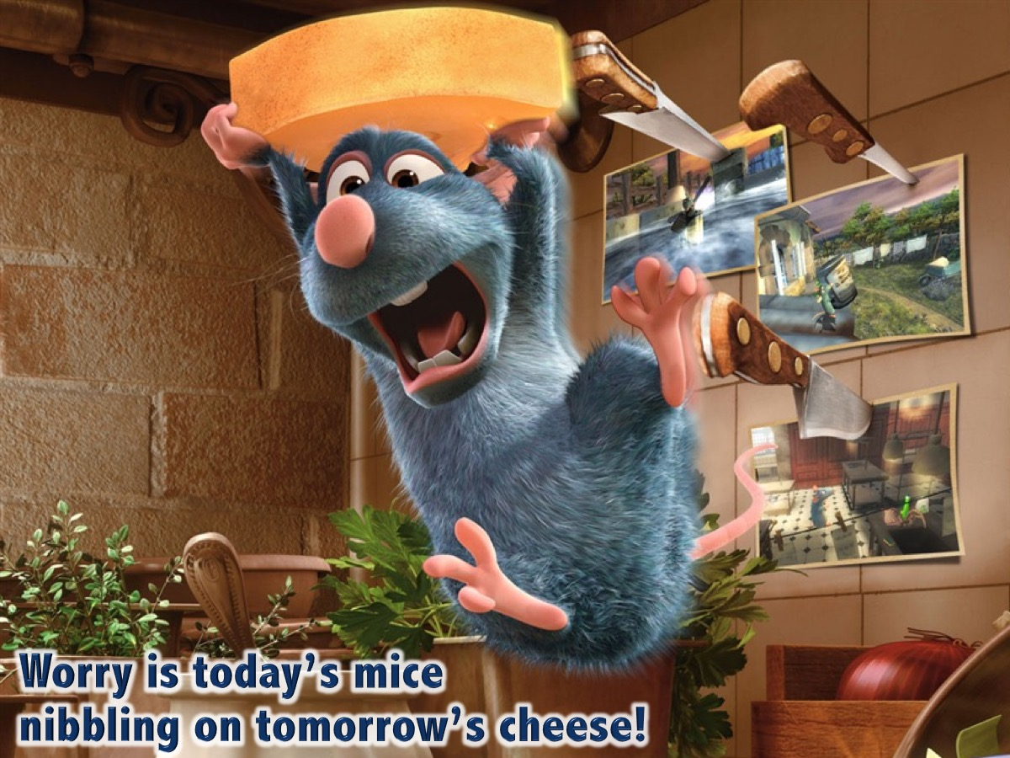
Notes:
Worry is today’s mice nibbling on tomorrow’s cheese.

Slide 23
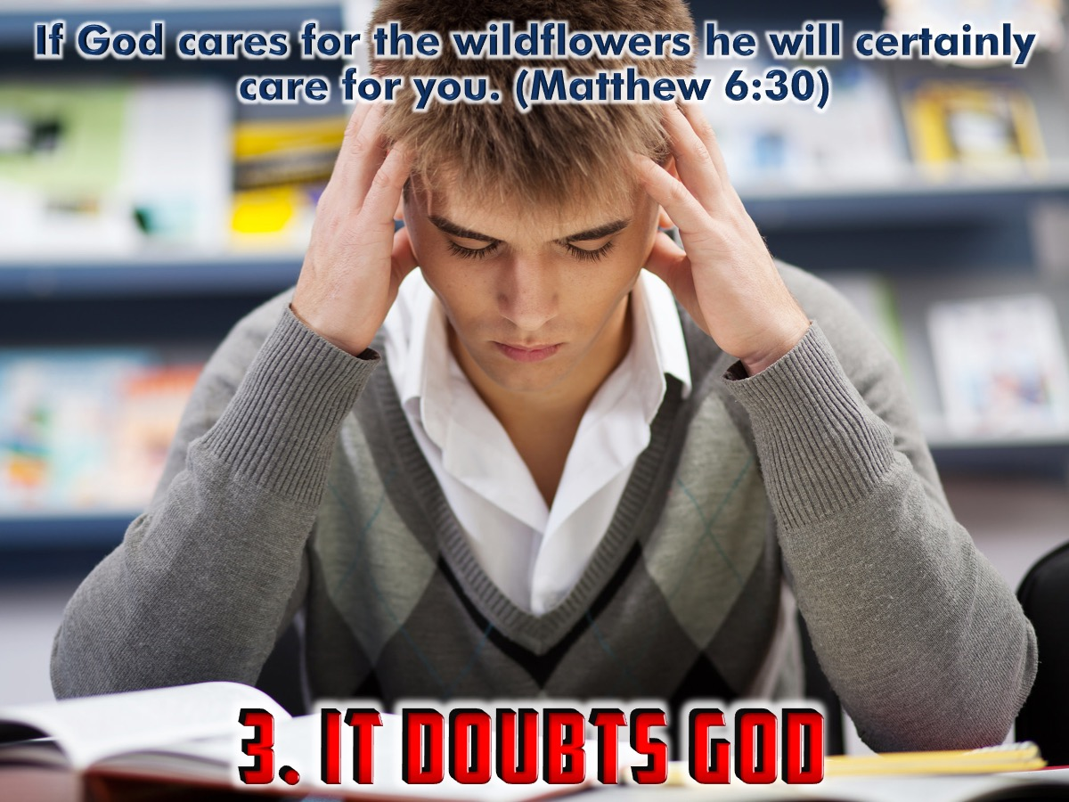
Notes:
3. It Doubts God! Worrying is Not Trusting God. “And if God cares so wonderfully for wildflowers that are here today and thrown into the fire tomorrow, he will certainly care for you. Why do you have so little faith?” (Matthew 6:30)

Slide 24
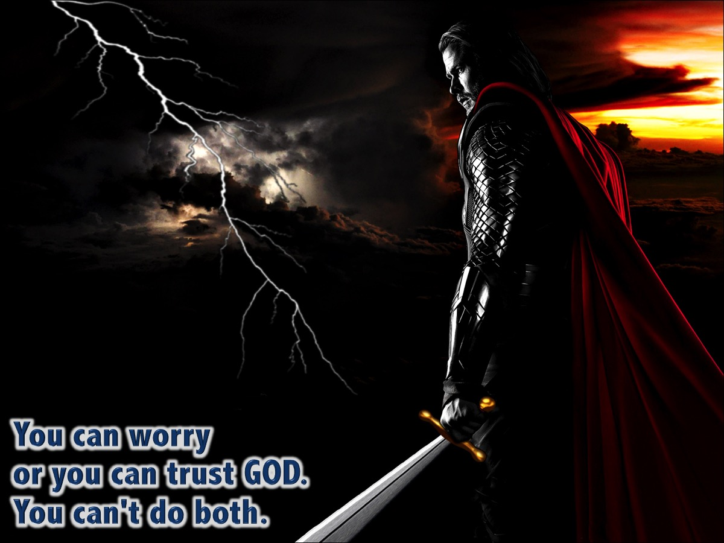
Notes:
You can worry or you can trust GOD. You can't do both. Trust in the Lord with all your heart.

Slide 25
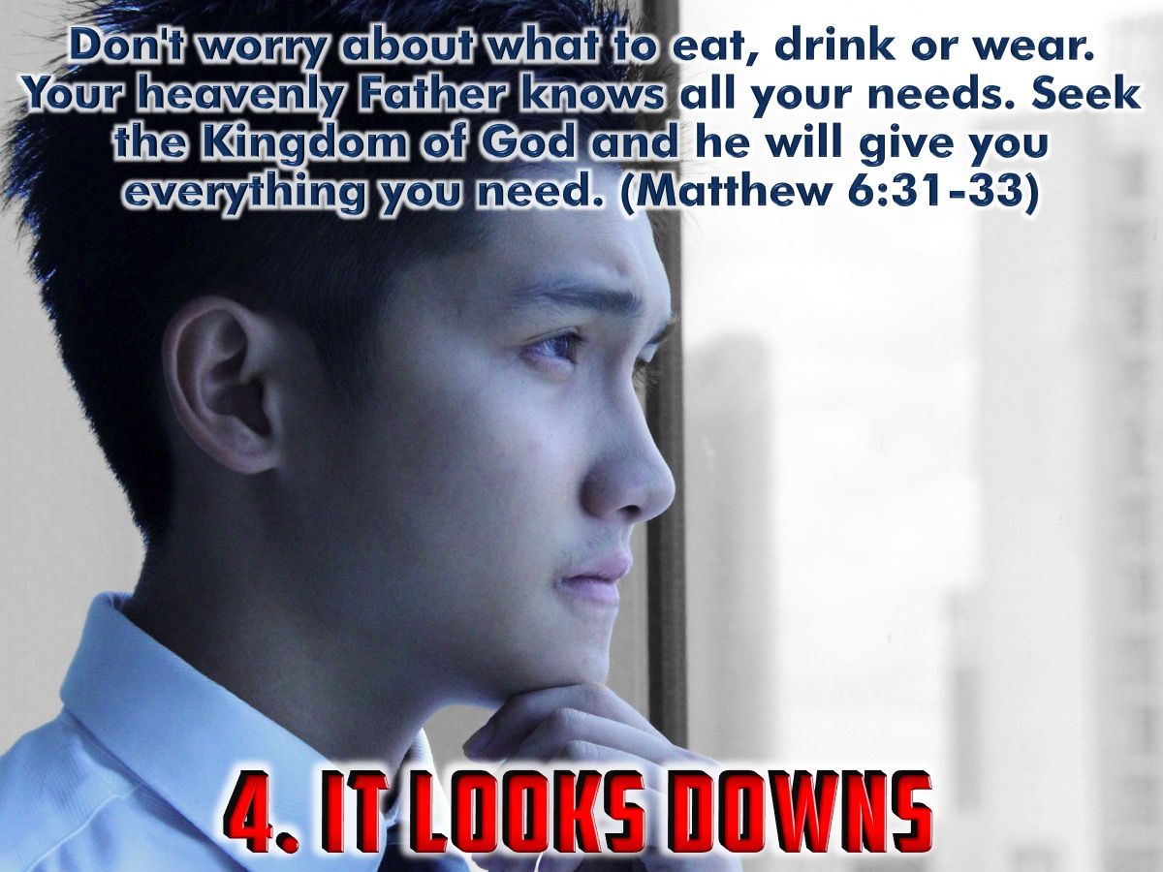
Notes:
4. It Looks Down! Worrying Puts Your Focus in the Wrong Direction. When we keep our eyes focused on God, we remember his love for us and we realize we truly have nothing to worry about. God has a wonderful plan for our lives, and part of that plan includes taking care of us. Even in the difficult times, when it seems like God doesn't care, we can put our trust in the Lord and focus on his kingdom. God will take care of our every need. “That is why I tell you not to worry about everyday life - whether you have enough food and drink, or enough clothes to wear. Isn't life more than food, and your body more than clothing? (Matthew 6:25). “So don't worry about these things, saying, 'What will we eat? What will we drink? What will we wear?' These things dominate the thoughts of unbelievers, but your heavenly Father already knows all your needs. Seek the Kingdom of God above all else, and live righteously, and he will give you everything you need.” (Matthew 6:31-33)

Slide 26
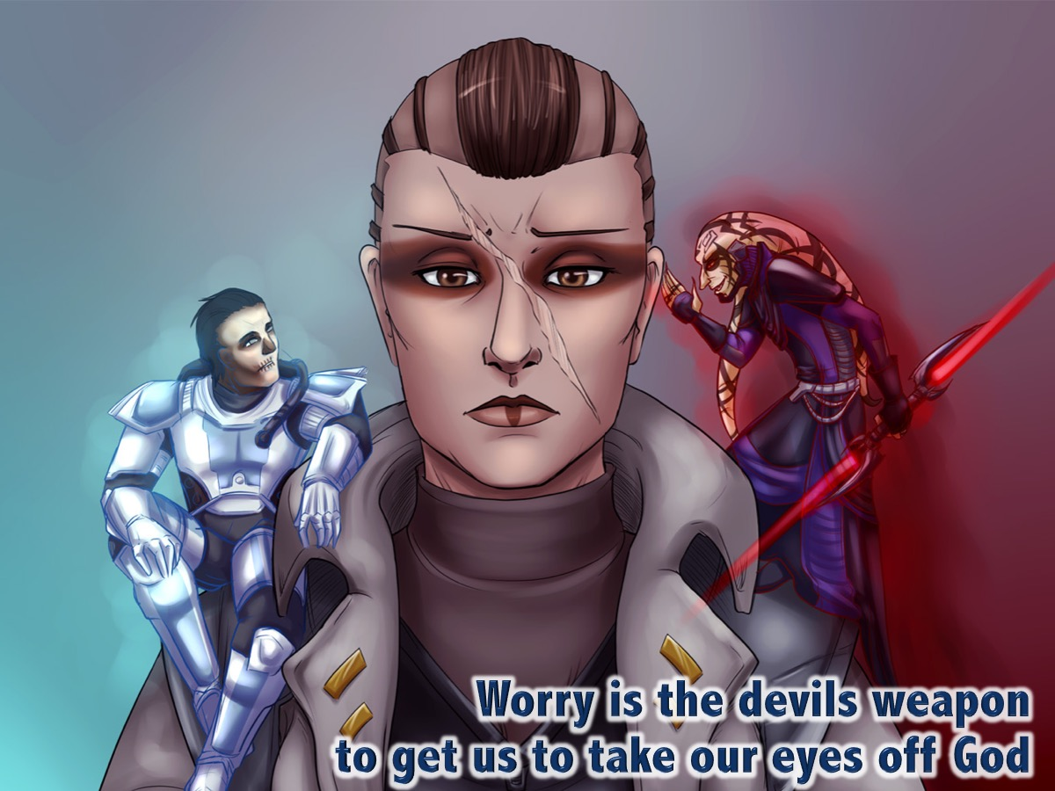
Notes:
Worry is the devils weapon to get us to take our eyes off God.

Slide 27
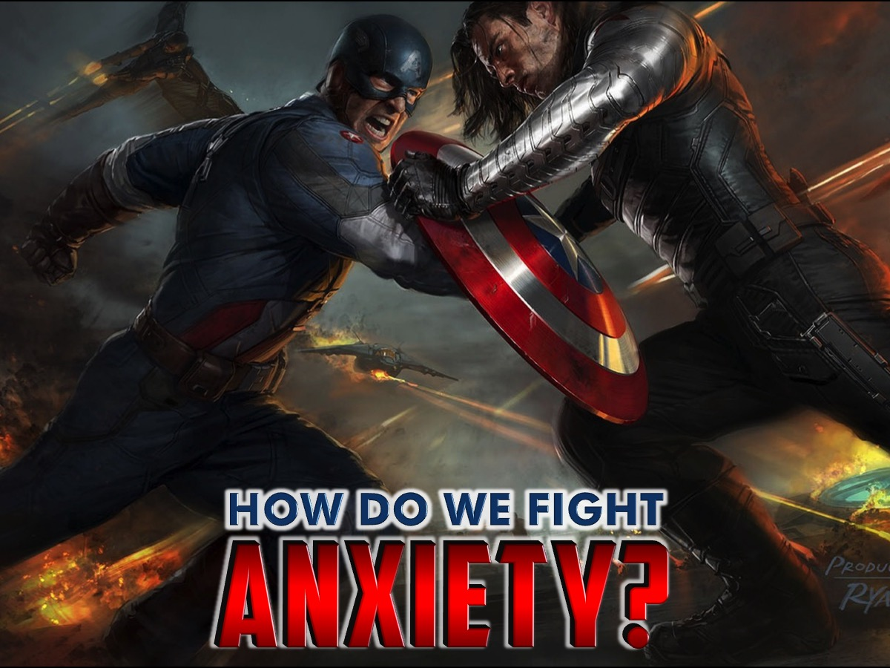
Notes:
How Do We Fight Anxiety?

Slide 28
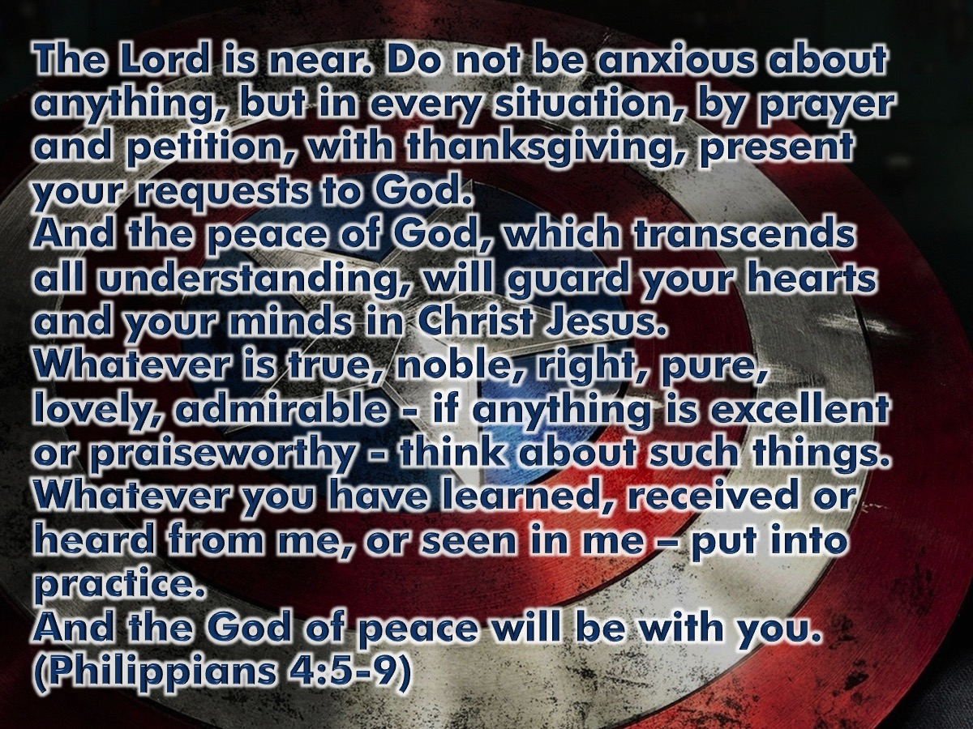
Notes:
God's Cure for Anxiety is found in Philippians 4:5-9. “The Lord is near. Do not be anxious about anything, but in every situation, by prayer and petition, with thanksgiving, present your requests to God. And the peace of God, which transcends all understanding, will guard your hearts and your minds in Christ Jesus. Whatever is true, noble, right, pure, lovely, admirable - if anything is excellent or praiseworthy - think about such things. Whatever you have learned, received or heard from me, or seen in me – put into practice. And the God of peace will be with you.” (Philippians 4:6-9)

Slide 29
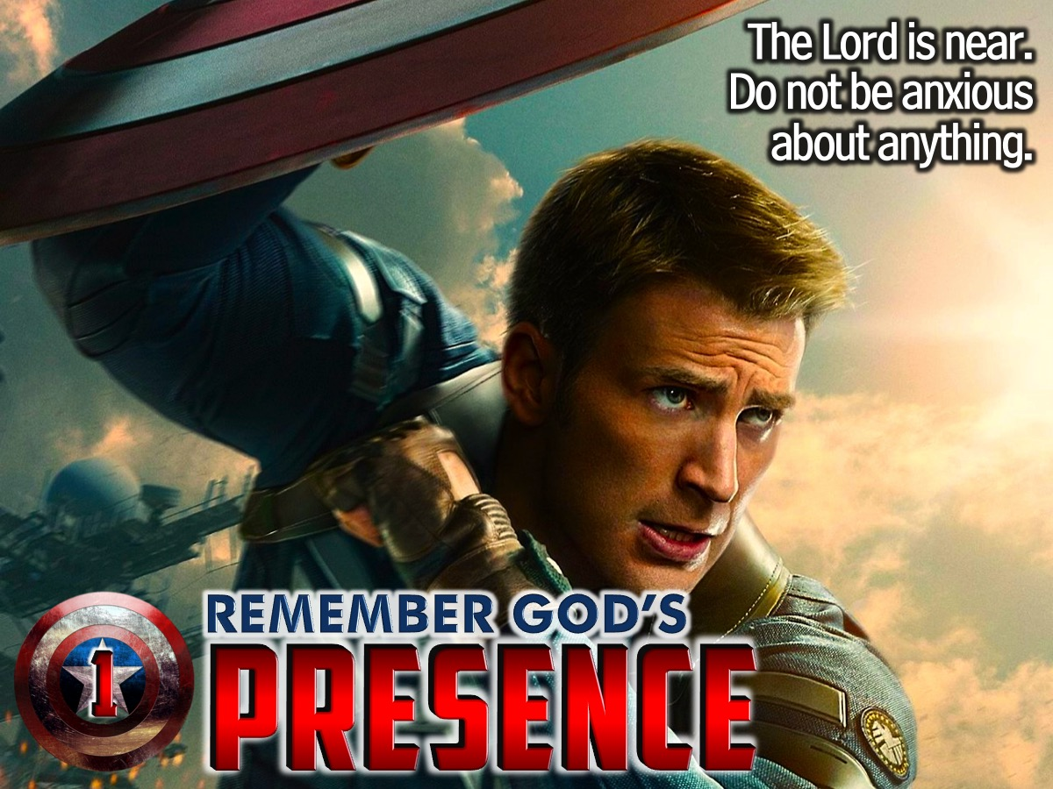
Notes:
1. Remember God’s Presence. “The Lord is near. Do not be anxious about anything” (Philippians 4:5-6). You are not alone. You don’t have to handle the anxious circumstances by yourself because God is with you. The first thing to do when you worry is come to His presence where we don’t have to be anxious abut anything. When we read this phrase in the Greek we see that it is a command not a suggestion. The Lord who is with us commands us not to worry, not to be anxious about anything in our lives. Nothing means not one thing is to make you anxious.

Slide 30
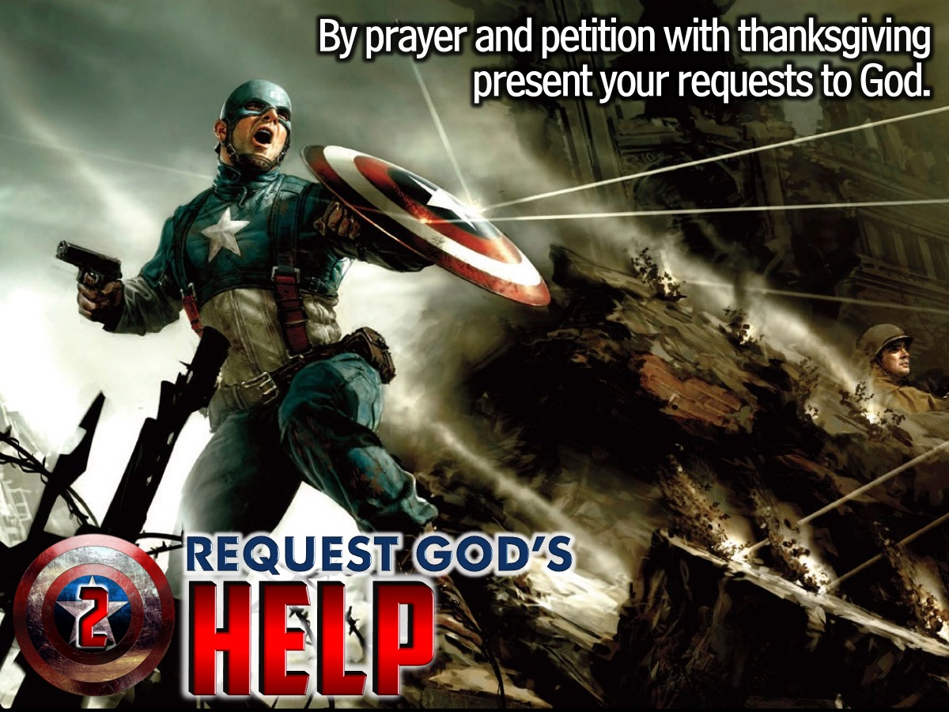
Notes:
2. Request God’s Help. "By prayer and petition with thanksgiving present your requests to God." (Philippians 4:6). Prayer most of us understand as talking with God, but petition is to make an appeal, a plea, or request. So now, we are commanded to not worry but to talk with the Lord who is near and ask Him for what we want. Go to God and make your appeal for a change in your situations. We do it with thanksgiving because we are thankful that He hears our prayers, is involved in our lives and loves us greatly.

Slide 31

Notes:
3. Receive God’s Peace. “And the peace of God, which transcends all understanding, will guard your hearts and your minds in Christ Jesus.” (Philippians 4:7).The peace of God comes after we go to God. We acknowledge that God is almighty, sovereign, good, righteous, powerful, loving, kind, and wise beyond measure. Knowing that God is near to us, is listening to our requests, that He loves us deeply and unconditionally and that He is all-powerful AND all - wise to know what to do about our worries bring us the peace of God Himself because we no longer have to be in control.

Slide 32

Notes:
4. Think Godly Thoughts. “Whatever is true, noble, right, pure, lovely, admirable, excellent or praiseworthy - think about such things. Whatever you have learned, received or heard from me, or seen in me – put into practice.” (Philippians 4:8). Now that you have found peace about your circumstances what are you to do with the anxiety filled thoughts that will come and try to take that peace away? Now it is time to trade your anxious thoughts for new ones: You have to replace one truth with another truth. For example: This is a hard circumstance (truth) but God is all powerful and good (truth). Here is another example: “I am scared (truth) but God is all-wise and has a plan for my life (truth).” Instead of anxiety filled thoughts discipline your mind to think of what is true, what has dignity, things that are right according to the Lord, things that are pleasing, what is of good standing. Think on what is excellent and worthy of praise. Consider these things in your mind rather than allowing anxiety in your mind. We cannot think two things simultaneously. When we think of what is true about God we are not thinking about the scary things that could happen.

Slide 33

Notes:
5. Take Godly Action. “Put into practice whatever you have learned from me. and the God of peace shall be with you.” (Philippians 4:9). The last step is to take action. What have you learned and seen and received since you became a Christ follower? What would a more mature Christ follower do in situations like this? Do that!

Slide 34

Notes:
6. Seek Godly Counsel. If things are still hectic do not be afraid to get professional help from a Christian Counsellor.

Slide 35
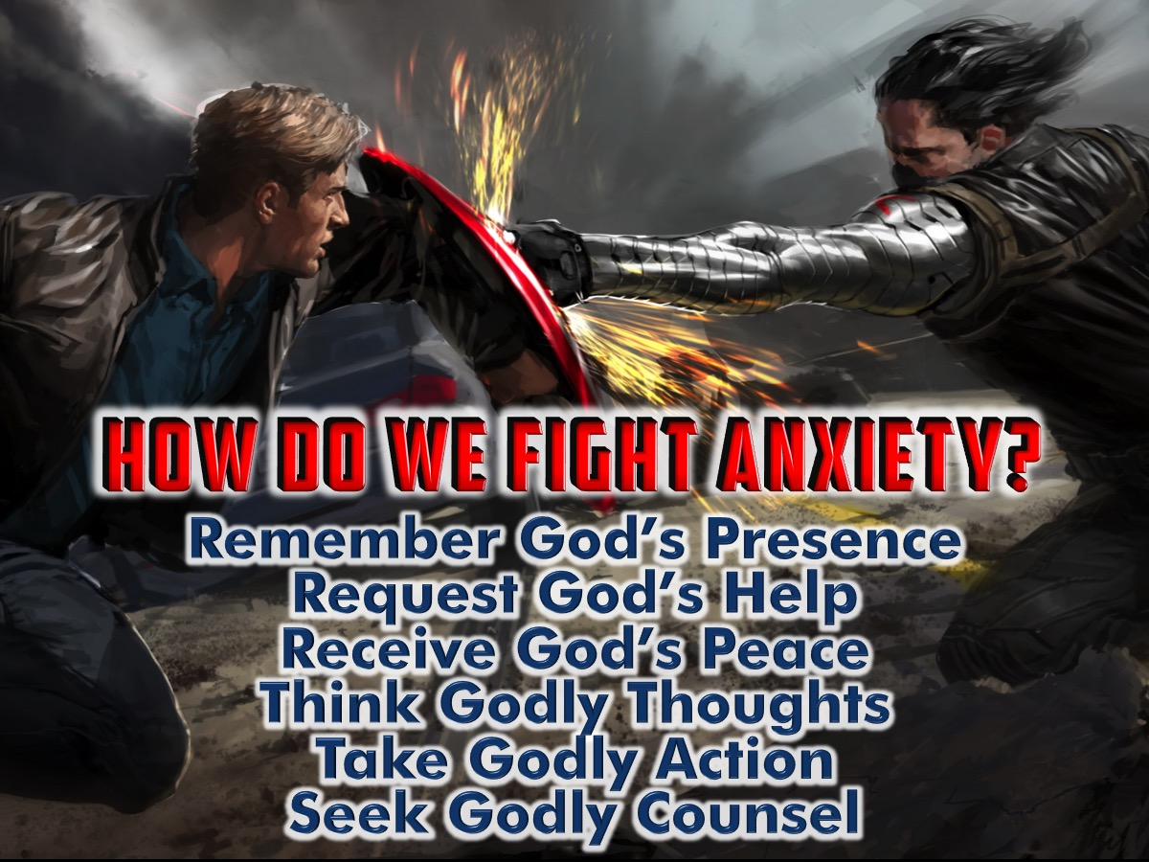
Notes:
Here is a summary of the six steps to fighting anxiety: (1) Remember God’s Presence. (2) Request God’s Help. (3) Receive God’s Peace. (4) Think Godly Thoughts. (5) Take Godly Action. (6) Seek Godly Counsel.

Slide 36

Notes:
Let’s Pray

