Slide 1
Notes:
This week we are looking at fighting breakups. Any ideas on who our superhero is this week?

Slide 2
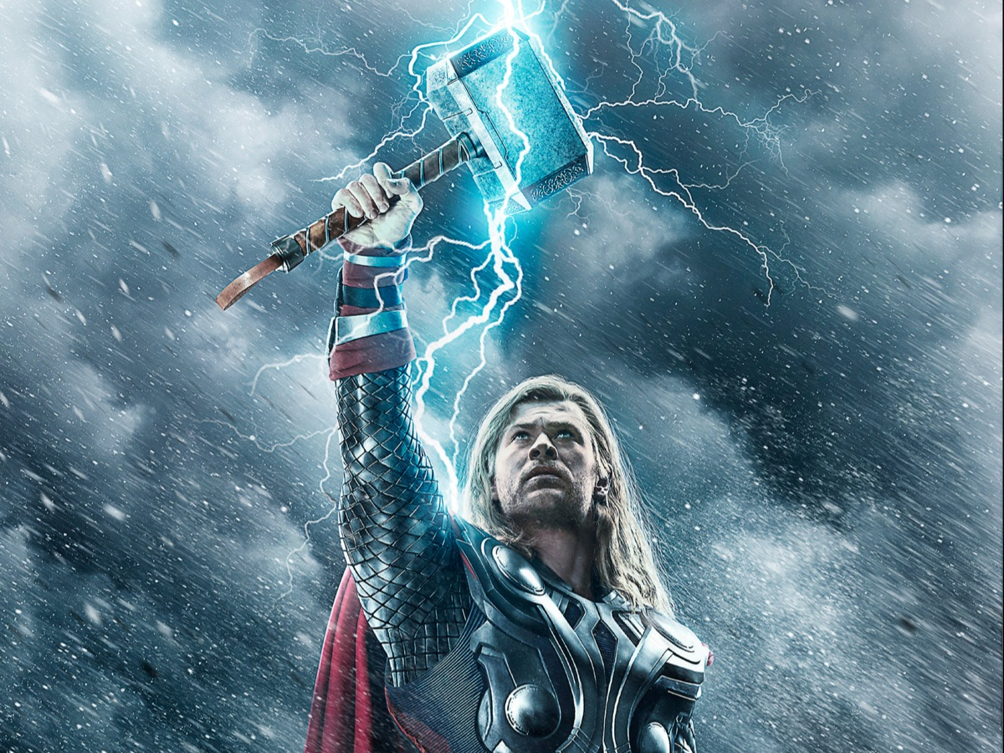
Notes:
It is Thor.

Slide 3
Notes:
Thor’s relationships were complex.

Slide 4
Notes:
With his dad, Odin, the king of Asgaard

Slide 5
Notes:
With his brother, Loki

Slide 6
Notes:
And with his girl friend on earth, Jane.

Slide 7
Notes:
They had some great times together

Slide 8
Notes:
Created some very special memories

Slide 9
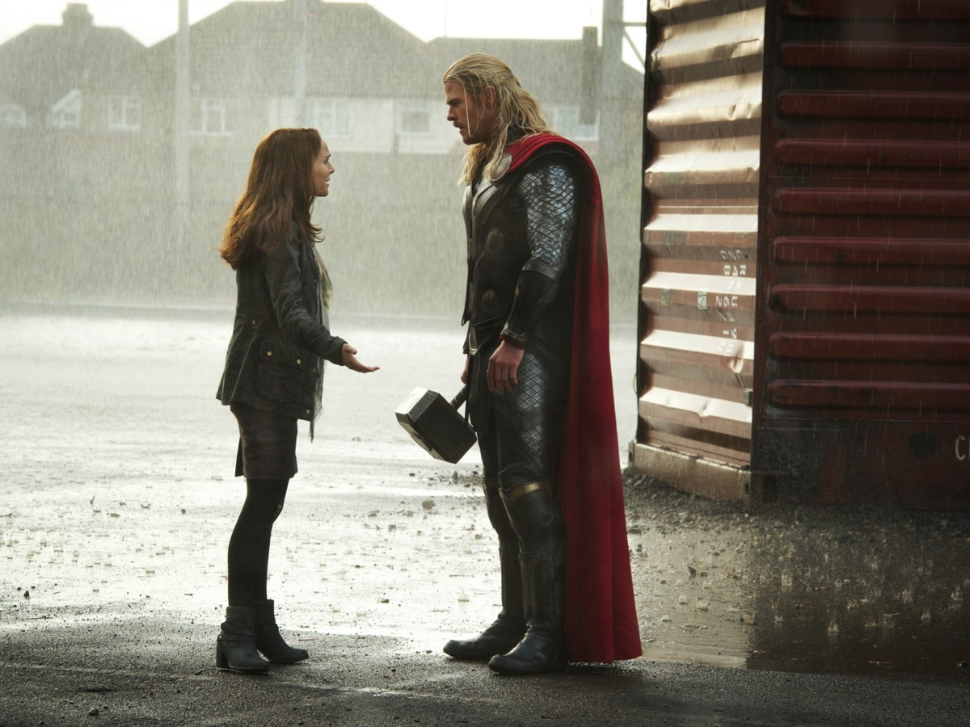
Notes:
But he went away and they had some pretty serious disagreements which led to what we would call a breakup!

Slide 10
Notes:
Sharing: What experience of breakup have you or someone close to you had?

Slide 11
Notes:
Let’s begin by understanding breakups.

Slide 12
Notes:
Why do we enter into Relationships?

Slide 13
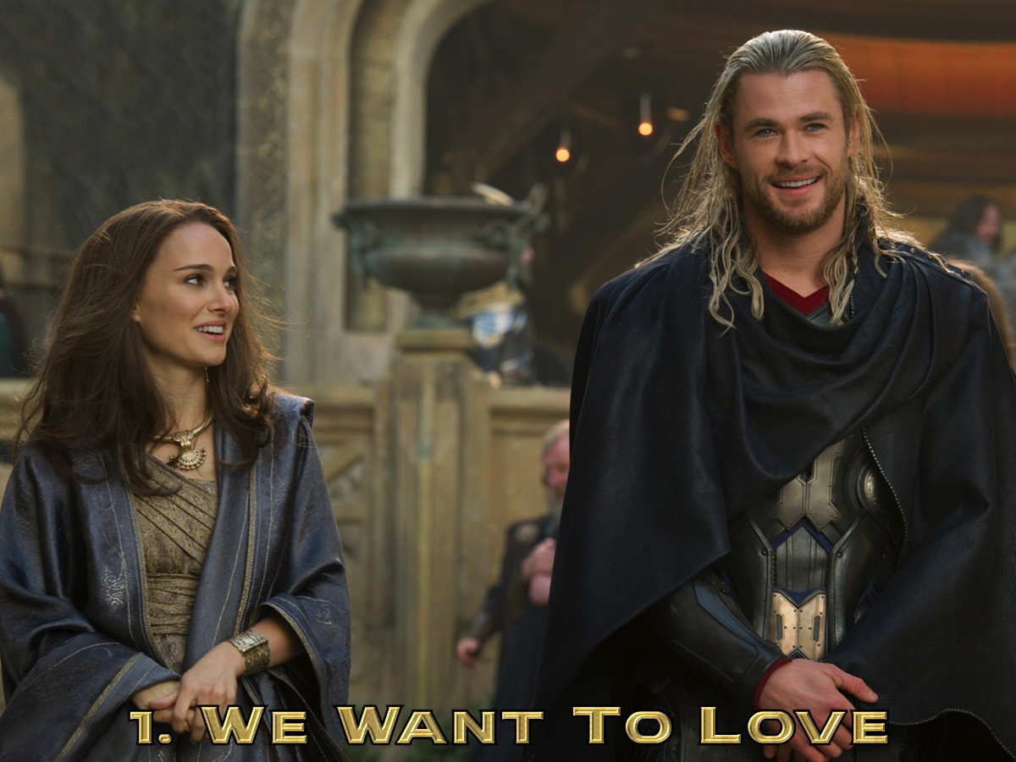
Notes:
1. We want to love - we like or even love the other person.

Slide 14
Notes:
2. We want to be loved - As much as we want to give our love, we also want to receive love.

Slide 15
Notes:
3. We want to belong.

Slide 16
Notes:
This is all because we were created interdependent.

Slide 17
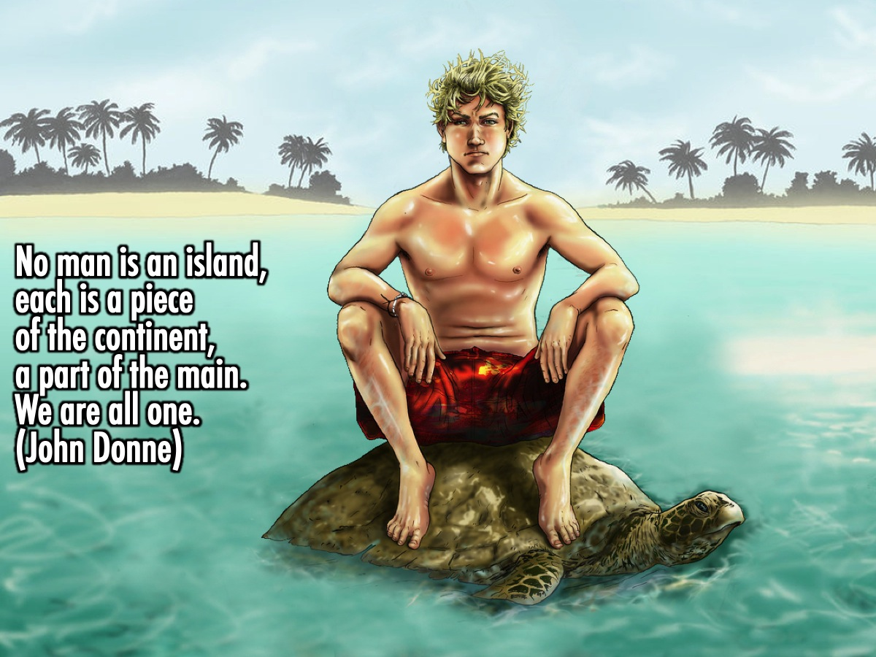
Notes:
No man is an Island, each is a piece of the continent, a part of the main. We are all one. (John Donne)

Slide 18
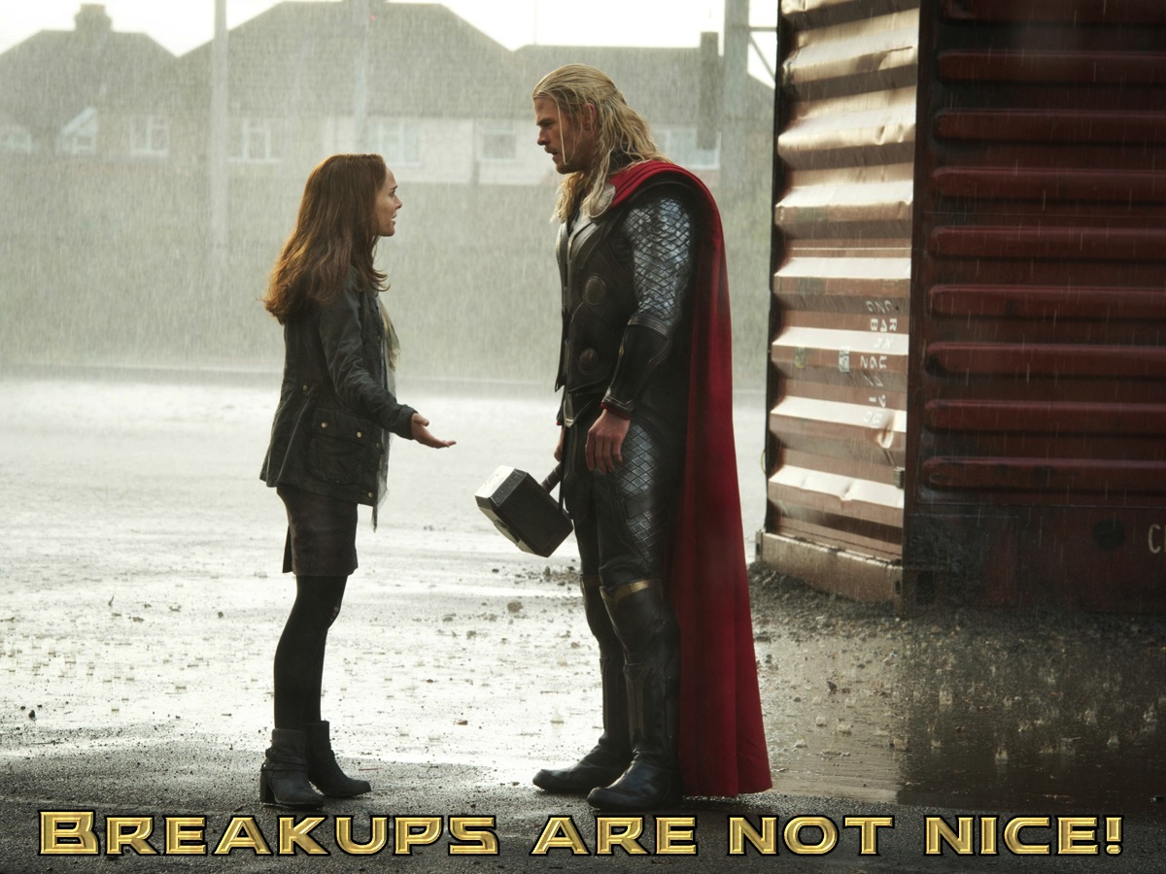
Notes:
That's why breakup's are not a nice thing to go through.

Slide 19
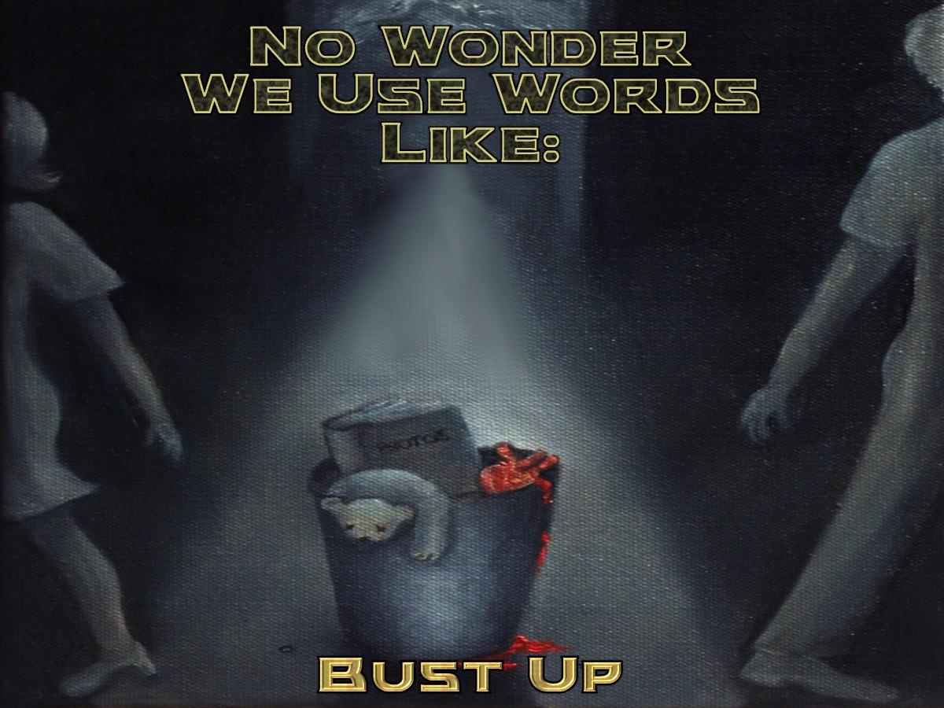
Notes:
That why we have terms for the experience like: Bust up

Slide 20
Notes:
Split up

Slide 21
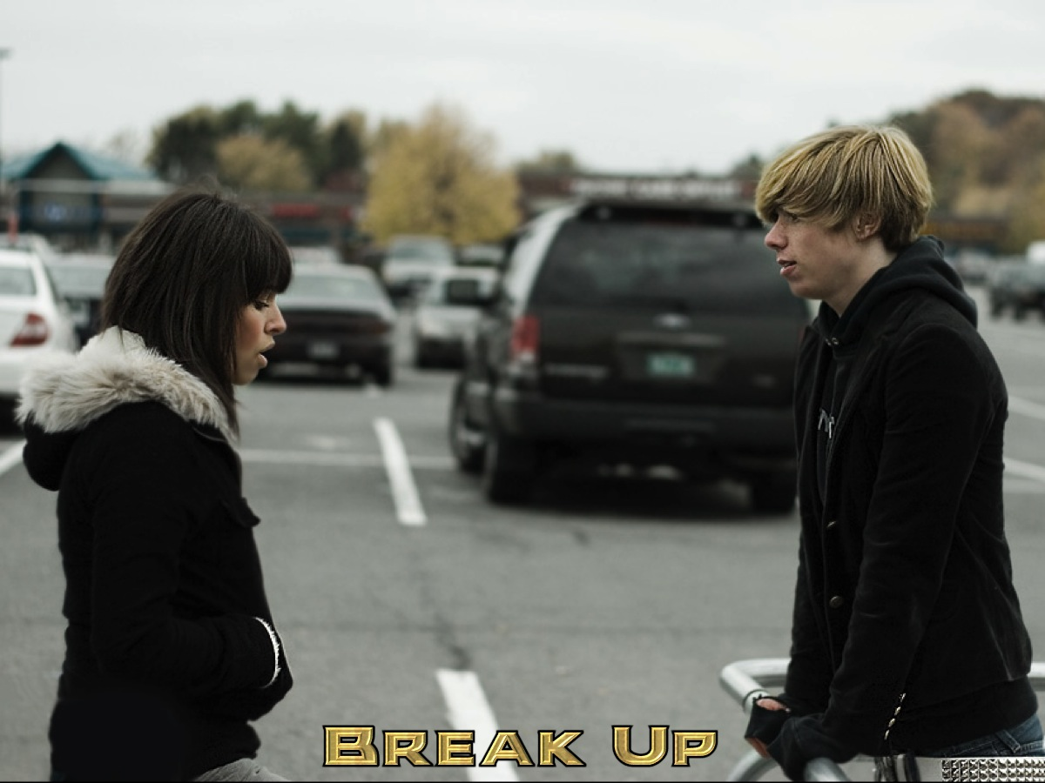
Notes:
Break up

Slide 22
Notes:
Dumped

Slide 23
Notes:
Ditched

Slide 24
Notes:
Rejected

Slide 25
Notes:
Getting over a relationship breakup is hectic!

Slide 26
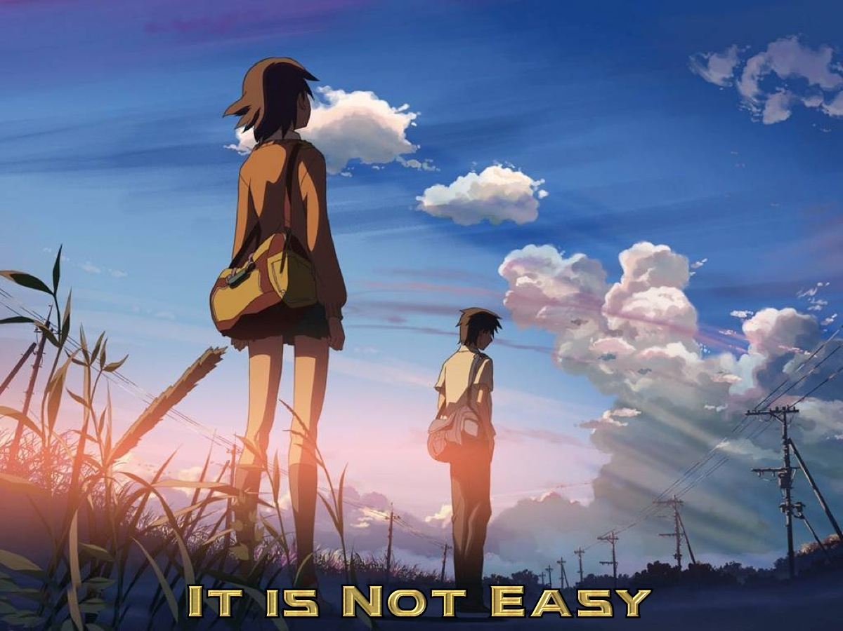
Notes:
* It is not an easy task.

Slide 27
Notes:
* It takes time - At times you tell yourself, “I should be over it by now.” Every wound needs time to heal, depending on the size and the deepness of the wound. For example (a person who is stabbed will need more time to heal than a person who just fell and scraped their knee.) So imagine what it takes to mend a broken-heart!!!!

Slide 28
Notes:
* It Can’t be Shortcut - For some of us, the big illusion is that immediately enter into another relationship will stop the emotional hurt or wound. By doing this it means you are bringing into the new relationship unresolved issues that will damage or perhaps even ruin the new relationship.

Slide 29
Notes:
So how do we go about fighting breakups?

Slide 30
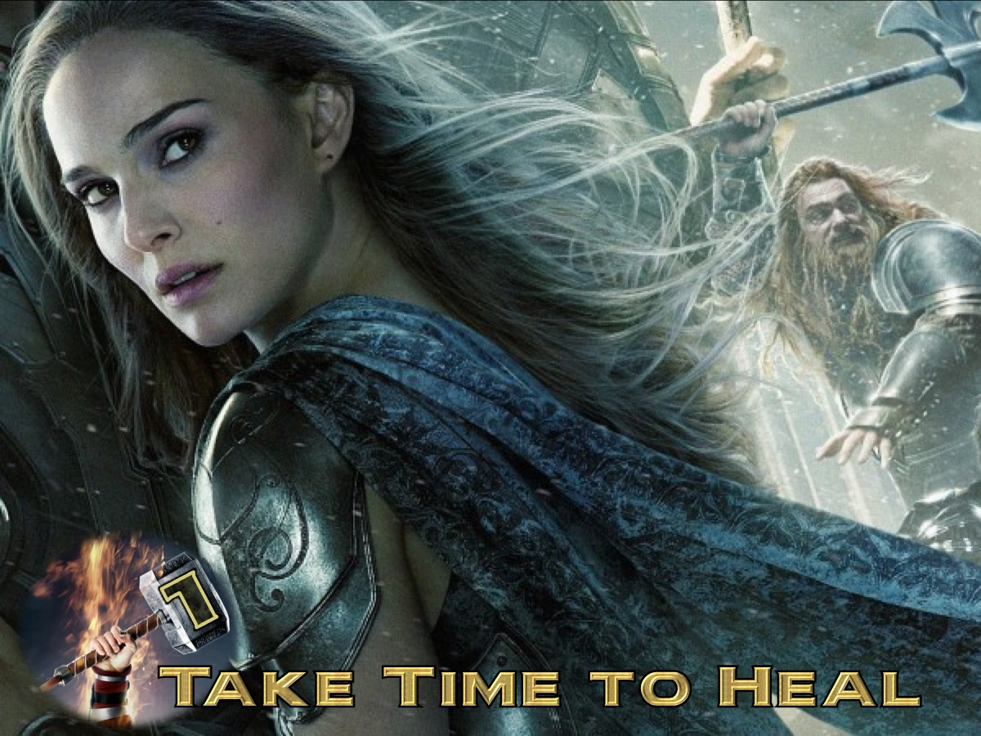
Notes:
1. Take Time to Heal. Well maybe the next person you date will be your future husband or wife but, if you’ve just had your heart broken, it will take more than five minutes to get over it. You’ve got to allow yourself time to grieve and to heal so that you are mentally ready by the time you start preparation for your next relationship.

Slide 31
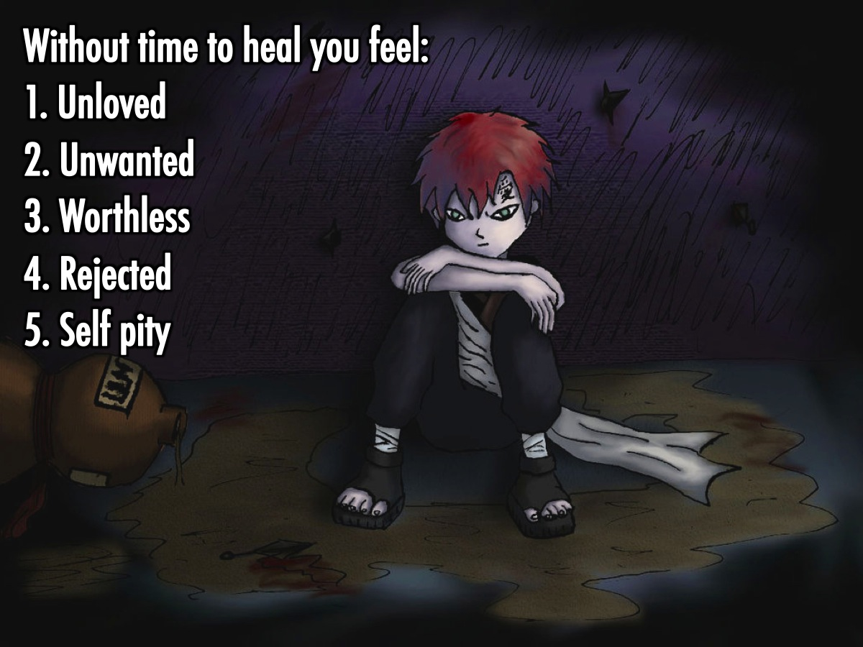
Notes:
If you don't give yourself time to heal you will feel: (1) Unloved. (2) Unwanted. (3) Worthless. (4) Rejected. (5) Self pity.

Slide 32
Notes:
If these feelings are not dealt with they can lead you to: (1) Drugs. (2) Suicide. (3) Ending the other person's life. (4) Stalking. (5) Lack of trust.

Slide 33
Notes:
I remain confident of this: I will see the goodness of the Lord in the land of the living. Wait for the Lord; be strong and take heart and wait for the Lord. (Psalm 27:13-14 )

Slide 34
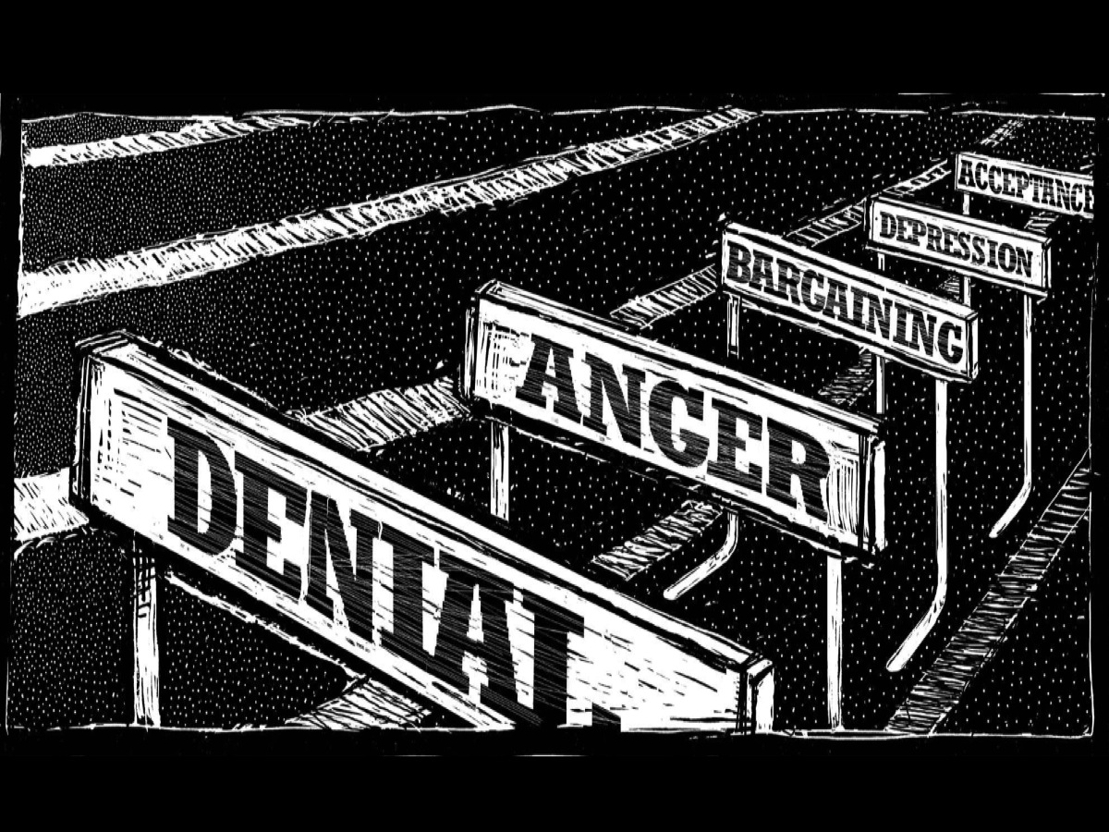
Notes:
Healing does not take place over night – in fact there are a number of stages you will go through as you are grieving. In some way these stages are like hurdles in our path and we need to get past them to move towards healing.

Slide 35
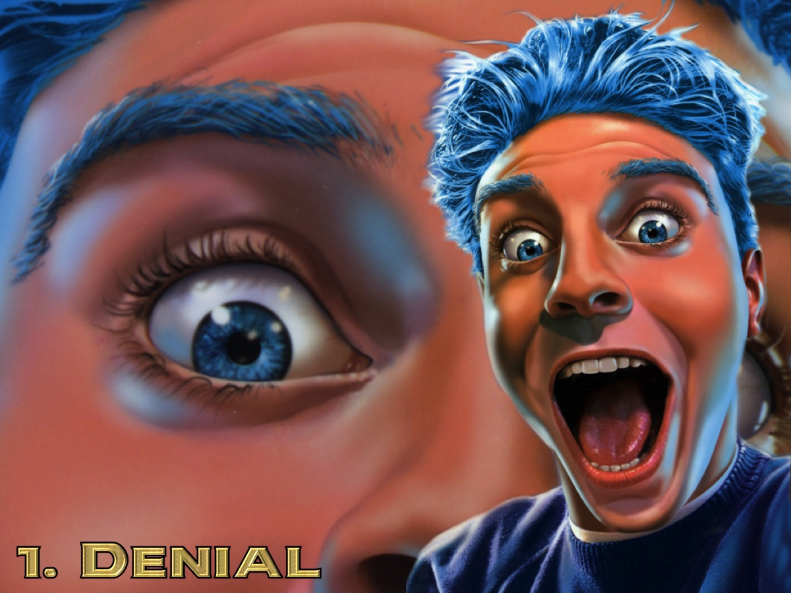
Notes:
(1) Denial. The first stage is “Denial”. Typical head-in-the-sand attitude – ‘It can’t be happening.’ ‘If I ignore it, it’ll go away.’ Maybe you haven’t broken up yet but it’s a possibility and you’re pretending to your friends family that everything’s still okay.

Slide 36
Notes:
(2) Anger. After this is “Anger”. ‘Why is this happening to me?? It’s not fair!’ Perhaps you lie awake at night scheming ways to get revenge.

Slide 37
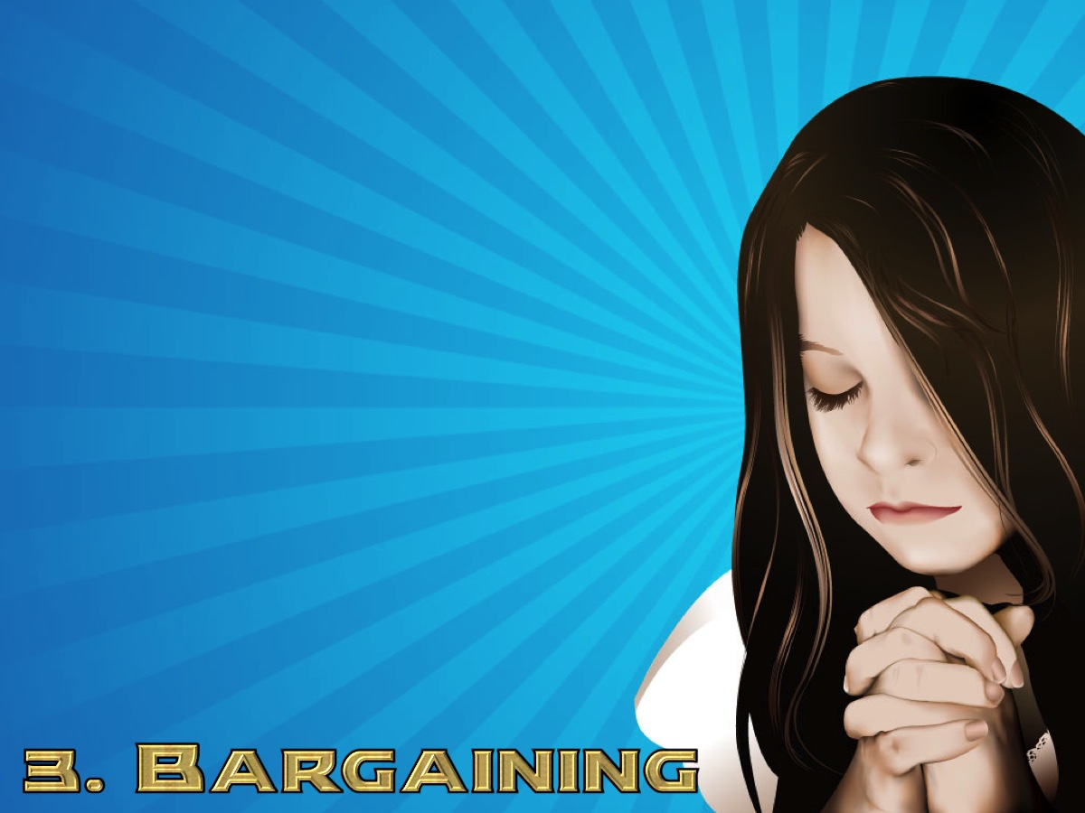
Notes:
(3) Bargaining. The next stage is “Bargaining”. Maybe we realize we weren’t all we could have been in the relationship. We see faults – whether real or imagined – and think that if we rectify them we can bargain with our ex to get the relationship back. ‘I promise you, I’ll stop chewing my toenails.

Slide 38
Notes:
(4) Depression. Then comes “Depression”. “Nothing’s ever going to get better so what’s the point? Why bother with anything?” You shut yourself away from everyone and become even more depressed.

Slide 39
Notes:
(5) Acceptance. Finally, there’s “Acceptance”. You’ve realized that things are as they are – there’s nothing you can do about them – so it’s time to get on with your own life. You might think it’s an uphill struggle to start piecing things back together but at least you’ve taken a step along that road of acceptance and that’s all you need to do for now – just keep taking one small step at a time.

Slide 40
Notes:
Grief is not a disorder, a disease or a sign of weakness. It is an emotional, physical, and spiritual necessity – it is the price you pay for love.

Slide 41
Notes:
Let Yourself Grieve: "Blessed are they who mourn, for they shall be comforted." (Matthew 5:4). Mourning is God's way of healing the grieving and bereaved heart.

Slide 42
Notes:
2. Connect with God. The good news is you don't have to grieve alone. God is always by your side, waiting for you to call on him.

Slide 43
Notes:
God is with you! After all, “nothing is impossible with God” (Luke 1:37). Remember that: (1) You are a child of God (1 John 3:1). (2) You are fearfully and wonderfully made (Psalm 139:14). (3) You are a treasured possession (Exodus 19:5).

Slide 44
Notes:
3. Talk to Someone.

Slide 45
Notes:
I know it's not easy to pray when you feel horrible inside.

Slide 46
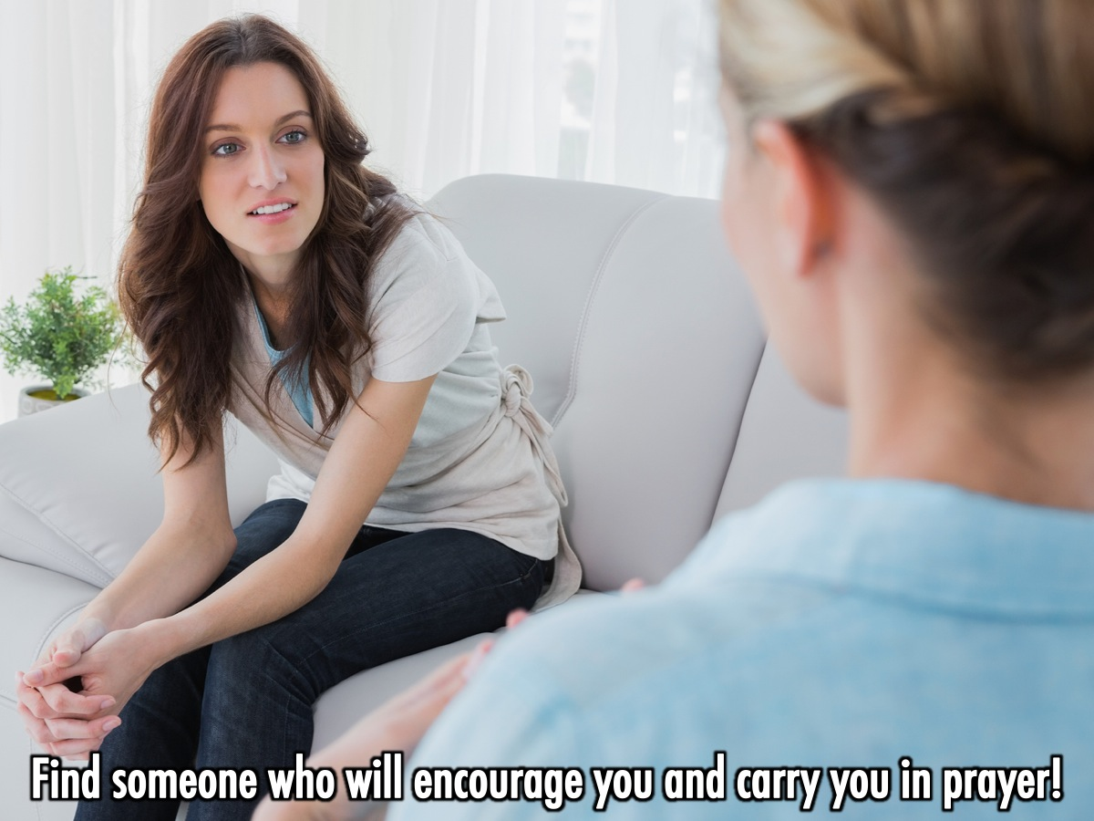
Notes:
That's why it's important to have someone wise to talk to, so that yet can give you encouragement and carry you in prayer.

Slide 47
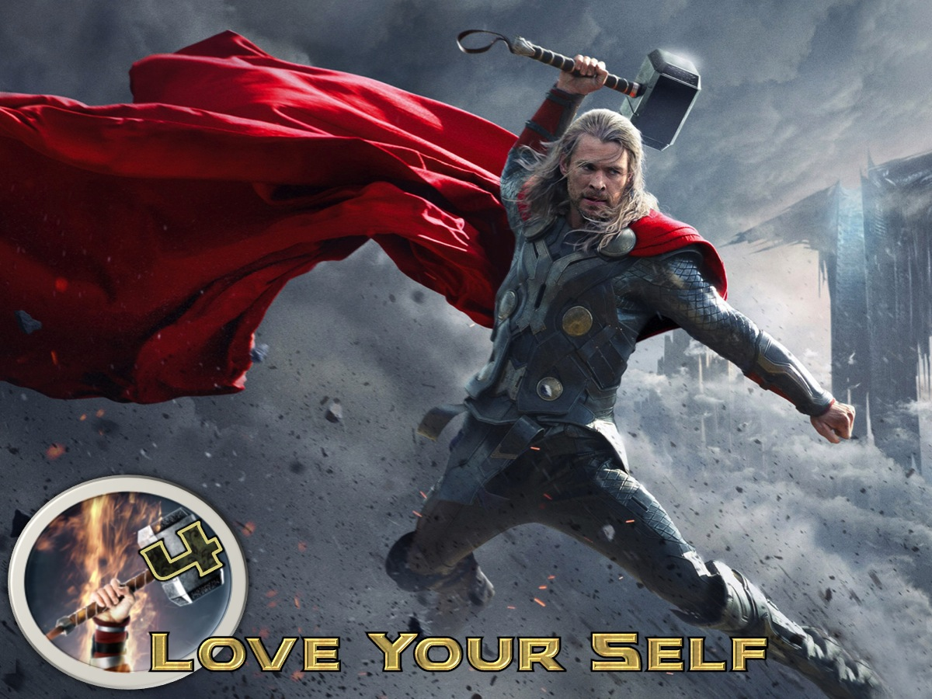
Notes:
4. Love Yourself - You will find that it's easier for others to love and accept you if you first do that for yourself. Find yourself and allow God to have control over your life. There is a time and a season for everything under the sun. Nothing lasts forever.

Slide 48
Notes:
“Love the Lord your God with all your heart and with all your soul and with all your strength and with all your mind'; and, 'Love your neighbor as yourself.’” (Luke 10:27)

Slide 49
Notes:
5. Grow Through the Experience.

Slide 50
Notes:
“Count it all joy, my brothers, when you meet trials of various kinds, for you know that the testing of your faith produces steadfastness. And let steadfastness have its full effect, that you may be perfect and complete, lacking in nothing.” (James 1:2-4)

Slide 51
Notes:
Summary: How do we fight breakups? (1) Take Time to Heal. (2) Connect With God. (3) Speak to Someone. (4) Love Your Self. (5) Grow Through It.

Slide 52
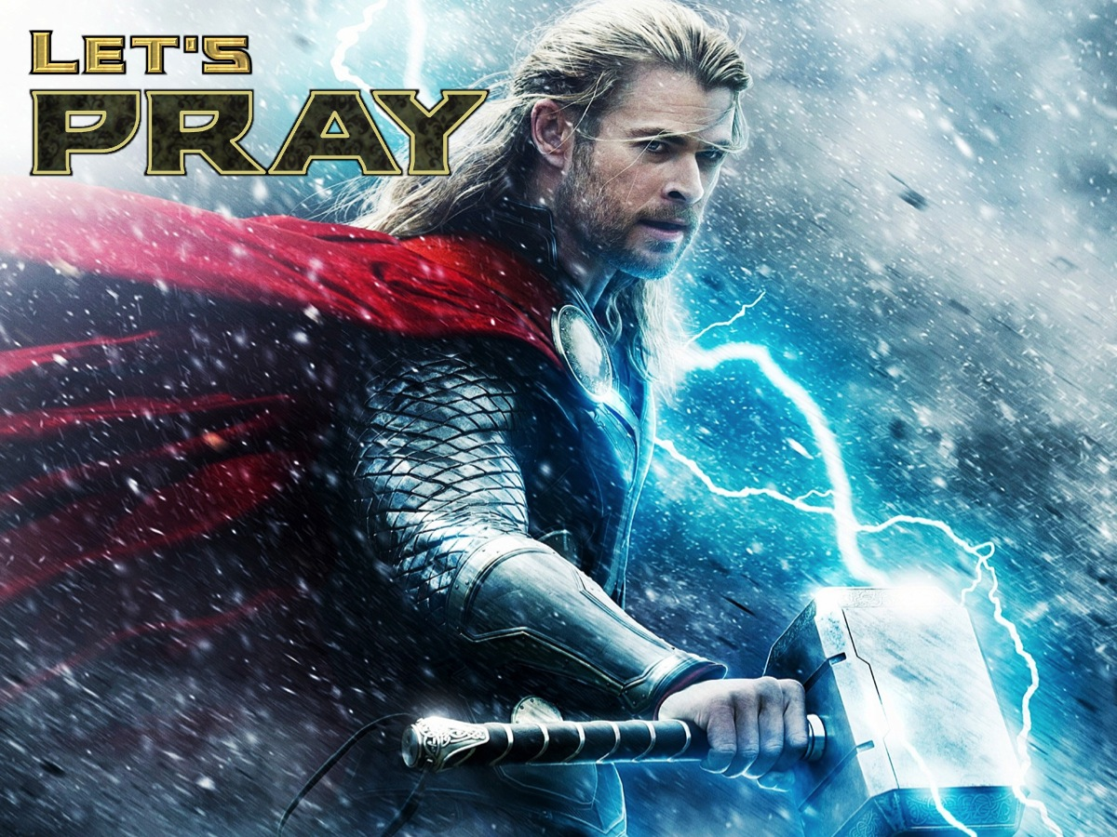
Notes:
Let’s Pray

