Slide 1

Notes:
This week we will learn how to Fight Depression! Can you guess who our superhero is this week?

Slide 2

Notes:
it is Iron Man, of course. Here is the trailer for the third movie in the series.

Slide 3
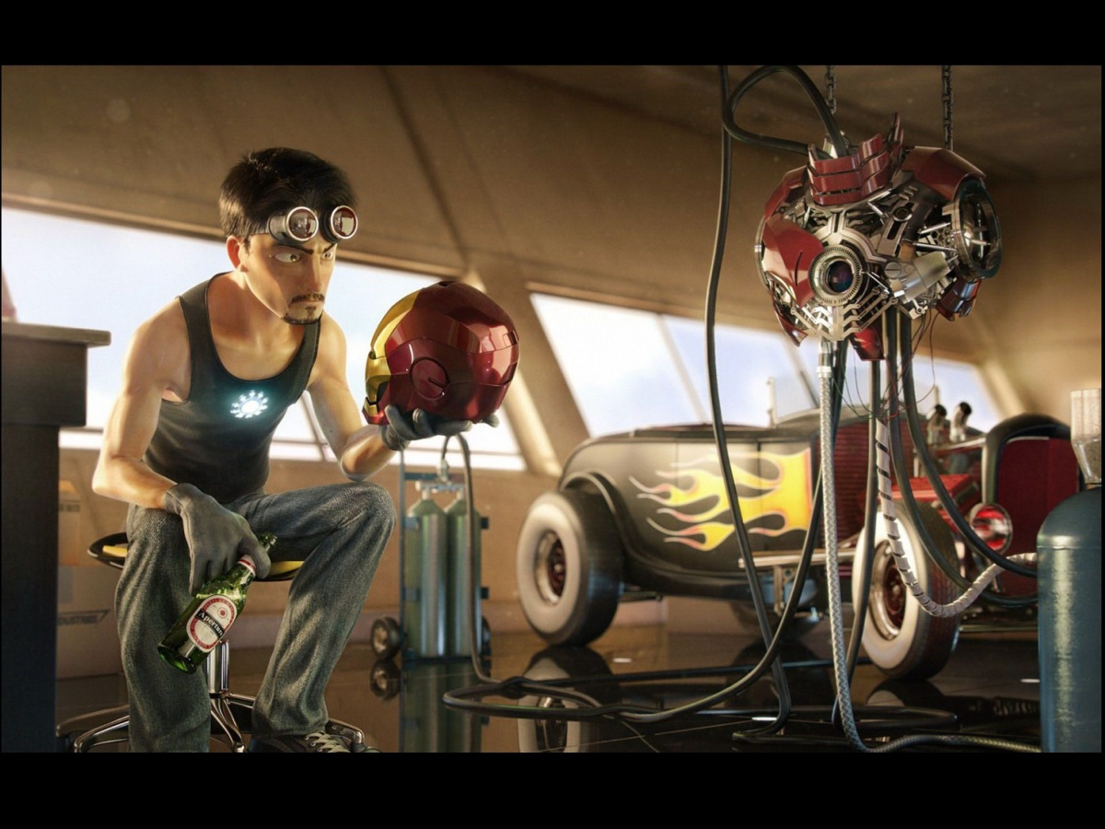
Notes:
Iron Man 3 starts with a glimpse where everything is dark and depressive for Tony Stark.

Slide 4

Notes:
We are transported back in time to discover why he was in such a mess. After the Avengers saved the earth, you might think Tony Stark would be even more egotistic and richer and happier than ever. But you would be wrong!

Slide 5

Notes:
Even though he is in a committed relationship with Pepper Potts…

Slide 6

Notes:
…the man is a mess. He is depressed, can’t sleep, and has panic attacks. These attacks leave him in tears and sitting helpless on the ground. And no armor or technology can protect or help him.

Slide 7

Notes:
And to make matters worse, there are two men who want to destroy the world and everything Tony loves. The first is The Mandarin. He is a mix of a James Bond villain and Osama Bin Laden, a mad man who represents no country but has a following of psychopaths who help him.

Slide 8

Notes:
The other villain is Aldrich Killian, a scientist who has a grudge against Tony Stack and is far more evil and deadly than he appears.

Slide 9

Notes:
So, in a matter of days, Tony Stark’s best friend (James Rhodes) is left in a coma after a terrorist attack…

Slide 10

Notes:
his girlfriend is kidnapped and tortured

Slide 11

Notes:
and his Malibu mansion is blown to pieces.

Slide 12

Notes:
What will happen to Tony Stark? To Iron Man? Is he going to quit the superhero business because it is too hard on him?

Slide 13

Notes:
Or will he seek support from the people who love him?

Slide 14

Notes:
Thankfully by the end of the movie we see he is in a much better place and has won his fight against depression!

Slide 15
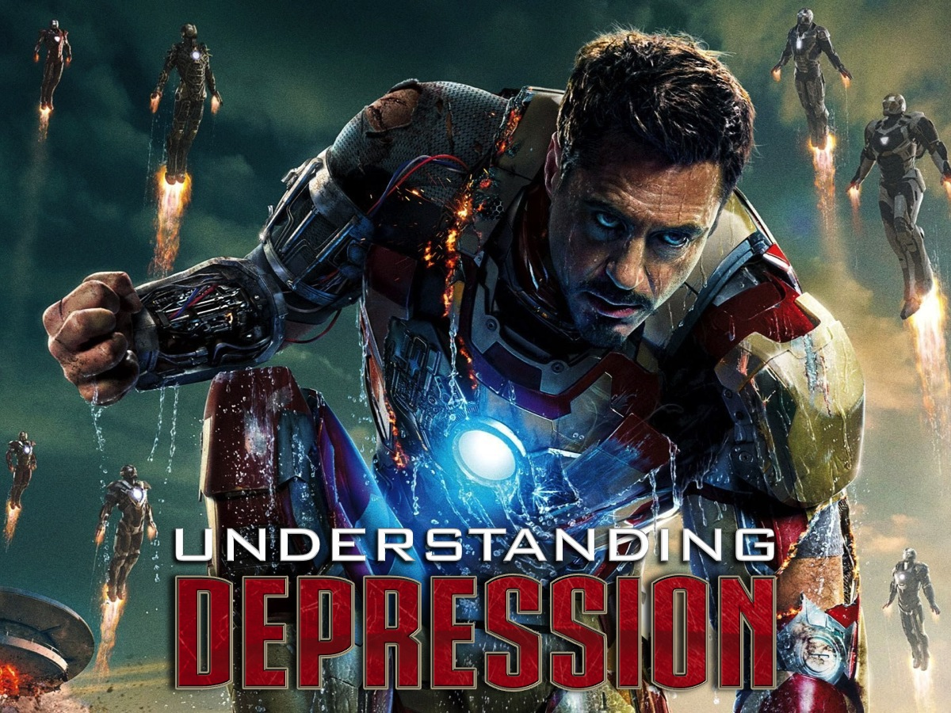
Notes:
Let’s begin by understanding depression.

Slide 16
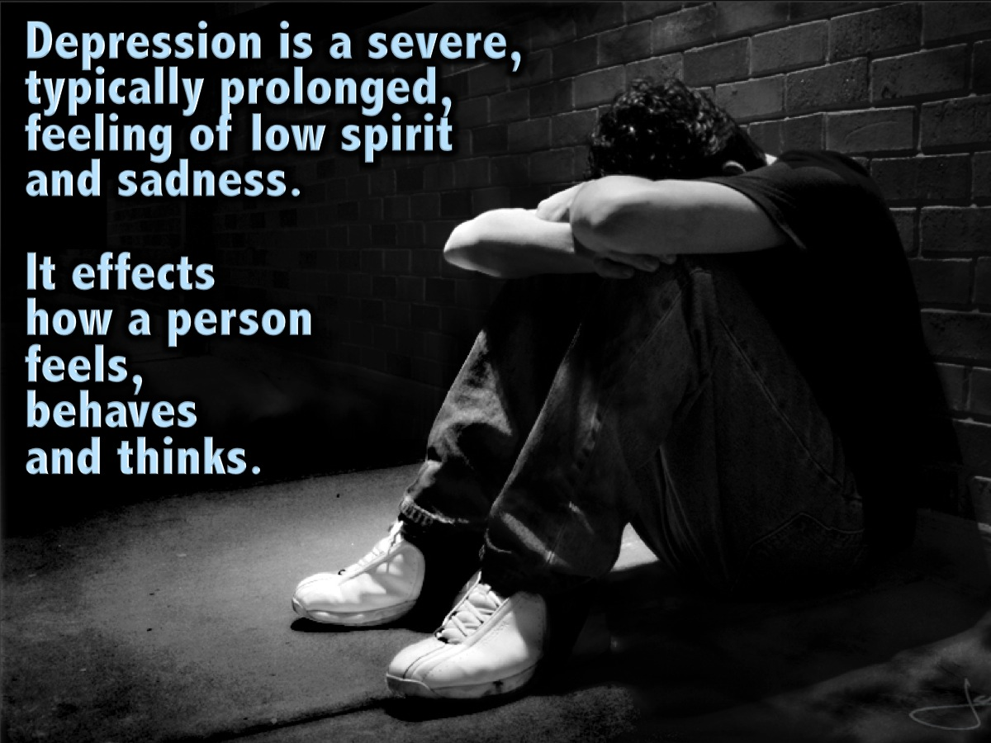
Notes:
Depression is a severe, typically prolonged, feeling of low spirit and sadness. It effects how a person feels, behaves and thinks.

Slide 17
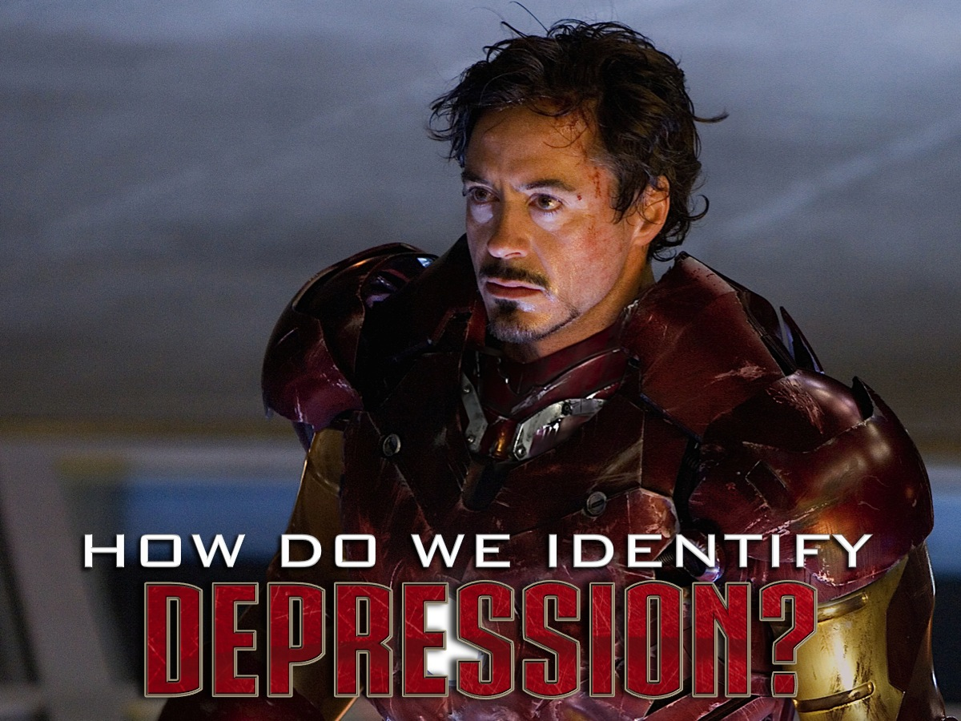
Notes:
How Do We Identify Depression? What are the signs of depression?

Slide 18

Notes:
(1) Persistent sadness that lingers

Slide 19

Notes:
(2) Change in appetite

Slide 20

Notes:
(3) Difficulty sleeping – or a change in sleeping patterns.

Slide 21

Notes:
(4) Constant irritability

Slide 22
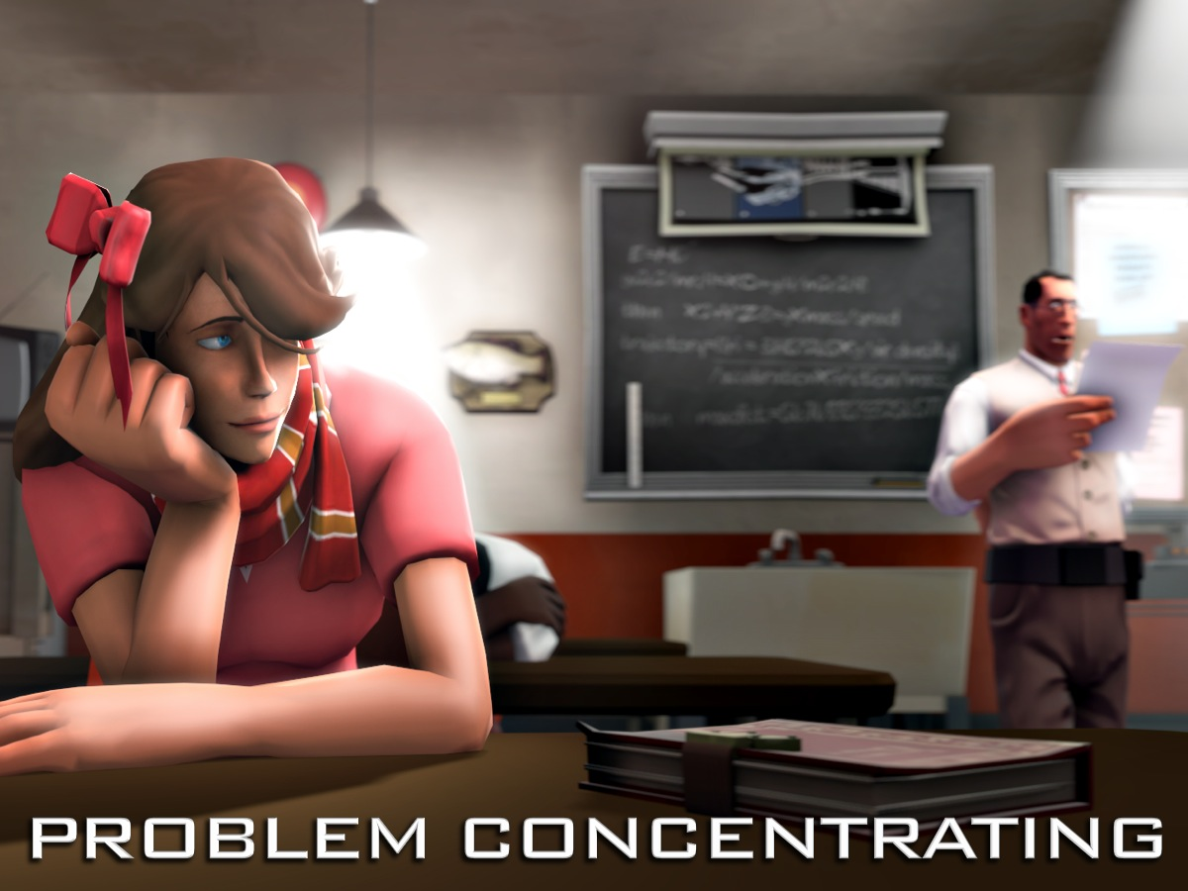
Notes:
(5) Problems concentrating

Slide 23

Notes:
(6) Tendency to Isolation

Slide 24

Notes:
(7) Lack of Enjoyment – An inability to enjoy things.

Slide 25
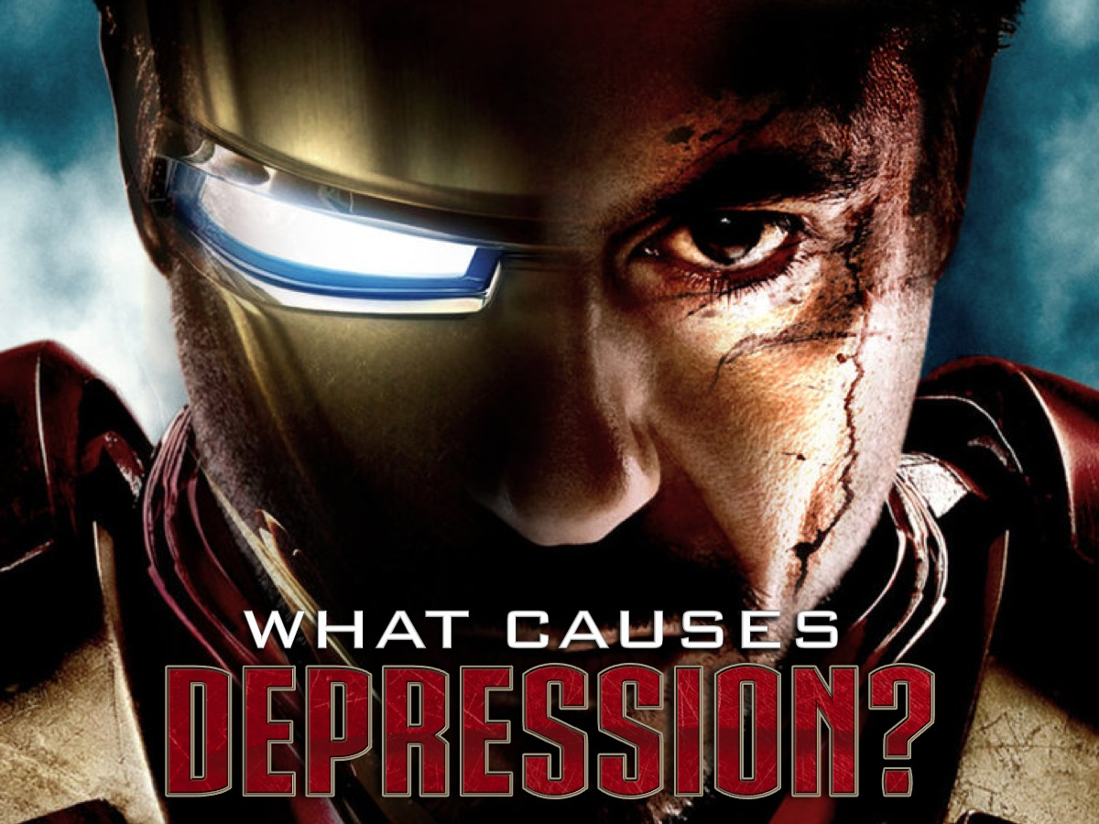
Notes:
What Causes Depression? Here are some things that may cause someone to become depressed:

Slide 26
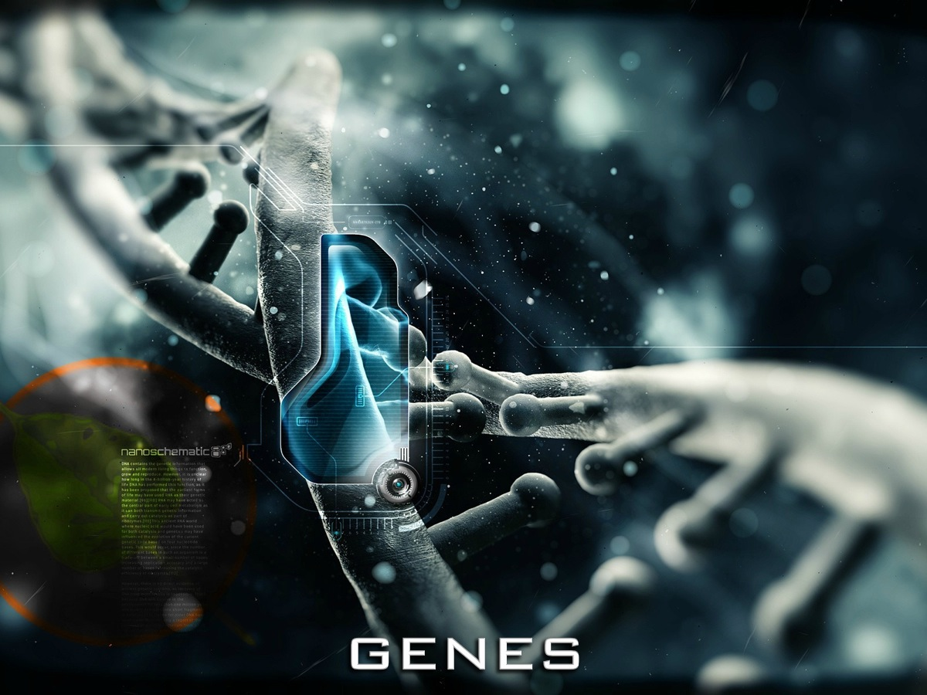
Notes:
(1) Genes - Depression can be passed on through family lines but it is not guaranteed - just more likely that you could experience depression if there is a history of depression in your family.

Slide 27
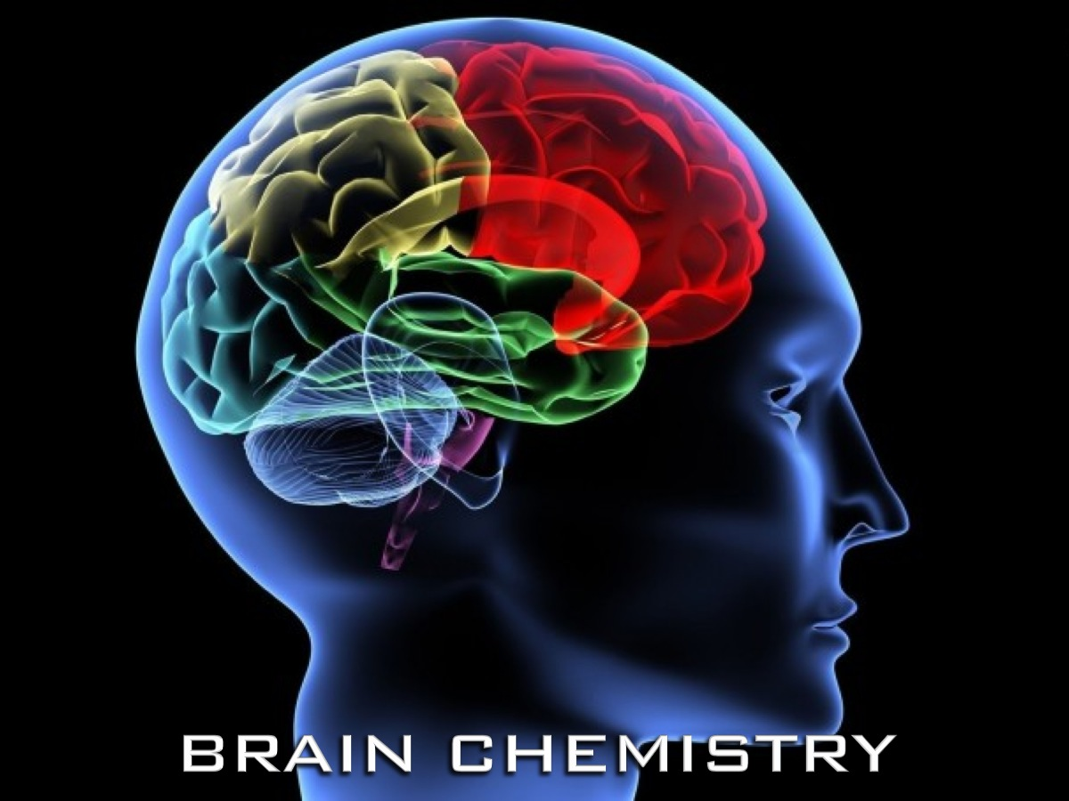
Notes:
(2) Brain Chemistry – There are neurotransmitters in our brains that help regulate our moods.

Slide 28
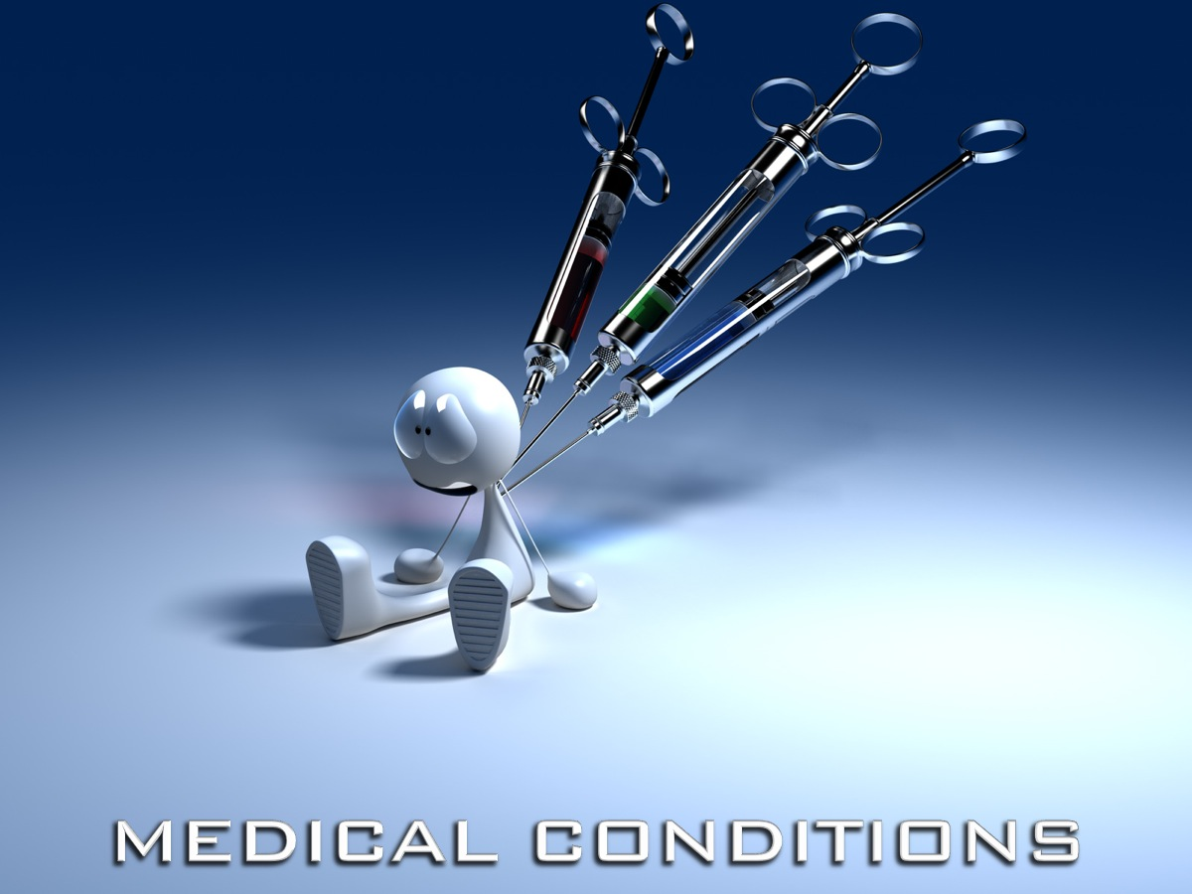
Notes:
(3) Medical Conditions - when you receive medication for various illnesses or conditions you could be more at risk of experiencing depression.

Slide 29

Notes:
(4) Social Environment - if you are surrounded by unhappiness and fighting and negativity you will be more susceptible to depression.

Slide 30

Notes:
(5) Daylight and Seasons – the more sunlight you have in your world the more serotonin you will have and the less likely you will be to experience depression.

Slide 31

Notes:
(6) Life Events - if you experience a challenging life event like breaking an arm or losing a pet or a loved one or experiencing a divorce the more likely you will be to experience depression.

Slide 32

Notes:
(7) Outlook on Things

Slide 33

Notes:
Celebrities and Depression. You may be surprised to know that many famous people struggle with depression:

Slide 34

Notes:
Owen Wilson

Slide 35

Notes:
Jim Carrey

Slide 36

Notes:
Brad Pitt

Slide 37

Notes:
Halle Berry

Slide 38
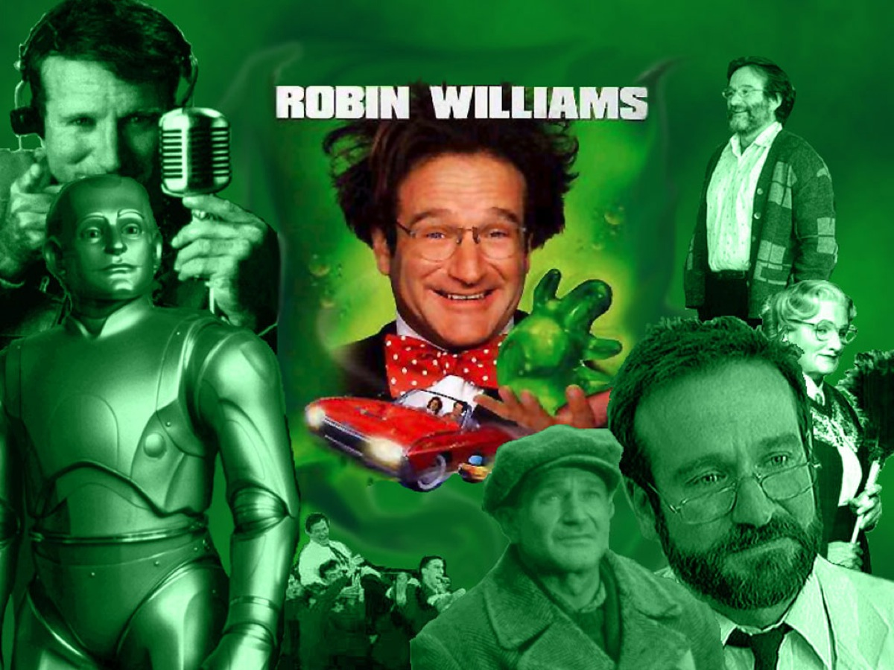
Notes:
Robin Williams

Slide 39

Notes:
How do we, like Tony Stark, suit-up, become Iron Man and fight depression?

Slide 40

Notes:
1. Write It Down – it is helpful to keep a journal of your thoughts so you can identify the triggers or causes of your depression as you record your thoughts and read them at a later stage.

Slide 41

Notes:
2. Speak to Father

Slide 42
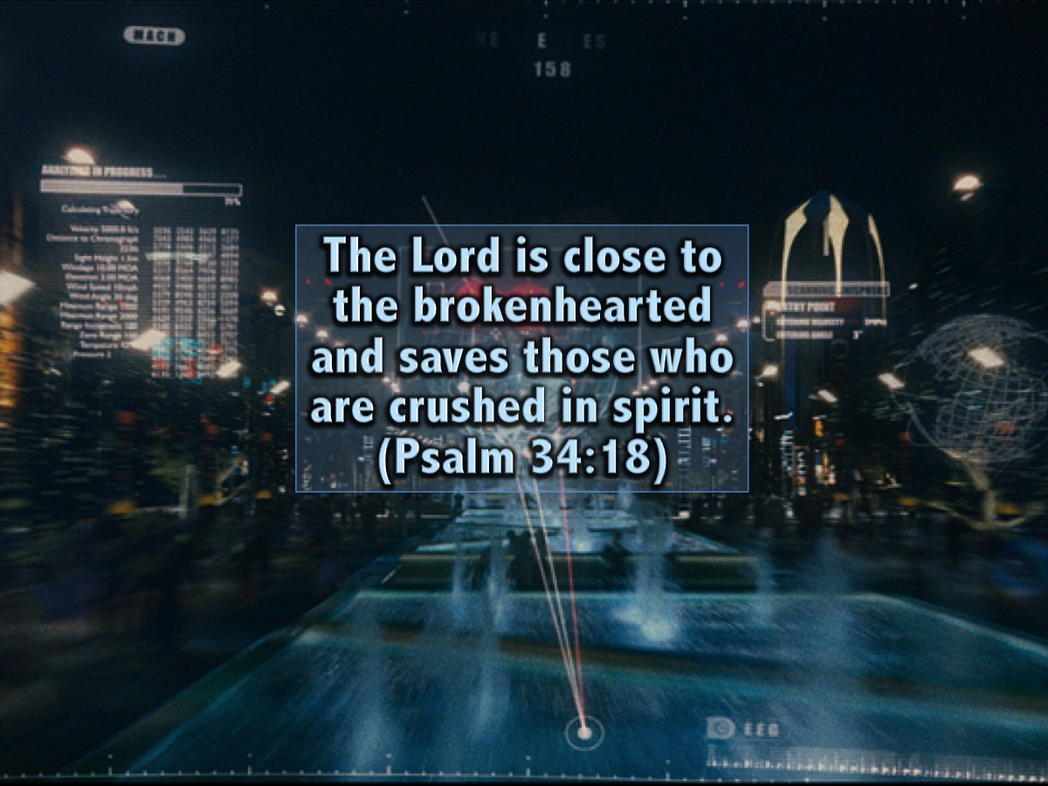
Notes:
The Lord is close to the brokenhearted and saves those who are crushed in spirit. (Psalm 34:18)

Slide 43
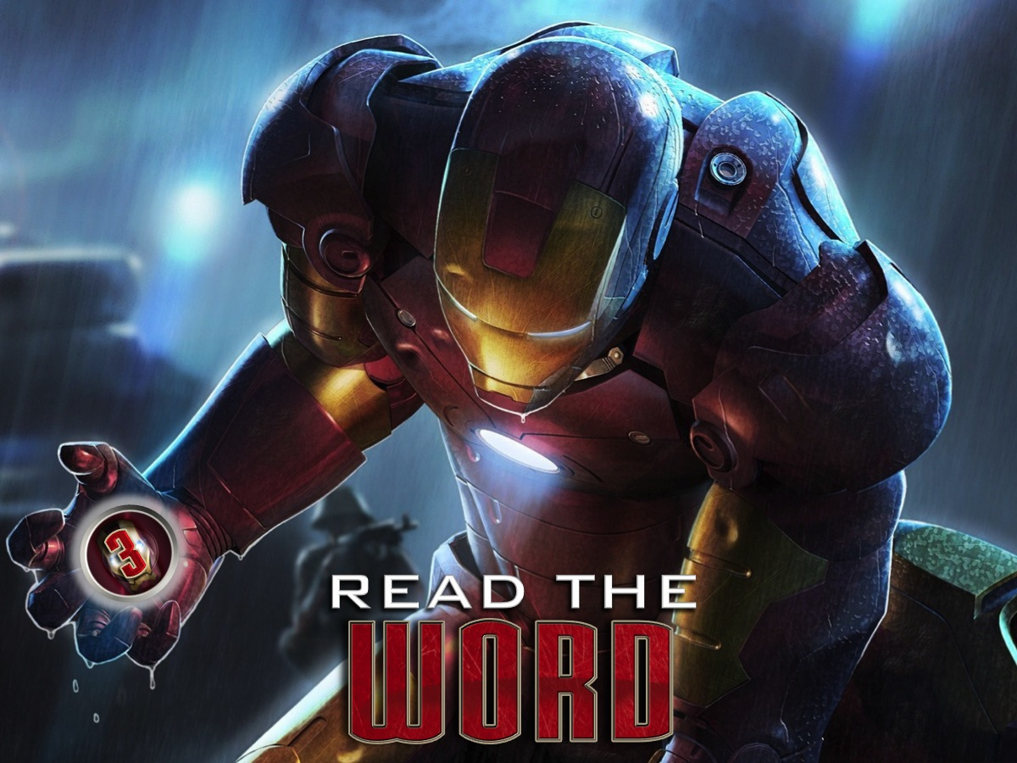
Notes:
3. Read the Word (Spend Time in the Word)

Slide 44
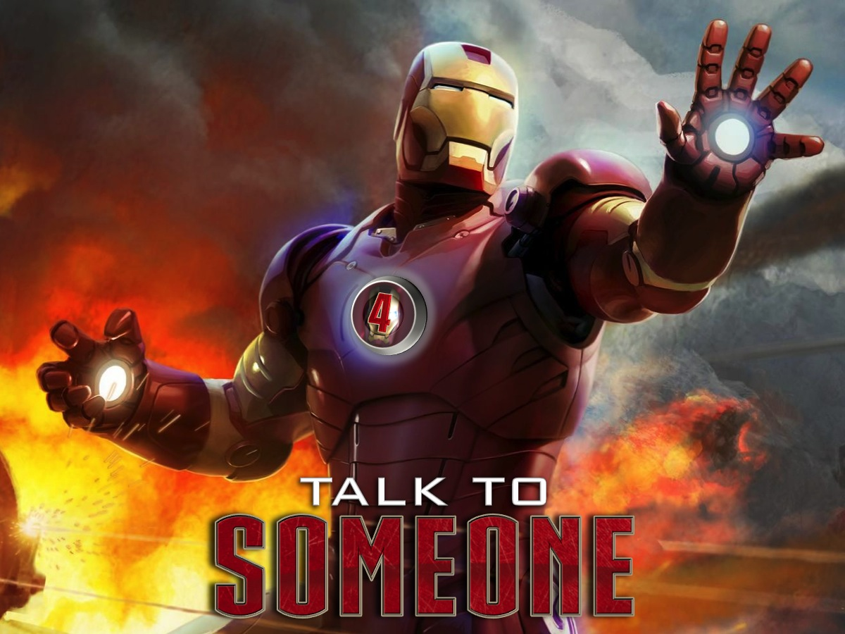
Notes:
4. Talk to Someone – Don’t bottle things up inside because it will destroy you.

Slide 45
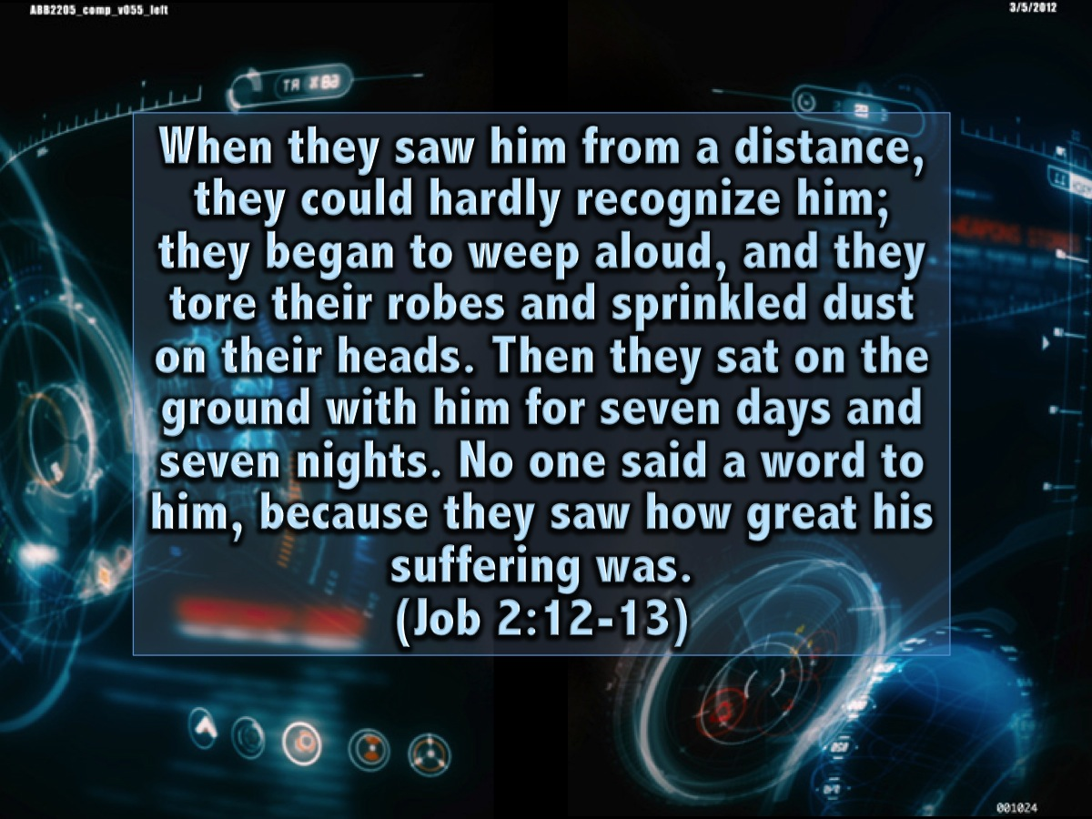
Notes:
When they saw him from a distance, they could hardly recognize him; they began to weep aloud, and they tore their robes and sprinkled dust on their heads. Then they sat on the ground with him for seven days and seven nights. No one said a word to him, because they saw how great his suffering was. (Job 2:12-13)

Slide 46

Notes:
5. Do Happy Stuff - play a sport or go for a run (do something that used to make you happy even if you don't feel like doing it).

Slide 47

Notes:
6. Live With Positivity (Surround Yourself with Positivity) – see the glass as half-full!

Slide 48
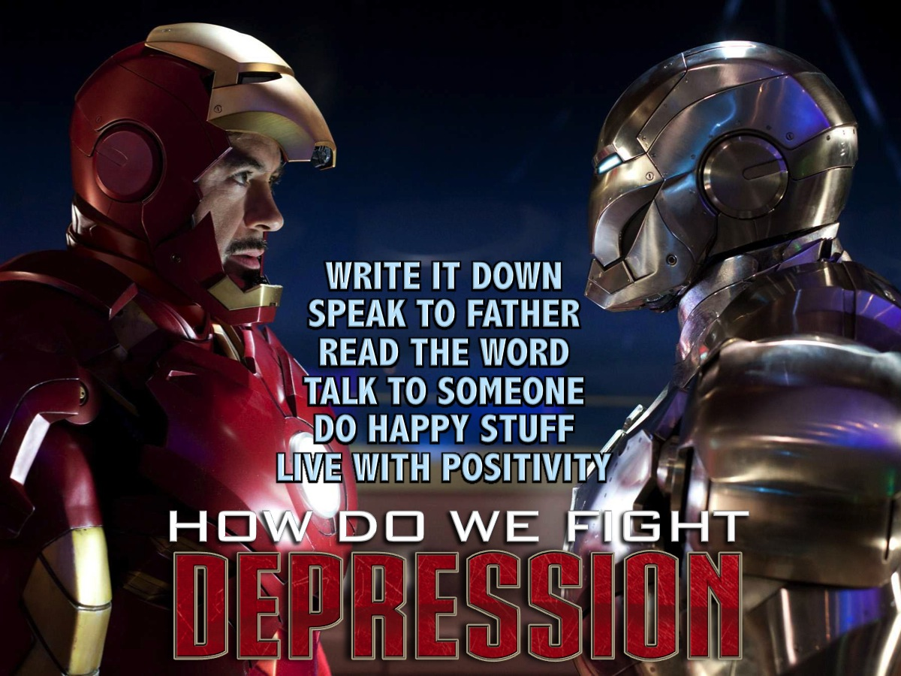
Notes:
Summary: So how do we fight depression? (1) Write it down. (2) Speak to Father. (3) Read the Word. (4) Talk to Someone. (5) Do Happy Stuff. (6) Live with Positivity.

Slide 49

Notes:
Let’s Pray

