Slide 1

Notes:
This week we are going to learn how to fight drugs.

Slide 2
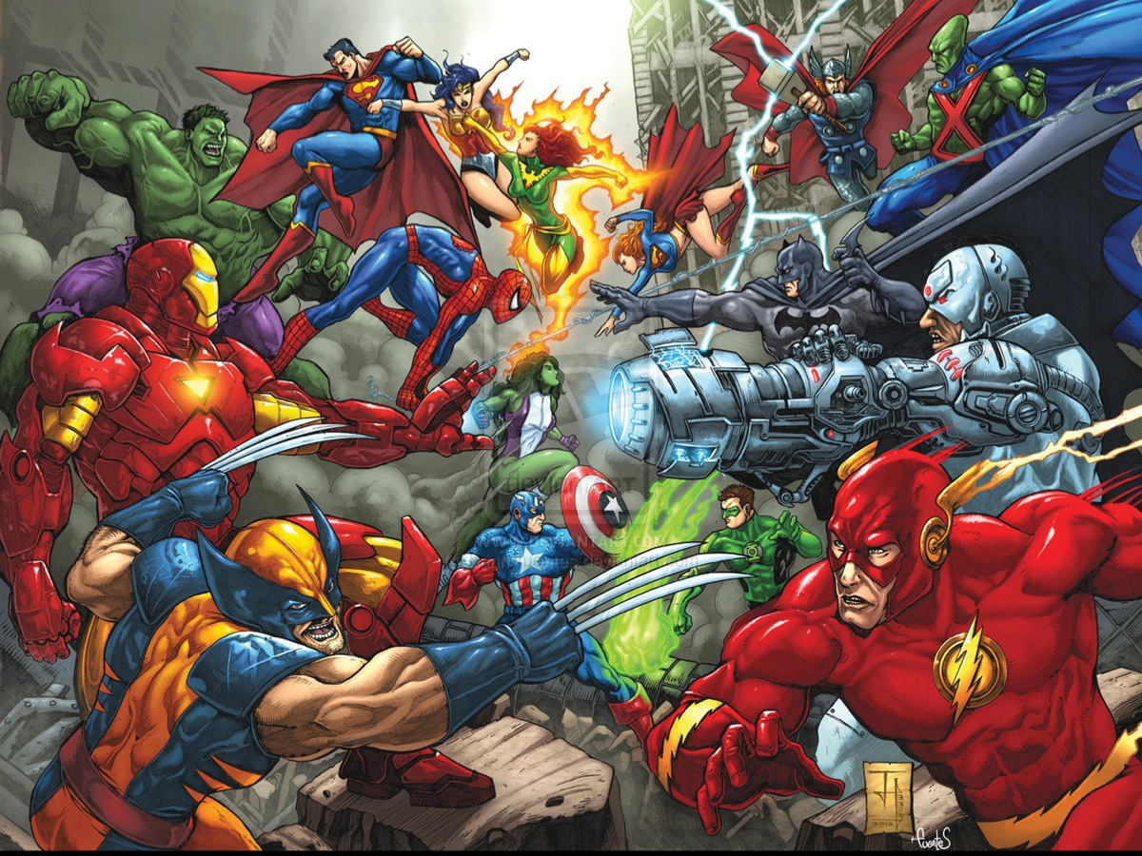
Notes:
So we’ve been dealing with a couple of superheroes in the past couple of weeks. If there’s anything all of them have in common – it’s that they’ve all got a weakness. Anybody want to guess who our Superhero for this week is?

Slide 3
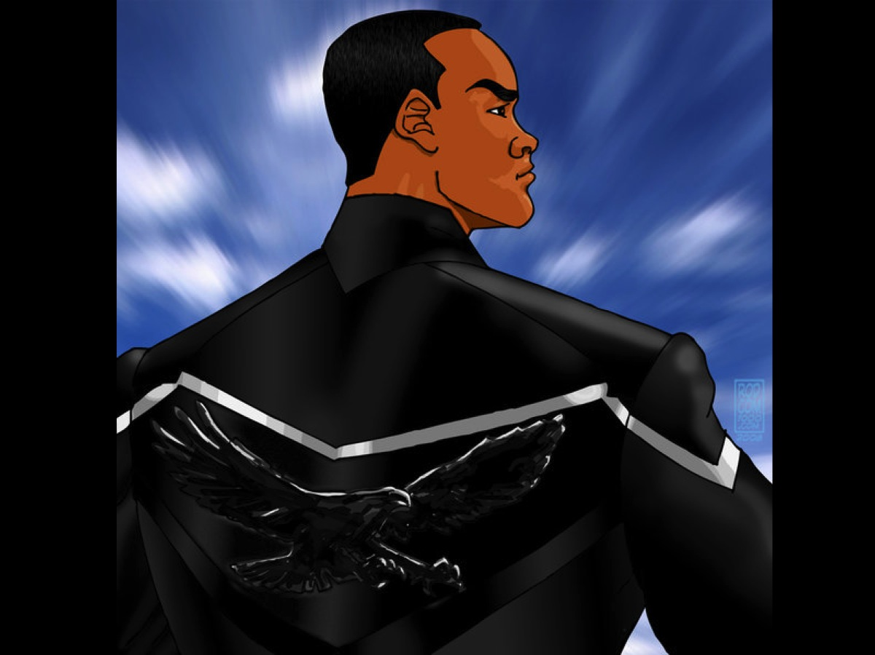
Notes:
Here is a clue… But a tough one!!!

Slide 4

Notes:
It is Hancock!

Slide 5
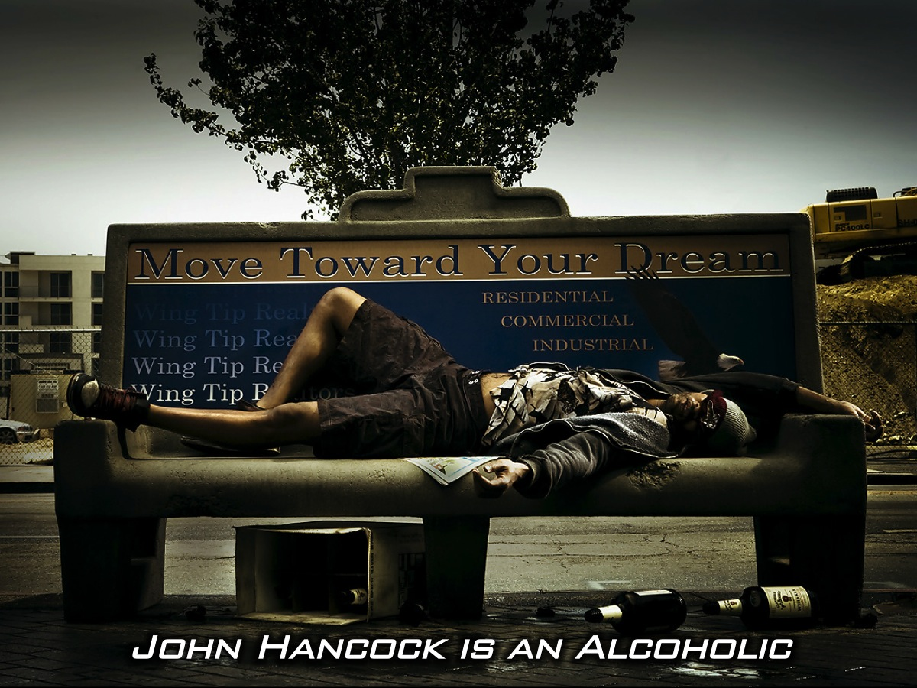
Notes:
John Hancock is an alcoholic

Slide 6
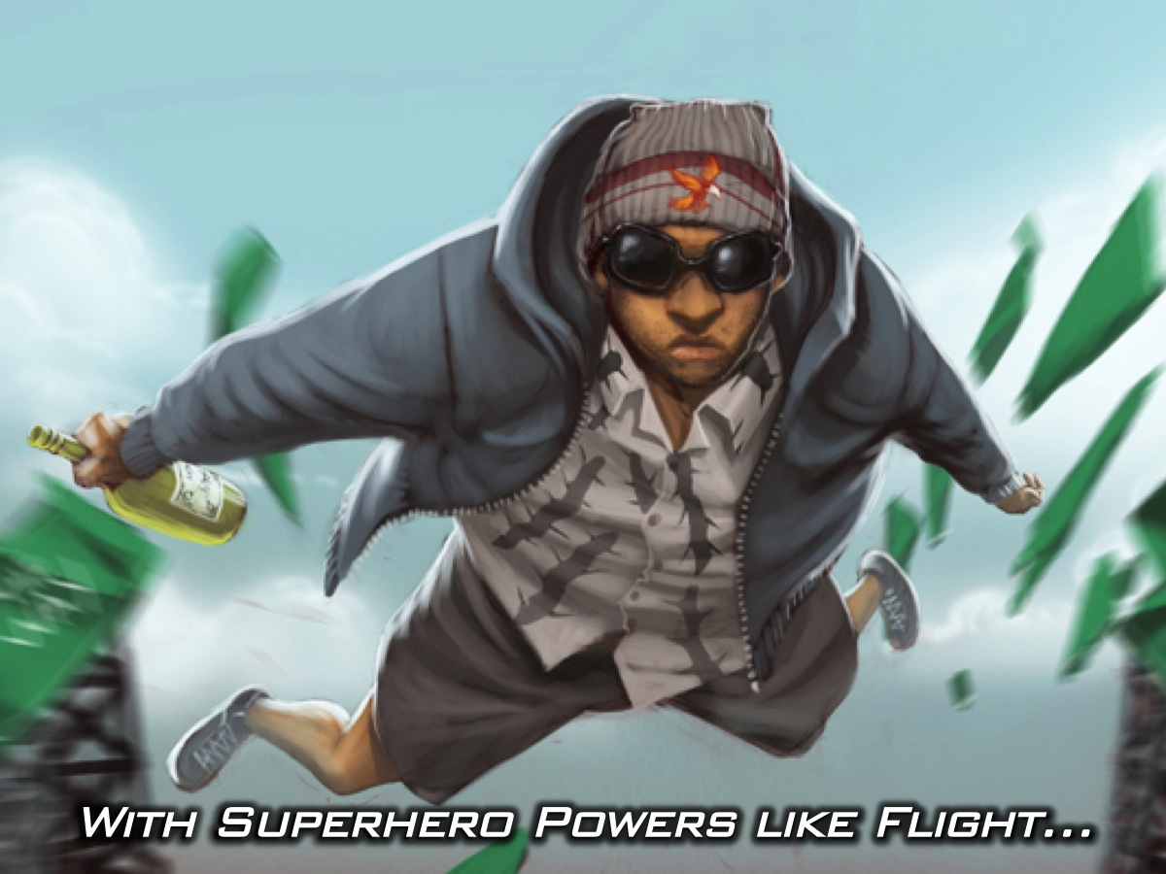
Notes:
With superhero powers…including flight

Slide 7
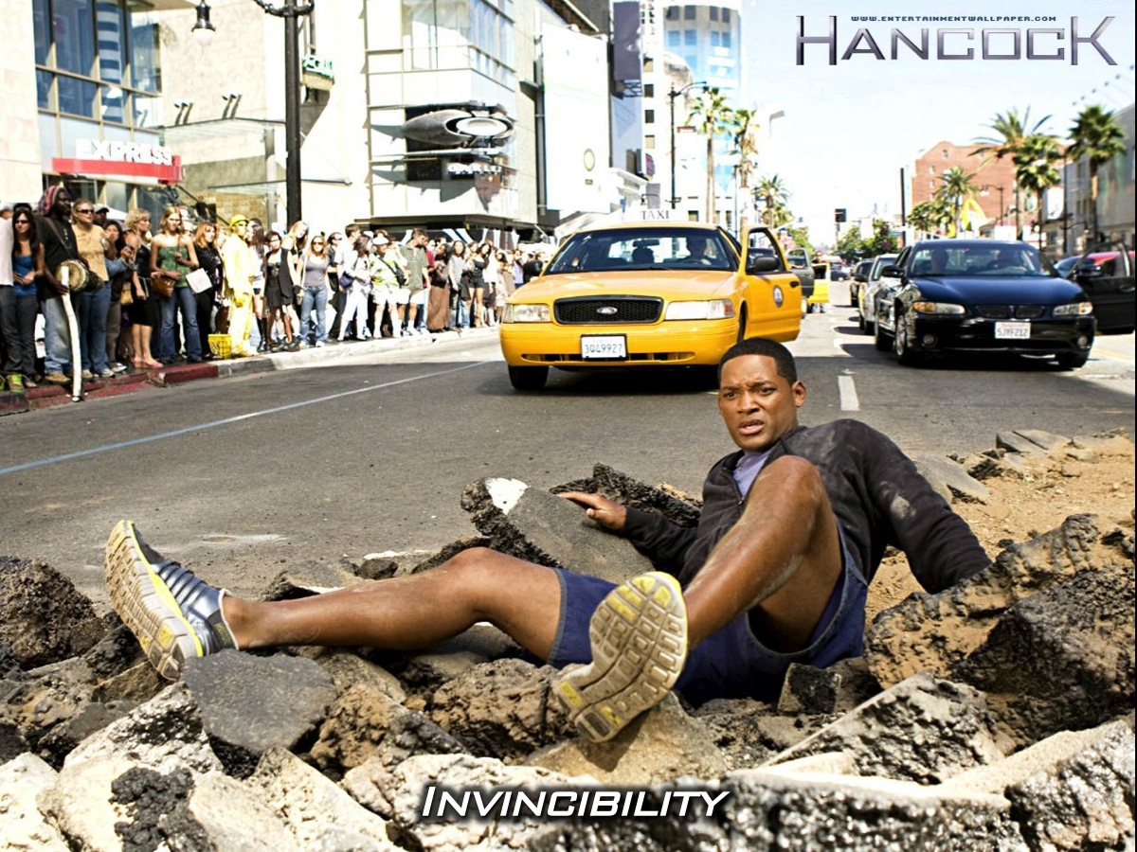
Notes:
invincibility

Slide 8
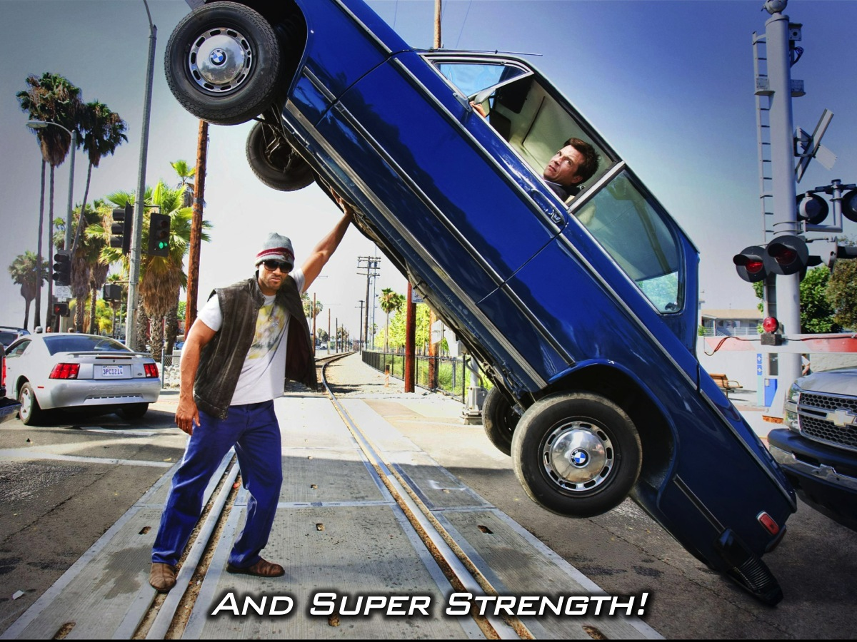
Notes:
and super-strength.

Slide 9
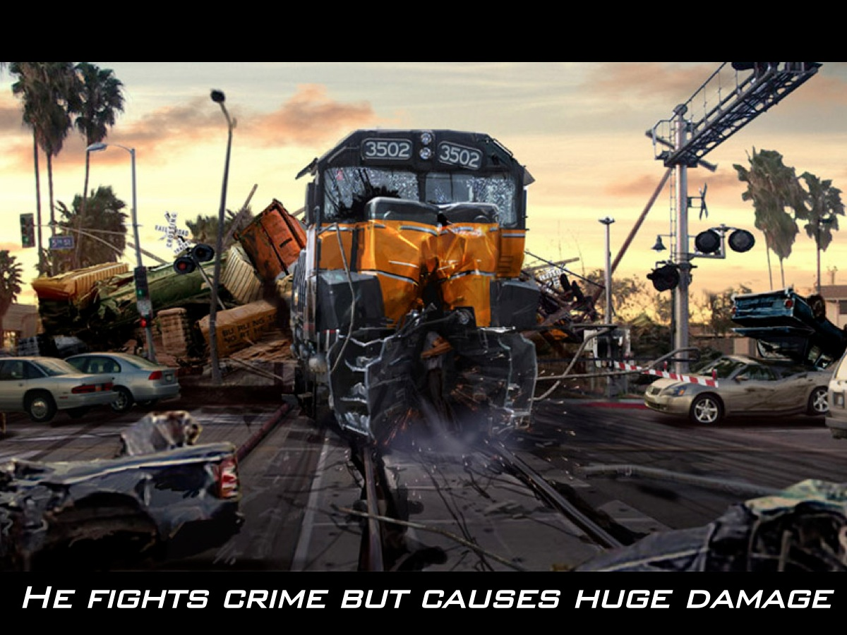
Notes:
Though he uses his powers to stop criminals in his current residence of Los Angeles - his activity inadvertently causes millions of dollars in property damage due to his constant intoxication.

Slide 10
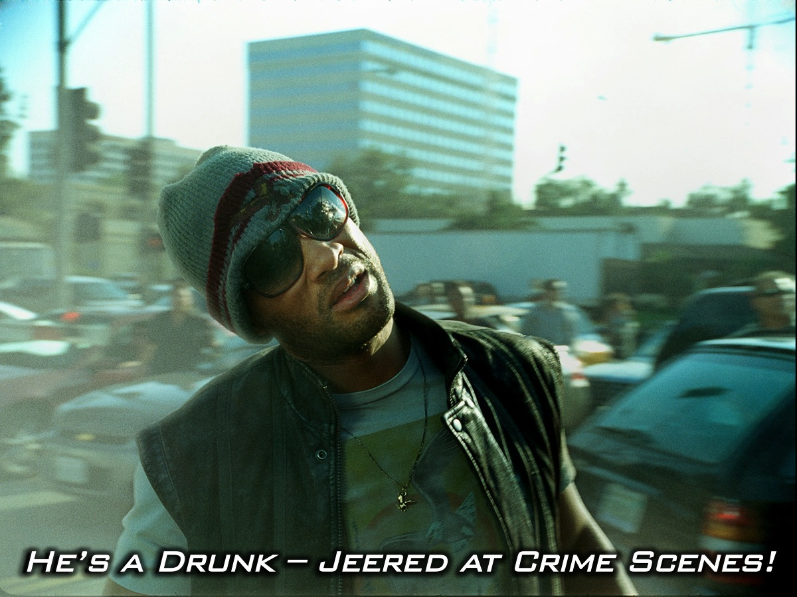
Notes:
He’s a drunk! As a result, he is routinely jeered at the crime scenes. Hancock also ignores court subpoenas from the city of Los Angeles to address the property damage he has caused.

Slide 11
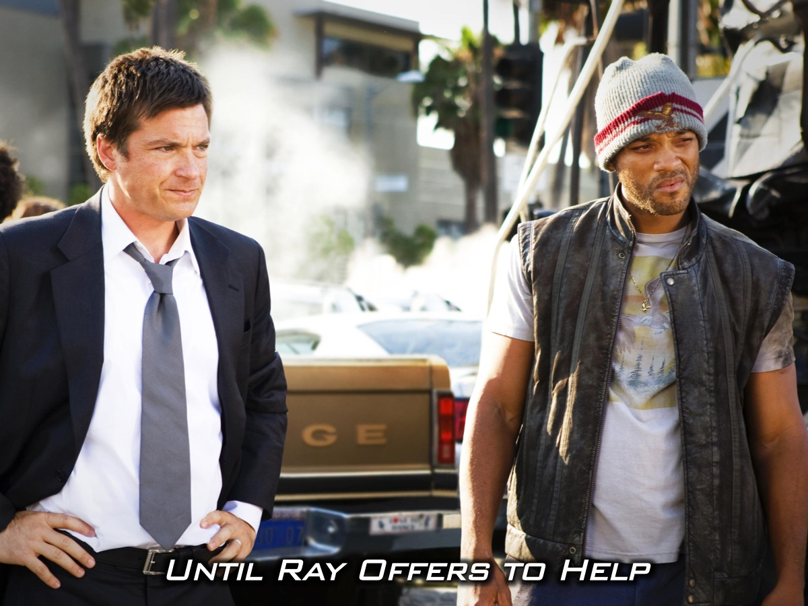
Notes:
At one of these crime scenes Hancock meets PR specialist Ray who offers to improve Hancock’s public image and Hancock agrees.

Slide 12

Notes:
This partnership later leads to a complete transformation, elevating him to a reformed superhero status where everyone loves him.

Slide 13
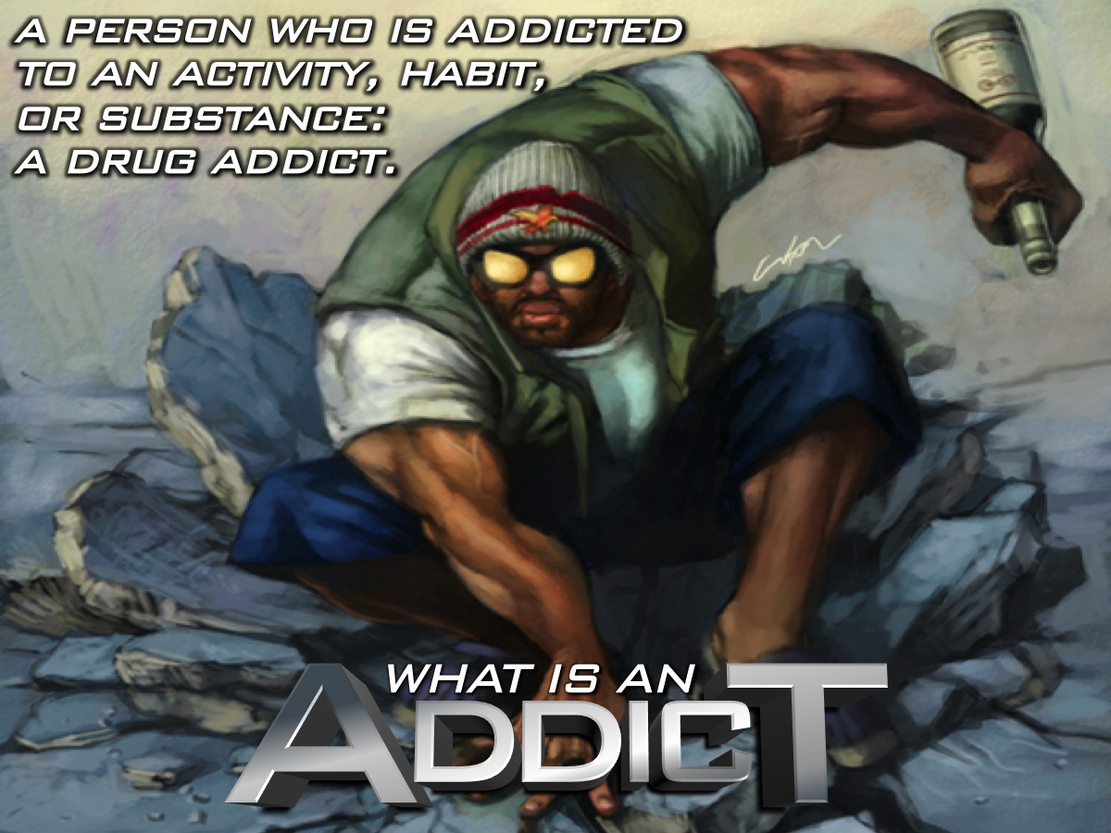
Notes:
Before we understand why Hancock was addicted lets define who an addict is. The dictionary definition is: “..a person who is addicted to an activity, habit, or substance: a drug addict.”

Slide 14
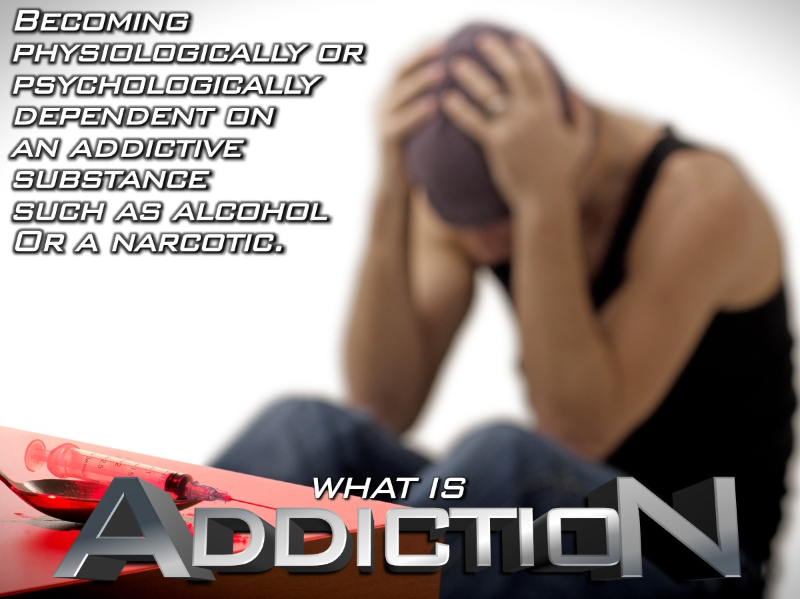
Notes:
One the other hand, the ‘actual’ habit of addiction is defined as: Becoming physiologically or psychologically dependent on an addictive substance such as alcohol or a narcotic.

Slide 15
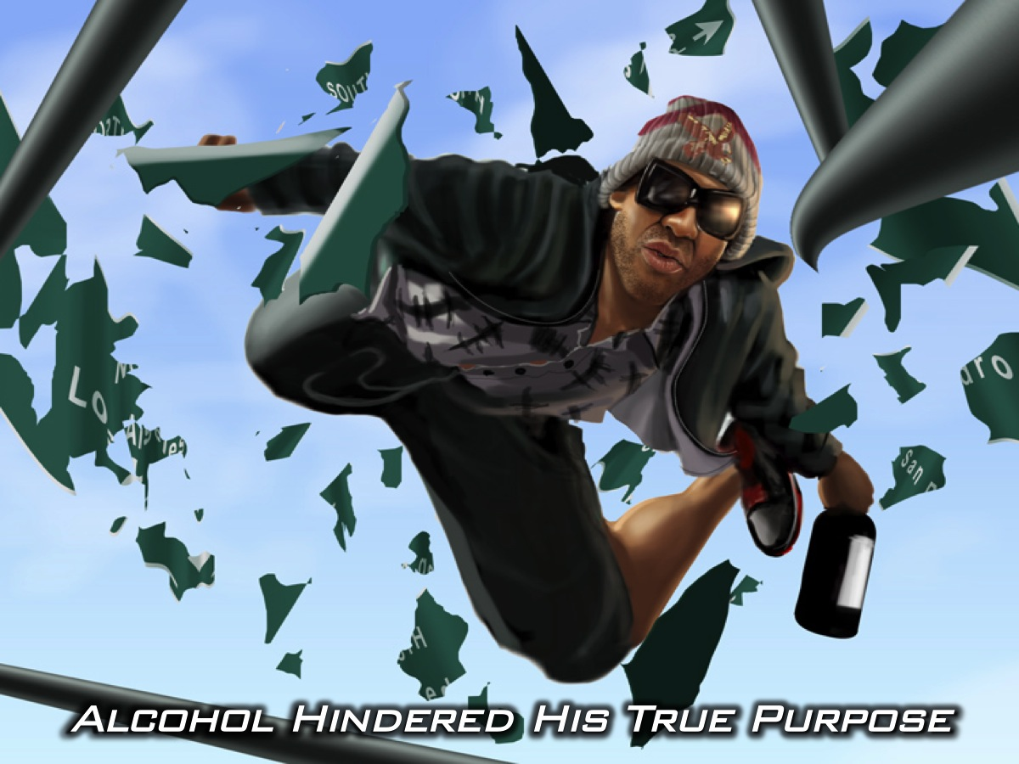
Notes:
Hancock’s drug of choice was his alcohol. Hancock becomes so dependent on his alcohol that it hinders his ability to help people. The true purpose for which he was created.

Slide 16
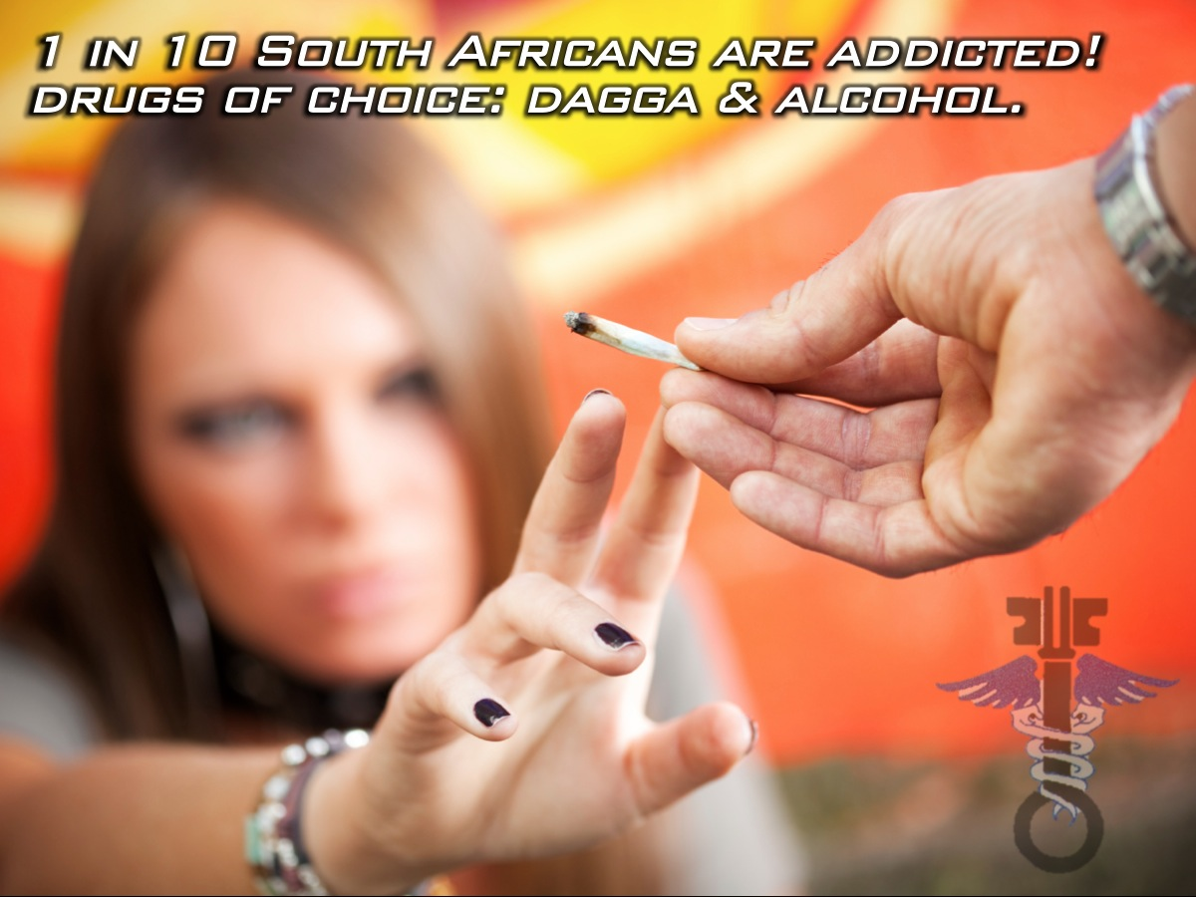
Notes:
According to the South African National Council on Alcoholism and Drug Dependence, 1 in 10 South Africans have an addiction problem and their top drugs of choice are dagga and alcohol.

Slide 17
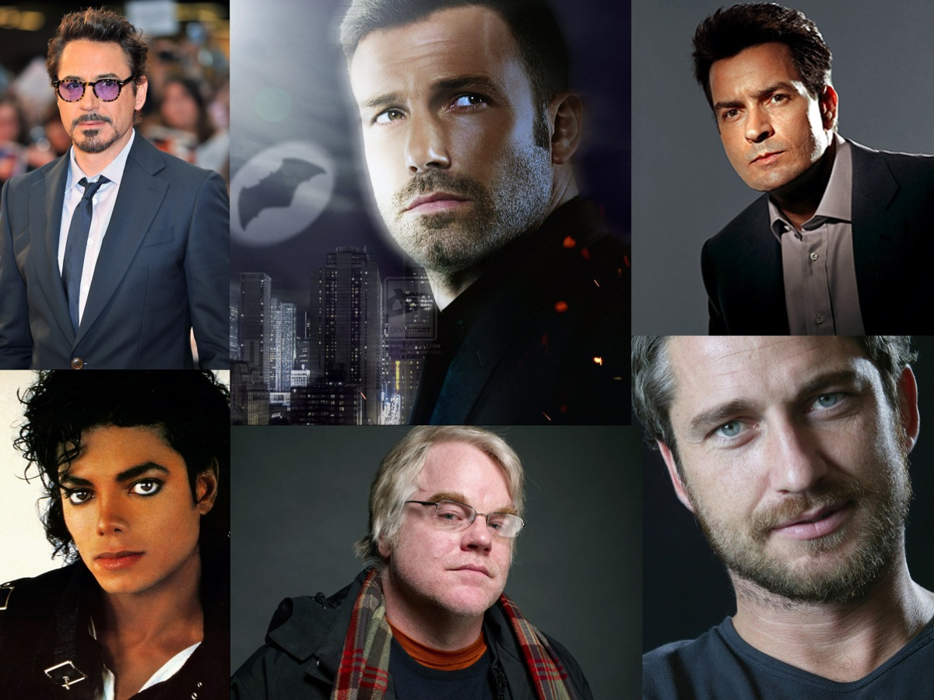
Notes:
Drug and alcohol addiction does not discriminate. Take a look at how many famous people have battled with drug and alcohol addiction - Here are just some of the guys in Hollywood who have been addicted to drugs. Robert Downey, Ben Affleck, Charlie Sheen, Michael Jackson, Philip Seymour Hoffman, Gerald Butler.

Slide 18

Notes:
Here are some of the ladies who have also been addicted: Lindsay Lohan, Whitney Houston, Amy Winehouse, Kisten Dunst, Mark Kate Olson.

Slide 19
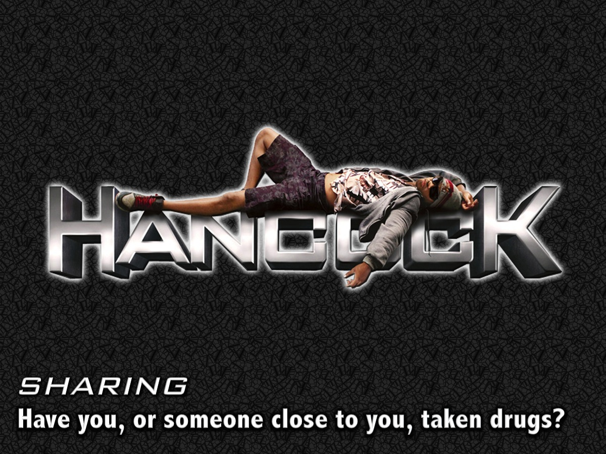
Notes:
Sharing: Have you or someone close to you, taken drugs?

Slide 20
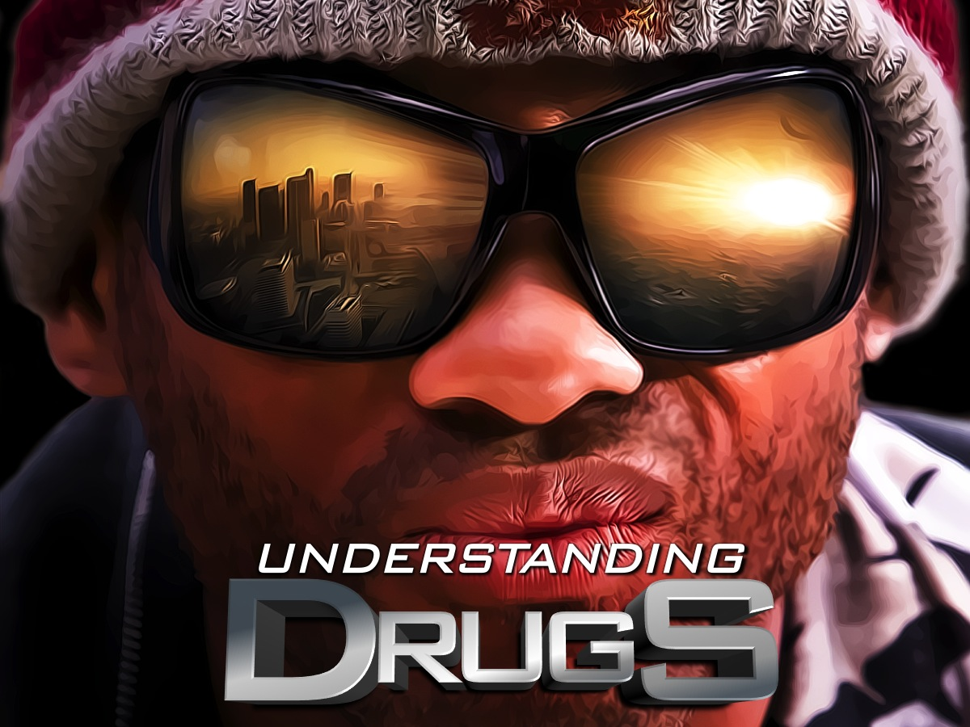
Notes:
Let’s begin by understanding drugs.

Slide 21
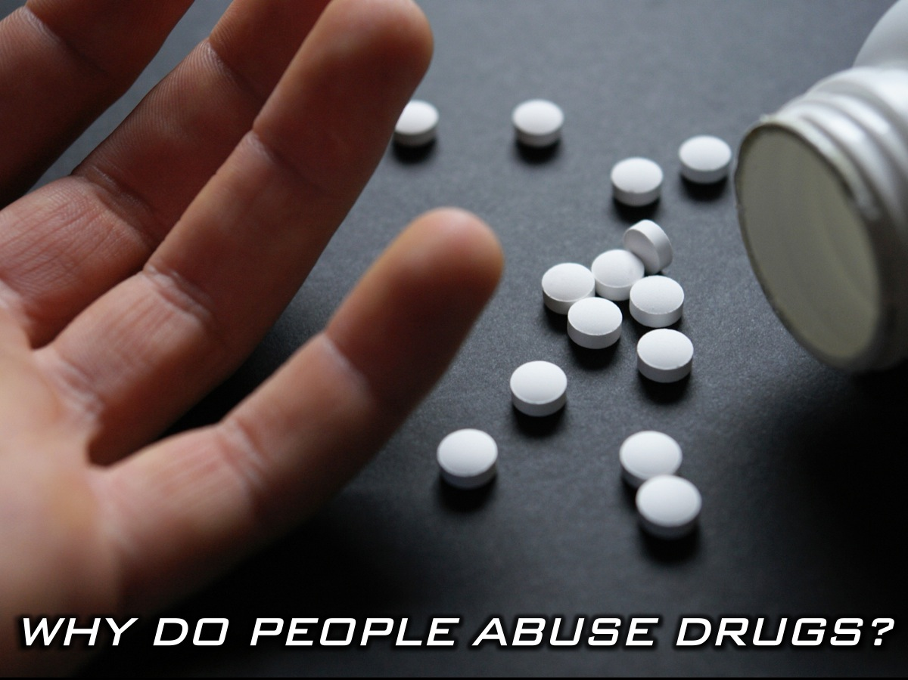
Notes:
Why do people abuse drugs?

Slide 22
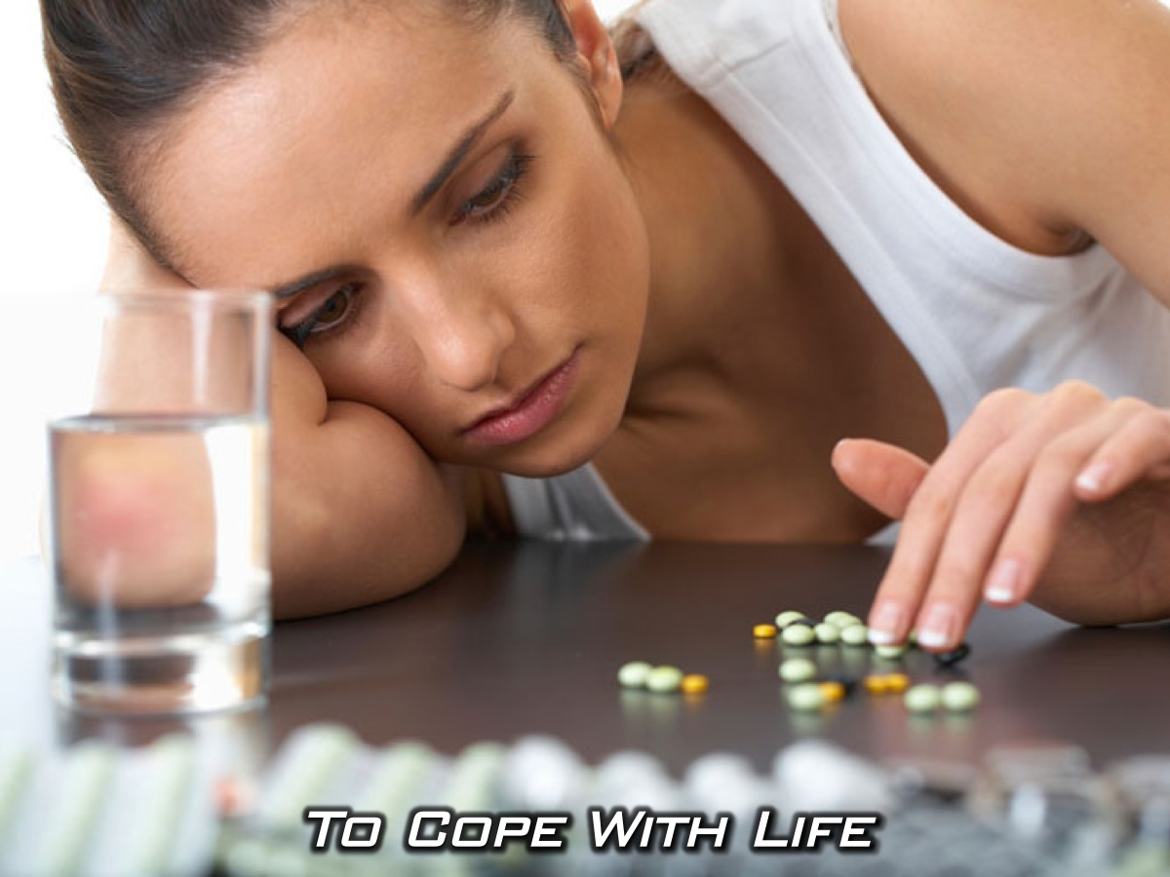
Notes:
Many people use drugs as a coping mechanism to deal with life - to ease stress, anxiety, or depression.

Slide 23
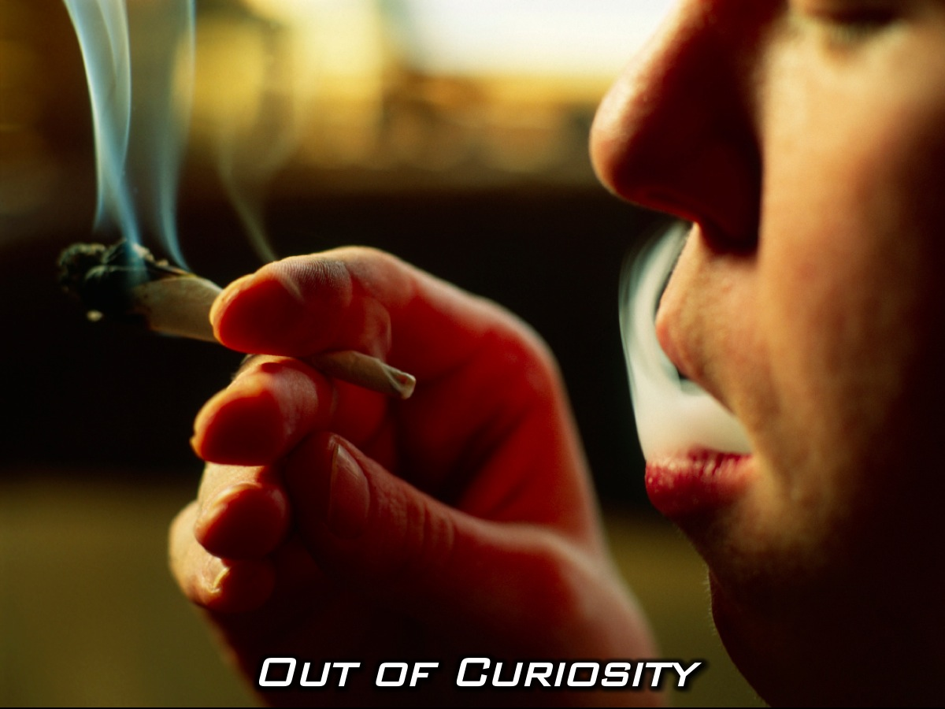
Notes:
Some first try drugs out of curiosity,

Slide 24
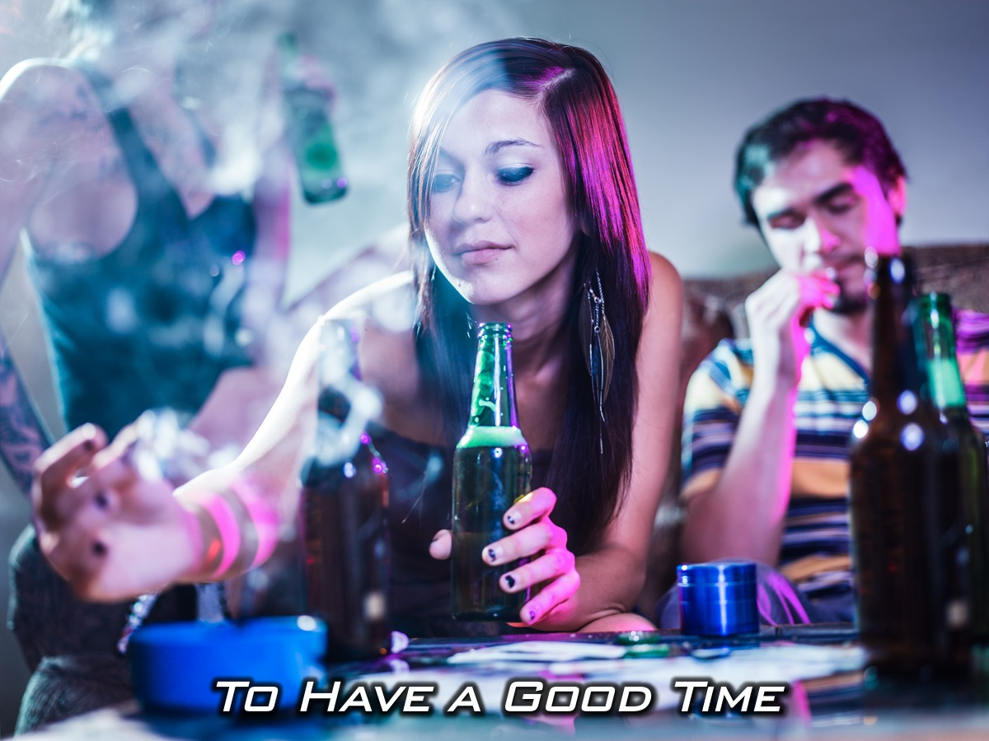
Notes:
Some first try drugs to have a good time

Slide 25
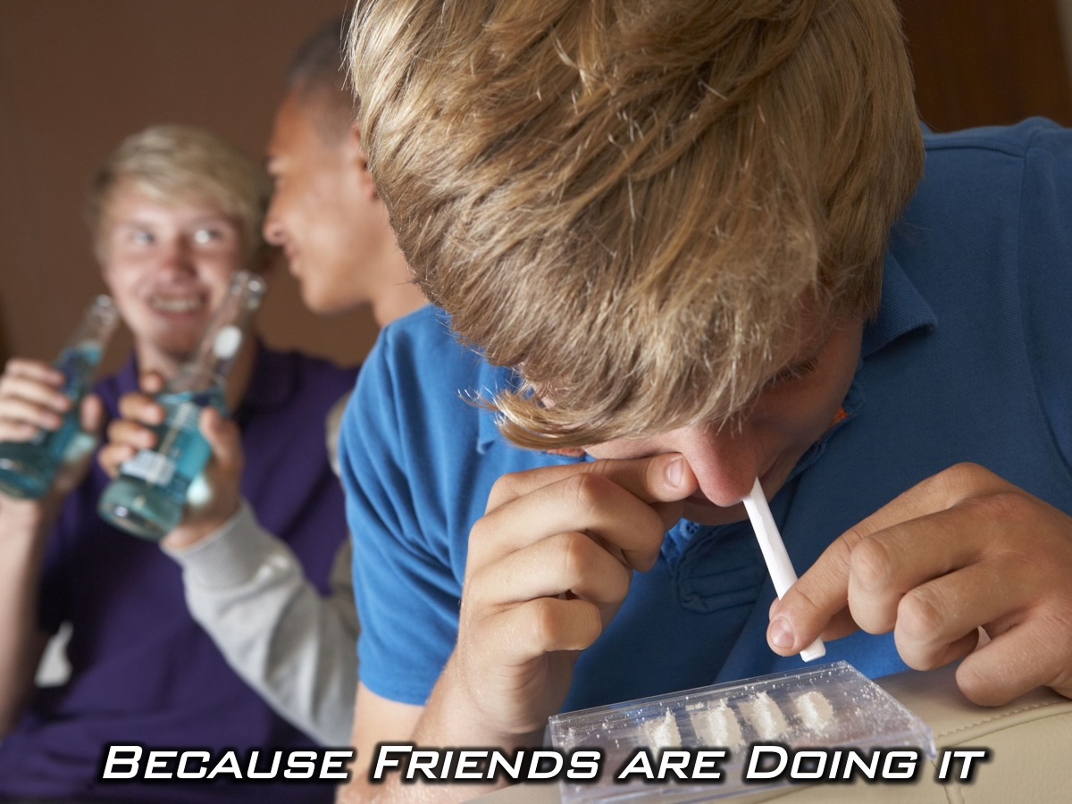
Notes:
Or because friends are doing it,

Slide 26
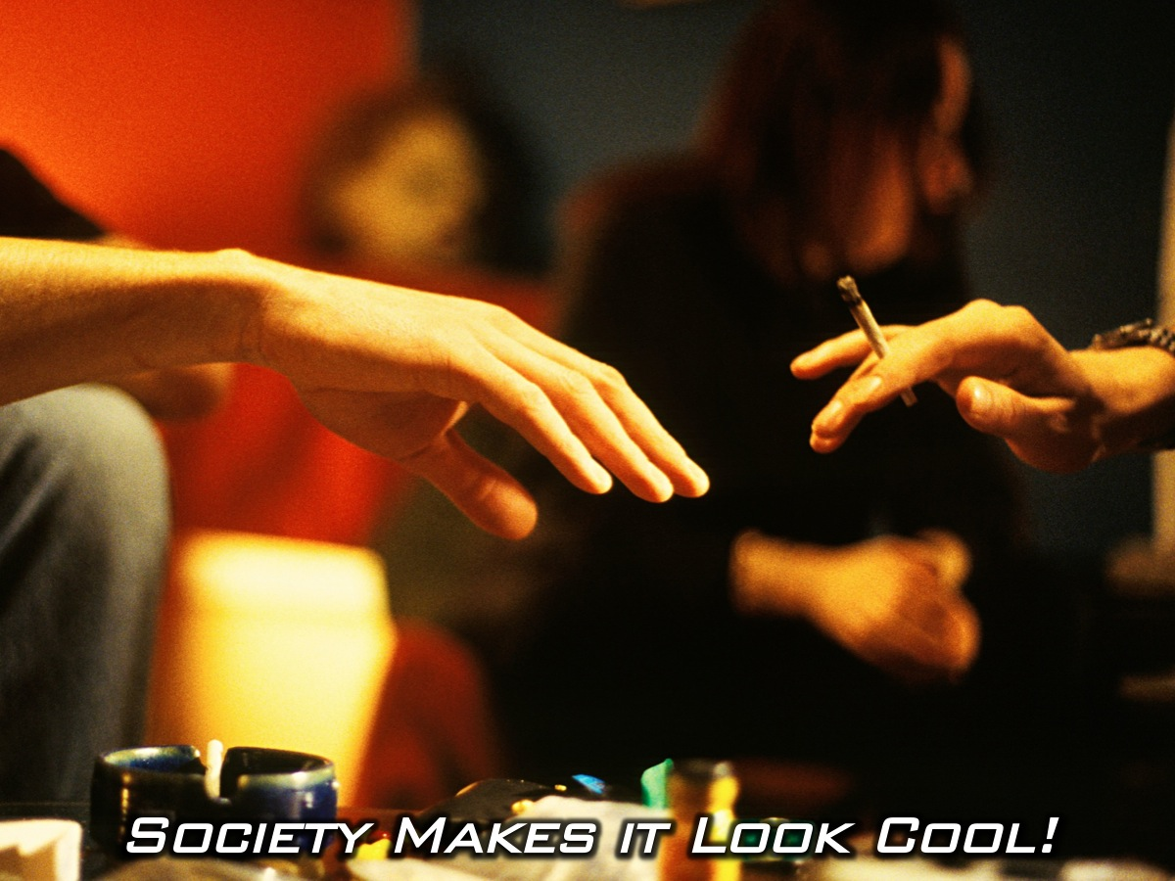
Notes:
And also because society makes it look cool

Slide 27

Notes:
You have Weeds – the TV series.

Slide 28
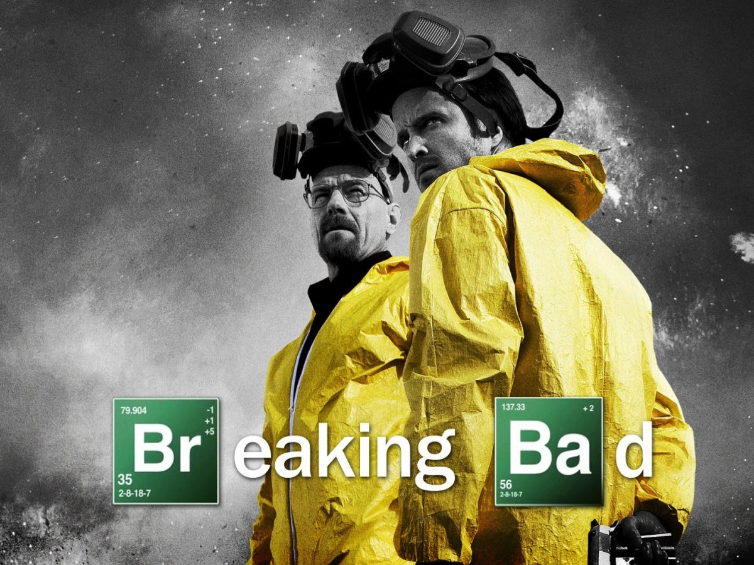
Notes:
And Breaking Bad which is the award winning series about a Chemistry teacher who recruits his former student to cook meth with him.

Slide 29
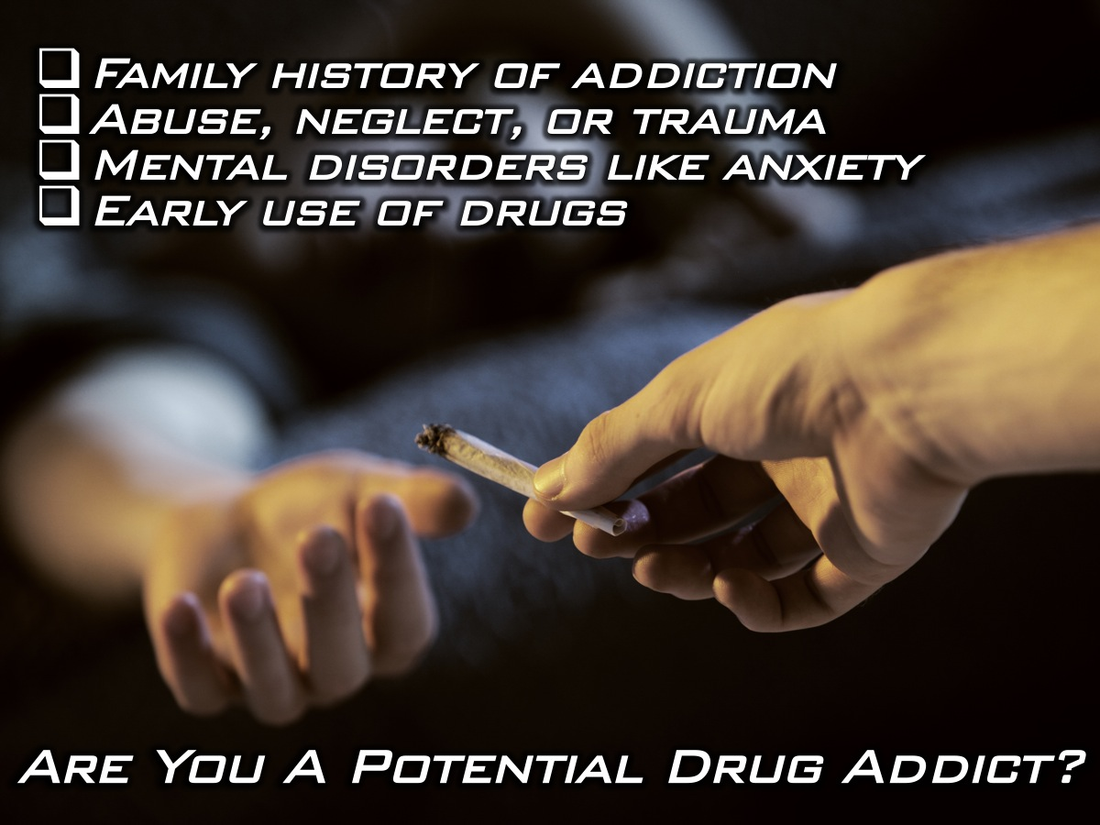
Notes:
Are You A Potential Drug Addict? There are many risk factors that increase your vulnerability to drug addiction: (1) Family history of addiction. (2) Abuse, neglect, or other traumatic experiences in childhood. (3) Mental disorders such as depression and anxiety. (4) Early use of drugs.

Slide 30
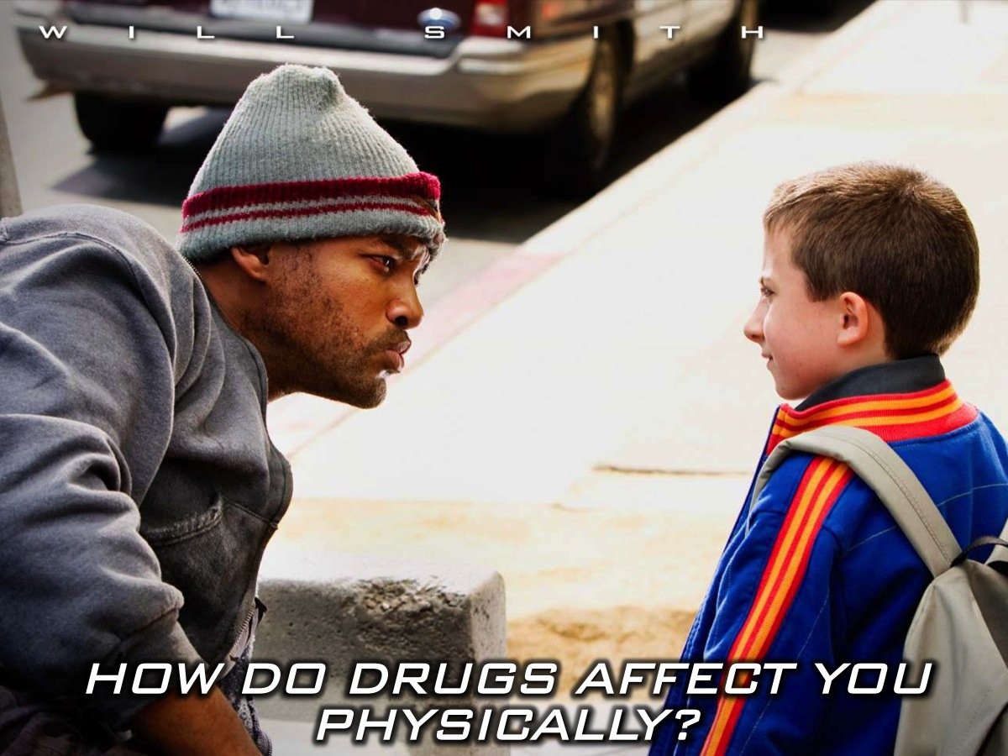
Notes:
How do drugs affect you physically?

Slide 31
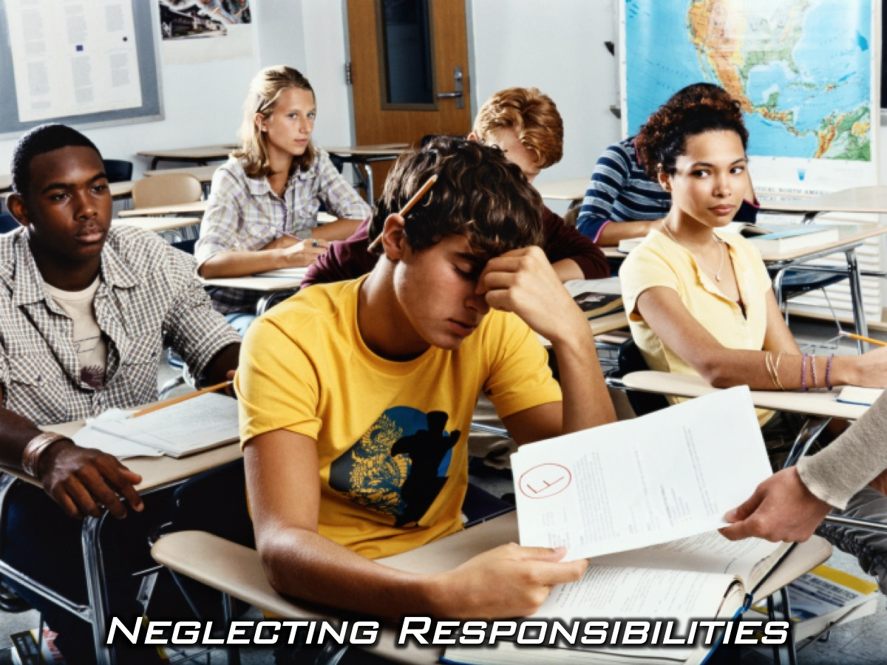
Notes:
You neglect your responsibilities at school, at home or at work. Skipping class. Failing your exams continually because of your drug use

Slide 32
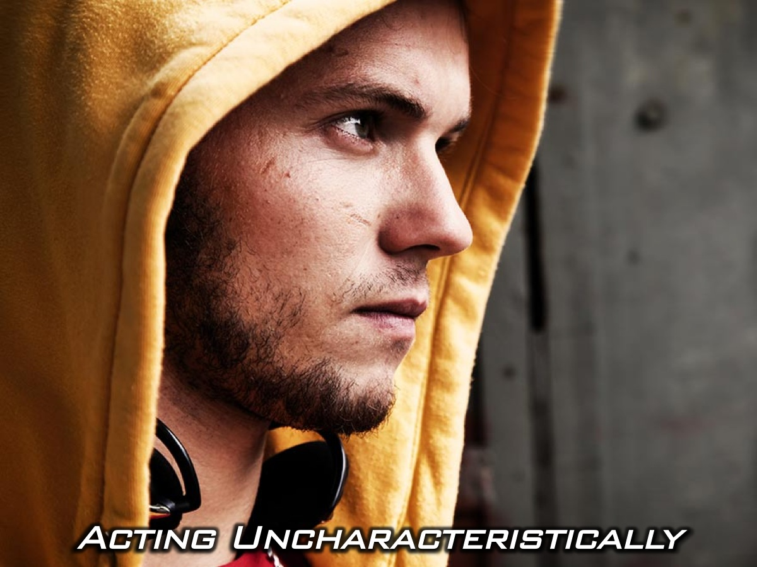
Notes:
Acting uncharacteristically isolated, withdrawn, angry, or depressed

Slide 33
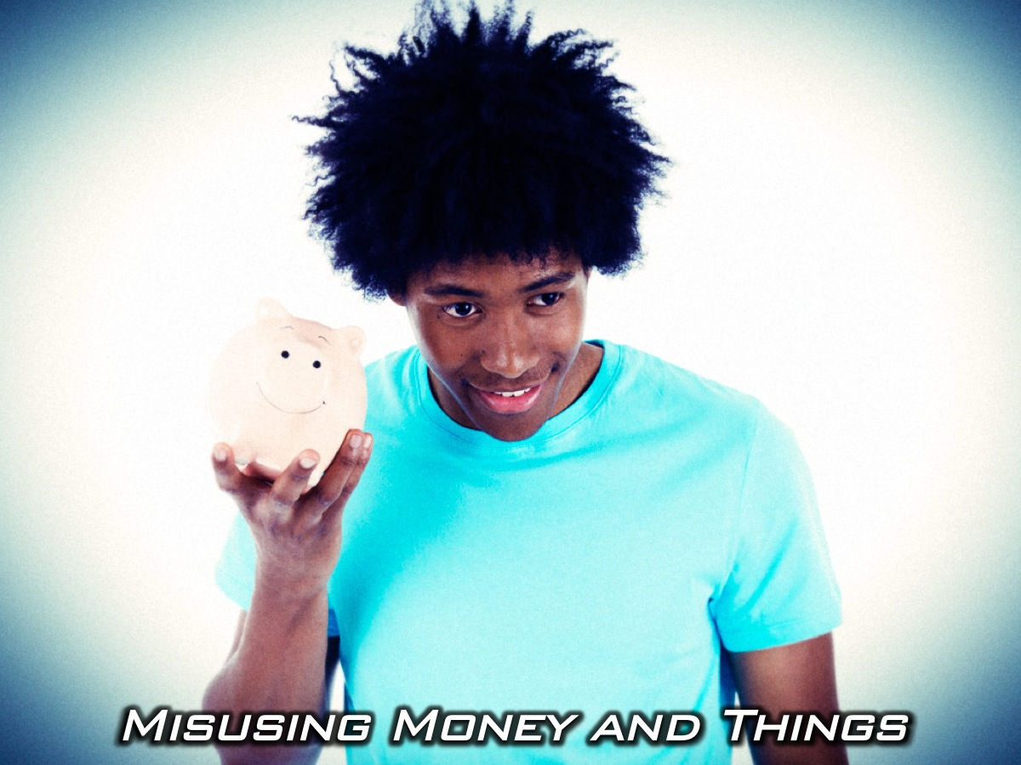
Notes:
Misusing money, valuables or prescriptions. Unexplained need for money.

Slide 34
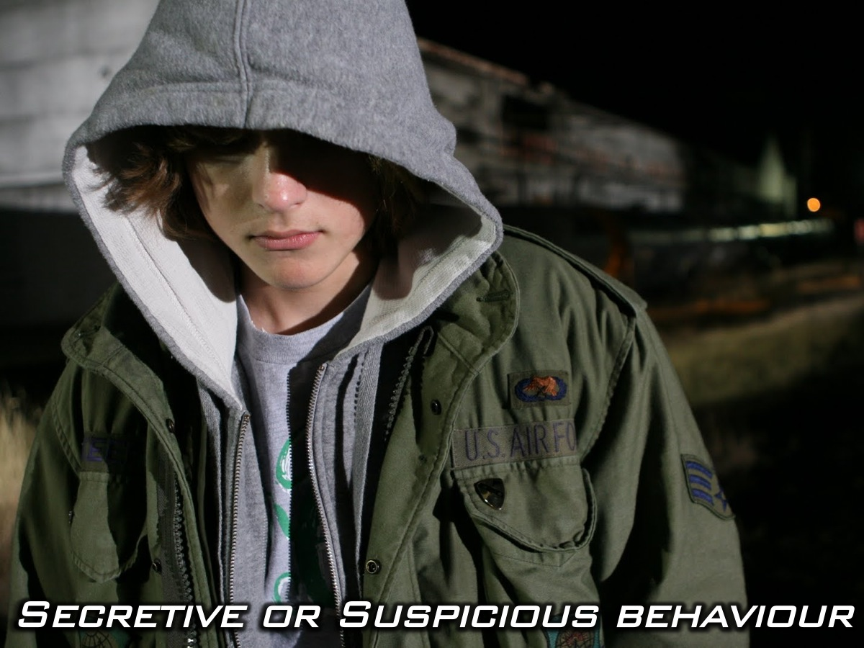
Notes:
Engaging in secretive or suspicious behavior. Demanding more privacy; locking doors; avoiding eye contact; sneaking around

Slide 35
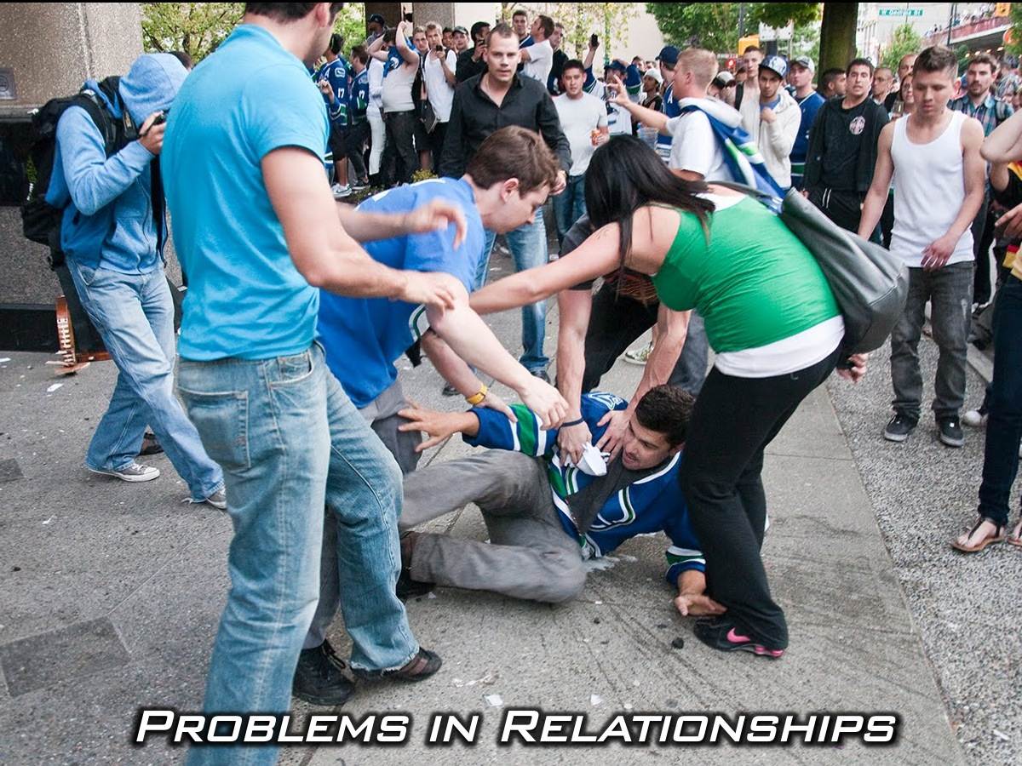
Notes:
Your drug use starts to cause problems in your relationships – fights with friends and family, loss of friends.

Slide 36
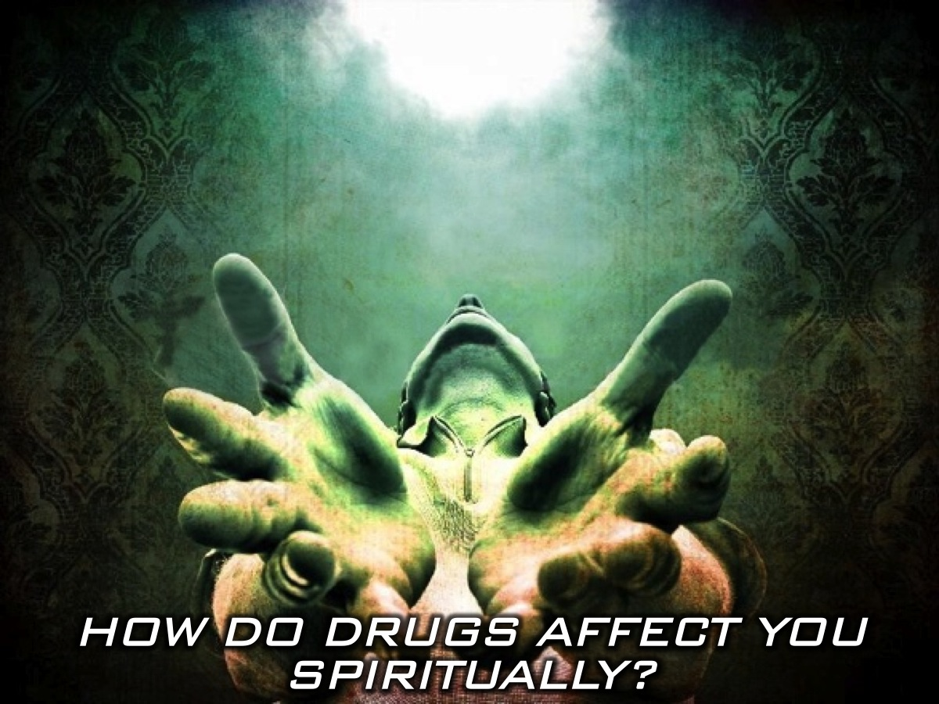
Notes:
How do drugs affect you spiritually?

Slide 37
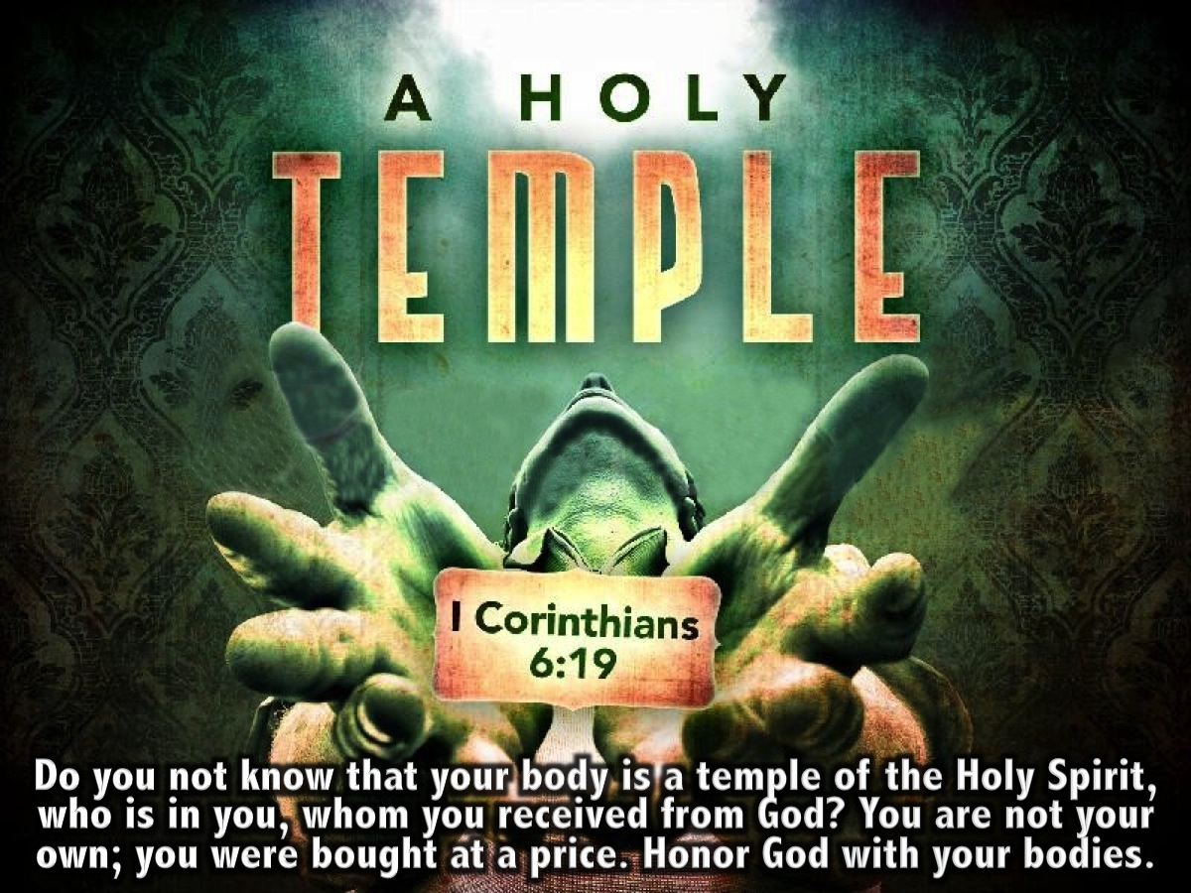
Notes:
The bible says that YOUR BODY IS THE TEMPLE OF THE HOLY SPIRIT. Do you not know that your body is a temple of the Holy Spirit, who is in you, whom you received from God? You are not your own; you were bought at a price. Honor God with your bodies. (1 Corinthians 1:16-20).

Slide 38

Notes:
If indeed the presence of God dwells in us, we must clean house. We must ensure that God’s living room is clean and tidy enough for him to come in and chill with us. When we abuse drugs or alcohol we defile our own bodies created to be God’s temple.

Slide 39
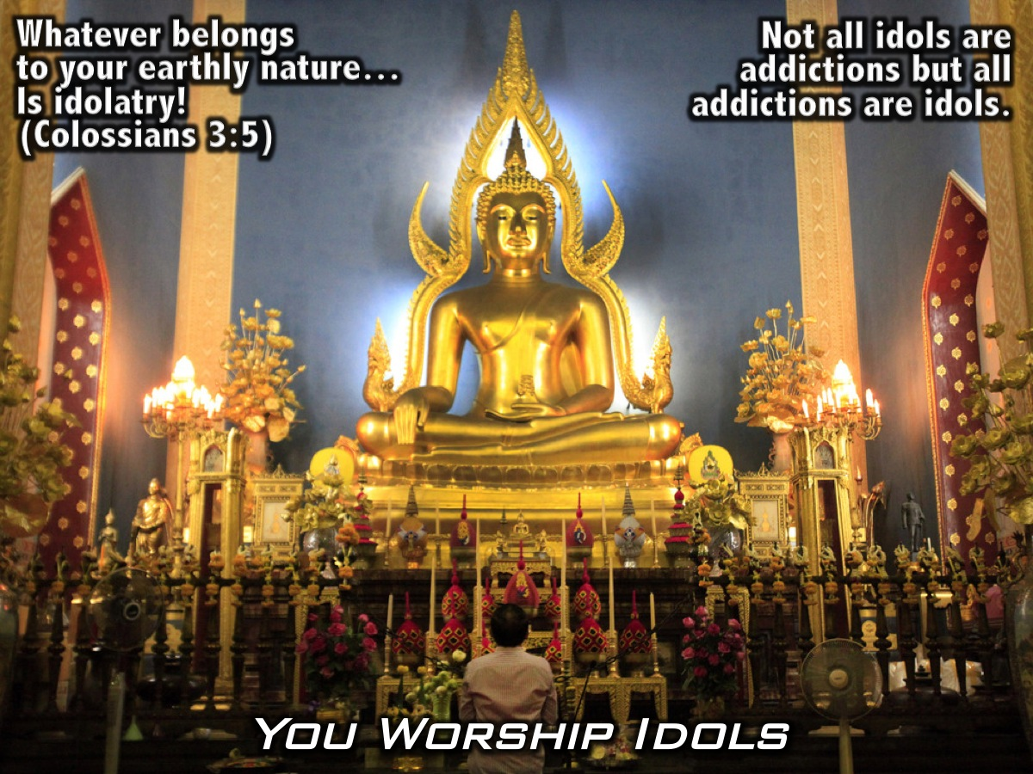
Notes:
Addiction is an Idol. As an addict all you attention is focused on your next fix. Satisfying this deep desire to cope in life by filling that empty space. Thus turning your addiction into this Idol craving your attention. Taking your focus away from God.
“Put to death, therefore, whatever belongs to your earthly nature: Sexual immorality, impurity, lust, evil desires and greed, which is idolatry.” (Colossians 3:5)
Anything that we use to take the place of God in our lives to bring us comfort or relief, to fulfill or define us other than God himself – that thing is an idol.
Not all idols are addictions but all addictions are idols.

Slide 40
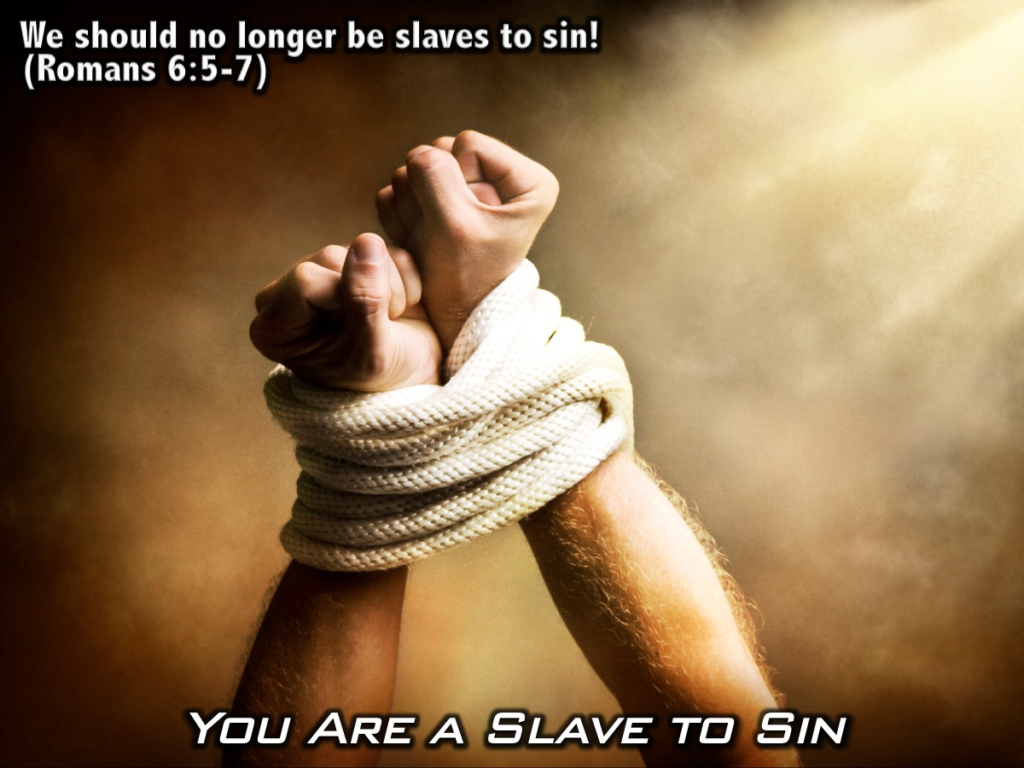
Notes:
You become a Slave to sin. “For if we have been united with him in a death like his, we will certainly also be united with him in a resurrection like his. For we know that our old self was crucified with him so that the body ruled by sin might be done away with, that we should no longer be slaves to sin - because anyone who has died has been set free from sin.” (Romans 6: 5-7)

Slide 41
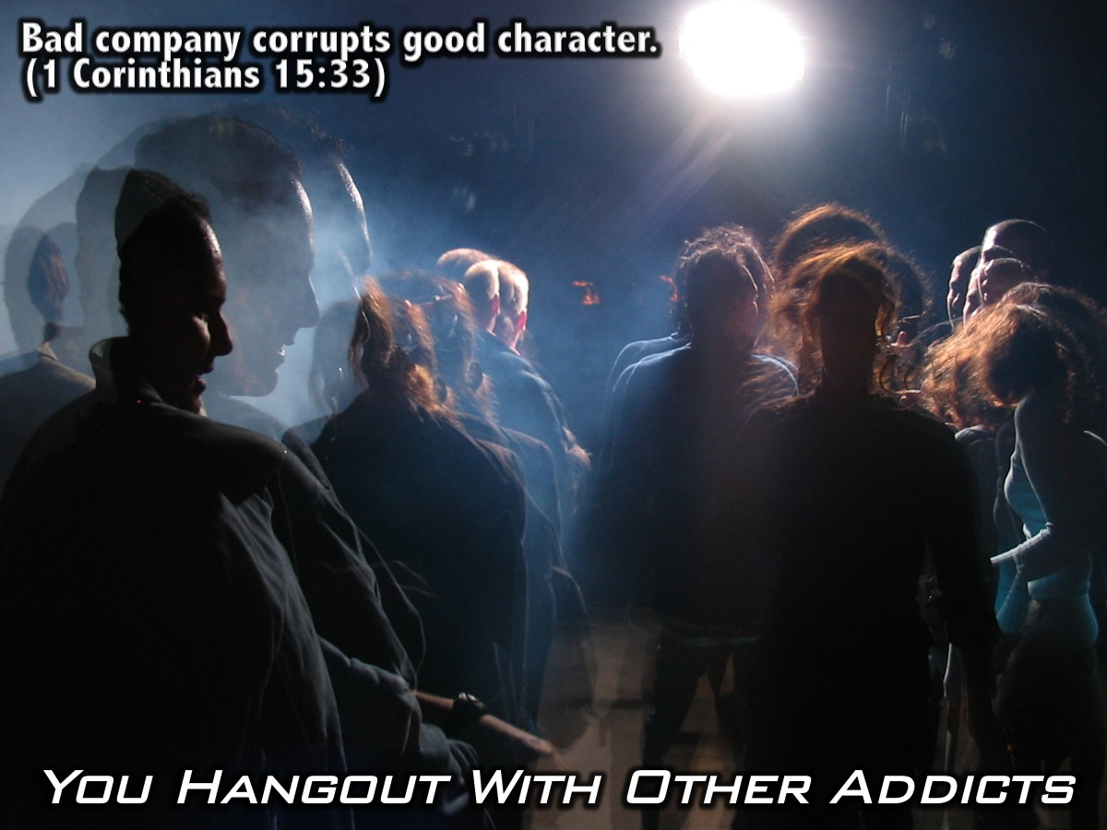
Notes:
You start to surround yourself with other addicts. Do not be misled: “Bad company corrupts good character.” (1 Corinthians 15:33)

Slide 42
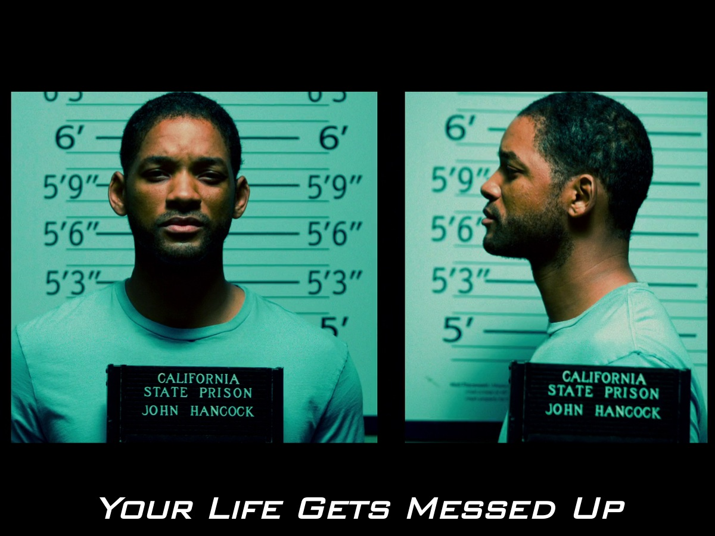
Notes:
The unfortunate truth about addiction, is that addiction leads to server consequences in life. For Hancock, it landed him in jail. Even if he went willingly, it forced him to reconsider his behavior and how he treated the people of LA.

Slide 43
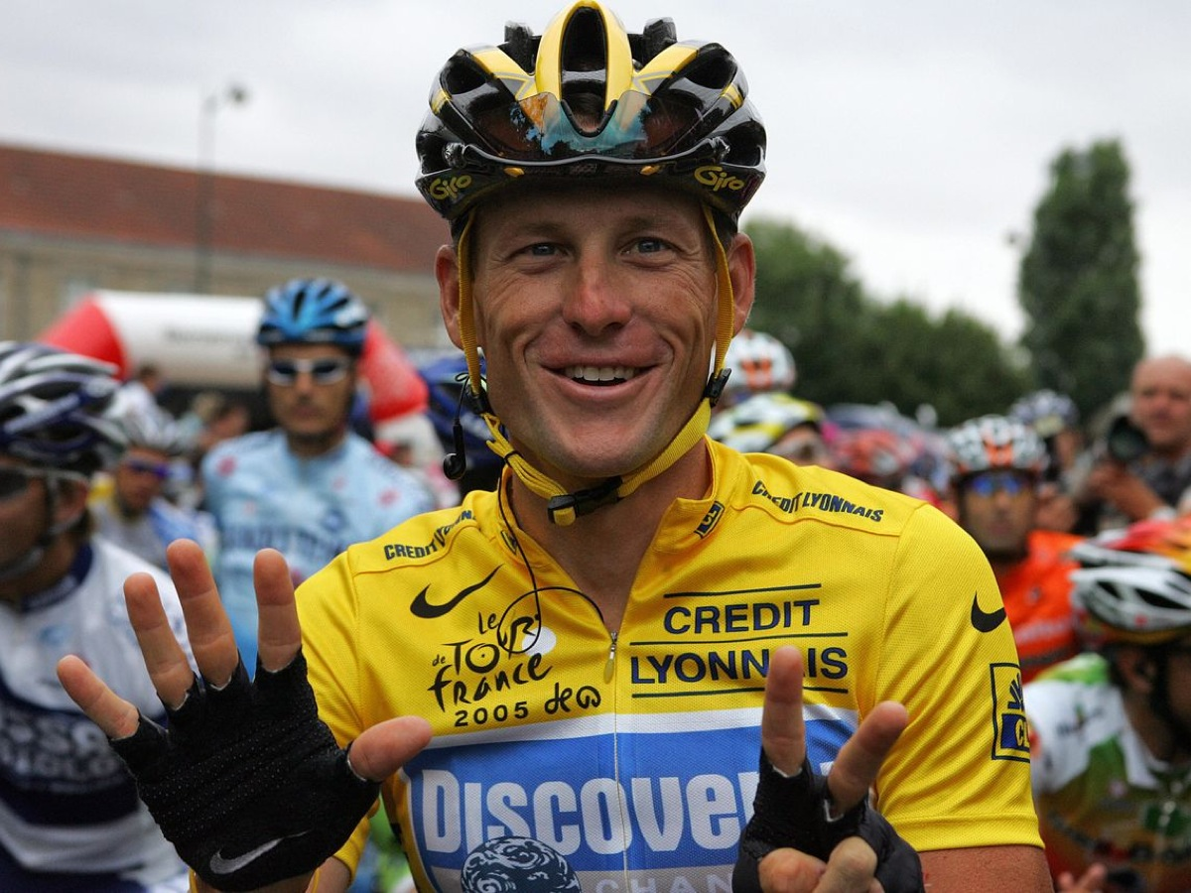
Notes:
Lance Armstrong was know as the world’s greatest cyclist - he had won the Tour De France – 7 times.

Slide 44
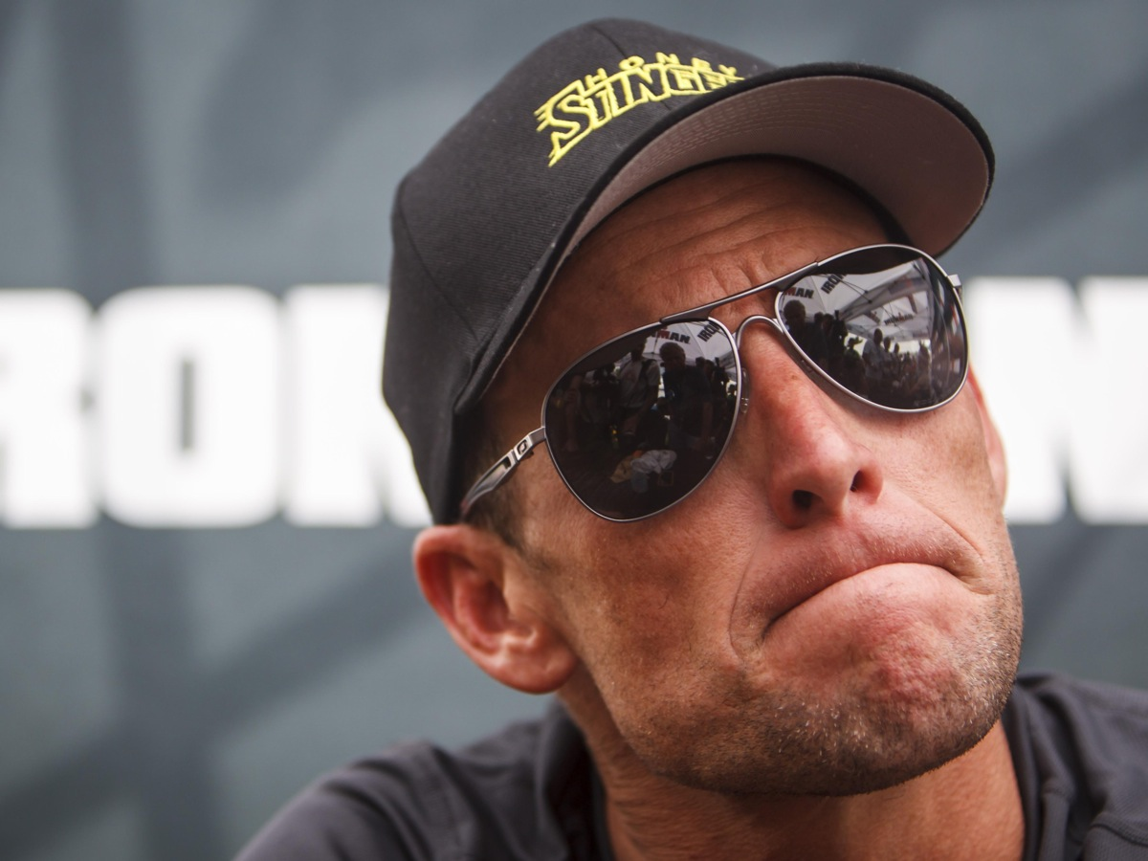
Notes:
And then his drug problem was revealed. Imagine if he hadn’t taken the drugs?

Slide 45
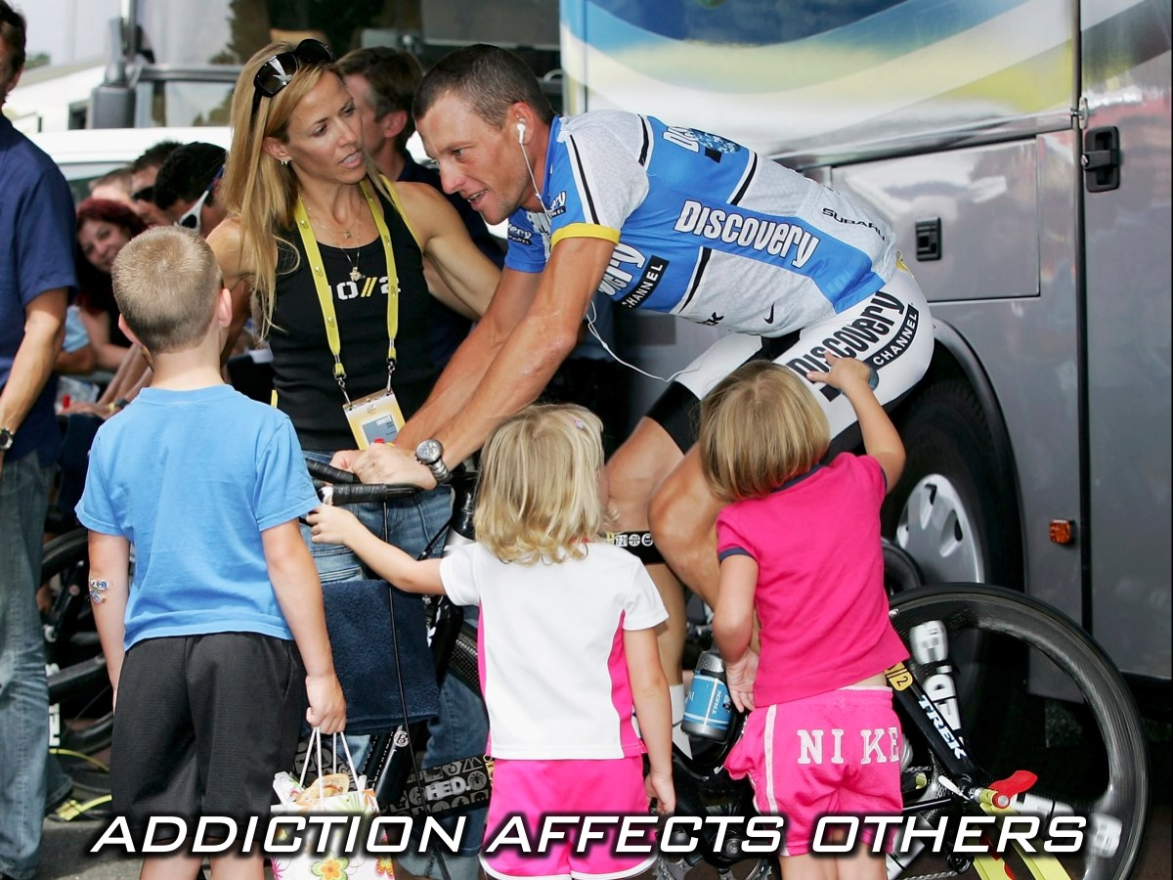
Notes:
Addiction is not something that just affects you – it affects the lives of those around you! Imagine how it affected Lance, his wife (who left him) and his children.

Slide 46
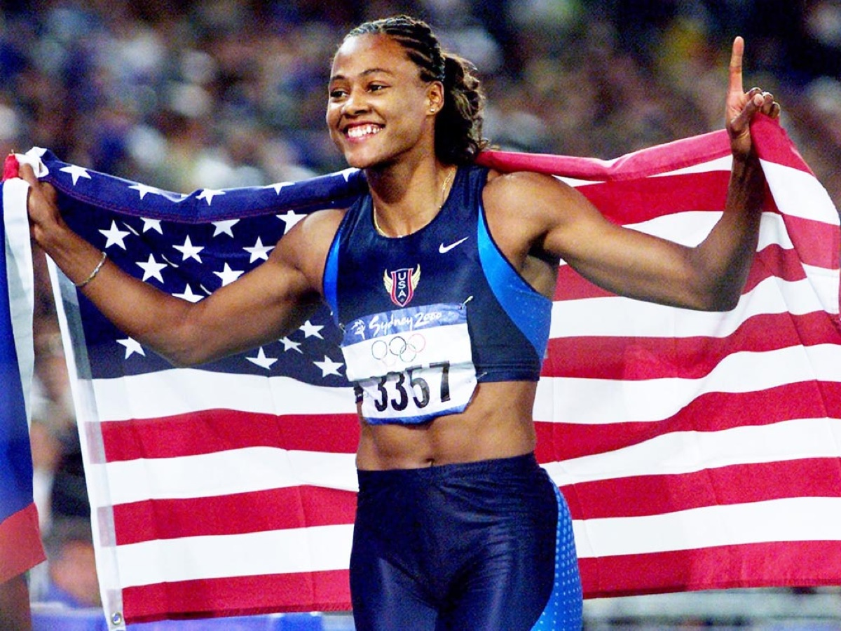
Notes:
Does anyone remember Marion Jones? The Gold Winning Olympian. After pleading guilty to doping charges, Marion found herself in Jail.

Slide 47
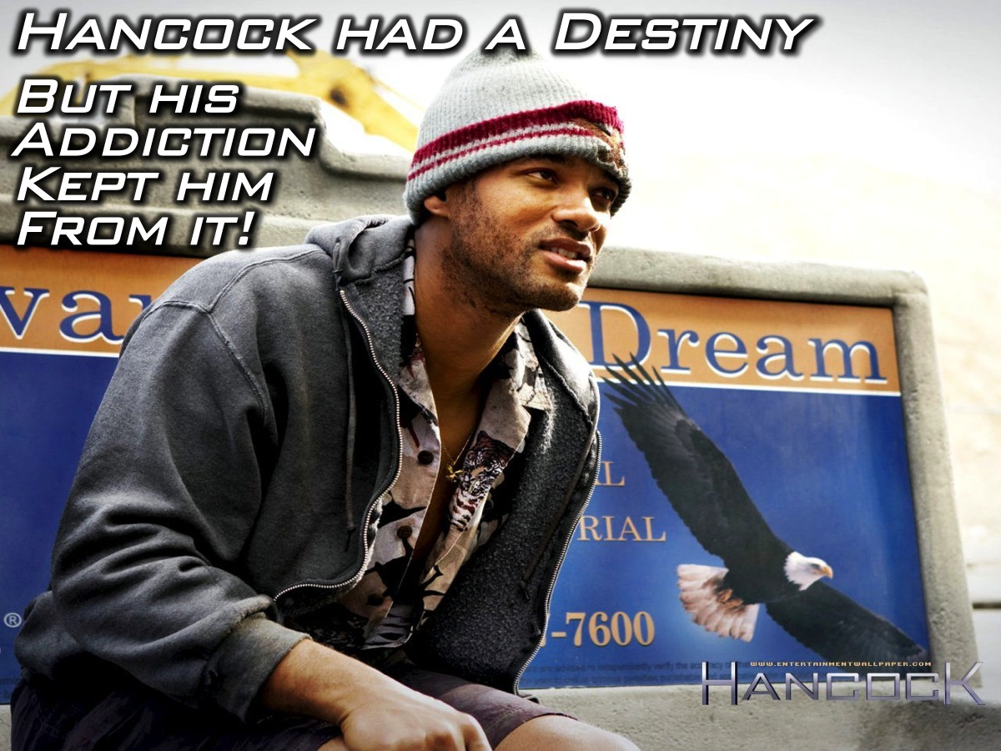
Notes:
Hancock was created for a specific purpose. He had a destiny. His addiction kept him from his destiny.

Slide 48
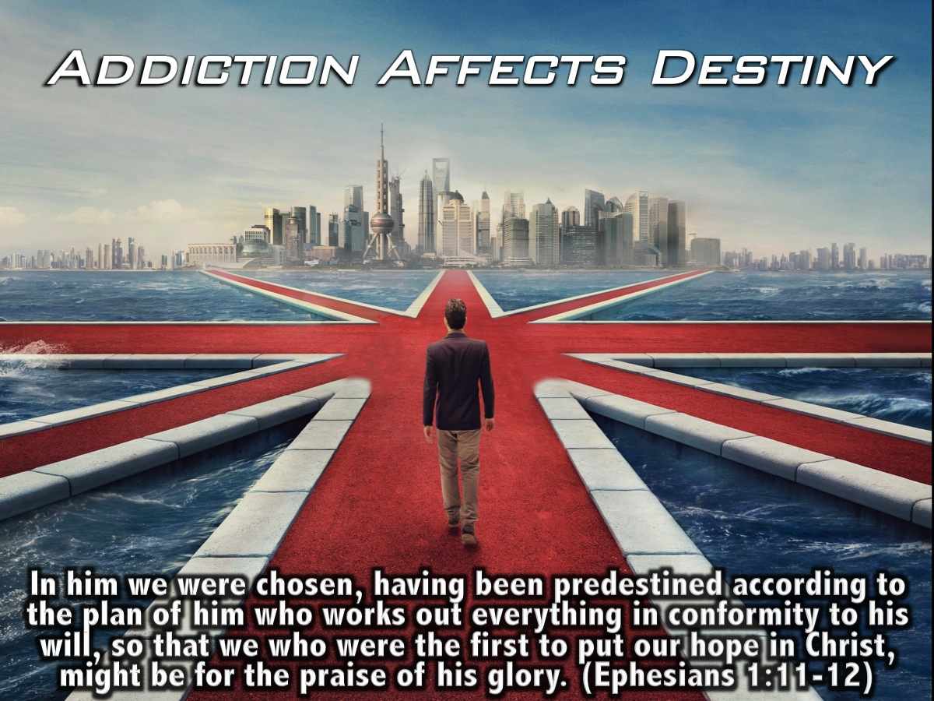
Notes:
Addiction takes the focus off our journey, the true purpose for which God called each and every one of us for. Addiction affects not just us, but the reason for which we were created. “In him we were chosen, having been predestined according to the plan of him who works out everything in conformity to his will , so that we who were the first to put our hope in Christ, might be for the praise of his glory.” (Ephesians 1:11-12).

Slide 49
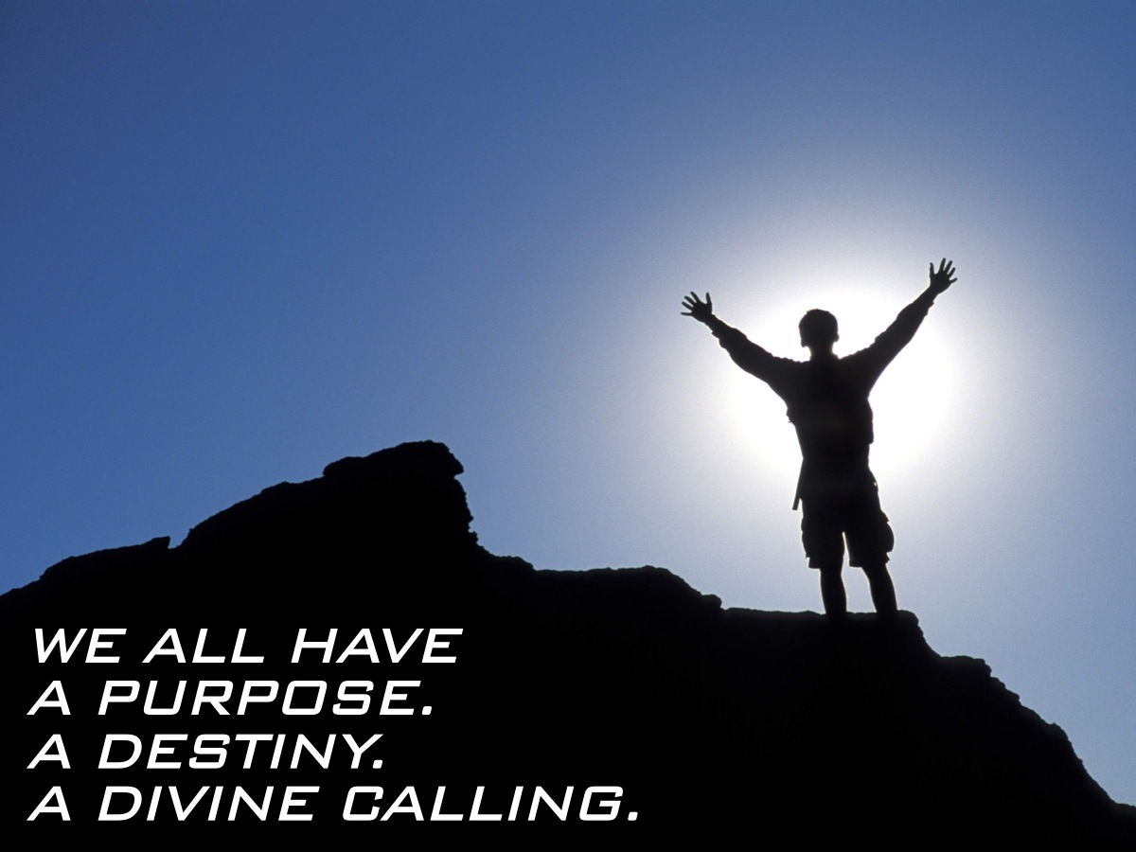
Notes:
We all have a Purpose. A Destiny. A Divine Calling.

Slide 50

Notes:
There is hope. None of your stories have to be like the stories I’ve told today.

Slide 51
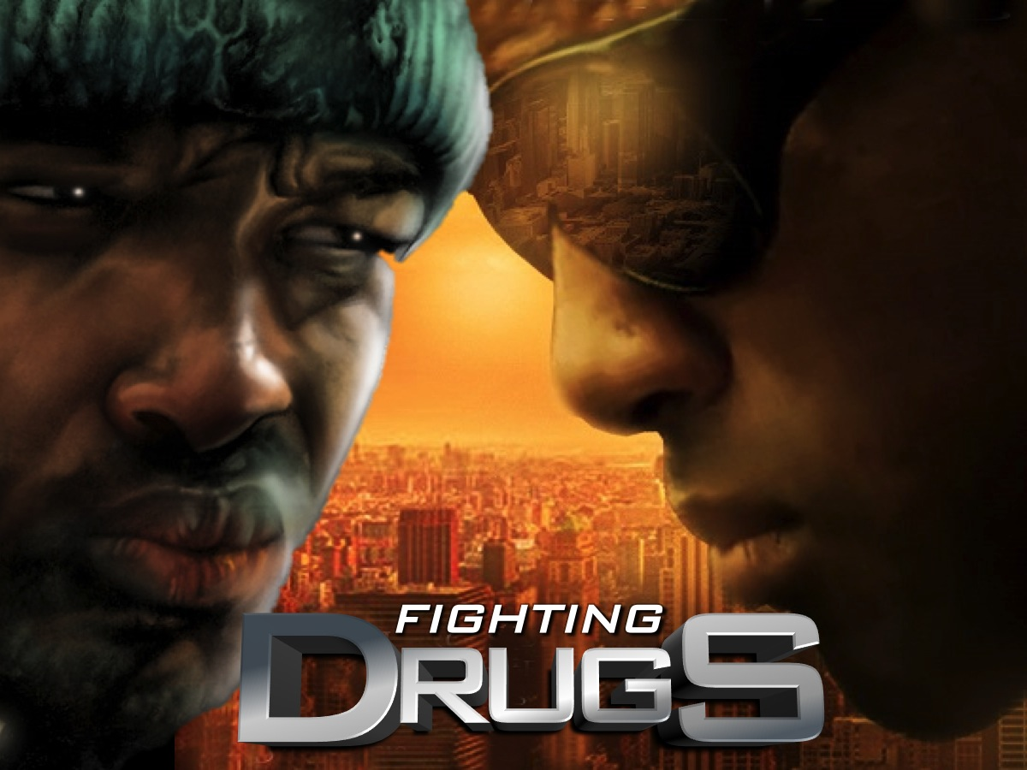
Notes:
So how do we go about fighting drugs?

Slide 52
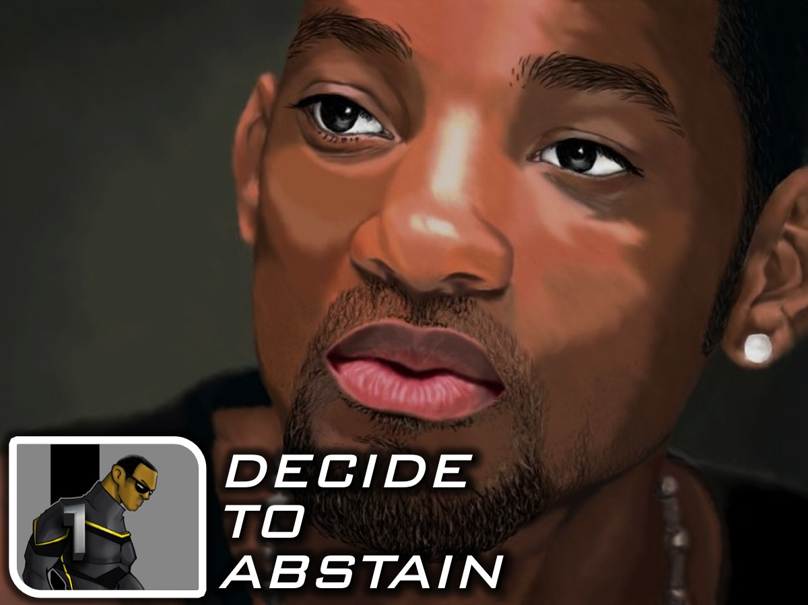
Notes:
1. Decide to Abstain. JUST SAY NO! Don’t start doing drugs!

Slide 53
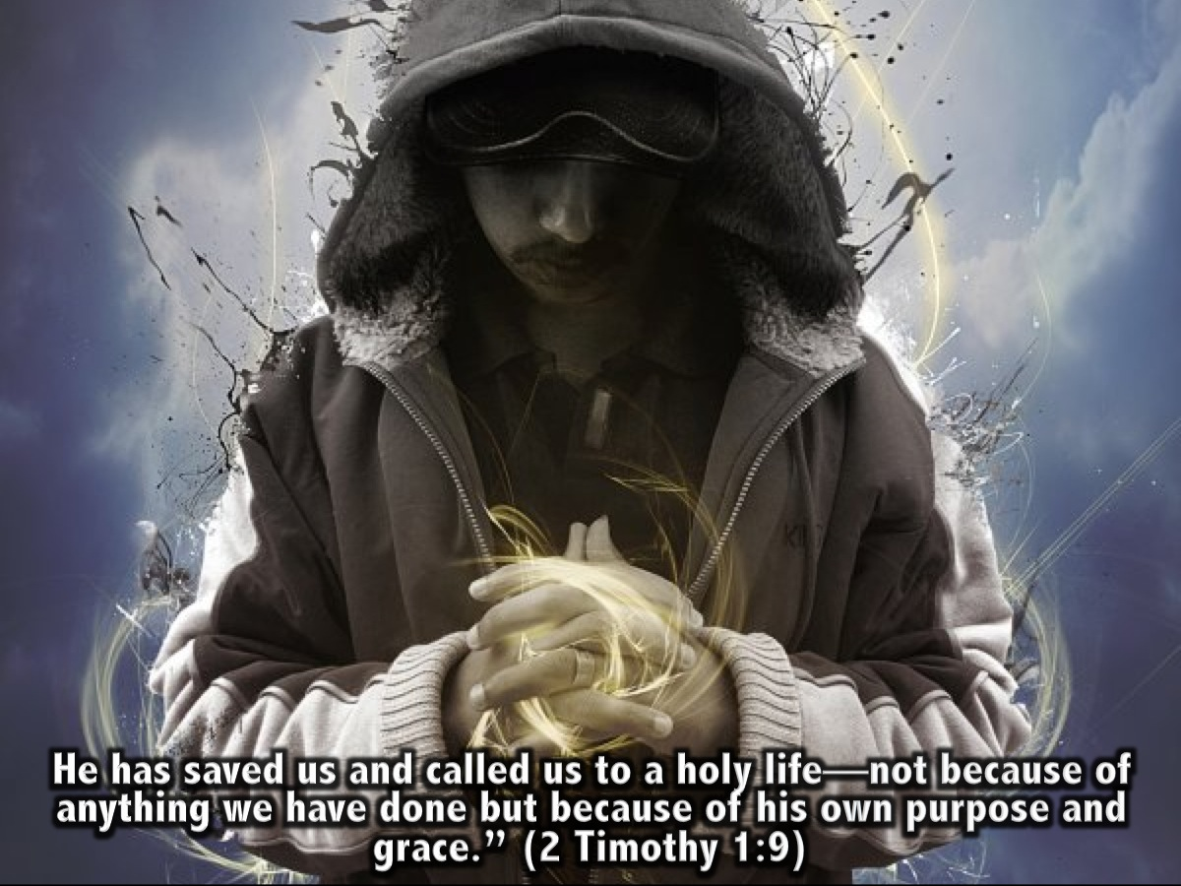
Notes:
“He has saved us and called us to a holy life—not because of anything we have done but because of his own purpose and grace.” (2 Timothy 1:9)

Slide 54
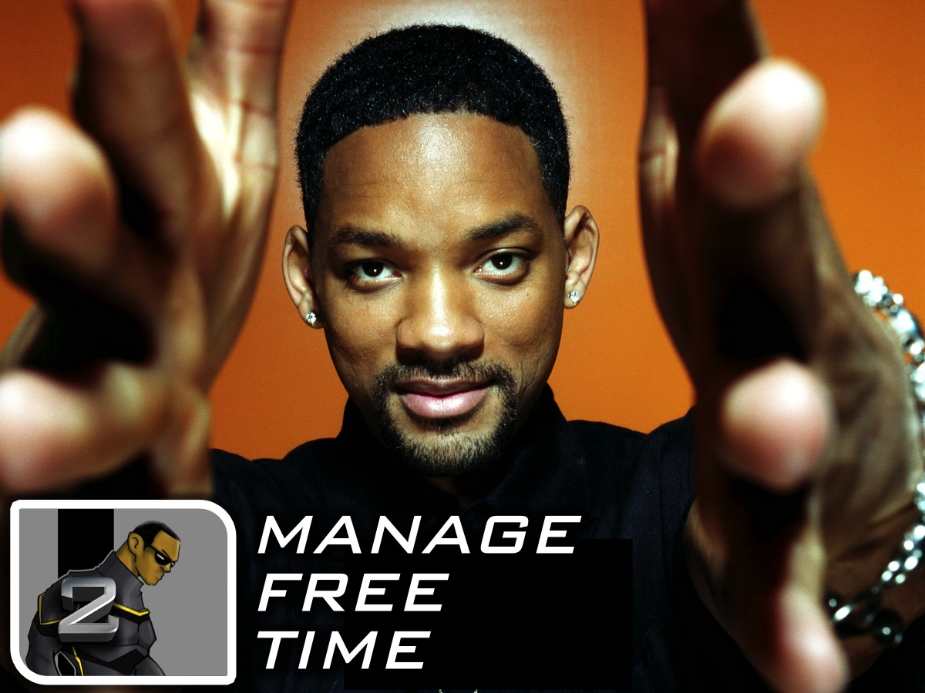
Notes:
2. Manage Free Time. Focus on the good things in your life and spend time doing them. Spend time with family and friends, read a book, watch a movie, spend sometime outdoors – I promise. It’s good for you

Slide 55
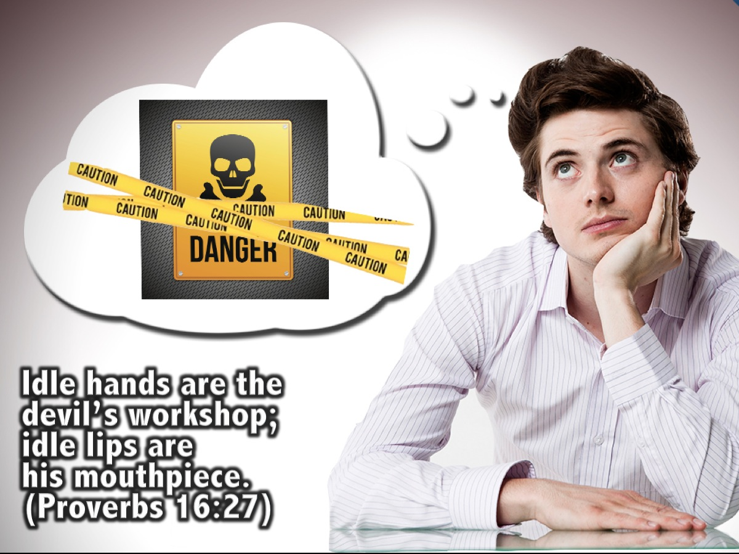
Notes:
“Idle hands are the devil’s workshop; idle lips are his mouthpiece.” (Proverbs 16:27)

Slide 56
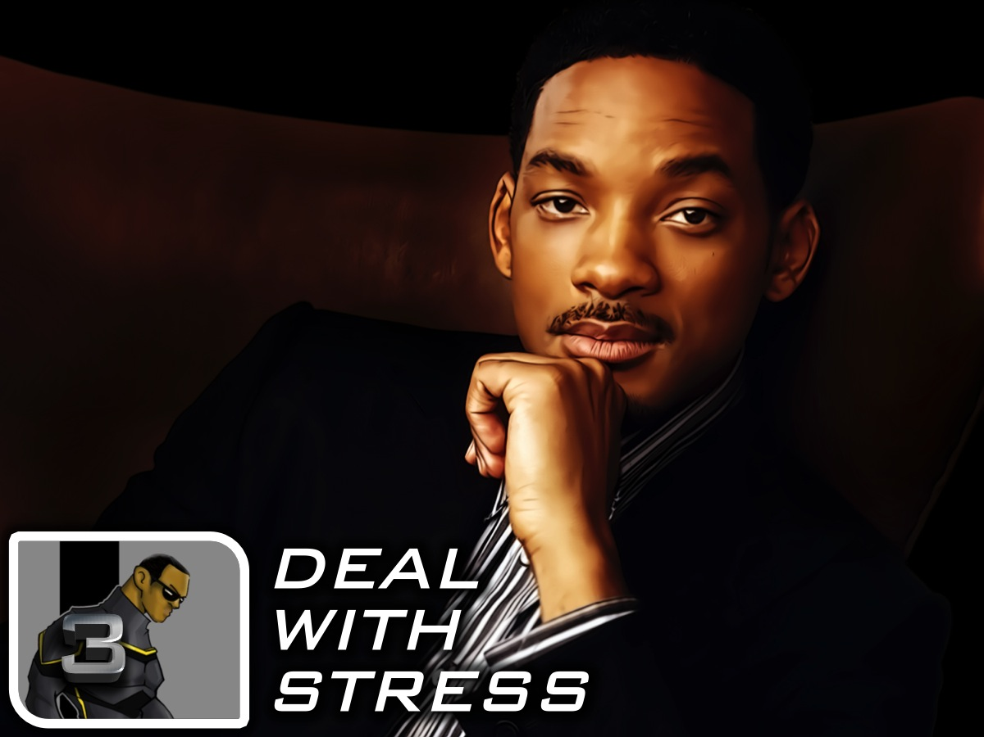
Notes:
3. Deal With Stress. Take a break from technology!!! – Seriously! Take up exercise. Listen to calming music. Enjoy the beauty of your environment – walk in the garden or the park – enjoy a beautiful view or landscape. If you’re stressed talk to someone. We often become overwhelmed by issues in life. Some of these issue’s we talked about in the last few weeks: Angers, Anxiety, Depression, Suicide. If you’re feeling overwhelmed talk to someone who’s willing to listen.

Slide 57
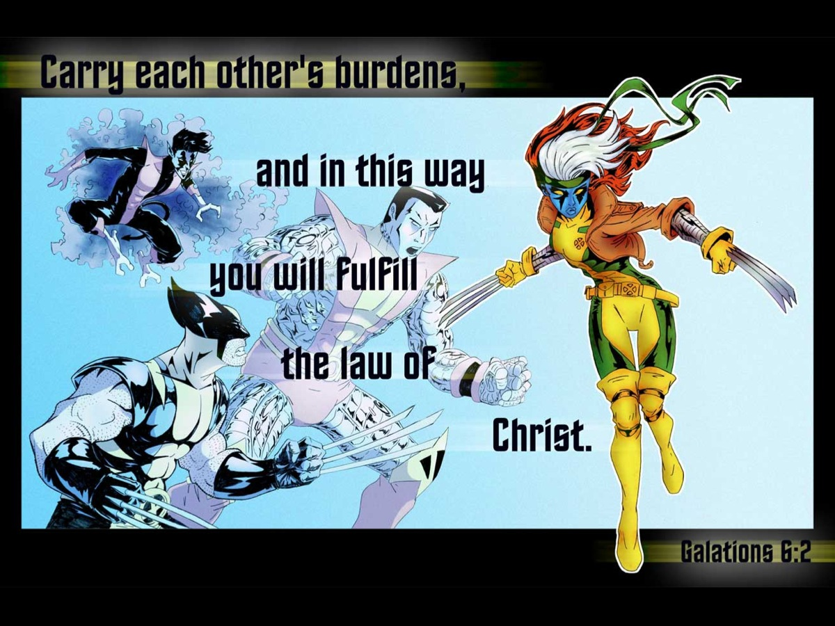
Notes:
“Carry each other’s burdens, and in this way you will fulfill the law of Christ.” (Galatians 6:2)

Slide 58

Notes:
And remember that Jesus will ultimately carry all your burdens: “Come to me, all you who are weary and burdened, and I will give you rest.” (Matthew 11:28)

Slide 59

Notes:
Recovering from addiction is a long process, one that requires time, commitment, motivation, and support. If you (or someone you are discipling) are using drugs, the next four steps will be really helpful for you to follow:

Slide 60

Notes:
4. Admit the Problem – in the Alcoholics Anonymous program one of the most important stages in the recovery process is getting to the point when you admit in front of the whole group that you are an alcoholic!

Slide 61

Notes:
5. Identify the Triggers. Figure out what triggers your abuse: Certain places, people or situations may give you a strong urge to abuse. You need to avoid them. Minimize your triggers as much as possible.

Slide 62

Notes:
6. Look for Support (Family, Friends or a Support Group). Seek support from Family and Friends. It is extraordinarily difficult to quit all by yourself. Don’t rely on someone else to quit with you. Avoid people and friends that use or talk about drugs in front of you.

Slide 63

Notes:
If necessary, join a support group. You are not alone. Other recovering addicts will encourage you to share your story and talk to people who have been through your struggle too.

Slide 64

Notes:
In South Africa an excellent resource is Narcotics Anonymous: http://www.na.org.za/

Slide 65

Notes:
7. Go for Counseling. Find a Therapist or a Counselor. Look for someone who specializes in helping people overcome addictions, and who has plenty of experience and a good track record.
Being able to work one-on-one with someone you trust is an especially good option if you're not as interested in sharing your experience in a group setting.

Slide 66

Notes:
Here is a summary of the steps we have explored to fight drugs: Decide to Abstain; Manage Free Time; Deal With Stress; Admit the Problem; Identify the Triggers; Look for Support and Go for Counseling.

Slide 67

Notes:
Let’s Pray

