Slide 1
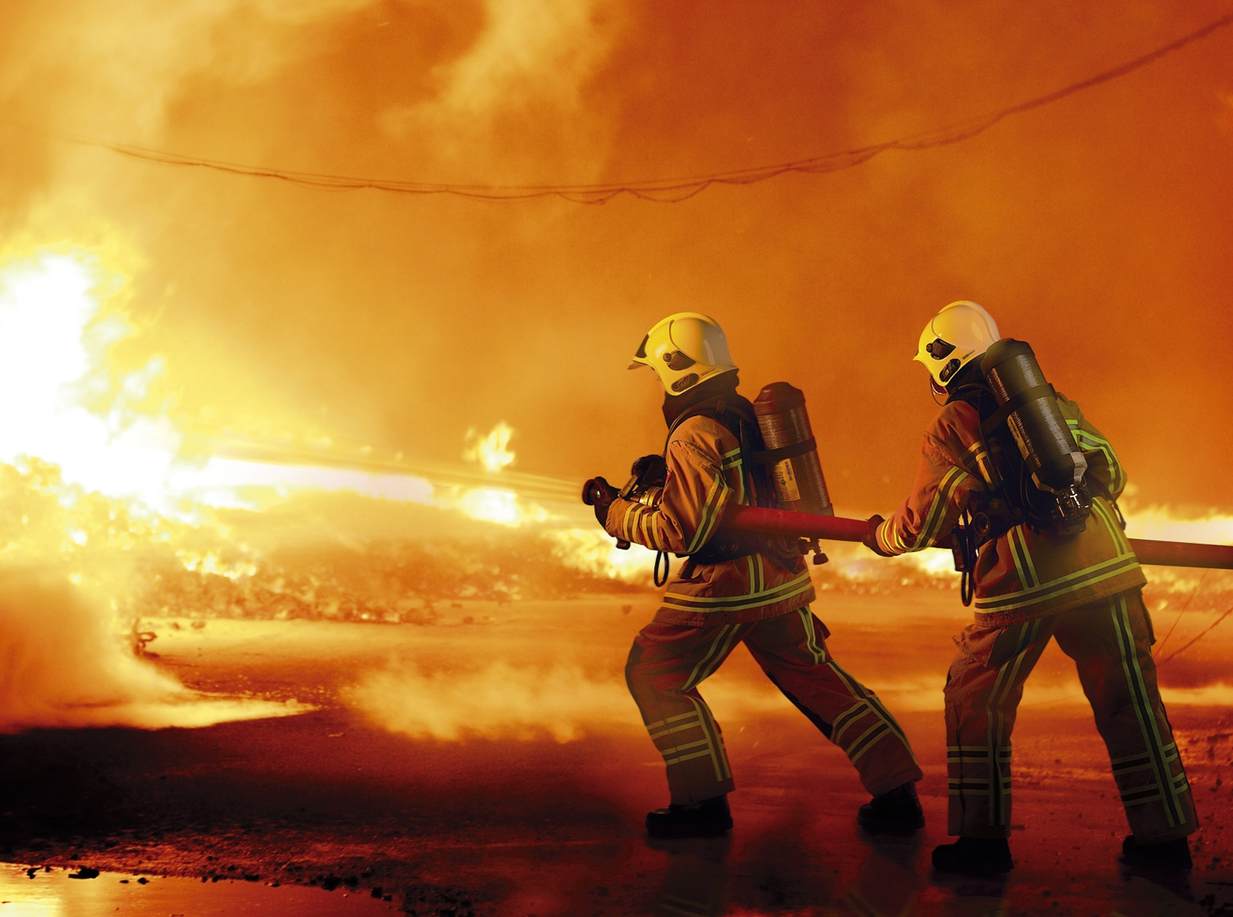
FIGHTING
PRESSURE
The
Fire fighters
Series
Notes:
This week we are talking about fighting pressure.

Slide 2
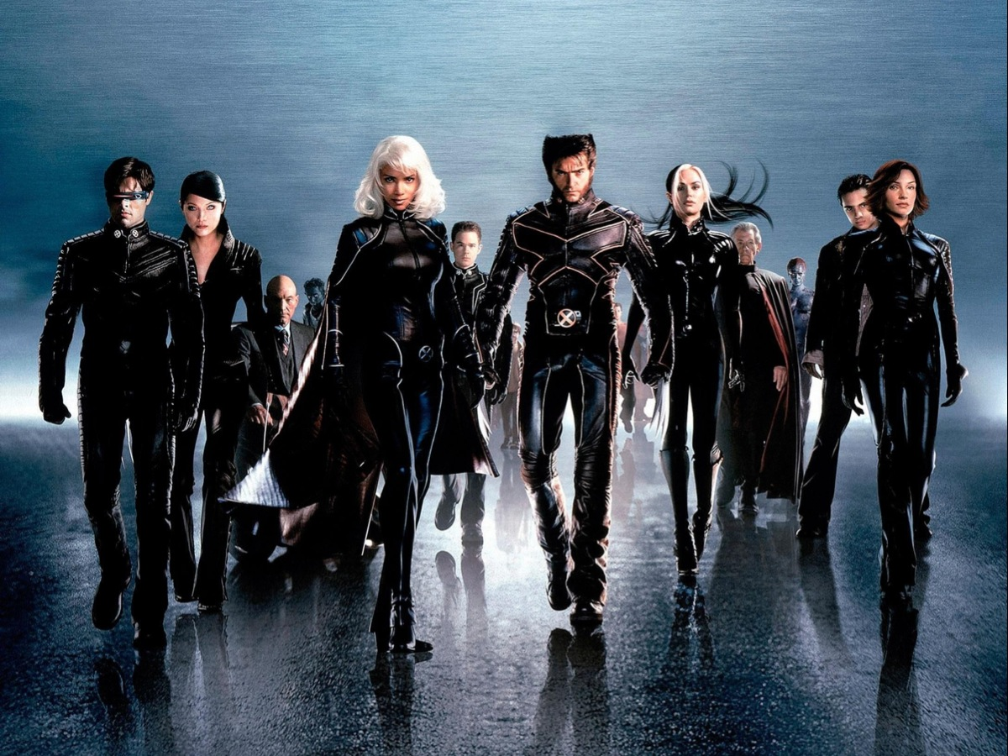
Notes:
I am sure there are not many people here today who have not watched an X-Men movie. Here is the trailer from X-Men: The Last Stand. Look out for the way in which two guys (Magneto and Xavier) exert pressure on the mutants to decide who they will stand with.

Slide 3
Notes:
Xavier and Magneto both exerted pressure on to the mutants.

Slide 4
Notes:
Magneto influences his group called “The Brotherhood of Mutants”. They were effectively a terrorist organisation that did not hesitate to kill humans.

Slide 5
Notes:
Xavier influences his group called “The Gifted Youngsters” – even creating a school in which they were helped to deal with their mutation.

Slide 6
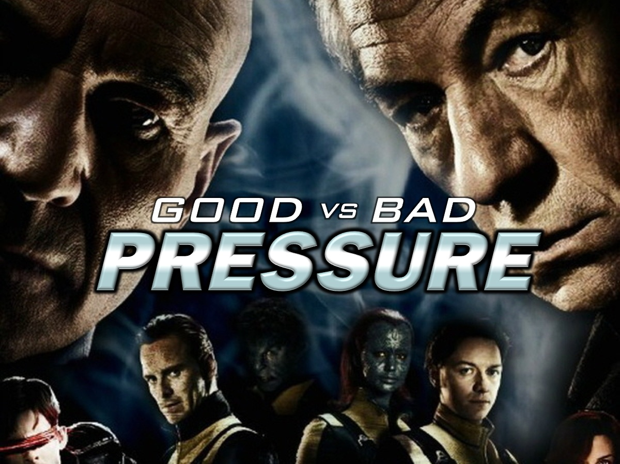
Notes:
In the X-Men we see how pressure can be exerted on people – either for Good or for Bad.

Slide 7
Notes:
Good Peer Pressure: While peer pressure can be bad, there are also circumstances in which peer pressure can also be a good thing. But how do we know whether peer pressure is good or bad? Lets look at some characteristics of good verses bad pressure.

Slide 8
Notes:
Good peer pressure is when you are encouraged to follow good role models and exhibit Godly character.

Slide 9
Notes:
Good peer pressure is when your friends affirm who you are and what you should become and encourage you to stand up and believe in something.

Slide 10
Notes:
Good peer pressure is when your friends encourage you to keep doing something when you doubt you can do it on your own.

Slide 11
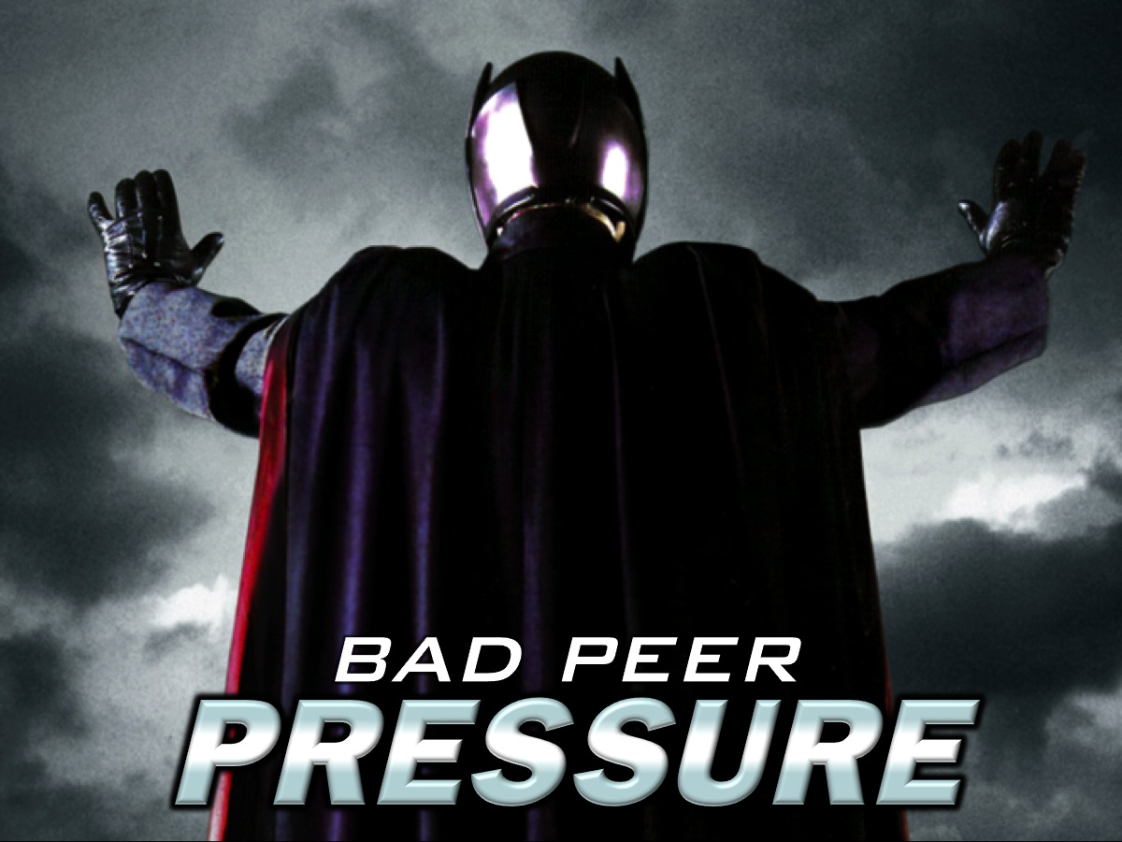
Notes:
Let’s think about bad peer pressure.

Slide 12
Notes:
Bad peer pressure is when our identity is attacked.

Slide 13
Notes:
Bad peer pressure is being encouraged to fit in and be part of the crowd.

Slide 14
Notes:
“Do not conform to the pattern of this world, but be transformed by the renewing of your mind.” (Romans 12:2)

Slide 15
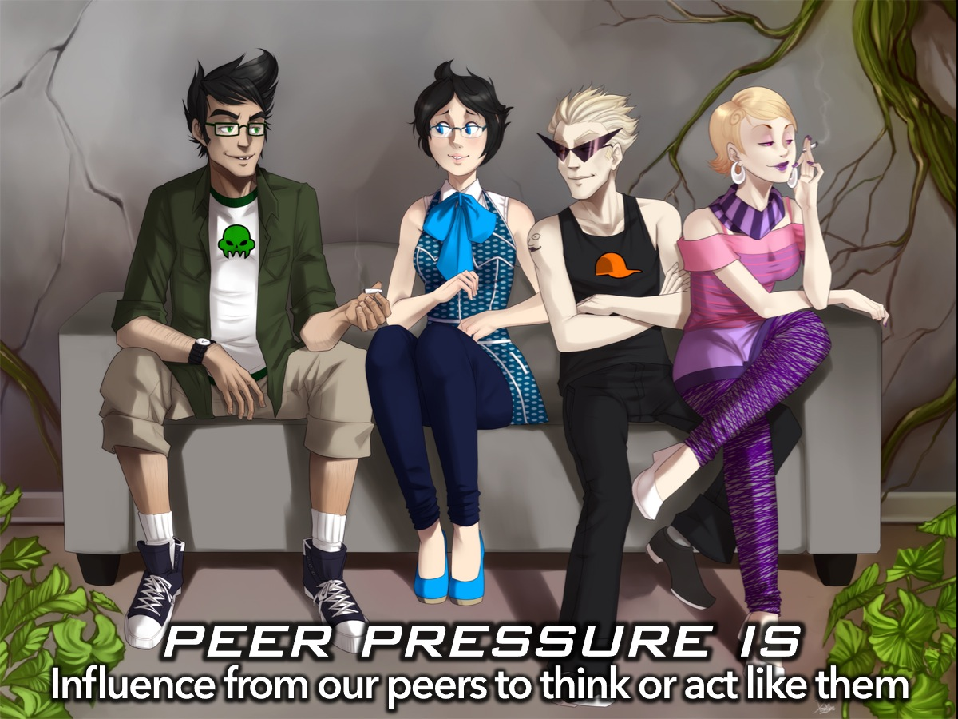
Notes:
What is Peer Pressure? Peer pressure is influence from our peers to think or act like them. It comes from the desire to please others and fit in as part of the crowd. We all have a longing to be loved and accepted and to belong. This desire is not inherently bad, but the problems start when we lose our God-given identity in the midst of this world.

Slide 16
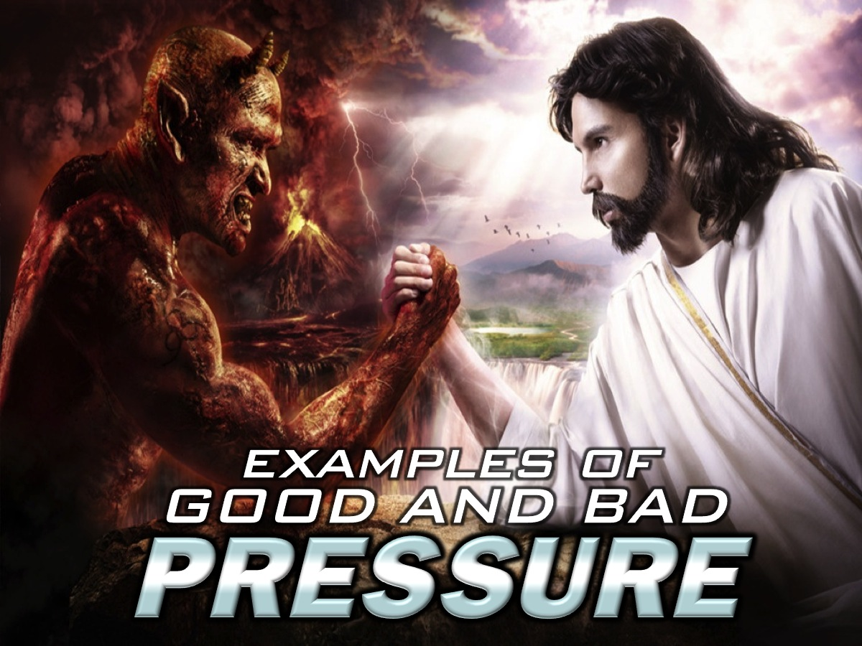
Notes:
Let’s take a look at examples of good and bad pressure in the Bible.

Slide 17
Notes:
Adam and Eve: “Now the serpent was more crafty than any other beast of the field that the Lord God had made. He said to the woman, “Did God actually say, ‘You shall not eat of any tree in the garden’?” (Gen 3:1)

Slide 18
Notes:
Joseph and Potiphar’s Wife. The second example we are going to look at is when Joseph came up against peer pressure.

Slide 19
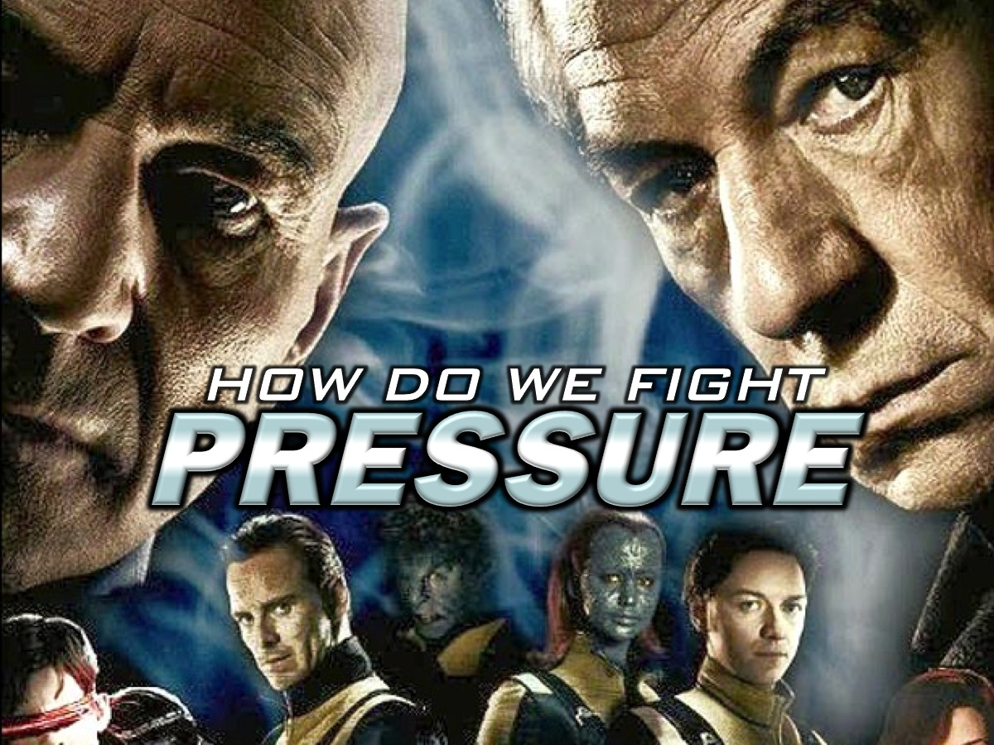
Notes:
How Do We Fight PRESSURE?

Slide 20
Notes:
1. Identify the Pressure. Know the "Uh-Oh" Feeling. That's the feeling that you feel when someone (or something) wants you to do something you do not feel comfortable doing.

Slide 21
Notes:
2. Spot the Behavior. What is it you are not comfortable with? Peer pressure is not always towards doing something dangerous, but often is. The question is: does this behavior potentially hurt yourself or others physically, mentally or emotionally?

Slide 22
Notes:
3. Check the Consequences. Will I Be Proud of This Tomorrow? This is a good rule to follow when in doubt. Will you be proud of yourself when the situation is over?

Slide 23
Notes:
4. Remember your Identity. Find your identity in Christ and be confident in who you are. Say” No” When you find yourself in bad peer-pressure situation.

Slide 24
Notes:
5. Find some Allies. You should get like-minded people to stand with you against the peer pressure by fighting the bad pressure with good pressure.

Slide 25
Notes:
6. Pray for Help. When in doubt or feeling pressured ask God for wisdom and strength to do the right thing.

Slide 26
Notes:
Summary: How Do We Fight PRESSURE? (1) Identify the Pressure. (2) Spot the Behaviour. (3) Check the Consequences. (4) Remember your Identity. (5) Find some Allies. (6) Pray for Help.

Slide 27
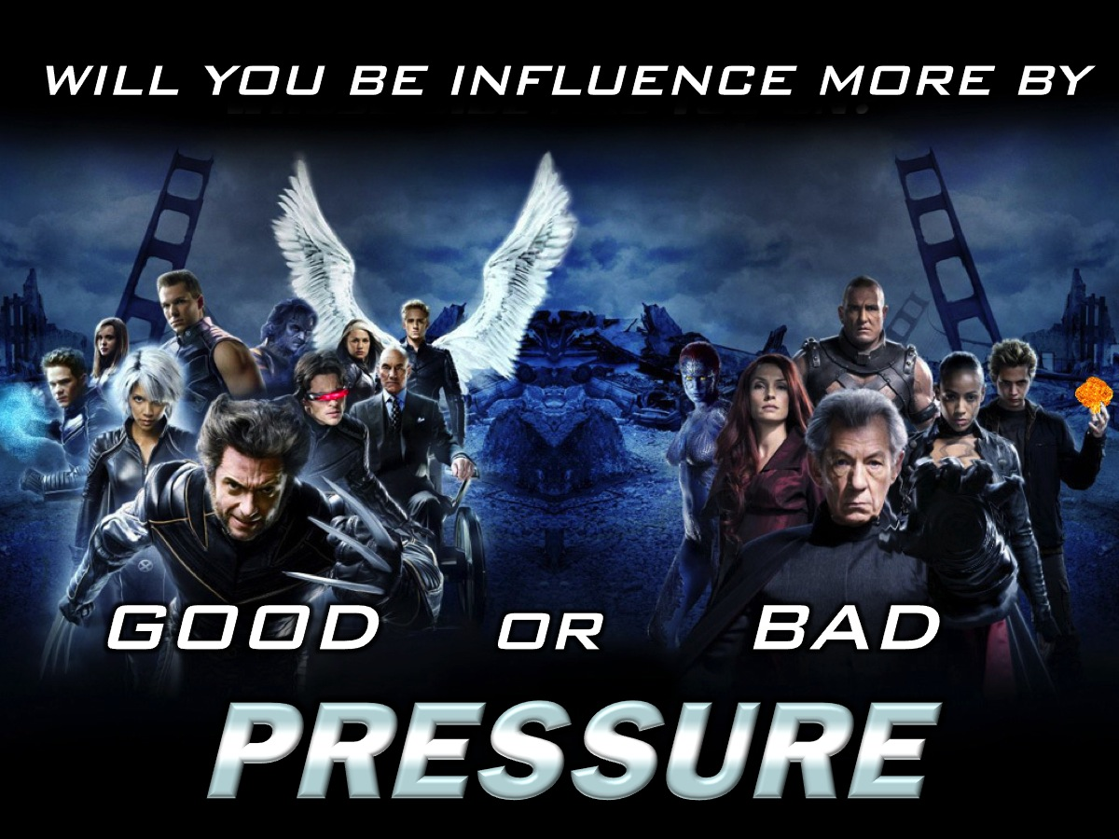
Notes:
Will you be influenced more by good or bad pressure?

Slide 28
Notes:
Let’s Pray

