Slide 1

Notes:
This week we are going to learn how to fight suicide. Can you guess who our superhero is for this week?

Slide 2

Notes:
It is Superman.

Slide 3
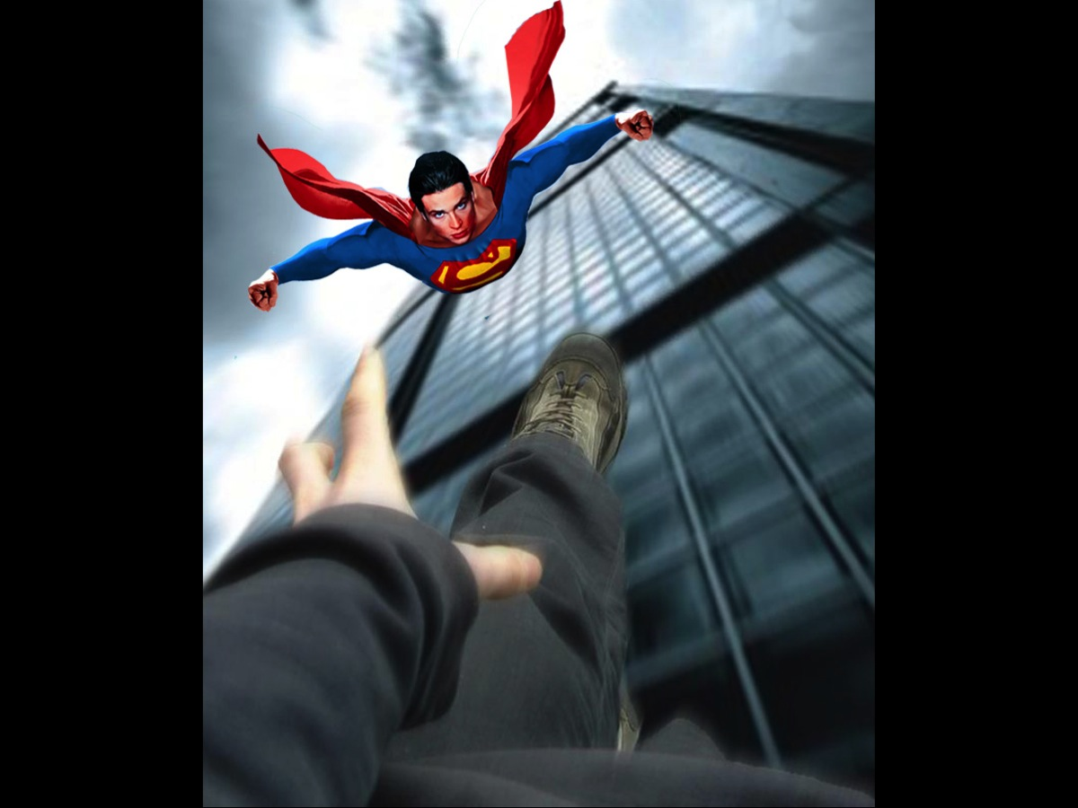
Notes:
I have no doubt that Superman would fly into action if he spotted someone jump off a building.

Slide 4

Notes:
Let’s begin by understanding suicide.

Slide 5

Notes:
In our last Fire Fighters session we spoke about fighting depression and mentioned how that Robin Williams had not only battled with depression but had taken his own life.

Slide 6
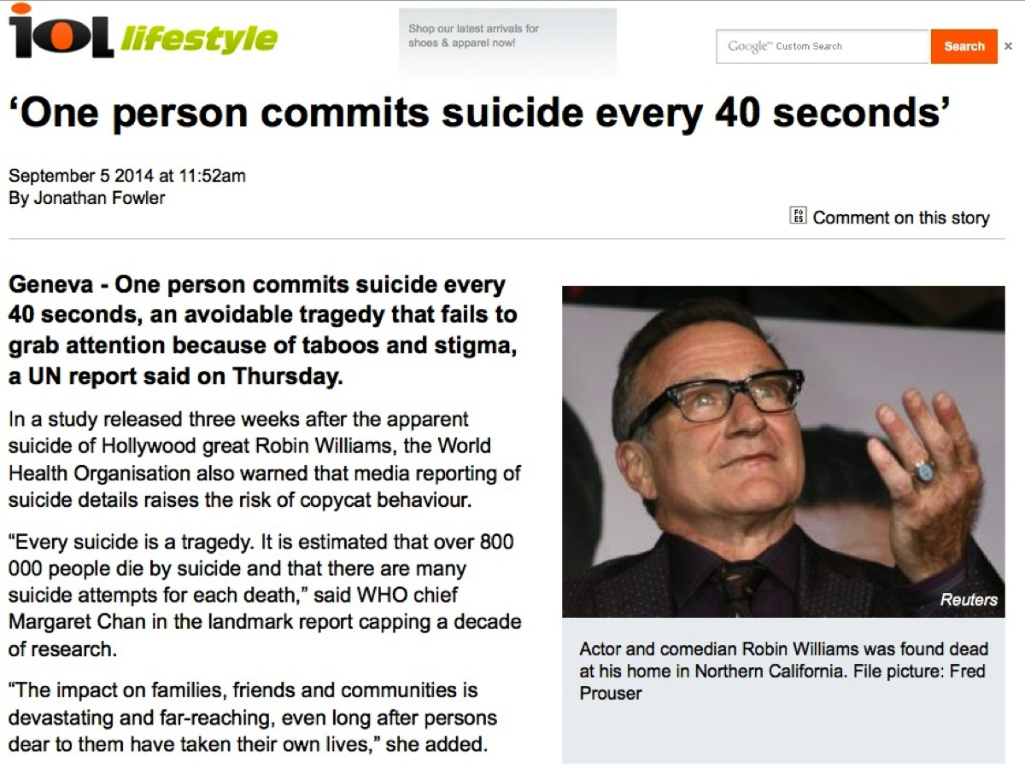
Notes:
According to a UN report this week – one person commits suicide ever 40 seconds. Source: http://www.iol.co.za/lifestyle/one-person-commits-suicide-every-40-seconds-1.1746594

Slide 7
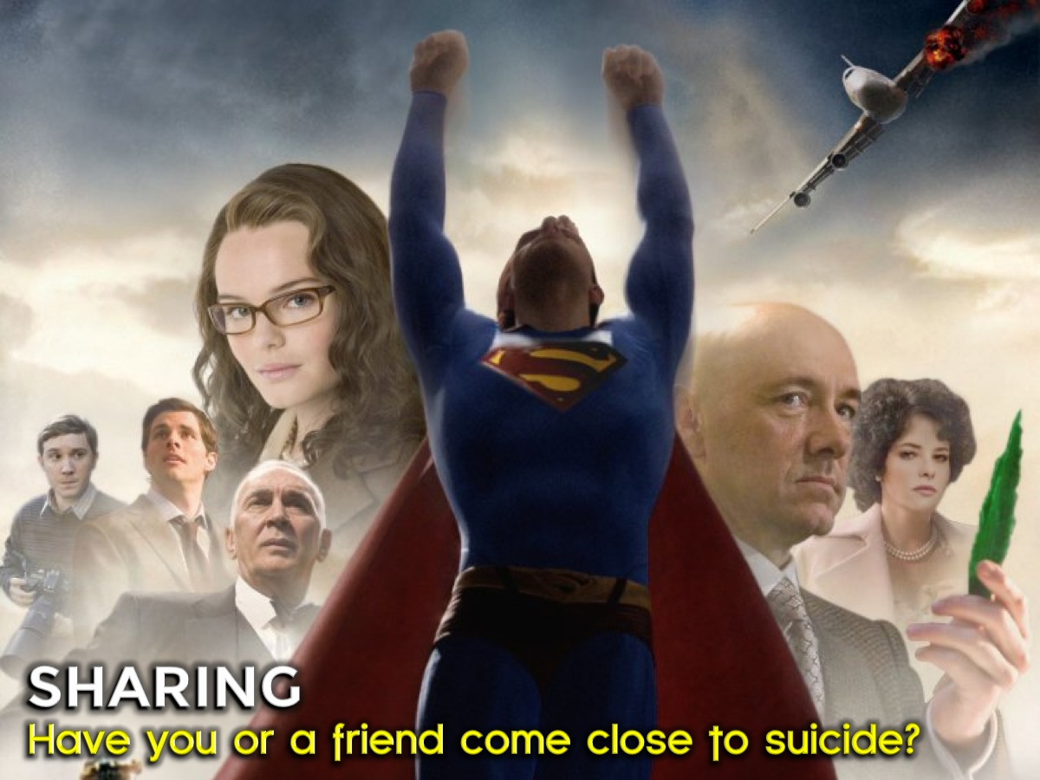
Notes:
Sharing: Have you or a friend come close to suicide?

Slide 8

Notes:
Suicide is not a new idea. The Bible records seven suicides.

Slide 9
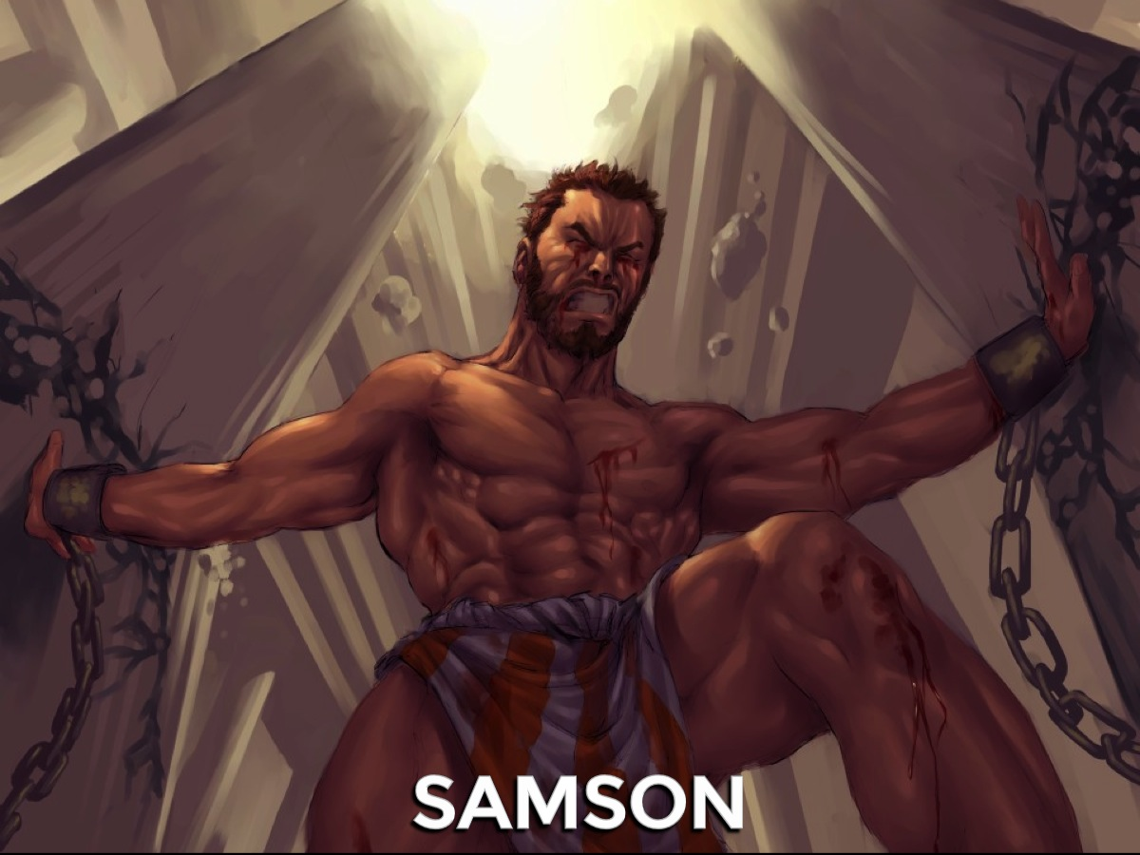
Notes:
1. Samson (Judges 16:25-30) - Samson died for a cause he believed in and for revenge.

Slide 10
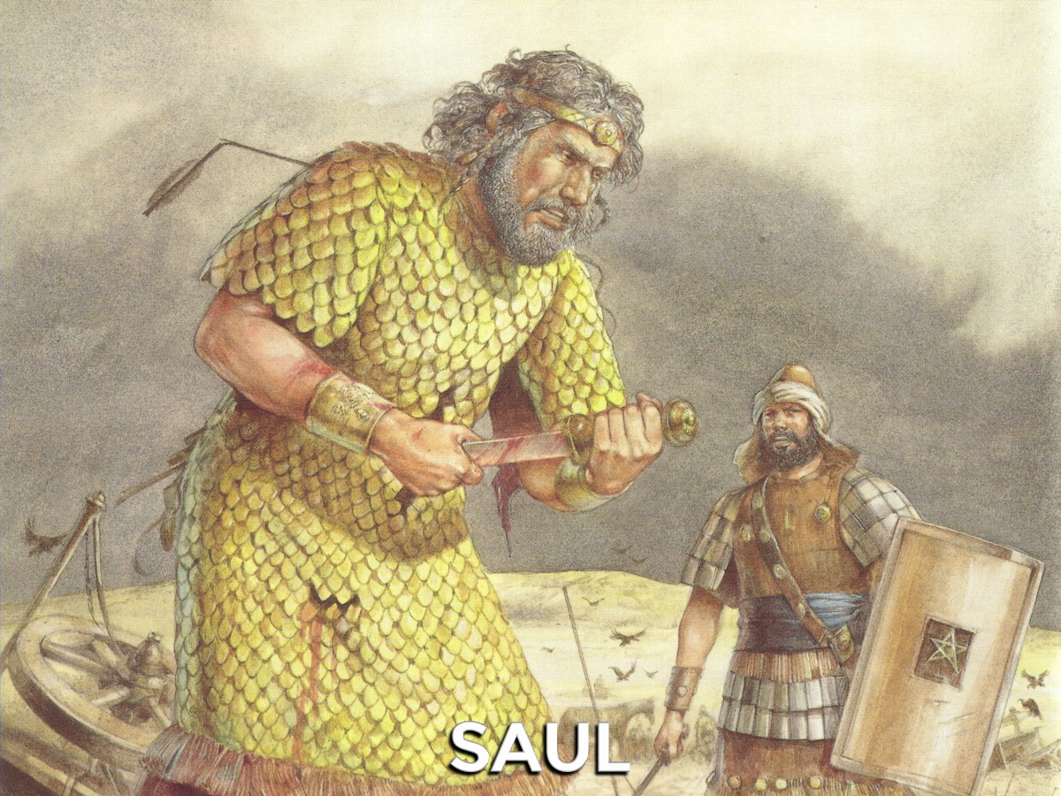
Notes:
2. Saul (1 Samuel 31:3-5) Saul was injured in battle and did not want the enemy to mock him so he took his own life.

Slide 11
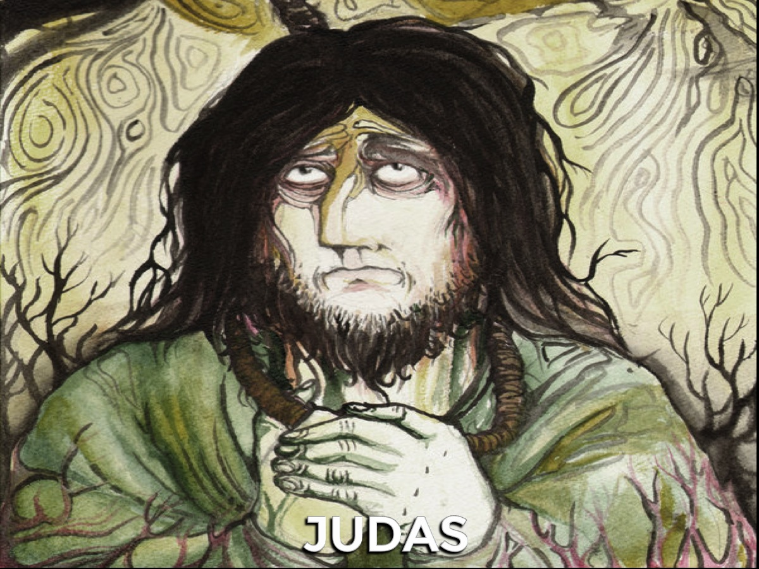
Notes:
3. Judas (Matthew 27:3-5) – Judas deely regretted betraying Jesus and went out and hanged himself.

Slide 12
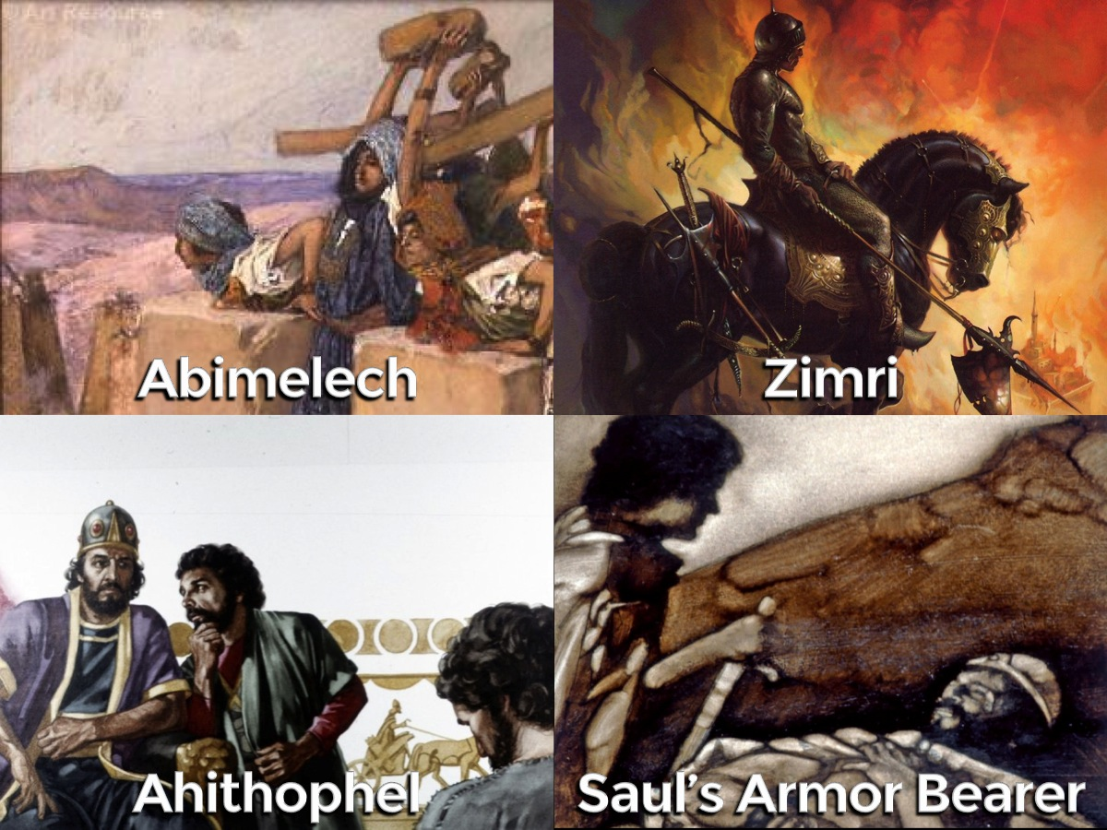
Notes:
Here are some others who committed suicide in the BIble: (1) Abimelech (Judges 9:52-54). (2) Saul's armor-bearer (1 Samuel 31:5). (3) Ahithophel (2 Samuel 17:23). (4) Zimri (1 Kings 16:15-20).

Slide 13
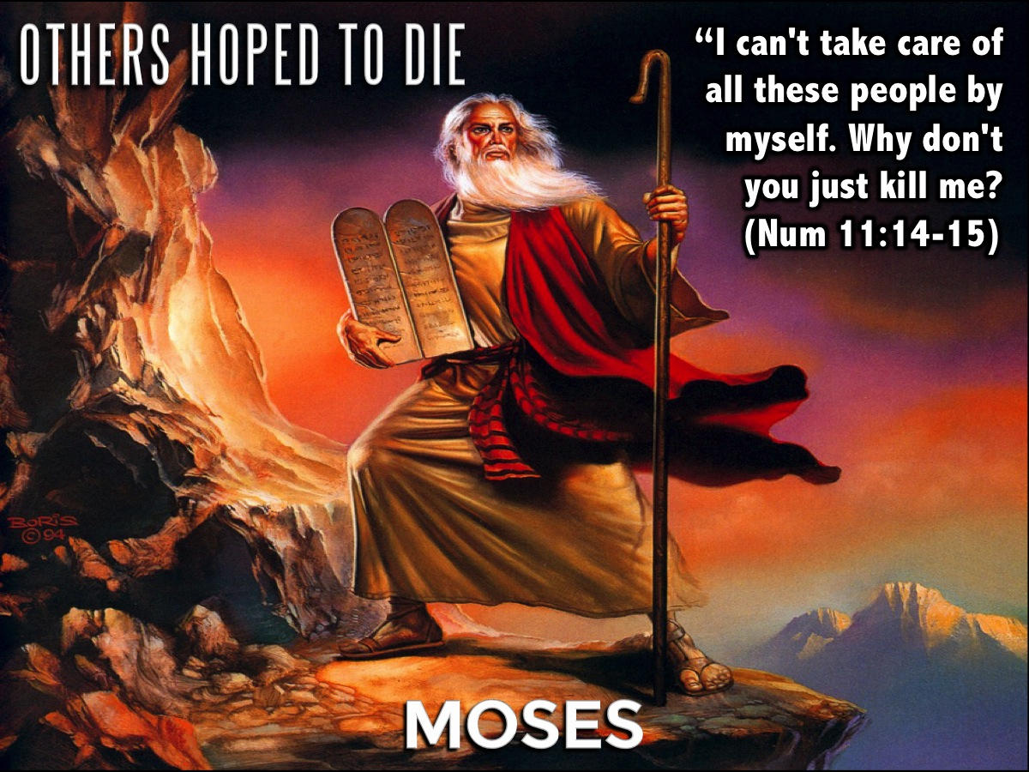
Notes:
There were also people who expressed a desire to end their lives: Moses (Numbers 11:10-15)

Slide 14
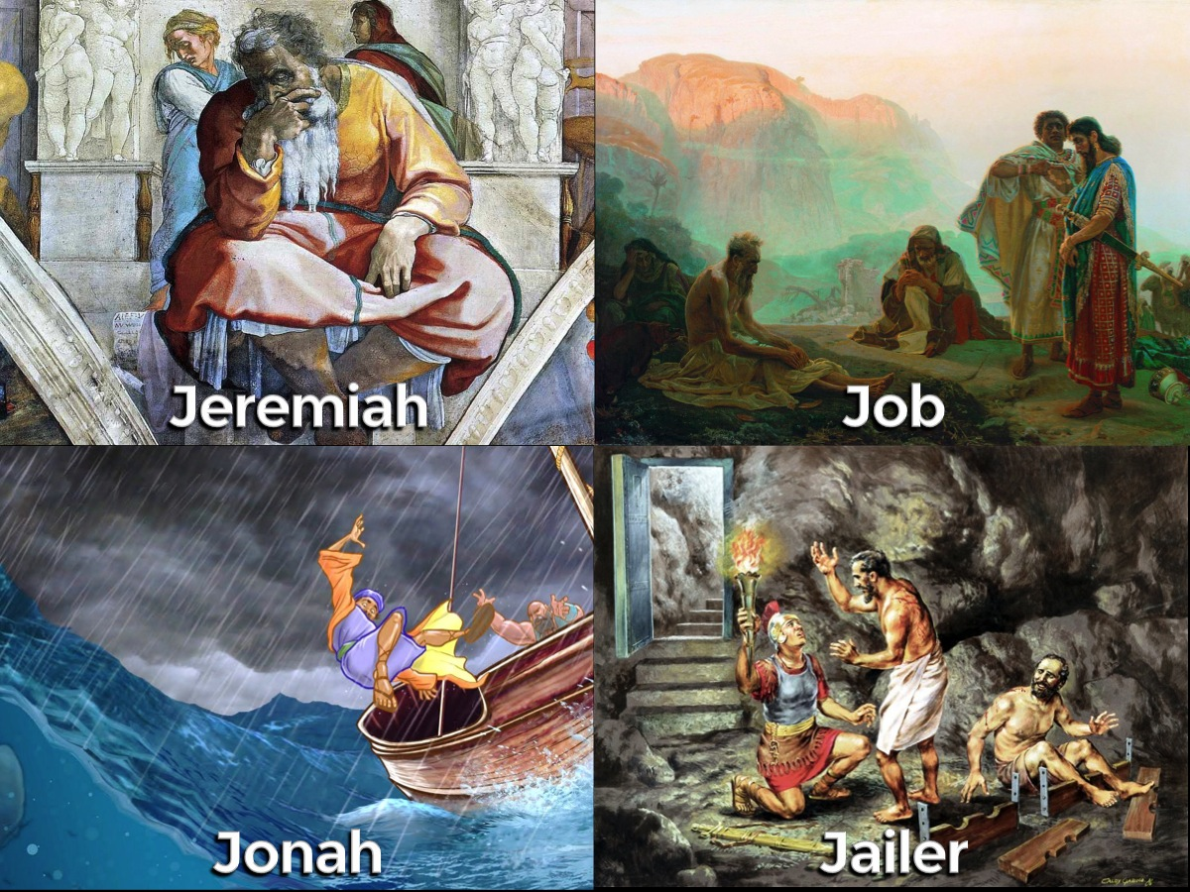
Notes:
Others who expressed a desire to die: (1) Jeremiah (Jeremiah 20:14-18). (2) Job (Job 7:15-16). (3) Jonah – twice in fact he wanted his life to end when he was caught out by the sailors (Jonah 1:11-12) and when God did not wipe out the Ninevites (Jonah 4:2). (4) The Philippian Jailer – when he thought his prisoners had escaped. (Acts 16:27). And don’t forget about Elijah in 1 Kings 19:4.

Slide 15

Notes:
So how do we go about fighting suicide?

Slide 16
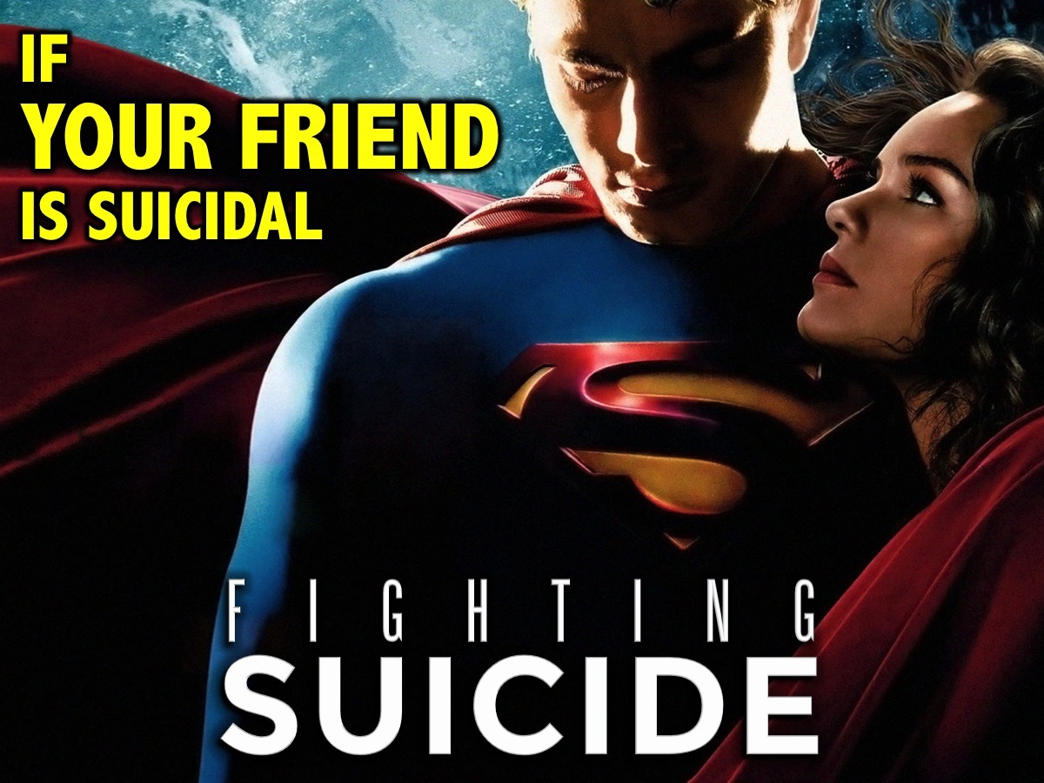
Notes:
If you have a friend who is suicidal… you can help them!

Slide 17

Notes:
1. Look for Warning Signs. There are many warning signs that suicide is about to happen:

Slide 18
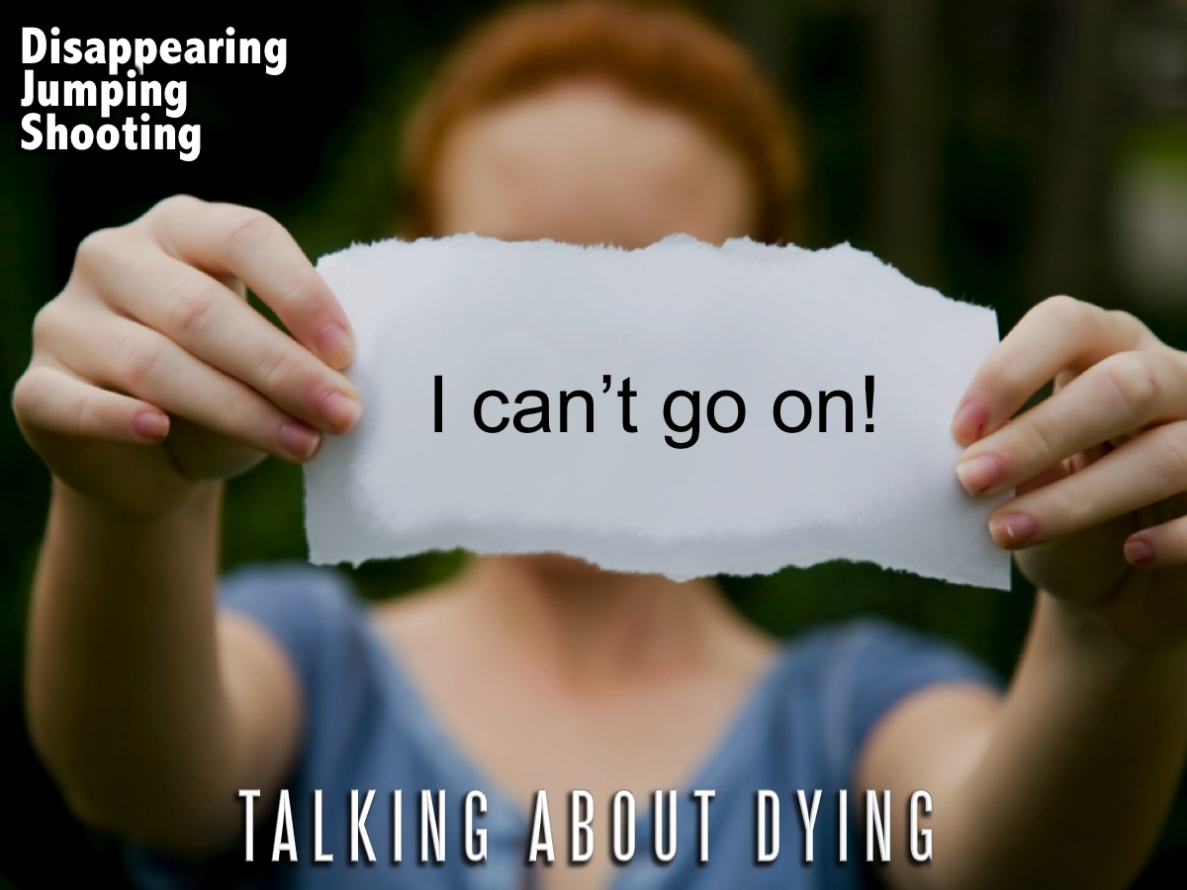
Notes:
* Talking about Dying - any mention of dying, disappearing, jumping, shooting oneself, or other self harm

Slide 19
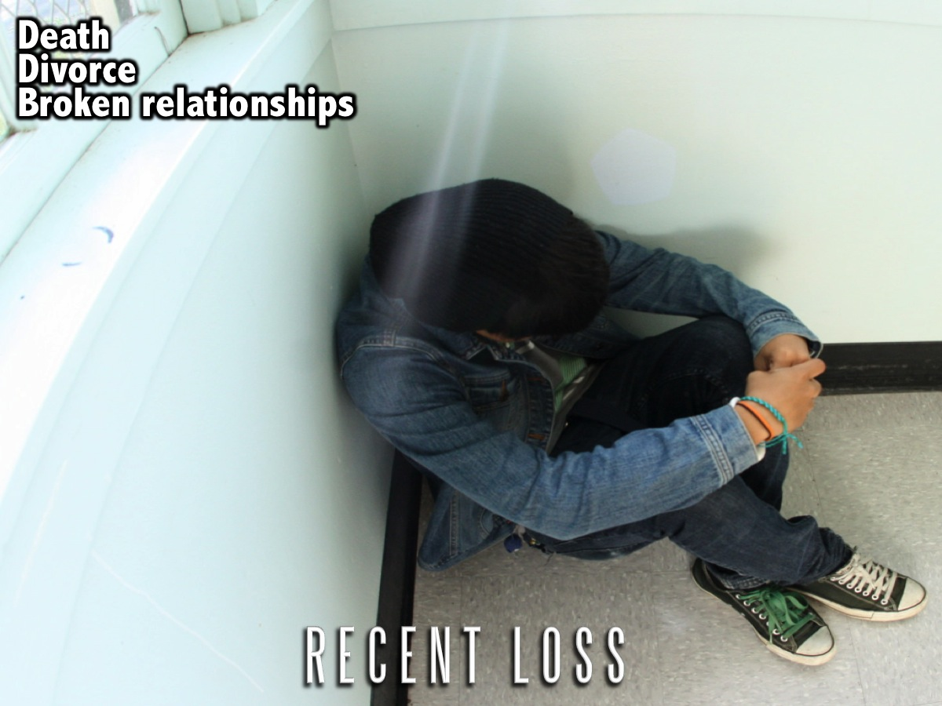
Notes:
* Recent Loss - through death, divorce, separation, or broken relationship.

Slide 20

Notes:
* Change in Personality - sad, withdrawn, irritable, anxious, tired, indecisive, apathetic

Slide 21
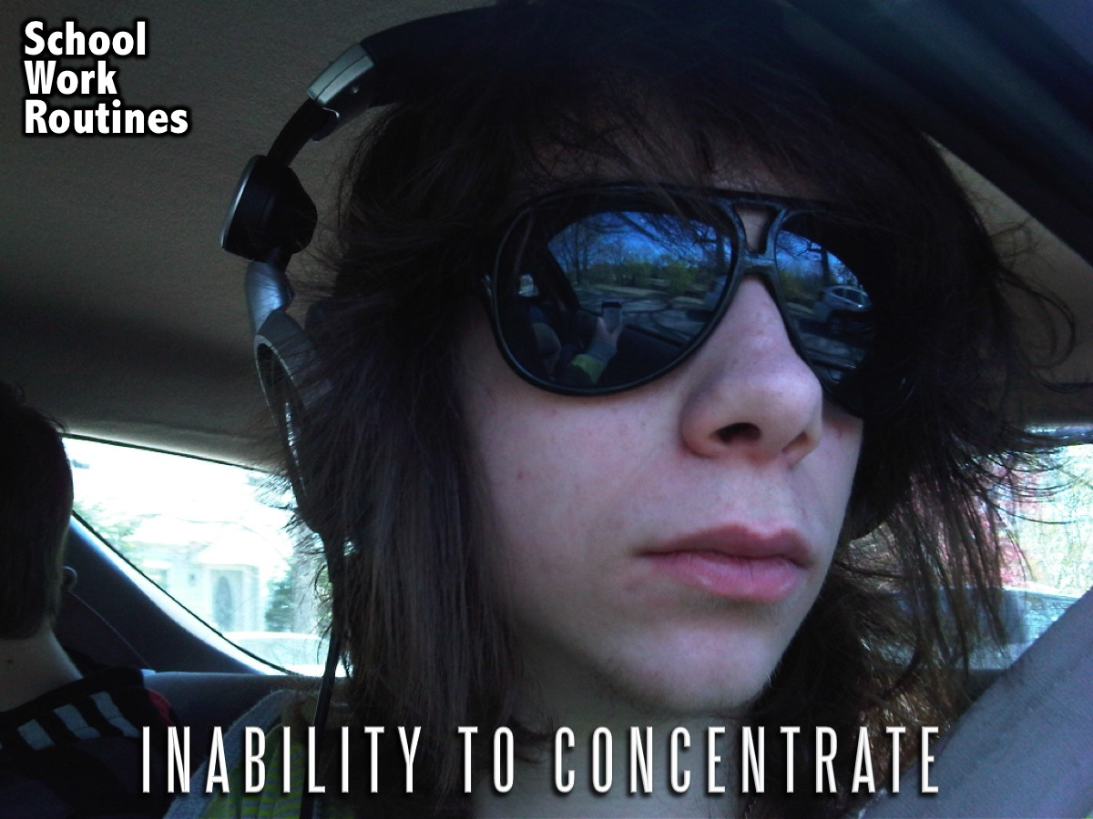
Notes:
* Inability to Concentrate – on school, work or routine tasks

Slide 22

Notes:
* Change in Sleep Patterns - insomnia, often with early waking or oversleeping, nightmares

Slide 23
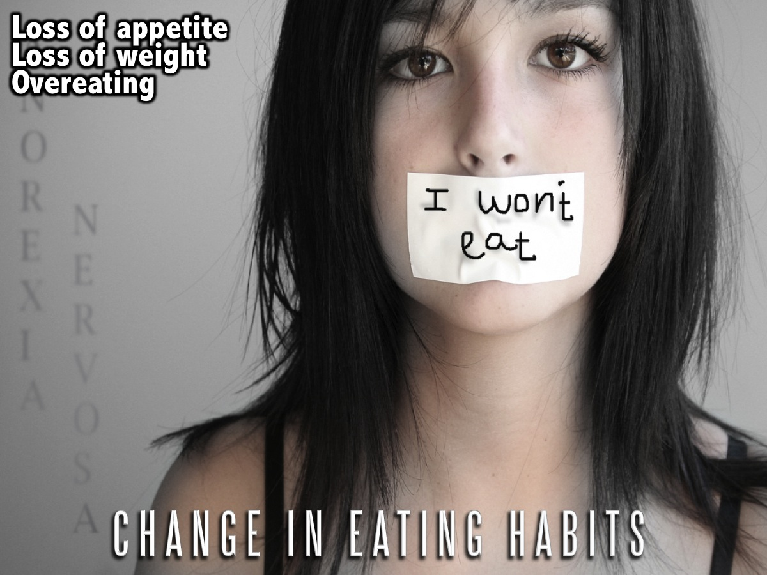
Notes:
* Change in Eating Habits - loss of appetite and weight, or overeating

Slide 24
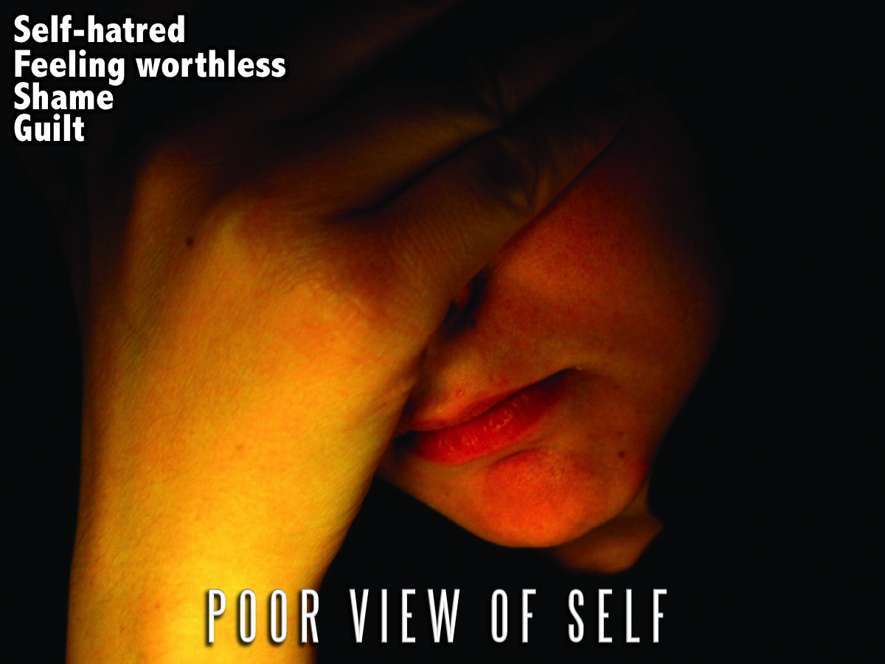
Notes:
* Poor View of Self - feeling worthless, shame, overwhelming guilt, self-hatred

Slide 25

Notes:
* Saying Goodbye to People - saying they are going to miss you when they are gone

Slide 26
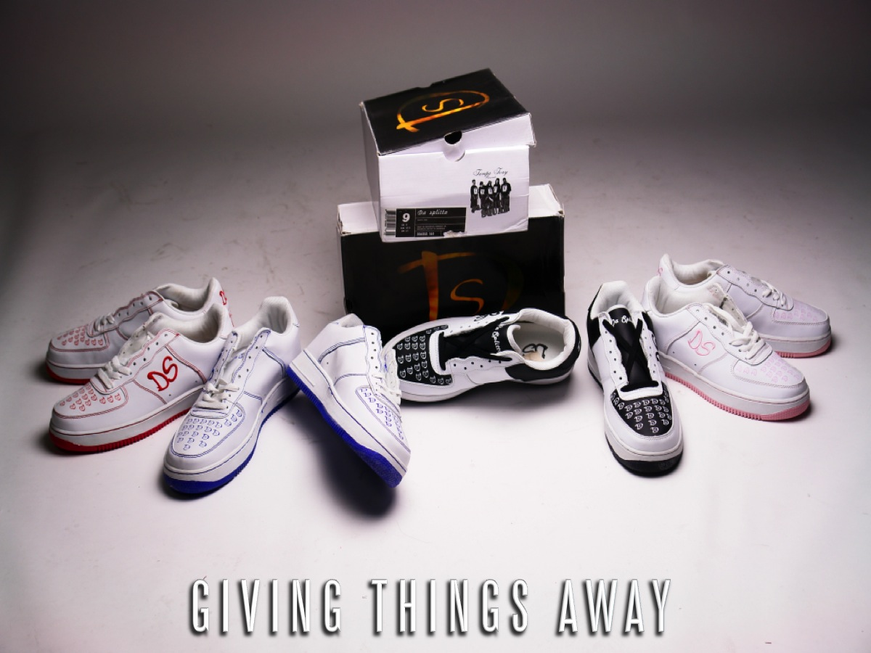
Notes:
* Giving Thing Away – they give away prized possessions.

Slide 27

Notes:
2. Assess the Risk of Suicide!

Slide 28

Notes:
You can evaluate the level of risk and the imminence of the danger by remembering the following acrostic: S-L-A-P:

Slide 29

Notes:
S = Specific plan. Is your teen considering a specific course of action for taking his own life (either communicated to you directly or brought to light in some other fashion)? If the answer is yes, go on to the next question.

Slide 30

Notes:
L = Lethality of the plan. Is this specific plan really deadly? If so, he's now running a fifty percent risk. Continue to "A."

Slide 31
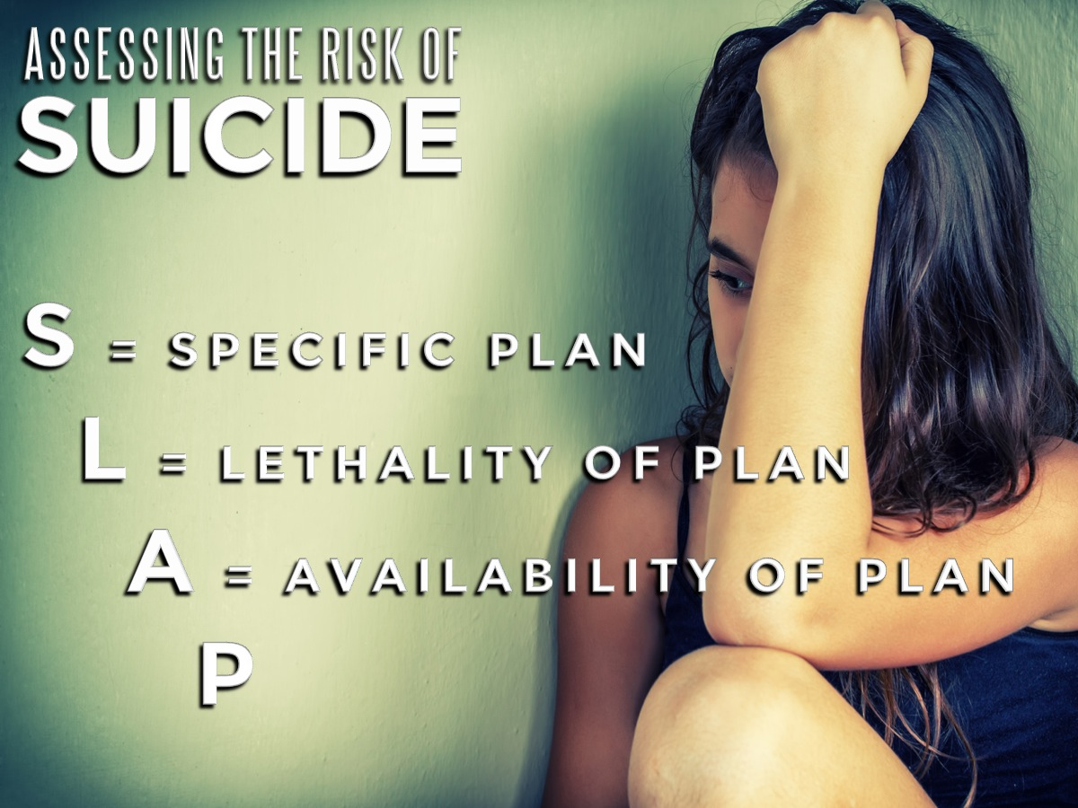
Notes:
A = Availability of plan. Can the plan be enacted? Does he have access to the means and/or materials needed to carry out his intentions? For example, are there any guns in the house? Would it be easy for him to lay his hands on large amounts of prescription medications? If so, he is in considerable danger, and you should take immediate action. Be sure to read the final question.

Slide 32

Notes:
P = Proximity of help. Are there people close enough to keep him from following through with this specific, lethal, and available plan? He probably won't try anything while friends, family, or others whom he respects are around. Most suicides happen when the depressed individual is alone or in the company of another suicidal person. If there is no help close by, get them to a place where they can be kept safe.

Slide 33

Notes:
3. Inspire Them: Find a time and a place where you can share verses and words of encouragement with them. For example, the following passages give reasons why suicide is not God's plan for their lives:

Slide 34

Notes:
1. I was created in God's image (Genesis 1:27) - Genesis 1:27 says that we are created in God's image. We're not some throwaway thing that can be discarded easily and without much thought. We are made in the image of the one who brought us into being and, as we shall see later, has plans for us.

Slide 35

Notes:
2. I was created very good (Genesis 1:31) - Genesis 1:31 sums up God's attitude toward us. On the sixth day of creation, after the creation of, among other things, human beings, God saw all that had been made and it was "very good." To use the old phrase, "God did not make junk." If that's so, then we shouldn't treat ourselves like junk.

Slide 36
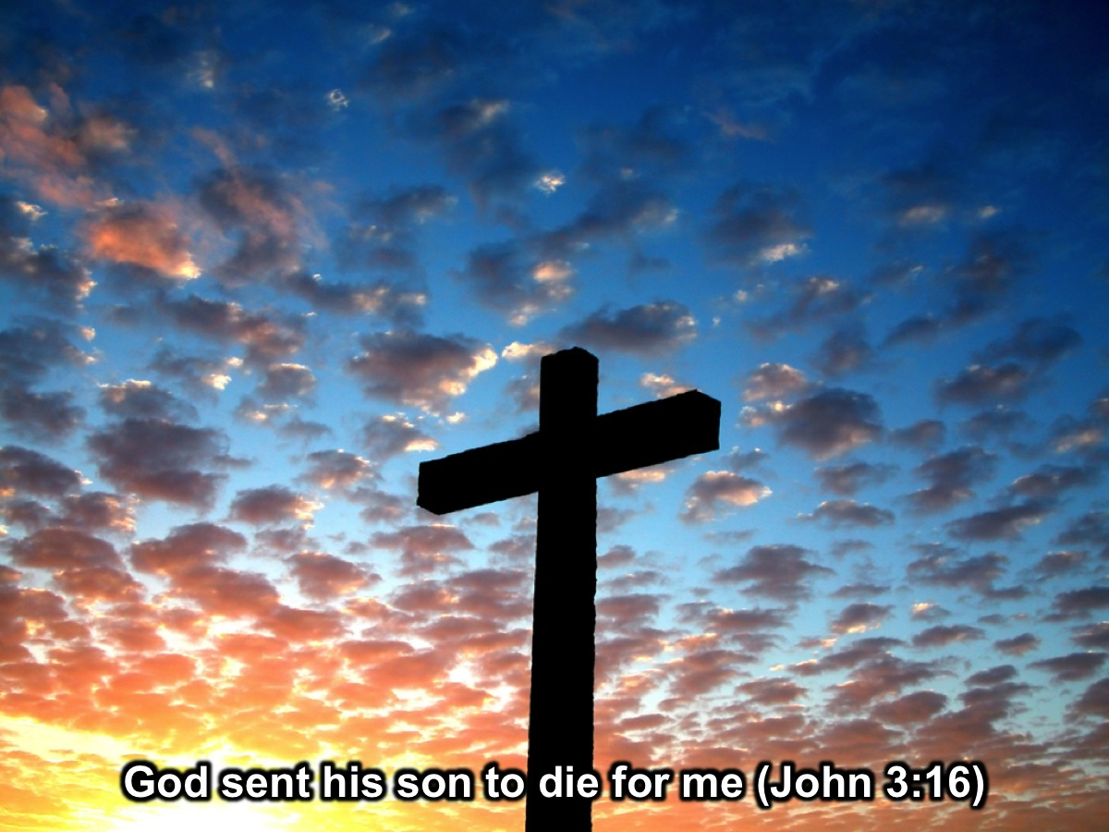
Notes:
3. God sent his son to die for me (John 3:16) - John 3:16, as much as any other passage in the Bible, expresses God's valuation of human beings when it says that "God so loved the world that he sent his only begotten Son..." If we were worth the death of the Son of God, we are too valuable to treat our lives as something to dispose of as we please.

Slide 37
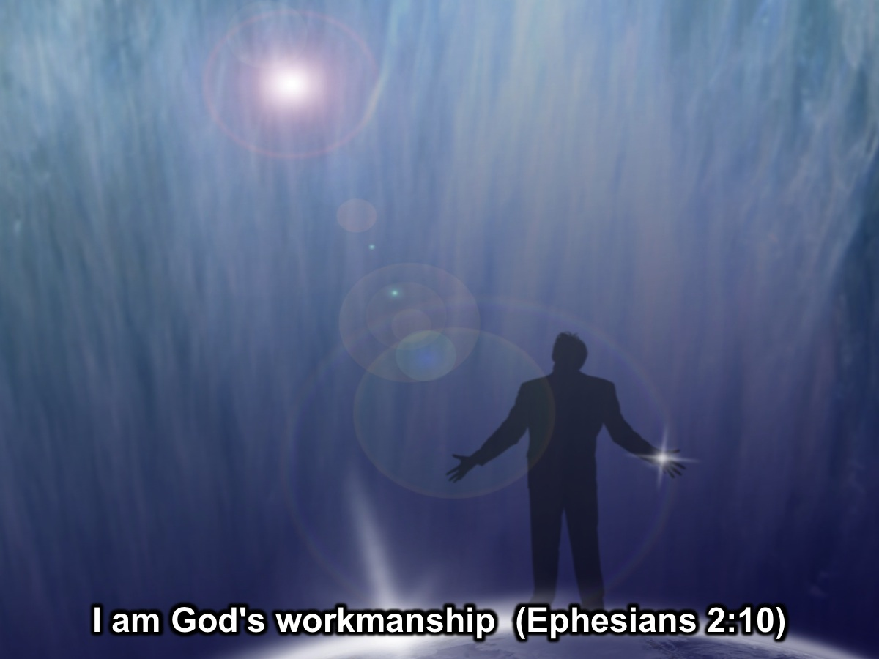
Notes:
4. I am God's workmanship (Ephesians 2:10) - Ephesians 2:10 speaks in particular to believers when it says that we "are God's workmanship, created in Christ Jesus to do good works, which God prepared in advance for us to do." In other words, we are placed in this world to be available to God to do things, which God has in mind for each one of us to do. While God may not be surprised by a person's decision to commit suicide, suicide is certainly not the plan that God had for that person.

Slide 38
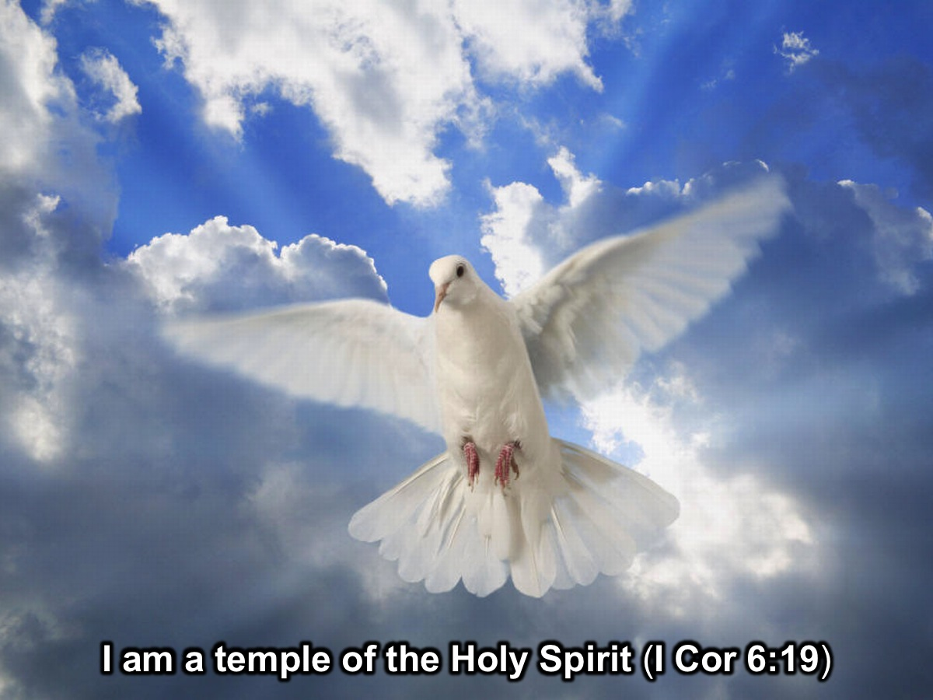
Notes:
5. I am a temple of the Holy Spirit (I Cor 6:19) - I Corinthians 6:19 tells me that my "body is a temple of the Holy Spirit." It goes on to tell me that I "am not my own." In short, as a Christian, I do not own my body and it is not mine to do with, as I want. It is to be used in the service of God to glorify God. Suicide is not an option.

Slide 39

Notes:
6. God works all things out for good (Romans 8:28) - Romans 8:28 recognizes that there are tough times in life, but it says "all things work together for good." If I trust in God and devote myself to serving God, those tough times will produce some good things. That's my faith.

Slide 40
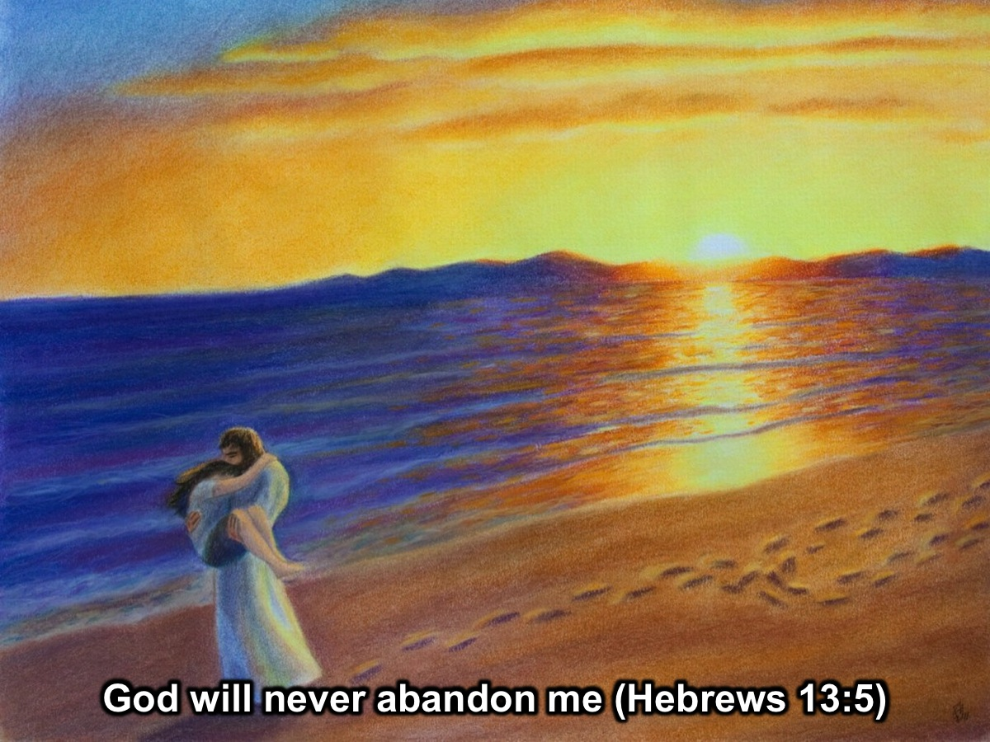
Notes:
7. God will never abandon me (Hebrews 13:5) - No matter how attractive suicide may seem, there are some solid biblical reasons to stay alive and be a witness to the power of God to overcome or work through any situation. God didn't promise any easy life; God promised "never to leave us or forsake us" (Hebrews 13:5).

Slide 41

Notes:
4. Connect Them - To a website designed to help people who are contemplating suicide:

Slide 42
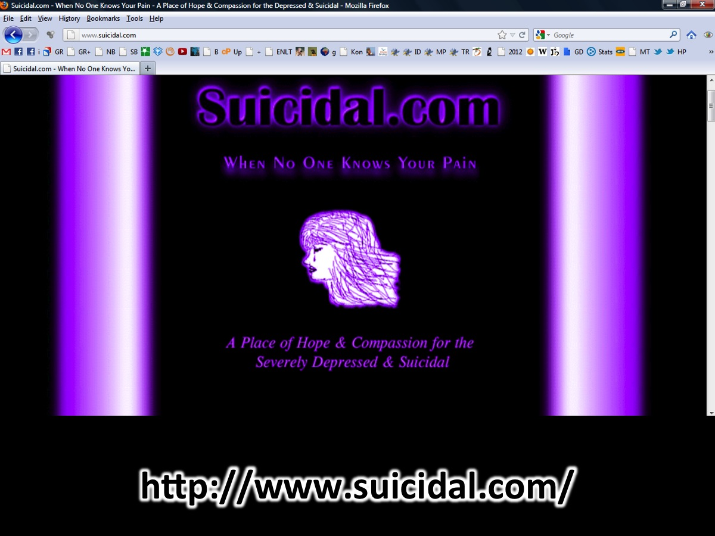
Notes:
http://www.suicidal.com/

Slide 43

Notes:
5. Refer them to a counsellor – the person may well need more help than you are able to give them so be sure to find someone who can help them further.

Slide 44
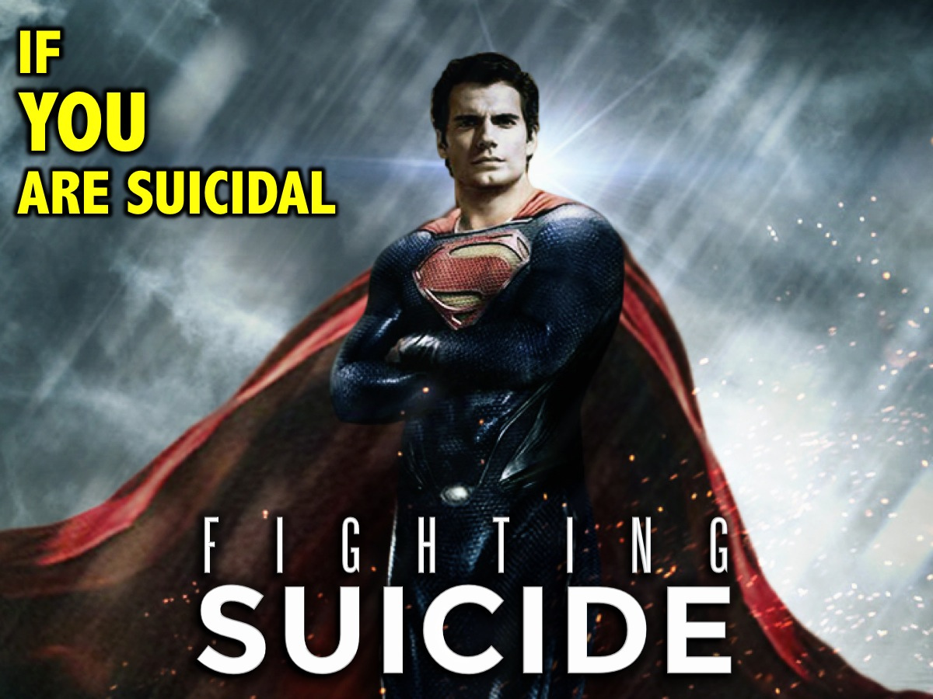
Notes:
If you are suicidal…

Slide 45

Notes:
1. Admit It – be honest with yourself about your thoughts and your feelings.

Slide 46
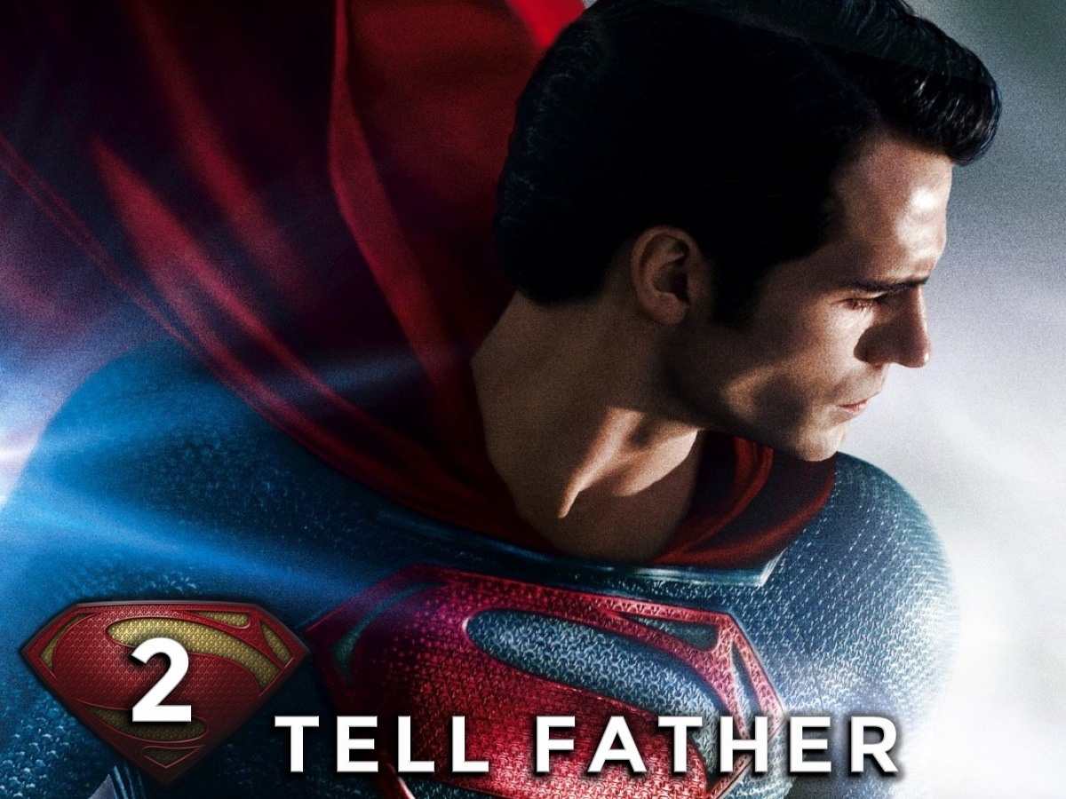
Notes:
2. Tell Father – Father God is there if you just turn to him and let him know what is going on in your mind and heart.

Slide 47

Notes:
3. Tell a Friend – find someone that you trust and open up to them.

Slide 48

Notes:
4. Ask for Help – Go to someone who you think can help you and ask them for help.

Slide 49

Notes:
5. Look Ahead – it really helps to think about the possibilities of the future rather than the mistakes of the past or the pressures of today.

Slide 50

Notes:
Let’s Pray

