Slide 1

Notes:
Tonight we launch our brand new Fitness Friday series for the first term of 2017.

Slide 2

Notes:
Welcome to regulars and newcomers. If this is your first time at youth, please come to the front.

Slide 3

Notes:
Term 1 Preview: We have an exciting line up of events this term - starting with a Cross Fit night next Friday night.

Slide 4
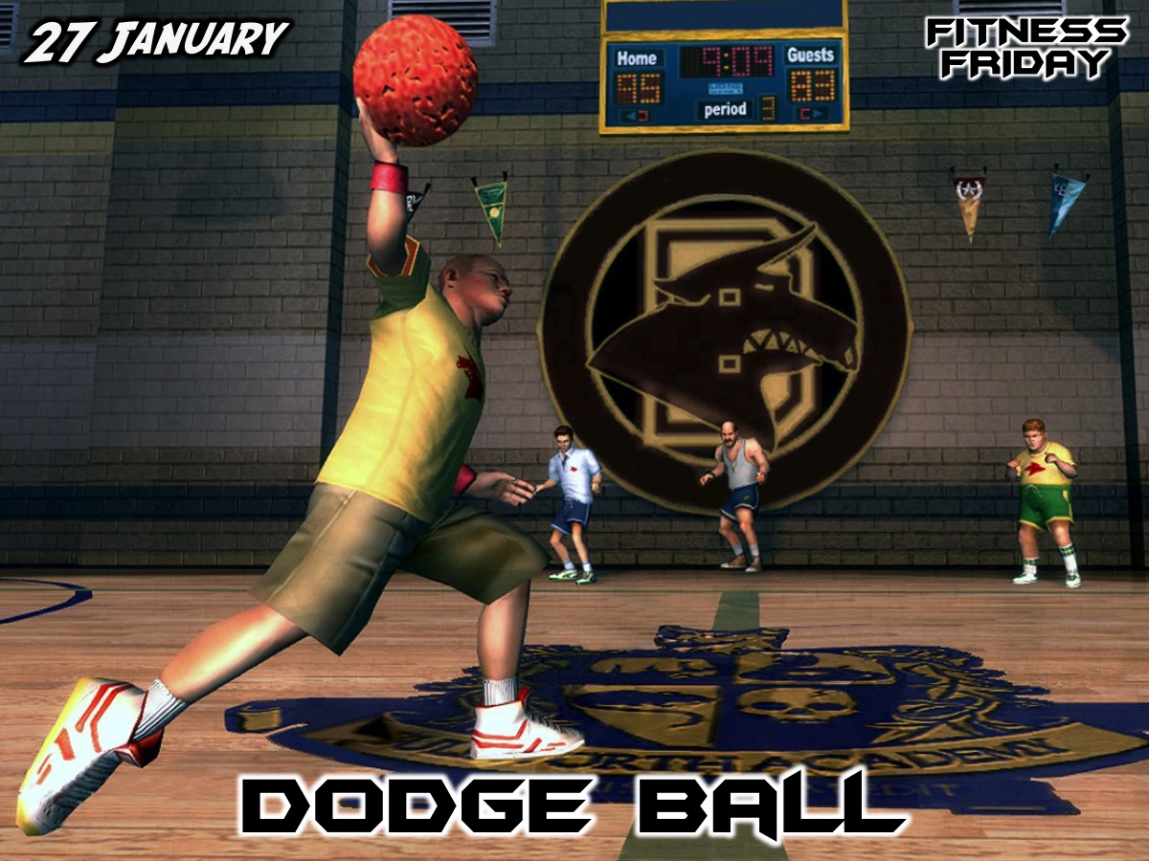

Slide 5
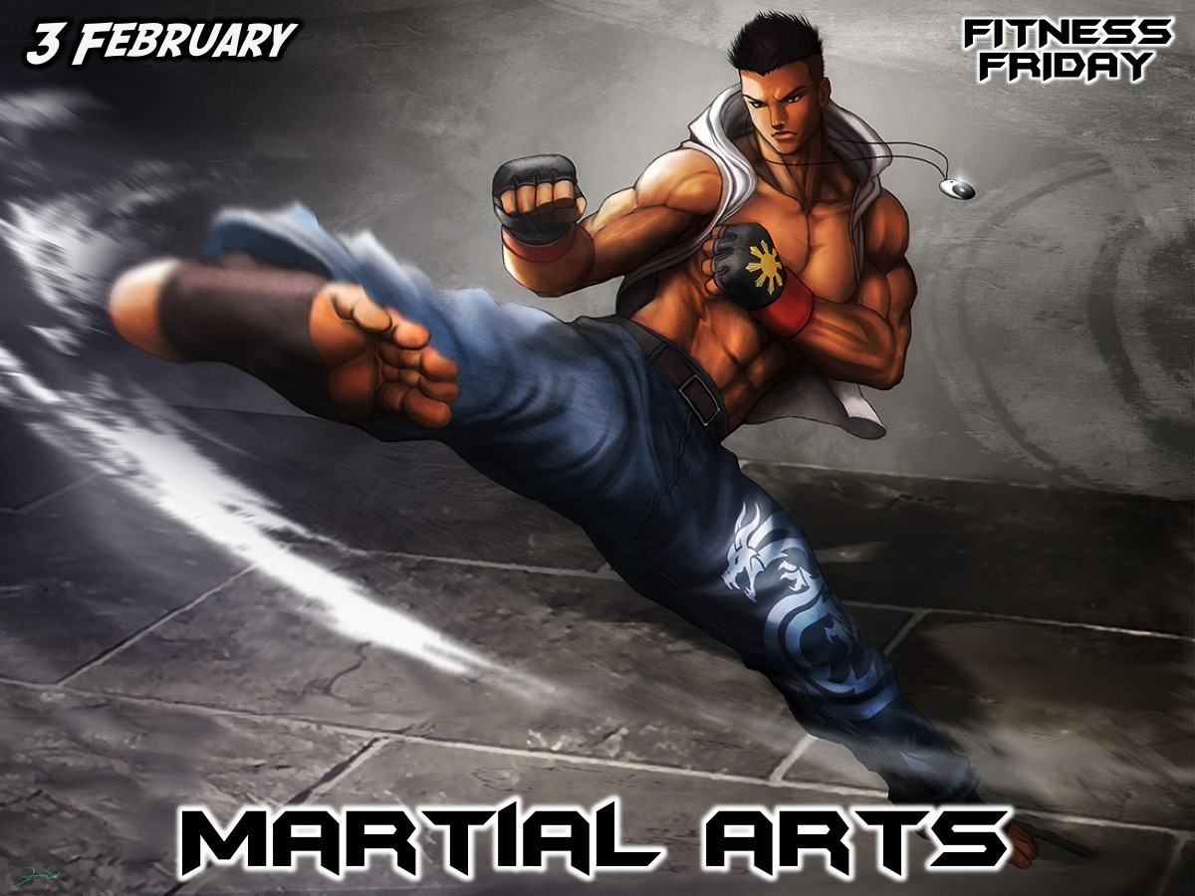

Slide 6
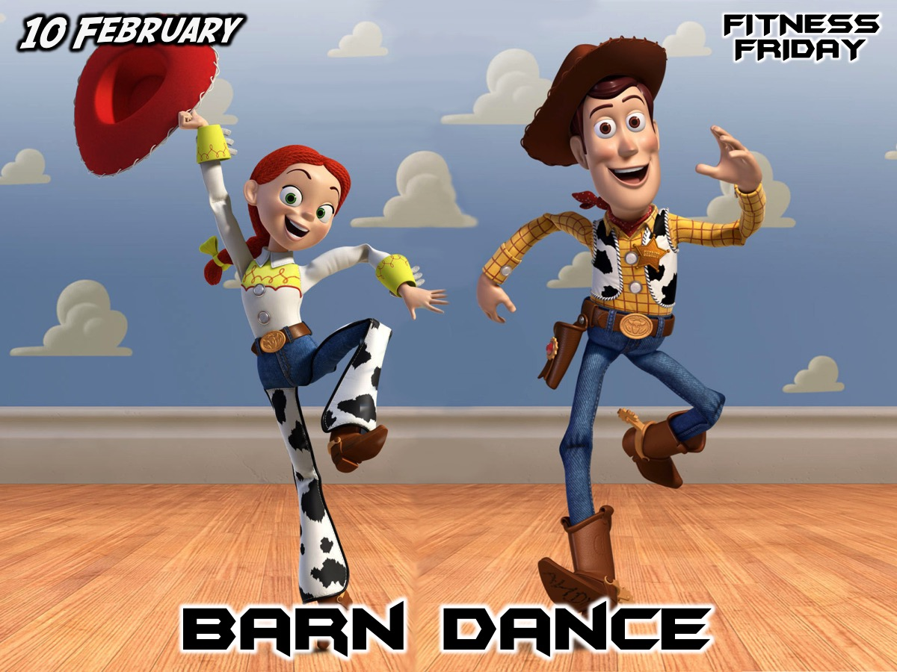

Slide 7
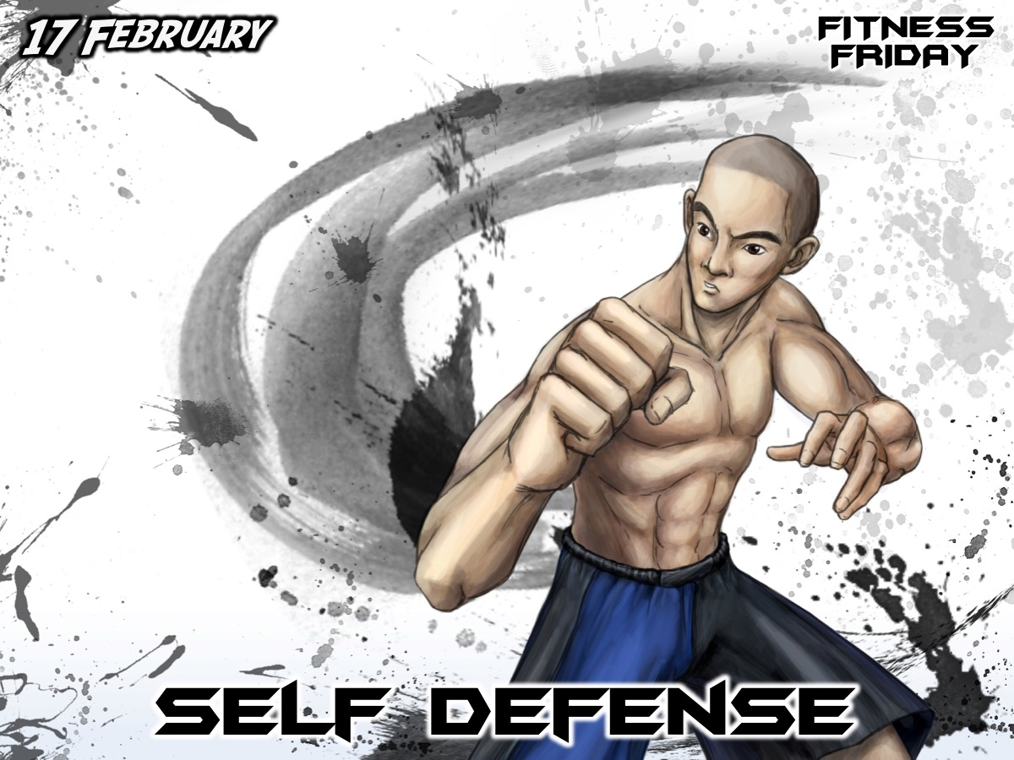

Slide 8


Slide 9


Slide 10


Slide 11


Slide 12


Slide 13
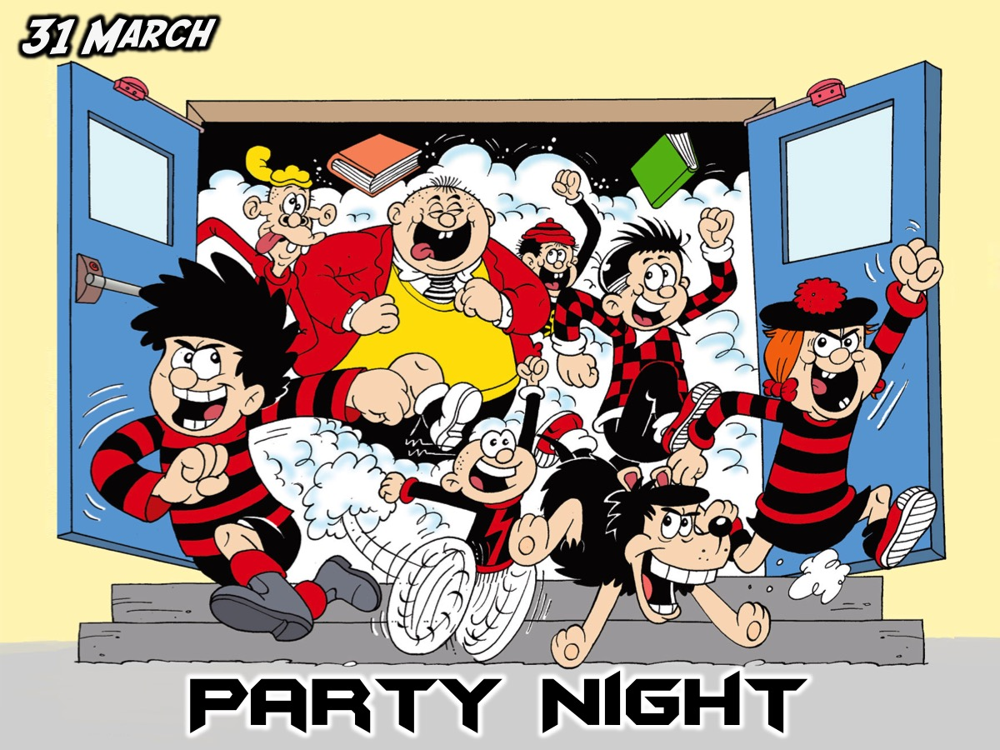

Slide 14

Notes:
On Sundays we are presenting the Workout Series where we will be exploring spiritual disciplines that will help us get fit spiritually!

Slide 15

Notes:
Tonight is Chill Out night - before you get to hang out we have an activity and a surprise!

Slide 16

Notes:
Speed Relating - form two concentric circles - make sure you are standing opposite someone. You will answer a question and then the inner circle will move to their right before you answer the next question and so on...

Slide 17
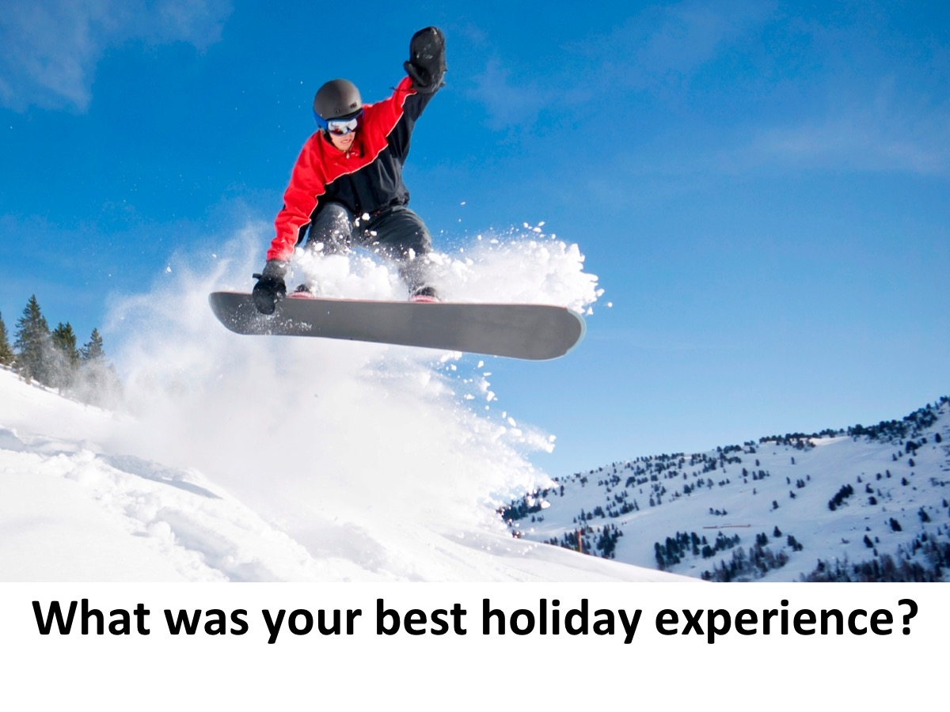

Slide 18
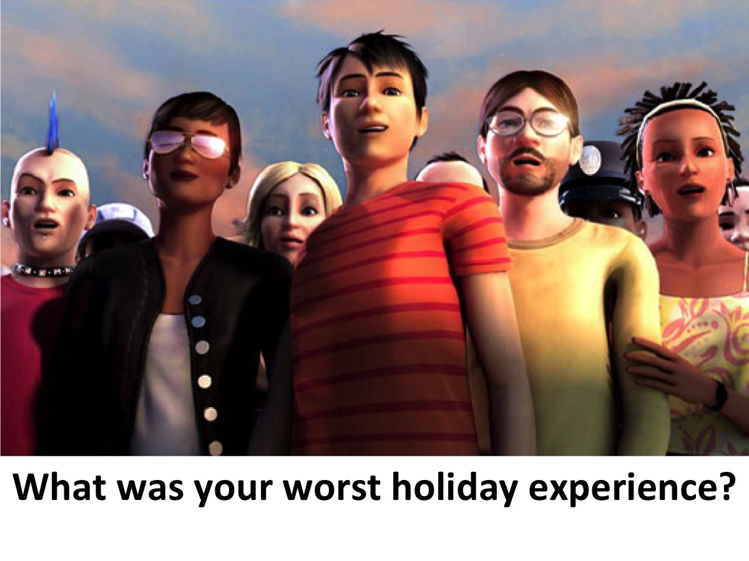

Slide 19


Slide 20


Slide 21
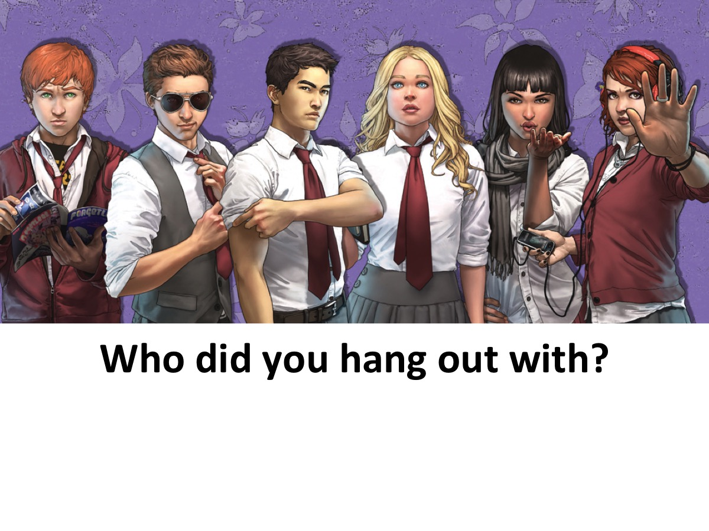

Slide 22


Slide 23
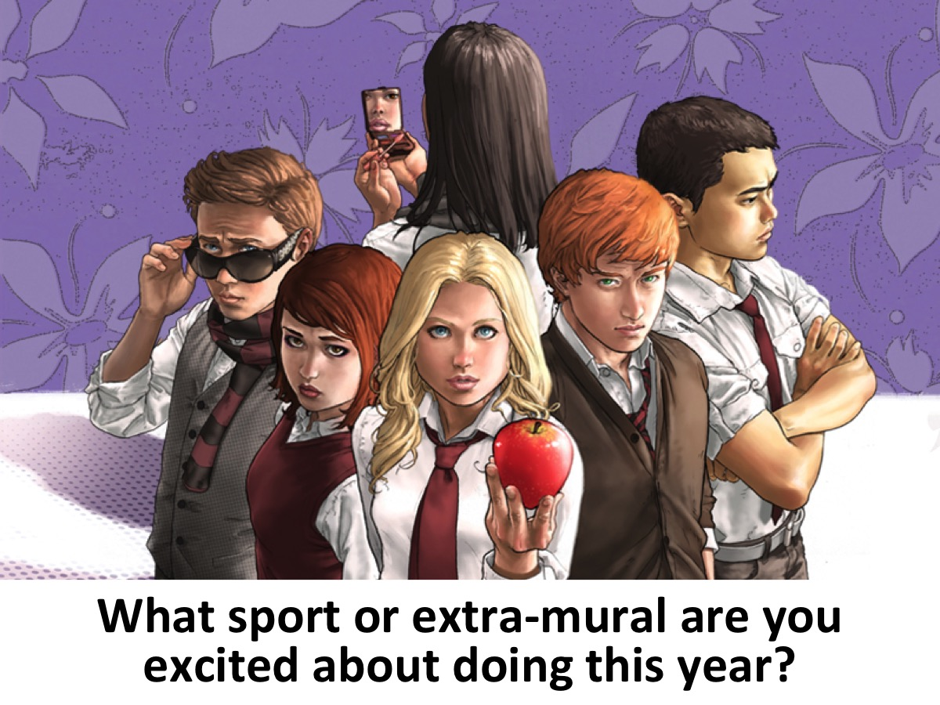

Slide 24
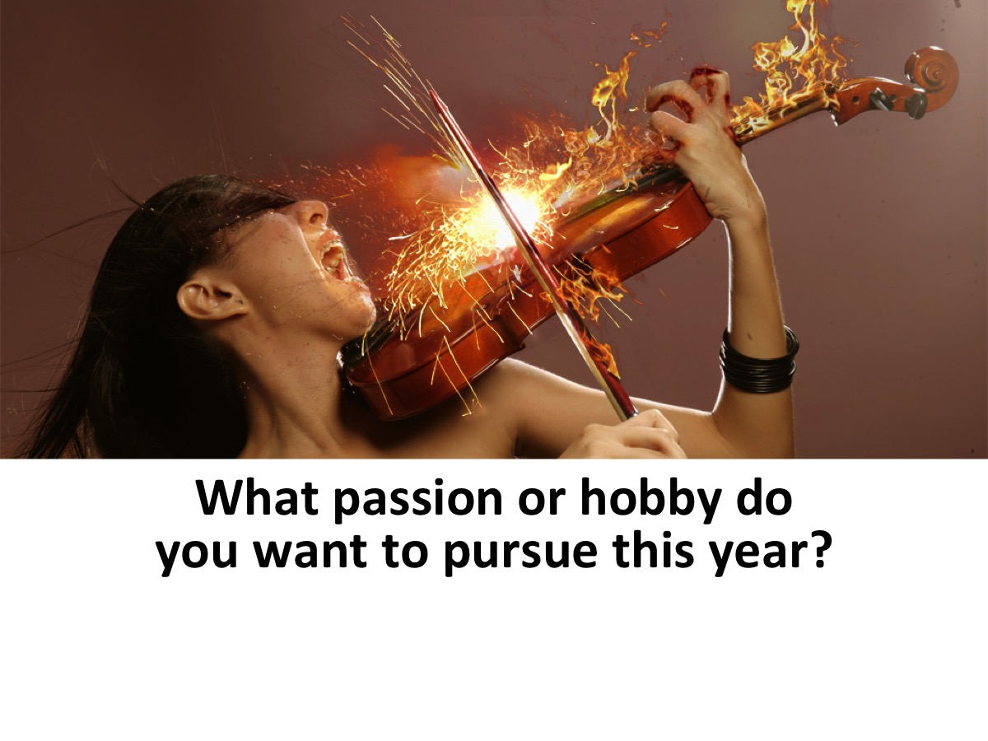

Slide 25
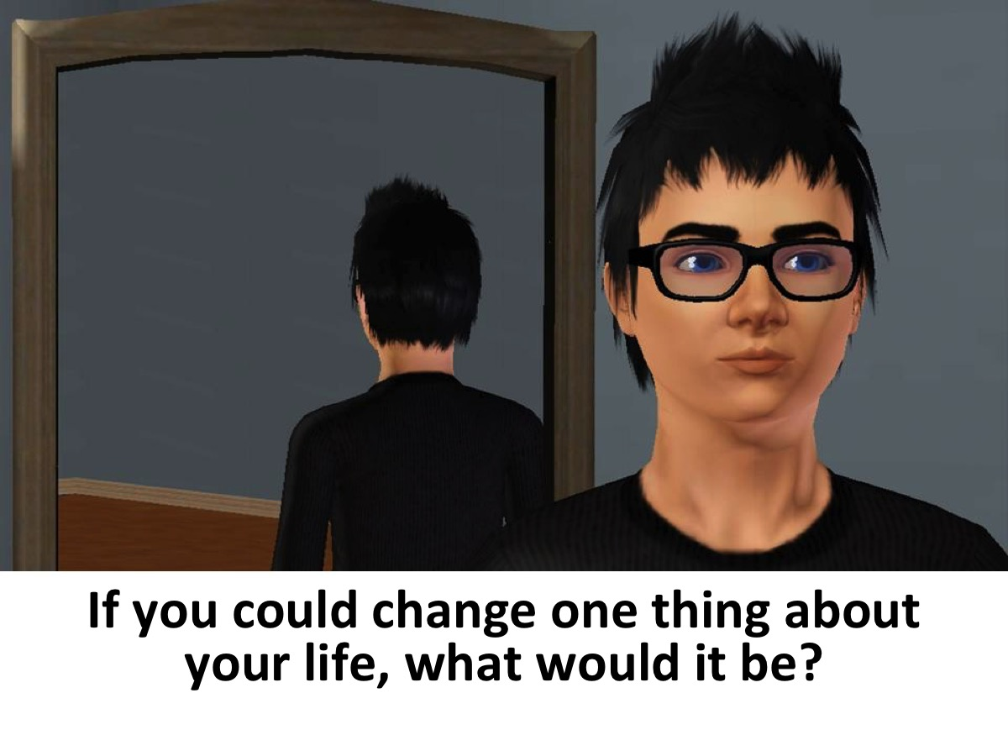

Slide 26


Slide 27
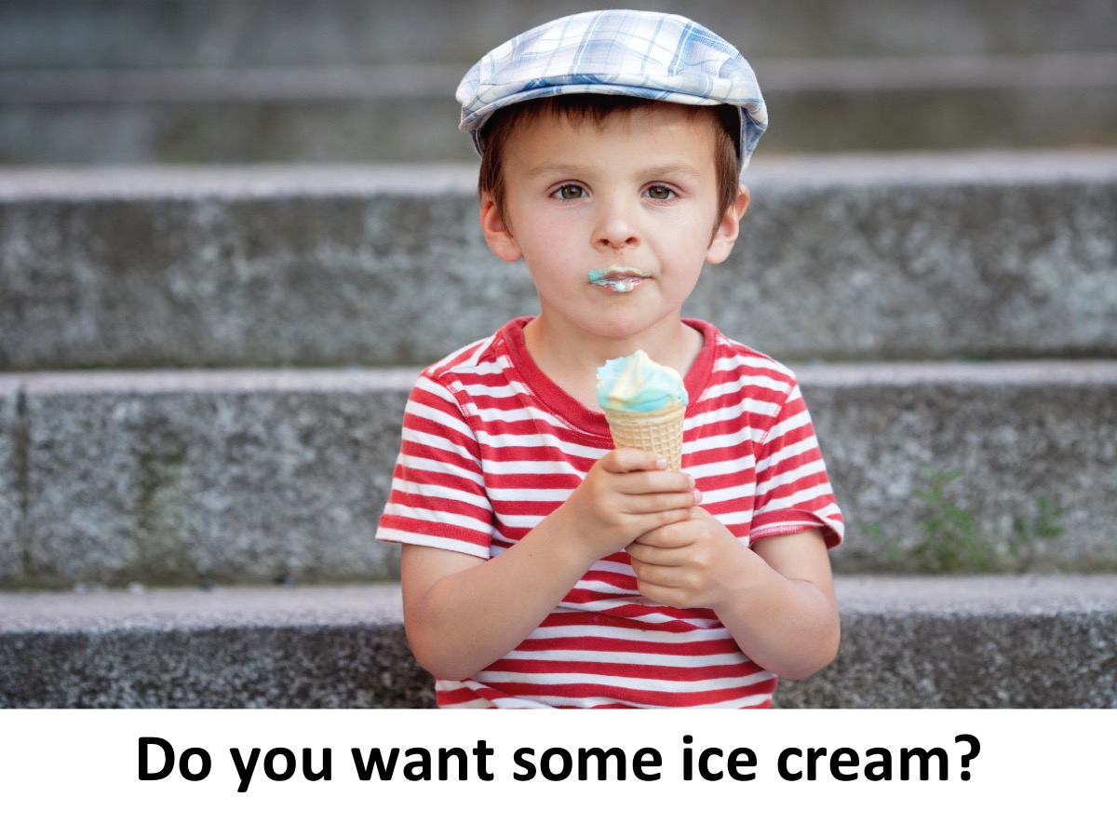

Slide 28

Notes:
Ice Cream and Oreos are served - enjoy the rest of the night as you chill out.

Slide 29
Notes:
Next Friday is our Cross Fit night - come dressed for the gym!

Slide 30

Notes:
Refreshments are served.

