Slide 1

Notes:
Tonight is our Cross-Fit night.

Slide 2

Notes:
Let’s open our meeting in prayer.

Slide 3

Notes:
Welcome to newcomers and regulars.

Slide 4
Notes:
Tonight is CrossFit Night.

Slide 5
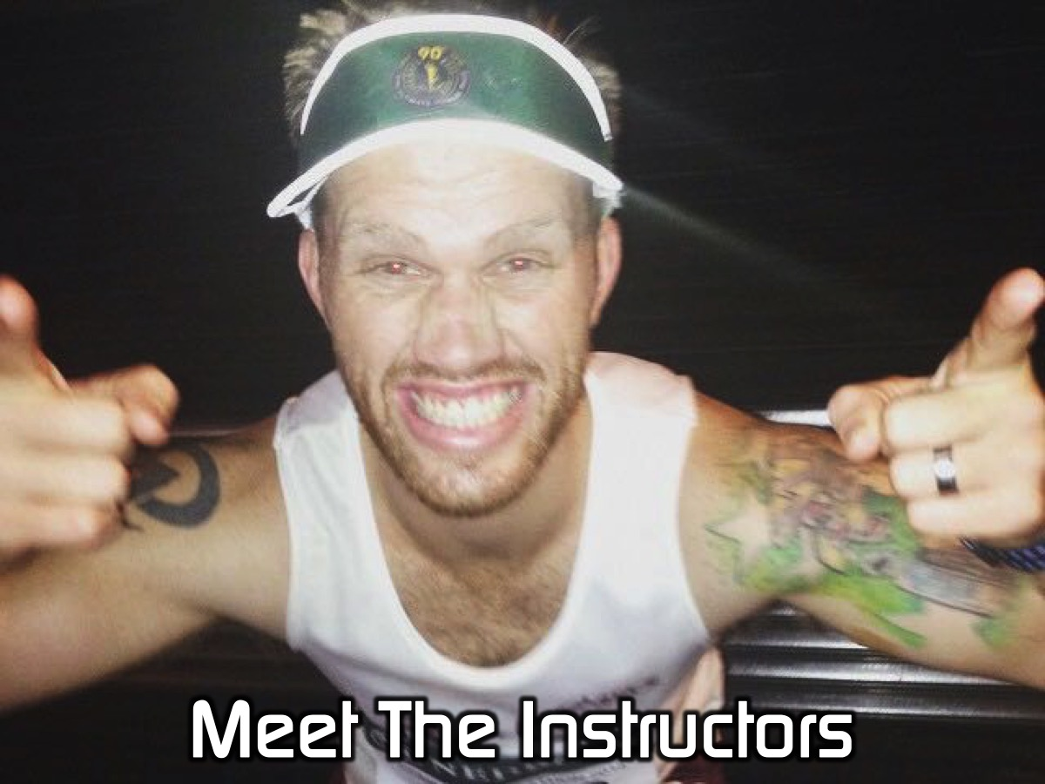
Notes:
Put your hands together for our CrossFit instructors!
Hi guys and girls, it is awesome to be with you this evening. Thank you for having us and thank you to Mark and Debs for inviting us to join you. So my name is Simon…

Slide 6
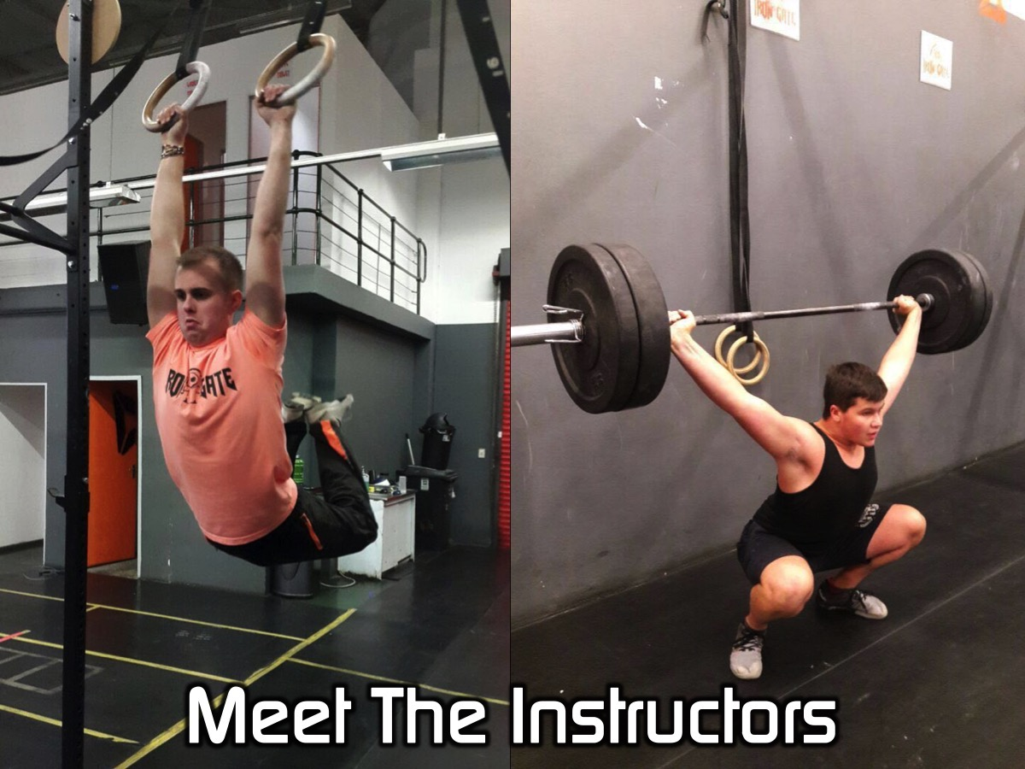
Notes:
…and these are two of my friends, Josh and Isaac. We mess around with a little sport you might of heard of before called CrossFit.

Slide 7

Notes:
So tonight we are going to be having some fun. We have three WODs planned so I hope you've brought your A game. A WOD stands for Workout Of the Day. With each WOD we will put you into teams, we will then demonstrate to you the movements and the rules.

Slide 8
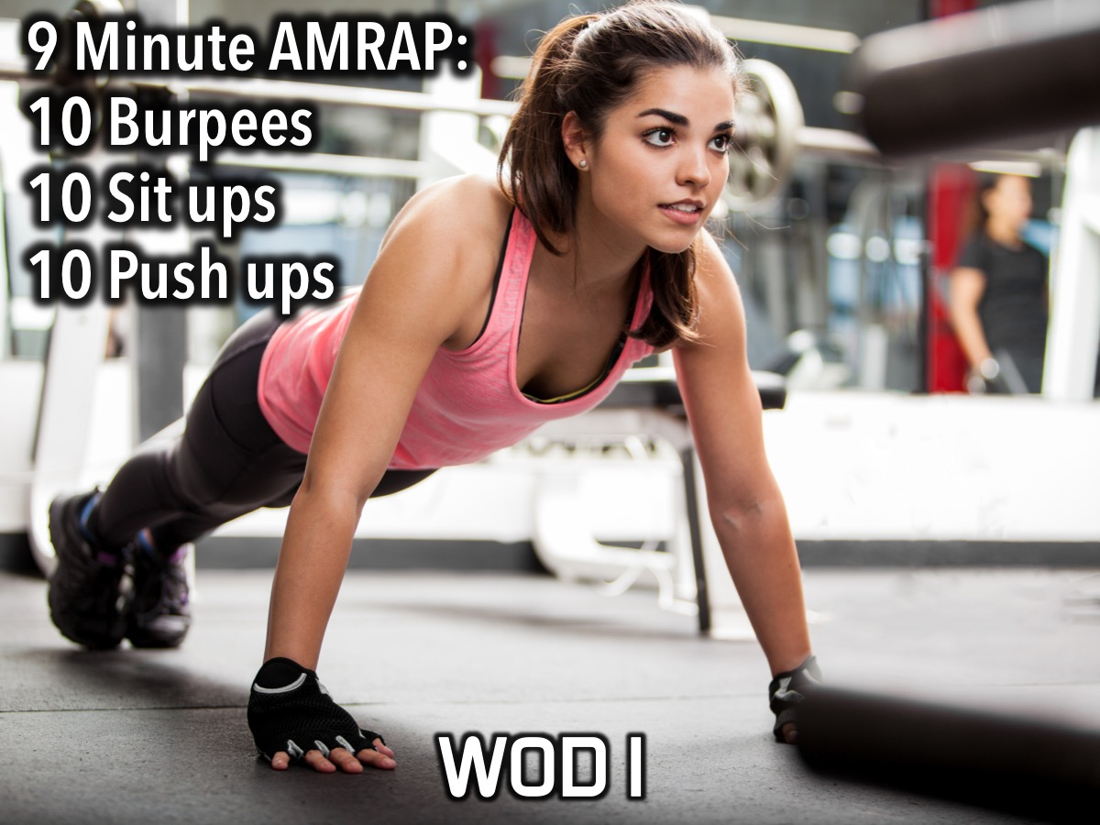
Notes:
WOD1: 9 Minute AMRAP. Complete 10 burpees, 10 sit ups, 10 push ups.
Burpees: Start from a standing position. Bend over and place both hands firmly on the ground in front of the feet. Kick (or step) both feet back into a push-up position and lower the entire body to the ground. This is not a push-up. The chest and thighs need to make full contact with the ground. Then extend the arms, lifting the chest and jump (or step) both feet in towards the chest. Stand, jump (opening the hips fully) and clap hands behind the head while in the air. Instruction Video: https://www.youtube.com/watch?v=TX60BcsO_wE

Slide 9

Notes:
WOD2: Complete 3 rounds for time: 15 slam balls; 15 goblet squats with the slam ball
Slam Ball Instructions:
Setup in a wide stance
Pick ball up and bring it to a full overhead position
From here you will slam the ball down pulling your hips back and finishing in a full squat
Be sure to catch the ball on it’s first hop.
From this position you bring the ball back over head driving it back down, pulling your hips to a full squat catching the ball on it’s first hop.
Instruction Video: https://www.youtube.com/watch?v=7gLEmS4nwi0

Slide 10
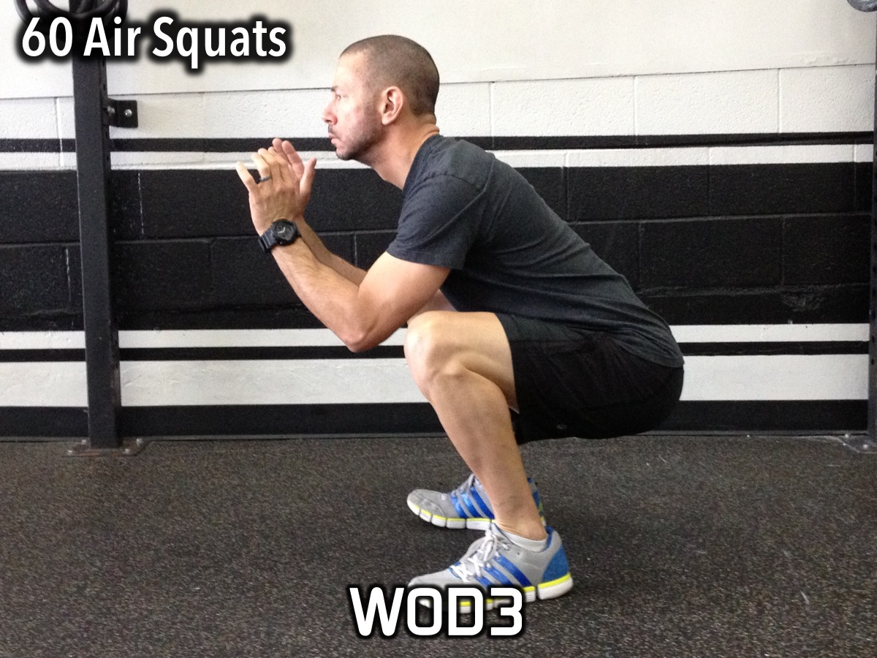
Notes:
WOD3: Complete 60 air squats.
Air Squats: Feet shoulder width apart (heels directly under shoulders) with toes slightly turned out. Weight should be distributed between the heel and mid-foot (heels). Maintaining a neutral spine (flat back), push the hips back then down. While pushing the hips back and down, make sure the knees stay inline with the toes (tracking). At no point should the knees roll inside of the ankle (collapse). Continue to descend until the crease of the hip is below the knee cap (full depth). After achieving full depth, stand to full extension in the hips and knees by driving through the heels.
Instruction Video: https://www.youtube.com/watch?v=JKtOS-xIbhg

Slide 11

Notes:
Small Groups: Here are the questions for our small group time: (1) How did you feel during the three sessions? (2) What would you need to do to excel at Cross-fit? (3) What would you need to give up to excel at Cross-fit? (4) What do you need to do to get spiritually fit? (5) What do you need to give up to get spiritually fit? Since we are surrounded by so many examples of faith, we must get rid of everything that slows us down, especially sin that distracts us. We must run the race that lies ahead of us and never give up. We must focus on Jesus, the source and goal of our faith. (Hebrews 12:1-2) (6) Pray for each other to become spiritually fit.

Slide 12

Notes:
On Sundays we are presenting the Workout Series where we will be exploring spiritual disciplines that will help us get fit spiritually!

Slide 13

Notes:
Next Friday night is our Dodgeball Night.

Slide 14

Notes:
It is time for Refreshments.

