Slide 1
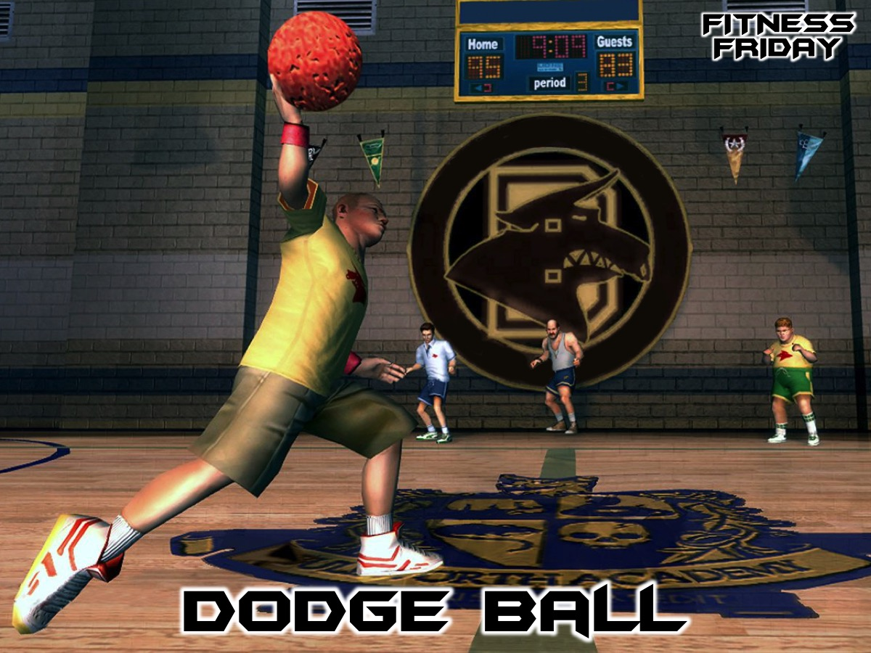
Notes:
Tonight is our Dodge Ball night.

Slide 2
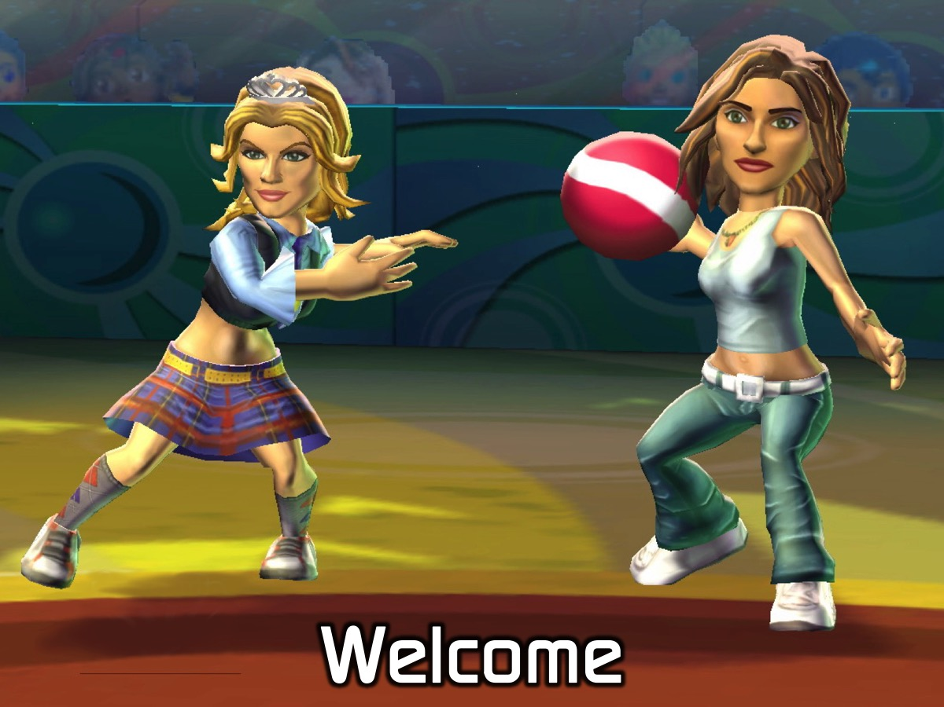
Notes:
Welcome to newcomers and regulars.

Slide 3
Notes:
Tonight is Dodge Ball Night.

Slide 4

Notes:
Video: Dubstep Dodgeball. Get it on YouTube at: https://www.youtube.com/watch?v=Z1l6czQ4Hs4

Slide 5

Notes:
The Rules of Dodgeball - check out this video…

Slide 6

Notes:
Video: Dodgeball Rules. An edited version of an IDA clip on YouTube: https://www.youtube.com/watch?v=bJ1vEQKX-hE

Slide 7
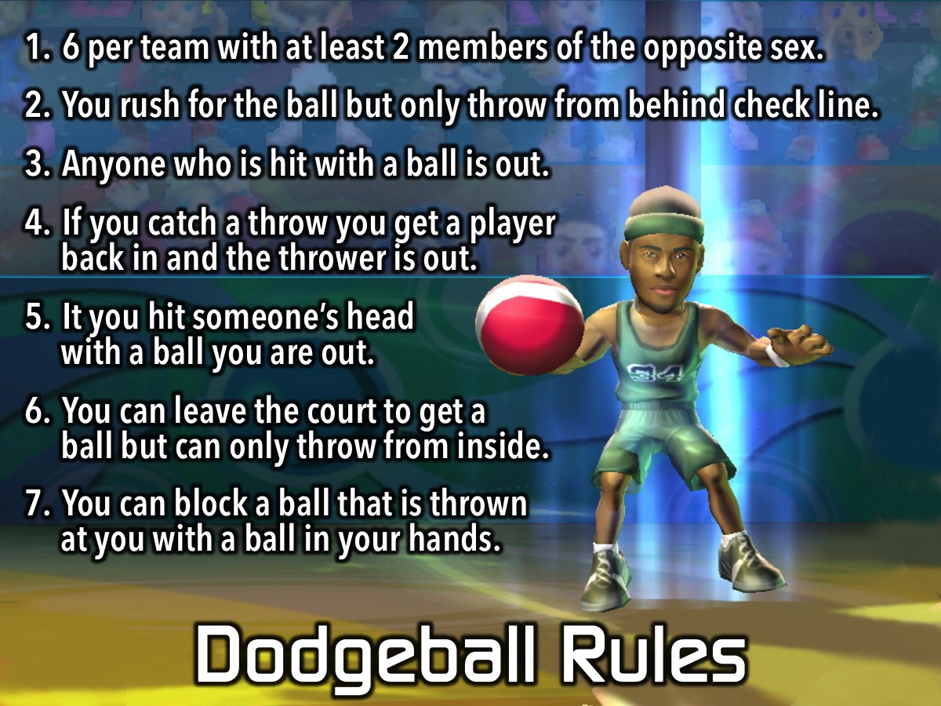
Notes:
Here are the rules of Dodgeball:
1. 6 per team with at least 2 members of the opposite sex.
2. You rush for the ball but only throw from behind check line.
3. Anyone who is hit with a ball is out.
4. If you catch a throw you get a player back in and the thrower is out.
5. It you hit someone’s head with a ball you are out.
6. You can leave the court to get a ball but can only throw from inside.
7. You can block a ball that is thrown at you with a ball in your hands.
In case you were not paying attention to this important rules, here is a video version!

Slide 8
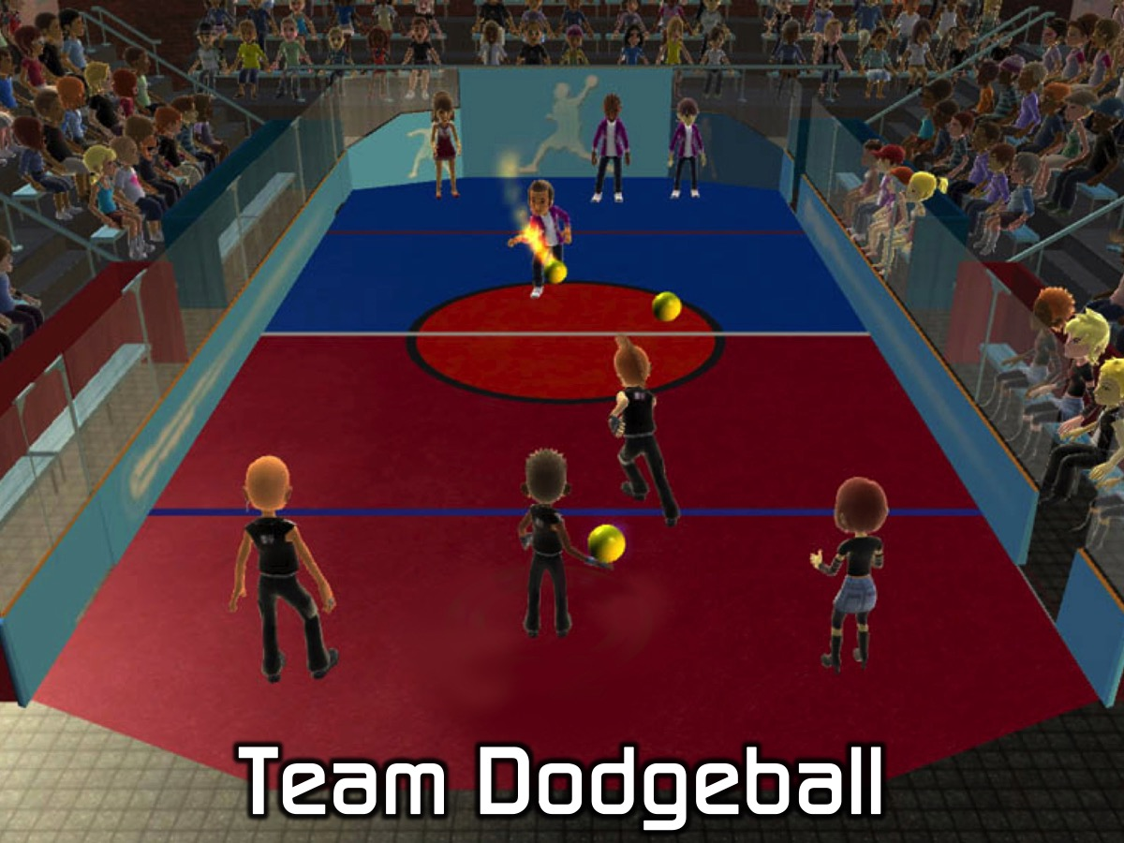
Notes:
Team Dodgeball. We will divide into 6 teams and start with a round of friendly games where two team play each other and then the other two teams play each other. Then we will have a knockout competition and there will be a draw to see which two teams play each other and then the next two teams play each other followed by a final game to reward the ultimate winners.

Slide 9
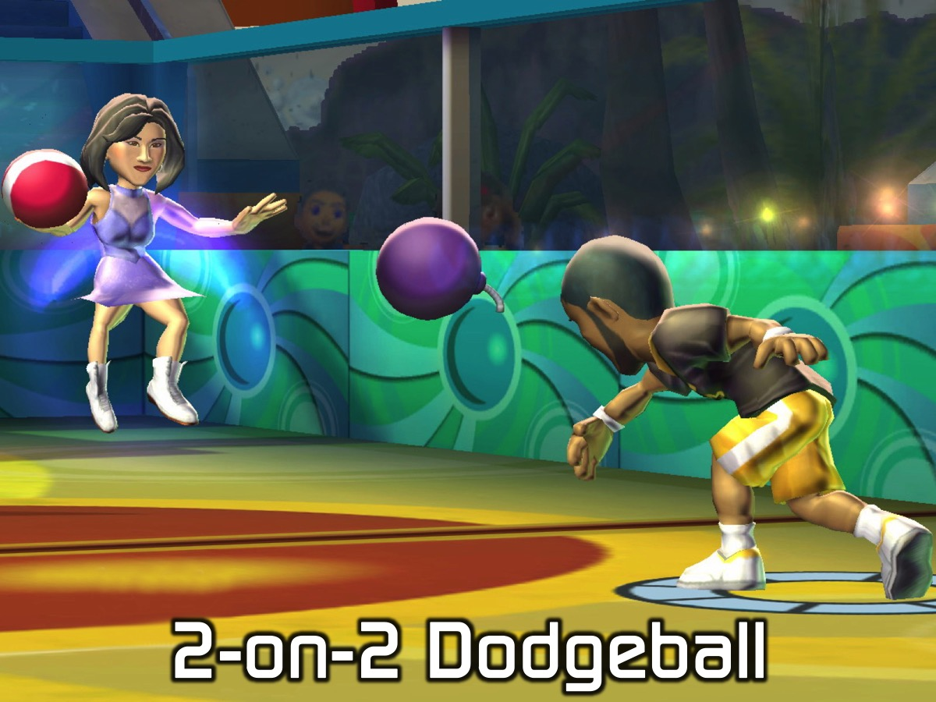
Notes:
2-on-2 Dodgeball. Each team will choose two players to compete in 2-on-2 Dodgeball - using the same knockout format as with the Team Dodgeball.

Slide 10

Notes:
Leaders Dodgeball. The leaders (Adult/Teens) are going to challenge the rest of the group to a game of dodgeball. Choose your best six players (remember there has to be 2 of the opposite sex in each team – and may the best team win!

Slide 11
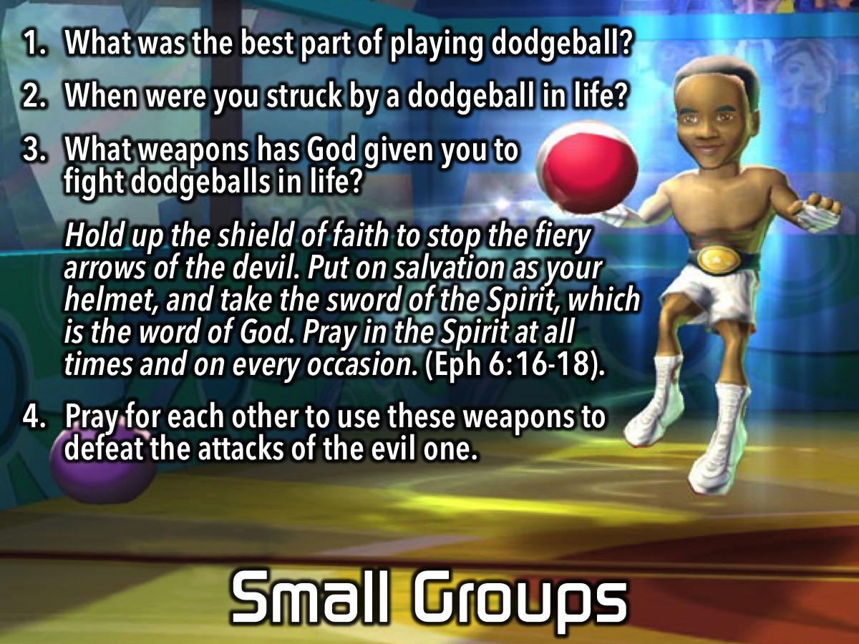
Notes:
Small Group Questions: (1) What was the best part of playing dodgeball? (2) When were you struck by a dodgeball in life? (Leaders Note: Life can be like a game of dodgeball where blows come from friends, family members, bad luck, the Devil, etc. Try and get your group members to talk about actual things that have harmed them in life). (3) What weapons has God given you to fight dodgeballs in life? “Hold up the shield of faith to stop the fiery arrows of the devil. Put on salvation as your helmet, and take the sword of the Spirit, which is the word of God. Pray in the Spirit at all times and on every occasion.” (Ephesians 6:16-18). (4) Pray for each other to use these weapons to defeat the attacks of the evil one.

Slide 12

Notes:
On Sundays we are presenting the Workout Series where we will be exploring spiritual disciplines that will help us get fit spiritually!

Slide 13

Notes:
Next Friday night is our Martial Arts Night.

Slide 14
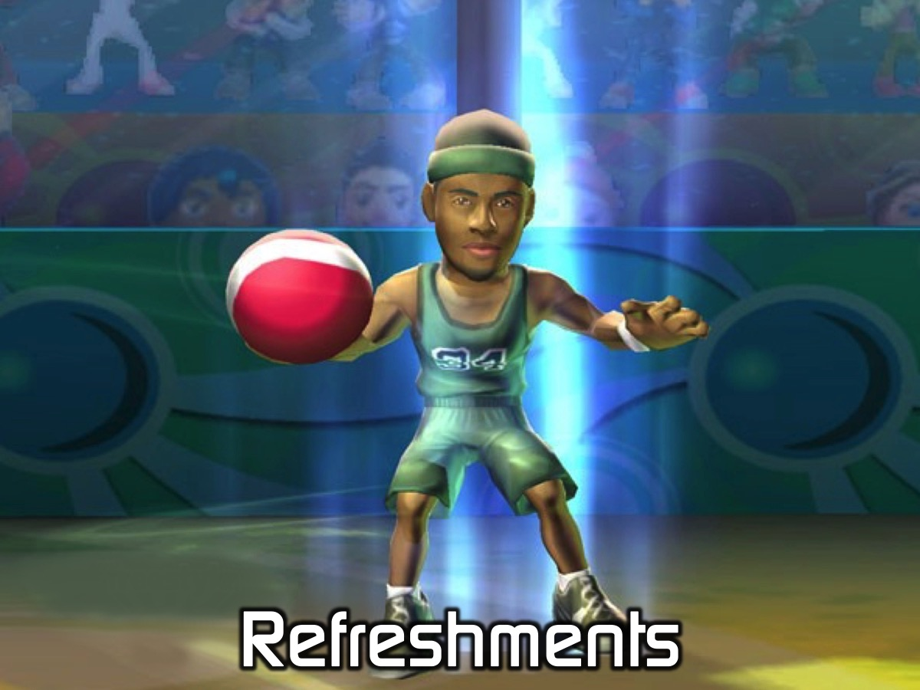
Notes:
It is time for Refreshments.

