Slide 1
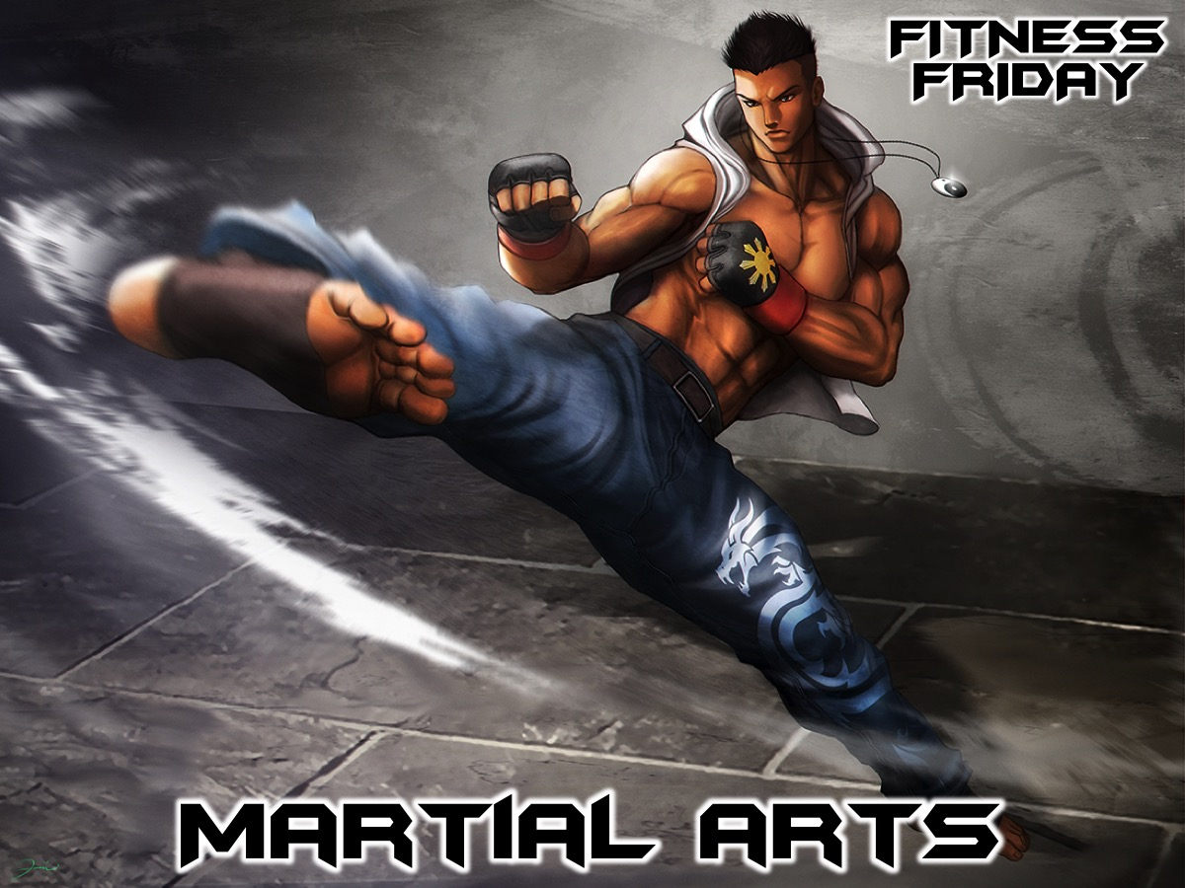
Notes:
Tonight is our Martial Arts night.

Slide 2
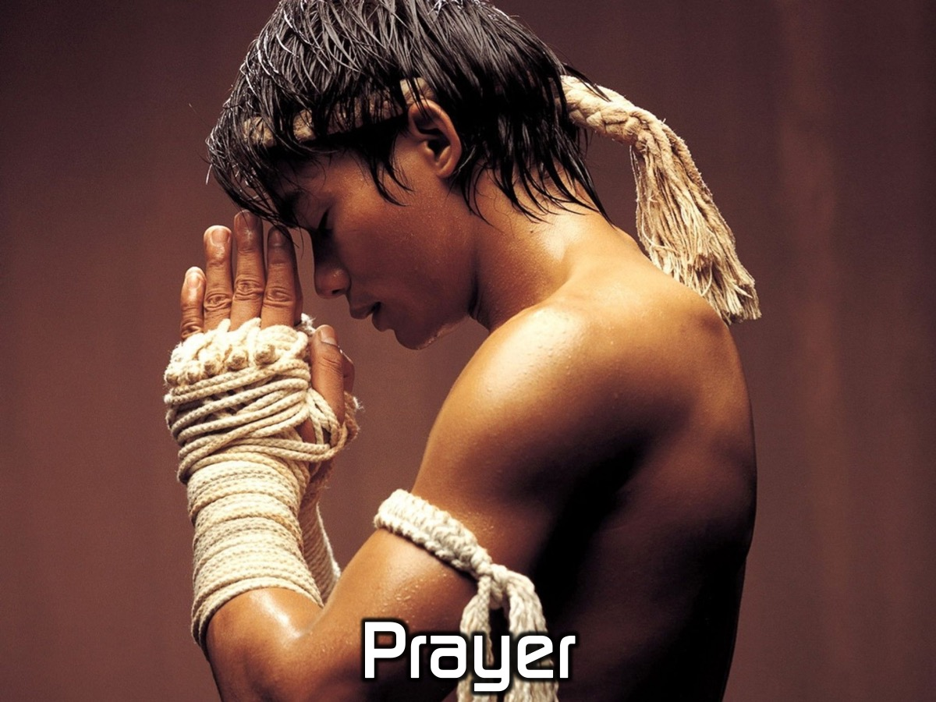
Notes:
Let’s open our meeting in prayer.

Slide 3
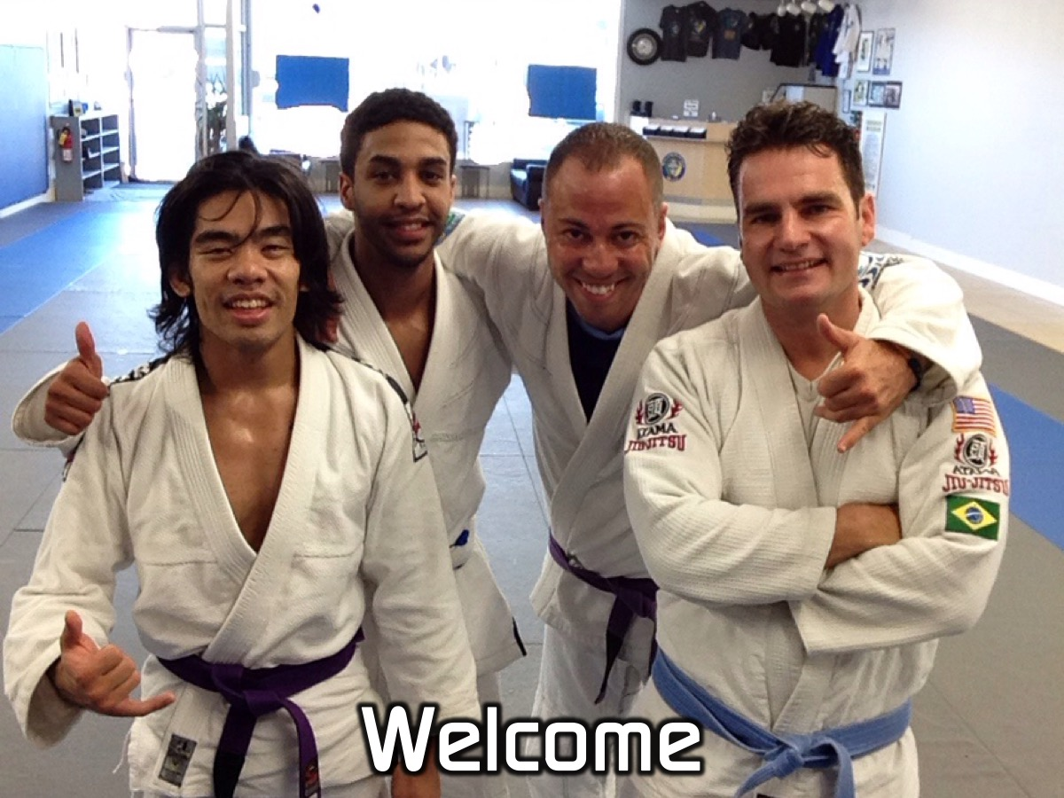
Notes:
Welcome to newcomers and regulars.

Slide 4
Notes:
Tonight is Martial Arts Night.

Slide 5
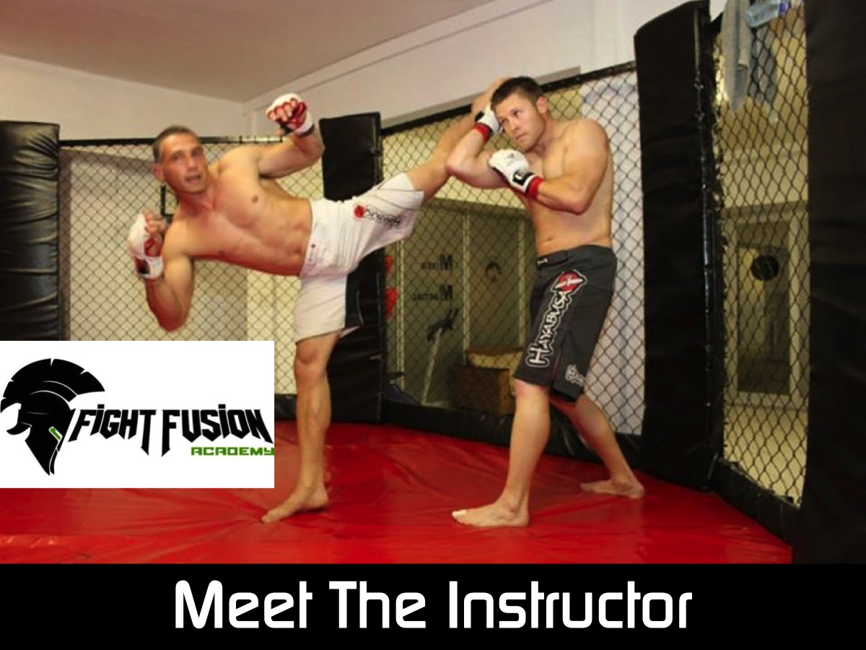
Notes:
Put your hands together for our Martial Arts instructor! Marlon Baptist from Fight Fusion Academy and a member at our church.

Slide 6
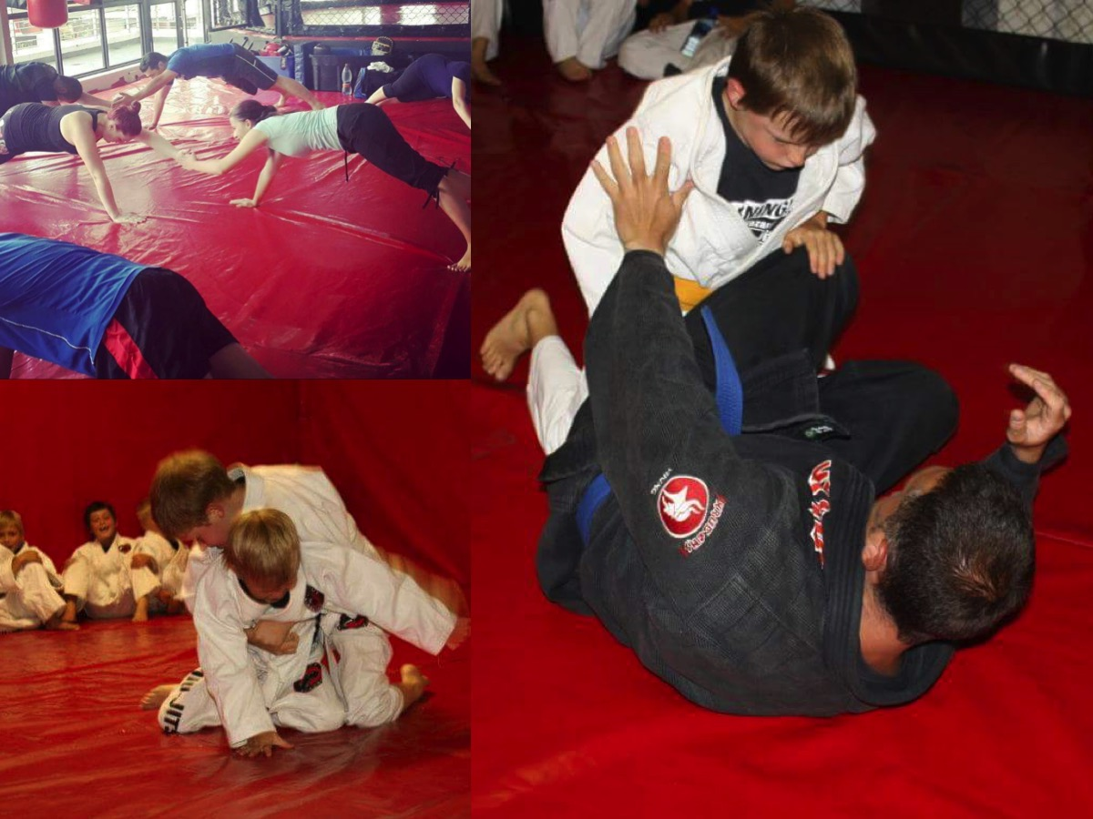

Slide 7
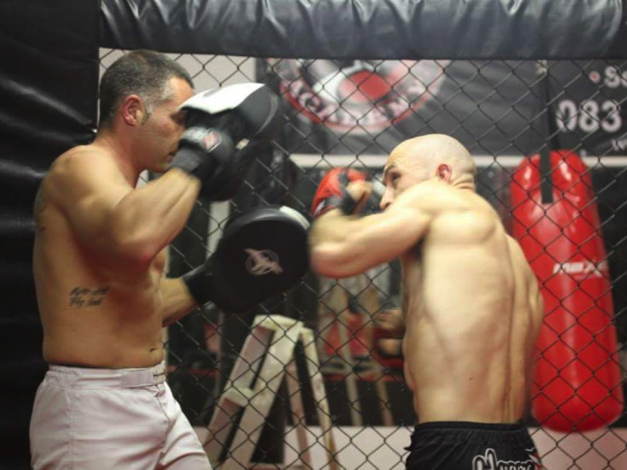

Slide 8
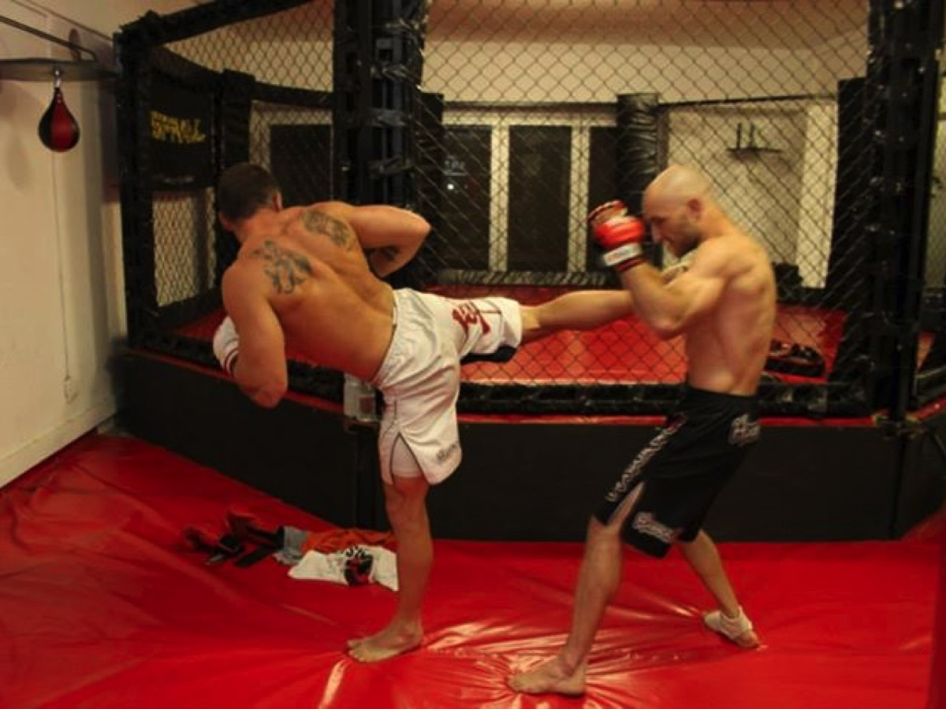

Slide 9
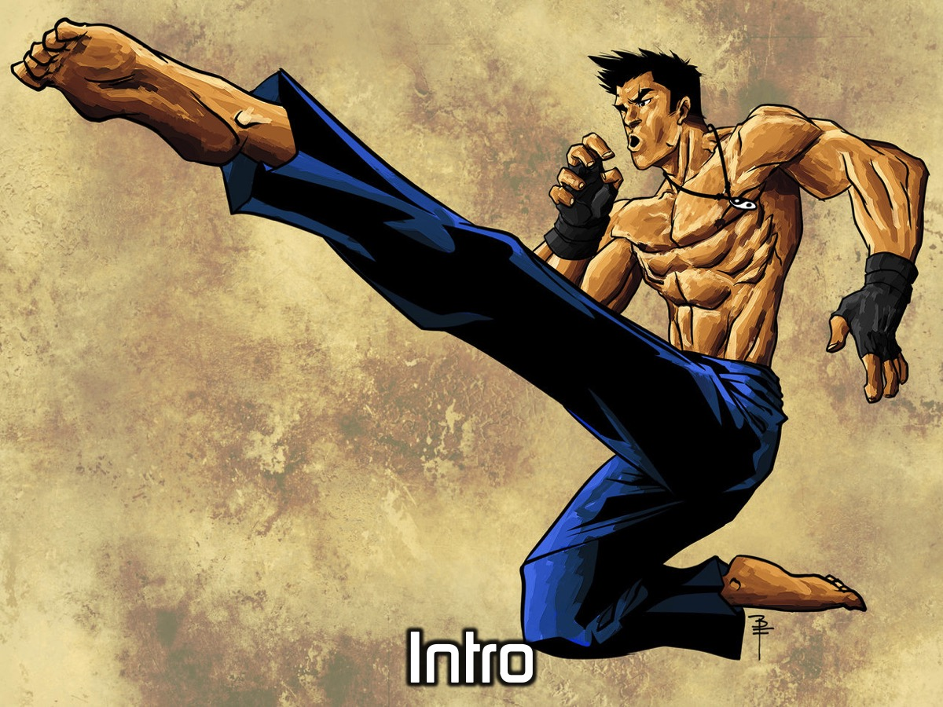
Notes:
Intro to MMA and BJJ

Slide 10
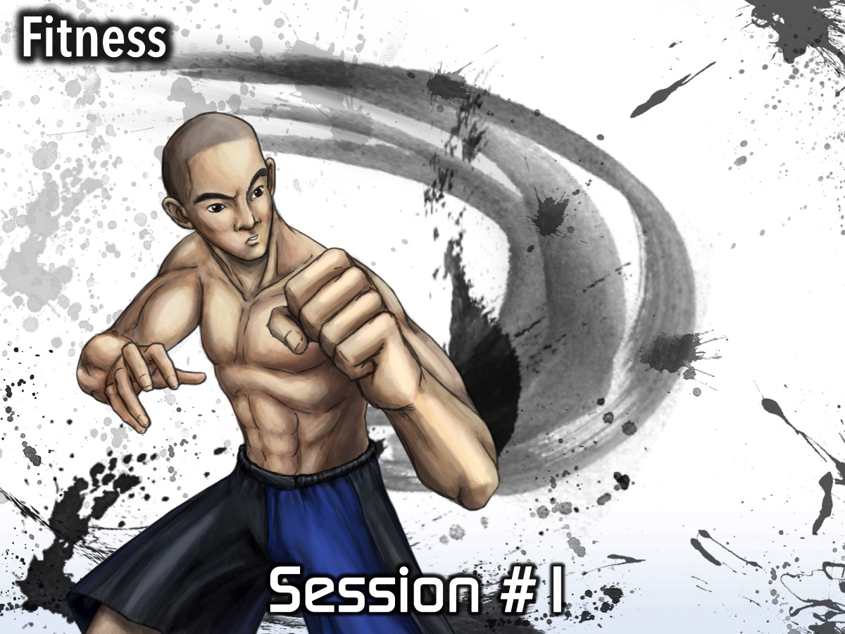
Notes:
Session #1 - do some fitness exercises.

Slide 11
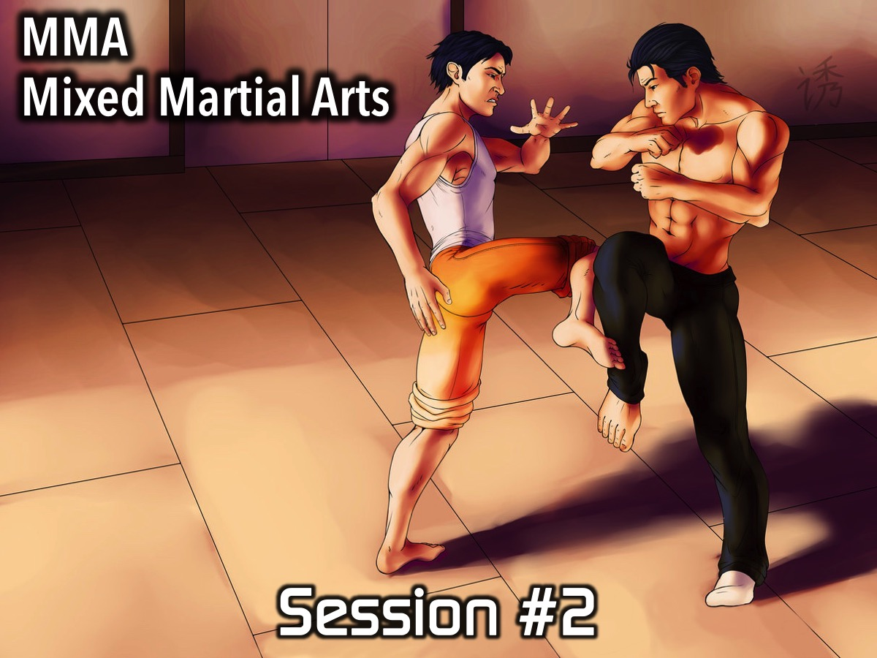
Notes:
Session #2 - teach some Mixed Martial Arts techniques.

Slide 12
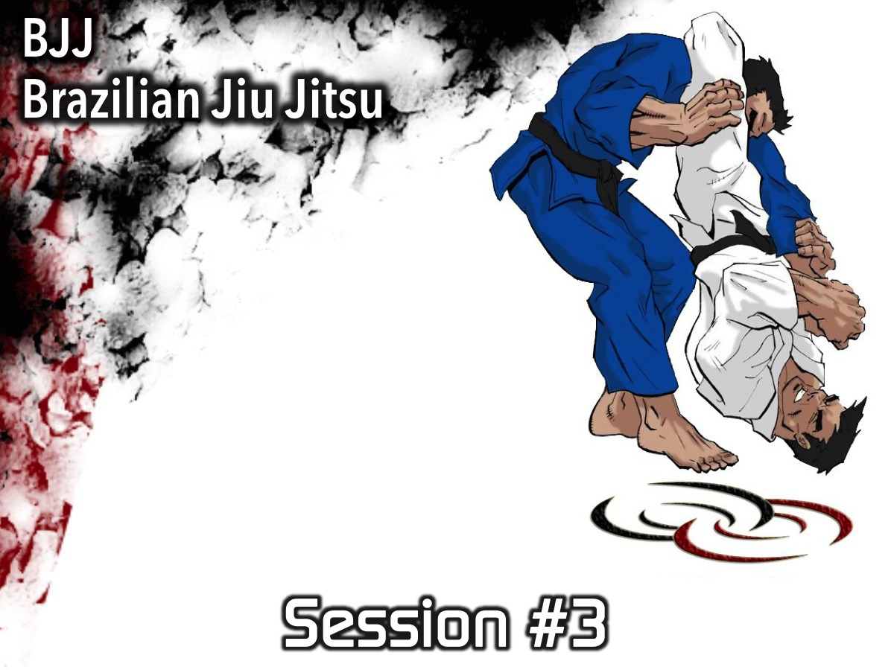
Notes:
Session #3 - teach some Brazilian Jiu Jitsu techniques.

Slide 13
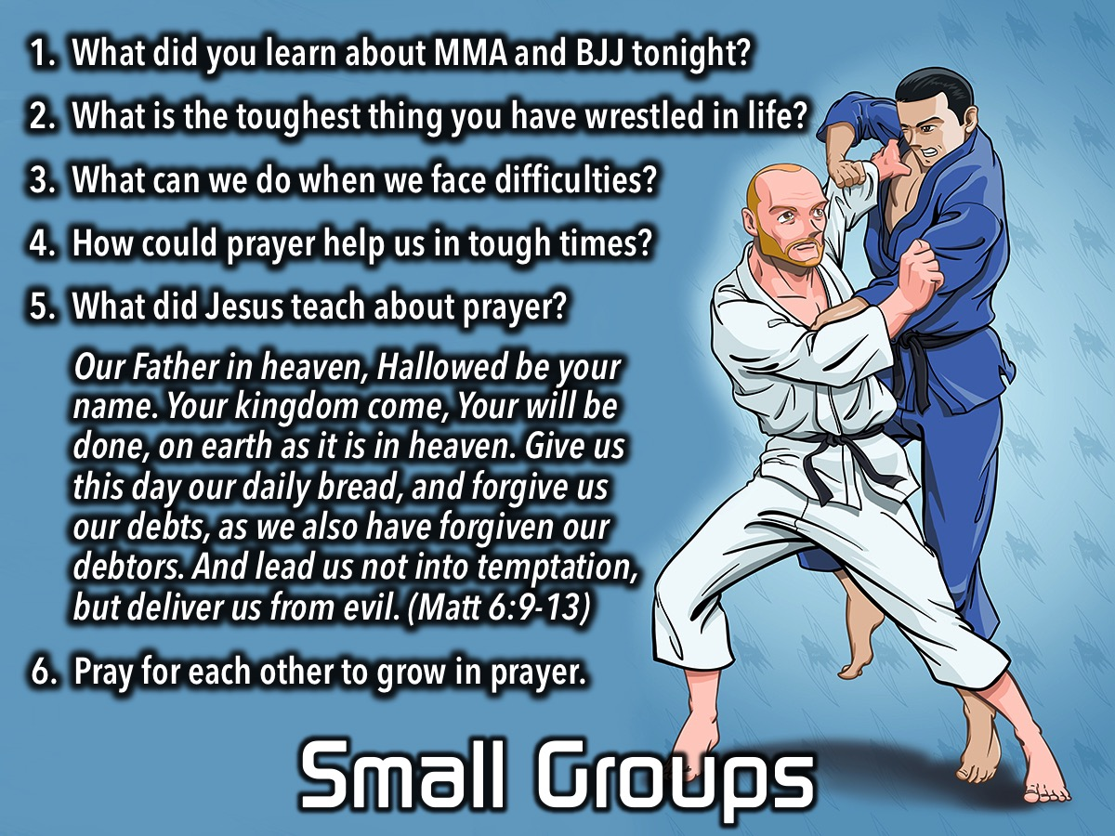
Notes:
Small Groups. Here are the questions for our small group time: (1) What did you learn about MMA and BJJ tonight? (2) What is the toughest thing you have wrestled in life? (3) What can we do when we face difficulties? (4) How could prayer help us in tough times? (5) What did Jesus teach about prayer? “Our Father in heaven, Hallowed be your name. Your kingdom come, Your will be done, on earth as it is in heaven. Give us this day our daily bread, and forgive us our debts, as we also have forgiven our debtors. And lead us not into temptation, but deliver us from evil? (Matt 6:9-13). (6) Pray for each other to grow in prayer.

Slide 14
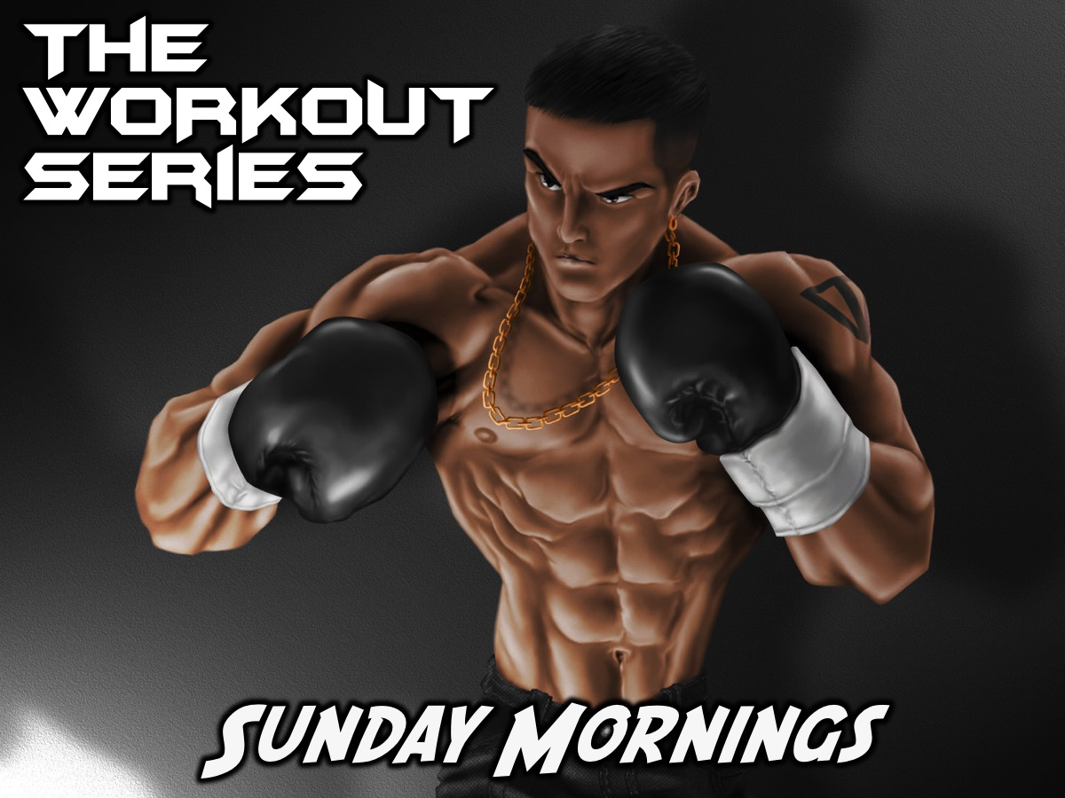
Notes:
On Sundays we are presenting the Workout Series where we will be exploring spiritual disciplines that will help us get fit spiritually!

Slide 15
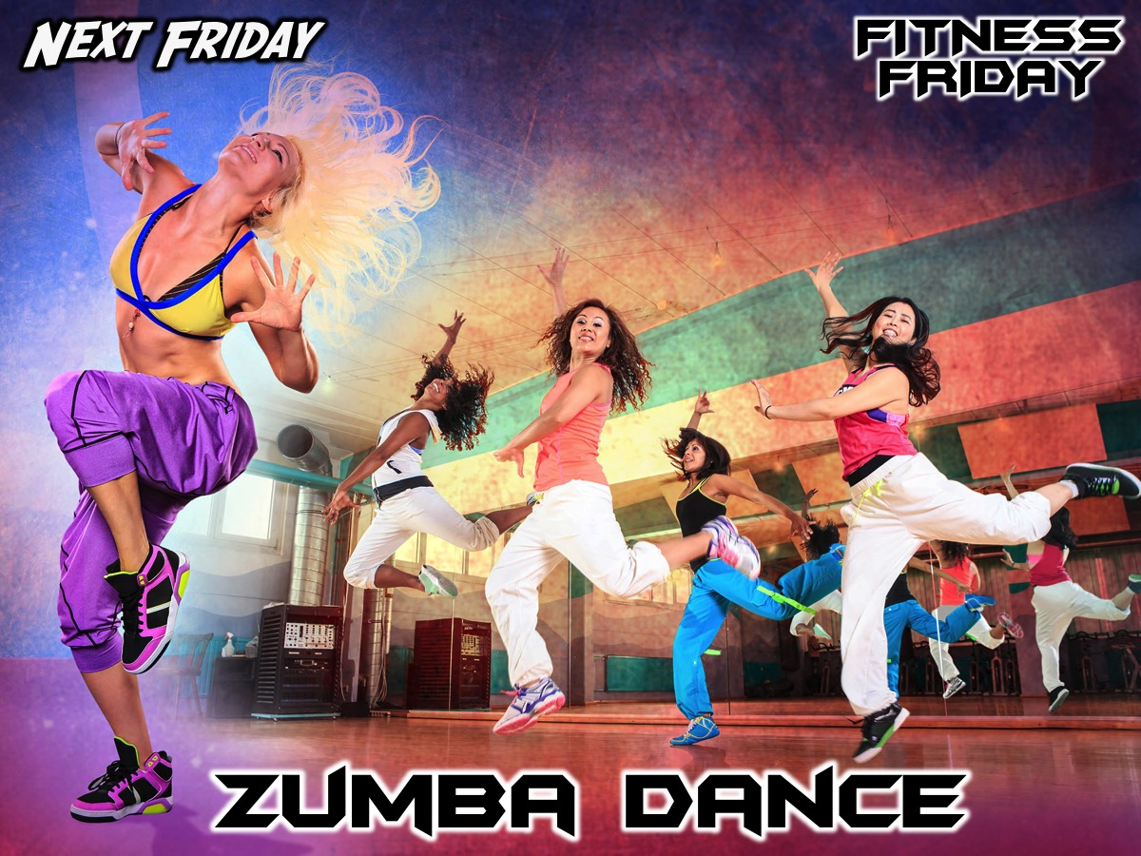
Notes:
Next Friday night is our Zumba Dance night.

Slide 16
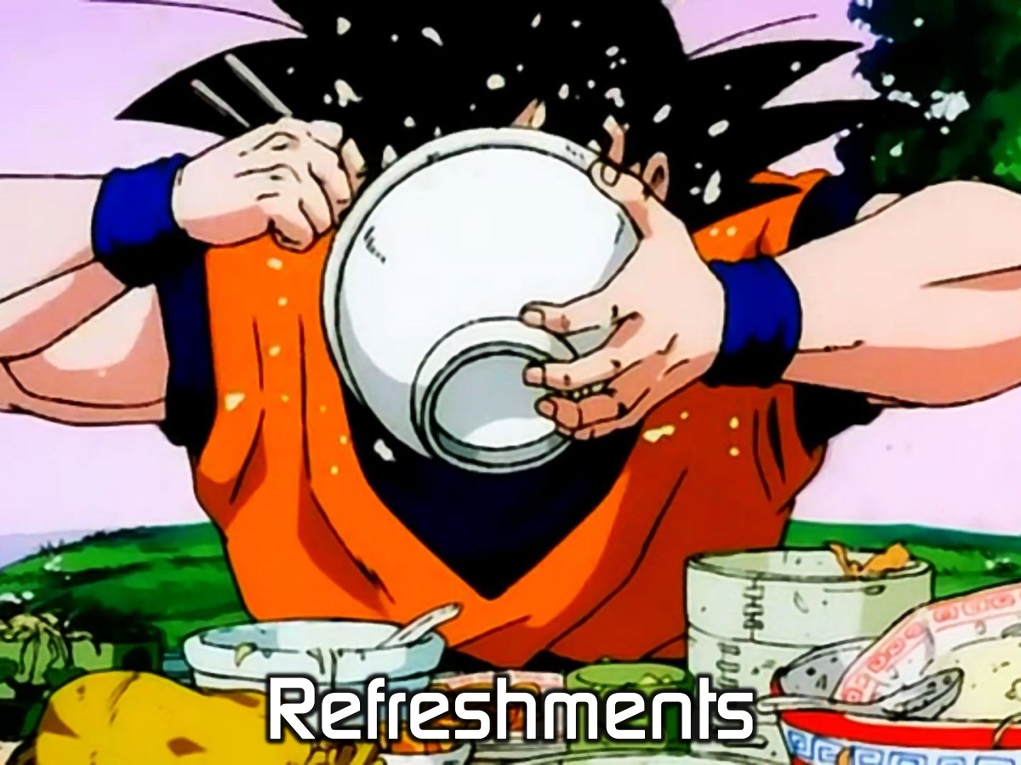
Notes:
It is time for Refreshments.

