Slide 1
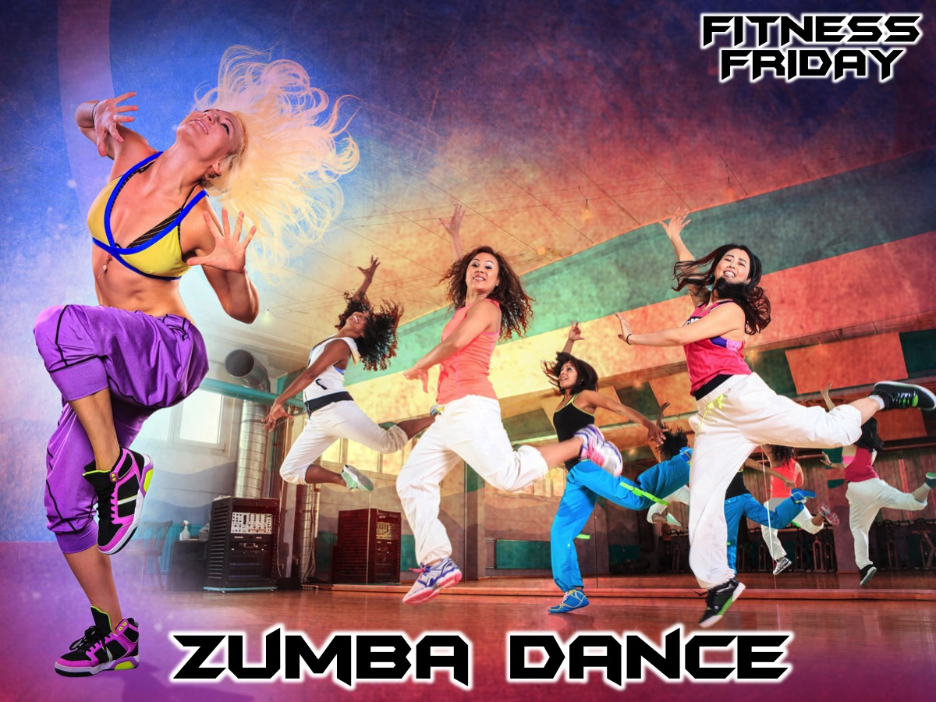
Notes:
Tonight is our Zumba Dance night.

Slide 2
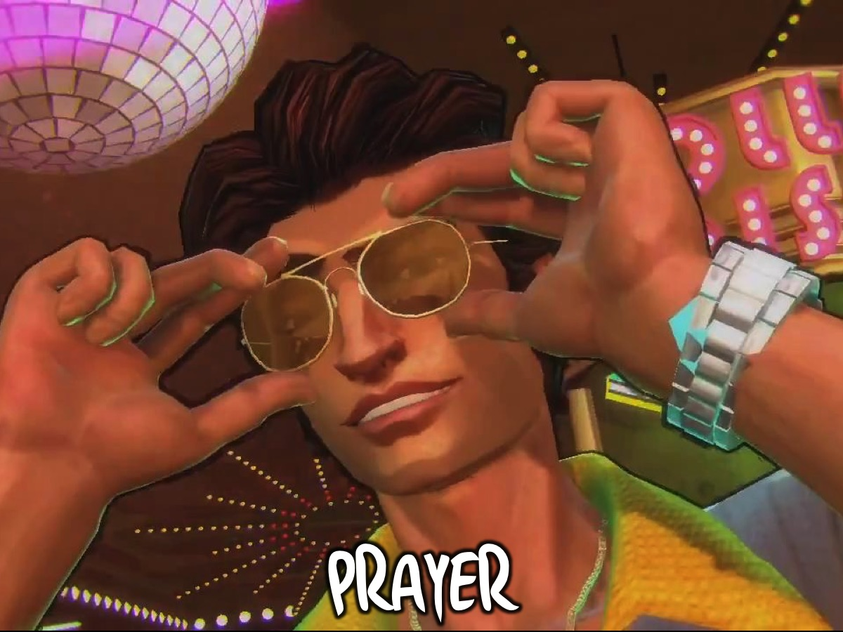
Notes:
Let’s open our meeting in prayer.

Slide 3

Notes:
Welcome to newcomers and regulars.

Slide 4
Notes:
Tonight is Zumba Dance Night.

Slide 5
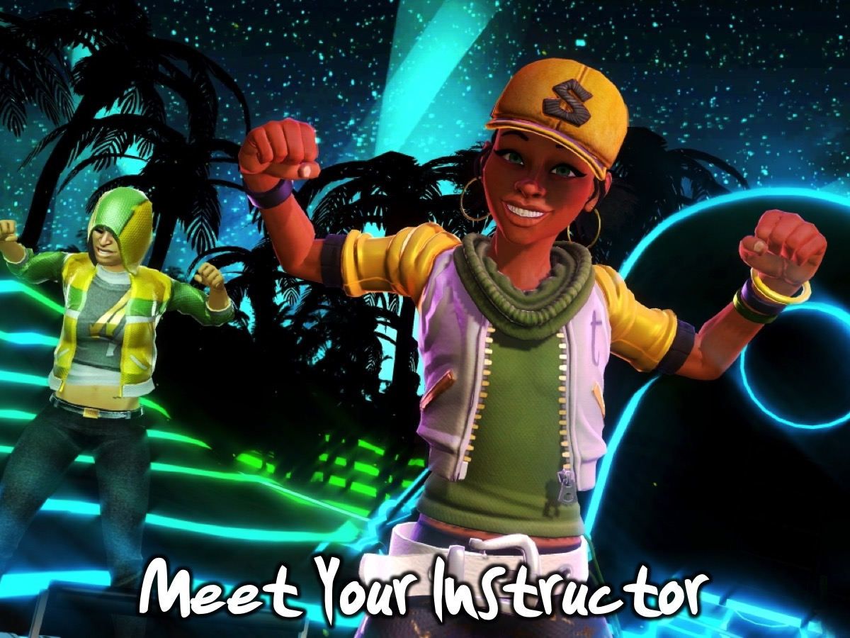
Notes:
Put your hands together for our Zumba Dance instructor, Ursula Zoghby.

Slide 6
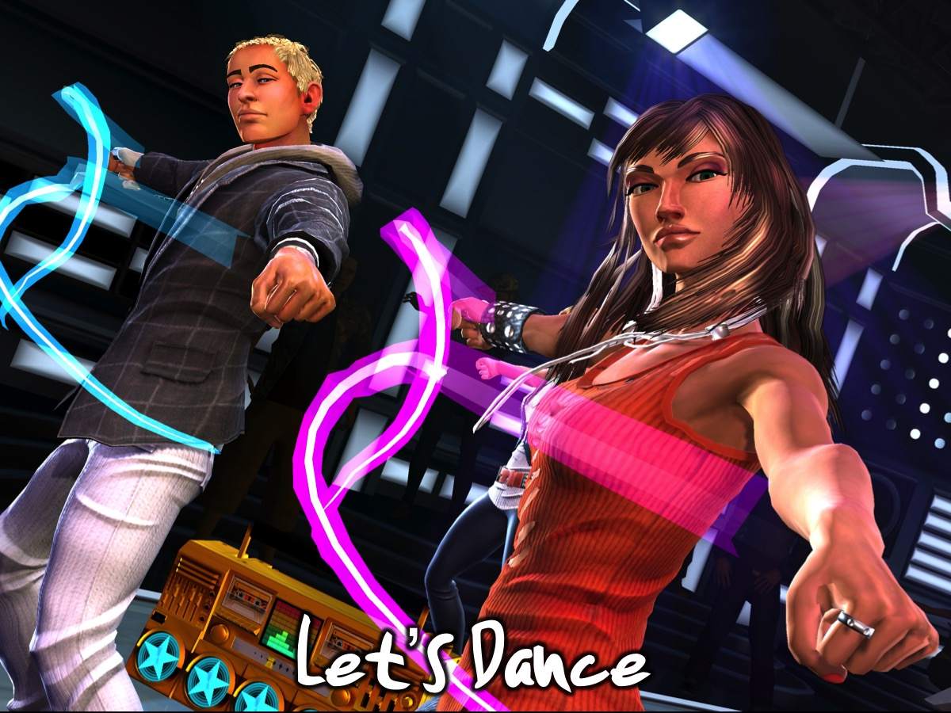
Notes:
Let’s Dance!

Slide 7
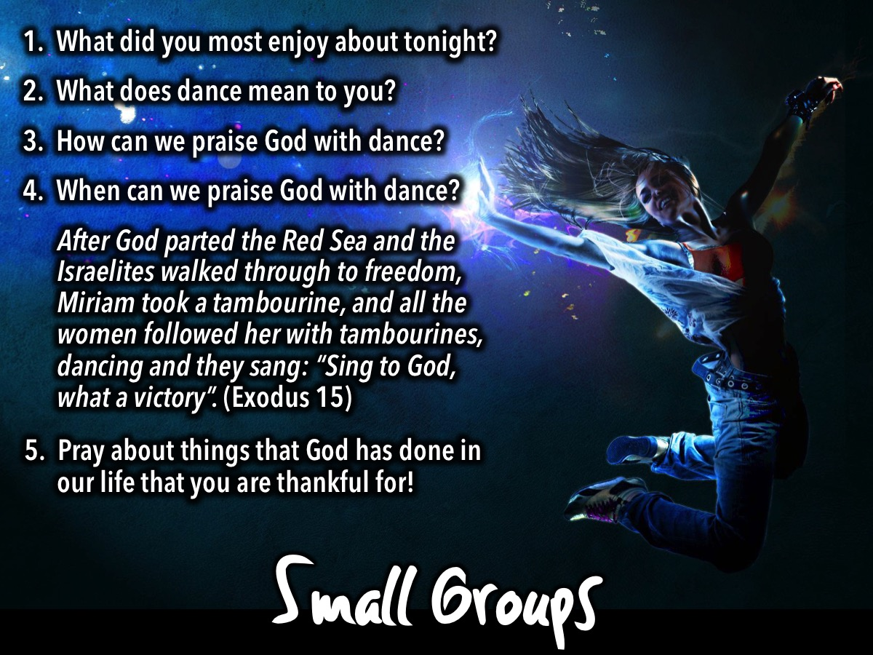
Notes:
Small Groups. Here are the questions for our small group time: (1) What did you most enjoy about tonight? (2) What does dance mean to you? (3) How can we praise God with dance? (4) When can we praise God with dance? After God parted the Red Sea and the Israelites walked through to freedom, Miriam took a tambourine, and all the women followed her with tambourines, dancing and they sang: “Sing to God, what a victory”. (Exodus 15). (5) Pray about things that God has done in our life that you are thankful for!

Slide 8
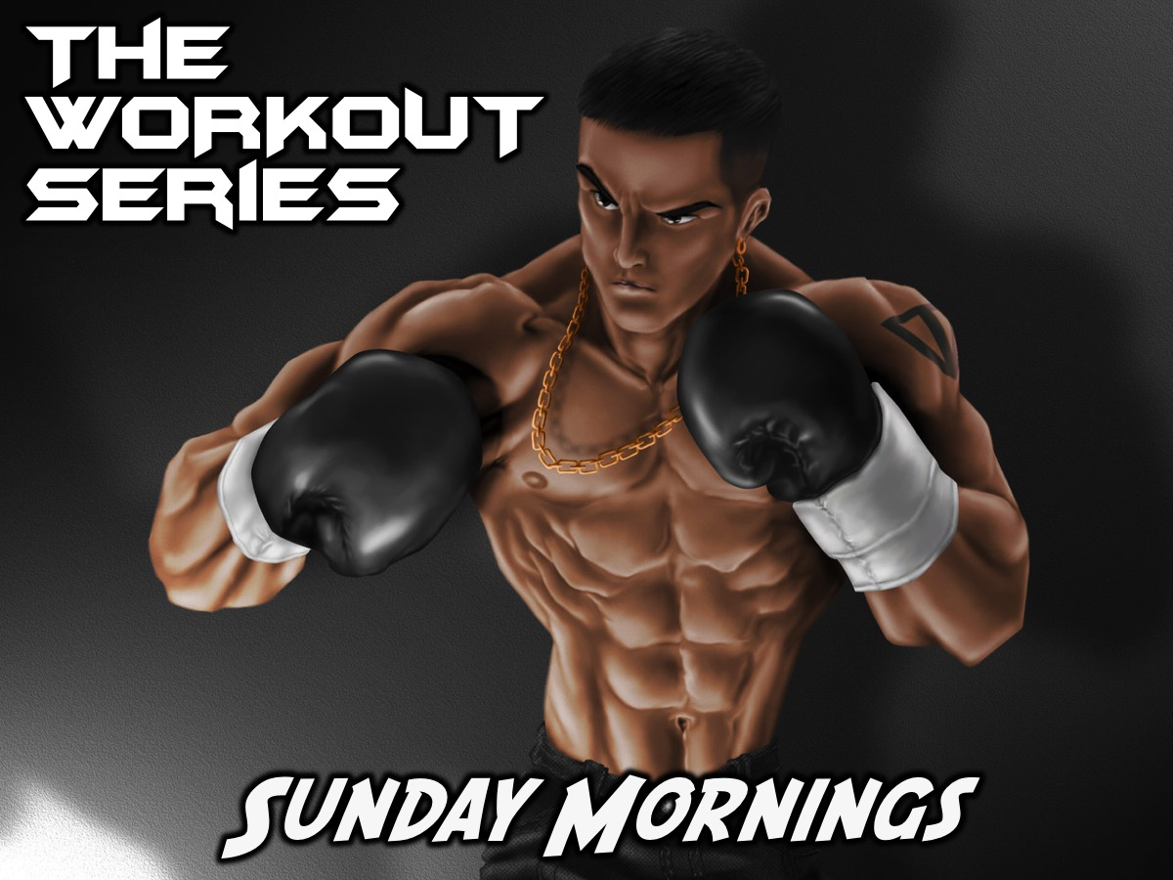
Notes:
On Sundays we are presenting the Workout Series where we will be exploring spiritual disciplines that will help us get fit spiritually!

Slide 9
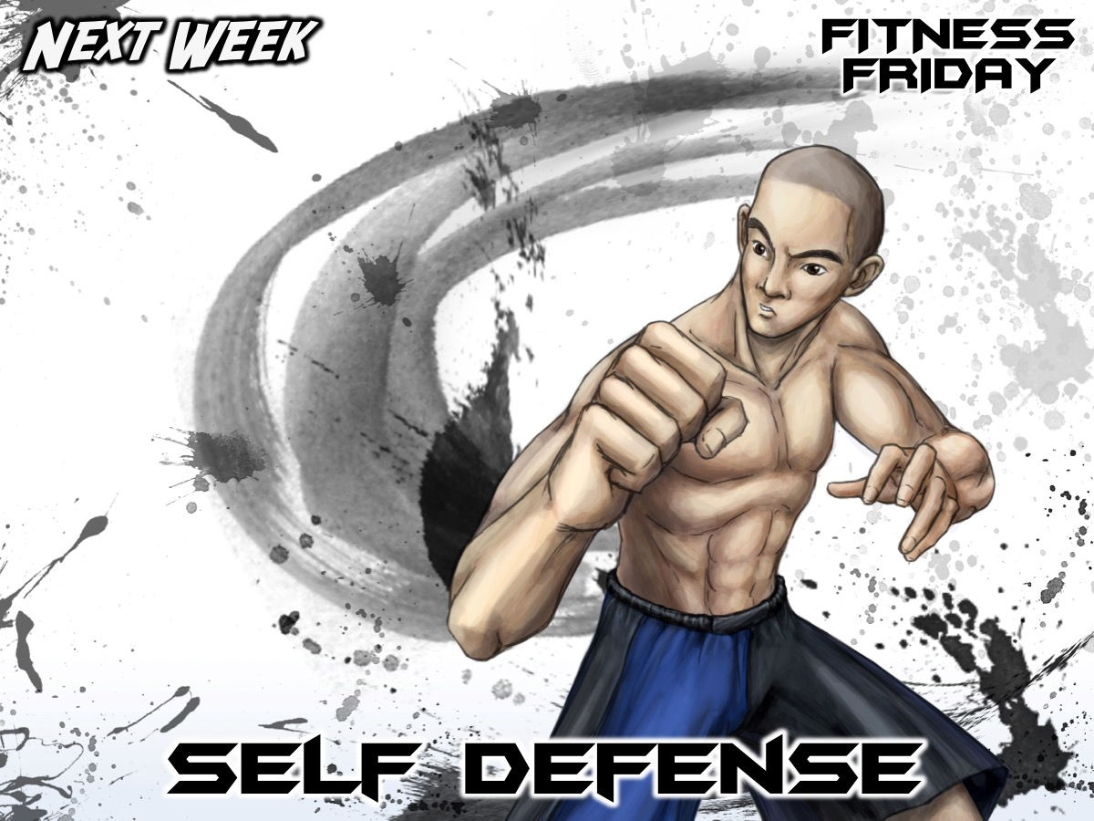
Notes:
Next Friday night is our Self-Defense night.

Slide 10

Notes:
It is time for Refreshments.

