Slide 1
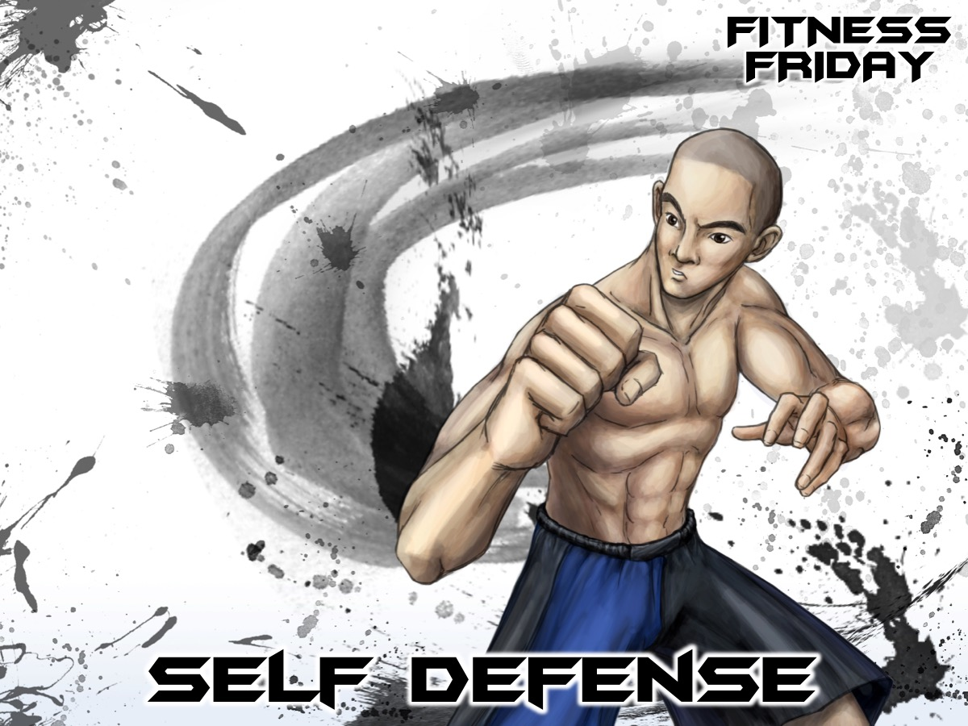
Notes:
Tonight is our Martial Arts night.

Slide 2
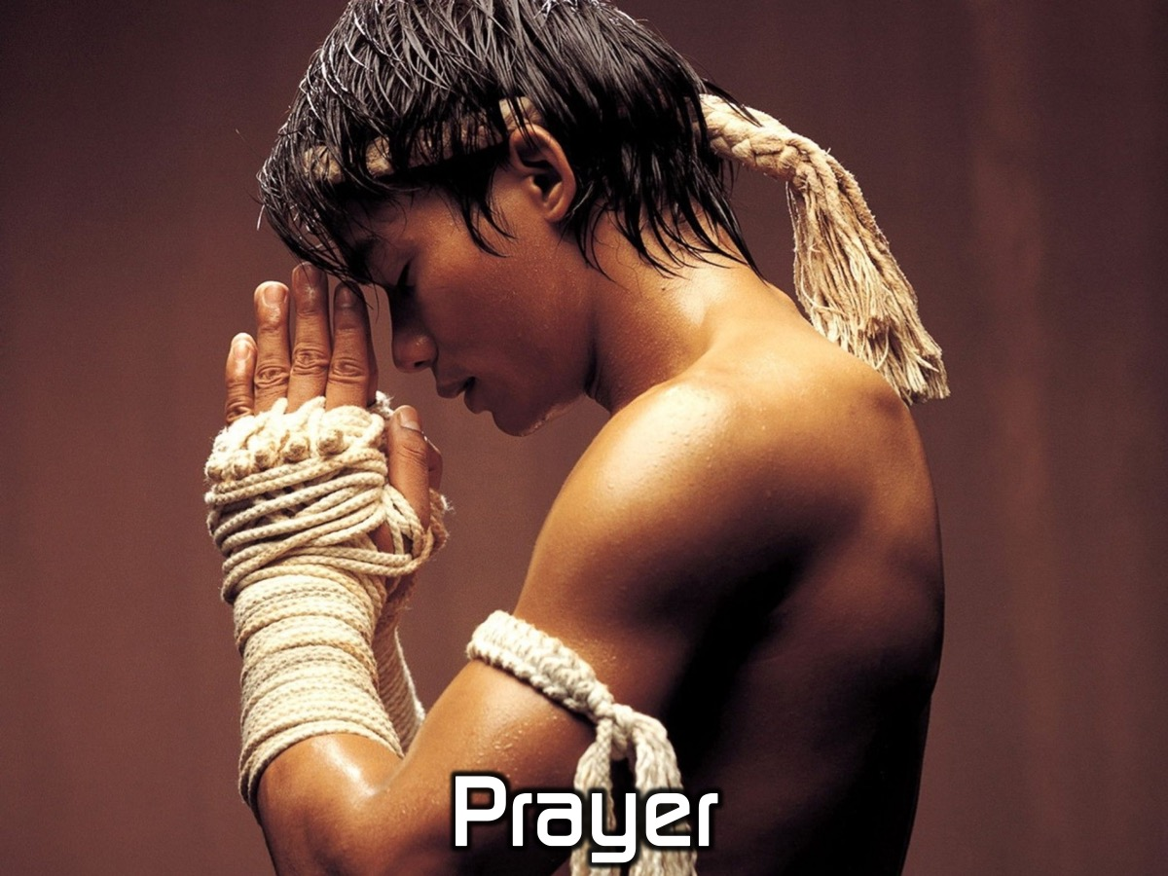
Notes:
Let’s open our meeting in prayer.

Slide 3
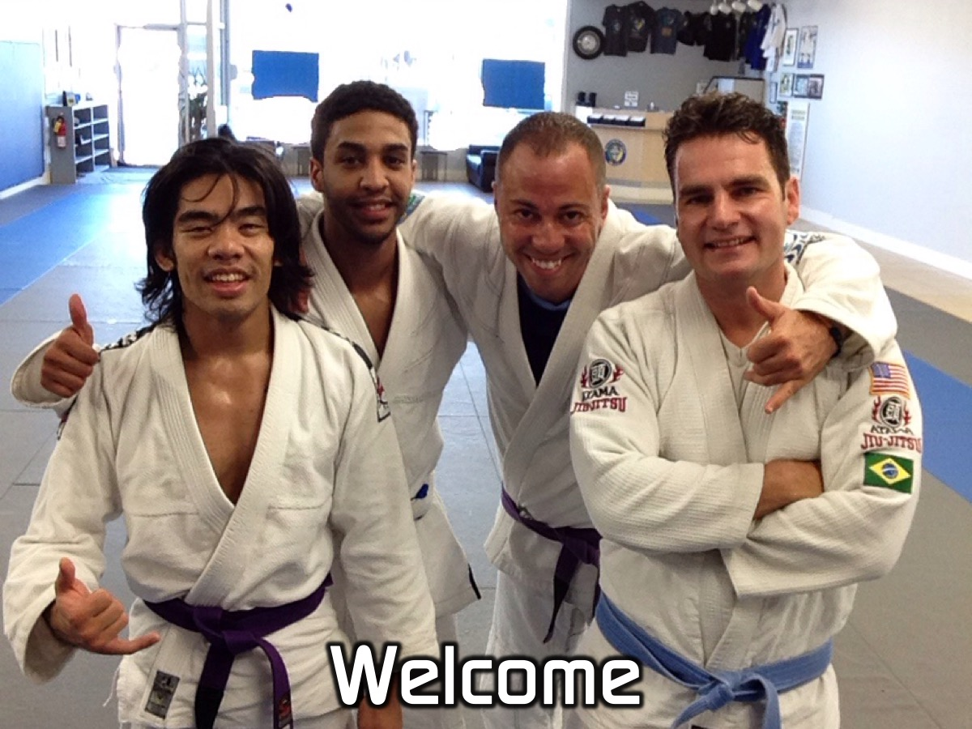
Notes:
Welcome to newcomers and regulars.

Slide 4

Notes:
Tonight we are introducing our Friday Night Group Rules:

Slide 5
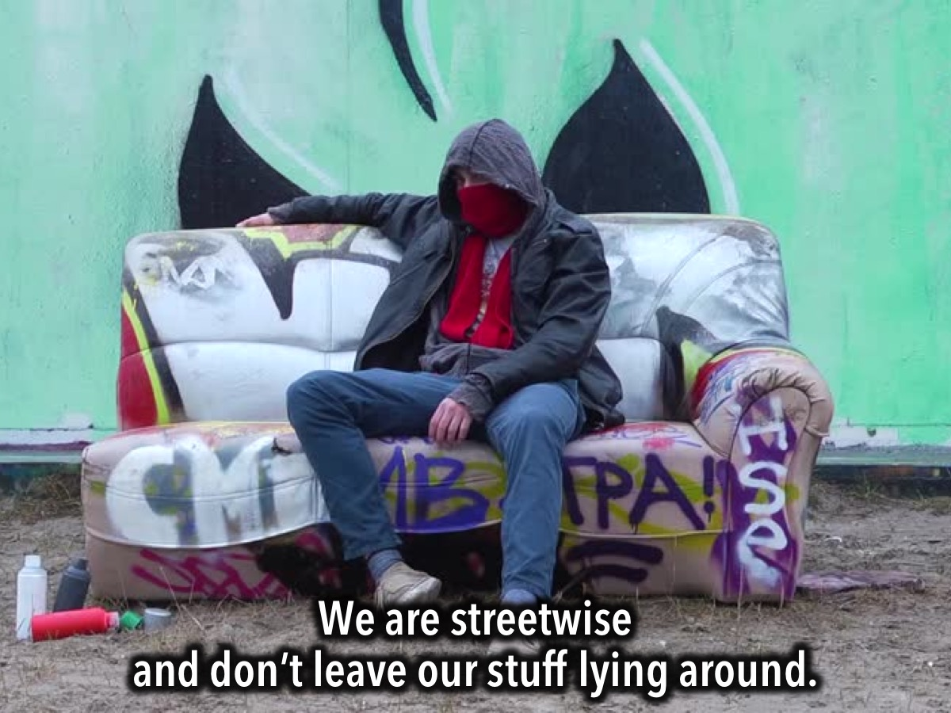
Notes:
We are streetwise and don’t leave our stuff lying around.

Slide 6
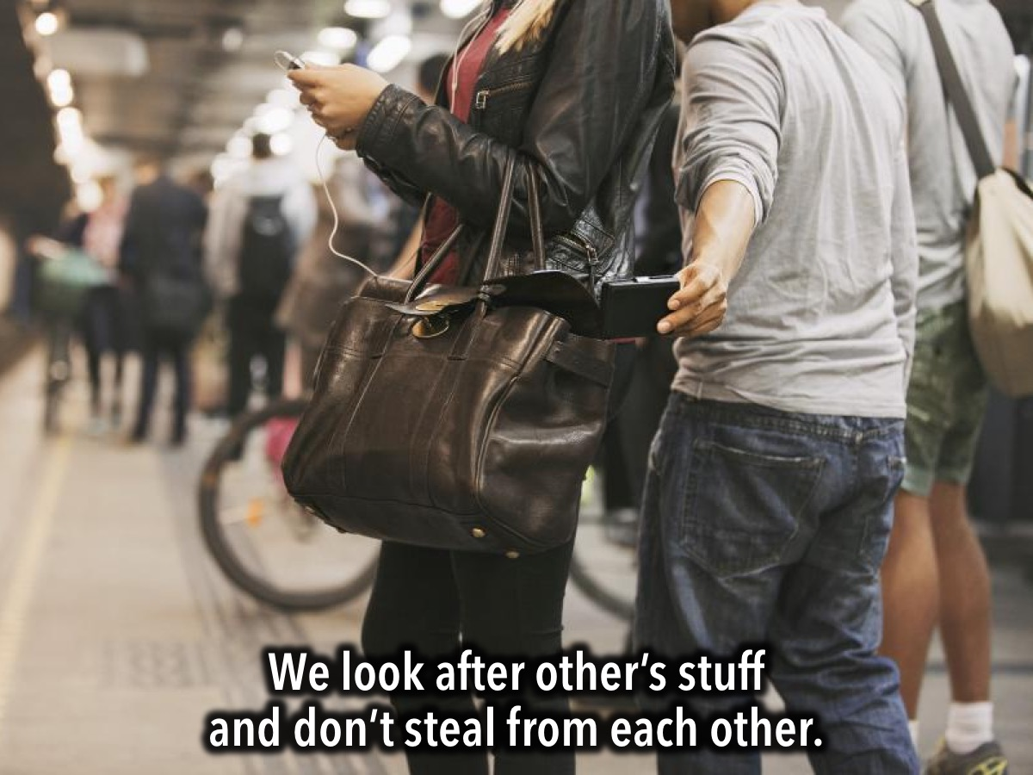
Notes:
We look after other’s stuff and don’t steal from each other.

Slide 7
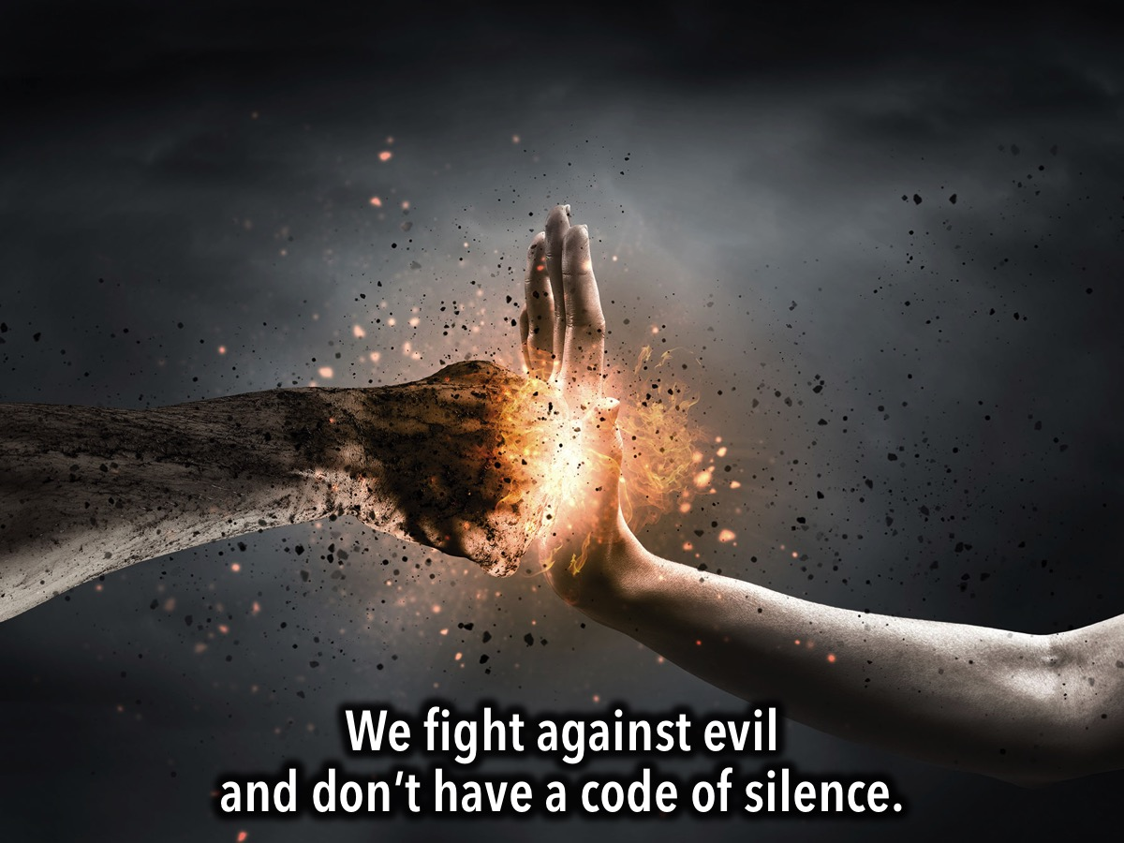
Notes:
We take action to combat evil and don’t have a code of silence.

Slide 8
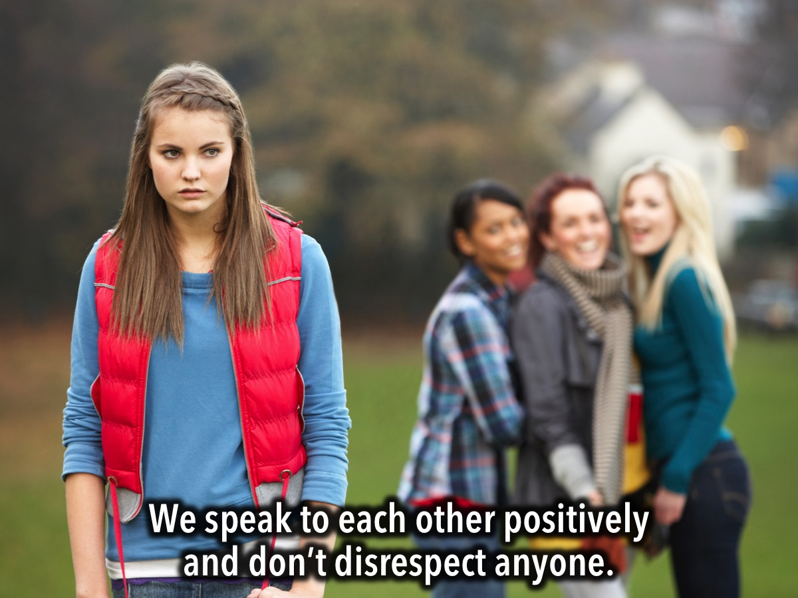
Notes:
We speak to each other positively and don’t disrespect anyone.

Slide 9

Notes:
We respect the person speaking and don’t speak at the same time.

Slide 10
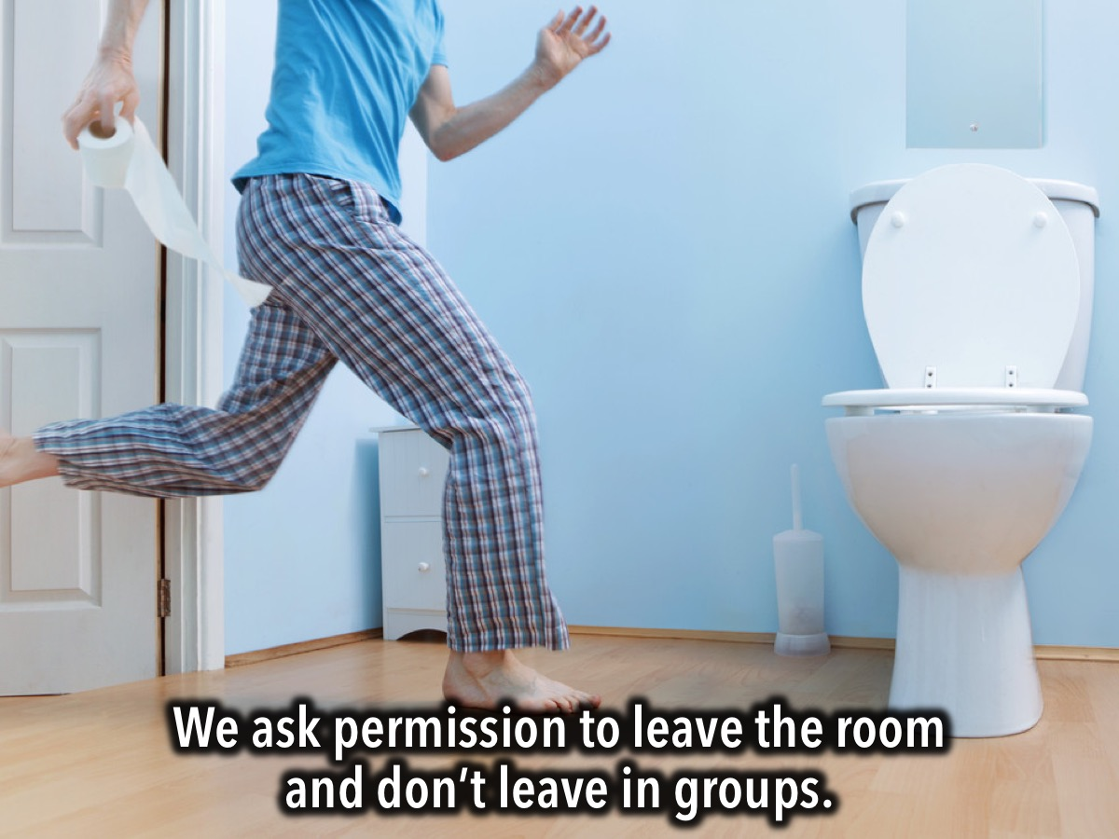
Notes:
We ask permission to leave the room and don’t leave in groups.

Slide 11
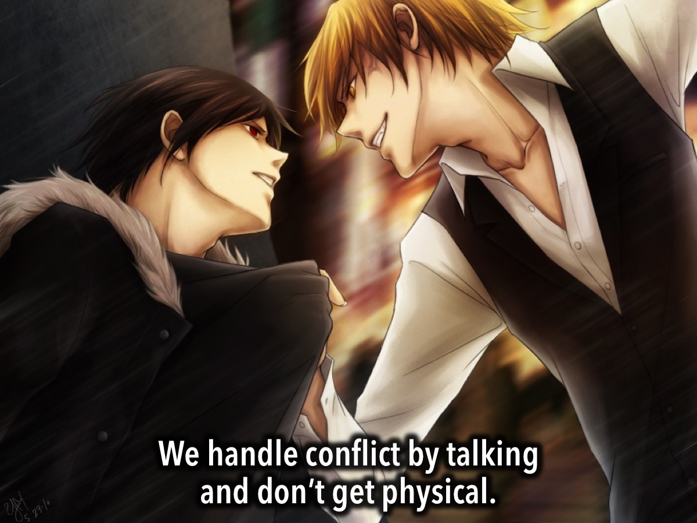
Notes:
We handle conflict by talking and don’t get physical.

Slide 12
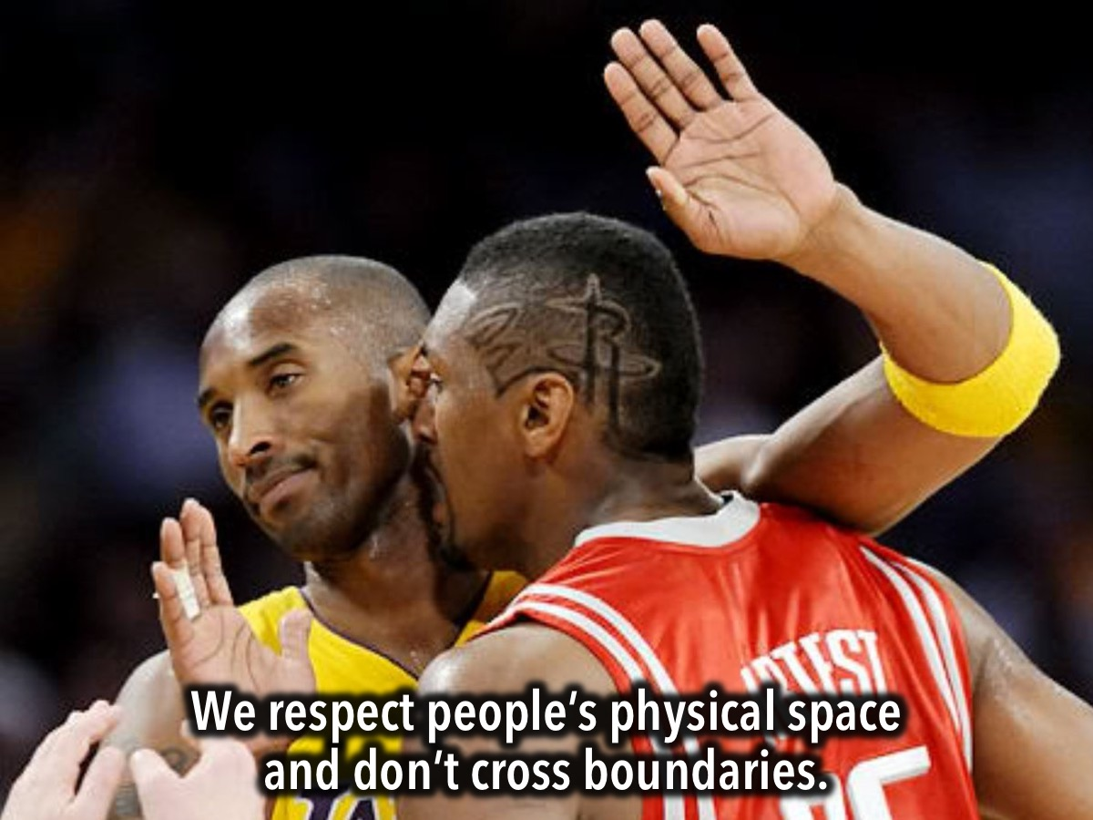
Notes:
We respect people’s physical space and don’t cross boundaries.

Slide 13
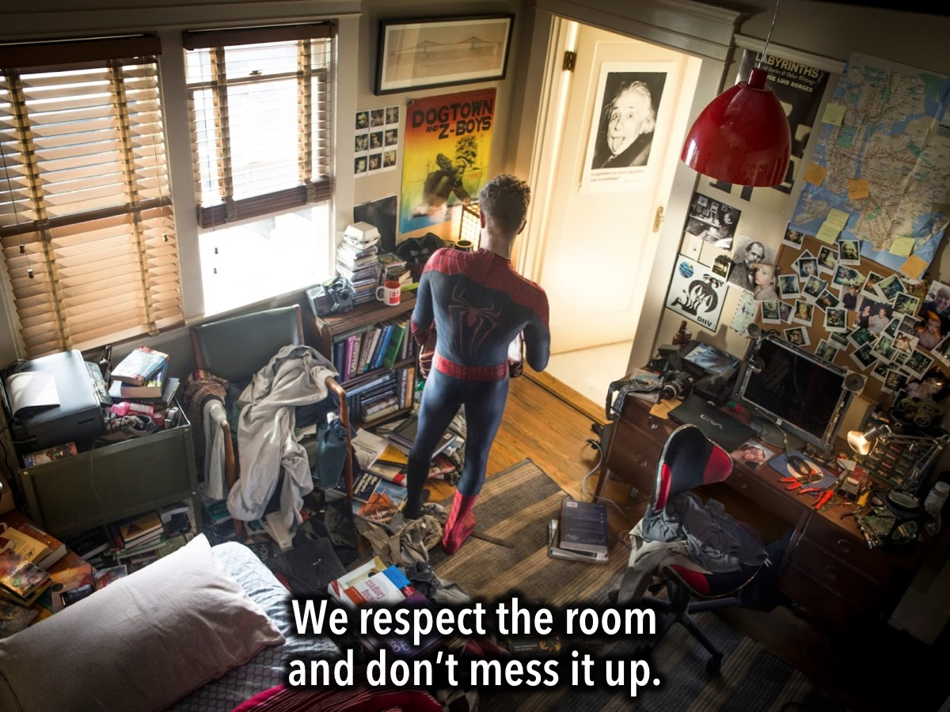
Notes:
We respect the room and don’t mess it up.

Slide 14
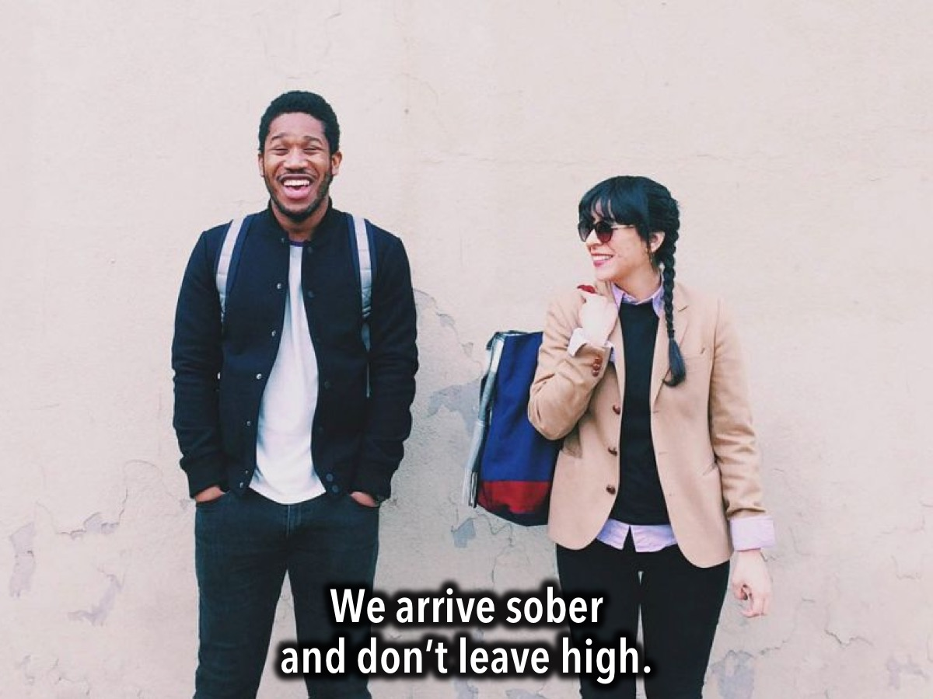
Notes:
We arrive sober and don’t leave high.

Slide 15
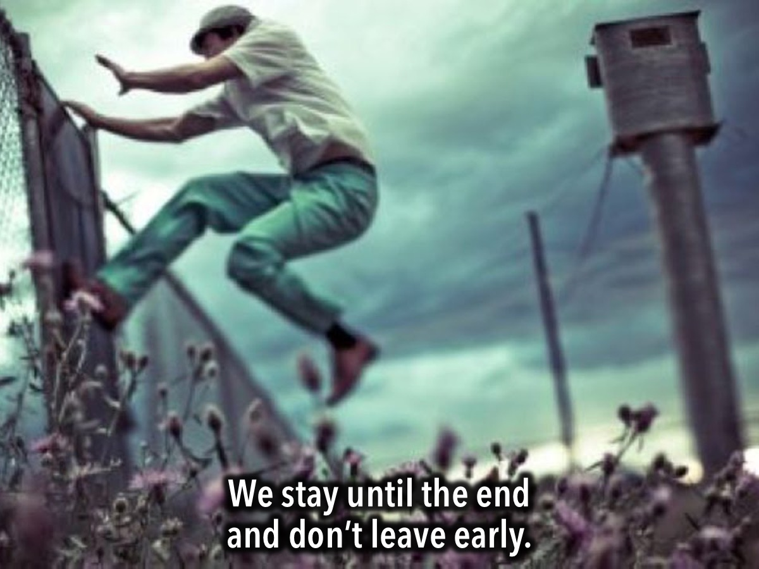
Notes:
We stay at youth until the end and don’t leave before.

Slide 16
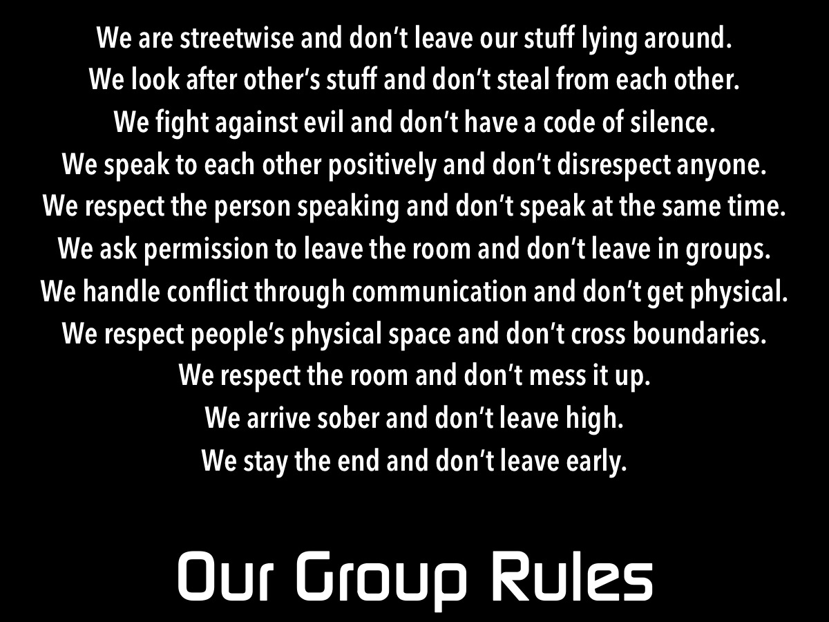
Notes:
Here is a summary of our Friday night group rules that will be posted on the notice board:
We are streetwise and don’t leave our stuff lying around.
We look after other’s stuff and don’t steal from each other.
We fight against evil and don’t have a code of silence.
We speak to each other positively and don’t disrespect anyone.
We respect the person speaking and don’t speak at the same time.
We ask permission to leave the room and don’t leave in groups.
We handle conflict through communication and don’t get physical.
We respect people’s physical space and don’t cross boundaries.
We respect the room and don’t mess it up.
We arrive sober and don’t leave high.
We stay the end and don’t leave early.

Slide 17
Notes:
Tonight is Self Defense Night.

Slide 18
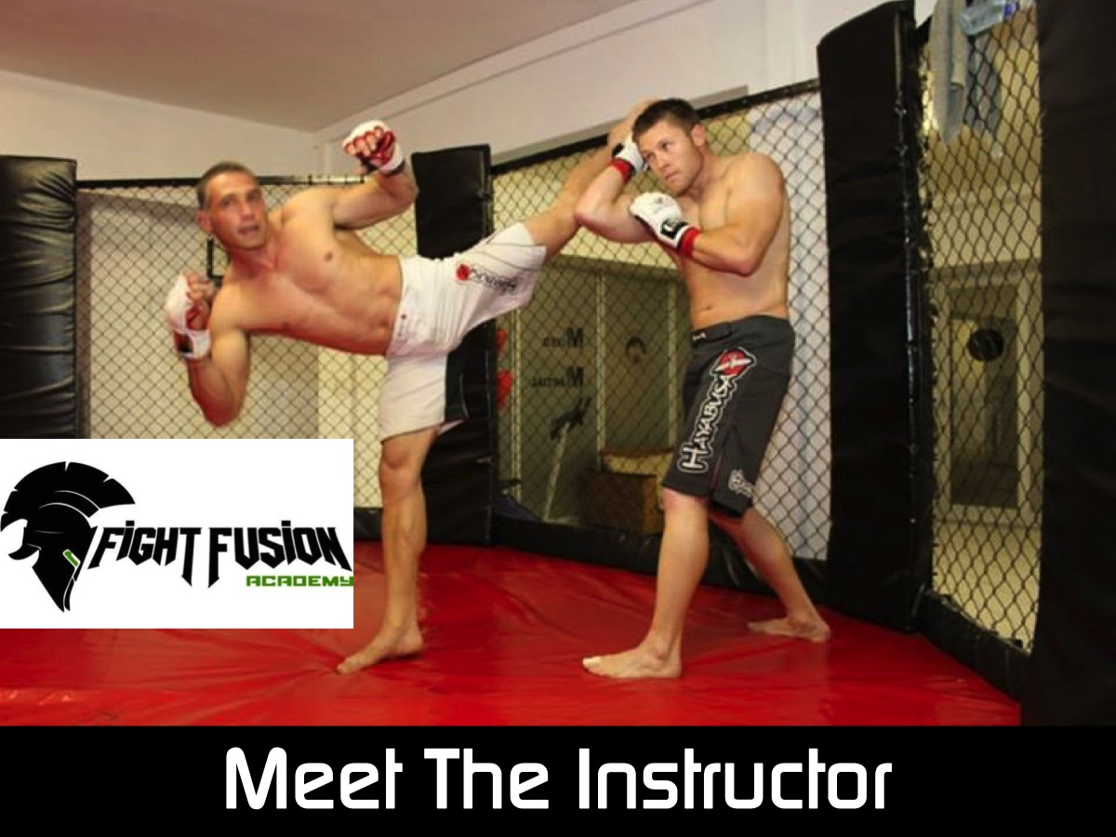
Notes:
Put your hands together for our Martial Arts instructor! Marlon Baptist from Fight Fusion Academy and a member at our church.

Slide 19
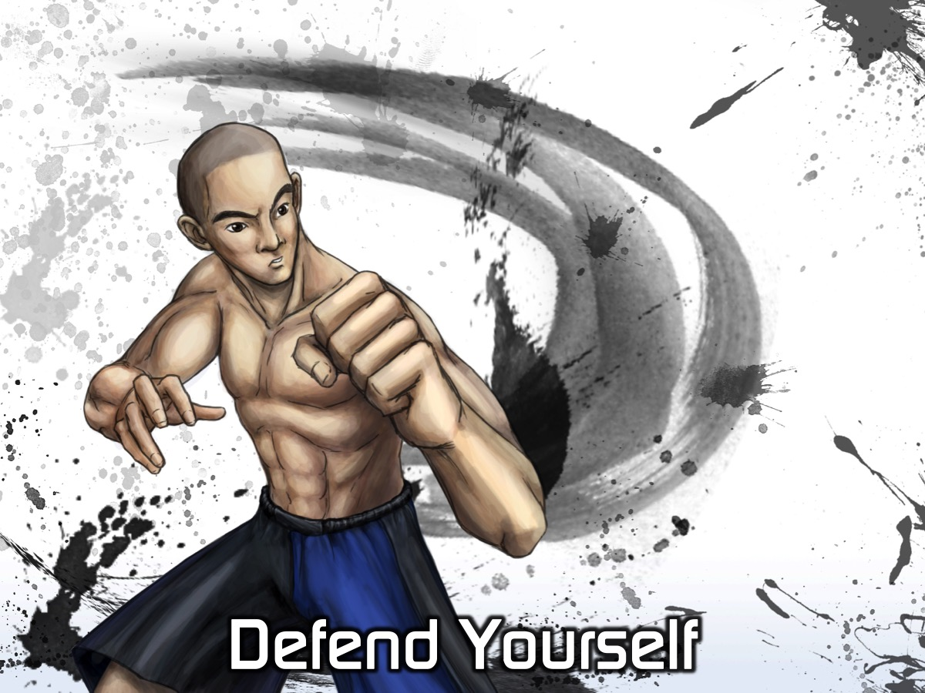
Notes:
Get ready to defend yourself!

Slide 20
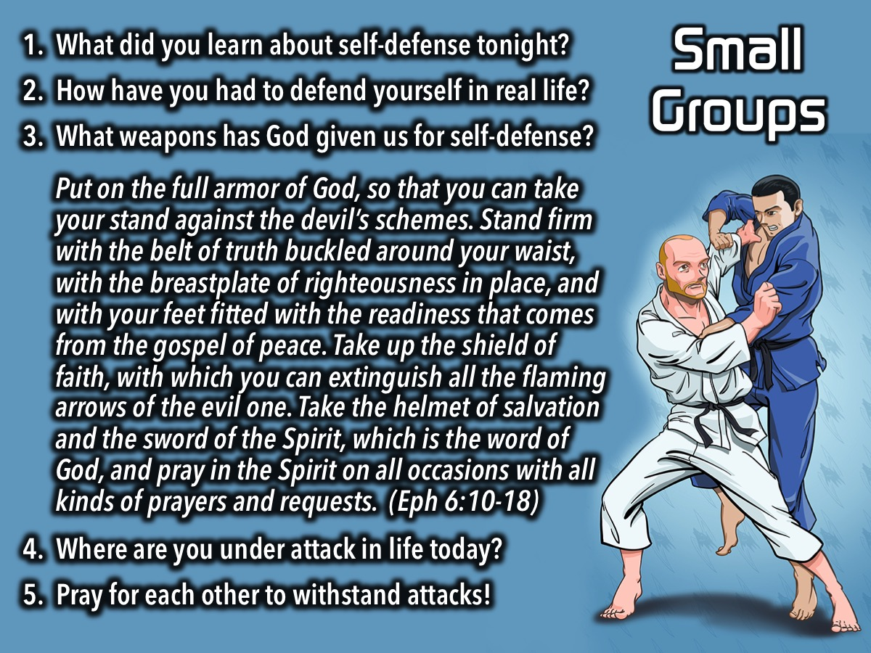
Notes:
Small Groups. Here are the questions for our small group time: (1) What did you learn about self-defense? (2) How have you had to defend yourself in real life? (3) What weapons has God given us for self-defense? Put on the full armor of God, so that you can take your stand against the devil’s schemes. Stand firm with the belt of truth buckled around your waist, with the breastplate of righteousness in place, and with your feet fitted with the readiness that comes from the gospel of peace. Take up the shield of faith, with which you can extinguish all the flaming arrows of the evil one. Take the helmet of salvation and the sword of the Spirit, which is the word of God, and pray in the Spirit on all occasions with all kinds of prayers and requests. (4) Where are you under attack in life today? (5) Pray for each other to withstand attacks!

Slide 21

Notes:
On Sundays we are presenting the Workout Series where we will be exploring spiritual disciplines that will help us get fit spiritually!

Slide 22
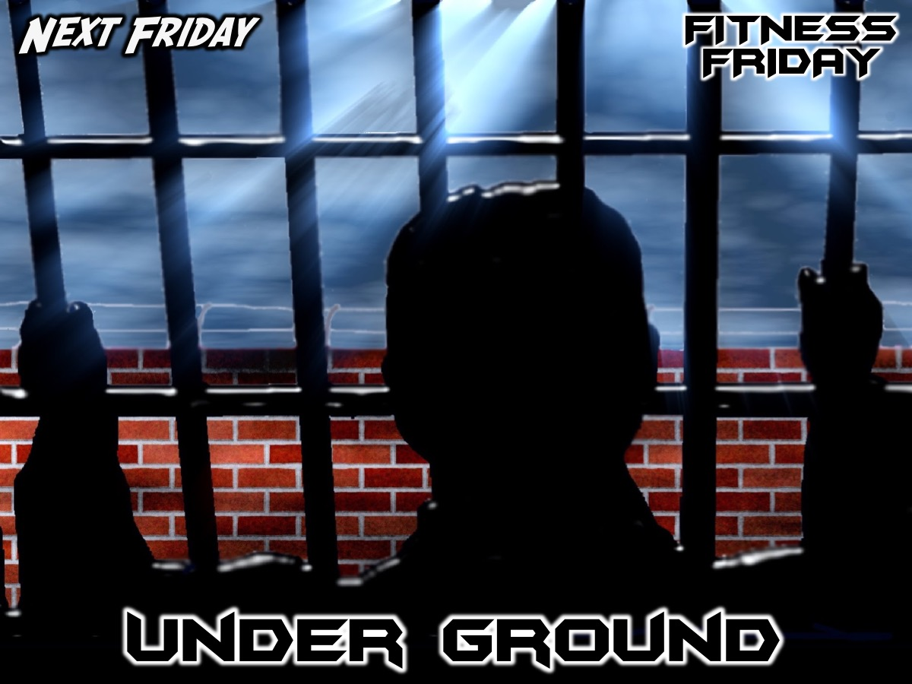
Notes:
Next Friday night is our Under Ground night with Natasja from Open Doors.

Slide 23
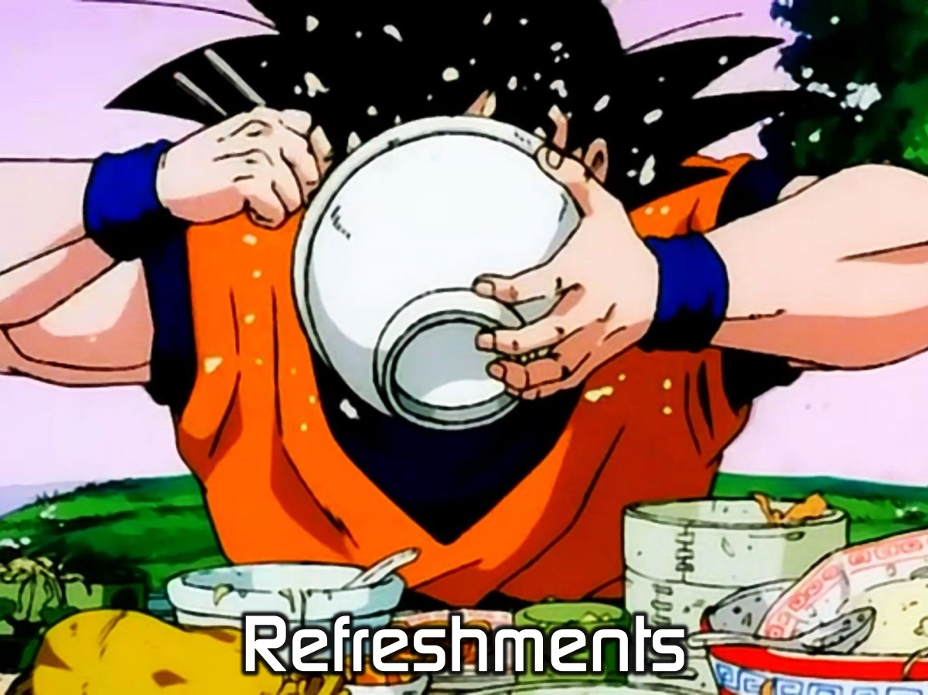
Notes:
It is time for Refreshments.

