Slide 1
Notes:
Tonight is our Under Ground night.

Slide 2
Notes:
Let’s open our meeting in prayer.

Slide 3
Notes:
Welcome to newcomers and regulars.

Slide 4
Notes:
Reminder: Last week we introduced you to our Friday Night Group Rules:
We are streetwise and don’t leave our stuff lying around.
We look after other’s stuff and don’t steal from each other.
We fight against evil and don’t have a code of silence.
We speak to each other positively and don’t disrespect anyone.
We respect the person speaking and don’t speak at the same time.
We ask permission to leave the room and don’t leave in groups.
We handle conflict through communication and don’t get physical.
We respect people’s physical space and don’t cross boundaries.
We respect the room and don’t mess it up.
We arrive sober and don’t leave high.
We stay to the end and don’t leave early.

Slide 5
Notes:
Tonight is our Under Ground night.

Slide 6
Notes:
Welcome our Facilitator from Open Doors

Slide 7
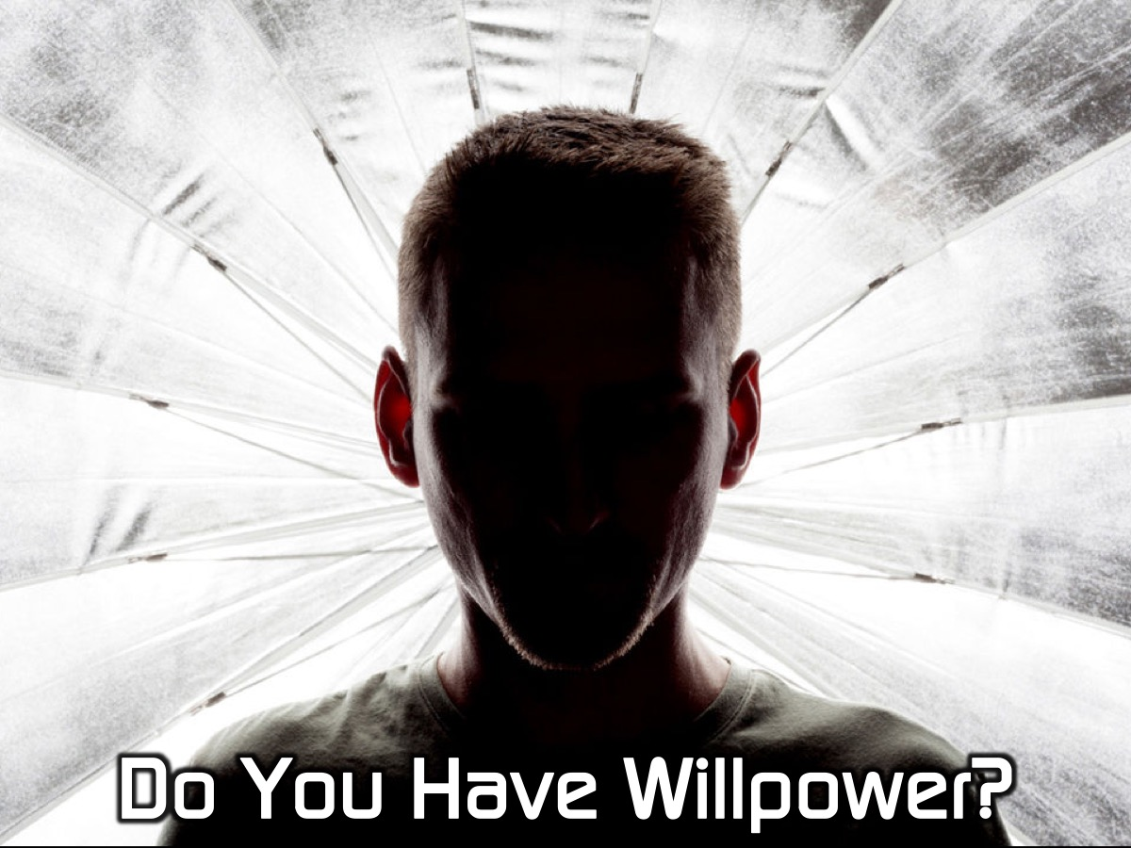
Notes:
Introduction: Willpower Activities: Ask some volunteers from group to perform the following tasks in two person challenges: (1) Hold a chair out in front of them. (2) Do the most number of press-ups. (3) Use chopsticks to move grains of rice from one bowl to another. Talk about what the activities illustrated: Determination, diligence, willpower to keep going…

Slide 8
Notes:
Ask group to explain what “perseverance” means in their own words: words like - hang in there, no turning back, endure, stick at it. Then ask group to share examples of where they need to “persevere” or where they have in the past. What do you find hard about being a Christian? How tough do we have it? (let them share with a friend and then get some feedback from group).

Slide 9
Notes:
Video: Samwise from LOTR: Two Towers. Get it on YouTube at: https://www.youtube.com/watch?v=A_u9Hc0Yg1o

Slide 10
Notes:
Being a Christian isn’t always an easy journey. it takes guts to have a value system and to live for Jesus. There are many times when we might feel like calling it quits, giving in and giving up. The Bible challenges and inspires us to walk the narrow road with Jesus: to hang in there when life hurts and totally sucks
after all, we do not walk the journey of faith alone: Jesus is with us! We have the choice to keep going – to persevere…!

Slide 11
Notes:
Scripture: Read Hebrews 11
By faith…
…Abel brought God a better offering than Cain did...
…Enoch was taken from this life without dying…
…Noah in holy fear built an ark to save his family. ..
…Abraham made his home in the promised land...
…Sarah was enabled to bear children…
…Abraham offered his only son Isaac as a sacrifice...
…Isaac blessed Jacob and Esau…
…Jacob blessed each of Joseph’s sons…
…Joseph spoke about the Exodus…
…Moses left Egypt…
…The people passed thru the Red Sea….

Slide 12
Notes:
By faith the walls of Jericho fell…By faith the prostitute Rahab was not killed…And there was Gideon, Barak, Samson, Jephthah, David, Samuel and the prophets, who through faith conquered kingdoms, administered justice, and gained what was promised; who shut the mouths of lions, quenched the fury of the flames, and escaped the edge of the sword; whose weakness was turned to strength; and who became powerful in battle and routed foreign armies. Women received back their dead, raised to life again. There were others who were tortured, refusing to be released so that they might gain an even better resurrection.

Slide 13
Notes:
Some faced jeers and flogging, and even chains and imprisonment. They were put to death by stoning; they were sawed in two; they were killed by the sword. They went about in sheepskins and goatskins, destitute, persecuted and mistreated - the world was not worthy of them. They wandered in deserts and mountains, living in caves and in holes in the ground. These were all commended for their faith, yet none of them received what had been promised, since God had planned something better for us so that only together with us would they be made perfect. (Hebrews 11)

Slide 14
Notes:
Who are your Christian heroes? They could be people from the Bible or people you have encountered or know personally? Why do you admite these “heroes” of faith? Do you think any of them faced tough times? When things get tough, when we feel lonely, when even our friends turn away from us, could we stay on the road of faith without turning back? Hebrews 11 tells us what kept people from turning back: FAITH – it says by faith they did things – faith is what kept them going when things looked bad, when times got tough and they were faced with the impossible.

Slide 15
Notes:
Video: Faithfulness. Get it on YouTube at: https://www.youtube.com/watch?v=LzqLiLWSSqo

Slide 16
Notes:
Scripture: Read Hebrews 12:1-2, which tells us that the “cloud of witnesses” surrounds us and cheer us on in the faith:

Slide 17
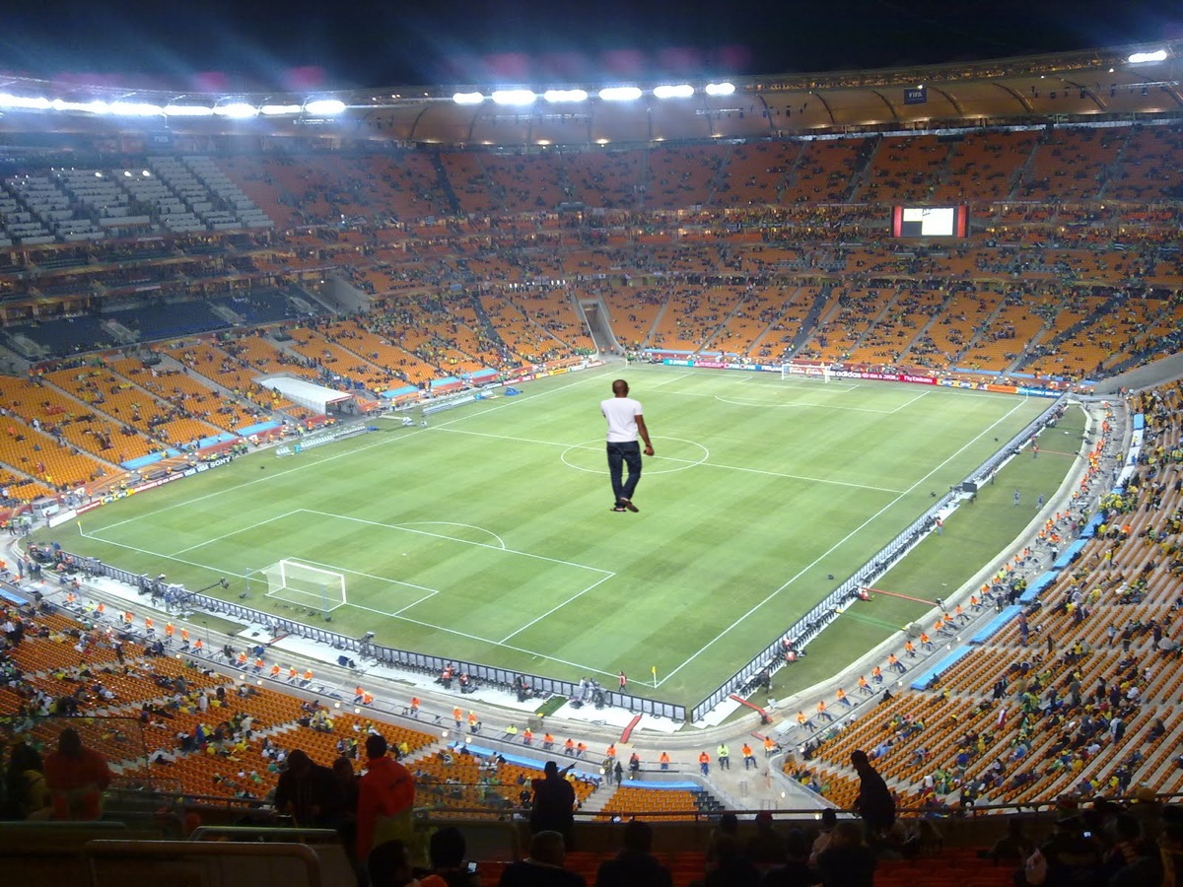
Notes:
Imagine the FNB Soccer Stadium packed out. There is little YOU standing in the middle of the field. Suddenly the crowd erupts, everyone is chanting YOUR name, cheering you on…

Slide 18
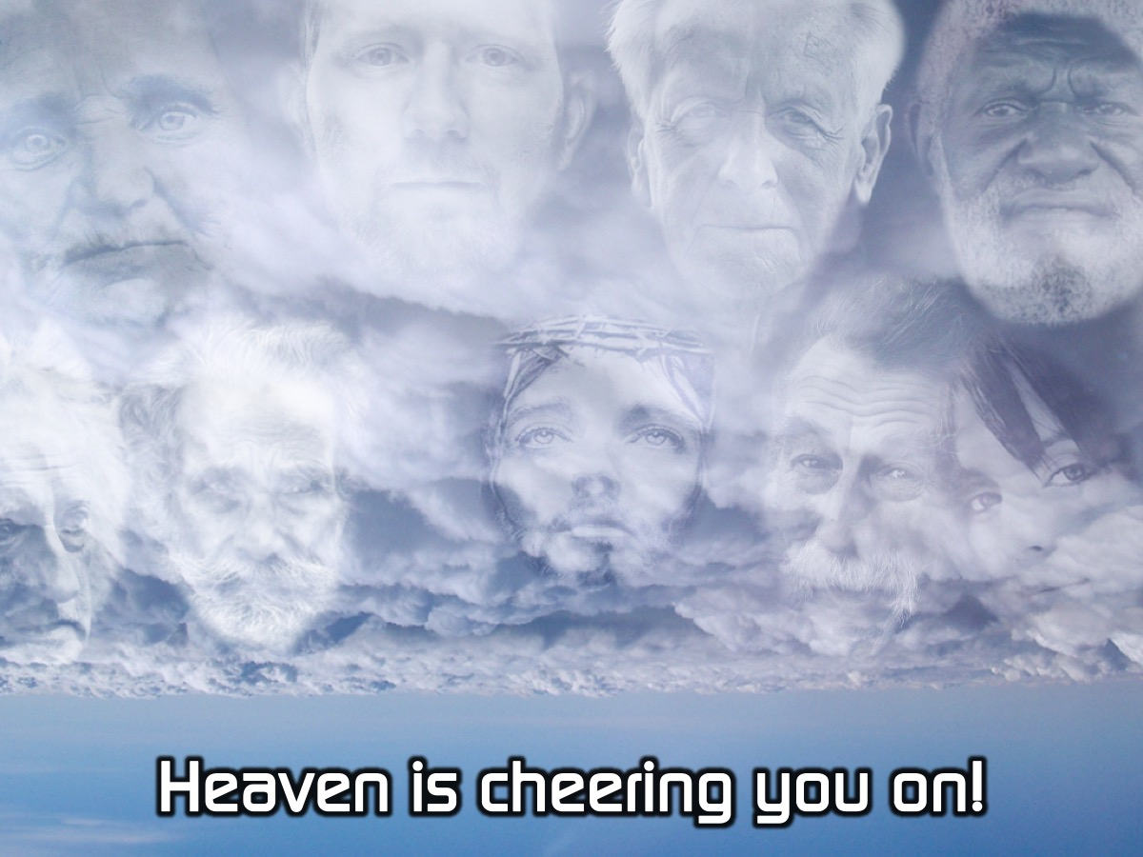
Notes:
YOU might not believe it, but in HEAVEN those who have gone before is, are cheering YOU on, saying: “YOU CAN MAKE IT!” and “YOU CAN LIVE FOR JESUS whatever it takes…!” The passage tells us that the way these people made it to the end of the race was by focusing on Jesus! Sometimes we can feel like we are the only Christian. But, as Christians we are NOT alone! God Himself promises to never leave or forsake us. And, we have those who have gone before us, cheering us on, encouraging us to keep going! And we have each other! Take the opportunity to encourage the group to share their struggles and to pray for and support each other.

Slide 19
Notes:
Reflect: Hand each person a prayer card and pen and then ponder below: (1) Write out some words on the card to God saying how you feel right now… (2) Does the story you are reading, move and inspire you to take Jesus more seriously?

Slide 20
Notes:
A disciple is someone who is passionate. Devoted and loving Jesus with everything they have. We become Christians but Jesus calls us to become disciples…Jesus calls us to journey with Him and not turn back when life gets tough and other things crowd Him out!

Slide 21
Notes:
STAND UP TOGETHER: Stand in a circle. We are going to pray for each person in the group and also for the people on our prayer cards.

Slide 22
Notes:
On Sundays we are presenting the Workout Series where we will be exploring spiritual disciplines that will help us get fit spiritually!

Slide 23
Notes:
Next Friday night is our Barn Dance night.

Slide 24
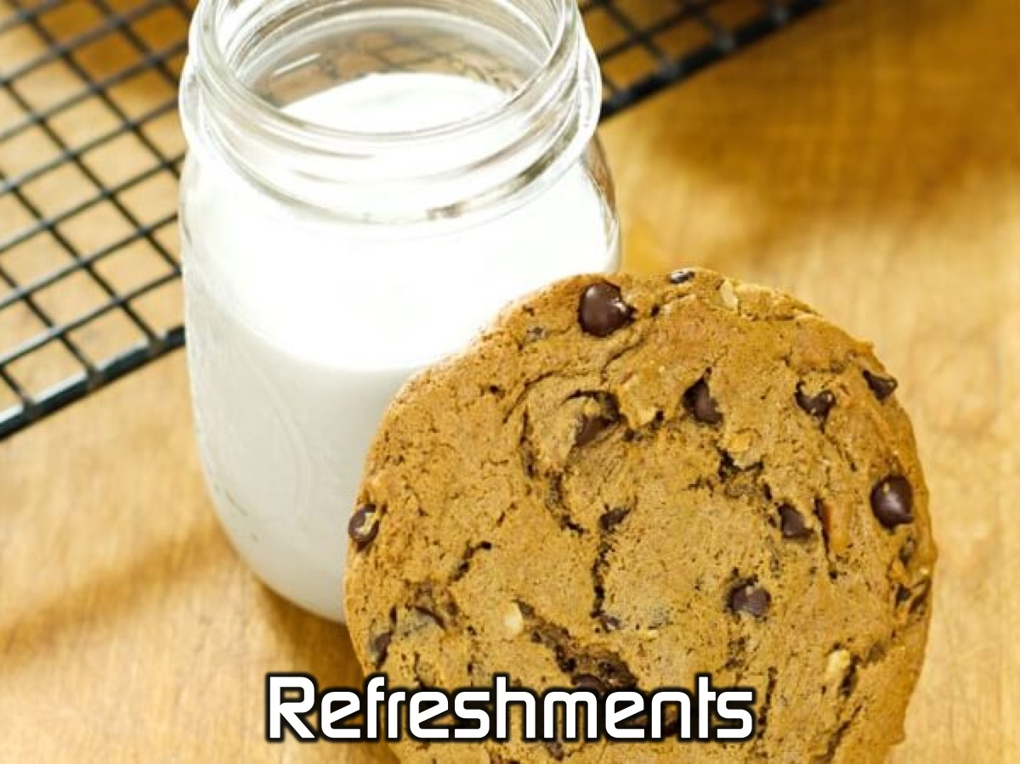
Notes:
It is time for Refreshments.

