Slide 1
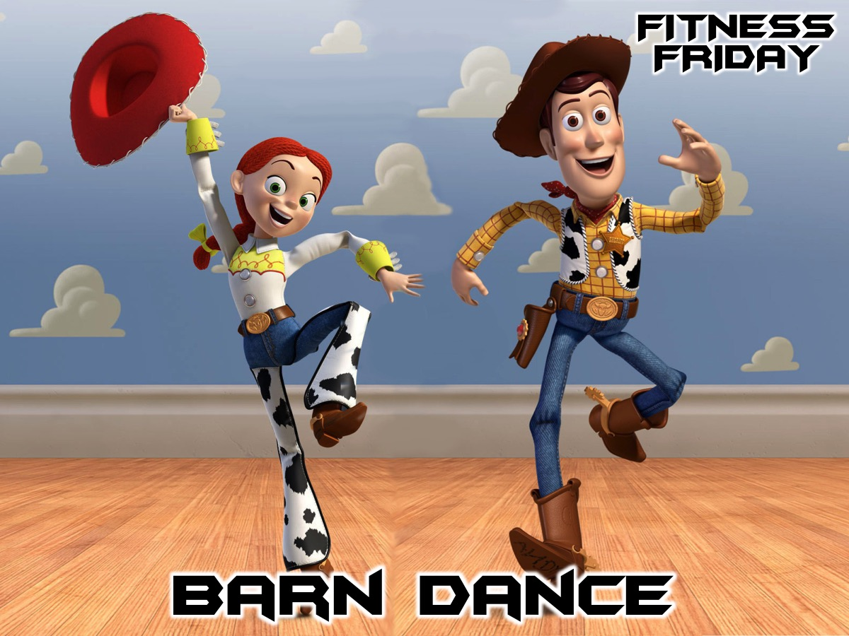
Notes:
Tonight is our Barn Dance night.

Slide 2
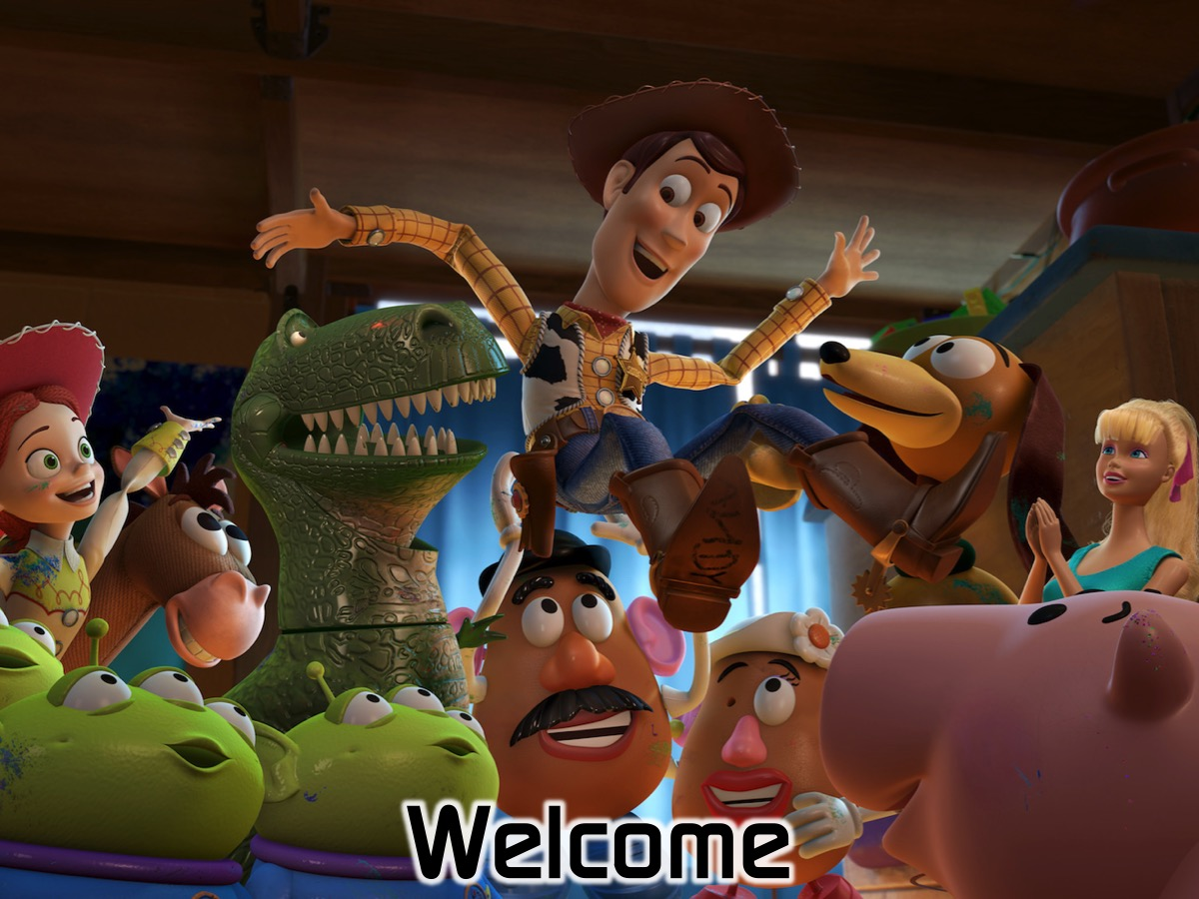
Notes:
Welcome to newcomers and regulars.

Slide 3
Notes:
Tonight is our Barn Dance night.

Slide 4

Notes:
Welcome to our Dance Instructor from Blundell Dance. We have booked for Blundell Barn Dancing to run our night - their contact number is: 011-7875476 or 0834564135.

Slide 5
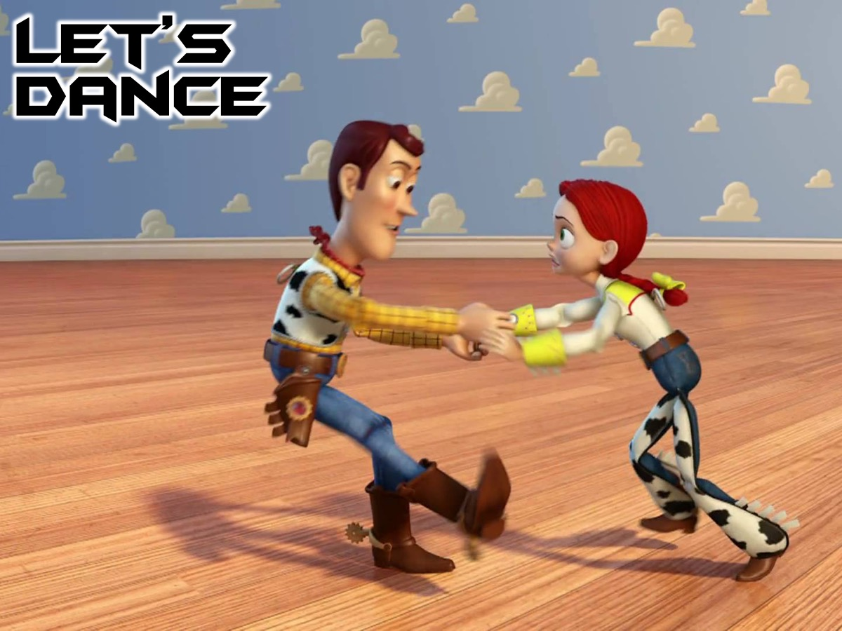
Notes:
Let’s Dance

Slide 6
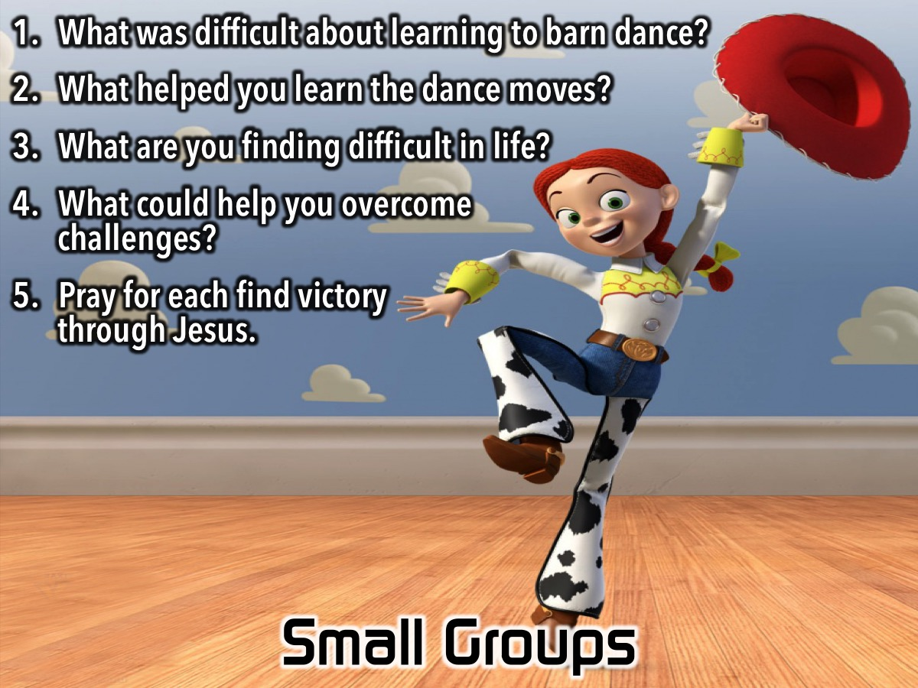
Notes:
Small Group Questions: (1) What was difficult about learning the barn dances? (2) What helped you learn the dance moves? (3) What are you finding difficult in life? (4) What could help you overcome challenges? (5) Pray for each other to find victory through Jesus. Small Group Leader Notes: On Sunday morning the message is all about discipline of Guidance - how God leads us in life and particulary how He grows our character. Your goal is to help your small group to think about things that God places in our lives to help us overcome challenges and grow our character so that we can experience victory.

Slide 7

Notes:
On Sundays we are presenting the Workout Series where we will be exploring spiritual disciplines that will help us get fit spiritually!

Slide 8

Notes:
Next Friday night is our Boot Camp night.

Slide 9
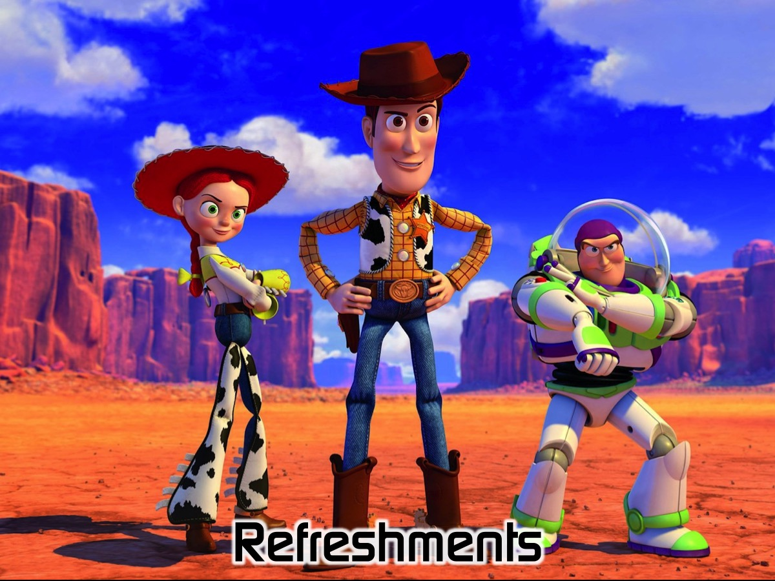
Notes:
It is time for Refreshments.

