Slide 1
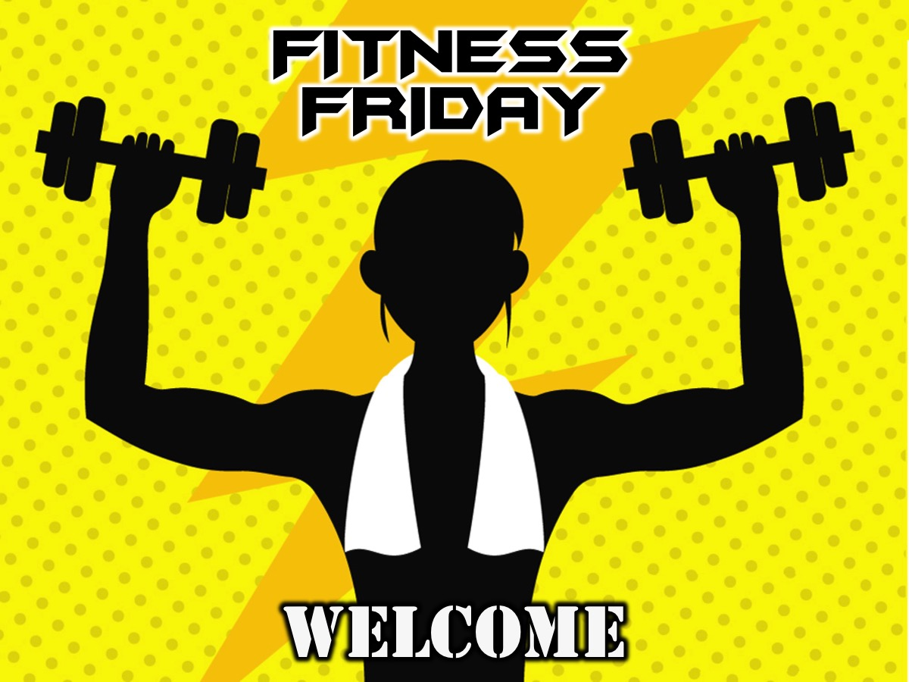
Notes:
Slide to show when teens are arriving until the MC kicks things off on stage

Slide 2
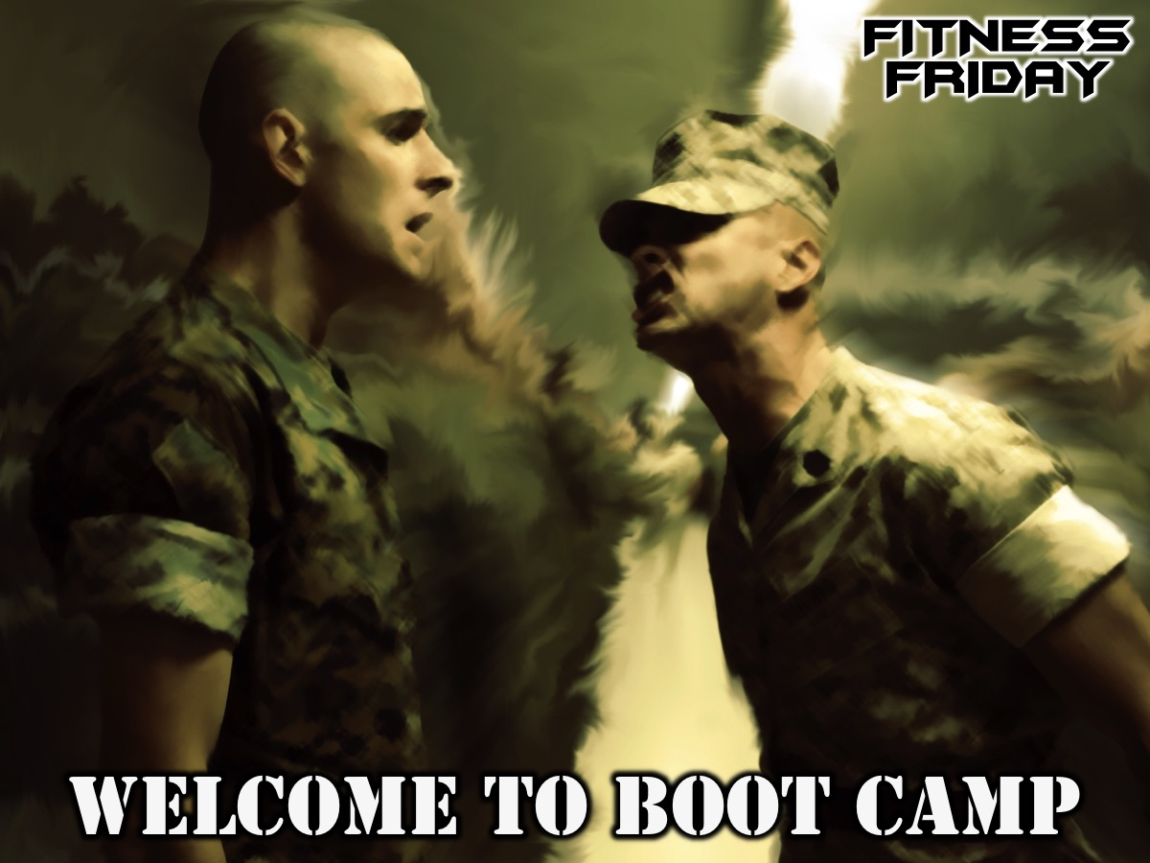
Notes:
Welcome to Boot Camp - welcome to newcomers and regulars.

Slide 3
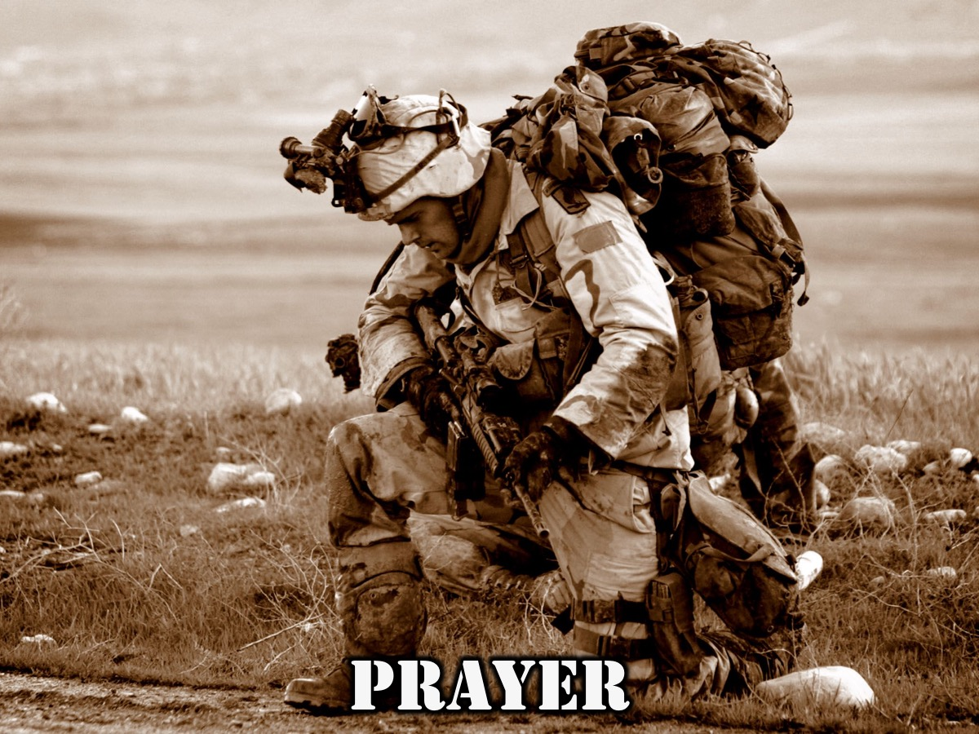
Notes:
Let’s open our meeting in Prayer.

Slide 4
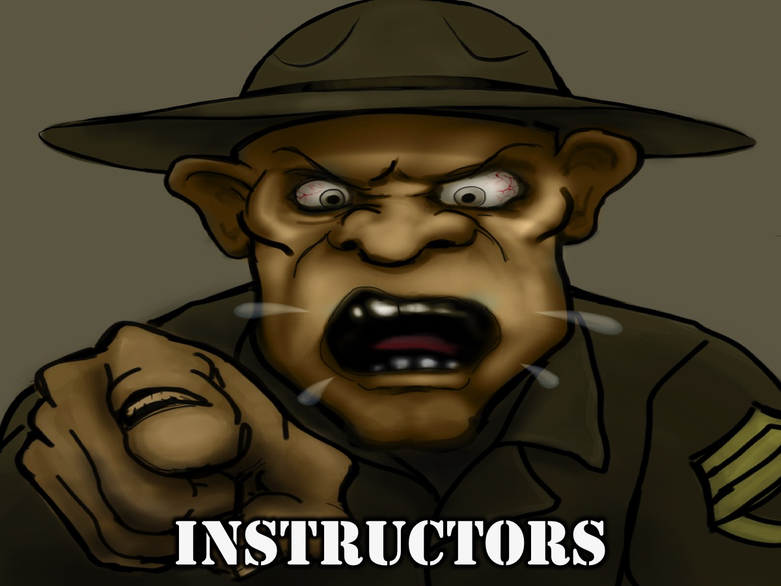
Notes:
It is time to meet your Instructors.

Slide 5
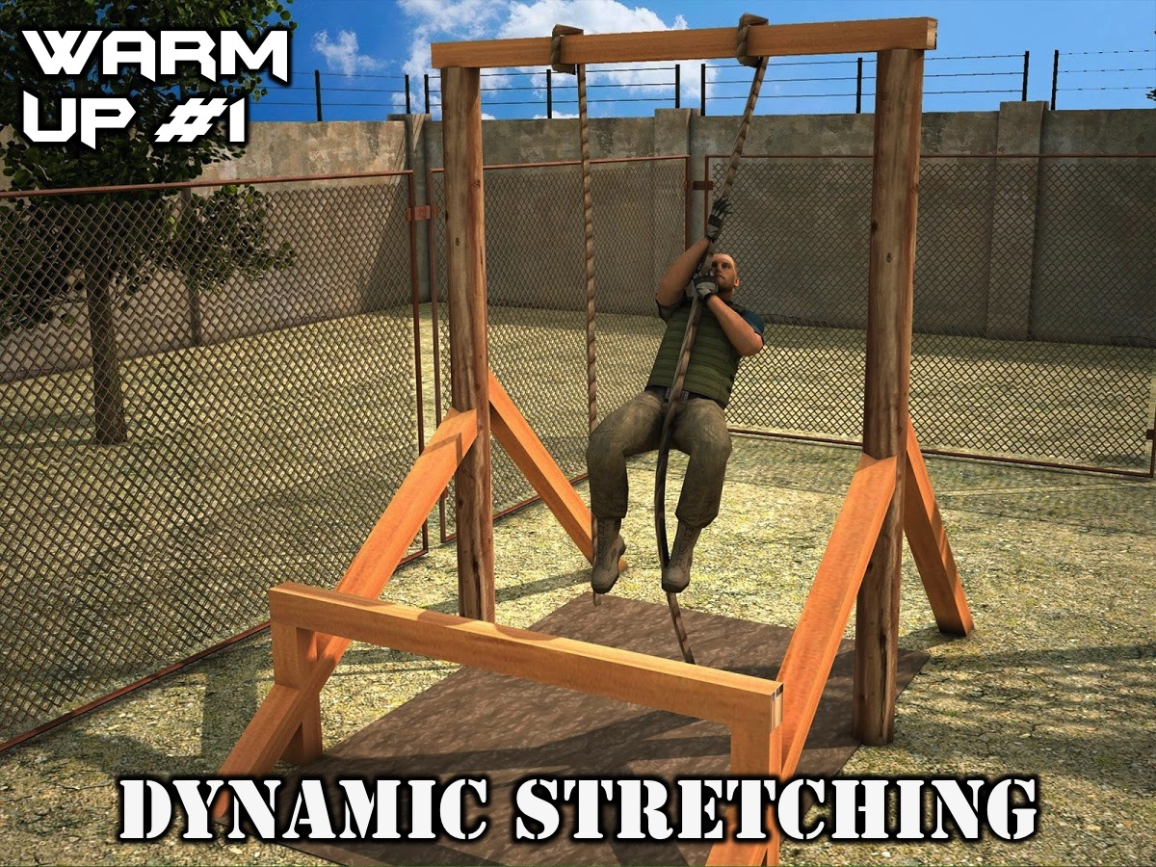
Notes:
Warm Up #1: Dynamic Stretching: Seal Jacks; Star Jumps; Pogo Hops and Squats; Bunny Hops; Glute Sitting; Scapula Stretching.

Slide 6
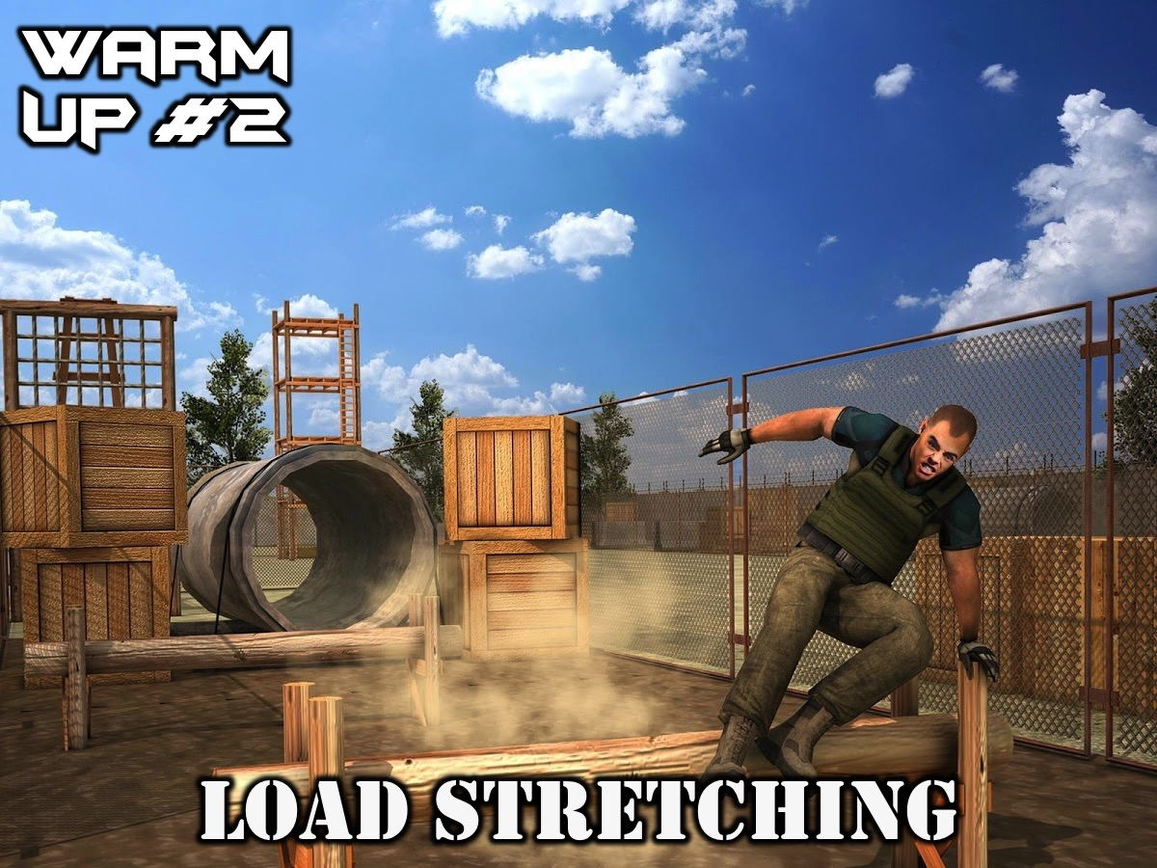
Notes:
Warm Up #2: Load Stretching: Seated Squats; Hamstring Stretches; Hip Flexor Stretches.

Slide 7

Notes:
Alpha Company: In five minutes you will do two sets of the following: Mass Squats; Tuck Jumps and Push Ups.

Slide 8
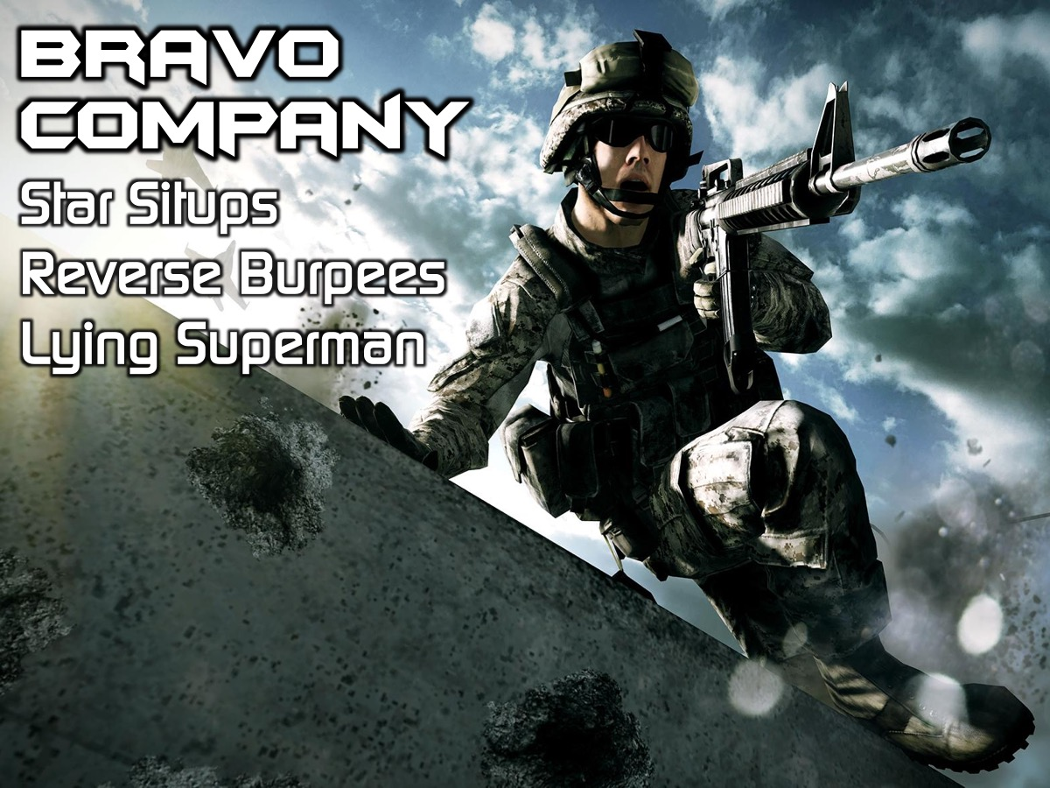
Notes:
Bravo Company: In five minutes you will do two sets of the following: Star Situps; Reverse Burpees and Lying Superman.

Slide 9
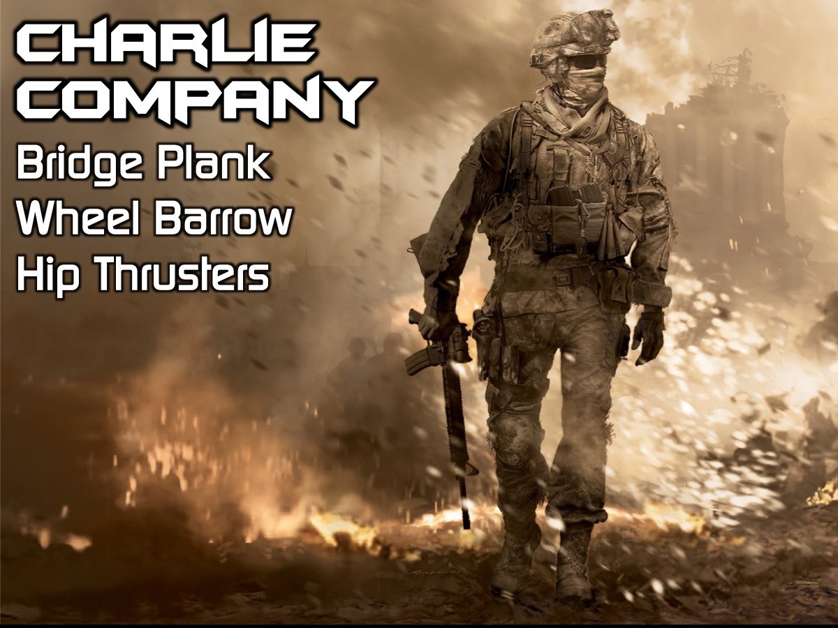
Notes:
Charlie Company: In five minutes you will two sets of the following: Bridge Plank; Wheel Barrow and Hip Thrusters.

Slide 10
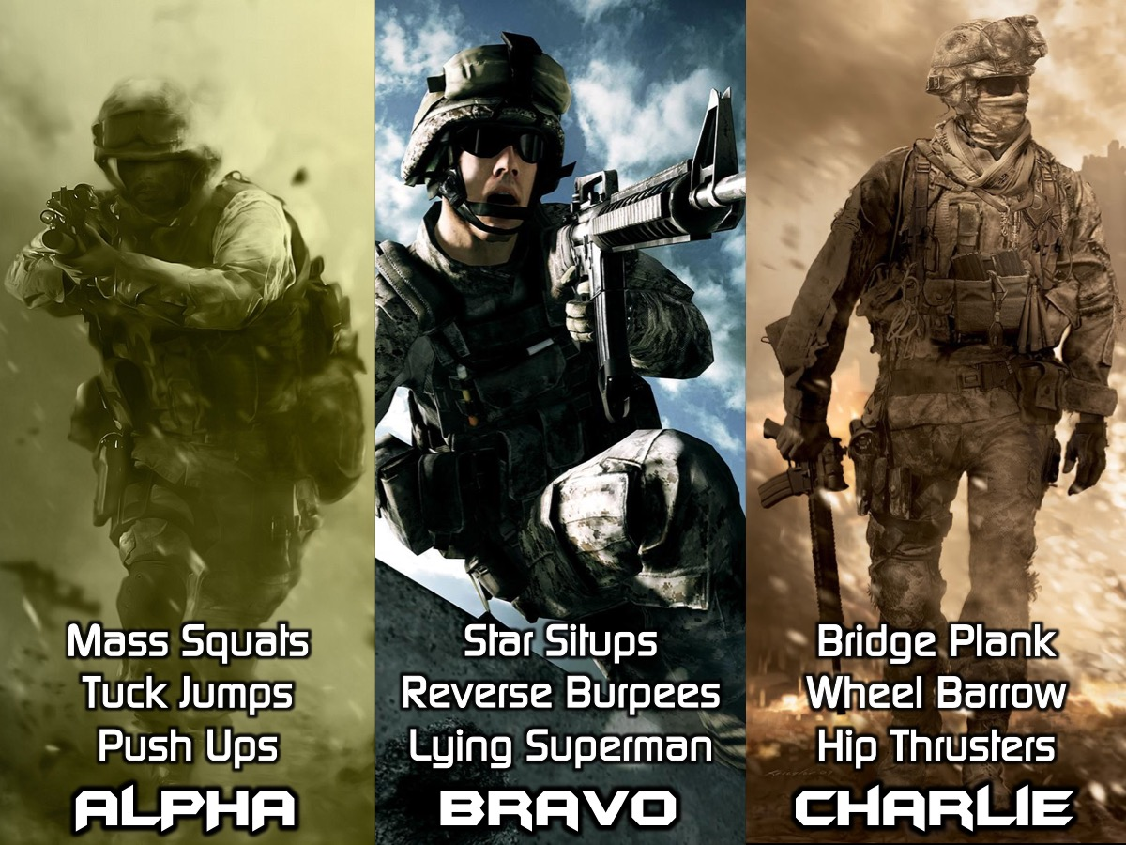
Notes:
You are going to spend 10 minutes at each of the 3 training companies - rotating in a clockwise direction.

Slide 11
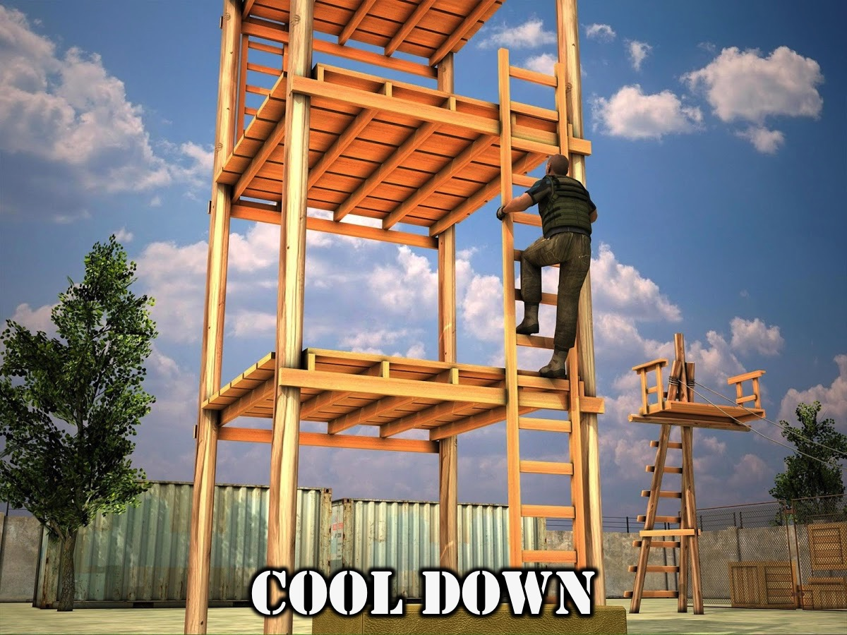
Notes:
Cool Down: Quad Stretches; Lower Back Stretches; Glute Stretches; Seated Squats; Hip Flexor Stretches; Hamstring Stretches.

Slide 12
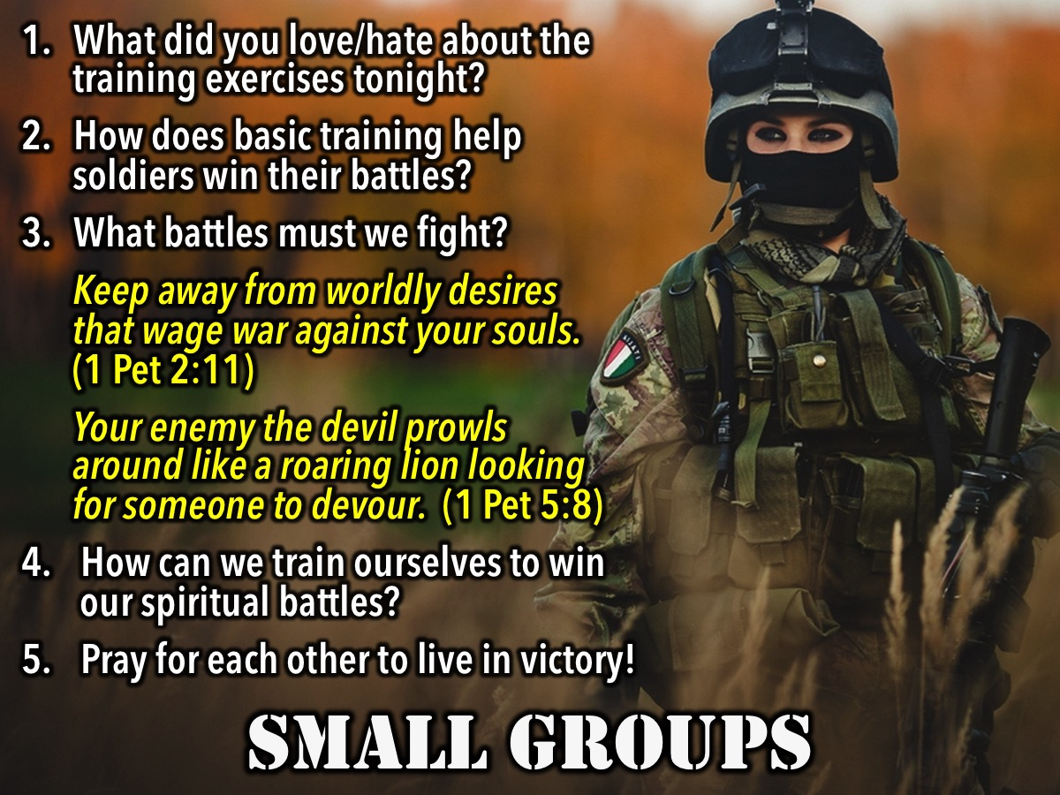
Notes:
Small Group Questions: (1) What did you love/hate about the training exercises tonight? (2) How does basic training help soldiers win their battles? (3) What battles must we fight? Keep away from worldly desires that wage war against your souls. (1 Peter 2:11). Your enemy the devil prowls around like a roaring lion looking for someone to devour. (1 Peter 5:8). (4) How can we train ourselves to win our spiritual battles? (5) Pray for each other to live in victory!

Slide 13

Notes:
On Sundays we are presenting the Workout Series where we will be exploring spiritual disciplines that will help us get fit spiritually!

Slide 14
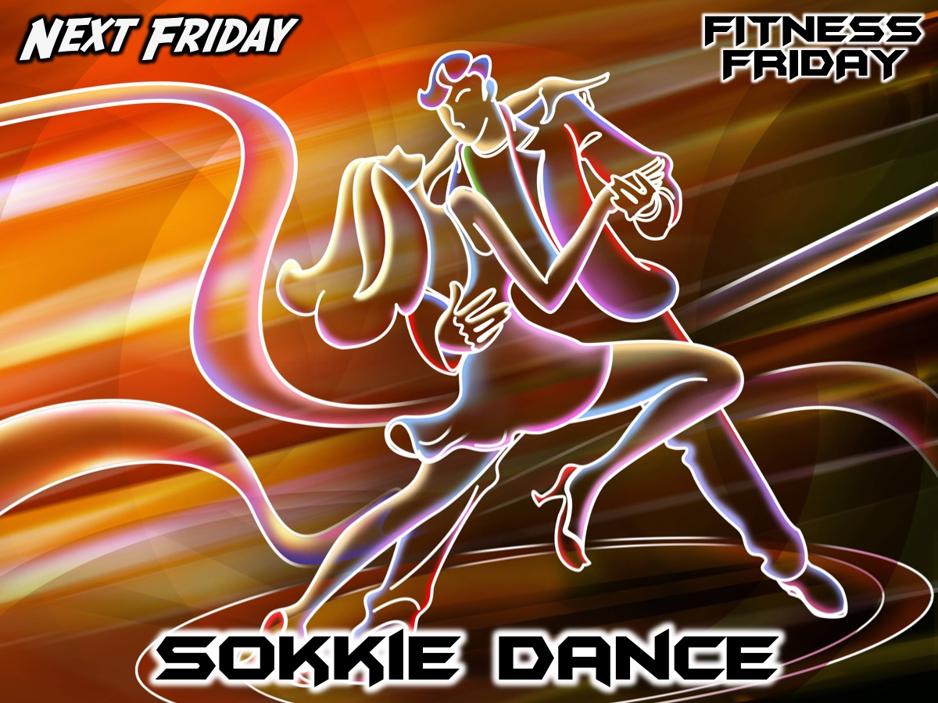
Notes:
Next Friday night is our Sokkie Dance night.

Slide 15
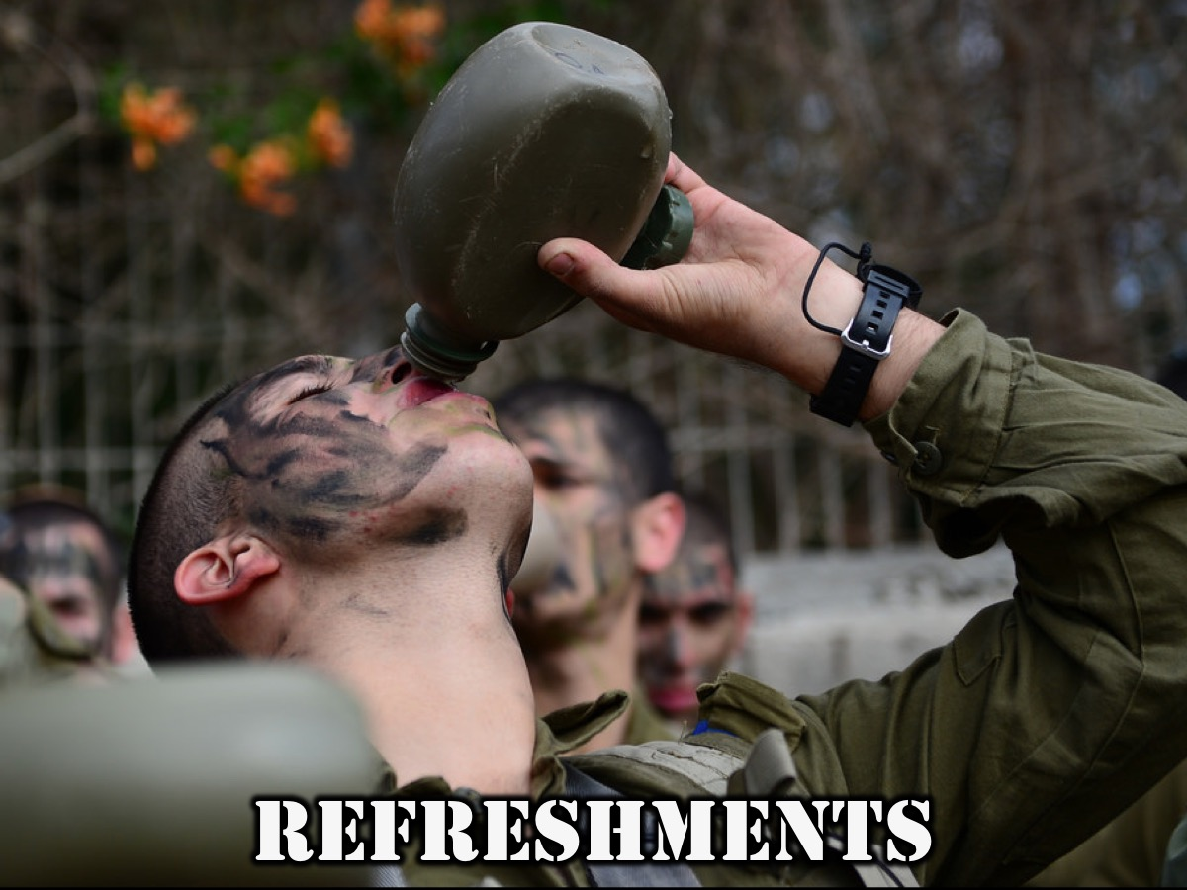
Notes:
It is time for Refreshments.

