Slide 1

Notes:
Welcome to our Sokkie Dance Night - welcome to newcomers and regulars.

Slide 2

Notes:
Let’s open our meeting in Prayer.

Slide 3
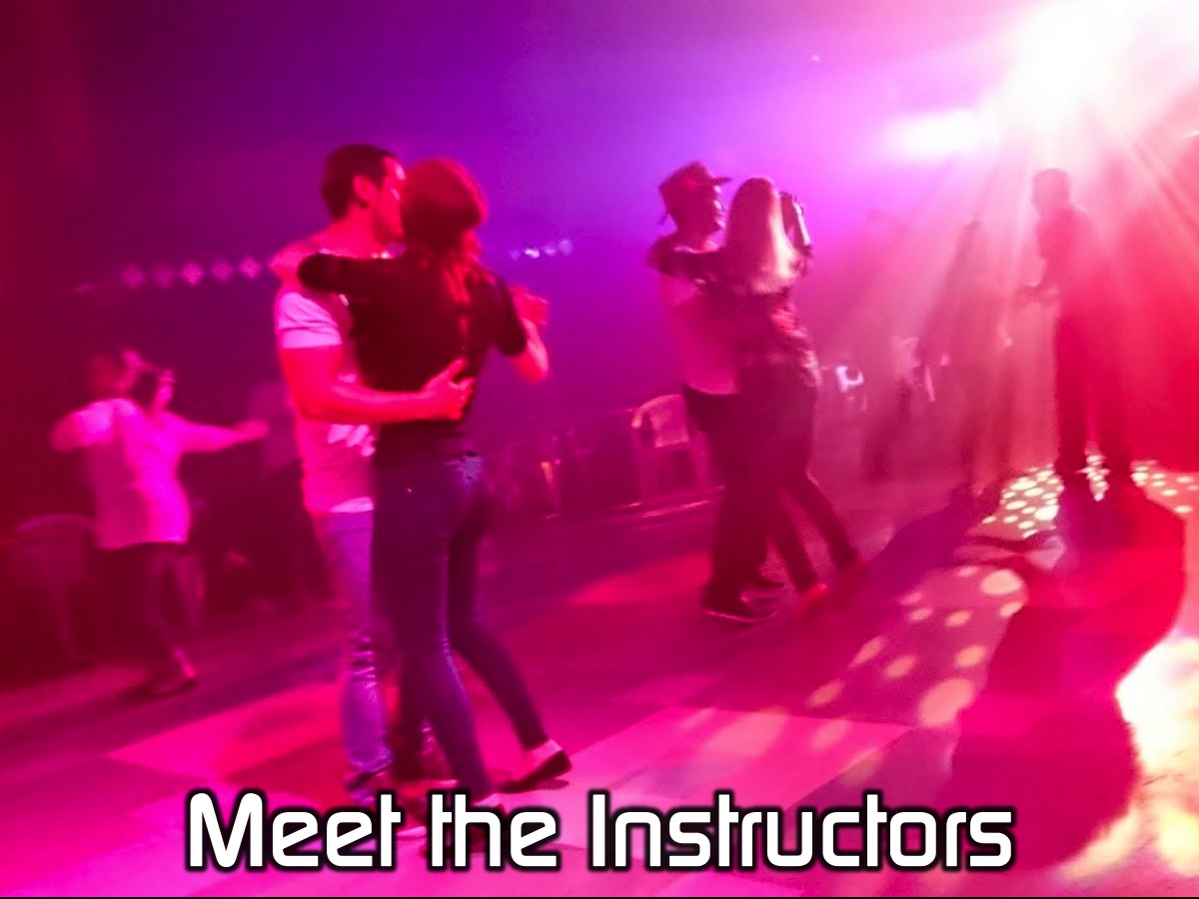
Notes:
It is time to meet your Instructors.

Slide 4

Notes:
Let’s Sokkie!

Slide 5
Notes:
Instruction Video: Sokkie Basic. Get it on YouTube at: https://www.youtube.com/watch?v=kycRqEKMQFM

Slide 6
Notes:
Let’s Sokkie!

Slide 7
Notes:
Instruction Video: Sokkie Underarm Turn - Video 2 in Sokkie Series. Get it on YouTube at: https://www.youtube.com/watch?v=Z2_bgwuXw2g

Slide 8
Notes:
Let’s Sokkie!

Slide 9
Notes:
Instruction Video: Sokkie In and Out with Dip. Get it on YouTube at: https://www.youtube.com/watch?v=VQyfESpgG-Q

Slide 10
Notes:
Let’s Sokkie!

Slide 11
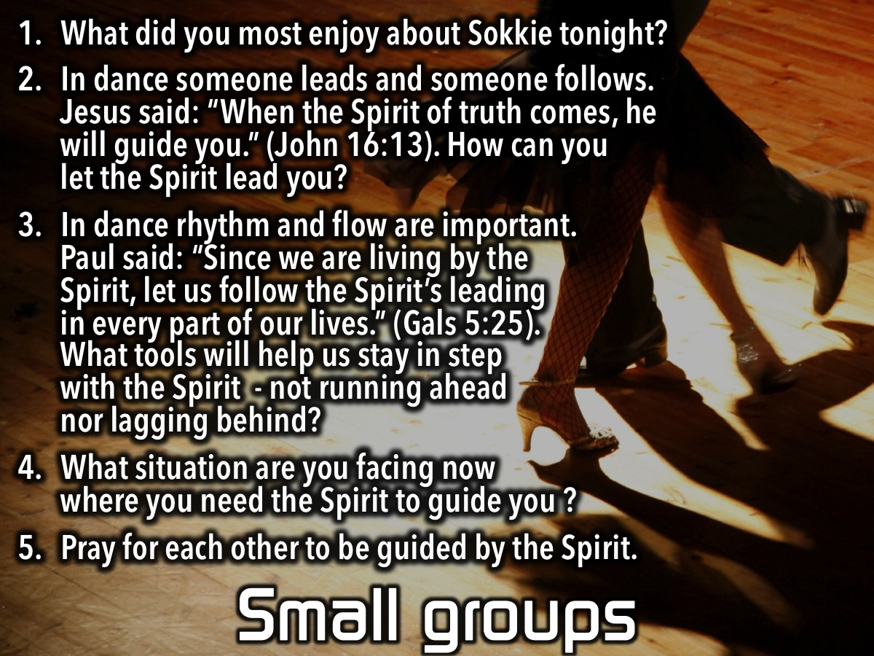
Notes:
Small Group Questions: (1) What did you most enjoy about the Sokkie tonight? (2) In dance someone leads and someone follows. Jesus said: “When the Spirit of truth comes, he will guide you.” (John 16:13). How do you let the Spirit lead you? (3) In dance rhythm and flow are important. Paul said: “Since we are living by the Spirit, let us follow the Spirit’s leading in every part of our lives.” (Galatians 5:25). What tools will help us stay in step with the Spirit - not running ahead nor lagging behind? (4) What situation are you facing where you need the Spirit to guide you? (5) Pray for each other to be guided by the Spirit.

Slide 12

Notes:
On Sundays we are presenting the Workout Series where we will be exploring spiritual disciplines that will help us get fit spiritually!

Slide 13

Notes:
Next Friday night is our Olympic Games night.

Slide 14

Notes:
It is time for Refreshments.

