Slide 1

Notes:
Welcome to our Olympics Games Night - welcome to newcomers and regulars.
Supplies Needed:
1. Masking tape (2 Rolls)
2. Paper plates (20)
3. Straws (20)
4. Spaghetti (1 pack)
5. Balls (6)
6. Print Country Flags on A3 Paper
7. Toilet Rolls (2)
8. Tennis Balls (6)
9. Newspapers (2)

Slide 2
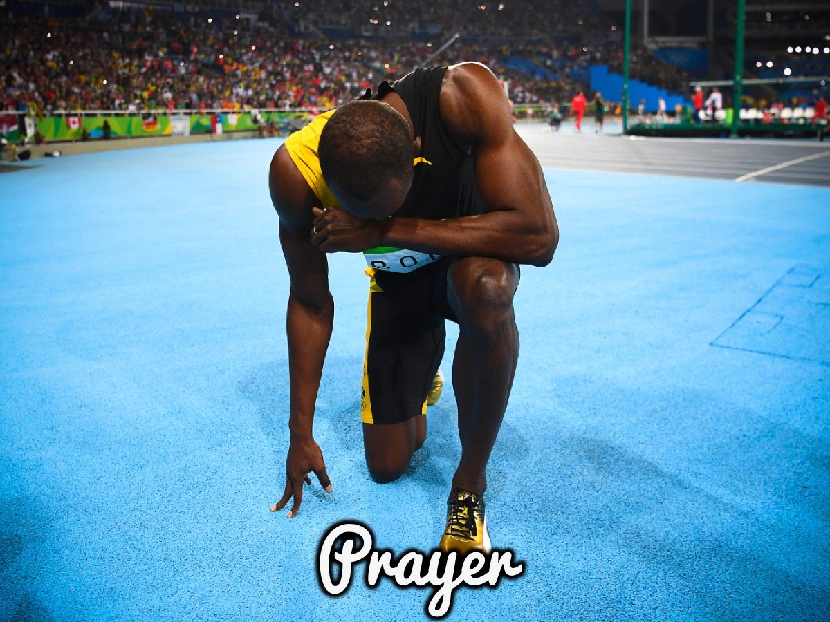
Notes:
Let’s open our meeting in Prayer.

Slide 3
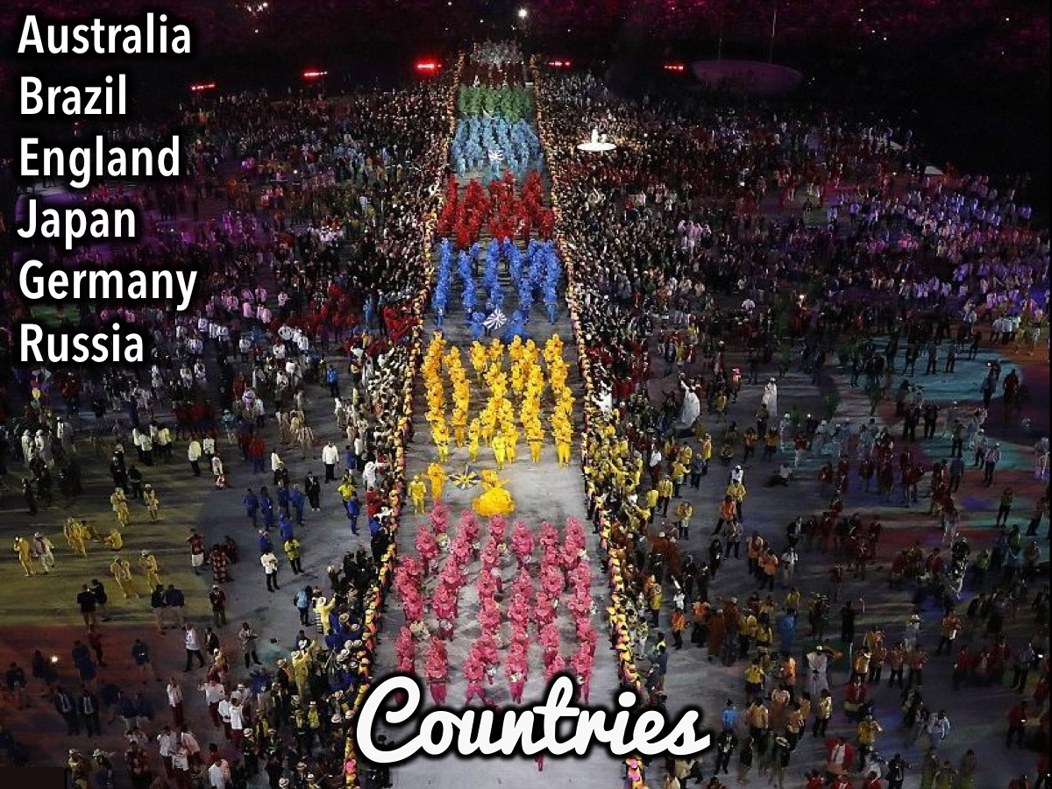
Notes:
Divide into 6 Countries: Australia, Brazil, England, Japan, Germany and Russia.

Slide 4
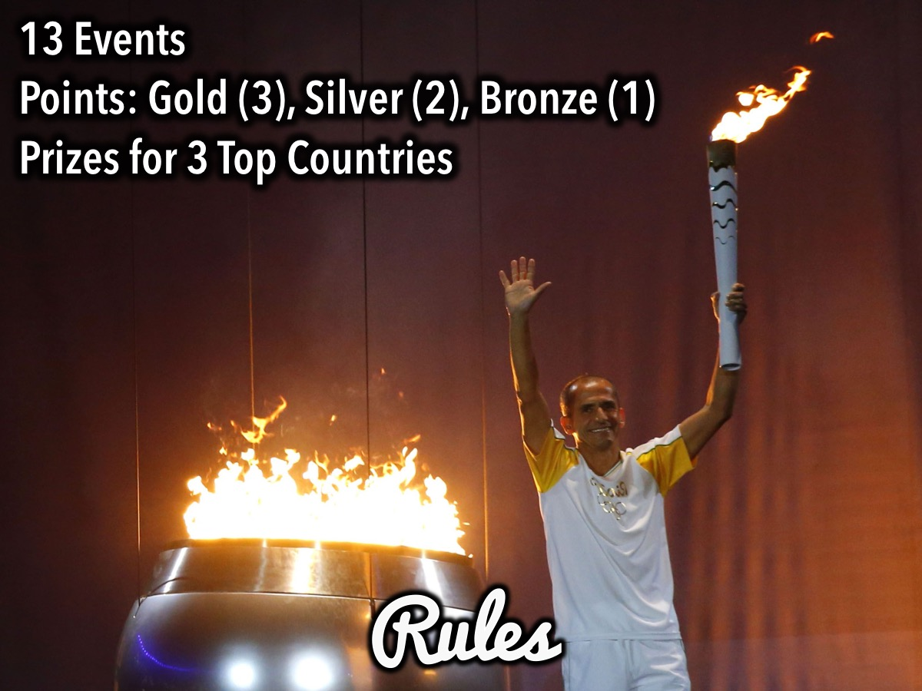
Notes:
Rules: Each game will result in one of 3 medals awarded: Gold, Silver and Bronze. The winning team at the end is the team with the most points (In each round, Gold is 3 points, Silver is 2 points and Bronze is 1 point). Use the graffiti wall as a giant scoreboard. There will be prizes for the three top scoring countries: Gold, Silver and Bronze.

Slide 5

Notes:
Let the Games Begin!

Slide 6
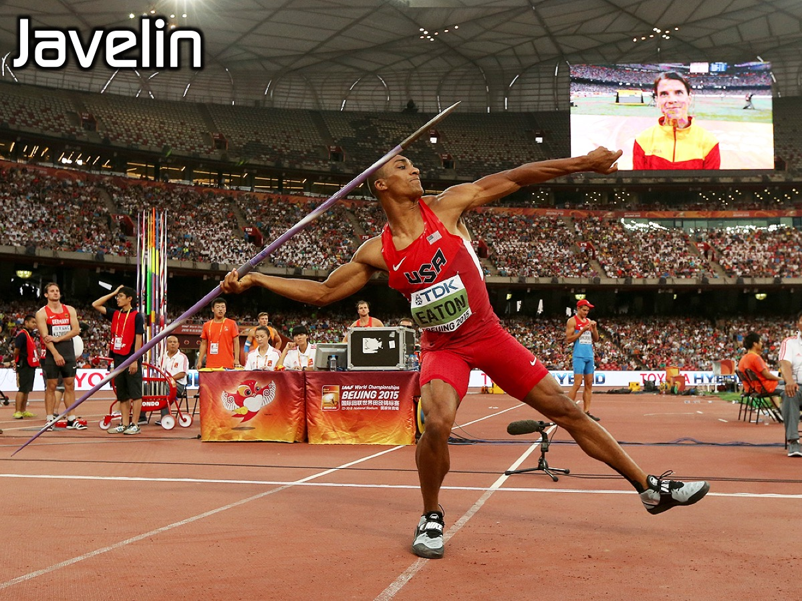
Notes:
1. Javelin. Each country sends 1 contestant who has to see how far they can throw a straw.

Slide 7
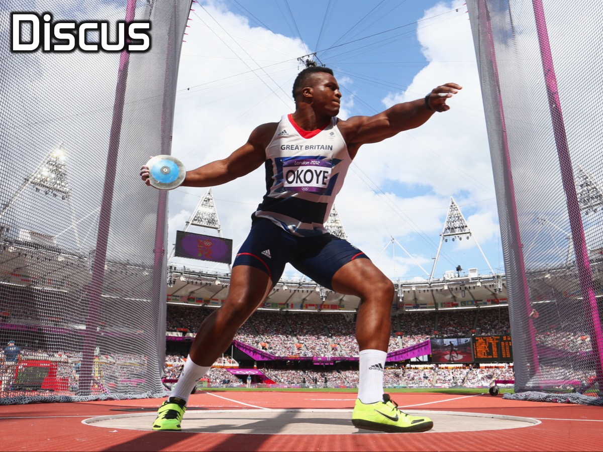
Notes:
2. Discus. Each country sends 1 contestant who has to see how far they can throw a paper plate.

Slide 8

Notes:
3. High Jump. Each country sends 1 contestant who has to jump from a standing position up against a wall and make a mark with their index finger that has been marked with the green chalk used for Pool.

Slide 9
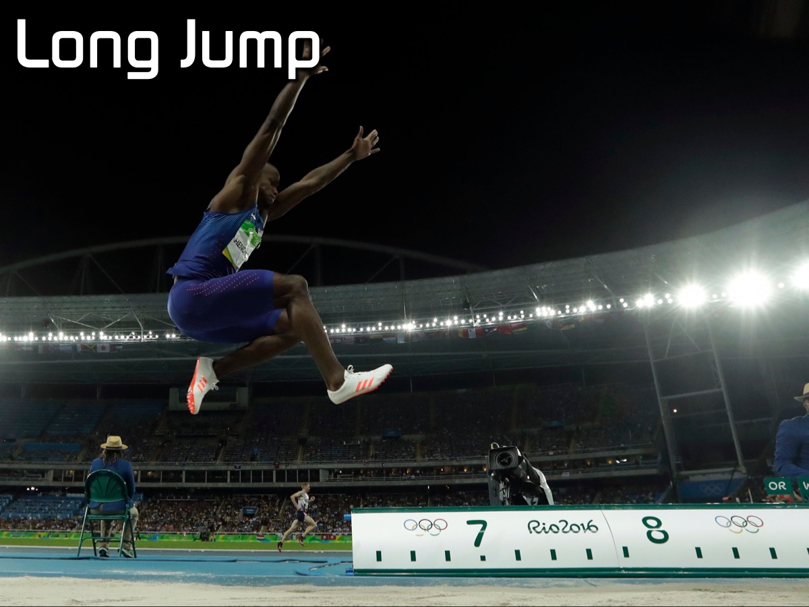
Notes:
4. Long Jump. Each country sends 1 contestant to jump from a standing position (mark their positions with chalk)

Slide 10
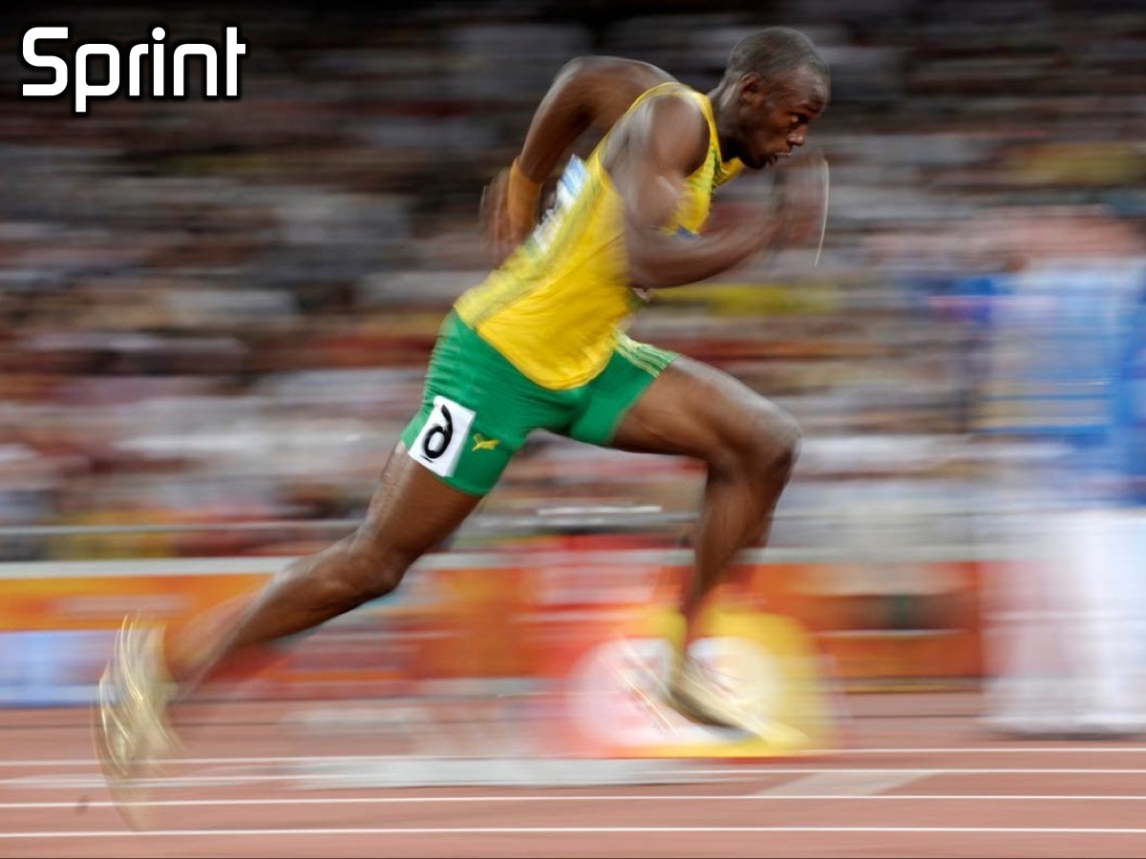
Notes:
5. Sprint. Each country sends 1 contestant who has to run a marked distance and back a few times.

Slide 11
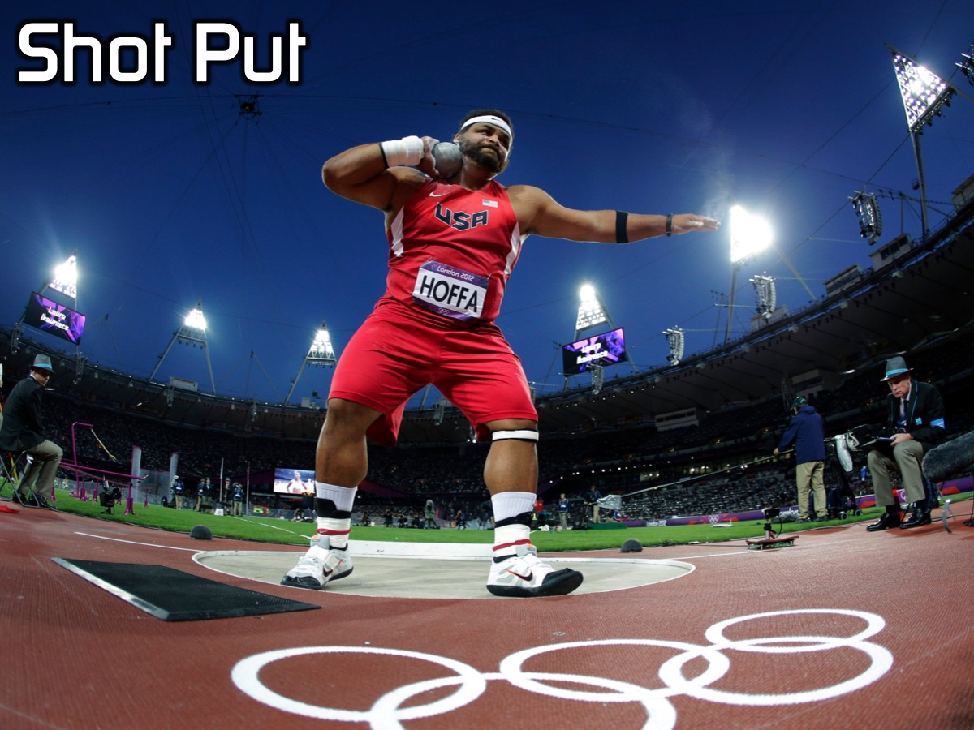
Notes:
6. Shot Put. Each country sends 1 contestant who has to see how far they can throw the shot (rolled up toilet paper).

Slide 12
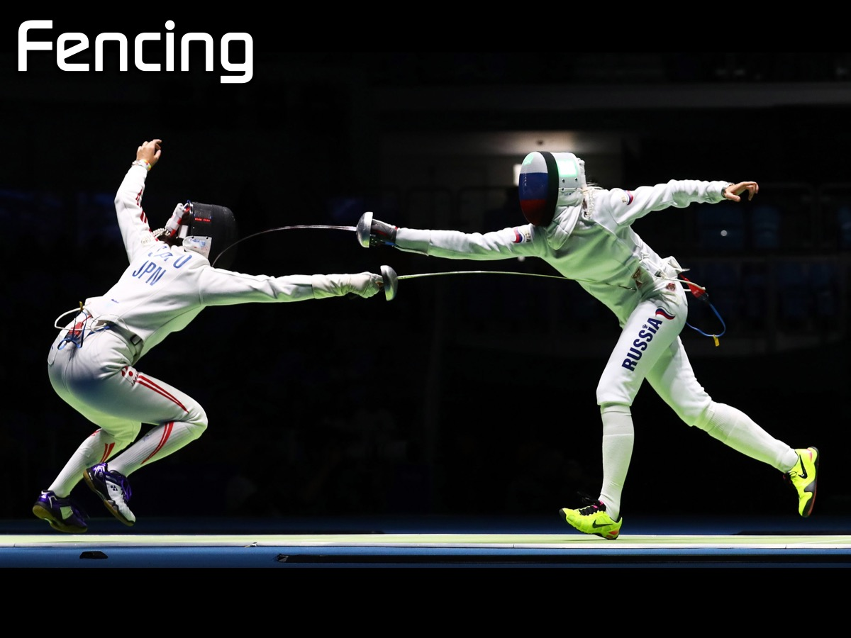
Notes:
7. Fencing. Each country sends 1 contestant and they have to try and break their opponents spaghetti without having their own broken.

Slide 13
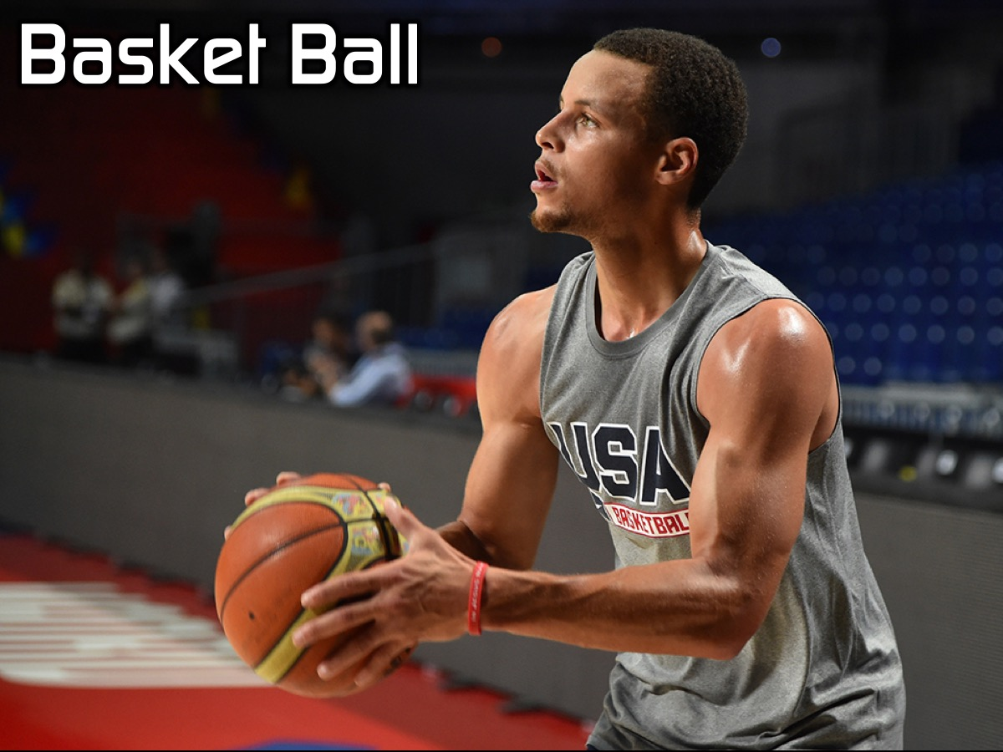
Notes:
8. Basketball. Each country sends one contestant to throw a ball to a person standing on a chair on the other side of the room. If the ball is caught they get a point. Each team gets 3 shots.

Slide 14
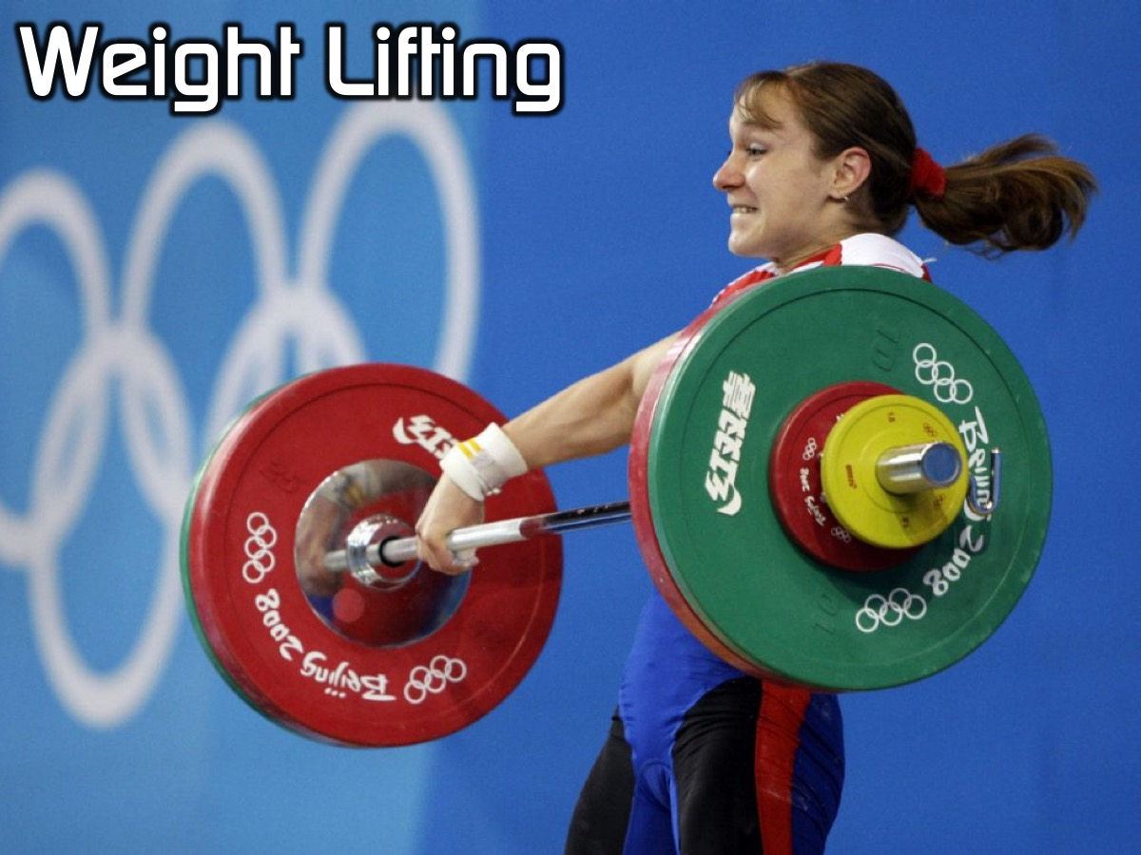
Notes:
9. Weightlifting. Each country sends one person to hold a chair out in front of them to see which teams last the longest.

Slide 15
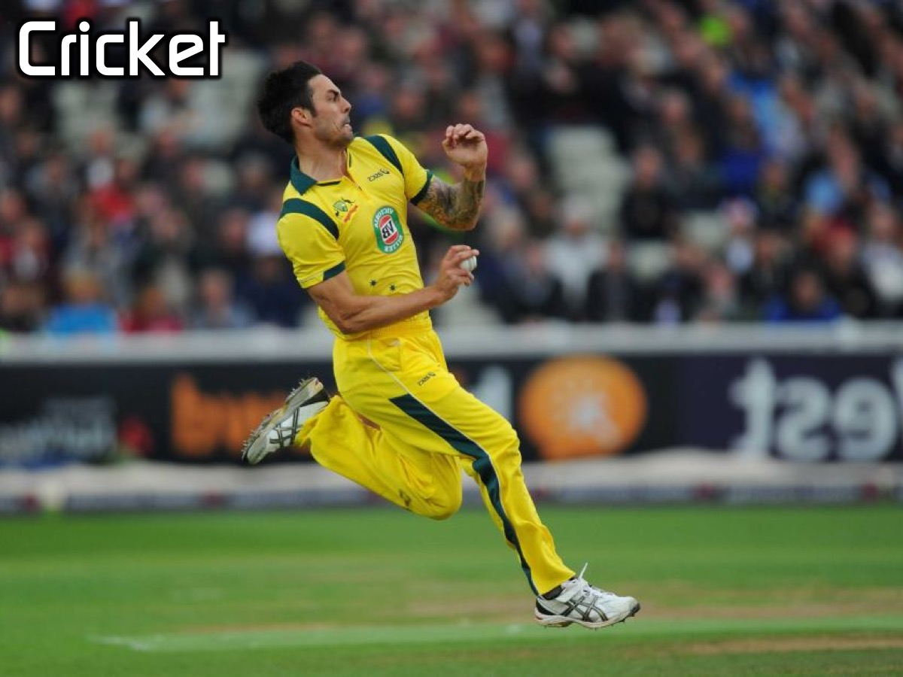
Notes:
10. Cricket. Each country sends one contestant to bowl a ball at a set of stumps. They bowl 3 balls.

Slide 16
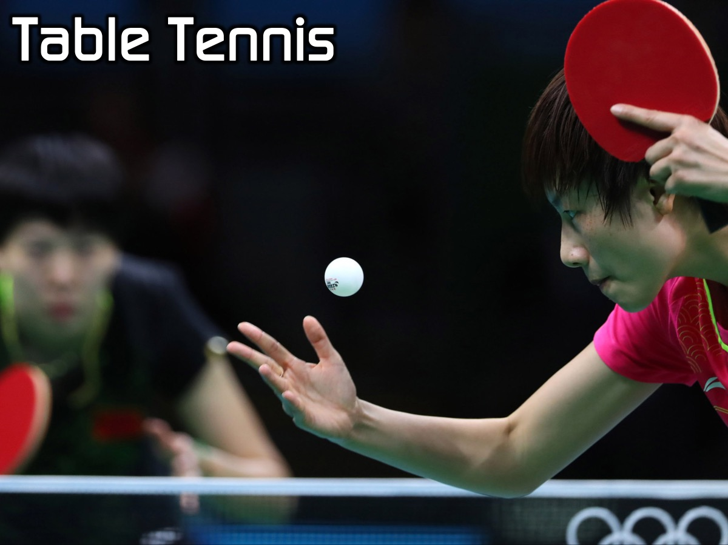
Notes:
11. Table Tennis. Each country sends one person to play table tennis in a first to 5 points game. Move the table into the middle of the room.

Slide 17
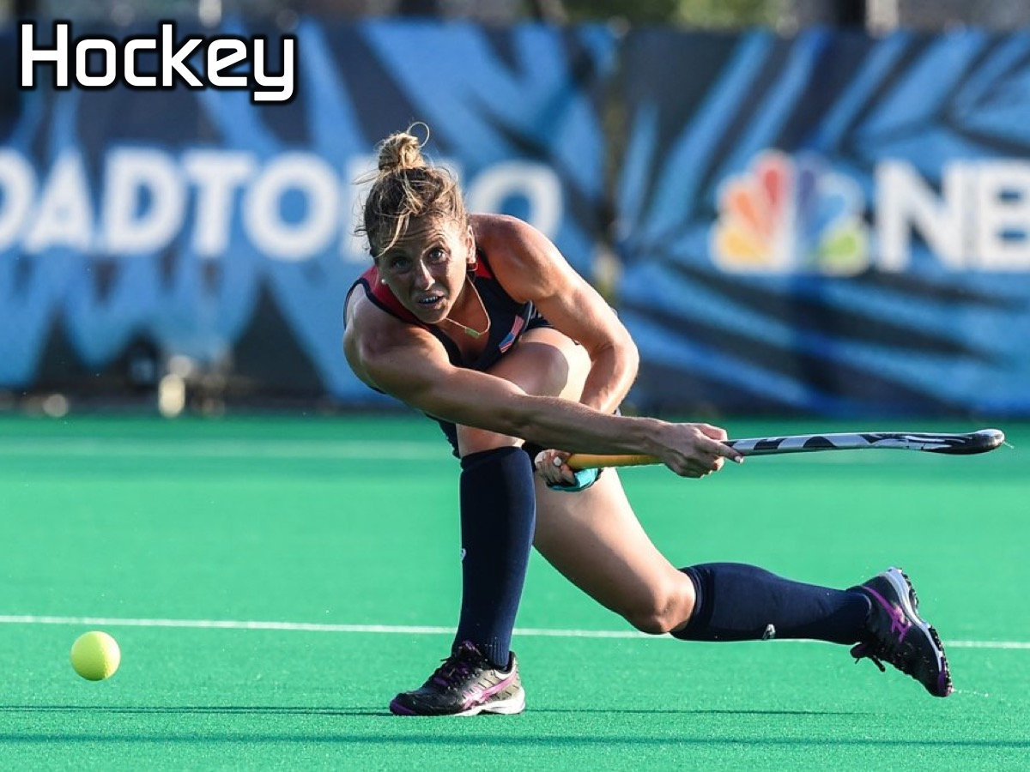
Notes:
12. Hockey. Each country sends one person to hit a ball into goals set up on the other side of the room. They have 3 tries and goals are counted. Use rolled up newspaper as hockey sticks and a tennis ball.

Slide 18
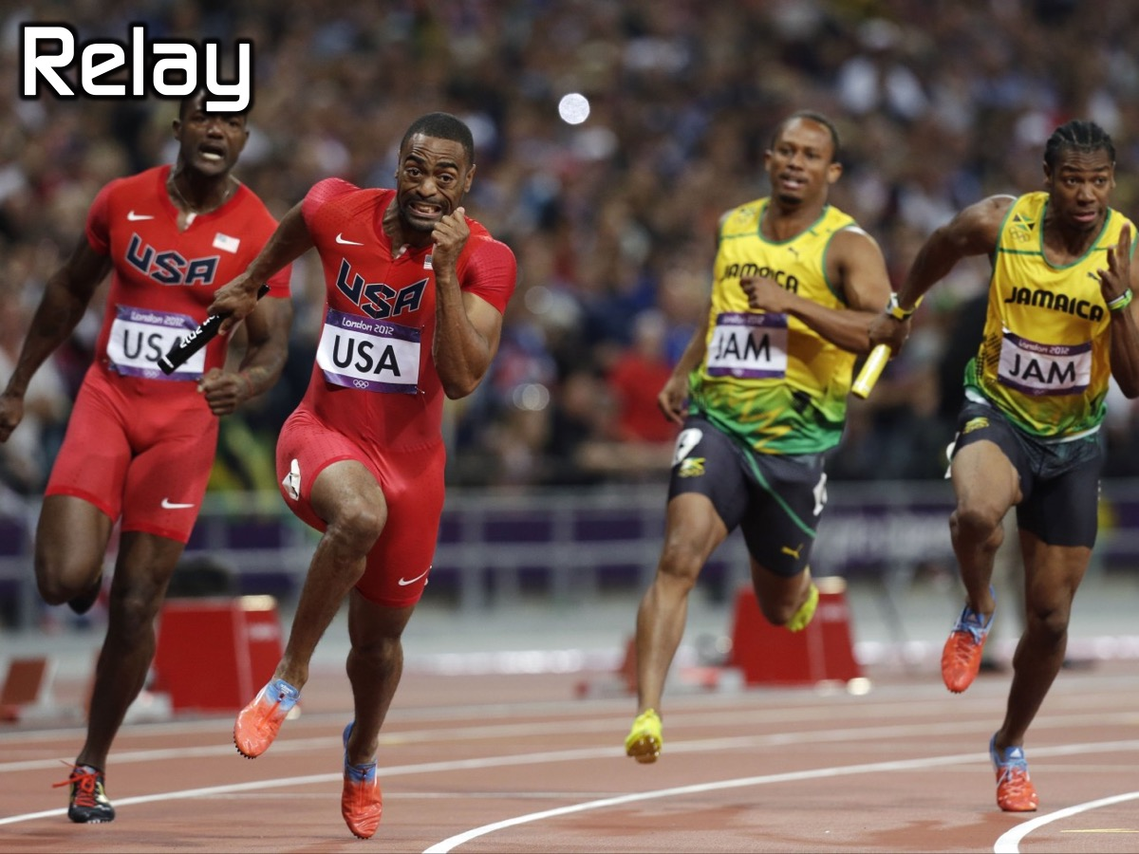
Notes:
13. Relay. The whole country stands in a line and has to pass a ball over their heads and through their legs from the front person to the back person and back again to see which teams come first, second or third.

Slide 19

Notes:
Winners: Third, Second and First place countries are announced and given prizes.

Slide 20

Notes:
Small Group Questions: (1) What did you most enjoy about competing tonight? (2) What do these verses say about competing in life? Don’t you realize that in a race everyone runs, but only one person gets the prize? So run to win! All athletes are disciplined in their training. They do it to win a prize that will fade away, but we do it for an eternal prize. (1 Cor 9:24-26). Because we are surrounded by such a huge crowd of witnesses to the life of faith, let us strip off every weight that slows us down, especially the sin that so easily trips us up. And let us run with endurance the race God has set before us. We do this by keeping our eyes on Jesus, the champion who initiates and perfects our faith. (Hebrews 12:1-2). (3) What prizes do you think await you in the next life? (4) Thank God for all that he has done for in this life!

Slide 21

Notes:
On Sundays we are presenting the Workout Series where we will be exploring spiritual disciplines that will help us get fit spiritually!

Slide 22
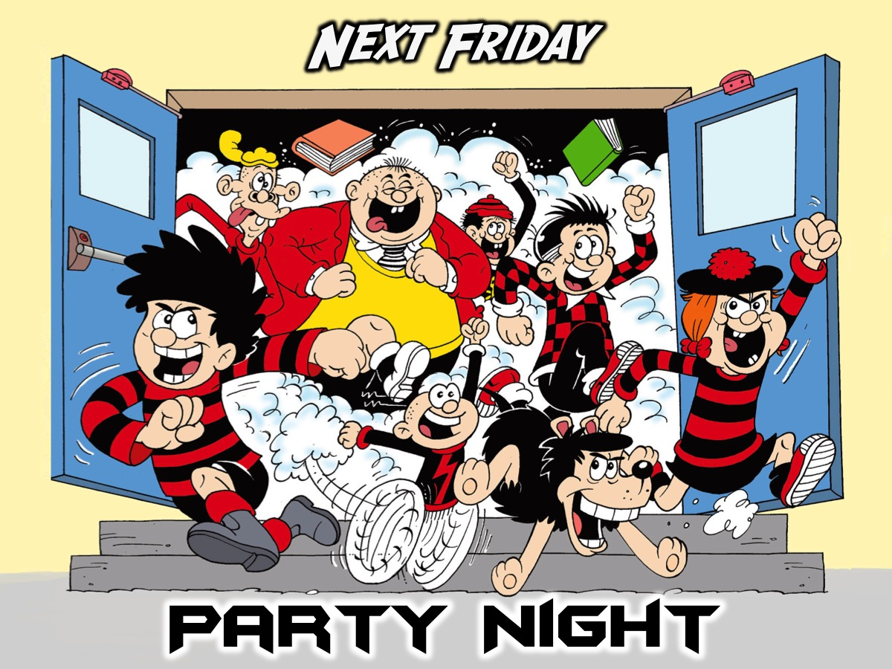
Notes:
Next Friday night is our last night of Term 1 and we end it with a Party Night!

Slide 23

Notes:
It is time for Refreshments.

