Slide 1
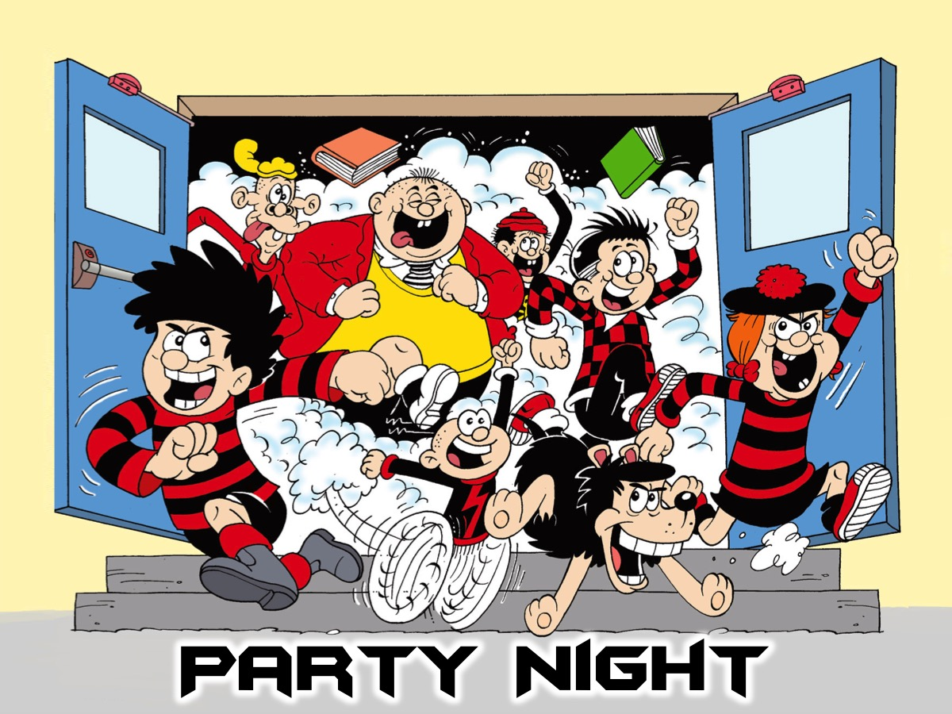
Notes:
Welcome to our Party Night - welcome to newcomers and regulars.

Slide 2
Notes:
Let’s open our meeting in Prayer.

Slide 3
Notes:
Term 1 Rewind - we are going to have some fun remembering all the events that we endured in our Fitness Friday series this term…

Slide 4
Notes:
Chill Out Night

Slide 5
Notes:
Speed Relating: Let’s get into two large circles - the inside circle facing out and the outside circle facing in. Introduce yourself to the person in front of you and take turns answering the question. Then the outside circle will rotate to their right for the next question and repeat until we are done.

Slide 6
Notes:
Question 1: What was your favourite event at youth this term?

Slide 7
Notes:
Question 2: What was the hardest thing that you did on a Friday night this term?

Slide 8
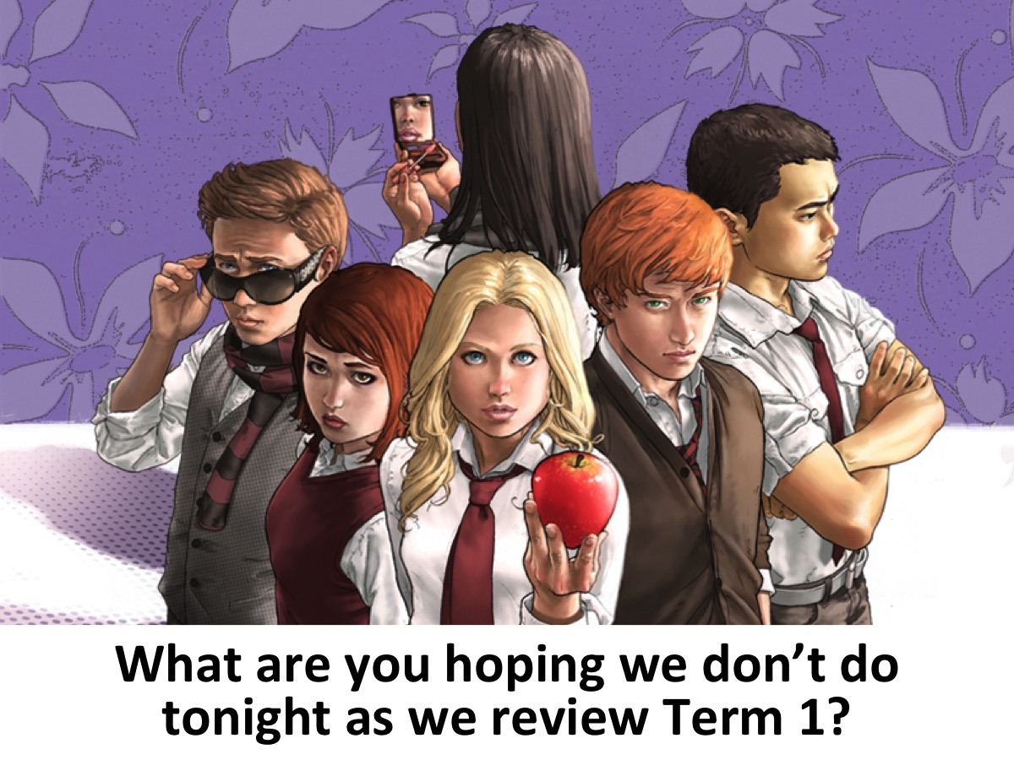
Notes:
Question 3: What are you hoping we don’t do tonight as we review Term 1?

Slide 9
Notes:
Question 4: What have you been challenged about during the events this term?

Slide 10
Notes:
Question 5: What new passion for life have you discovered in this past term?

Slide 11
Notes:
Cross-Fit Night

Slide 12
Notes:
Air Squats. Feet shoulder width apart (heels directly under shoulders) with toes slightly turned out. Weight should be distributed between the heel and mid-foot (heels). Maintaining a neutral spine (flat back), push the hips back then down. While pushing the hips back and down, make sure the knees stay inline with the toes (tracking). At no point should the knees roll inside of the ankle (collapse). Continue to descend until the crease of the hip is below the knee cap (full depth). After achieving full depth, stand to full extension in the hips and knees by driving through the heels.

Slide 13
Notes:
Instruction Video: https://www.youtube.com/watch?v=JKtOS-xIbhg

Slide 14
Notes:
In your own time, complete 10 Air Squats.

Slide 15
Notes:
Dodge Ball Night

Slide 16
Notes:
4 Square Dodge Ball: Instead of playing dodge ball with 2 teams facing each other - we will have four teams playing at the same time in a giant 4-Square field. The twist is that when you are hit with a ball you have to join the team that hit you wth the ball. You are never out!!! We will play for 4 minutes and see which team is the biggest.

Slide 17
Notes:
Martial Arts Night

Slide 19
Notes:
Zumba Dance Night

Slide 20
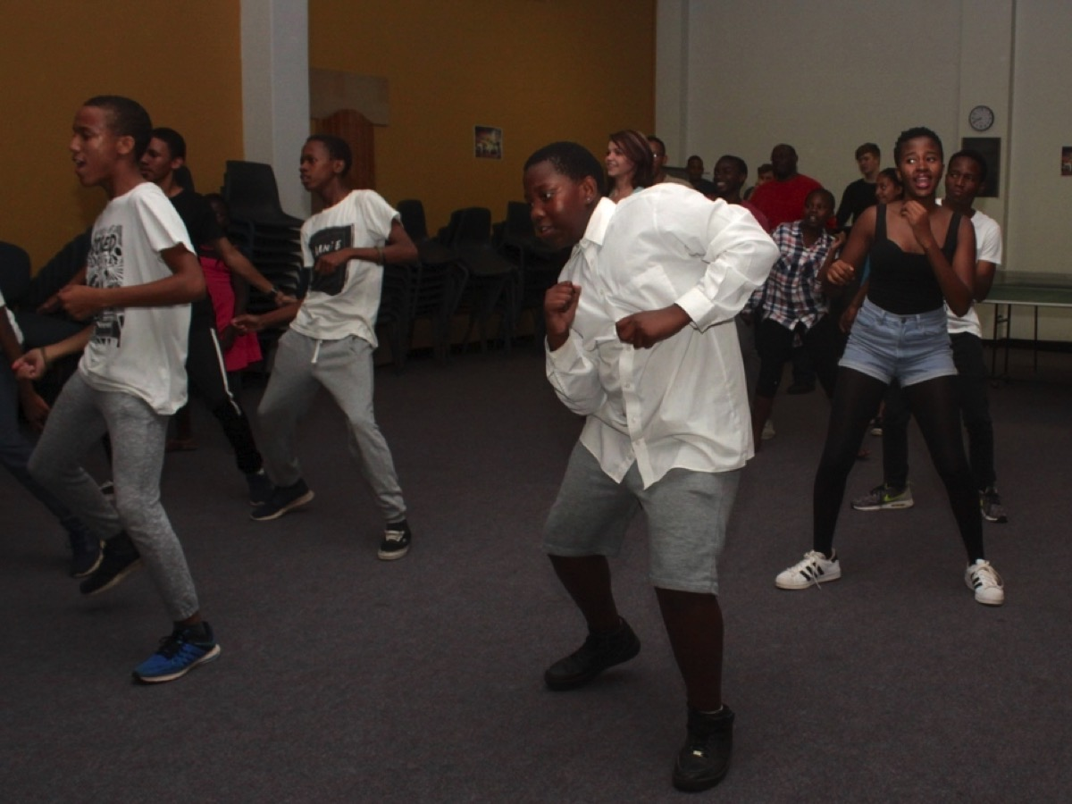

Slide 21
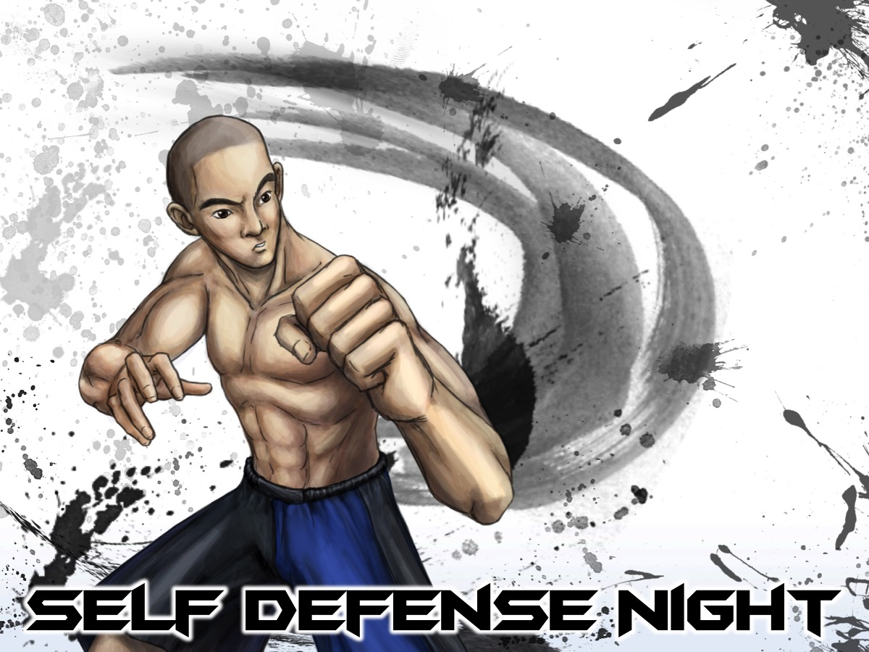
Notes:
Self Defense Night

Slide 22
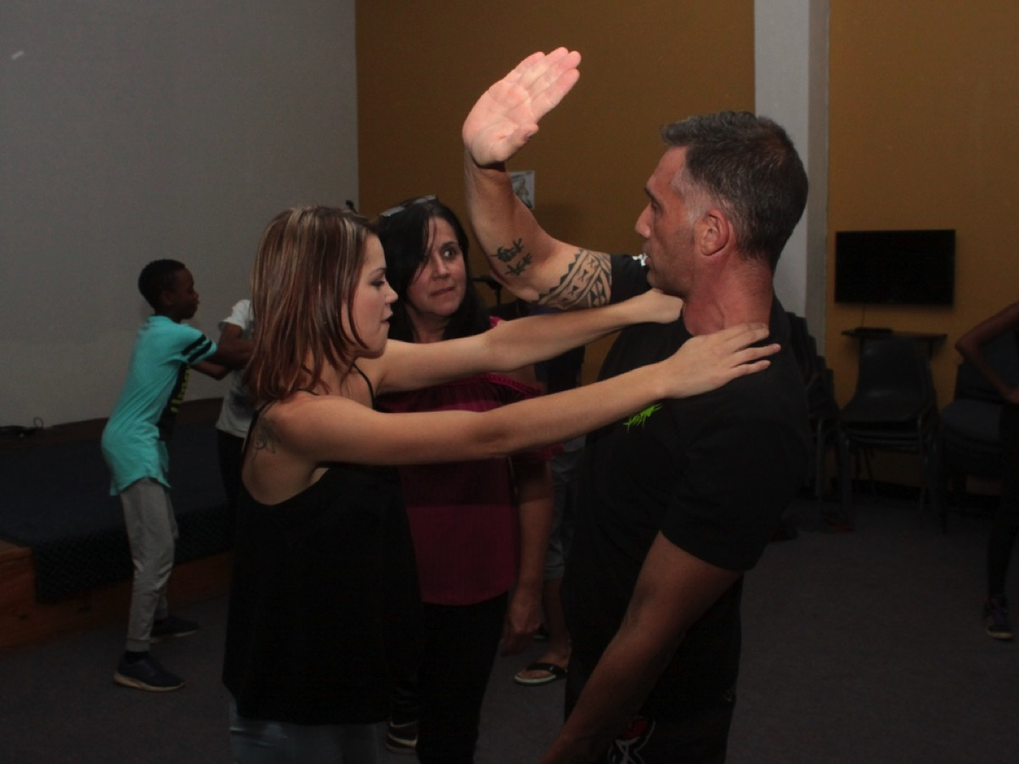

Slide 23
Notes:
Under Ground Night

Slide 25
Notes:
Barn Dance Night

Slide 26
Notes:
Block Dance: On our Barn Dance night we did a South African version of Barn Dance - a Block Dance. Let’s dance!

Slide 27
Notes:
Boot Camp Night.

Slide 28
Notes:
Monkeys and Giraffes: Every one pairs up and stands in a circle. Each group must give in one personal item they have on themselves and the items are placed in the center of the circle. One person in each pair is names a Monkey while the other is named a Giraffe. When the leader calls “Monkey on Giraffe” the Monkey has to jump on the back of the Giraffe. And vice versa. When the leader calls “Monkey Around Giraffe” – the Monkey has to climb around the Giraffe and back onto it’s back without touching the ground (and vice versa). When the leader calls: “Monkey Run” or “Giraffe Run” the person with that name has to run around the outside of the circle until they get back to their partner and then run into the middle of the circle and grab one of the items. The pair who does not grab one of the items has to return to the circle and sit down (they are out). Continue playing until there is a winning pair left over.

Slide 29
Notes:
Sokkie Dance Night

Slide 31
Notes:
Olympic Games Night

Slide 32
Notes:
Over & Under Relay: Divide into four teams. Each team stands in a line and has to pass a ball over their heads and through their legs from the front person to the back person. The person at the back has to bun forward and pass the ball over their heads to the person who was in the front. When each person has run once - the team sits down to show that they are finished.

Slide 33
Notes:
Small Group Questions: (1) What did you most enjoy doing tonight? (2) What one memory will you have of this term? (3) What plans do you have for the holiday break? (4) How can we pray for you as you take a break?

Slide 34
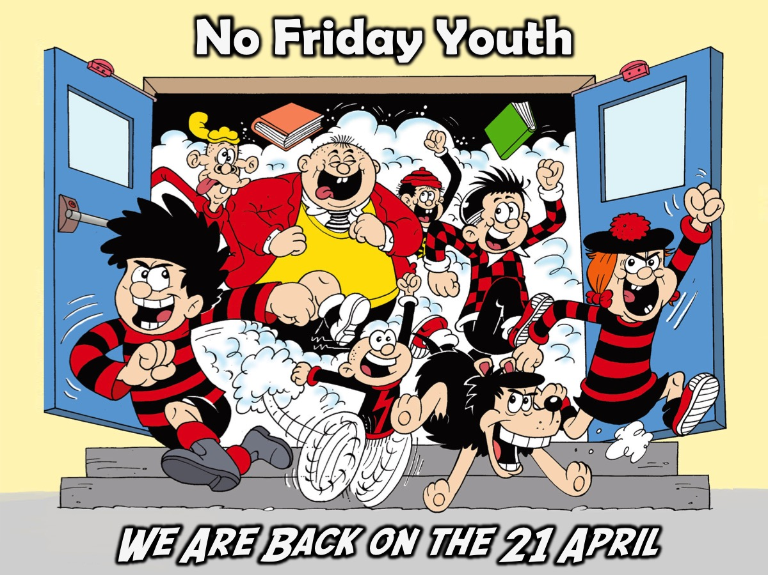
Notes:
There is no Friday Youth until school starts again on the 21st April.

Slide 35
Notes:
There is no Sunday Youth until after school starts again on the 23rd of April.

Slide 36
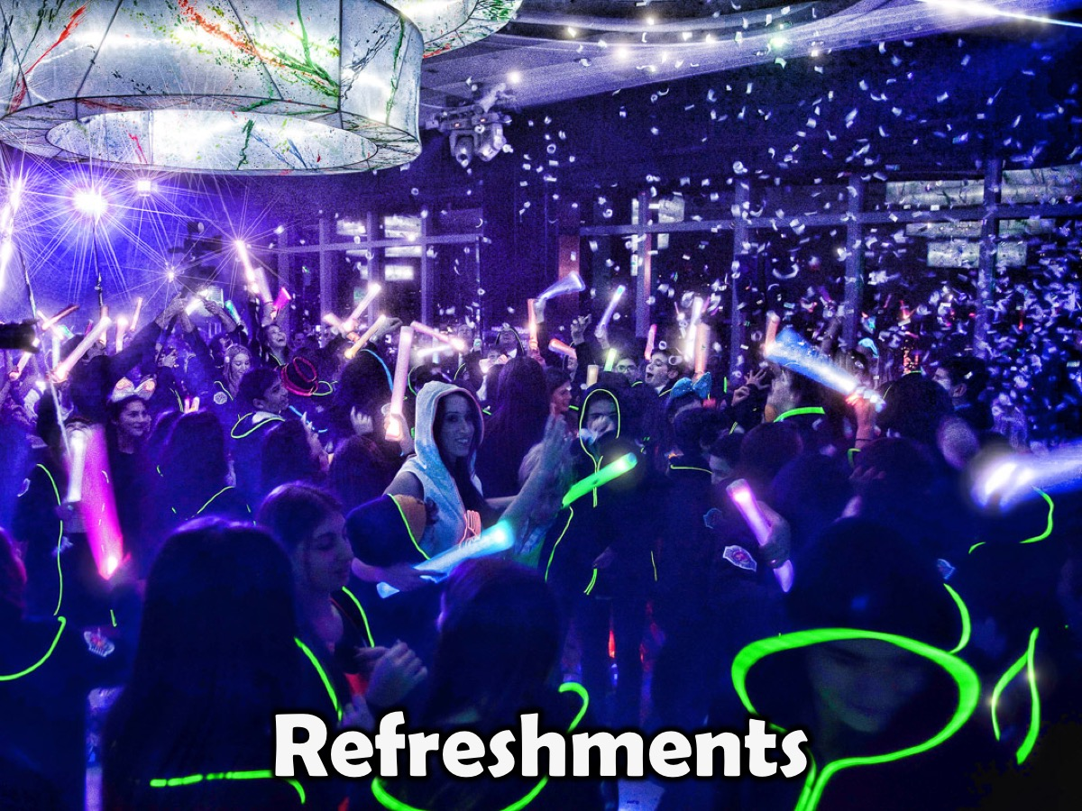
Notes:
It is time for Refreshments. Tonight because it is our end of the term party we are serving Donuts, Chips, Ice Cream Cones and Fizzy Drinks!

