Slide 1

Notes:
GTA Night
Stuff to Get:
* Prizes
* Leaders for games
* 10 Objects
* 4 Flags for Capture the Flag – 2 red and 2 yellow
6 Team Flags

Slide 2

Notes:
Welcome to Live Friday.

Slide 3
Notes:
Tonight is GTA Night

Slide 4
Notes:
Video: Grand Theft Auto 5 First-Person Trailer (an edited version of this video). Get it on YouTube at: https://www.youtube.com/watch?v=ABHUL2npIOw

Slide 5

Notes:
Welcome to any newcomers.

Slide 6

Notes:
Introduction: Listen closely as we explain how tonight is going to work!

Slide 7

Notes:
Teams: You are going to divide up into 6 equal sized teams. Choose one of the following 6 coloured cars and go and stand by the posters around the room.

Slide 8

Notes:
Black

Slide 9
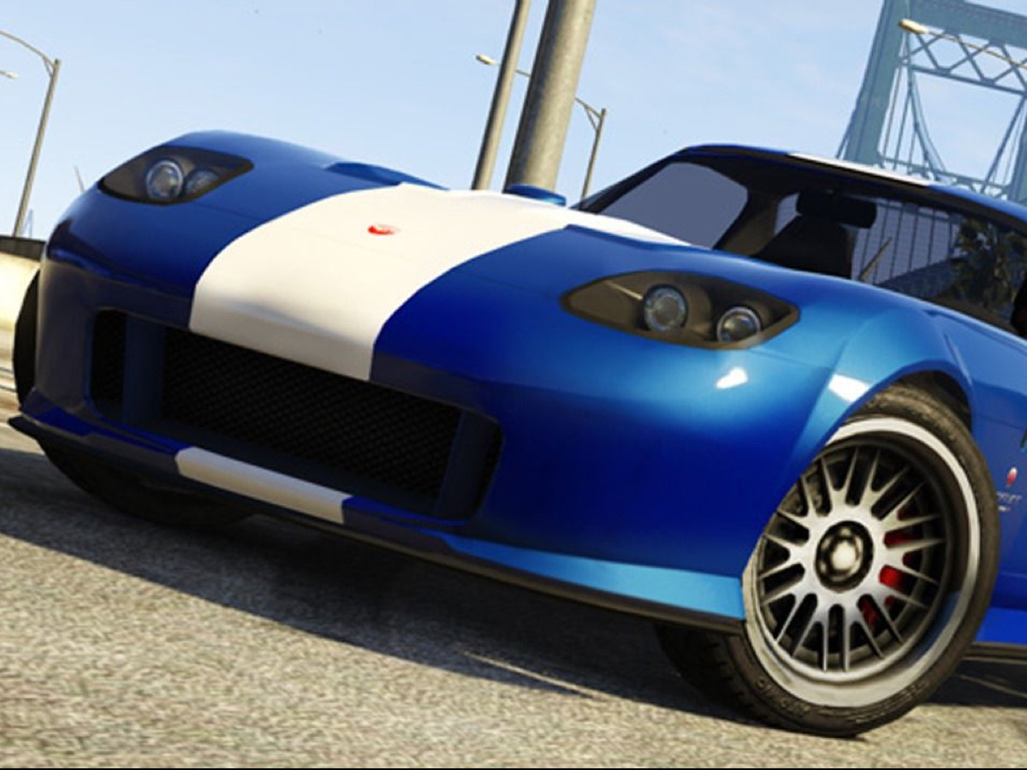
Notes:
Blue

Slide 10

Notes:
Red

Slide 11

Notes:
Yellow

Slide 12
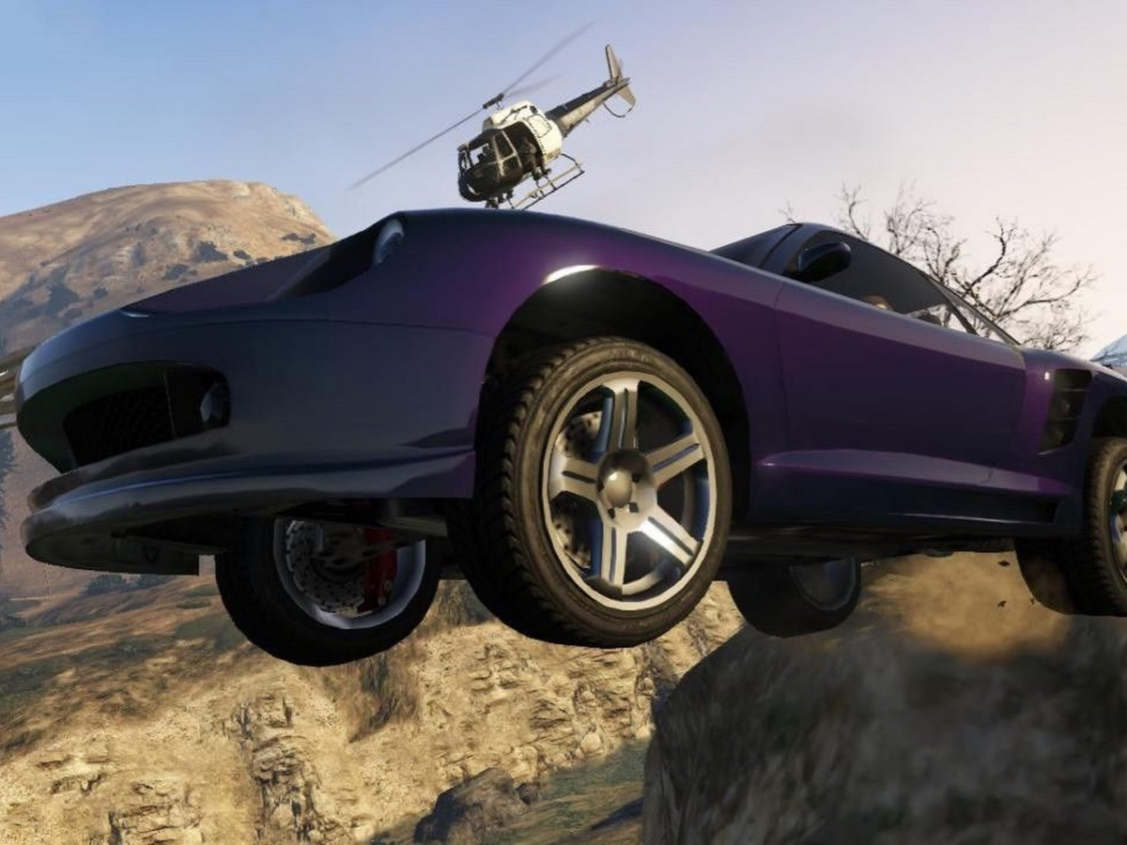
Notes:
Purple

Slide 13
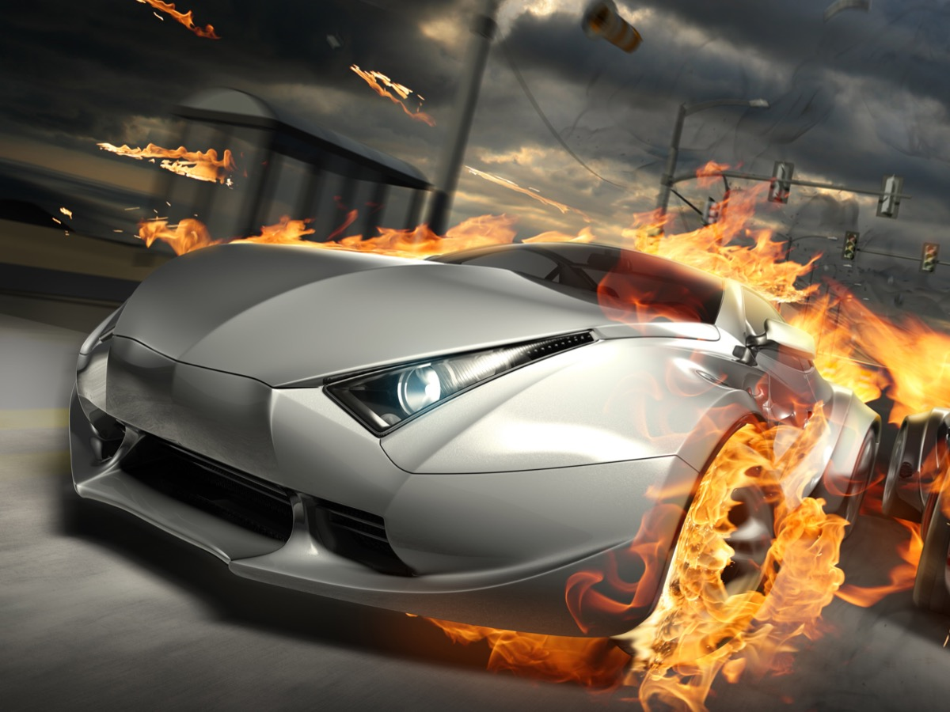
Notes:
Grey

Slide 14

Notes:
Flags: You receive a coloured flag to keep with your team during the missions.

Slide 15
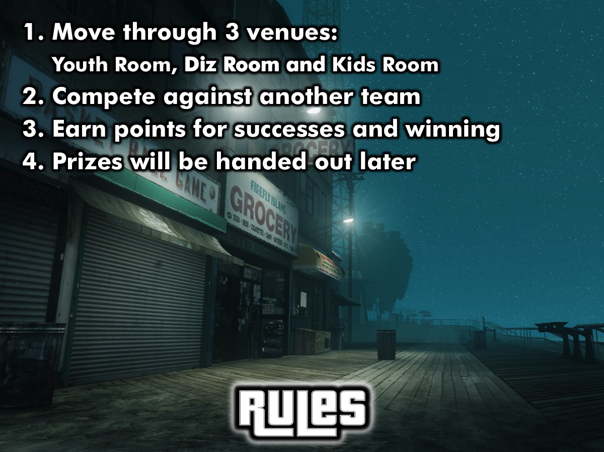
Notes:
Rules: You are going to move through 3 venues where 2 teams will compete at a time: the Youth room, Diz room and Kids room. You will compete against another team and you will earn points for successes and winning and prizes will be handed out later.

Slide 16

Notes:
Mission 1: Catch the Crooks - There will be a team of cops and a team of robbers. Decide on a location for the jail. The cops have to catch the robbers and put them in jail – this is done by tagging people. A robber can tag another robber in jail and they are released and have 30 seconds to get away from the area. Each team gets 5 minutes as cops and 5 minutes as robbers and the team with the most people out of jail at the end of their round wins 5 points.
Venue: Youth Room

Slide 17

Notes:
Mission 2: Capture the Flag - Each team is given 2 flags (of the same colour – one team gets 2 red flags and the other gets 2 yellow flags) – one is the true flag and the other is the decoy. A small black symbol on the flag indicates which is the true flag. The teams then have 10 minutes to capture their opponents flag. To capture a flag a team member simply has to tag a person who is carrying the flag. The flag is then taken back to their side and kept for 1 minute before it is returned to the other team. The team scores a point each time they capture one of the true flags. Each time a flag is returned – the teams have 20 seconds to reset before starting again (this gives them time to switch flags around and strategise). The team with the most flag captures wins 5 bonus points and both teams also earn the points they received for each flag captured.
Venue: Kids Room

Slide 18

Notes:
Mission 3: Collect the Loot - There will be 10 objects hidden in the room and the teams will have to go and search for them in the time allowed (10 minutes). On “Go” the teams will go and search for the objects. The team that finds the most loot by the the end of the time limit wins 5 bonus points and teams also win 1 point for each object they find.
Venue: Diz Room

Slide 19

Notes:
Here are your starting venues - you will rotate each round. Your group leader will be given instructions on the order of your venues.
Blue vs Black in the Youth Room.

Slide 20

Notes:
Red vs Yellow in the Diz Room.

Slide 21

Notes:
Purple vs Grey in the Kids Room.

Slide 22

Notes:
Go!

Slide 23

Notes:
Prize Giving: The winning teams will receive prizes.

Slide 24
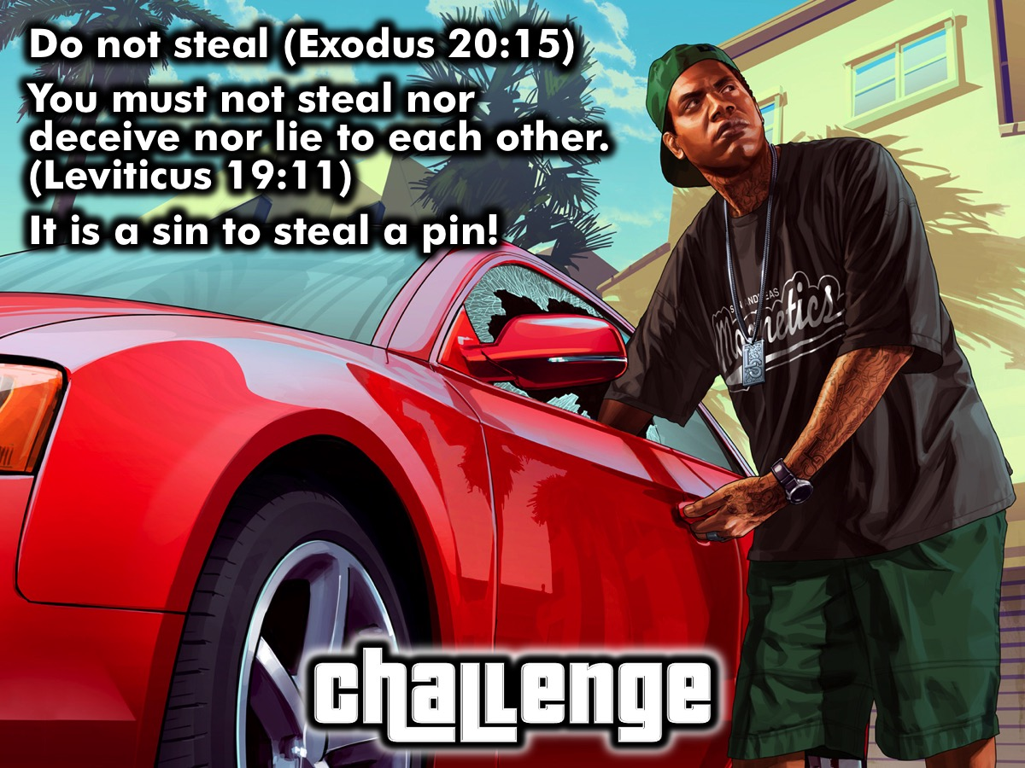
Notes:
Challenge: One of the Ten Commandments is: Do Not Steal. Leviticus 19:11 says: “You must not steal nor deceive nor lie to each other.” Do you know that it is a sin to steal a pin!

Slide 25
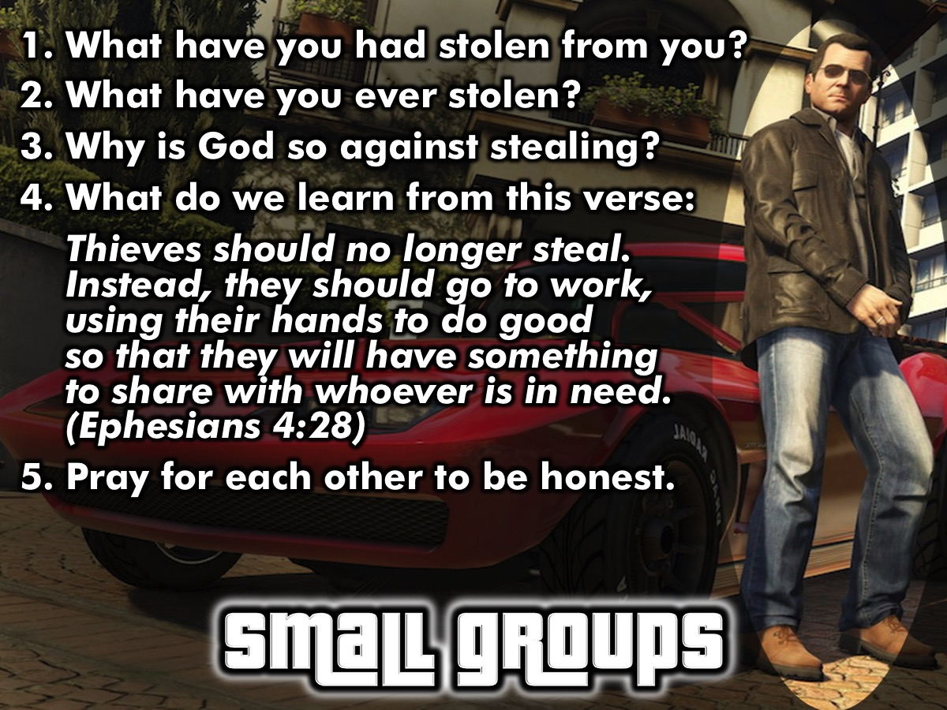
Notes:
Small Group Questions: (1) What have you had stolen from you? (2) What have you ever stolen? (3) Why is God so against stealing? (4) What do we learn from this verse: “Thieves should no longer steal. Instead, they should go to work, using their hands to do good so that they will have something to share with whoever is in need.” (Ephesians 4:28). (5) Pray for each other grow in honesty.

Slide 26

Notes:
Announcements: On Sunday morning we continue with our Revolution Series. And next Friday night it is our Valentine’s Night.

Slide 27

Notes:
Refreshments

