Slide 1


Slide 2
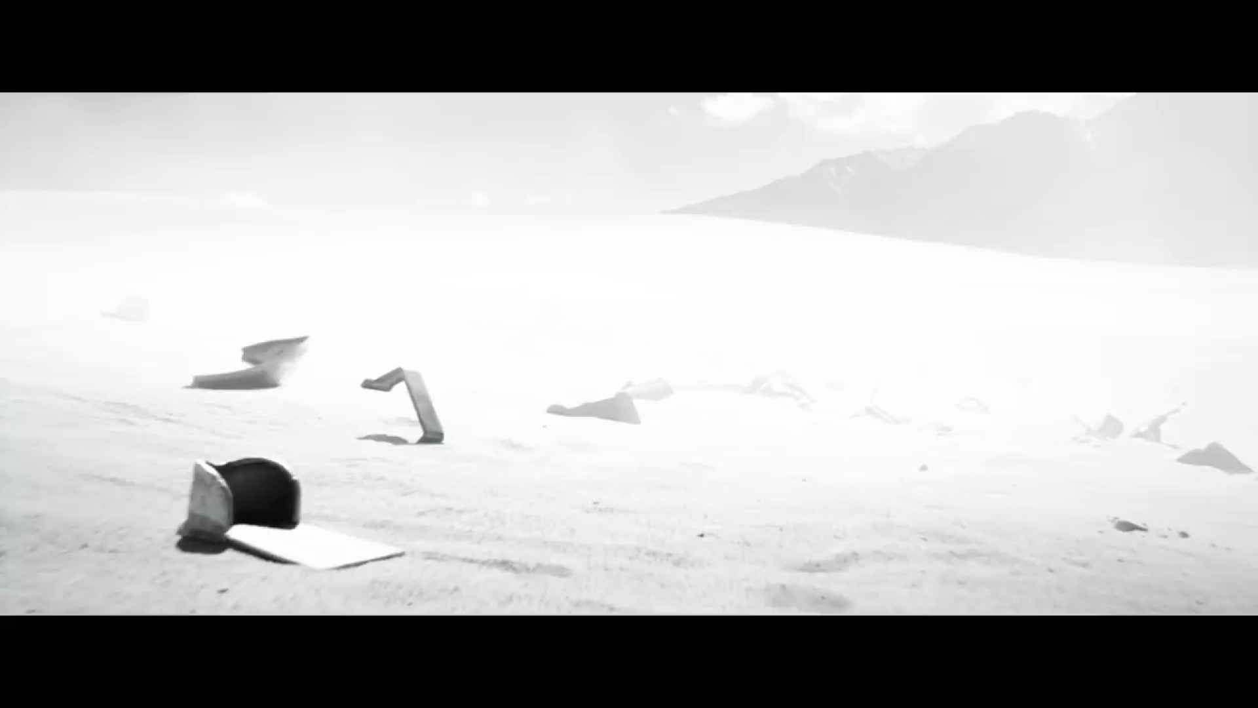
Notes:
Super Hero Clip: Avengers Endgame Trailer. Find it on YouTube at
https://www.youtube.com/watch?v=JyGGLB542ks

Slide 3

Notes:
Welcome to the Giving Series

Slide 4

Notes:
Sunday Morning: The Greatest Gift

Slide 5
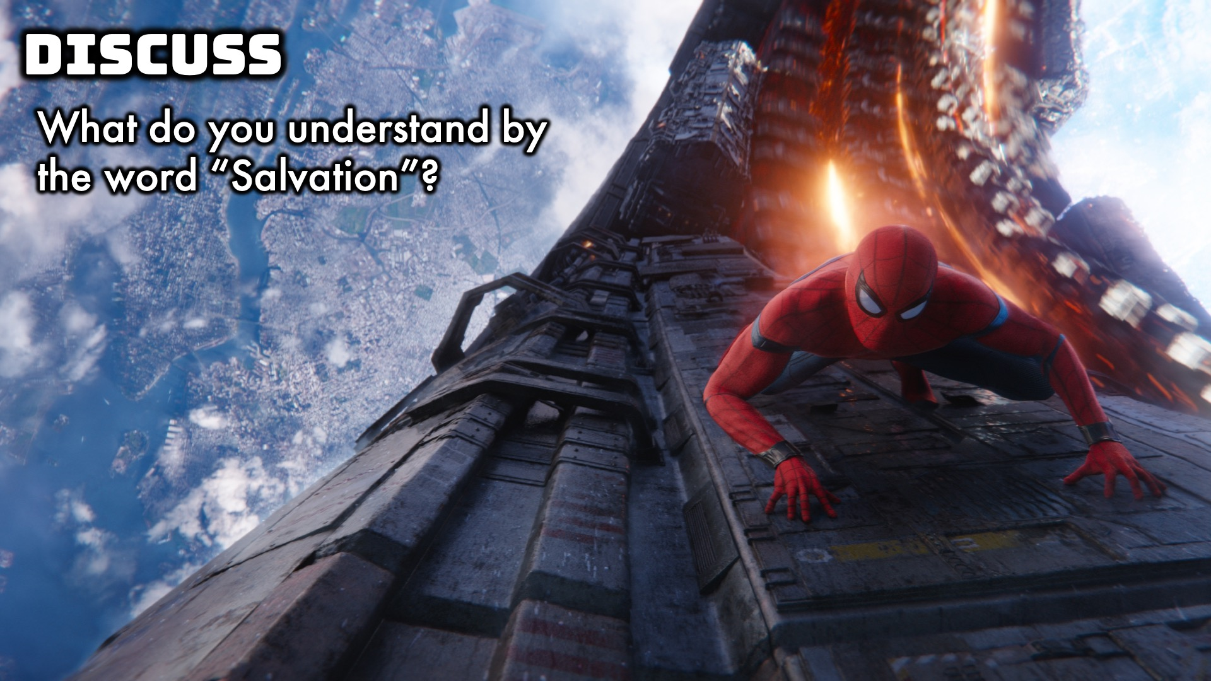
Notes:
Intro:
What do you understand by the word “salvation”?
I’m going to give you 3 points about Salvation.

Slide 6
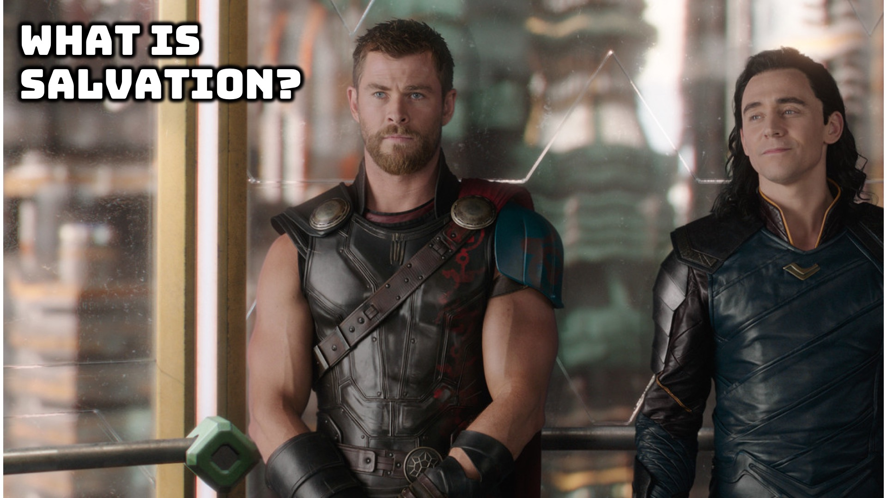
Notes:
What is Salvation?

Slide 7
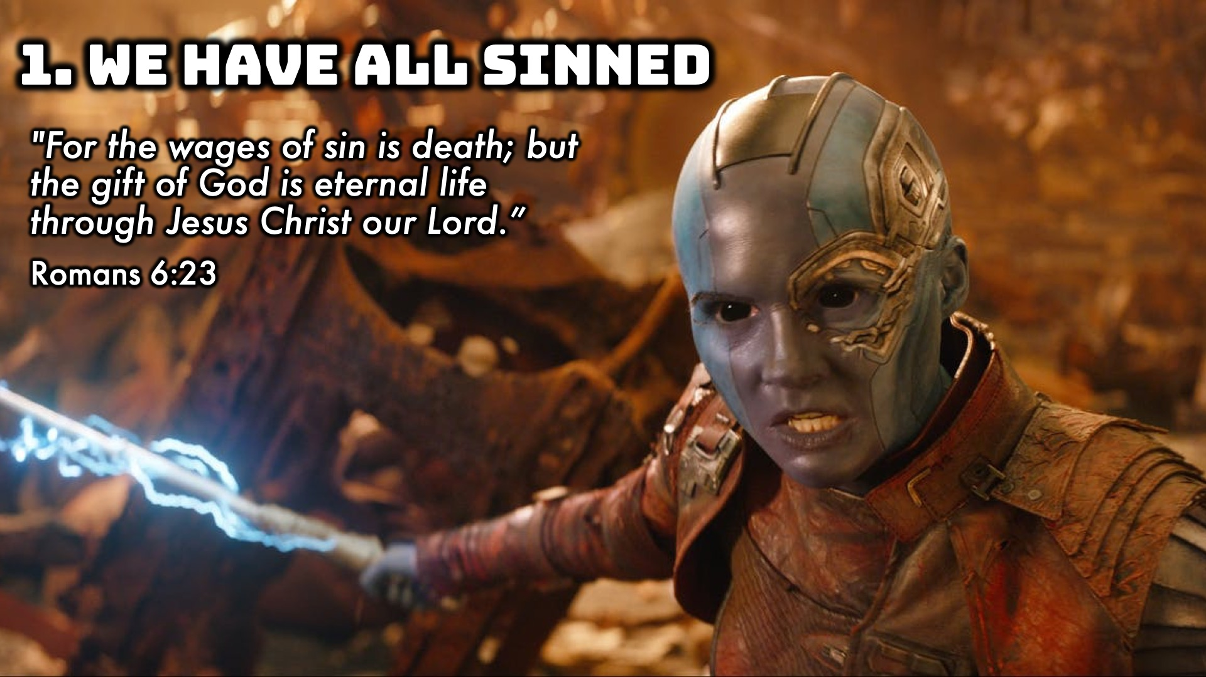
Notes:
We have all sinned.
Romans 6:23, "For the wages of sin is death; but the gift of God is eternal life through Jesus Christ our Lord."

Slide 8
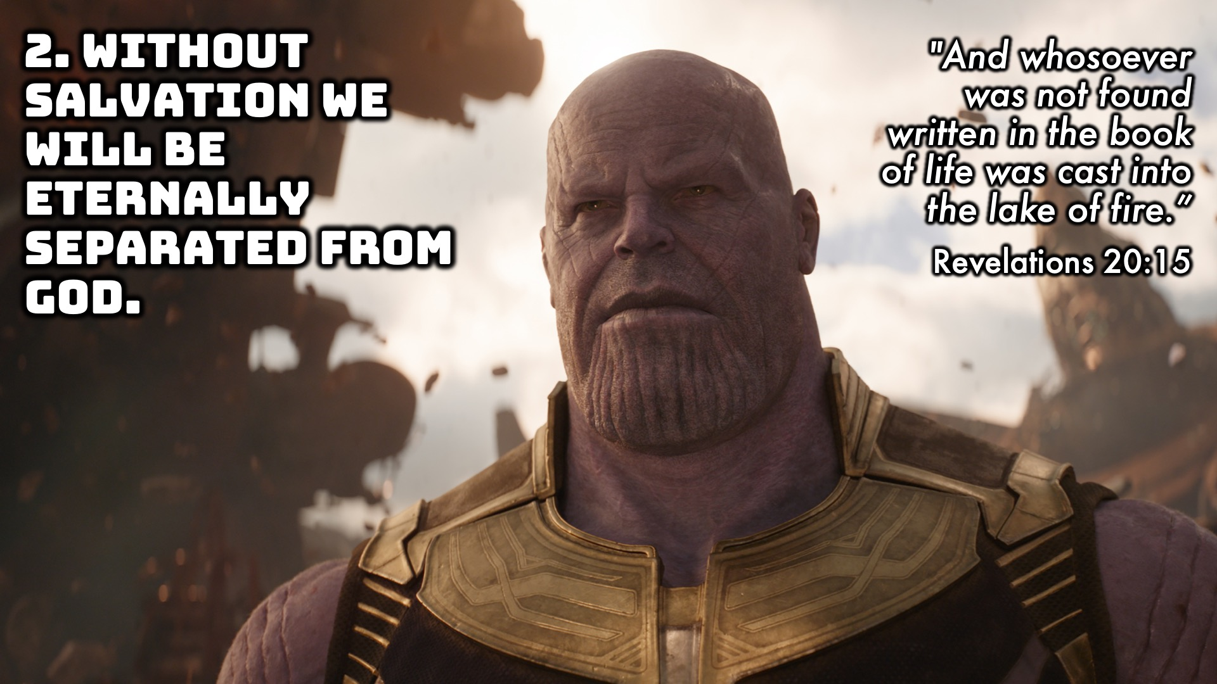
Notes:
Without Salvation we will eternally be separated from God.
Revelations 20:15, "And whosoever was not found written in the book of life was cast into the lake of fire."

Slide 9
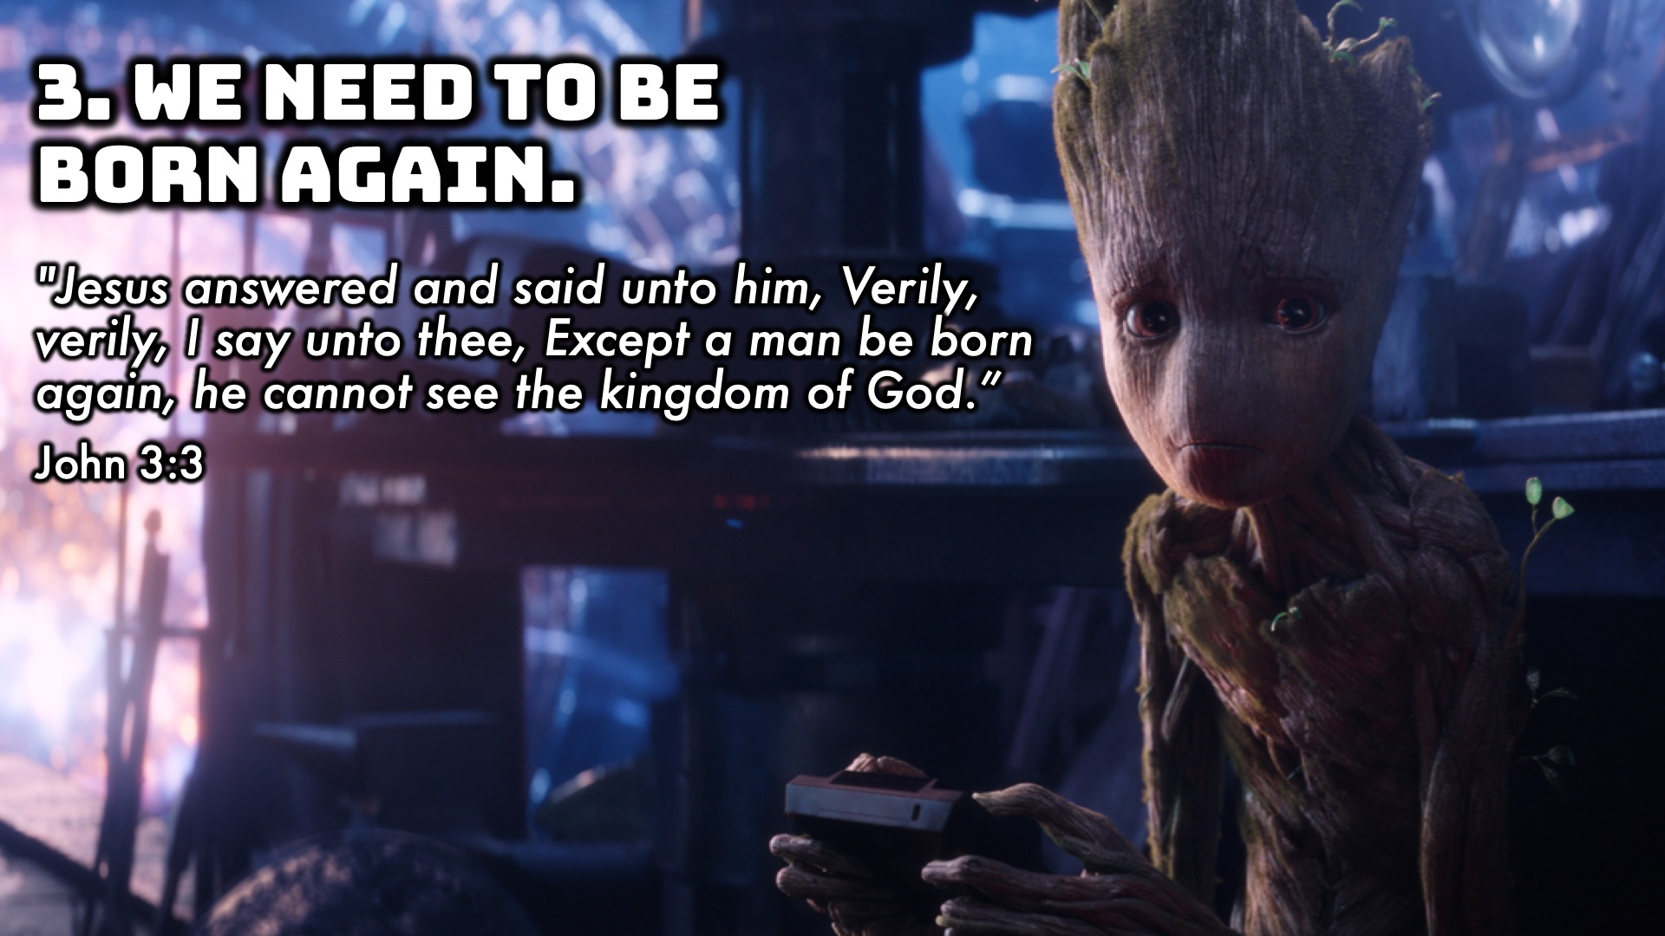
Notes:
We need to be born again.
John 3:3, "Jesus answered and said unto him, Verily, verily, I say unto thee, Except a man be born again, he cannot see the kingdom of God."
Adopted as children of God, and his heirs. (Shaylah example)

Slide 10
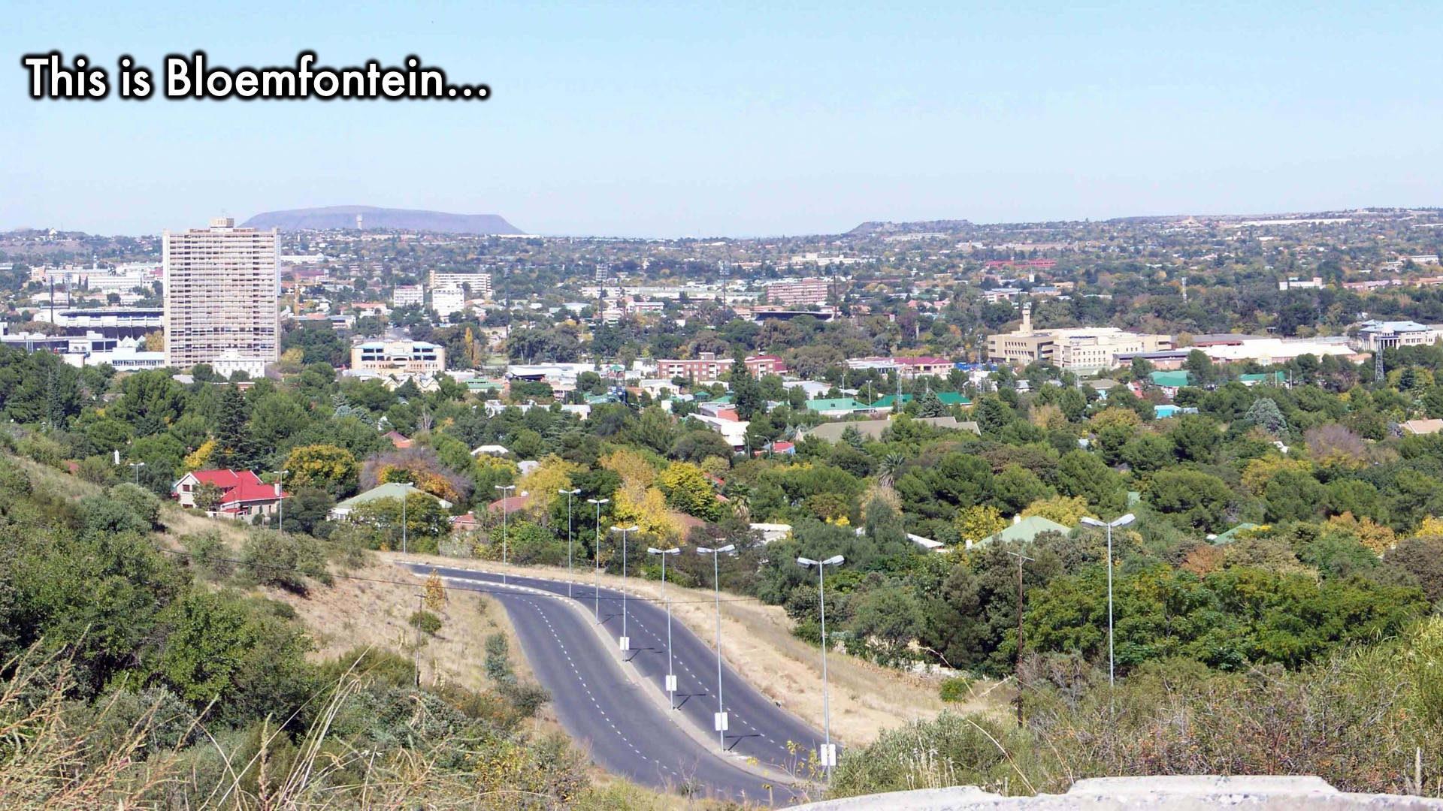
Notes:
Personal Story, how I need a savior:
Bloemfontein Story
We were travelling on our way to cape town, and we were nearing Bloemfontein when a bakkie started flagging us down… we didn’t know why. They stopped us, and said our wheel looked like it was going to fall off. They suggested we get it looked at. Now of course we were in a foreign land, and didn’t know where to go, and it was a Sunday… These guys with their hairy legs and short shorts took us to this place that was open, where they fixed our car.
They didn’t get any money, it was a free gift!
Just like the hairy legged afrikaaners, Jesus saved us from an ugly death, and more! At his cost.

Slide 11
Notes:
Video: Lecrae’s Testimony. Find it on Youtube at https://www.youtube.com/watch?v=CycgRU1VEXI

Slide 12
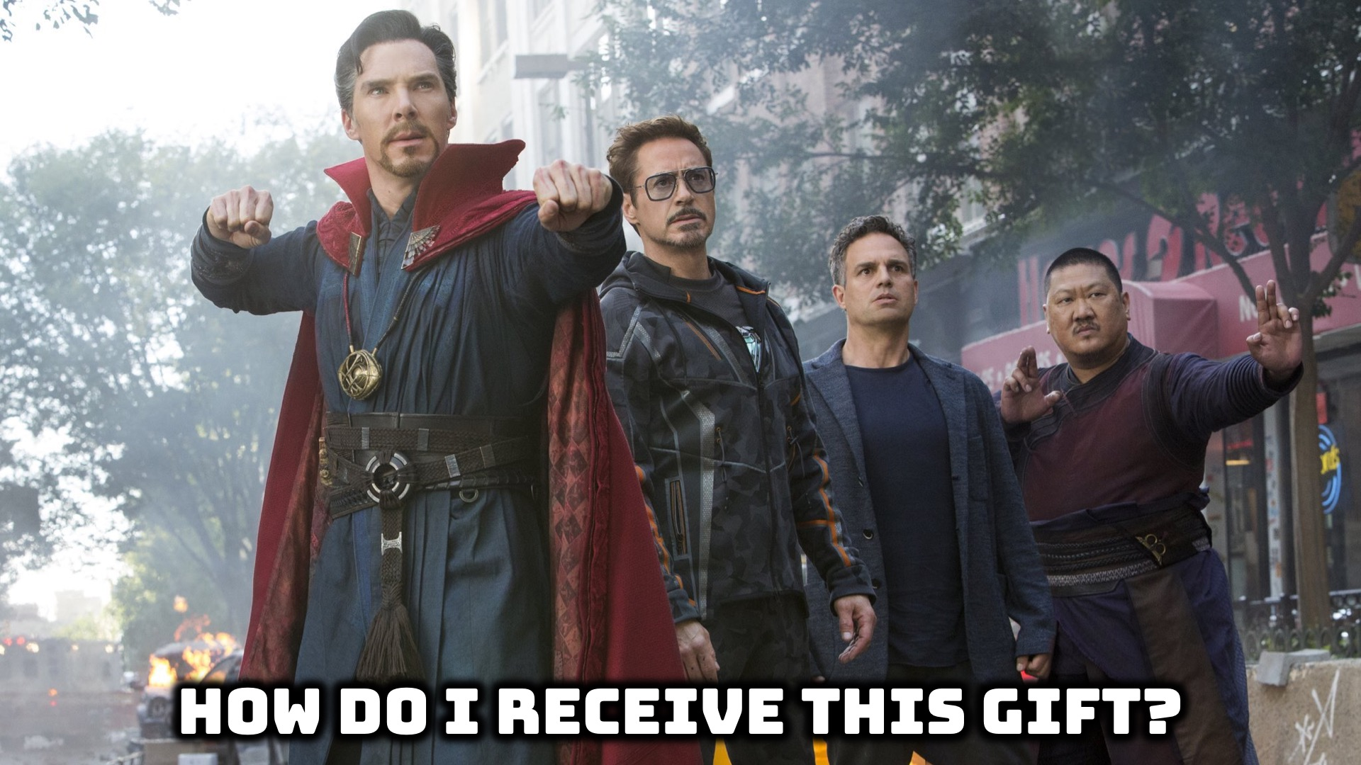
Notes:
How do I Receive this Gift?

Slide 13
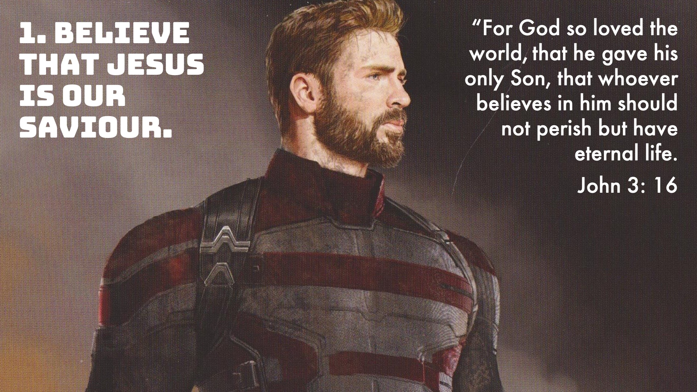
Notes:
1. Believe - That Jesus is our Saviour
John 3: 16

Slide 14
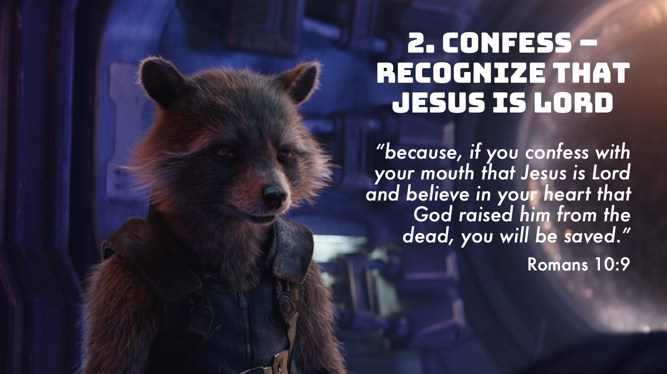
Notes:
Confess – Recognise that Jesus is lord
Romans 10:9

Slide 15
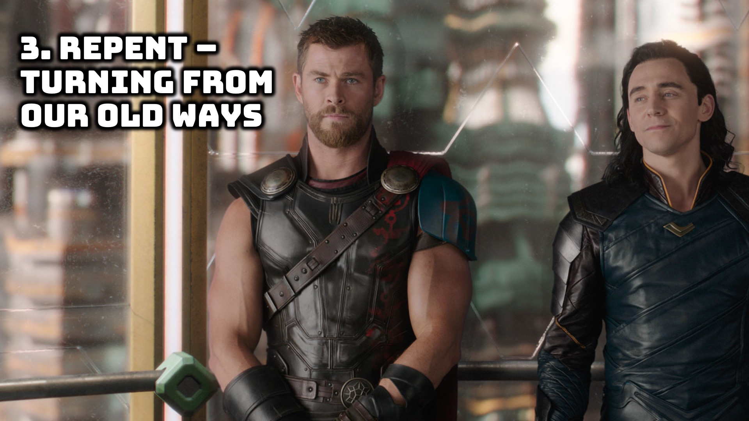
Notes:
Repenting – turning from our old ways
180 degress, not 360!

Slide 16
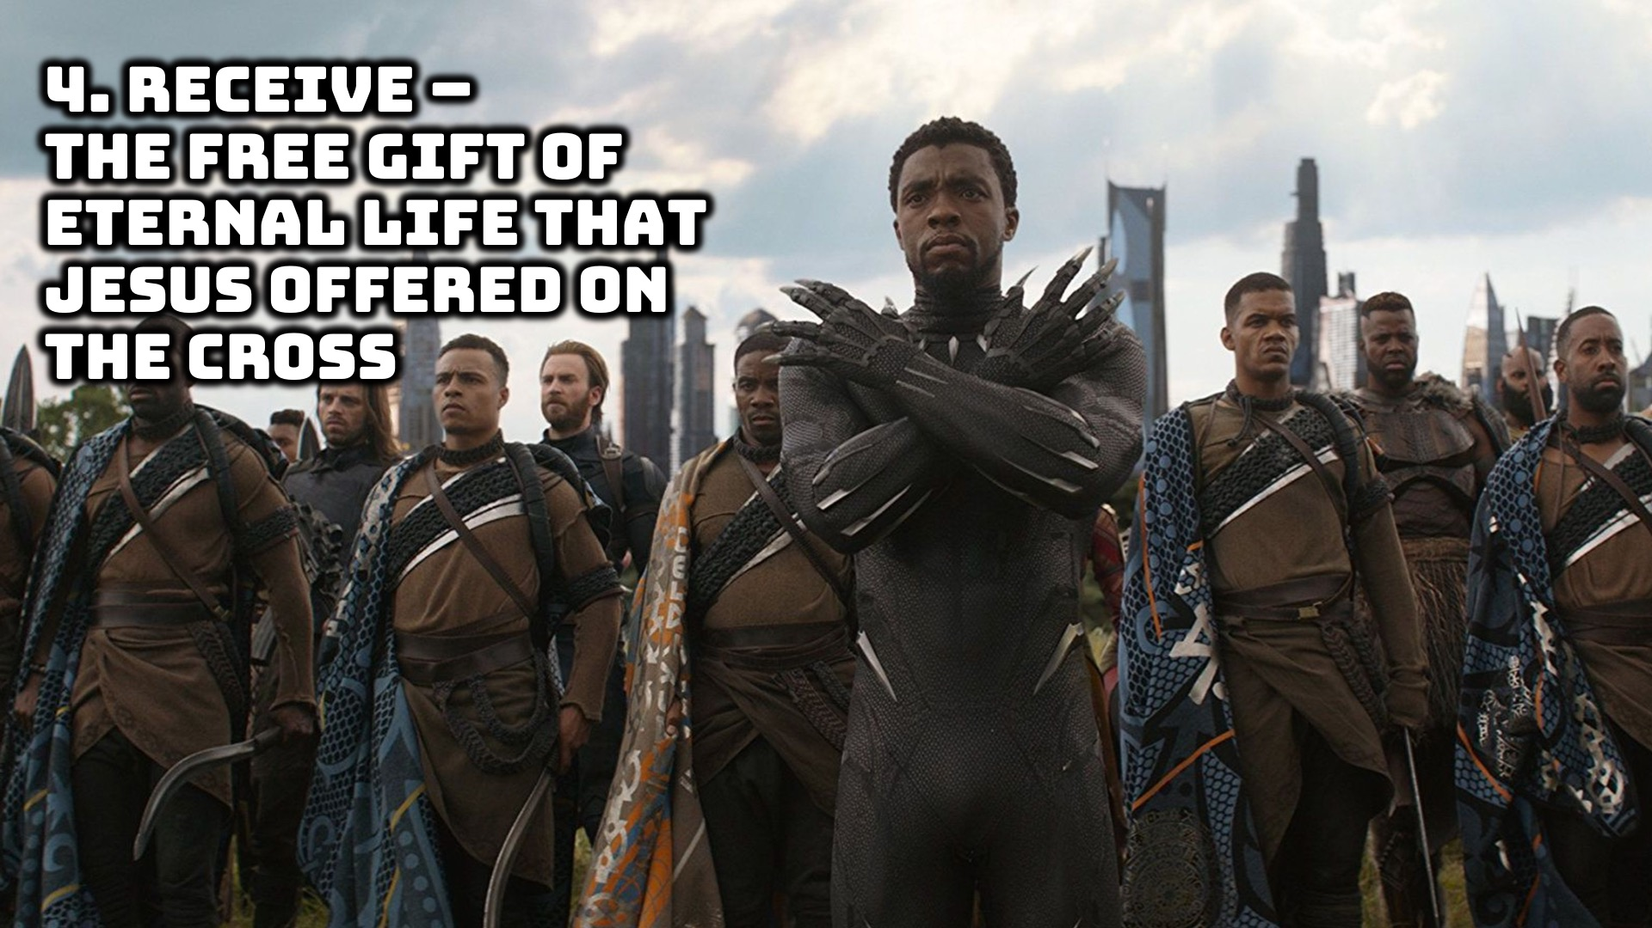

Slide 17
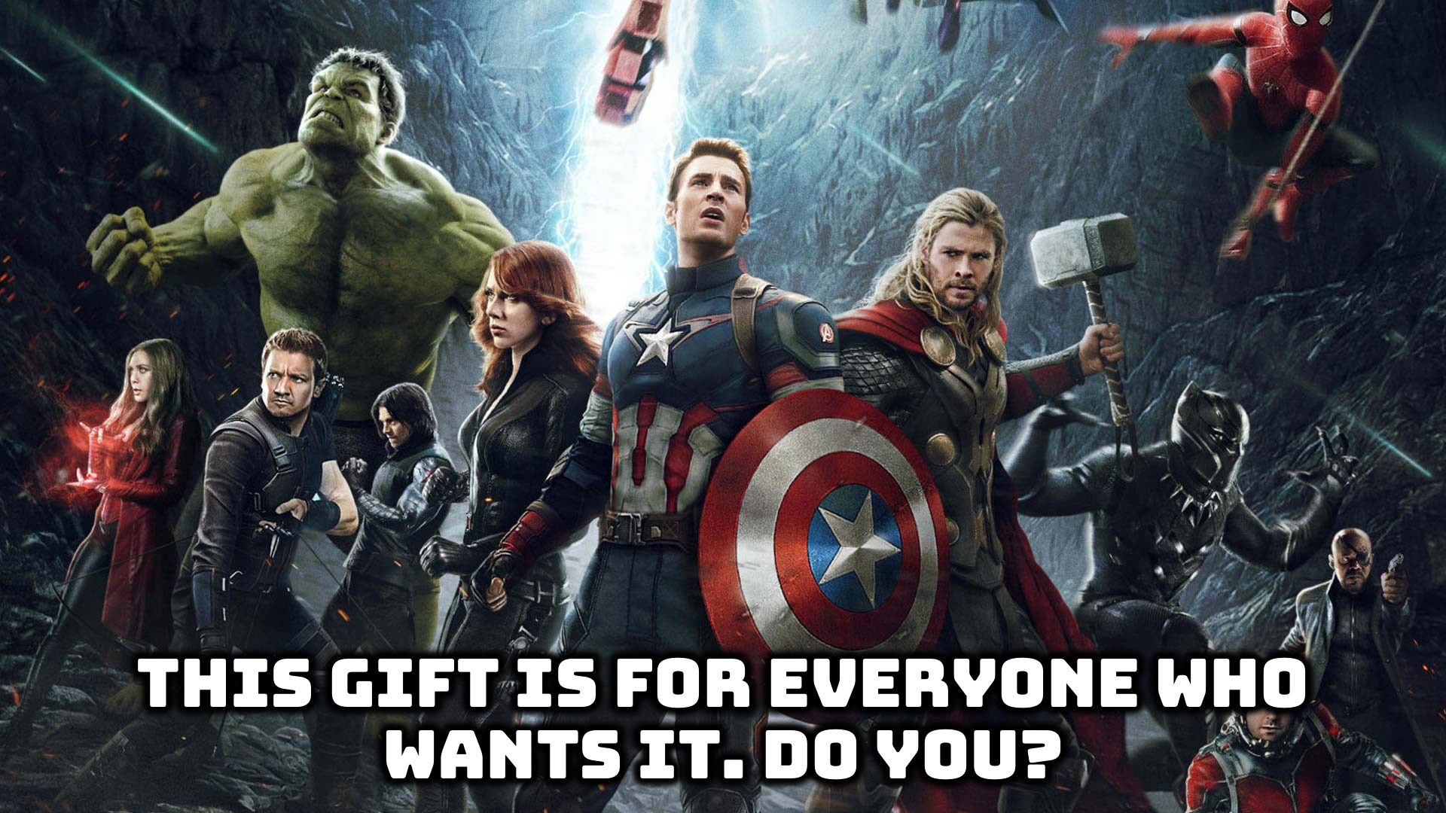
Notes:
Conclusion:
This gift is for anyone who wants it. Do you want this gift?

Slide 18
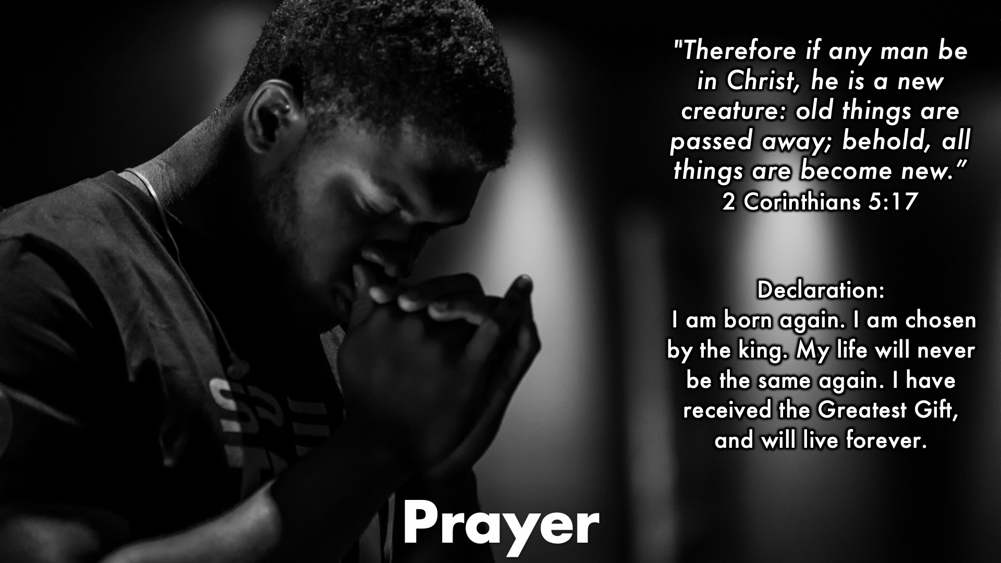
Notes:
"Lord Jesus, I believe that you are the son of God and that you came to earth and died for my sins and rose again on the 3rd day. I confess that I am a sinner and in need of your salvation. I come to you now and ask that you will come into my life, be my Lord and savior, and forgive me of my sins. In Jesus' name, amen!"

Slide 19

Notes:
Daily Devotions

Slide 20

Notes:
Next Sunday

