Slide 1

Notes:
Welcome to the Giving Series

Slide 2

Notes:
Last week we learnt about the Greatest Gift.

Slide 3

Notes:
Today: Giving Gives Back

Slide 4

Notes:
There are different types of shoes today in our lives. Shoes for sports, shoes for school, shoes for winter, shoes for the office, shoes for running, shoes for gardening, there are shoes for every occasion. Flat shoes, hills, boots, sneakers and whichever other make of shoe you may think of. Shoes are very important and they make walking in all seasons bearable and help us to stand firm. Today we going to focus on spiritual shoes fit for a spiritual warfare.

Slide 5


Slide 6
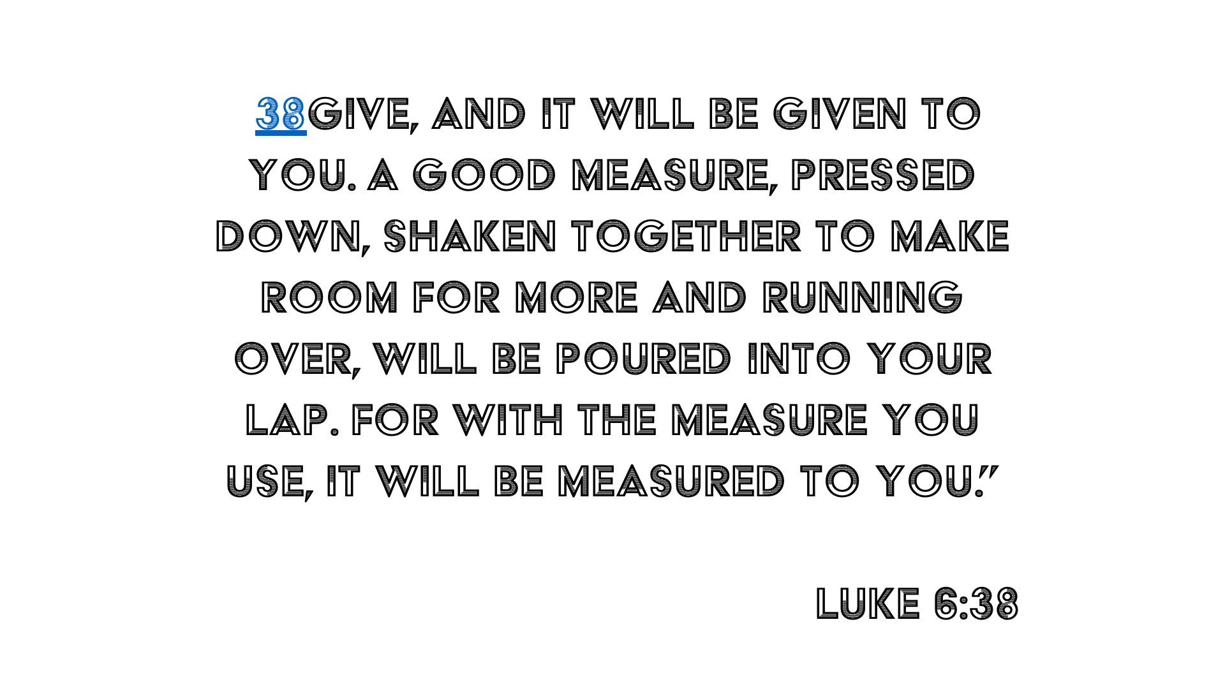
Notes:
Apostle Paul is making it clear that we are in warfare with spiritual beings, the devil and the demons are your enemies and they’ll do everything in their power to destroy your faith and your life. They want to steal everything great that God has created you for. And God says that I am not going to let the devil win, I will give you the full armor for the battle.

Slide 7
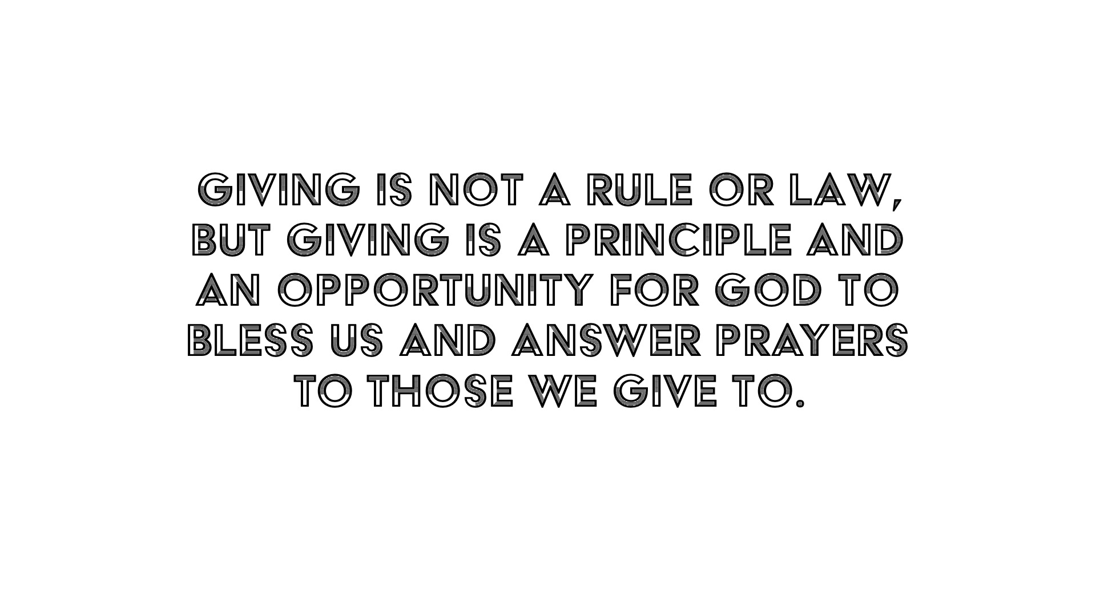

Slide 8
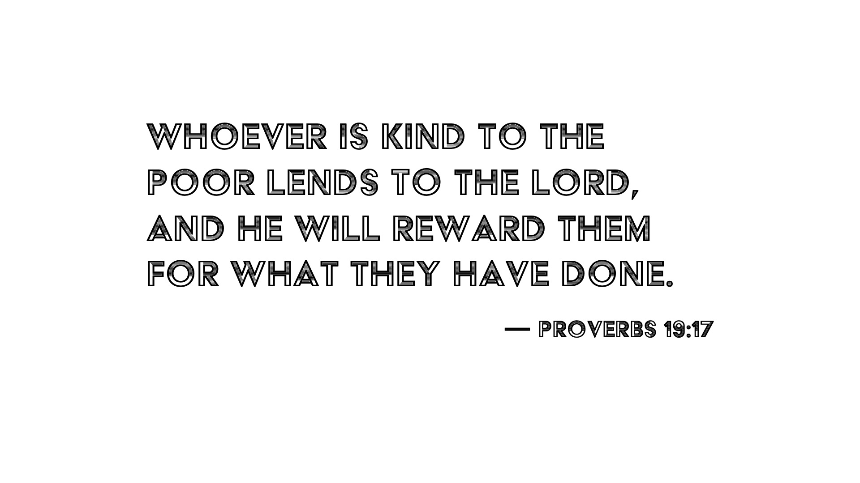
Notes:
God doesn’t want us to chill and start preparing when the enemy attacks. He is employing us to prepare ourselves for the battle. In fact, God wants us to grow in our faith through the word of God, so that no matter how hot or slippery the battle ground may be, we will have our feet fitted in the readiness of the battle to protect our peace. Because if the devil can steal our peace, then we can never stand firm against him. Because anxiety and depression will create a stronghold of a lie into your life and replace all the truth of God.

Slide 9
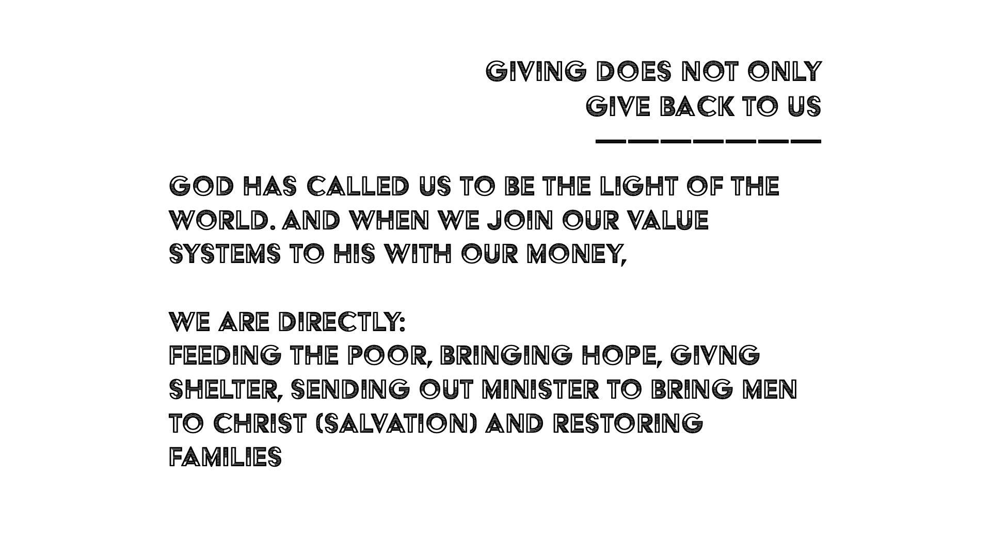
Notes:
The Roman battle sandal was superior to that of any other army. It was high technology of its day. It consisted of two basic parts. The first was the part that covered the foot itself. The sole of the shoe was very thick and fitted with spikes or nails to increase traction. The thickness of the sole provided protection from the traps set by the enemy.

Slide 10


Slide 11

Notes:
The enemy wants to steal our peace and replace is with anxiety, depression, anger, and anything that will suppress our peace and eventually kill our faith. We live is a world were mental illness is a big issue at the moment, because the devil is at war. We need the full amor of God to stand firm against any and all the strategies of the devil.

Slide 12
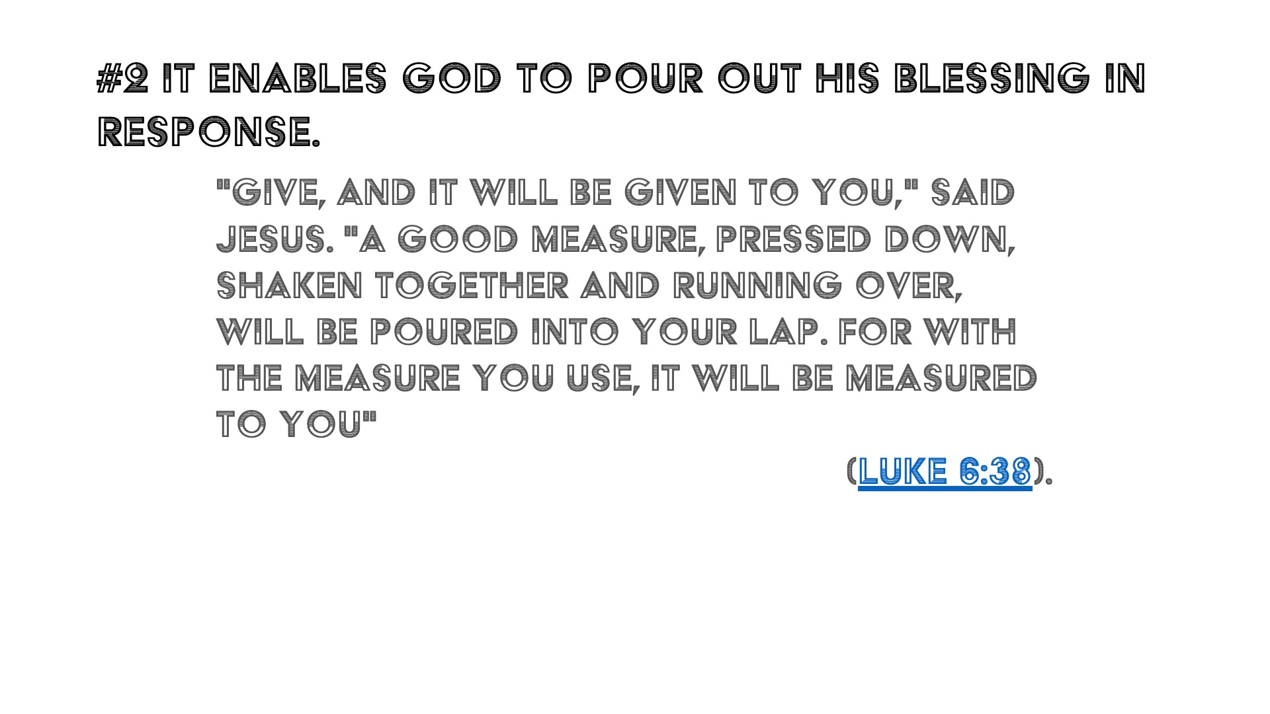
Notes:
John 1:1 In the beginning was the Word, and the Word was with God, and the Word was God.
5 And the light shineth in darkness; and the darkness comprehended it not. The Word of God, which John translates as Jesus is the only thing that will make you stand firm when the devil attacks you. (The Gospel is the Good News that Jesus came and died for our sins and that whoever believes in him alone will not perish)

Slide 13
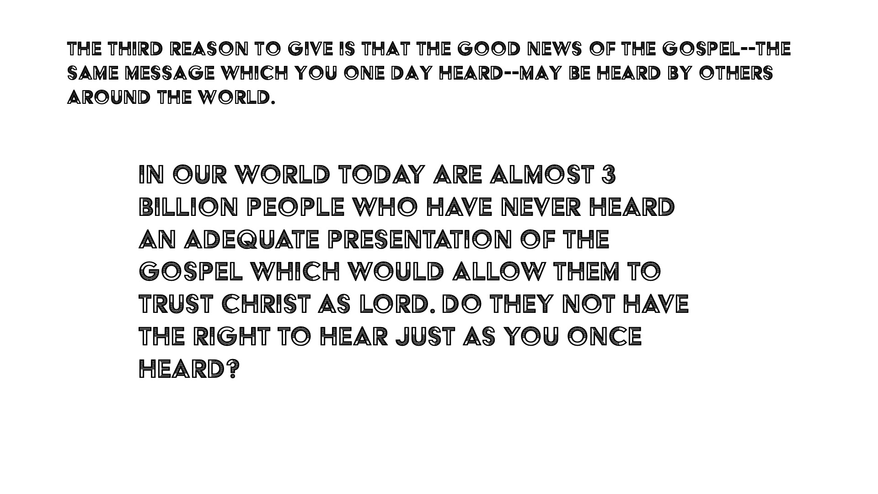
Notes:
Shoes of the Gospel of Peace help us live as peace with everyone. Peace is one of the most vital amour that happens to be one of the Fruits of the Holy Spirit. Which in my opinion when you have peace you may stand against everything without any blemish.

Slide 14
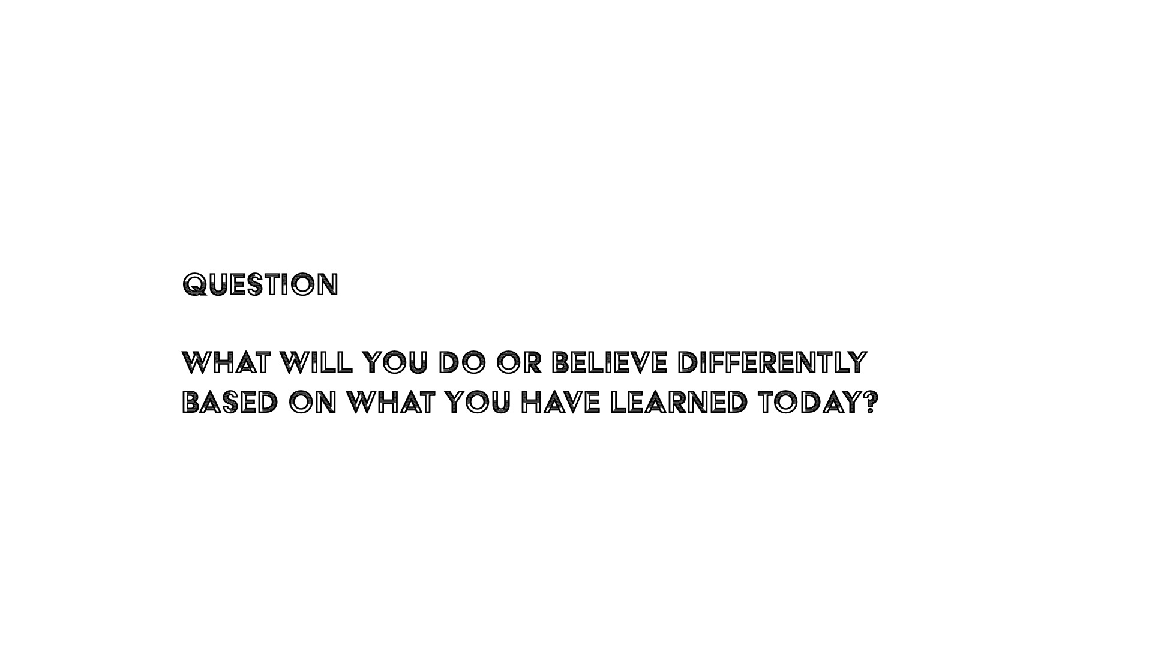

Slide 15
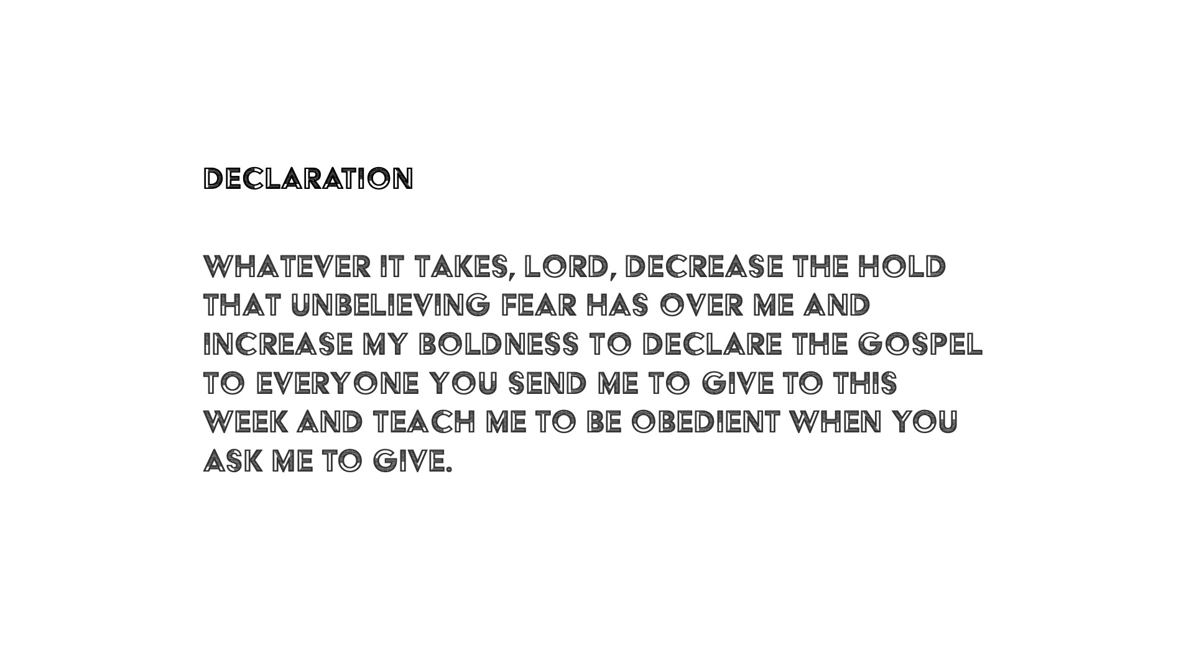

Slide 16


Slide 17

Notes:
Daily Devotions

Slide 18

Notes:
Next Friday: No youth, it is good friday

