Slide 1

Notes:
Welcome to the Giving Series

Slide 2
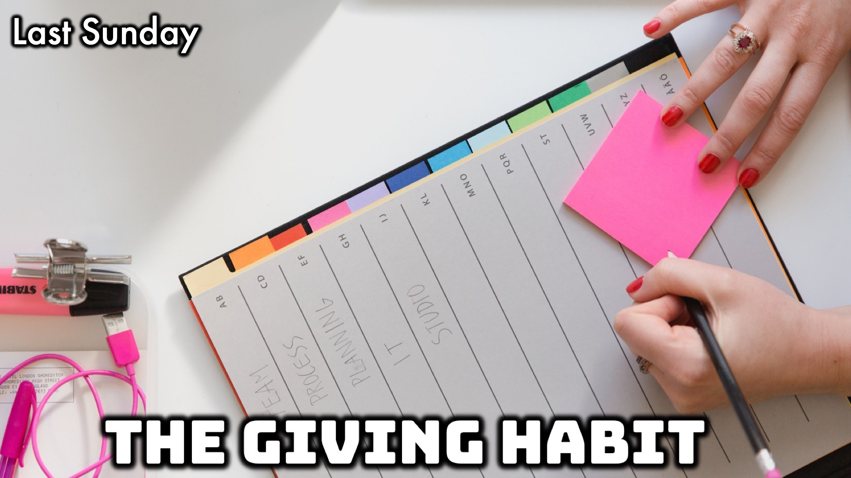
Notes:
The Giving Series

Slide 3

Notes:
Today: The Giving Habit

Slide 4
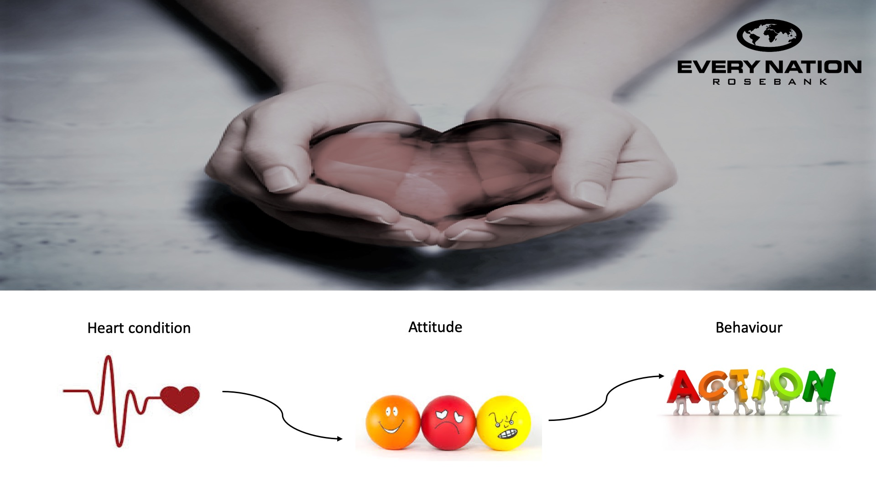

Slide 5
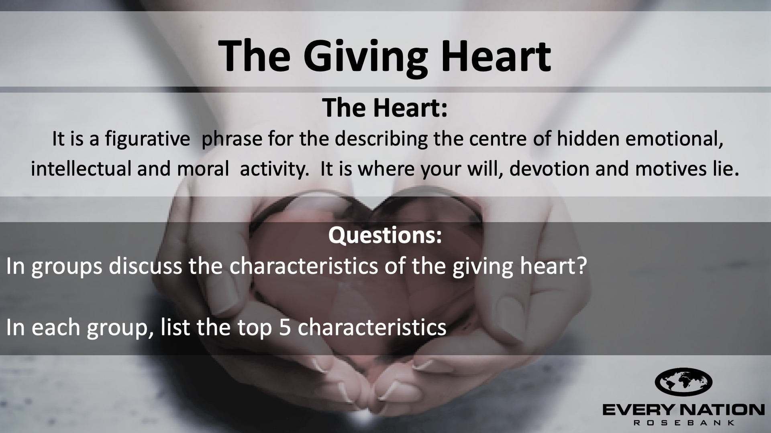

Slide 6
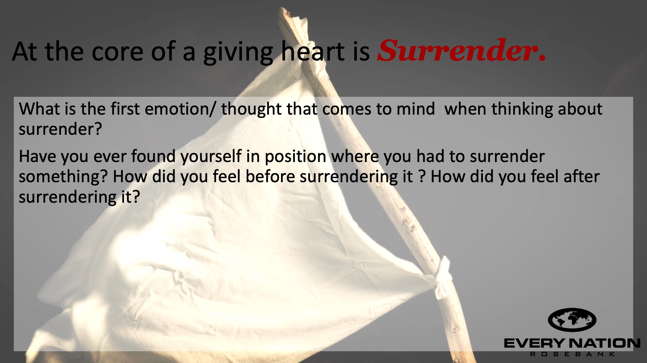

Slide 7
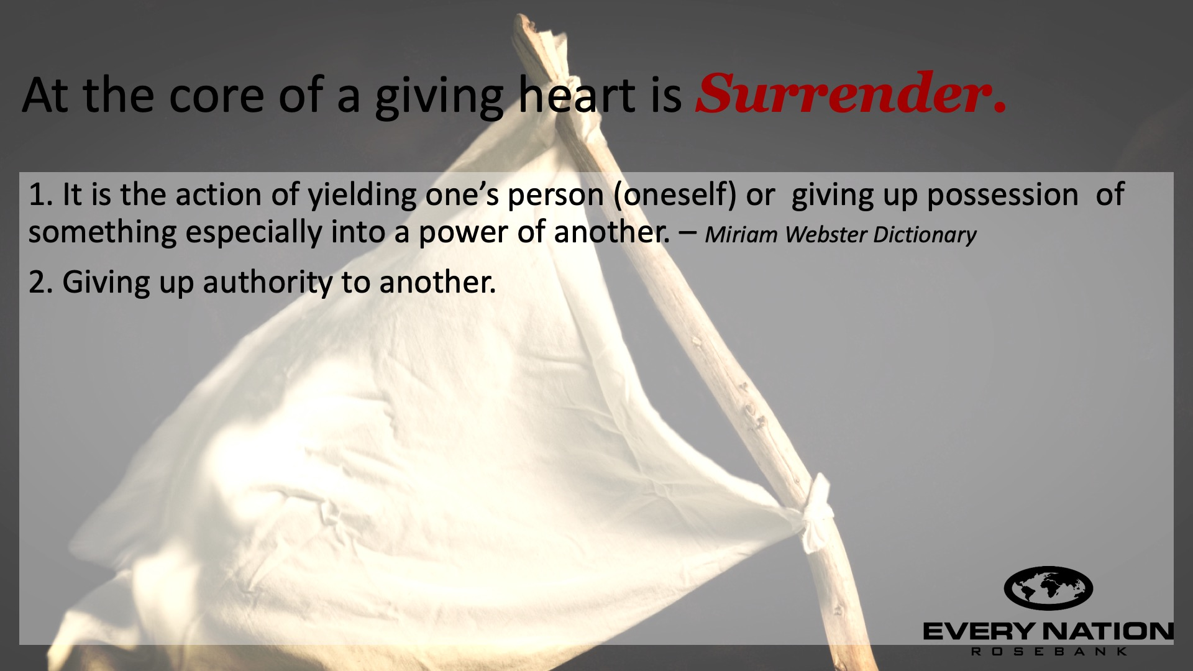

Slide 8
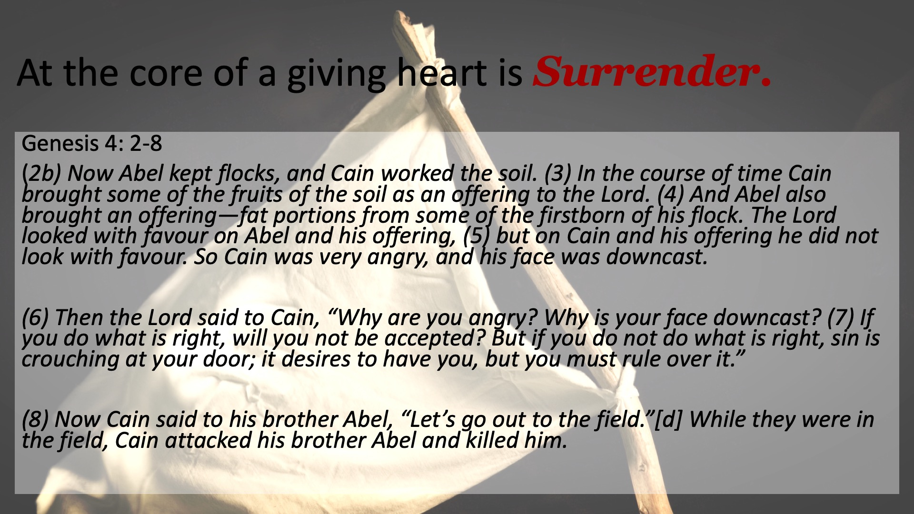

Slide 9
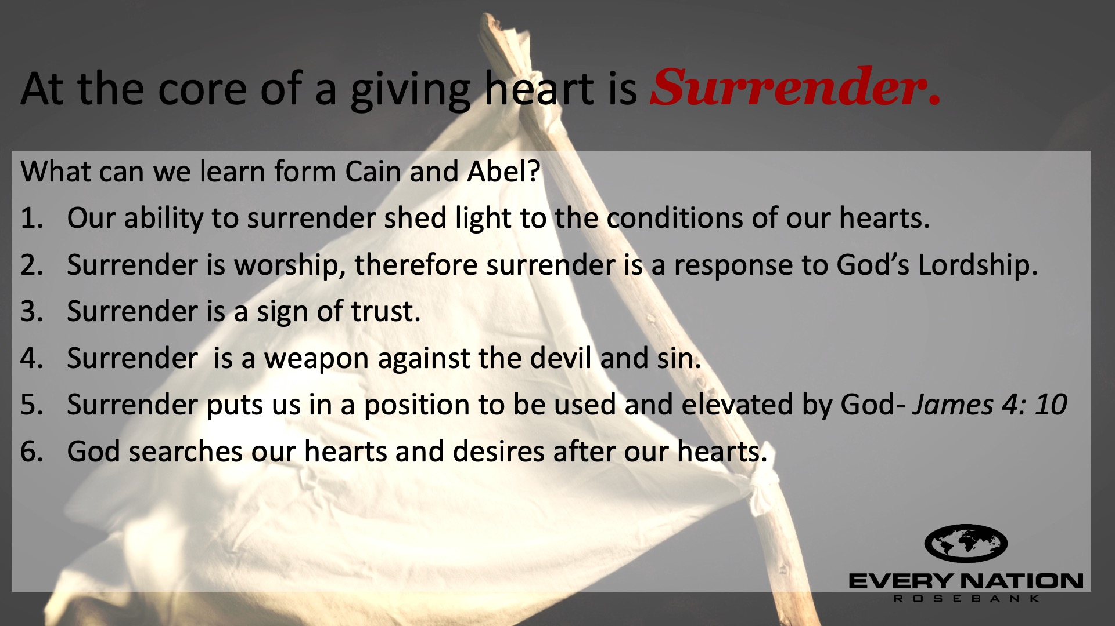

Slide 10
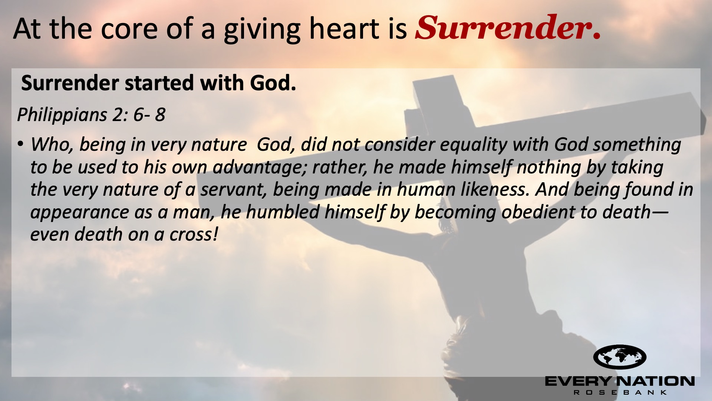

Slide 11
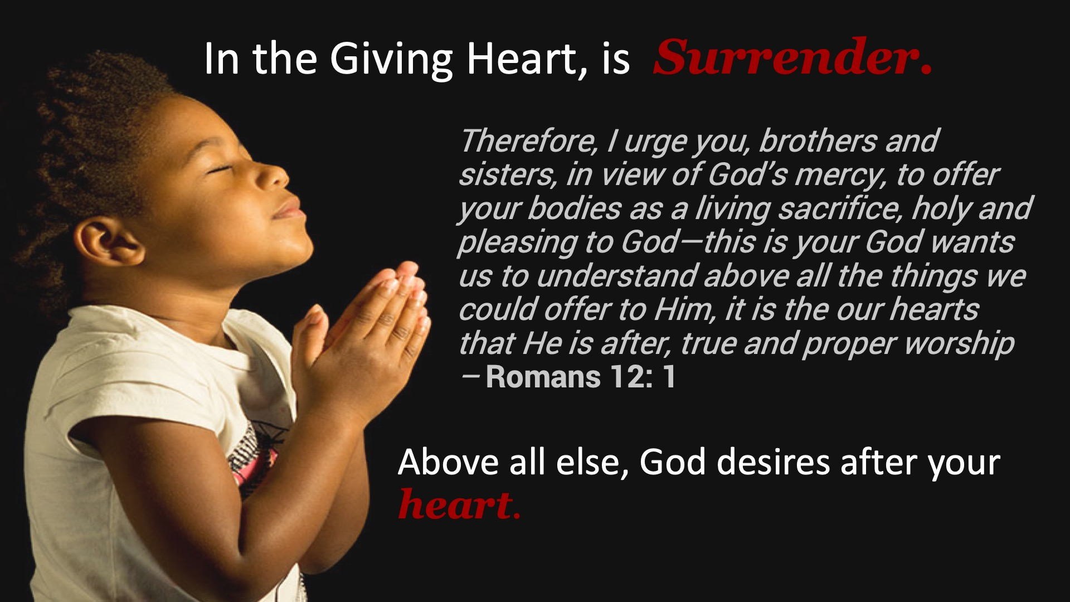

Slide 12
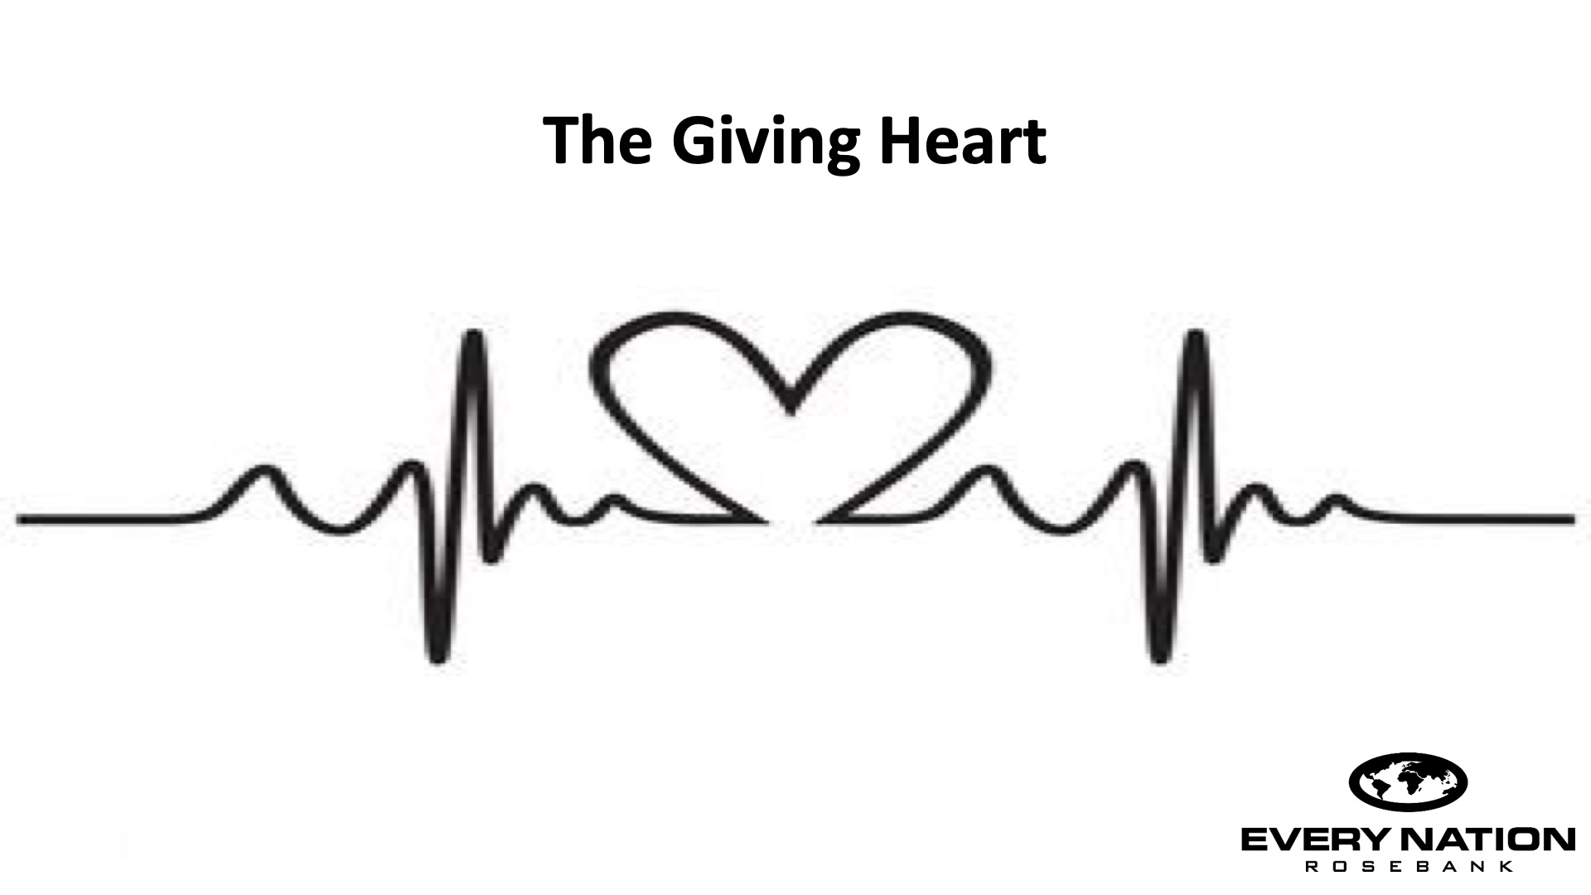

Slide 13

Notes:
Prayer

Slide 14

Notes:
Daily Devotions

Slide 15
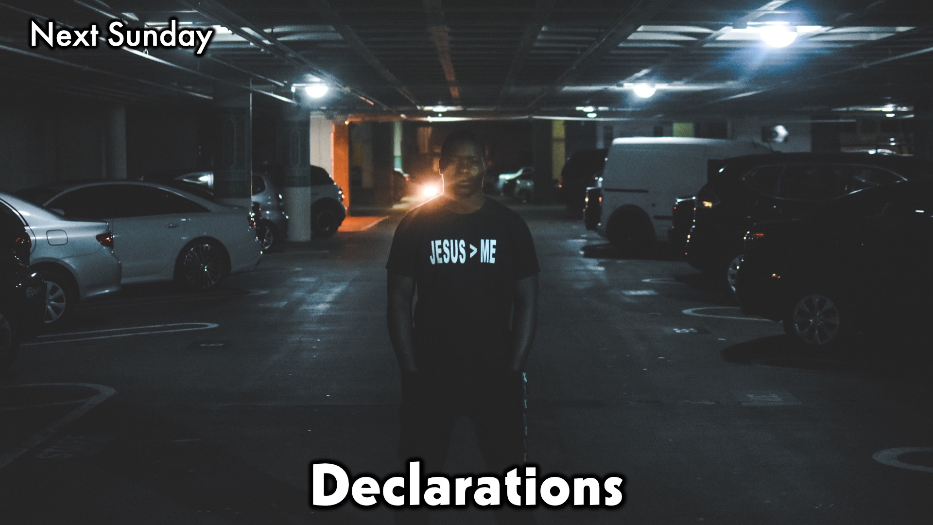
Notes:
Next Sunday: Declarations

