Slide 1

Notes:
Why do you think we do declarations? What is their point? We do them every Sunday morning before offering, but why?

Slide 2

Notes:
Get everyone to do a few kick boxing kicks to warm up, wake up, and link to the message.
Mention that it will be an out the box preach today.

Slide 3
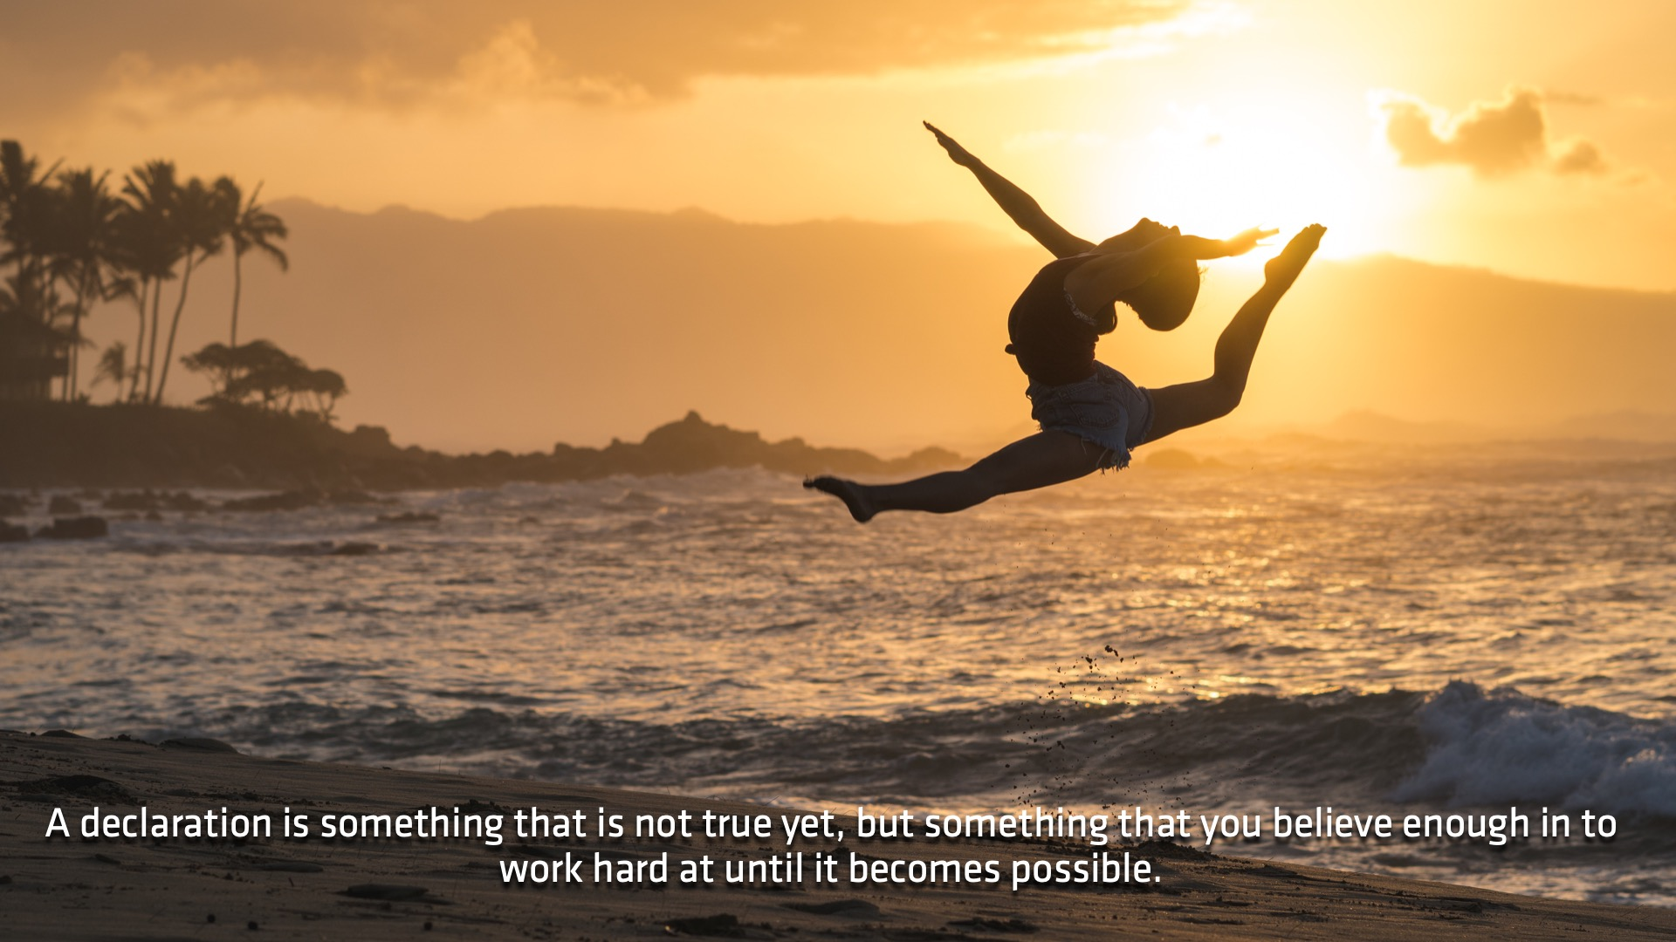
Notes:
Why do we do offering declarations? Because we believe and desire for our money and funds to be blessed by God to change the world. Maybe they aren’t changing the world just yet, but that at least gives us vision as something to move towards.

Slide 4
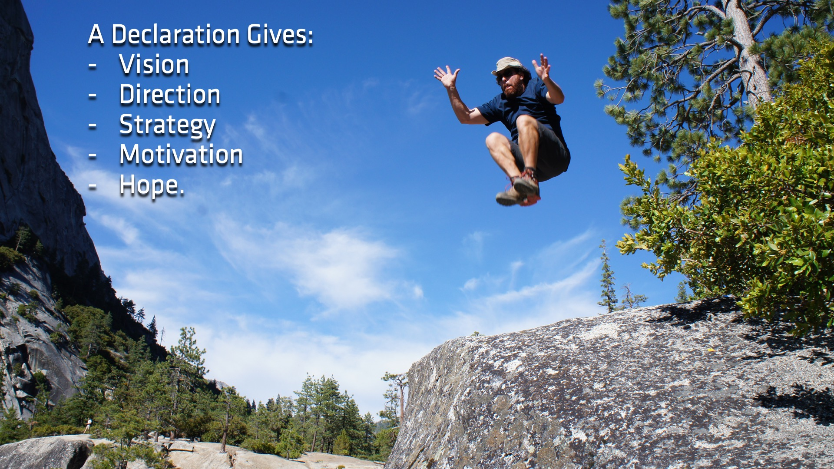

Slide 5
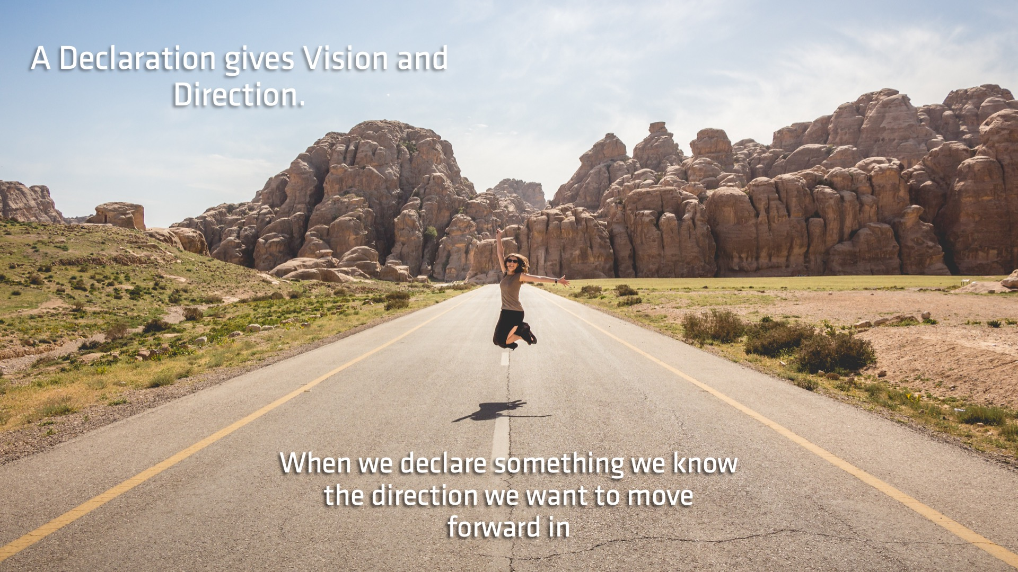

Slide 6
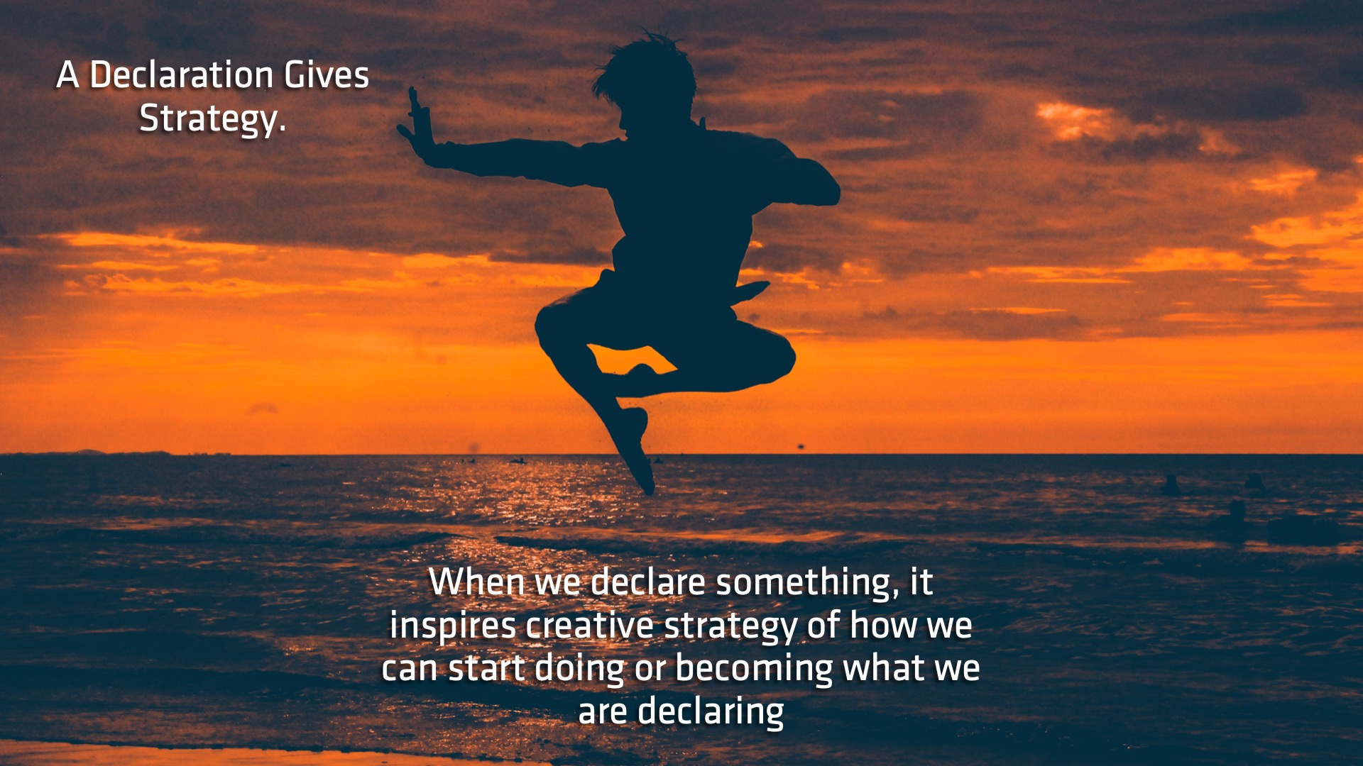
Notes:
If I am constantly telling myself that I am going to see myself impacting 100 lives before the end of the year, suddenly I will start coming up with plans and ways I can accomplish the goal that I set for myself

Slide 7
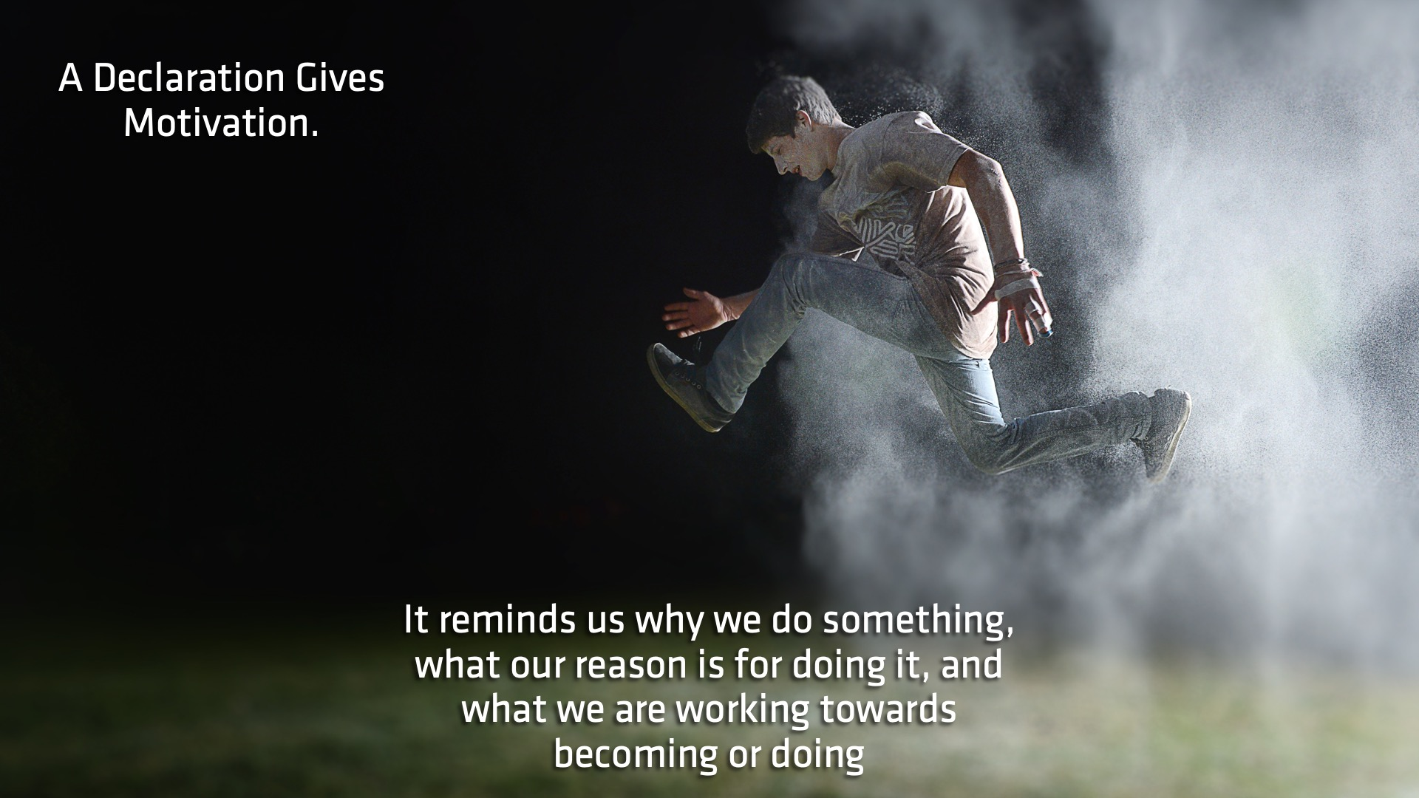

Slide 8
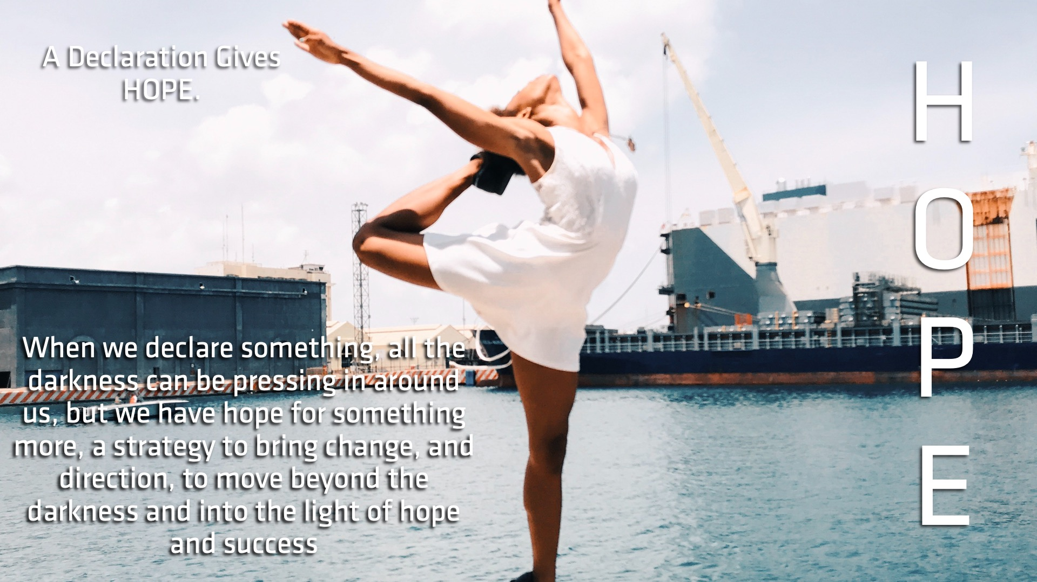

Slide 9

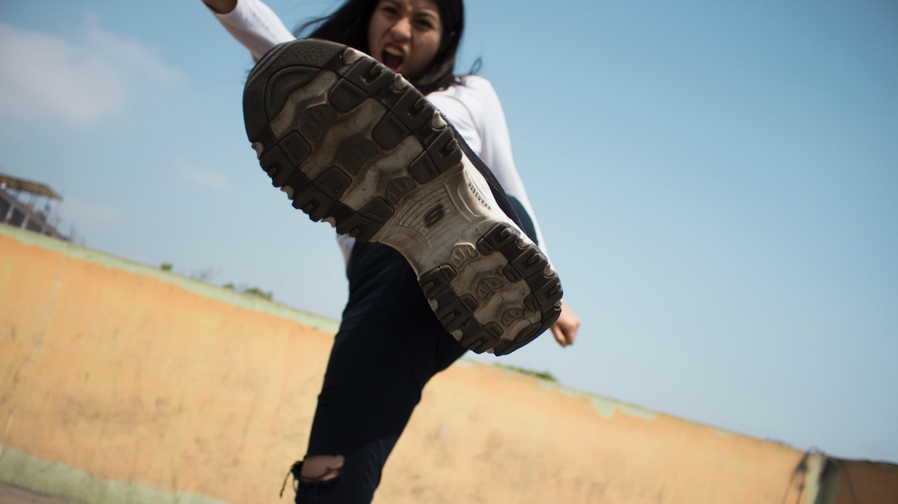
Notes:
I do kick boxing. Been trying to come up with a ‘Fighting Name’. Decided on ‘Shadow Fighter’, sounds fierce and dangerous. More than just physical shadows to fight.

Slide 10
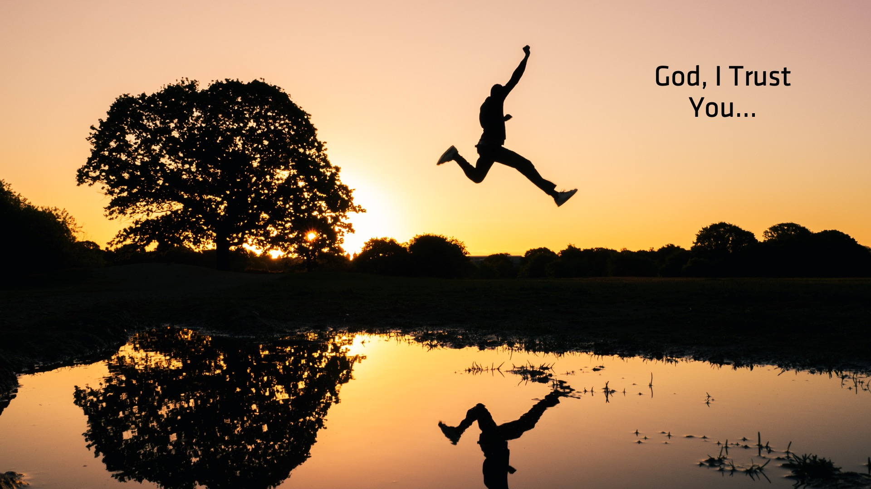
Notes:
Going through really hard time. God sometimes feels further then, right? Decided to declare that I would trust God, eventually did.

Slide 11
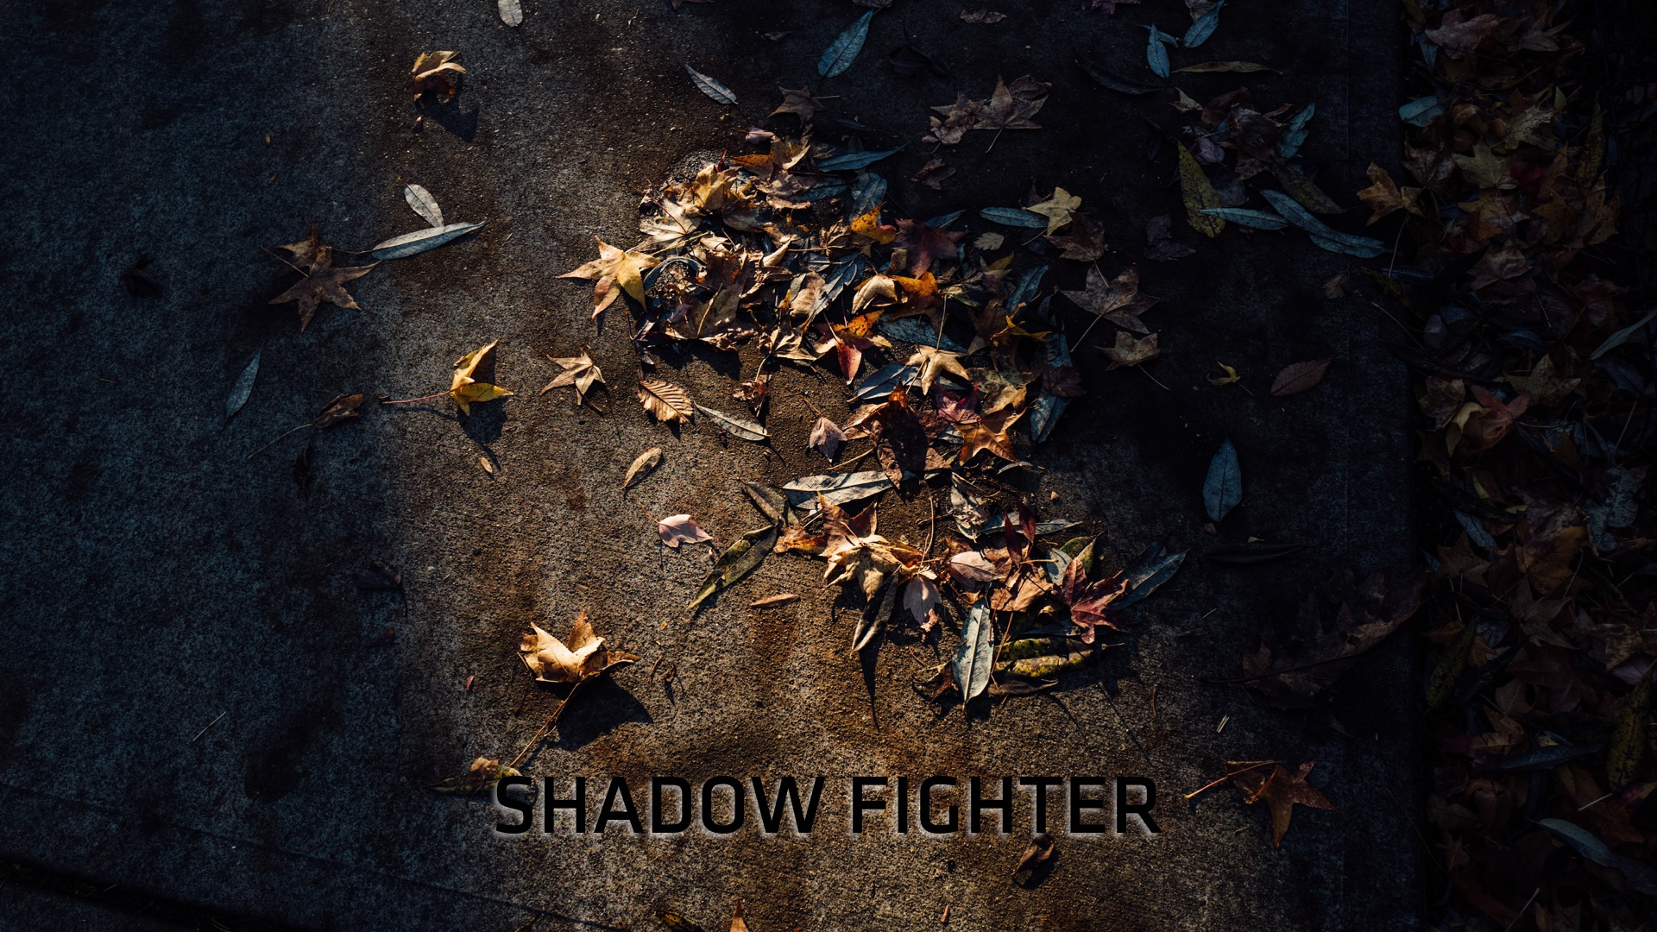
Notes:
I became shadow fighter. More than just a kick boxer, more than just someone who knows how to defend her body, but defend her heart and spirit as well

Slide 12
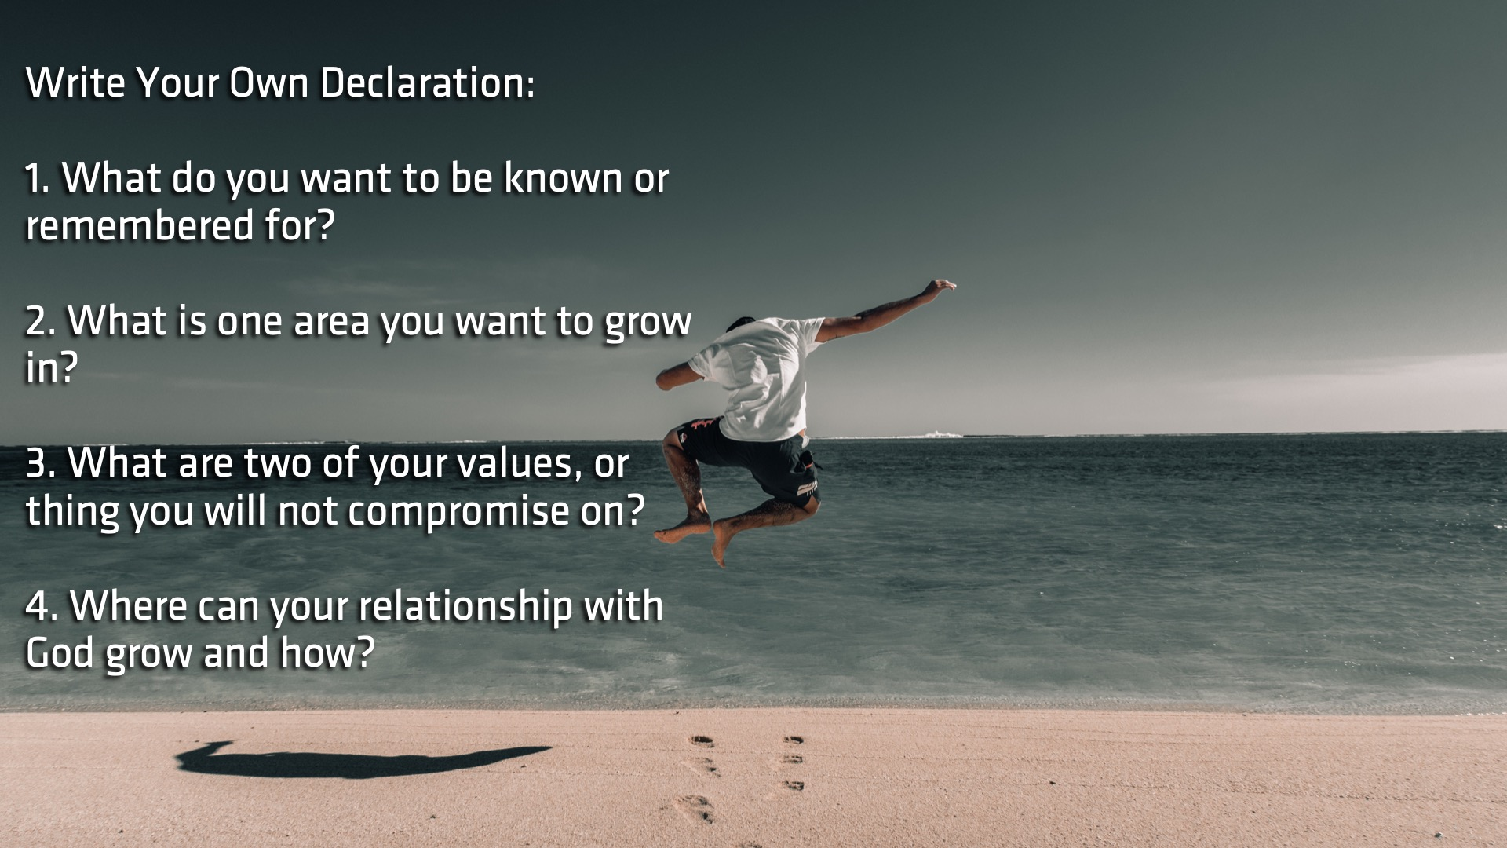
Notes:
Give you the chance to write a declaration over yourself. Sit with God, ask these questions, put answers into a few sentences to be ready every day.

Slide 13
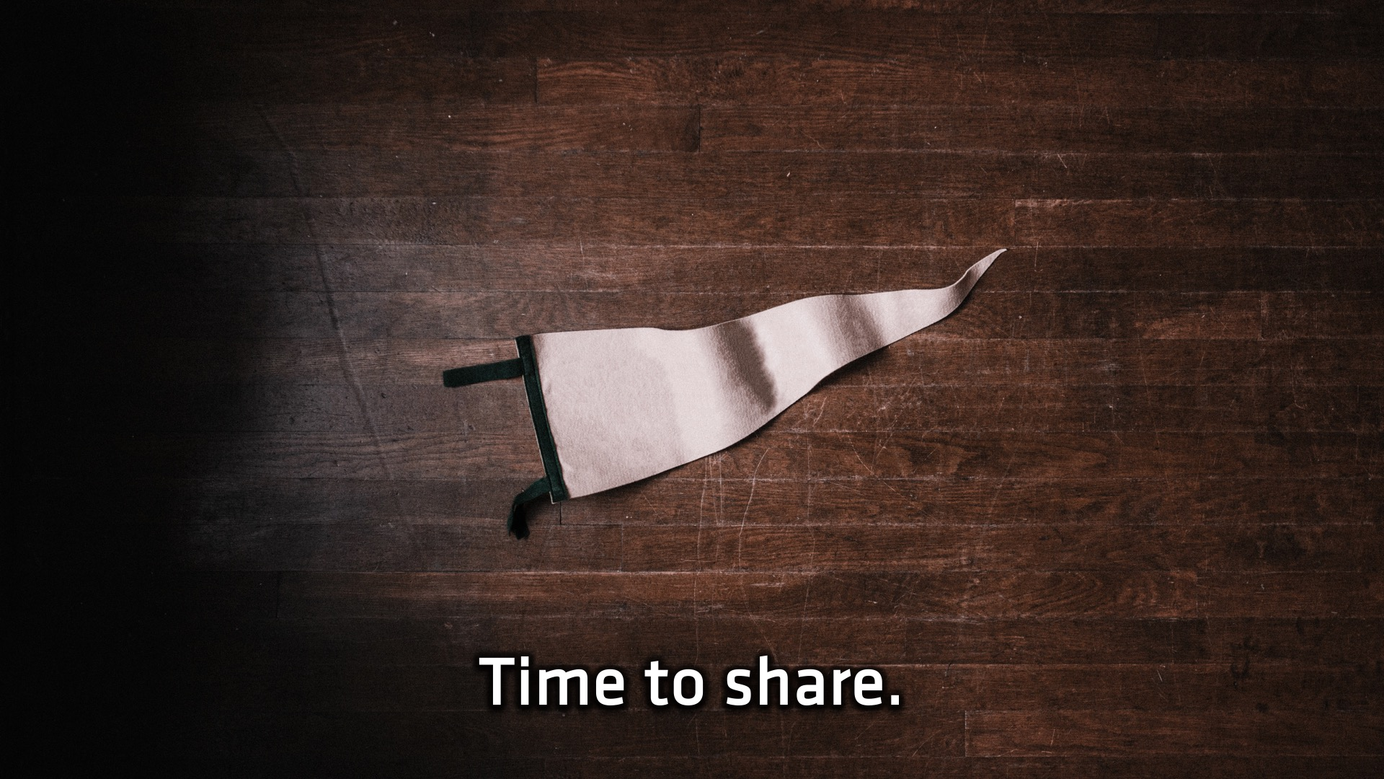
Notes:
Is there anyone who would like to come and say their declaration up front? If not, share with the person next to you and pray for each other that you would learn to declare the positive, not just the negative.

Slide 14
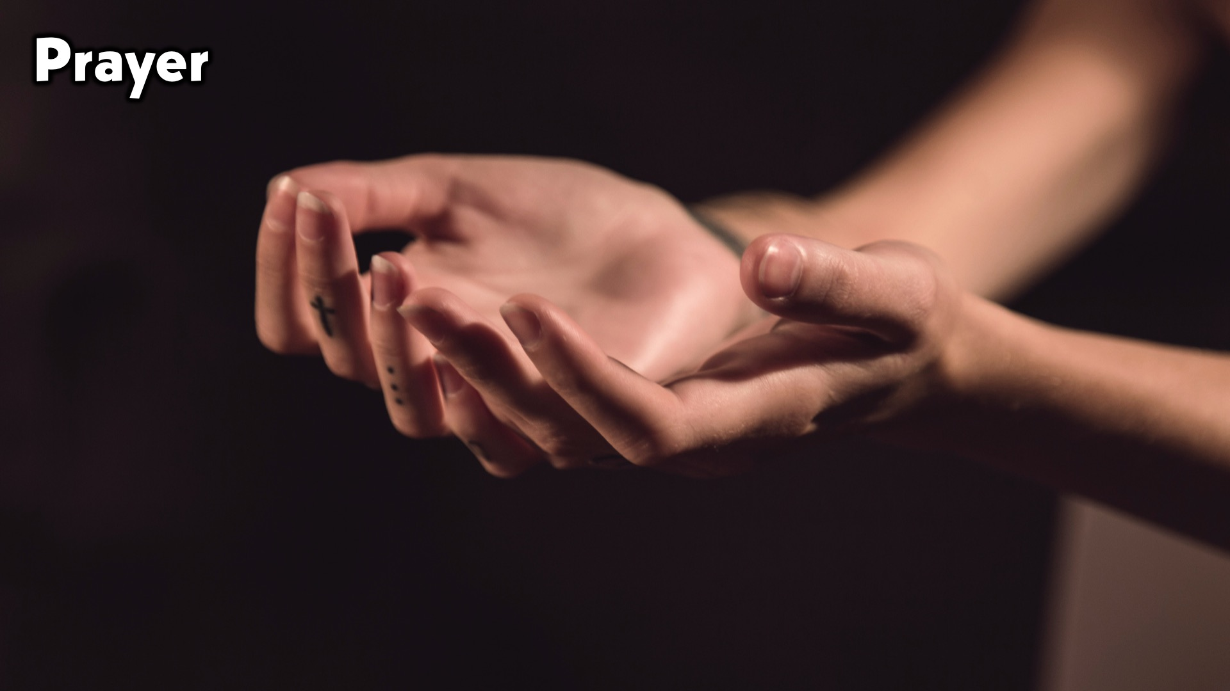

Slide 15
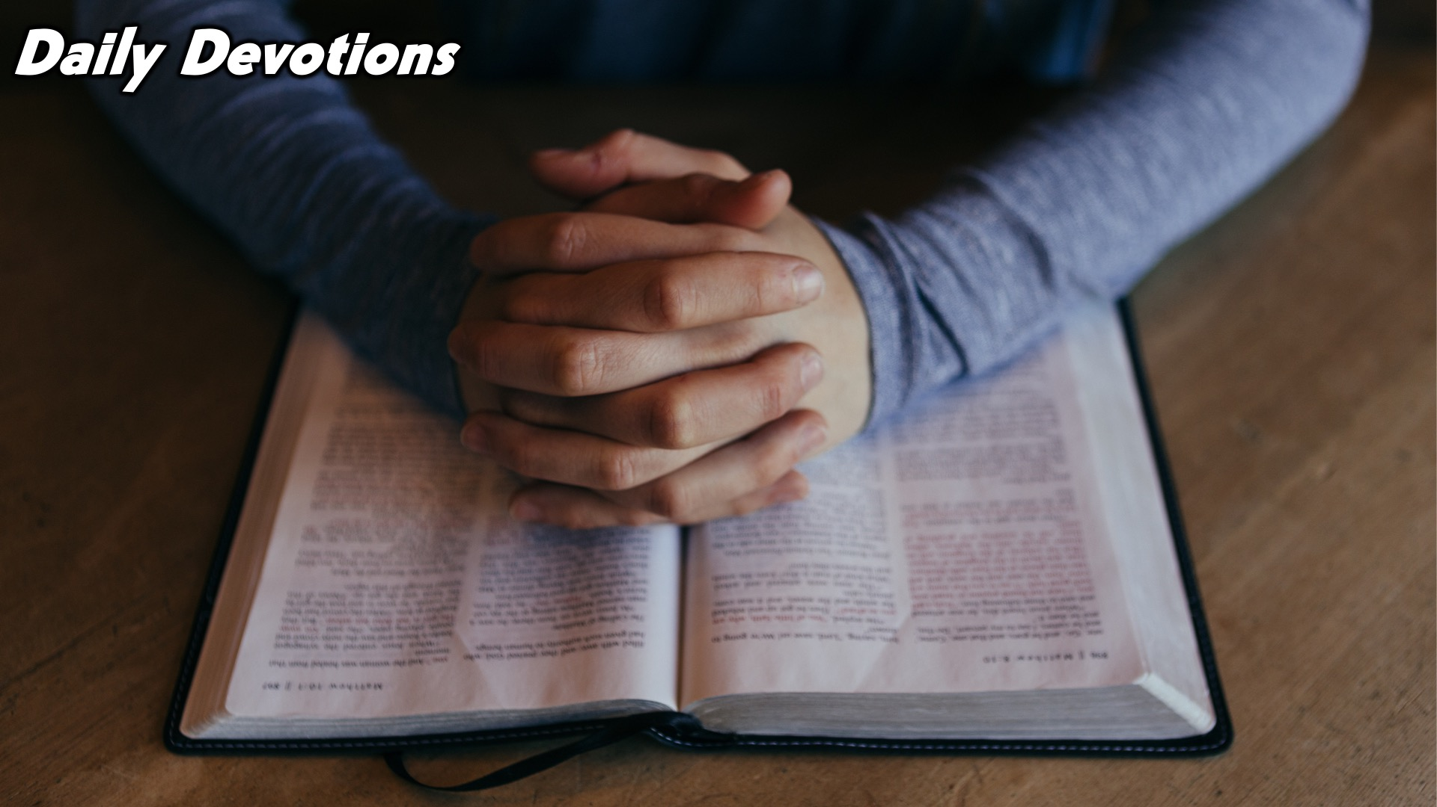
Notes:
Daily Devotions: We will post devotions on the WhatsApp group every night of the week throughout this series. Do everything you can to be a part of the daily journey in the Worship Series to come.

