Slide 1


Slide 2
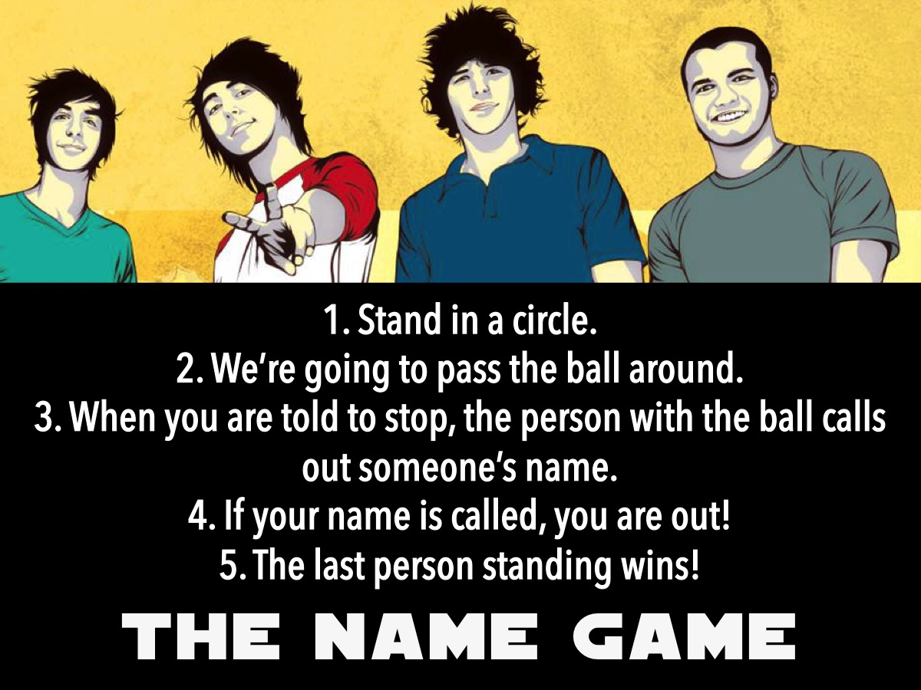

Slide 3


Slide 4


Slide 5


Slide 6


Slide 7
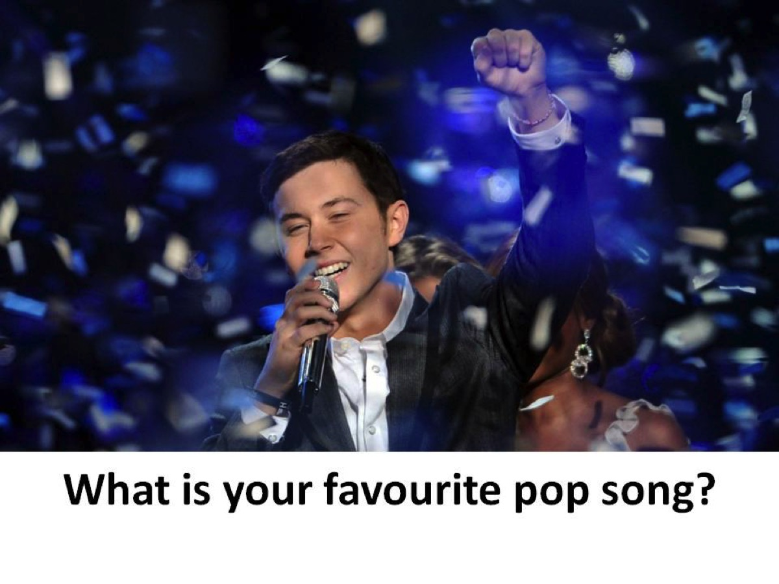

Slide 8


Slide 9


Slide 10


Slide 11


Slide 12
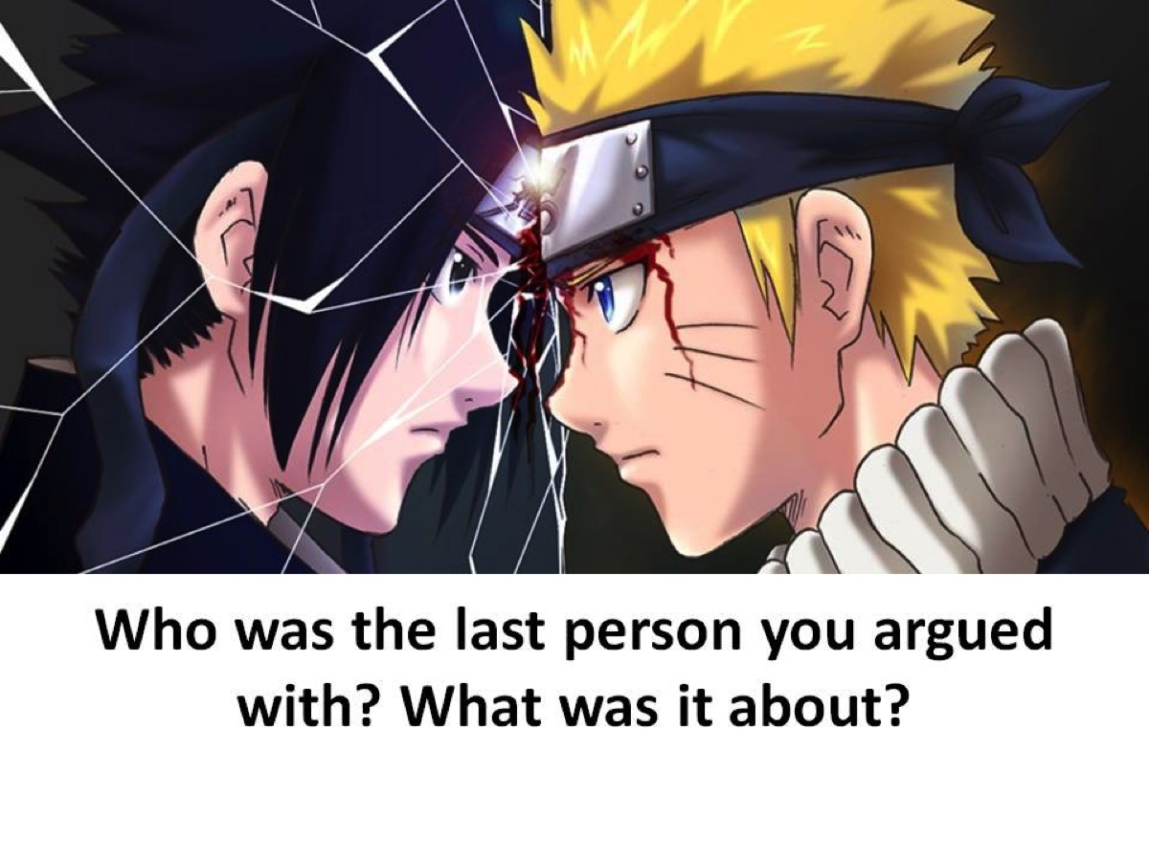

Slide 13


Slide 14


Slide 15


Slide 16


Slide 17


Slide 18


Slide 19

Notes:
The PRAYS Model is a method based on the prayer that Jesus used to teach his disciples to pray.

Slide 20
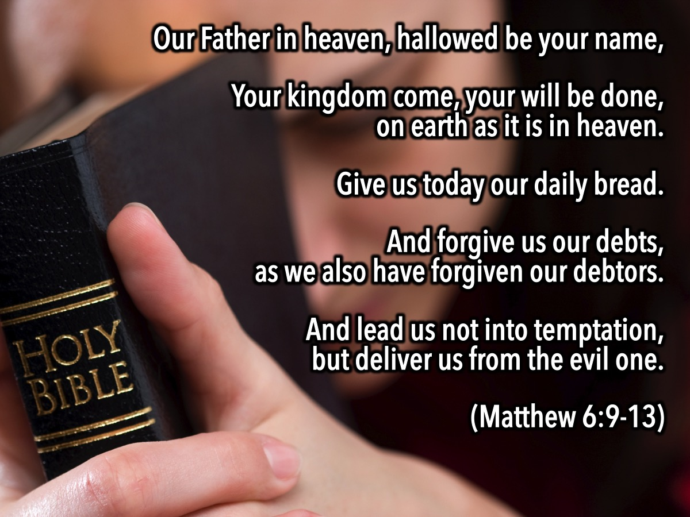
Notes:
It is found in Matthew 6:9-13: “Our Father in heaven, hallowed be your name, Your kingdom come, your will be done, on earth as it is in heaven. Give us today our daily bread. And forgive us our debts, as we also have forgiven our debtors. And lead us not into temptation, but deliver us from the evil one. ”

Slide 21
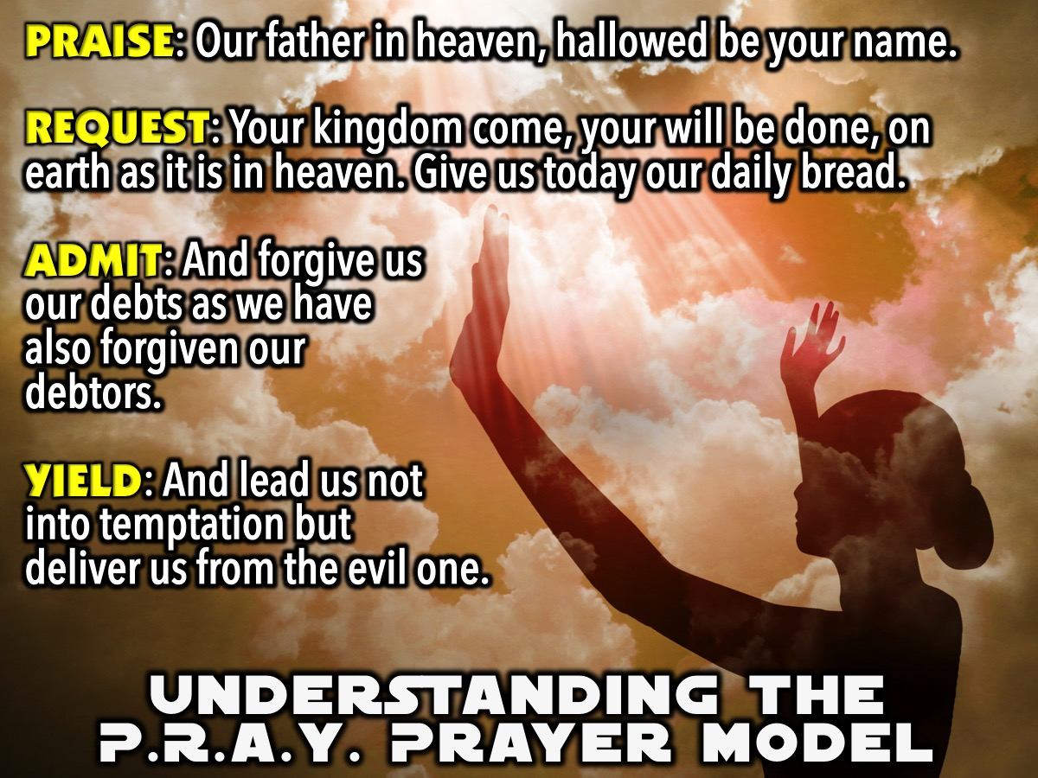
Notes:
1. Understanding the PRAY Prayer Model
Praise: “Our father in heaven, hallowed be your name.”
Request: “Your kingdom come, your will be done, on earth as it is in heaven. Give us today our daily bread.”
Admit: “And forgive us our debts as we have also forgiven our debtors.”
Yield: “And lead us not into temptation but deliver us from the evil one.”

Slide 22
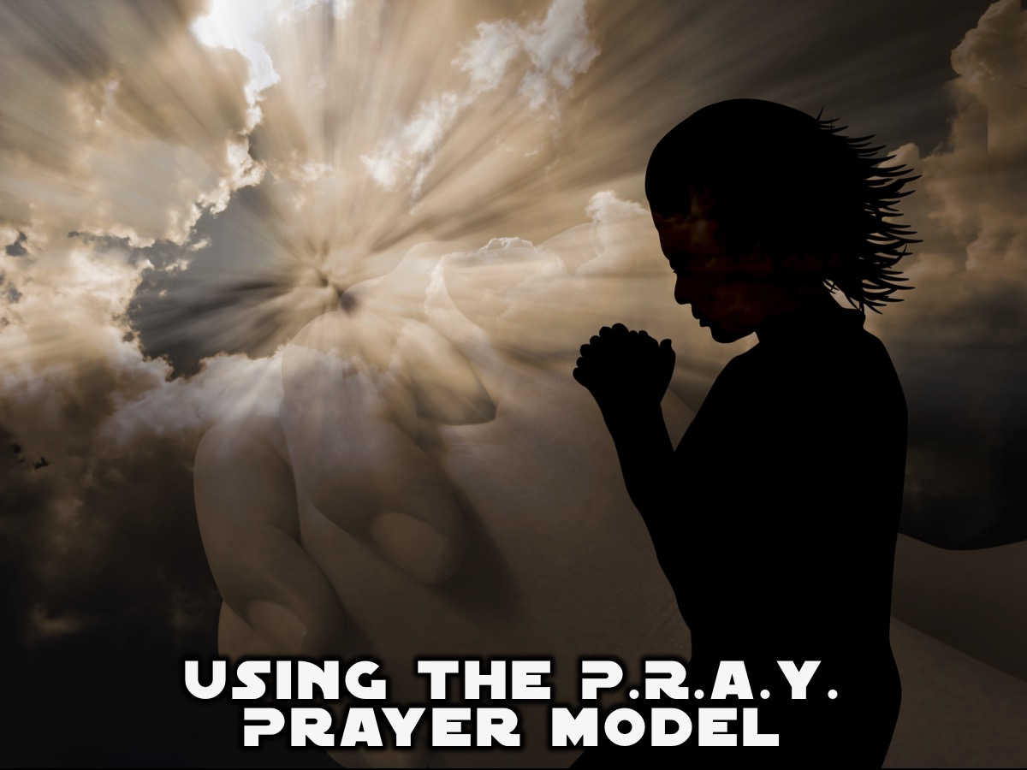
Notes:
2. Using the PRAY Prayer Model.

Slide 23
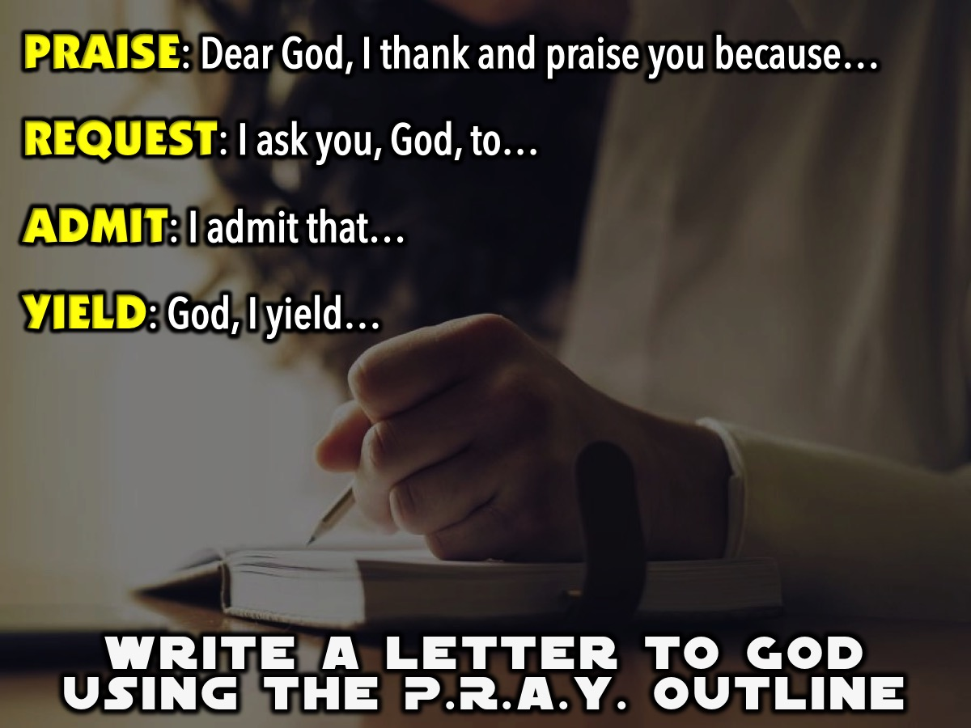
Notes:
A. Write a Letter to God Using the PRAY Outline
Praise: Dear God, I thank and praise you because…
Request: I ask you, God, to…
Admit: I admit that…
Yield: God, I yield…

Slide 24
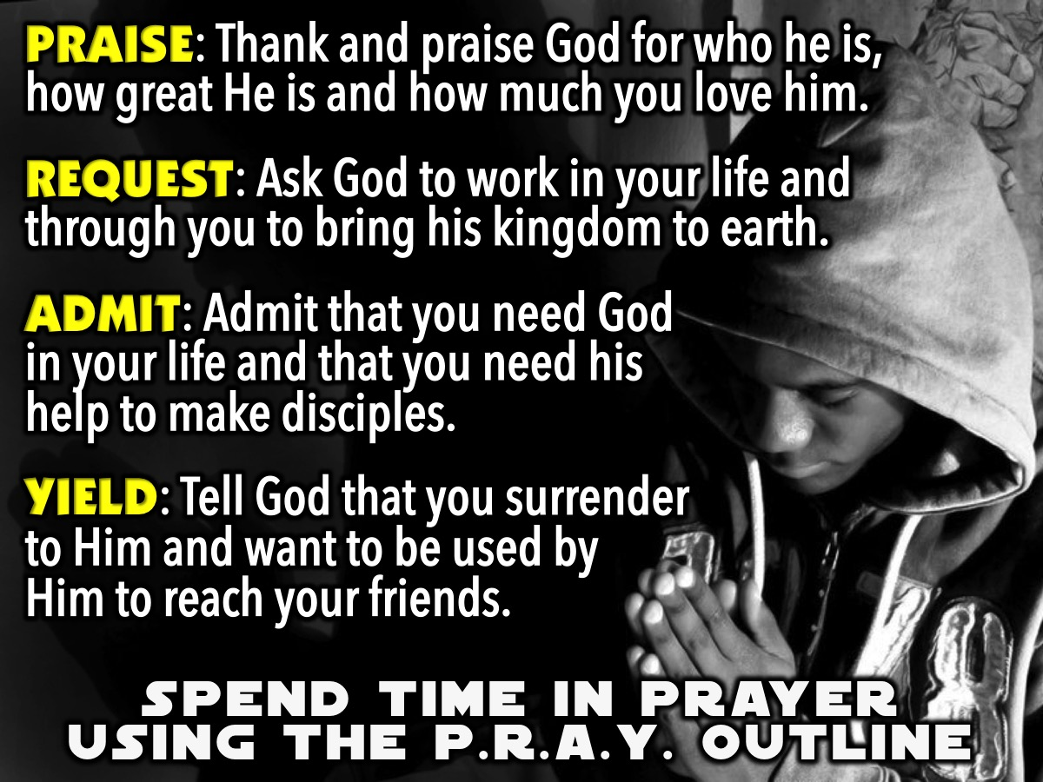
Notes:
B. Spend Time in Prayer Using the PRAY Outline
Praise: Thank and praise God for who he is, how great He is and how you love him.
Request: Ask God to work in your life and through you to bring his kingdom to earth.
Admit: Admit that you need God in your life and that you need his help to make disciples.
Yield: Tell God that you surrender to Him and want to be used by Him to reach your friends.

Slide 25
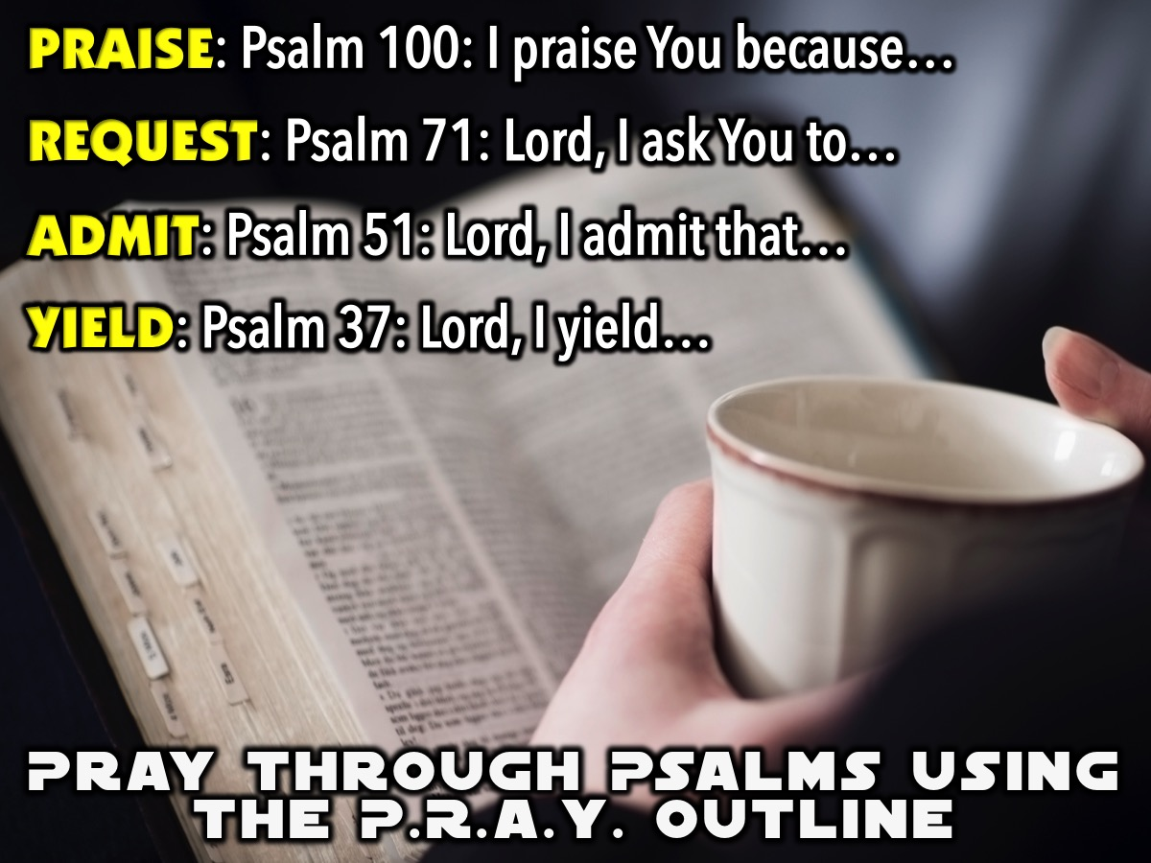
Notes:
C. Pray Through Psalms Using the PRAY Outline
Praise
We are going to begin our time of PRAISE by finding reasons to praise God in Psalm 100: "Shout with joy to the Lord, all the earth! Worship the Lord with gladness. Come before him, singing with joy. Acknowledge that the Lord is God! He made us, and we are his. We are his people, the sheep of his pasture. Enter his gates with thanksgiving; go into his courts with praise. Give thanks to him and praise his name. For the Lord is good. His unfailing love continues forever, and his faithfulness continues to each generation.”
I praise you God because you are….
Request
As we move into the next phase in the Lord’s Prayer let’s been to bring our REQUESTS before the Lord. Here is a passage from Psalm 71 to guide our prayers: In you, Lord, I have taken refuge; let me never be put to shame. In your righteousness, rescue me and deliver me; turn your ear to me and save me. Be my rock of refuge, to which I can always go; give the command to save me, for you are my rock and my fortress. Deliver me, my God, from the hand of the wicked, from the grasp of those who are evil and cruel.
Lord, I ask you to…
Admit
As we move into the next phase of our prayer, let’s ADMIT where we have fallen short of God’s best for our lives and receive his pardon and grace to live in freedom! Here is a passage from Psalm 51 to guide our prayers: Have mercy on me, O God, according to your unfailing love; according to your great compassion blot out my transgressions. Wash away all my iniquity and cleanse me from my sin.
Lord, I admit that…
Yield
As we move into the next phase of our prayer, let’s Yield ourselves to the Lord. Here is a Psalm to guide our prayers: “Surrender yourself to the Lord, and wait patiently for him. Do not be preoccupied with an evildoer who succeeds in his way when he carries out his schemes. Let go of anger, and leave rage behind. Do not be preoccupied. It only leads to evil. Evildoers will be cut off from their inheritance, but those who wait with hope for the Lord will inherit the land.”
Lord, I yield…

Slide 26

Notes:
Small Groups

