Slide 1
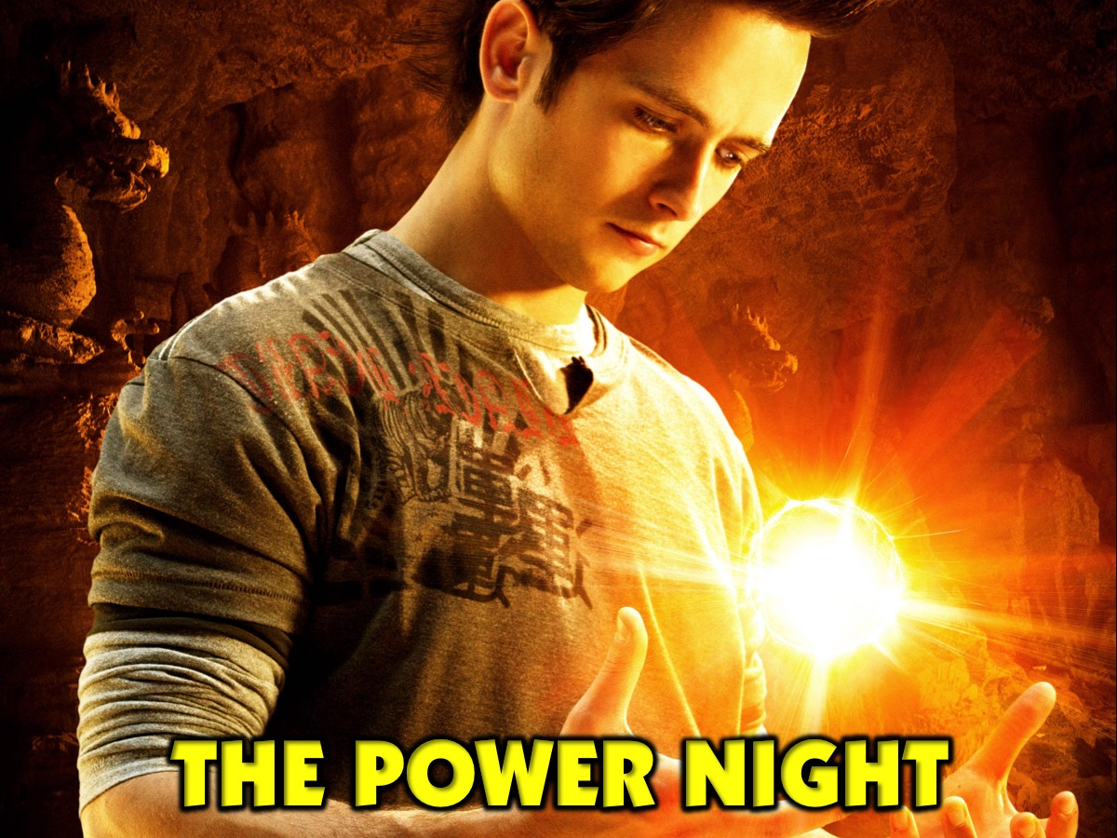
Notes:
Let’s open our session in prayer.

Slide 2
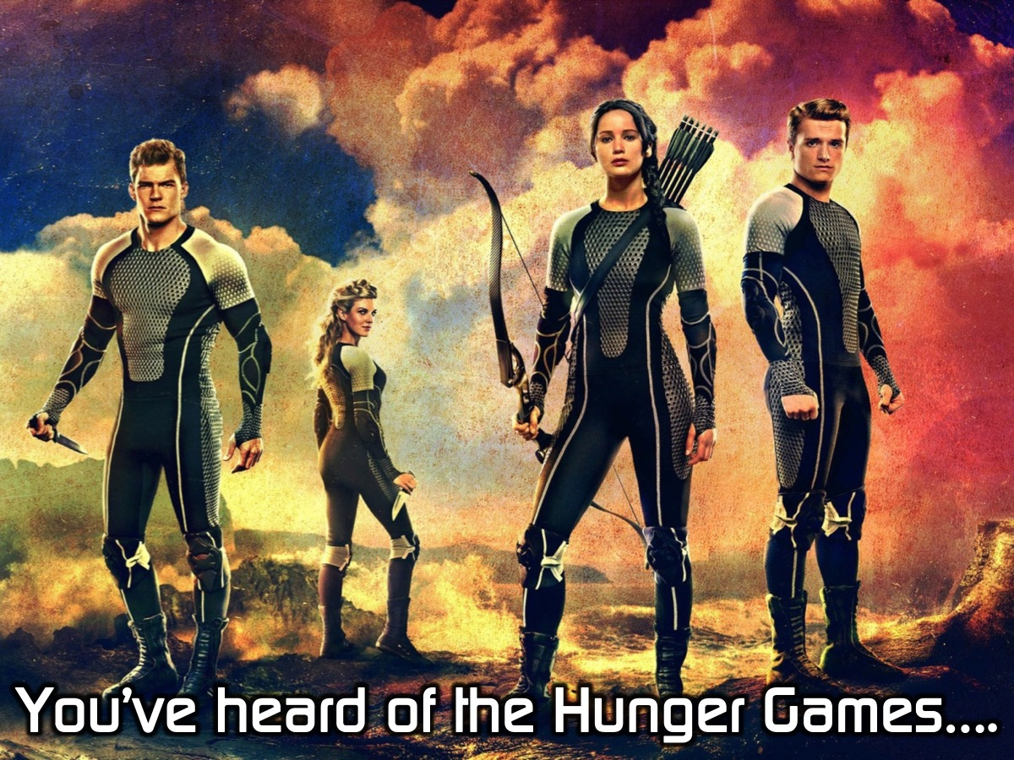
Notes:
You’ve heard of the Hunger Games…

Slide 3
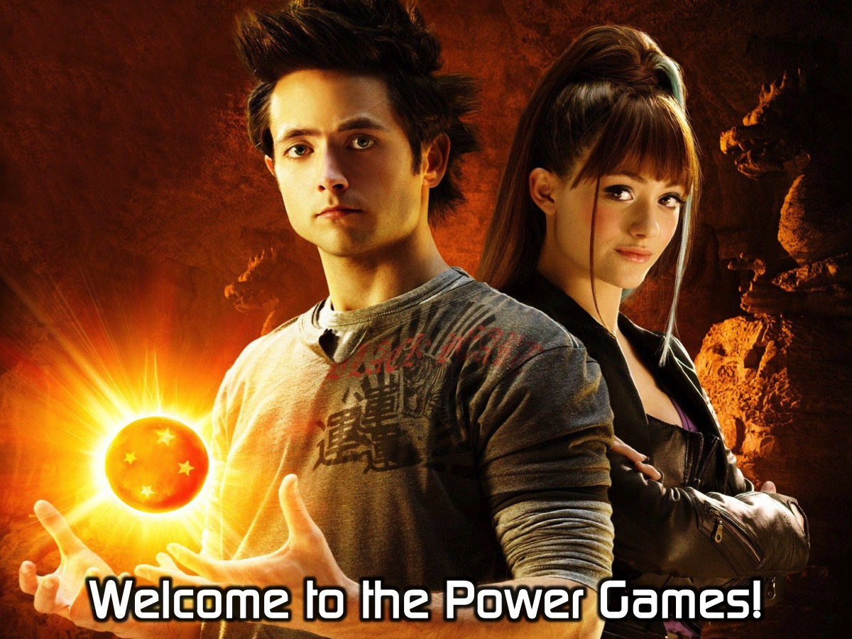
Notes:
Welcome to the Power Games!

Slide 4
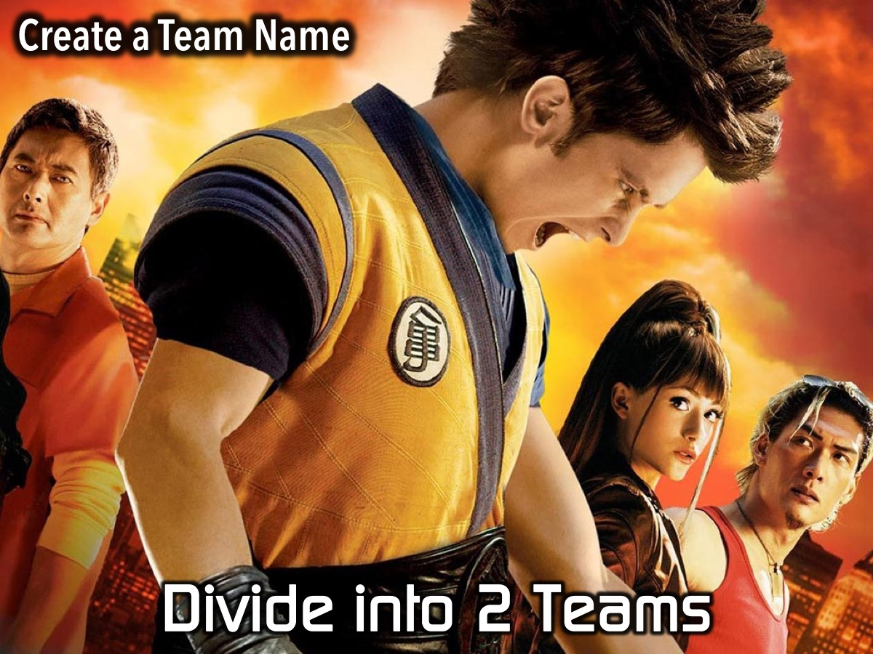
Notes:
First we are going to Divide into 2 Teams and give your team a name.

Slide 5
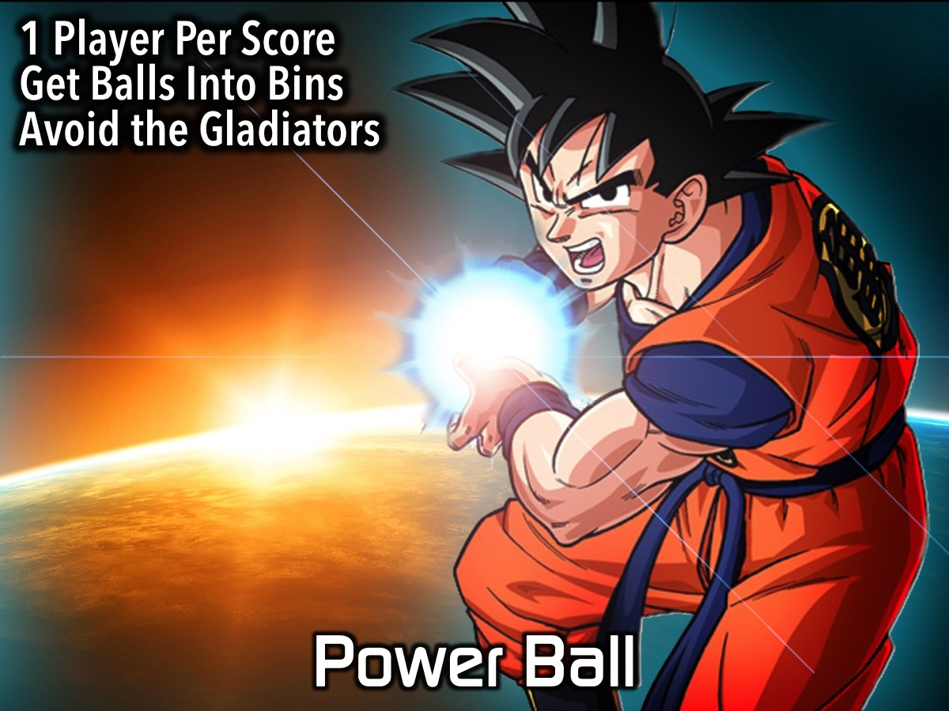
Notes:
Power Ball: Two teams battle each other at a time. Team members lines up in front of their team area and they have to score points by getting balls into one of three boxes in the middle of the room - the middle basket counts for 20 points while the two outside baskets count for 10 points. The objective is to score as many times as possible within the time limit. When a person drops a ball they have to retreat to their starting line and fetch another ball. There are 3 gladiators who will try and disrupt the teams from scoring by blocking the ball, knocking it out of peoples hands or generally just getting in the way - but they are not allowed to tackle or harm the contestants. Each round lasts for 2 minutes and then scores are counted and the next two teams play each other - with the winners going head to head in a final. Play some gladiator music while the game is going. Choose gladiators who won’t kill the contestants.

Slide 6
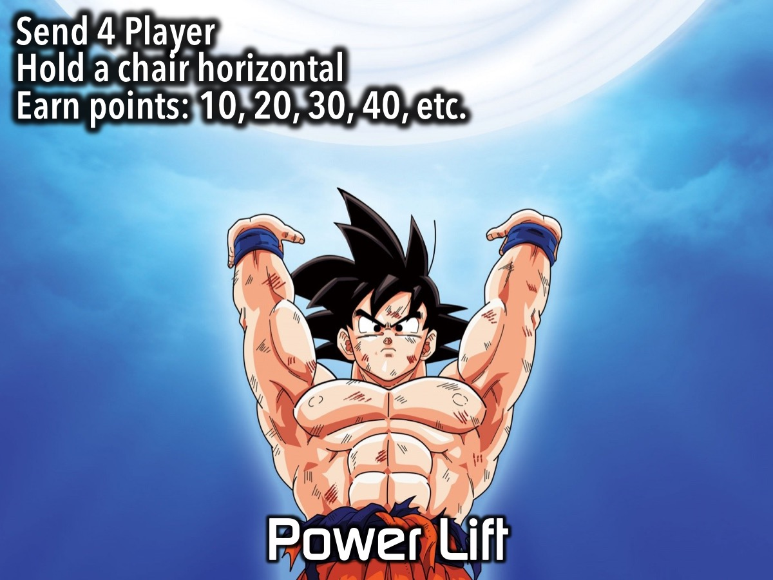
Notes:
Power Lift: Each of the four teams sends one competitor to the front. They have to hold a chair with arms extended in the air. The person who drops the chair first gets 10 points for their team, the second person out gets 20 points, third gets 30 points and the winner gets 40 points!

Slide 7
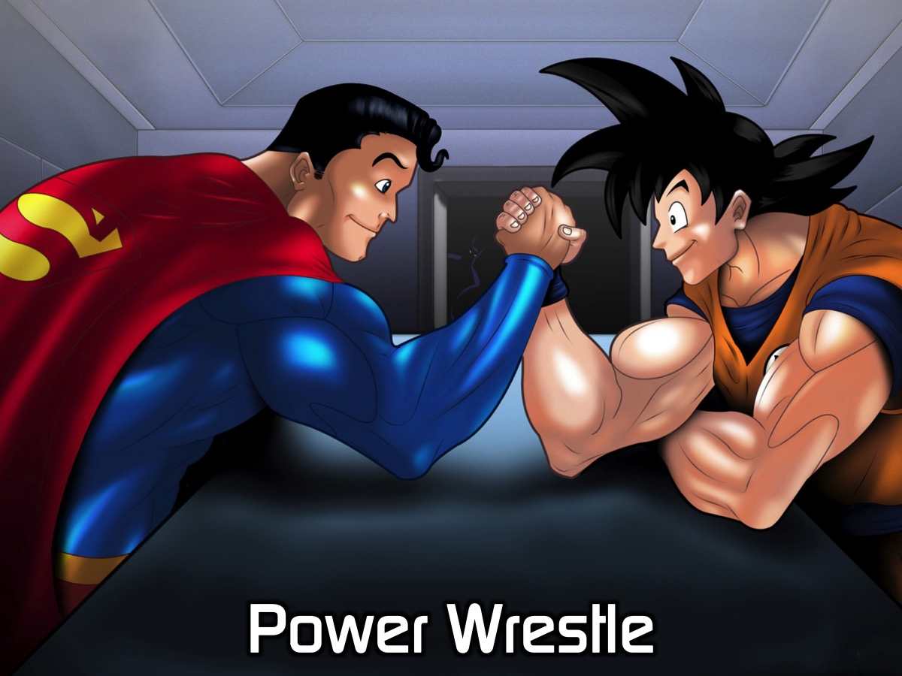
Notes:
Power Wrestle: Each team sends 1 contestant to compete in an arm wrestling competition. Two teams battle it out, then the next two teams and the two winners play in the final.

Slide 8
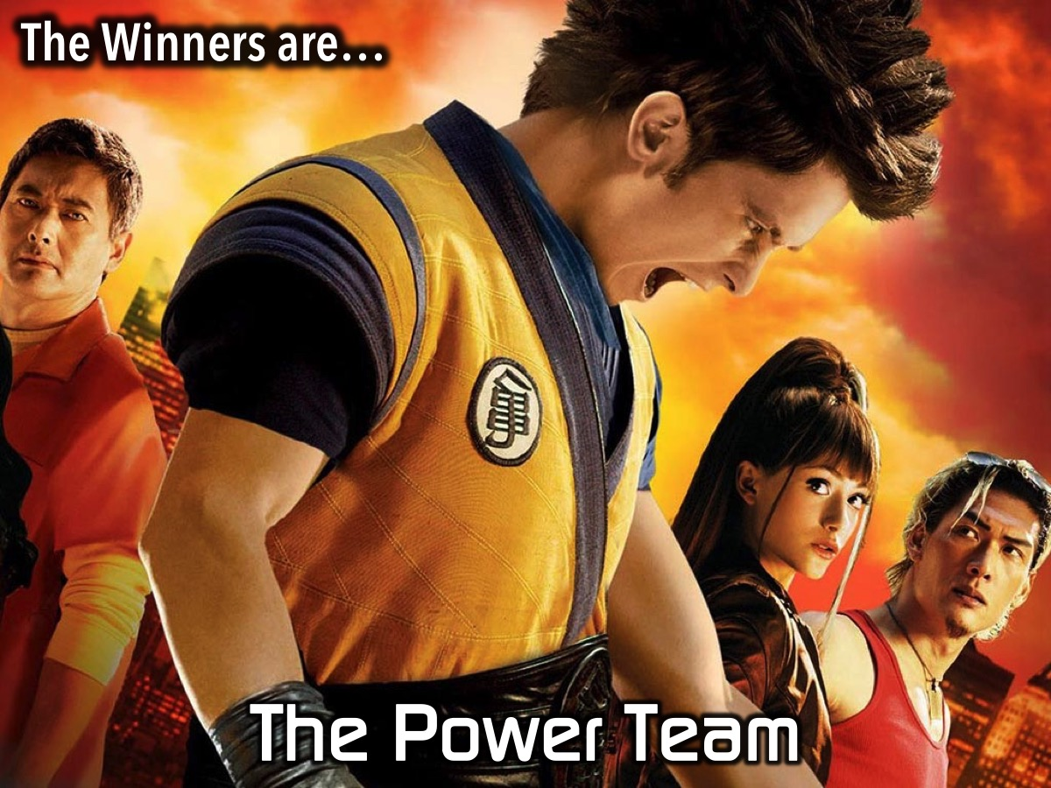
Notes:
The Winners are… Well done to our winning team they get a reward for their triumph!

Slide 9
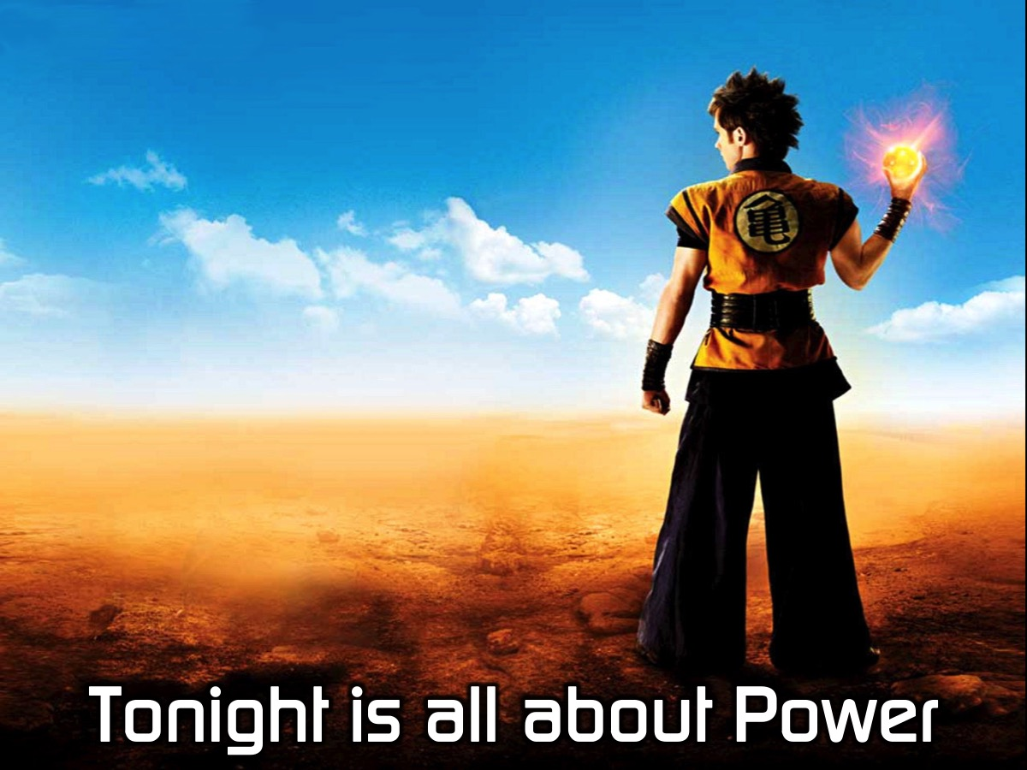
Notes:
Tonight is all about power…

Slide 10

Notes:
Have any of your watched the TV series - The Flash? Here is the trailer for season 1:

Slide 11
Notes:
Video: The Flash Story. An edited version of the extended trailer for the Flash TV series. Get it on YouTube at: https://www.youtube.com/watch?v=Yj0l7iGKh8g

Slide 12
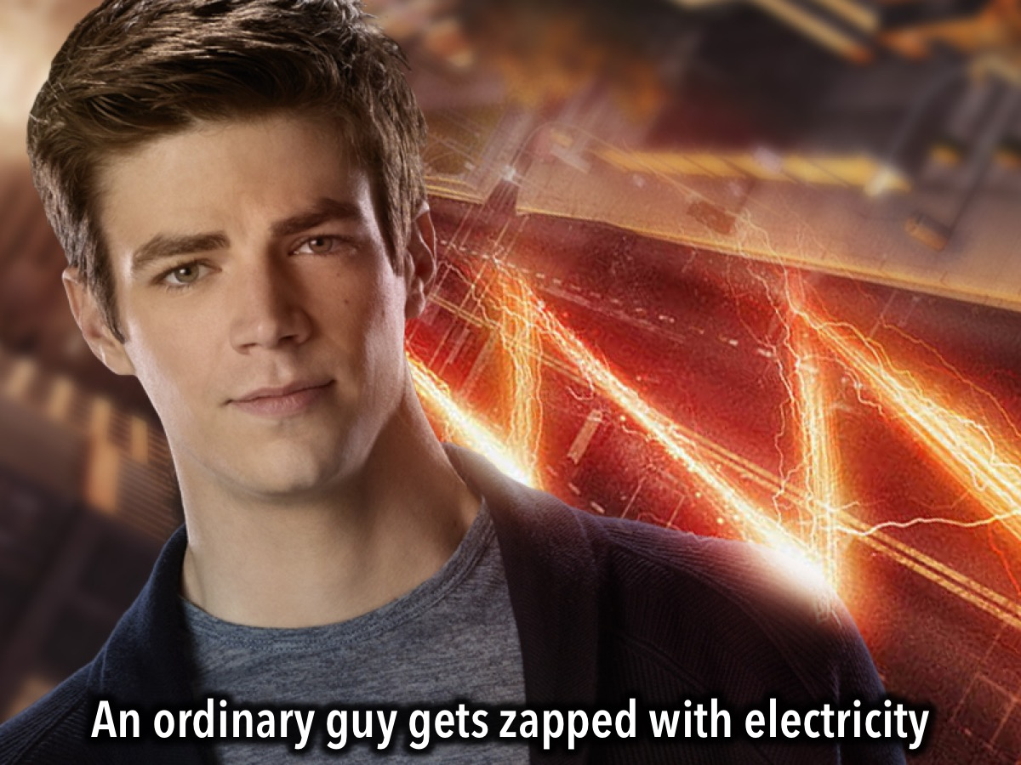
Notes:
An ordinary guy gets zapped with electricity

Slide 13
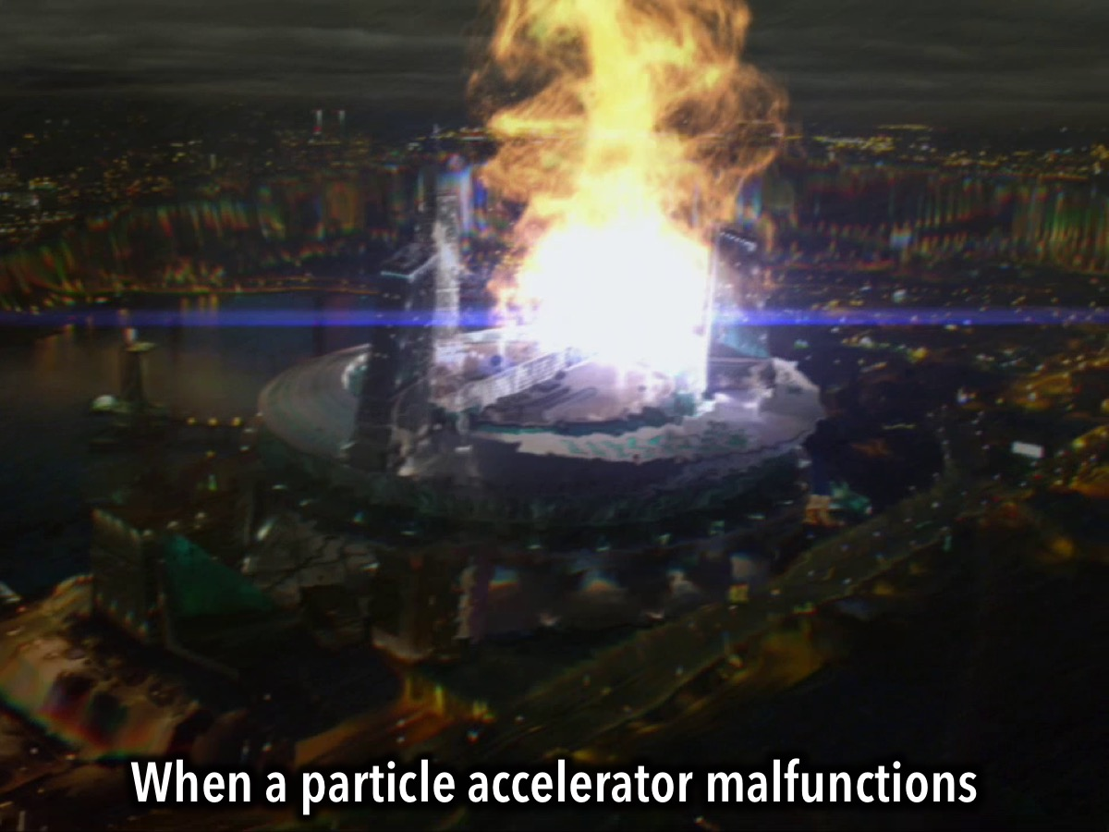
Notes:
When a particle accelerator malfunctions

Slide 14
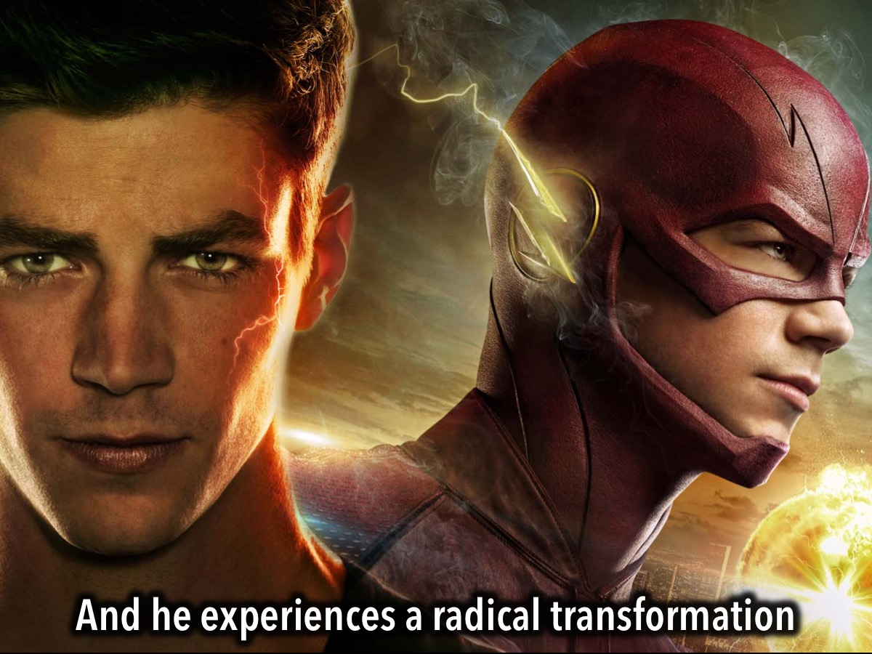
Notes:
And he experiences a radical transformation

Slide 15
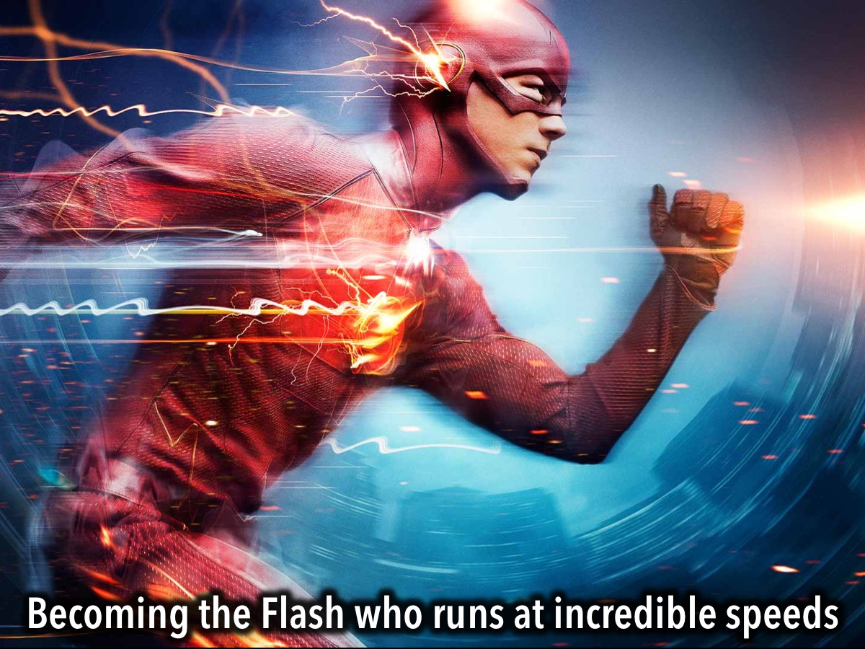
Notes:
Becoming the Flash who runs at incredible speeds

Slide 16
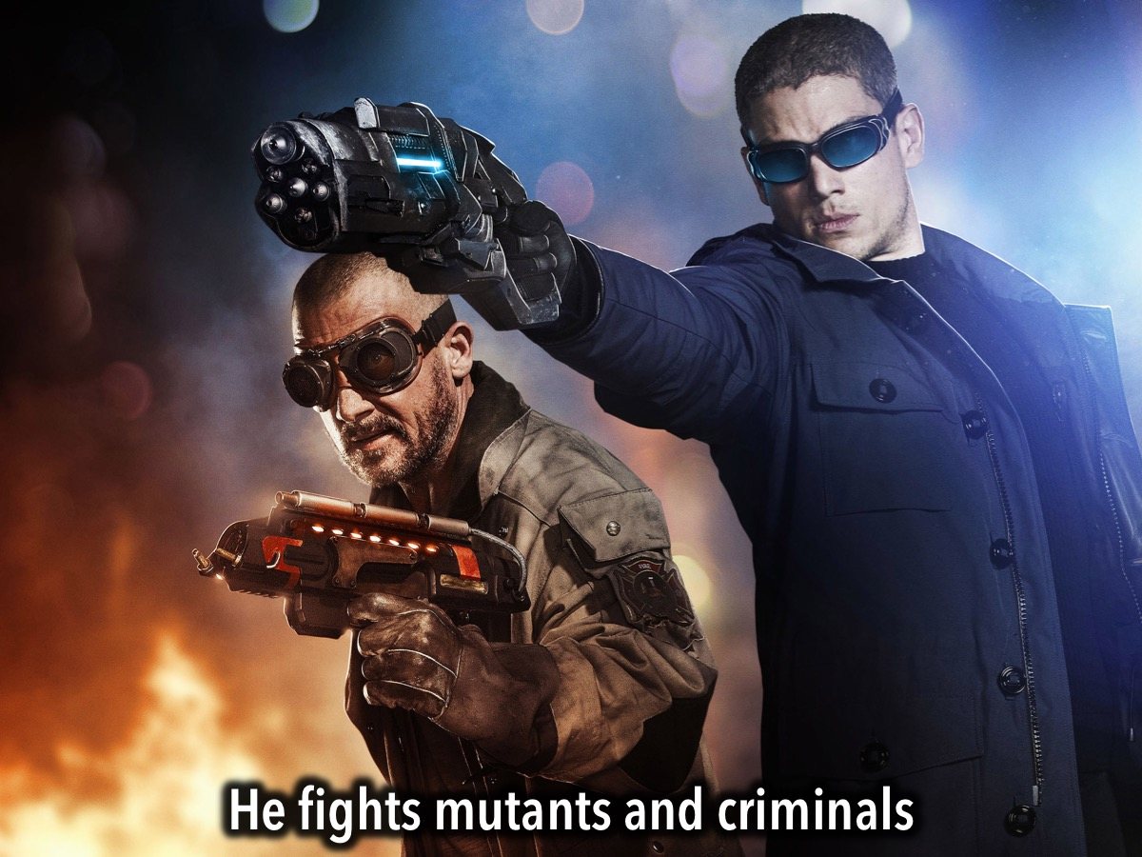
Notes:
And he fights mutants and criminals

Slide 17
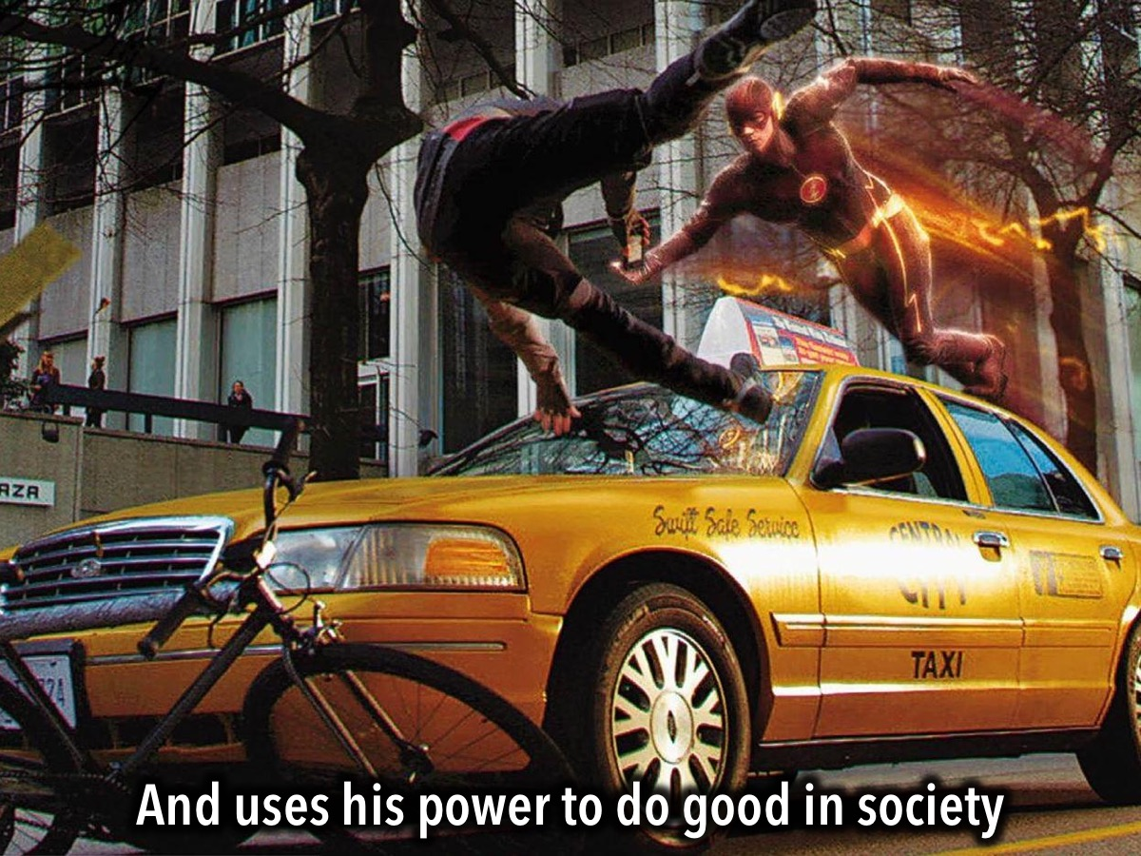
Notes:
And uses his power to do good in society

Slide 18
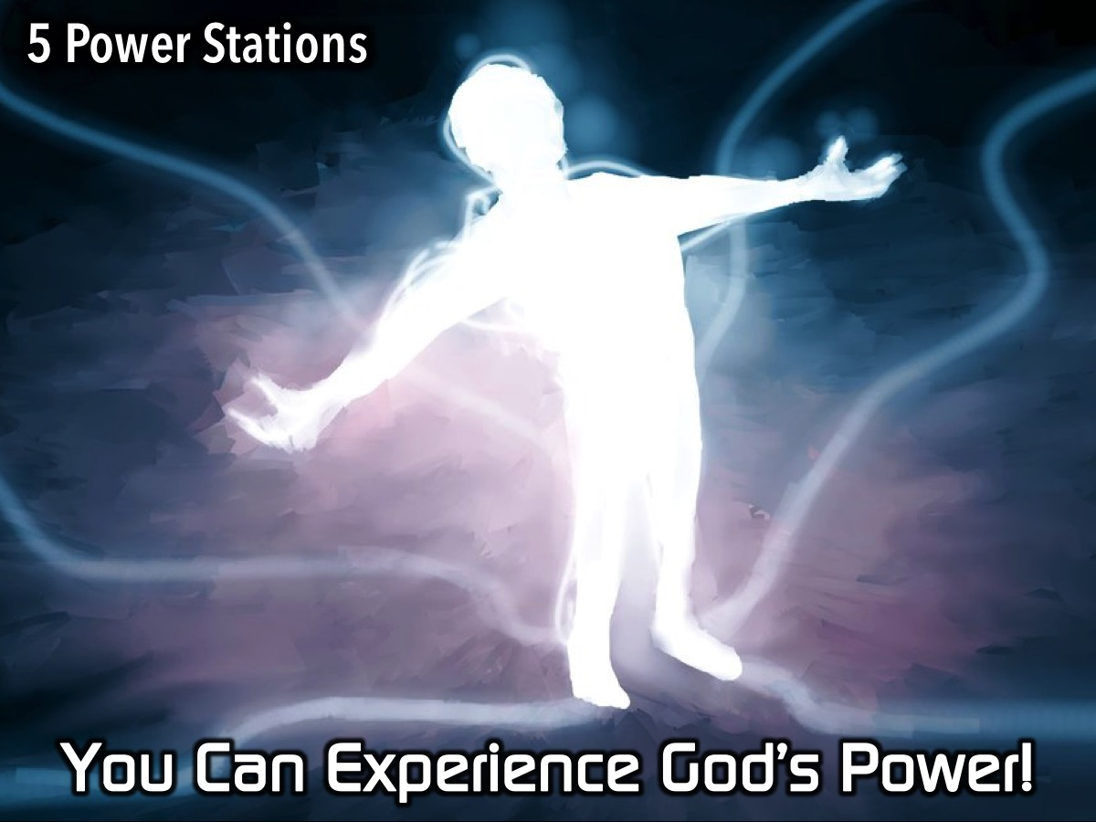
Notes:
You Can Experience God’s Power! Tonight we have the opportunity to experience God’s power. We have set up 5 Power Stations around the room - places you can visit and have someone pray for you to experience God in that area. The five power stations are:

Slide 19
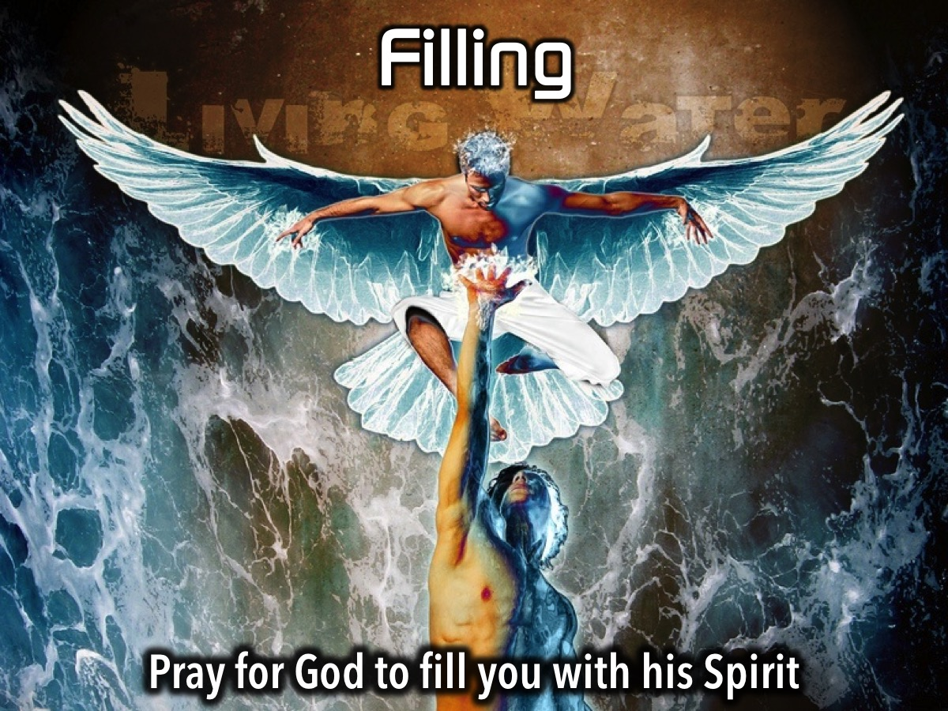
Notes:
1. Filling. At this station someone will pray for God to fill you with his Spirit.

Slide 20

Notes:
2. Deliverance. At this station someone will pray for God to set you free from something.

Slide 21

Notes:
3. Healing. At this station someone will pray for God to heal you from something.

Slide 22

Notes:
4. Miracles. At this station someone will pray for God to do a miracle for you.

Slide 23
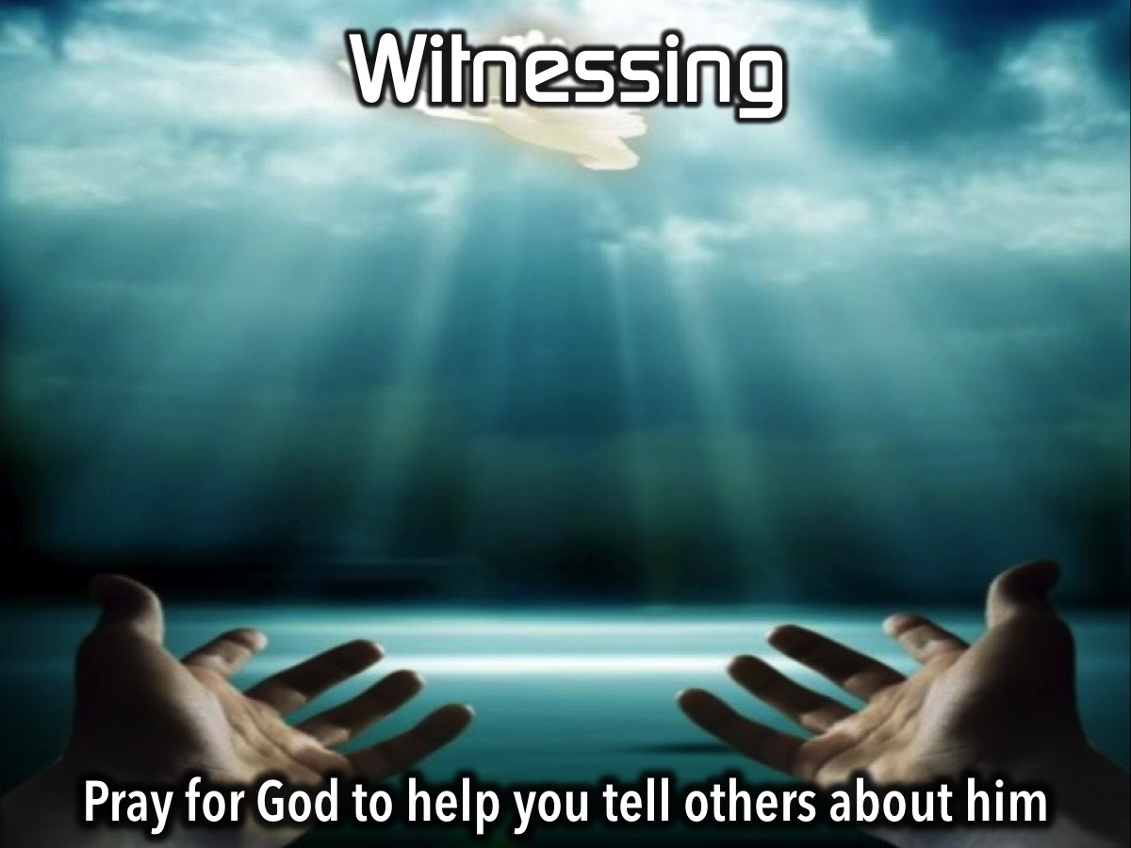
Notes:
5. Witnessing. At this station someone will pray for God to help you tell others about him.

Slide 24
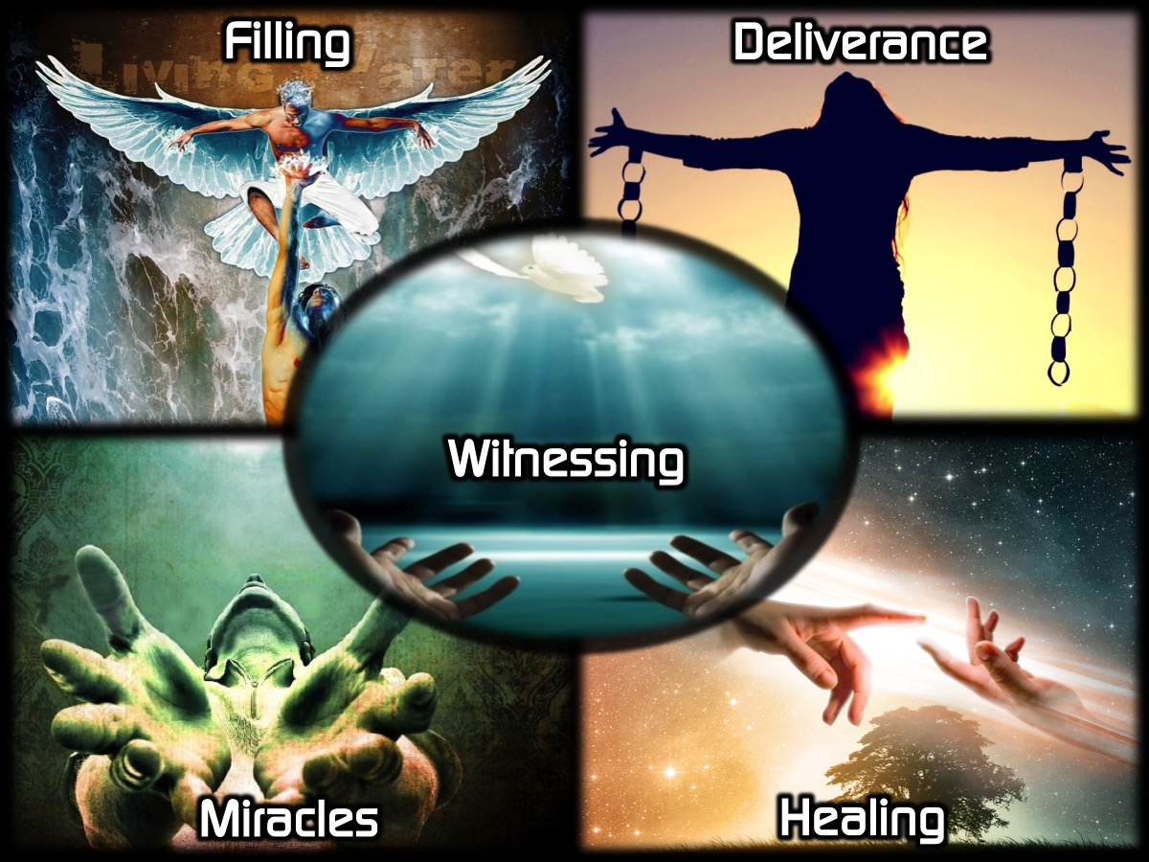
Notes:
Enjoy the Power Stations - you can visit more than one if time allows.

Slide 25

Notes:
Small Groups. Here are the questions for our small group time: (1) What did you most enjoy about the Power Games tonight? (2) How were you touched by God at the Power Stations? (3) Pray for each other to experience God’s Power in their lives!

Slide 26

Notes:
It is time for Refreshments.

