Slide 1

Notes:
Welcome to The GOD Series. Each session in this series will have 3 parts to it (each roughly 10 minutes in length): (1) Express: Questions will be used to get youth expressing what they know and believe about the topic in small groups. (2) Explore: The facilitator will explore the topic (using media, video, stories) to challenge understanding about the topic. (3) Experience: The facilitator will get youth to internalise what they have learnt through an intractive experience.

Slide 2
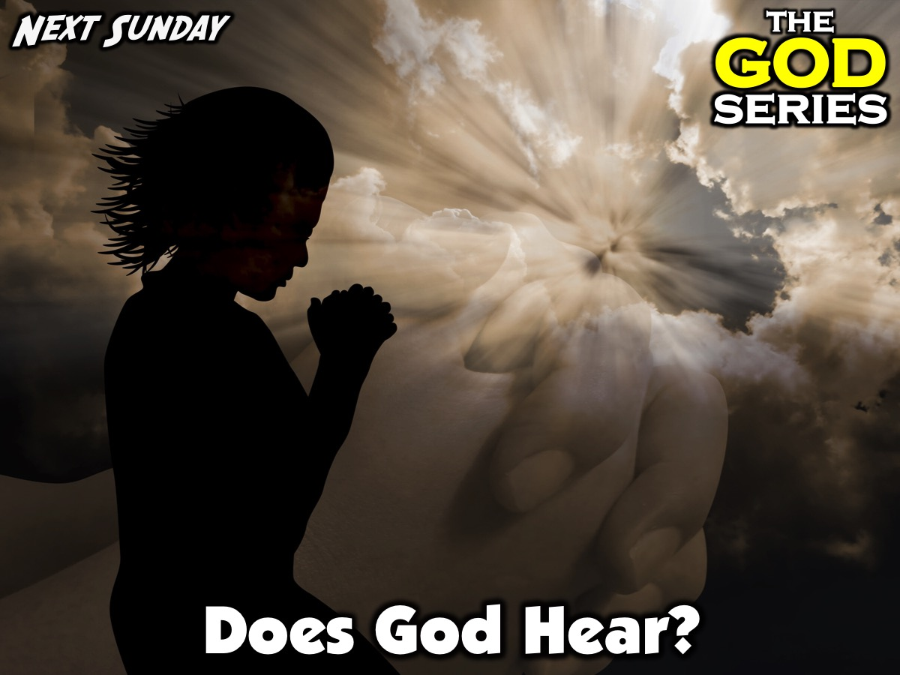
Notes:
Next Sunday we are going to answering the question: Does God Hear? And in the following weeks…

Slide 3
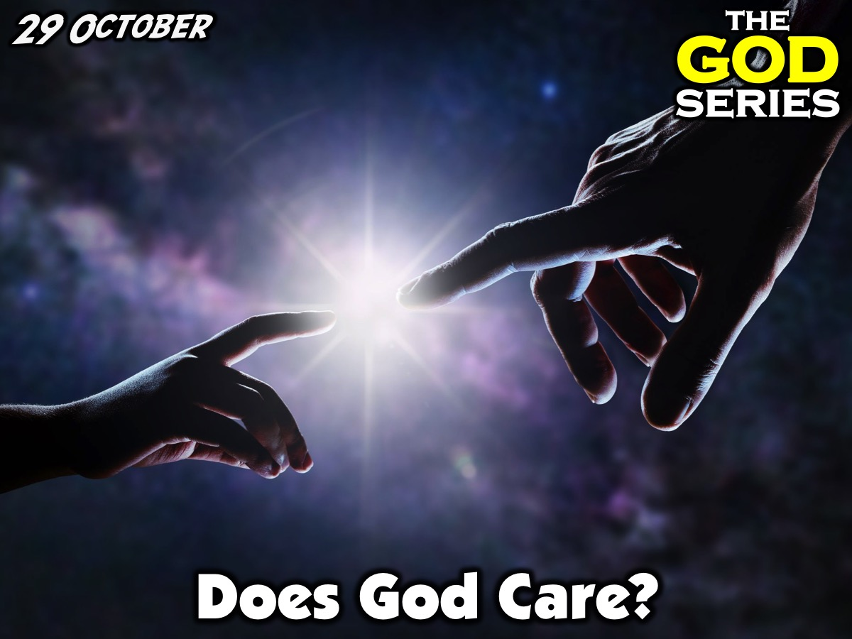
Notes:
Does God Care?

Slide 4
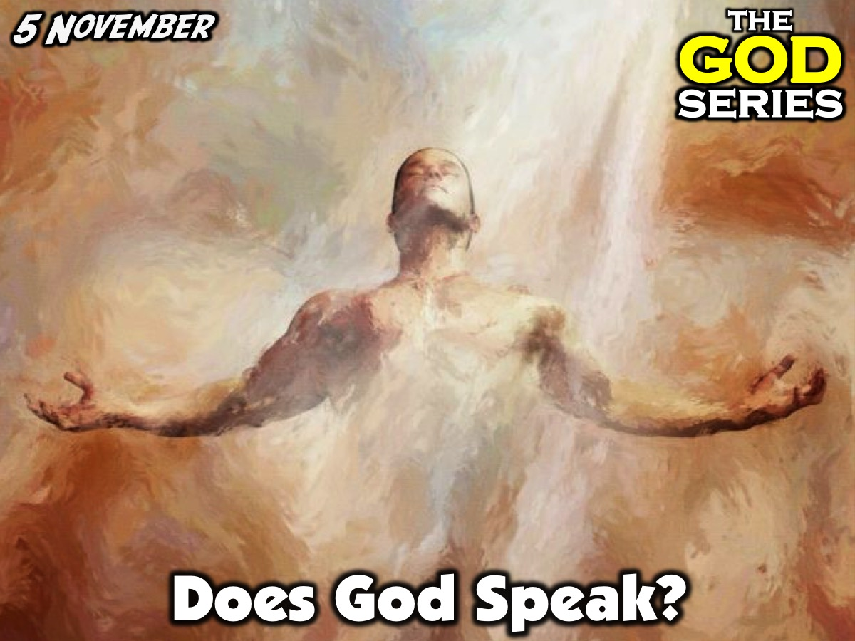
Notes:
Does God Speak?

Slide 5

Notes:
We will take a one-week break for a family service in the main sanctuary.

Slide 6
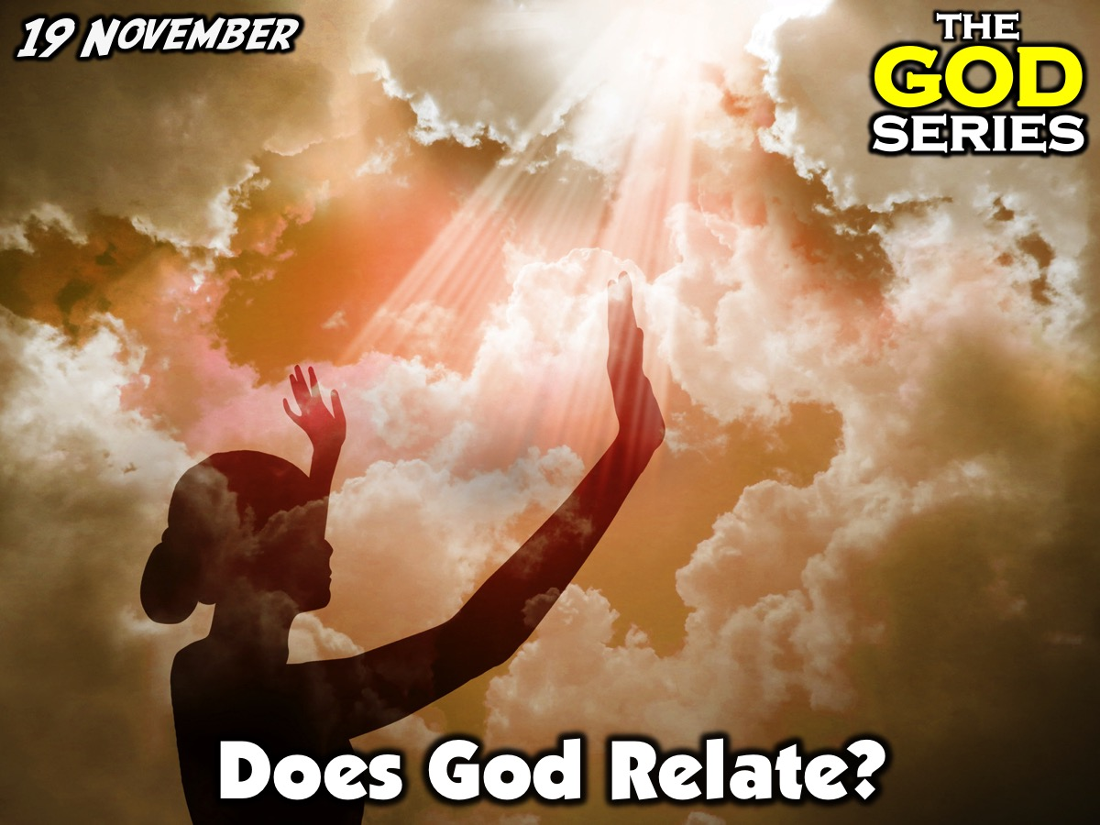
Notes:
Does God Relate?

Slide 7
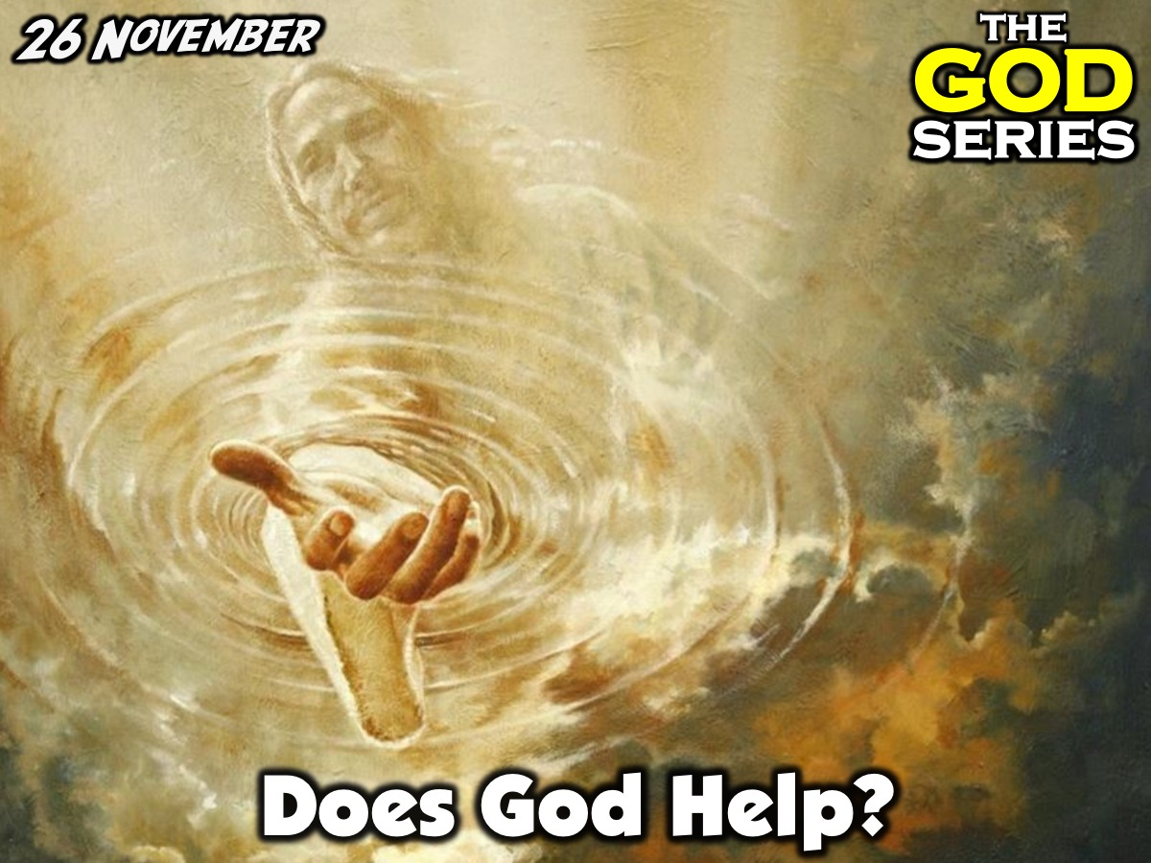
Notes:
Does God Help?

Slide 8

Notes:
Does God Restore?

Slide 9
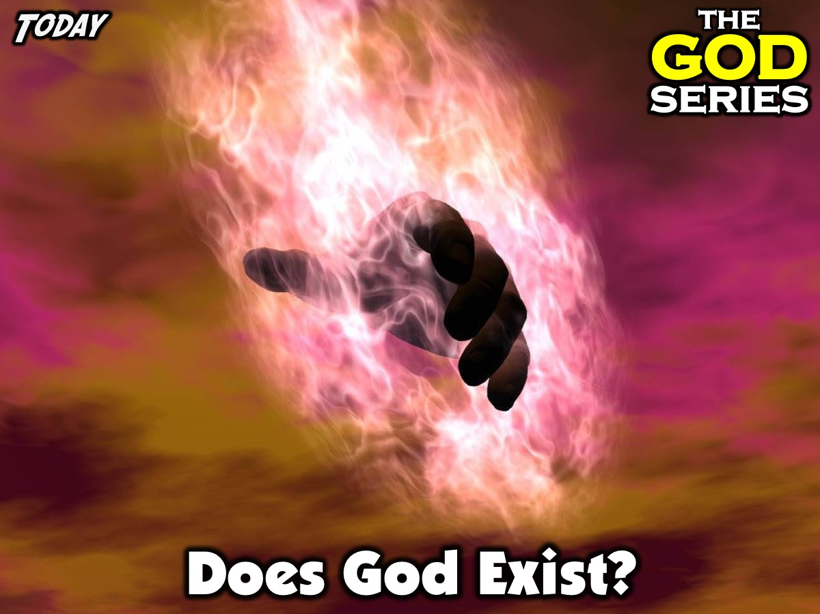
Notes:
Today is week 1 of our God Series and we are answering the question: Does God Exist?

Slide 10
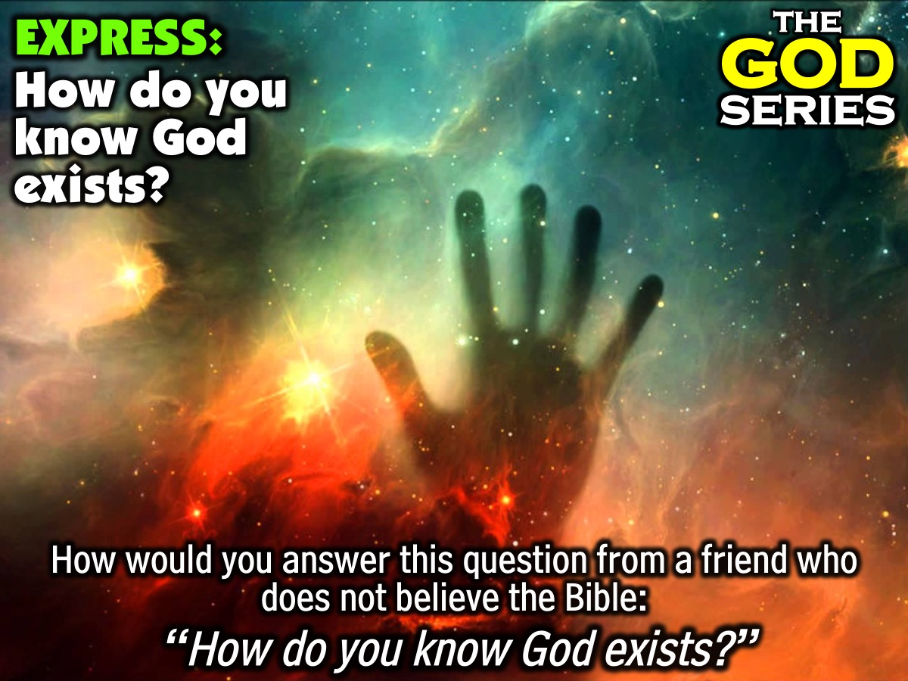
Notes:
Part 1: Express: Around your tables you are each going to get a chance to respond to this scenario: How would you answer this question from a friend who does not believe the Bible: “How do you know God exists?”. Your task is to come up with a list of evidences for the existence of God.

Slide 11
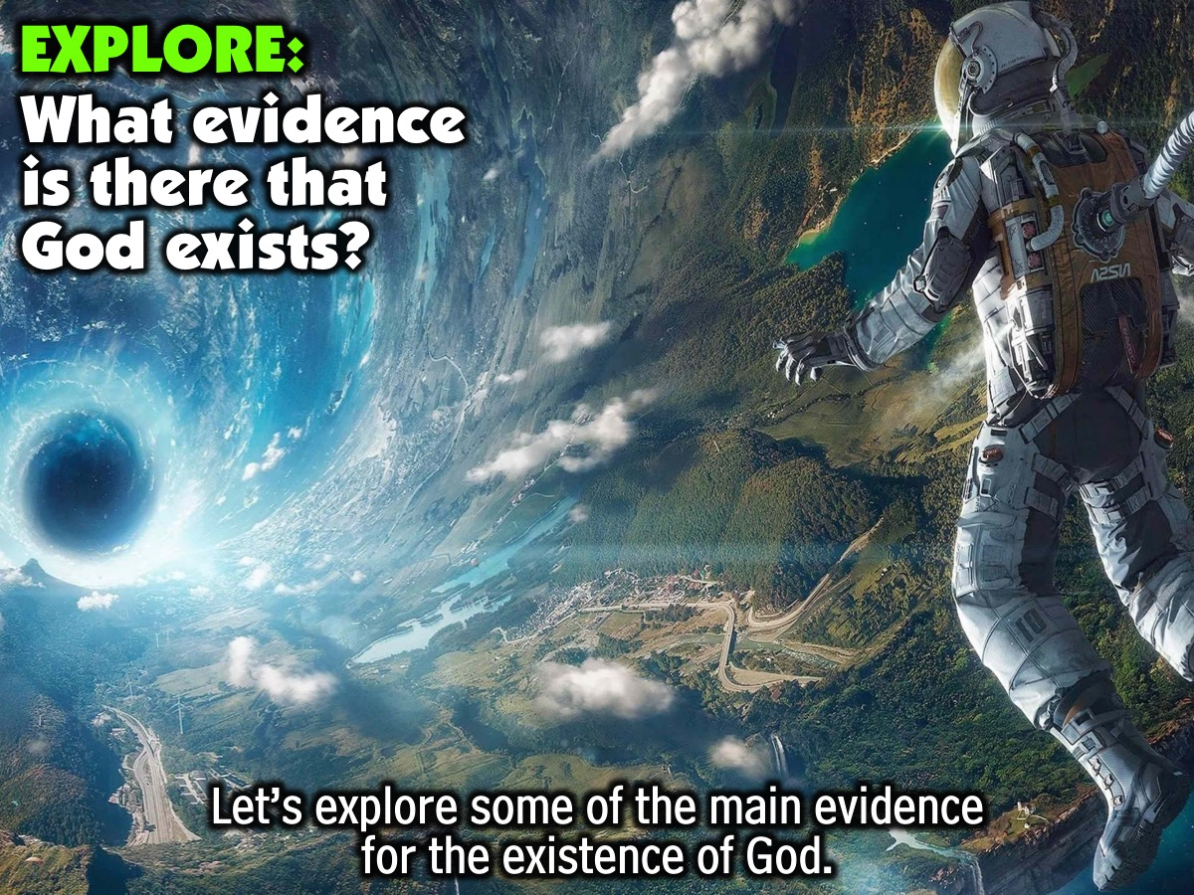
Notes:
Part 2: Explore: We are going to explore some of the main arguments that have been put forward for the existence of God. What Evidence is there that God Exists?

Slide 12
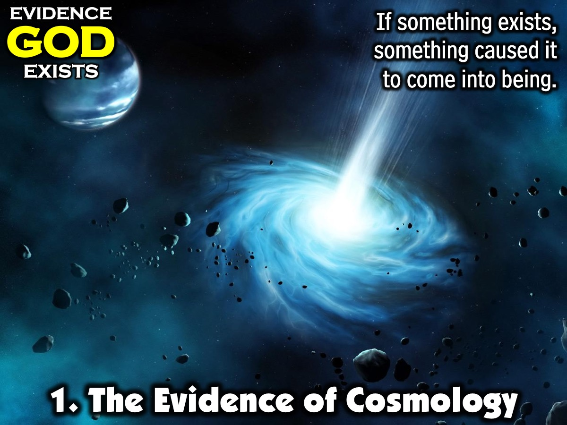
Notes:
1. The Evidence of Cosmology. If something begins to exist it's existence depends on something outside of it that pre-existed causing it to come into being. For example, I exist because of my parents.

Slide 13
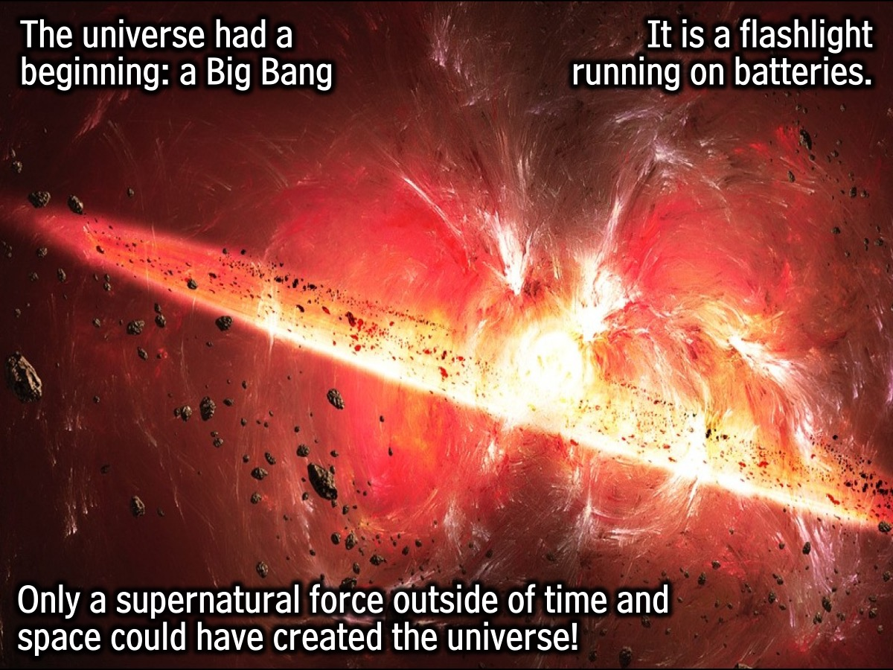
Notes:
The universe had a beginning - a Big Bang that started it all and ever since space is expanding. Also, according to the second law of thermodynamics the energy in the universe is decreasing because it is finite. It is a flashlight running on batteries - it is not eternal. We need to ask what caused the Big Bang. Genesis 1:1 says God created the universe starting with light. If nature had a defined beginning it could not have created itself. Only a supernatural force outside of time and space have done that.

Slide 14
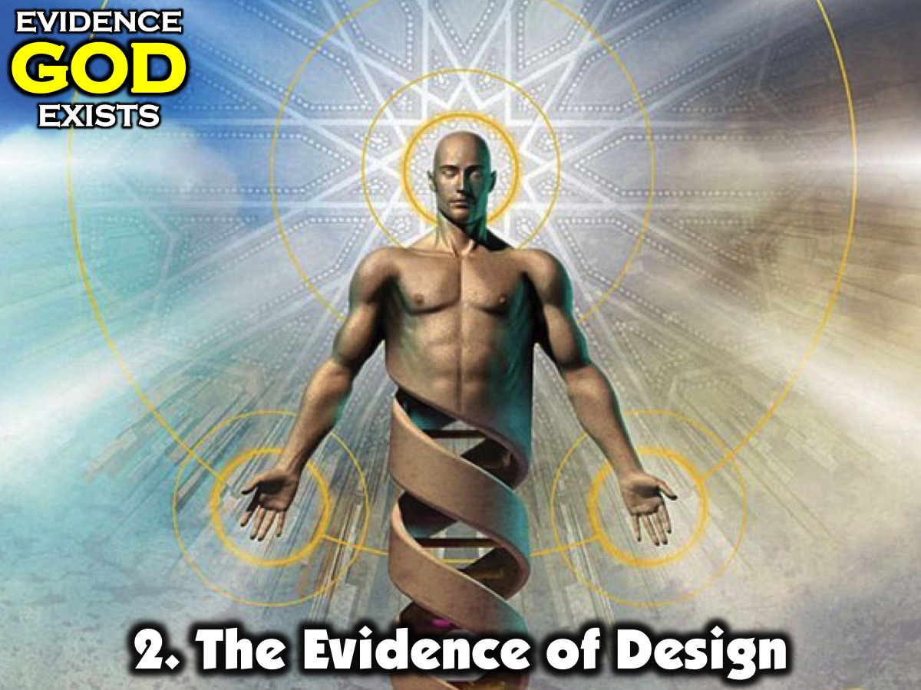
Notes:
2. The Evidence of Design. There is a strange and mysterious design to the cosmos, an anti-randomness that strongly points to a designer who created and crafted the world with very intentional precision and balance. We see this in biology (the “microscope” view) and in astronomy (the “telescope” view). Both of them point to a balancer, sustainer and designer: (1) Biology: when one looks at the DNA of any living organism it is packed with coherent and information-filled code. It is not random. This language points to an intelligent life or mind. (2) Astronomy: The chance that the universe just came into being and can support life by chance is basically impossible. 122 variables would have to be lined up in precise values in order for life to be possible. Apart from the impossibility of the universe existing by chance we also must note that the laws that could bring it about had to be created at some time. Certain conditions had to exist prior to the existence of the material universe.

Slide 15
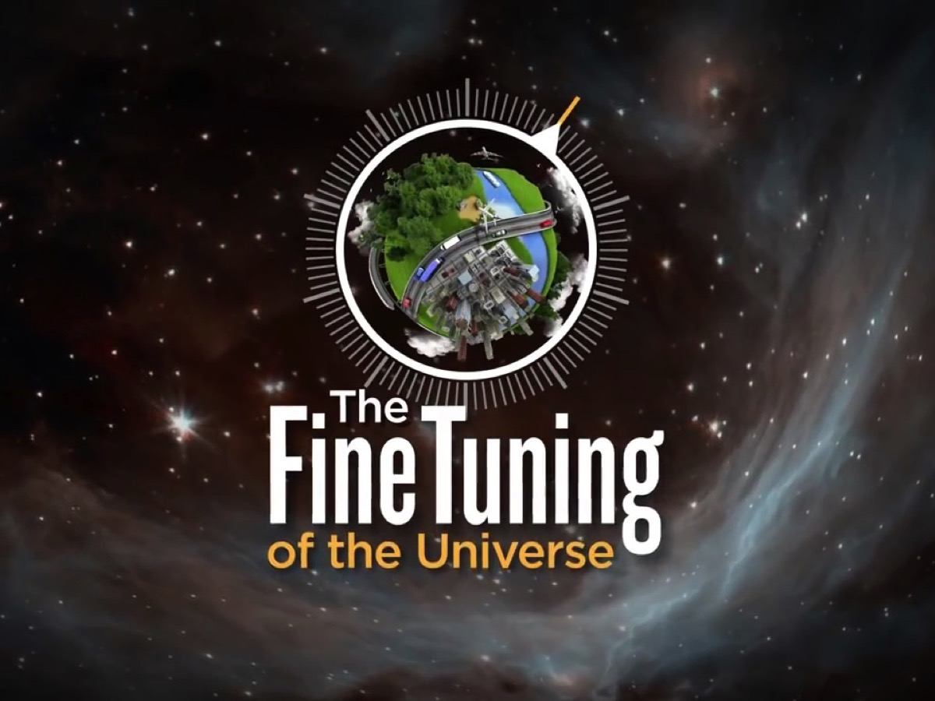
Notes:
The Fine-Tuned Universe. Scientists have come to the shocking realization that the fundamental constants and quantities of our universe have been carefully dialed to an astonishingly precise value – a value that falls within an exceedingly narrow, life-permitting range. If any one of these numbers were altered by even a hair’s breadth, no physical, interactive life of any kind could exist anywhere. There’d be no stars, no life, no planets, no chemistry.

Slide 16

Notes:
Video: The Fine Tuning of the Universe. Get it on YouTube at: https://www.youtube.com/watch?v=UpIiIaC4kRA

Slide 17
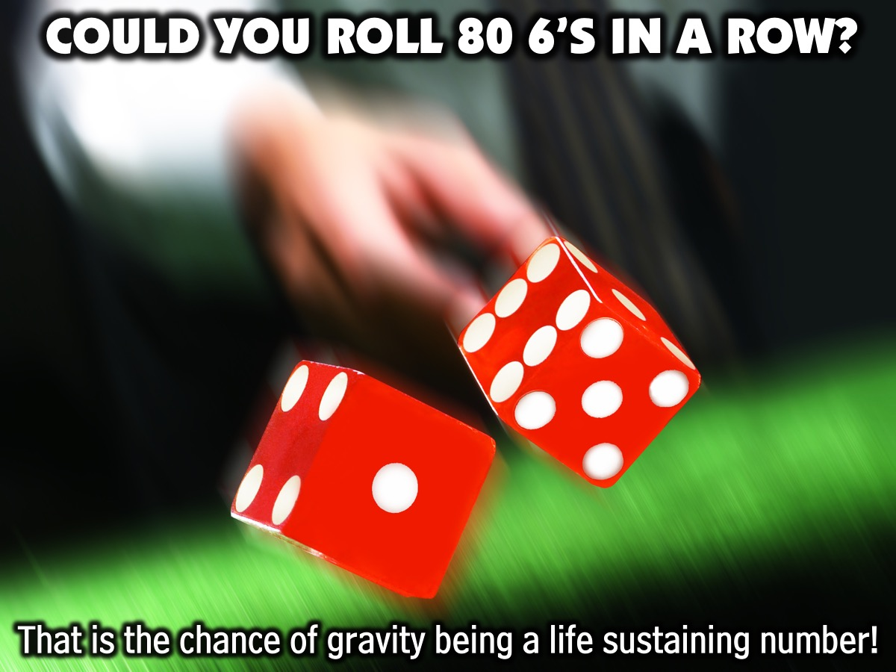
Notes:
Illustration: Could you roll a dice and get 80 6s in a row? That is the chance of gravity being a life sustaining number!

Slide 18

Notes:
The Watchmaker Analogy: Walking through a forest, you discover a watch lying on the ground. Due to its complex nature, you assume it is designed by some intelligence. Thus, by this reasoning, since life is even more complex, it must have also been designed by some intelligence.

Slide 19
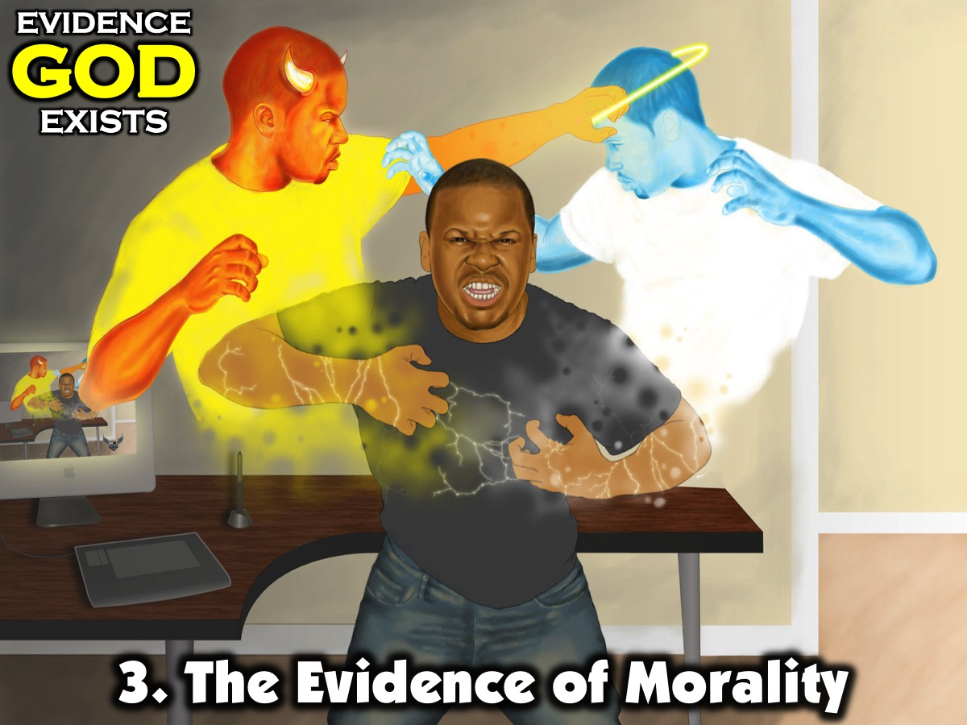
Notes:
3. The Evidence of Morality. There is a built in desire for justice in humankind - a code among people for how to treat each other fairly. This is not compatible with survival of the fittest. If there is a moral code there must be a moral law giver. Christian's believe that is God. He hard-wired it into us when he created us.

Slide 20
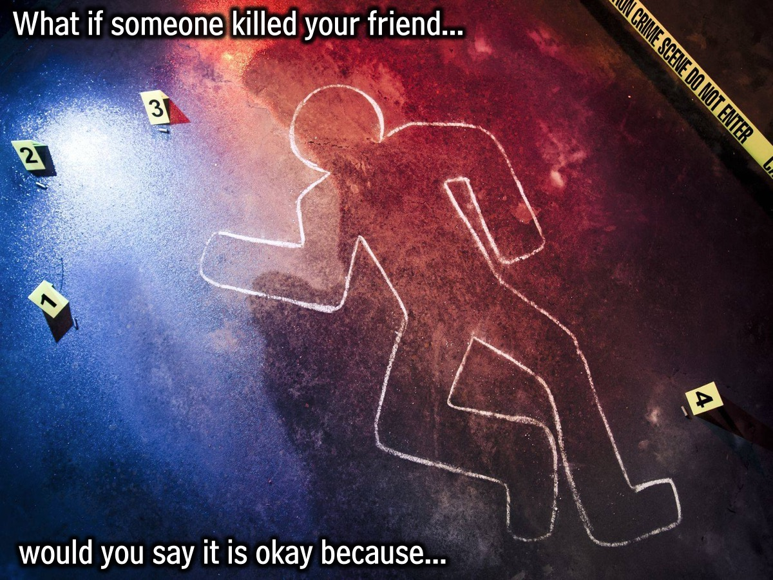
Notes:
Illustration: What if someone killed your friend…would you say it is okay because the fittest survive? There are things that are morally wrong - relativism would not work in this instance. Romans 2:14-15 says that there is a law written into people hearts.

Slide 21
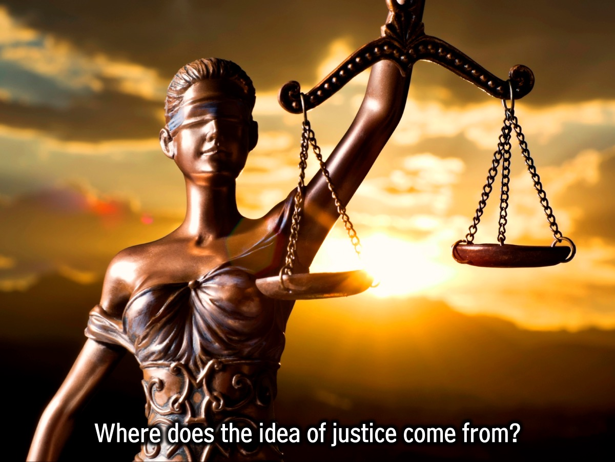
Notes:
Where does the idea of something being just or unjust come from, if not from God?

Slide 22
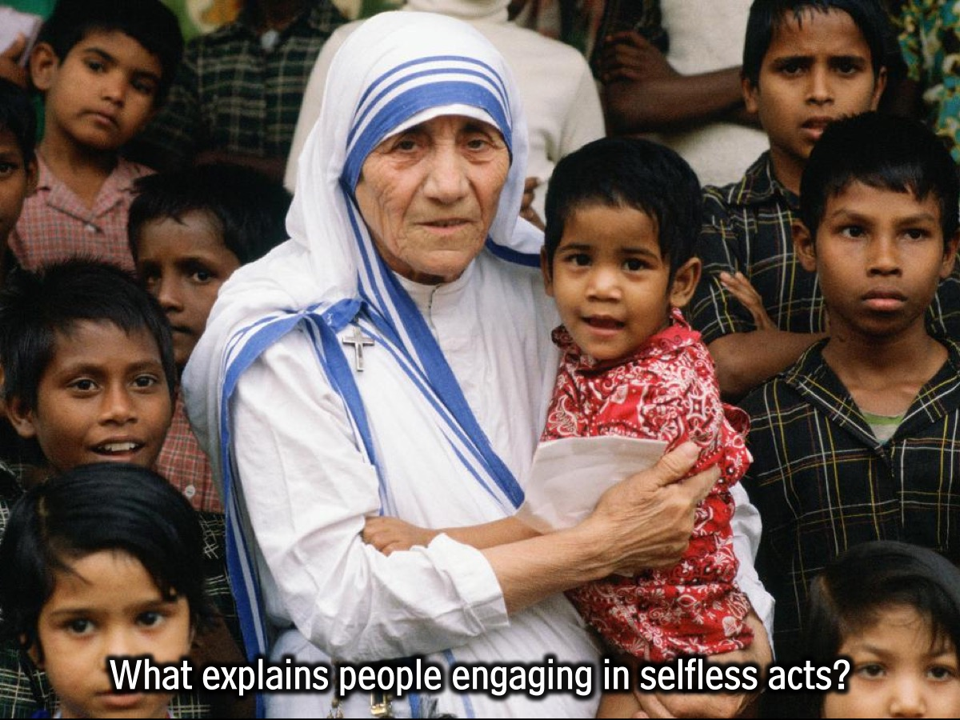
Notes:
What explains why people engage in selfless acts or show mercy? Can evolution explain it? If there is a God who is kind and loving, then that would explain it. Only with God is there human value!

Slide 23
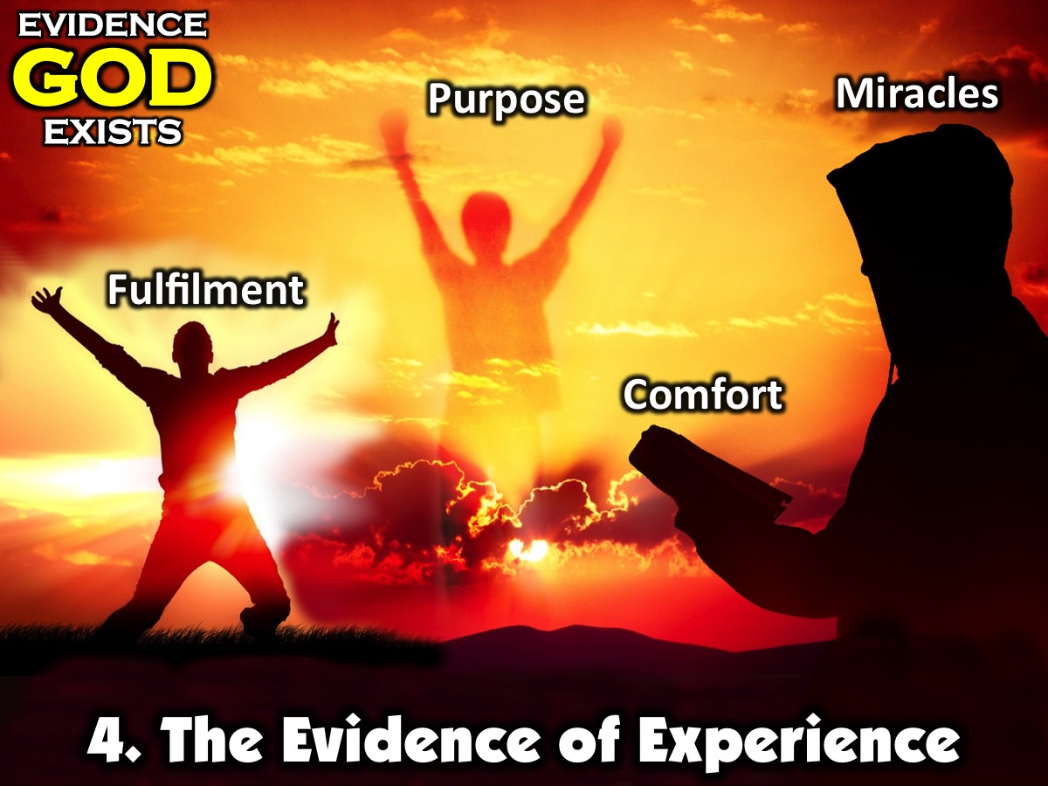
Notes:
4. The Evidence of Experience. Those of us who have come to know God through faith in Jesus can think of many experiences in our lives and can also report the testimony of others where we have experienced the presence and power of God in our lives as he has answered prayers, being with us through suffering or times of loss and given us a sense of purpose and fulfillment in life.

Slide 24
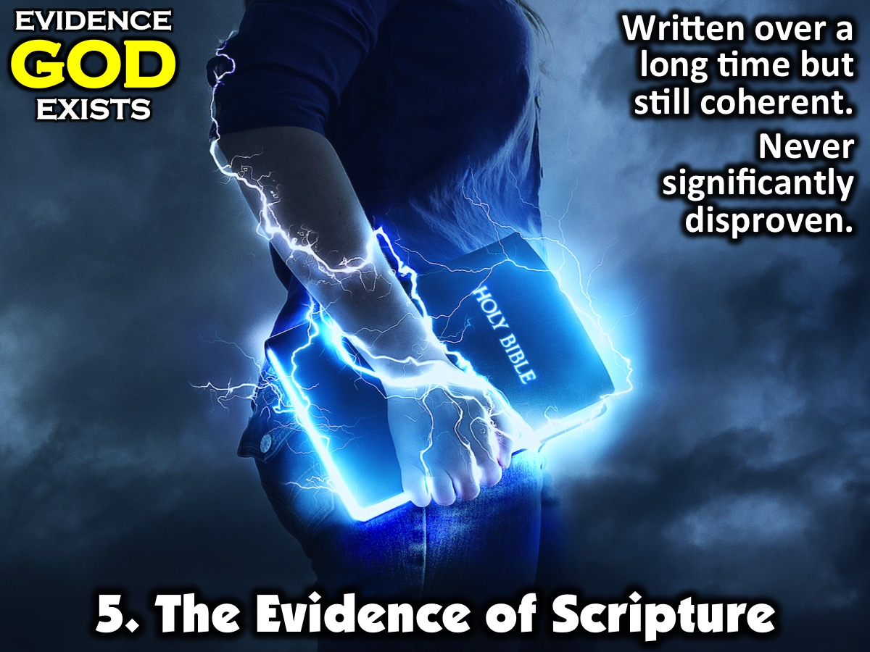
Notes:
5. The Evidence of Scripture. While some people many not believe the Bible is the Word of God - they can still come to appreciate how a book written over such a long period of time is so coherent and has never been disproved in any significant way. The Bible contains significant evidence as to the existence of God.

Slide 25
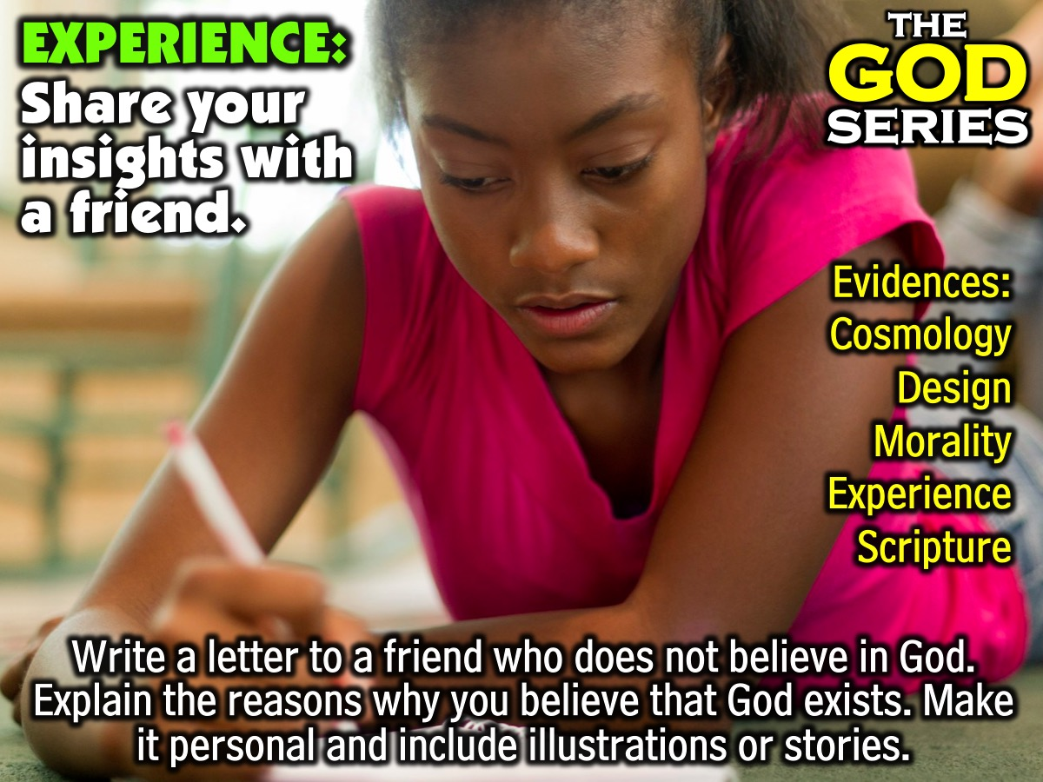
Notes:
Part 3: Experience: Write a letter to a friend who does not believe in God in which you explain to them the reasons why you believe that God exists. Be sure to make it personal and include illustrations or stories in your letter. Think of an actual person in your class or family and actually consider giving the letter to them when you next see them.

Slide 26
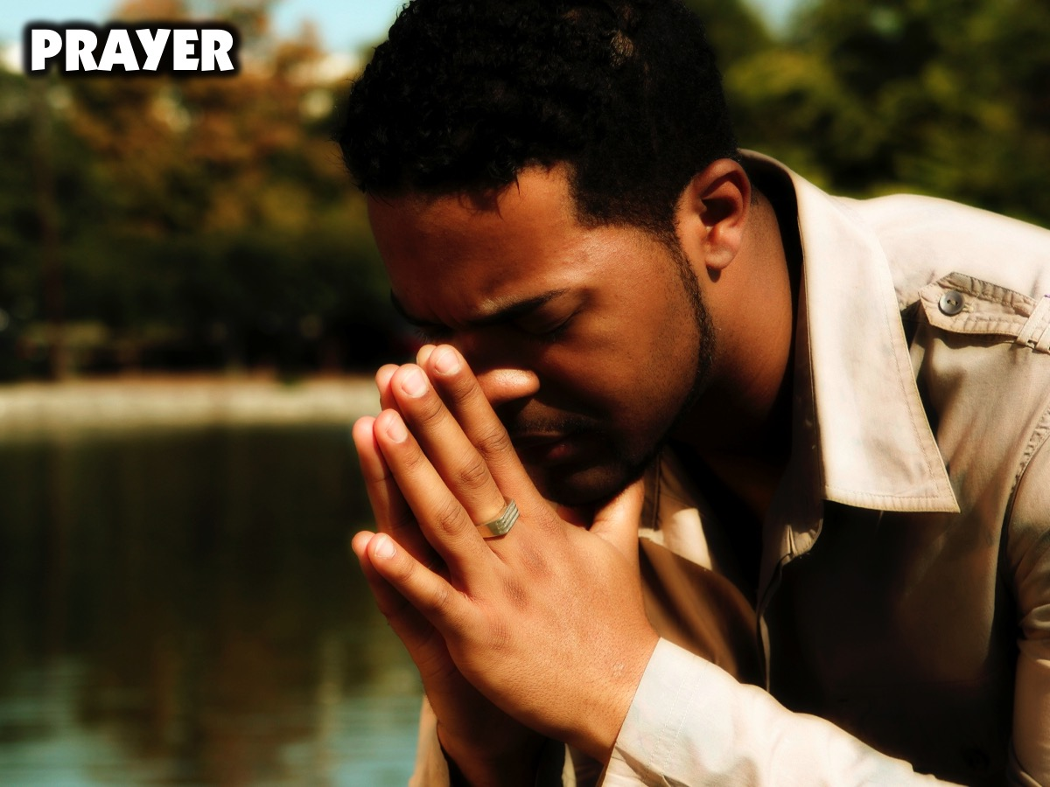
Notes:
Prayer.

Slide 27

Notes:
Next Sunday we will answer the question: Does God Hear?

