Slide 1

Notes:
Welcome to The GOD Series. Each session in this series will have 3 parts to it (each roughly 10 minutes in length): (1) Express: Questions will be used to get youth expressing what they know and believe about the topic in small groups. (2) Explore: The facilitator will explore the topic (using media, video, stories) to challenge understanding about the topic. (3) Experience: The facilitator will get youth to internalise what they have learnt through an intractive experience.

Slide 2

Notes:
This is week 2 of our God Series and today we are answering the question: Does God Hear?

Slide 3

Notes:
Part 1: Express: Have each person in the group share about a time when they felt that God heard their prayer. What did they pray about and what happened?

Slide 4

Notes:
Part 2: Explore: How does the Bible answer the question: Does God hear? Each person is given a verse to read that shows that God hears us when we pray. Here are the verses: Psalm 34:15; 2 Chronicles 7:14; Jeremiah 33:3; Luke 11:9; John 9:31; 1 Peter 3:12 and 1 John 5:14.

Slide 5

Notes:
The Lord’s eyes are on righteous people. His ears hear their cry for help. (Psalm 34:15)

Slide 6
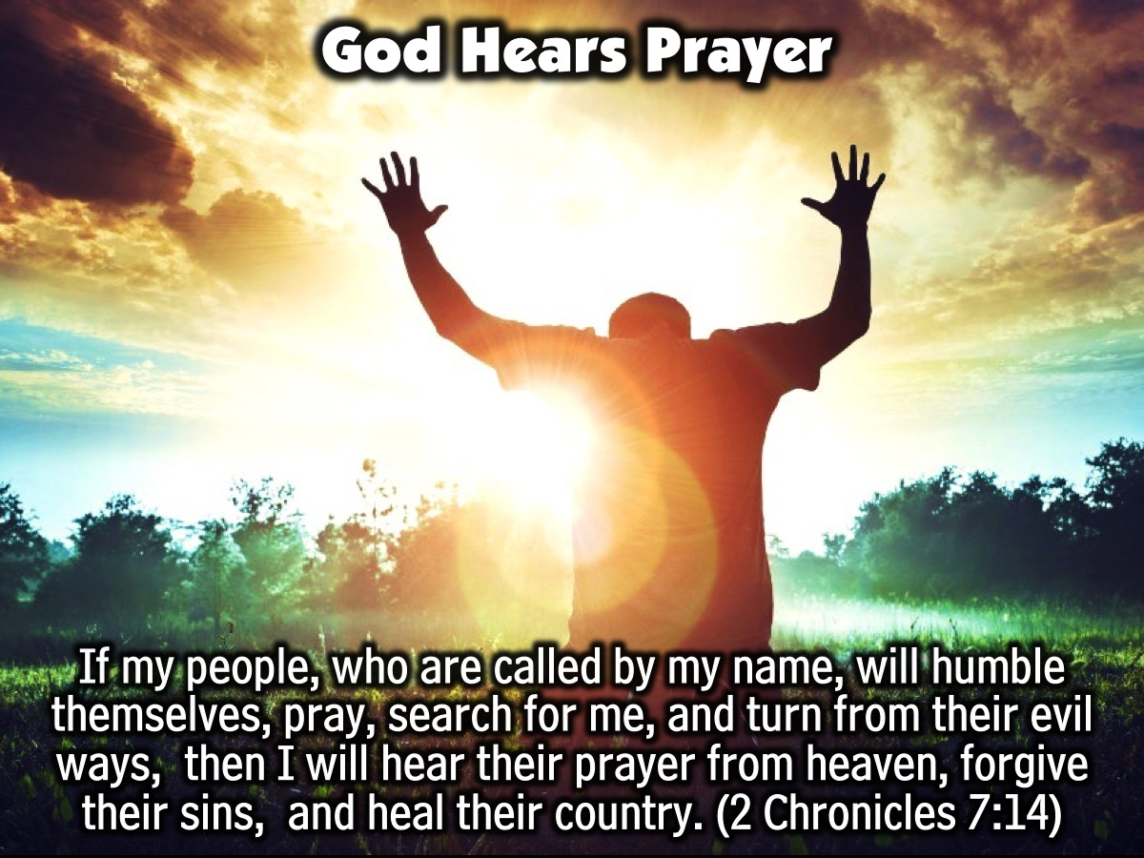
Notes:
If my people, who are called by my name, will humble themselves, pray, search for me, and turn from their evil ways, then I will hear their prayer from heaven, forgive their sins, and heal their country. (2 Chronicles 7:14)

Slide 7
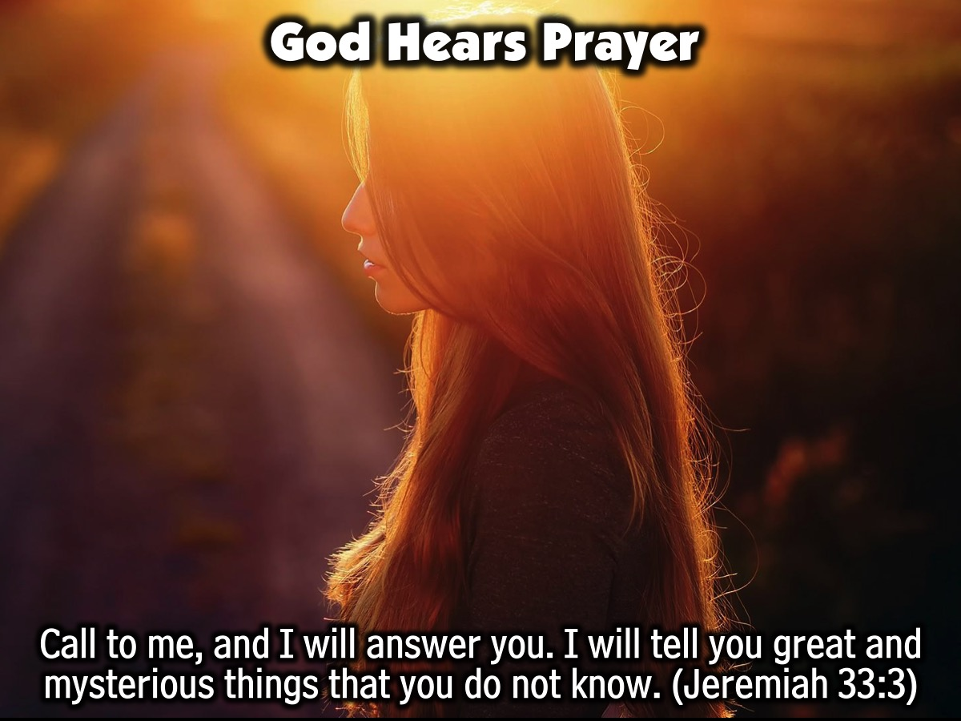
Notes:
Call to me, and I will answer you. I will tell you great and mysterious things that you do not know. (Jeremiah 33:3)

Slide 8
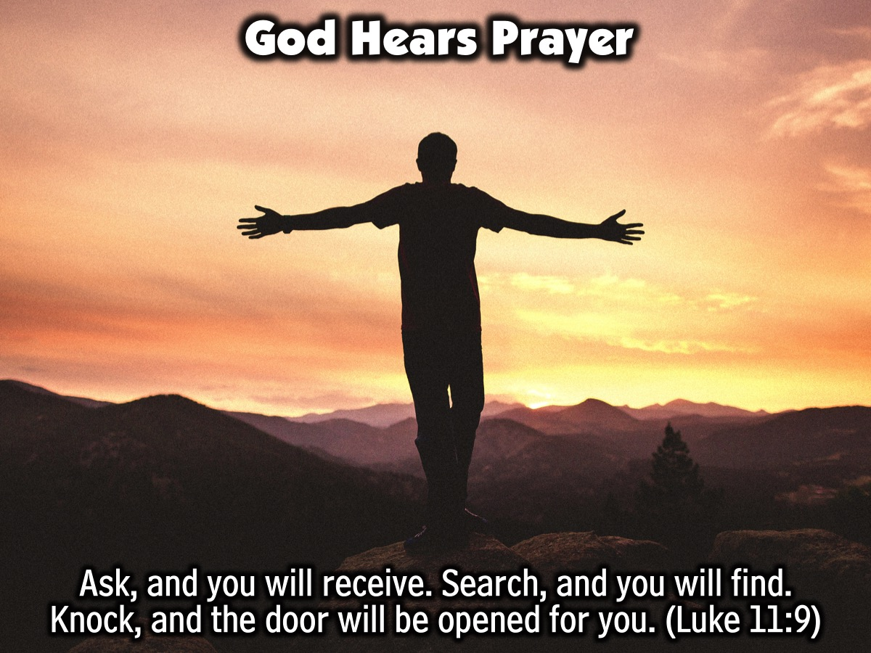
Notes:
Ask, and you will receive. Search, and you will find. Knock, and the door will be opened for you. (Luke 11:9)

Slide 9
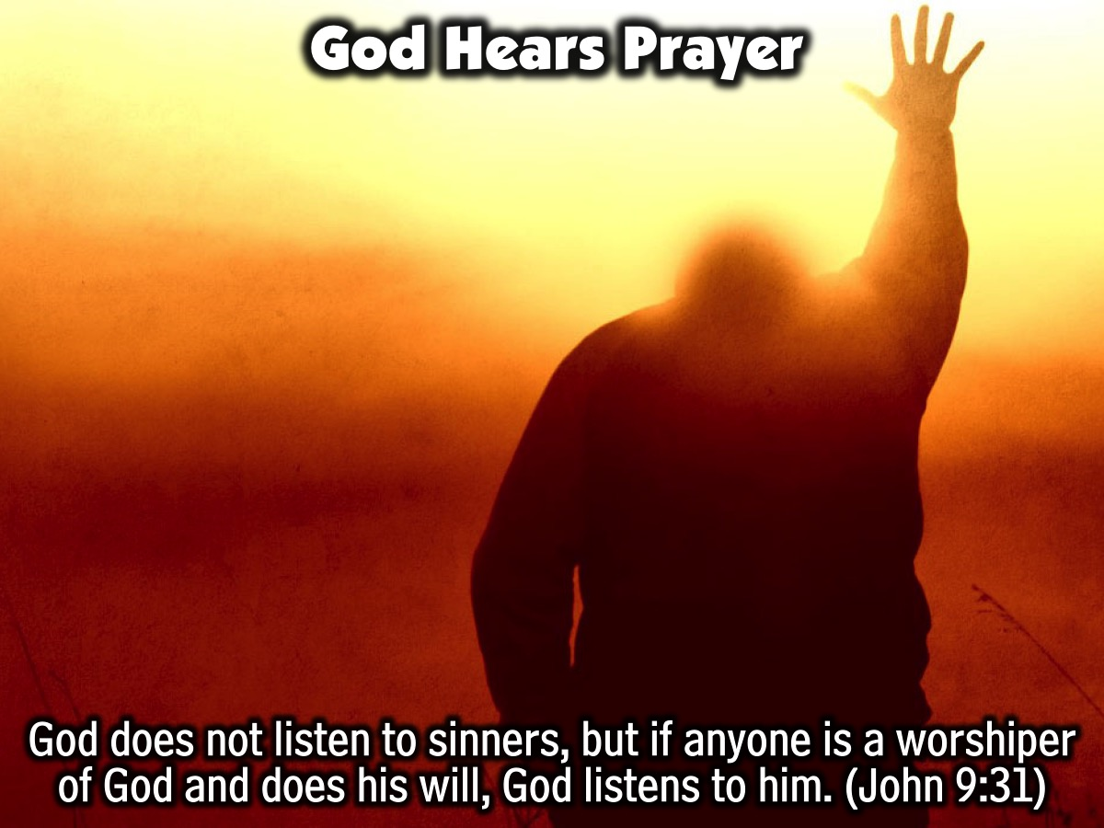
Notes:
God does not listen to sinners, but if anyone is a worshiper of God and does his will, God listens to him. (John 9:31)

Slide 10
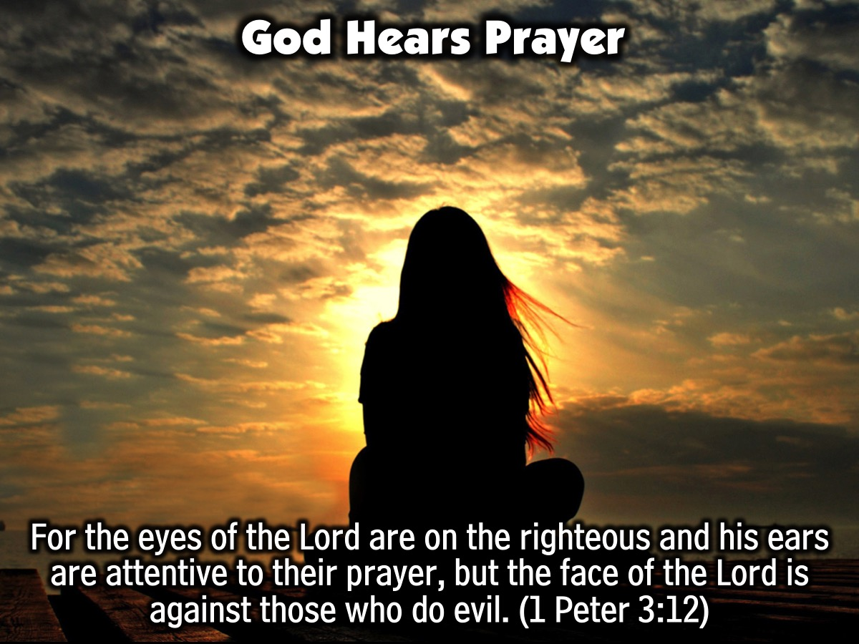
Notes:
For the eyes of the Lord are on the righteous and his ears are attentive to their prayer, but the face of the Lord is against those who do evil. (1 Peter 3:12)

Slide 11
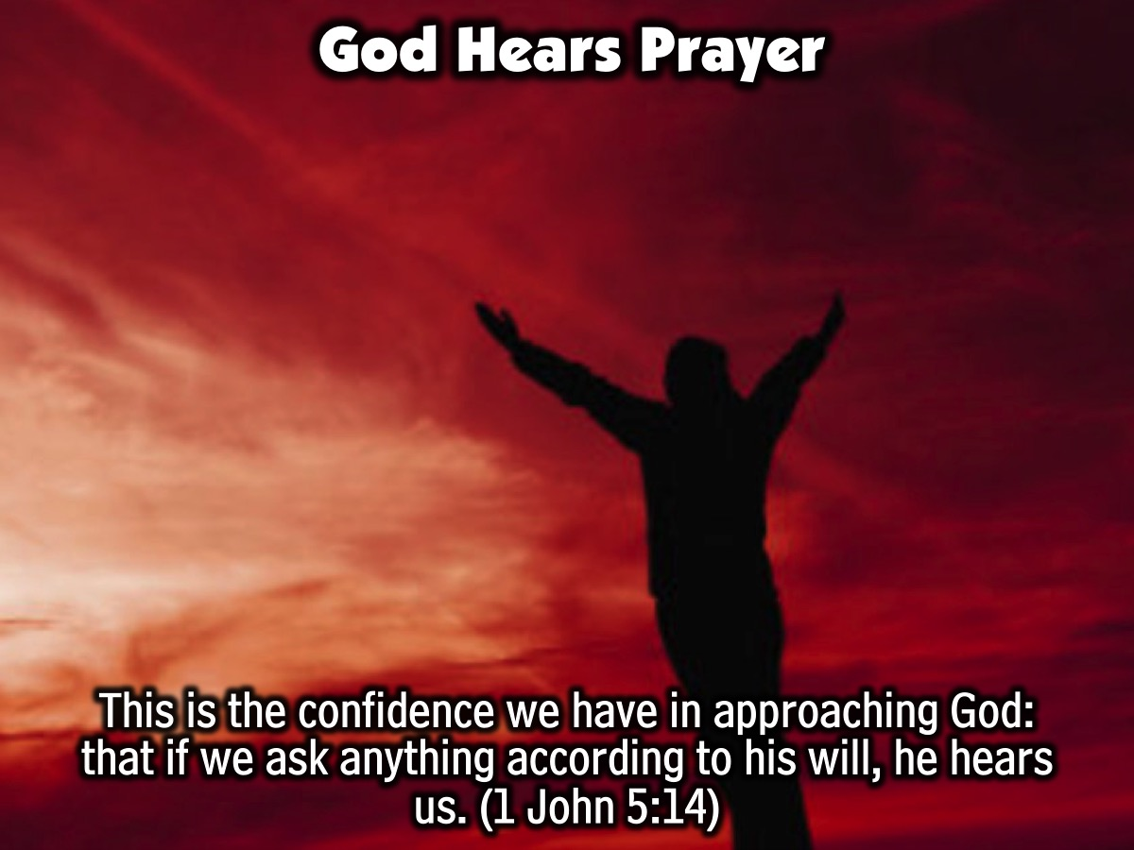
Notes:
This is the confidence we have in approaching God: that if we ask anything according to his will, he hears us. (1 John 5:14)

Slide 12

Notes:
Video: God is Always Listening. Get it on YouTube at: https://www.youtube.com/watch?v=p8NbvglO4MU

Slide 13

Notes:
Part 3: Experience: What helps God hear our prayers? Each person at your table (or ever second person) is going to get a verse and they have to find out what helps God hear our prayers. They will reflect on the verse and then read it out loud and share their insight. Here are the verses: Psalm 66:18; Mark 11:25; James 4:3; 1 John 5:14; Matthew 21:22;

Slide 14
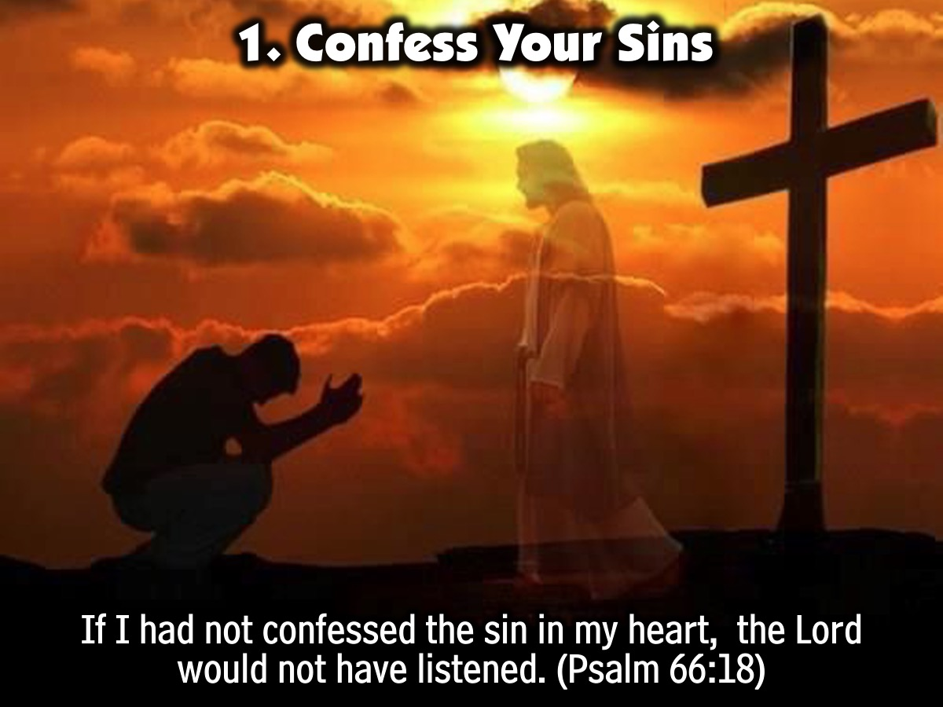
Notes:
1. Confess your Sins: “If I had not confessed the sin in my heart, the Lord would not have listened.” (Psalm 66:18)

Slide 15
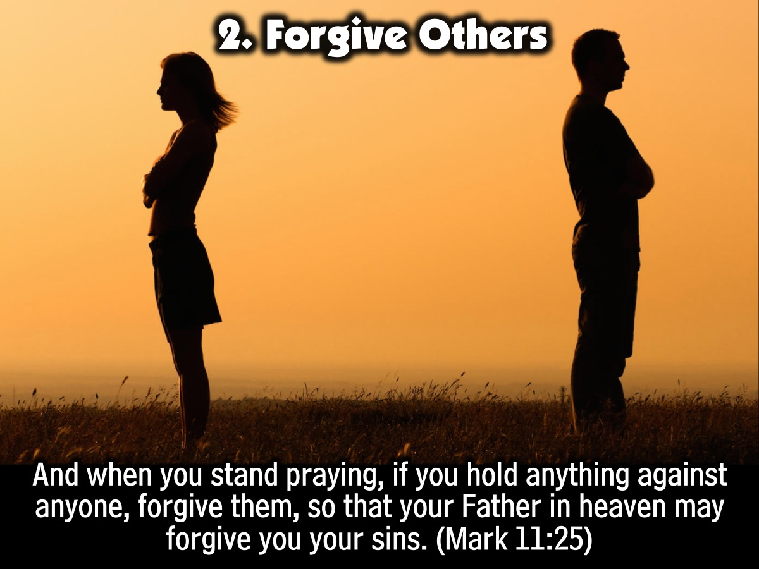
Notes:
2. Forgive Others: “And when you stand praying, if you hold anything against anyone, forgive them, so that your Father in heaven may forgive you your sins.” (Mark 11:25)

Slide 16

Notes:
3. Have Right Motives: “When you ask, you do not receive, because you ask with wrong motives, that you may spend what you get on your pleasures.” (James 4:3)

Slide 17
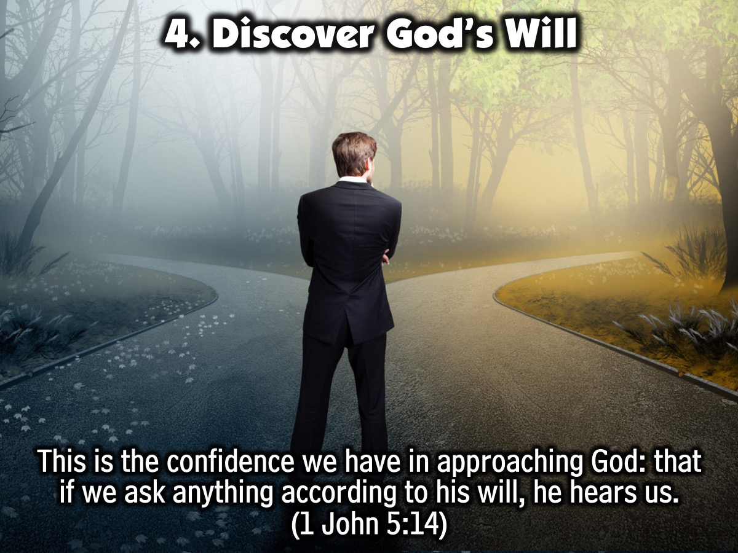
Notes:
4. Discover God’s Will: ”This is the confidence we have in approaching God: that if we ask anything according to his will, he hears us.” (1 John 5:14)

Slide 18
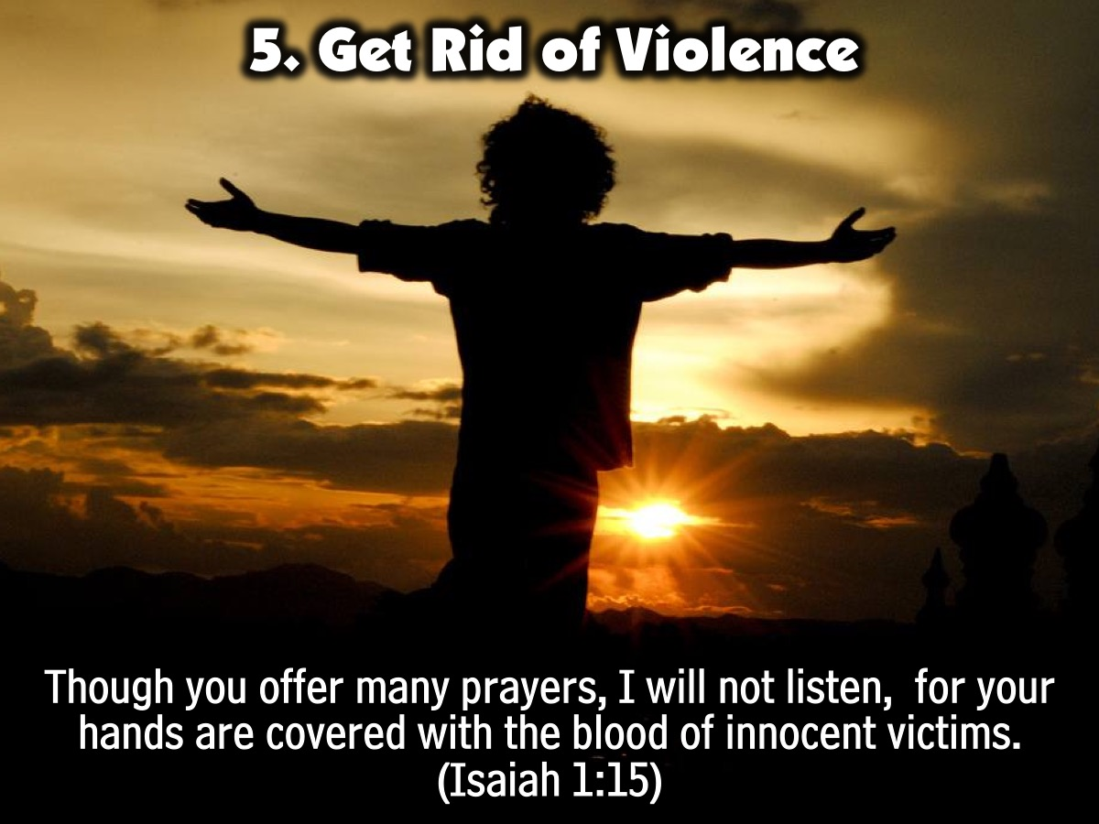
Notes:
5. Get Rid of Violence: “Though you offer many prayers, I will not listen, for your hands are covered with the blood of innocent victims”. (Isaiah 1:15)

Slide 19
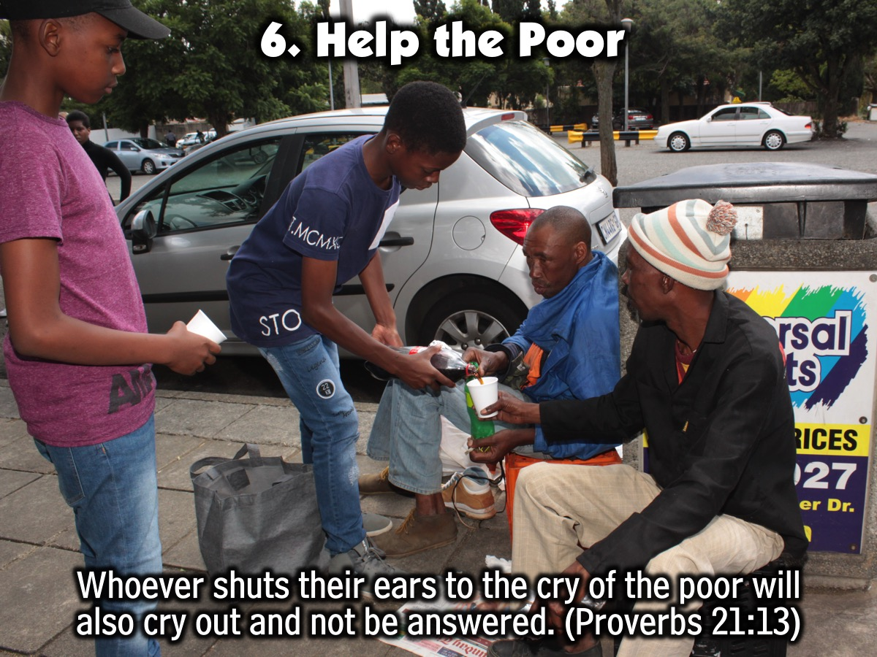
Notes:
6. Help the Poor: “Whoever shuts their ears to the cry of the poor will also cry out and not be answered”. (Proverbs 21:13)

Slide 20
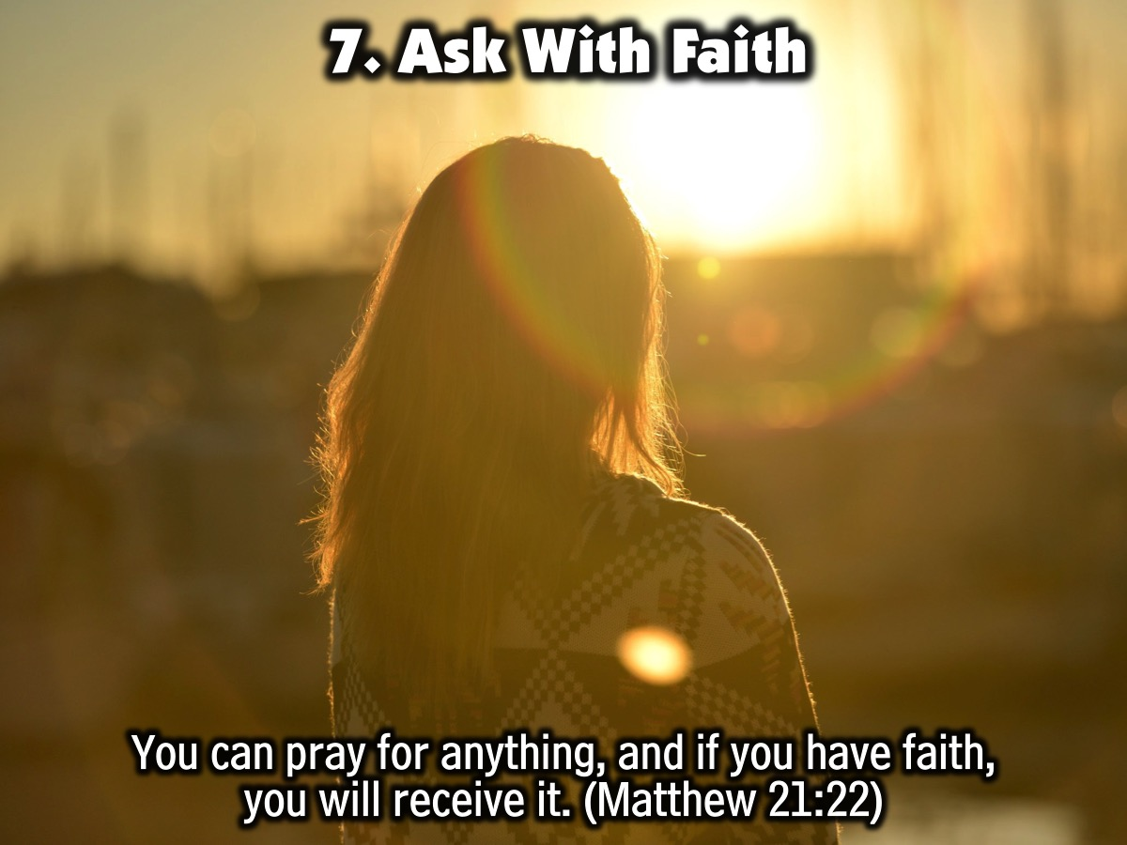
Notes:
7. Ask With Faith: “You can pray for anything, and if you have faith, you will receive it.” (Matthew 21:22)

Slide 21
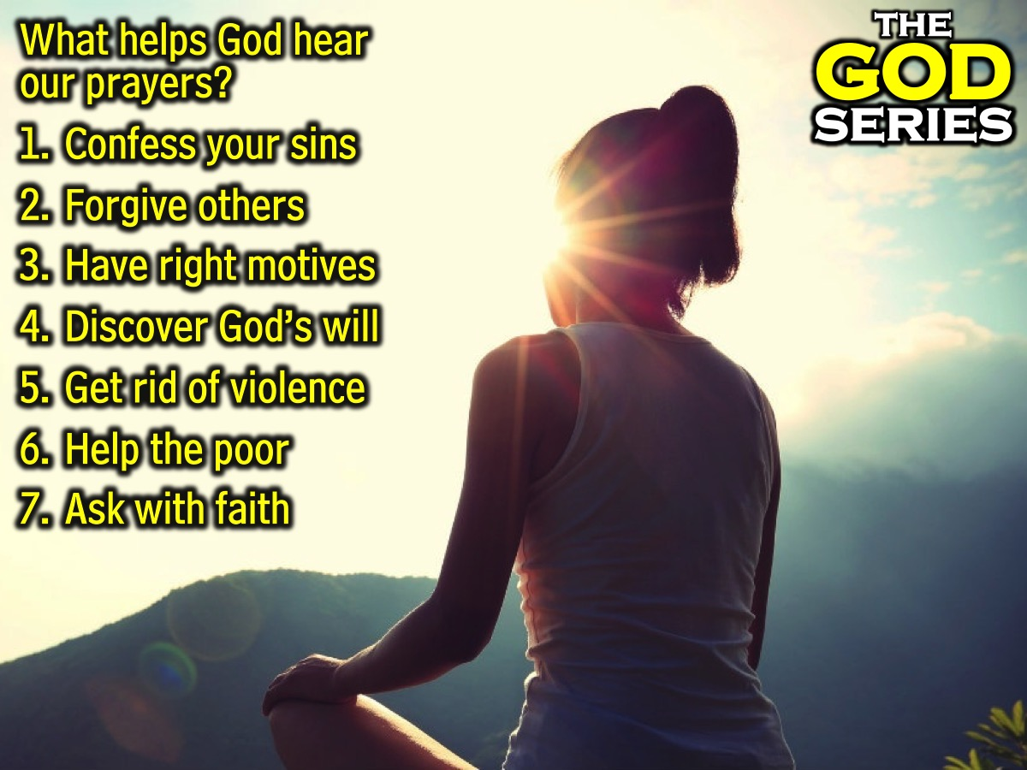
Notes:
Summary: What helps God hear our prayers? (1) Confess your sins. (2) Forgive others. (3) Have right motives. (4) Discover God’s will. (5) Get rid of violence. (6) Help the poor. (7) Ask with faith.

Slide 22
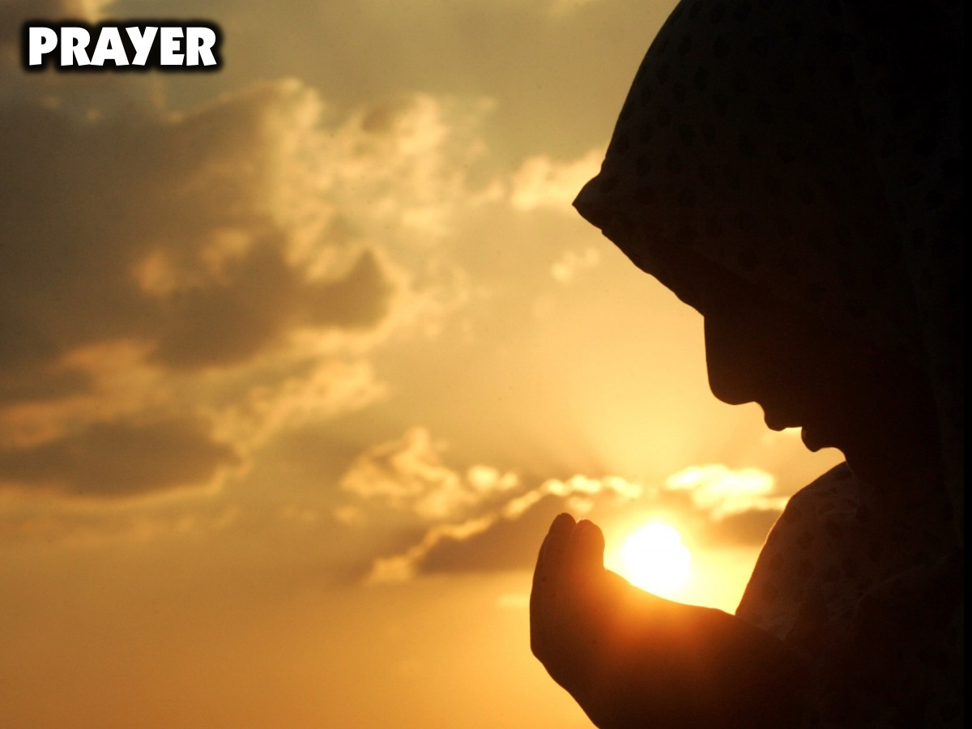
Notes:
Prayer.

Slide 23

Notes:
Next Sunday morning we will be answering the question: Does God Care?

