Slide 1

Notes:
Welcome to The GOD Series.

Slide 2
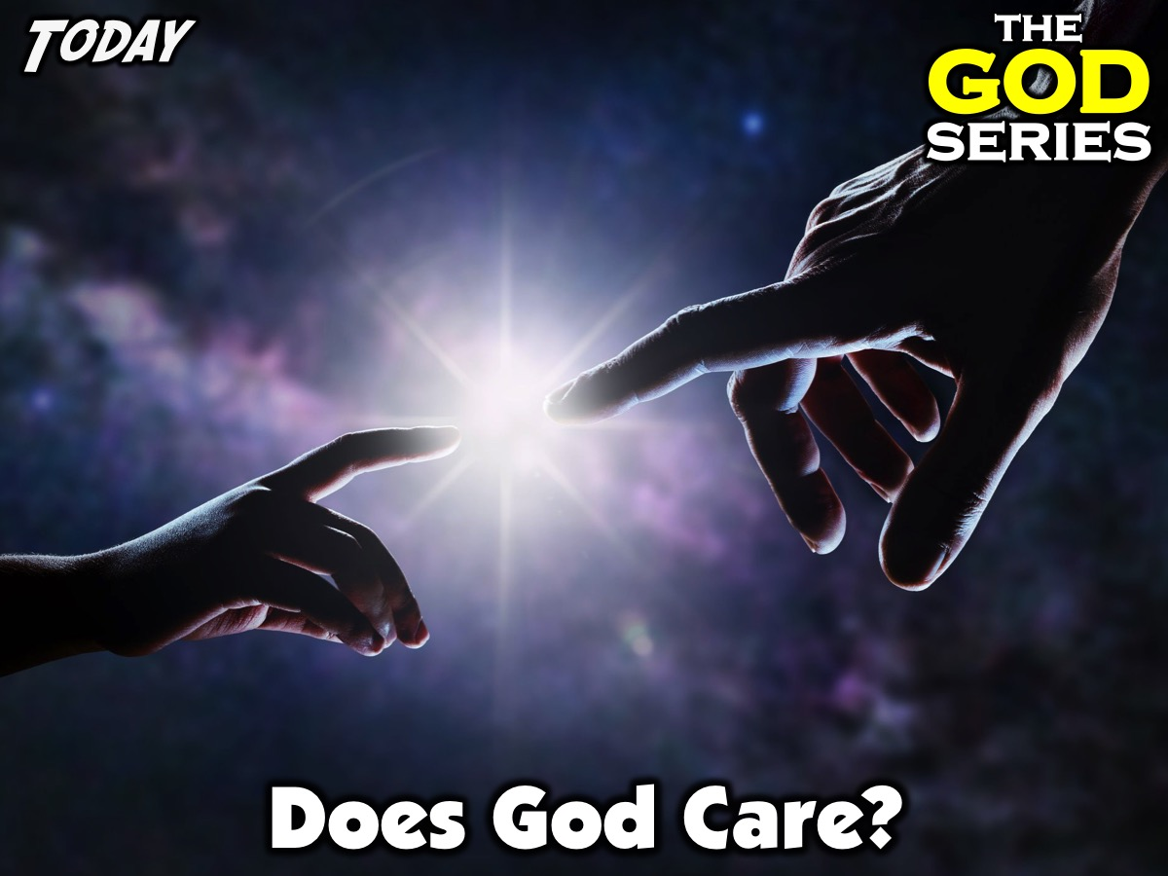
Notes:
Today is week 3 of the God Series and we will be answering the question: Does God Care?

Slide 3
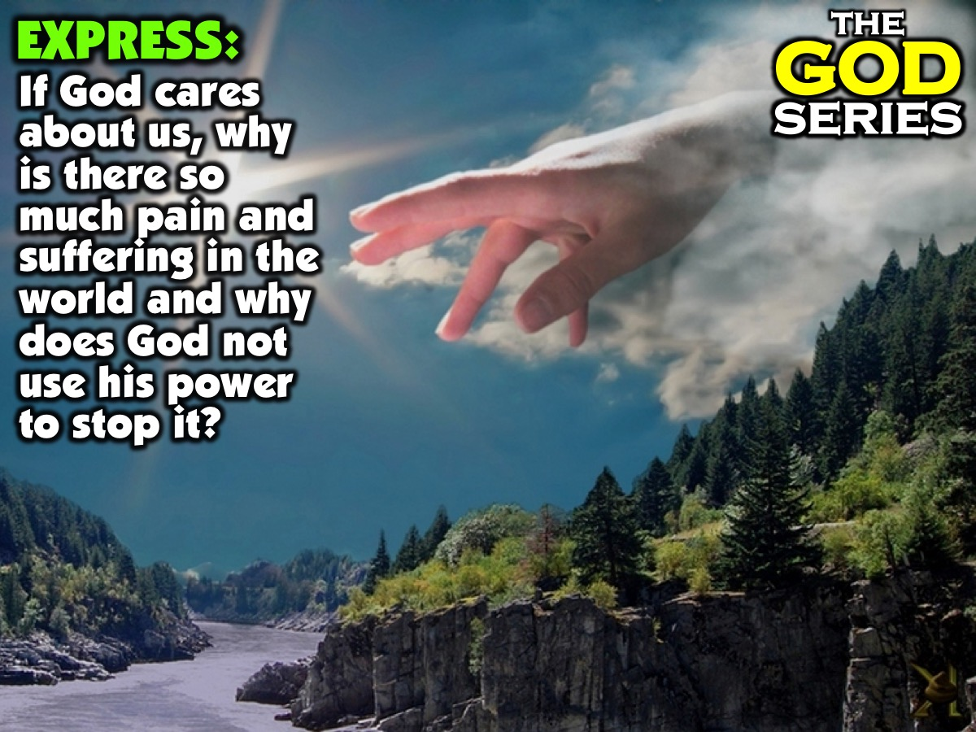
Notes:
Part 1: Express: Have each person in the group share their answers to this question: “If God cares about us, why is there so much pain and suffering in the world and why does God not use his power to stop it?”

Slide 4
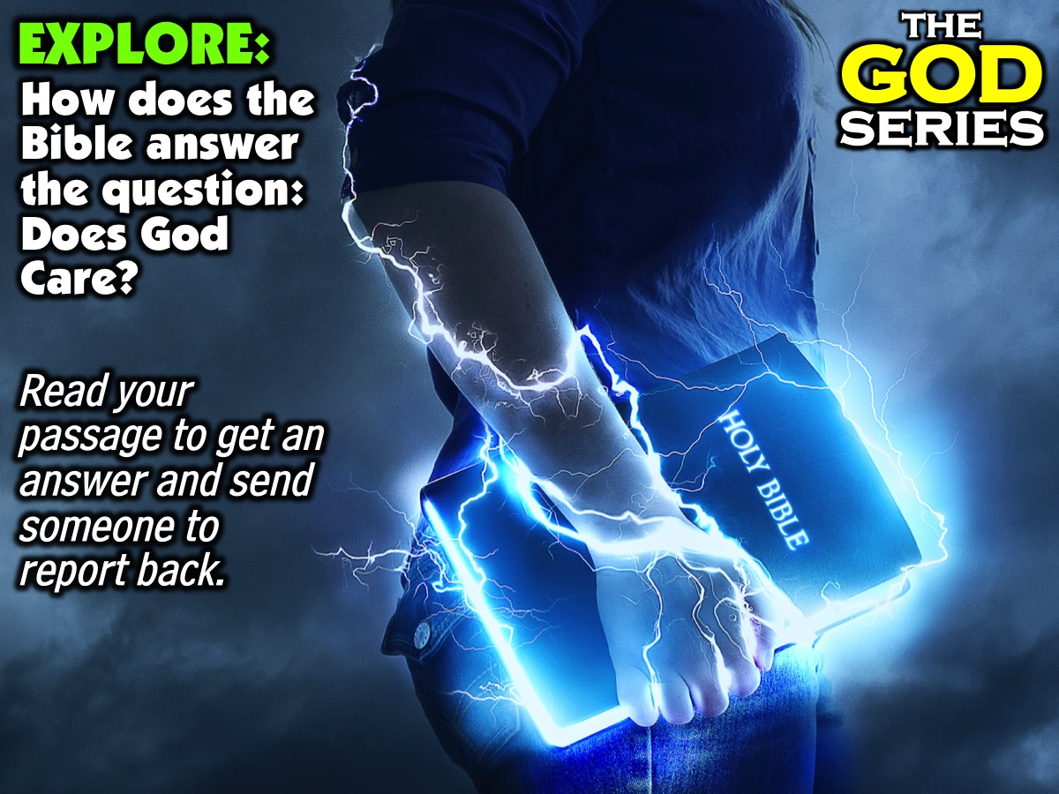
Notes:
Part 2: Explore: How does the Bible answer the question: Does God Care? Each group will be given a Bible passage they have to reflect on and one person will share how it answers the question: Does God Care? Here are the Passages: Exodus 3: Psalm 103:8-13; Isaiah 63:7-9; Matthew 6:25-30; John 11; John 13:1-4; Matthew 9:35-38.
God appeared to Moses at the burning bush and said: ‘I have indeed seen the misery of my people in Egypt. I have heard them crying out because of their slave drivers, and I am concerned about their suffering. So I have come down to rescue them from the hand of the Egyptians and to bring them up out of that land into a good and spacious land, a land flowing with milk and honey... And now the cry of the Israelites has reached me, and I have seen the way the Egyptians are oppressing them. So now, go. I am sending you to Pharaoh to bring my people the Israelites out of Egypt.’ (Exodus 3:7-10)
The Lord is compassionate and gracious, slow to anger, abounding in love. He will not always accuse, nor will he harbour his anger for ever; he does not treat us as our sins deserve or repay us according to our iniquities. For as high as the heavens are above the earth, so great is his love for those who fear him; as far as the east is from the west, so far has he removed our transgressions from us. As a father has compassion on his children, so the Lord has compassion on those who fear him (Psalm 103:8-13)
Jesus said: Do not worry about your life, what you will eat or drink; or about your body, what you will wear. Is not life more than food, and the body more than clothes? Look at the birds of the air; they do not sow or reap or store away in barns, and yet your heavenly Father feeds them. Are you not much more valuable than they? Can any one of you by worrying add a single hour to your life? ‘And why do you worry about clothes? See how the flowers of the field grow. They do not labour or spin. Yet I tell you that not even Solomon in all his splendour was dressed like one of these. If that is how God clothes the grass of the field, which is here today and tomorrow is thrown into the fire, will he not much more clothe you – you of little faith? (Matthew 6:25-30)
Now a man named Lazarus was ill. He was from Bethany, the village of Mary and her sister Martha. So the sisters sent word to Jesus, ‘Lord, the one you love is ill.’ On his arrival, Jesus found that Lazarus had already been in the tomb for four days. When Mary reached the place where Jesus was and saw him, she fell at his feet and said, ‘Lord, if you had been here, my brother would not have died.’ When Jesus saw her weeping, and the Jews who had come along with her also weeping, he was deeply moved in spirit and troubled. ‘Where have you laid him?’ he asked. ‘Come and see, Lord,’ they replied. Jesus wept. Then the Jews said, ‘See how he loved him!’ Jesus, once more deeply moved, came to the tomb. It was a cave with a stone laid across the entrance. ‘Take away the stone,’ he said. So they took away the stone. Jesus called in a loud voice, ‘Lazarus, come out!’ The dead man came out, his hands and feet wrapped with strips of linen, and a cloth round his face. Jesus said to them, ‘Take off the grave clothes and let him go.’ (John 11)
It was just before the Passover Festival. Jesus knew that the hour had come for him to leave this world and go to the Father. Having loved his own who were in the world, he loved them to the end. The evening meal was in progress, and the devil had already prompted Judas, the son of Simon Iscariot, to betray Jesus. Jesus knew that the Father had put all things under his power, and that he had come from God and was returning to God; so he got up from the meal, took off his outer clothing, and wrapped a towel round his waist. After that, he poured water into a basin and began to wash his disciples’ feet, drying them with the towel that was wrapped round him. (John 13:1-4)
Jesus went through all the towns and villages, teaching in their synagogues, proclaiming the good news of the kingdom and healing every disease and illness. When he saw the crowds, he had compassion on them, because they were harassed and helpless, like sheep without a shepherd. Then he said to his disciples, ‘The harvest is plentiful but the workers are few. Ask the Lord of the harvest, therefore, to send out workers into his harvest field.’ (Matthew 9:35-38)

Slide 5
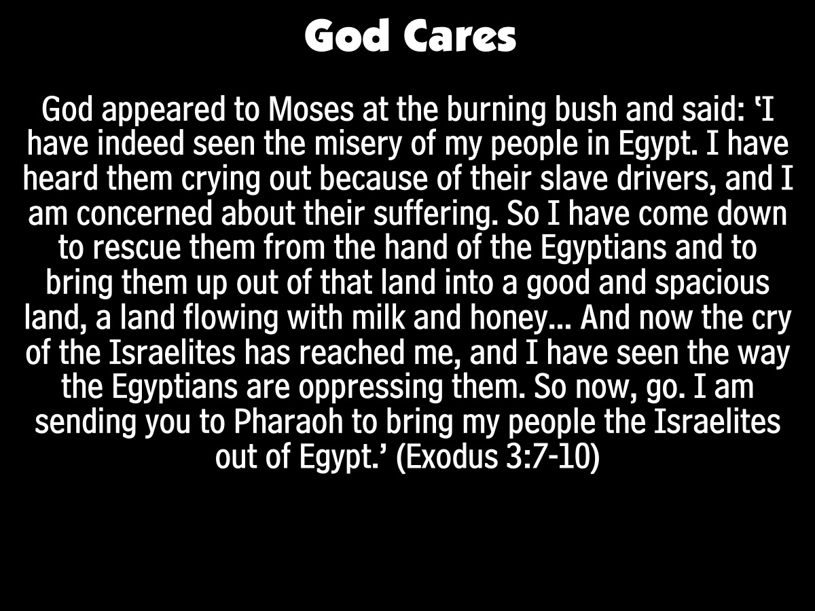
Notes:
God appeared to Moses at the burning bush and said: ‘I have indeed seen the misery of my people in Egypt. I have heard them crying out because of their slave drivers, and I am concerned about their suffering. So I have come down to rescue them from the hand of the Egyptians and to bring them up out of that land into a good and spacious land, a land flowing with milk and honey... And now the cry of the Israelites has reached me, and I have seen the way the Egyptians are oppressing them. So now, go. I am sending you to Pharaoh to bring my people the Israelites out of Egypt.’ (Exodus 3:7-10)

Slide 6
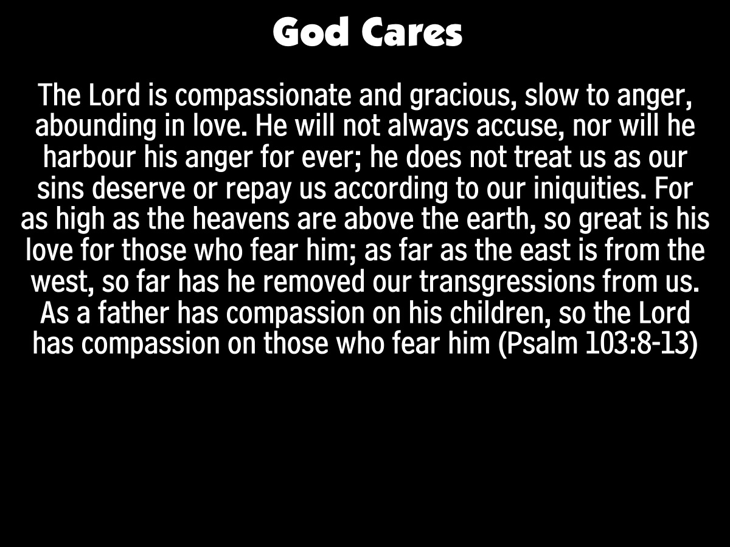
Notes:
The Lord is compassionate and gracious, slow to anger, abounding in love. He will not always accuse, nor will he harbour his anger for ever; he does not treat us as our sins deserve or repay us according to our iniquities. For as high as the heavens are above the earth, so great is his love for those who fear him; as far as the east is from the west, so far has he removed our transgressions from us. As a father has compassion on his children, so the Lord has compassion on those who fear him (Psalm 103:8-13)

Slide 7
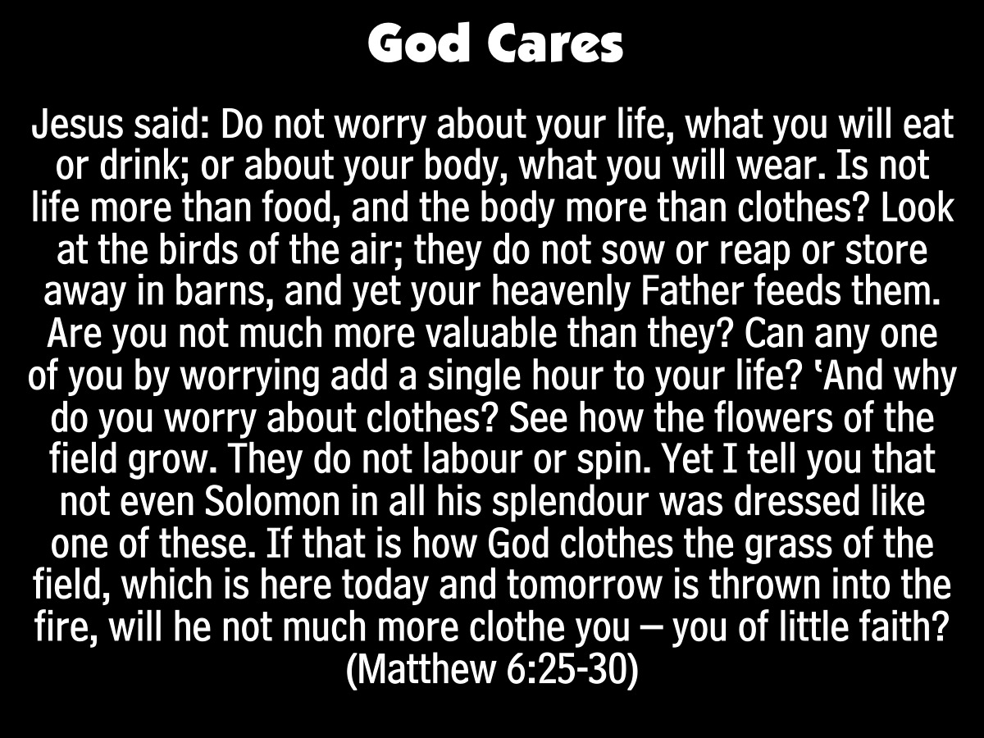
Notes:
Jesus said: Do not worry about your life, what you will eat or drink; or about your body, what you will wear. Is not life more than food, and the body more than clothes? Look at the birds of the air; they do not sow or reap or store away in barns, and yet your heavenly Father feeds them. Are you not much more valuable than they? Can any one of you by worrying add a single hour to your life? ‘And why do you worry about clothes? See how the flowers of the field grow. They do not labour or spin. Yet I tell you that not even Solomon in all his splendour was dressed like one of these. If that is how God clothes the grass of the field, which is here today and tomorrow is thrown into the fire, will he not much more clothe you – you of little faith? (Matthew 6:25-30)

Slide 8
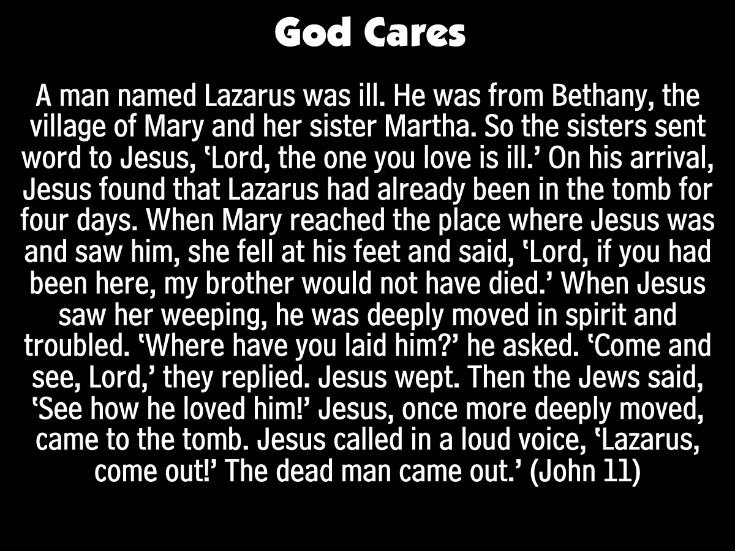
Notes:
A man named Lazarus was ill. He was from Bethany, the village of Mary and her sister Martha. So the sisters sent word to Jesus, ‘Lord, the one you love is ill.’ On his arrival, Jesus found that Lazarus had already been in the tomb for four days. When Mary reached the place where Jesus was and saw him, she fell at his feet and said, ‘Lord, if you had been here, my brother would not have died.’ When Jesus saw her weeping, he was deeply moved in spirit and troubled. ‘Where have you laid him?’ he asked. ‘Come and see, Lord,’ they replied. Jesus wept. Then the Jews said, ‘See how he loved him!’ Jesus, once more deeply moved, came to the tomb. Jesus called in a loud voice, ‘Lazarus, come out!’ The dead man came out.’ (John 11:1-3,17,32-36,38,43)

Slide 9
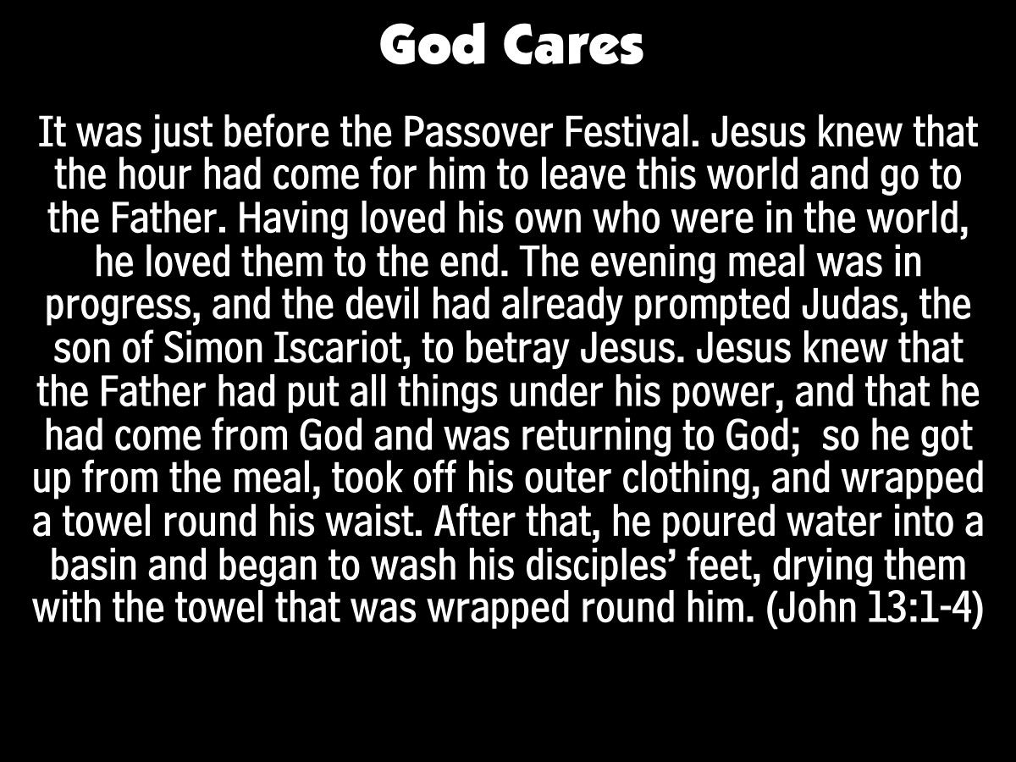
Notes:
It was just before the Passover Festival. Jesus knew that the hour had come for him to leave this world and go to the Father. Having loved his own who were in the world, he loved them to the end. The evening meal was in progress, and the devil had already prompted Judas, the son of Simon Iscariot, to betray Jesus. Jesus knew that the Father had put all things under his power, and that he had come from God and was returning to God; so he got up from the meal, took off his outer clothing, and wrapped a towel round his waist. After that, he poured water into a basin and began to wash his disciples’ feet, drying them with the towel that was wrapped round him. (John 13:1-4)

Slide 10
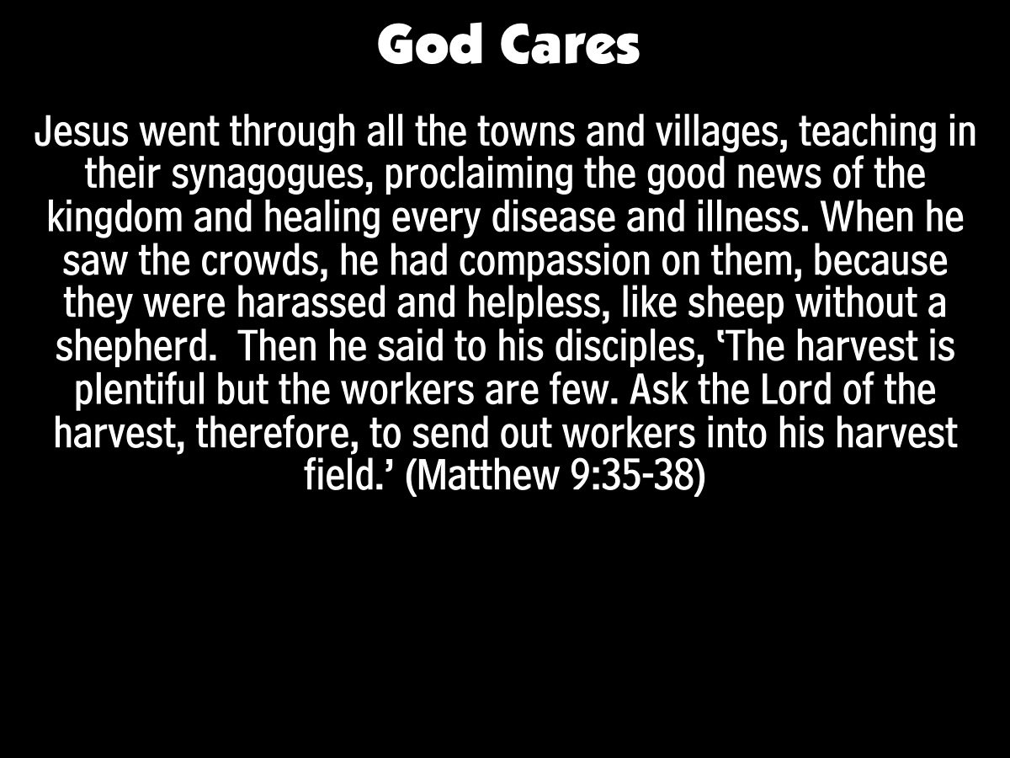
Notes:
Jesus went through all the towns and villages, teaching in their synagogues, proclaiming the good news of the kingdom and healing every disease and illness. When he saw the crowds, he had compassion on them, because they were harassed and helpless, like sheep without a shepherd. Then he said to his disciples, ‘The harvest is plentiful but the workers are few. Ask the Lord of the harvest, therefore, to send out workers into his harvest field.’ (Matthew 9:35-38)

Slide 11
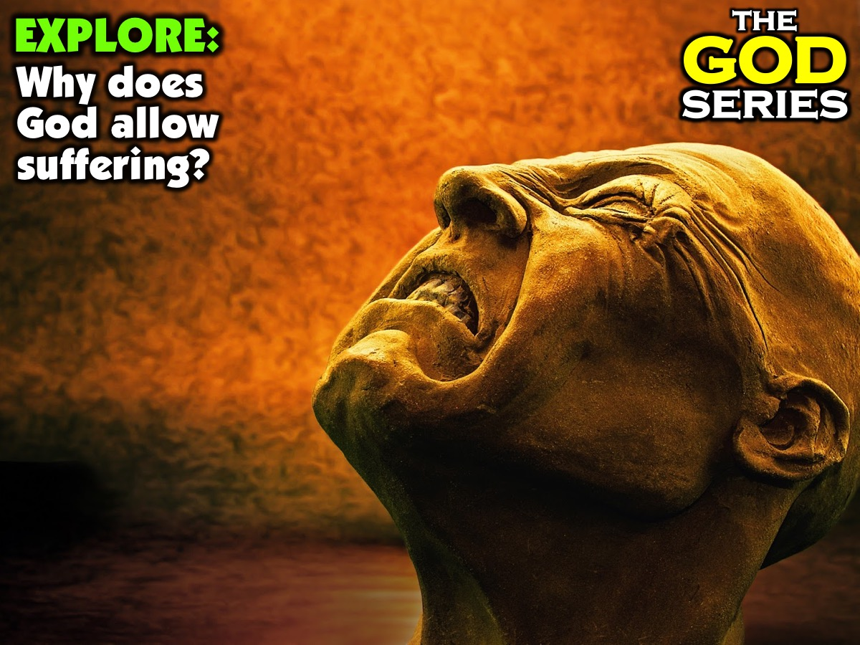
Notes:
Part 2: Explore: Why does God allow suffering? Here are some reasons why God does not remove pain and suffering (this section has been drawn from chapter 7 of the book: The Problem of God by Mark Clark):

Slide 12
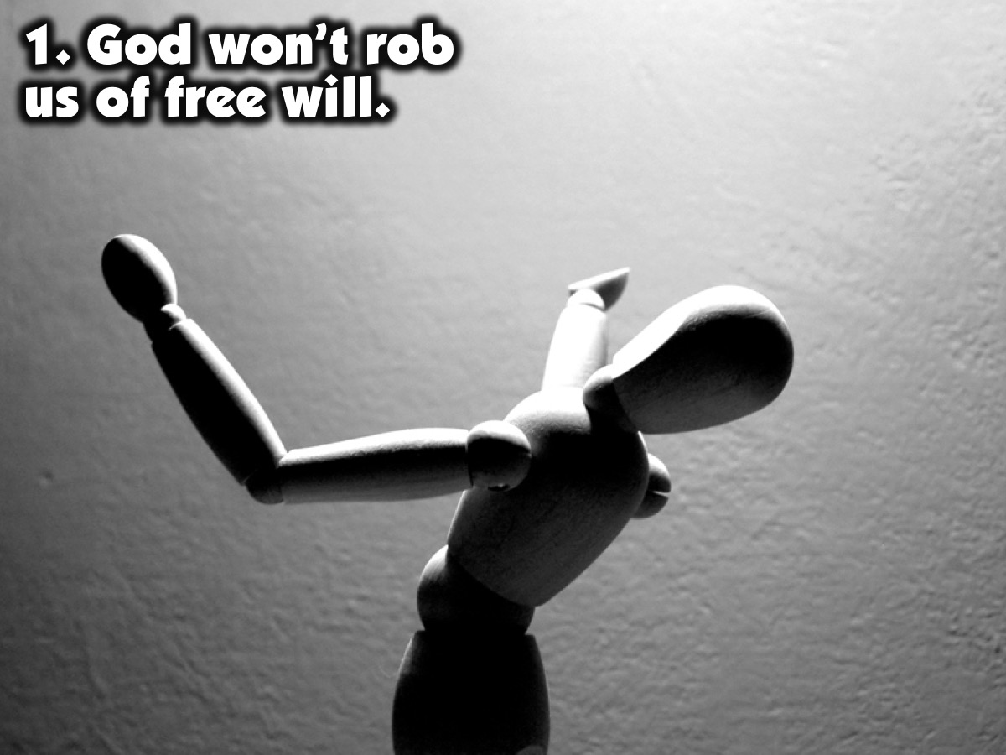
Notes:
1. God won’t rob us of free will.

Slide 13
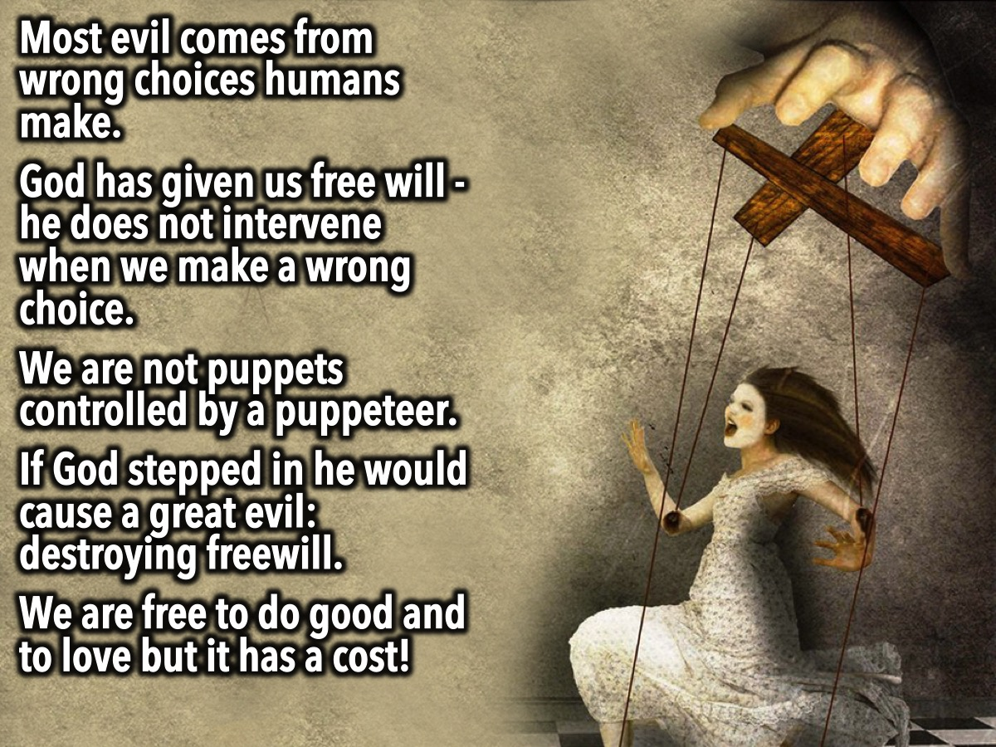
Notes:
Most of the evil in the world is a direct consequence of our wrong choices as human beings - and yet God has given us free will - the ability to choose right and wrong. The problem is that many people choose to do evil rather that good. Imagine if God intervened at every moment anyone was going to make a wrong choice. Freedom of action would no longer exist. If God waved his magic wand to undo every instance where we made a bad choice, we would merely be puppets controlled by a puppeteer who overrules our thoughts and actions. Would we want to live in such a world, even if it meant we were insulated from suffering? Could we even speak of concepts such as goodness, generosity and love without them being freely given, and freely rejected? The Hitlers, Maos and Stalins of this world have wreaked terrible evils on the world. Why does God not step in supernaturally to put an end to such monstrous dictators? One answer is that to do so would force a greater evil on the world - the banishing of a world in which humans make free decisions. Instead, God gives us the awesome responsibility of creating the kind of world we want to live in. In the freedom we have been given, we are each called to stand for good against evil. So the gift of freedom and love that God has given us comes at the cost of the evil that people freely choose to carry out in the world.

Slide 14
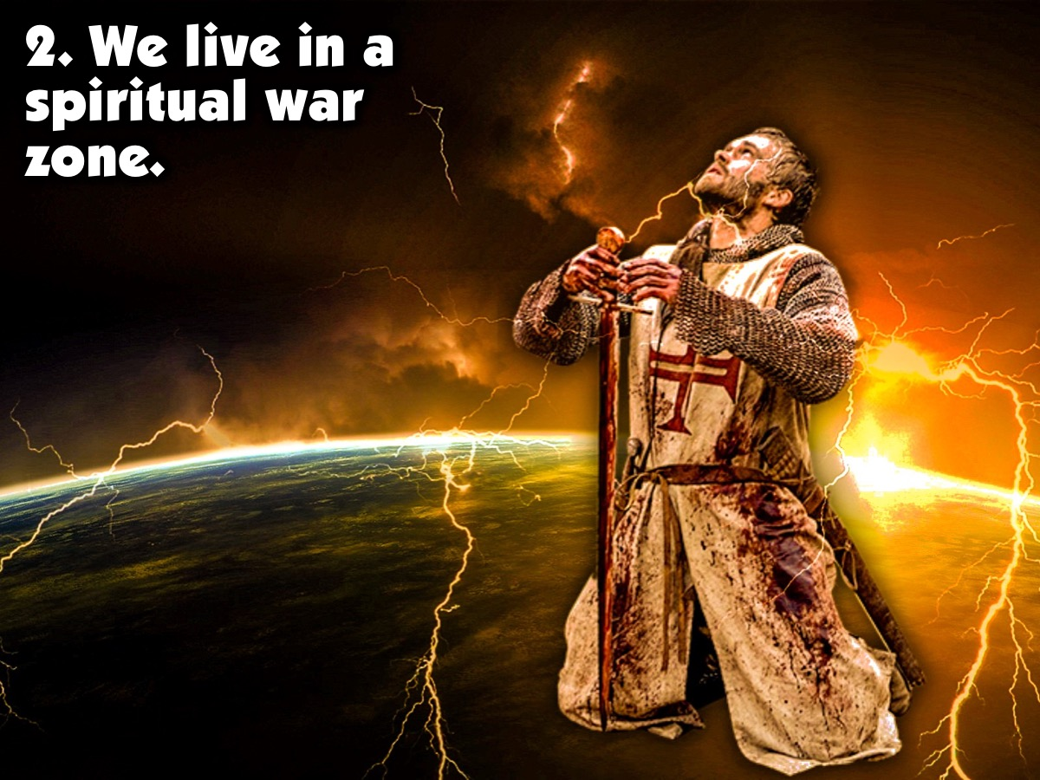
Notes:
2. We live in a spiritual war zone.

Slide 15
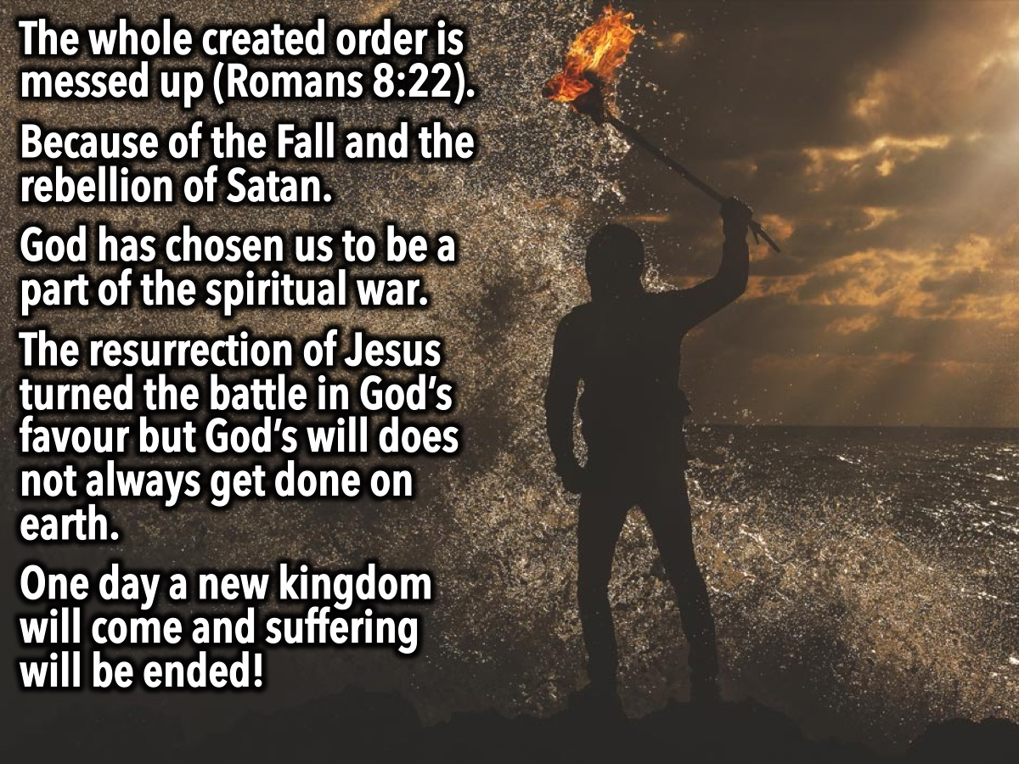
Notes:
Paul wrote: “We know that the whole creation has been groaning as in the pains of childbirth right up to the present time.” (Romans 8:22). The Christian story is that the whole created order is messed up at a cosmic level. This can be traced back to the human rebellion when Adam and Eve fell and even before that to the rebellion in the angelic realm that sparked a ‘cosmic fall’ (hinted at in Revelation 12:9). Whatever the origin, the result is a world that is not as it should be and one day “the creation itself will be liberated from its bondage to decay and brought into the freedom and glory of the children of God.” (Romans 8:21). Throughout the New Testament we are presented with a worldview of spiritual warfare in which God has chosen his people to be fellow combatants waging a war, not against flesh and blood, but against spiritual ‘principalities and powers (Ephesians 6:12) through our prayer, love and action. We live in a world where natural disasters, disease and evil are tied up not only with the choices of human beings but with the freedom exercised by spiritual forces in rebellion against God. Although the war was decisively turned towards victory through the death and resurrection of Jesus, there still remains a world of running spiritual battles. We pray “Your will be done on earth as it is in heaven” because God does not always get his will on earth. There are casualties in the ongoing battle to redeem a fallen and broken world. The groaning of creation brings both good and bad across our path. The natural laws that operate are both a blessing and a curse: (a) Tectonic plate activity renews the surface of the earth with minerals, yet causes havoc when human build cities on the fault lines; (b) Cell replication allows our vogues to grow and develop, yet can result in cancer when natural processes misfire; and (c) Death is a necessary part of the cycle of life yet still remains our “last enemy” (1 Corinthians 15:26). The Christian story is of a broken and rebellious creation that is awaiting the renewal of all things. Christians are called to live faithfully for the kingdom that has already come in Jesus, while waiting for the kingdom that is coming in which “He will wipe every tear from their eyes and there will be no more death or mourning or crying or pain, for the old order of things has passed away.”

Slide 16
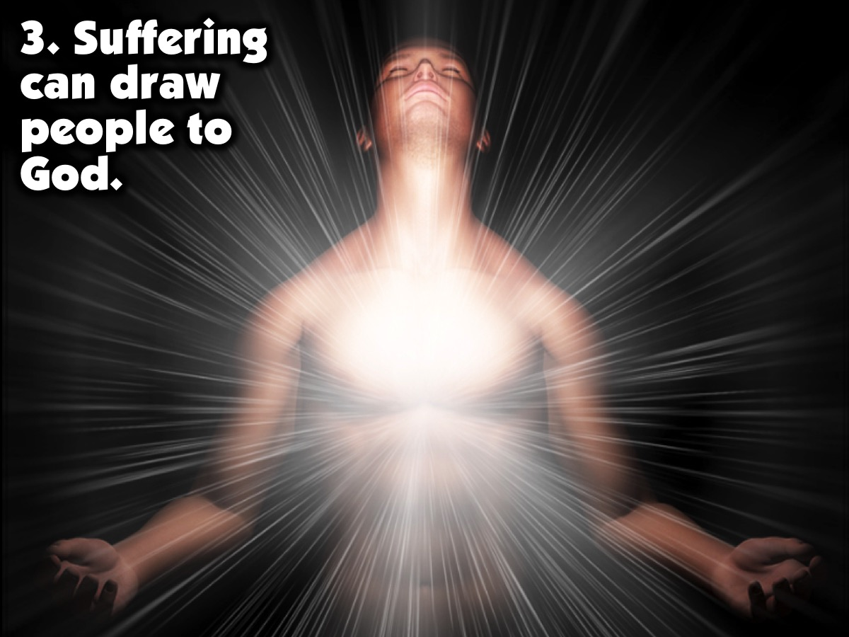
Notes:
3. Suffering can draw people to God.

Slide 17
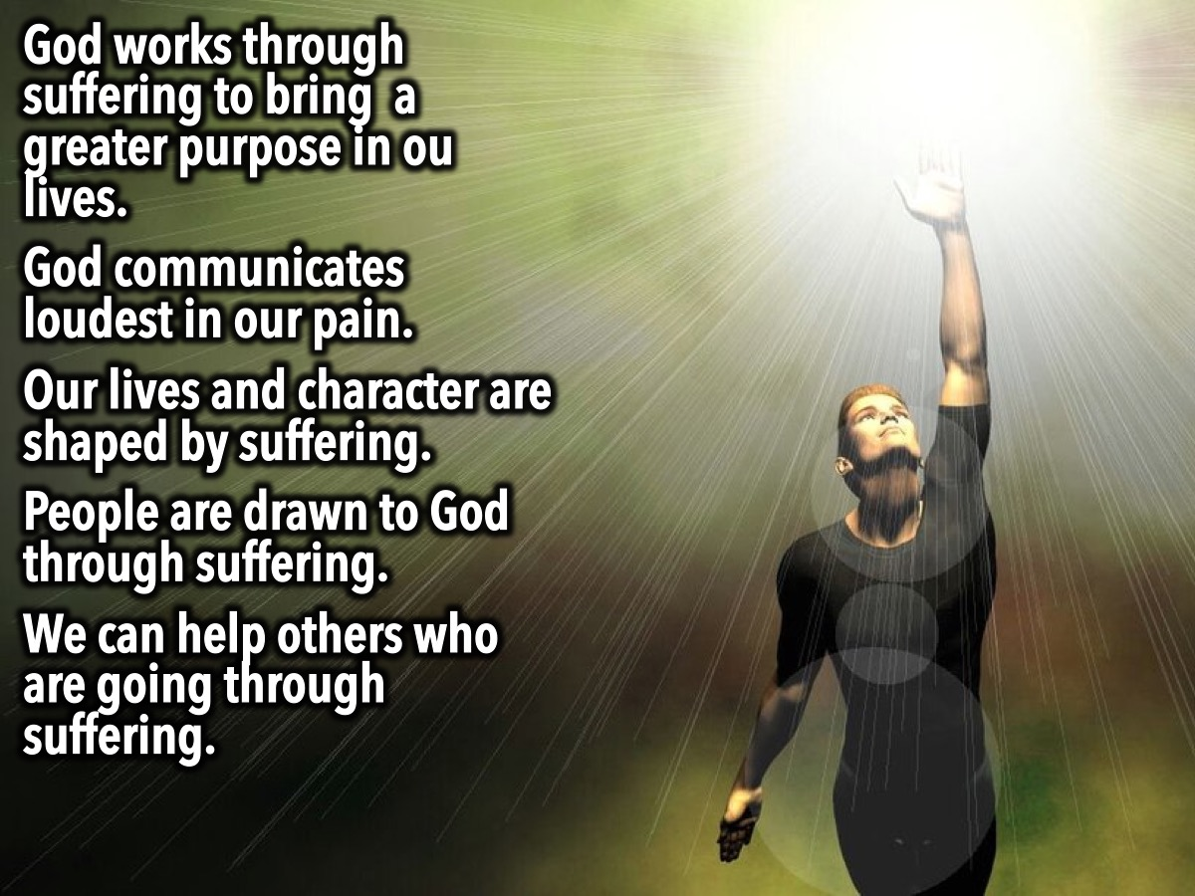
Notes:
God works through the circumstances of our suffering to bring about a greater purpose in our lives that may have otherwise not been possible. God is able to somehow able to do this with his superior wisdom and power and his freedom from the constraints of time and space in which we live. It is helpful to remember why God created us in the first place. One answer is that God’s job is to keep humans happy, comfortable and pain-free” - and this is what some people assume is meant by God being loving. But there is another answer: God’s purpose for human beings is to bring them to know and love him. In fact, coming to know and love God may be quite different from being kept comfortable and happy. The reality is that comfort tends to make us forget about God. Christianity often thrives in places that are experiencing persecution or hardship. For some, suffering leads to abandoning belief in God, but for many the opposite is true - it causes them to seek God. C.S. Lewis wrote in the Problem of Pain: “God whispers to us in our pleasures, speaks in our conscience but shouts in our pain: it is His megaphone to rouse a deaf world.” Many people who were deaf to God encountered circumstances that stripped them of their security and comfort and their only option was to turn towards God - and they found that was the thing they had been searching for all along. Our own lives and character can ultimately be shaped by suffering if we are willing to more resemble the character of God. We become better human beings when we go through painful situations and we can often help others who are going through similar circumstances. Of course, there are many situations of suffering in which no good is seen and we can only throw ourselves onto the mercy of God and wait for answers on the other side of eternity.

Slide 18
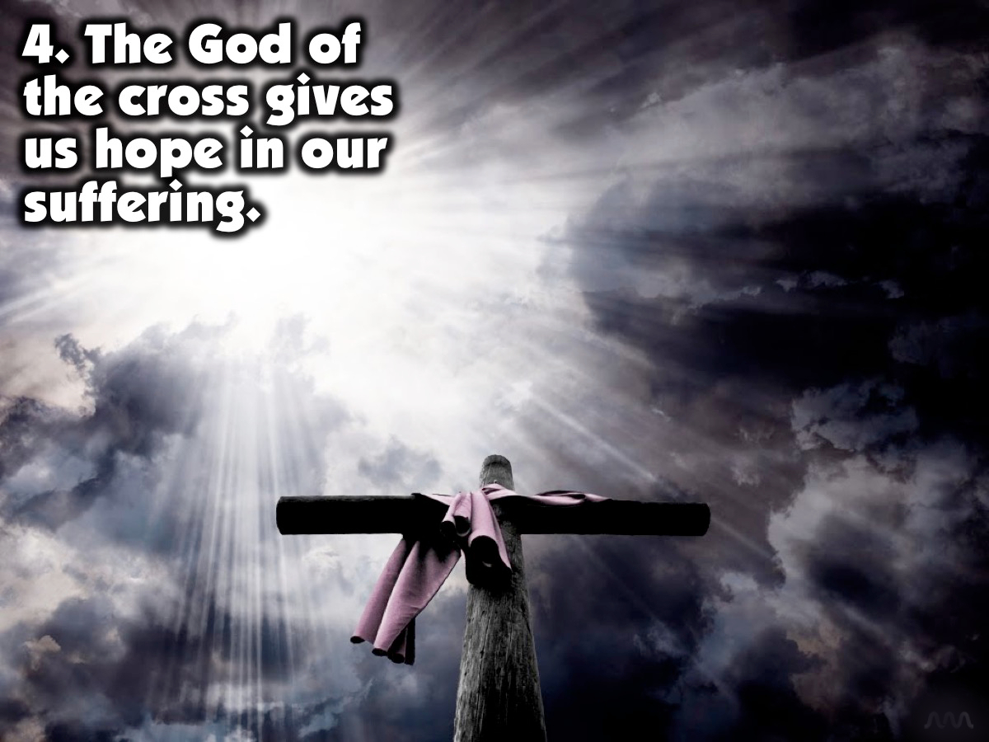
Notes:
4. The God of the cross gives us hope in our suffering.

Slide 19
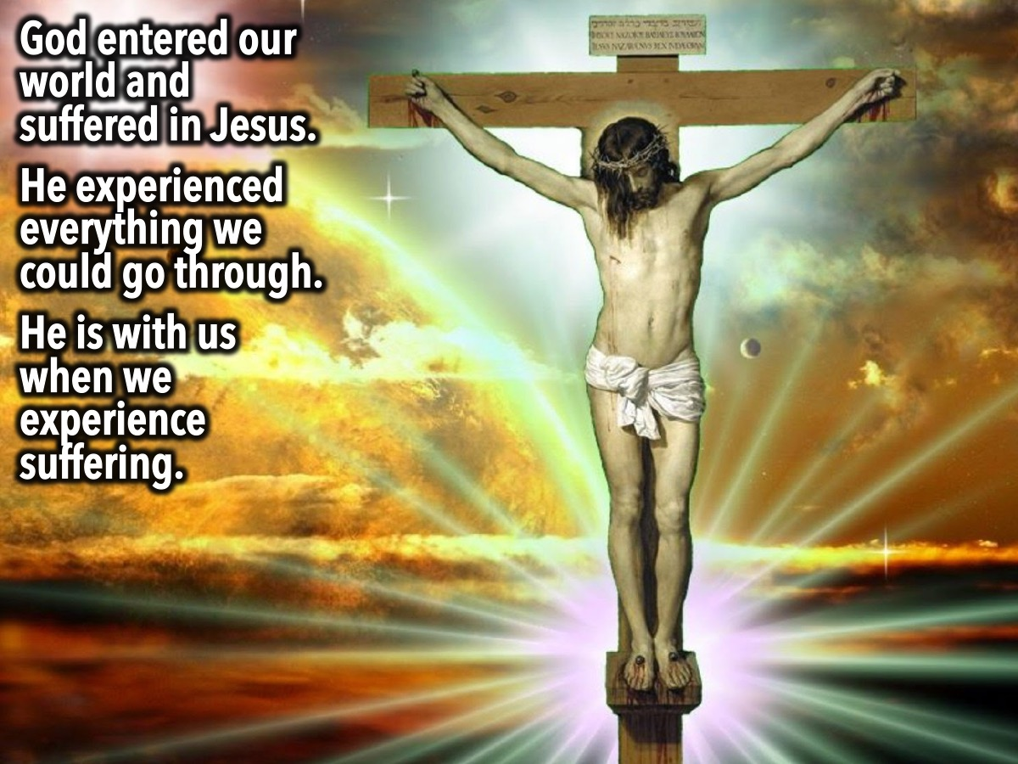
Notes:
Jesus wept when confronted with the death of his friend, Lazarus. People who are suffering don’t need an explanation - they need someone to sit with them, weep with them, pray with them, love them - and if there is a time for words, to let them know that God understands how they feel, for he has chosen to enter our suffering. This is the God we worship - he chose to get involved. When he came to earth in Jesus, he shared our joys and he shared our sorrows too. He suffered rejection, betrayal, beating, humiliation and death. God knows what we go through in pain, suffering, humiliation and fear because he’s been through it too. Life is messy, ugly and hurts at times, but we have a God who comes alongside and says, ‘I know what it feels like.’ And while this does not take away the pain, it can be enough to enable someone to hang on. Ironically, the Christian faith has not caused people to resign themselves to a broken world, but has been the prime motive for millions to go out and change it. Like Jesus we are sent to ‘proclaim good news to the poor, freedom for the prisoners and recover of sight for the blind, to set the oppressed free’ (Isaiah 61). Being a Christian offers no magic exemption from the trials of life. In fact, being a Christian may bring more suffering than we’d otherwise experience, as those who live under threat of persecution and death for their faith know only too well. The fact that God suffered on the cross helps us bear our suffering and will help us eventually to find purpose in the pain.

Slide 20
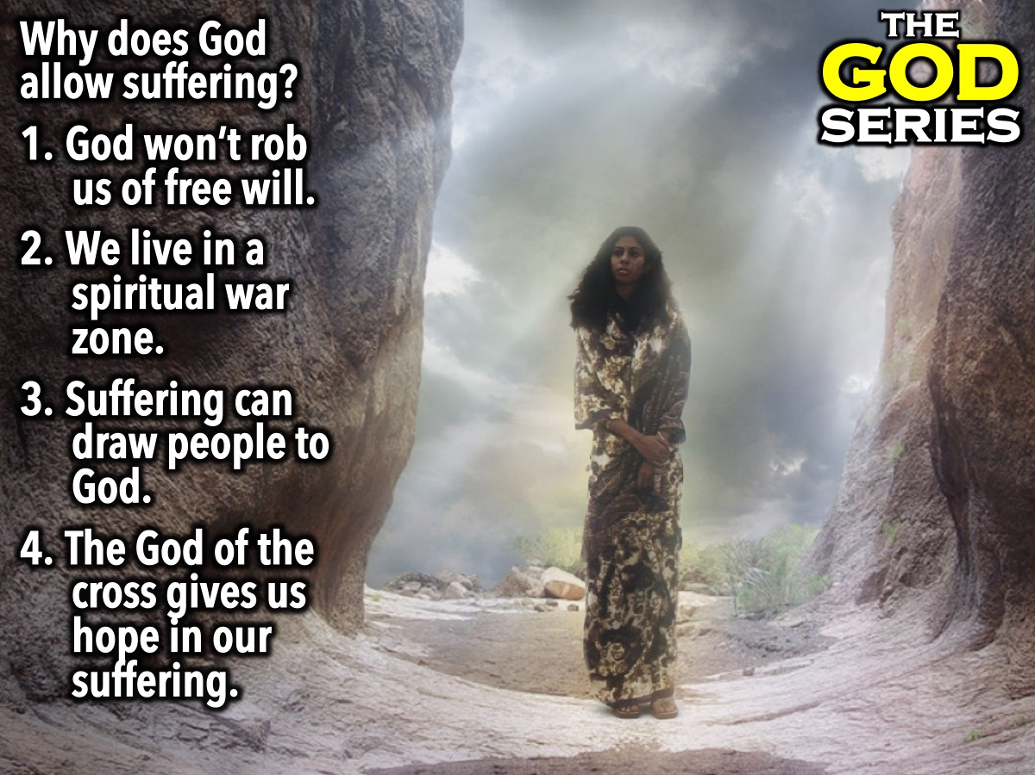
Notes:
Summary: (1) God won’t rob us of free will. (2) We live in a spiritual war zone. (3) Suffering can draw people to God. (4) The God of the cross gives us hope in our suffering.

Slide 21
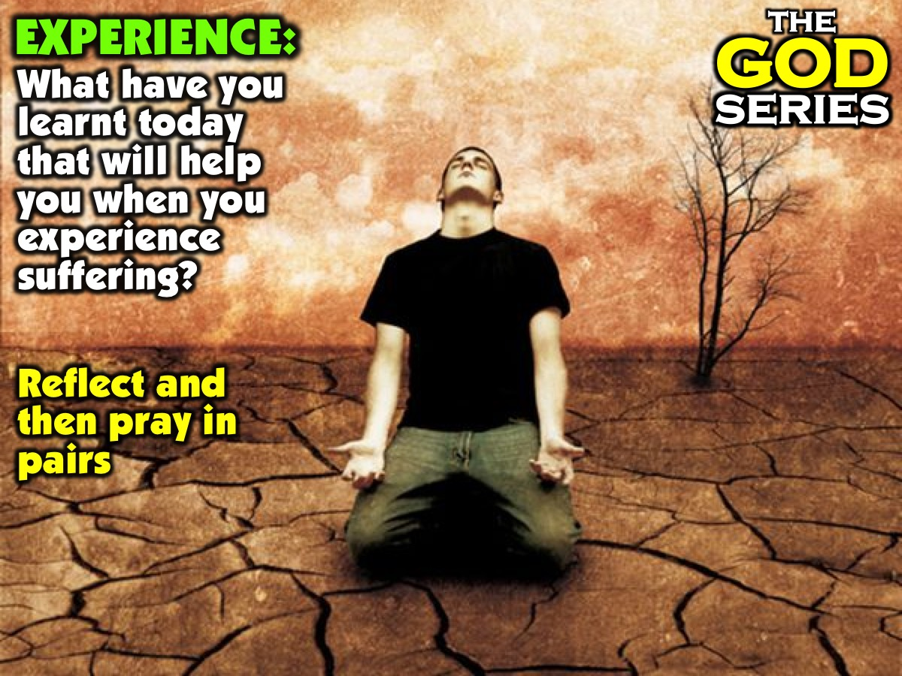
Notes:
Part 3: Experience: What have you learnt today that will help you when you experience suffering? (Let each person reflect on this question and share with someone sitting next to them before you pray).

Slide 22
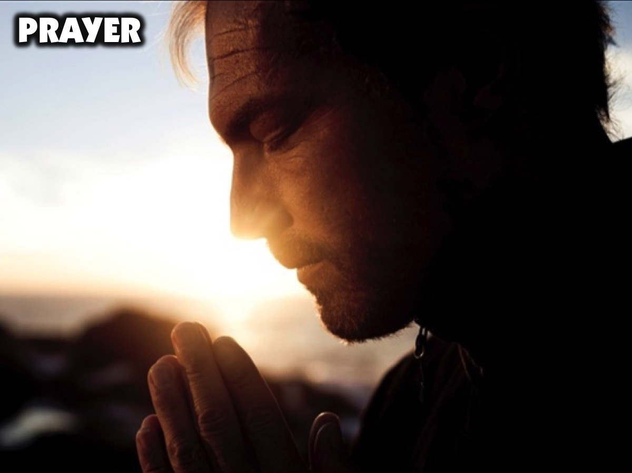
Notes:
Prayer.

Slide 23
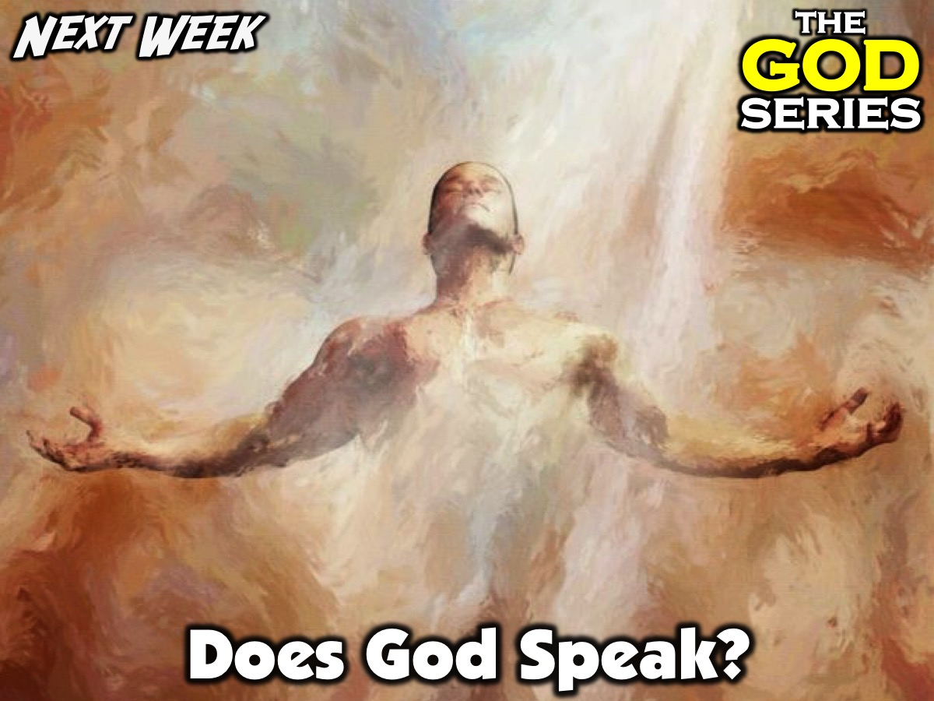
Notes:
Next Sunday morning we will be answering the question: Does God Speak?

