Slide 1

Notes:
Welcome to The GOD Series.

Slide 2

Notes:
Today is week 4 of the God Series and we will be answering the question: Does God Speak?

Slide 3
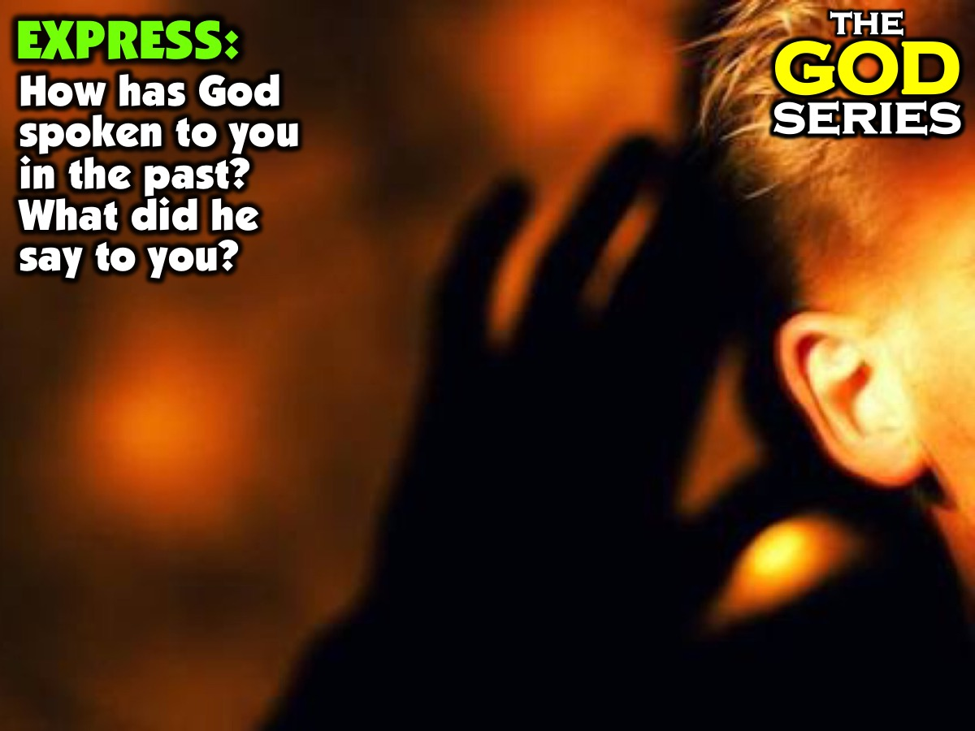
Notes:
Part 1: Express: Have each person in the group share their answers to this question: “How has God spoken to you in the past? What did he say?”

Slide 4
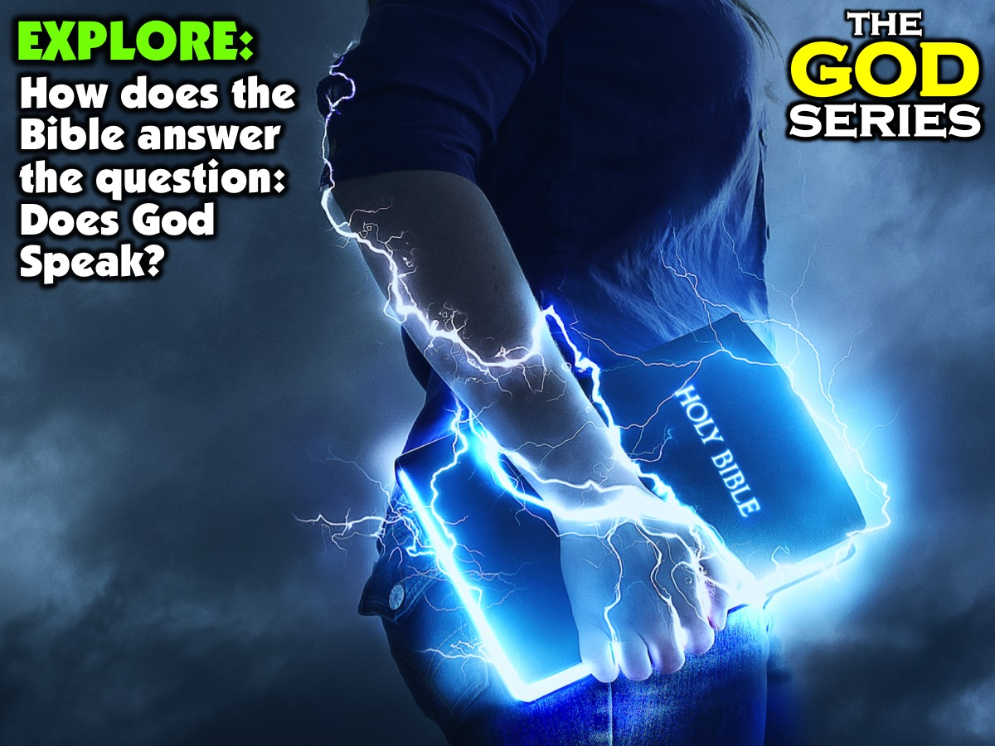
Notes:
Part 2: Explore: How does the Bible answer the question: Does God Speak?

Slide 5
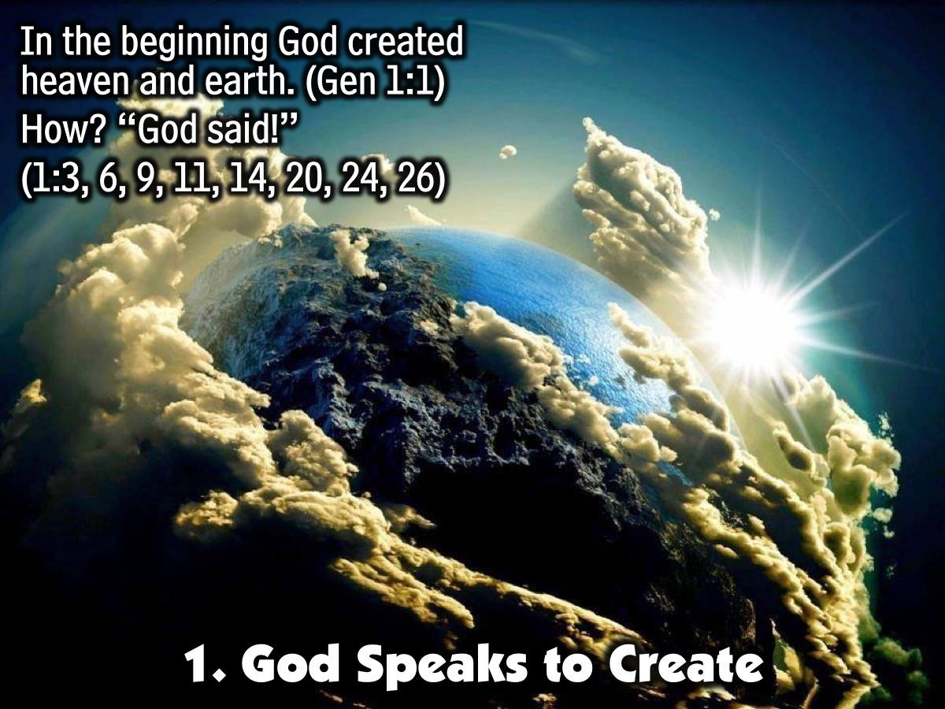
Notes:
1. God Speaks to Create. Let’s start by looking at the Bible to where we discover that God speaks to create. Genesis 1:1 says:” In the beginning God created heaven and earth!”. Like an artist God used a tool to create everything. How did he do it? In verse 3, 6, 9, 11, 14, 20, 24, and 26 – eight times the tool God used is mentioned – “God said!” The tool is his Word. God just speaks and things come into existence.

Slide 6
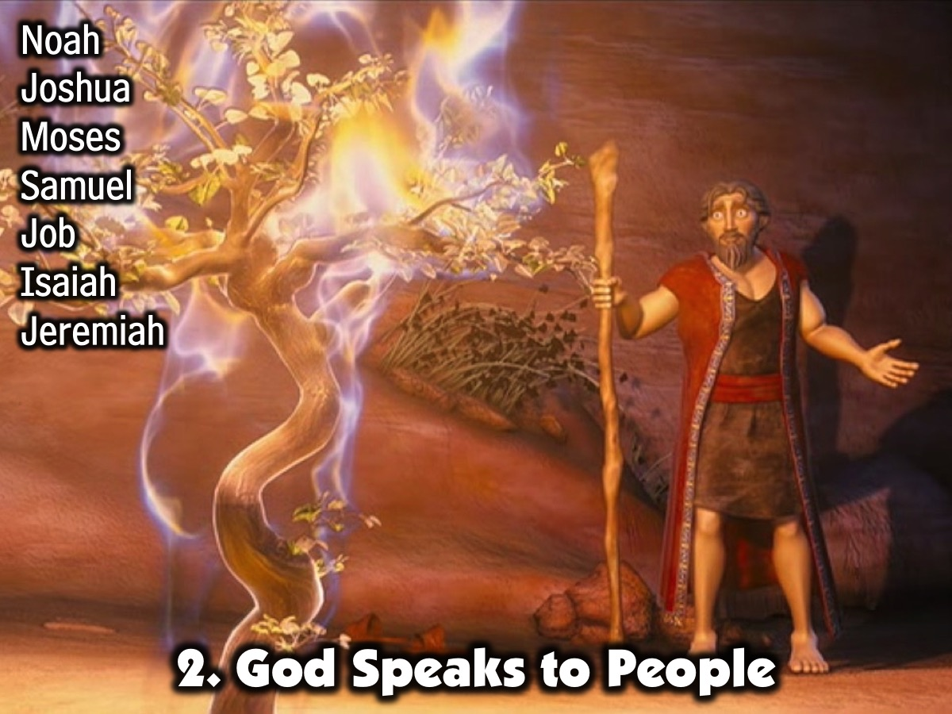
Notes:
2. God Speaks To People. Here are a few examples from the Bible where God speaks to specific individuals: (1) Noah: In Genesis 6-7 we read the story of how God speaks to Noah about building an Ark. (2) Moses: In Exodus 3 we read the story of how God speaks to Moses in the wilderness. (3) Samuel: In 1 Samuel 3 we read the story of how God speaks to Samuel. (4) Job: In Job 38-42 God speaks to Job. (5) Samuel: 1 Samuel 3:11. (6) Job: Job 40:1. (7) Isaiah: Isaiah 7:3. (8) Jeremiah: Jeremiah 1:7.

Slide 7
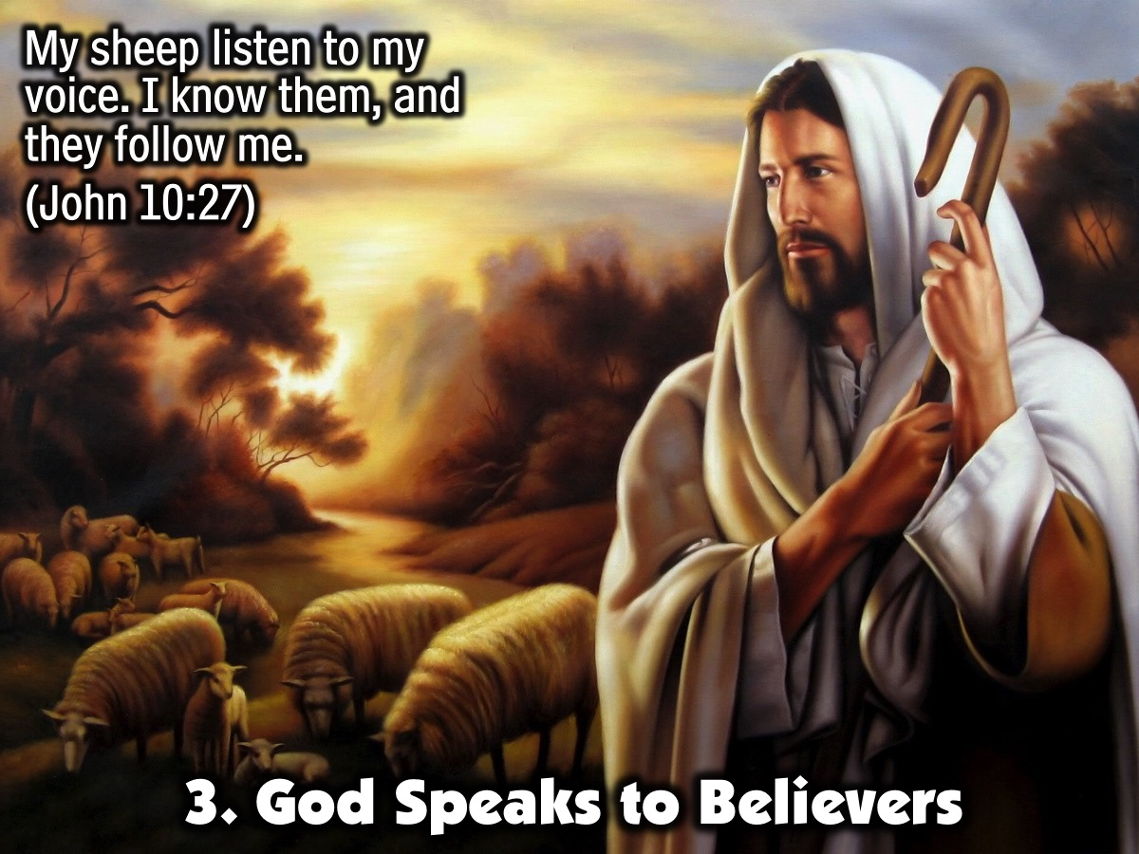
Notes:
3. God Speaks to Believers. Jesus said in John 10:27: “My sheep listen to my voice. I know them, and they follow me.”

Slide 8
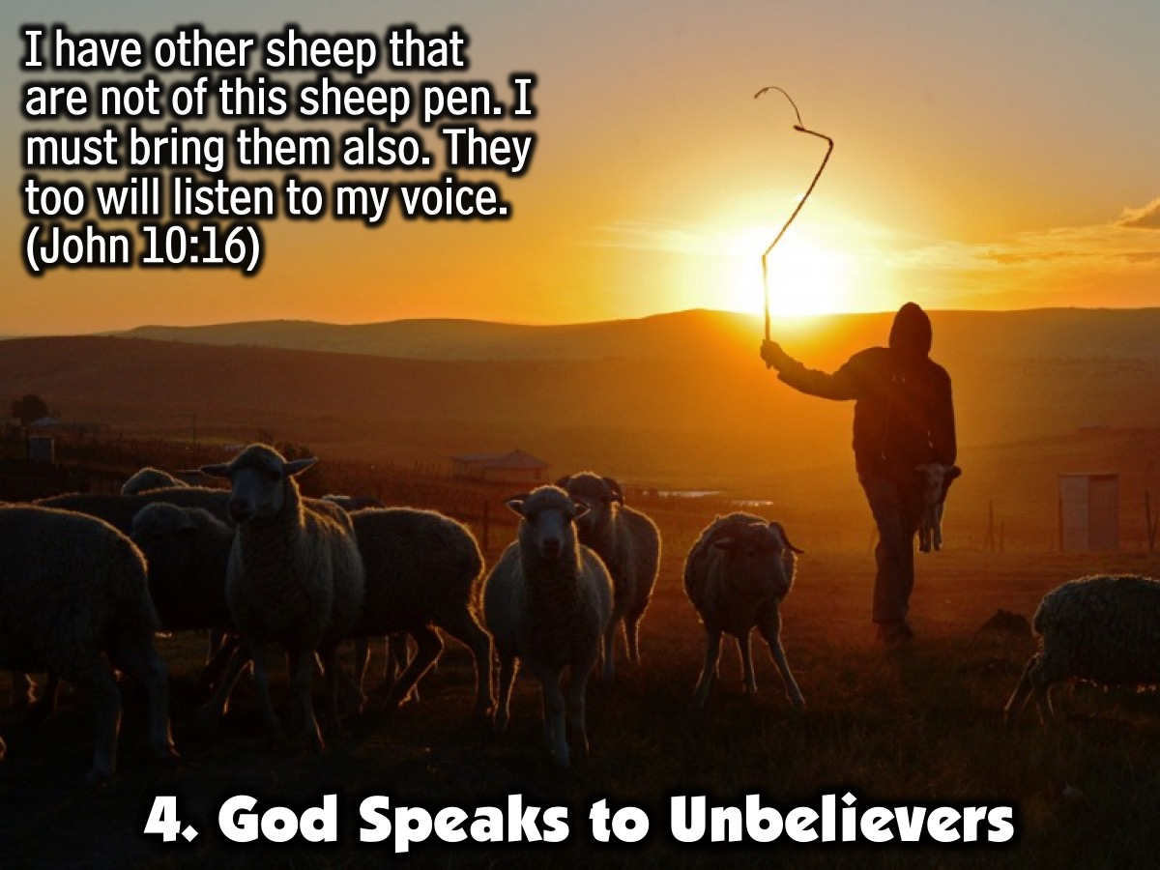
Notes:
4. God Speaks To Unbelievers. In John 10:16, Jesus says: “I have other sheep that are not of this sheep pen. I must bring them also. They too will listen to my voice.” Anyone who has ears can hear God speak to them.

Slide 9
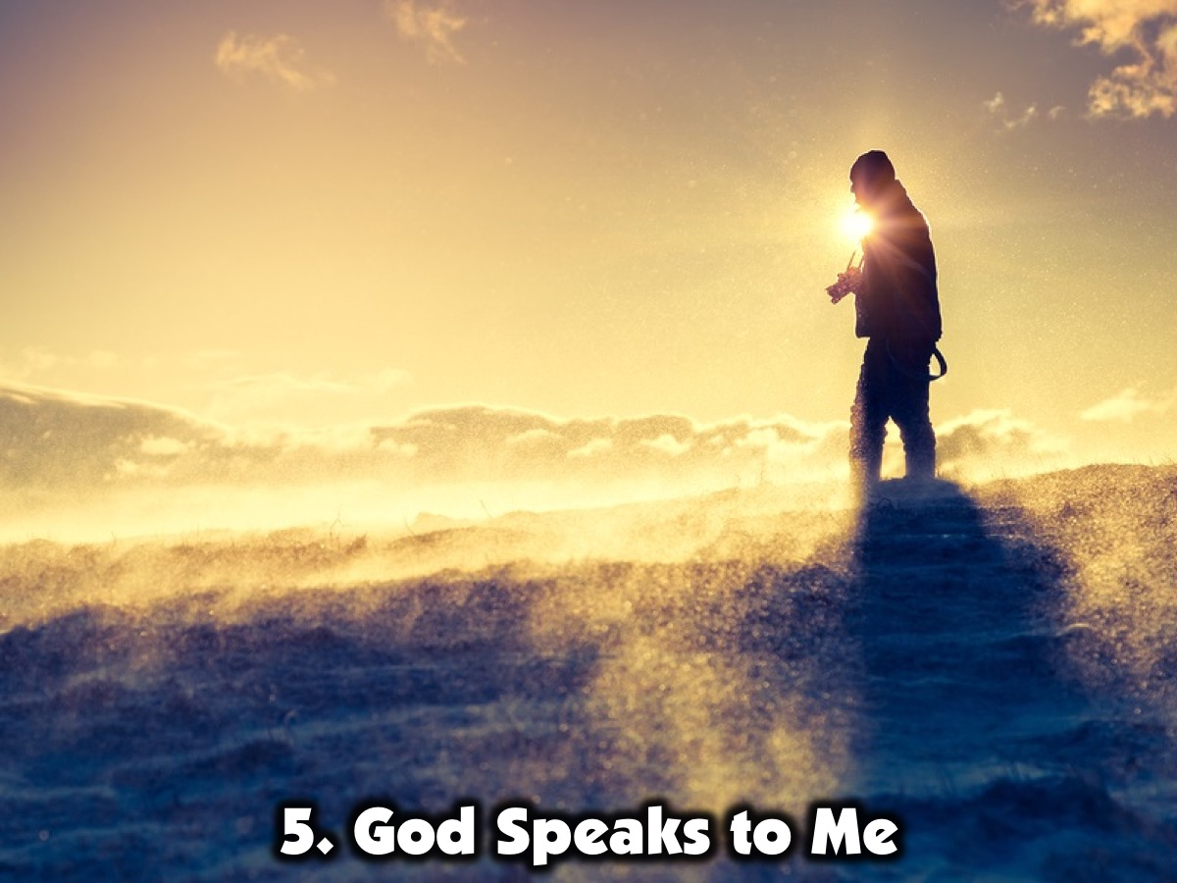
Notes:
5. God Speaks To Me. Share an example of how God has spoken to you in the past.

Slide 10

Notes:
6. God Speaks To You. If you are a follower of Jesus, and even if you are not, you can hear God speak to you!

Slide 11

Notes:
Part 2: Explore: How Does God Speak: “God does speak — sometimes one way and sometimes another — even though people may not understand it.” (Job 33:14). What are some of the way in which God speaks to people?

Slide 12

Notes:
1. Scripture. “The whole Bible was given to us by inspiration from God and is useful to teach us what is true and to make us realize what is wrong in our lives; it straightens us out and helps us do what is right.” (2 Timothy 3:16).

Slide 13
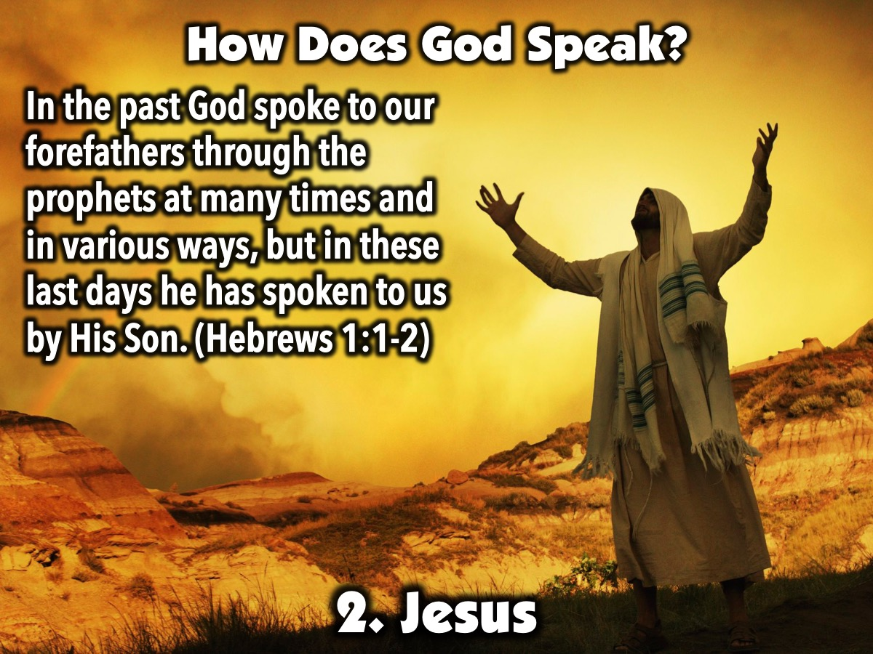
Notes:
2. Jesus. “In the past God spoke to our forefathers through the prophets at many times and in various ways, but in these last days he has spoken to us by His Son.” (Hebrews 1:1-2)

Slide 14
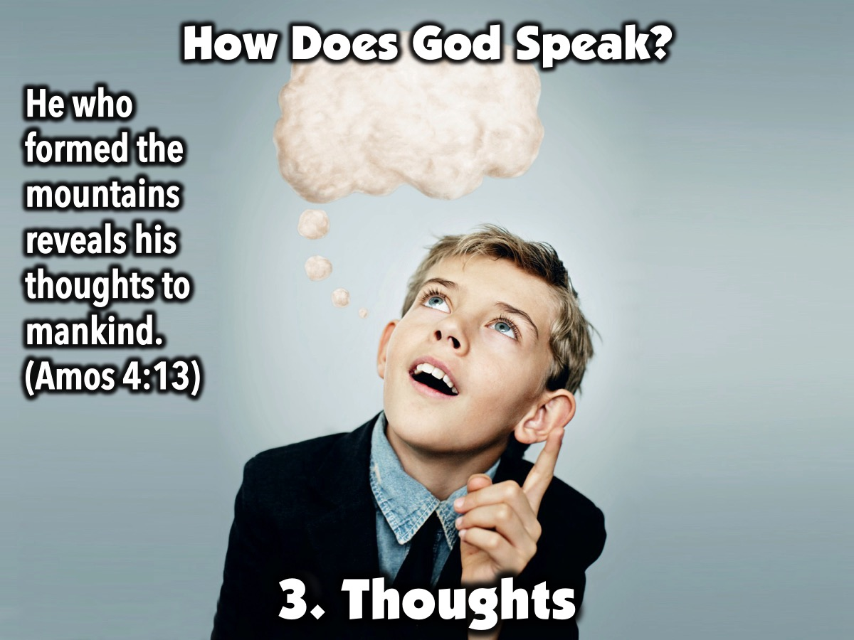
Notes:
3. Thoughts. “He who formed the mountains reveals his thoughts to mankind.” (Amos 4:13)

Slide 15
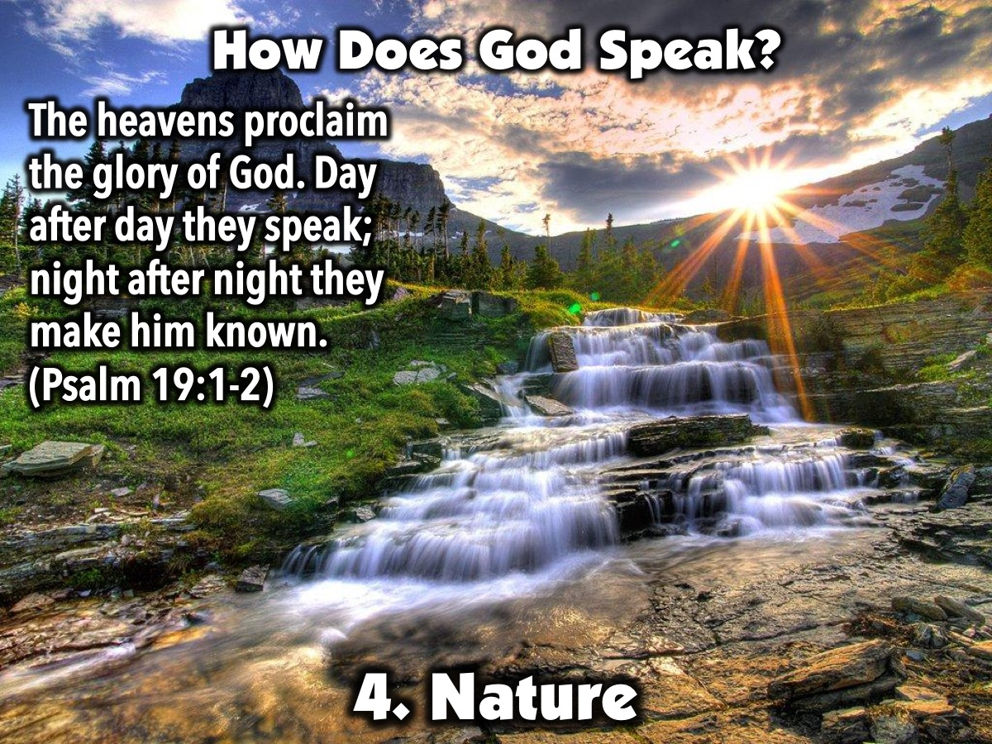
Notes:
4. Nature. “The heavens proclaim the glory of God. Day after day they speak; night after night they make him known.(Psalm 19:1-2)

Slide 16

Notes:
5. People. “The godly give good advice to their friends.” (Proverbs 11:14). We learn throughout the book of Proverbs that when we seek godly counsel we can hear the voice of God.

Slide 17
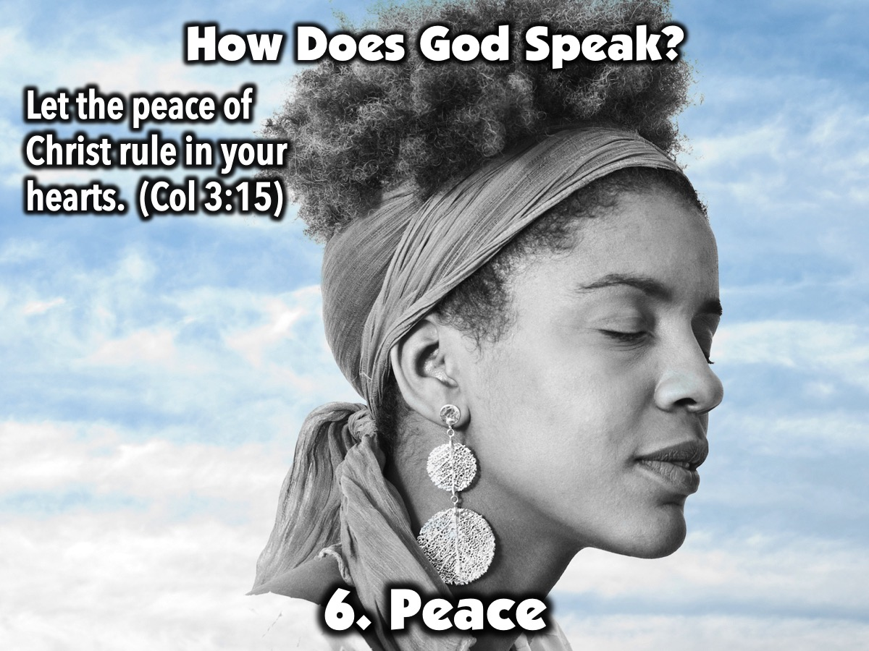
Notes:
6. Peace. "Let the peace of Christ rule in your hearts, to which indeed you were called in one body; and be thankful" (Colossians 3:15). God’s peace can rule in our hearts. The word rule means to reign or to be a deciding factor. If we don’t have peace about a decision, then it isn’t from the Lord. Don’t move forward unless you have peace.

Slide 18
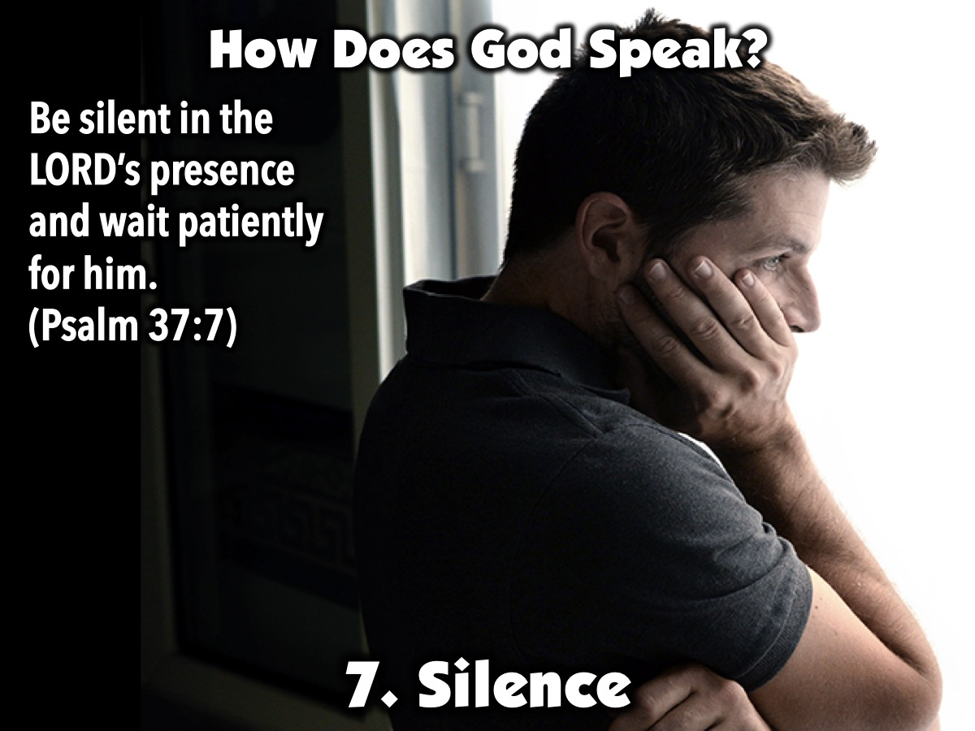
Notes:
7. Silence. “Be silent in the LORD’s presence and wait patiently for him.” (Psalm 37:7). There are many reasons for God’s silence: maybe he spoke in the past and we did not pay attention, maybe he wants us to follow a difficult path without easing the load to gain strength and stamina or maybe He is teaching us that we have to trust Him even if we are facing the death of a loved one.

Slide 19

Notes:
Summary: God speaks through Scripture; Jesus; Thoughts; Nature; People; Peace and Silence.

Slide 20
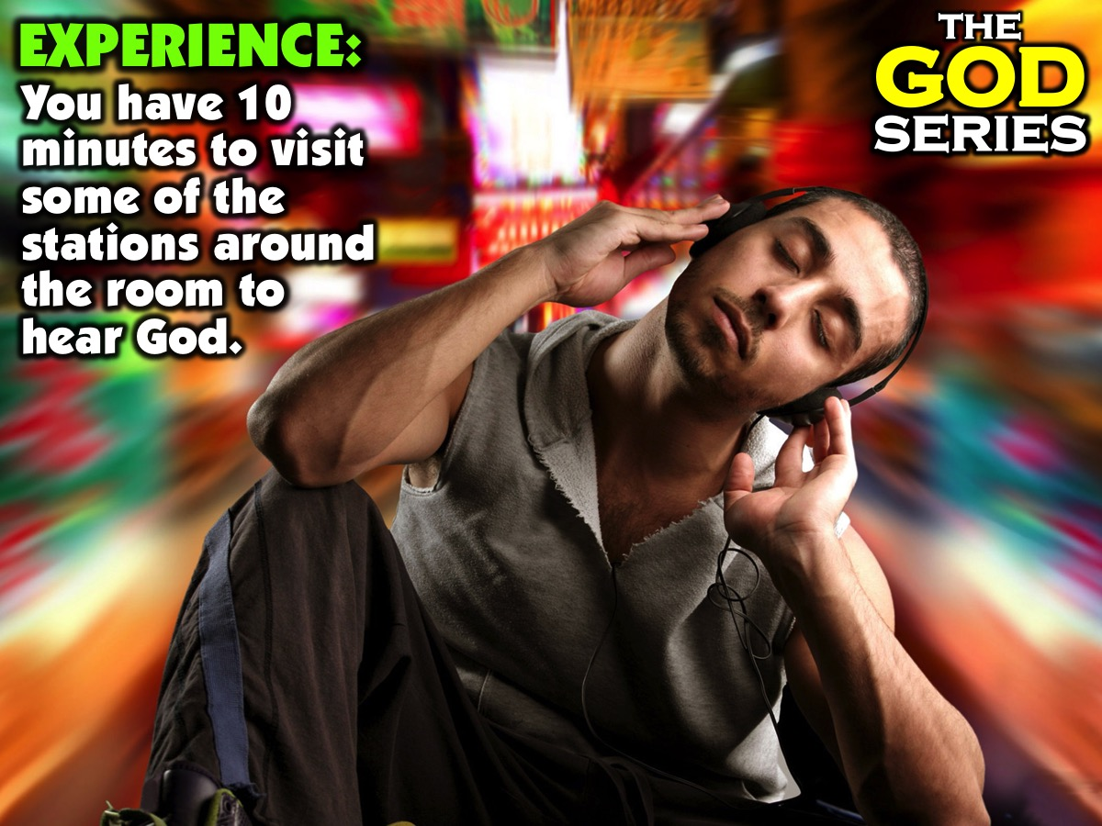
Notes:
Part 3: Experience: You have 10 minutes to visit some of the stations around the room to hear God. Here is a brief description of what happens at each station: (1) Scripture: Read the passage and ask God to speak to you through it. (2) Jesus: Read the words of Jesus and ask God what he is saying to you. (3) Thoughts: Ask God to speak to you and write down the flow of thoughts that come to mind. (4) Nature: Look at the picture and ask God to speak to you through it. (5) People: Share a situation with a leader and ask them to tell you what they think God is saying to you. (6) Peace: Reflect on a decision you are making and see if you have peace in your heart about it. (7) Silence: Sit in silence for a few minutes and ask God to speak to you through the silence.

Slide 21

Notes:
Wrap Up: Here are a few closing thoughts about hearing God speak: (1) God speaks differently because he is creative and we are unique. (2) God will never contradict what he has said in his Word. (3) We must make time to listen to God so we can hear Him speak to us.

Slide 22

Notes:
Prayer.

Slide 23

Notes:
Next Sunday is a Family Service so we will be staying in the sanctuary for the whole service.

