Slide 1

Notes:
Welcome to The GOD Series.

Slide 2

Notes:
Today is week 5 of the God Series and we will be answering the question: Does God Relate?

Slide 3
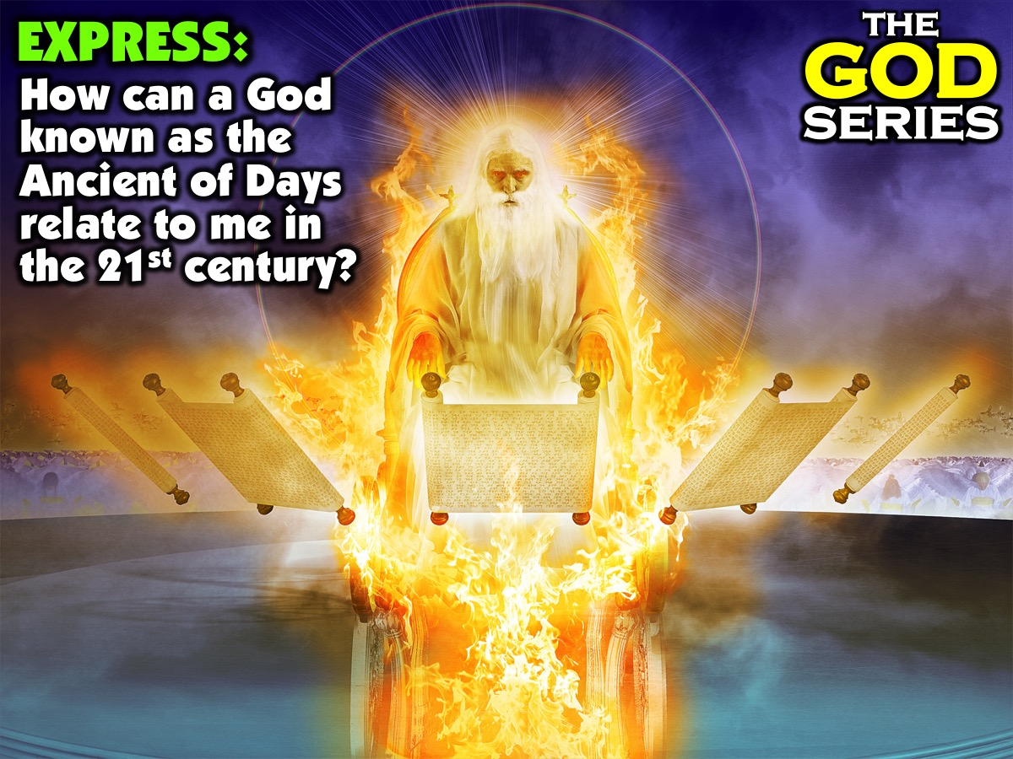
Notes:
Part 1: Express: How can a God knows as the Ancient of Days relate to me in the 21st century?

Slide 4
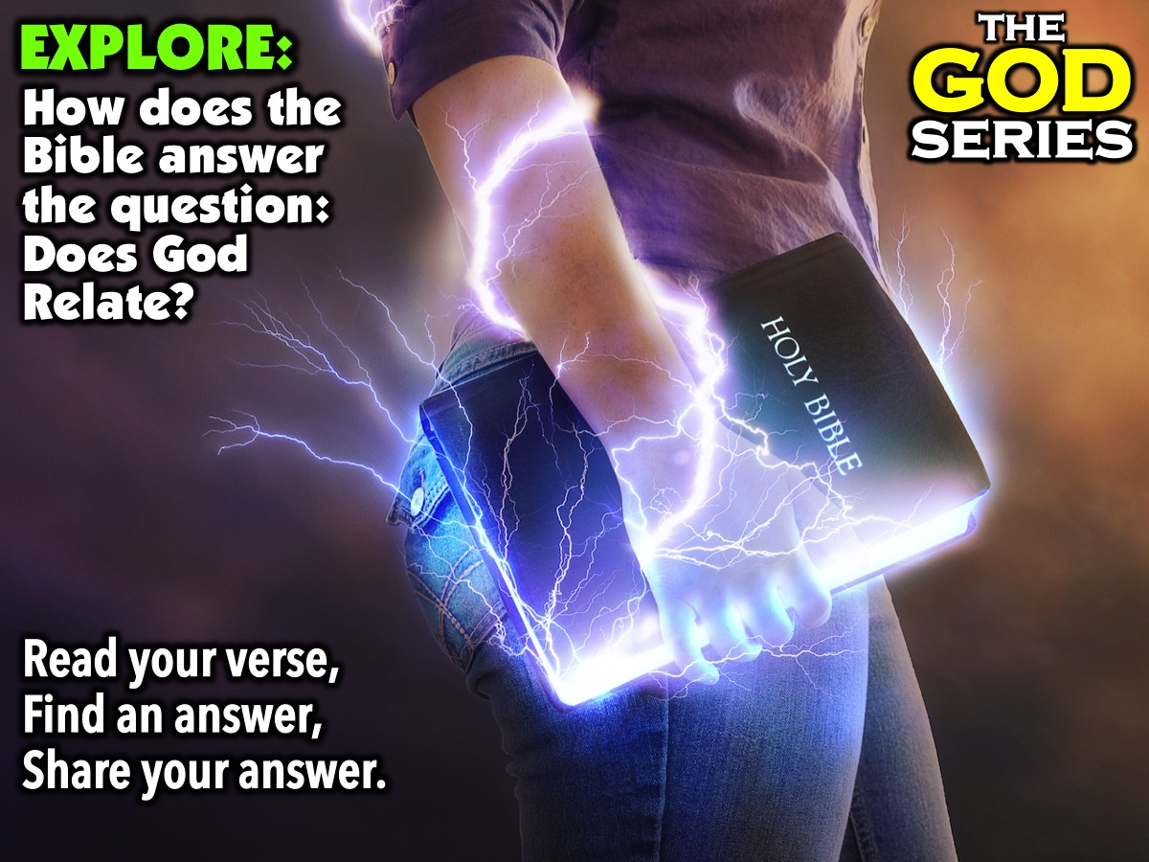
Notes:
Part 2: Explore: How does the Bible answer the question: Does God Relate? Read the verse you are given, find an answer and share your answer on the mic. Here are the verses that will be used: Isaiah 40:28; Psalm 139:1-5; 1 Chronicles 29:11-12; Psalm 139:7-11; Hebrews 5:14-15 and John 14:16-17.

Slide 5

Notes:
We are going to explore 6 truths about God from the Bible that show how God is able to relate to us:

Slide 6
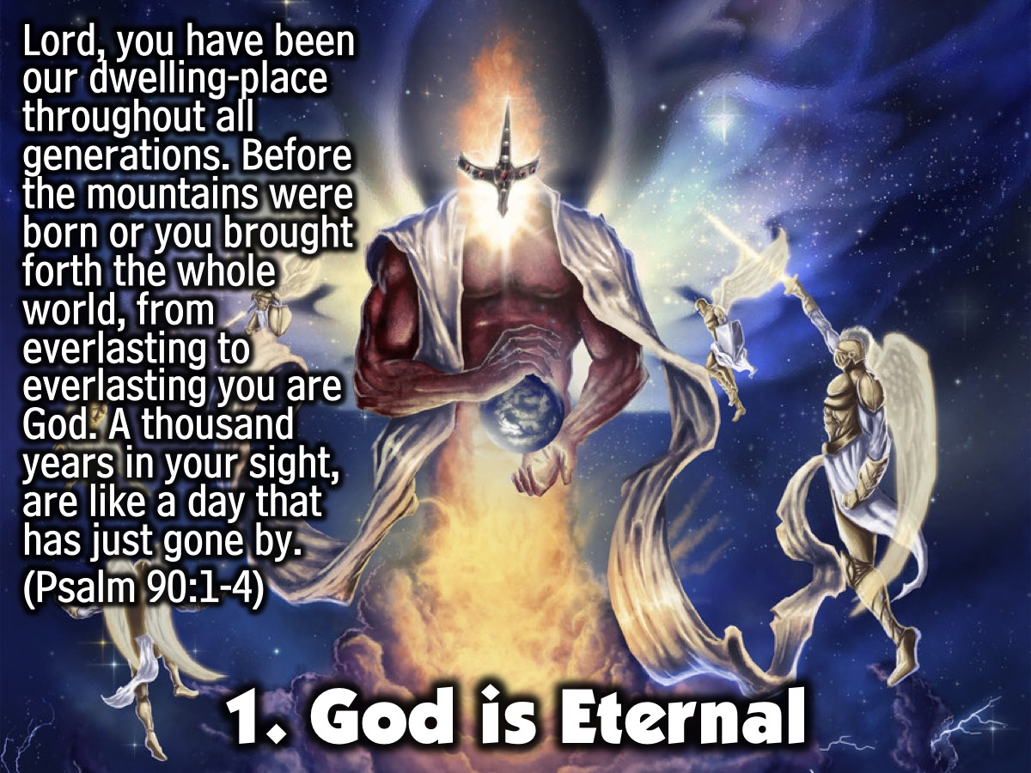
Notes:
1. God is Eternal. God does not age - God lives outside of the limits of time and space. “Lord, you have been our dwelling-place throughout all generations. Before the mountains were born or you brought forth the whole world, from everlasting to everlasting you are God. A thousand years in your sight, are like a day that has just gone by.” (Psalm 90:1-4)

Slide 7
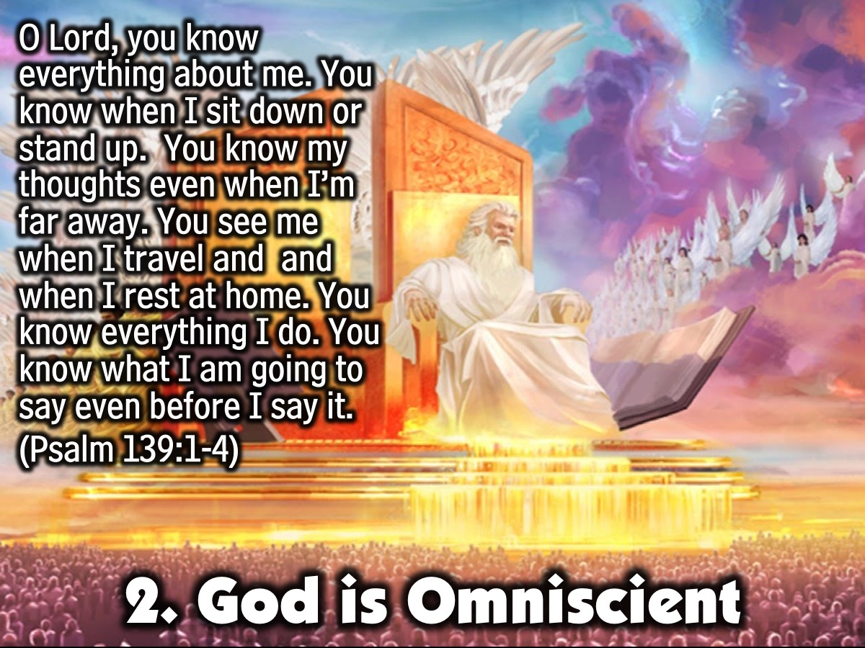
Notes:
2. God is Omniscient. God knows all things - Past, Present and Future. “O Lord, you know everything about me. You know when I sit down or stand up. You know my thoughts even when I’m far away. You see me when I travel and and when I rest at home. You know everything I do. You know what I am going to say even before I say it.” (Psalm 139:1-4)

Slide 8
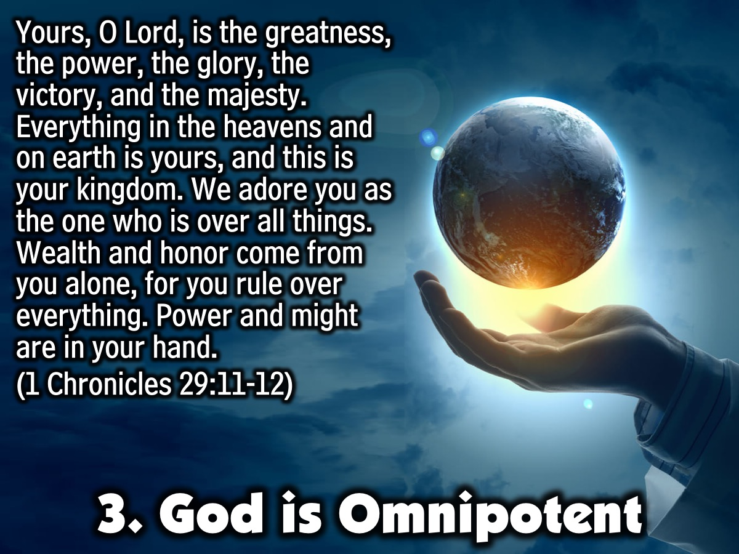
Notes:
3. God is Omnipotent. God can intervene in our lives because he has umlimited power. “Yours, O Lord, is the greatness, the power, the glory, the victory, and the majesty. Everything in the heavens and on earth is yours, O Lord, and this is your kingdom. We adore you as the one who is over all things. Wealth and honor come from you alone, for you rule over everything. Power and might are in your hand.” (1 Chronicles 29:11-12)

Slide 9
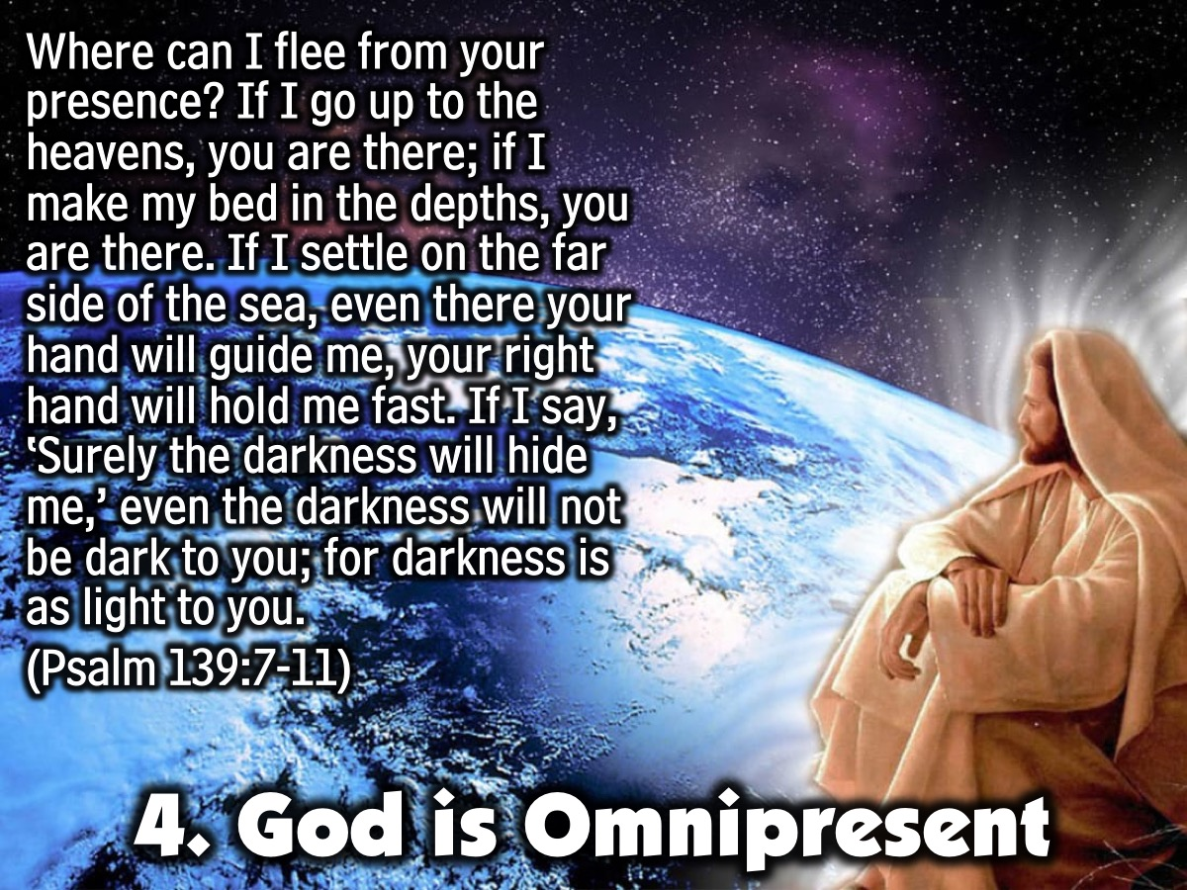
Notes:
4. God is Omnipresent. God is everywhere present all the time. “Where can I flee from your presence? If I go up to the heavens, you are there; if I make my bed in the depths, you are there. If I settle on the far side of the sea, even there your hand will guide me, your right hand will hold me fast. If I say, ‘Surely the darkness will hide me,’ even the darkness will not be dark to you; for darkness is as light to you.” (Psalm 139:7-11)

Slide 10
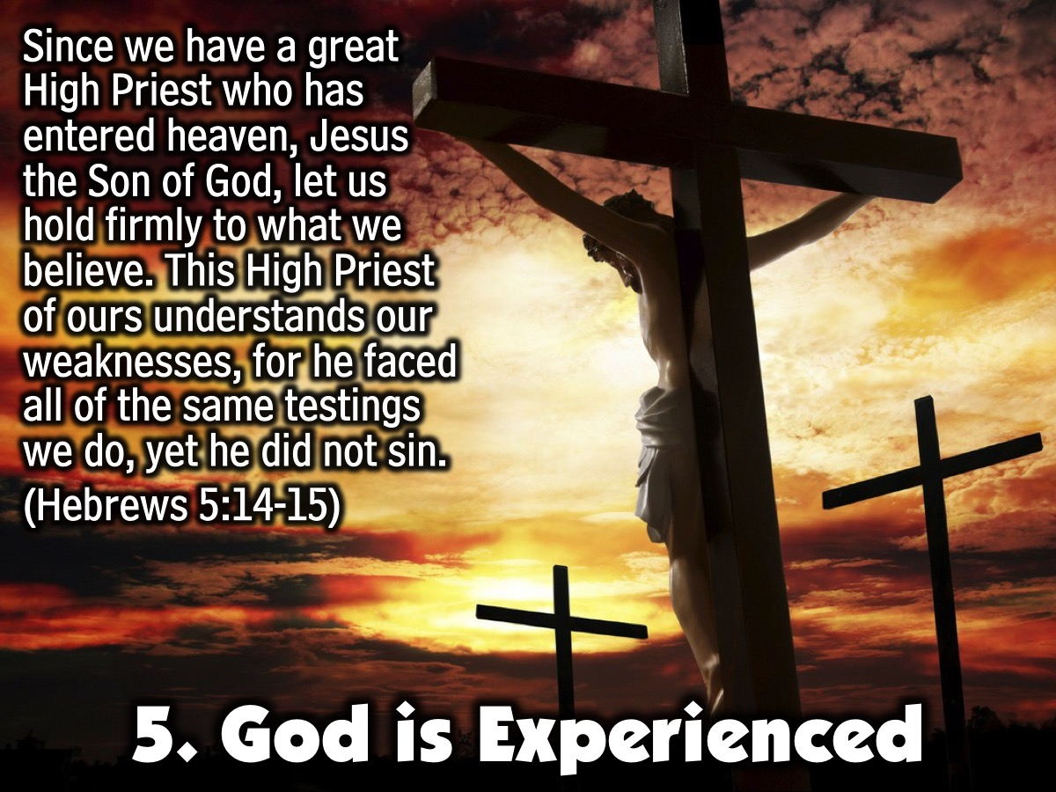
Notes:
5. God is Experienced. know what it is like to be human - he became human in Jesus and experienced pain and suffering - in Jesus and especially at the cross. “Since we have a great High Priest who has entered heaven, Jesus the Son of God, let us hold firmly to what we believe. This High Priest of ours understands our weaknesses, for he faced all of the same testings we do, yet he did not sin.” (Hebrews 5:14-15)

Slide 11
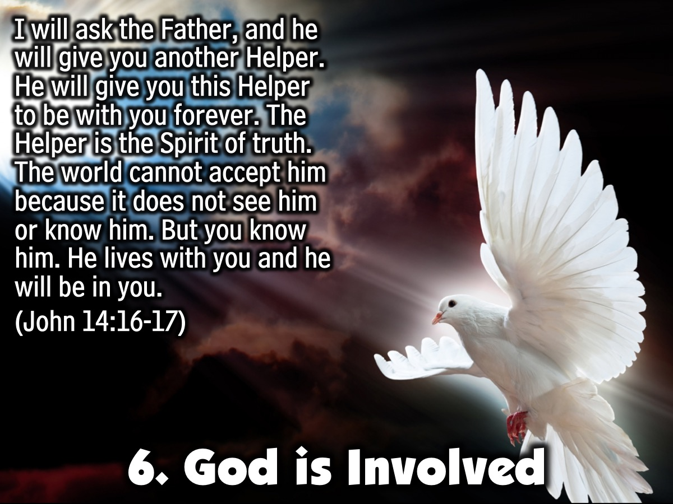
Notes:
6. God is Involved. God is intimately aware of what is happening on earth right now - his Holy Spirit is living inside of us. “I will ask the Father, and he will give you another Helper. He will give you this Helper to be with you forever. The Helper is the Spirit of truth. The world cannot accept him because it does not see him or know him. But you know him. He lives with you and he will be in you.” (John 14:16-17)

Slide 12
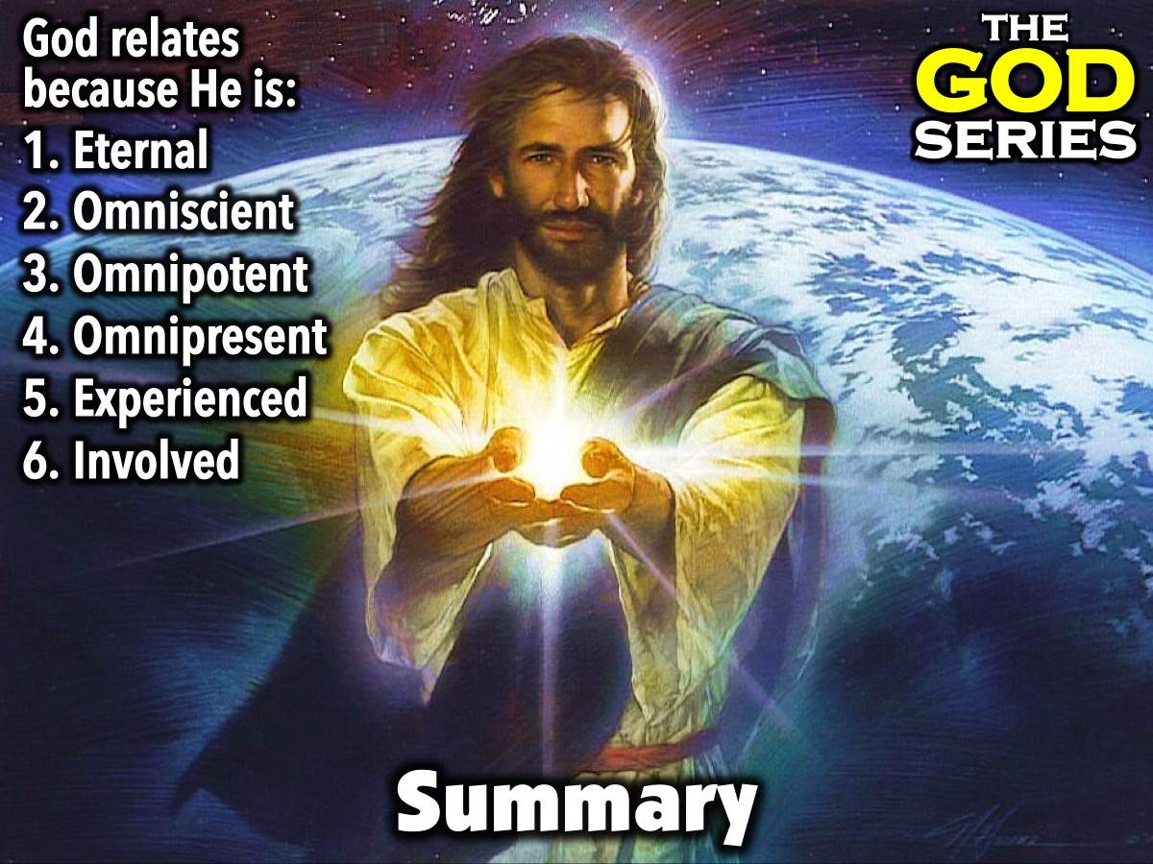
Notes:
Summary: God relates because he is Eternal, Omniscient, Omnipotent, Omnipresent, Experienced and Involved.

Slide 13
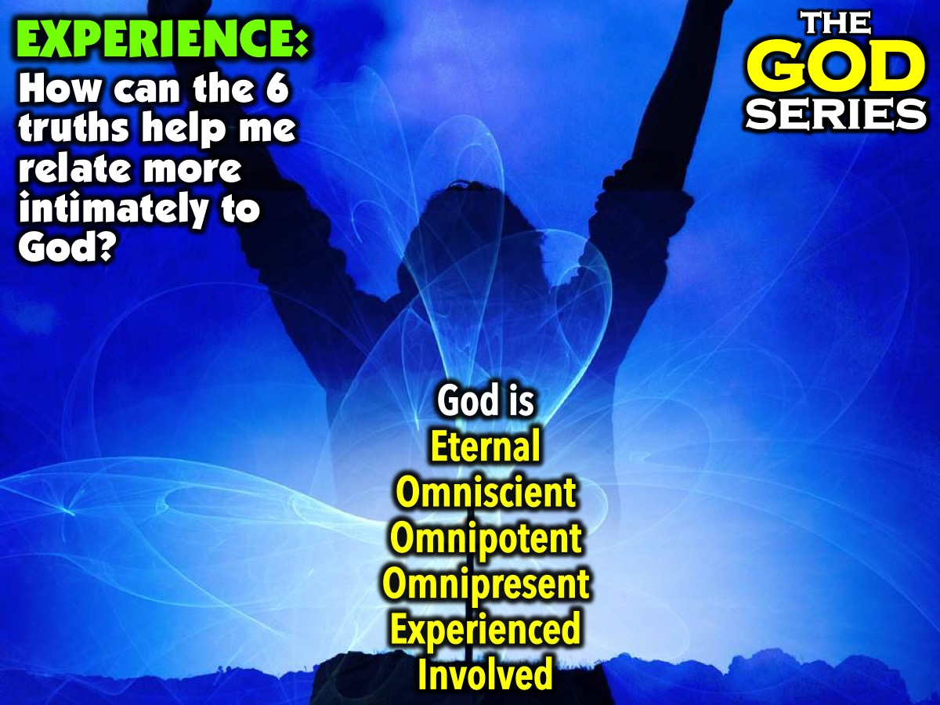
Notes:
Part 3: Experience: How can the 6 trusth we explored today (God is Eternal, Omniscient, Omnipotent, Omnipresent, Experienced and Involved) help me relate more intimately to God?

Slide 14
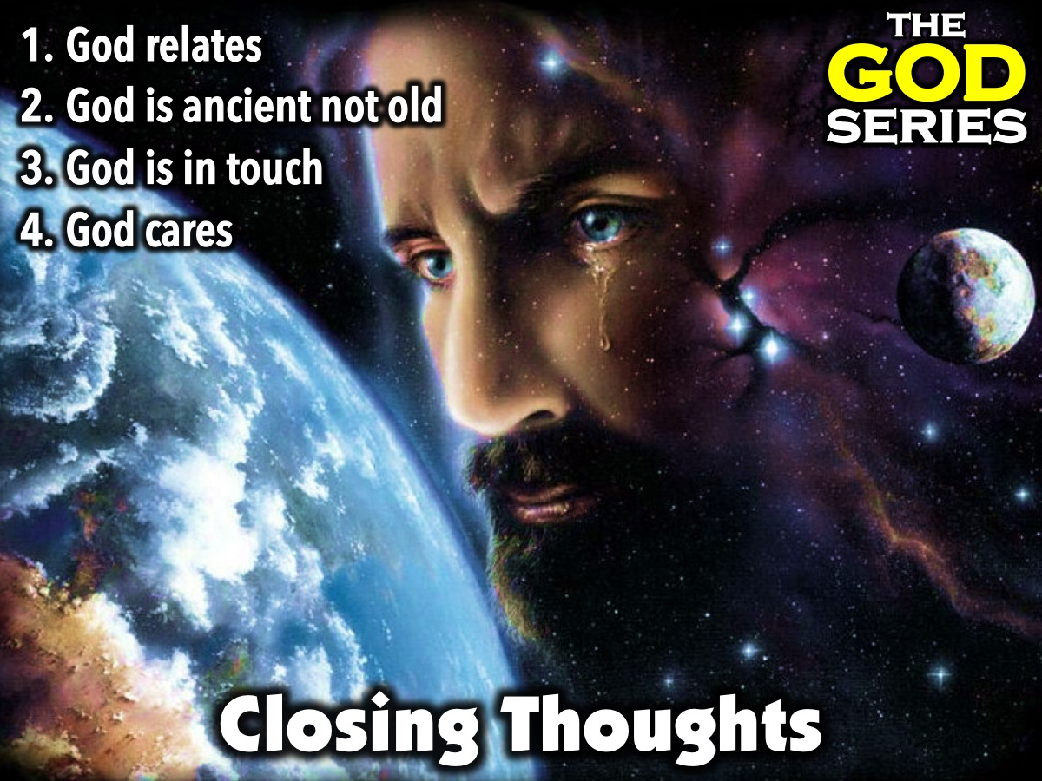
Notes:
Wrap Up: Here are a few closing thoughts: (1) God relates. (2) God is ancient not old! (3) God is in touch! (4) God cares about us.

Slide 15
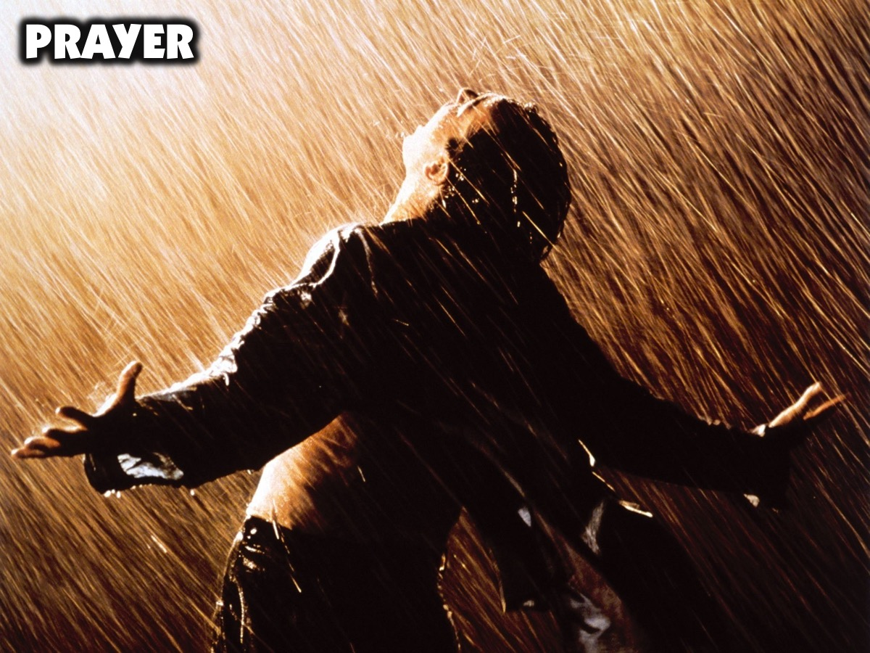
Notes:
Prayer.

Slide 16
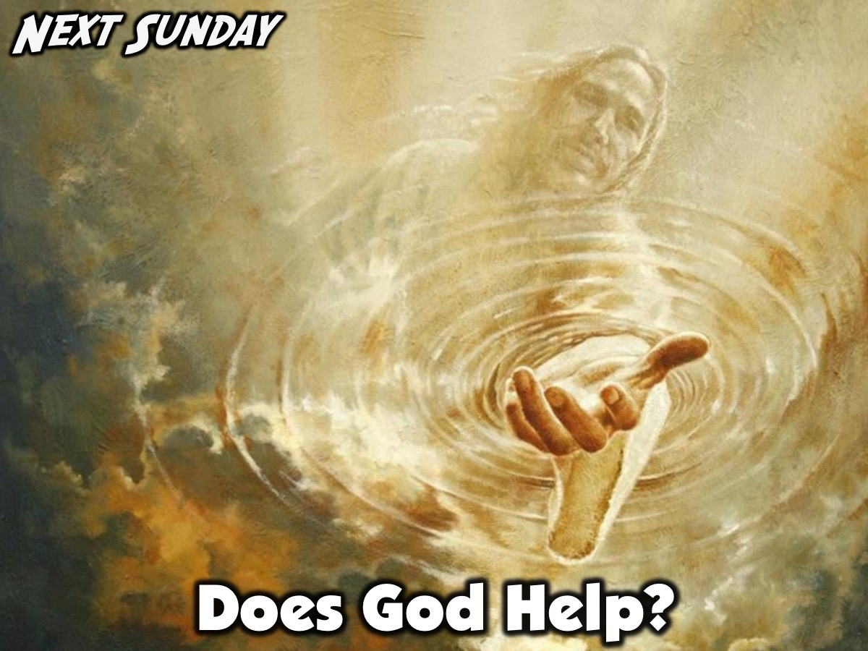
Notes:
Next Sunday morning we will be answering the question: Does God Help?

