Slide 1

Notes:
Welcome to The GOD Series.

Slide 2

Notes:
Today is week 6 of the God Series and we will be answering the question: Does God Help?

Slide 3

Notes:
Part 1: Express: Turn to the person next to you and share with them how has God helped you in the past?

Slide 4

Notes:
Part 2: Explore: What can we do when we feel helpless or out of control? Read your verse, Discuss how the verse answers the question and send someone to Share your answer on stage.

Slide 5
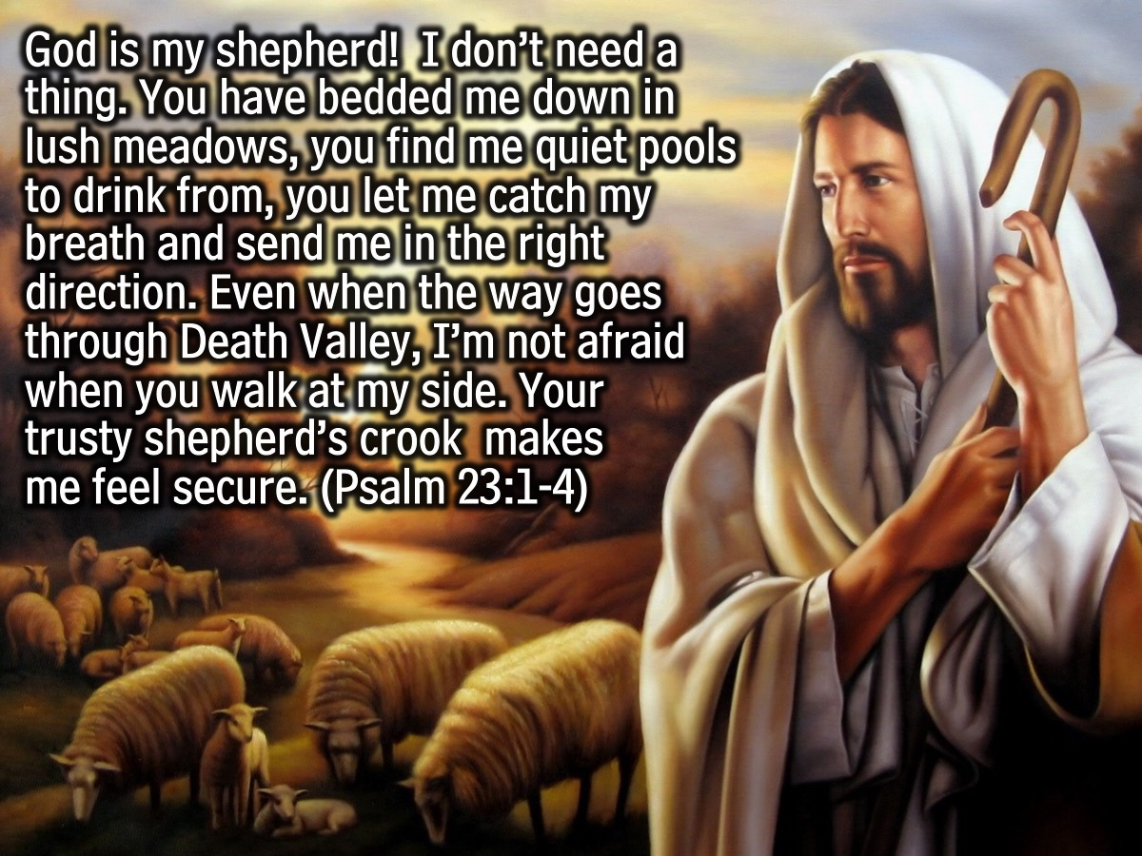
Notes:
Passage #1: “God is my shepherd! I don’t need a thing. You have bedded me down in lush meadows, you find me quiet pools to drink from, you let me catch my breath and send me in the right direction. Even when the way goes through Death Valley, I’m not afraid when you walk at my side. Your trusty shepherd’s crook makes me feel secure. (Psalm 23:1-4)

Slide 6
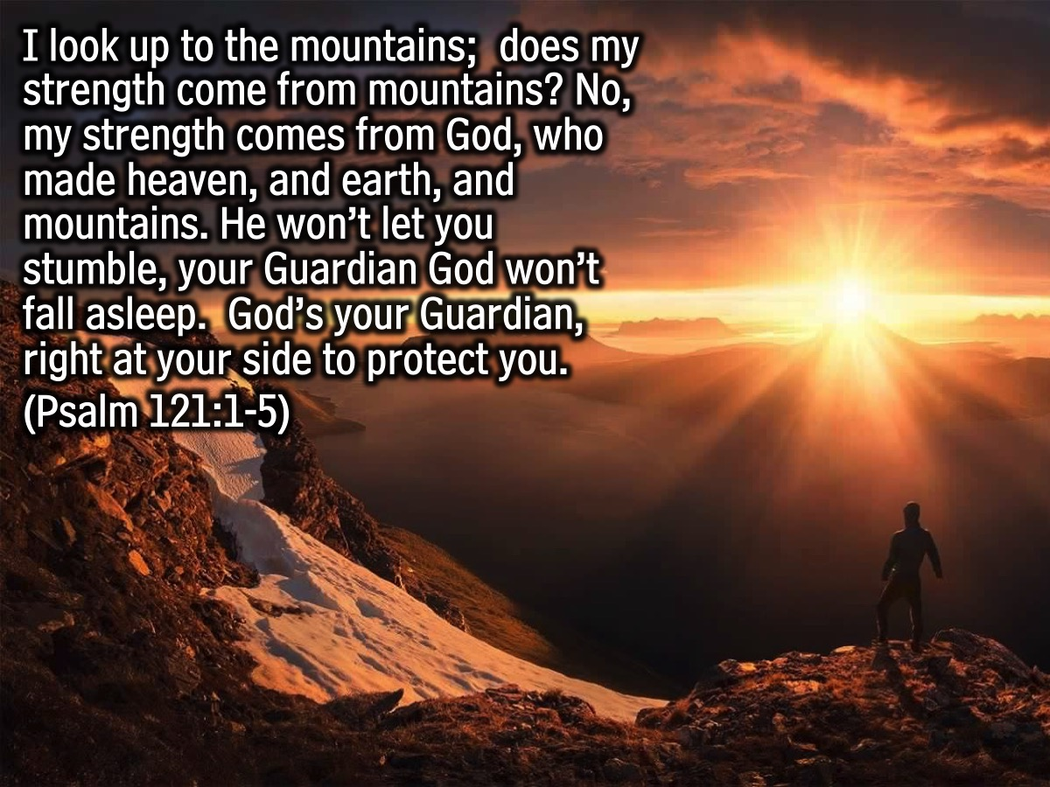
Notes:
Passage #2: “I look up to the mountains; does my strength come from mountains? No, my strength comes from God, who made heaven, and earth, and mountains. He won’t let you stumble, your Guardian God won’t fall asleep. God’s your Guardian, right at your side to protect you.” (Psalm 121:1-5)

Slide 7
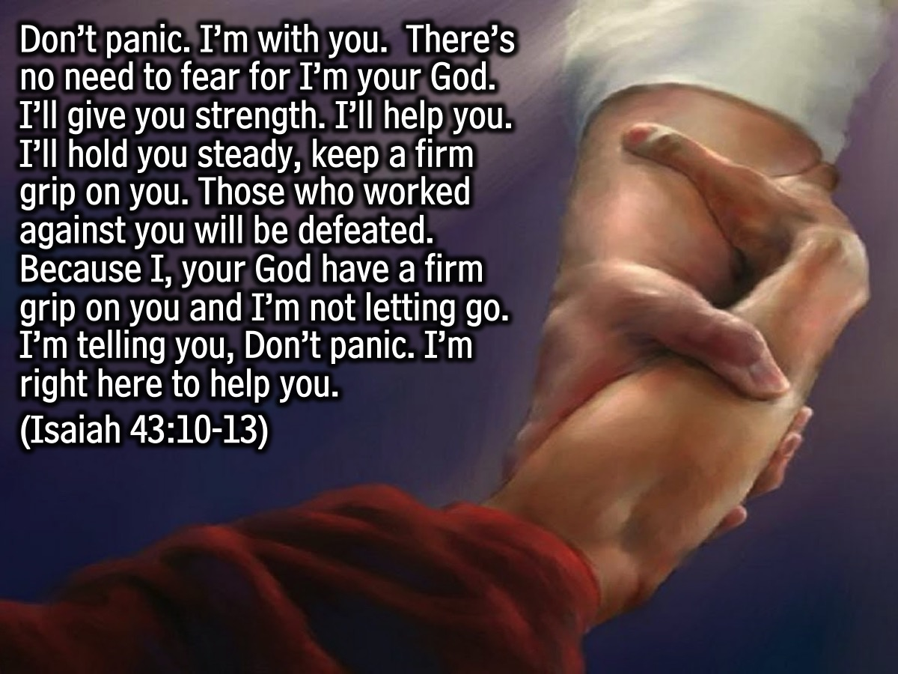
Notes:
Passage #3: “Don’t panic. I’m with you. There’s no need to fear for I’m your God. I’ll give you strength. I’ll help you. I’ll hold you steady, keep a firm grip on you. Those who worked against you be defeated. Because I, your God have a firm grip on you and I’m not letting go. I’m telling you, Don’t panic. I’m right here to help you.” (Isaiah 43:10-13)

Slide 8

Notes:
Passage #4: “Don’t bargain with God. Be direct. Ask for what you need. If your child asks for fish, do you scare him with a live snake on his plate? As bad as you are, you wouldn’t think of such a thing. How much more will your heavenly Father give good gifts to those who ask him.” (Matthew 7:7-10)

Slide 9
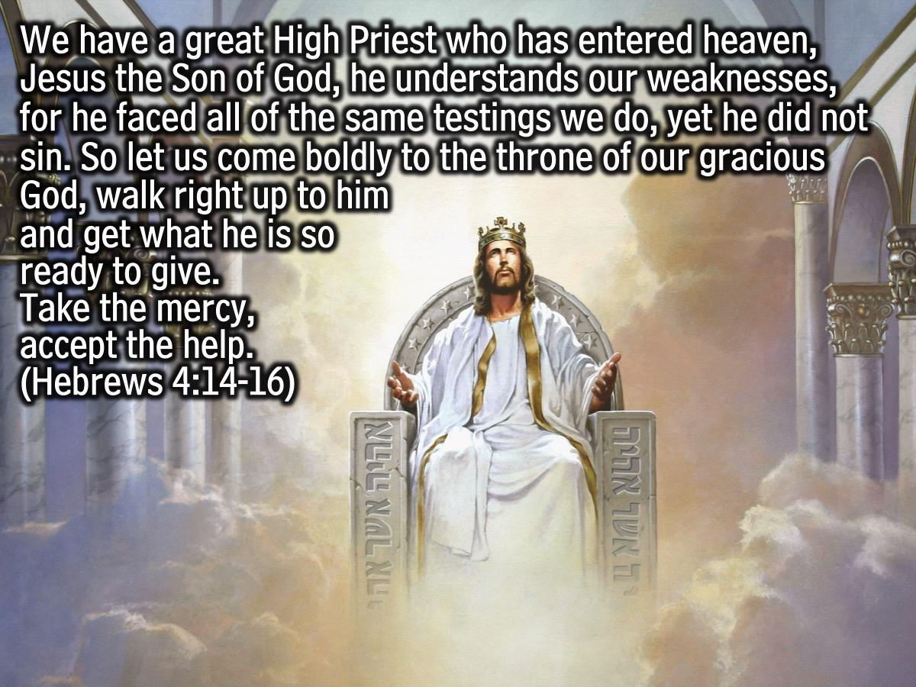
Notes:
Passage #5: “We have a great High Priest who has entered heaven, Jesus the Son of God, he understands our weaknesses, for he faced all of the same testings we do, yet he did not sin. So let us come boldly to the throne of our gracious God, walk right up to him and get what he is so ready to give. Take the mercy, accept the help.” (Hebrews 4:14-16)

Slide 10
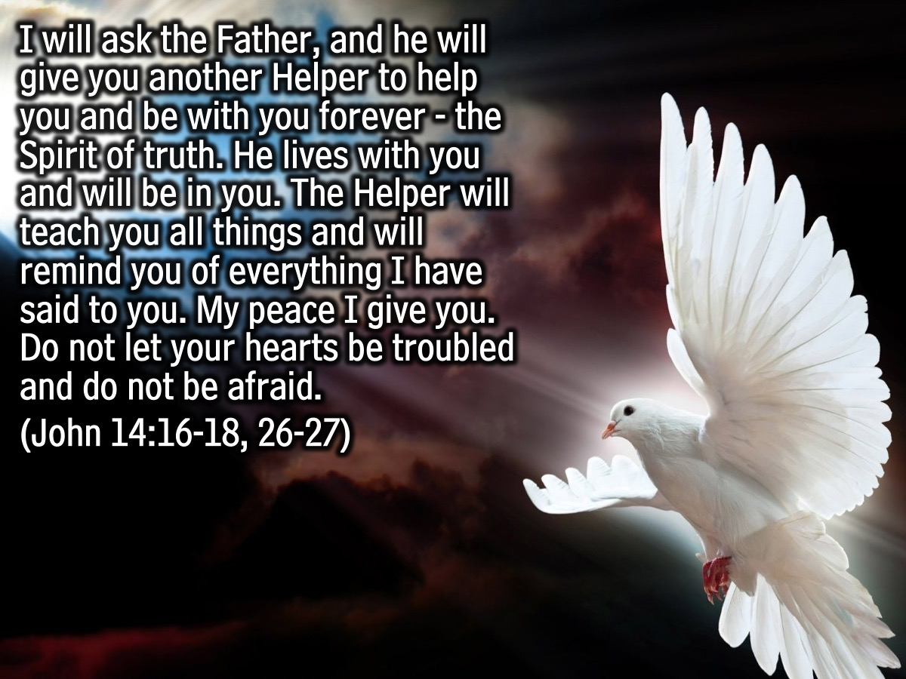
Notes:
Passage #6: “I will ask the Father, and he will give you another Helper to help you and be with you forever - the Spirit of truth. He lives with you and will be in you. The Helper will teach you all things and will remind you of everything I have said to you. My peace I give you. Do not let your hearts be troubled and do not be afraid.” (John 14:16-18, 26-27)

Slide 11

Notes:
Part 3: Experience: Think about an area in your life where you need help, go to a stations, read the passage and let it guide you as you ask God to help you.

Slide 12

Notes:
Wrap Up: Here are a few closing thoughts: (1) God cares. (2) God wants to help. (3) God waits for us to ask.

Slide 13
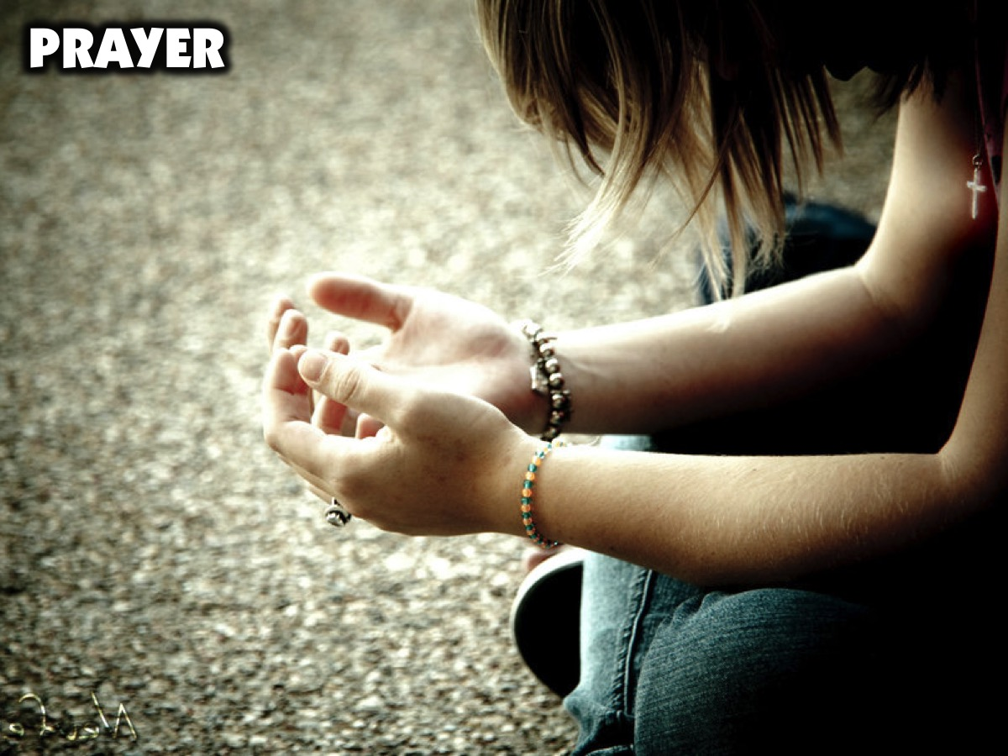
Notes:
Prayer.

Slide 14

Notes:
Next Sunday morning we will be answering the question: Does God Restore?

