Slide 1

Notes:
Welcome to The GOD Series.

Slide 2
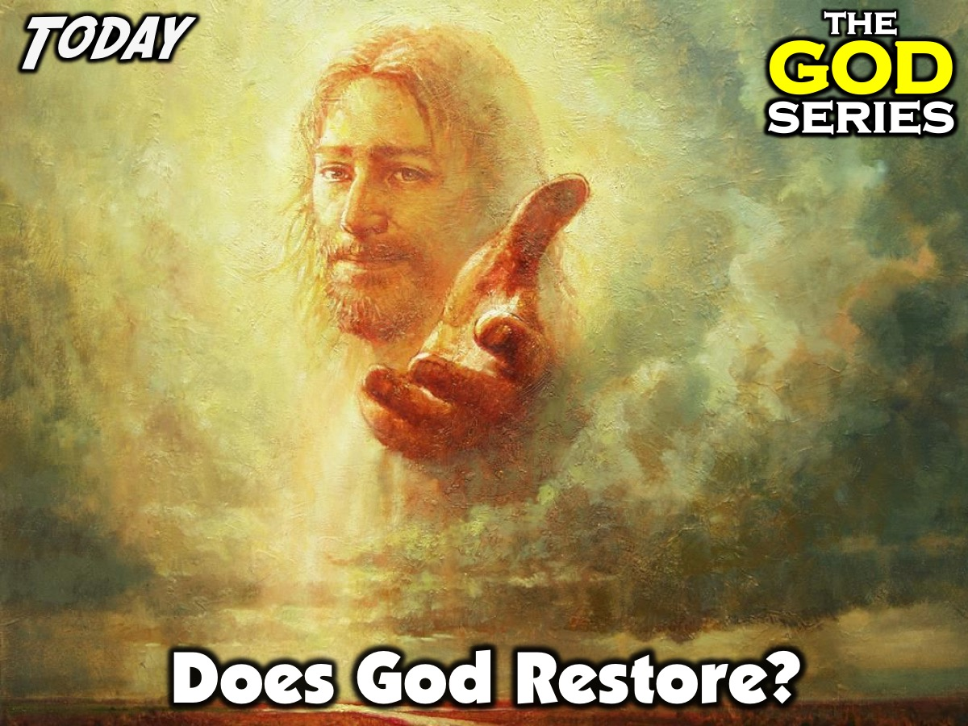
Notes:
Today is week 7 of the God Series and we will be answering the question: Does God Restore?

Slide 3

Notes:
Part 1: Express: What is the worst thing you have ever done where you needed someone to forgive you?

Slide 4
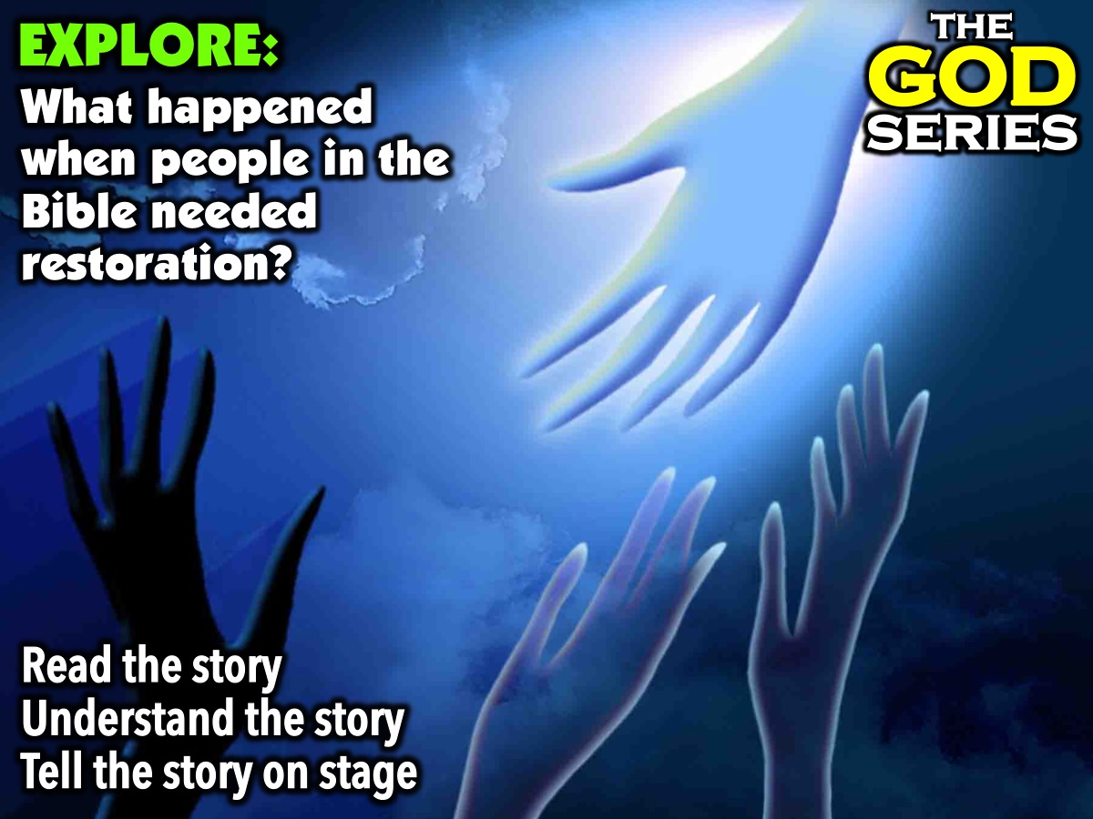
Notes:
Part 2: Explore: Each small group reads about one person in the Bible who fell and who needed restoring. They reflect on the story and nominate someone to tell the story (not read it) to the big group. Here are the Bible characters we will be using: (1) Adam and Eve; (2) The King of Nineveh; (3) King David; (4) The Prodigal Son; (5) The Thief on the Cross and (6) Simon Peter.

Slide 5
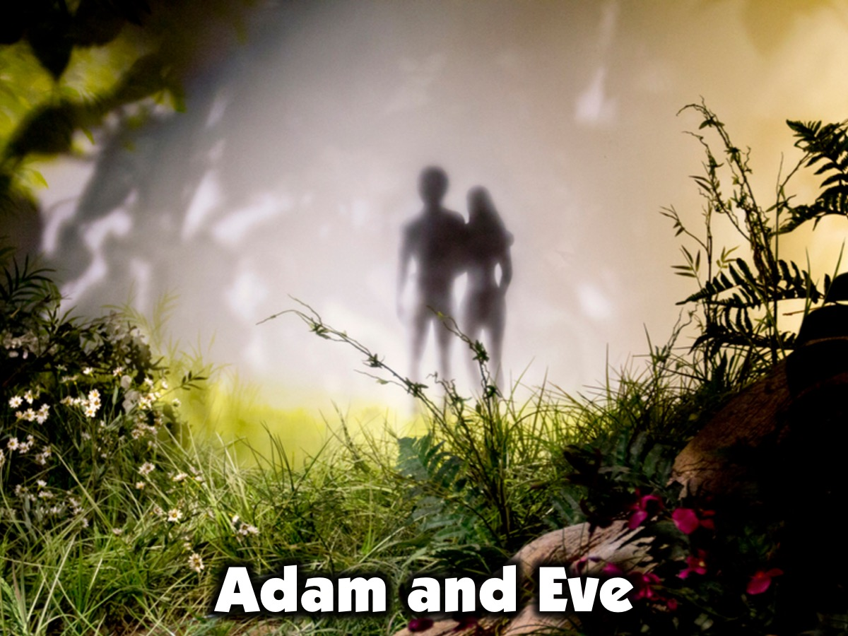
Notes:
1. Adam and Eve - Now the snake was more crafty than any of the wild animals the Lord God had made. He said to the woman, ‘Did God really say, “You must not eat from any tree in the garden”?’ The woman said to the snake, ‘We may eat fruit from the trees in the garden, but God did say, “You must not eat fruit from the tree that is in the middle of the garden, and you must not touch it, or you will die.” ’ ‘You will not certainly die,’ the snake said to the woman. ‘For God knows that when you eat from it your eyes will be opened, and you will be like God, knowing good and evil.’ When the woman saw that the fruit of the tree was good for food and pleasing to the eye, and also desirable for gaining wisdom, she took some and ate it. She also gave some to her husband, who was with her, and he ate it. Then the eyes of both of them were opened, and they realised that they were naked; so they sewed fig leaves together and made coverings for themselves. Then the man and his wife heard the sound of the Lord God as he was walking in the garden in the cool of the day, and they hid from the Lord God among the trees of the garden. But the Lord God called to the man, ‘Where are you?’ He answered, ‘I heard you in the garden, and I was afraid because I was naked; so I hid.’ And he said, ‘Who told you that you were naked? Have you eaten from the tree from which I commanded you not to eat?’ The man said, ‘The woman you put here with me – she gave me some fruit from the tree, and I ate it.’ Then the Lord God said to the woman, ‘What is this you have done?’ The woman said, ‘The snake deceived me, and I ate.’ Then the Lord cursed the snake; he told Eve that she would have severe pains in childbearing and he told Adam that working the group would be really difficult. Then the Lord God made garments of skin for Adam and his wife and clothed them. And the Lord God said, ‘The man has now become like one of us, knowing good and evil. He must not be allowed to reach out his hand and take also from the tree of life and eat, and live for ever.’ So the Lord God banished him from the Garden of Eden to work the ground from which he had been taken. After he drove the man out, he placed on the east side of the Garden of Eden cherubim and a flaming sword flashing to and fro to guard the way to the tree of life. (Genesis 3)

Slide 6
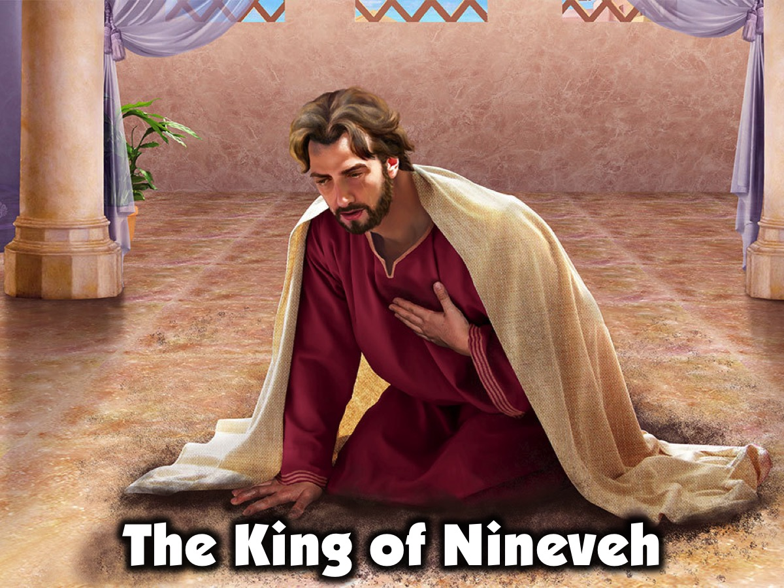
Notes:
2. The King of Nineveh - Then the word of the Lord came to Jonah: ‘Go to the great city of Nineveh and proclaim to it the message I give you.’ Jonah obeyed the word of the Lord and went to Nineveh. Now Nineveh was a very large city; it took three days to go through it. Jonah began by going a day’s journey into the city, proclaiming, ‘Forty more days and Nineveh will be overthrown.’ The Ninevites believed God. A fast was proclaimed, and all of them, from the greatest to the least, put on sackcloth. When Jonah’s warning reached the king of Nineveh, he rose from his throne, took off his royal robes, covered himself with sackcloth and sat down in the dust. This is the proclamation he issued in Nineveh: ‘By the decree of the king and his nobles: Do not let people or animals, herds or flocks, taste anything; do not let them eat or drink. But let people and animals be covered with sackcloth. Let everyone call urgently on God. Let them give up their evil ways and their violence. Who knows? God may yet relent and with compassion turn from his fierce anger so that we will not perish.’ When God saw what they did and how they turned from their evil ways, he relented and did not bring on them the destruction he had threatened. (Jonah 3)

Slide 7
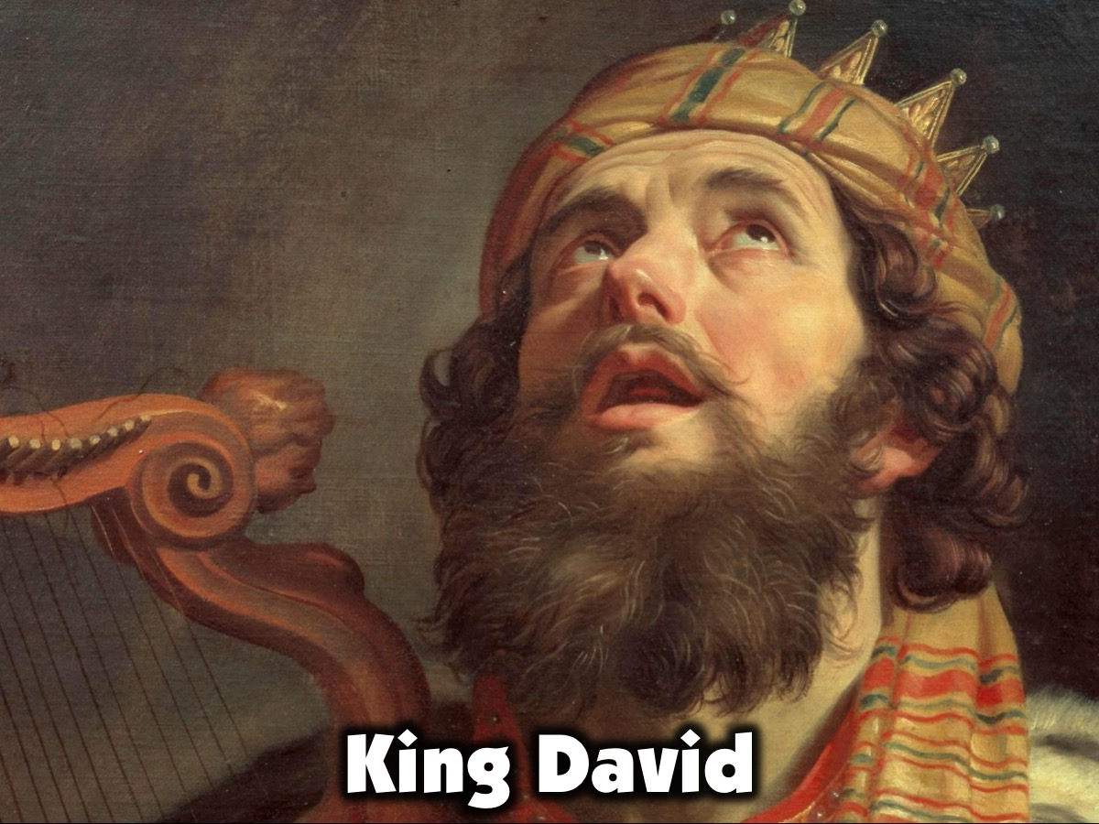
Notes:
3. King David - In the spring, at the time when kings go off to war, David sent Joab out with the king’s men and the whole Israelite army. They destroyed the Ammonites and besieged Rabbah. But David remained in Jerusalem. One evening David got up from his bed and walked around on the roof of the palace. From the roof he saw a woman washing. The woman was very beautiful, and David sent someone to find out about her. The man said, ‘She is Bathsheba, the daughter of Eliam and the wife of Uriah the Hittite.’ Then David sent messengers to get her. She came to him, and he slept with her. Then she went back home. The woman conceived and sent word to David, saying, ‘I am pregnant.’ So David had her husband placed in the front line of the battle so he would be killed. When Uriah’s wife heard that her husband was dead, she mourned for him. After the time of mourning was over, David had her brought to his house, and she became his wife and bore him a son. But the thing David had done displeased the Lord. (2 Samuel 11) Some years later David wrote this Psalm about his sin with Bathsheba: “When I kept silent, my bones wasted away through my groaning all day long. For day and night your hand was heavy on me; my strength was sapped as in the heat of summer. Then I acknowledged my sin to you and did not cover up my iniquity. I said, ‘I will confess my transgressions to the Lord.’ And you forgave the guilt of my sin.” (Psalm 32:3-5)

Slide 8
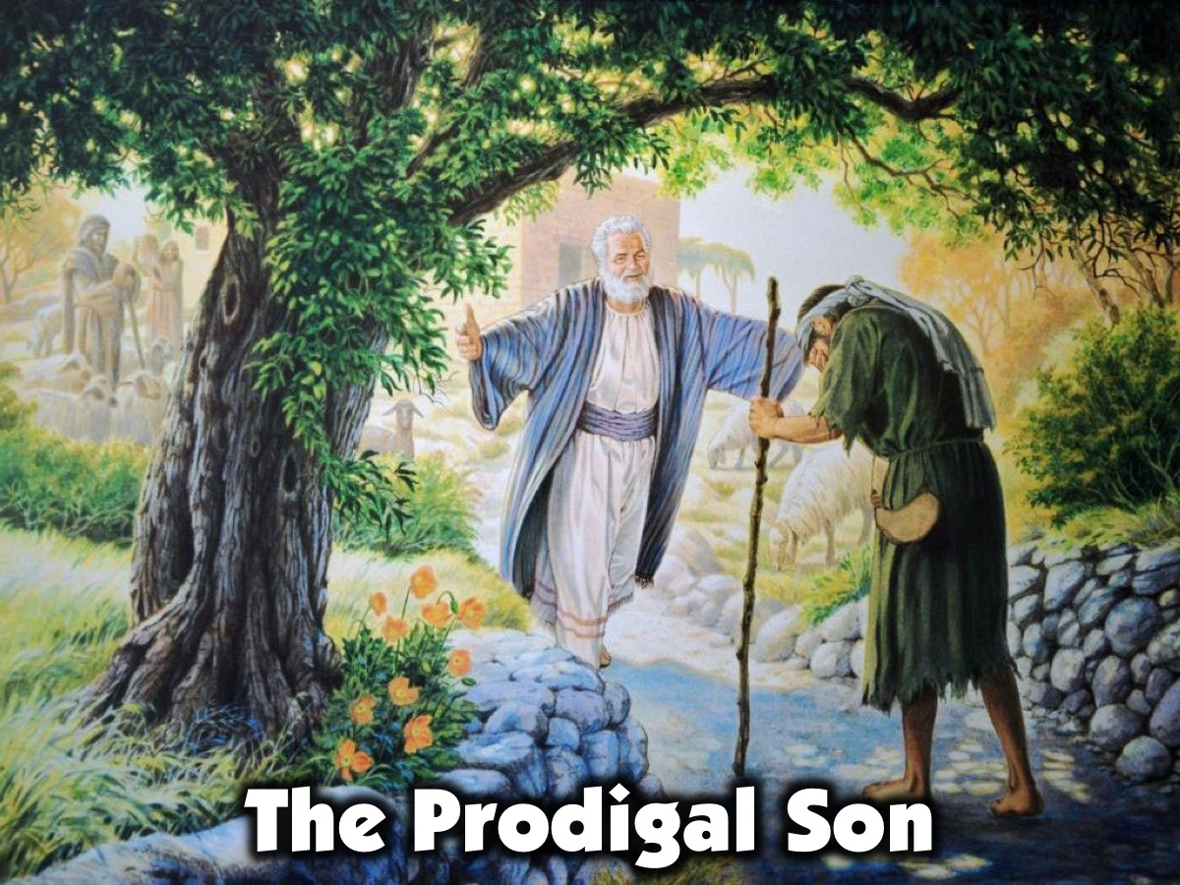
Notes:
4. The Prodigal Son - Jesus told this parable: “There was a man who had two sons. The younger one said to his father, “Father, give me my share of the estate.” So he divided his property between them. ‘Not long after that, the younger son got together all he had, set off for a distant country and there squandered his wealth in wild living. After he had spent everything, there was a severe famine in that whole country, and he began to be in need. So he went and hired himself out to a citizen of that country, who sent him to his fields to feed pigs. He longed to fill his stomach with the pods that the pigs were eating, but no-one gave him anything. ‘When he came to his senses, he said, “How many of my father’s hired servants have food to spare, and here I am starving to death! I will set out and go back to my father and say to him: Father, I have sinned against heaven and against you. I am no longer worthy to be called your son; make me like one of your hired servants.” So he got up and went to his father. ‘But while he was still a long way off, his father saw him and was filled with compassion for him; he ran to his son, threw his arms round him and kissed him. ‘The son said to him, “Father, I have sinned against heaven and against you. I am no longer worthy to be called your son.” ‘But the father said to his servants, “Quick! Bring the best robe and put it on him. Put a ring on his finger and sandals on his feet. Bring the fattened calf and kill it. Let’s have a feast and celebrate. For this son of mine was dead and is alive again; he was lost and is found.” So they began to celebrate. (Luke 15:11-27)

Slide 9
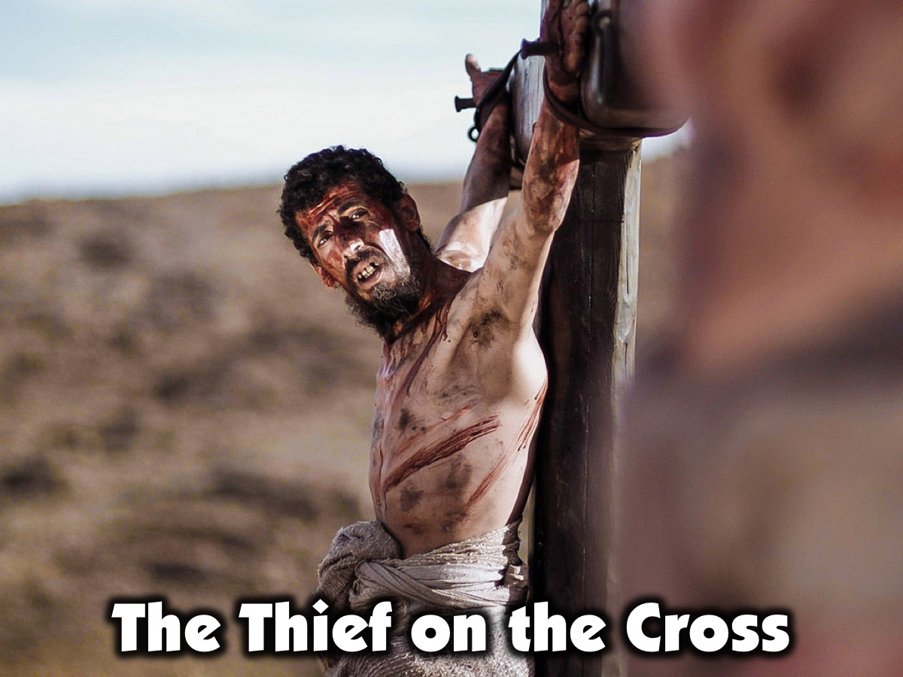
Notes:
5. The Thief on the Cross - Two other men, both criminals, were also led out with him to be executed. When they came to the place called the Skull, they crucified him there, along with the criminals – one on his right, the other on his left. Jesus said, ‘Father, forgive them, for they do not know what they are doing.’ And they divided up his clothes by casting lots. The people stood watching, and the rulers even sneered at him. They said, ‘He saved others; let him save himself if he is God’s Messiah, the Chosen One.’ The soldiers also came up and mocked him. They offered him wine vinegar and said, ‘If you are the king of the Jews, save yourself.’ There was a written notice above him, which read: this is the king of the Jews. One of the criminals who hung there hurled insults at him: ‘Aren’t you the Messiah? Save yourself and us!’ But the other criminal rebuked him. ‘Don’t you fear God,’ he said, ‘since you are under the same sentence? We are punished justly, for we are getting what our deeds deserve. But this man has done nothing wrong.’ Then he said, ‘Jesus, remember me when you come into your kingdom.’ Jesus answered him, ‘Truly I tell you, today you will be with me in paradise.’ (Luke 23:32-43)

Slide 10
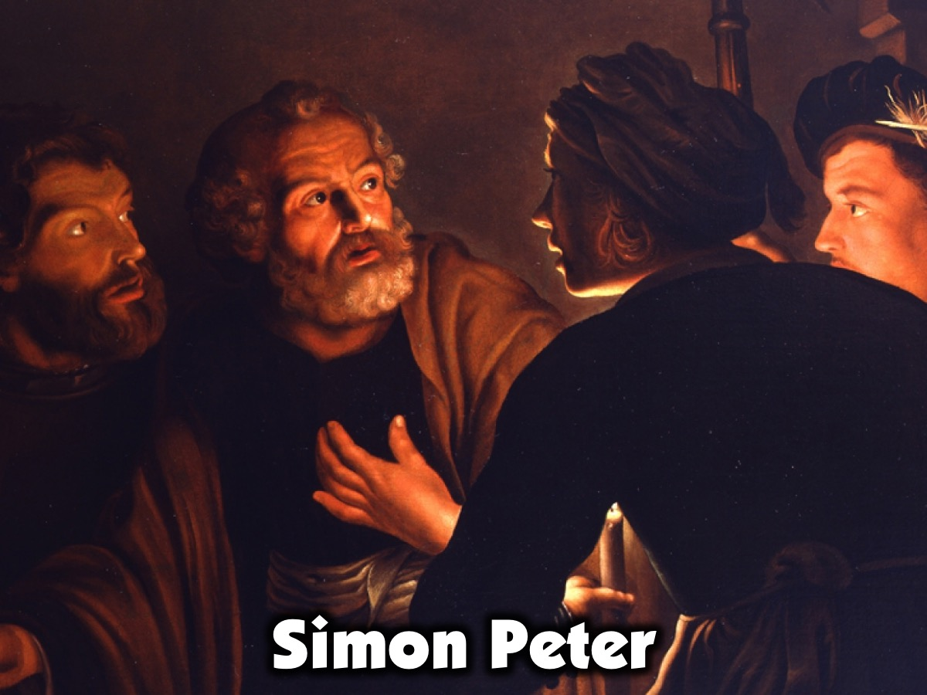
Notes:
6. Simon Peter - While Peter was below in the courtyard, one of the servant-girls of the high priest came by. When she saw Peter warming himself, she looked closely at him. ‘You also were with that Nazarene, Jesus,’ she said. But he denied it. ‘I don’t know or understand what you’re talking about,’ he said, and went out into the entrance. When the servant-girl saw him there, she said again to those standing round them, ‘This fellow is one of them.’ Again he denied it. After a little while, those standing near said to Peter, ‘Surely you are one of them, for you are a Galilean.’ He began to call down curses, and he swore to them, ‘I don’t know this man you’re talking about.’ Immediately the cock crowed the second time. Then Peter remembered the word Jesus had spoken to him: ‘Before the cock crows twice you will disown me three times.’ And he broke down and wept. (Mark 14:66-72) Later when Jesus had risen from the dead, he appeared to Peter and asked him: ‘Simon son of John, do you love me more than these?’ ‘Yes, Lord,’ he said, ‘you know that I love you.’ Jesus said, ‘Feed my lambs.’ Again Jesus said, ‘Simon son of John, do you love me?’ He answered, ‘Yes, Lord, you know that I love you.’ Jesus said, ‘Take care of my sheep.’ The third time he said to him, ‘Simon son of John, do you love me?’ Peter was hurt because Jesus asked him the third time, ‘Do you love me?’ He said, ‘Lord, you know all things; you know that I love you.’ Jesus said, ‘Feed my sheep.” (John 21:15-17)

Slide 11
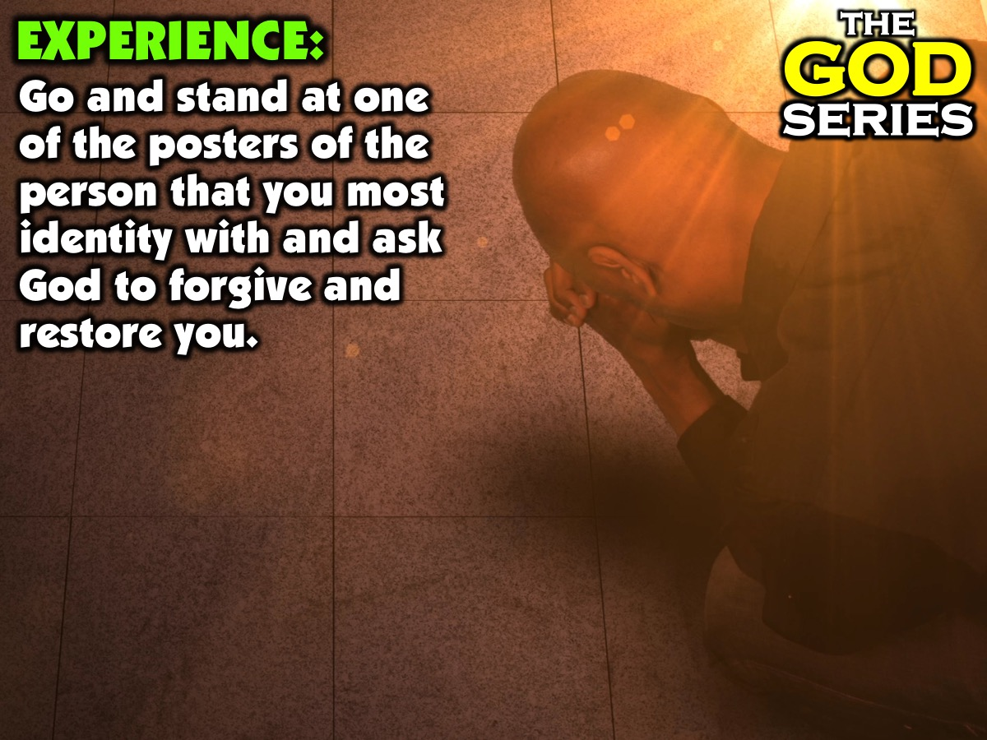
Notes:
Part 3: Experience: Go and stand at one of the posters of the person that you most identity with and ask God to forgive and restore you.

Slide 12
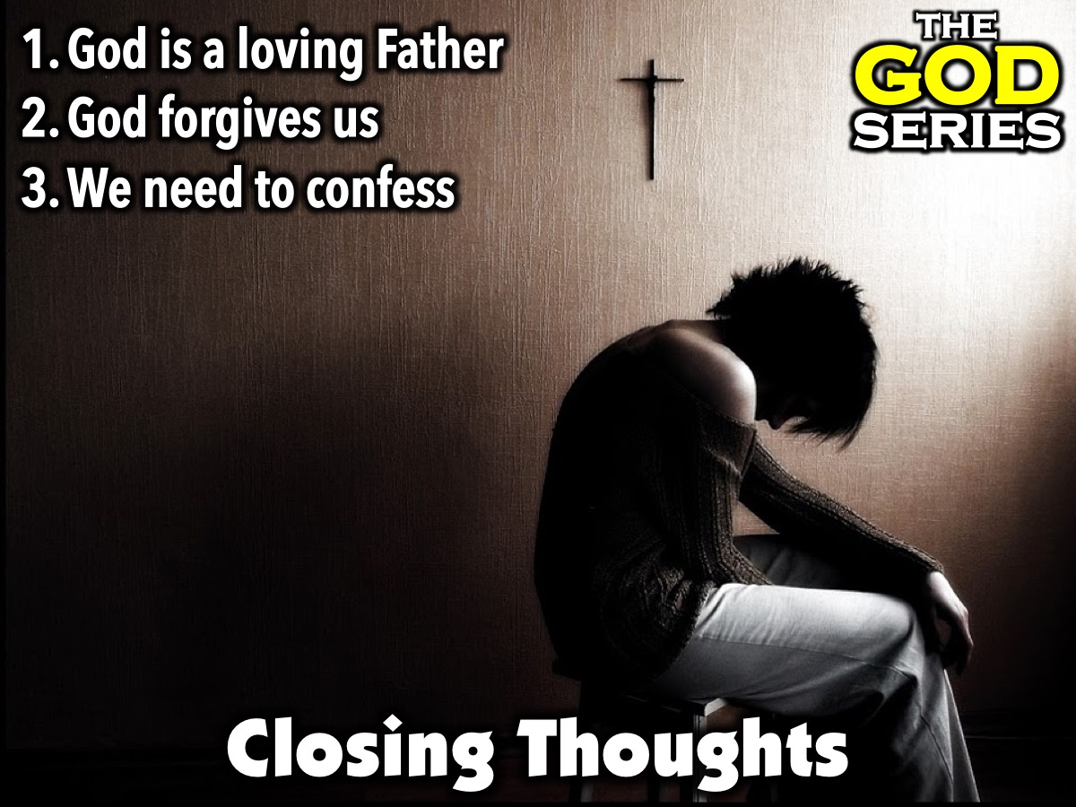
Notes:
Wrap Up: Here are a few closing thoughts: (1) God is a loving Father. (2) God forgives us. (3) We need to confess.

Slide 13
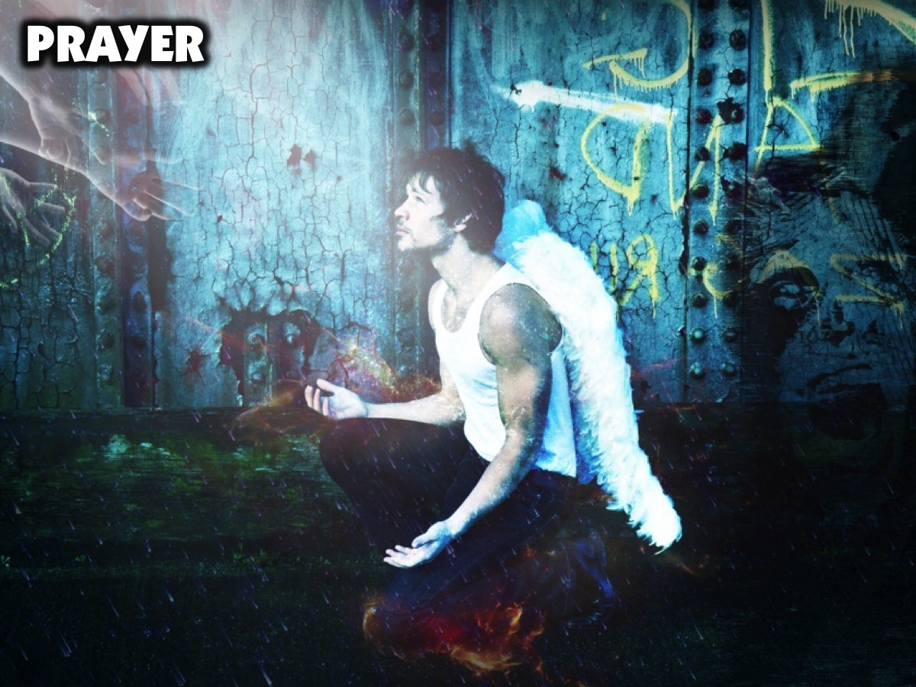
Notes:
Prayer.

Slide 14

Notes:
Holidays: Youth starts when schools open in January.

