Slide 1
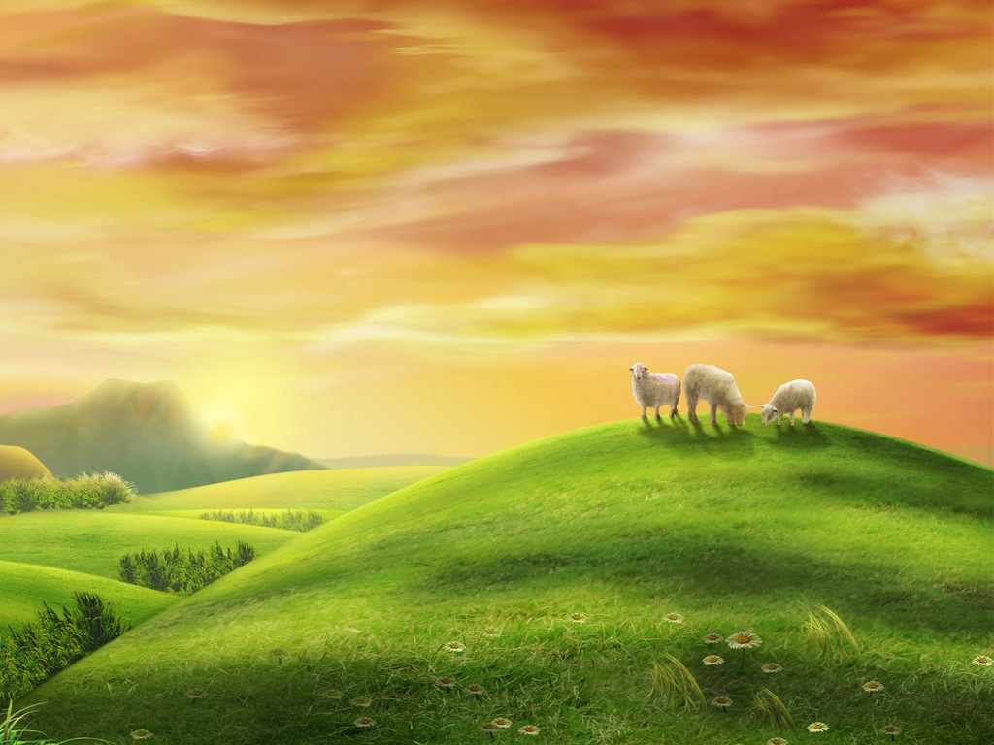
Notes:
Have you ever seen sheep on a hillside? I know some of you are so city bound that the only time you see sheep is when you have a Sunday roast of leg of lamb. Anyway, imagine a hillside with some sheep.

Slide 2
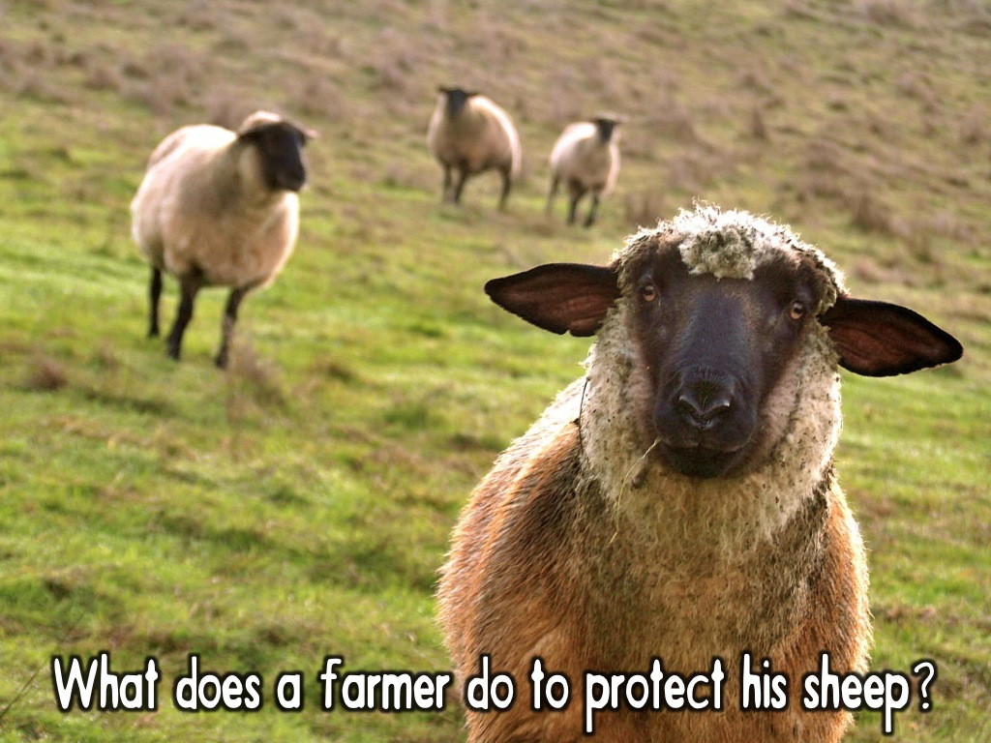
Notes:
What does the farmer do to protect his sheep from danger?

Slide 3
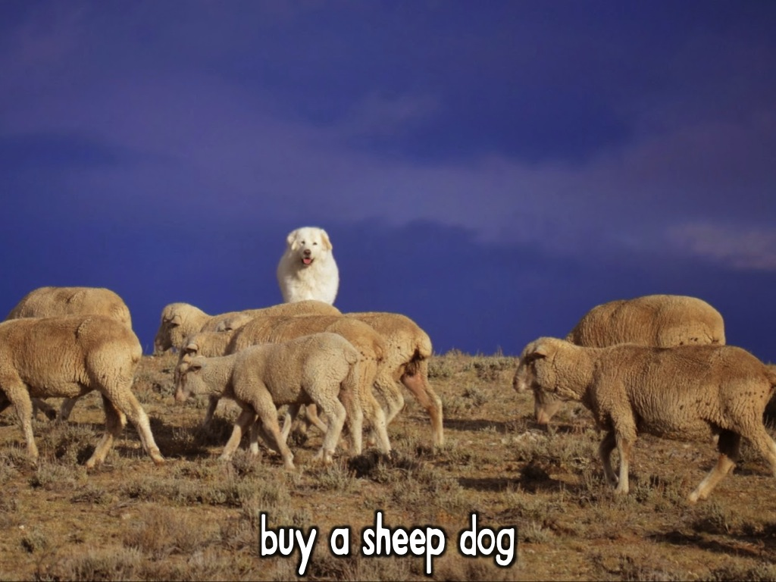
Notes:
Buy a sheep dog

Slide 4
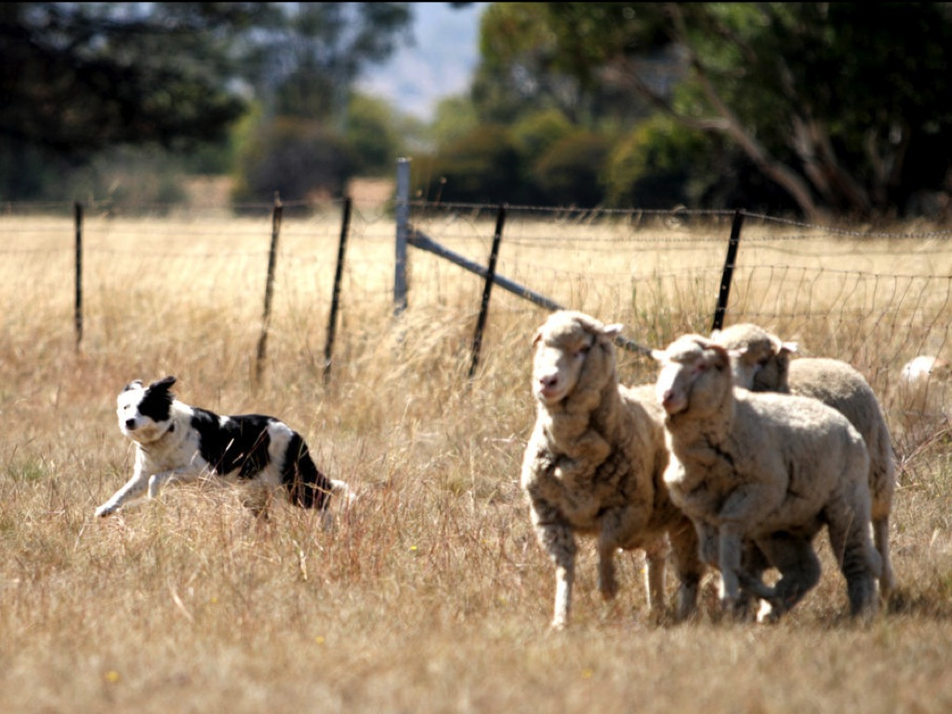
Notes:
They do a great job of keeping the sheep together and away from danger.

Slide 5
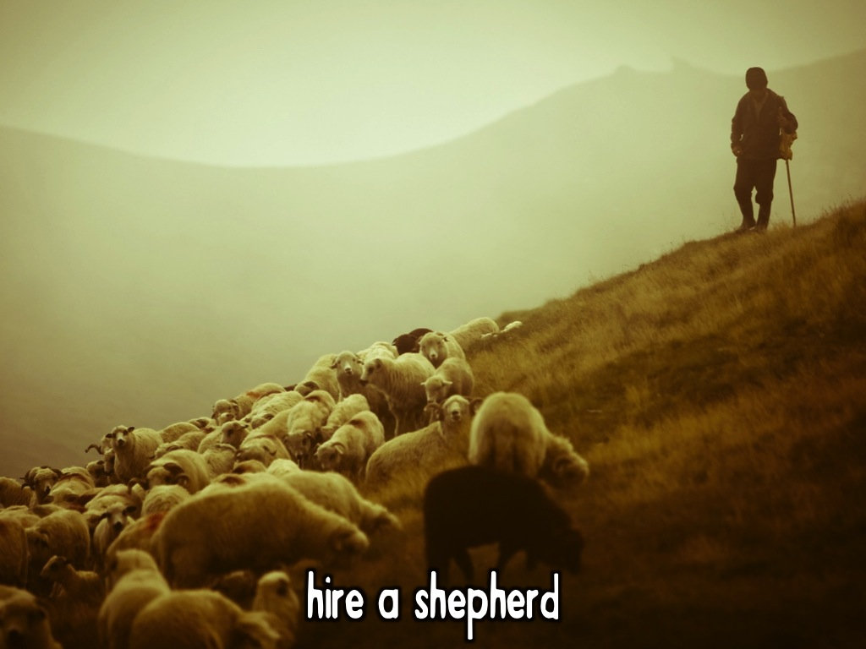
Notes:
He can hire a shepherd - he can't be there all day and night watching over the sheep himself!

Slide 6
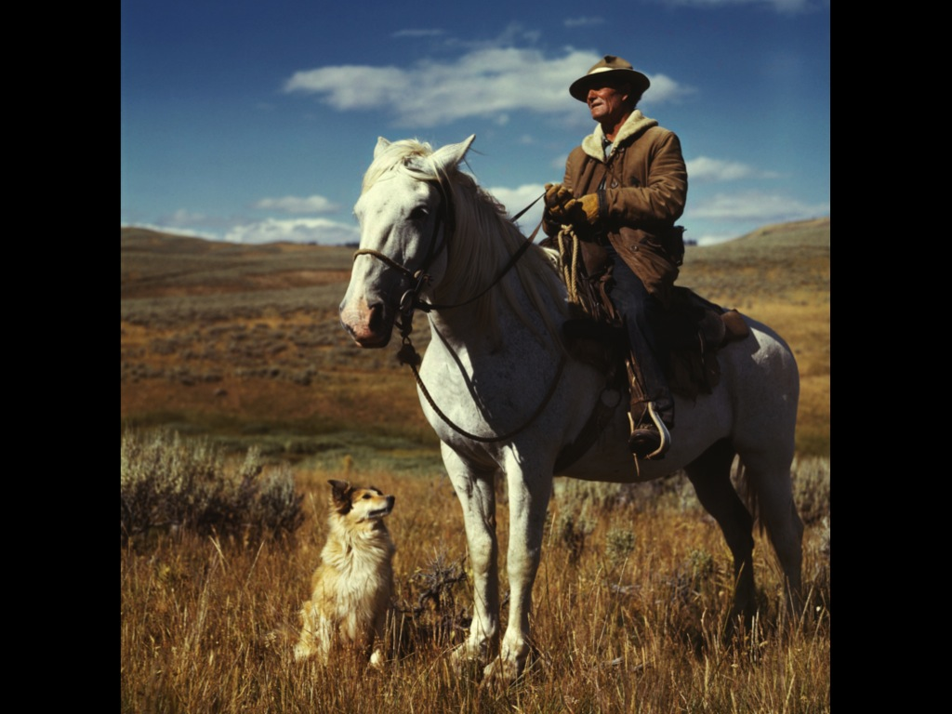
Notes:
A shepherd on a horse and a dog are pretty good protection for sheep!

Slide 7
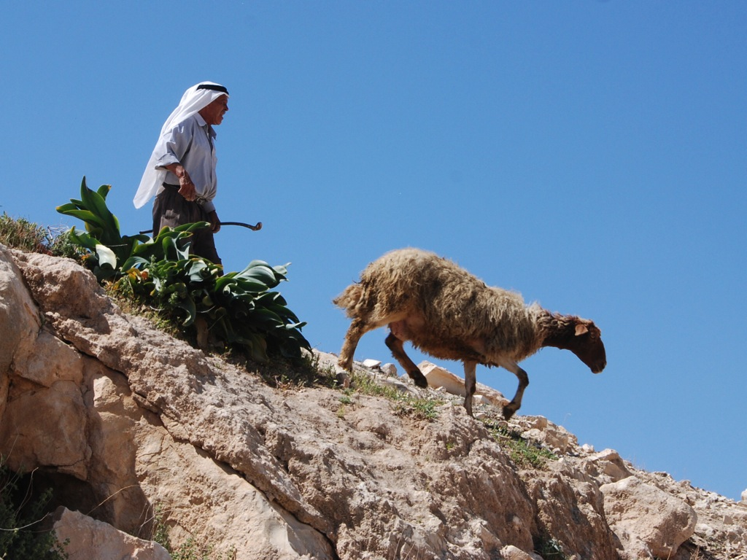

Slide 8
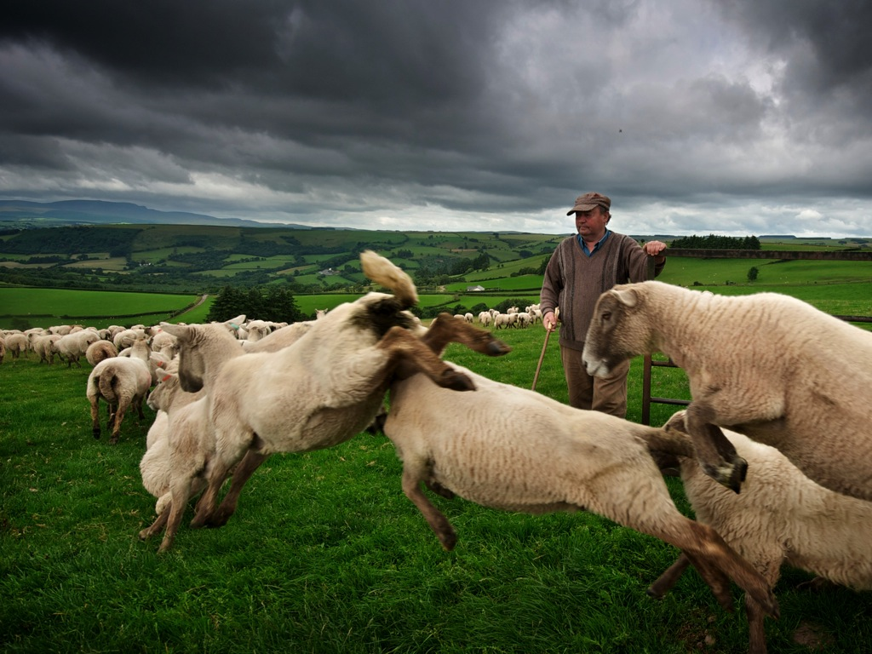
Notes:
The shepherd will always count the sheep at the end of the day to make sure they are all safe – and will go looking for any that are missing!

Slide 9
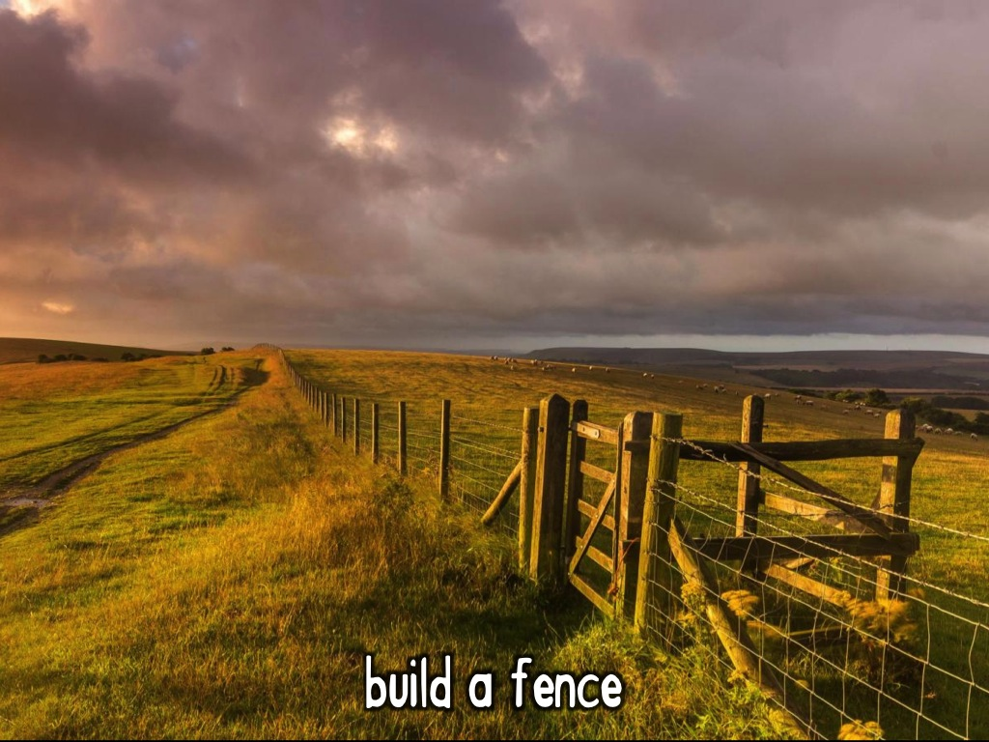
Notes:
The farmer will most importantly build a fence to protect his sheep!

Slide 10
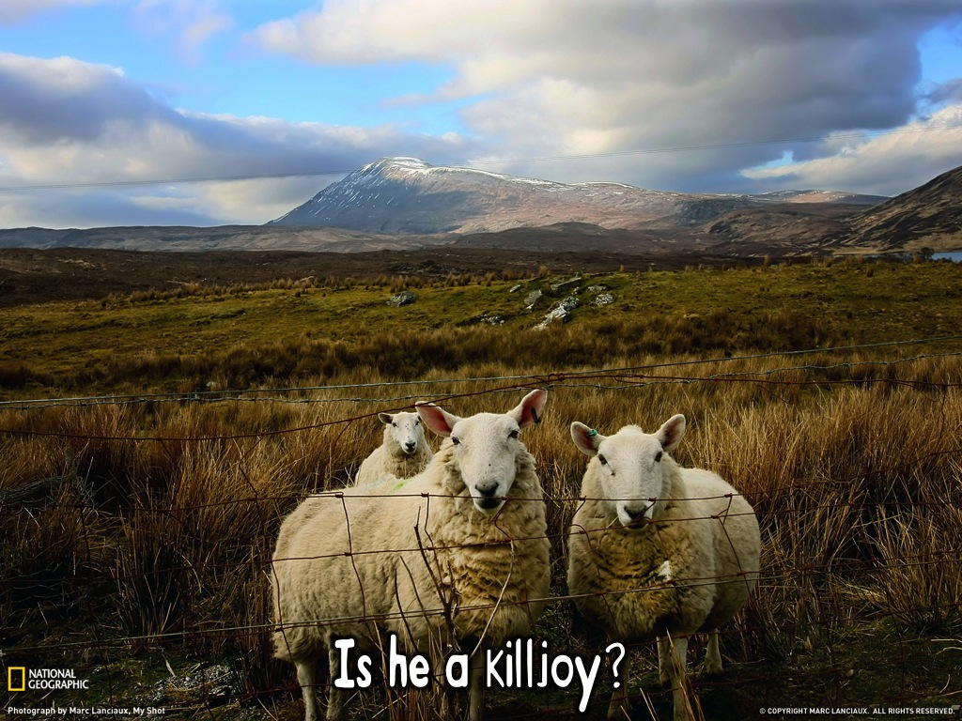
Notes:
Why a fence? Is the farmer a killjoy?

Slide 11
Notes:
There are wolves on the prowl!

Slide 12
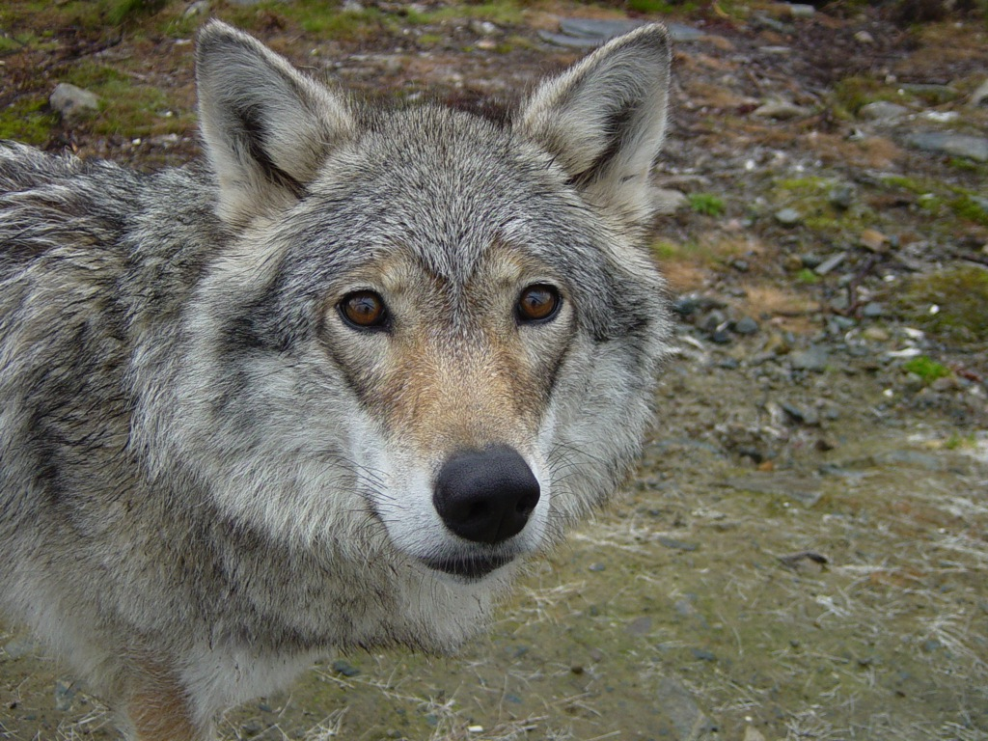
Notes:
They may look cute and cuddly but they are ferocious!

Slide 13
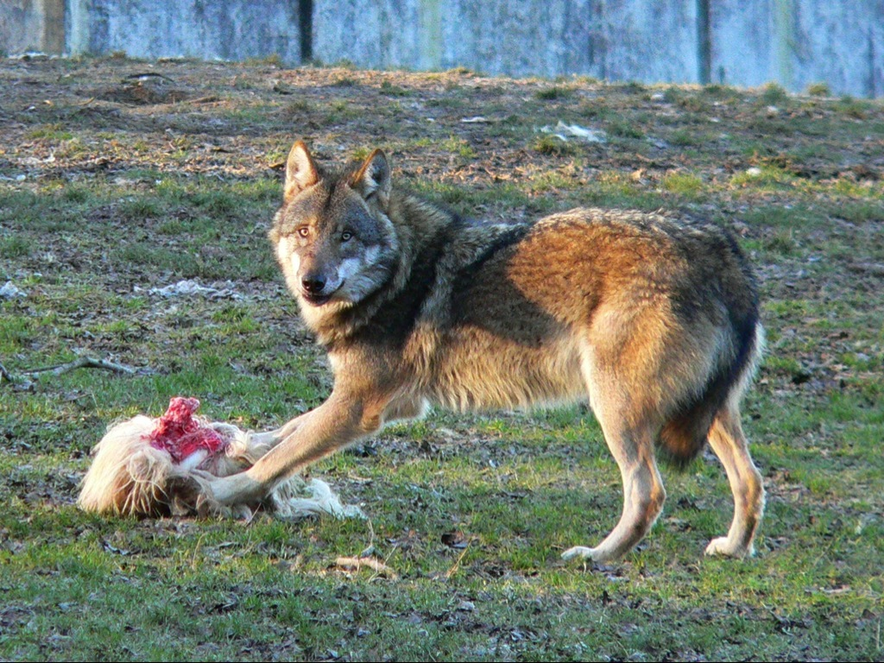
Notes:
They have bad intentions with the sheep!

Slide 14
Notes:
God is a shepherd!

Slide 15
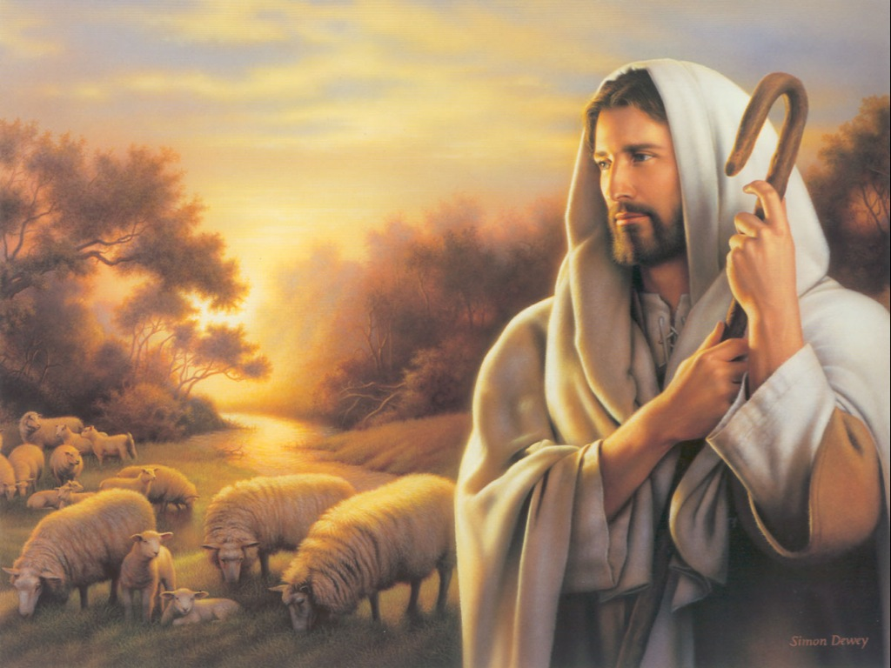
Notes:
He has a flock that he takes care of.

Slide 16
Notes:
In Psalm 23, God is presented as a shepherd taking care of his people to protect them from harm.

Slide 17
Notes:
God protects us from danger.

Slide 18
Notes:
Why does he lay down boundaries – like the fences that farmers build? Is he a killjoy?

Slide 19
Notes:
No, he does it to protect us from danger.

Slide 20
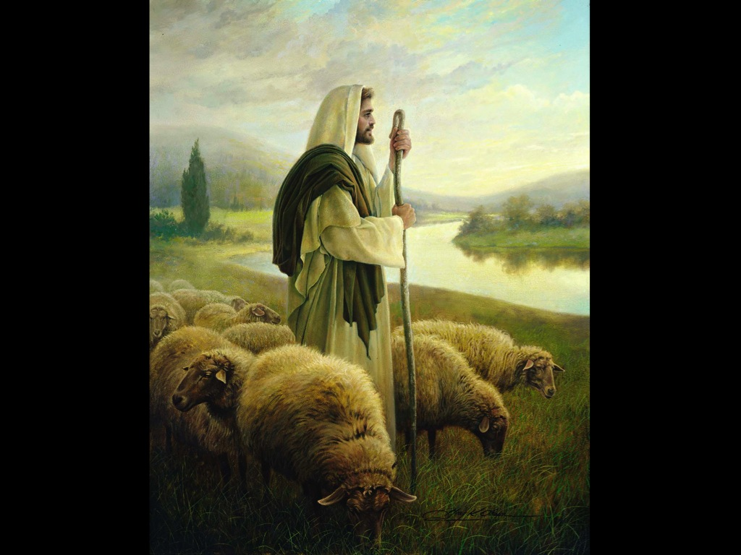
Notes:
He watches over us and leads us to refreshment

Slide 21
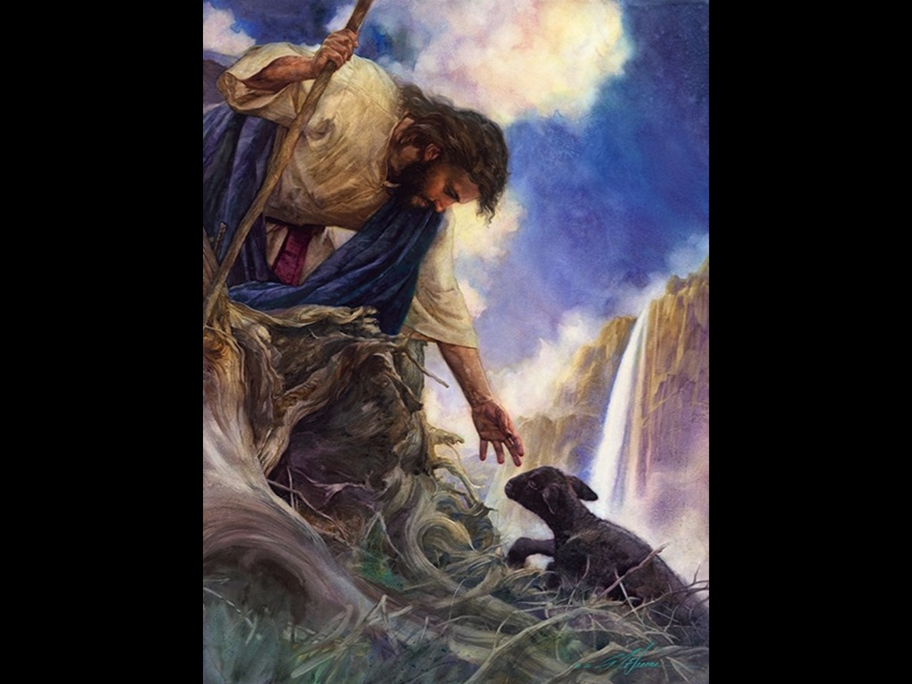
Notes:
He rescues us when we get into trouble.

Slide 22
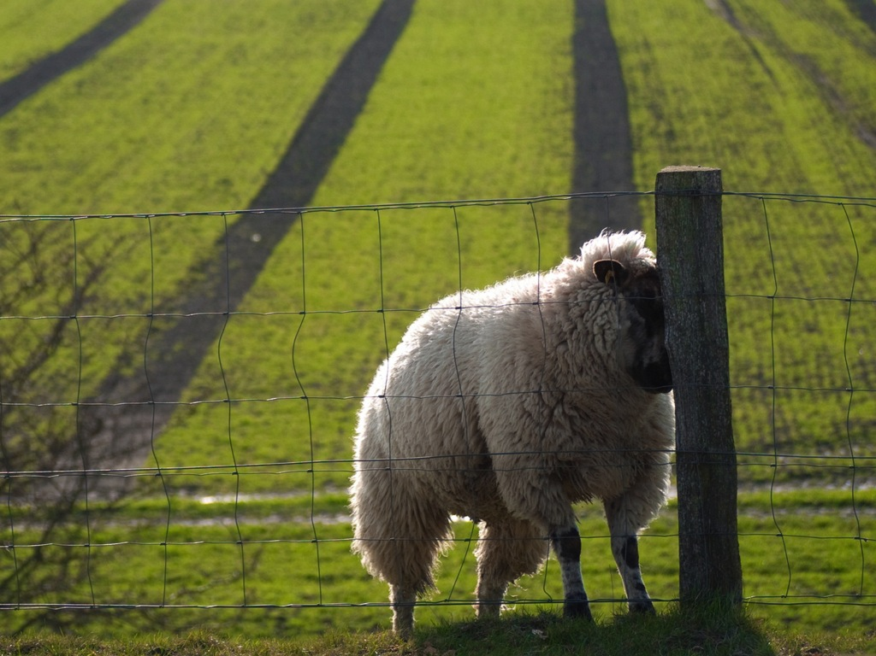
Notes:
Sadly sheep are always looking for ways to get out of the safety of the fenced in area – maybe the grass looks greener on the other side.

Slide 23
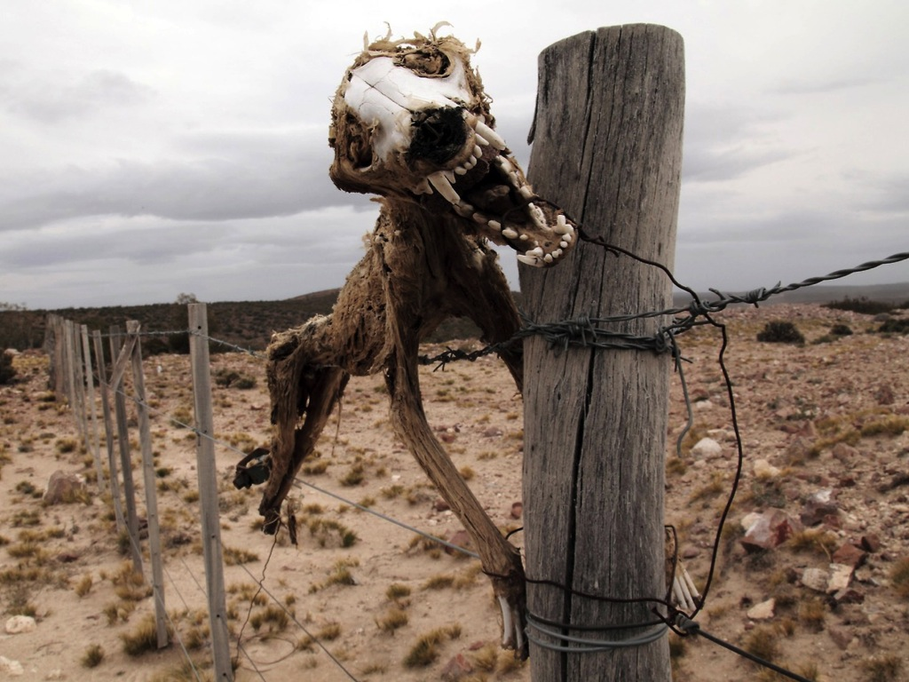
Notes:
God’s boundaries for our lives are meant to keep us safe and not just to spoil our fun.

Slide 24
Notes:
In the coming weeks we are going to see how this idea of boundaries applies to different areas of our lives.

