Slide 1

Notes:
This week we are looking at God’s Fence and Sex.

Slide 2

Notes:
"When God gave sex to men and women, He gave them a wonderful gift - and a tremendous responsibility. Is it any wonder, then, that the Bible tells us to handle sex with care? A lot of self-appointed experts who seldom open the Bible claim that God is against sex. Nothing could be further from the truth. What God is against is stupid, selfish use of sex to gratify lust. Of course the Bible warns against stupid sex because God created sex for your good and enjoyment - to be done in the right place at the right time - within marriage with someone you love in a lifetime commitment.” (Michael W. Smith, Old Enough to Know”)

Slide 3

Notes:
What are some of the fences around our sexuality that God has set up?

Slide 4

Notes:
Among you there must not even be a hint of immorality. (Ephesians 5:3)

Slide 5
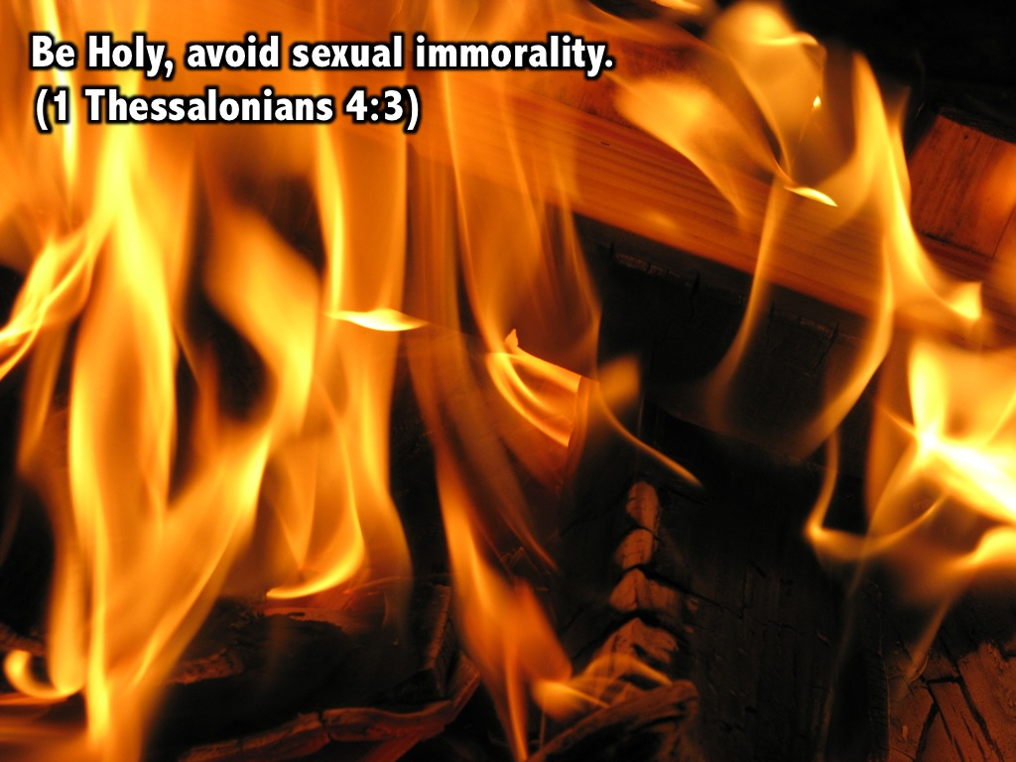
Notes:
Be Holy, avoid sexual immorality. (1 Thessalonians 4:3)

Slide 6
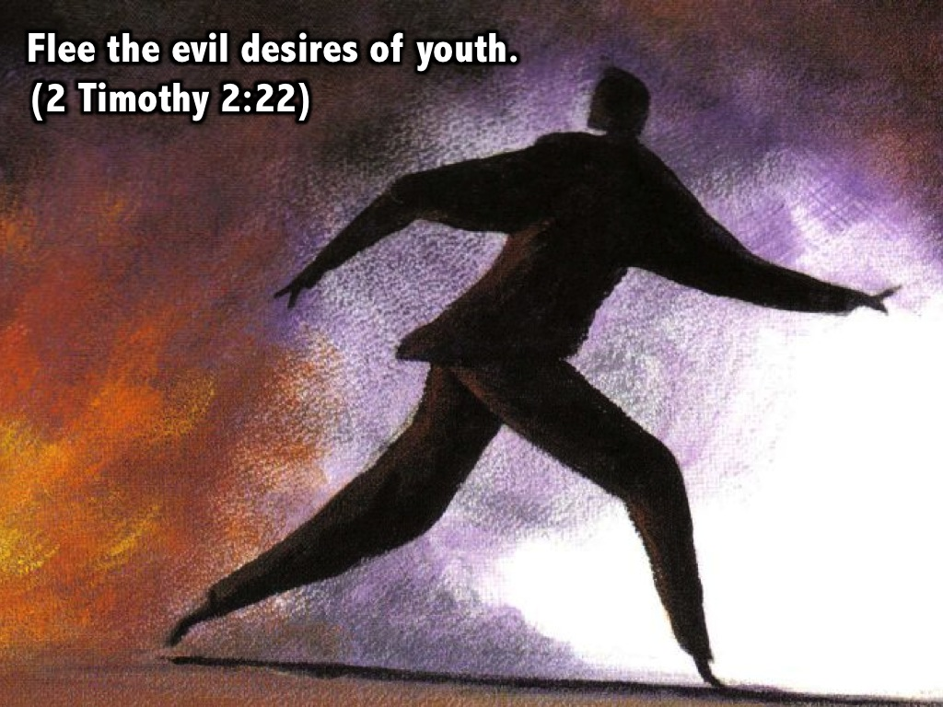
Notes:
Flee the evil desires of youth. (2 Timothy 2:22)

Slide 7
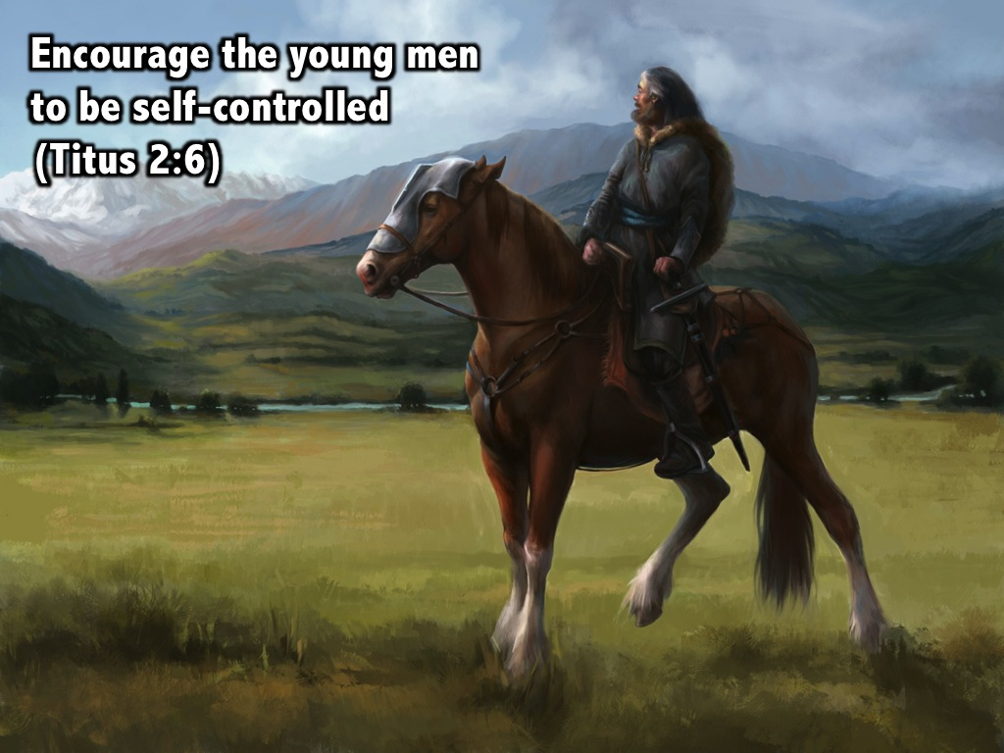
Notes:
Encourage the young men to be self-controlled. (Titus 2:6)

Slide 8
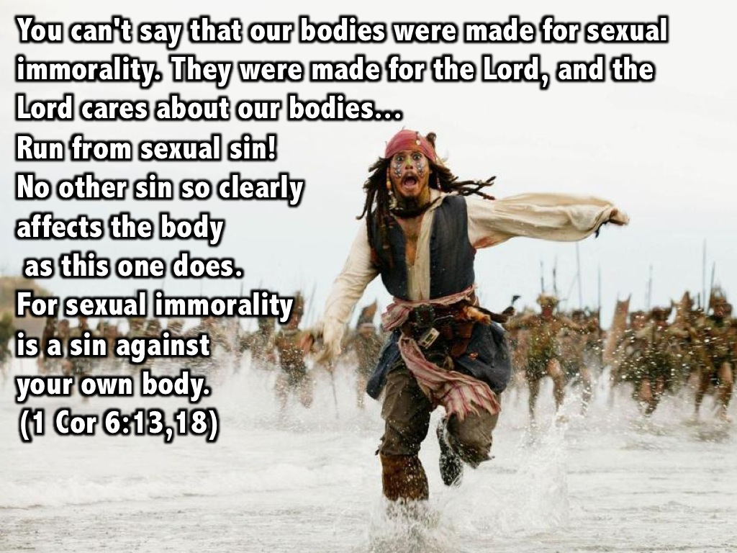
Notes:
You can't say that our bodies were made for sexual immorality. They were made for the Lord, and the Lord cares about our bodies... Run from sexual sin! No other sin so clearly affects the body as this one does. For sexual immorality is a sin against your own body. (1 Cor 6:13,18)

Slide 9
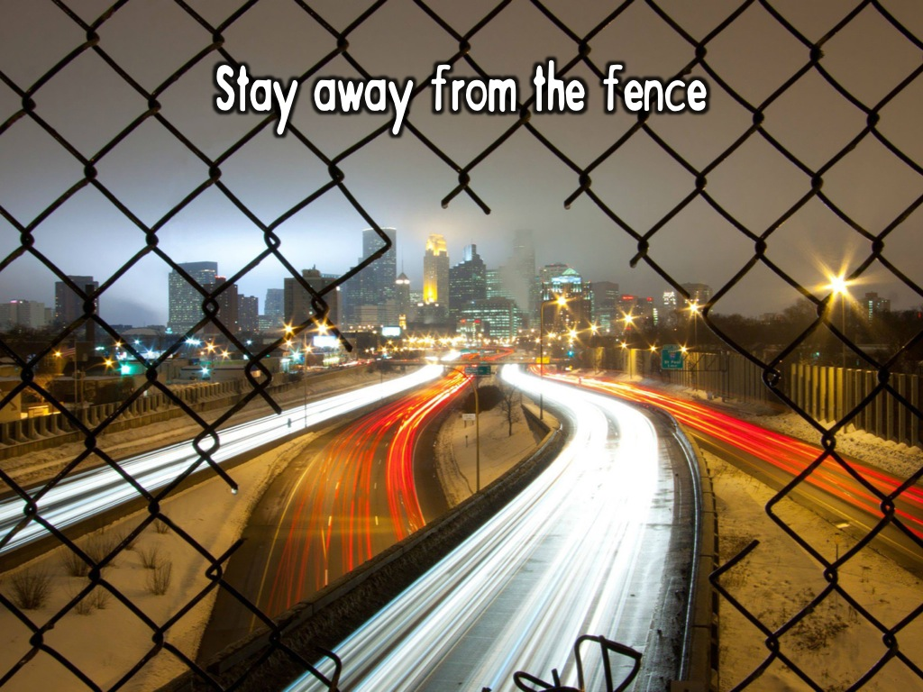
Notes:
There is no such thing as bending the fence. When we decide that God's desire for us to leave sex for marriage is cramping our style, and that bending his rule is cool so long as we are in love and stay in control, we are "breaking" and not just "bending" the rules. Scripture clearly says, "Marriage should be honoured by all and the marriage bed kept pure, for God will judge the adulterer and all the sexually immoral" (Hebrews 13:4).

Slide 10
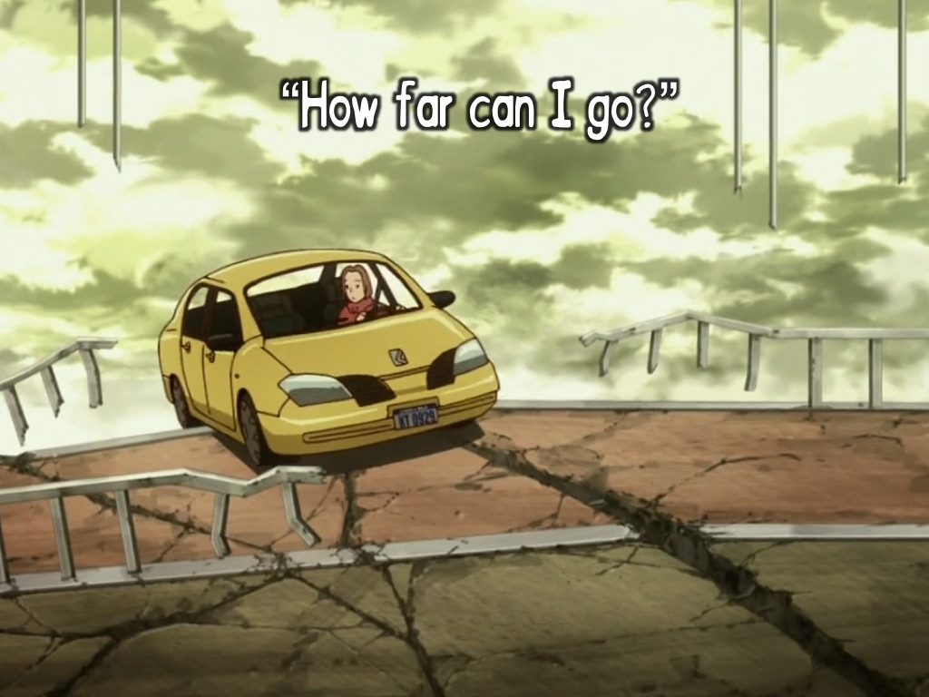
Notes:
It takes incredible courage and determination for young people to stand against what Michael calls "stupid sex" when society accepts it as the norm, where sex out of marriage is the main theme of the afternoon soaps, and where youth culture attaches more importance to losing virginity than to protecting it. Next time you face a decision between love and lust, stop! Take time to pray that God will help you follow Christ and not your feelings. But it is no use pushing it to the limit, using the "how-far-can-I-go" approach, and then hoping to be safe. That's like a person on ski's who tries to stop the ride on the way down the slope - the only way out at that stage of the ride is to take a tumble. It is the "tumble" that God is wanting to protect you from!

Slide 11
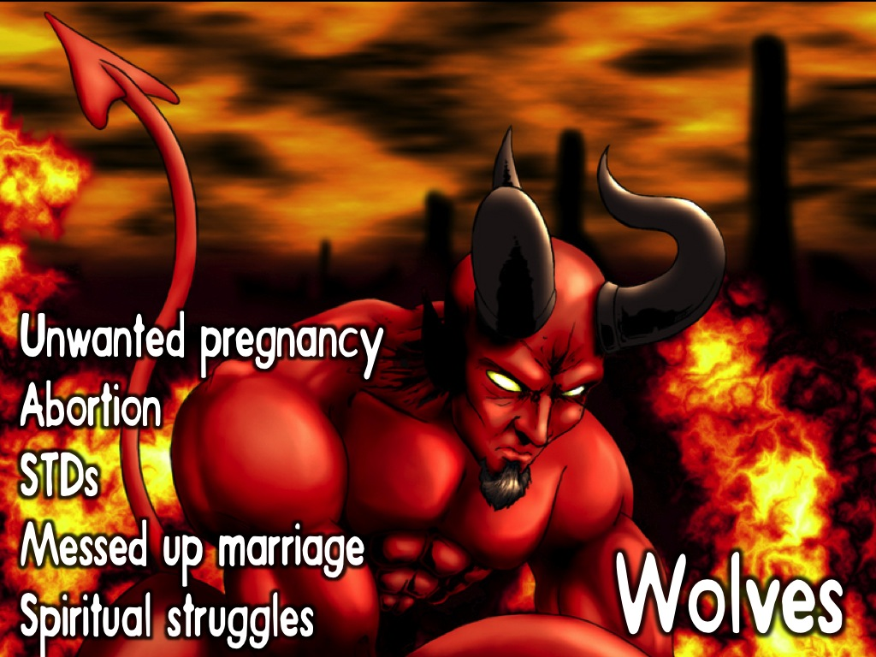
Notes:
The Wolves outside the fence are real. There is the possibility of an unwanted pregnancy and the horror of abortion; the reality of a sexually transmitted disease, like AIDS; and later finding your marriage relationship is severely scarred by pre-marital experimentation; but, most importantly there is the break in fellowship with Father God that results whenever you go against what He has decided is best for you. Nothing is worse than a broken relationship with the only person who can truly satisfy your craving for love and security.

Slide 12
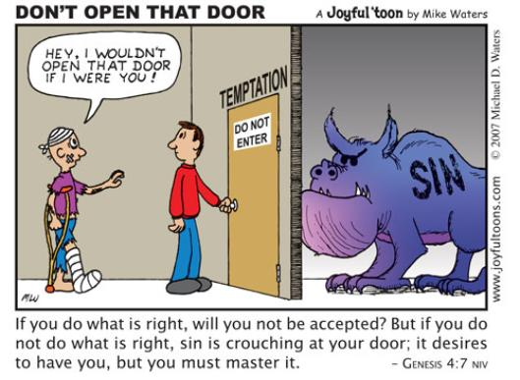
Notes:
“If you do what is right, will you not be accepted? But if you do not do what is right, sin is crouching at your door; it desires to have you, but you must master it.” (Genesis 4:7)

Slide 13
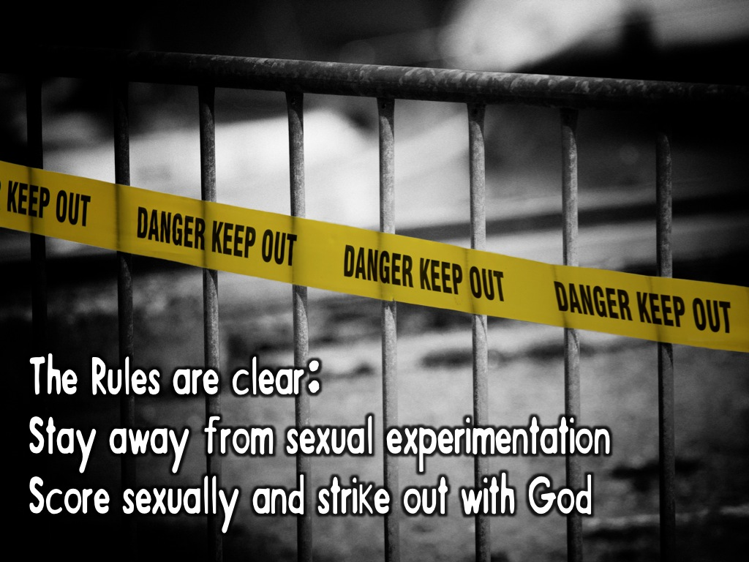
Notes:
The rules are clear: Stay away from sexual experimentation. Remember scoring sexually with your partner means striking out with God! [1 Thessalonians 4:3]. Check out Psalm 119:9-11 for sound advice on how you can stay sexually pure:
1. Know the Principles of God found in His Word to guide you
2. Discover the Presence of Christ in your life to guard you
3. Rely on the Power of the Holy Spirit to help you overcome temptation

Slide 14
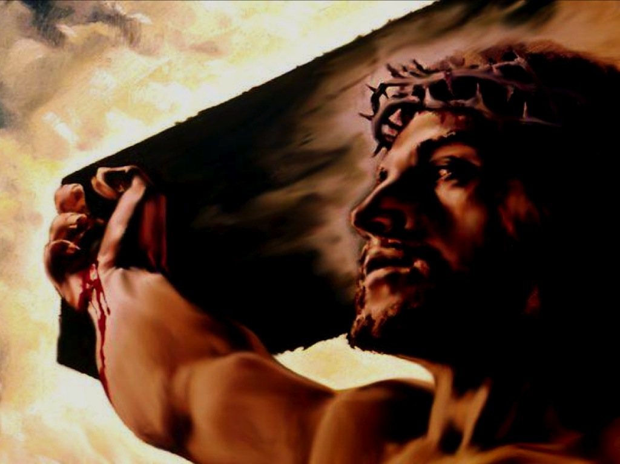
Notes:
Christ died to set us deal with our sin and to make a way for us to live pure lives.

Slide 15

Notes:
We can live in a way that ensures we are pure before God!

Slide 16

Notes:
By creating healthy boundaries in the area of our sexuality!

Slide 17
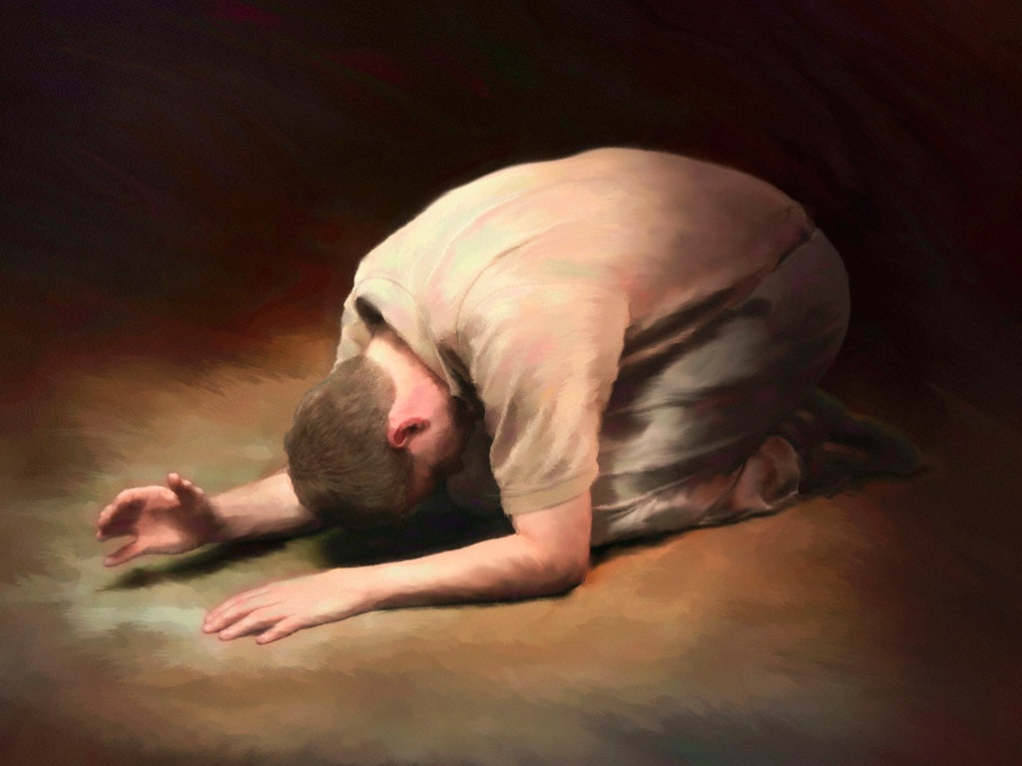
Notes:
Let’s pray that God will help us respect the boundaries that are meant to keep us safe!

