Slide 1

Notes:
This week we are looking at God’s Fence and our Speech.

Slide 2
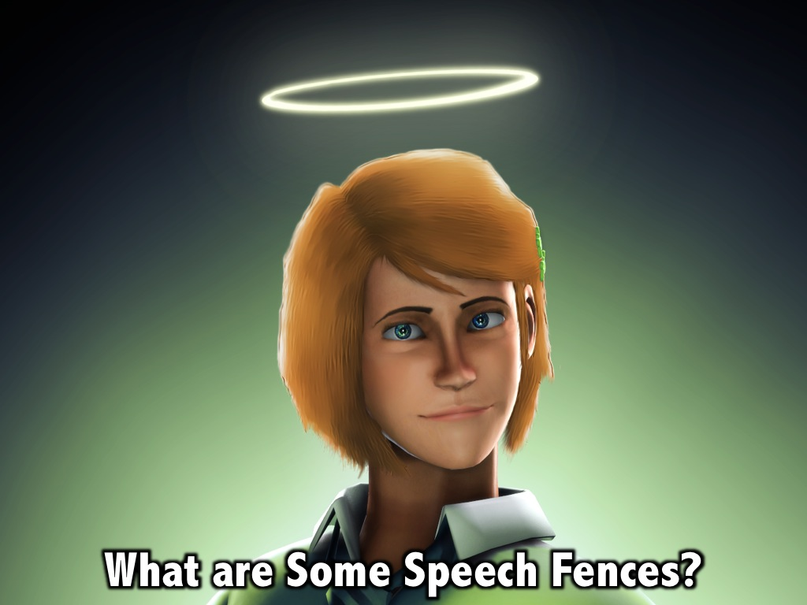
Notes:
What are some of the fences around our speech that God has established?

Slide 3
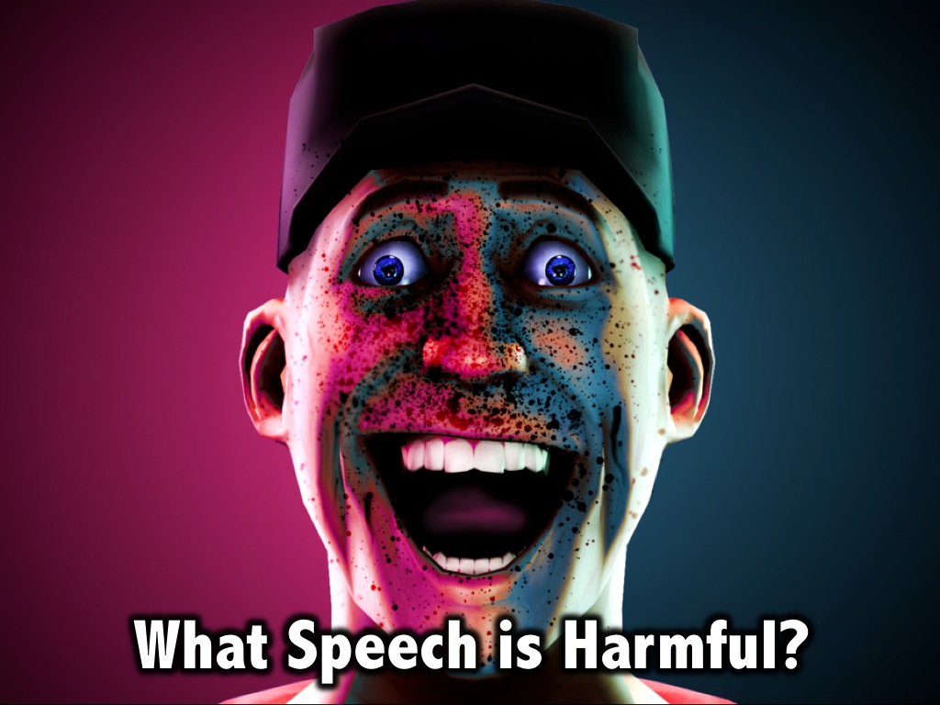
Notes:
What speech is harmful to people around us?

Slide 4

Notes:
(1) Gossiping: Don’t criticize and speak evil about each other. (James 4:11)

Slide 5
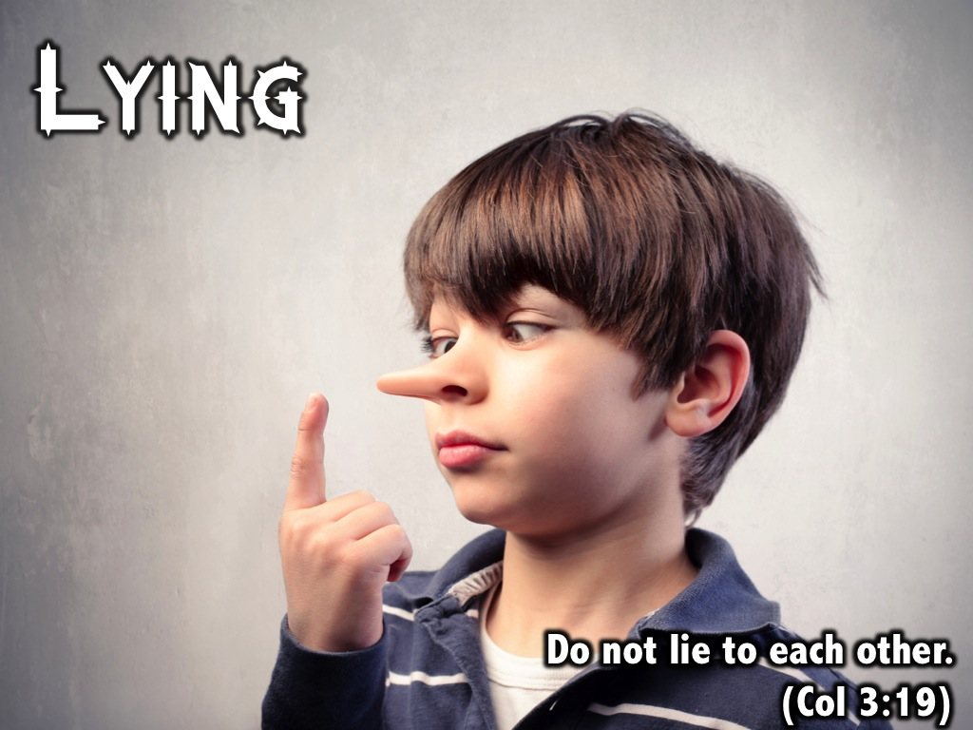
Notes:
(2) Lying: Do not lie to each other. (Colossians 3:19)

Slide 6
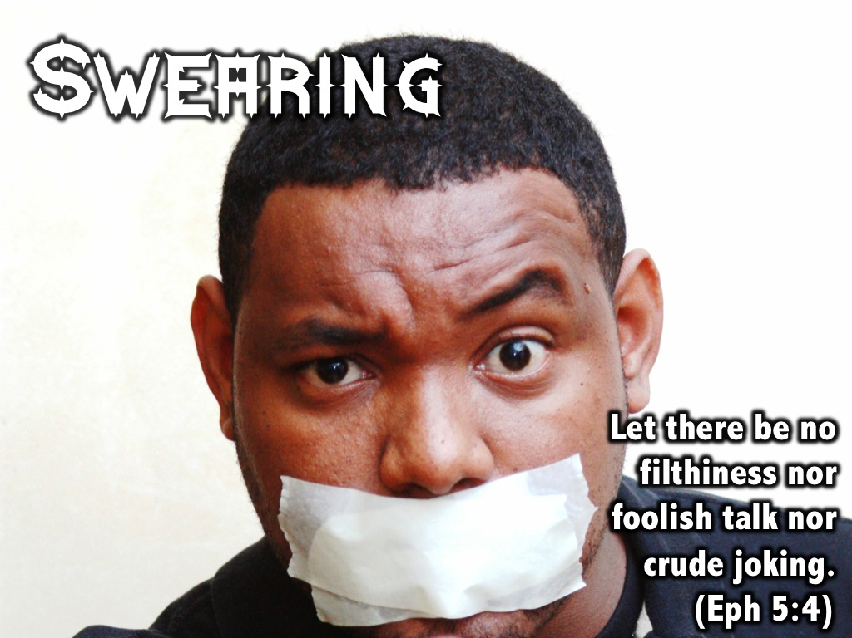
Notes:
(3) Swearing. Let there be no filthiness nor foolish talk nor crude joking. (Ephesians 5:4)

Slide 7
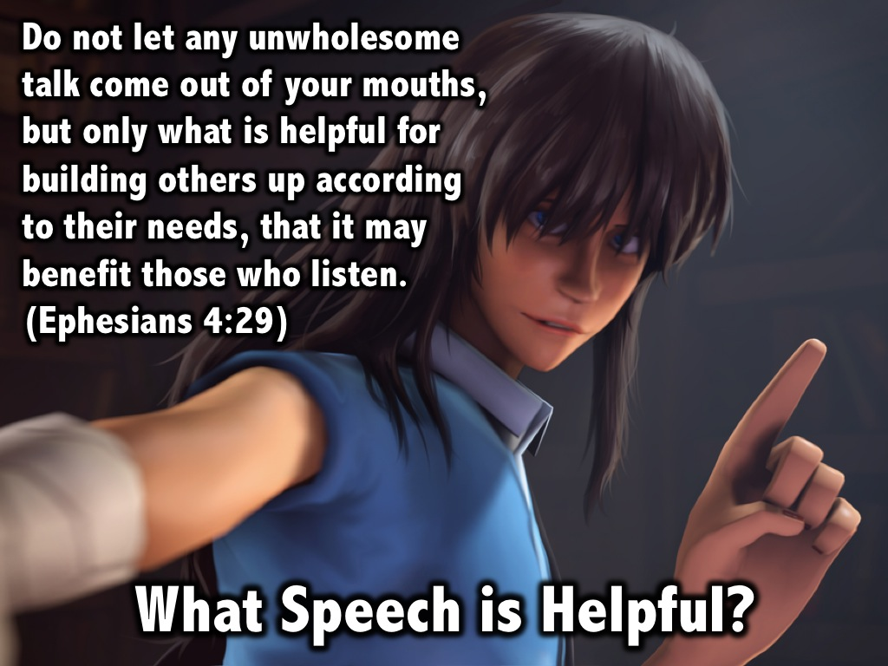
Notes:
What Speech is Helpful? “Do not let any unwholesome talk come out of your mouths, but only what is helpful for building others up according to their needs, that it may benefit those who listen.”
(Ephesians 4:29)

Slide 8
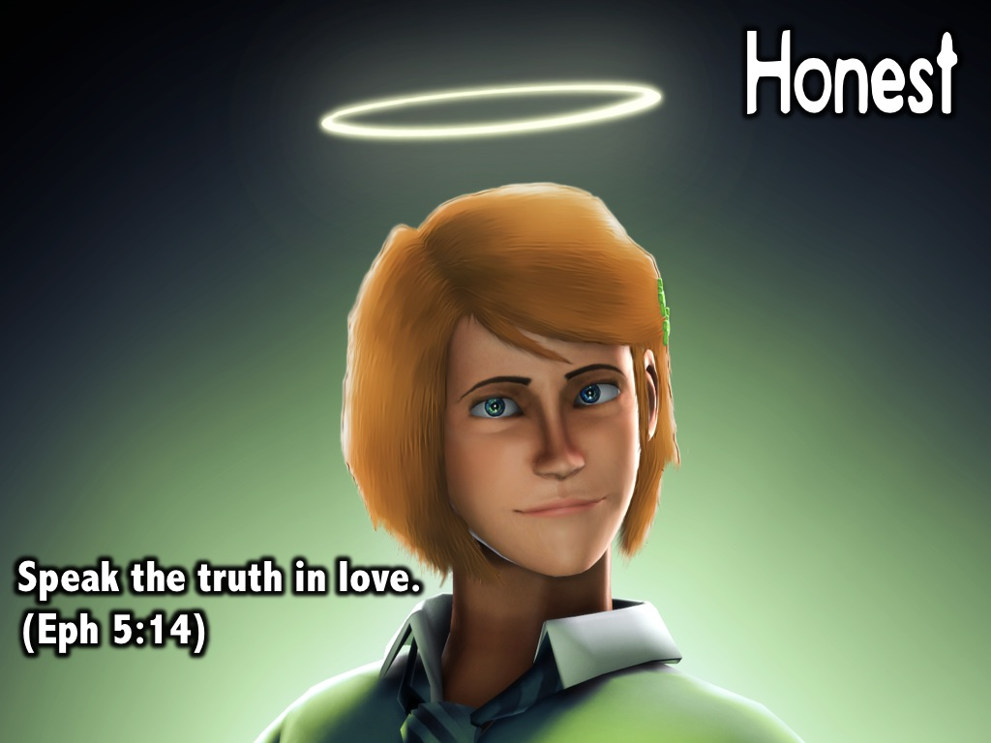
Notes:
(1) Honest. Speak the truth in love. (Ephesians 5:14)

Slide 9
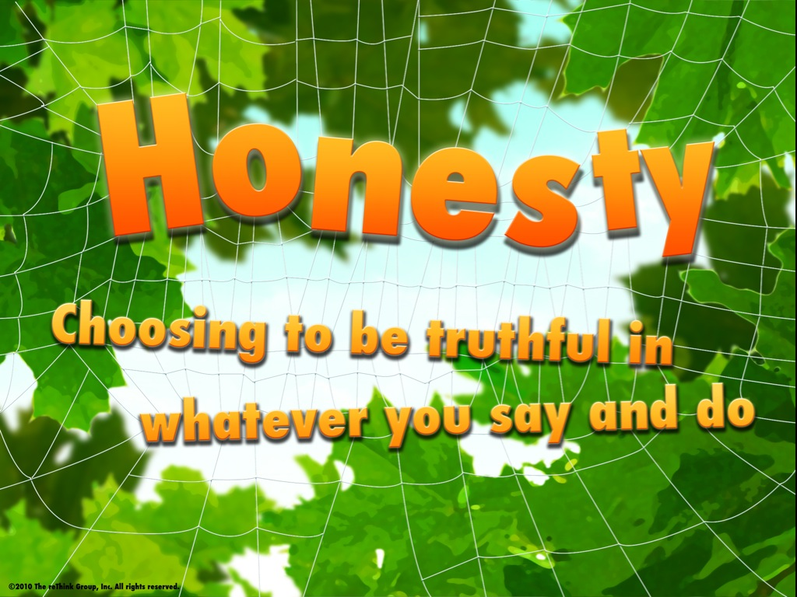
Notes:
Honesty is choosing to be truthful in whatever you say and do.

Slide 10
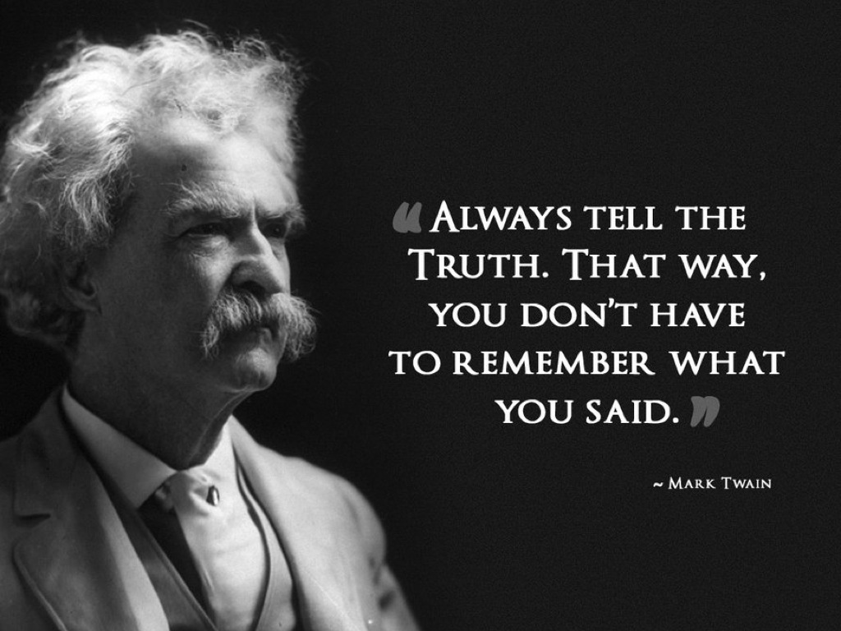
Notes:
Mark Twain said these wise words: “Always tell the truth. That way, you don’t have to remember what you said.”

Slide 11
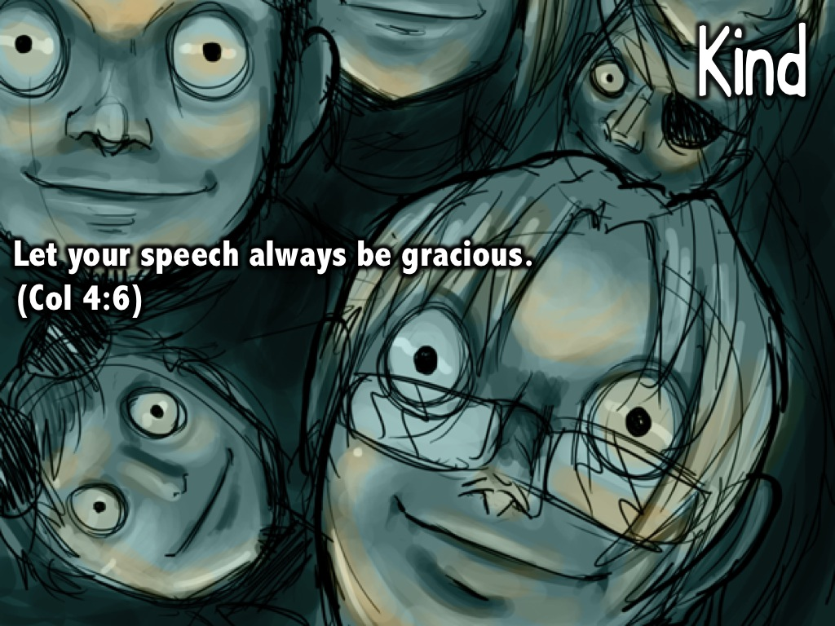
Notes:
(2) Kind. Let your speech always be gracious. (Col 4:6)

Slide 12
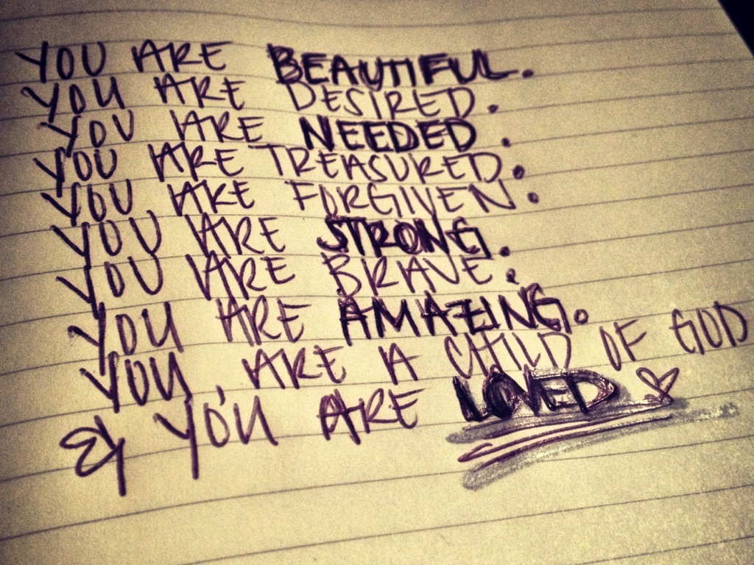
Notes:
There are so many positive things we can say to people.

Slide 13

Notes:
We don’t have to say negative things!

Slide 14
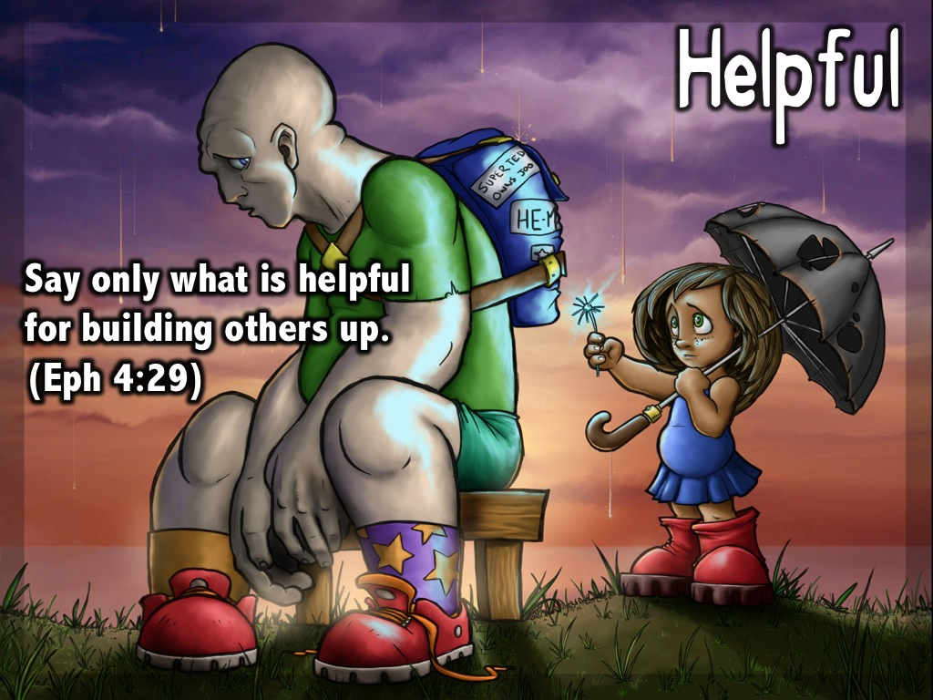
Notes:
(3) Helpful. Say only what is helpful for building others up. (Ephesians 4:29)

Slide 15
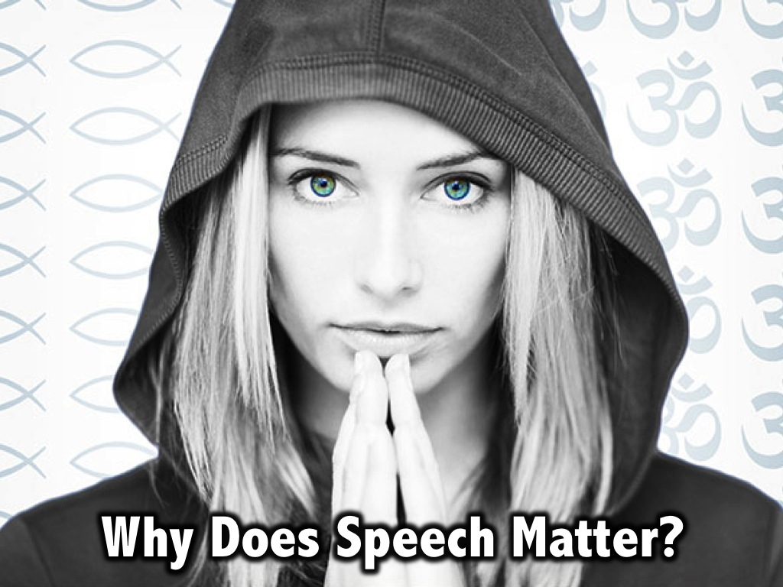
Notes:
Why Does Speech Matter?

Slide 16
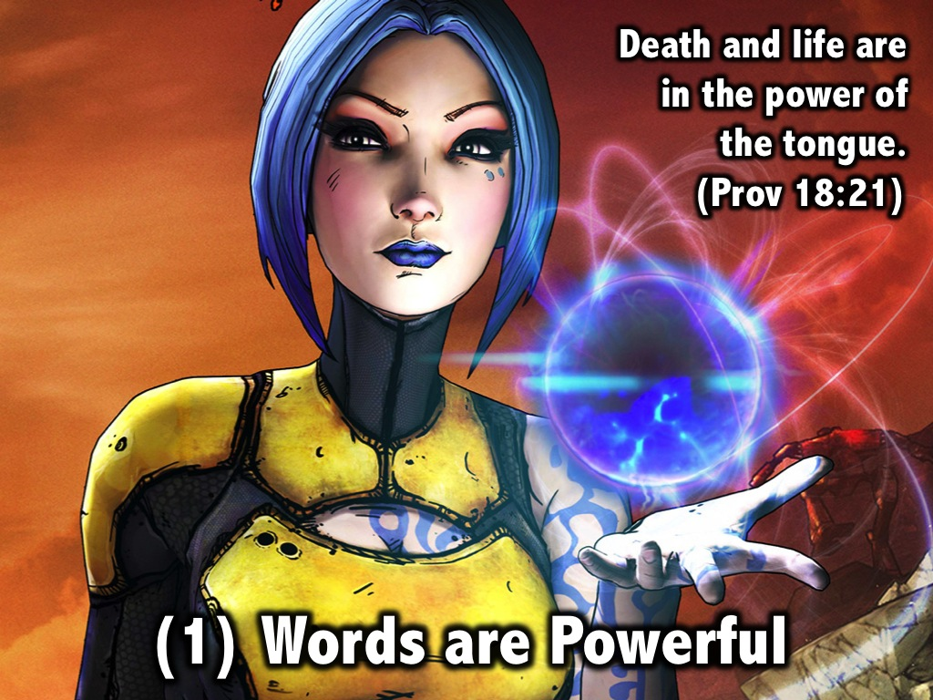
Notes:
(1) Words are powerful. Death and life are in the power of the tongue. (Proverbs 18:21)

Slide 17
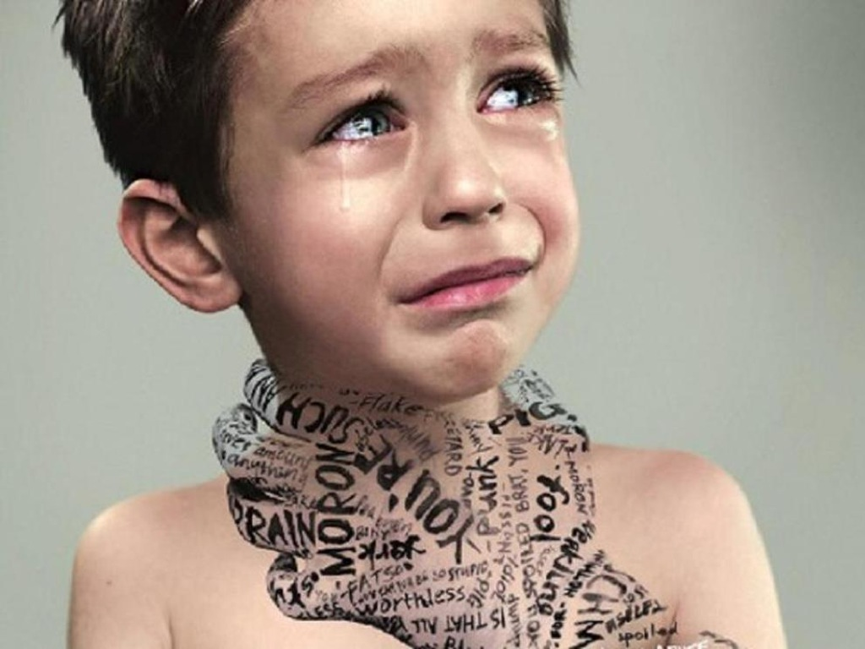
Notes:
Words can tear people down!

Slide 18
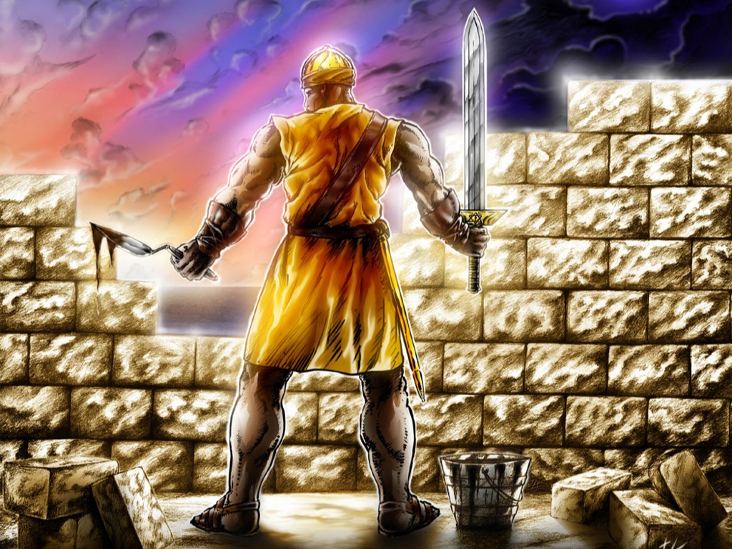
Notes:
Words can build people up!

Slide 19
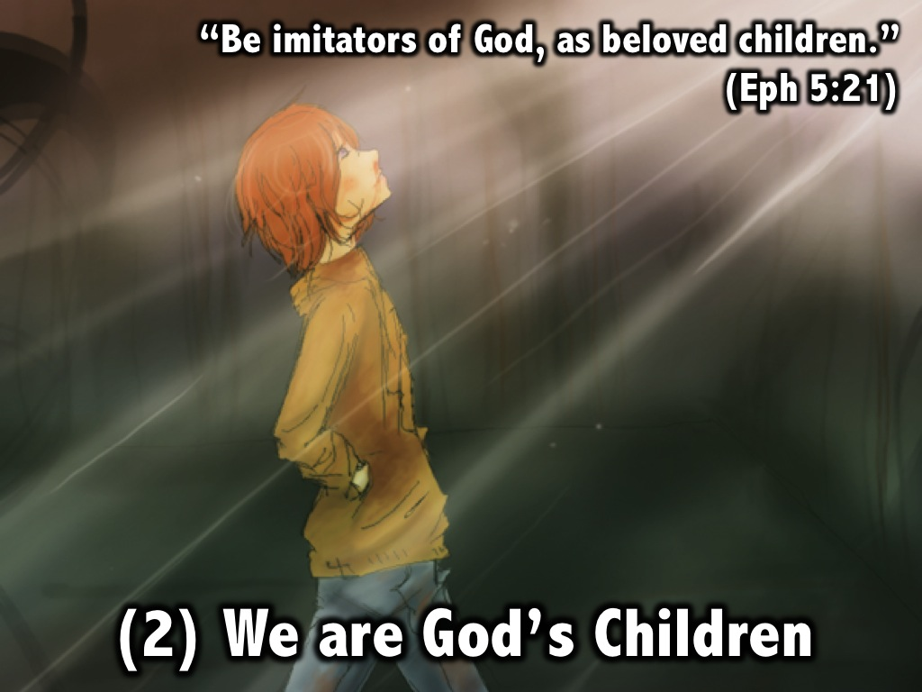
Notes:
(2) We are God’s Children. “Be imitators of God, as beloved children.” (Ephesians 5:21)

Slide 20
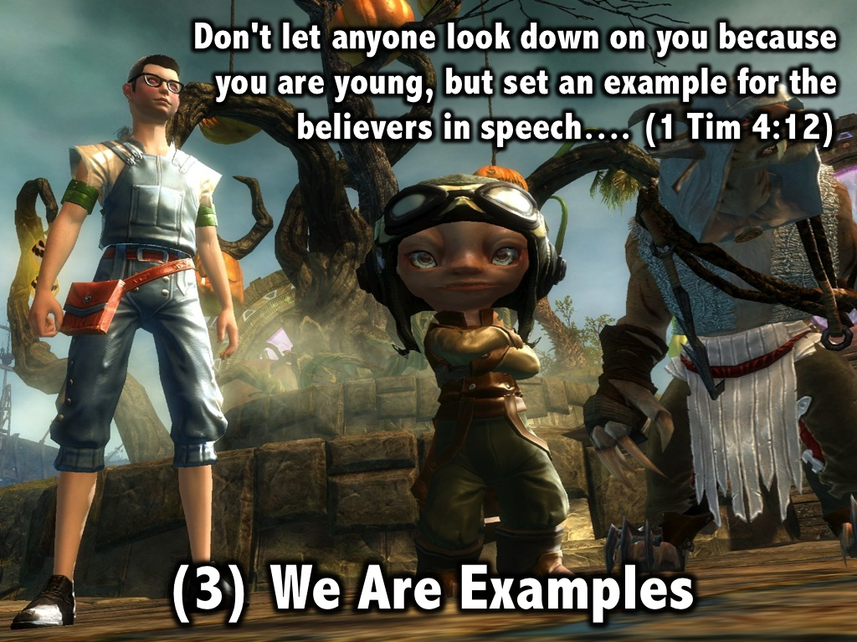
Notes:
(3) We are Examples: “Don't let anyone look down on you because you are young, but set an example for the believers in speech, in life, in love, in faith and in purity.” (1 Timothy 4:12)

Slide 21
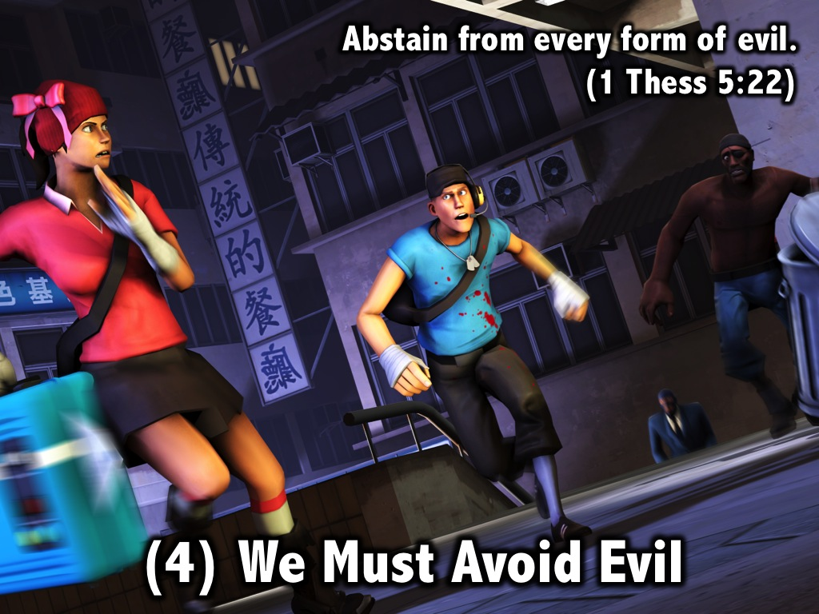
Notes:
(4) We must Avoid Evil. “Abstain from every form of evil.” (1 Thess 5:22)

Slide 22
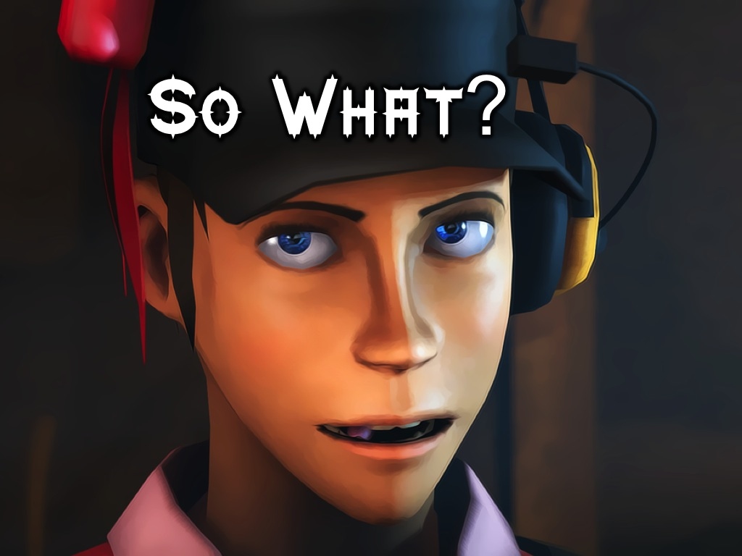
Notes:
So What?

Slide 23

Notes:
So guard your tongue!

Slide 24
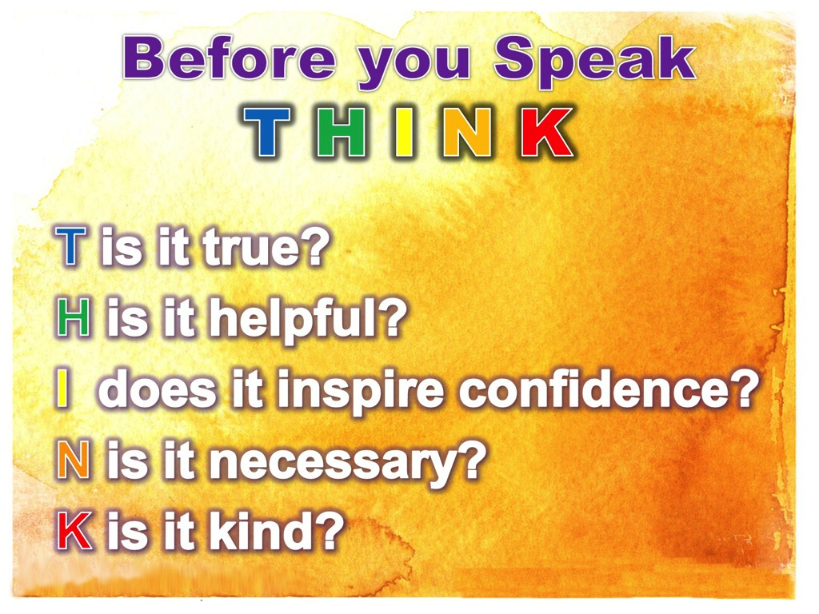
Notes:
Before you speak, Think. Is what I am about to say True, Helpful, Inspiring, Necessary and Kind?

Slide 25
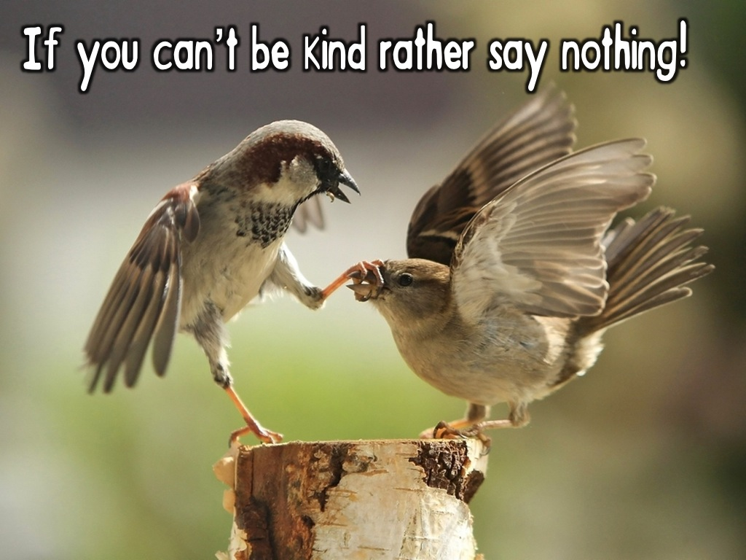
Notes:
If you can’t be kind, rather say nothing!

Slide 26

Notes:
Prayer

