Slide 1
Notes:
This week we are looking at God’s fence and our Heart.

Slide 2
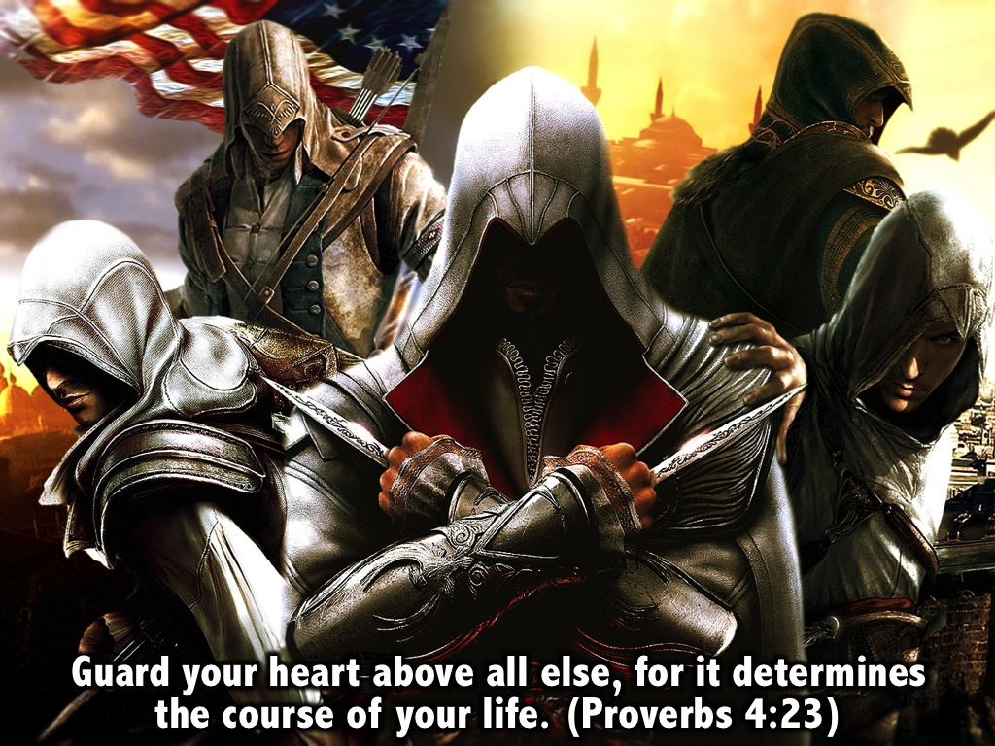
Notes:
Proverbs 4:23 says: “Guard your heart above all else, for it determines the course of your life.” Clearly the wise guy who wrote the book of Proverbs considered our heart to be very valuable – something to be guarded – because it actually sets the course for our whole life.

Slide 3
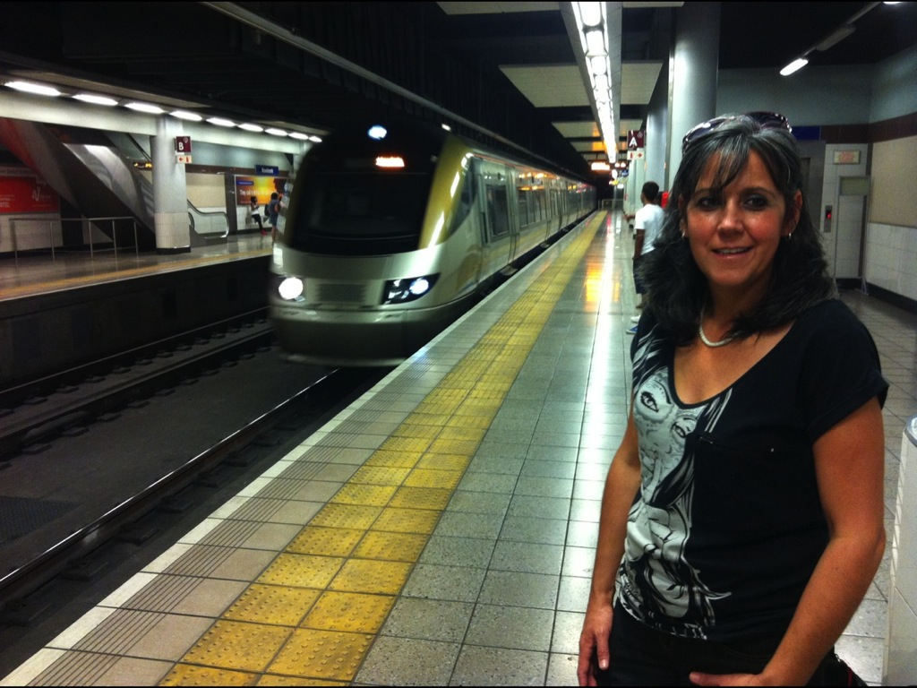
Notes:
My wife and I have just had an incredible experience travelling to New Zealand. We got to take the Gautrain for the first time to airport.

Slide 4
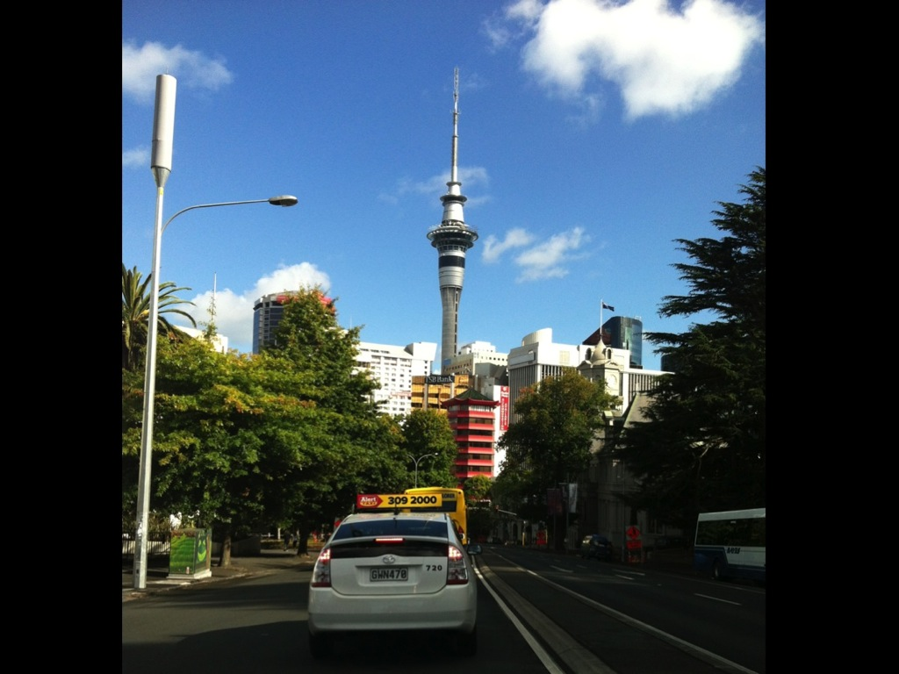
Notes:
We spent some time exploring the city of Auckland on the north island of New Zealand.

Slide 5
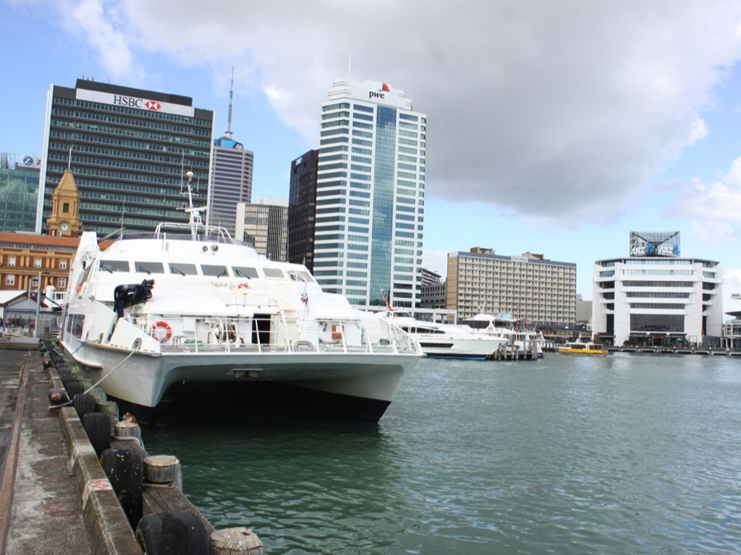
Notes:
We explored the harbour

Slide 6
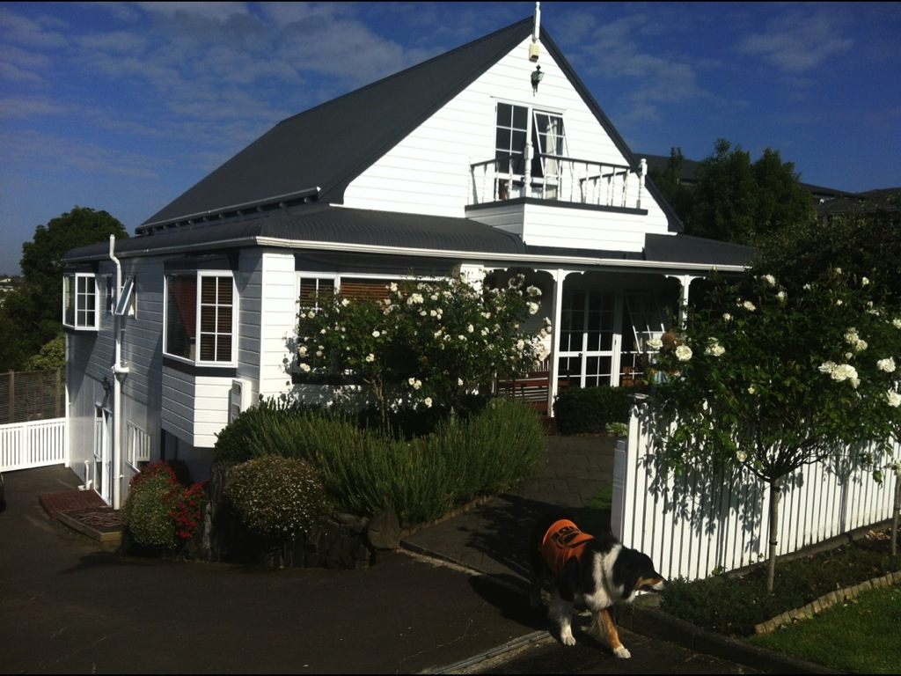
Notes:
Stayed with my sister in her quaint home.

Slide 7
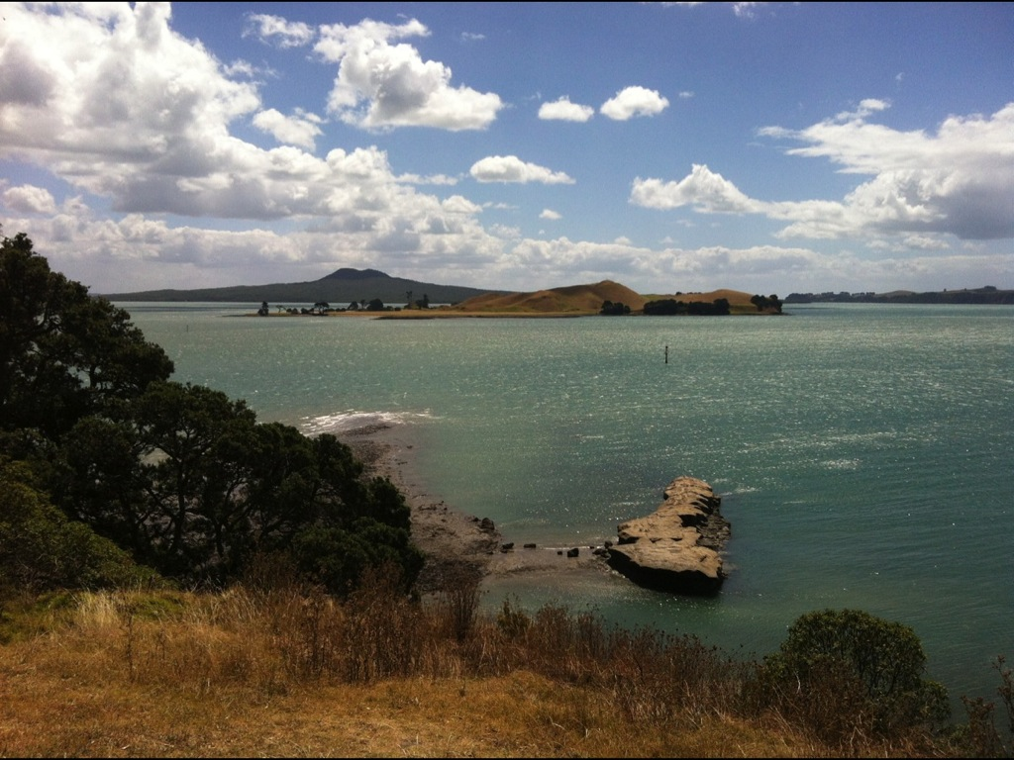
Notes:
And everywhere we looked there was the most amazing coastal scenery that we have ever seen…

Slide 8
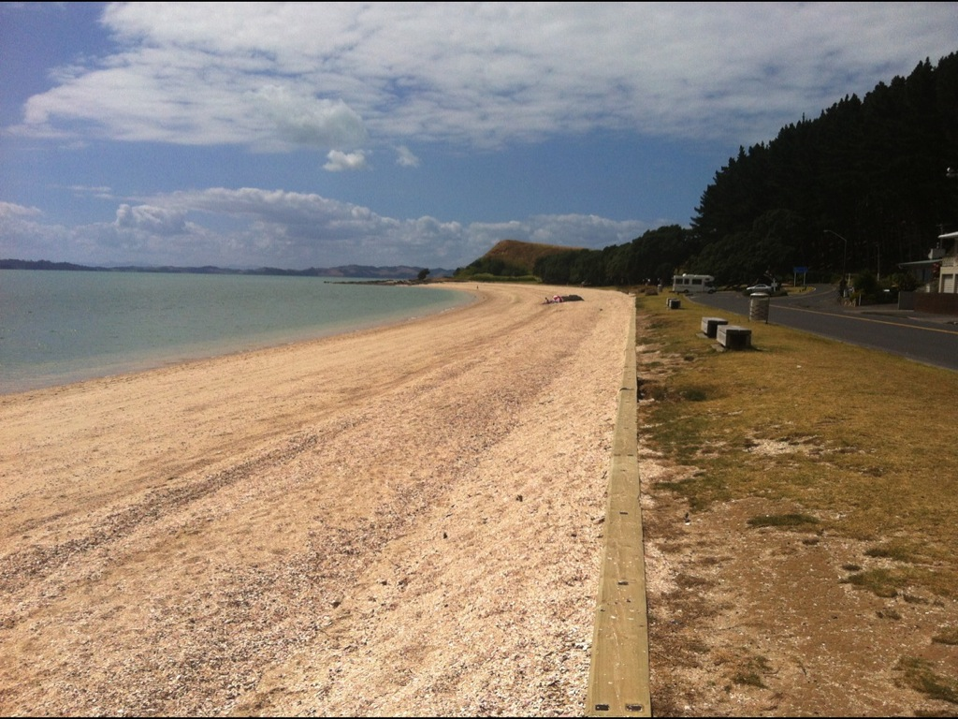

Slide 9
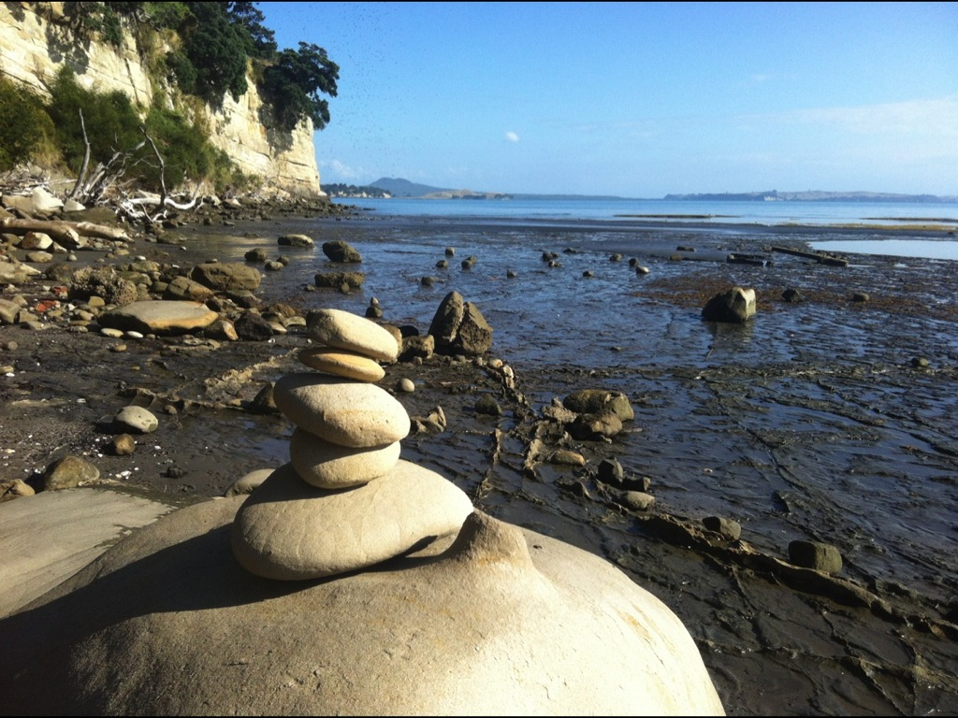

Slide 10
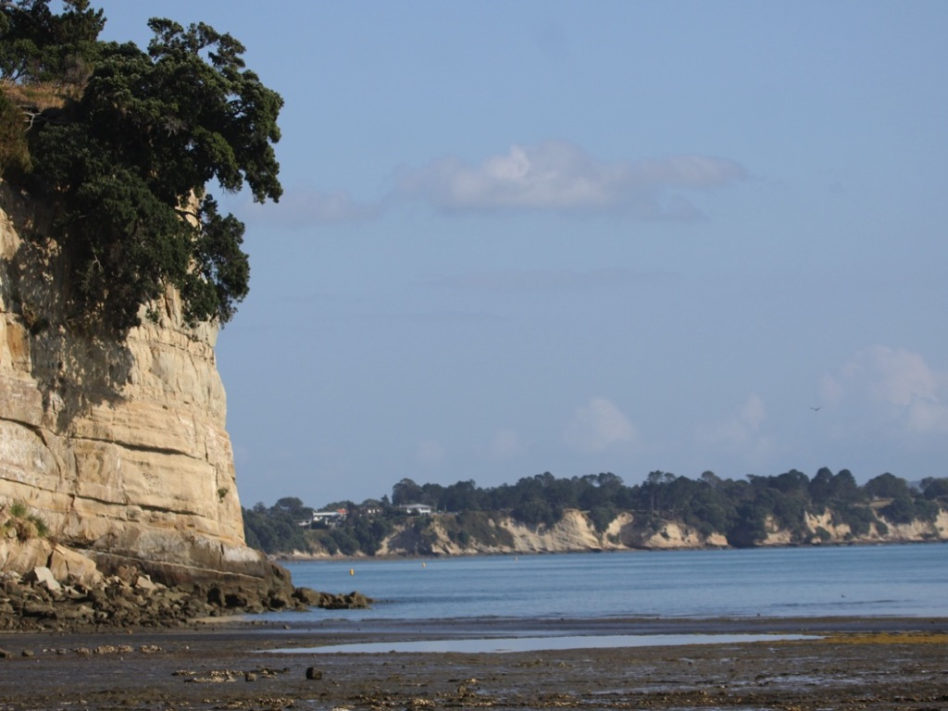

Slide 11
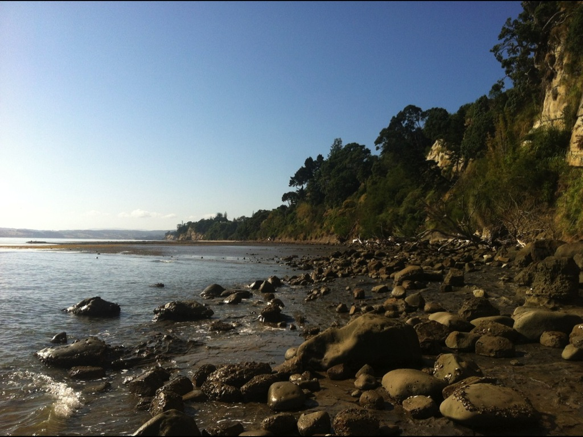

Slide 12
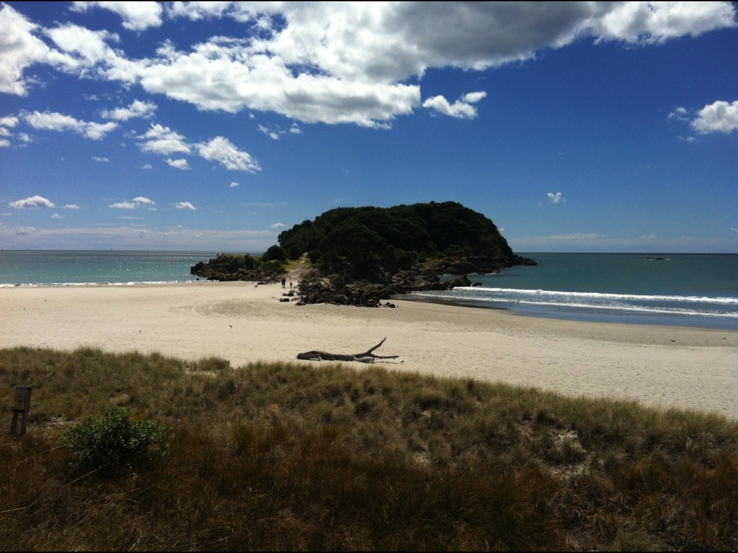

Slide 14
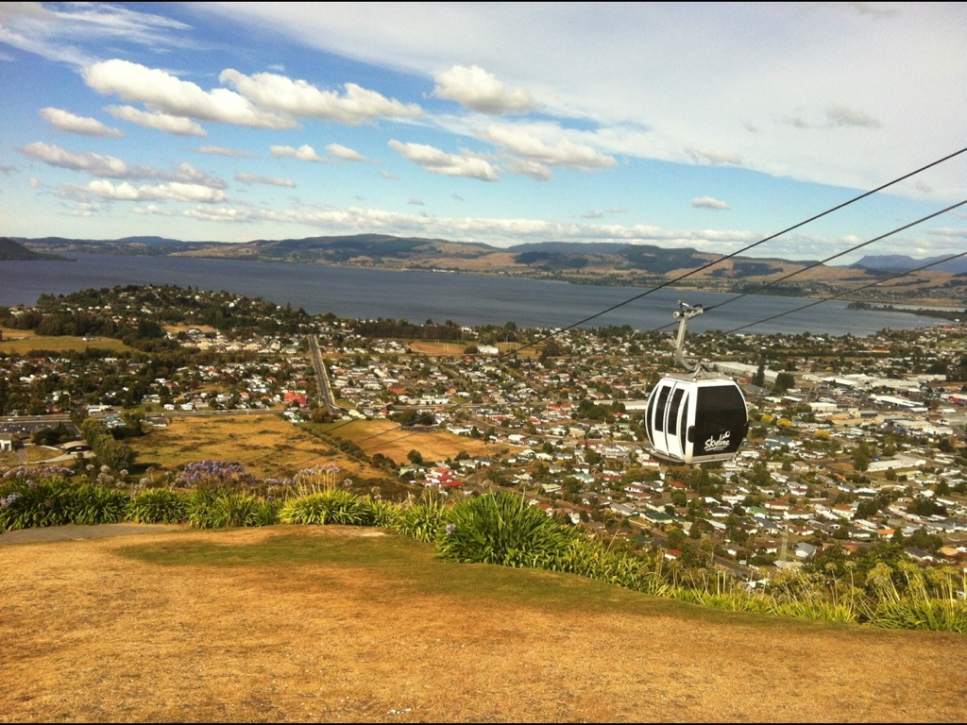
Notes:
We went up a cable car at Rotorua

Slide 15
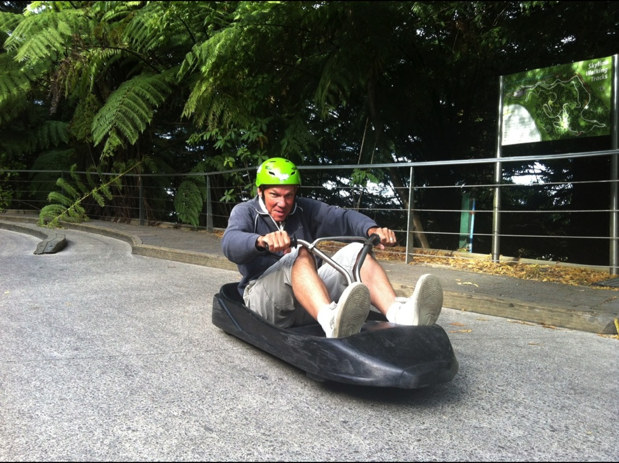
Notes:
Rode the Luge

Slide 16
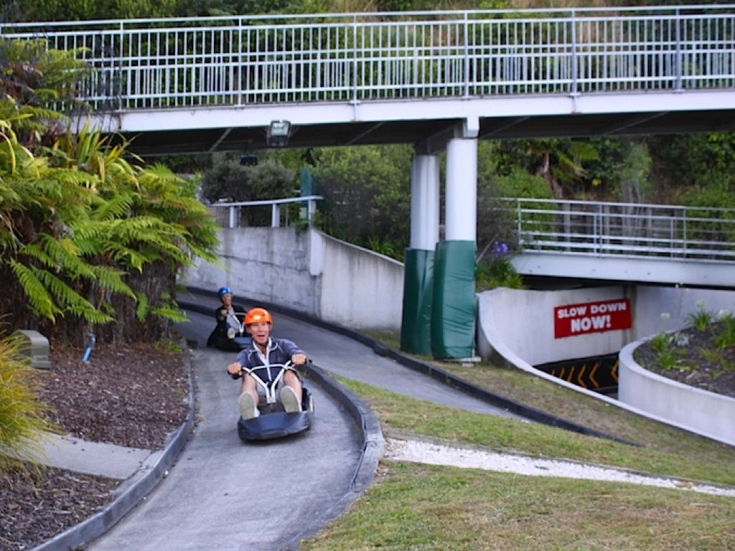
Notes:
Here is proof that I beat my sister in our race

Slide 17
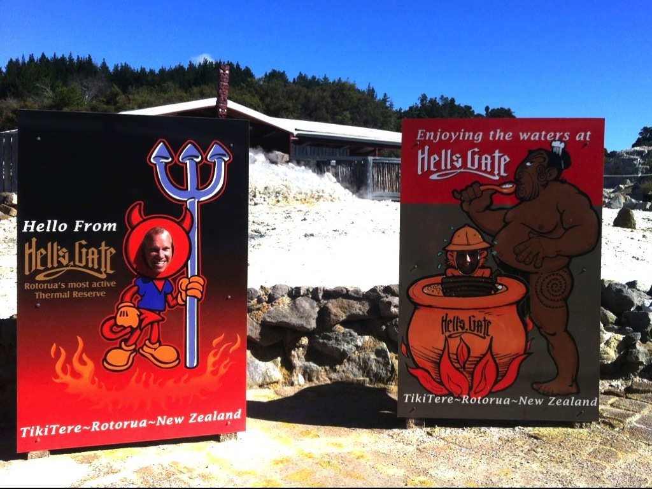
Notes:
Visited Hell’s gate – a place where geothermal activity is taking place.

Slide 18
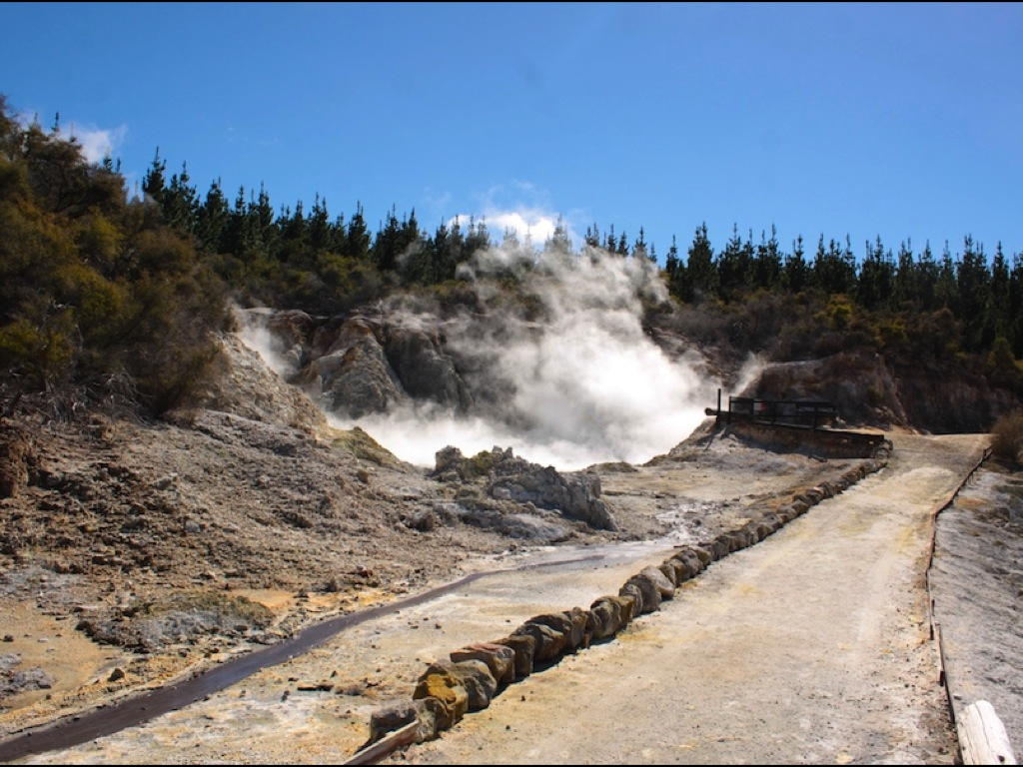
Notes:
Everywhere we looked there was steam rising – smelling of sulphur – not pleasant!

Slide 19
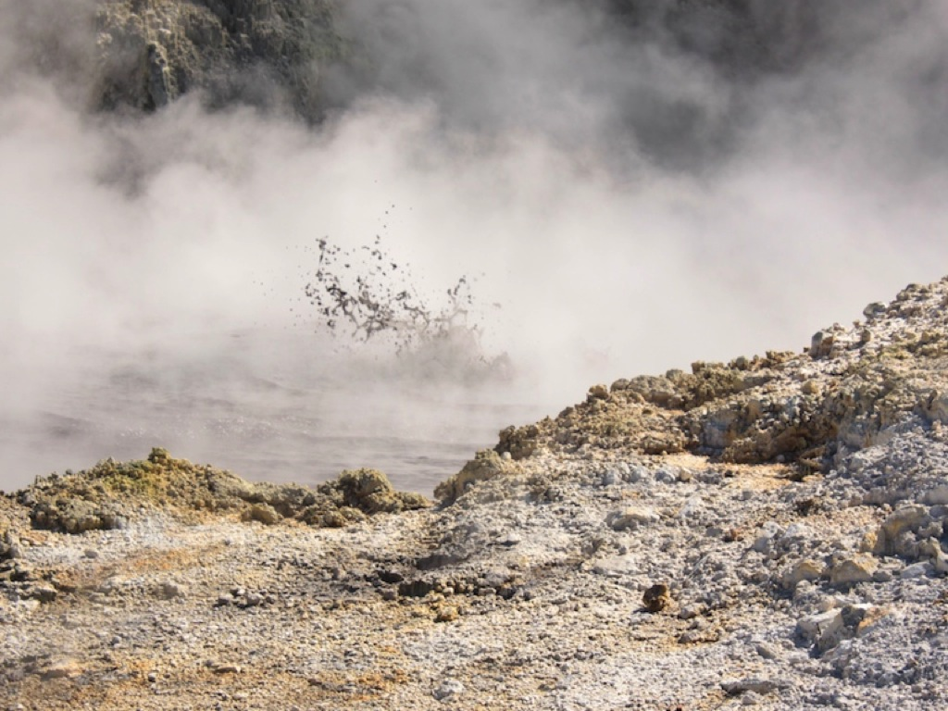
Notes:
And bubbling mud everywhere!

Slide 20
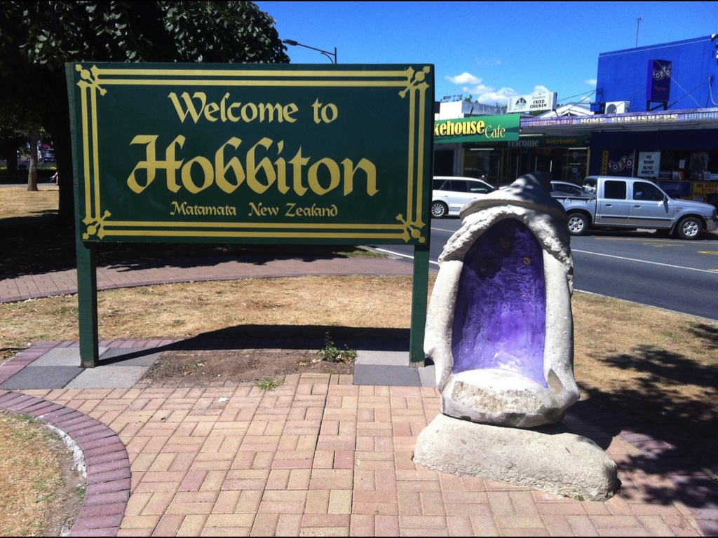
Notes:
We made a quick stop at Hobbiton on our way back to Auckland

Slide 21
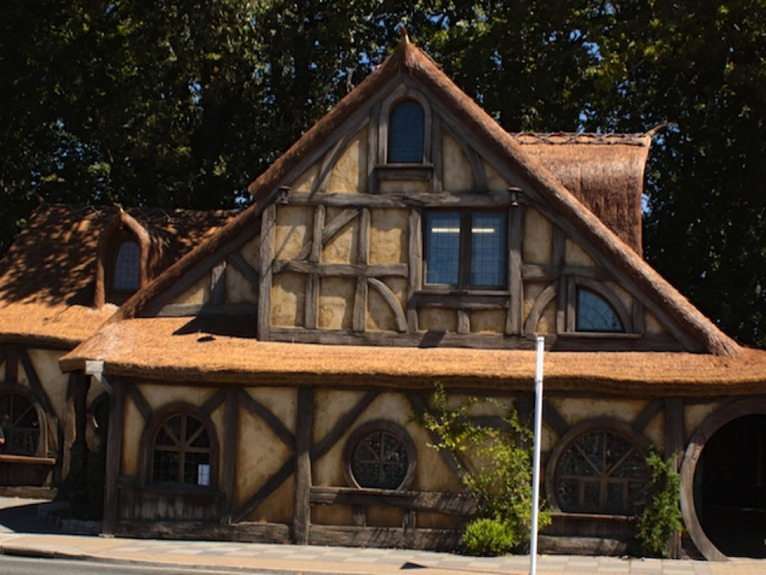
Notes:
Visiting a Hobbit-styled home

Slide 22
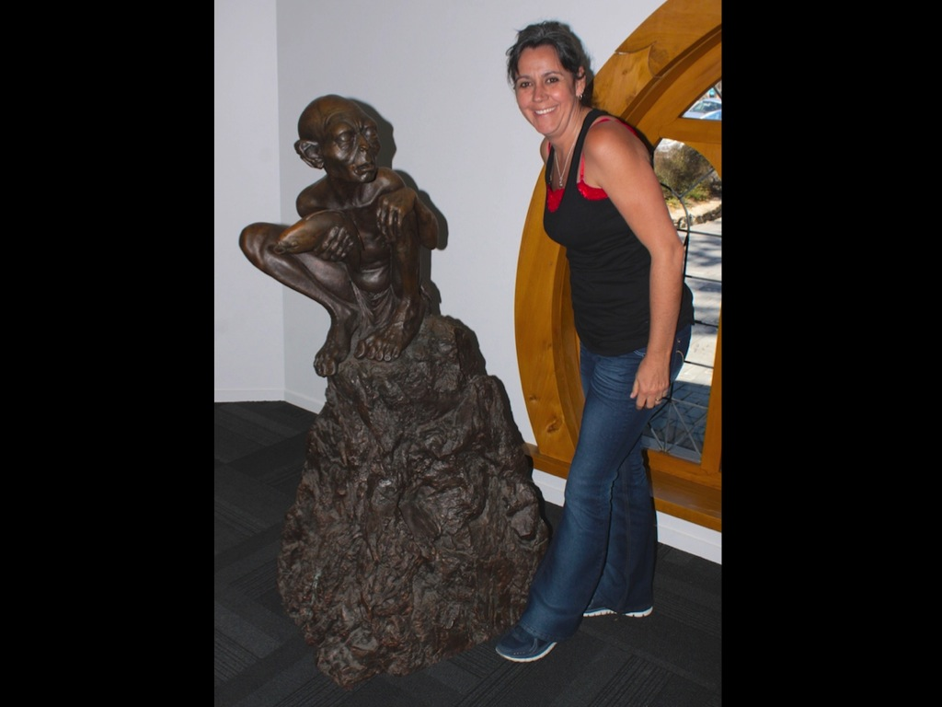
Notes:
Debbie even got to chat with Gollum

Slide 23
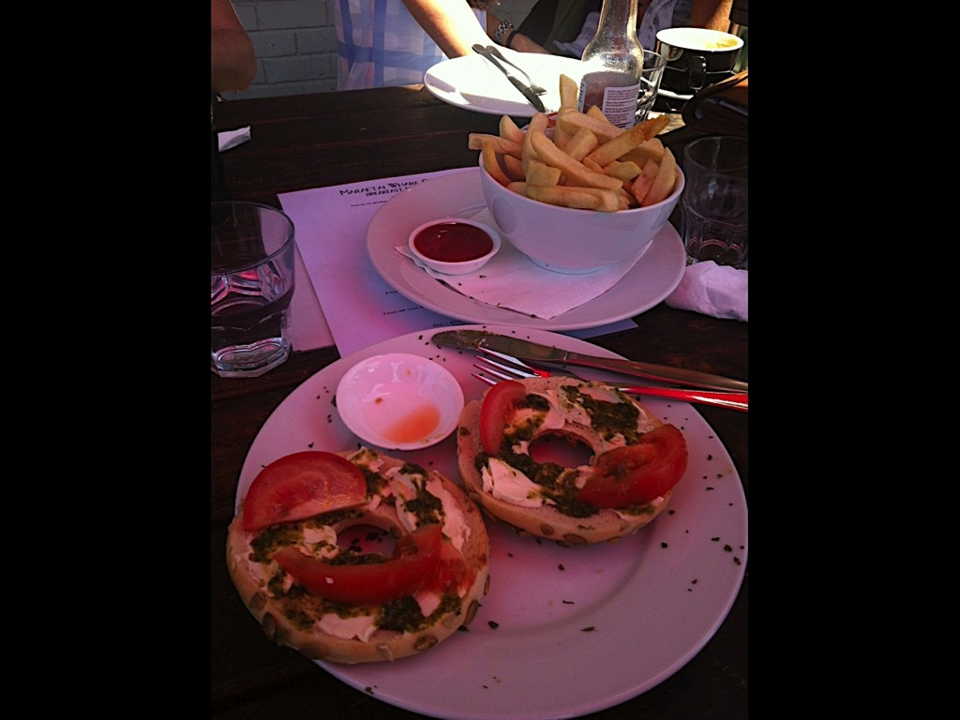
Notes:
And along the way we ate some pretty amazing food – like Bagels and creamed cheese

Slide 24
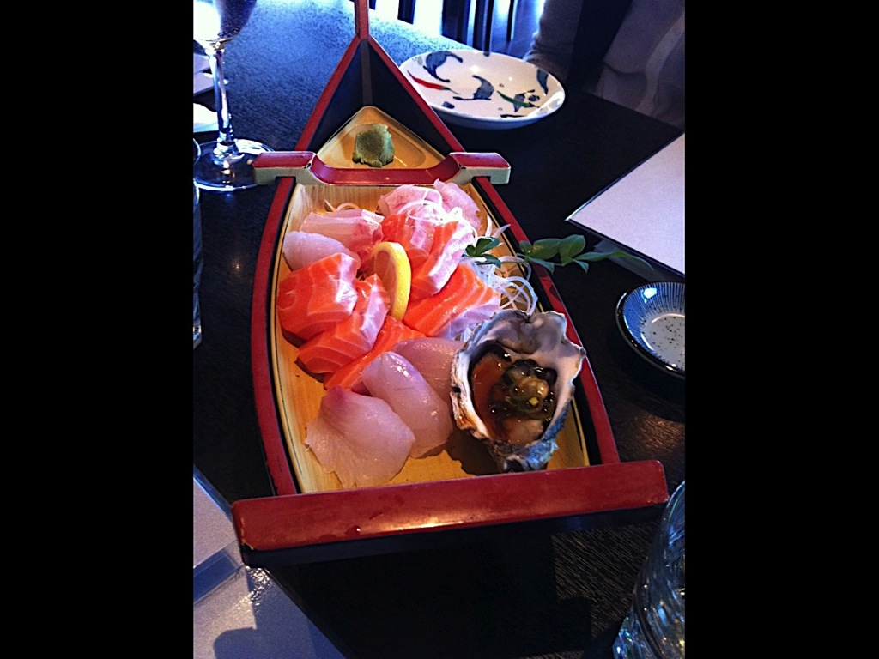
Notes:
Raw fish and squid and oysters at a Japanese Restaurant

Slide 25
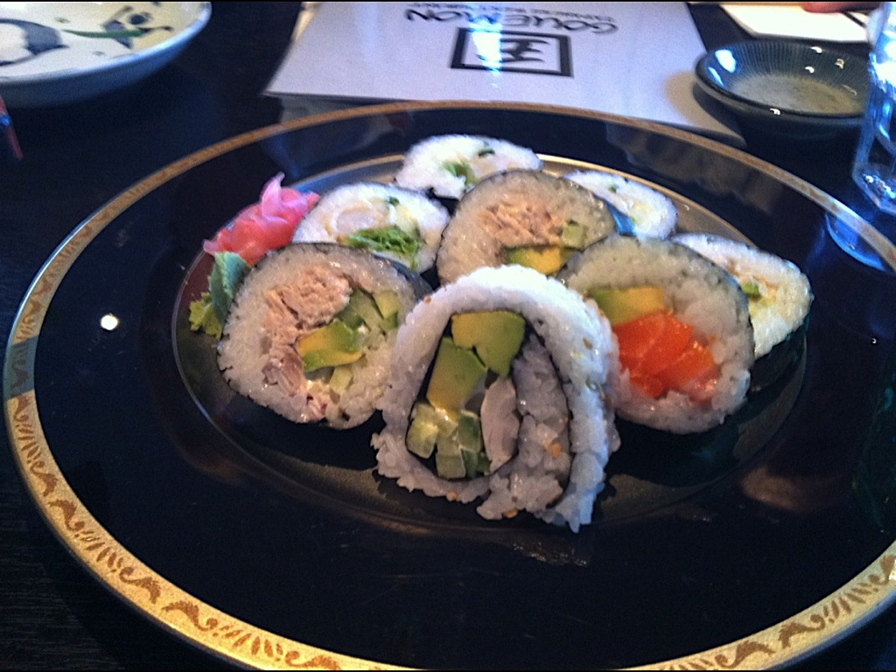
Notes:
Sushi

Slide 26
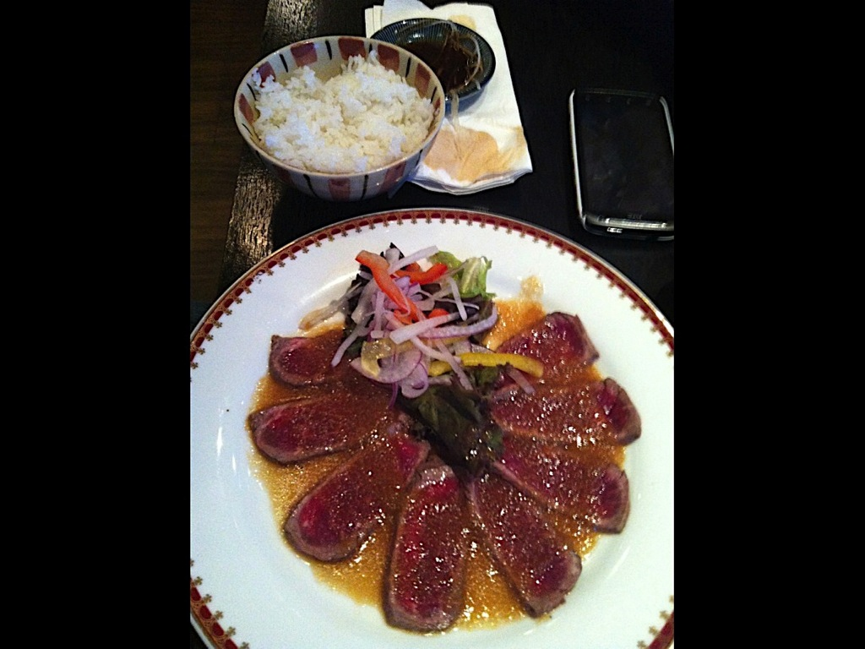
Notes:
Beef Teriyake

Slide 27
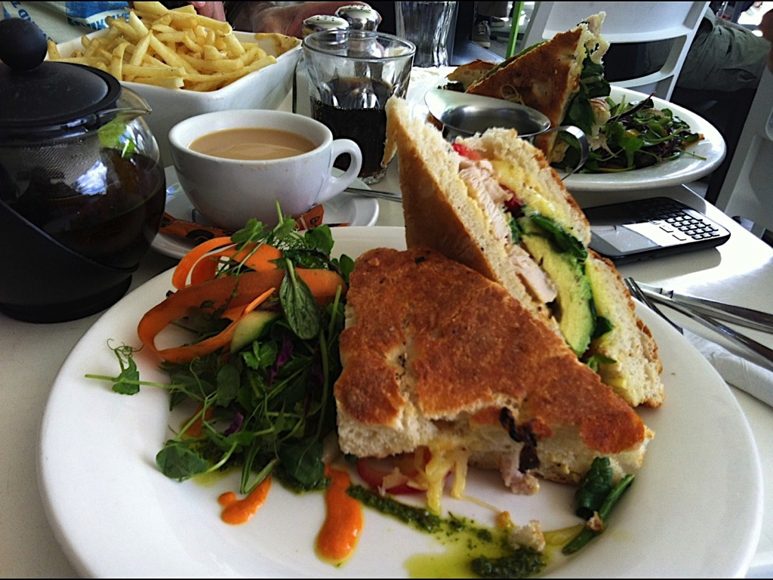
Notes:
And huge toasted sandwiches that were too much for us to finish

Slide 28
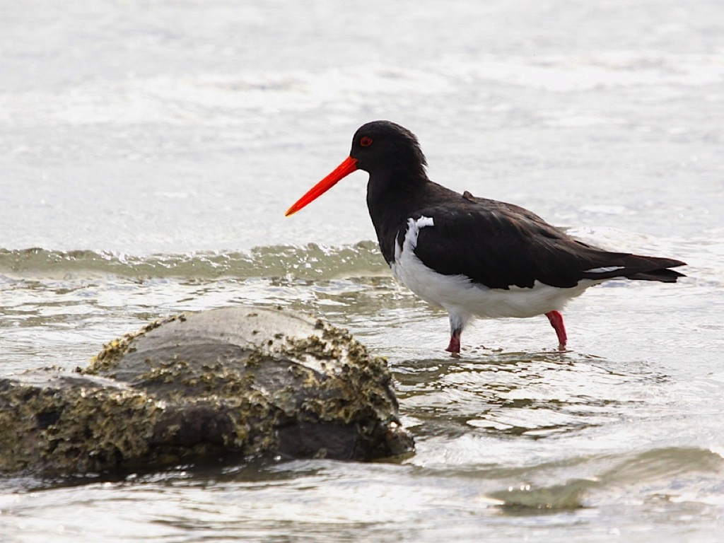
Notes:
Oystercatchers at the ocean

Slide 29
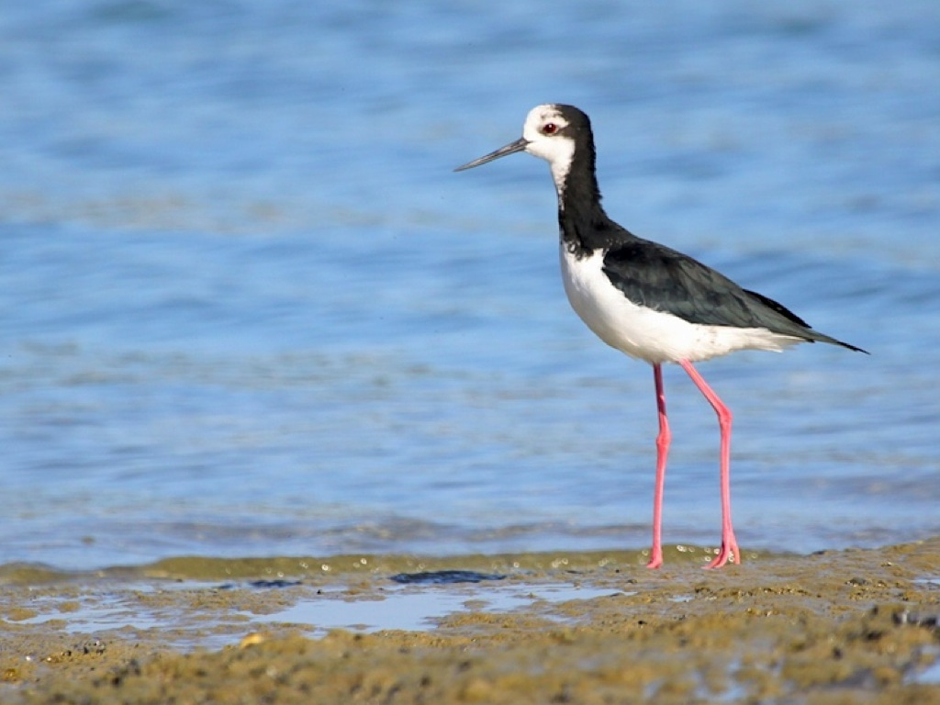
Notes:
Pied Stilts

Slide 30
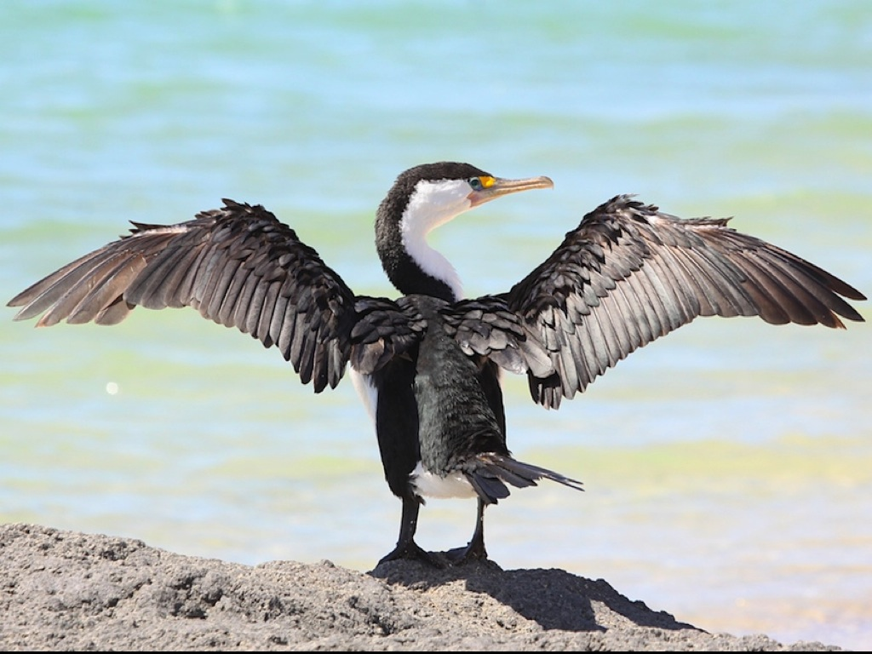
Notes:
Shags – or cormorants we we call them

Slide 31
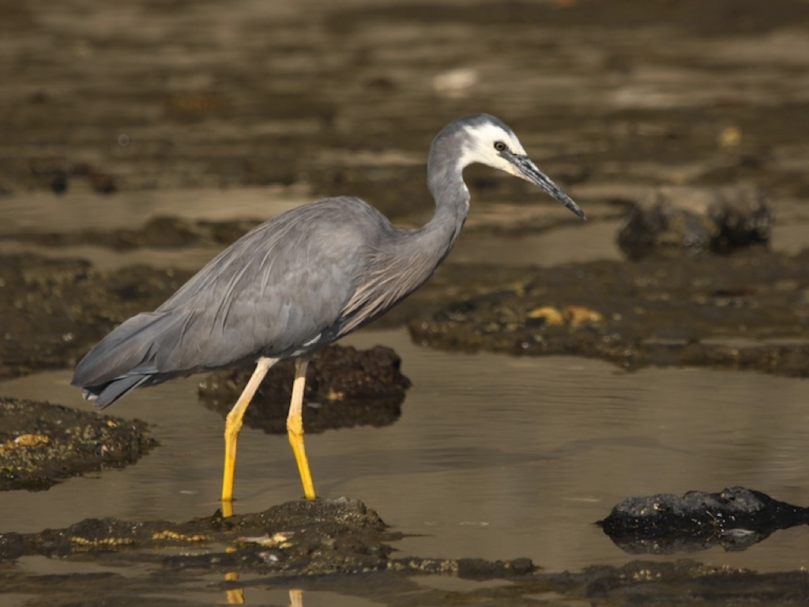
Notes:
White-faced Herons

Slide 32
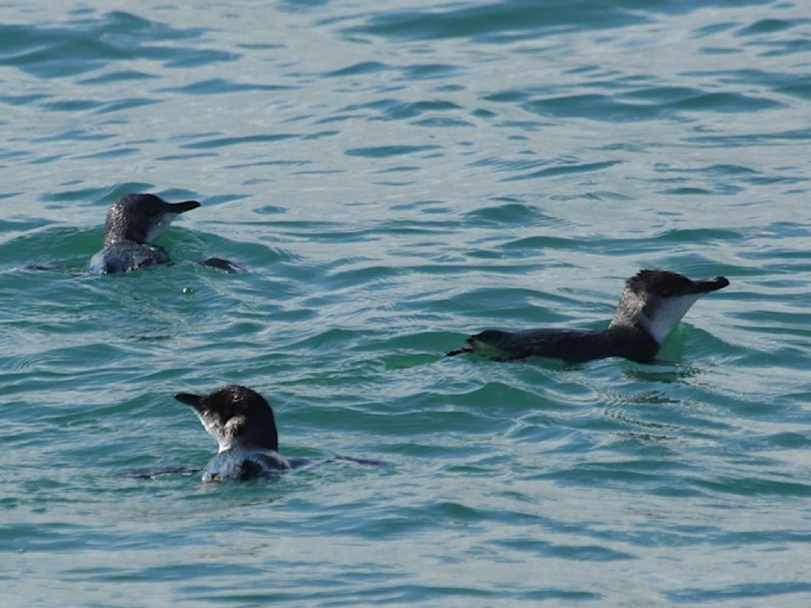
Notes:
Little Penguins fishing in the ocean

Slide 33
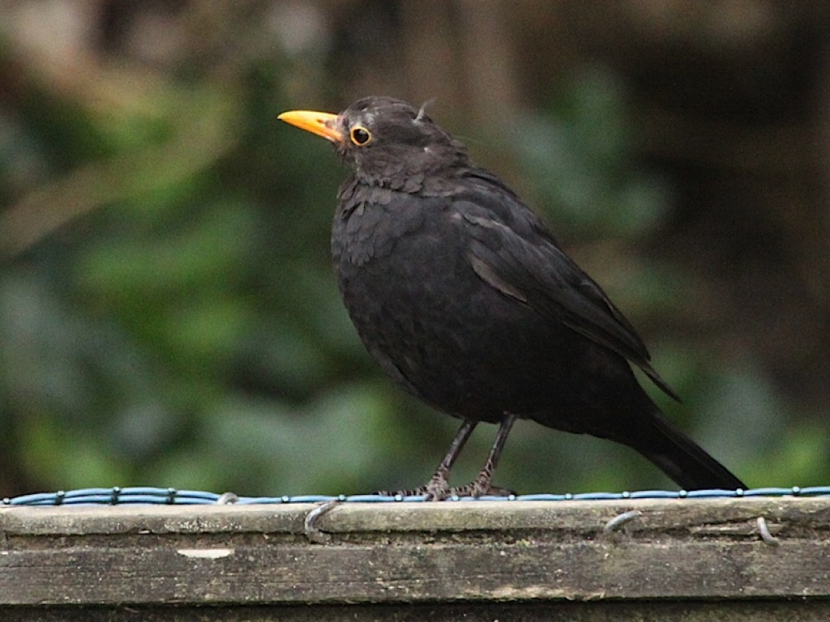
Notes:
Blackbirds

Slide 34
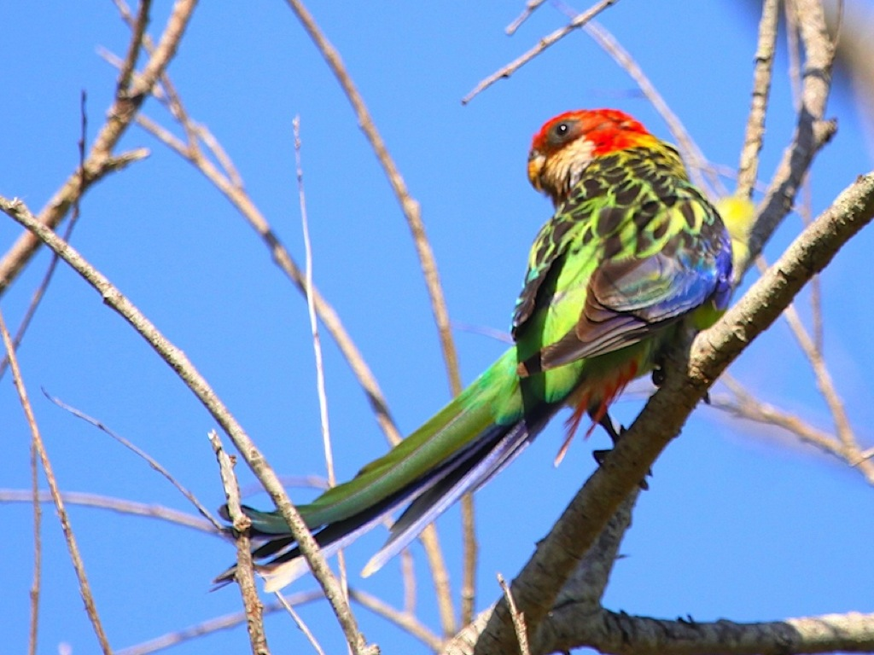
Notes:
This colourful Eastern Rosella

Slide 35
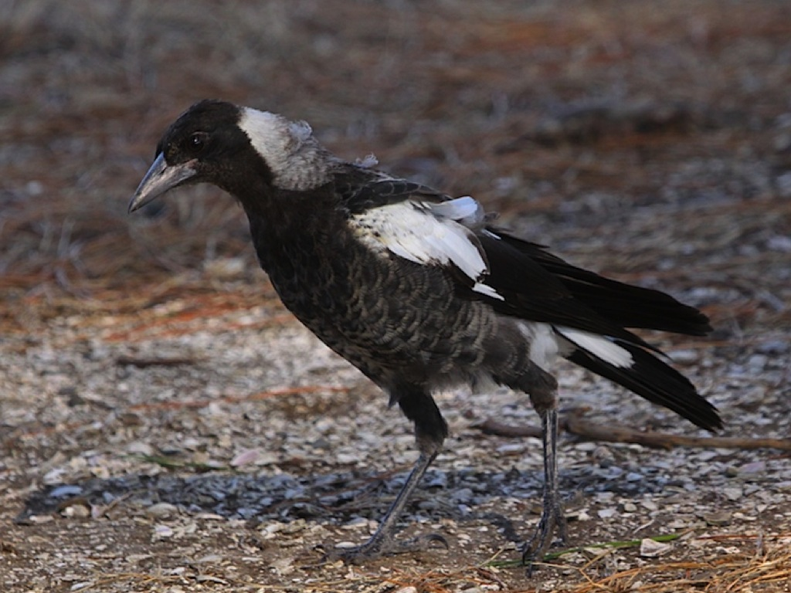
Notes:
Australian Magpies

Slide 36
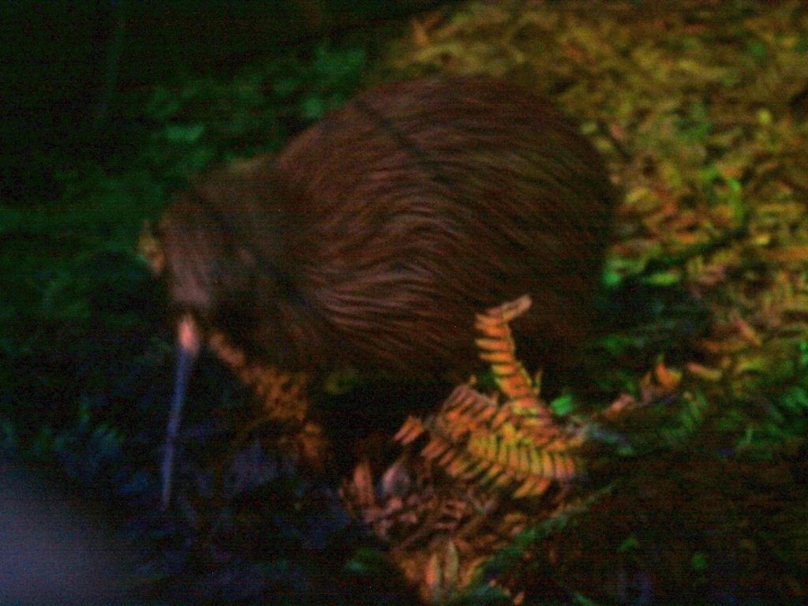
Notes:
And even this rare Kiwi that we had to wait until after 9:30 at night to see it emerge to hunt for food.

Slide 37
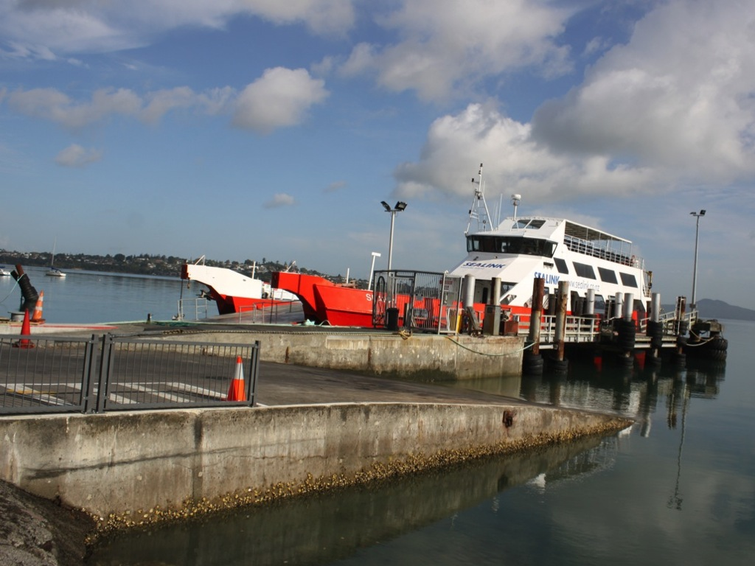
Notes:
We took a ferry ride to an Island where my nieces’ wedding took place.

Slide 38
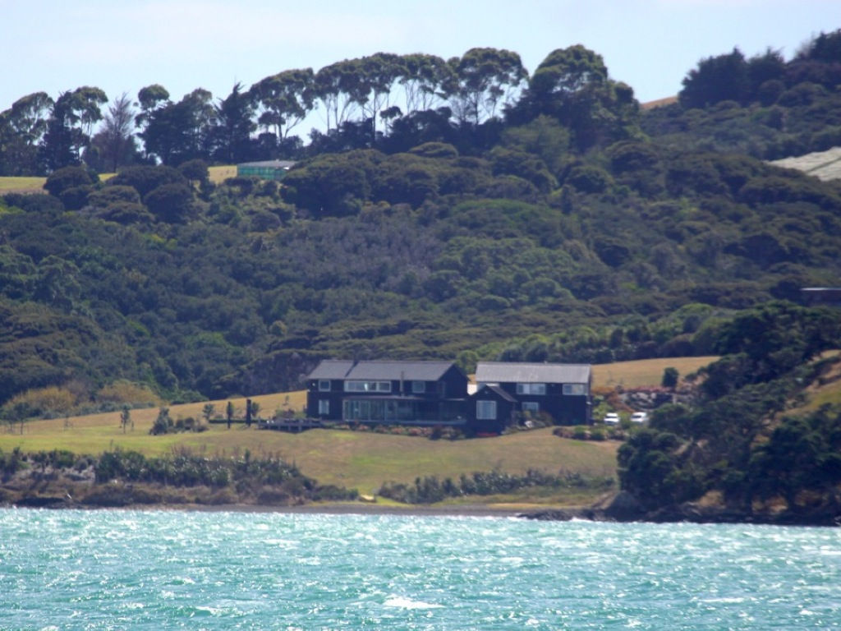
Notes:
This is the lodge where the wedding took place.

Slide 39
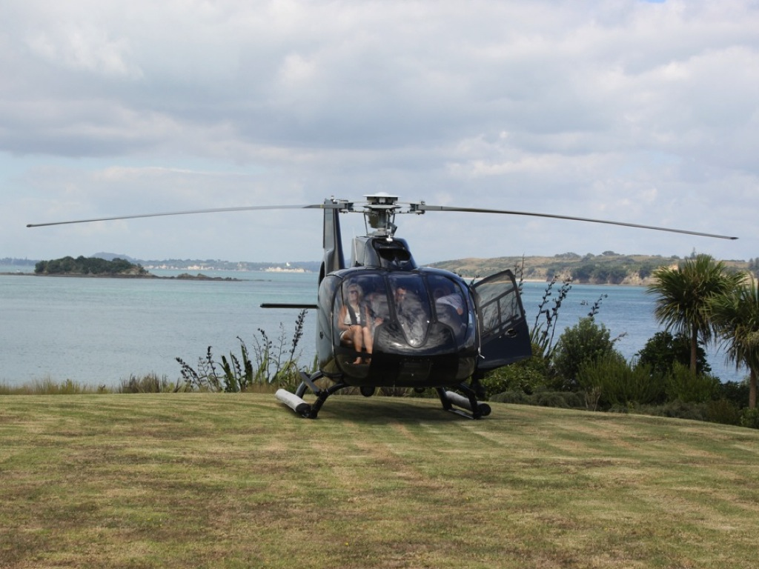
Notes:
My niece arrived in a helicopter for her wedding.

Slide 40
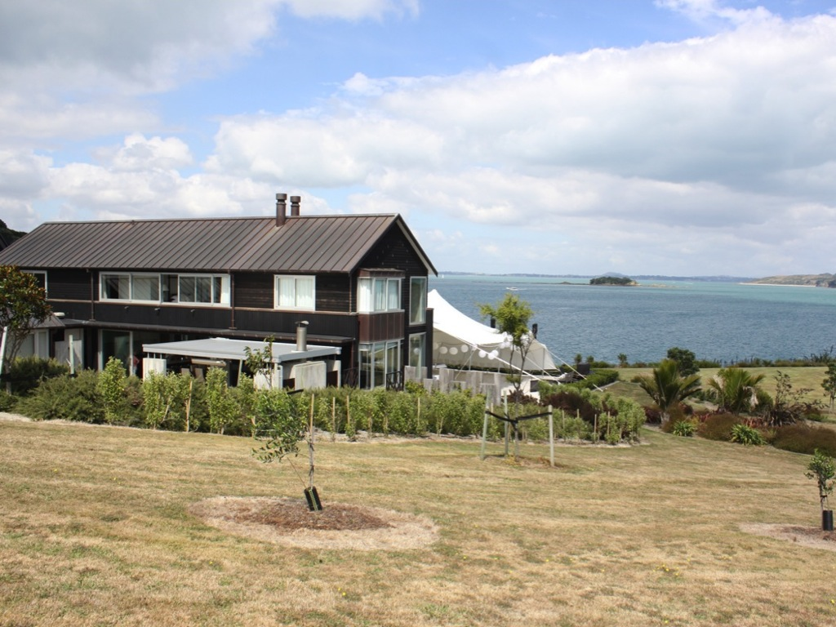
Notes:
What a venue for a wedding

Slide 41
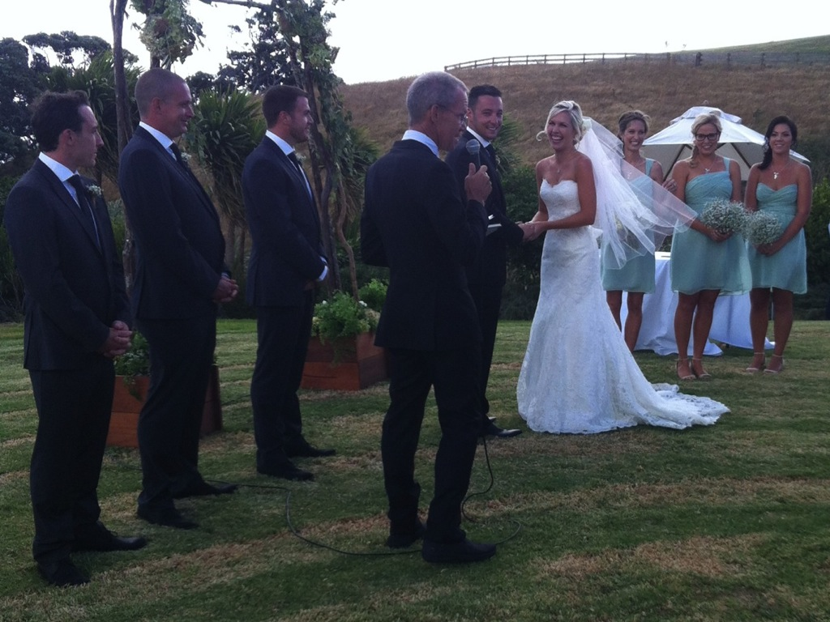
Notes:
I even hired a suit to wear to perform the marriage ceremony for Kellie and Brendan

Slide 42
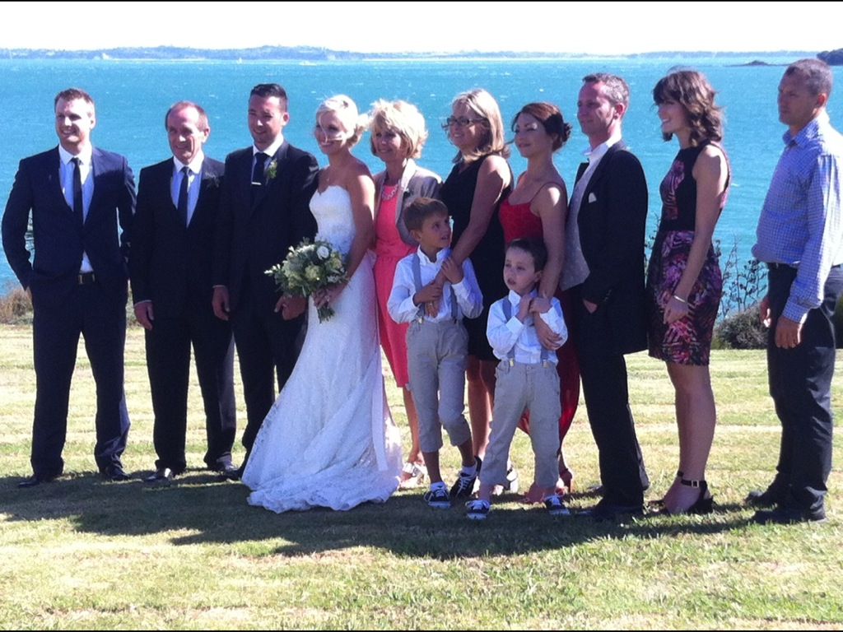
Notes:
Here is a pic of the whole bridal party

Slide 43
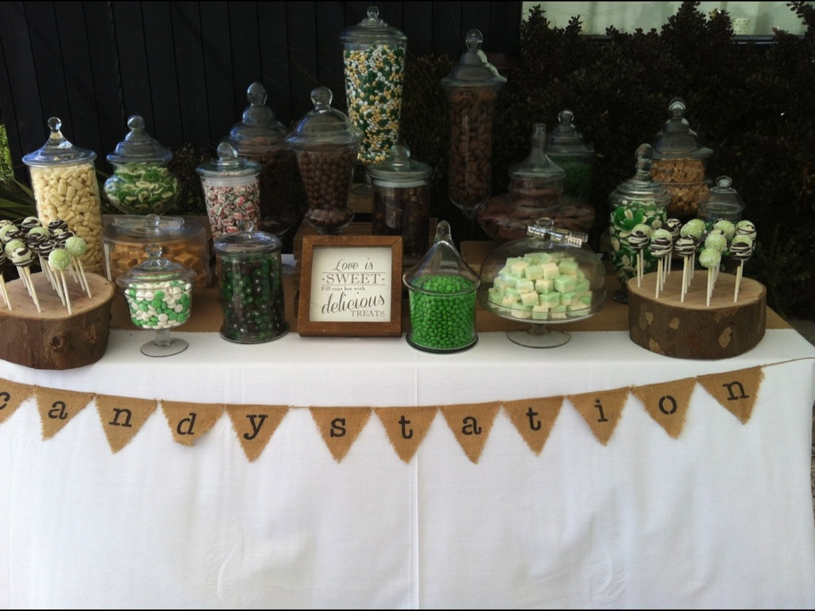
Notes:
There was even a lolly table

Slide 44
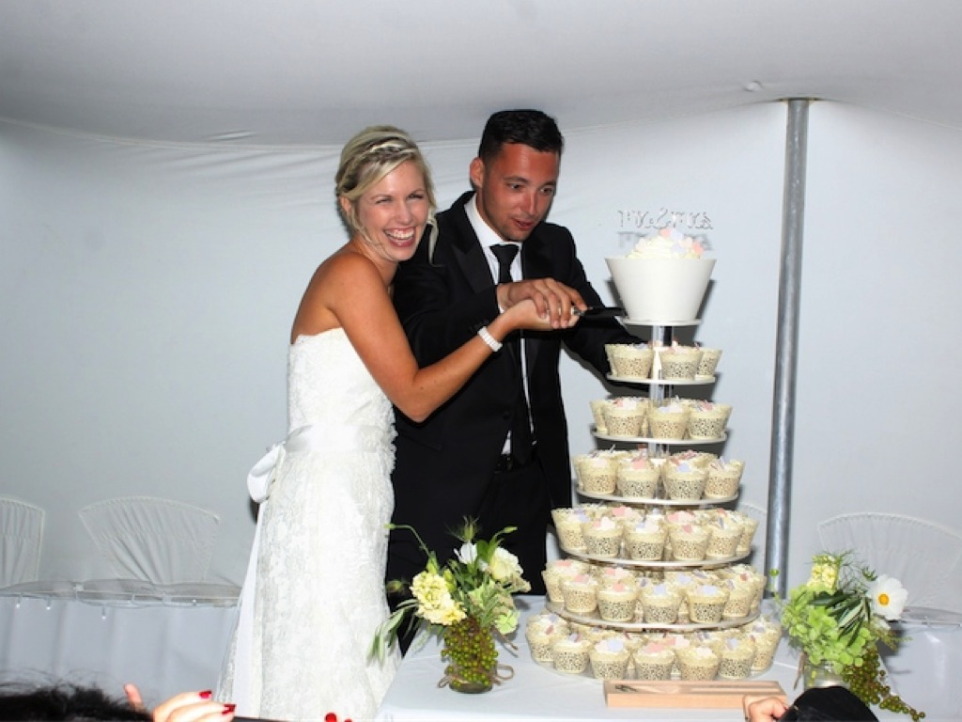
Notes:
People could fill up their boxes with as many sweets as they wanted

Slide 45
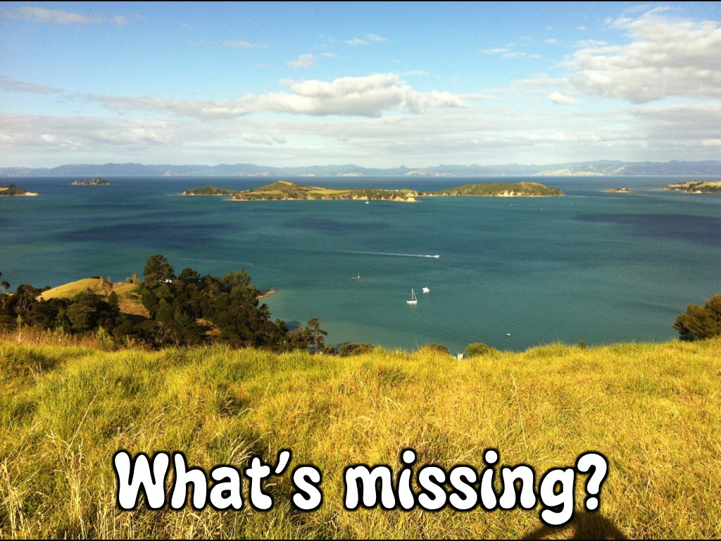
Notes:
The cake was incredible

Slide 46
Notes:
What is missing in this incredible reflection on our holiday in New Zealand?

Slide 47
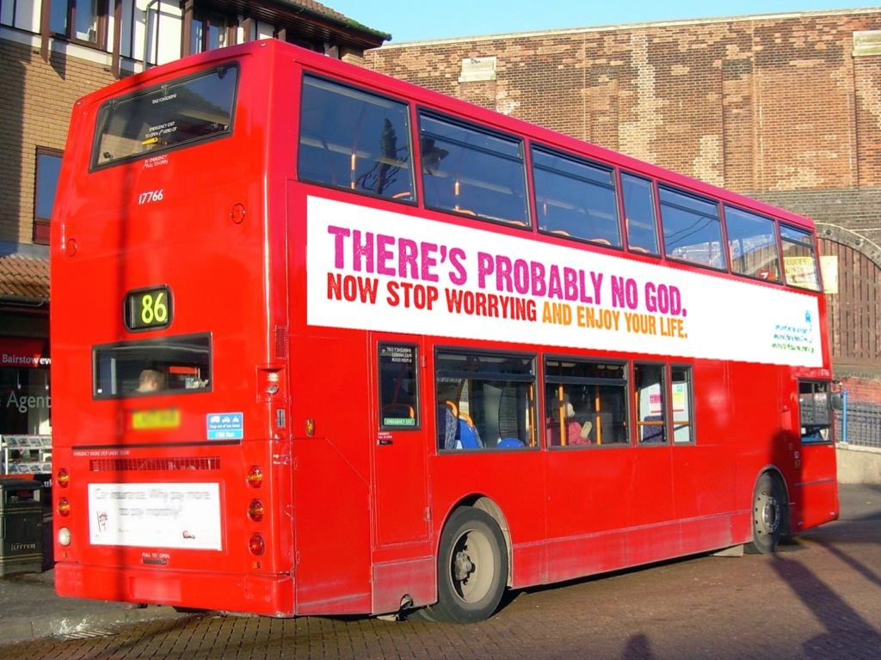
Notes:
God is missing! There is a atheist bus campaign in New Zealand…

Slide 48
Notes:
Kiwis claim that they can be good without God – they don’t really need God at all – in fact there is probably no God anyway!

Slide 49
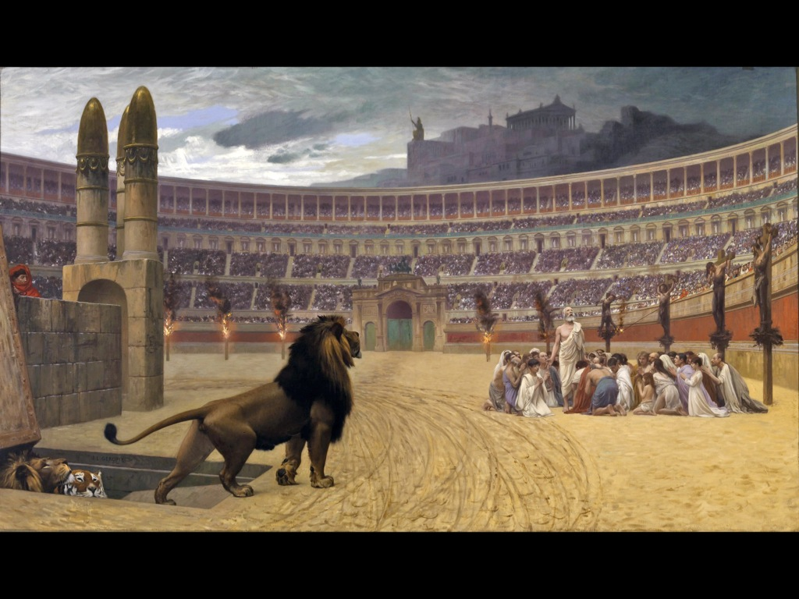
Notes:
How serious do you think people are about their relationship with God in times of persecution?

Slide 50
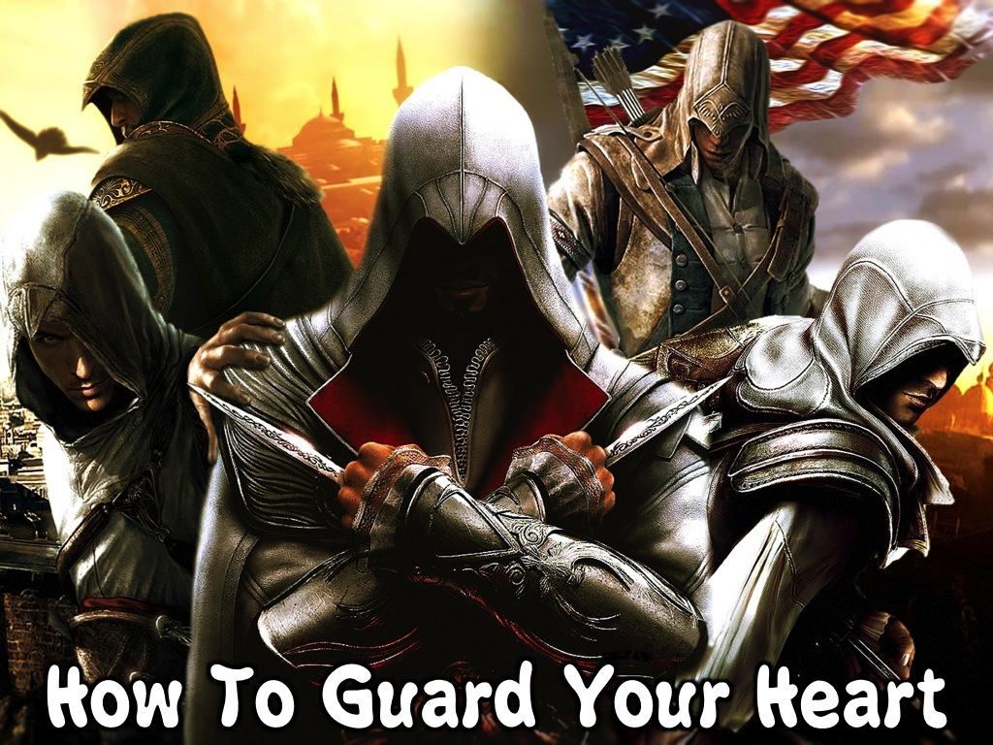
Notes:
Do how do we guard our hearts? How do we stay close too God in good times or in tough times?

Slide 51
Notes:
1. Speak to God – it is easy to forget about God because we don’t see him with our eyes or feel him with out hands.

Slide 52
Notes:
Ecclesiastes 12:1 challenges us to remember our Creator in the days of our youth. We need to discipline ourselves to keep turning towards God in prayer.

Slide 53
Notes:
If we look back at some of the highlights from my trip you can see how with some discipline there are opportunities to connect with God: When we see the beauty of creation we can praise God for what he has made…

Slide 54
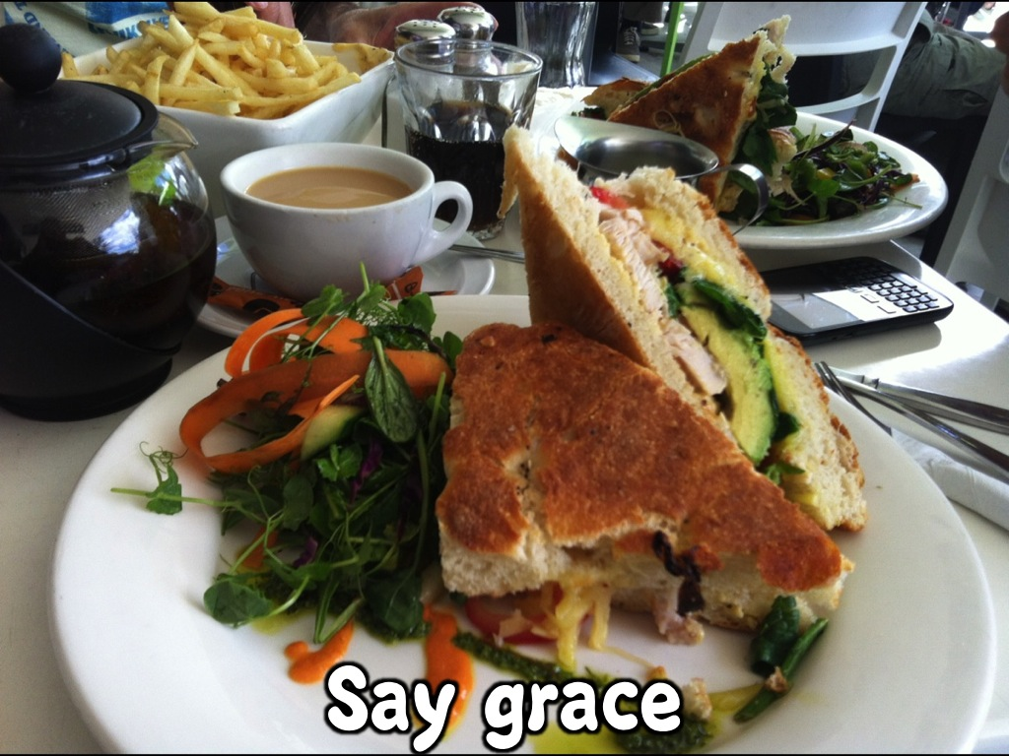
Notes:
Before we tuck into incredible meals we can say a prayer of thanks for what God has provided for us!

Slide 55
Notes:
When we see beautiful creatures in the sky or on land or in the sea we can thank God for making them for his glory and our enjoyment.

Slide 56
Notes:
When we are with family who don’t have a relationship with God we can pray that God will make himself know to them.

Slide 57
Notes:
When we visit interesting places with a spiritual connection we can remember that life is not just about living on earth but in eternity!

Slide 58
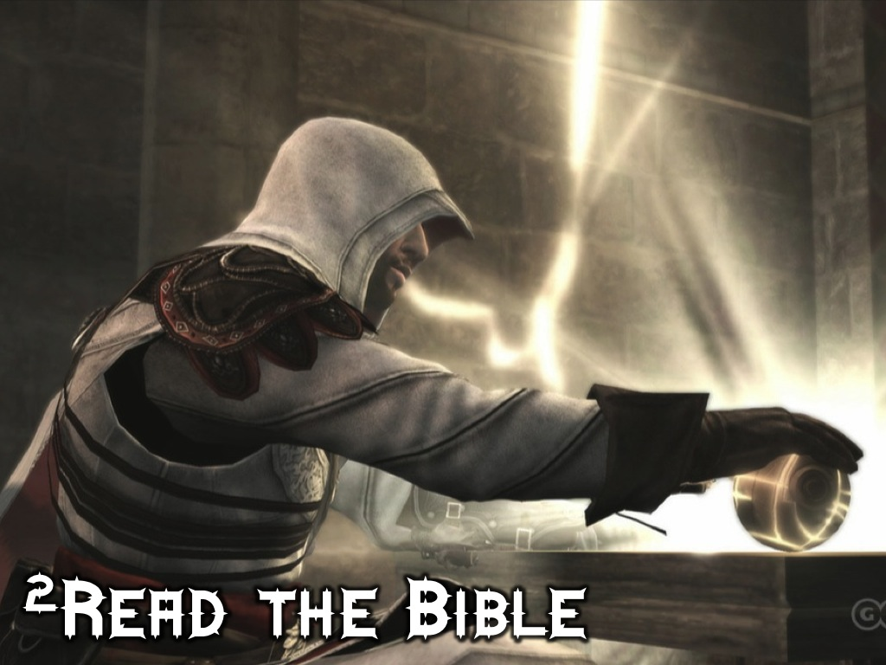
Notes:
2. Read the Bible – a second way to guard our heart is to read what God has written in his word.

Slide 59
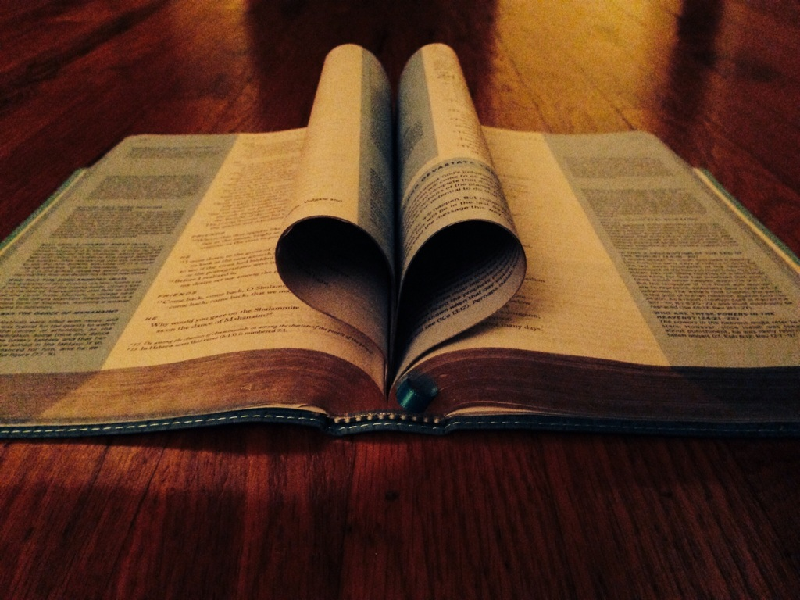
Notes:
After all, the Bible is God’s love letter to us and when we read it we experience his love!

Slide 60
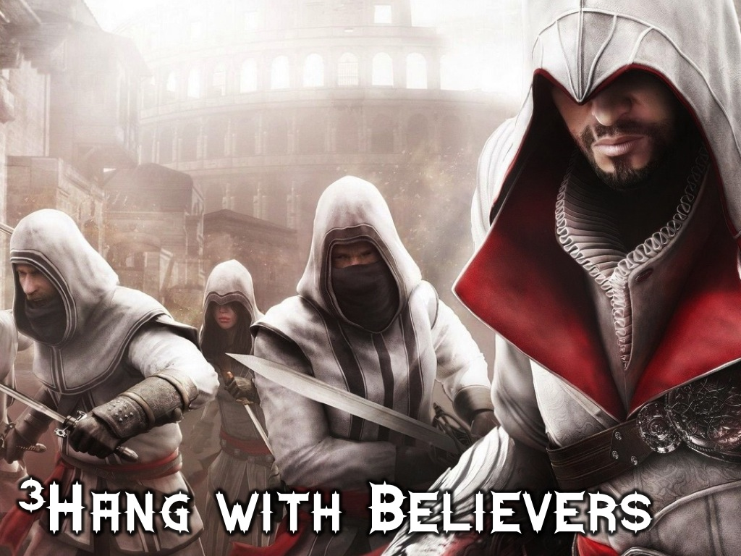
Notes:
3. Hang with Believers – a third way to guard our heart is to find other believers and spend time with them.

Slide 61
Notes:
One of the highlights of my trip was spending time with a friend that I grew up with, Arnold, and we could chat about what God is doing in our lives – we are both serving God as pastors at the moment.

Slide 62
Notes:
We need friends who can encourage us and help us stay close to God!

Slide 63
Notes:
4. Run from Temptation – a fourth way to guard our heart is to flee from temptation – especially when times are good we may be tempted to do things that are not glorifying to God.

Slide 64
Notes:
God has promised (1 Corinthians 10:13) to provide a way out when we are faced with temptation!

Slide 65
Notes:
So, guard your heart – like a Ninja!

Slide 66
Notes:
Let’s pray that God will help us guard our hearts!

