Slide 1

Notes:
Welcome to Gospel Friday. This series is based on a DVD curriculum from Dare2Share and is available for purchase from their website: https://store.dare2share.org/products/gospel-journey-adventure

Slide 2

Notes:
Welcome to regulars and newcomers.

Slide 3

Notes:
As we start Term 2 let’s preview what this term is all about…

Slide 4

Notes:
Tonight is a Preview of our Gospel Friday series.

Slide 5

Notes:
Next Friday there is no Youth because we are hosting the Lead The Cause weekend and those who are registered will be part of the experience.

Slide 6
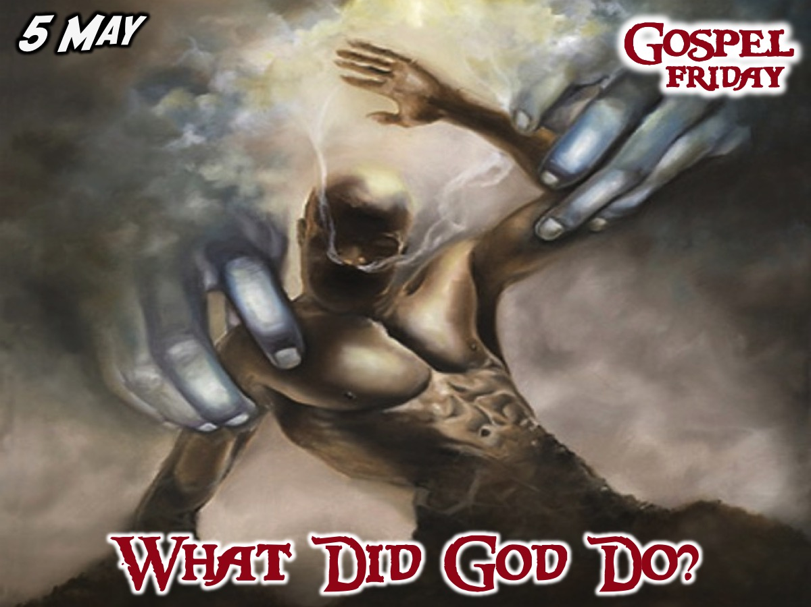
Notes:
On the 5th May we answer the question: What Did God Do?

Slide 7
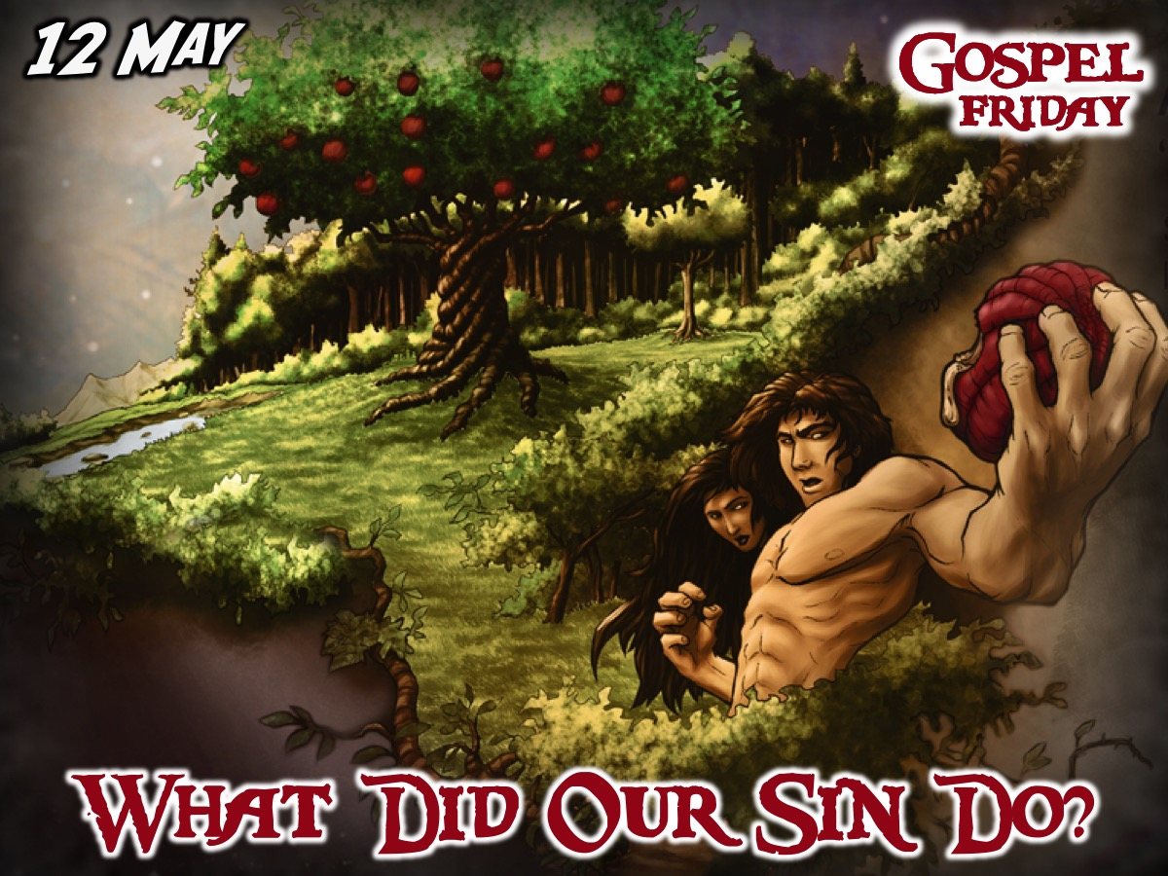
Notes:
On the 12th May we answer the question: What Did Our Sin Do?

Slide 8
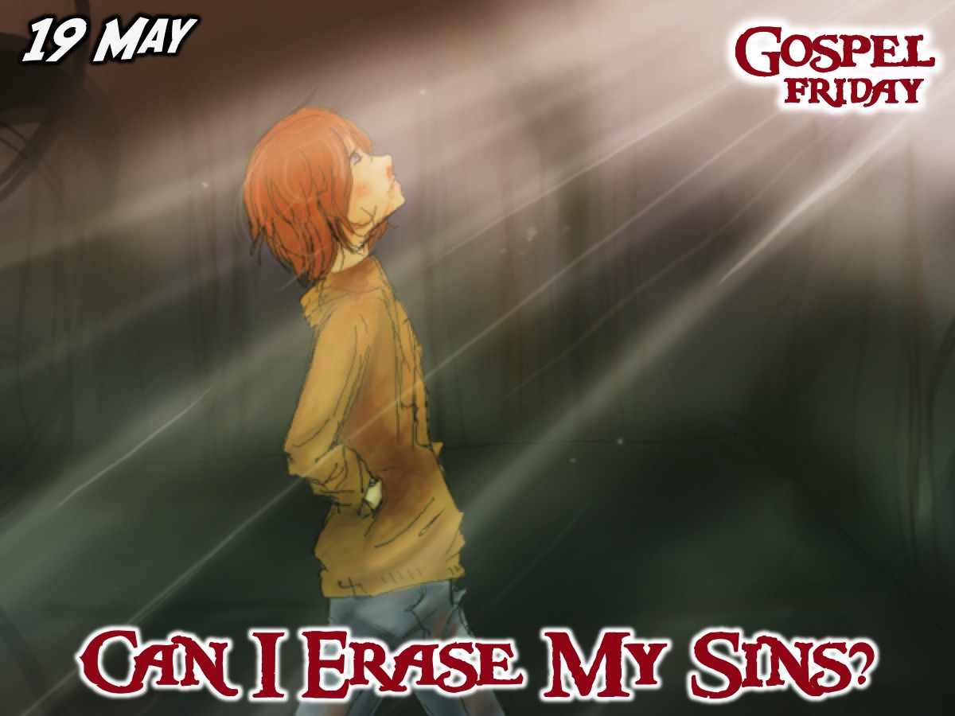
Notes:
On the 19th May we answer the question: Can I Erase My Sins?

Slide 9
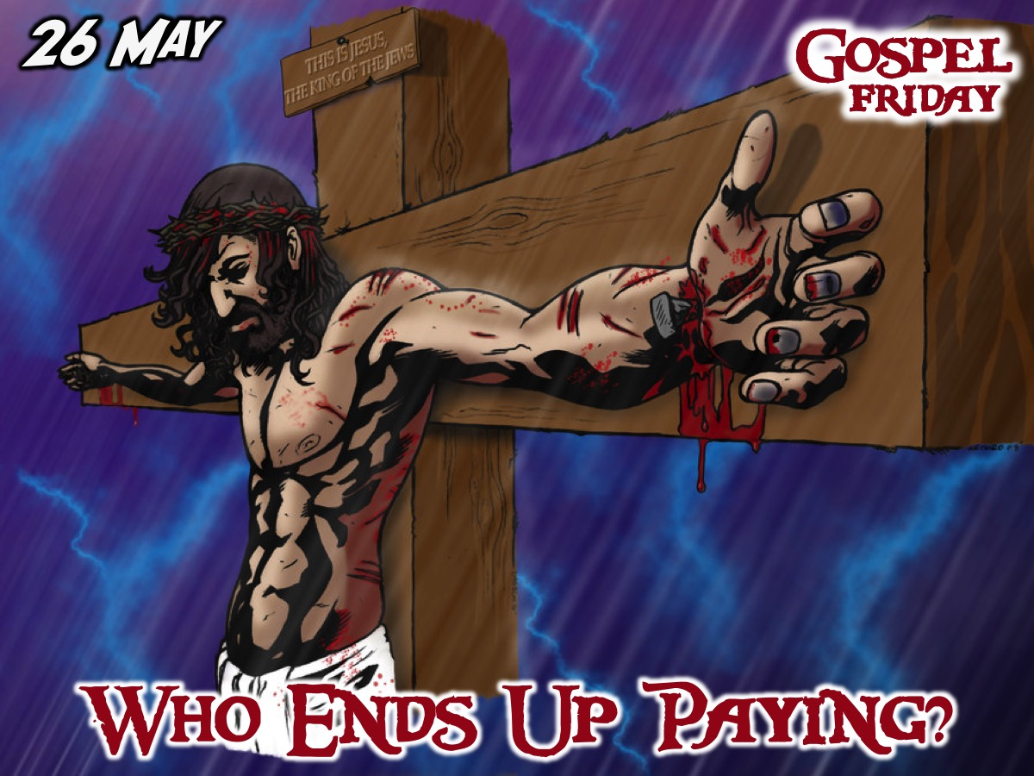
Notes:
On the 26th May we answer the question: Who Ends Up Paying?

Slide 10
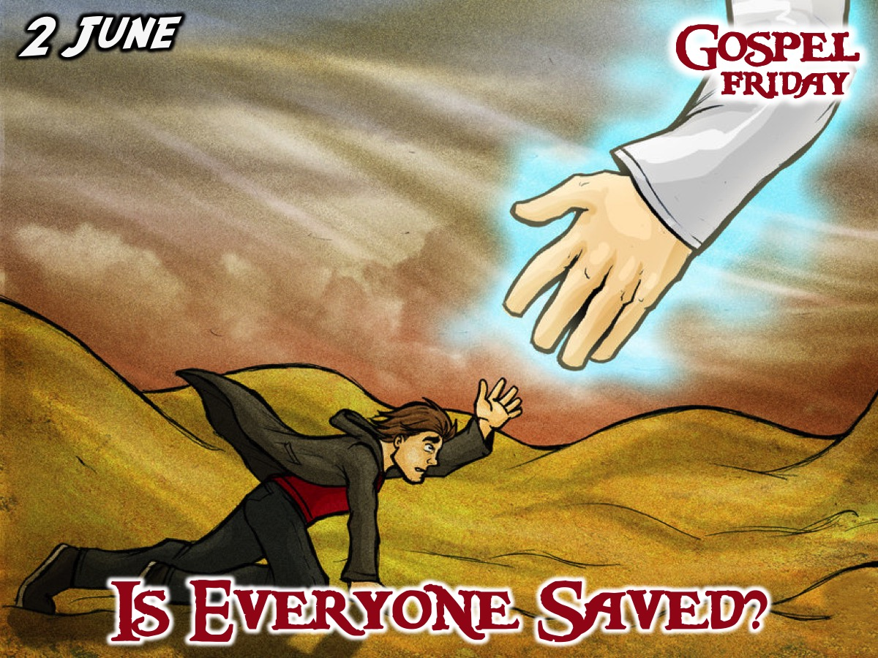
Notes:
On the 2nd June we answer the question: Is Everyone Saved?

Slide 11
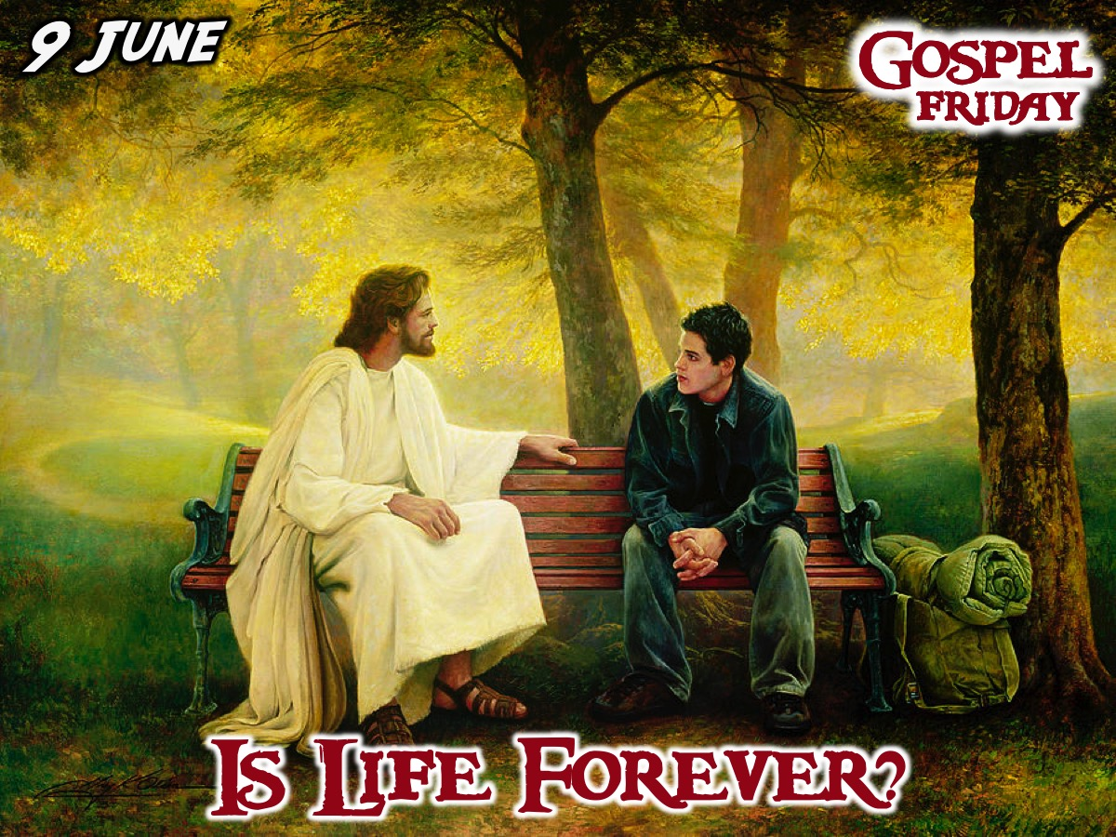
Notes:
On the 9th June we answer the question: Is life Forever?

Slide 12

Notes:
On the 16th June we have an outing to Soweto during the day.

Slide 13

Notes:
On the 23rd June we answer the question: What Can I Do?

Slide 14

Notes:
On the 30th June we end the term with a Party Night!

Slide 15

Notes:
On Sunday mornings we are presenting The Shine Series.

Slide 16
Notes:
Tonight is week 1 of our Gospel Journey.

Slide 17

Notes:
Share: What adventure do you want to go onin life? What is the most extreme thing you have ever done in life?

Slide 18

Notes:
The video starts after this slide

Slide 19
Notes:
Video: Session 1 of the Gospel Journey DVD series. Length: 17 minutes. To get a taste of the series, you can download a low resolution version of the video for the first week of the Gospel Journey DVD series from: http://bit.ly/GospelVideo1

Slide 20
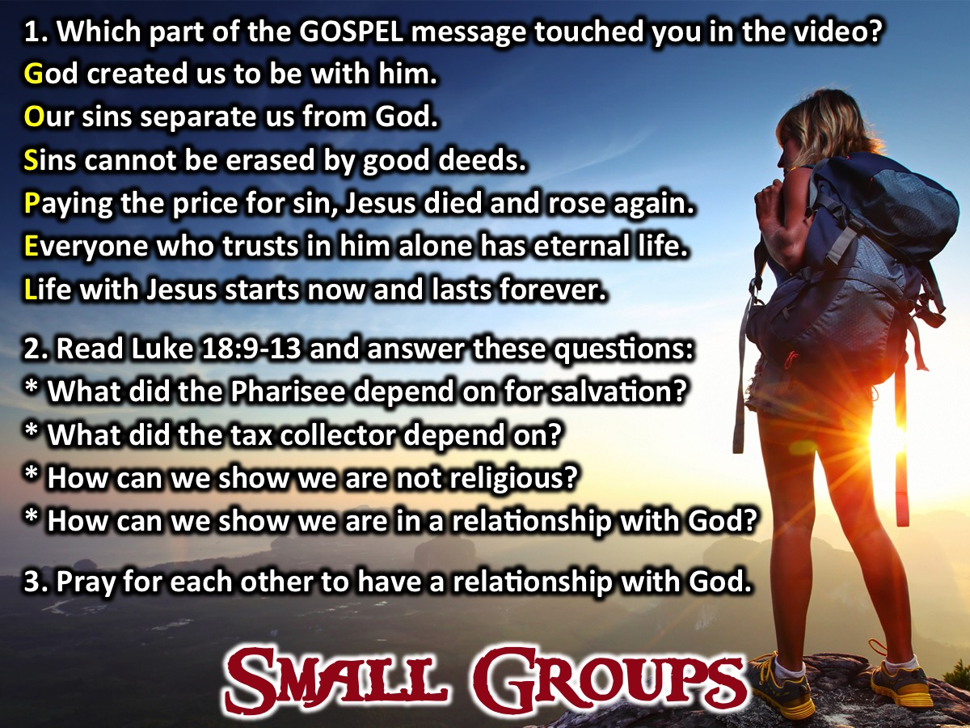
Notes:
Small Groups: (1) Which part of the GOSPEL message stood out to you as you watched the video? God created us to be with him. Our sins separate us from God. Sins cannot be erased by good deeds. Paying the price for sin, Jesus died and rose again. Everyone who trusts in him alone has eternal life. Life with Jesus starts now and lasts forever. (2) Read Luke 18:9-13 and answer these questions: What did the Pharisee depend on for salvation? What did the tax collector depend on? How can we show we are not religious? How can we show we are in a relationship with God? (3) Pray for each other to have a relationship with God.

Slide 21

Notes:
Next Friday there is no Youth because we are hosting the Lead The Cause weekend and those who are registered will be part of the experience.

Slide 22

Notes:
On Sunday mornings we are presenting The Shine Series.

Slide 23

Notes:
It is time for refreshments.

