Slide 1
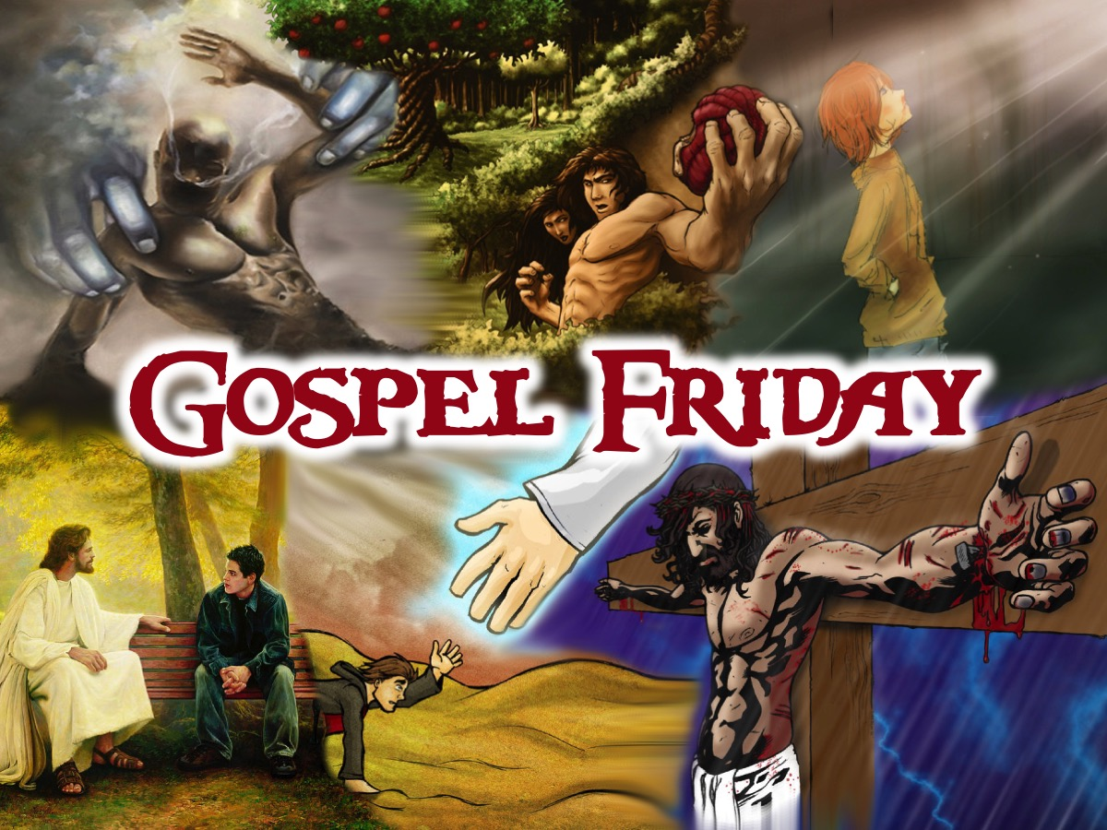
Notes:
Welcome to Gospel Friday

Slide 2
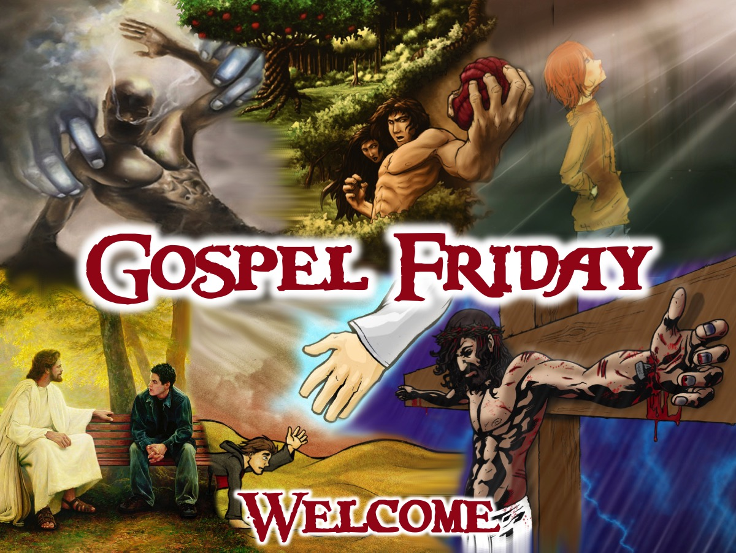
Notes:
Welcome to regulars and newcomers.

Slide 3
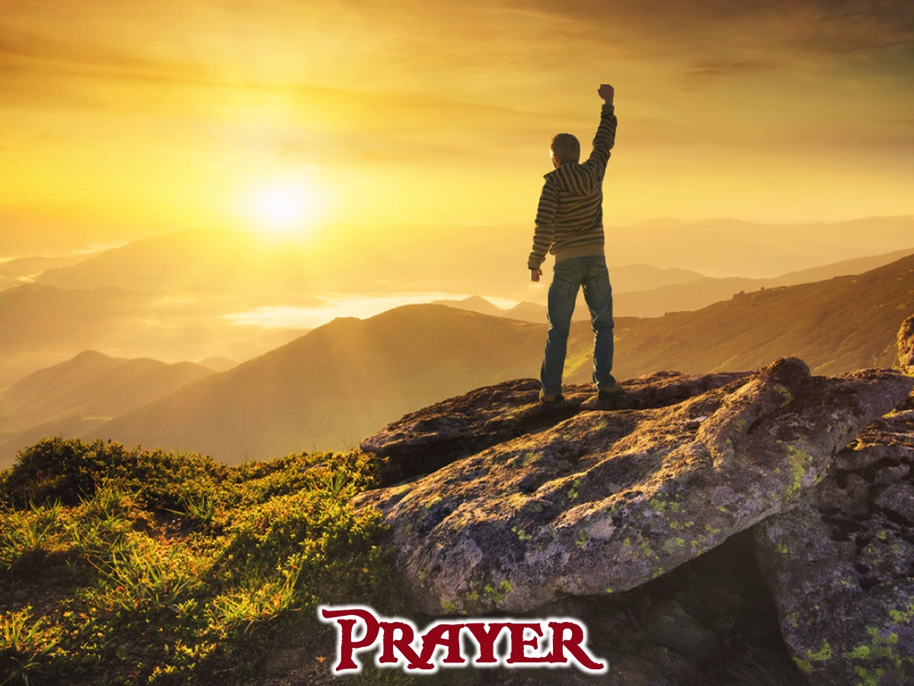
Notes:
Prayer: Let’s open our meeting in prayer.

Slide 4
Notes:
Review: Last week we started the Gospel Journey DVD series and met 7 teenagers who set out on a 6 day wilderness adventure into the Colorado mountains. We learnt that G.O.S.P.E.L. is Life in 6 Words: God created us to be with him. Our Sins separate us from God. Sins cannot be removed by good deeds. Paying the price for sin, Jesus died and rose again. Everyone who trusts in him alone has eternal life. Life with Jesus starts now and lasts forever.

Slide 5
Notes:
Tonight we answer the question: What Did God Do?

Slide 6
Notes:
Group Task: Make a list of beliefs about God or gods or spirit beings. Group them under 3 headings: No God, One God, Many gods

Slide 7
Notes:
Intro: Tonight we’re going to be watching the second episode of the GOSPEL Journey series. In this episode we will find out what each of the teenagers believe about God.

Slide 8
Notes:
Video: Session 2 of the Gospel Journey DVD series. Length: 24 minutes.

Slide 9
Notes:
Small Groups: (1) What is your view of God? Share it with the group. In the beginning God created the heavens and the earth. (Genesis 1:1). (2) What did you learn about God from the video? So God created mankind in his own image, in the image of God he created them. (Genesis 1:27). (3) How does the idea of a personal Creator God, who made you to live in relationship with Him, make you feel? Then the Lord God formed a man from the dust of the ground and breathed into his nostrils the breath of life, and the man became a living being. (Genesis 2:7). (4) Pray for each other to know and experience a personal relationship with God.

Slide 10
Notes:
Wrap Up: The story of the Bible starts with a clear message that the universe is not just some random place with no intelligent thought or design behind it. There is a God! Genesis lays out the amazing concept that the first human beings are handmade creatures who were PERFECT people in a PERFECT environment united together with each other and with a PERFECT God. Obviously something went wrong with both the universe and people since then, we will focus on that when we meet together next Friday night.

Slide 11
Notes:
Announcements: On Sunday mornings we are presenting The Shine Series.

Slide 12
Notes:
Announcements: Next Friday night we answer the question: What Did Our Sin Do?

Slide 13
Notes:
Refreshments: It is time for refreshments.

