Slide 1
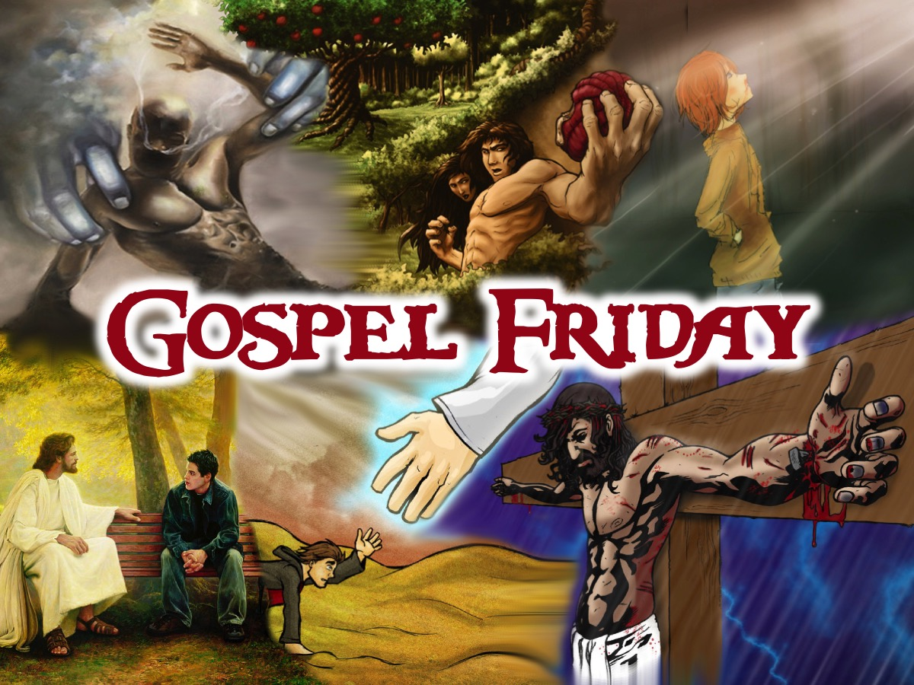
Notes:
Welcome to Gospel Friday

Slide 2
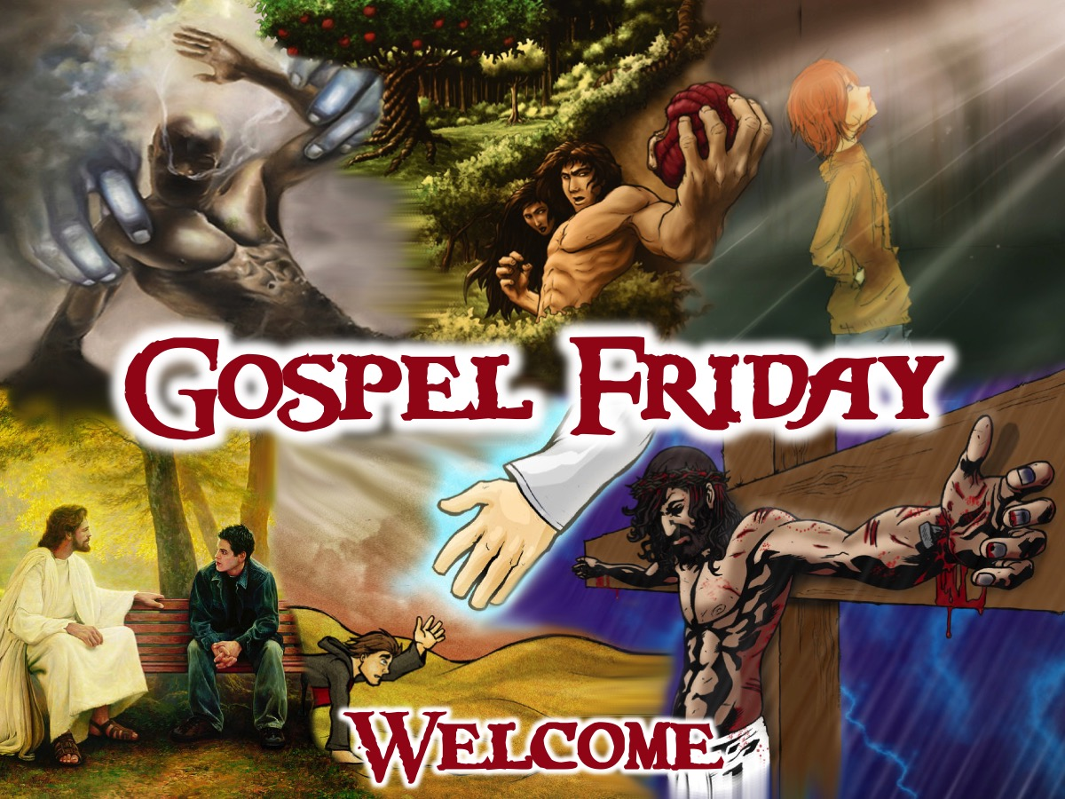
Notes:
Welcome to regulars and newcomers.

Slide 3
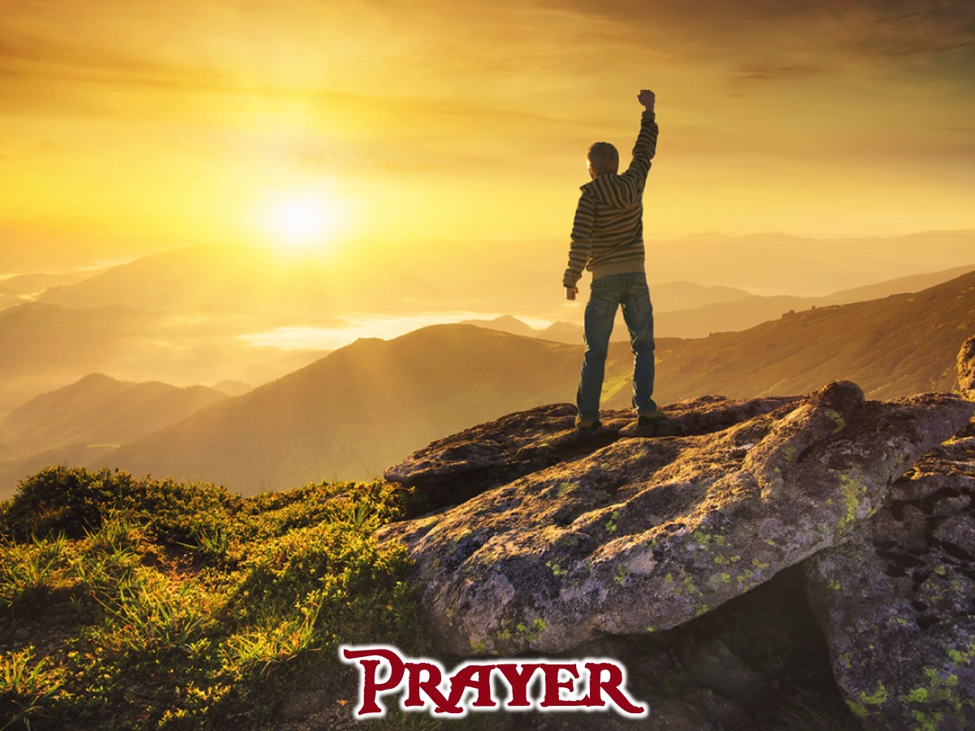
Notes:
Prayer: Let’s open our meeting in prayer.

Slide 4
Notes:
Review: We continued the adventure with the 7 teens into the Colorado mountains.. We explored the G in G.O.S.P.E.L.: God created us to be with him. Our Sins separate us from God. Sins cannot be removed by good deeds. Paying the price for sin, Jesus died and rose again. Everyone who trusts in him alone has eternal life. Life with Jesus starts now and lasts forever.

Slide 5
Notes:
Tonight we answer the question: What Did Our Sin Do?

Slide 6
Notes:
Group Task: Each person has to introduce themselves using an adjective and their name and the first letter of the adjective must match the first letter of their name. The adjective must be a word that best describes who they are and they must share why they chose it with the group.
Week 4 Task: Complete the Bad Deeds and Good Deeds handout and see how it balances out. Write down all the sins you have committed in your life on the lift hand side; then write down the good you have done on the right hand side and see how the two sides compare to each other.

Slide 7
Notes:
Intro: Tonight we’re going to be watching the third episode of the GOSPEL Journey series. In this episode we will find out how sin has messed up our lives.

Slide 8
Notes:
Video: Session 3 of the Gospel Journey DVD series. Length: 24 minutes.

Slide 9
Notes:
Small Groups: Here are the small group question for this week: (1) How did the video challenge your view of sin? “For all have sinned and fall short of the glory of God.” (Romans 3:23). (2) How does our sin create a tension between God’s love and His holiness? (3) How does sin effect us physically, emotionally, relationally or spiritually? “The man and his wife heard the sound of the Lord God as he was walking in the garden in the cool of the day, and they hid among the trees of the garden. But the Lord God called to the man, ‘Where are you?’ Adam answered, ‘I heard you in the garden, and I was afraid because I was naked; so I hid.’” (Genesis 3:8-10). (4) Ask God to help us understand the devastating effect of sin in our lives.

Slide 10
Notes:
Wrap Up: (1) Sin has separated us from God. Your sinful acts have alienated you from your God; your sins have caused him to reject you and not listen to your prayers.” (Isaiah 59:2). (2) Sin has messed up our lives and our relationships. (3) We have to admit that we are sinners before we can have any chance of knowing God. (4) Next week we will start exploring what we can do about our sin.

Slide 11
Notes:
Announcements: On Sunday mornings we are presenting The Shine Series.

Slide 12
Notes:
Announcements: Next Friday night we answer the question: Can I Erase My Sins?

Slide 13
Notes:
Refreshments: It is time for refreshments.

